Slide 1
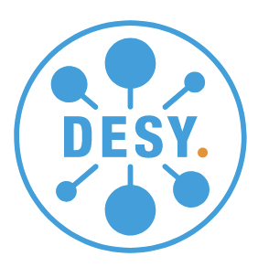
Proposal to participate to an INFRA-TECH-2025-01-01 call
python Middle Layer or python storage ring digital twin
S.Liuzzo, on behalf of the EURIZON Task 4.1 collaboration (ESRF + DESY)

Slide 2
What we have already and what the project would give us
WE HAVE AVAILABLE:
Matlab Middle Layer
A solid and benchmarked python Accelerator Toolbox package for storage ring simulations
Correction algorithms for orbit, tunes, chromaticity, first turns, optics, etc…code is part of python Simulated Commissioning (outcome of EURIZON ~ 1year of collaboration ESRF-DESY)
User experience from MML
WE WOULD GET FROM THE PROJECT:
Adapt pySC correction tools to real beam control
Updated graphical interfaces as those available in MML
Complex magnet calibrations and control (to be ported from TANGO C++ for example)
(optional) Commissioning Simulation mode (use pyMML in background for many error seeds)
Easy installation and configuration for any accelerator
Easy upgrade from MML to pythonML (similar interface)
Thorough documentation, tests and examples

Slide 3
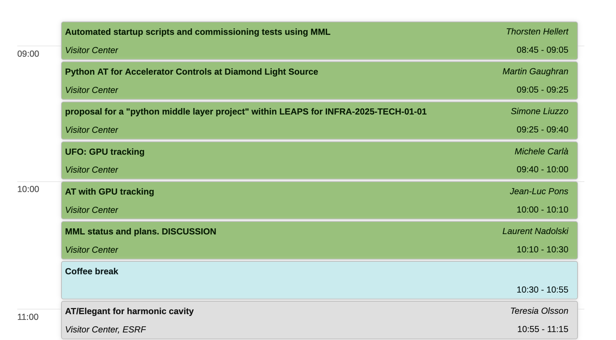
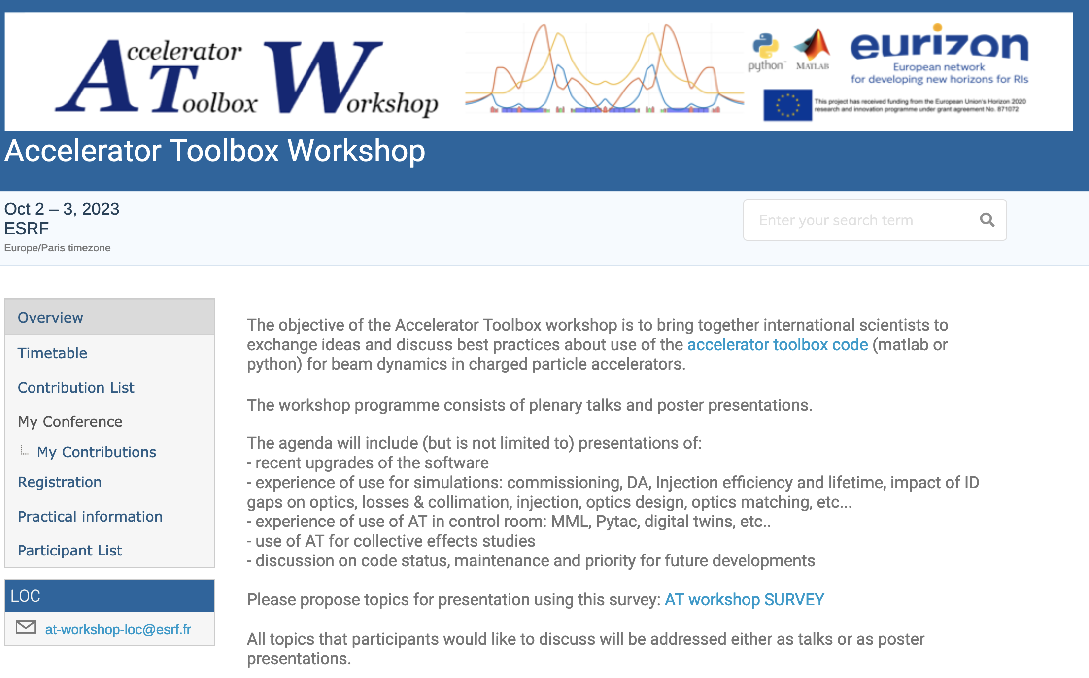
Construction and consolidation of the AT collaboration
Extremely positive, active and fruitful collaboration within EU project. TO BE CONTINUED and EXTENDED.
A net revolution compared to CremlinPlus activities.
25 world-wide laboratories
Planned to present this project proposal during AT workshop in October. Expected discussion and return of interest for collaboration.

Slide 4
Project preliminary/draft budget / human resources
2 Post-Docs/COD for 4 years (or equivalent): experts of python programming (either physicist or software engineer) one of those two positions could be based at ESRF and travel to other labs. ~ 150kEuros/year/person (1.2 MEuro over 4 years)
Finances for travelling (~10kEuro/year/lab) (assuming 5 labs participating, ~200 kEuros)
Finances for conferences/workshops (~10kEuro/conference) (~40 kEuros)
Finances for office material (computers for the hired people) (~10 kEuros)
Finances to finance external colleagues to work on the project for limited amount of time even if not members of the project (50kEuro)
For a total of about 1.5 MEuro over 4 years.
On top of the 2 positions above, an additional ~2 full time equivalent (8-10 FTE for the 4 years) will be needed for the project to be completed. Those are intended as the time spent by members of each lab on the project activities.

Slide 5
DRAFT/EXAMPLE TIMELINE
July-202(3) to Mar-202(4) : establishment of a group of partner laboratories and preparation of detailed project proposal.
21st-Sep-2023: meeting with LEAPS R&D board. Positive outcome: need list of labs and names.
too late for Infra-TECH-2024-01-01.
if collaboration community exists, then project will be discussed in
LEAPS plenary 18th October 2023
Mar-2025: submission of LEAPS project as part of a larger INFRA-TECH project (1.5ME out of 5-6 ME)
Oct-2025: if project approval/start of activities.
Year #1 : analysis of the existing MML. Collaborative work on the definition of the main structure of the code. Kick-off Workshop.
Year #2 : documentation and first draft with basic features: digital twin, magnet calibrations, correction of tune, orbit and chromaticity. Yearly Workshop.
Year #3 : use as a commissioning simulations tool. Extension with additional tuning features for optics correction (LOCO). Yearly Workshop.
Year #4 : test in at least 3 labs (ex: EBS, PETRA-III, Elettra), refinement of installation procedures, improve documentation, additional correction tools. Final Workshop.

Slide 6
List of interested labs and name of a corresponding person (as requested by LEAPS R&D)
Laboratory | Contact person(s) | notes
ESRF | Simone Liuzzo, S.White | pyAT, LOCO, injectors, beamtime
DESY | Ilya Agapov, L.Malina | pySC,

