Slide 1
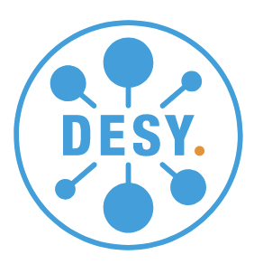
python storage ring digital twin
Proposal to participate to an INFRA-TECH-202?-01-01 call
S.Liuzzo, on behalf of the EURIZON Task 4.1 collaboration (formerly CremlinPlus task 4.1)

Slide 2
~Januray 2019, EBS commissioning

Slide 3
Use of a Storage ring digital-twin
Evaluate expected beam dynamics
debug,
optimize,
correct,
tune,
prepare beam commissioning,
test new software tools,
etc… etc…
While beam is delivered to the users or without an SR
Less Machine Dedicate Time lost in code development
➔ More frequent and secure improvement of beam parameters.

Slide 4
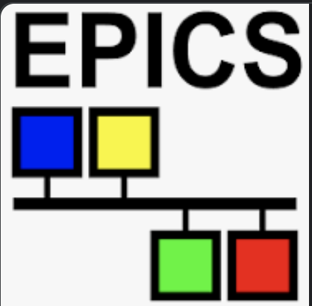
Matlab middle layer
>> switch2online;
MML IS used as an SR DIGITAL-TWIN with great profit in many labs since several years.
Matlab Middle Layer (MML)
Allows to develop high level applications and tuning tools based on simulations and use the same identical tools for operation.
It is control system agnostic.
It is collaborative (same code for every one)
Code configuration for a new SR is clear (needs experts to start with).
tango
Accelerator Toolbox (AT) simulations
Operation phase
Development phase
Home made
>> switch2sim;

Slide 5
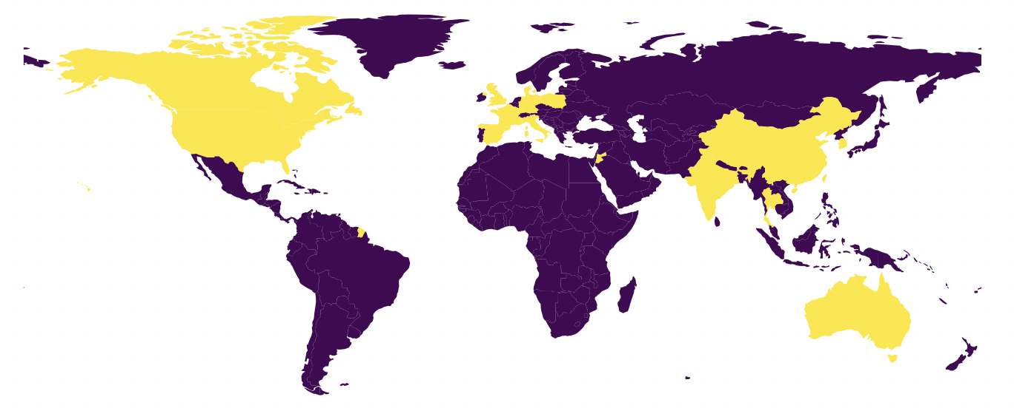
Matlab Middle layer has World wide users (incomplete list)
USA: ALS, Stanford (Spear3), Duke FEL, Brookhaven (VUV or X-Ray rings), B-Factory
Canada: CLS Europe: SOLEIL (France), DIAMOND (England), ALBA (Spain), Soleil (Poland), MAX-IV (Sweden)
Asia: PLS2 (Korea), SLS (Thailand), SSRF (Shanghai), NSRRC (Taiwan)
Middle East: SESAME (Jordan)
Australia: ASP

Slide 6
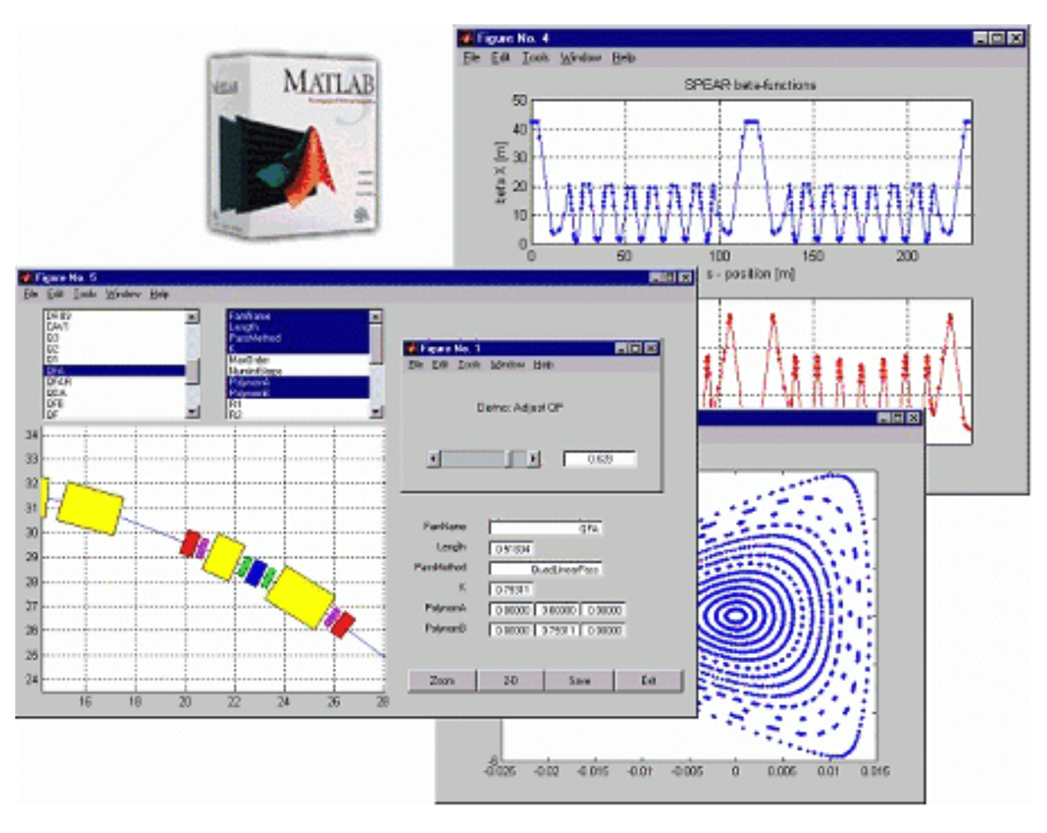
Matlab middle layer ISSUES
>> switch2online;
~ 2005
MML IS used as an off-line SR DIGITAL-TWIN with great profit in many labs since several years.
Matlab Middle Layer
Last minor updates in 2013 and 2018
Based on deprecated matlab graphical interfaces
Not easy to set up and start with
Scarse documentation
Community of old and new users is looking towards alternatives, often leading to home-made solutions.
tango
Accelerator Toolbox simulations
Operation phase
Development phase
Home made
>> switch2sim;

Slide 7
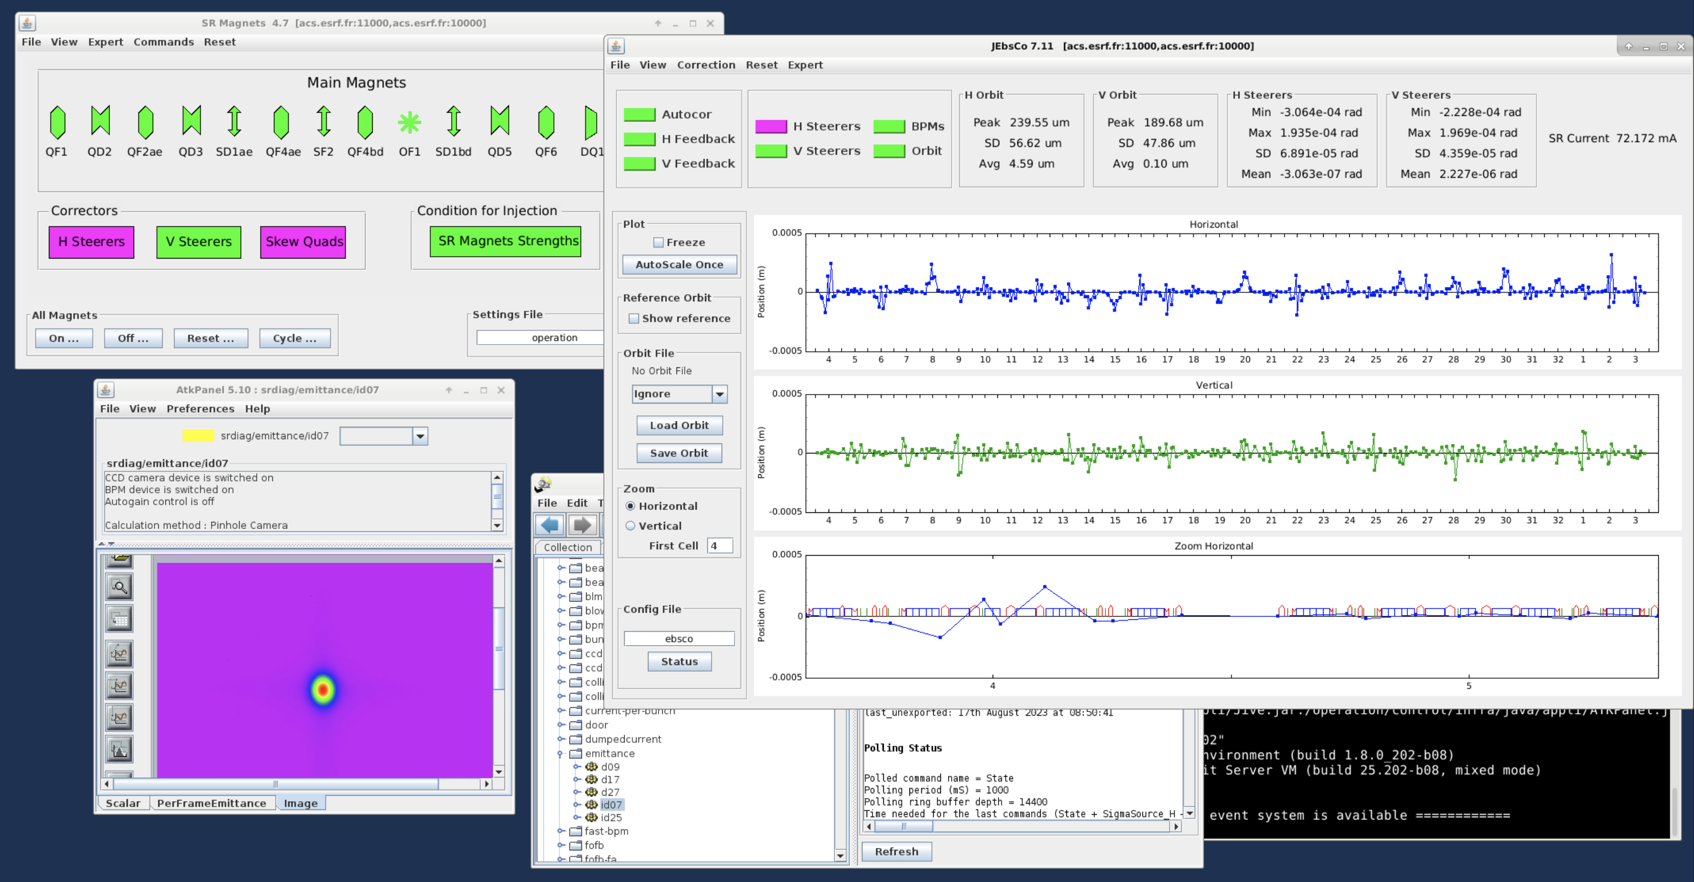
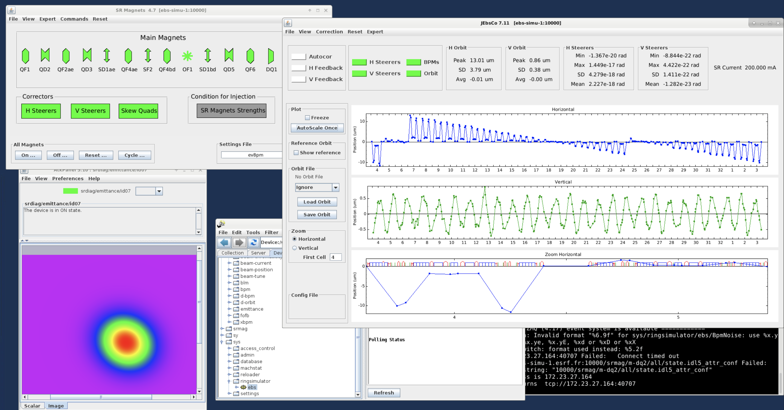
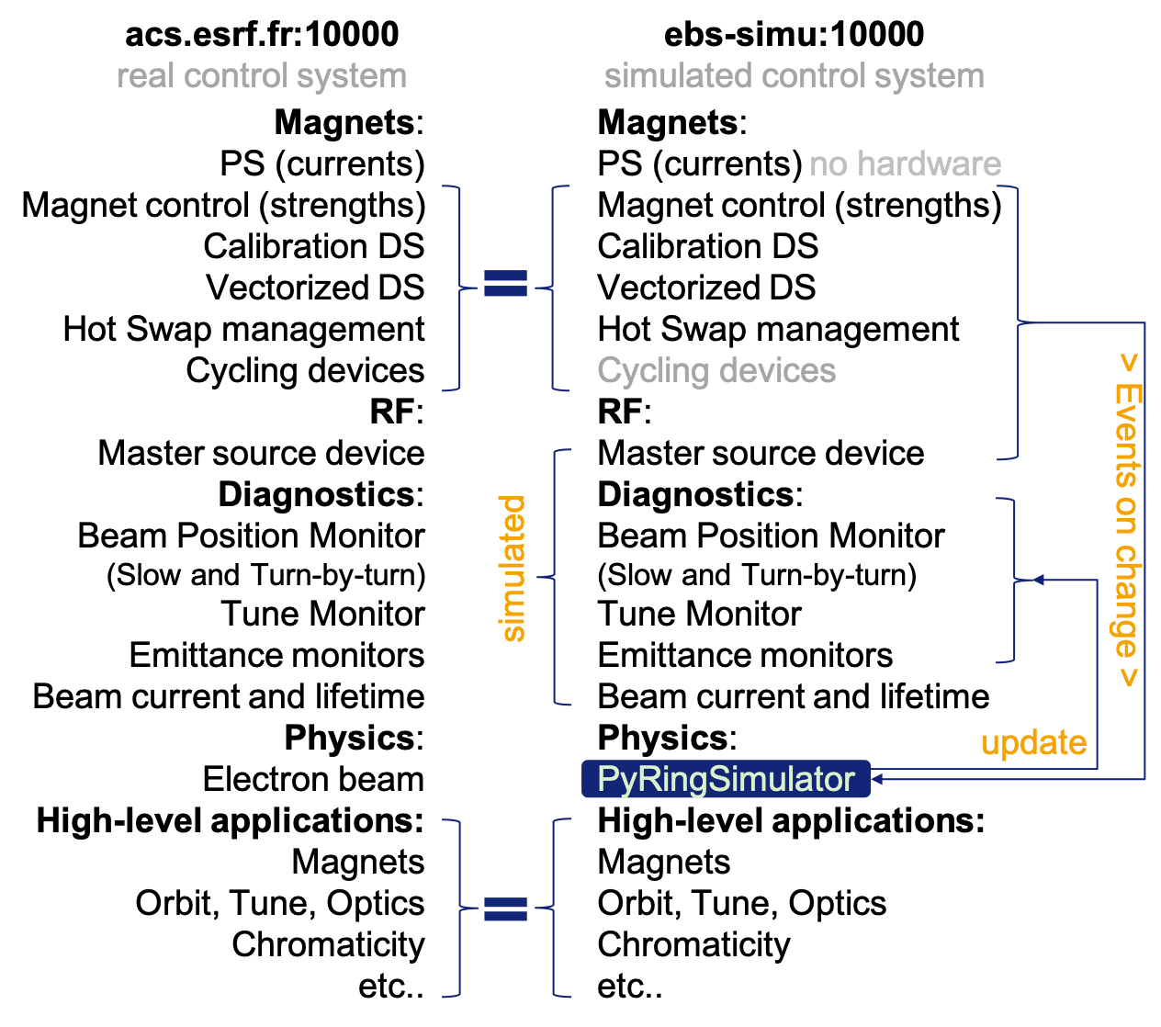
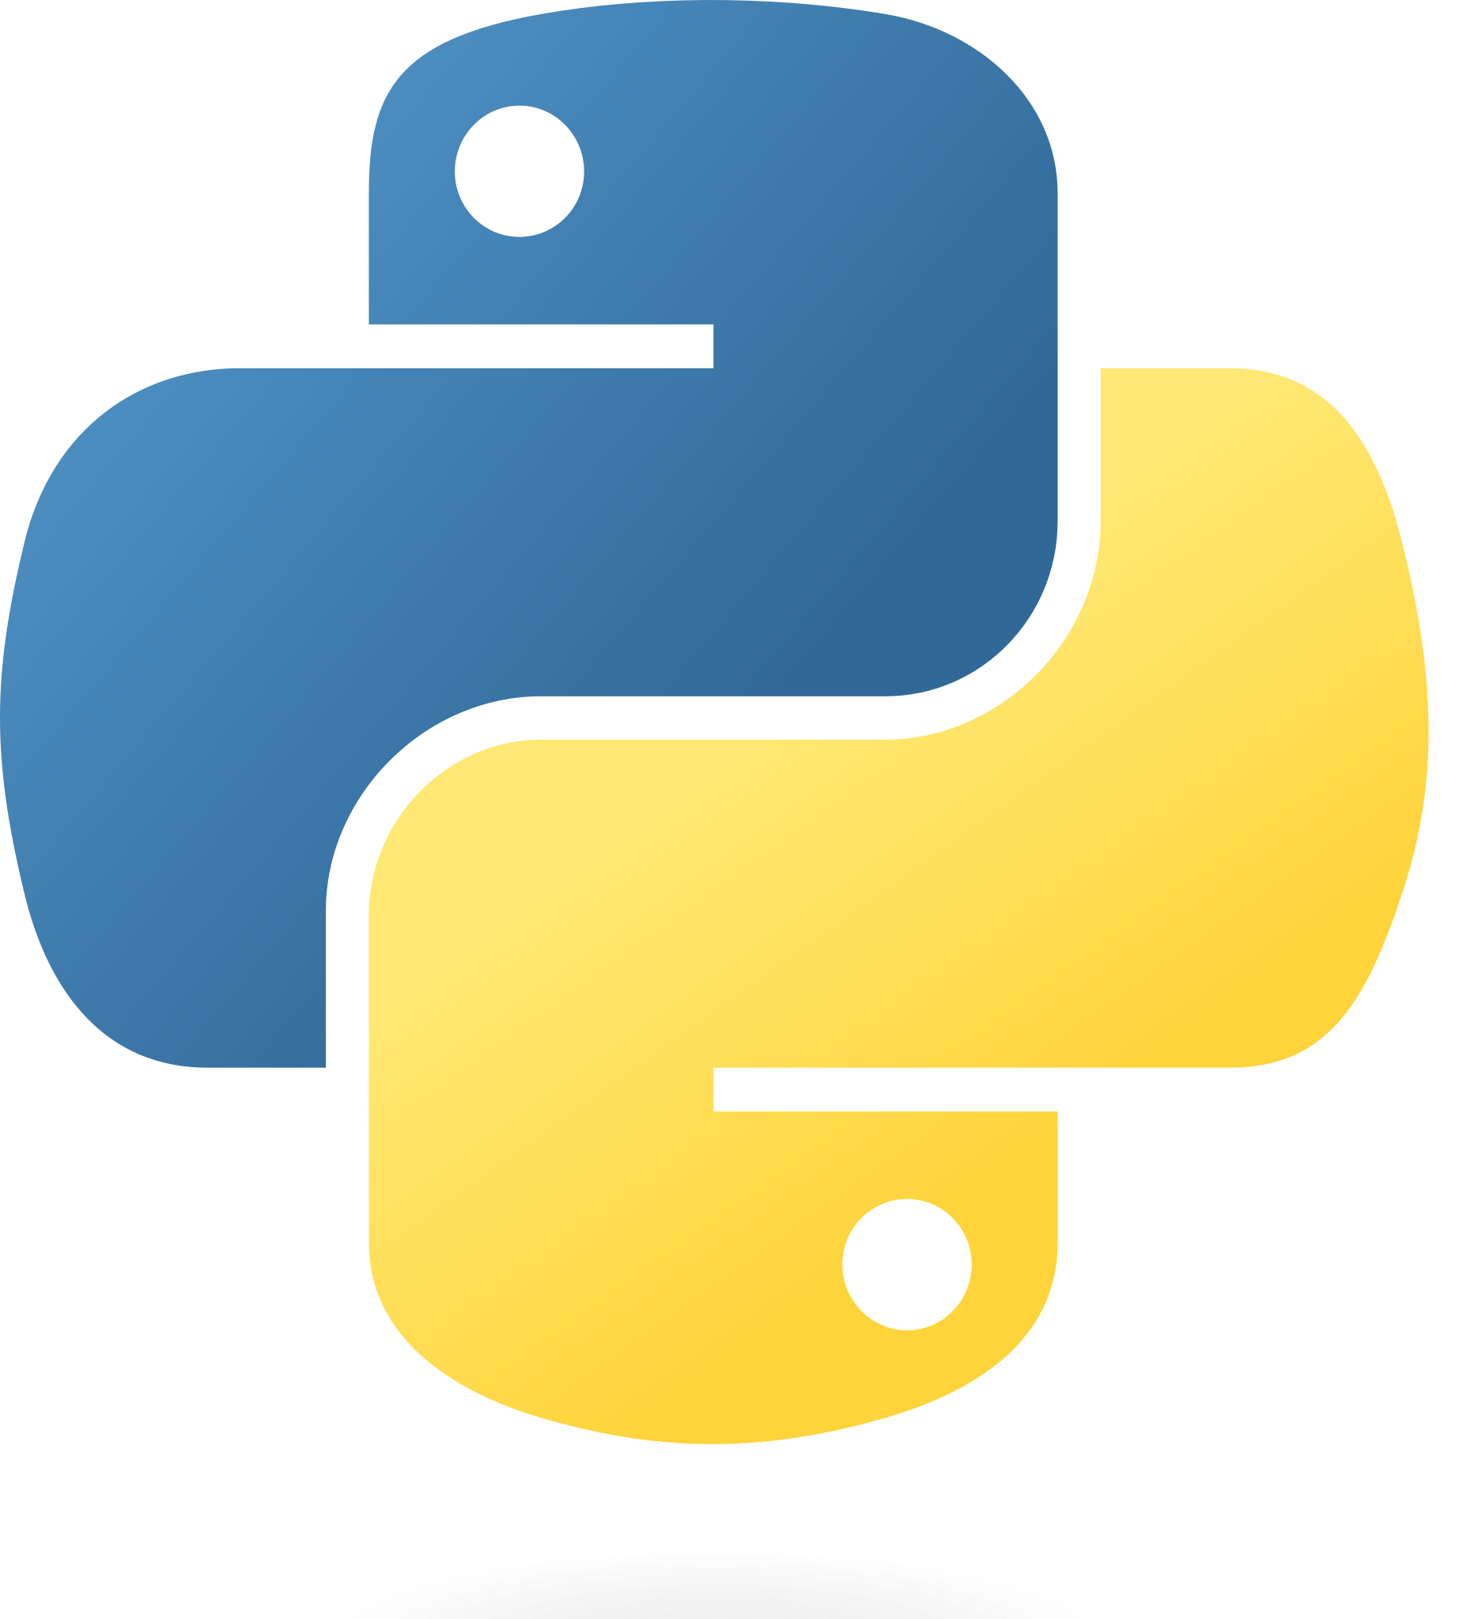
ESRF In-house Digital-Twin
REAL CONTROL
SIMULATED CONTROL
PRESENT ESRF-EBS
Digital twin
ESRF based solution.
Con’s: DIFFICULT TO SHARE, strongly linked to control system infrastructure.
Pro’s: Has online monitoring.
PYTHON
TANGO

Slide 8
Python digital-twin
>>> switch_to_hardware()
Call it with the correct name
Free from licenses
Easier to maintain
Very large user community
Easy to collaborate and add features
Python Digital-Twin
Matlab Middle Layer
Allows to develop high level applications and tuning tools based on simulations and use the same identical tools for operation.
It is control system agnostic.
It is collaborative (same code for every one) as MML.
EASY to extend, interface with AI/ML tools (ex. Badger, XOpt, etc..)
Works for SR, Transfer lines, booster, (linacs)
Clear&EASY code configuration for new SR users.
Python
Accelerator Toolbox simulations
Operation phase
Development phase
Home made
>>> switch_to_physics()

Slide 9
What we have already and what the project would give us
WE HAVE AVAILABLE:
A solid and benchmarked python Accelerator Toolbox package for storage ring simulations
Correction algorithms for orbit, tunes, chromaticity, first turns, optics, etc…code is part of python Simulated Commissioning (outcome of EURIZON ~ 1year of collaboration ESRF-DESY)
User experience from MML
WE WOULD GET FROM THE PROJECT:
Adapt pySC correction tools to real beam control
Graphical interfaces as those available in MML
Magnet calibrations and control (to be ported from TANGO C++ for example)
Commissioning Simulation mode (use simulations software in background for many error seeds)
Easy installation and configuration for any accelerator
Easy upgrade from MML to pythonDigitalTwin (similar interface)
Thorough documentation, tests and examples

Slide 10
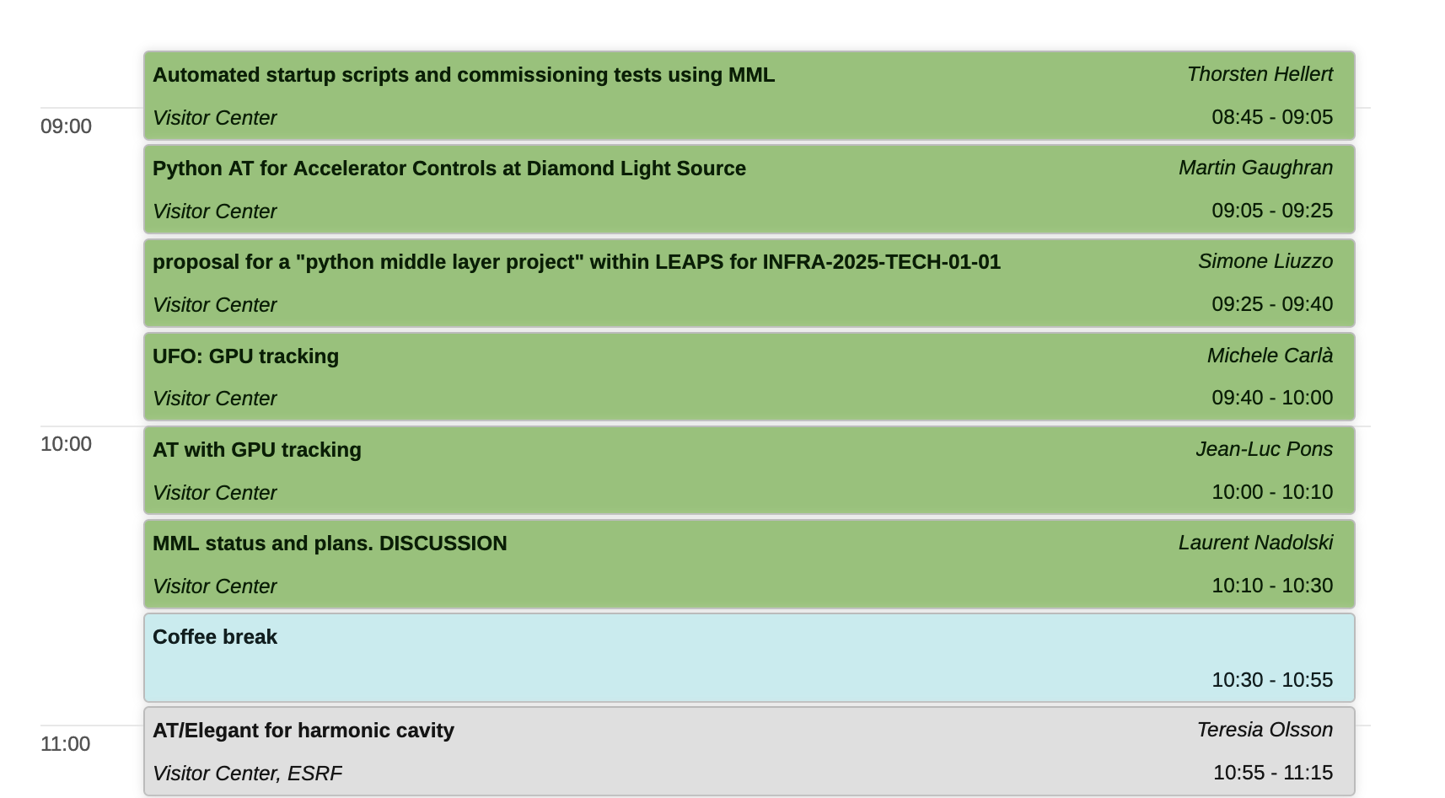
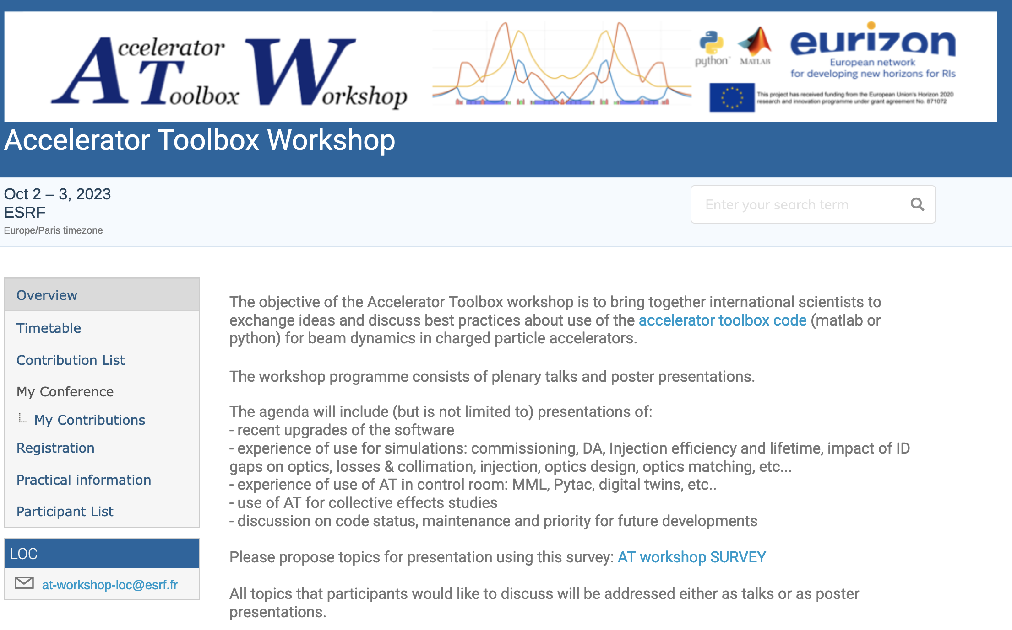
Construction and consolidation of the AT collaboration
Extremely positive, active and fruitful collaboration within EU project. TO BE CONTINUED and EXTENDED.
A net revolution compared to CremlinPlus activities.
25 world-wide laboratories
Planned to present this project proposal during AT workshop in October. Expected discussion and return of interest for collaboration.

Slide 11
Project preliminary draft budget / human resources
2 Post-Docs/COD for 4 years (or equivalent): experts of python programming (either physicist or software engineer) one of those two positions would need to be based at ESRF 100%. ~ 150kEuros/year/person (1.2 MEuro over 4 years)
Finances for travelling (~10kEuro/year/lab) (assuming 5 labs participating, ~200 kEuros)
Finances for conferences/workshops (~10kEuro/conference) (~40 kEuros)
Finances for office material (computers for the hired people) (~10 kEuros)
Finances to finance external colleagues to work on the project for limited amount of time even if not members of the project (50kEuro)
For a total of about 1.5 MEuro over 4 years.
On top of the 2 positions above, an additional ~2 full time equivalent (8-10 FTE for the 4 years) will be needed for the project to be completed. Those are intended as the time spent by members of each lab on the project activities.

Slide 12
TIMELINE
July-202(3) to Mar-202(4) : establishment of a group of partner laboratories and preparation of detailed project proposal.
Mar-202(4): submission of LEAPS project as part of a larger INFRA-TECH project
Year #1 : analysis of the existing MML. Collaborative work on the definition of the main structure of the code. Kick-off Workshop.
Year #2 : documentation and first draft with basic features: digital twin, magnet calibrations, correction of tune, orbit and chromaticity. Yearly Workshop.
Year #3 : use as a commissioning simulations tool. Extension with additional tuning features for optics correction (LOCO). Yearly Workshop.
Year #4 : test in at least 3 labs (ex: EBS, PETRA-III, Elettra), refinement of installation procedures, improve documentation, additional correction tools. Final Workshop.

Slide 13
Conclusion
Python Storage Ring Digital-Twin
Would benefit to a large community of laboratories
in Europe (PETRAIV, SOLEIL, ALBA, ..) and outside Europe
Especially those that foresee an new SR or an upgrade in the close future.
No single laboratory in Europe has sufficient energy to start such project alone.
It is thus a perfect topic for an EU project
with welcome participation of non-European laboratories (not financial).
Extremely positive, productive and rewarding previous experience from EURIZON Task 4.1

Slide 14
References
MML: https://indico.ijclab.in2p3.fr/event/2075/attachments/3275/4037/LALseminarMML_nadolski.pdf
AT: https://github.com/atcollab/at
pySC: https://github.com/lmalina/pySC
S. White, L. Carver, L. Farvacque, and S. Liuzzo, “Status and recent developments of python Accelerator Toolbox”, presented at the IPAC'23, Venice, Italy, May 2023, paper WEPL031.
A.Terebilo, “Accelerator Modeling with MATLAB Accelerator Toolbox”, in Proc. PAC'01, Chicago, IL, USA, Jun. 2001, paper RPAH314, pp. 3203-3205.
W. A. H. Rogers, N. Carmignani, L. Farvacque, and B. Nash, “pyAT: A Python Build of Accelerator Toolbox”, in Proc. IPAC'17, Copenhagen, Denmark, May 2017, pp. 3855-3857. doi:10.18429/JACoW-IPAC2017-THPAB060
B. Nash et al., “New Functionality for Beam Dynamics in Accelerator Toolbox (AT)”, in Proc. IPAC'15, Richmond, VA, USA, May 2015, pp. 113-116. doi:10.18429/JACoW-IPAC2015-MOPWA014
S. Liuzzo et al., “Commissioning simulations tools based on python Accelerator Toolbox”, presented at the IPAC'23, Venice, Italy, May 2023, paper MOPA142, unpublished.
S. M. Liuzzo et al., “The ESRF-EBS Simulator: A Commissioning Booster”, in Proc. ICALEPCS'21, Shanghai, China, Oct. 2021, pp. 132-137. doi:10.18429/JACoW-ICALEPCS2021-MOPV012
G. J. Portmann, W. J. Corbett, and A. Terebilo, “An Accelerator Control Middle Layer Using Matlab”, in Proc. PAC'05, Knoxville, TN, USA, May 2005, paper FPAT077, pp. 4009-4011.
S. M. Liuzzo et al., “UPDATE ON THE EBS STORAGE RING BEAM DYNAMICS DIGITAL TWIN”, in Proc. ICALEPCS’23, Cape Town, South Africa, Oct. 2023, THPDP010
L. Malina et al., “Python Library for Simulated Commissioning of Storage-Ring Accelerators”, in Proc. ICALEPCS’23, Cape Town, South Africa, Oct. 2023, FR2AO05

