Slide 1
Python AT for Accelerator Controls
Martin Gaughran, Diamond Light Source

Slide 2
Background

Slide 3
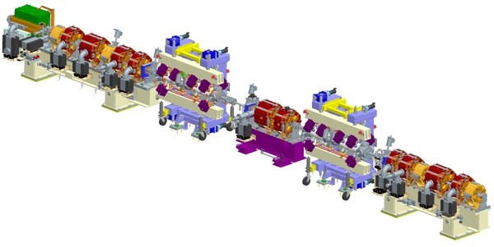
Accelerator Tools
High-Level Applications team is part of Accelerator Controls
We are responsible for several accelerator tools, including:
Top-up process
Slow Feedbacks
Transitioning some tools away from Accelerator Physics for HLA support:
Beam-Based Alignment (soon!)

Slide 4
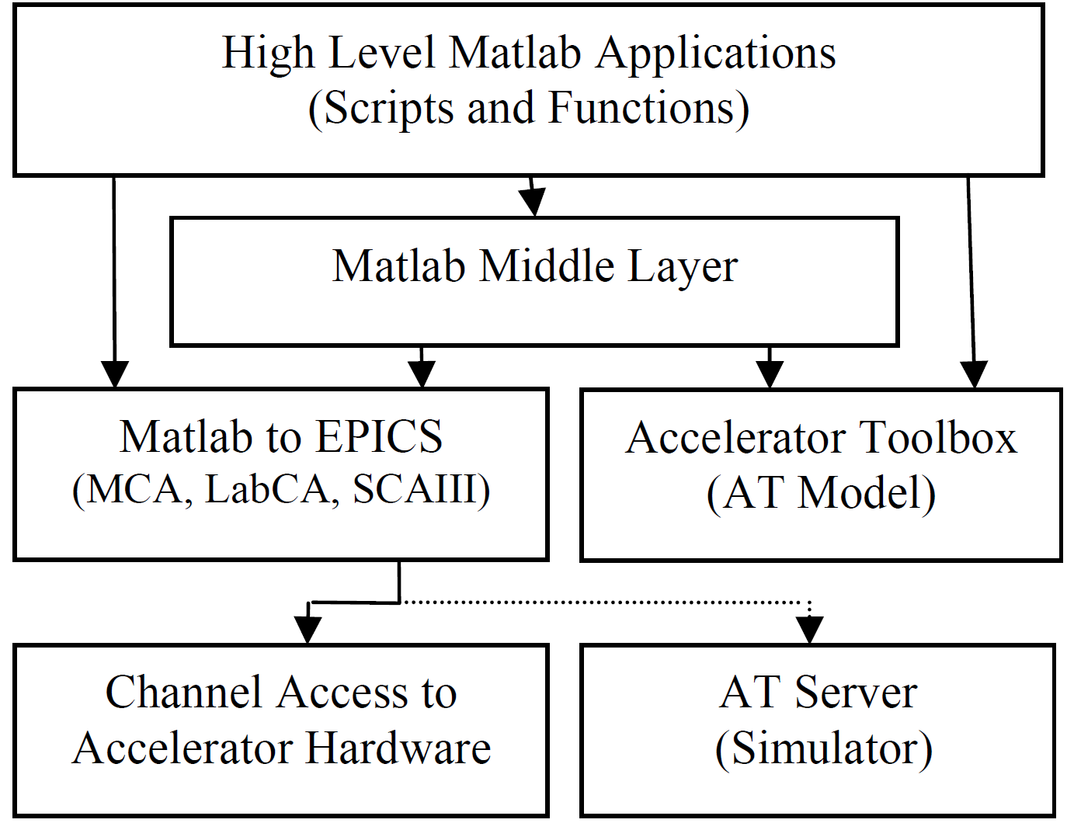
MATLAB Middle Layer (MML)
Used at Diamond by Accelerator Physics and Operations
Simulation or direct control
Includes generic tools and utilities
Currently used at Diamond for:
Beam-based alignment
Chromaticity and dispersion
Response matrix calculations
Etc.
G. Portmann, J. Corbett, A. Terebilo, “An Accelerator Control Middle Layer using MATLAB”, Proceedings of 2005 Particle Accelerator Conference, 2005

Slide 5
Migration to Python
Diamond intends to move tools critical to user operations away from Matlab:
Improved support from Controls group
Better programming language
Easier to integrate with other Controls tools
Etc.
Interest in a more uniform approach to Python development

Slide 6
Python Tools

Slide 7
Pytac
Python Toolkit for Accelerator Controls
Work with standard Lattice elements similar to pyAT
Load elements from MML configuration
Customise Control System backend for EPICS support
Physics / engineering unit conversions

Slide 8
Pytac interface
S01.get_value('b2’, pytac.RB, pytac.PHYS, pytac.LIVE)
S03.set_value('b2', value, pytac.SP, pytac.PHYS, pytac.LIVE)
CA
CA
IOC
IOC
Machine hardware

Slide 9
ATIP
Accelerator Toolbox Interface for Pytac
Provides a simulator to Pytac, using pyAT
Enables offline testing of accelerator controls applications

Slide 10
ATIP interface
S01.get_value('b2’, pytac.RB, pytac.PHYS, pytac.SIM)
S03.set_value('b2', value, pytac.SP, pytac.PHYS, pytac.SIM)
Accelerator Toolbox simulation

Slide 11
Virtual Accelerator (Virtac)
Standalone application with EPICS interface.
EPICS backend to Pytac is then able to interact with the Virtac
Complete end-to-end simulation of our high-level Controls applications
Virtual accelerator can be used with non-pytac commands by including extensions

Slide 12
Virtac interface
S01.get_value('b2’, pytac.RB, pytac.PHYS, pytac.LIVE)
S03.set_value('b2', value, pytac.SP, pytac.PHYS, pytac.LIVE)
CA
CA
IOC
Virtual Accelerator

Slide 13
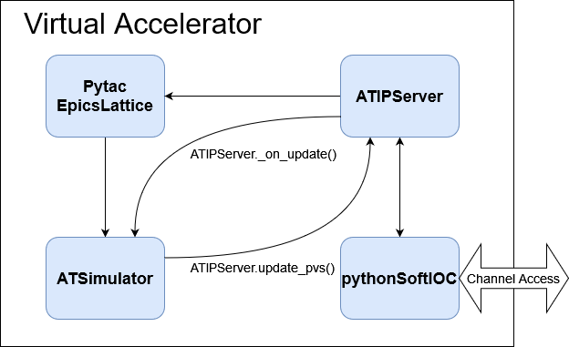
Virtual Accelerator (design)
ATSimulator provided by ATIP library
ATIPServer designed for Virtac
pythonSoftIOC used for EPICS IOC generation
Tobyn Nicholls

Slide 14
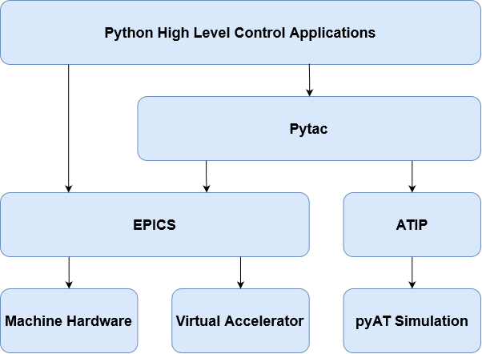
Python tools overview
Pytac can be used for the majority of tasks
Direct EPICS control required for non-standard components

Slide 15
Adoption at Diamond

Slide 16
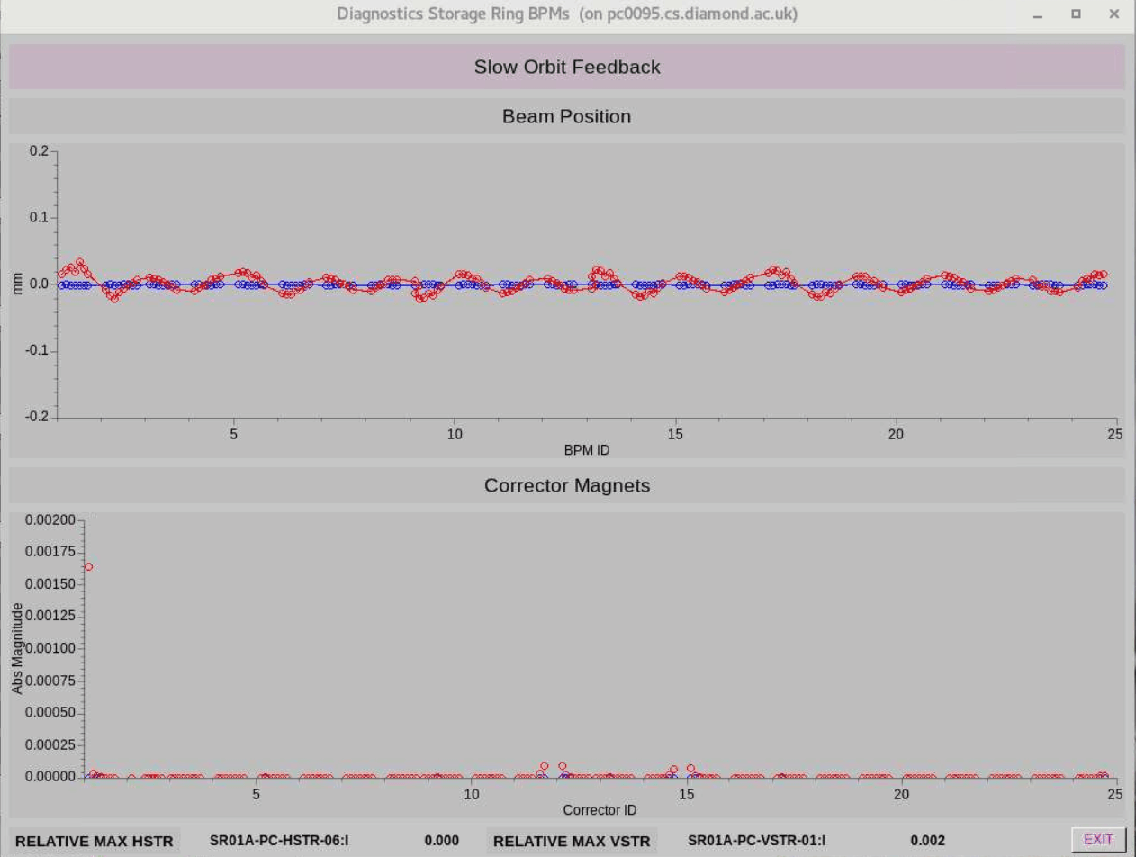
Slow Feedbacks
Python IOC
Uses Pytac for majority of features
Includes:
Slow orbit feedback
RF feedback
Tune feedback
Vertical emittance feedback
Virtual Accelerator is used for offline testing

Slide 17
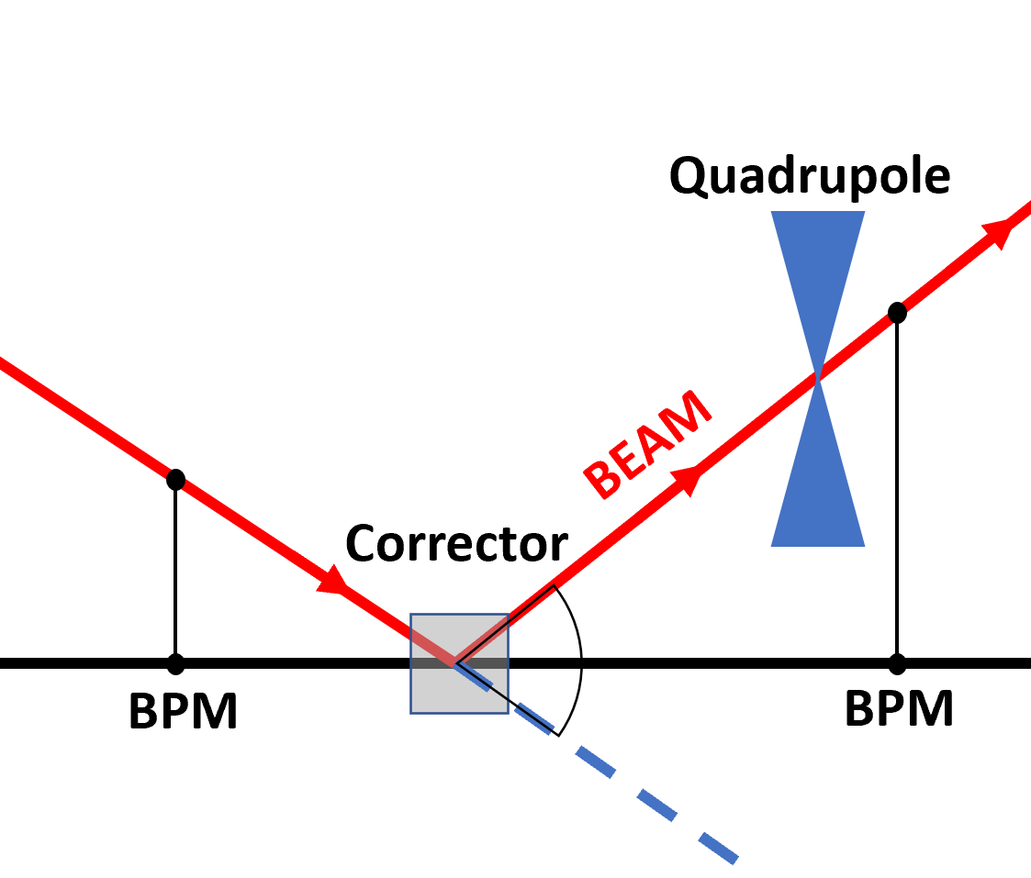
Beam-Based Alignment (BBA)
Python ‘Slow’ and ‘Fast’ Beam-Based Alignment developed in 2023
Uses Pytac for control of lattice components
Intend to add Virtac support for testing ‘slow’ BBA
Joshua Appleby, Development of Fast Beam-Based Alignment for Diamond Light Source, 2023

Slide 18
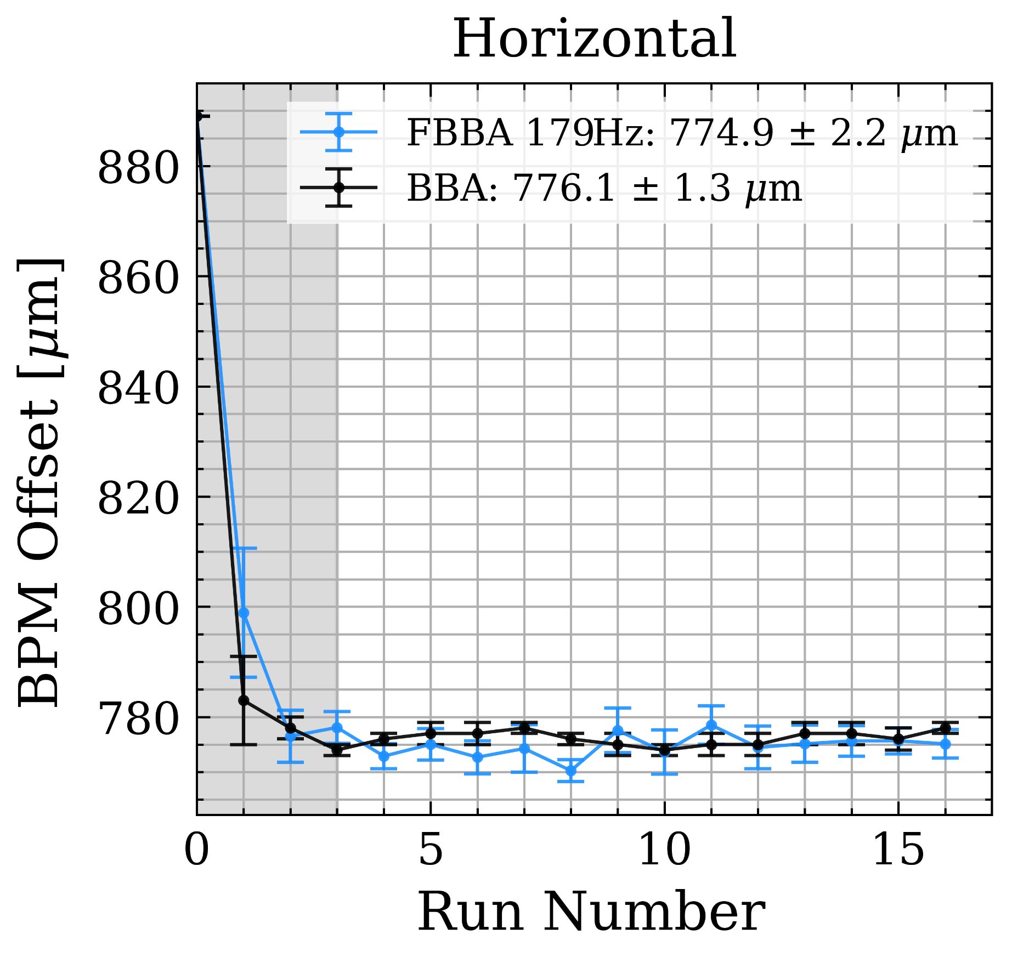
Fast Beam-Based Alignment
Priority for our BBA development
Process developed by ALBA
No simulator support due to non-standard components, e.g. :
Fast archiver
Corrector oscillation control
Uses unit and integration tests
Joshua Appleby, Development of Fast Beam-Based Alignment for Diamond Light Source, 2023

Slide 19
Near-term Improvements
Improve design of Virtac extensions for customisability
Provide standard pattern for integration of facility-specific components with Pytac
Adopt modern Python features
Type hints problematic due to cothread – use different EPICS library

Slide 20
Summary
Pytac & Friends
Only supports EPICS
Matlab Middle Layer
Supports EPICS and Tango
Feedback systems, tools etc. available for anyone
Wide collaboration
Supports Accelerator Toolbox
No generic tools and utilities
Only maintained by Diamond Light Source
Supports Accelerator Toolbox

Slide 21
Repositories and Documentation
https://github.com/DiamondLightSource/pytac
https://github.com/dls-controls/atip
Includes ATIP and Virtual Accelerator
Will be moved soon to DiamondLightSource

Slide 22
Acknowledgements
Will Rogers, Razvan Vasile
Pytac, Slow Feedbacks
Tobyn Nicholls
ATIP, Virtual Accelerator
Joshua Appleby
FBBA

Slide 23
Demo

Slide 24
Any Questions?

