Slide 1
Diamond-II Commissioning Simulations
Hung-Chun Chao
ESRF, Grenoble, 2-3 Oct 2023
AT workshop (https://indico.esrf.fr/event/93/)

Slide 2
Outline
Introduction
Diamond-II lattice
Error specification
Different magnetic fiducialisation approaches
Commissioning Strategies
Implementations for Diamond-II Simulation
Anti-bend quad modelling
Multipole error implementation example
Beam based alignment
Beta-beating correction
Summary and Future tasks

Slide 3
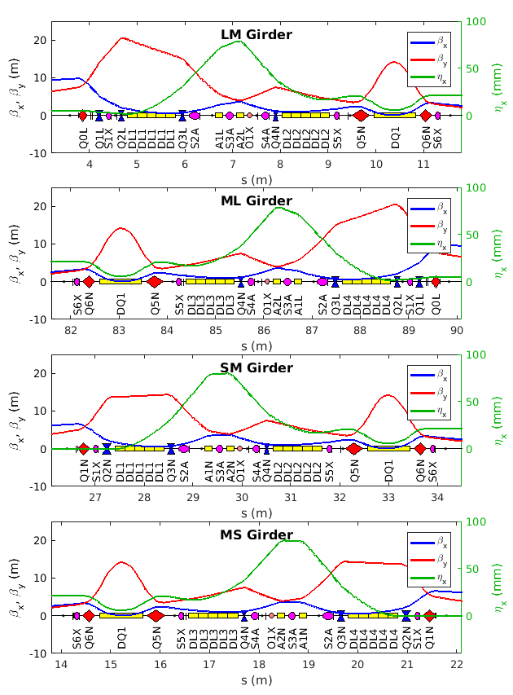
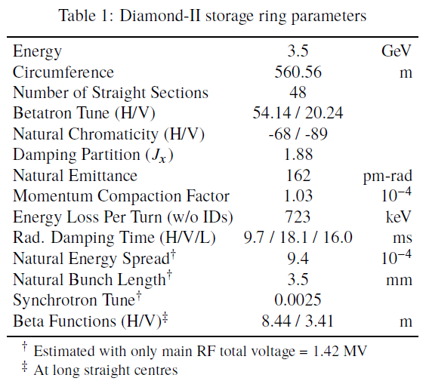
Diamond-II Parameters
4 girder modules (LM, ML, SM, MS):
L: long straight, M: middle straight, S: standard straight
Diamond-II upgrade features:
H6BA lattice (stemmed from ESRF-EBS’s H7BA lattice)
Combine DDBA ideal to create 24 new middle straights (2.9 m)
Energy 3 -> 3.5 GeV, Emittance 2.7 nm -> 160 pm
Lattice: (LM,MS,SM,MS,SM,MS,SM,ML)*6

Slide 4
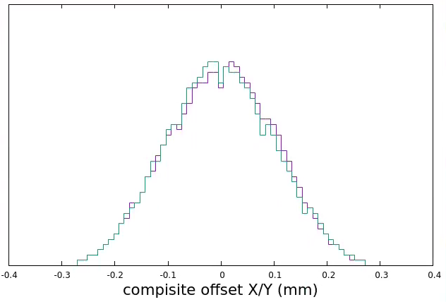
Diamond-II Storage Ring Error Specifications
Error specs are still evolving!
All populated with 2 standard deviation truncated
Various sources of multipole errors
Eventually all will be replaced by Diamond’s own measured data
To be added:
Missing multiple random errors
Multipole fields arising from trim coils of DQ and anti-bend quads
Errors of Magnet and Girder
 | Misalignment Errors |  | Setpoint Errors
 | Offset (µm) | Roll (µrad) | Main Field (%) | Secondary Field (%)
Girder Centre | 100
Girder Ends¹ | 40 | 150
Longitudinal Varying Dipole | 100 | 100 | 0.05
Gradient Dipole | 100/40# | 100 | 0.05 | 0.10
Anti-bend Quad | 40 | 100 | 0.05 | 0.10
Quadrupole | 40 | 100 | 0.10
Sextupole | 40 | 100 | 0.10
Octupole | 40 | 100 | 0.10
Corrector² |  |  |  | 0.10
Skew Quad³ |  |  |  | 0.50
Composite quad offset ~ 100 μm rms (obtained from translation parameter T1/T2)
Multipole Error References
 | Systematic | Random | Max order
DL | Diamond II** | NULL | 14
DQ | ESRF-EBS* | ESRF-EBS* | 8
Pure Quad | APS-U# | APS-U# | 15
Anti-bend quad | APS-U# | APS-U# | 15
Sextupole | APS-U# | APS-U# | 15
Octupole | Diamond II** | NULL | 17
CM (in sextupole)^ | Diamond II** | NULL | 5
CM (in octupole)^ | Diamond II** | NULL | 9
1 Relative to girder centres
2 Embedded in sextupoles and octupoles
3 Embedded in sextupoles
# Horizontal / vertical
Injection Beam Errors
Systematic Offsets |  | Pulse Jitter |  | unit
Δx | 500 | σ_{x} | 100 | μm
Δx’ | 150 | σ_{x’} | 10 | μrad
Δy | 500 | σ_{y} | 100 | μm
Δy’ | 150 | σ_{y’} | 10 | μrad
Δδ | 0.1 | σ_{δ} | 0.1 | %
Δφ | 0 | σ_{φ} | 0.1 | degree
BPM Errors |  | RF Errors**
Initial Offsets* | 500 µm | Frequency | 100 Hz
Roll | 10 mrad | Voltage | 1.5 %
Calibration | 5 % | Phase Offset | 90°
Noise (Turn-By-Turn) | 60 µm | Circumference | 0.001%
Noise (Closed Orbit) | 1 µm
* “pseudomultipole coefficients (DQ1-063)” PRAB 22, 102402 (2019) Table V. ** from simulations
# scaled from APS-U’s measurement data
^ adding low order multiple coefficients induced by corrector coils
* Total effects from both mechanical and electronical parts
** Net effects from all 7 main cavities
Injection pulsed magnet jitter 0.024%

Slide 5
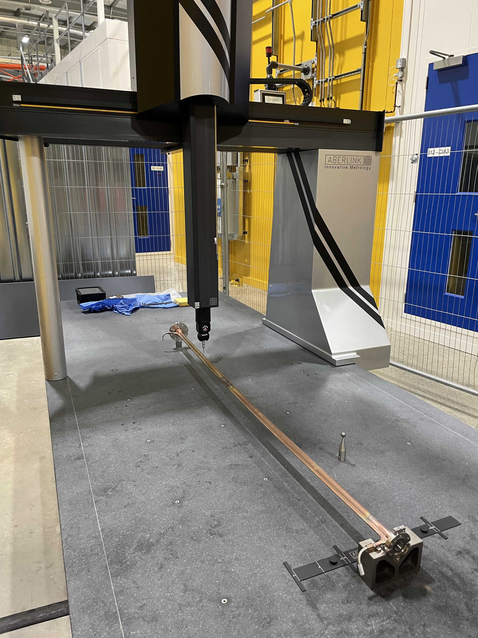
Multipole Magnet Fiducialisation Uncertainties -- Comparison of different procedures: Laser Tracker vs CMM
Wire holder inspection | 2
Magnetic measurement | 5
Wire holder survey | 25
Magnet fiducial survey | 10
Magnet surveyed into position on girder | 35
Splitting/joining Of Magnet | 8
Survey ball in cone repeatability | 3
Transport | 10
SMR Centering | 3
Combined Uncertainty of magnet position on Girder | 46
Wire position measurement | 5
Magnetic measurement | 5
Survey Feature position measurement | 5
Magnet surveyed into position on girder | 35
Splitting/joining Of Magnet | 8
Survey ball in cone repeatability | 3
Transport | 10
SMR Centering | 3
Combined Uncertainty of magnet position on Girder | 38
CMM system
17% Improvement
Current position uncertainty table
CMM in place of tracker position uncertainty table*
unit: µm
Courtesy of Paul Vivian

Slide 6
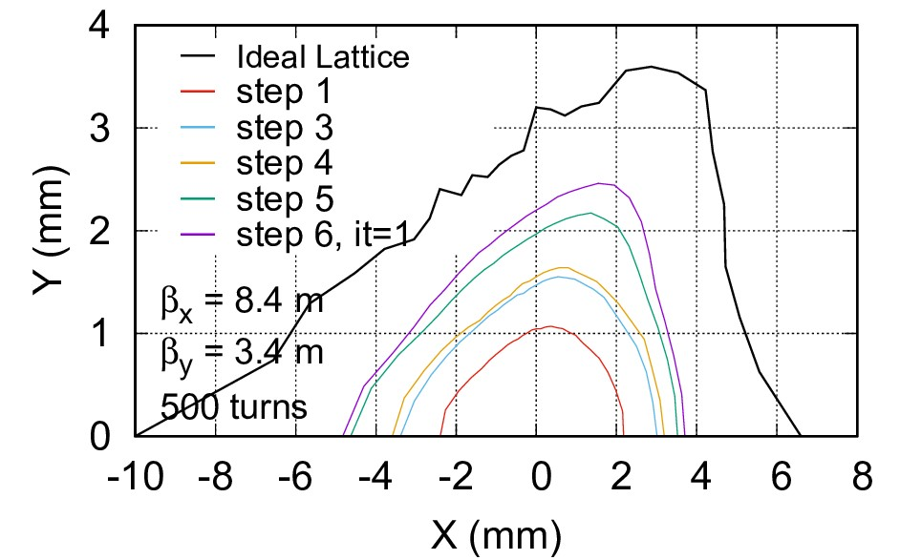
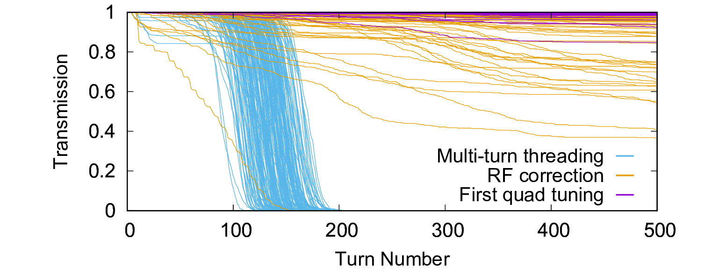
Current Commissioning Plans and Simulation Results
First-turn threading and sextupoles Iteratively applying the first turn threading procedure with increasing sextupole strengths until at full strengths
Multi-turn threading
Apply stitching procedure multiple times with a greater number of BPMs, until satisfactory results
RF tuning
Coarse RF setting
Fit RF frequency and phase
Refined RF setting
bisection search methods
Tune scan
Grid scan Q±0.3, 169 points
Change 7 quad families (pre-calculated with ideal lattice RM)
Selection criteria
Remove cases without stable orbit
Remove cases with transmission < 0.7
Tune away from integer and half-integer resonance (margin=0.12)
Beam loss < 0.3 at 512 turns
Sorting order:
Bigger fractional tune separation
Smaller quad changes
Larger transmission
Closer to designed tune
Manually pick for bad cases
200 seeds simulated
First tuning
First closed orbit correction (alpha=1000)
weak BPM calibration
orbit variation measurements (5 CM setpoints, 2 Q setpoints, 2 directions)
Fit the BPM-quad centres and apply half BPM offset update
orbit corrections
BBA48-1
Visit all 48 girders once
Tune scan if needed
only one seed changed
Premilitary beta-beating correction
Fix the integer tune
BBA and linear optics corrections (some missing cases)
Coupling and ID-induced beta-beating correction, etc (to-be-finished)
Off-axis injection ready
FLS23-TU4P20
Tune detected
IPAC23-MOPA158
In principle, prefer to reduce BPM noise with stronger current.
May revise strategies following commissioning experience of other low emittance light sources.
D-II is designed for off-axis injection with accumulation,
larger DA compared to on-axis injection machine:
Easier to establish a closed orbit and get a beam stored
Can turn on sextupoles at early stage

Slide 7
What has been changed? (to fit into Diamond-II situations)
Based on AT2/SC-toolkit
AT lattice and implements:
Routines for aperture markers: atRemoveApertures.m and atInsertApertureElement.m
Add girder start/end markers
Pre-defined aperture data files: with ID and collimator open/closed.
Use 'BndStrMPoleSymplectic4Pass’ pass method for shifted quads
Allocate pre-defined ID straights: to be replaced by ID kickmaps
SC data structure:
Add container SC.DUMMY struct to store dummy info such as indices, RMs, girder info, BBA group, flags, etc. (safe to remove)
Lattice error assignment:
register_error_45.m: Dedicated error register function
initNomPolynomAB.m: Initialise NomPolynomB/A
SC scripts modified:
SCupdateMagnets.m: PolynomB/A generation is overridden by patch_PolynomAB.m
SCapplyErrors.m and SCregisterSupport.m: add implementation of girder centre offset according to the current alignment procedures
SCgetModelRING.m: add atsetcavity
SCfeedbackRun.m: add “rescale” option
SC scripts added:
SCsynchPhaseSearch.m: modified from SCsynchPhaseCorrection.m
SCsynchEnergySearch.m: modified from SCsynchEnergyCorrection.m
capture_test_updateRM.m: tracking tests and update response matrix
SCgetQC, SCfixQC.m and SCstepQby.m: get and fix tune and chromaticity
SCcorrectCO.m: wrapper for an orbit correction sequence (many options)
SCfix_integerQ.m: fix integer tune
BBA routine (BBA48_xxx.m): perform BBA on all 48 BBA groups
meas_orbits.m: perform orbit measurements for BBA and store the data in SC data structure (instead of quadrupole modulation system struct)
QuadCenterFit1.m: find the most probable quad centres by searching and fitting (gaussfit.m, outlier.m)
QuadCenterFit2.m: algorithm from G. Portmann (PAC’95 RPQ13)
QuadCenterFit3.m: algorithm from the current control room
sort_girders_BPM.m: rank girders for BBA (many options)
getBPMCMstat.m: get BPM and CM statistics
Wrapper for matlab-based LOCO routine:
LOCO_Q300.m: with all separate function quadrupoles
LOCO_SQ.m: with skew quads for coupling correction
LOCO_ID.m: for ID effect correction
Other routines:
beta-beat correction, LOCO parameter scan scripts, etc
Miscellaneous scripts:
Data collection, log file analyser, plotting scripts, etc
Still under development, open to collaboration

Slide 8
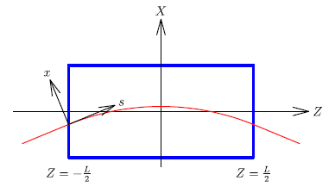
Anti-bend Quad Modelling
Straight-bend pass method was introduced to correctly model shifted quads so that multipole fields defined in a cartesian geometry can be correctly applied
Ideal lattice: atsbend with 'BndMPoleSymplectic4Pass’ is ok
Lattice with error: with 'BndStrMPoleSymplectic4Pass’
Two additional parameters (X0ref and RefDZ) as part of the modelling. They are found numerically. (use fminsearch in find_X0ref_RefDZ.m)
The pass method `BndStrMPoleSymplectic4Pass’ is patched
The radiation version of straight-bend pass method `BndStrMPoleSymplectic4RadPass’ is added.
Small radiation from anti-bend quad is now included.
 | X0ref (m) | RefDZ (m) | Offset (k0/k1) (m)
A1N | 3.278410e-05 | 4.299196e-08 | -3.6331e-03
A2N | 3.278484e-05 | 4.299389e-08 | -3.5884e-03
A1L | 3.276008e-05 | 4.292894e-08 | -6.1144e-03
A2L | 3.280267e-05 | 4.304072e-08 | -2.7667e-03
Instead of re-alignment at later commissioning stage, one should add these physical offsets(X0ref) into mechanical alignment at first place
Final offsets will be decided based on numerical tracking through magnet models after including the effects of extended fringe fields and cross-talk with adjacent magnet yokes.

Slide 9
Codes Development Example (sextupoles)
combine multipole errors from different sources
% Add decapolar fields excited from the trim coils in sextupoels
iStrim = SCgetOrds(ring,'S1X|S2A|S5X|S6X');
for nn = 1:length(iStrim)
ring{iStrim(nn)}.NomPolynomA2=[0.1167,0,0,0,1.57e6,0,0,0,0,0,0,0,0,0,0];
ring{iStrim(nn)}.NomPolynomB2=[0.1167,0,0,0,1.57e6,0,0,0,0,0,0,0,0,0,0];
end
iStrim = SCgetOrds(ring,'S4A');
for nn = 1:length(iStrim)
ring{iStrim(nn)}.NomPolynomA2=[1,0,0,0,2.94e7,0,0,0,0,0,0,0,0,0,0];
ring{iStrim(nn)}.NomPolynomB2=[1,0,0,0,2.94e7,0,0,0,0,0,0,0,0,0,0];
end
in initNomPolynomAB.m
pd = makedist('Normal’); t = truncate(pd,-2,2);
s_s_norm = [ 0, 0, 0, 0.57, 3.40, -0.15, ...]*1e-4;
s_s_skew = ...; s_r_norm = ...; s_r_skew = ...;
R_ref = 0.01; nref = 3;
isext = findcells(ring,'Class','Sextupole');
for nn = 1:length(isext)
bref = ring{isext(nn)}.NomPolynomB(nref);
ring{isext(nn)}.MaxOrder = 14;
for i=4:15
ring{isext(nn)}.NomPolynomB(i) = (s_s_norm(i) + random(t,1)*s_r_norm(i))*bref*r_ref^(nref-i);
ring{isext(nn)}.NomPolynomA(i) = (s_s_skew(i) + random(t,1)*s_r_skew(i))*bref*r_ref^(nref-i);
end
end
Different usage for NomPolynomA/B(2)
in patch_PolynomAB.m
function SC = patch_PolynomAB(SC,target)
tmp = SC.RING{target};
if strcmp(tmp.Class,'Sextupole')
for i=4:15
tmp.PolynomB(i) = tmp.NomPolynomB(i)/tmp.NomPolynomB(3)*tmp.SetPointB(3)*(1+tmp.CalErrorB(3));
tmp.PolynomA(i) = tmp.NomPolynomA(i)/tmp.NomPolynomB(3)*tmp.SetPointB(3)*(1+tmp.CalErrorB(3));
end
if ~(strcmp(tmp.FamName,'S3A')) % correctors in sextupoles
for i=1:15
tmp.PolynomB(i) = tmp.PolynomB(i) + tmp.NomPolynomB2(i)/tmp.NomPolynomB2(1)*tmp.SetPointB(1)*(1+tmp.CalErrorB(1));
tmp.PolynomA(i) = tmp.PolynomA(i) + tmp.NomPolynomA2(i)/tmp.NomPolynomA2(1)*tmp.SetPointA(1)*(1+tmp.CalErrorA(1));
end
end

Slide 10
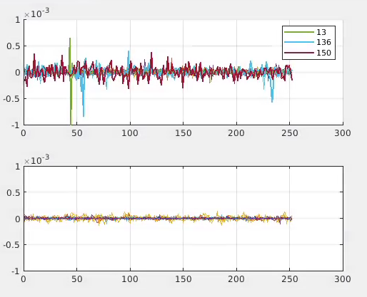
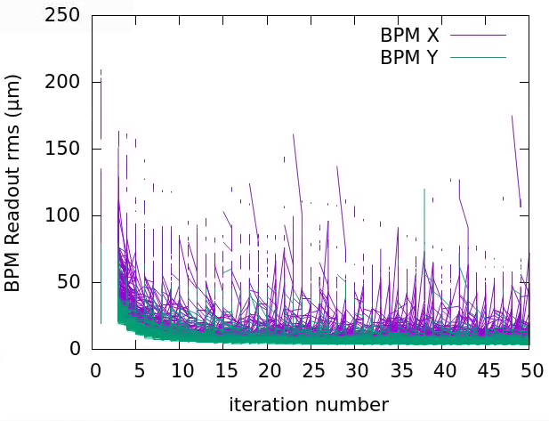
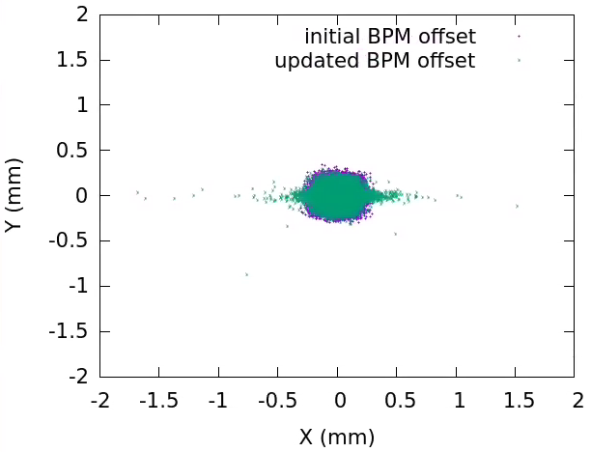
BPM offset update and Beam Based Alignment
BPM readout (X/Y) (m)
Quad index
After second BBA, a few cases have larger BPM x readouts
Usually happen at dispersive areas
Still under development
Need to improve the algorithms and more iterations to fix it
Pseudo code for BBA48_xxx.m, xxx=first, second, third
loop (until all girders visited)
foreach (BPM index i) in (girder index ig)
SC = meas_orbits(SC, i)
SC = QuadCenterFitx(SC, i)
end
SC = SCcorrectCO(SC, …)
SC = SCfixQC(SC, …)
ig = decide_next_girder(SC); % where sort_girder_BPM is called
end loop
Different sorting algorithms and parameters applied

Slide 11
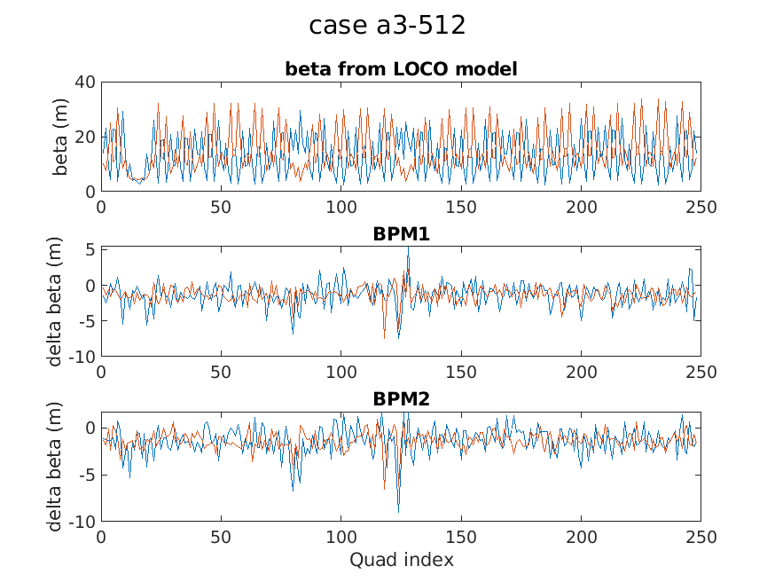
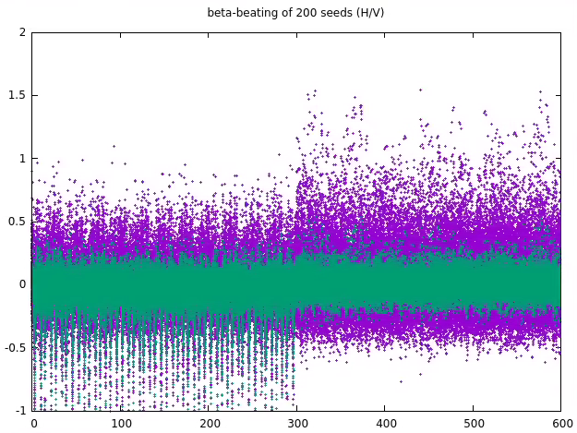
Beta beating correction (preliminary)
Measure average beta at quads by tune variation
Beta beating is linear to the quadrupole strengths
Standard SVD technique to attack linear problems
${\overline{β}}_{0}$ calculated by simulation of ideal model, R_{ij} from simulated measurement
Diamond-II simulations:
Beta function measurement tested in Diamond-I (248 quads)
Fill 1.3 mA into first 10 buckets, closed ID gaps
Tune can be extracted by NAFF 512 TBT data
Measured results:
Problematic quads are discovered near double minimal section
Time consuming, may consider reduced RM size
H/V tune should be identified with NAFF as long as a few hundred turns are reached
Suggested beam condition: 1mA (on-axis injected) and stored for > 10 min
Consider to fix integer tune before this step
Can also use model RM
301~600 for vertical
Quad index

Slide 12
Summary and Future Work
Summary
Review of current Diamond-II lattice and commissioning plans and simulation results
Review of error specifications and magnet fiducialisation uncertainties
Recap of special implementations for Diamond-II commissioning simulations
Error assignment modifications
AT modelling for anti-bend quadrupoles
BPM-to-quad offset and BBA methods
A simple beta-beating correction scheme (testing on D-I)
200 seed simulated until off-axis injection
Future Work
Finish all 200 seed simulations (coupling, ID-effects)
Add missing multipole errors
Ensure all magnet within engineering limits during commissioning
Investigate the possibility to fix the integer tune at early stages
Tuning method for multi-RF
Refine BBA routine: sorting algorithm and fitting algorithm
Human supervision and intervention are beneficial at early commissioning stages.

