Slide 1
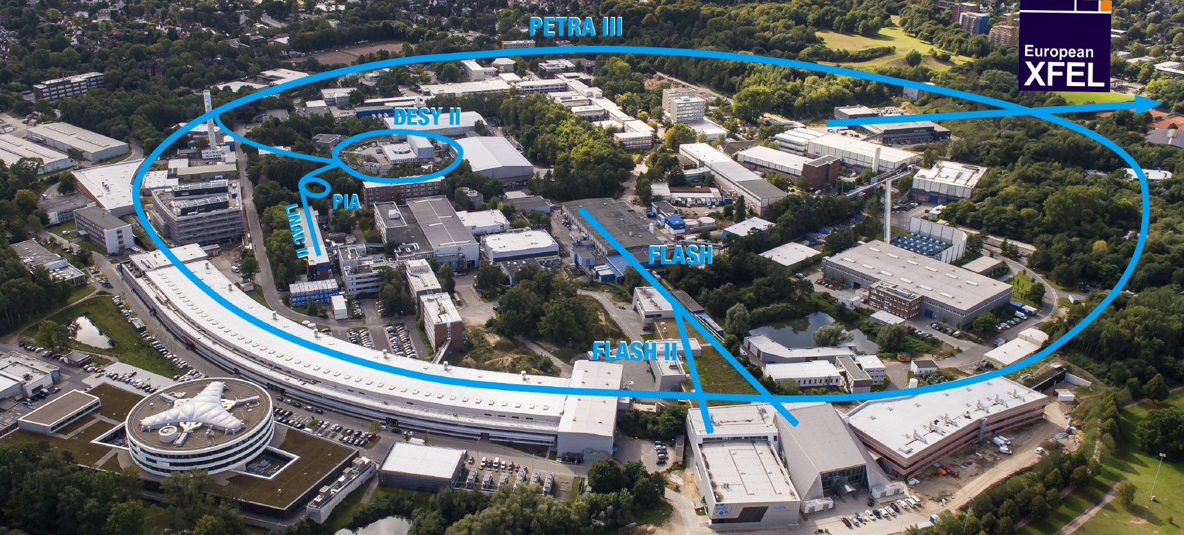
PETRA III.
PETRA III Lifetime Optimization with Badger
Bianca Veglia
Eurizon Task 4.1 general update
April 13 2023

Slide 2
Petra III MDT
Test n1:
Disturb the lifetime setting QS1, QS4 to 10 A and QS2, QS3 to 0
Use Badger to minimize the lifetime adjusted to the current (to reduce fluctuations)
Compare the resulting lifetime with the one obtained with the “broken” and the operational values (in each case correcting the orbit)
Test n2:
Disturb the lifetime using QS1, QS4, QF, QD
…
Test n3:
Disturb the lifetime and minimize it again using the 4 skew quadrupoles in the North sector
…
Test n4:
Disturb the lifetime and minimize it again using the 8 skew quadrupoles in the North and West sectors.
…

Slide 3
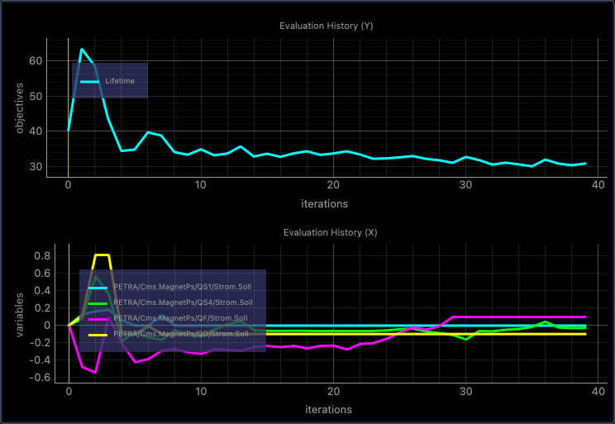
Lt optimization with QS1-4
Substituting QS2 and QS3 with QF and QD
Lifetime*current
Lifetime*current
QS1
QS2
QS3
QS4
QS1
QS4
QF
QD

Slide 4
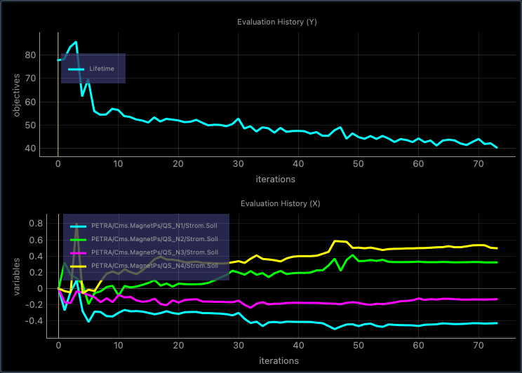
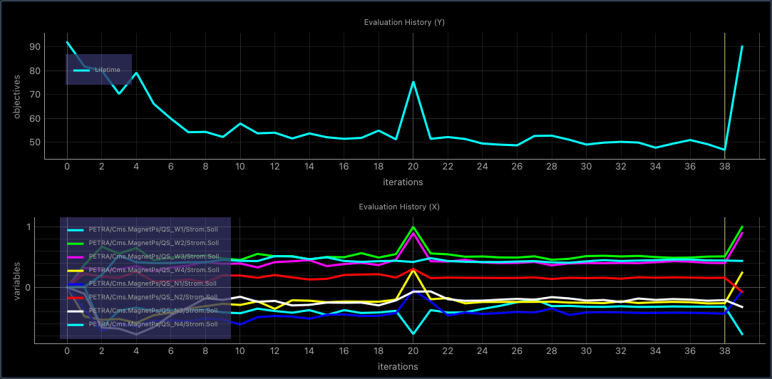
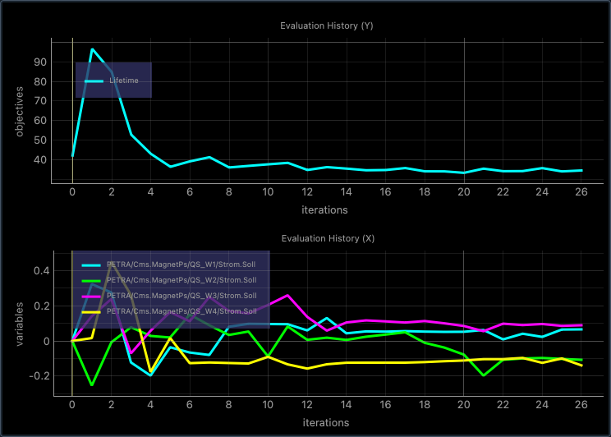
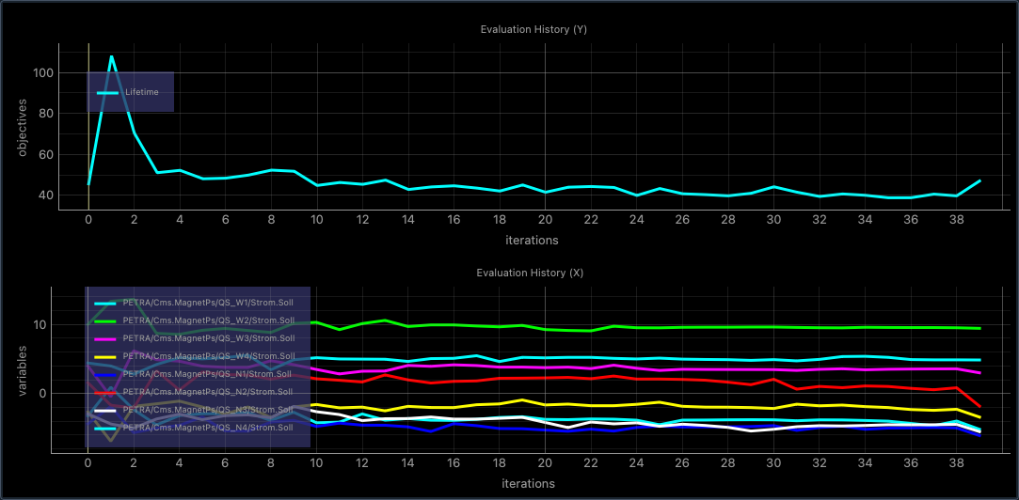
Lt optimization with QS_N and QS_W
Only one family at the time
Using all 8 knobs
Here the optimization was interrupted and restarted it again setting the skews to the optima values found previously

Slide 5
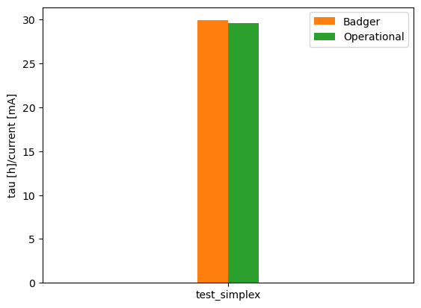
Lt optimization with QS_N and QS_W
Using Simplex algorithm
Here the optimization run started from the operational values.

Slide 6
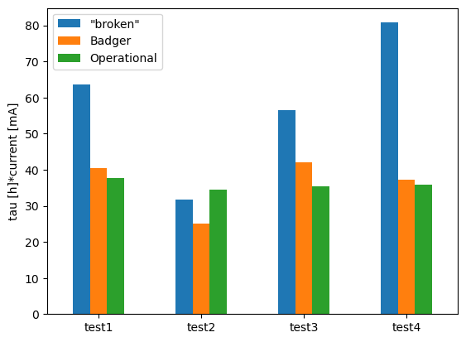
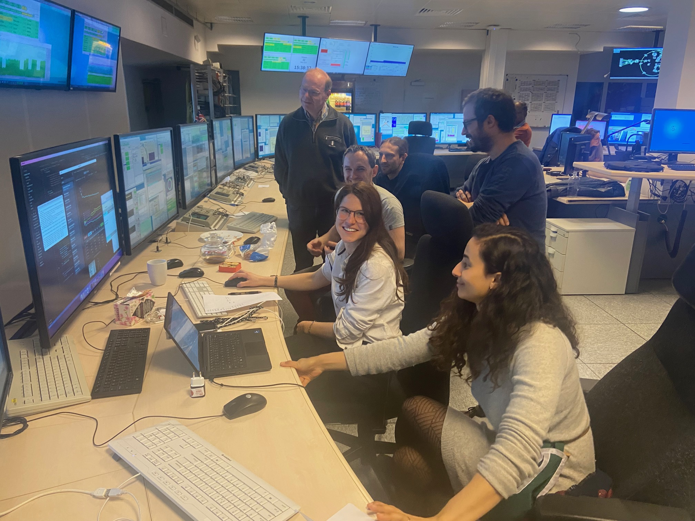
Lifetime comparison
Future Plans
Keeping track of the emittance (the pinhole camera needs re-calibration, if possible by then).
Compare simplex with BO at same conditions.
Injection efficiency tests
In most cases the lifetime minimization worked.
The final settings are comparable to the optimal operation ones.

Slide 7
Bianca Veglia
MPY
bianca.veglia@desy.de
+49 40 8998 5328

