Slide 1
Static bump at injection
P.Raimondi, S.Liuzzo

Slide 2
Static bump of 2mm at injection (1mm at BPMs adjacent to injection)

Slide 3
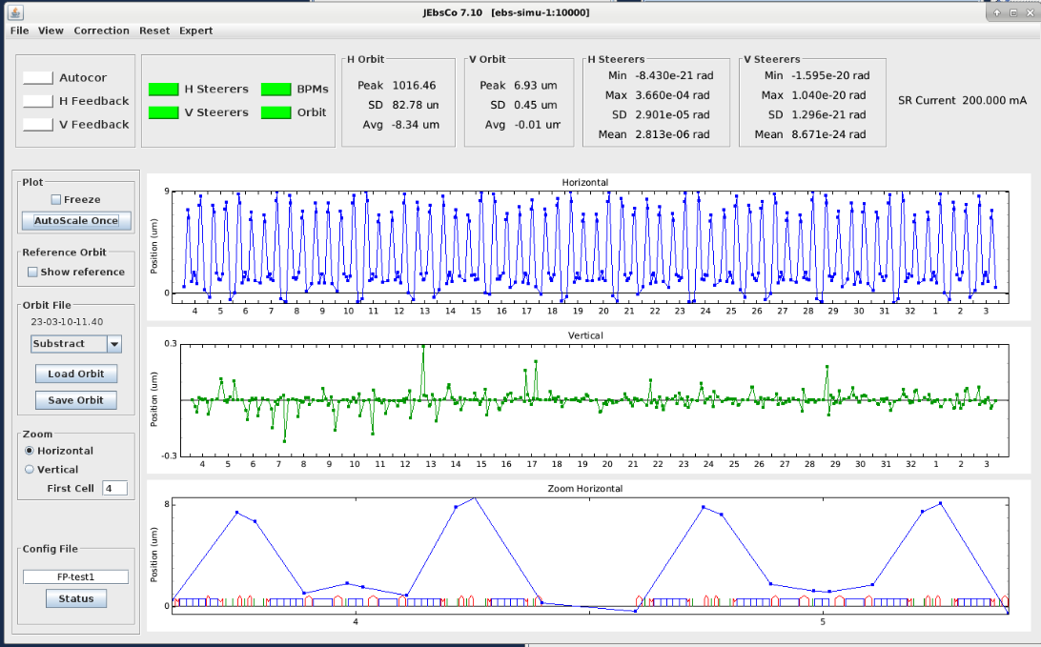
QF4-C03-E and QF4-C04-A +0.0001 adjust the dispersion.
QF1-C03-E and QF1-C04-A +?? To fix beta beating and tunes (very small values), not tested

Slide 4
MDT test and implementation with quadrupoles offsets
If with this static bump:
injection efficiency unchanged for -11 mm injection bump (instead of -13)
same lifetime
reduced injected beam perturbations
Then run in operation for some weeks. If successful could be complementary to septum realignment. The bump could be implement with Quadrupole displacements to releave partially the septum displacement.
This will do most of the bump (at almost pi/2 from injection)
Close bump with one of the two QDs at the side of JL, the one that has to be displaced less.
Iterate MDT test and quadrupole displacements until there is gain.
Could use part of the MDT of 24th March morning to test and assess perturbations at injection.
Else 25th Afternoon. P.Raimondi would join via ZOOM. Would need B.Roche for compensation tuning.
Objective would be to save a set of operation files.
Could add also angle bumps at septum.

