Slide 1
Badger set-up and test in simulator

Slide 2
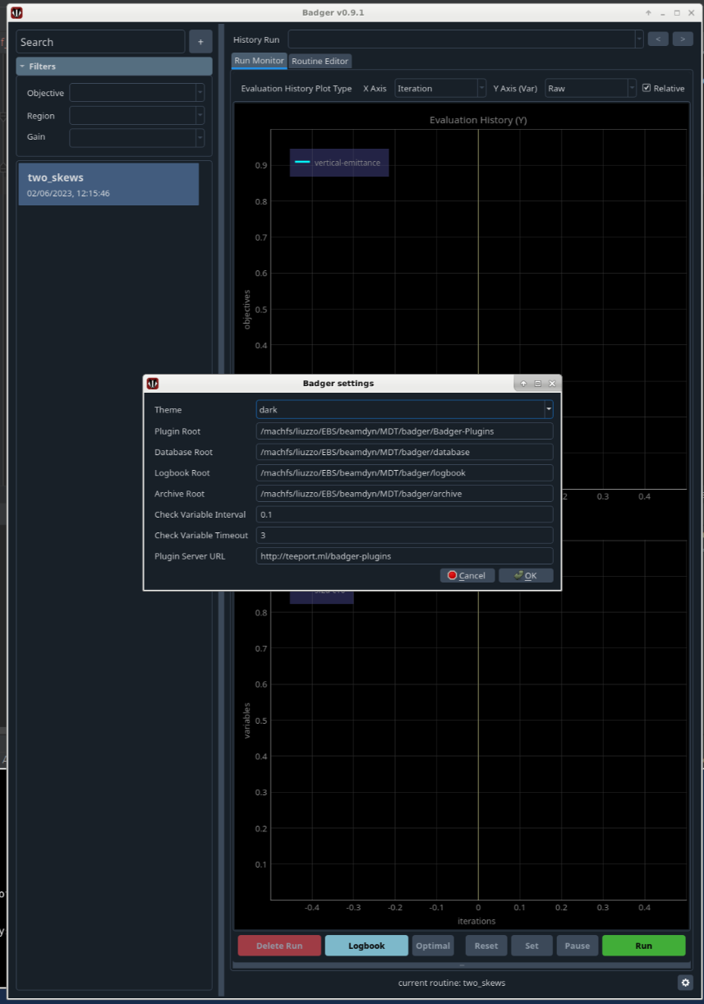
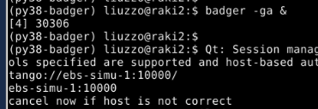
Tests and setups before running

Slide 3
One single SKEW set to a rather large value: 2.4 pm vertical emittance

Slide 4
One skew works!

Slide 5
2 variables

Slide 6
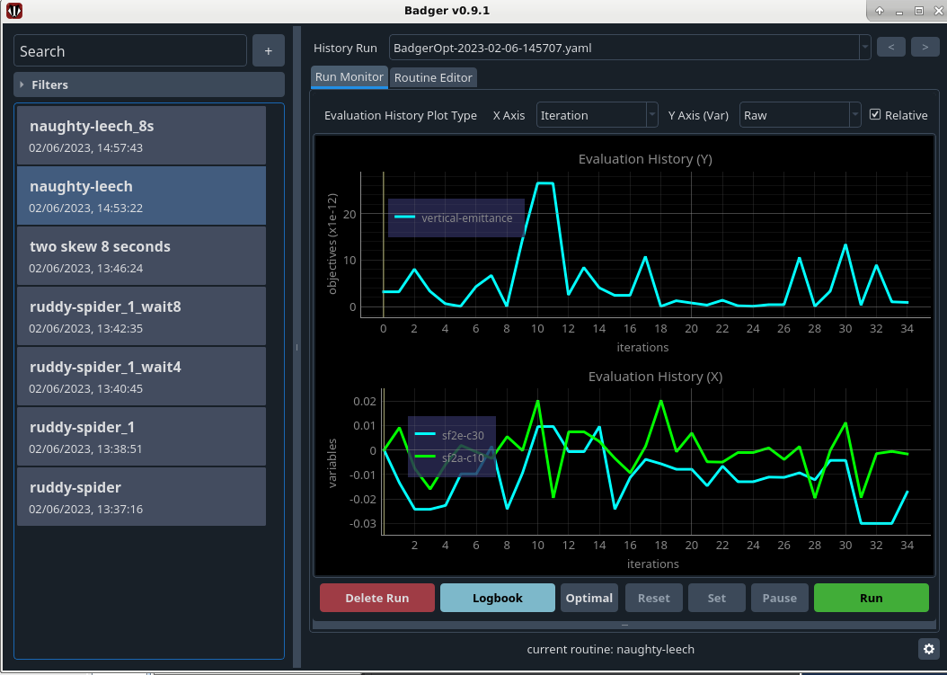
2 variables basic Bayesian optimizer

Slide 7
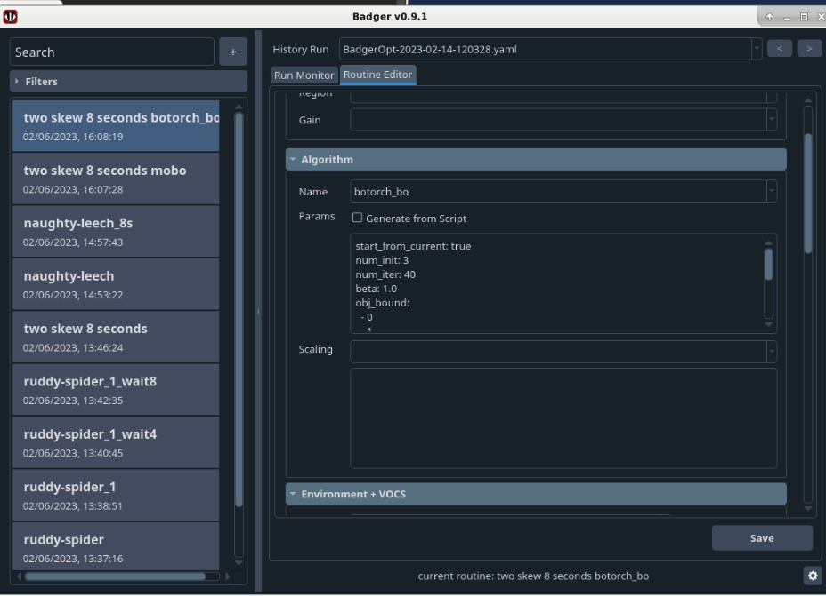
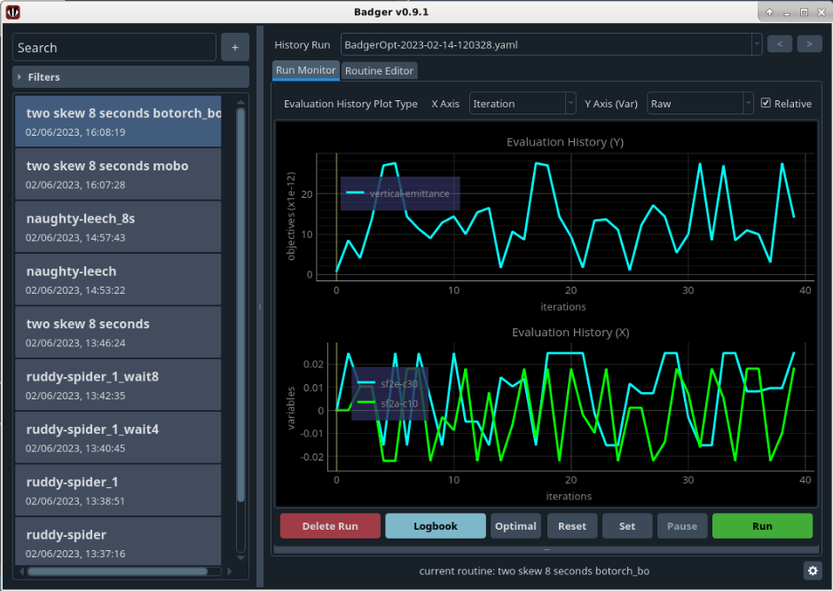
Bo-torch
Not reducing

