Slide 1
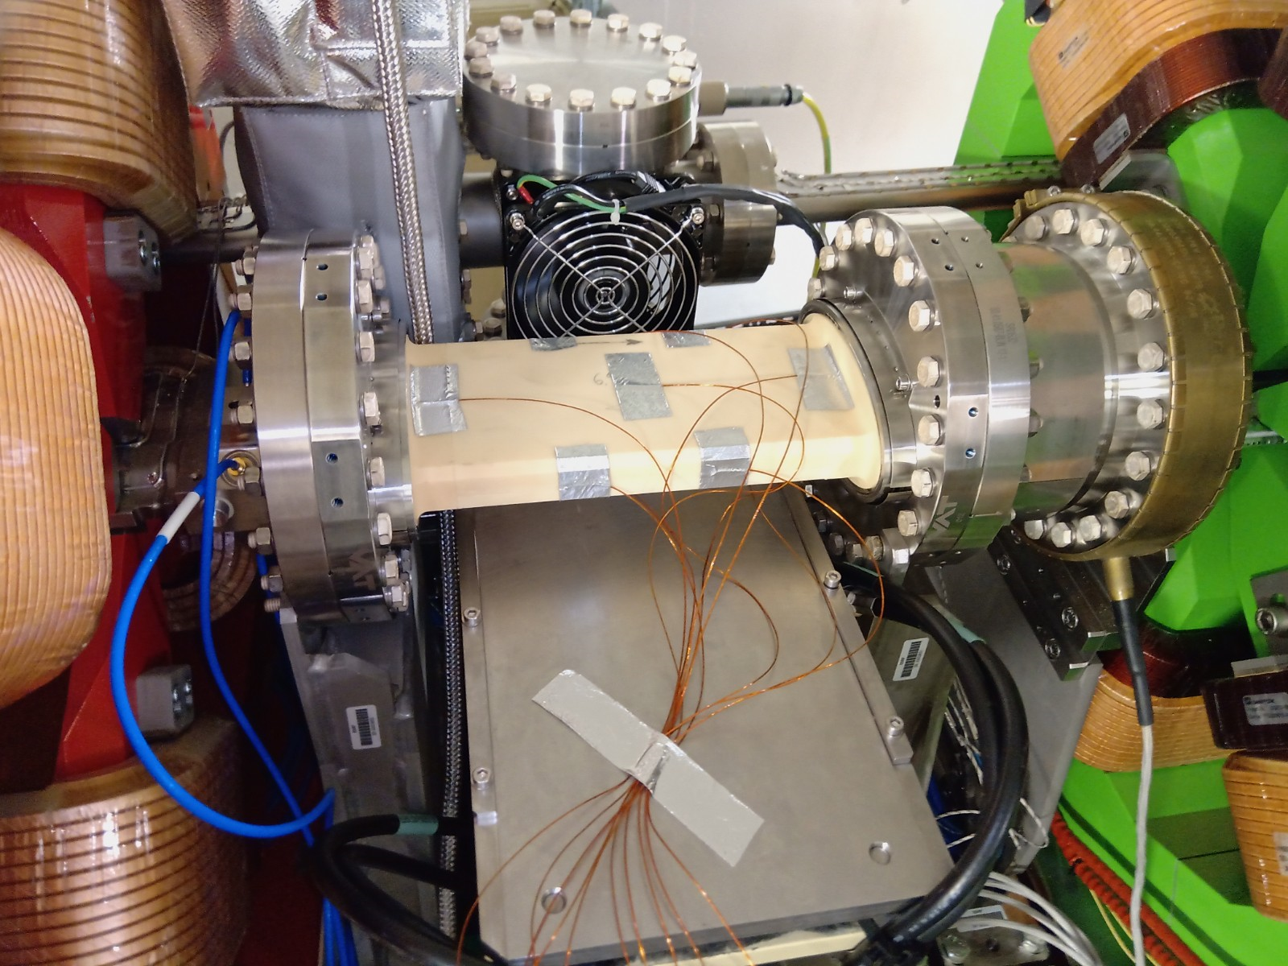
14th February 2023
Beam blow-up due to injection kickers
B. Roche

Slide 2
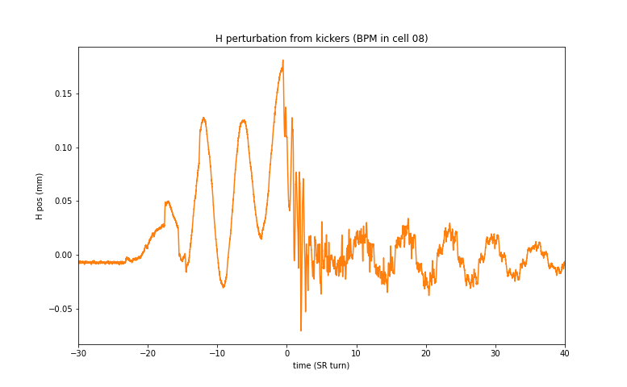
Perturbations in USM conditions
In USM condition we can measure the beam position after an injection kick.
But due to high chromaticity the oscillations of all particules become soon incoherent.
→ this measurement does not give the full picture with the high chromaticity
→ measured H emittance is below 300 pm

Slide 3
Question
We know that the high chromaticity is responsible for turning the betatron oscillations into emittance blow-up.
What happens at low chromaticity?
→ MDT 30/01/2023

Slide 4
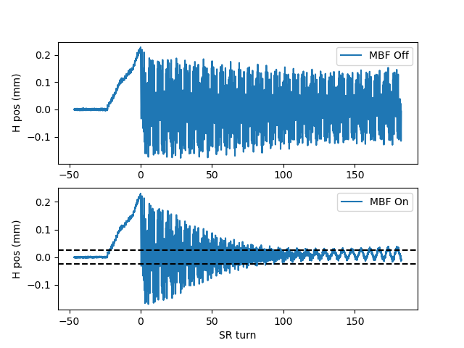
Perturbations at low chromaticity
→ very long coherent oscillations
The MBF is used to damp the betatron oscillations
→ 400 pm H emittance :(

Slide 5
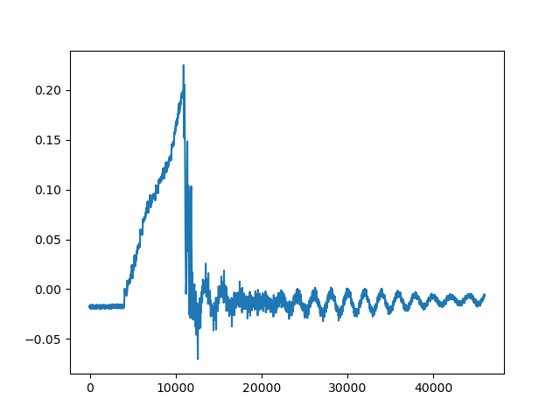
Perturbations at low chromaticity
Still low chromaticity, but using the feedforward compensation instead of the MBF
→ H emittance still around 350 pm :-((

Slide 6
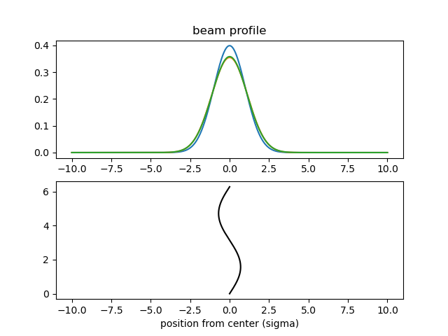
Perturbations at low chromaticity
To estimate the resulting beam blow-up, I just use a simple model considering that the beam oscillates, and compute the resulting “averaged beam profile”.
With a sin wave amplitude of 25 microns (measured before), the resulting “effective emittance” is 167 pm
Where does the H emittance blow-up come from???

