Slide 1
SBM - X-BPM Position and angle correlation
S.Liuzzo, K.Scheidt

Slide 2
Request from Diagnostics group
Dear Simone, Thanks for this. I would appreciate if you could come to my office one of these days. It is not urgent, please propose at your convenience. The central & crucial question is the following : What does the V2-X-BPM, that is a about 22m from its source which is the (entrance of the) DQ1D, which is just behind QF8D, and about 0.8m downstream the SBM, tell us (in terms of vertical position) that is in relation with the vertical angle of the SBM beam ? Let me explain further : A) before we had the V1-X-BPM, with its source the SBM, at 23m from that source. The vertical position reading of this V1-X-BPM is extremely sensitive to the e-beam's vertical angle in the SBM, thanks to the 23m distance. This X-BPM is much less sensitive (1/23) to the e-beam's position in the SBM. In fact we really appreciate its high sensitivity to angle, and low sensitivity to position, since this corresponds very well to what the Beamlines find themselves. B) now with the V2-X-BPM (with the new source as explained above), I try to understand fully what it is sensitive too, concerning e-beam changes (of angle, position) at the SBM point. best regards, Kees

Slide 3
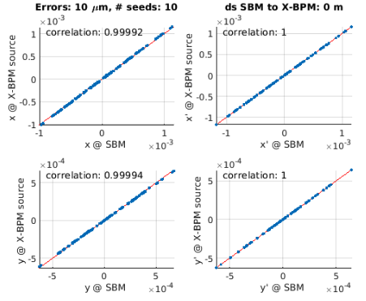
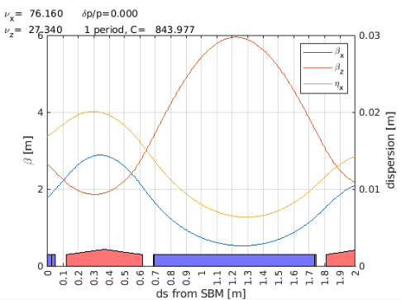
simulation
Place the X-BPM x ray source at a given distance from SBM.
Add random errors and compute orbit for several different seeds
Store orbit at SBM and X-BPM source point
Plot and compute correlation
Repeat for different distances SBM-XBPM

Slide 4
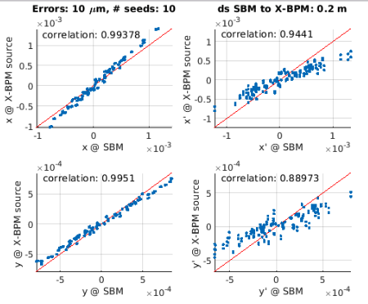
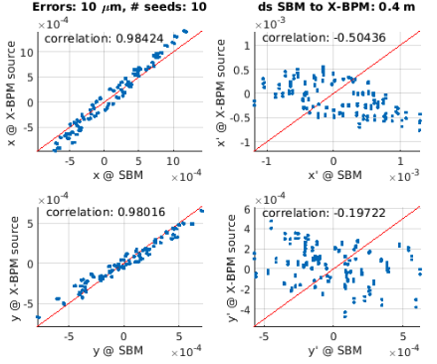
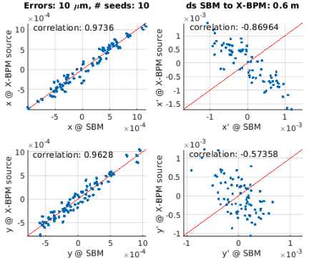
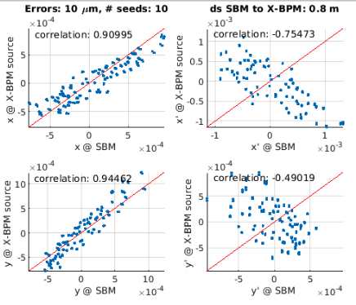
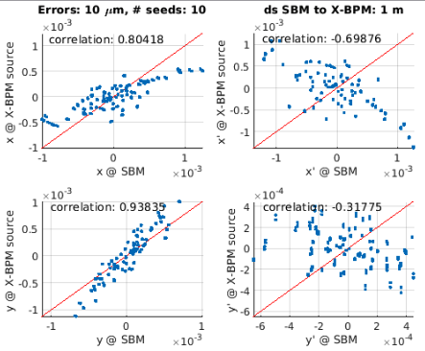
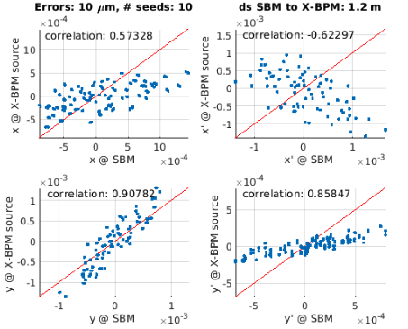
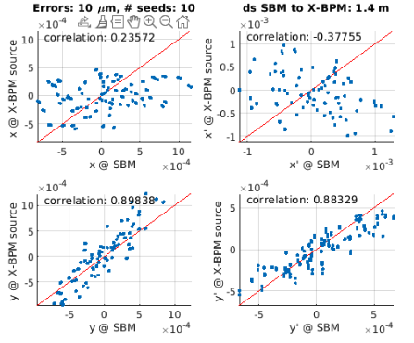
Plots varying ds

Slide 5
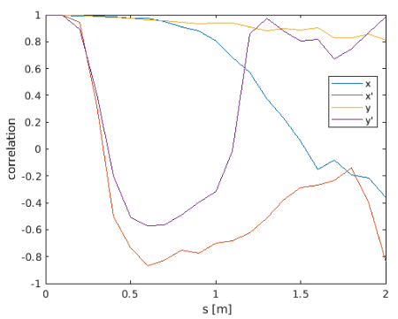
Plot of correlation vs distance of the source point.

