Slide 1
SOLEIL UI experience, … and future plans P.MADELA, G.ABEILLE, R.GIRARDOT, YM.ABIVEN

Slide 2
Outline
Towards SOLEIL II
UI status around control system
UI organization
Future plans

Slide 3
Towards SOLEIL II

Slide 4
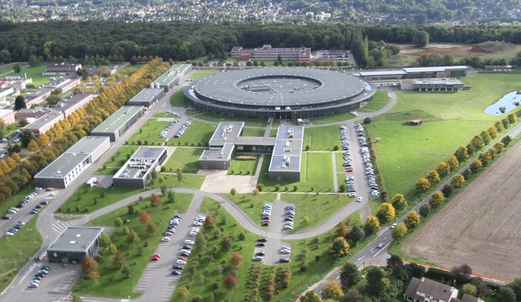
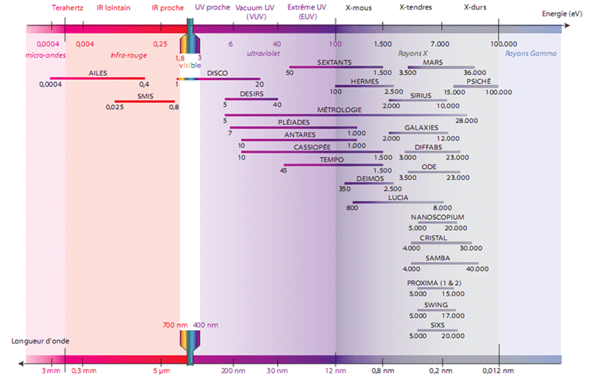
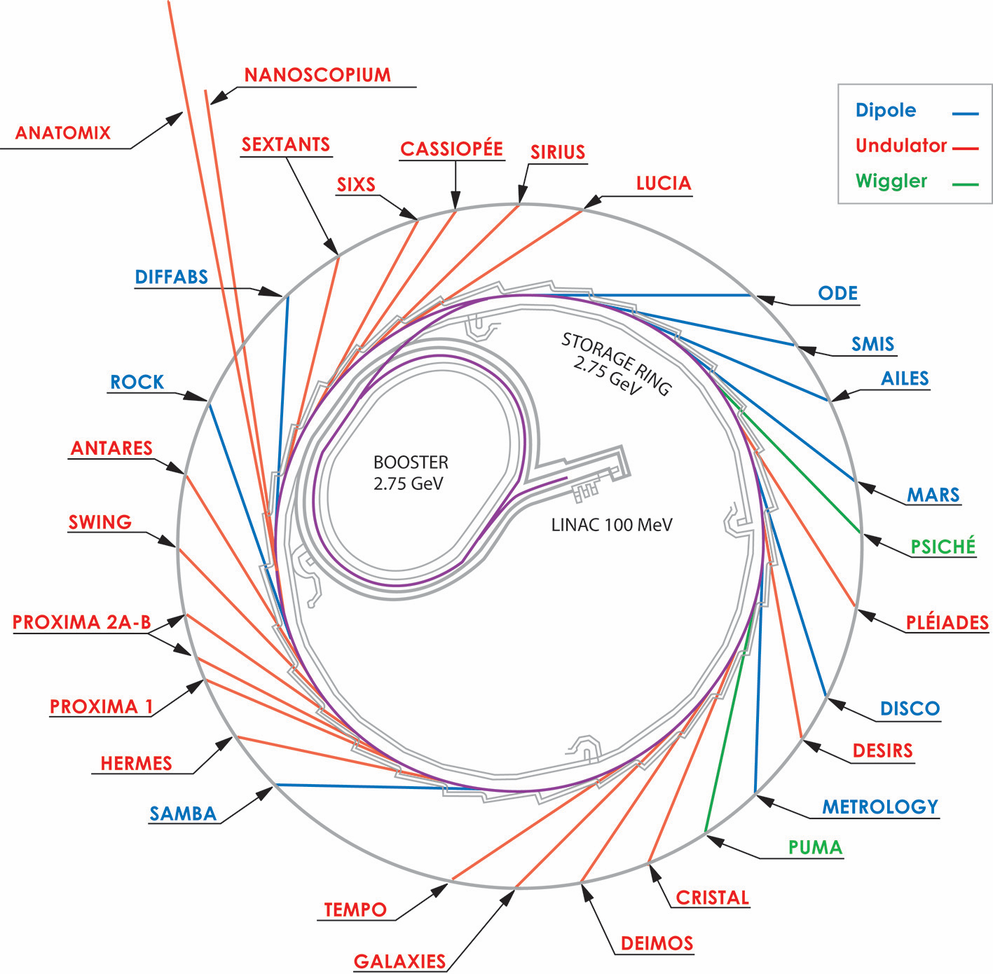
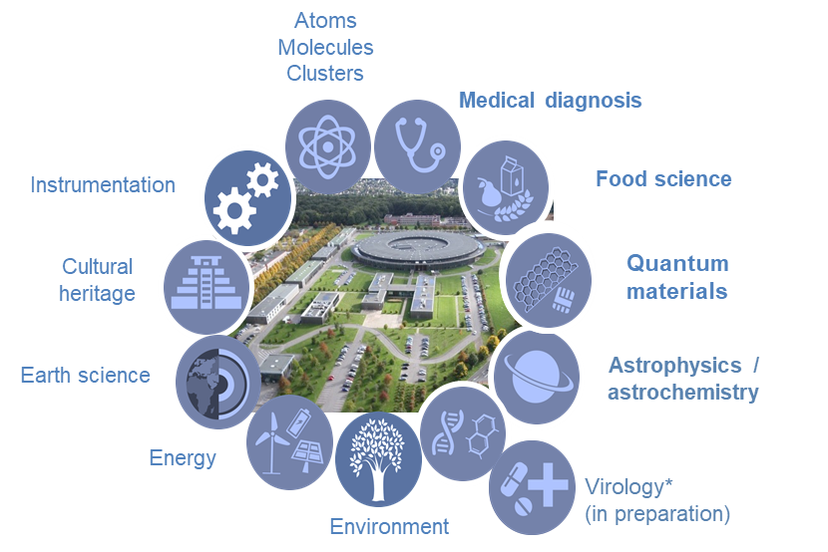
SOLEIL in a nutshell
Storage ring 354m, 2.75GeV
29 beamlines
From far IR to hard X-rays
Open to external users in 2008
~ 450 staff members
in 2022
~ 2746 single users
(~150 remote access)
More than
12 000
users since
2008
Notes:
Soleil is a synchrotron radiation facility located near Paris in France
The facility uses a circular accelerator to generate extremely bright beams of light
The beams of lights are used for a wide range of scientific research, including physics, chemistry, biology, and materials science.
The facility has 29 beamlines with a wide range of experimental stations.
The experimental stations including imaging, diffraction, and spectroscopy, which enable scientists to study a variety of materials and phenomena.
The synchrotron radiation produced at Soleil covers a broad spectrum, ranging from infrared to X-rays.
It was opened to external users in 2008

Slide 5
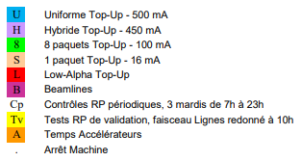
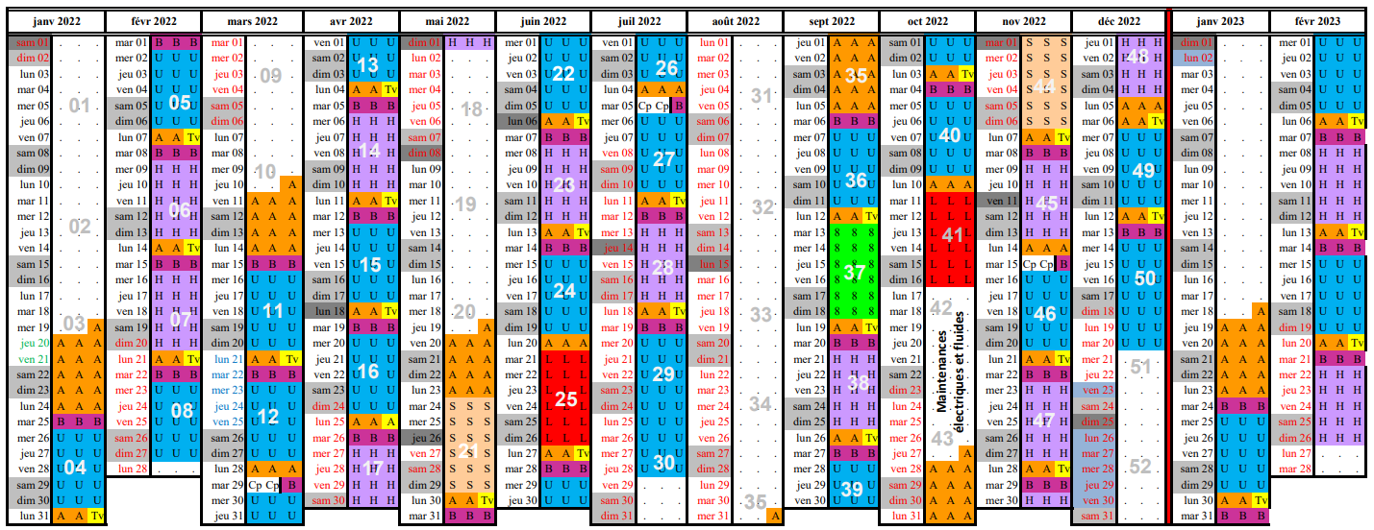
Operation
Beam delivery 24 hours, 7 days a week
5019 h (x 29!) ~ 145000 hours of beamtime in 2022
Beam availability 98,95% in 2022
Mean time between failures (MTBF) 139 hours in 2022

Slide 6
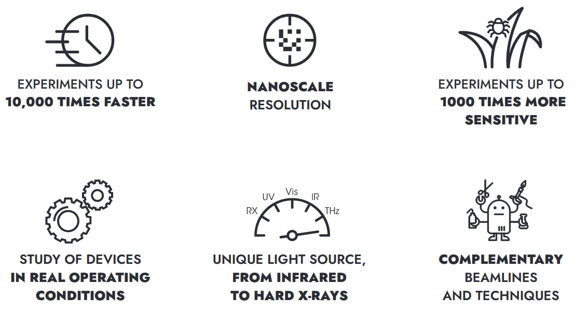
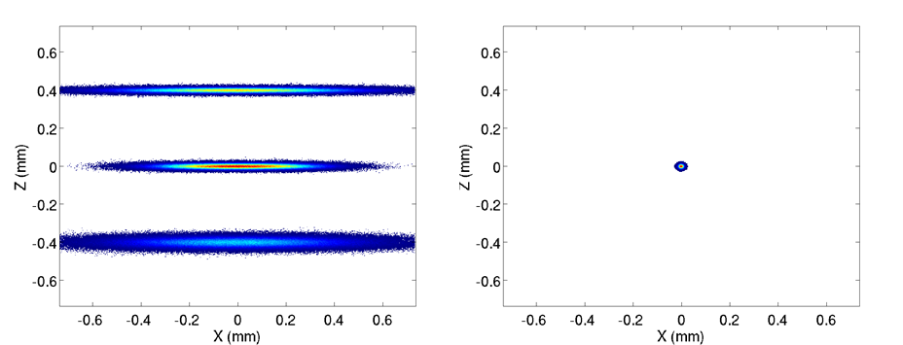
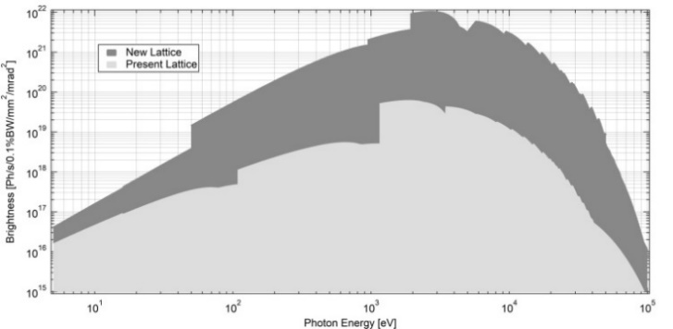
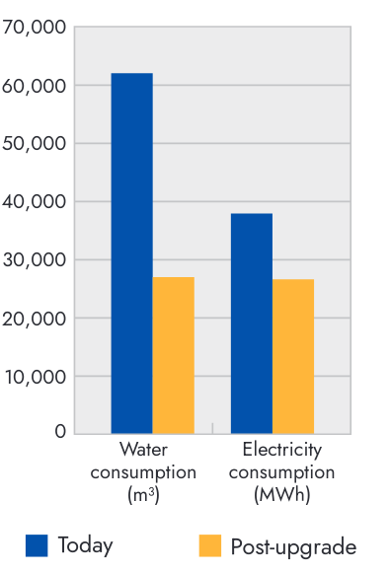
SOLEIL Upgrade
Better performances for Accelerator and photon sources
Reaching an emittance < 100 pm.rad.
Keeping the same electron beam energy : 2.75 GeV
Preserving a maximum current of 500 mA
in the multibunch mode.
Upgrade Timeline (1 year delay from initial planning)
New access mode with more efficient use of the SOLEIL Beamline
Green infrastructure
Reduction in the facility
environmental footprint
Lower power and water
consumption
Reduce operational cost
Beam SIZES
Brightness
< 10 μm x 10 μm

Slide 7
Operational organization
Acquisition and Control System Engineering (ISAC) team,
in charge of
Accelerators and beamlines control systems
~12000 Electronics devices (motion, cPCI, PLC, Robotics, …
~24000 Tango devices and ~12000 device servers
Involved in daily operation with 3 on-call duty 24/7:
Software
DaQ and motion control
PLC, Robotic
Involve in TDR around 50 WBS for
Accelerators program
Infrastructure Program
BeamLine and Laboratory (BL2) program
IT and Data management (transverse to support the others program)
Works with other computing teams for SOLEIL IT systems integration
ISI: Infrastructure & networks
ISG: Management Information System
GRADES: Data analysis
Software in operation
459 c++ Devices
32 Java Devices
44 GUI / API
300 Embeded codes for motion, DAQ, Robotic, PLC

Slide 8
UI status around control system

Slide 9
What is your control system made of?
Tango has become a SOLEIL standard de-facto
Tango is used on all control systems (Accelerators, Beamlines and Labs)
Strategy to integrate everything in Tango devices (ancestor of SOA/µService architecture?):
Hardware (motors, vacuum, power supplies, …)
Hardware sets (insertions devices, monochromators,…)
External systems (Building Management in OPC, LINAC in LabVIEW….)
Calculations, orchestration, workflows (beamline energy, beamline acquisitions processes, experimental data management, archiving…)
Client
Client
Process, Calculation: Beamline energy…
HW set: insertion, monochromator…
Hardware: motors, power supplies…
Outcomes:
A seamless integration in all Tango clients (GUIs), in archiving…
Built-in data correlation
Autonomy to our users with Tango client API (Python, Matlab, Labview, Igor Pro)

Slide 10
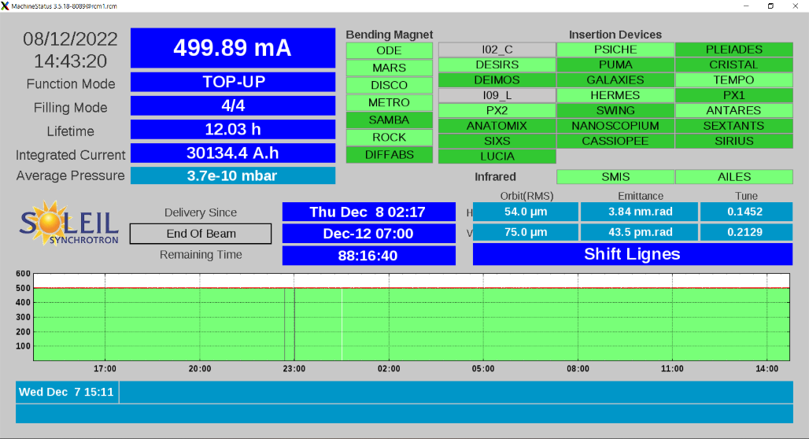
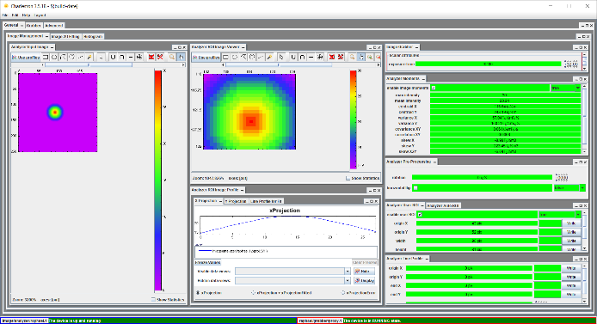
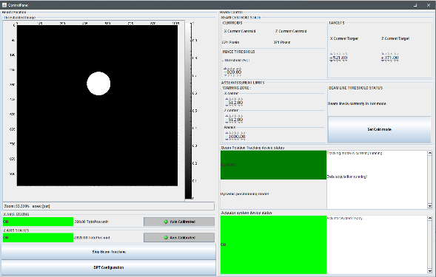
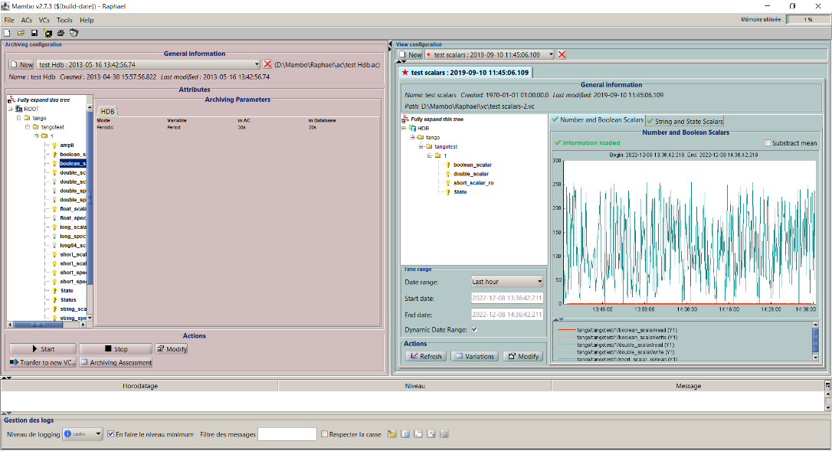
Comete Framework
For its common GUIs, SOLEIL use Java SWING language and has developed the Comete framework.
Library of widgets and data sources, with intermediates that manage the connection in between.
This framework enables to quickly develop new GUI.

Slide 11
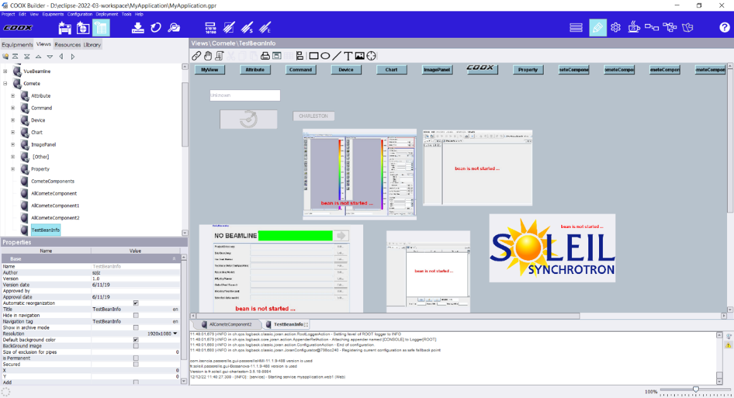
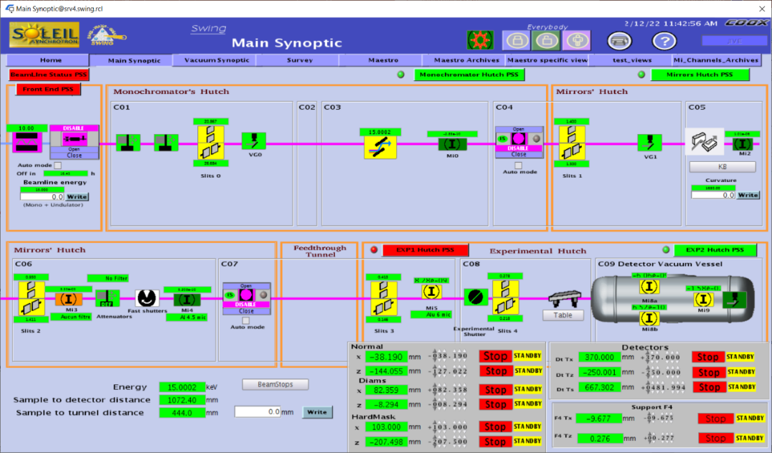
SCADA Coox
No-code tool to create GUIs with drag & drop.
Developed in Java 8 by ORDINAL company
Based on Comete wigdets
Used by almost all beamlines which are autonomous in creating their views
Builder
Creation of views by drag’n’drop
(uses SOLEIL’s components with Comete)
Viewer
Runs the views previously created with Builder

Slide 12
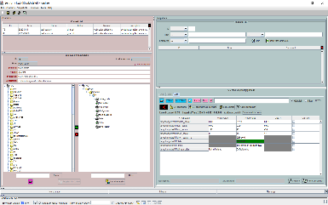
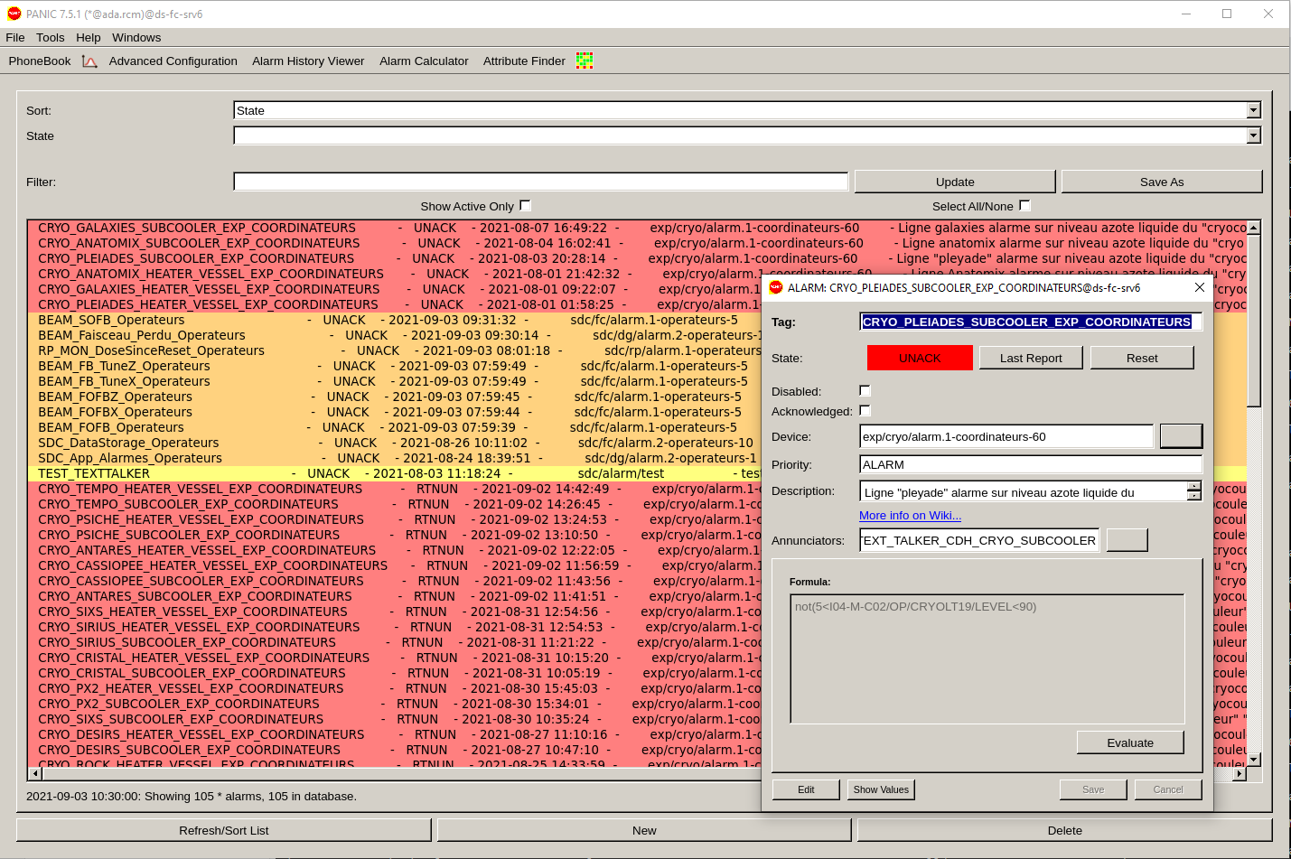
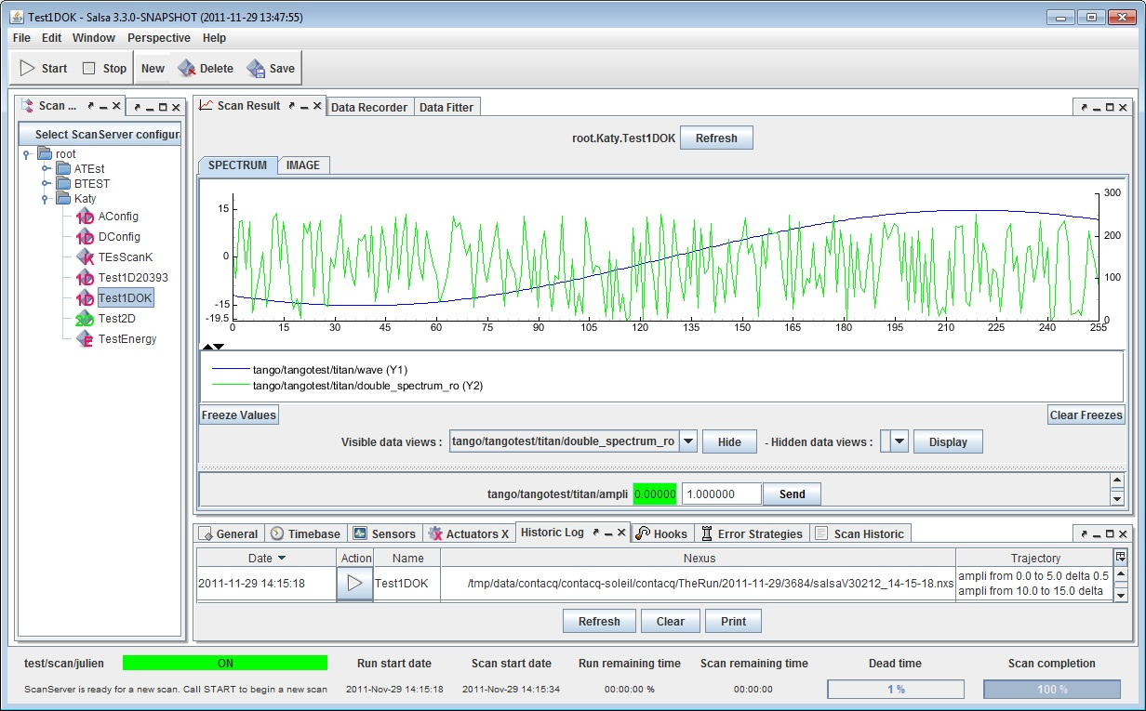
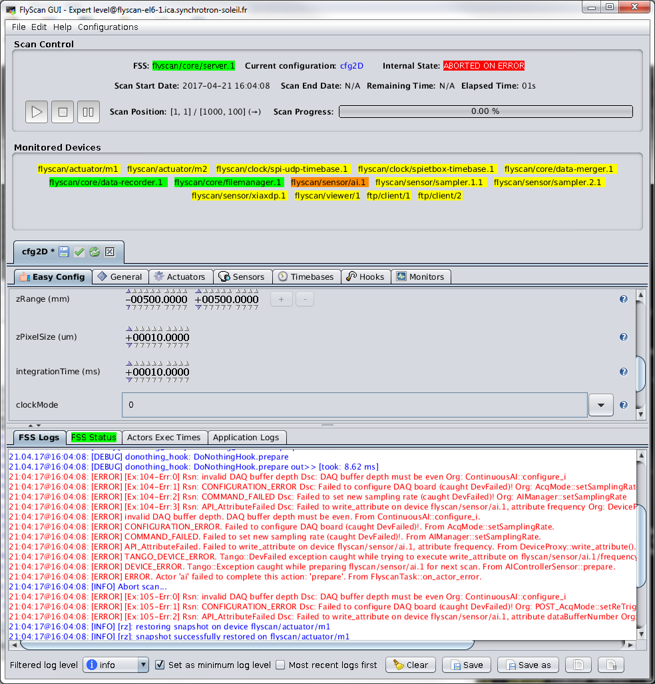
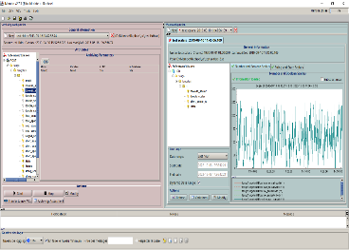
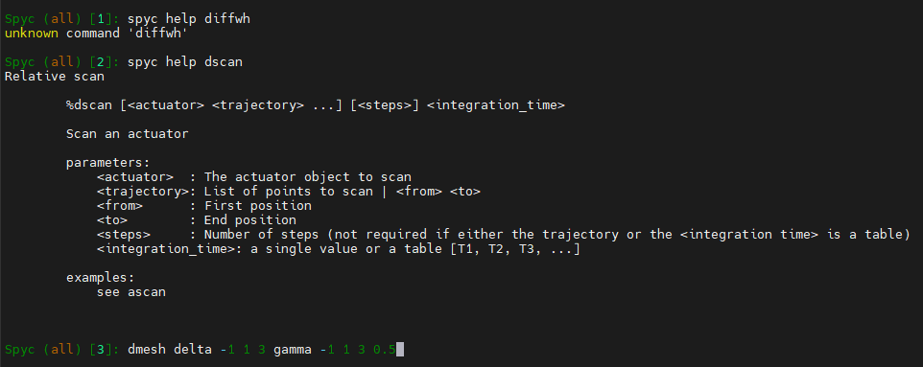
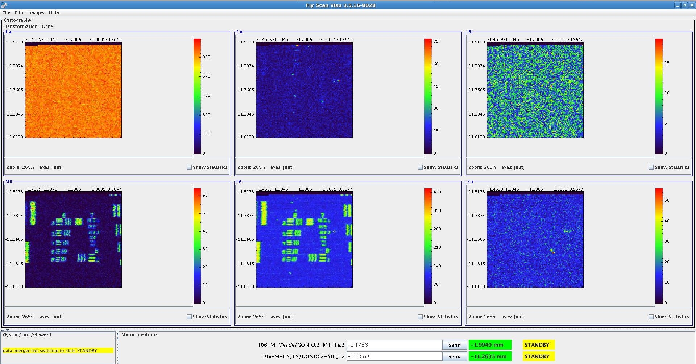
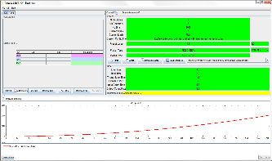
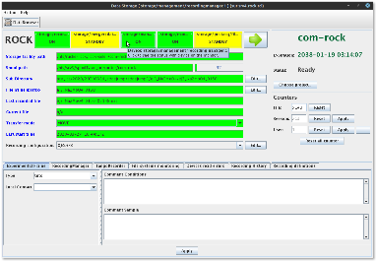
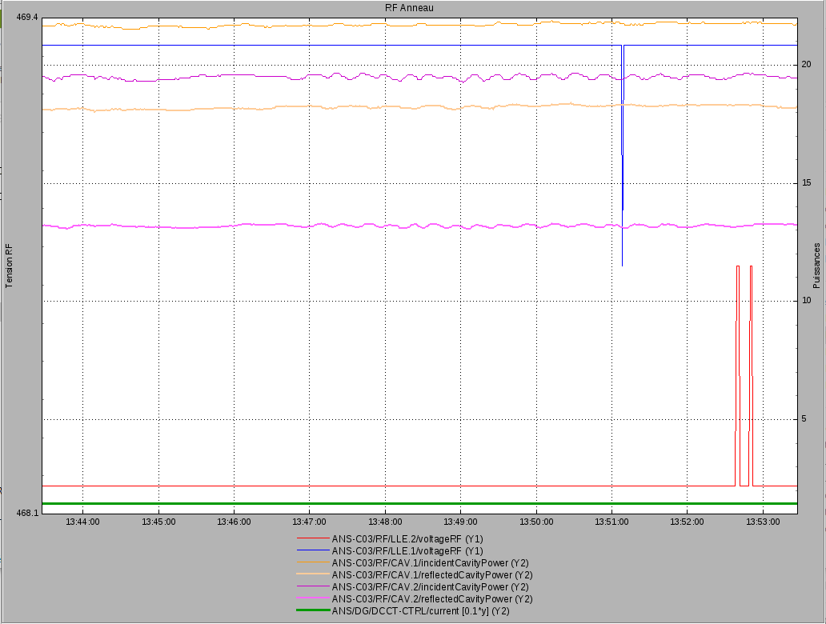
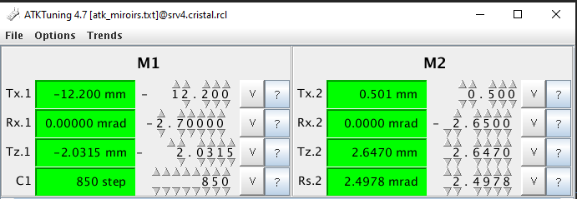
Common GUIs
Tango Archiving
Alarms - PANIC
Acquisition
Fronts for scan devices
(FlyScan & ScanServer)
Configure & plot
HDB & TDB & Snap
Spyc: SOLEIL Python CLI
Experimental data recording
Tango tools
Detectors
v
Multi Channel Analyzer
Large usage of ATKPanel, ATKTuning, Jive, Astor, ATKTrend
Configure & plot
Beam image calculations
All the Java GUI based on Comete are also beans that can be integrated into COOX screens

Slide 13
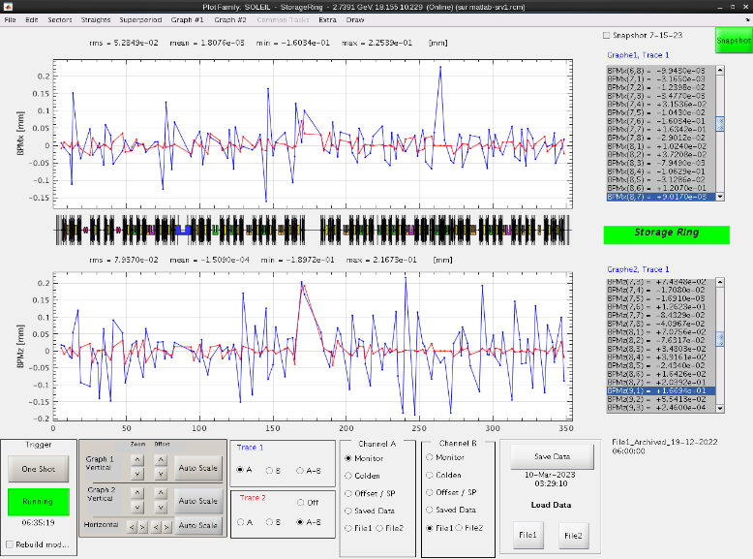
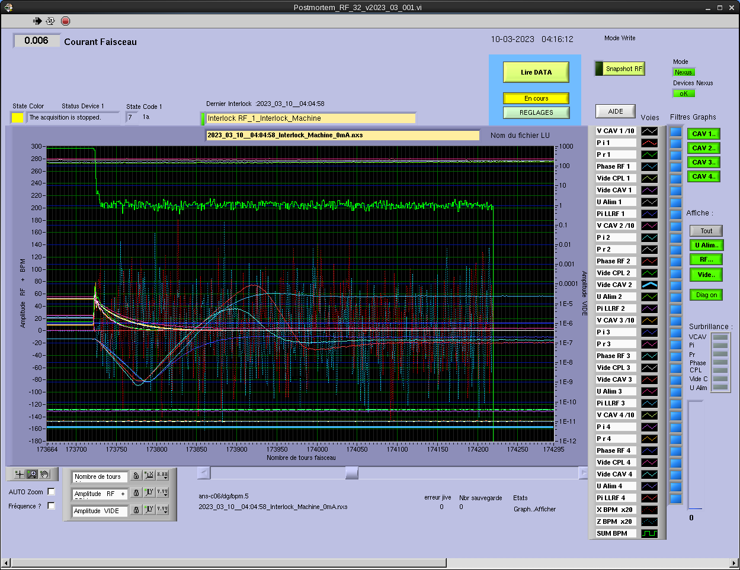
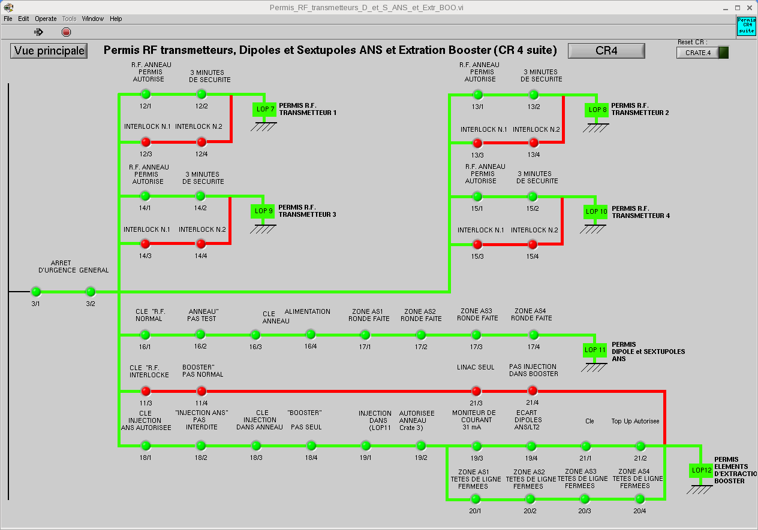
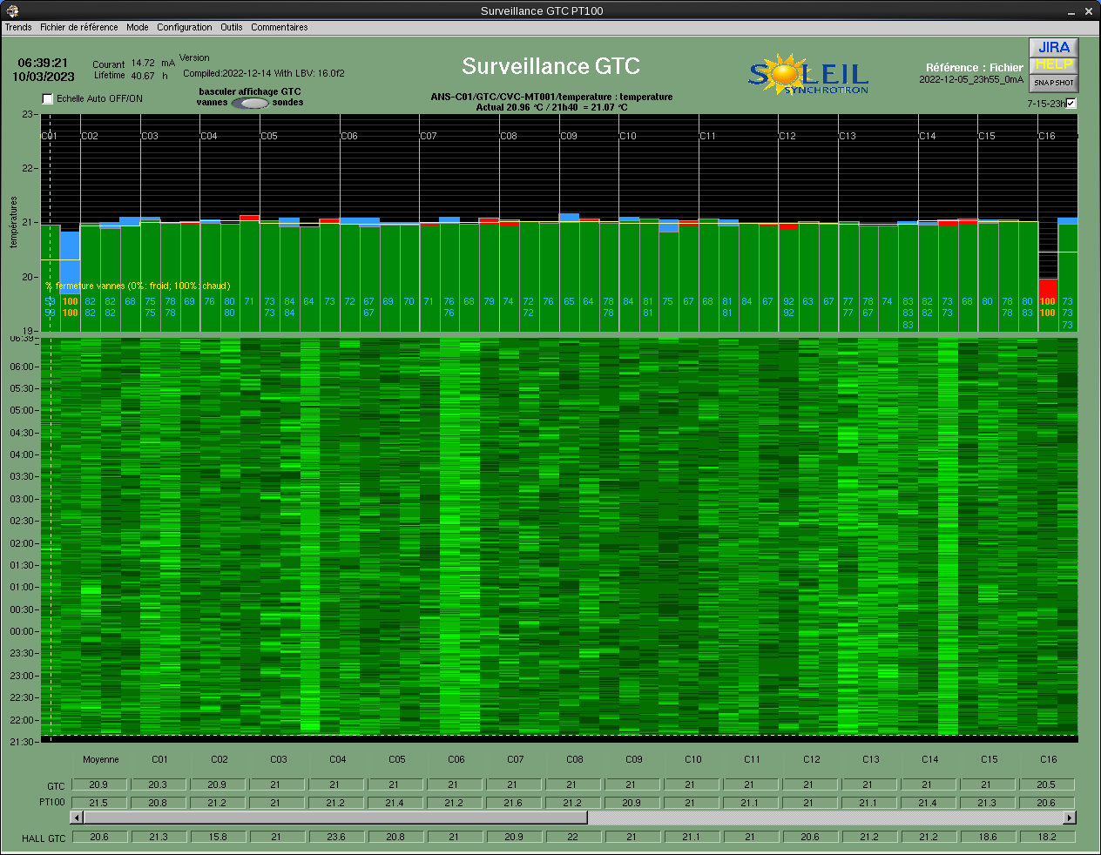
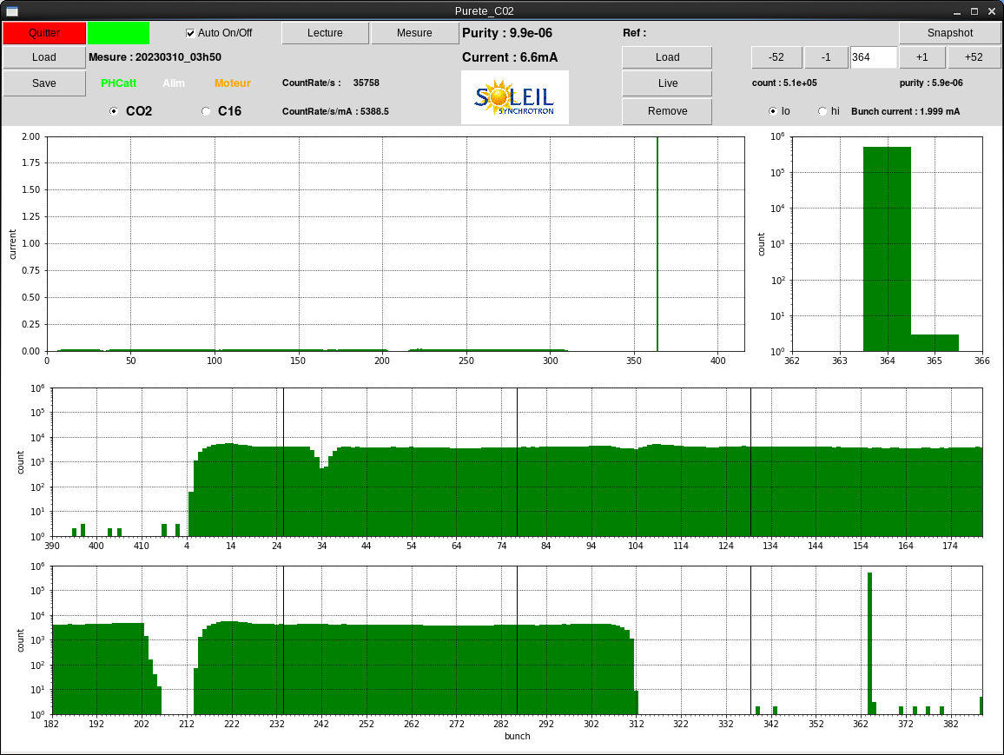
Accelerators GUIs
Beam positions - Matlab
Beam Nu/WaveNumber measure - Labview
Postmortem analysis - Labview
PSS permits (Personal Safety System)- Labview
Utilities monitoring (AC & Fluids) - Labview
Beam purity measure - Python

Slide 14
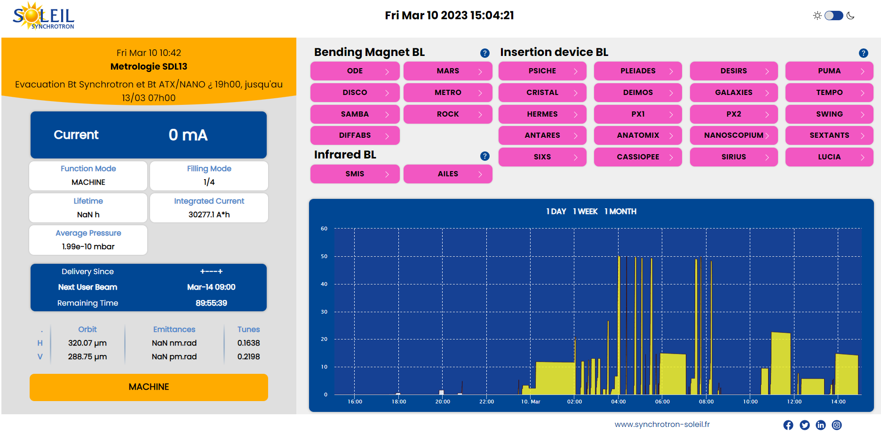
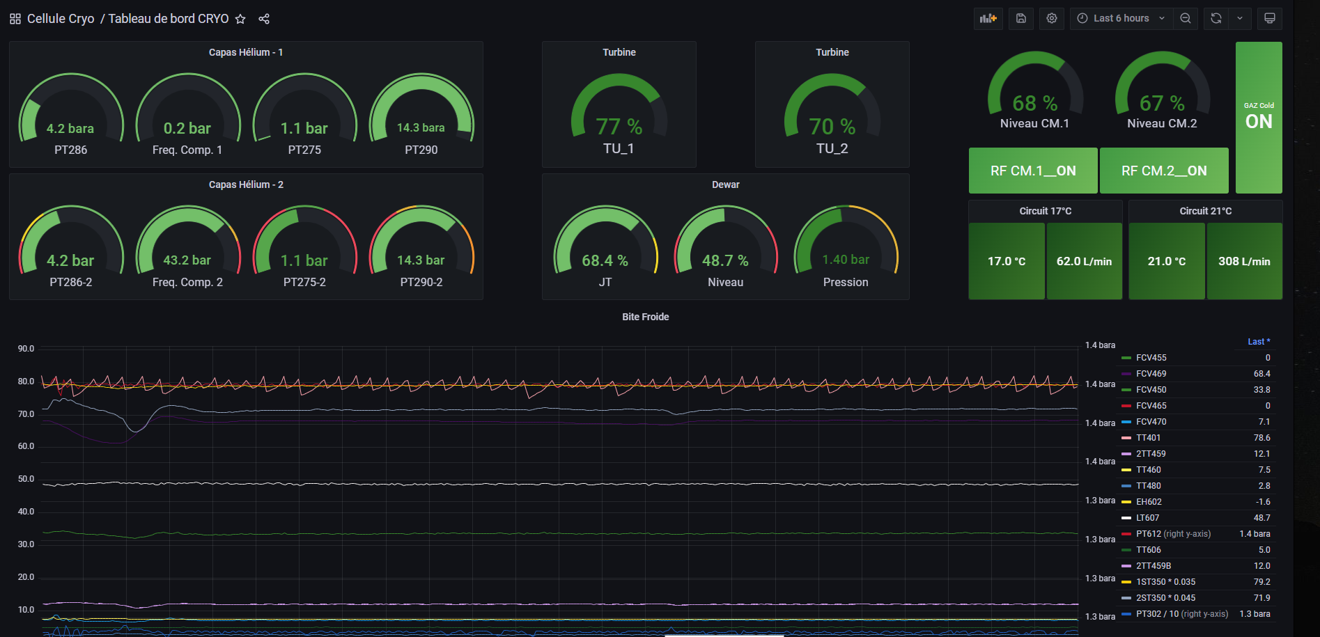
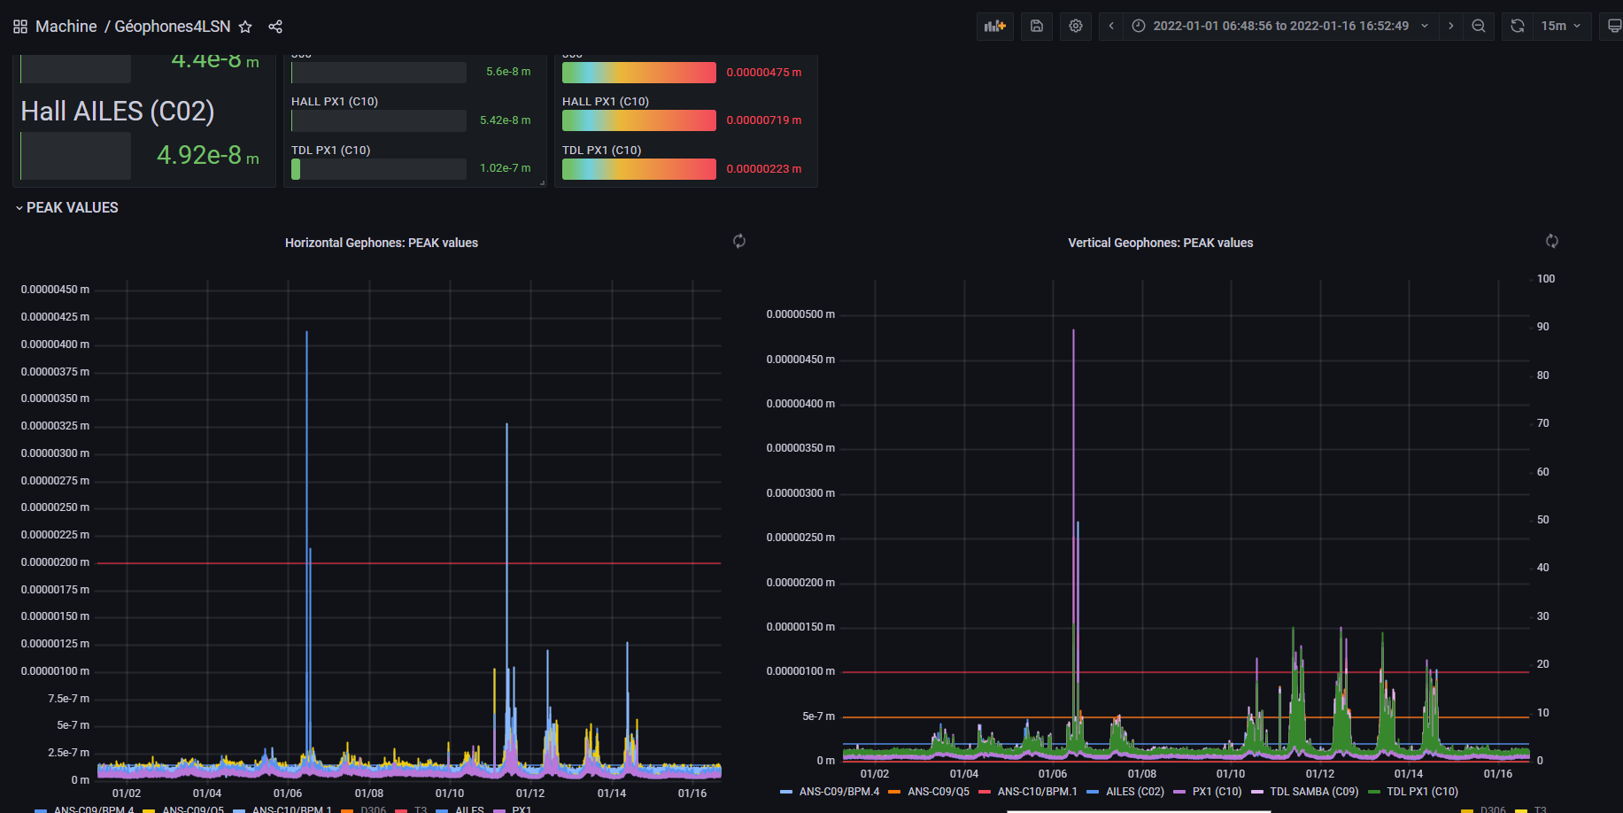
Apps for web evaluation
Machine status
Grafana
GraphQL backend to archiving
Machine
Status
HDB
accelerators

Slide 15
UI Organization

Slide 16
Accelerators practices
Accelerators as owner of
Labview apps
Python apps
Matlab apps
Accelerators staff develop their own scripts/devices/GUI
LabView, maintained by operators, acc. groups
Matlab, maintained by physicists
Python (TkInter, scripts, Tango devices), maintained by operators, physicists and acc. groups
GUI apps that embed the process are critical
Top-up Injection process (Labview)
Some feedbacks (Slow orbit feedback, …) (Matlab) …
Lots of accelerators' GUI are only for experts, and not for operations
Accelerators as user of
Tango GUI (Jive, ATK…)
PANIC
Databrowser
Mambo / Bensikin
MachineStatus
Grafana (under evaluation)
152 LabVIEW apps
56 Python apps
114 Matlab apps
60 Grafana dashboards

Slide 17
Beamlines practices
Beamlines as owner of
Python apps
Igor Pro apps
Labview apps
Beamline staff develops their own scripts/devices/GUI
Python (TkInter, scripts, Tango devices)
On a few beamlines and laboratories
Igor Pro,
LabVIEW
Matlab
Beamline staff creates and maintains views of COOX synoptics
Beamlines as user of
Tango GUI (Jive, ATK…)
PANIC
COOX
Salsa / FlyScan GUIs
Datastorage/Databrowser
Mambo/Bensikin
MachineStatus

Slide 18
Computing teams practices
Computing teams as owner of
Tango generic GUI (Jive…)
Comete framework
GUI based on Comete
PANIC
COOX
Spyc
Tango Bindings
Grafana (under evaluation)
Support on deployment of products (Matlab,Labview,Python…)
Computing teams provide common GUI solutions (Comete, COOX, Tango binding)
Development, delivery, deployment, training and support
Computing teams provide a very limited support for Matlab, Labview, Python and Igor Pro
Provides help for deployment of these products, their licenses and their tango bindings
Resources for GUI (not fulltime)
ISAC :
1 expert for Java Swing GUI development
1 expert for back-end in Java
1 expert for front in React.JS
ISI:
1 sys. admin for products and licenses installation, OS upgrades
Tango
Nexus

Slide 19
Who is responsible for the development and the maintenance of the GUIs?
Accelerators
Computing teams
Beamlines
Accelerators as owner of
Labview apps
Python apps
Matlab apps
Computing teams as owner of
Tango generic GUI (Jive…)
Comete framework
GUI based on Comete
PANIC
COOX
Spyc
Tango Bindings
Grafana (under evaluation)
Support on deployment of products (Matlab,Labview,Python…)
Beamlines as owner of
Python apps
Igor Pro apps
Labview apps
Accelerators as user of
Tango GUI (Jive, ATK…)
PANIC
Databrowser
Mambo / Bensikin
MachineStatus
Grafana (under evaluation)
Beamlines as user of
Tango GUI (Jive, ATK…)
PANIC
COOX
Salsa / FlyScan GUIs
Datastorage/Databrowser
Mambo/Bensikin
MachineStatus
Tango
Nexus

Slide 20
Feedbacks
Feedbacks on user autonomy
Positive feedbacks from users of COOX and apps w/ Tango bindings
First feedbacks w/ Grafana are also positive
Sharing concerns between computing teams and business teams difficult to balance :
Computing teams: focus on stability and reliability
Business teams: focus on flexibly and changes
Long term maintainability to be build :
Migration from Python 2 to Python 3 is in progress with a support of ISAC on Beamlines and Accelerators
At some point, IT expertise is mandatory to operate GUI applications as they interact with a lot of IT components (Tango devices, the OS, network….)

Slide 21
Future plans

Slide 22
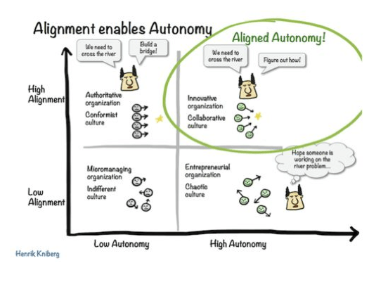
Future strategy
Transversal TDR program has a project dedicated to UI just started
Strategy definition is under construction in the IT & Data management program
Accelerators, beamlines and computing teams working together on the project
UI requirements
Shared development between business & computing teams
Well-known technologies are important -> Possibility to sub-contract
Existing framework with a strong community to be able to share experience /dev
Control layer between Tango device servers & GUI:
Add security/authentication: to allow only approved clients
Add requests tracking: to track clients requests and abnormal usage
UI short/mid term perspectives:
Maintain existing Java Swing
Organize transition to new GUI technologies
Deploy Grafana for monitoring on the control systems
Provide Python ecosystem
Accelerators & Beamlines requests:
Python/PyQt and other Python packages
Web solutions
Computing teams & business teams work together to share the strategy

Slide 23
Expectations from the workshop
Understanding organization in the other institutes
Who do what? How?
Experience of migrating to new GUI technologies: skills, complexity
What about long-term maintenance of the GUI? Which policy did you choose?
UX Expertise?
Understanding operational architecture up to the desktop
Cloud technology approach
What about security for these upcoming solutions?
What about library packaging?
How to transition smoothly?
Feedbacks about Taurus
Users’ feedbacks from other institutes
Which skills required to provide and deliver Taurus?
Technical feedbacks: complexity, maintainability

Slide 24
Conclusion
GUI strategy under construction in the context of SOLEIL II TDR
Current challenge is to manage the transition
Balance between desktop and web to be defined
Looking for partners to share UI frameworks and experiences
Robustness
Flexibility
Architecture and technology Transformation
complexity/reliability/maintenability
Collaboration
Strong community

