Slide 1
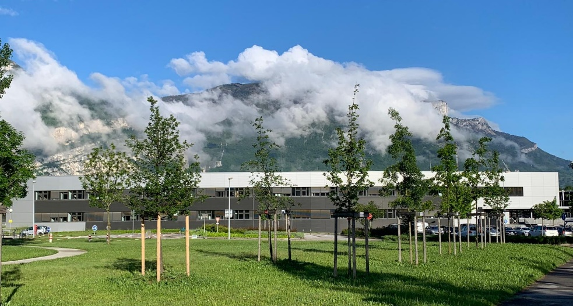

TAURUS Meeting
14-15 March 2023
Life after Java at ACU
Nicolas Leclercq on behalf of the software group

Slide 2

a few words about
web.dev@esrf

Slide 3
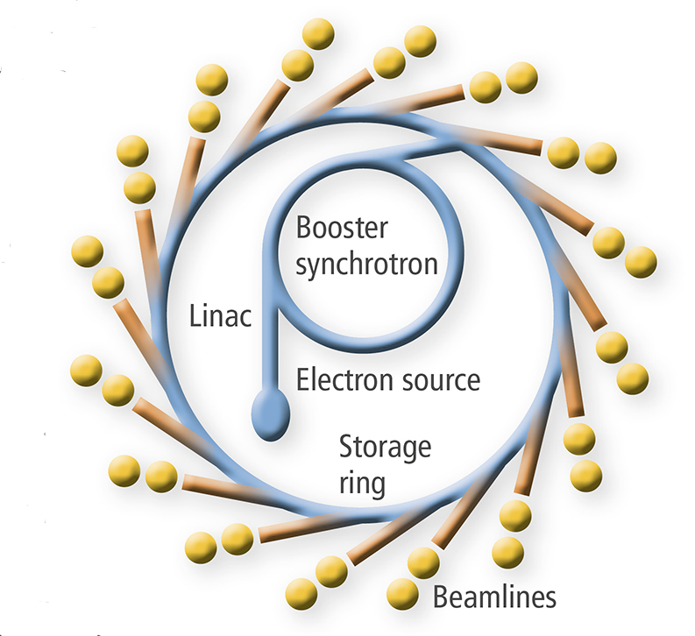
PREAMBLE: SYNCHROTRON = ACCELERATOR (BLUE) + BEAMLINES (YELLOW)
SWG=
ACU BCU
DAU

Slide 4
PREAMBLE: SYNCHROTRON = ACCELERATOR (BLUE) + BEAMLINES (YELLOW)
SWG=
ACU BCU
DAU

Slide 5

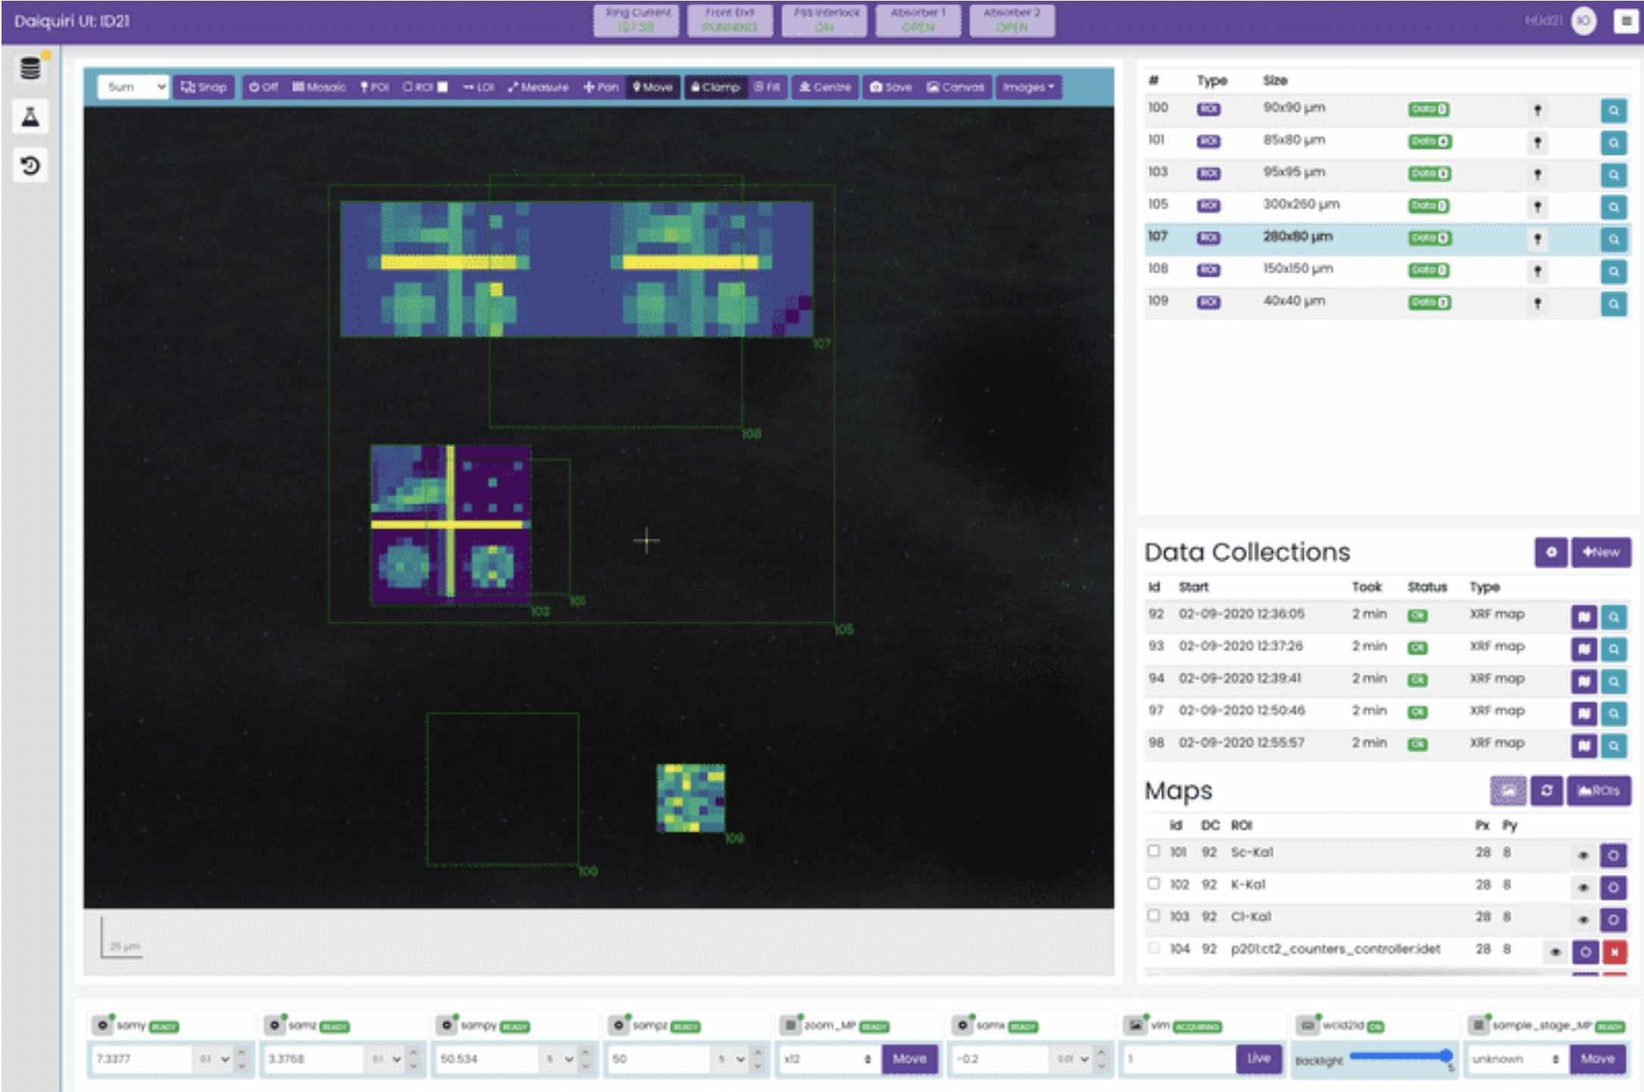
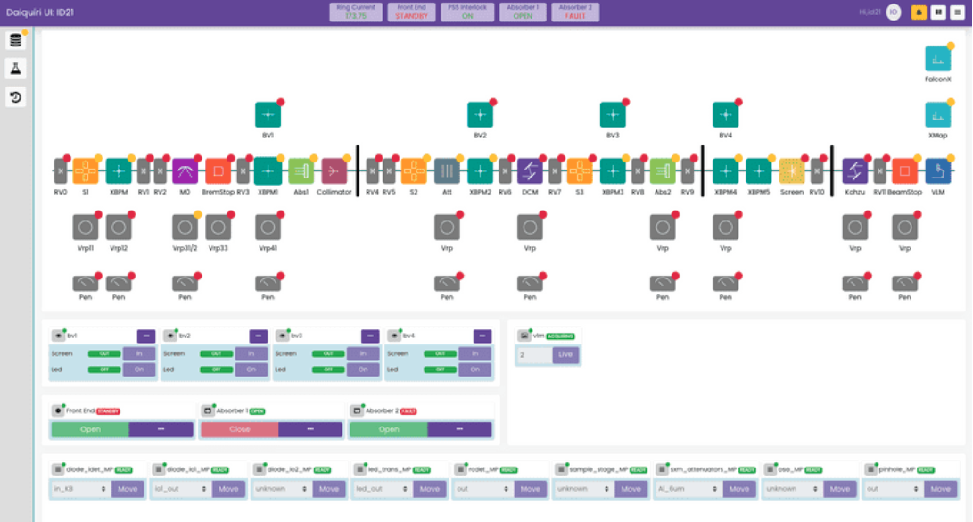
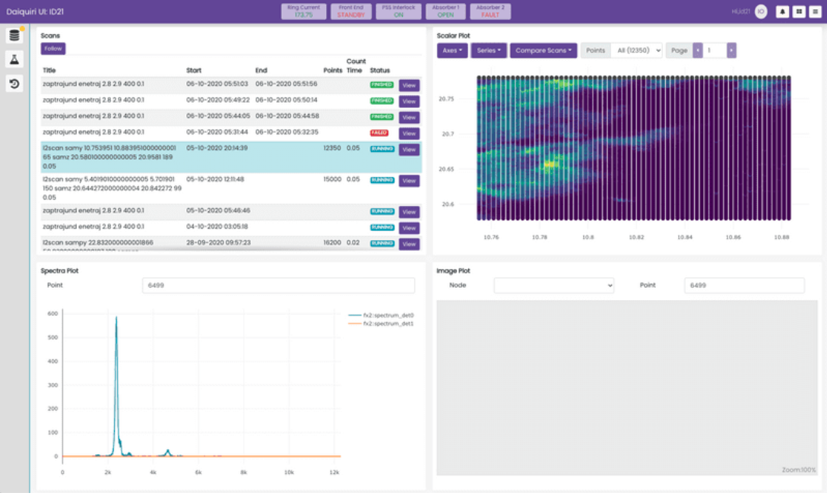
WEB.DEV@ESRF
a lot of activity for scientific data acquisition & analysis
      Daiquiri: a UI layer for controls & data acquisition on beamlines (from ESRF-BCU)
        visit https://ui.gitlab-pages.esrf.fr/daiquiri-landing/about for more details

Slide 6
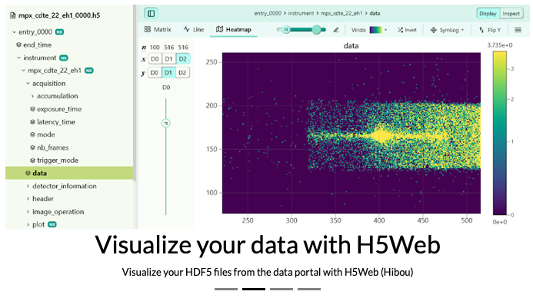
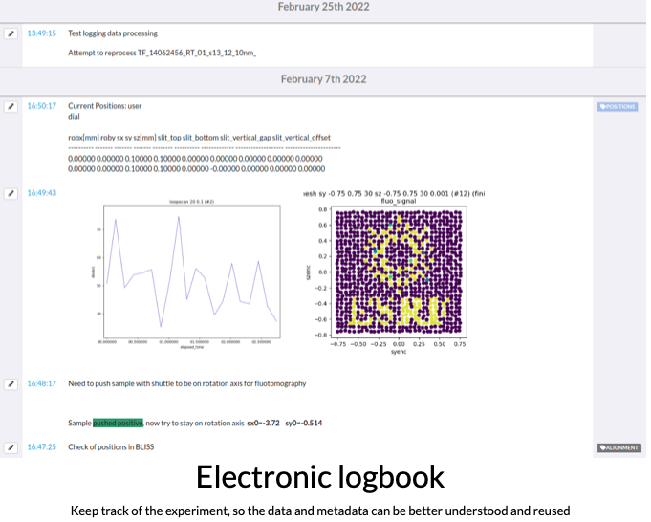
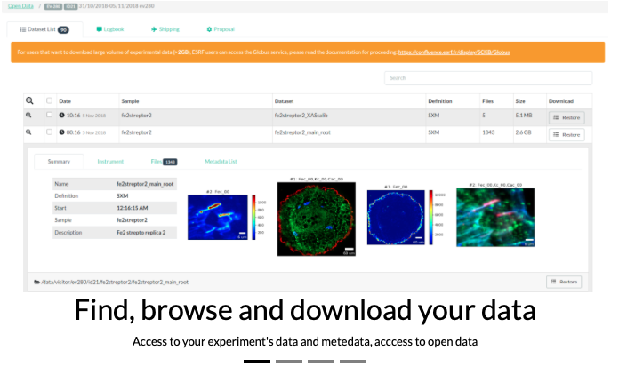
WEB.DEV@ESRF
a lot of activity for scientific data acquisition & analysis
      UI tools for scientific data processing & management (from ESRF-DAU)
        visit https://data.esrf.fr/login

Slide 7
WEB.DEV@ESRF
What about the accelerator?
      today: +110 Java-SWING[-ATK]-based standalone applications
      the context: no web culture/experience @ ACU → some tech. & org. unknowns
        are web technologies adapted to large scale control system? do they scale properly?
        what about applications with hundreds of underlying connections to Tango devices?
        are the operators ready to work in the browser?
        in case they aren’t, would Electron (or similar tech.) be a solution to dev. desktop applications?
        what about the required skills & profiles? transition cost?
      evaluating the web-technologies for the ESRF-EBS
        let’s start with the backend…

Slide 8
WEB.TECH.EVAlUATION@ESRF
ESRF backend specifications
      ideally: lightweight solution + easy integration to Tango CS + high performance + modern communication schema + async. com. support (i.e. events) + no (or minimum) dependencies
ESRF backend implementation
      pure backend – doesn’t deal with frontend stuffs (no GUI components)
      a HTTP(S) server encapsulated in a C++ Tango device w/ GraphQL schema + websockets (for async com.) ≈ a GraphQL binding for the Tango C++ API (syntactically similar).
      own/powerful GraphQL parser: F. Loitsch's Grisu2 for floats + binary JSON (to do)
      discriminates GraphQL from Tango errors using a dedicated error field
      exports a GraphiQL interface to its clients
      see https://gitlab.com/tango-controls/TangoGraphQL
ESRF backend compatibility with TARANTA frontend
      not compatible! so far at least…
MOPV025

Slide 9
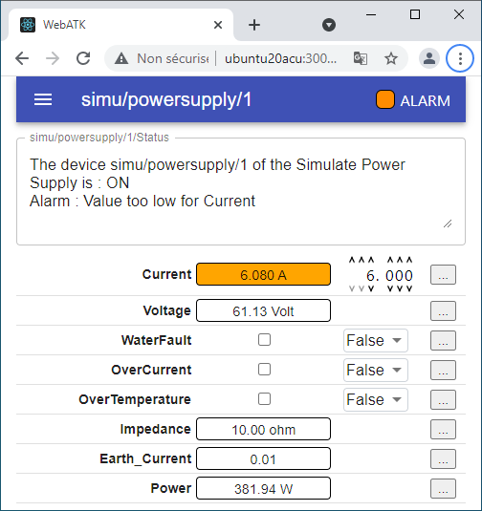
WEB.TECH.EVAlUATION@ESRF
a few words about the ESRF frontend
      a POC for a web version of our Java-Swing ATK framework based on a MVC pattern for React – uses Material UI components

Slide 10
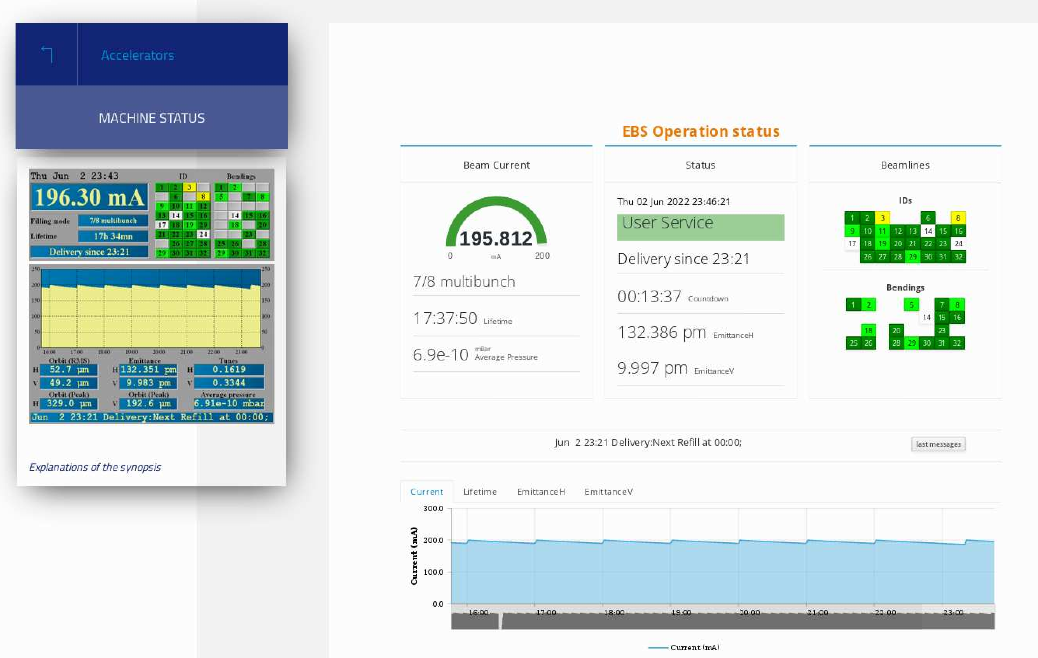
FIRST USE CASE@ESRF
Replacing the EBS operation status page
      Currently base on an obsolete technology (Jyse)
      Almost done – based on ACU C++ backend + custom frontend by DAU

Slide 11
FIRST USE CASE@ESRF
Replacing the EBS operation status page
      custom frontend based on the following technologies and packages…

Slide 12
FIRST USE CASE@ESRF
Replacing the EBS operation status page
      custom frontend based on the following technologies and packages…
      React for building/orchestrating the user interface
      zustand for managing UI state
      visx for building SVG visualisations
      ... plus a lot of smaller front-end libraries: dayjs, d3-format, @reach/tooltip, @react-hookz/web, lodash, normalize.css, react-icons, etc.
      Relay for fetching/caching resources with GraphQL
      GraphQL, the API query language
      graphql-ws for communicating with the API via WebSockets
      wretch for making HTTP requests to the API
      TangoGraphQL, the back-end API
      Vite for running the dev server and building the project for production
      TypeScript for statically typing the codebase
      pnpm for managing dependencies
      Node, of course, the JS runtime environment for running all these tools
😱

Slide 13
a few words about
python@swg-acu

Slide 14
Python@ACu
so far, not a major tool at SWG-ACU
      heavily used in other units
        e.g., BLISS is 100% python-based
      ACU local culture mainly C++ & Java oriented
      slow but growing adoption of python
        increasing number of Tango devices
        Java devices now prohibited (22 classes)
      using the Sardana macro-server
        plenty of macros for the EBS operation (e.g., top-up sequence)
      no experience with python-Qt
        no TAURUS evaluation/prototype so far (to do)

Slide 15
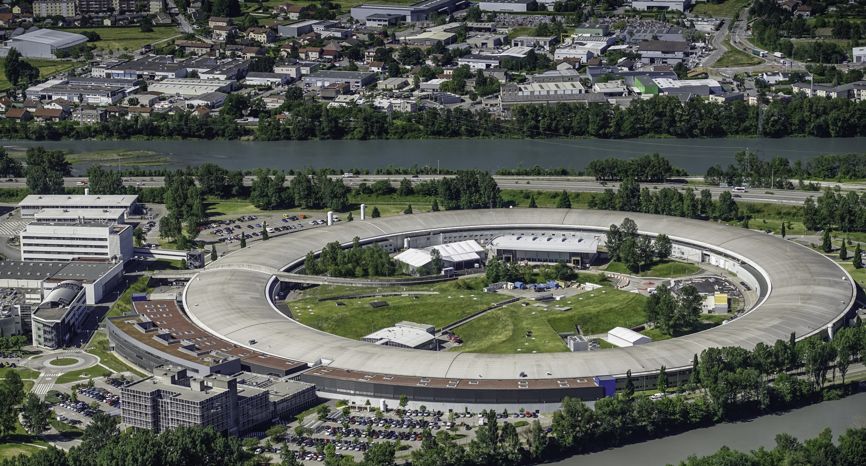
Many thanks for your attention

