Slide 1
TAURUS Workshop
14-15 March 2023
Accelerator Control GUIs at ESRF
F. Poncet

Slide 2
Current Status : Architecture
Control Application GUI
(Java Swing)
Tango DS
Tango DS
Tango DS
Tango DS
Tango DS
Tango DS
Tango DS
Equipment 1
Equipment 2
Equipment 3
Equipment 4
Equipment 5
Notes:
The Accelerator controls GUI are all Java Tango Clients accessing the Tango device servers (C++, Python, a few Java)
The Tango Device Severs can be high level device servers or aggregators which implement the control logic.
The control logic / intelligence is always implemented in a Tango device server

Slide 3
Accelerator control System Figures
371 Controlled hosts (control PC and VMs)
2 820 Tango servers running
5 159 Tango classes
23 227 Tango devices
417 678 Device properties
153 489 Attribute properties

Slide 4
Accelerator controls GUI examples

Slide 5
GUIs Characteristics and figures
130 Java GUI applications deployed and used in operation. Many of them also include expert sub-panels
All of them are desktop standalone applications
100% of these applications are developed by our team (ACU)
Among them lots of medium complexity applications and a few very complex applications
The number of tango devices connected to one application : up to 2 000
Pure clients talking to Tango devices. The control logics are coded inside the device servers not in GUI applications
In addition to the above applications, more than 60 dashboards based on Jdraw Synoptic made by non programmers : equipment responsibles or operators

Slide 6
Accelerator control GUI applications
Java applications based on Tango ATK framework
Control Application GUI
Tango ATK
Java Swing
JTango

Slide 7
Homogenous LOOK & FEEL
Color code, ToolTips, conventions
Same tools for chart, plots
Error handling and windows : popup and history
Synoptic drawings

Slide 8
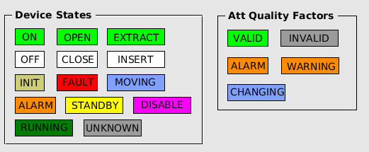
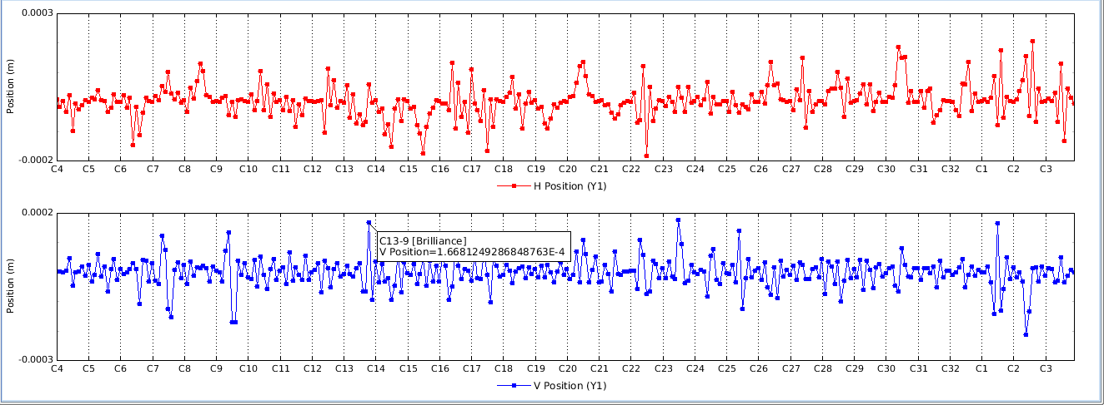
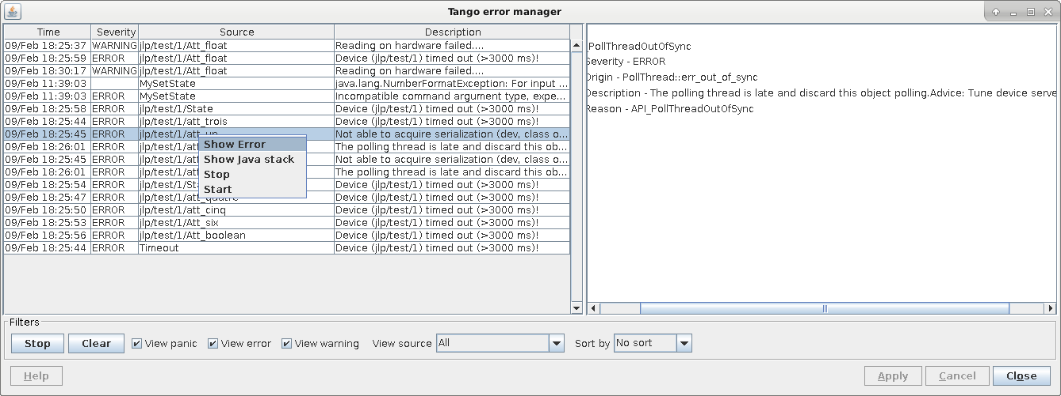
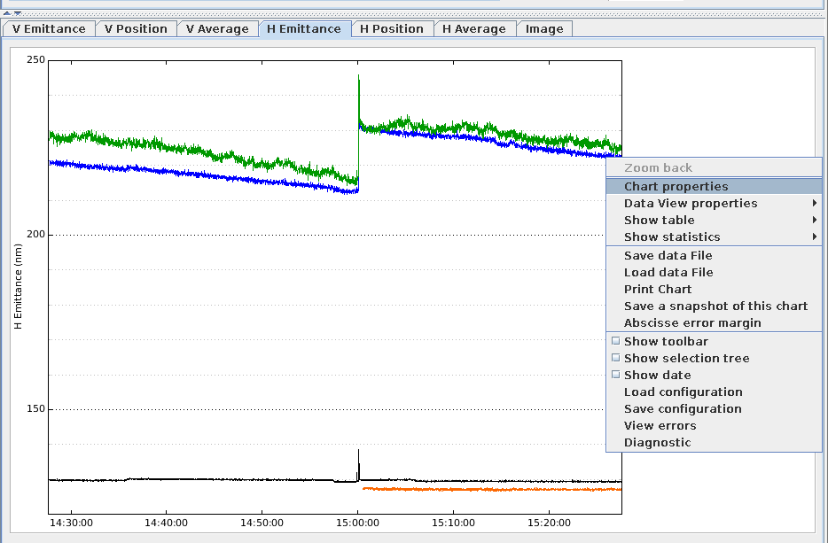
Homogenous LOOK & FEEL

Slide 9
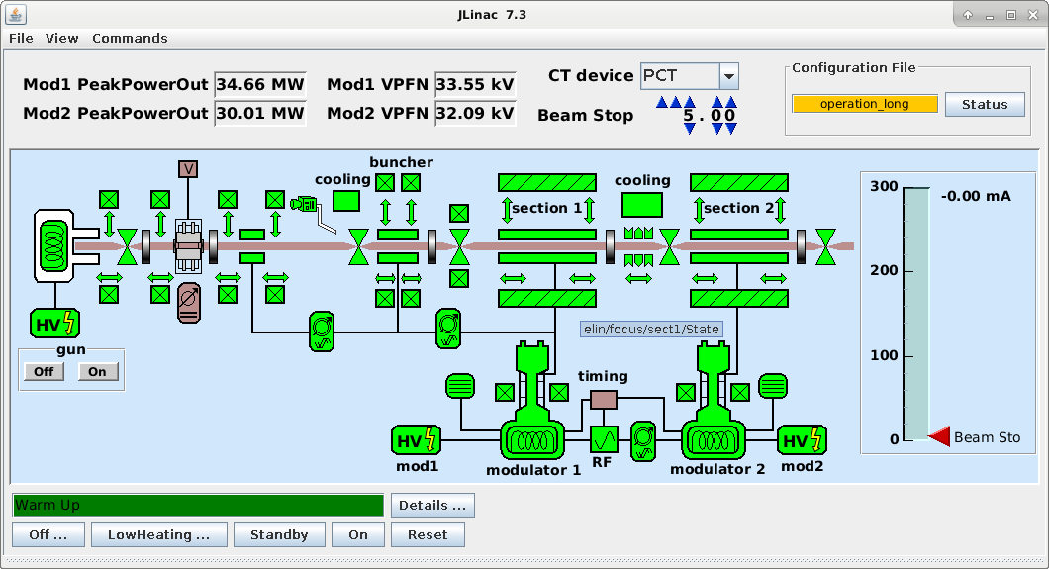
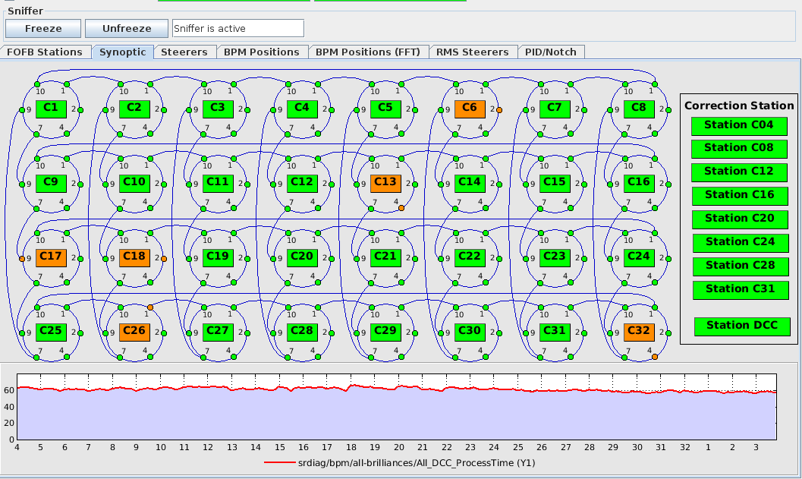
Homogenous LOOK & FEEL
Synoptic drawings
The unique tool at ESRF which allows to build a simple GUI with zero programming. The equipment experts and/or the operators can build a GUI in autonomy.
This tool is included in Tango ATK.

Slide 10
FUtURE of Java and SWING
Oracle Support for Java
Oracle Supports Java : see the oracle document “Java Client Roadmap Update” last updated May 11, 2020
Latest LTS release Java 17 and the next LTS release Java 21 is planned for September 2023
A non LTS release every 6 months and one LTS release every 2 years according to the Oracle Java SE Support Roadmap
Oracle Support for AWT and Swing
In Oracle document “Java Client Roadmap Update” last page : Oracle will continue developing Swing and AWT across all supported releases as a core Java SE technology

Slide 11
FUtURE of TANGO JAVA API
JACORB
There is no update or apparent activity on this project since 2017
Are the JACORB source codes included inside the Jtango project so that they are compiled / recompiled with Jtango ?
What will be the future of Tango Java clients : AtkPanel, Jive, Astor, HDB++ tools and clients?
JEROMQ
It is still updated. The last release jeromq-0.5.3 December 2022
Jtango
ESRF : for the moment no contributor (Since Pascal’s retirement)
SOLEIL : Main contributor
S2 Innovaltion
Are we going to actively maintain Jtango? Resources? What about JACORB and JEROMQ?

Slide 12
FUtURE of JAVA GUIS AT ESRF
JAVA and Swing support 
JEROMQ 
JACORB 
JTANGO 

Slide 13
Many thanks for your attention

