Slide 1
Simulations of DA measurements
with strong shaker

Slide 2
outline
Simulation of blow-up with the shaker using Benoit’s signal.
Chromaticity dependence
Simulation of DA measurement

Slide 3
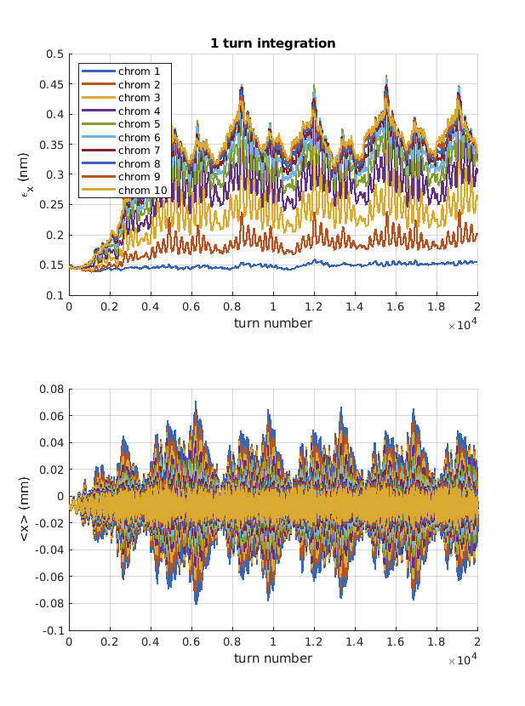
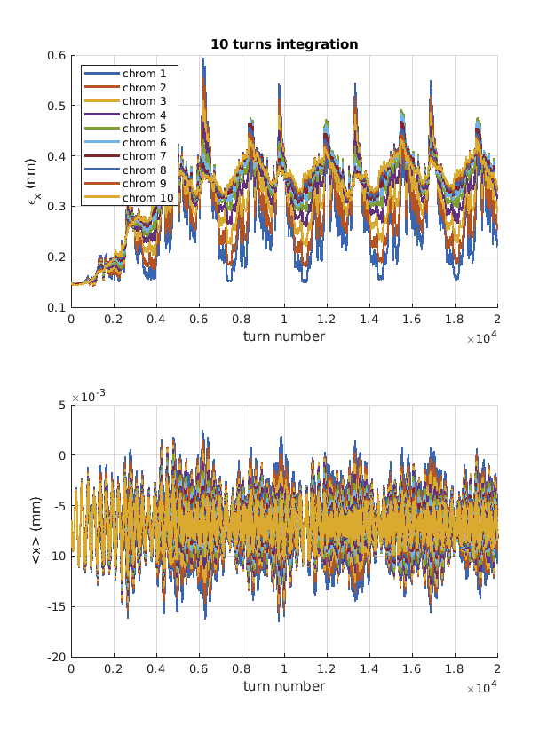
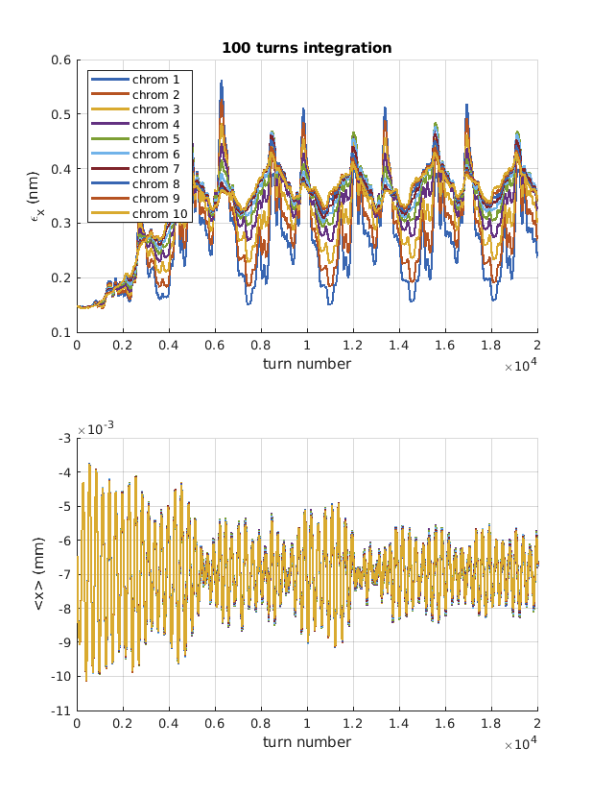
Simulation of blow-up as a function of chromaticity

Slide 4
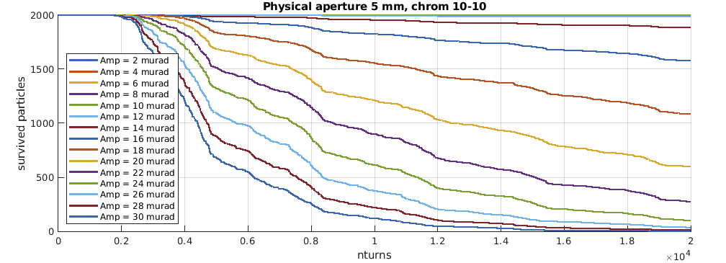
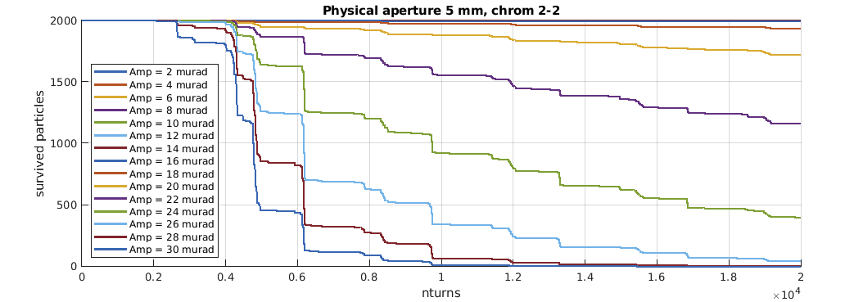
Fast ring with physical apertures at 5 mm
The idea is to use a fix amplitude of the shaker and then move a scraper until you see a change of the slope.
If the DA is only defined by the physical aperture, then the simulation is not very interesting, so I want to build a fast ring with a finite DA due to nonlinear dynamics.

Slide 5
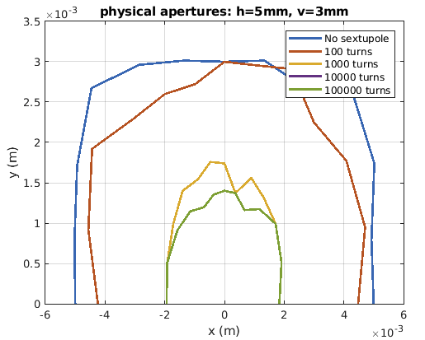
Fast ring with a sextupole and physical apertures
Fast ring with the following elements:
RF cavity
6x6 linear matrix with radiation damping
Nonlinear element with chromaticity and amplitude detuning
Physical aperture at 5mm/3mm (h/v)
A single SF sextupole
At 10000 turns the DA is fully converged to slightly less than 2 mm.

Slide 6
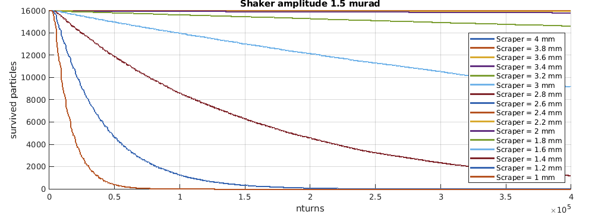
Shaker amplitude well tuned
When the shaker is well tuned to give almost no losses at scraper fully open, we see when the scraper intercepts the DA.

Slide 7
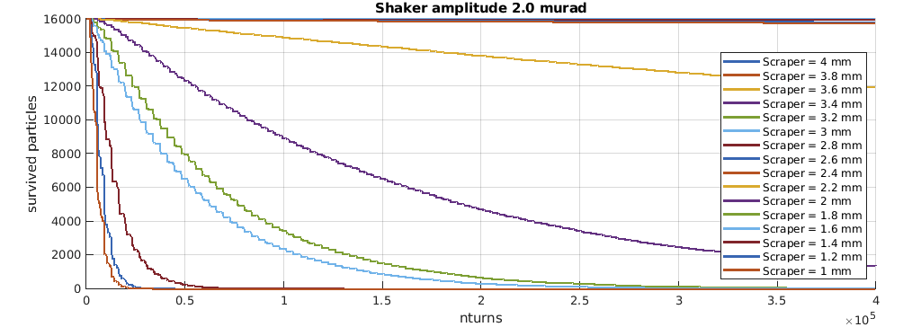
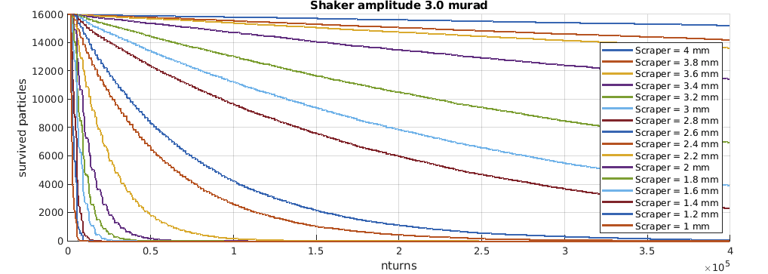
Stronger shaker amplitude
With stronger shaker amplitude the simulation is unclear.
Even if the DA is 2 mm, the scraper at 3-4 mm changes the measured DA.
Is this real?
Can a scraper much larger than the DA reduce the DA?

Slide 8
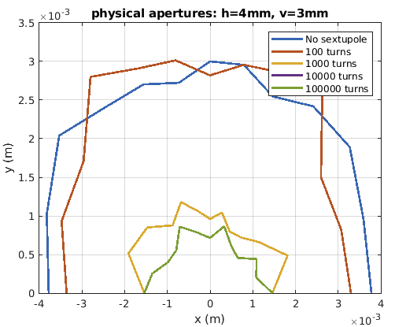
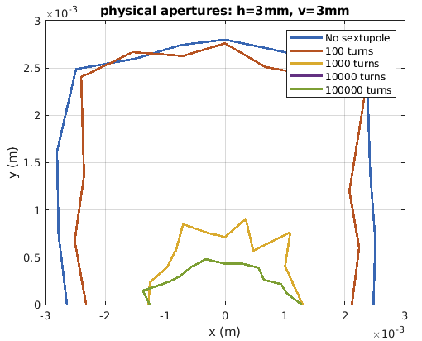
Standard DA simulation with different physical apertures
Also with standard DA simulations the physical apertures can reduce the DA much more than what expected (by me, maybe you knew already).
5 mm
4 mm
3 mm

