Slide 2
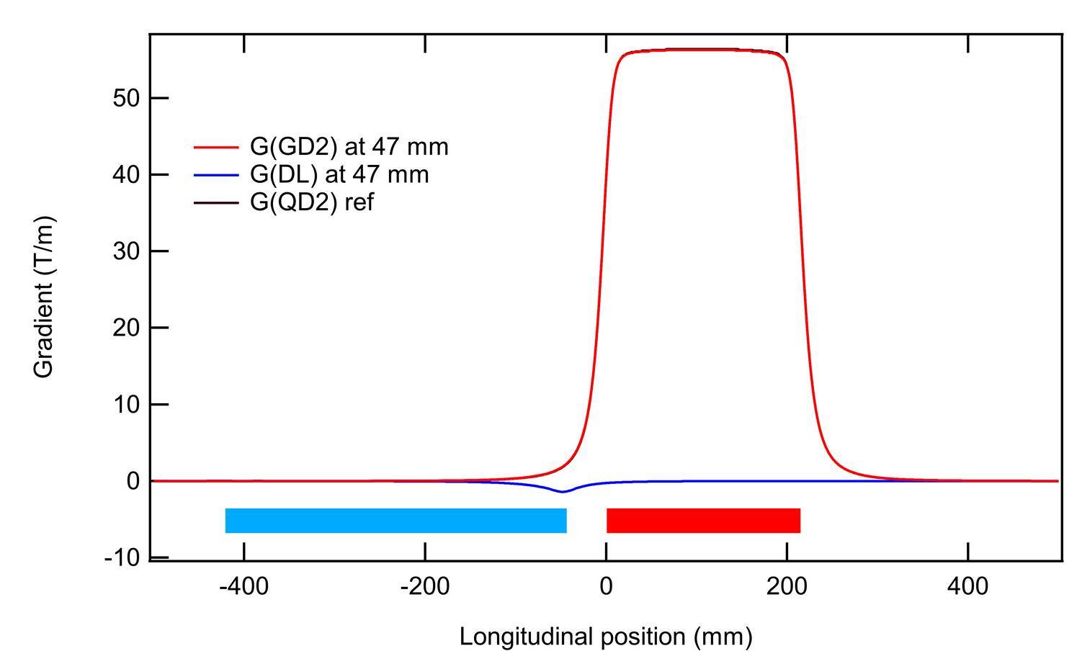
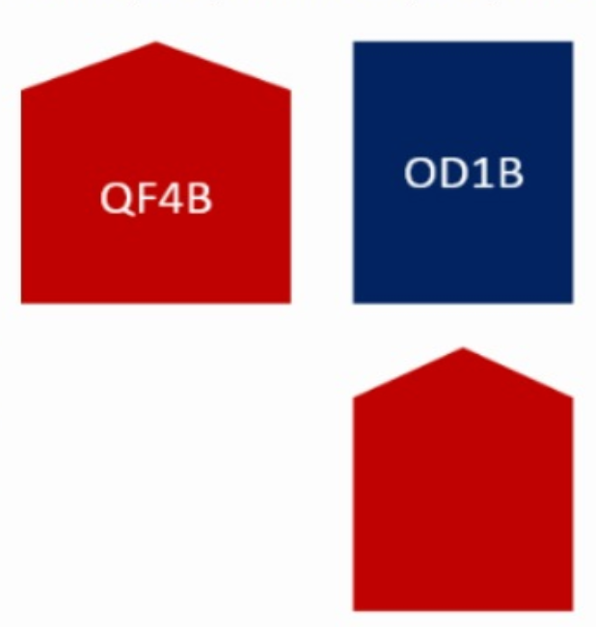
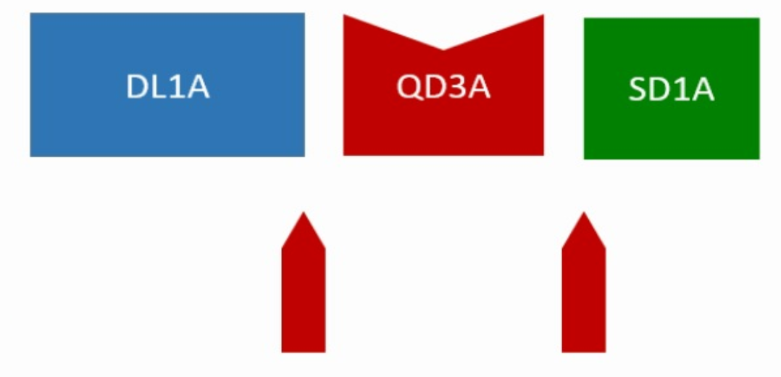
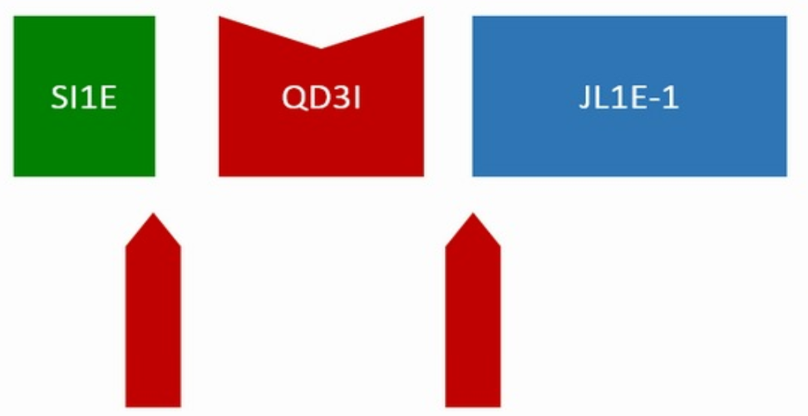
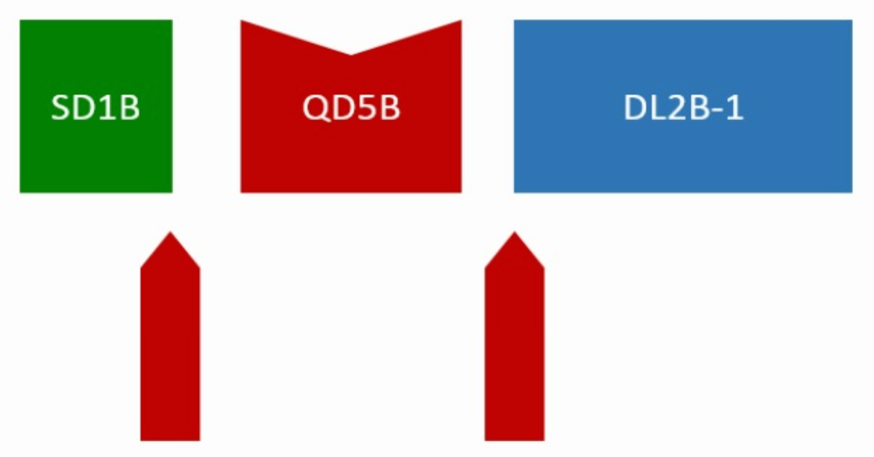
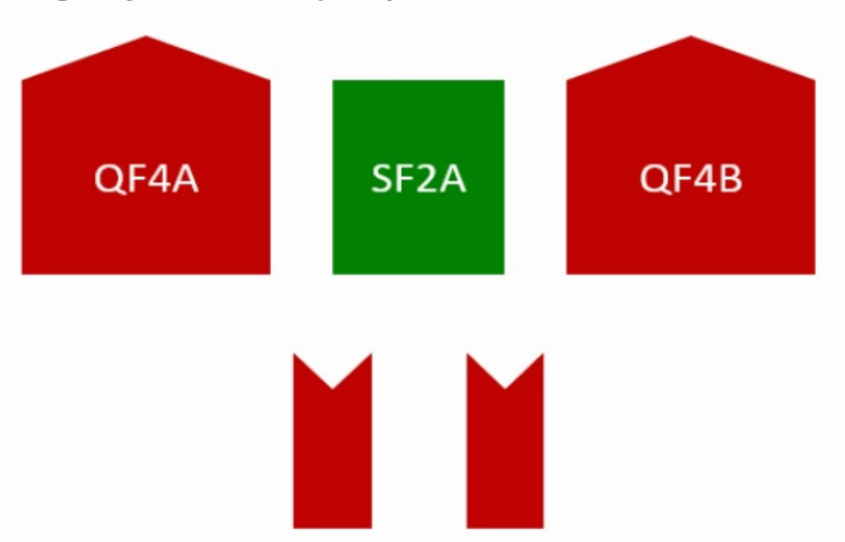
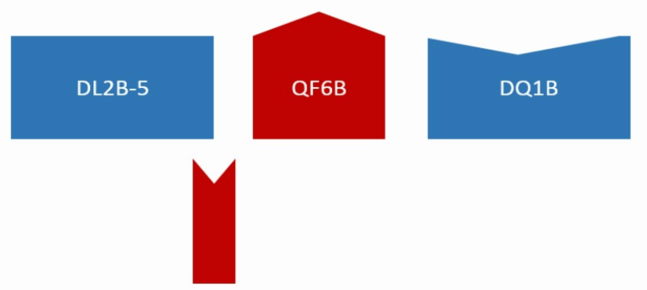
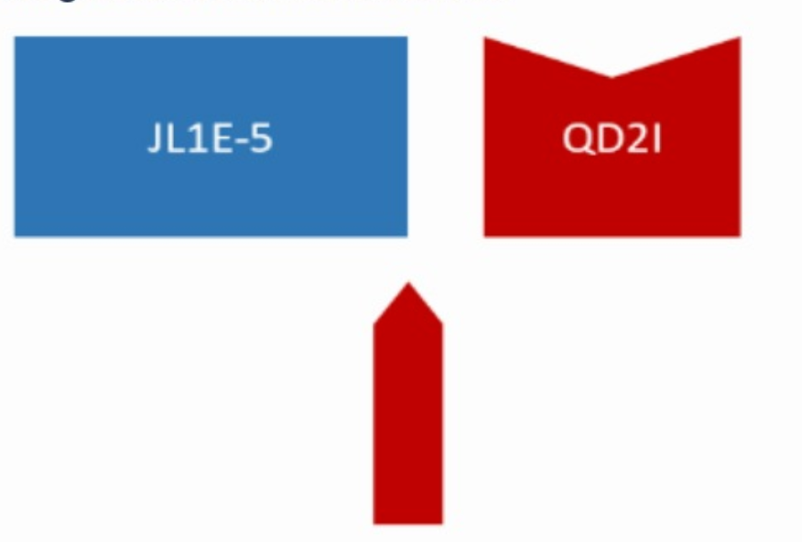
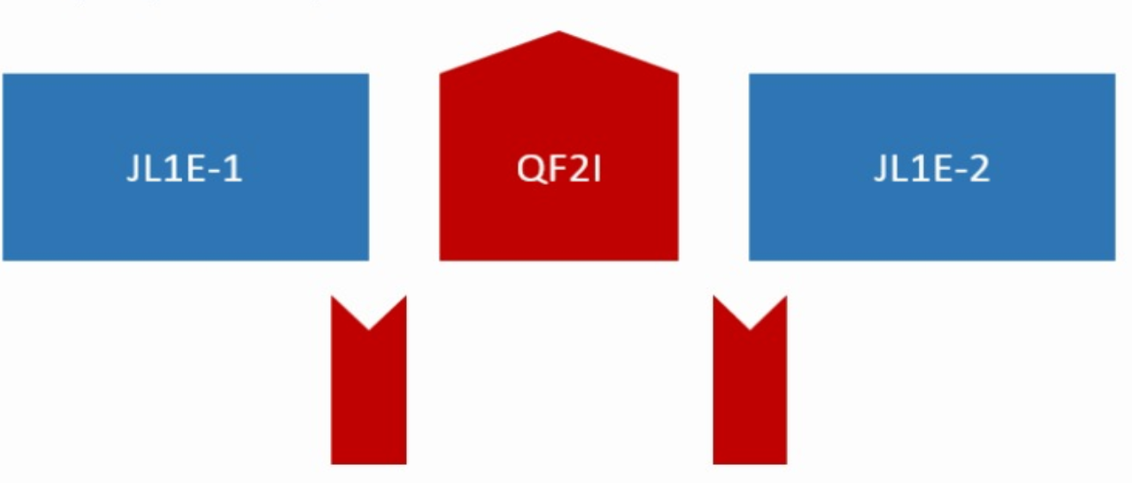
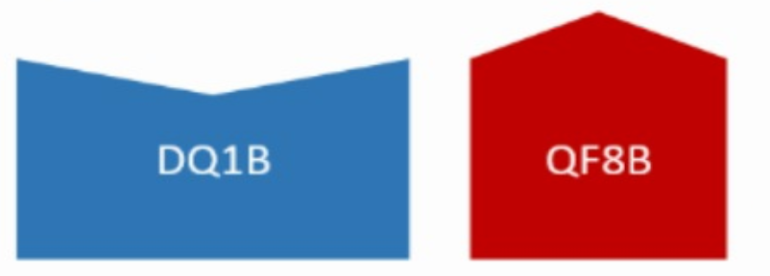
Optics during winter shutdown: cross talk
G.Le Bec, J.Chavanne
Magnetic simulations show a cross-talk effect among neighboring magnets.
Gradient recomputed + calibration scaling
Thin lens fix field multipole
+1.3% *QF4B
-0.8%*QD2A
model tunes: 76.2100 27.3400
+ Cross Talks: 76.6973 26.0038
-1.3 Δν_{y}

Slide 3
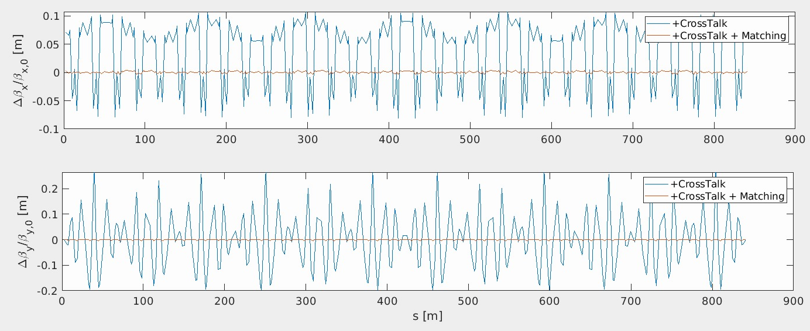
Optics with cross talk quadrupole fields and matched main magnets gradients
Δβ/β 10% H 20% V after introducing cross talks thin elements and matching tunes.
Cell 04
Cell 05
Required gradient changes
Up to 1.7% main quadrupole working point changes to recover ideal optics

Slide 4
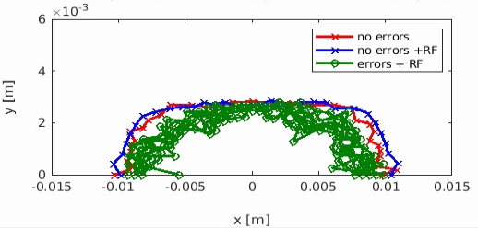
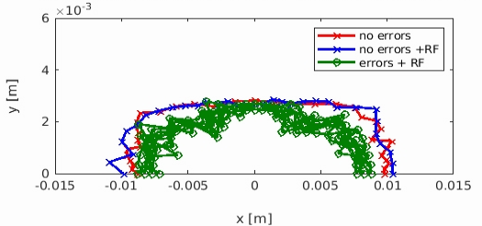
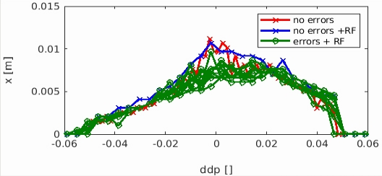
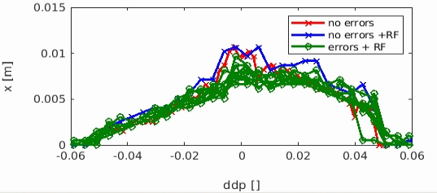
Da on- and off-energy including cross talks does not change lattice performances
Ideal lattice model
DA : -8.7 +/- 0.3 mm
T.L.T. : 19.6 +/- 0.7 h
I.E. : 85 +/- 5 %
Ideal lattice model + cross talks
DA : -8.3 +/- 0.4 mm
T.L.T. : 19.7 +/- 1.4 h
I.E. : 88 +/- 7 %
NO NET CHANGE IN LATTICE PERFORMANCE INTRODUCING CROSS TALKS
ELEMENTS

Slide 5
Hor. Dispersion measurements after model and control system corrections
09 Dec 2019 first measurement
Not possible to separate the effects, all adtions where interleaved in time.
calibrations, cross talks, steering with 162,128 singular values (more than foreseen), BBA,
NO quadrupole correction (apart tune)
Machine is “corrected” based on theory
30 Jan 2020
“uncorrected”
45% injection efficiency

Slide 6
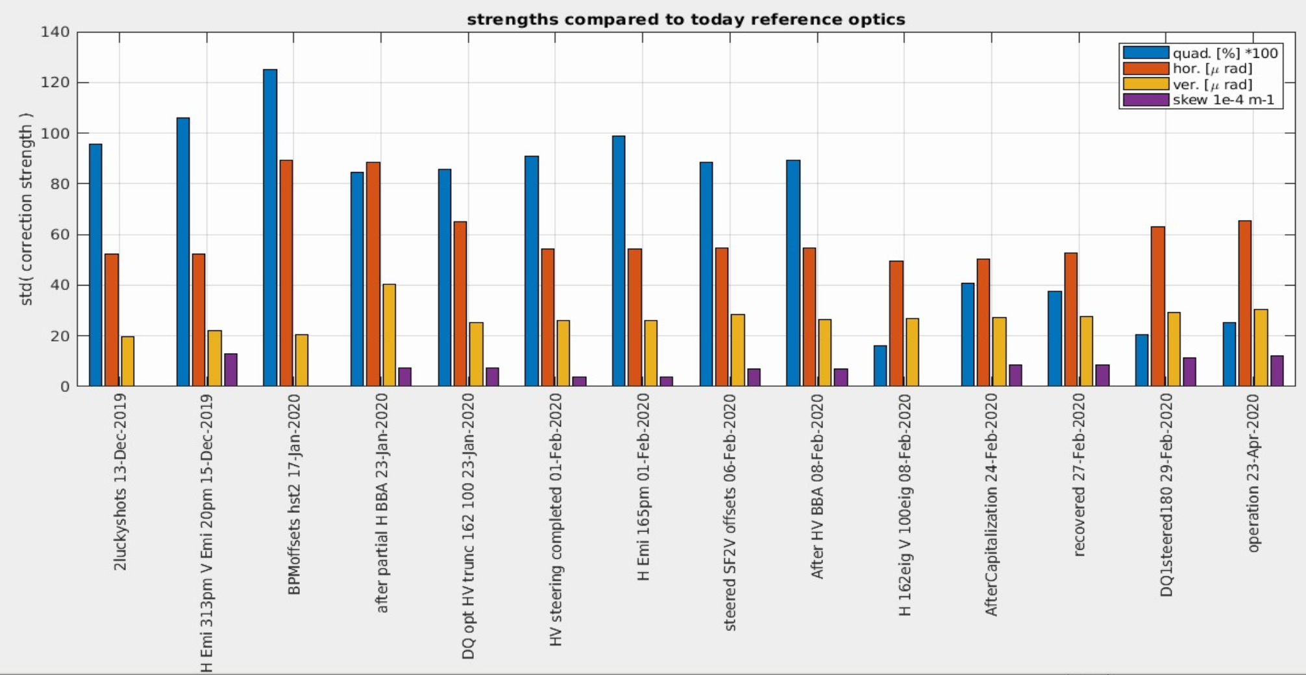
Steerers and quadrupole strengths evolution
BBA
Cross talks
truncation
BBA
More eig.
Truncation,
DQ Hor. steering
New optics
Today: 0.2 % std(quad gradients), ~ 65μrad, ~30μrad, std(H V steerers)
Simulations: 0.26 % std(quad gradients), ~160μrad, ~120μrad, std(H V steerers)

