Slide 1
What PaNOSC changed for ESRF
Andy Götz
ESRF
30 November 2022
This project has received funding from the European Union’s Horizon 2020 research and innovation programme under grant agreement No. 823852

Slide 2
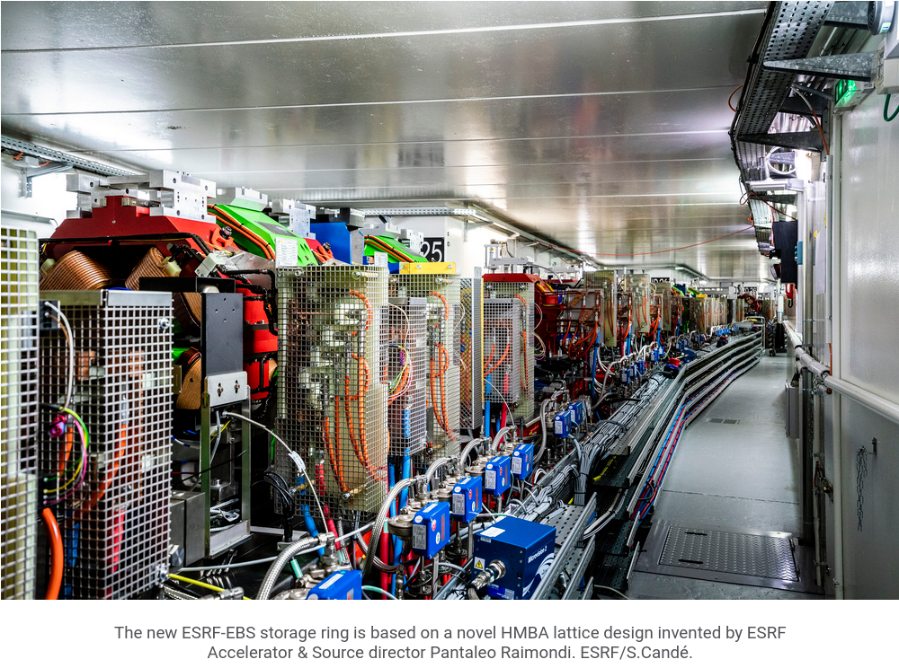
ESRF upgraded the source during PaNOSC
PaNOSC enabled FAIR data management to be implemented on ESRF-EBS beamlines
The challenge: building a new generation of synchrotron within an existing infrastructure
“The body of the car remains the same, but we took out the old motor and put in the new engine of a Ferrari,” explains Pantaleo Raimondi.
On 10 December 2018, after 26 years of loyal service, one of the highest-performing X-ray sources in the world was shut down for 20 months. … (https://ebs.esrf.fr/2020/08/25/esrf-ebs-opens-to-users/)
PaNOSC started 1 December 2018 …

Slide 3
What PaNOSC changed for ESRF?
1. Making FAIR data a reality
2. Building the PaN EOSC

Slide 4
PaNOSC changed for ESRF
First draft of FAIR Data Policy (thanks to PaNOSC DP framework)
Data Policy+data portal+e-logbook on 42/44 beamlines (thanks to ESRF staff)
Nexus/HDF5 on half of all beamlines (thanks to BLISS+NexusWriter+Lima)
DMPs implemented for all proposals (thanks to DS-Wizard)
Data visualisation in Jupyter + data portal + other web applications (thanks to H5Web)
Jupyter-slurm service used daily (thanks to jupyterhub-moss)
VISA+CERNVMFs deployed and being tested on beamlines (thanks to VISA)
OASYS training developed + implemented new algorithms (thanks to Vinyl)
Search API implemented and deployed (thanks to ICAT)
Human Organ Atlas deployed (thanks to PaNOSC search portal)
Data transfer solved for users (thanks to Globus + Aspera deployed )
E-learning platform ready to be adopted (thanks to e-learning.e-training.org)
→ Open Science and FAIR data became the new normal to aim for (thanks to EOSC)

Slide 5
Data curated in ICAT @ ESRF over last 12 months
44 beamlines have the data policy installed and 42 are collecting metadata + data :

Slide 6
PaNOSC is PEOPLE @ ESRF
First draft of FAIR Data Policy (thanks to Rudolf)
Data Policy+data portal+e-logbook on 42/44 beamlines (thanks to Alex+Marjolaine)
Nexus/HDF5 on half of all beamlines (thanks to Wout+Matias)
DMPs implemented for all proposals (thanks to Marjolaine)
Data visualisation in data portal + other web applications (thanks to Loic+Axel+Thomas)
Jupyter-slurm service used daily (thanks to Thomas+Loic)
OASYS training+implemented new algorithms (thanks to Manolo+Juan+Melissa)
VISA+CERNVMFS deployed and being tested on beamlines (thanks to Antoine+Aidan+Cedric+Francois+Jean-Francois+Jordi)
Search API implemented and deployed (thanks to Alex+STFC team)
Human Organ Atlas deployed (thanks to Axel+Axel+Jean-Francois)
Data transfer solved for users (thanks to Jean-Francois+team )
E-learning platform learning material (thanks to Marius+Manolo+Andy)
→ Open Science and FAIR data (thanks to ESRF management)

Slide 7
What is coming after PaNOSC @ ESRF
Adoption of FAIR Data Policy (Andy+Jean-Francois+ESRF management)
CTS certification + Data Policy implemented on 44/44 beamlines (ESRF staff)
Nexus/HDF5 enhanced definitions on all beamlines e.g. NxMx+IUCr (ESRF staff)
Useful DMPs for users (Marjolaine+User office+Beamline staff)
Data visualisation in data portal of processed data (Axel+Loic+Thomas)
Jupyter-slurm service continues (Thomas+Loic)
VISA+CERNVMFS opened to users + beamlines (Jean-Francois+team)
OASYS training + instrument database (Manolo+Juan)
Search API+scoring improvements (Alex+Marjolaine+Axel)
Human Organ Atlas enhanced (Axel+Claire+Alex+Marjolaine)
Paleontology + materials science repositories (Marjolaine+Alex+Paul)
E-learning platform training courses (ESRF staff)
→ Open Science policy (ESRF management+Jean-Francois+Andy)
→ INFRA-EOSC-01-01 collaboration with science clusters (Andy+Jordi+Jean-Francois)

Slide 8
Thank you!
Andy Götz (PaNOSC coordinator) + Mincka (his cat)!

