Slide 1
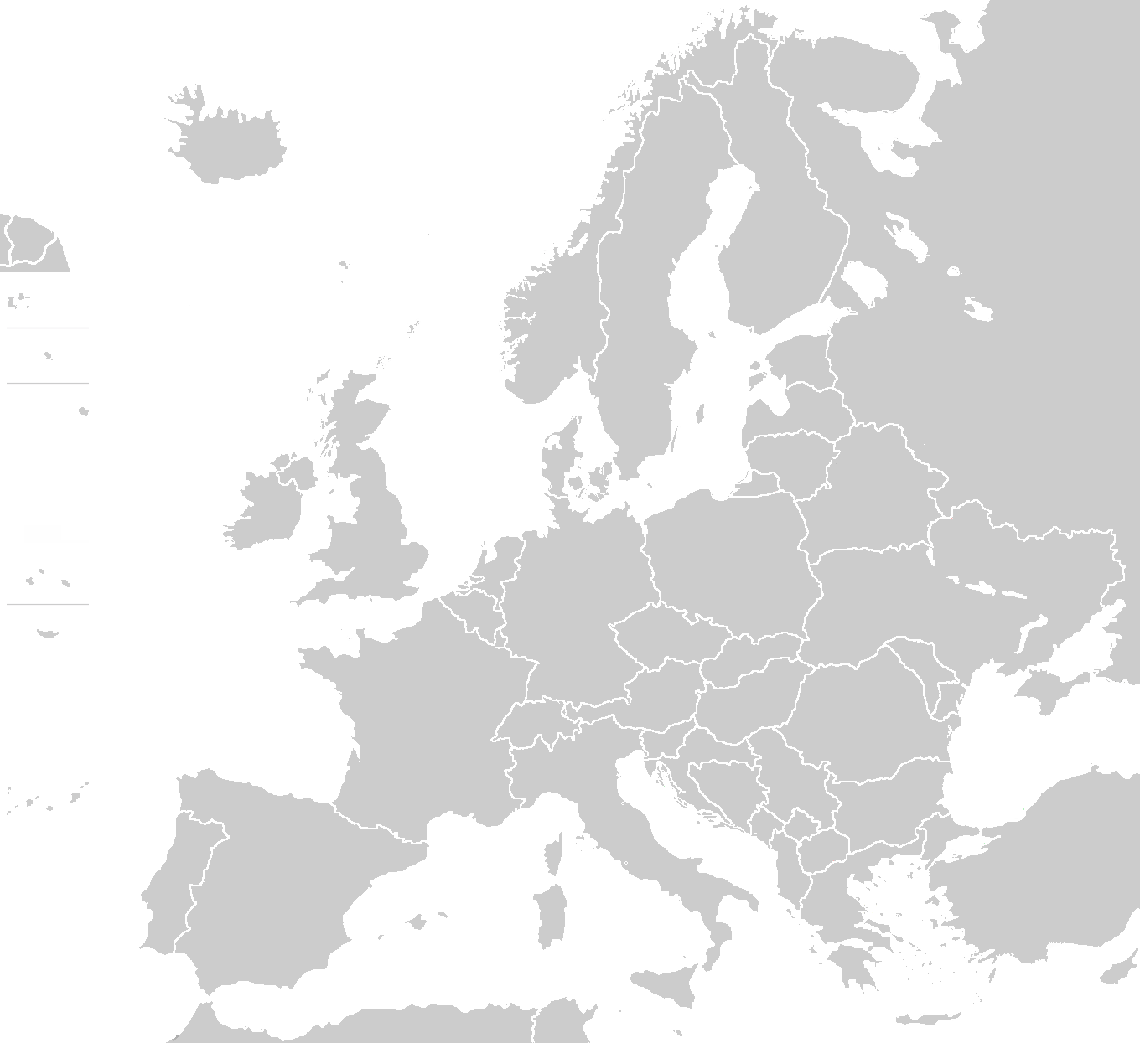
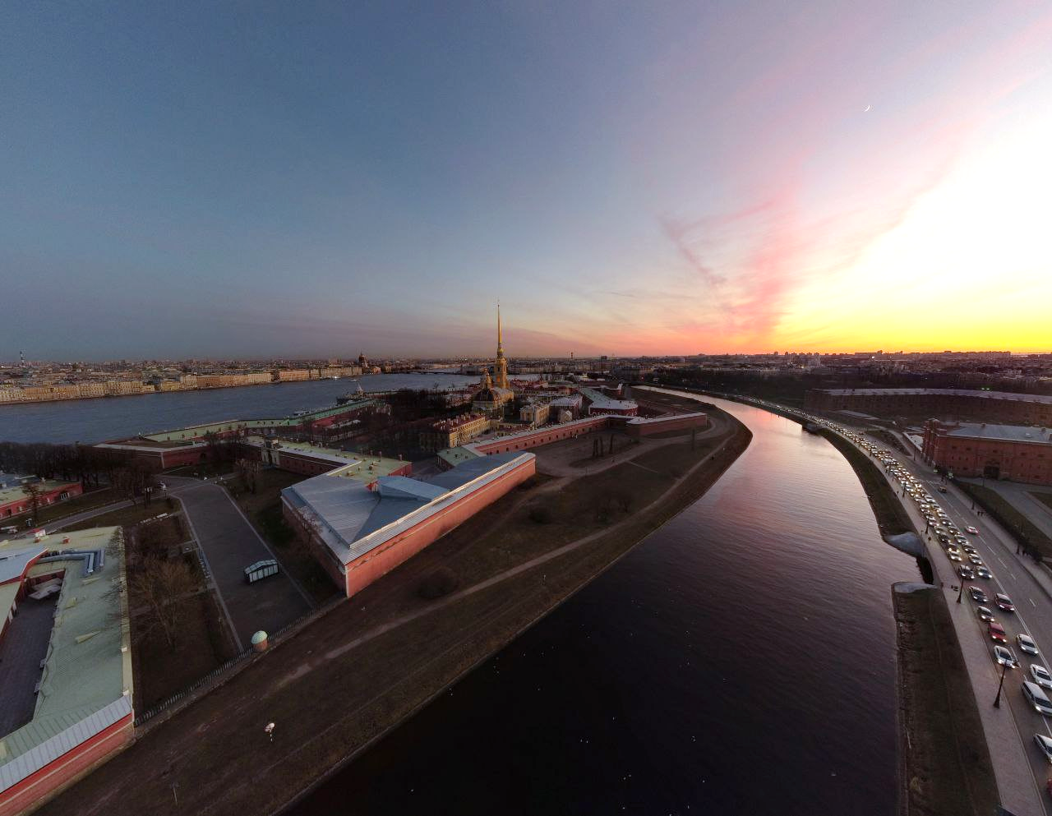
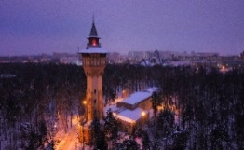
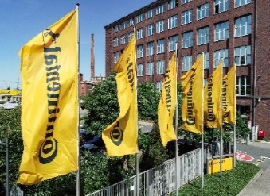
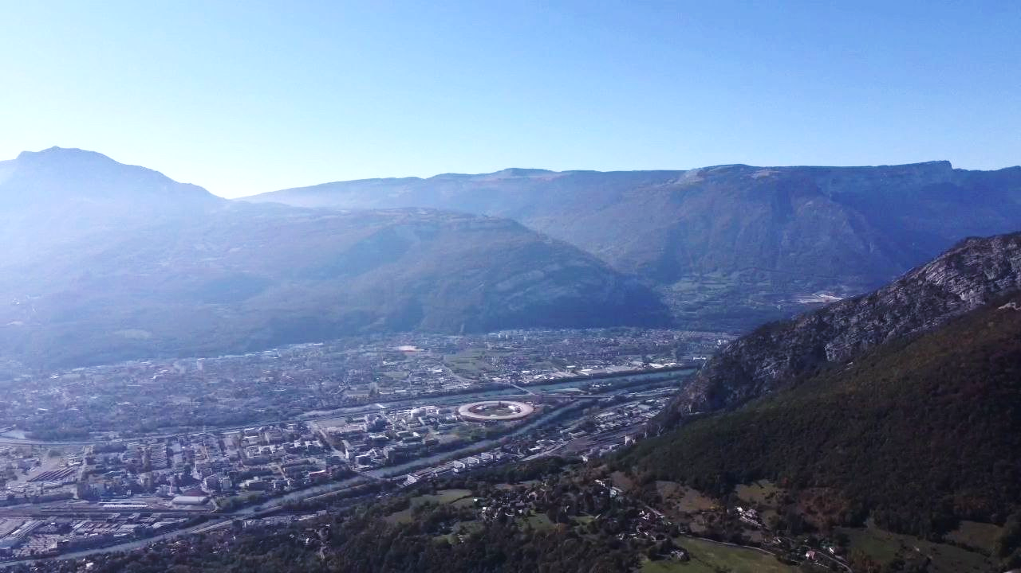





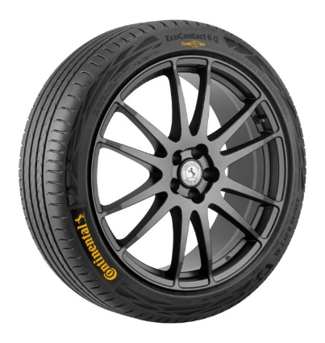
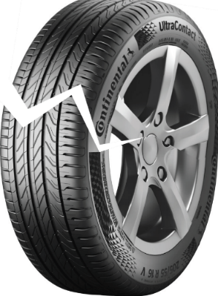

St. Petersburg
Hannover
Cavity formation in highly strained silica-filled rubbers observed by Ultra Small-Angle X-Ray Scattering
Grenoble
Ilya Yakovlev
ESRF, ID02 & ID13
2-nd Year PhD student
Michael Sztucki
Manfred Burghammer
Theyencheri Narayanan
Ali Karimi
Jorge Lakayo-Pineda
Ulrich Giese
Ralf Schweins

Slide 2
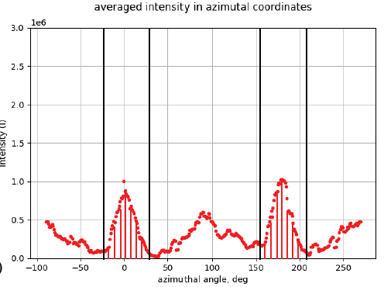
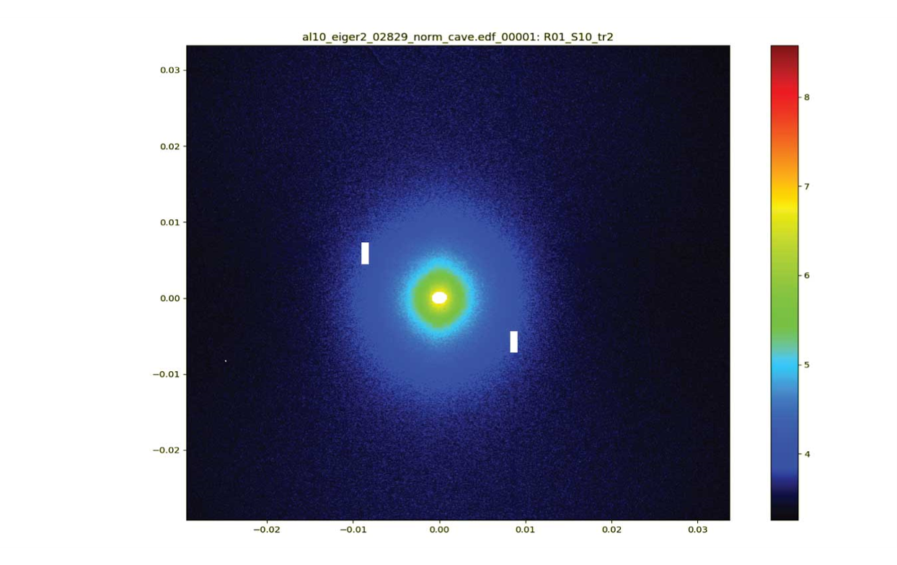
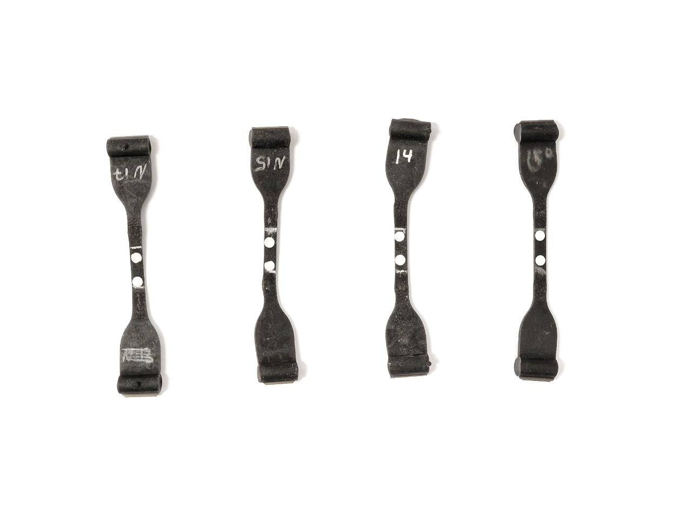
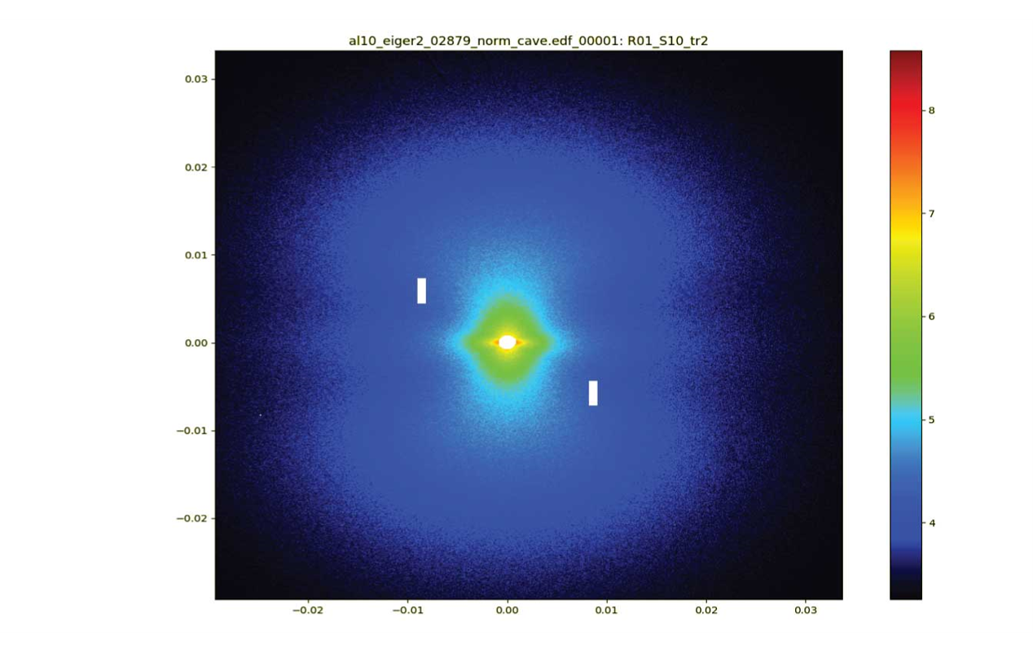
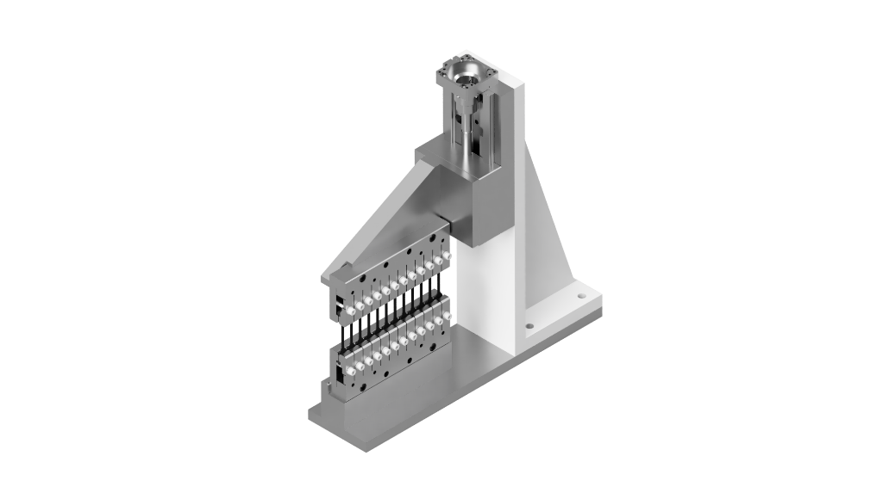
Powerful methods to determine the microstructure of multi-component systems.
With wide range of length scales available from a few Angstroms up to micron scale.
Strain level
3 different silanes
Focuses on the local nanostructure of very small objects and allows their investigation with micro- or nanometric real space resolution.
0⁰
ID02:
Look into rubber samples structure and particle sizes for better understanding of cavitation (USAXS, 4 orders of magnitude in q scale)
Resolve Cavity Formation Mechanism
Poster #31

