Slide 1
Injection efficiency from HDB

Slide 2
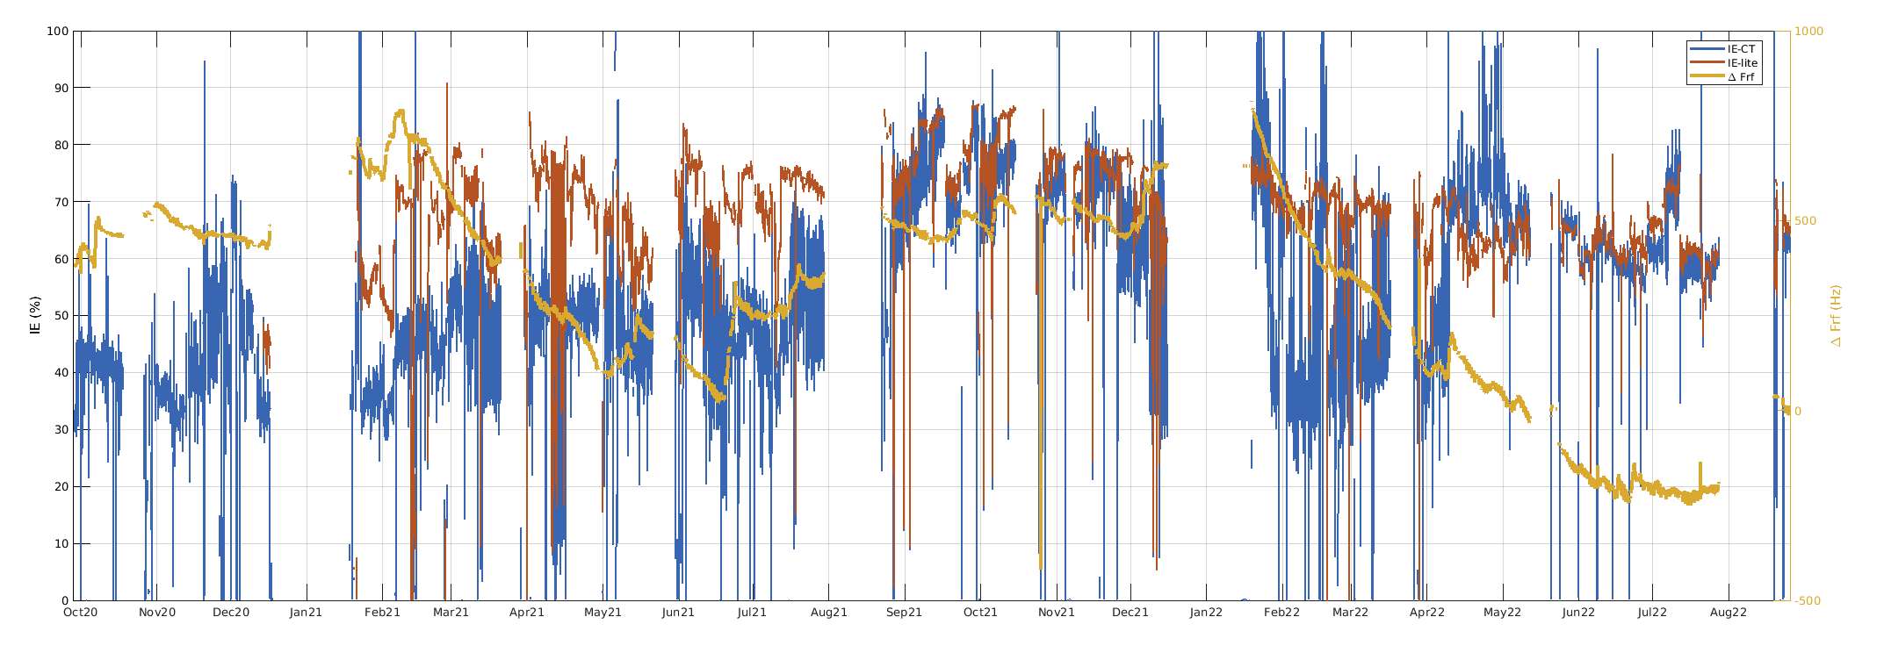
Comparison of injection efficiency lite and ct based from HDB

