Slide 1

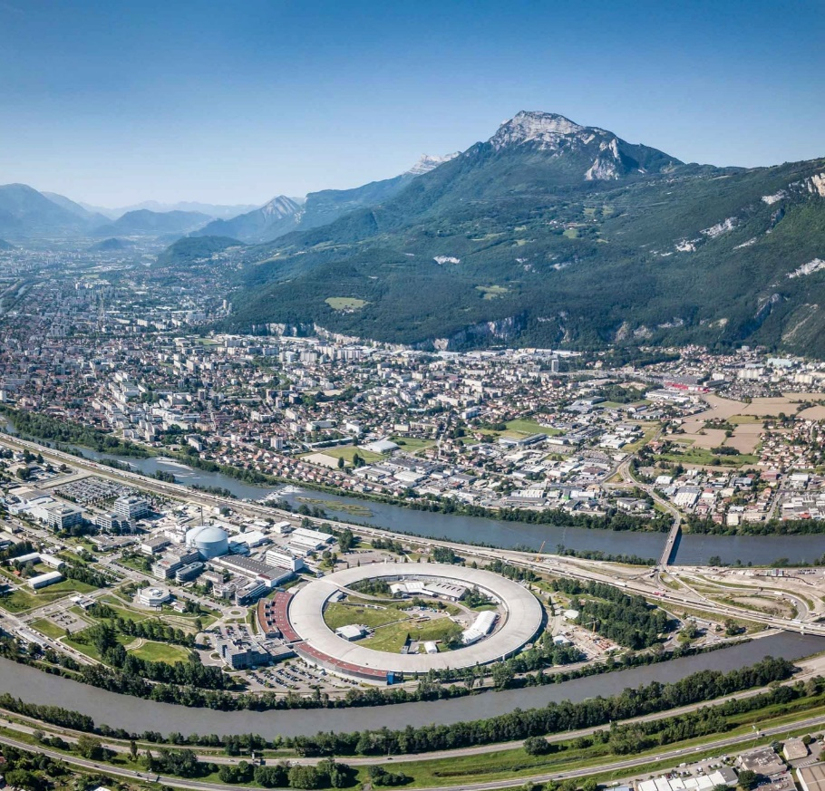

Permit to work for Injector upgrade
G. Chazot on behalf of the PTW / J5 Team :
Isabelle Leconte, Anne-Cécile Rocheville, Laurent Hardy, Vincent Druesne
Tools / Developments done by the on Shift Operators

Slide 2
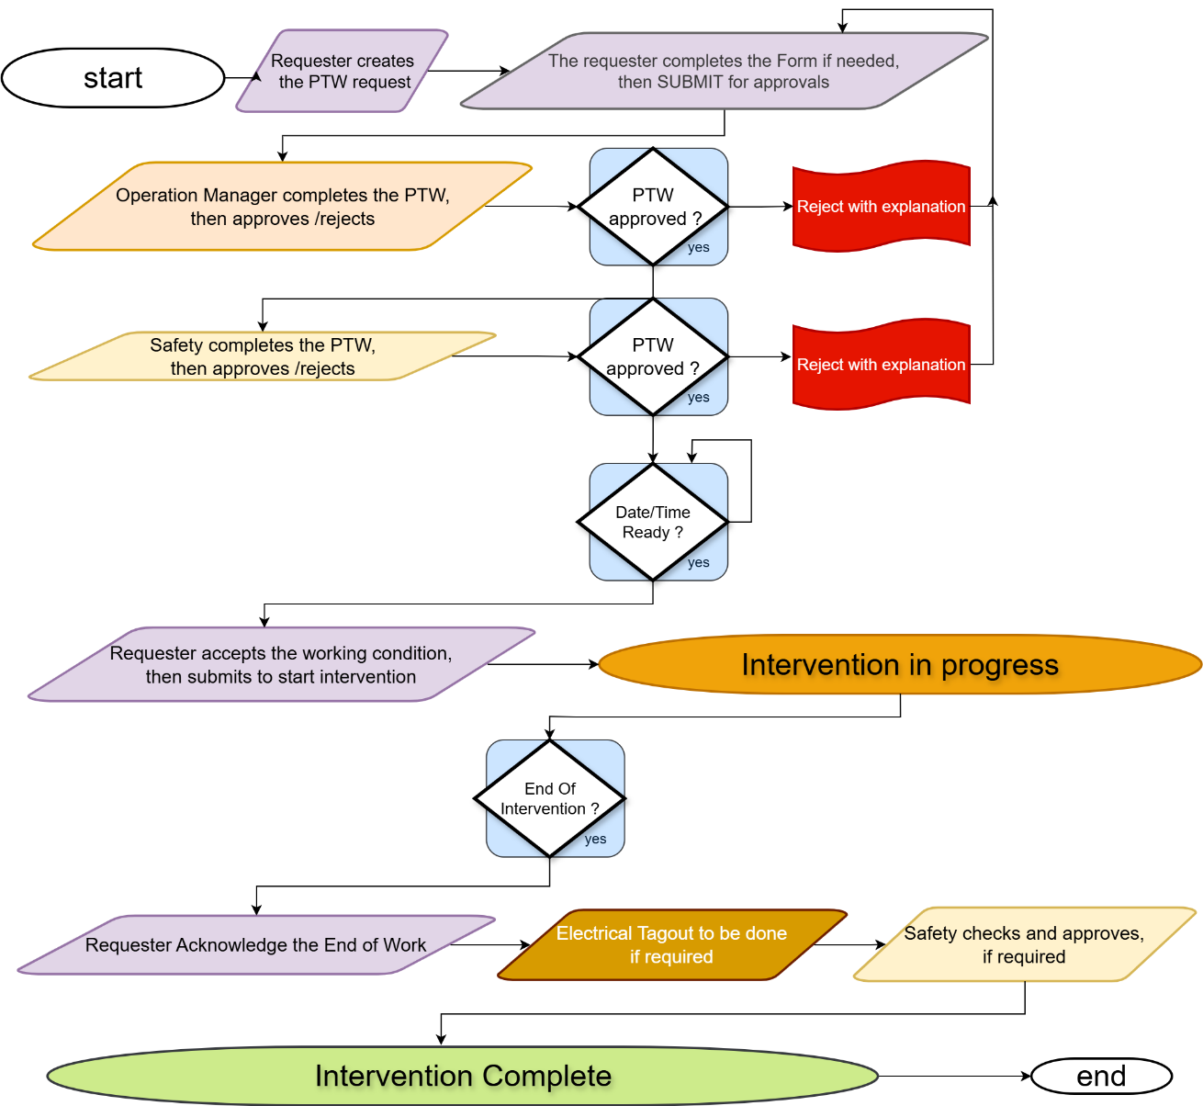
PTW Workflow synopsis

Slide 3
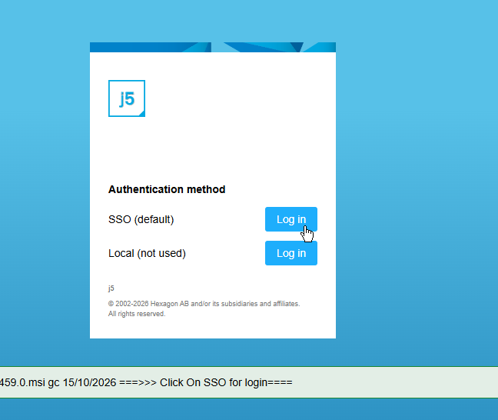
Permit To Work Injector Upgrade How To
Log in J5 Server : https://wspcj5.esrf.fr

Slide 4
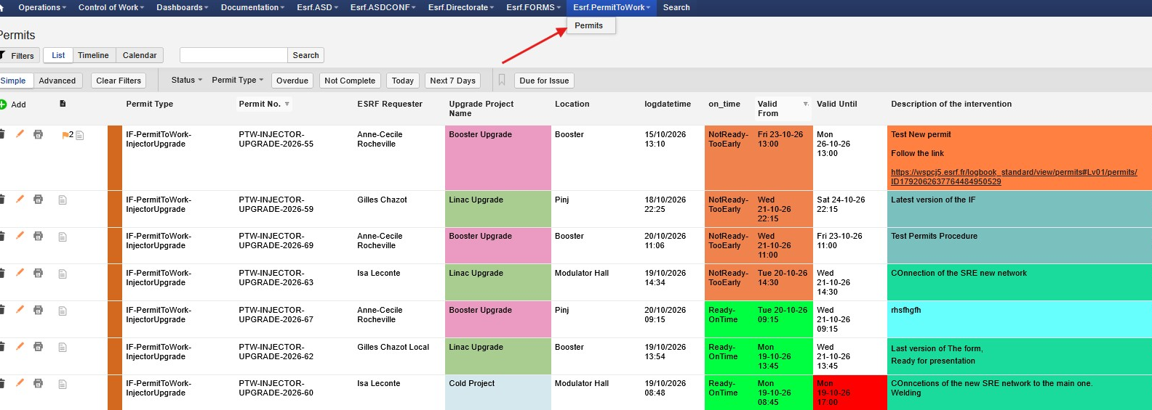
Access to the PTW log pages

Slide 5
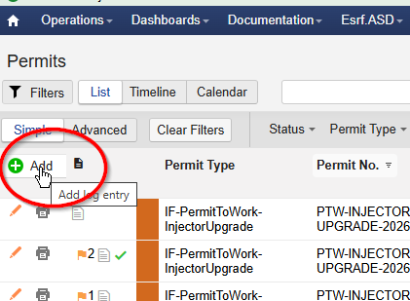
Create a new PTW using Add icon

Slide 6
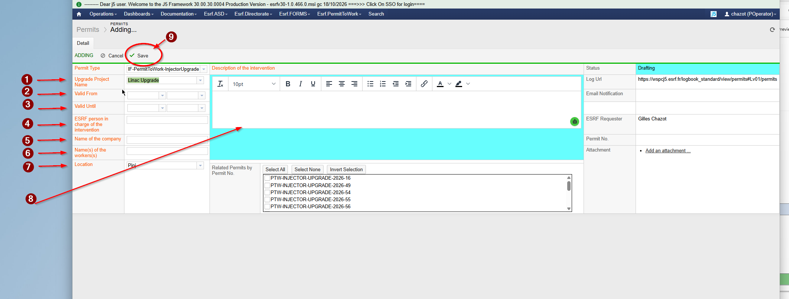
Fill the required fields

Slide 7
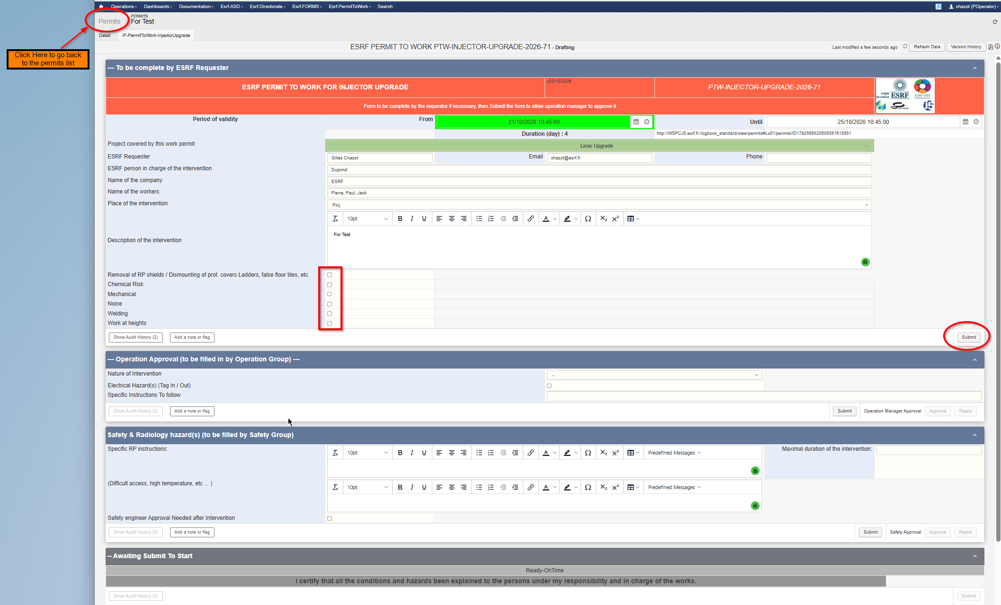
Checks and complete the Created form
Email
Phone number
The potential risks by clicking on the checkbox button :
Removal of RP shields / Dismounting of prot covers
Chemical Risk
Mechanical
Noise
Welding
Work at heights
Click on Submit button to send your request for Operation Manager and Safety approvals
Finally, Click to the Tab permit to return to the permits log main page
Inj-ptw 22/10/2026

Slide 8
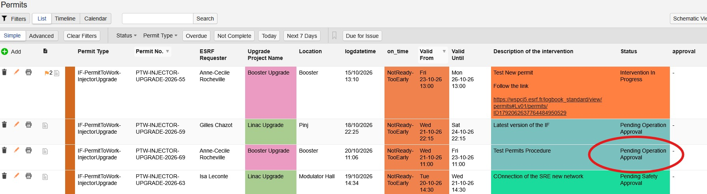
follow your PTW status in general view
Statuses of the PTW :
Drafting
Pending Operation Approval
Pending Safety Approval
Awaiting Start of Intervention
Intervention In Progress
Awaiting End Of Intervention Validation
Complete

Slide 9
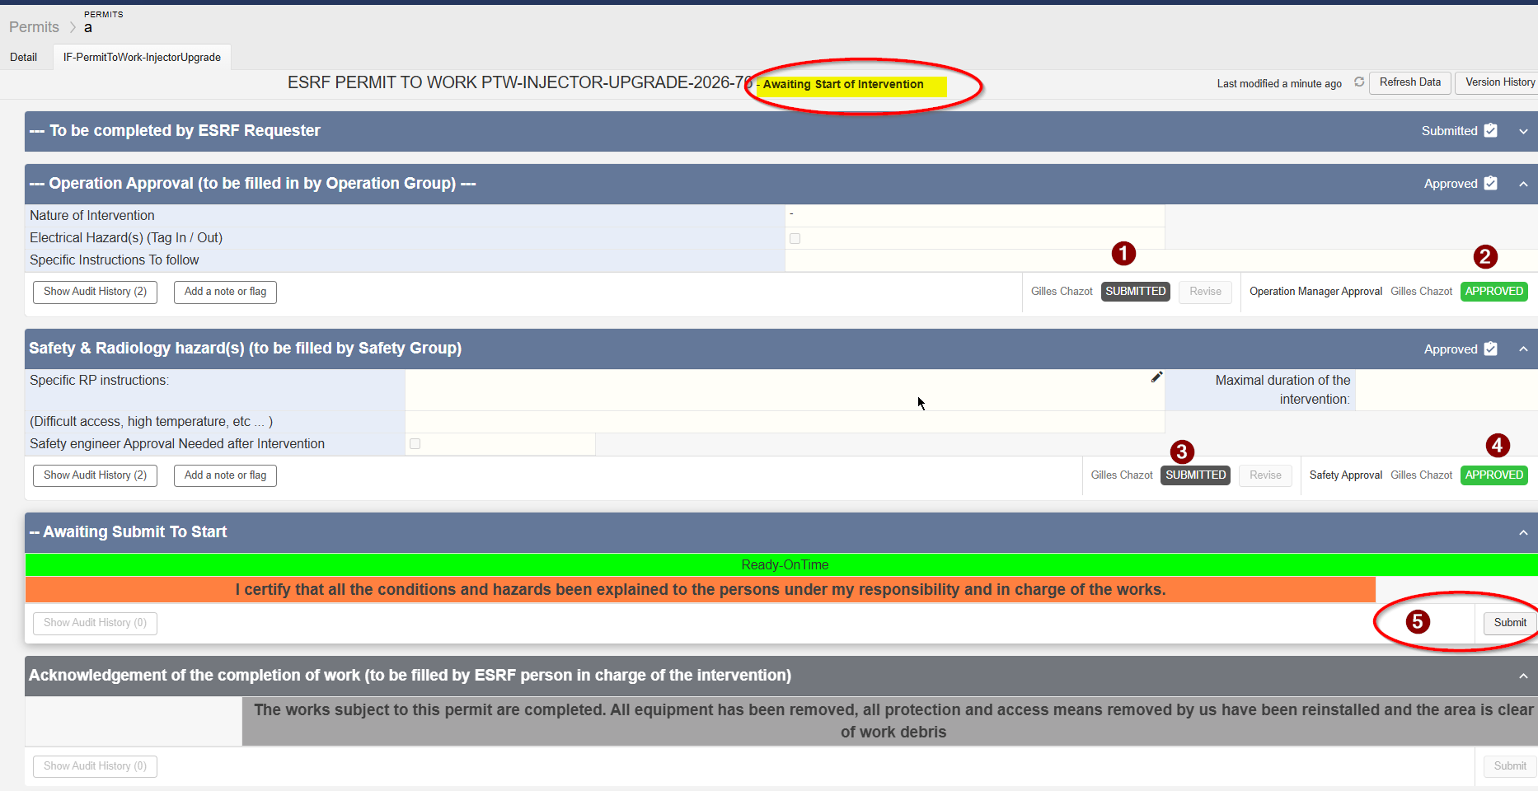
Start of intervention

Slide 10
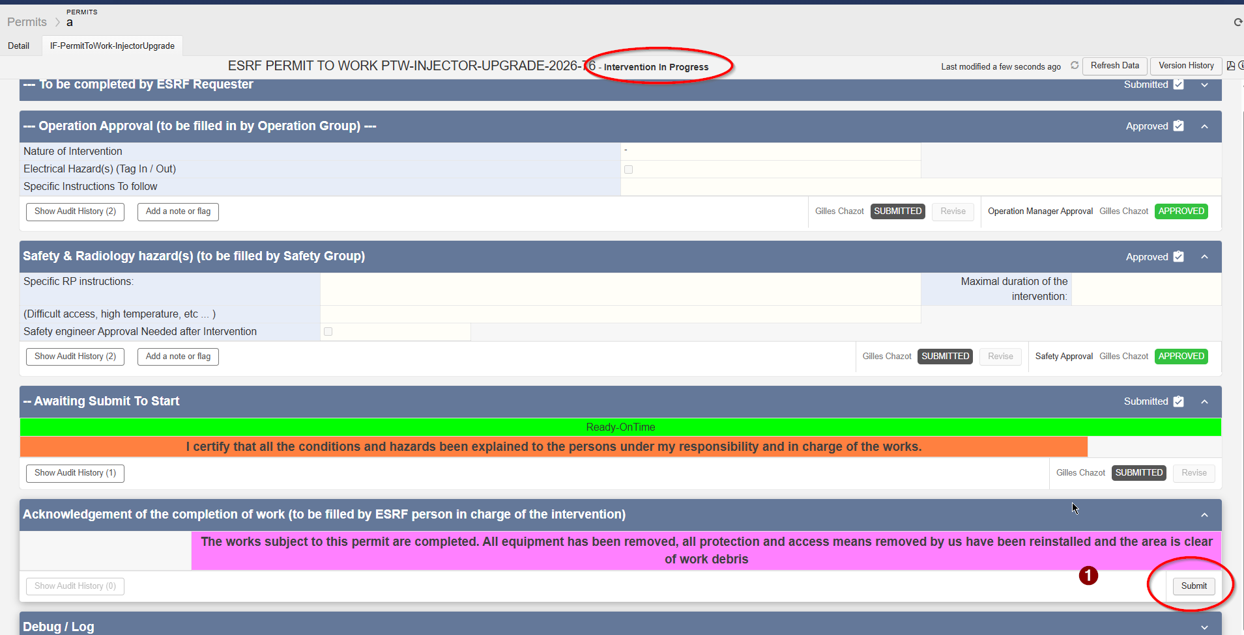
End of intervention

