Slide 1
1/ Review of the tasks performed since last meeting 24th September 2026
2/ Next steps
3/ Specific points addressed during the meeting

Slide 2
1/ Review of the tasks performed since last meeting 24th September 2026
Periods | LINAC upgrade
RUN2026-04 | Modulator0 : Scandinova investigations on site
Oct-26 | Wave guides installed from Mod3 to RI section window
 | Wave guides installed between Mod3 & Mod1

Slide 3
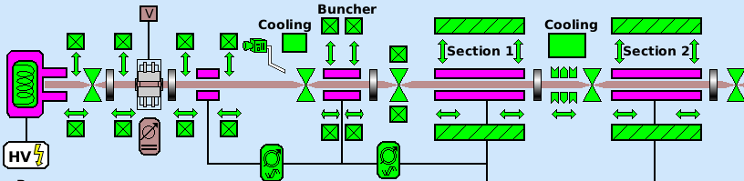
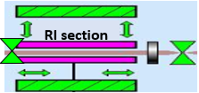
October shutdown : Wave guides connection between Mod1, Mod3 & RI section
LINAC upgrade
Load from Mod0
Modulator 3
Modulator 1
Modulator 2
Status of LINAC upgrade
Modulator0 :
  Connected to SF6 load for conditioning – Waiting for load under vacuum
Modulator3
  Connected to Mod1
  Waiting for the load coming from Mod0
  Waiting for RI coupler to finalize the connection to the RI section
Modulator 0
Load SF6

Slide 4
1/ Review of the tasks performed since last meeting 24th September 2026
Periods | LINAC upgrade | Booster upgrade
RUN2026-04 | Modulator0 : Scandinova investigations on site | Movable gantry certification with APAVE (29/09)
Oct-26 | Waiting for couplers, RI section installed @ its right position | Validation of the movable gantry in the booster
 | Bake-out preparation for RI section
 | water cooling investigations

Slide 5
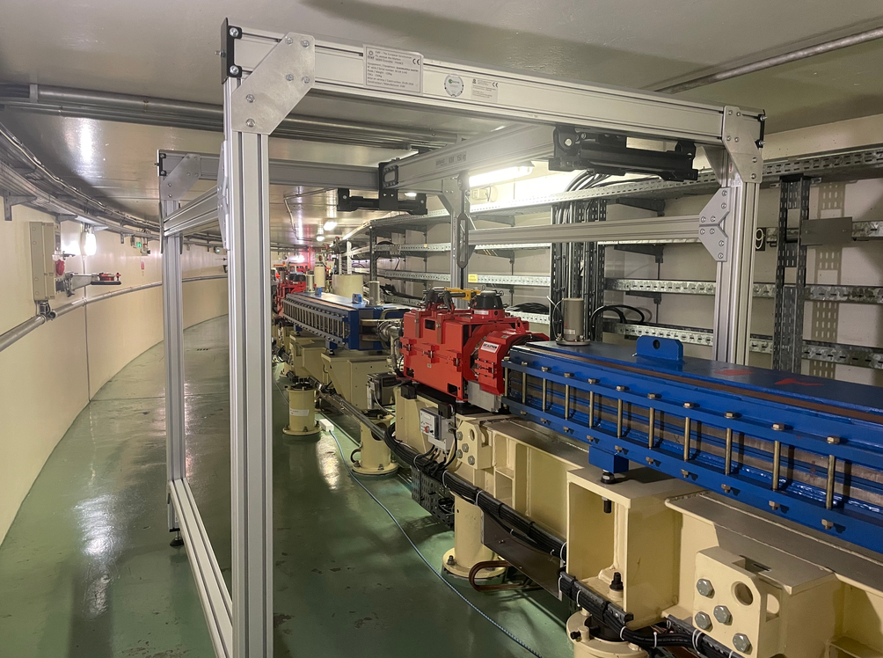
October shutdown : Movable gantry validation
BOOSTER upgrade

Slide 6
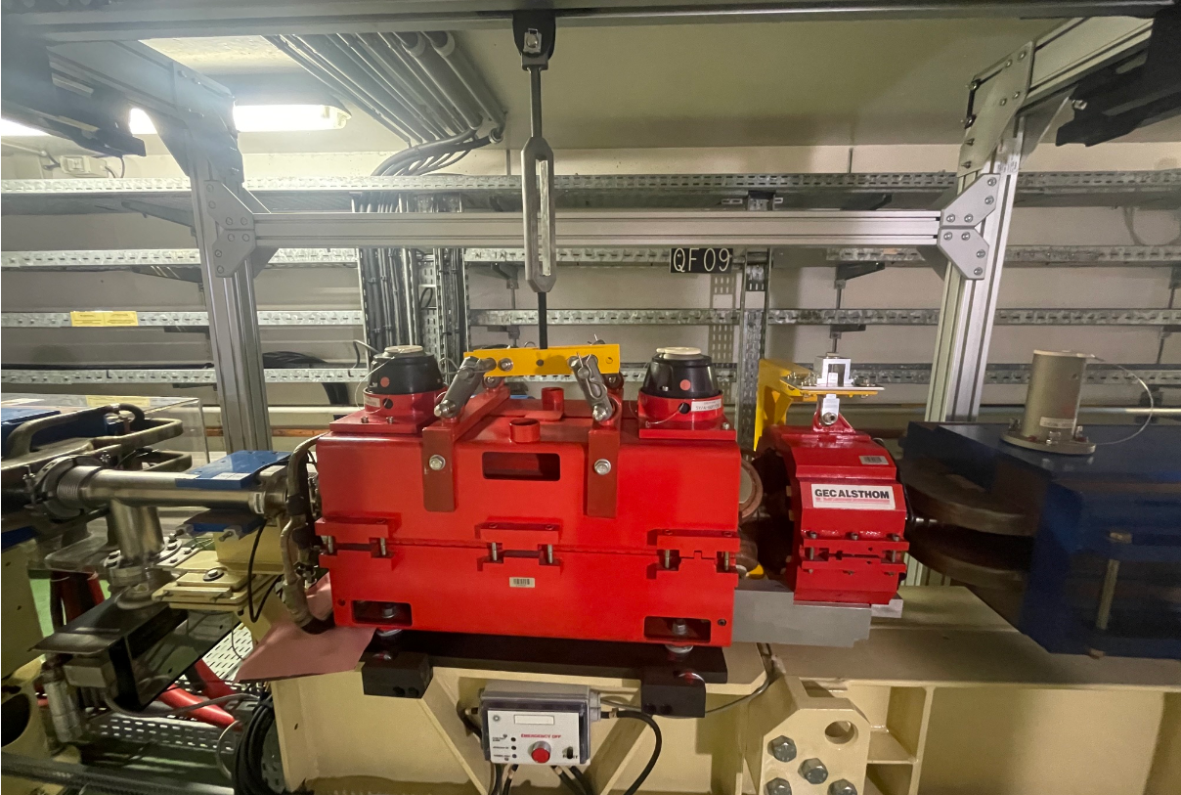
October shutdown : Movable gantry validation
BOOSTER upgrade

Slide 7
1/ Review of the tasks performed since last meeting 24th September 2026
Periods | LINAC upgrade | Booster upgrade | COLD project
RUN2026-04 | Modulator0 : Scandinova investigations on site | Movable gantry certification with APAVE (29/09) | SRE piping installation
 |  |  | cranes’ drawing refused
Oct-26 | Waiting for couplers, RI section installed @ its right position | Validation of the movable gantry in the booster | Earthing of the 2 manholes
 | Bake-out preparation for RI section / wave guides installation |  | Temporary SRE piping connection to the network (19/10)
 | water cooling investigations |  | cranes’ drawing approved

Slide 8
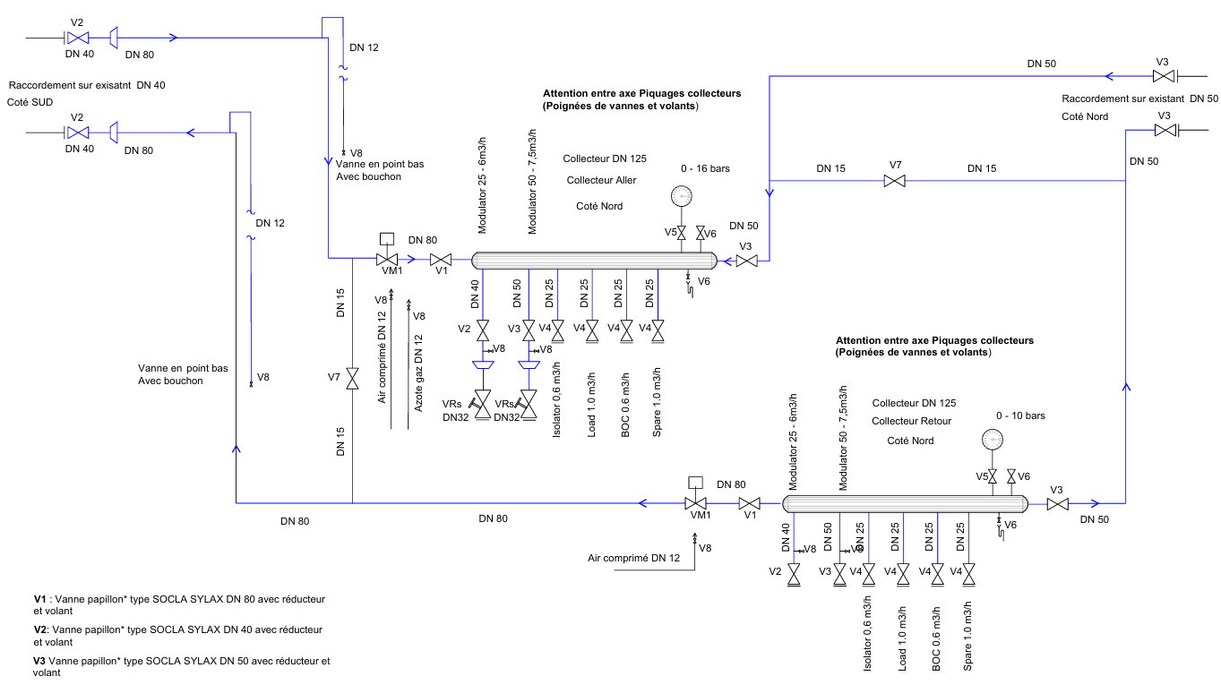
RUN2026-04 : LINAC SRE network extended
COLD project
Main inlet
Backup inlet
Main outlet
Backup outlet
Final connections and put under SRE on 19th October

Slide 9
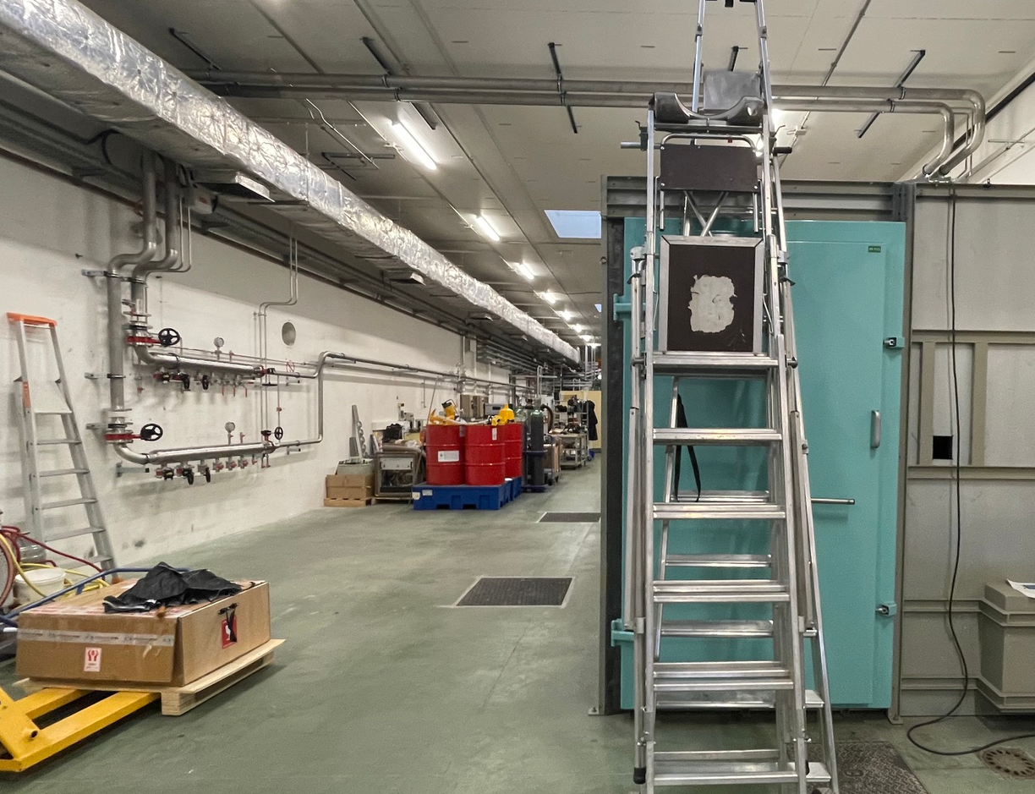
RUN2026-04 : LINAC SRE network extended
COLD project
Main circuits
Back-up circuits

Slide 10
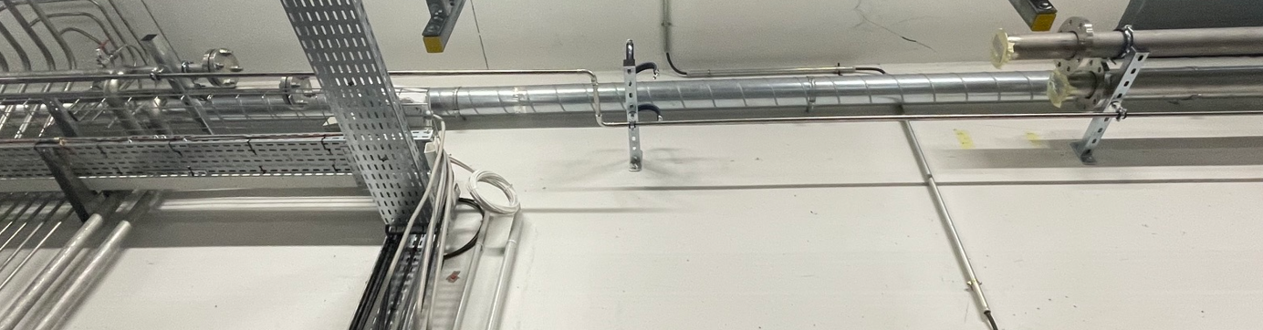
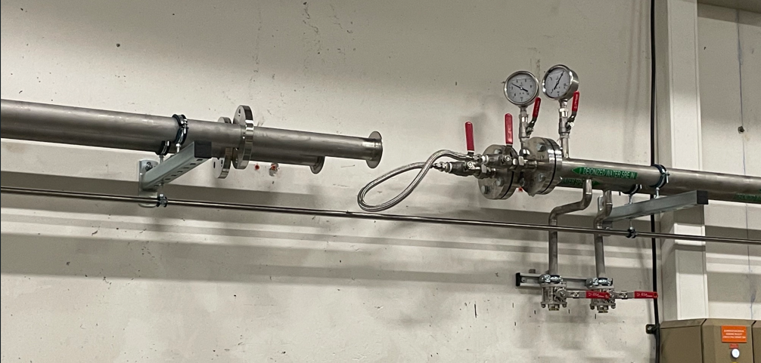
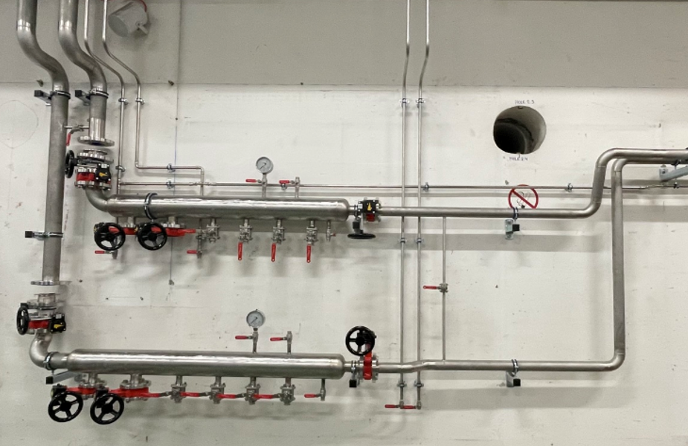
October shutdown : New SRE network connections
COLD project
Existing network
New main network
New back-up network
Existing network

Slide 11
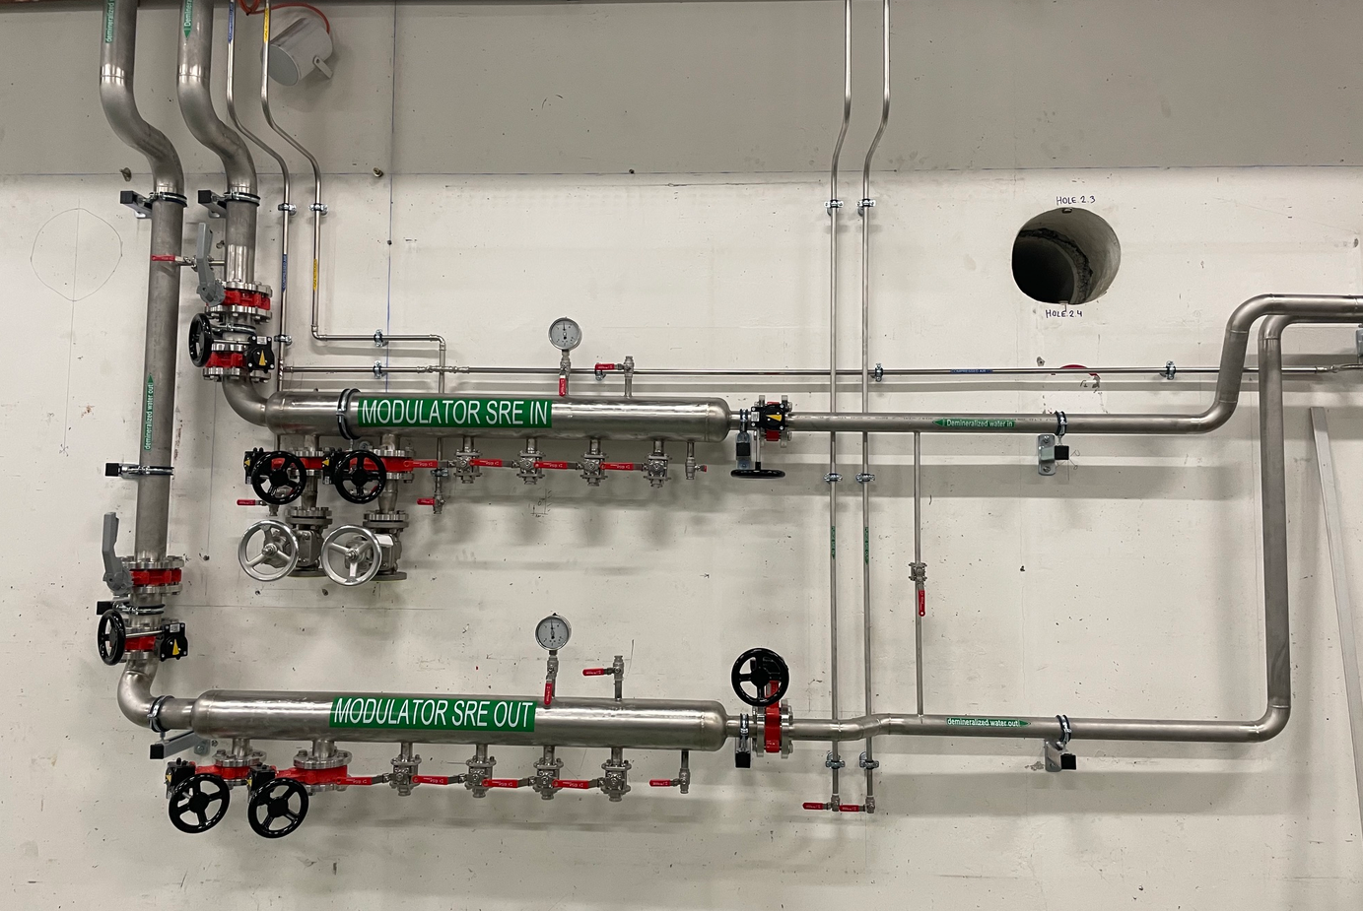
October shutdown : New SRE network connections
COLD project

Slide 12
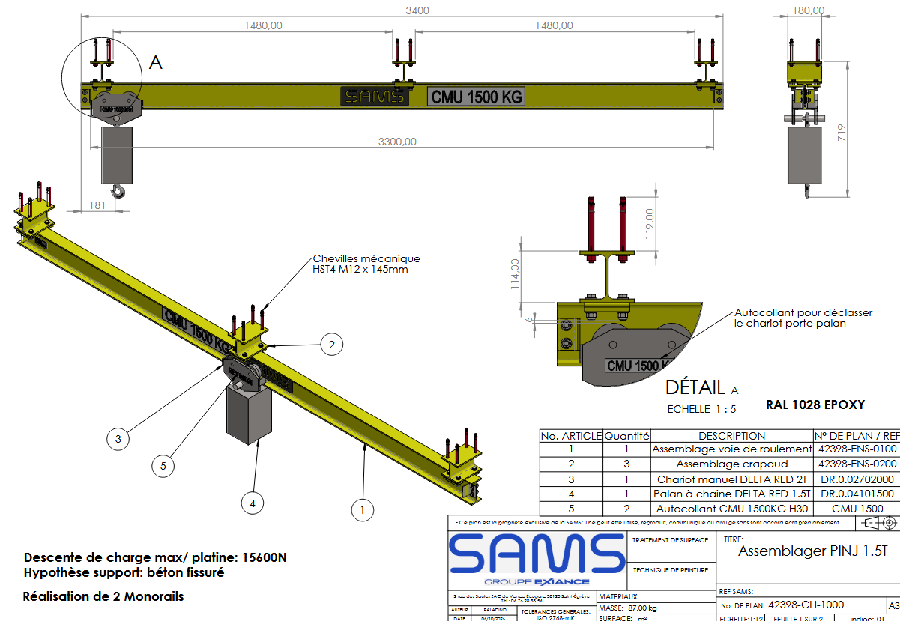
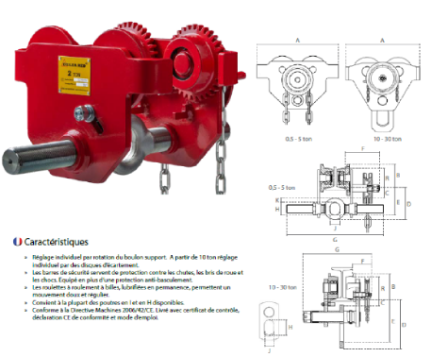
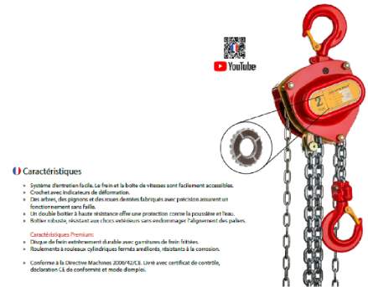
RUN2026-04 : Cranes’ drawing sent for approval – week41
COLD project
Finally approved week42
Installation scheduled week50 - USM

Slide 13
October shutdown : Earthing of the 2 manholes
COLD project

Slide 14
2/ Next steps

Slide 15
2/ Next steps - LINAC upgrade
Periods | LINAC upgrade
RUN2026-05
Winter-26 | Modulator0 on section2 for tests
 | Modulator3 on RI section connection
 | Couplers installation on RI cavity
RUN2027-01 | Tests Modulator3 on RI section
Mar-27
RUN2027-02
May-27
RUN2027-03
Summer-27
Oct-27
Winter-27 | Crane installation for modulator3
Mar-28
May-28
Summer-28
Oct-28

Slide 16
2/ Next steps - BOOSTER upgrade
Periods | LINAC upgrade | Booster upgrade
RUN2026-05
Winter-26 | Modulator0 on section2 for tests | Injection zone : Installation of a dedicated crane
 | Modulator3 on RI section connection | Extraction zone : Removal of the rail
 | Couplers installation on RI cavity
RUN2027-01 | Tests Modulator3 on RI section
Mar-27
RUN2027-02
May-27
RUN2027-03
Summer-27
Oct-27
Winter-27 | Crane installation for modulator3 | Quadrupoles installation
Mar-28
May-28
Summer-28
Oct-28

Slide 17
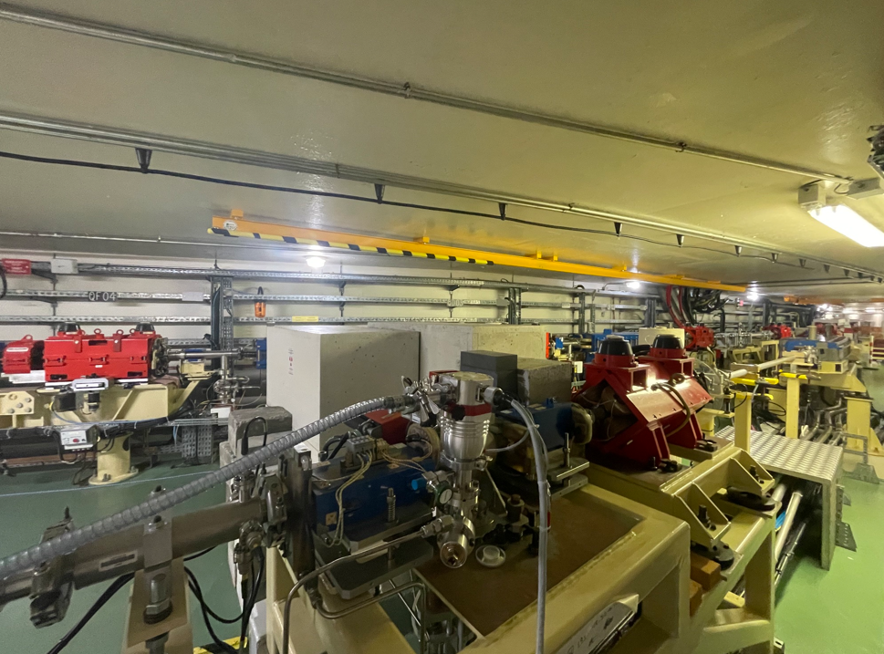
Winter shutdown : Rail removal
BOOSTER upgrade
Extraction zone

Slide 18
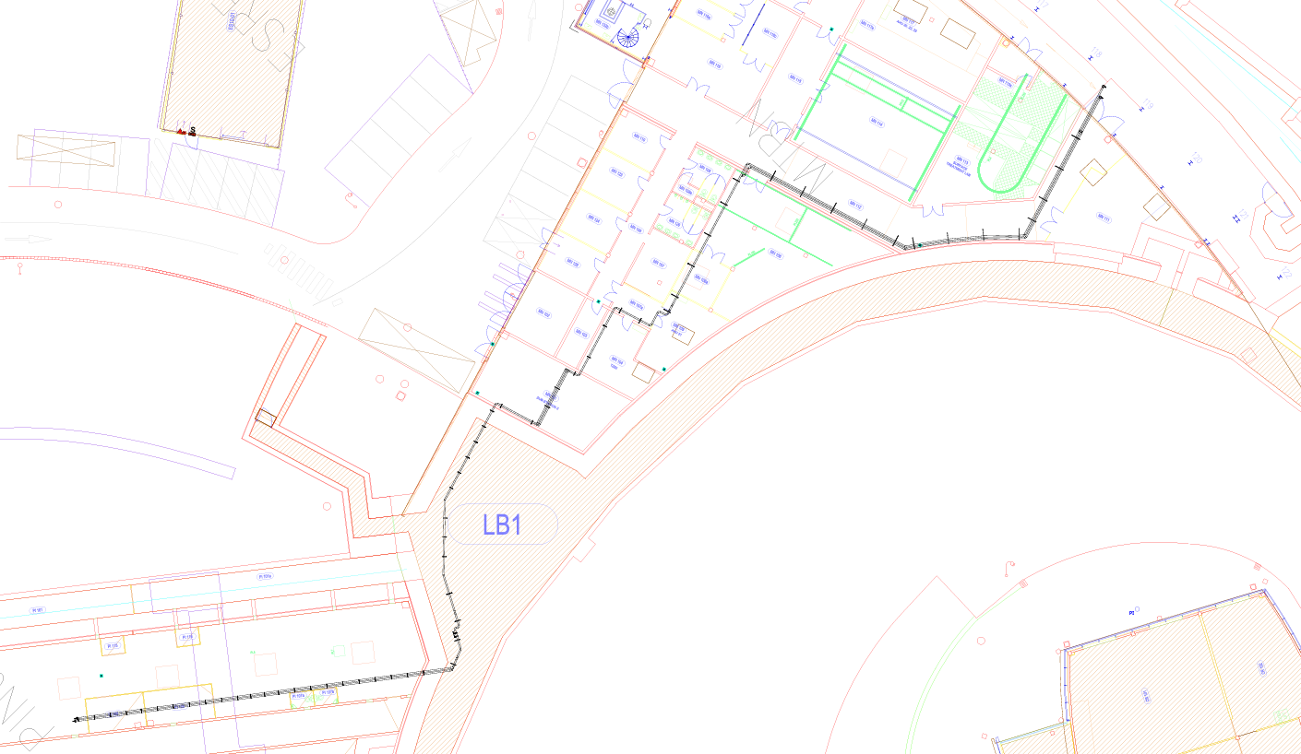
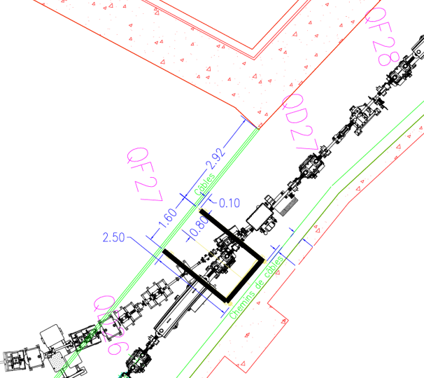
Winter shutdown : Crane installation above QF27
BOOSTER upgrade
MN112
MN107
MN105
MN104
MN101
coring
Acoustic insulation if needed

Slide 19
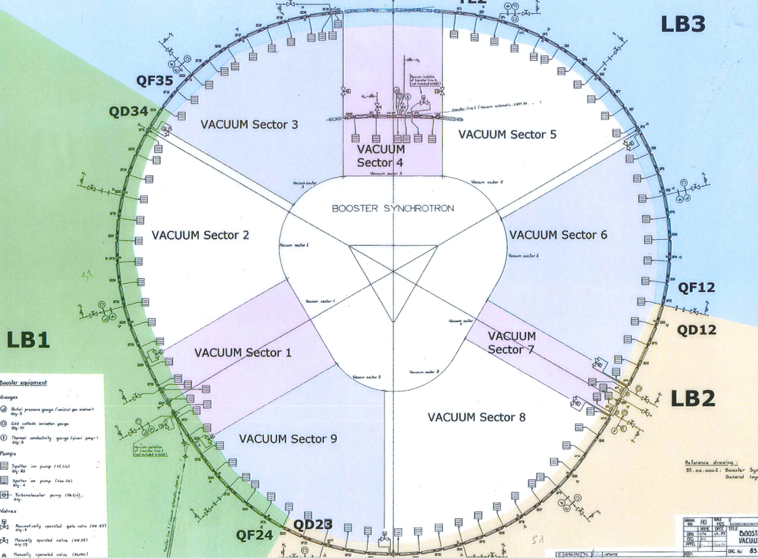
QF38-39-1-2-3-4
TL2
Winter-27 shutdown : 18 QF replacement
QF25-26-27-28-29-30
QF12-13-14-15-16-17
TL1

Slide 20
2/ Next steps - COLD project
Periods | LINAC upgrade | Booster upgrade | COLD project
RUN2026-05 |  |  | Faraday cage removal
 |  |  | Cranes installation (week50)
 |  |  | LN2 drawing available end of October ( Containers removal to be planned)
Winter-26 | Modulator0 on section2 for tests | Injection zone : Installation of a dedicated crane | Civil work : corings in the LINAC wall for
 | Modulator3 on RI section connection | Extraction zone : Removal of the rail | Laser, LN2, SRE, cables, wave guides
 | Couplers installation on RI cavity

Slide 21
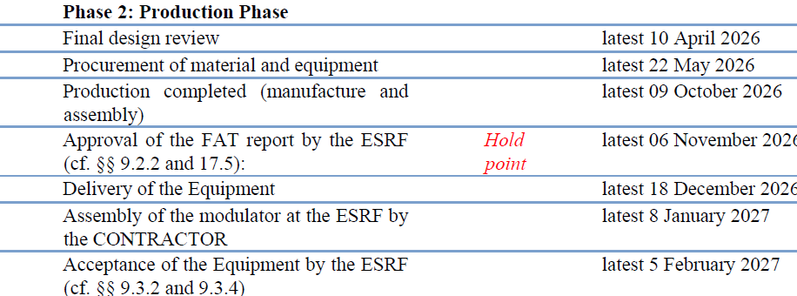
RUN2026-05 : Modulator hall
Oct 2026 |  |  |  | Nov 2026 |  |  |  | Dec 2026 |  |  |  | Jan 2027
Thu 01 | 40 |  |  | Sun 01 |  |  |  | Tue 01 |  |  |  | Fri 01
Fri 02 |  |  |  | Mon 02 | M | M | M | Wed 02 |  |  |  | Sat 02
Sat 03 |  |  |  | Tue 03 |  |  |  | Thu 03 | 49 |  |  | Sun 03
Sun 04 |  |  |  | Wed 04 |  |  |  | Fri 04 |  |  |  | Mon 04
Mon 05 | M | M | M | Thu 05 | 45 |  |  | Sat 05 |  |  |  | Tue 05 | s | s | s
Tue 06 |  |  |  | Fri 06 |  |  |  | Sun 06 |  |  |  | Wed 06 | s | s | s
Wed 07 |  |  |  | Sat 07 |  |  |  | Mon 07 |  |  |  | Thu 07 | 01
Thu 08 | 41 |  |  | Sun 08 |  |  |  | Tue 08 | M | M | M | Fri 08 | s | s | s
Fri 09 |  |  |  | Mon 09 | M | M | M | Wed 09 |  |  |  | Sat 09 | s | s | s
Sat 10 |  |  |  | Tue 10 |  |  |  | Thu 10 | 50 |  |  | Sun 10 | s | s | s
Sun 11 |  |  |  | Wed 11 |  |  |  | Fri 11 |  |  |  | Mon 11 | s | s | s
Mon 12 |  |  |  | Thu 12 | 46 |  |  | Sat 12 |  |  |  | Tue 12 | s | s | s
Tue 13 | s | s | s | Fri 13 |  |  |  | Sun 13 |  |  |  | Wed 13 | s | s | s
Wed 14 | s | s | s | Sat 14 |  |  |  | Mon 14 |  |  |  | Thu 14 | 02
Thu 15 | 42 |  |  | Sun 15 |  |  |  | Tue 15 |  |  |  | Fri 15 | M | M | M
Fri 16 | s | s | s | Mon 16 | M | M | M | Wed 16 |  |  |  | Sat 16 | M | M | M
Sat 17 | s | s | s | Tue 17 |  |  |  | Thu 17 | 51 |  |  | Sun 17 | M | M | M
Sun 18 | s | s | s | Wed 18 |  |  |  | Fri 18 | s | s | s | Mon 18 | M | M | M
Mon 19 | s | s | s | Thu 19 | 47 |  |  | Sat 19 | s | s | s | Tue 19
Tue 20 | s | s | s | Fri 20 |  |  |  | Sun 20 | s | s | s | Wed 20
Wed 21 | s | s | s | Sat 21 |  |  |  | Mon 21 | s | s | s | Thu 21 | 03
Thu 22 | 43 |  |  | Sun 22 |  |  |  | Tue 22 | s | s | s | Fri 22
Fri 23 | M | M | M | Mon 23 | M | M | M | Wed 23 | s | s | s | Sat 23
Sat 24 | M | M | M | Tue 24 |  |  |  | Thu 24 | 52 |  |  | Sun 24
Sun 25 | M | M | M | Wed 25 |  |  |  | Fri 25 |  |  |  | Mon 25 | M | M | M
Mon 26 | M | M | M | Thu 26 | 48 |  |  | Sat 26 |  |  |  | Tue 26
Tue 27 |  |  |  | Fri 27 |  |  |  | Sun 27 |  |  |  | Wed 27
Wed 28 |  |  |  | Sat 28 |  |  |  | Mon 28 |  |  |  | Thu 28 | 04
Thu 29 | 44 |  |  | Sun 29 |  |  |  | Tue 29 |  |  |  | Fri 29
Fri 30 |  |  |  | Mon 30 | M | M | M | Wed 30 |  |  |  | Sat 30
Sat 31 |  |  |  |  |  |  |  | Thu 31 |  |  |  | Sun 31
COLD project
Week41 => S-band production completed
Week42 => cranes’ drawing approved
Week45 => Faraday cage removal
Week 46 => Safe corridor installation
Week48 => FAT of S-band
Week50 => Cranes installation
Week51 => S-band delivery (< 18/12/2026)
Week01 => Assembly of modulator (<08/01/2027)
Week05 : SAT (<05/02/2027)
W41
W45
W51
W01
W05

Slide 22
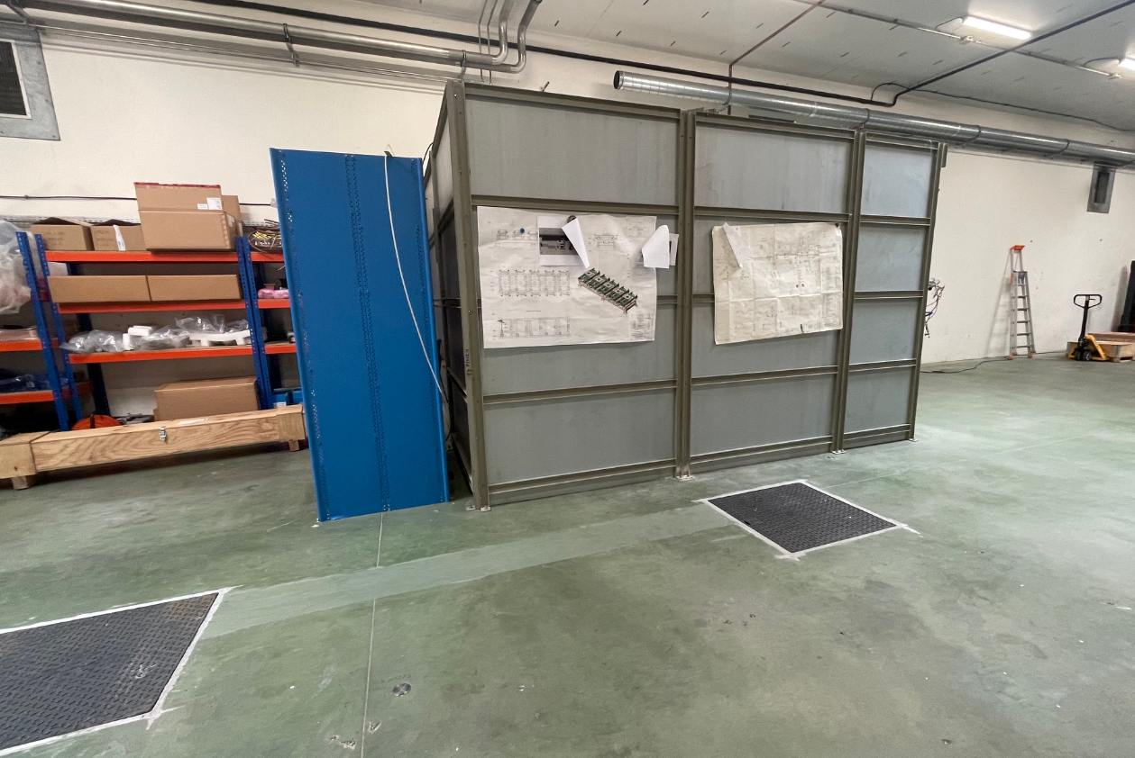
Week45 : Removal of the Faraday cage => Protection of the resin ?
Large groove with resin, potentially damaged during the removal ????

Slide 23
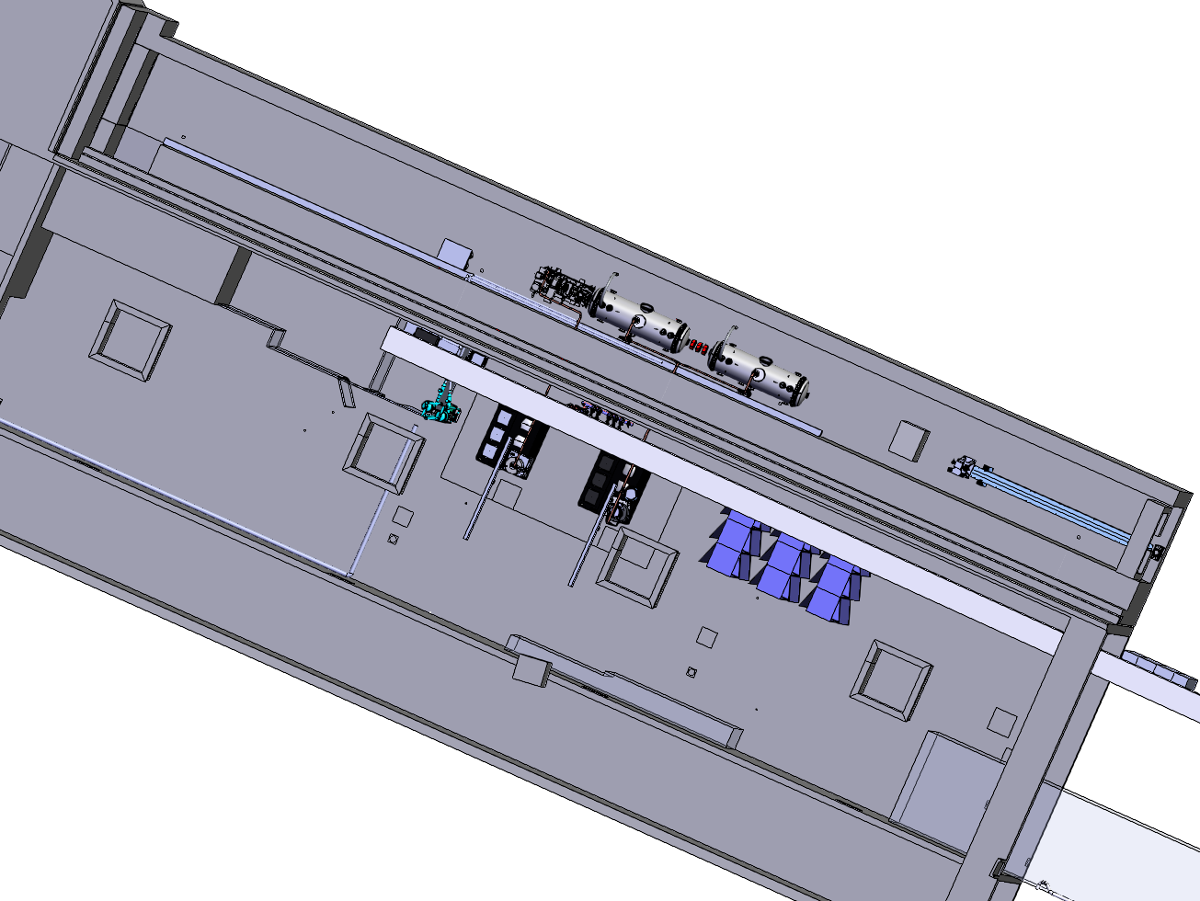
Week46 : Safe corridor implementation
Safe corridor to access to the LINAC CTRM

Slide 24
Winter shutdown 2026 : Civil work
COLD project
 |  |  | COLD project
 |  | Mode | Modulator hall |  |  | PINJ (Tunnel)
Mon | 14-Dec | USM
Tues | 15-Dec |  | Confinement in the modulator hall
Wed | 16-Dec |  | Confinement in the modulator hall
Thurs | 17-Dec | SD |  |  |  |  | HLS removal | (1/2day)
Fri | 18-Dec |  | S-band | delivery
Sat | 19-Dec
Sun | 20-Dec
Mon | 21-Dec
Tues | 22-Dec
Wed | 23-Dec
Tues | 05-Jan
Wed | 06-Jan |  | Buffer for coring |  |  | HLS | back (1/2day)
Thurs | 07-Jan |  | Buffer for coring
Fri | 08-Jan
Sat | 09-Jan
Sun | 10-Jan
Mon | 11-Jan | Booster
Tues | 12-Jan | restart
Wed | 13-Jan
Thurs | 14-Jan | Restart
Fri | 15-Jan
Sat | 16-Jan
Sun | 17-Jan
Mon | 18-Jan
Tues | 19-Jan | USM
Wed | 20-Jan
2026
Coring :
  1 wave guide diam 250mm
  1 cables diam 250mm
  1 LN2 diam 250mm
  1 Laser diam 100mm
  1 water cooling diam 250mm
2027

Slide 25
Winter shutdown 2026 : Civil work
COLD project
 |  |  | COLD project |  |  |  |  |  | LINAC upgrade
 |  | Mode | Modulator hall |  |  | PINJ (Tunnel) |  |  | Modulator hall |  |  | PINJ (Tunnel)
Mon | 14-Dec | USM |  |  |  |  |  |  |  |  |  |  |  |  | 14-Dec | Mon
Tues | 15-Dec |  | Confinement in the modulator hall |  |  |  |  |  |  |  |  |  |  |  | 15-Dec | Tues
Wed | 16-Dec |  | Confinement in the modulator hall |  |  |  |  |  |  |  |  |  |  |  | 16-Dec | Wed
Thurs | 17-Dec | SD |  |  |  |  | HLS removal | (1/2day) |  |  |  |  | HLS removal | (1/2d) | 17-Dec | Thurs
Fri | 18-Dec |  | S-band | delivery | elsewhere |  |  |  |  |  |  |  |  |  | 18-Dec | Fri
Sat | 19-Dec |  |  |  |  |  |  |  |  |  |  |  |  |  | 19-Dec | Sat
Sun | 20-Dec |  |  |  |  |  |  |  |  |  |  |  |  |  | 20-Dec | Sun
Mon | 21-Dec |  |  |  |  |  |  |  |  |  |  |  |  |  | 21-Dec | Mon
Tues | 22-Dec |  |  |  |  |  |  |  |  |  |  |  |  |  | 22-Dec | Tues
Wed | 23-Dec |  |  |  |  |  |  |  |  |  |  |  |  |  | 23-Dec | Wed
Tues | 05-Jan |  |  |  |  |  |  |  |  |  |  |  |  |  | 05-Jan | Tues
Wed | 06-Jan |  | Buffer for coring |  |  | HLS | back (1/2day) |  | Modulator0 on section2 for tests |  |  | HLS back (1/2d) |  |  | 06-Jan | Wed
Thurs | 07-Jan |  | Buffer for coring |  |  |  |  |  | Modulator3 on RI section ready |  |  | Couplers installation on RI section |  |  | 07-Jan | Thurs
Fri | 08-Jan |  |  |  |  |  |  |  |  |  |  |  |  |  | 08-Jan | Fri
Sat | 09-Jan |  |  |  |  |  |  |  |  |  |  |  |  |  | 09-Jan | Sat
Sun | 10-Jan |  |  |  |  |  |  |  |  |  |  |  |  |  | 10-Jan | Sun
Mon | 11-Jan | Booster |  |  |  |  |  |  |  |  |  |  |  |  | 11-Jan | Mon
Tues | 12-Jan | restart |  |  |  |  |  |  |  |  |  |  |  |  | 12-Jan | Tues
Wed | 13-Jan |  |  |  |  |  |  |  |  |  |  |  |  |  | 13-Jan | Wed
Thurs | 14-Jan | Restart |  |  |  |  |  |  |  |  |  |  |  |  | 14-Jan | Thurs
Fri | 15-Jan |  |  |  |  |  |  |  |  |  |  |  |  |  | 15-Jan | Fri
Sat | 16-Jan |  |  |  |  |  |  |  |  |  |  |  |  |  | 16-Jan | Sat
Sun | 17-Jan |  |  |  |  |  |  |  |  |  |  |  |  |  | 17-Jan | Sun
Mon | 18-Jan |  |  |  |  |  |  |  |  |  |  |  |  |  | 18-Jan | Mon
Tues | 19-Jan | USM |  |  |  |  |  |  |  |  |  |  |  |  | 19-Jan | Tues
Wed | 20-Jan |  |  |  |  |  |  |  |  |  |  |  |  |  | 20-Jan | Wed
2026
Coring :
  1 wave guide diam 250mm
  1 cables diam 250mm
  1 LN2 diam 250mm
  1 Laser diam 100mm
  1 water cooling diam 250mm
Noisy work
2027

Slide 26
Winter shutdown 2026 : Civil work
COLD project
 |  |  | COLD project |  |  |  |  |  | LINAC upgrade
 |  | Mode | Modulator hall |  |  | PINJ (Tunnel) |  |  | Modulator hall |  |  | PINJ (Tunnel)
Mon | 14-Dec | USM |  |  |  |  |  |  |  |  |  |  |  |  | 14-Dec | Mon
Tues | 15-Dec |  | Confinement in the modulator hall |  |  |  |  |  |  |  |  |  |  |  | 15-Dec | Tues
Wed | 16-Dec |  | Confinement in the modulator hall |  |  |  |  |  |  |  |  |  |  |  | 16-Dec | Wed
Thurs | 17-Dec | SD |  |  |  |  | HLS removal | (1/2day) |  |  |  |  | HLS removal | (1/2d) | 17-Dec | Thurs
Fri | 18-Dec |  | S-band | delivery |  |  |  |  |  |  |  |  |  |  | 18-Dec | Fri
Sat | 19-Dec |  |  |  |  |  |  |  |  |  |  |  |  |  | 19-Dec | Sat
Sun | 20-Dec |  |  |  |  |  |  |  |  |  |  |  |  |  | 20-Dec | Sun
Mon | 21-Dec |  |  |  |  |  |  |  |  |  |  |  |  |  | 21-Dec | Mon
Tues | 22-Dec |  |  |  |  |  |  |  |  |  |  |  |  |  | 22-Dec | Tues
Wed | 23-Dec |  |  |  |  |  |  |  |  |  |  |  |  |  | 23-Dec | Wed
Tues | 05-Jan |  |  |  |  |  |  |  |  |  |  |  |  |  | 05-Jan | Tues
Wed | 06-Jan |  | Coring |  |  |  |  |  | Modulator0 on section2 for tests |  |  |  |  |  | 06-Jan | Wed
Thurs | 07-Jan |  | Coring |  |  |  |  |  | Modulator3 on RI section ready |  |  | Couplers installation on RI section |  |  | 07-Jan | Thurs
Fri | 08-Jan |  |  |  |  | HLS | back (1/2day) |  |  |  |  | HLS | back (1/2d) |  | 08-Jan | Fri
Sat | 09-Jan |  |  |  |  |  |  |  |  |  |  |  |  |  | 09-Jan | Sat
Sun | 10-Jan |  |  |  |  |  |  |  |  |  |  |  |  |  | 10-Jan | Sun
Mon | 11-Jan | Booster |  |  |  |  |  |  |  |  |  |  |  |  | 11-Jan | Mon
Tues | 12-Jan | restart |  |  |  |  |  |  |  |  |  |  |  |  | 12-Jan | Tues
Wed | 13-Jan |  |  |  |  |  |  |  |  |  |  |  |  |  | 13-Jan | Wed
Thurs | 14-Jan | Restart |  |  |  |  |  |  |  |  |  |  |  |  | 14-Jan | Thurs
Fri | 15-Jan |  |  |  |  |  |  |  |  |  |  |  |  |  | 15-Jan | Fri
Sat | 16-Jan |  |  |  |  |  |  |  |  |  |  |  |  |  | 16-Jan | Sat
Sun | 17-Jan |  |  |  |  |  |  |  |  |  |  |  |  |  | 17-Jan | Sun
Mon | 18-Jan |  |  |  |  |  |  |  |  |  |  |  |  |  | 18-Jan | Mon
Tues | 19-Jan | USM |  |  |  |  |  |  |  |  |  |  |  |  | 19-Jan | Tues
Wed | 20-Jan |  |  |  |  |  |  |  |  |  |  |  |  |  | 20-Jan | Wed
2026
Coring :
  1 wave guide diam 250mm
  1 cables diam 250mm
  1 LN2 diam 250mm
  1 Laser diam 100mm
  1 water cooling diam 250mm
Noisy work
2027
?
?

Slide 27
2/ INJECTOR UPGRADE : Next steps - COLD project
Periods | LINAC upgrade | Booster upgrade | COLD project
RUN2026-05 |  |  | Faraday cage removal
 |  |  | Cranes installation (week50)
 |  |  | LN2 drawing available end of October ( Containers removal to be planned)
Winter-26 | Modulator0 on section2 for tests | Injection zone : Installation of a dedicated crane | Civil work : corings in the LINAC wall for
 | Modulator3 on RI section connection | Extraction zone : Removal of the rail | Laser, LN2, SRE, cables, wave guides
 | Couplers installation on RI cavity
RUN2027-01 | Tests Modulator3 on RI section
Mar-27
RUN2027-02
May-27
RUN2027-03
Summer-27
Oct-27
Winter-27 | Crane installation for modulator3 | Quadrupoles installation
Mar-28
May-28
Summer-28
Oct-28

Slide 28
2/ INJECTOR UPGRADE : Next steps - COLD project
Periods | LINAC upgrade | Booster upgrade | COLD project
RUN2026-05 |  |  | Faraday cage removal
 |  |  | Cranes installation (week50)
 |  |  | LN2 drawing available end of October ( Containers removal to be planned)
Winter-26 | Modulator0 on section2 for tests | Injection zone : Installation of a dedicated crane | Civil work : corings in the LINAC wall for
 | Modulator3 on RI section connection | Extraction zone : Removal of the rail | Laser, LN2, SRE, cables, wave guides
 | Couplers installation on RI cavity
RUN2027-01 | Tests Modulator3 on RI section |  | S-band RF-unit installation => SAT / Cable trays installation for electrical cubicles
Mar-27
RUN2027-02
May-27
RUN2027-03
Summer-27
Oct-27
Winter-27 | Crane installation for modulator3 | Quadrupoles installation
Mar-28
May-28
Summer-28
Oct-28

Slide 29
2/ INJECTOR UPGRADE : Next steps - COLD project
Periods | LINAC upgrade | Booster upgrade | COLD project
RUN2026-05 |  |  | Faraday cage removal
 |  |  | Cranes installation (week50)
 |  |  | LN2 drawing available end of October ( Containers removal to be planned)
Winter-26 | Modulator0 on section2 for tests | Injection zone : Installation of a dedicated crane | Civil work : corings in the LINAC wall for
 | Modulator3 on RI section connection | Extraction zone : Removal of the rail | Laser, LN2, SRE, cables, wave guides
 | Couplers installation on RI cavity
RUN2027-01 | Tests Modulator3 on RI section |  | S-band RF-unit installation => SAT // Cable trays installation for electrical cubicles
Mar-27 |  |  | LN2 : Slab construction (outside work)
 |  |  | 4 coring in TL1 position - May for completion if needed
RUN2027-02
May-27
RUN2027-03
Summer-27
Oct-27
Winter-27 | Crane installation for modulator3 | Quadrupoles installation
Mar-28
May-28
Summer-28
Oct-28

Slide 30
SRE network implementation : CORING
COLD project
TZ
MN112
MN107
MN105
MN104
March-27
7
MN101
PINJ
8
Modulator hall

Slide 31
2/ INJECTOR UPGRADE : Next steps - COLD project
Periods | LINAC upgrade | Booster upgrade | COLD project
RUN2026-05 |  |  | Faraday cage removal
 |  |  | Cranes installation (week50)
 |  |  | LN2 drawing available end of October ( Containers removal to be planned)
Winter-26 | Modulator0 on section2 for tests | Injection zone : Installation of a dedicated crane | Civil work : corings in the LINAC wall for
 | Modulator3 on RI section connection | Extraction zone : Removal of the rail | Laser, LN2, SRE, cables, wave guides
 | Couplers installation on RI cavity
RUN2027-01 | Tests Modulator3 on RI section |  | S-band RF-unit installation => SAT / Cable trays installation for electrical cubicles
Mar-27 |  |  | LN2 : Slab construction (outside work)
 |  |  | 4 coring in TL1 position - May for completion if needed
RUN2027-02 |  |  | LN2 : tank installation + protection + Electrical cabinet installation (outside work)
May-27 |  |  | 8 coring in MTBN (TZ-MN104))
RUN2027-03
Summer-27
Oct-27
Winter-27 | Crane installation for modulator3 | Quadrupoles installation
Mar-28
May-28
Summer-28
Oct-28

Slide 32
SRE network implementation : CORING
COLD project
1
TZ
2
MN112
3
MN107
MN105
4
MN104
May-27
7
MN101
PINJ
8
Modulator hall

Slide 33
2/ INJECTOR UPGRADE : Next steps - COLD project
Periods | LINAC upgrade | Booster upgrade | COLD project
RUN2026-05 |  |  | Faraday cage removal
 |  |  | Cranes installation (week50)
 |  |  | LN2 drawing available end of October ( Containers removal to be planned)
Winter-26 | Modulator0 on section2 for tests | Injection zone : Installation of a dedicated crane | Civil work : corings in the LINAC wall for
 | Modulator3 on RI section connection | Extraction zone : Removal of the rail | Laser, LN2, SRE, cables, wave guides
 | Couplers installation on RI cavity
RUN2027-01 | Tests Modulator3 on RI section |  | S-band RF-unit installation => SAT / Cable trays installation for electrical cubicles
Mar-27 |  |  | LN2 : Slab construction (outside work)
 |  |  | 4 coring in TL1 position - May for completion if needed
RUN2027-02 |  |  | LN2 : tank installation + protection + Electrical cabinet installation (outside work)
May-27 |  |  | 8 coring in MTBN (TZ-MN104))
RUN2027-03 |  |  | LN2 : Installation of prefabricated piping and cryogenic systems
 |  |  | LN2 : Electrical works
Summer-27 |  |  | SRE piping Booster phase1 & 2
 |  |  | 4 coring in MTBN (MN01-MN107)
 |  |  | LN2 : Commissioning of the cryogenic installation
 |  |  | SLAC's cryomodule installation => Concrete door opening
 |  |  | C-band RF-unit installation
 |  |  | Waveguides installation
Oct-27
Winter-27 | Crane installation for modulator3 | Quadrupoles installation
Mar-28
May-28
Summer-28
Oct-28

Slide 34
SRE network implementation : CORING
COLD project
1
TZ
2
MN112
3
MN107
MN105
5
4
6
MN104
Summer-27
7
MN101
PINJ
8
Modulator hall

Slide 35
SRE network implementation : PIPING
COLD project
1
TZ
2
MN112
3
MN107
MN105
5
4
6
MN104
7
MN101
Summer-27 : Phase1 (TL1) & 2 (MTBN)
PINJ
8
Modulator hall

Slide 36
2/ INJECTOR UPGRADE : Next steps - COLD project
Periods | LINAC upgrade | Booster upgrade | COLD project
RUN2026-05 |  |  | Faraday cage removal
 |  |  | Cranes installation (week50)
 |  |  | LN2 drawing available end of October ( Containers removal to be planned)
Winter-26 | Modulator0 on section2 for tests | Injection zone : Installation of a dedicated crane | Civil work : corings in the LINAC wall for
 | Modulator3 on RI section connection | Extraction zone : Removal of the rail | Laser, LN2, SRE, cables, wave guides
 | Couplers installation on RI cavity
RUN2027-01 | Tests Modulator3 on RI section |  | S-band RF-unit installation => SAT / Cable trays installation for electrical cubicles
Mar-27 |  |  | LN2 : Slab construction (outside work)
 |  |  | 4 coring in TL1 position - May for completion if needed
RUN2027-02 |  |  | LN2 : tank installation + protection + Electrical cabinet installation (outside work)
May-27 |  |  | 8 coring in MTBN (TZ-MN104))
RUN2027-03 |  |  | LN2 : Installation of prefabricated piping and cryogenic systems
 |  |  | LN2 : Electrical works
Summer-27 |  |  | SRE piping Booster phase1 & 2
 |  |  | 4 coring in MTBN (MN01-MN107)
 |  |  | LN2 : Commissioning of the cryogenic installation
 |  |  | SLAC's cryomodule installation => Concrete door opening
 |  |  | C-band RF-unit installation
 |  |  | Waveguides installation
Oct-27 |  |  | C-band RF distribution and LLRF
 |  |  | LN2 distribution ?????
Winter-27 | Crane installation for modulator3 | Quadrupoles installation | SRE piping MTBN phase3
Mar-28
May-28
Summer-28 |  |  | SRE piping phase4
Oct-28 |  |  | SRE : General test

Slide 37
SRE network implementation : PIPING
COLD project
1
TZ
2
MN112
3
MN107
MN105
5
4
6
MN104
7
MN101
Winter-27 : Phase3
Summer-28 : Phase4
October-28 : General test under water
PINJ
8
Modulator hall

Slide 38
3/ Specific points addressed during the meeting

Slide 39
3/ Specific points addressed during the meeting :
LN2 drawing available, end of October, plan the removal of X containers before 30 March 2027 => Who in charge ?
Ordering of electrical cubicles in November 2026, the detailed list is defined (20/10/2026)
For the Faraday cage removal, protection of the resin between the 2 manholes ? If yes, Operation in charge
Faraday cage removed, creation of a safe passage ( week46) to secure the access to the LINAC CTRM while works are in progress in the COLD area => Safety & MEG.
Delivery of the S-band during the civil works in the modulator hall. A temporary storage area needs to be defined => Operation
RUN2027-01 works in PINJ authorized in USM between 2 refills.

