Slide 1
Tasks already performed
Periods | LINAC upgrade | Booster upgrade | COLD project
Summer-25 | Modulator hall : Civil works - Earthing of the 3 modulators
 | PINJ : New fence door connected to the PSS
Oct-25 |  | QF28 & QF29 replacement in order to test the 2
 |  | quadrupoles spare
Winter-25 | Modulator0 delivery - SAT in July-26
Mar-26 | Spare accelerating section delivered & stored in the modulator hall
May-26 | Refurbishment of the modulator hall entrance door |  | HLS installation in PINJ
Summer 26 | Spare accelerating section installed in PINJ & | Preparatory meeting for the installation of a crane | Free space in the modulator hall
 | connected to Modulator3 | & the removal of a rail | Civil work : Manholes & groove + copper plate
 | Klystron conditioning on Modulator0

Slide 2
Periods | LINAC upgrade
RUN2026-04 | Faraday cage dismantling (02/11 to 06/11)
Oct-26 | Test Modulator0 on section2
 | Couplers installation on RI cavity
RUN2026-05
Winter-26 | Modulator0 on section2 for Operation => RUN2027-01 (TBC)
 | Tests Modulator3 on section1
RUN2027-01
Mar-27
May-27
Summer-27
Oct-27
Winter-27 | Crane installation for modulator3

Slide 3
Periods | LINAC upgrade | Booster upgrade
RUN2026-04 | Faraday cage dismantling (02/11 to 06/11) | Movable gantry certification with APAVE
Oct-26 | Test Modulator0 on section2 | Validation of the movable gantry in the booster
 | Couplers installation on RI cavity
RUN2026-05
Winter-26 | Modulator0 on section2 for Operation => RUN2027-01 (TBC) | Injection zone : Installation of a dedicated crane
 | Tests Modulator3 on section1 | Extraction zone : Removal of the rail
RUN2027-01
Mar-27
May-27
Summer-27 |  | Quadrupoles installation if available
Oct-27
Winter-27 | Crane installation for modulator3 | Quadrupoles installation

Slide 4
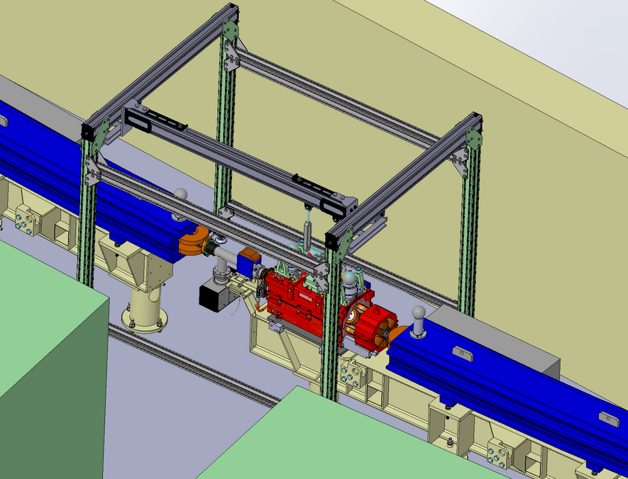
October shutdown : Movable gantry validation (TBC)
BOOSTER upgrade

Slide 5
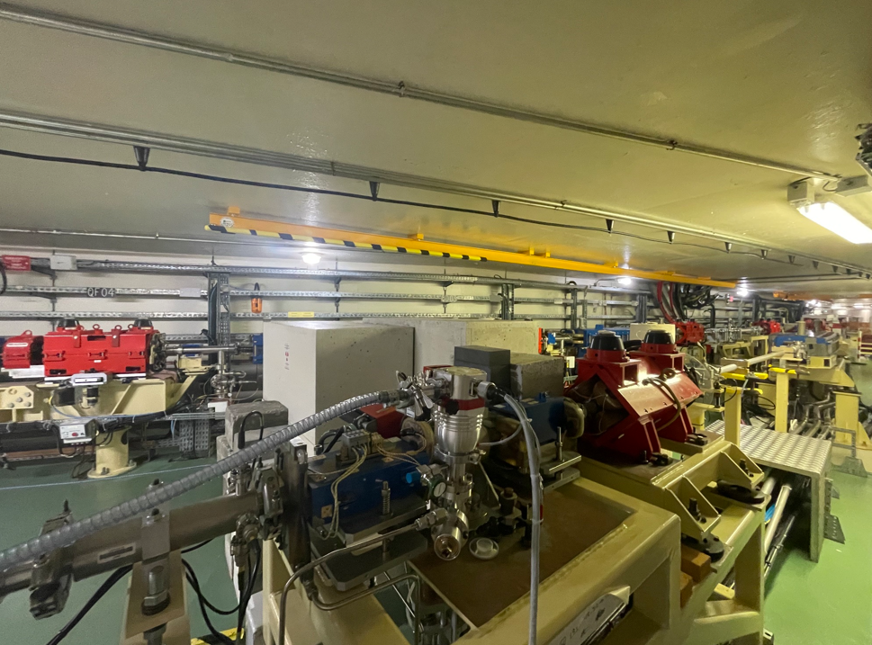
Winter shutdown : Rail removal
BOOSTER upgrade
Extraction zone

Slide 6
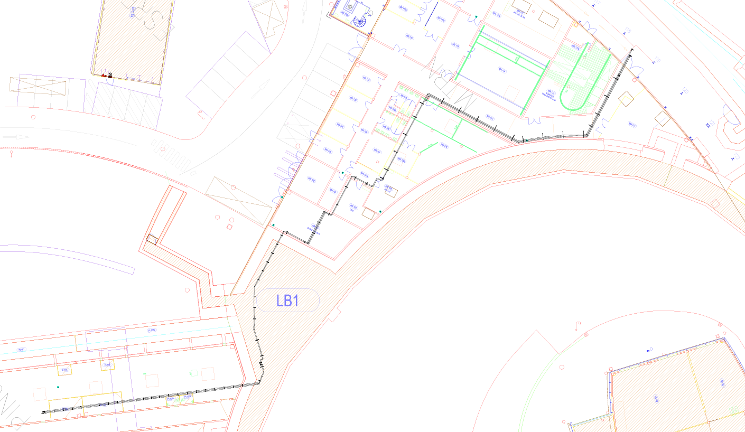
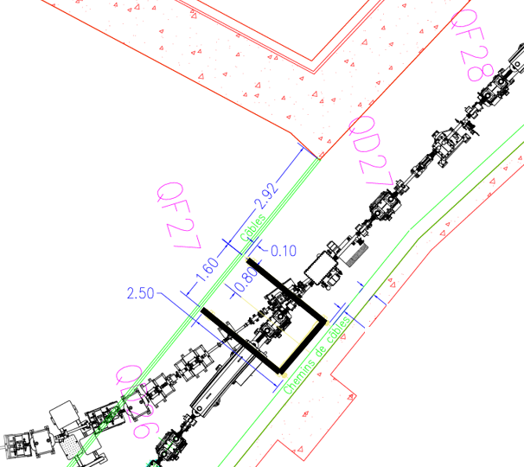
Winter shutdown : Crane installation above QF27
BOOSTER upgrade
MN112
MN107
MN105
MN104
MN101
coring
Acoustic insulation !?

Slide 7
Periods | LINAC upgrade | Booster upgrade | COLD project
RUN2026-04 | Faraday cage dismantling (02/11 to 06/11) | Movable gantry certification with APAVE | Temporary SRE piping
 |  |  | Faraday cage dismantling (02/11 to 06/11)
Oct-26 | Test Modulator0 on section2 | Validation of the movable gantry in the booster | Earthing of the 2 manholes
 | Couplers installation on RI cavity |  | SRE piping connection to the network (19th October)
RUN2026-05 |  |  | Cranes installation if available
Winter-26 | Modulator0 on section2 for Operation => RUN2027-01 (TBC) | Injection zone : Installation of a dedicated crane | Civil work : corings in the LINAC wall for
 | Tests Modulator3 on section1 | Extraction zone : Removal of the rail | Laser, LN2, SRE, cables, wave guides
 |  |  | Cranes installation if not performed during RUN2026-05
RUN2027-01 |  |  | S-band RF-unit installtion
Mar-27 |  |  | 2 coring in TL1 position - May for completion if needed
May-27 |  |  | 2 coring in MTBN (MN105-MN112)
Summer-27 |  | Quadrupoles installation if available | 2 coring in MTBN (MN01-MN107)
 |  |  | SRE piping Booster phase1
 |  |  | SLAC's cryomodule installation
 |  |  | C-band RF-unit installation
 |  |  | Waveguides installation
Oct-27 |  |  | C-band RF distribution and LLRF
 |  |  | LN2 distribution
Winter-27 | Crane installation for modulator3 | Quadrupoles installation | SRE piping Booster phase3

Slide 8
October shutdown 2026
COLD project
 |  |  | COLD project |  |  | LINAC upgrade
 |  | Mode | Modulator hall |  |  | Modulator hall |  |  | PINJ (Tunnel)
Thursday | 01-Oct | USM
Friday | 02-Oct
Saturday | 03-Oct
Sunday | 04-Oct
Monday | 05-Oct | MDT
Tuesday | 06-Oct | USM
Wednesday | 07-Oct
Thursday | 08-Oct
Friday | 09-Oct
Saturday | 10-Oct
Sunday | 11-Oct
Monday | 12-Oct
Tuesday | 13-Oct | SD
Wednesday | 14-Oct
Thursday | 15-Oct |  | Earthing 2 manholes |  |  |  |  |  | Couplers installation on RI
Friday | 16-Oct |  |  |  |  |  |  |  | section
Saturday | 17-Oct
Sunday | 18-Oct
Monday | 19-Oct |  | SRE connection to network |  |  | Test Modulator0 on section2
Tuesday | 20-Oct
Wednesday | 21-Oct
Thursday | 22-Oct | Restart
Friday | 23-Oct
Saturday | 24-Oct
Sunday | 25-Oct
Monday | 26-Oct
Tuesday | 27-Oct | USM
Wednesday | 28-Oct
Thursday | 29-Oct
Friday | 30-Oct
Saturday | 31-Oct
Bonjour,
Pour faire suite à notre conversation téléphonique et après lecture du plan de prévention, je te confirme que l'enfoncement des pieux de terre doit être réalisé sans aucune co-activité, y compris de la part de l'ESRF.
Bonne journée.
Stéphanie
Stéphanie RICOT Classical Safety Engineer - ESRF 04 76 88 28 50

Slide 9
Winter shutdown 2026
COLD project
 |  |  | COLD project |  |  |  |  |  | LINAC upgrade
 |  | Mode | Modulator hall |  |  | PINJ (Tunnel) |  |  | Modulator hall |  |  | PINJ (Tunnel)
Monday | 14-Dec | USM |  |  |  |  |  |  |  |  |  |  |  |  | 14-Dec | Monday
Tuesday | 15-Dec |  |  |  |  |  |  |  |  |  |  |  |  |  | 15-Dec | Tuesday
Wednesday | 16-Dec |  |  |  |  |  |  |  |  |  |  |  |  |  | 16-Dec | Wednesday
Thursday | 17-Dec | SD |  |  |  |  |  |  |  |  |  |  |  |  | 17-Dec | Thursday
Friday | 18-Dec |  |  |  |  |  |  |  |  |  |  |  |  |  | 18-Dec | Friday
Saturday | 19-Dec |  |  |  |  |  |  |  |  |  |  |  |  |  | 19-Dec | Saturday
Sunday | 20-Dec |  |  |  | Civil work : Coring |  |  |  |  |  |  |  |  |  | 20-Dec | Sunday
Monday | 21-Dec |  |  |  | 1 week |  |  |  |  |  |  |  |  |  | 21-Dec | Monday
Tuesday | 22-Dec |  |  |  | Noisy work |  |  |  |  |  |  |  |  |  | 22-Dec | Tuesday
Wednesday | 23-Dec |  |  |  |  |  |  |  |  |  |  |  |  |  | 23-Dec | Wednesday
Tuesday | 05-Jan |  |  |  |  |  |  |  |  |  |  |  |  |  | 05-Jan | Tuesday
Wednesday | 06-Jan |  | cranes installation |  |  |  |  |  |  |  |  |  |  |  | 06-Jan | Wednesday
Thursday | 07-Jan |  |  |  |  |  |  |  |  |  |  |  |  |  | 07-Jan | Thursday
Friday | 08-Jan |  |  |  |  |  |  |  |  |  |  |  |  |  | 08-Jan | Friday
Saturday | 09-Jan |  |  |  |  |  |  |  |  |  |  |  |  |  | 09-Jan | Saturday
Sunday | 10-Jan |  |  |  |  |  |  |  |  |  |  |  |  |  | 10-Jan | Sunday
Monday | 11-Jan | Booster |  |  |  |  |  |  | Modulator0 connected to section2 for Operation |  |  |  |  |  | 11-Jan | Monday
Tuesday | 12-Jan | restart |  |  |  |  |  |  | Tests Modulator3 on section1 |  |  |  |  |  | 12-Jan | Tuesday
Wednesday | 13-Jan |  |  |  |  |  |  |  |  |  |  |  |  |  | 13-Jan | Wednesday
Thursday | 14-Jan | Restart |  |  |  |  |  |  |  |  |  |  |  |  | 14-Jan | Thursday
Friday | 15-Jan |  |  |  |  |  |  |  |  |  |  |  |  |  | 15-Jan | Friday
Saturday | 16-Jan |  |  |  |  |  |  |  |  |  |  |  |  |  | 16-Jan | Saturday
Sunday | 17-Jan |  |  |  |  |  |  |  |  |  |  |  |  |  | 17-Jan | Sunday
Monday | 18-Jan |  |  |  |  |  |  |  |  |  |  |  |  |  | 18-Jan | Monday
Tuesday | 19-Jan | USM |  |  |  |  |  |  |  |  |  |  |  |  | 19-Jan | Tuesday
Wednesday | 20-Jan |  |  |  |  |  |  |  |  |  |  |  |  |  | 20-Jan | Wednesday

Slide 10
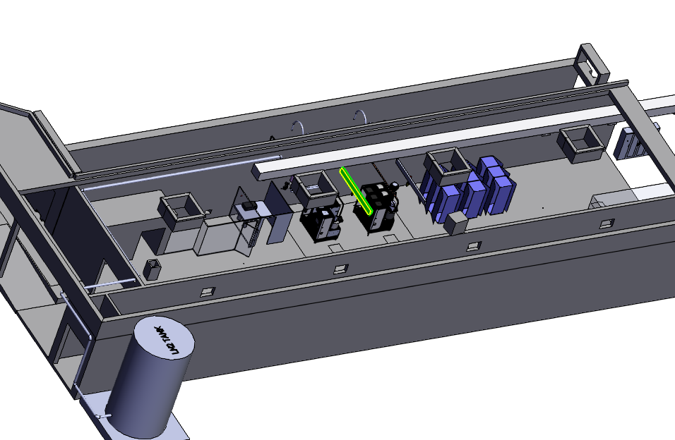
Winter shutdown 2026 : Civil work
COLD project
1 wave guide de 250mm
1 cables de 250mm
1 LN2 de 250mm
1 Laser de 100mm
1 water cooling de 250mm

Slide 11
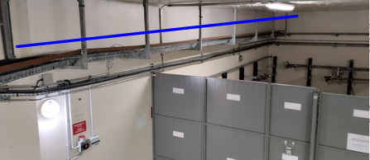
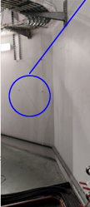
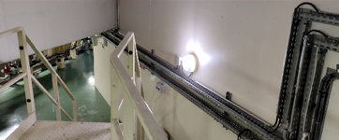
SRE network implementation : Coring
COLD project
TZ
MN112
MN107
MN105
MN104
MN101
March-27
May-27
Summer-27
Coring with 30° angle & chicane
Modulator hall

Slide 12
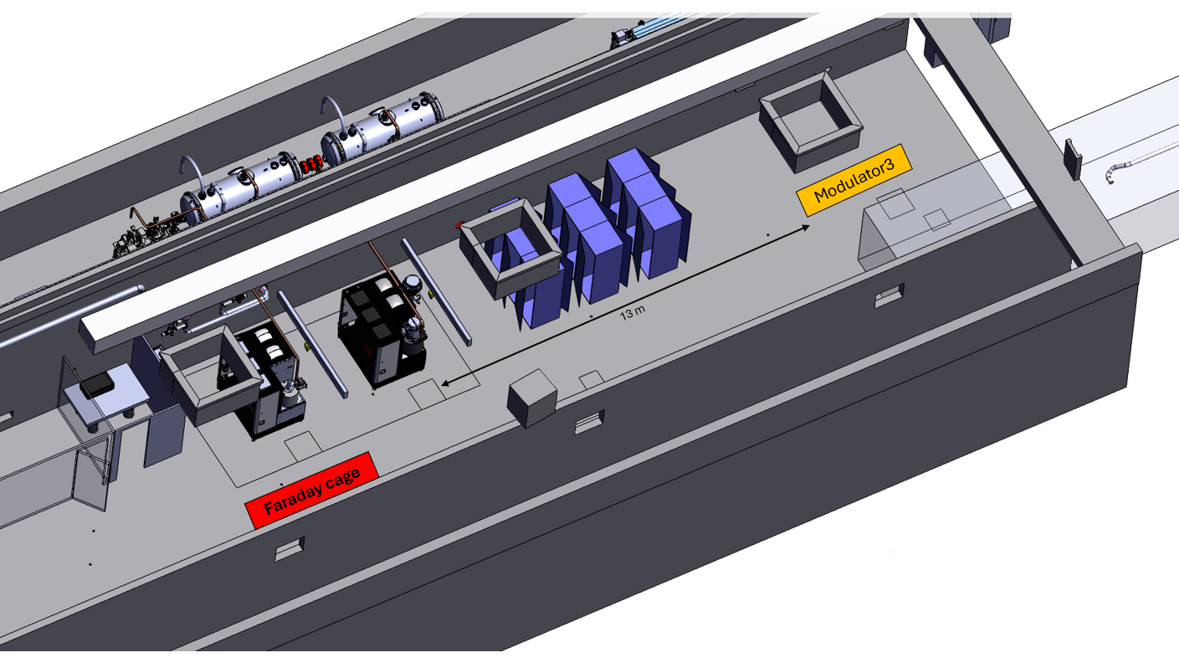
Several points have been validated during the meeting :
Remove the Faraday cage => 02/11 to 06/11
Postpone the 2 coring in TL1 to enable the installation of the QF27 crane (from Winter-26 to March-27) => OK
Install sound insulation at the entrance of TL1 to enable the installation of the QF27 crane while coring in PINJ => OK
Authorize the installation of the S-band & C-band cranes during RUN 2026-05 if available => OK
Modify the PSS logic in order to authorize PINJ works without switching OFF RIPS => October or winter shutdown

