Slide 1
C-Band High Power
RF Components and Planning for Phase 0
A. D’Elia

Slide 2
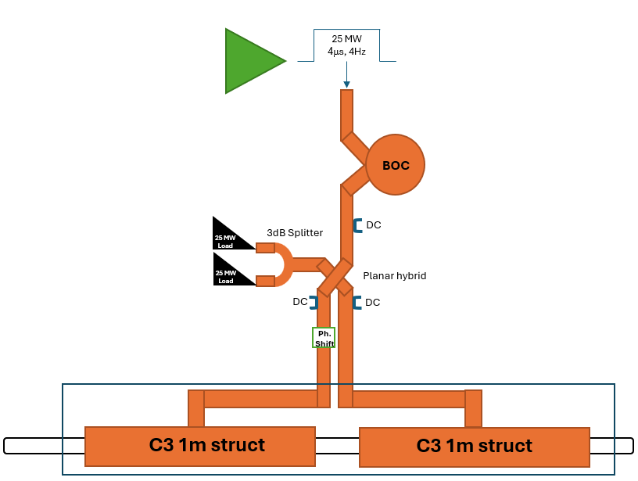
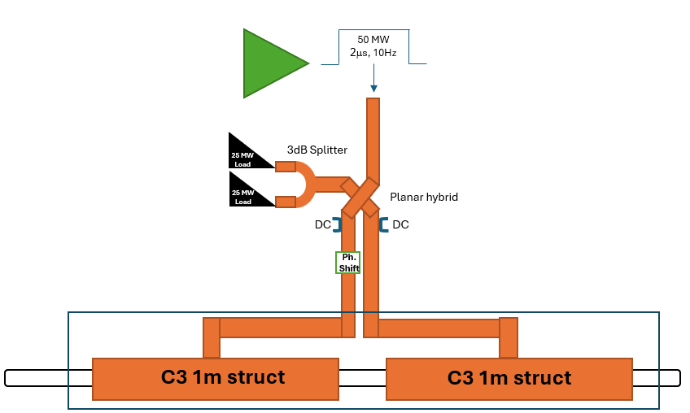
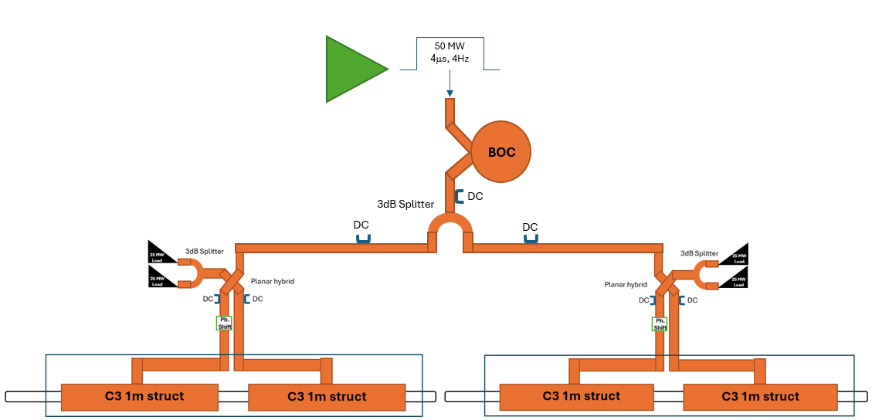
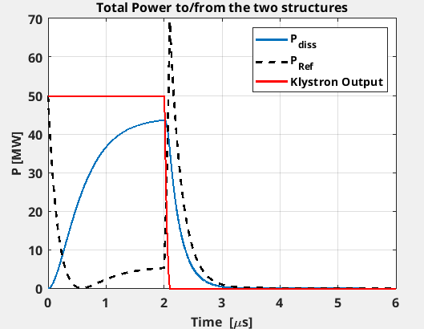
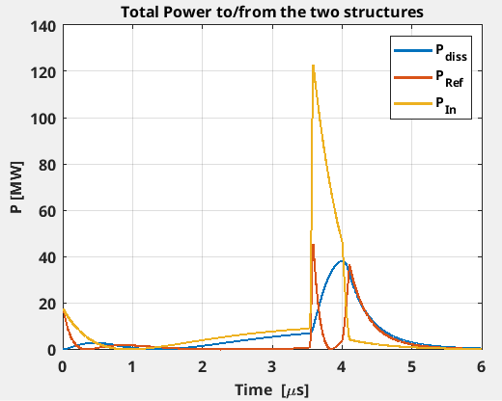
C-Band RF Layout of each phase
Phase 0:
PSI can provide for Directional Couplers and Loads if needed
Question about the phase shifter: the phase shifter for me, is to guarantee 90deg phase difference between the reflected powers from the cavities, what about the phase difference between the two accel. structures? Do we rely only on the correct length of the waveguides?
Phase 1
Pref peak~50MW/branch
Pref peak~70MW
Phase 2

Slide 3
Needs of C-Band Components during the project Phases
In red, components containing ceramics: 1 year lead time to be considered
Type | Hybrid Couplers | RF Loads* | Pulse Compressor | Pumping Ports | Directional Couplers | 3dB Splitters | Phase Shifters | Waveguides
Phase 0 | 1 | 2 | 0 | ? | 2 | 1 | 1 | To be drawn
Phase 1 | 0 | 0 | 1 | ? | 1 | 0 | 0 | To be drawn
Phase 2 | 1 | 2 | 0 | ? | 4 | 2 | 1 | To be drawn
Total | 2 | 4 | 1 | ? | 7 | 3 | 2
+
+
=
* 50MW RF Loads are difficult to find: we will use 2 x 25MW loads with a splitter

Slide 4
Status of the Survey
Y ➔ Yes
? ➔ Asked for
Company | Contact Date | Reply | Hybrid Couplers | RF Loads | Directional Couplers | 3dB Splitters | Phase Shifters | Waveg.
SPINNER** | 2/6 | 10/6 | Y | Y RF Power tests at the ESRF | Y 19,95 kEuro with PP 14,45 kEuro w/o PP | Y | Y | Y
CML | 25/6 re-launched 08/07 | 27/6 Acknow. but no answer yet |  | ?
RADIABEAM (.eu) | 30/6 | No answer yet |  | ?
NIHON KOSHUHA | 8/7 | 18/8 | Y 5 MYen (=27 kEuro) | Y*** 7 MYen (=38 kEuro) | Y 3,4 MYen (=18,5 kEuro) | - | - | -
ARVA RF (MEGA) | 2/6 | 9/6 |  | Y*
* PSI very negative about MEGA RF Loads
** From SPINNER: “SPINNER can support you with the complete project. If we are awarded the full package, we could provide ESRF with a turnkey solution, including drawings, detailed specifications, installation materials, and the necessary documentation.”
*** Two RF Loads connected by a T-Junction that can be considered as a single load (50-70 MW peak power, 2.8 kW average). Lead time 11 months from the order.

Slide 5
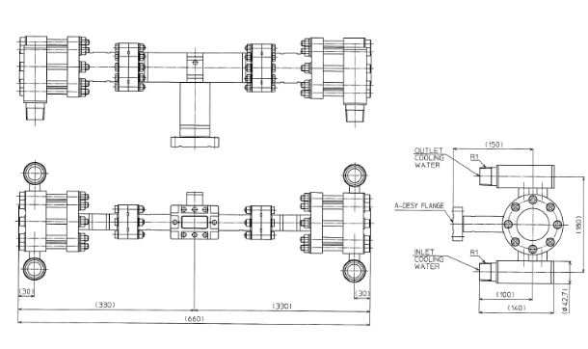


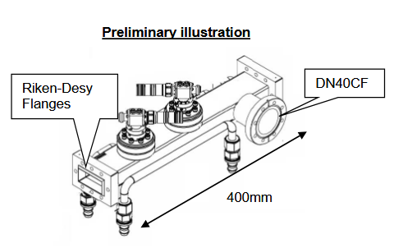
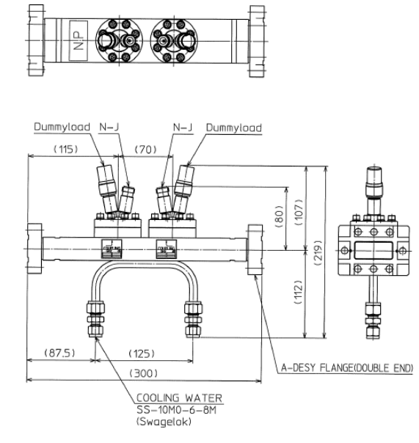
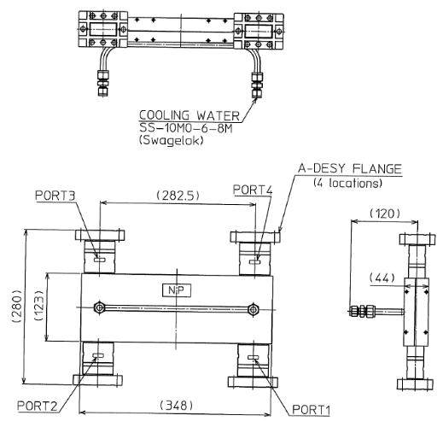
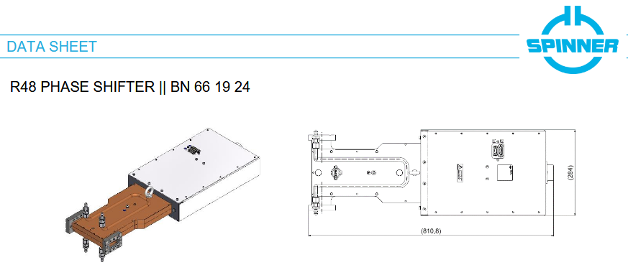
Relatively heavy components
Weight=20kg
Load
DC
Weight=15kg
Weight=8kg
DC
Weight=15kg
Hybrid
Weight=35kg
Relatively heavy components: mechanical support!!
Estimated Cost for Phase 0: ~140 kEuro + 20 kEuro/m for waveguides (PSI rough estimation)

Slide 6
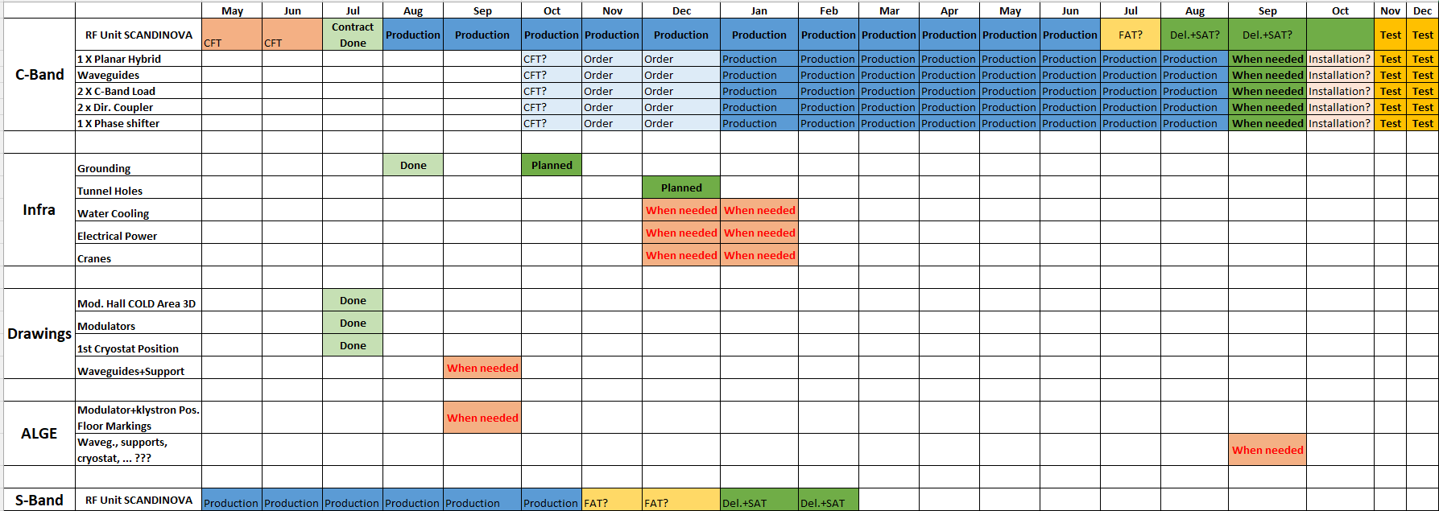
Schedule Phase 0
We are here
2026
2027
Realistic start of the RF Test
This is “my personal” schedule for the RF where I marked when I need the services from other WPs. You will notice that nothing is marked for the LN2 in INFRA as I have no idea of what is planned and scheduled so far;
SPINNER can provide for all components for Q3 of 2027 if ordered in Q4 2026: CFT?
NIHON KOSHUHA can provide loads, hybrids and DC in 11 months from the order: CFT?
Information: PSI in case of emergency can loan Directional Couplers and Loads. But Hybrids and Waveguides need to be purchased.
Nothing has been foreseen yet for the LLRF: no electronics, no cables, no components, … Without an official collaboration with PSI and due to the lack of resources, we decided to outsource the LLRF, a meeting with I-Tech will be setup for next week to discuss with them this aspect.

Slide 7
What we need to finalize the RF waveguide network
The main action was to provide for the 3D survey of the Modulator Hall and Linac Tunnel and to provide for the position of the RF Units and waveguide passage through the wall: this is done!
We need to identify where the support can be hold:
  We need to fix the BOC position since the beginning: I suggest to use the frame of the C-Band RF Unit for this (similarly as Marc did on the Modulator 0). BOC weight: 131 kg w/o supports and vacuum pumps ➔ the crane could be used to install it;
  Hybrid, Phase shifter and RF loads would be better to install them in the tunnel, relatively close to the first cryomodule: if so, when we will install the second network for Phase 2, we need just to insert a splitter and mirroring the line of the first cryomodule to the second one. We need to verify the space, the holding points and considering that the Phase Shifter needs to be installed vertically and to foresee the space for the motor;
  Last detail: for Phase 2 we need to install two additional DC after the splitter in the tunnel, to be foreseen possible holding points in the tunnel.
We need to define the number of the pumping ports we need. For information the BOC is equipped with a pumping port. Do we need additional pumping ports? How many? If we need them, we can either decide to pump form the waveguides or from DC which will be, of course more expensive.
Last remark: I do not think we need water cooling for Hybrid Couplers and Phase Shifter but for the RF loads we need. If in the tunnel, we need to provide in the tunnel for this cooling (max flow rate 6 l/min).
A meeting with SPINNER is going to be setup for beginning of September, a first, even very preliminary draft is needed for the discussion.

Slide 8
Possible procurement strategy for Phase 0
Ask PSI for the loan of C-Band loads and Directional Couplers: this will allow at least to perform the SAT of the C-Band RF Unit;
Order placement of the Phase Shifter to SPINNER before the end of this year*;
Order placement of the Hybrid Coupler to SPINNER or NIHON KOSHUHA before the end of this year;
Drawing the RF network to send to SPINNER for waveguide quotation: the order must be placed before November to get the components for Q3 of 2027;
Order placement of Directional Couplers and RF loads (CFT? Common CFT or two different?) if they arrive in time for Phase 0 will be installed otherwise we will continue using PSI components (if PSI agrees…)
* Do I need more quotations? Comment: no many Companies have such a components in their catalogues and even if they have, a qualification would be needed if no references (see PSI’s remarks on the RF Loads).

Slide 9
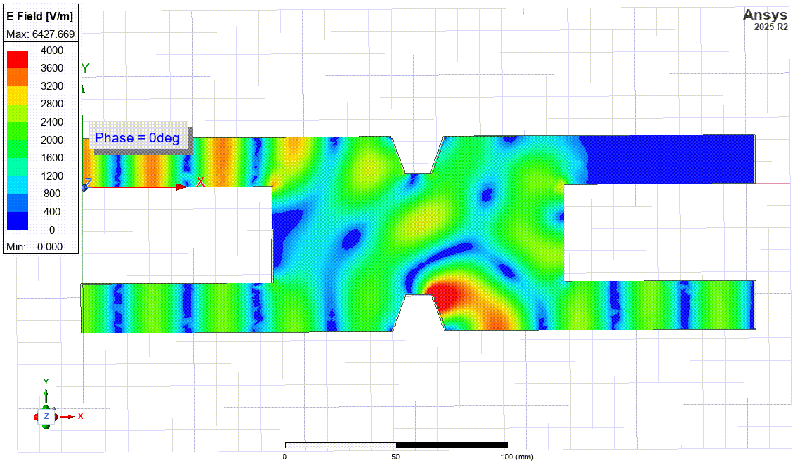
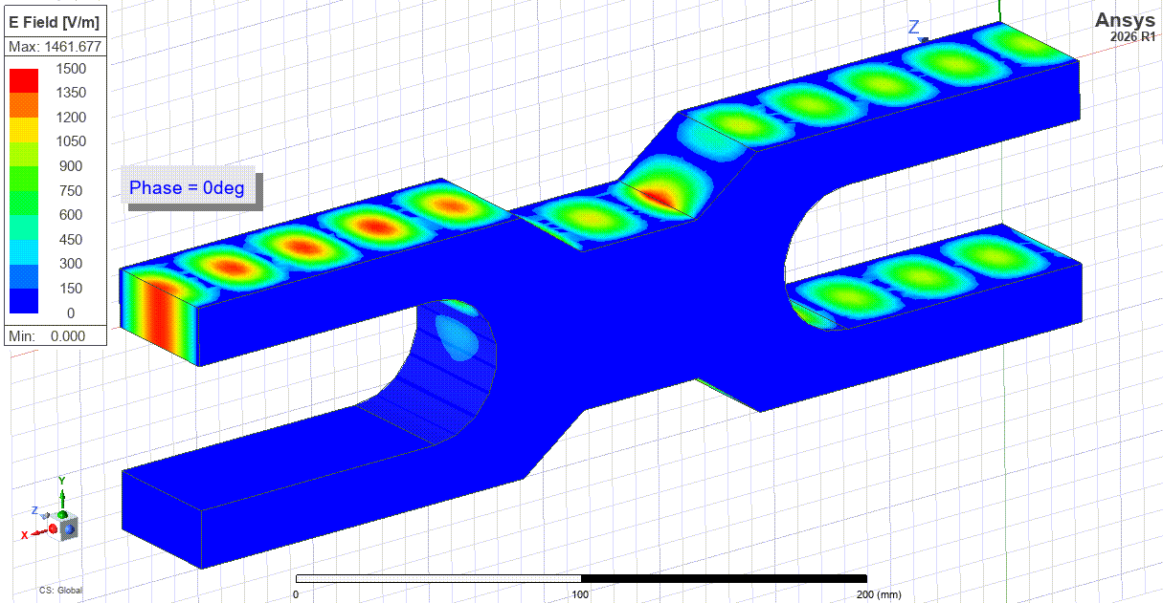
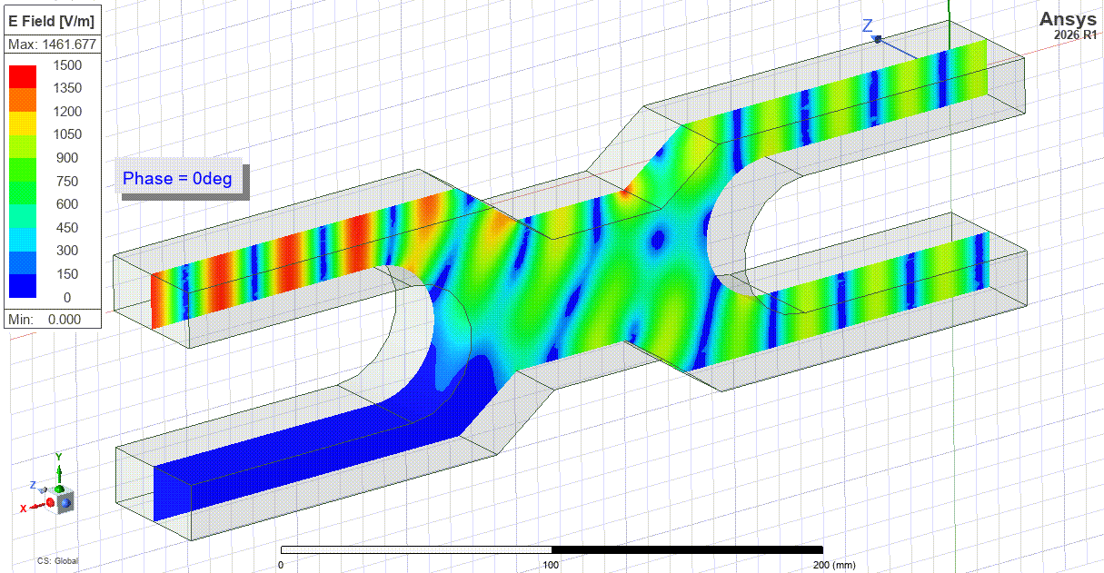
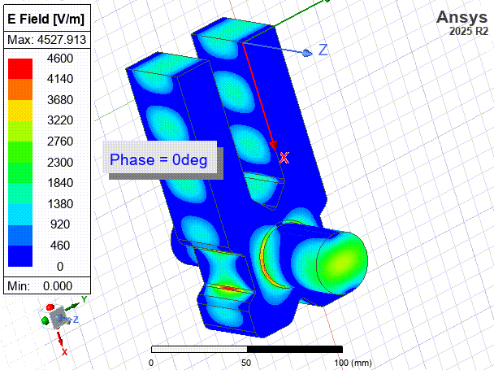
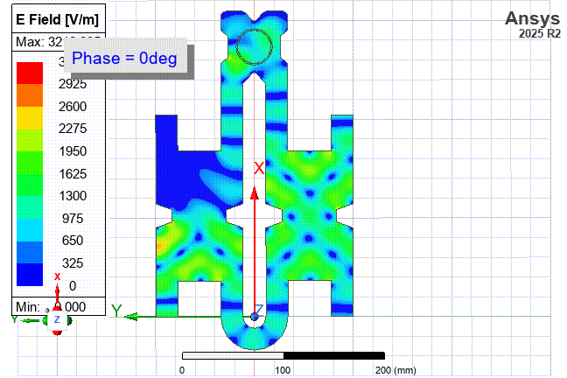
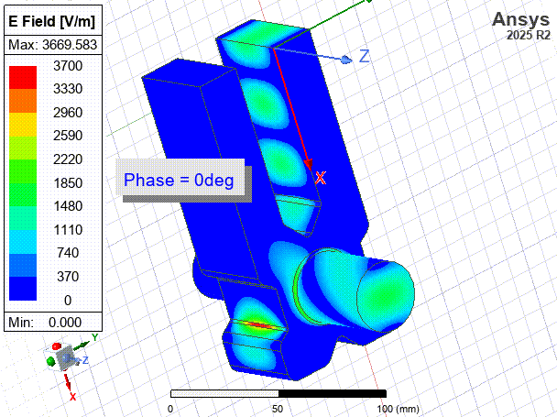
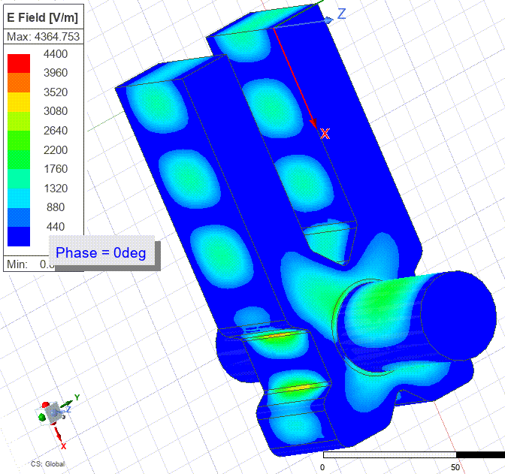
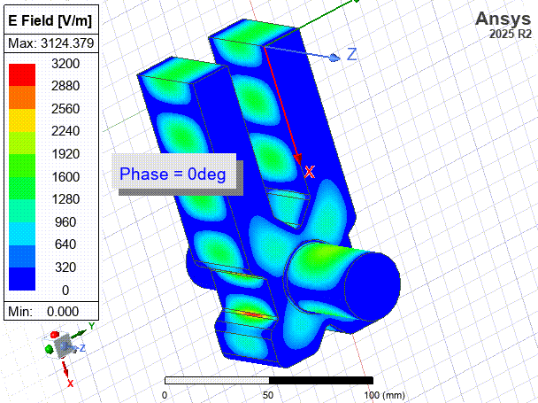
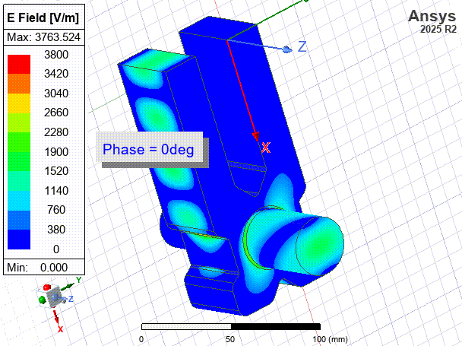
Design of Compact High Power RF Components at C-Band
Power Combiner
Hybrid Coupler
Port 1
(0deg)
Port 2
(0deg)
Power Attenuator
Phase Shifter
Short-Circuit
Port 3:
Launch Vx
TDS Mode Launcher
Port 1
(180deg)
Port 2
(0deg)
E-Rotator
Short-Circuit
Port 3:
Launch Vy

Slide 10
Additional Slides

Slide 11
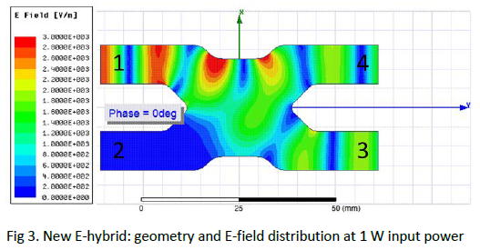
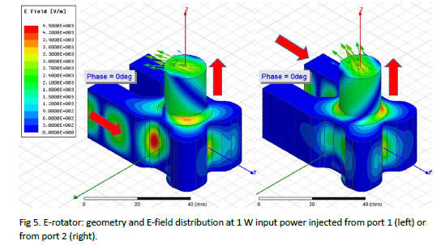
High Power RF C-Band RF Components for the (next) future
X-Band E-Hybrid
Many high power RF components have been developed for CLIC:
X-Band E-Field Rotator

Slide 12
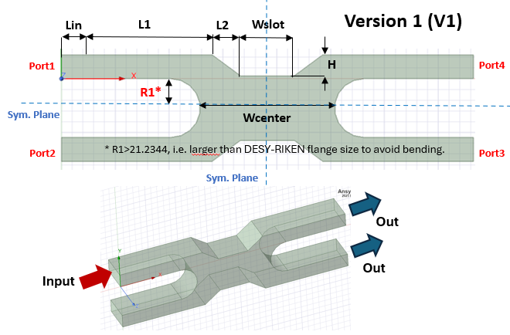
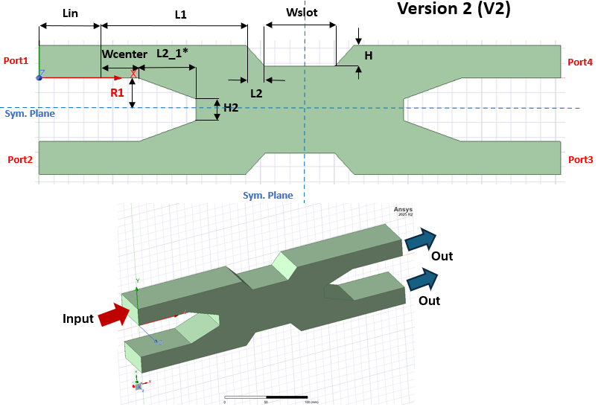
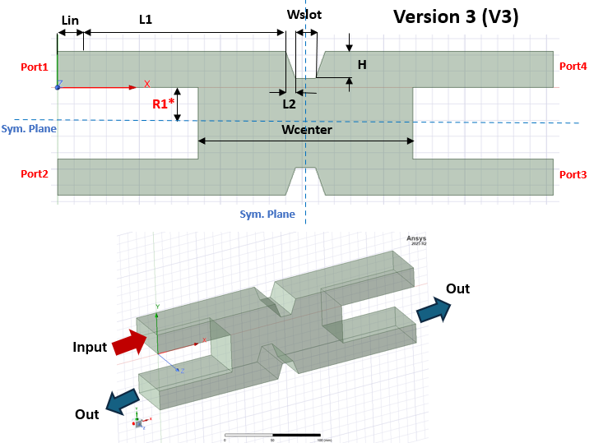
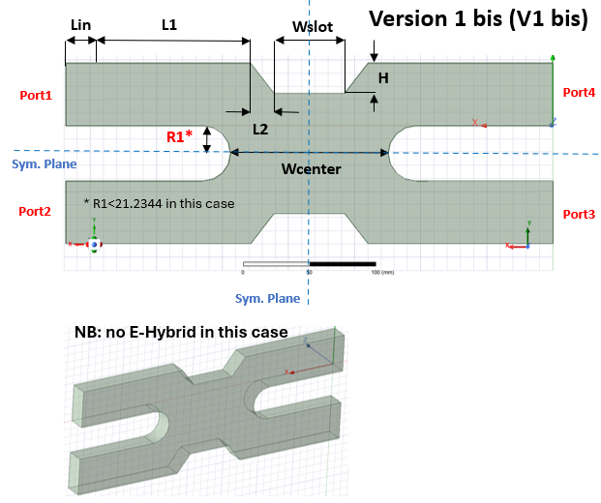
C-Band E-Hybrid: 3D Models
This is the base for the E-Rotator
In Combination with E-Rotator allows to build a power attenuator
Rectangular waveguide size fixed to WR187

Slide 13
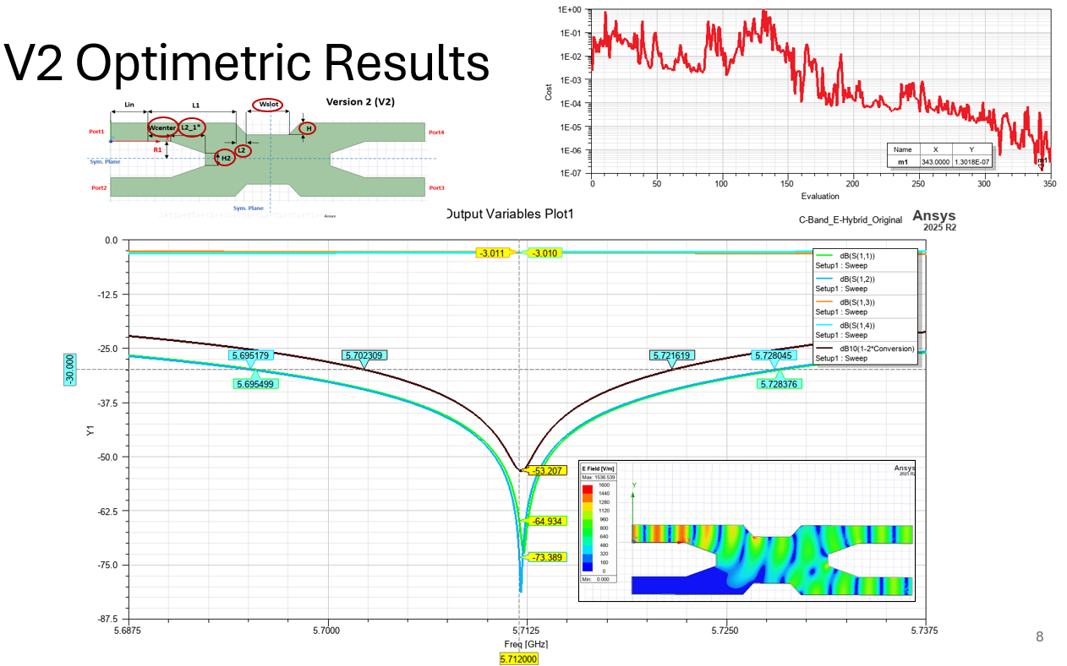
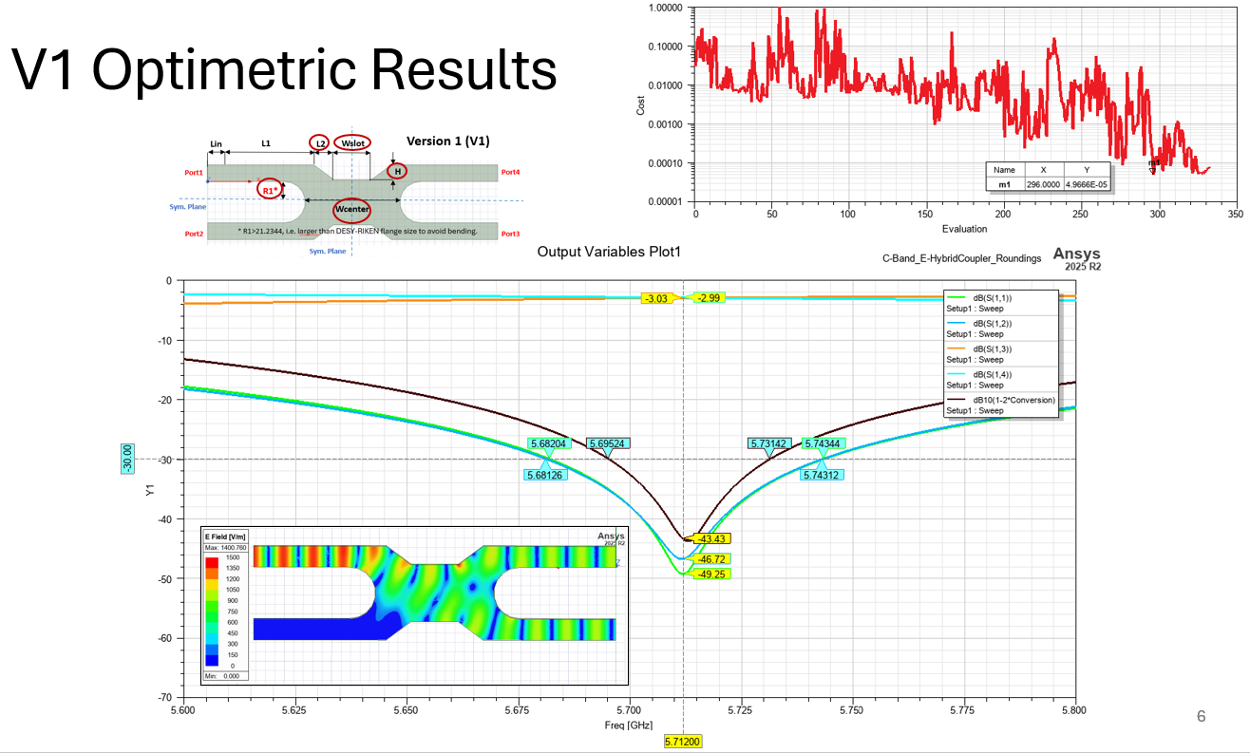
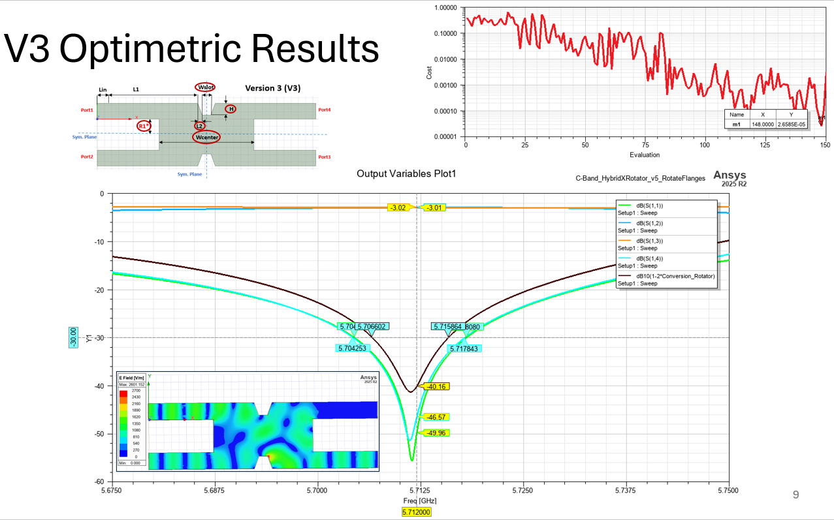
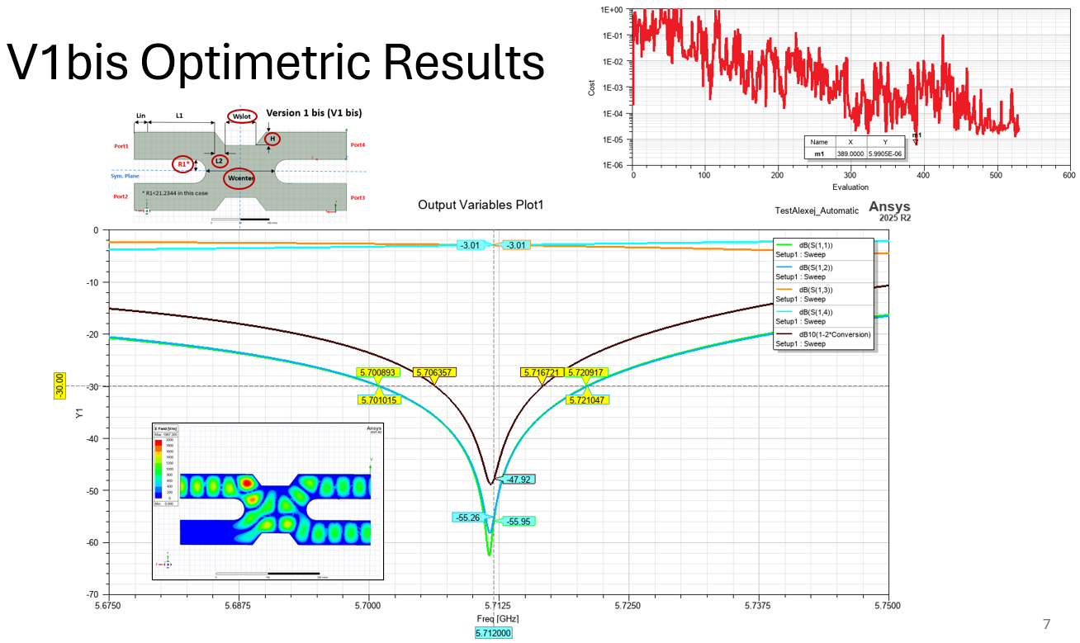
Results

Slide 14
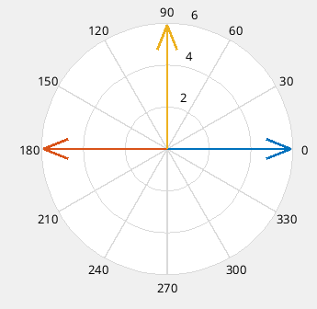
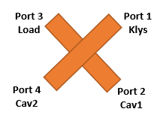
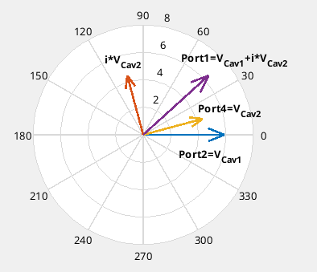
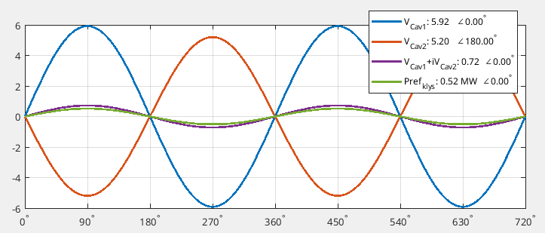
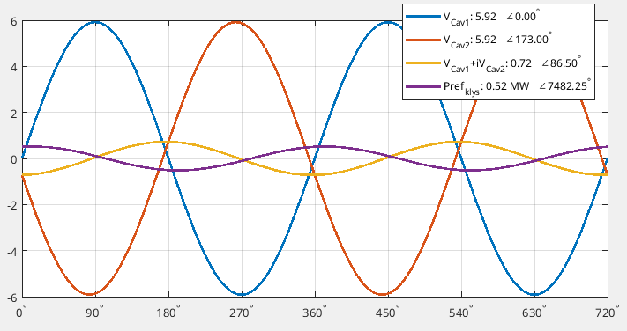
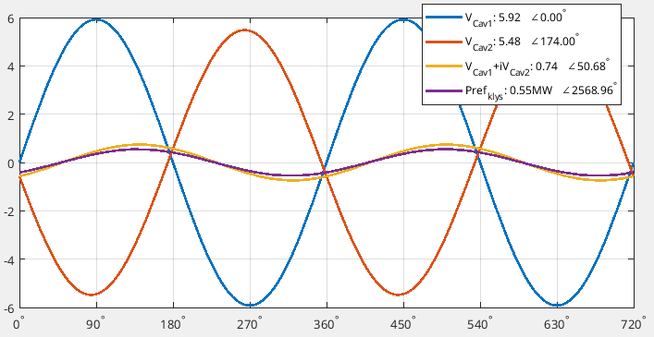


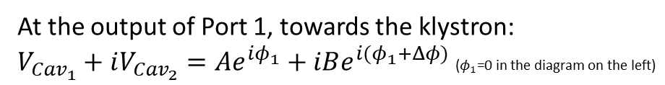
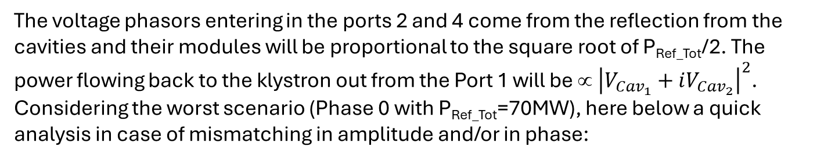
Some calculation on the hybrid scheme
Phasor Diagram
At the output of Port 1, towards the klystron:
$V_{{Cav}_{1}}+iV_{{Cav}_{2}}=Ae^{iφ_{1}}+iBe^{i{(φ}_{1}+Δφ)}$ ($φ_{1}$=0 in the diagram on the left)
$${\left|V_{{Cav}_{1}}+iV_{{Cav}_{2}}\right|}^{2}=A^{2}+B^{2}−2AB\sin{(Δφ)}$$
P_{ref klys}=0 only if A=B and $Δφ$=π /2
(The choice of the module of the sum is independent on the choice of $φ_{1}$ but the sign of $∆φ$ depends upon direction of the frame rotation: positive if counterclockwise, negative clockwise, for this latter the module will be 0 at | $∆φ$|=3$π$/2 if and A=B
Δφ
The voltage phasors entering in the ports 2 and 4 come from the reflection from the cavities and their modules will be proportional to the square root of P_{Ref_Tot}/2. The power flowing back to the klystron out from the Port 1 will be ∝ ${\left|V_{{Cav}_{1}}+iV_{{Cav}_{2}}\right|}^{2}$. Considering the worst scenario (Phase 0 with P_{Ref_Tot}=70MW), here below a quick analysis in case of mismatching in amplitude and/or in phase:
Δφ=84°; Pref₁=35MW; Pref₂=30MW
Δβ/β≈5% or ΔV/V≈7%; Δφ/φ<7%
Δφ=90°; Pref₁=35MW; Pref₂=27MW ➔ Δβ/β≈10% or ΔV/V≈11%
Δφ=83°; Pref₁=Pref₂=35MW ➔ Δφ/φ≈8%

Slide 15
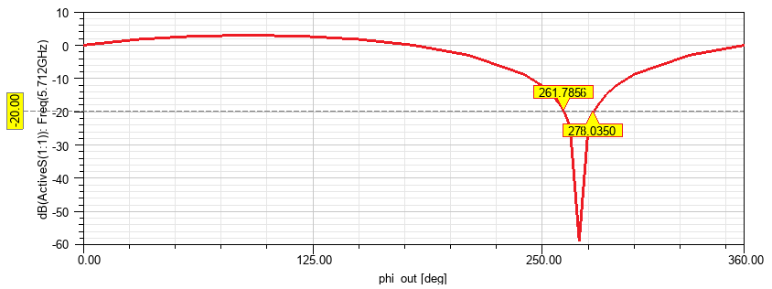
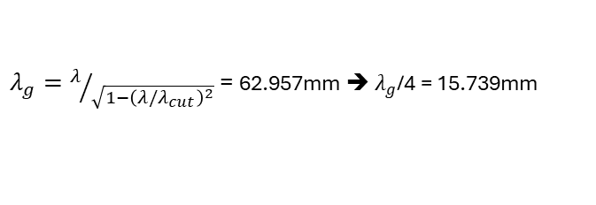

Phase error
Typical return loss values for klystrons are 20dB and we had evaluated that this would correspond to a Δφ/φ≅8 deg. Here below the confirmation from the simulation.
270deg*
-8deg
+8deg
* Full isolation at 270deg instead of 90deg because of the reference $φ$ in the simulation (see previous slide)
Active S1
$λ=c/5.712GHz$; $λ_{c_WR187}=c/3.15465GHz$
$λ_{g}=λ/{\sqrt{1−{\left(λ/λ_{cut}\right)}^{2}}}$ = 62.957mm ➔ $λ_{g}$/4 = 15.739mm
Considering the two plots we need to correct the phase better than 8 deg which corresponds to length variation in the waveguide network of <±1.5mm ➔ Phase shifter needed.

Slide 16
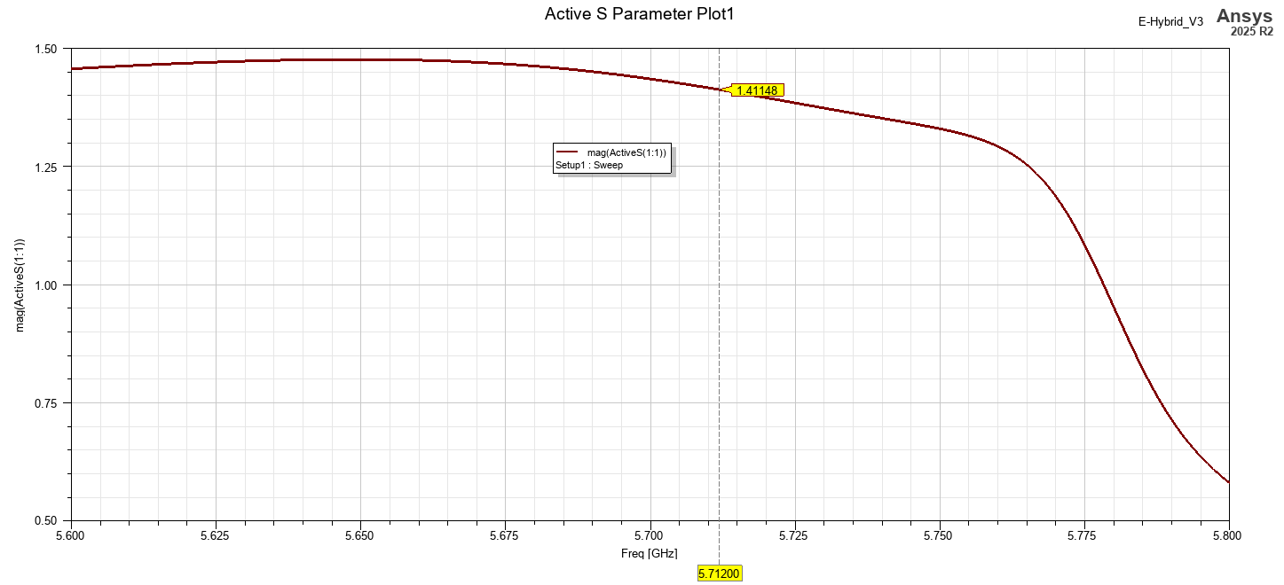
Power Combiner
Using a Hybrid Coupler at the “wrong phase”, -90deg instead of 90deg, allows to combine (sum) the power from Port 2 and 3 at the Port 1. This principle is used in CLIC Test Stands and/or XBOX to combine the power from two X-Band klystrons.
Vout=1.41V➔Pout=2W
Port1=2W
Port4
Port2=1W
Port3=1W

Slide 17
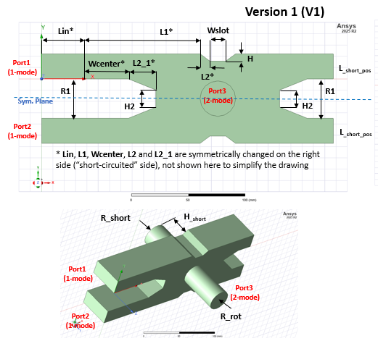
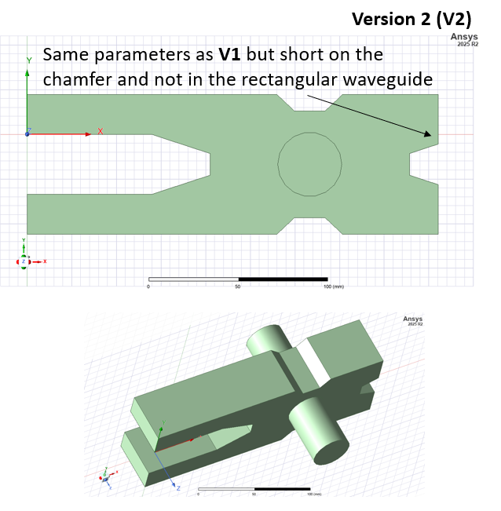
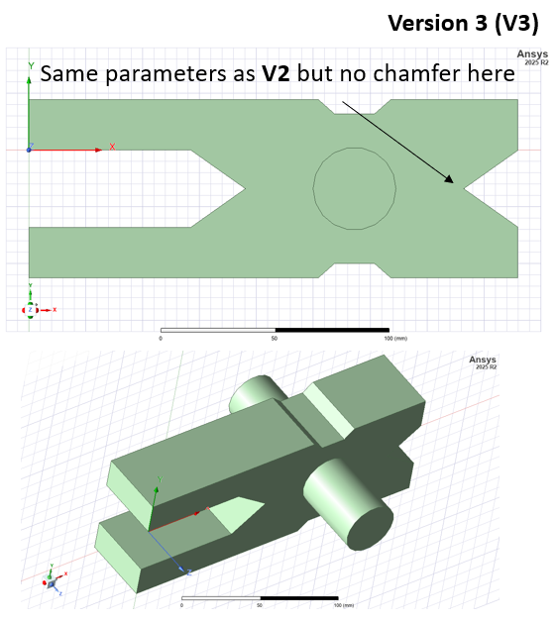
C-Band E-Rotator: 3D Models, all sharp edges
Rectangular waveguide size fixed to WR187

Slide 18
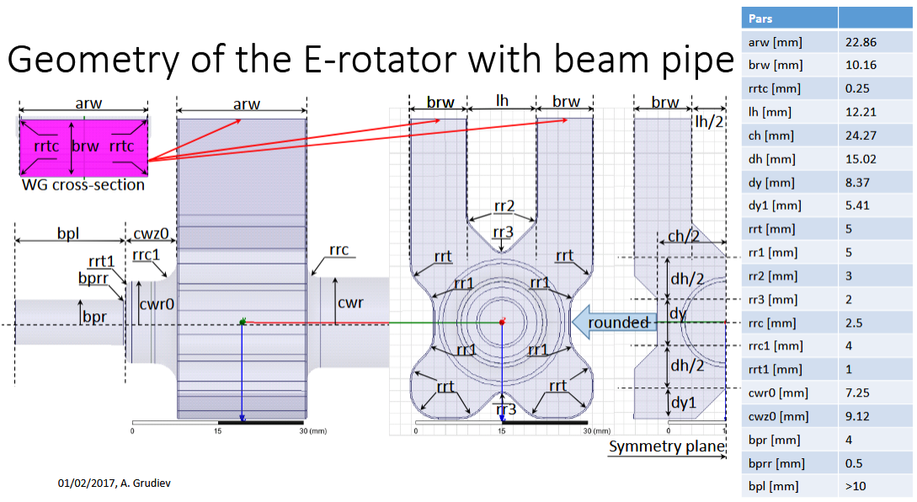
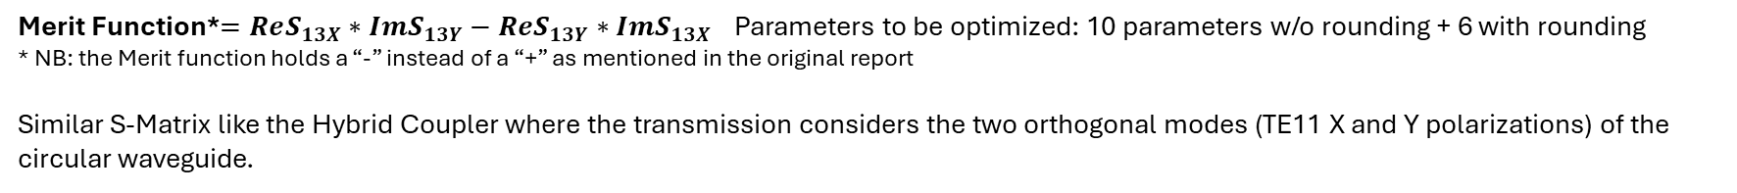
  https://indico.cern.ch/event/527312/contributions/2434220/attachments/1405515/2147153/20161201_DesignofXbandTDS_Waltersmeeting.pdf
Merit Function*$=ReS_{13X}∗ImS_{13Y}−ReS_{13Y}∗ImS_{13X}$ Parameters to be optimized: 10 parameters w/o rounding + 6 with rounding
* NB: the Merit function holds a “-” instead of a “+” as mentioned in the original report
Similar S-Matrix like the Hybrid Coupler where the transmission considers the two orthogonal modes (TE11 X and Y polarizations) of the circular waveguide.

Slide 19
V3 optimization procedure
Some mail exchange with Alexej who confirmed the difficulty of optimizing such a device:
Many variables to be taken into account all together;
Non conformal device (because of the presence of rectangular and circular waveguides): symmetry and rounding play an important role in the optimization.
Following these discussion, I firstly worked on the “sharp edge” model. The number of variables needs to be “fair”: enough to reach a good optimization level, not too many to avoid either problems such as a very long or never ending optimization loops. Then I considered the rounding (and all variables needs to be optimized again!).

Slide 20
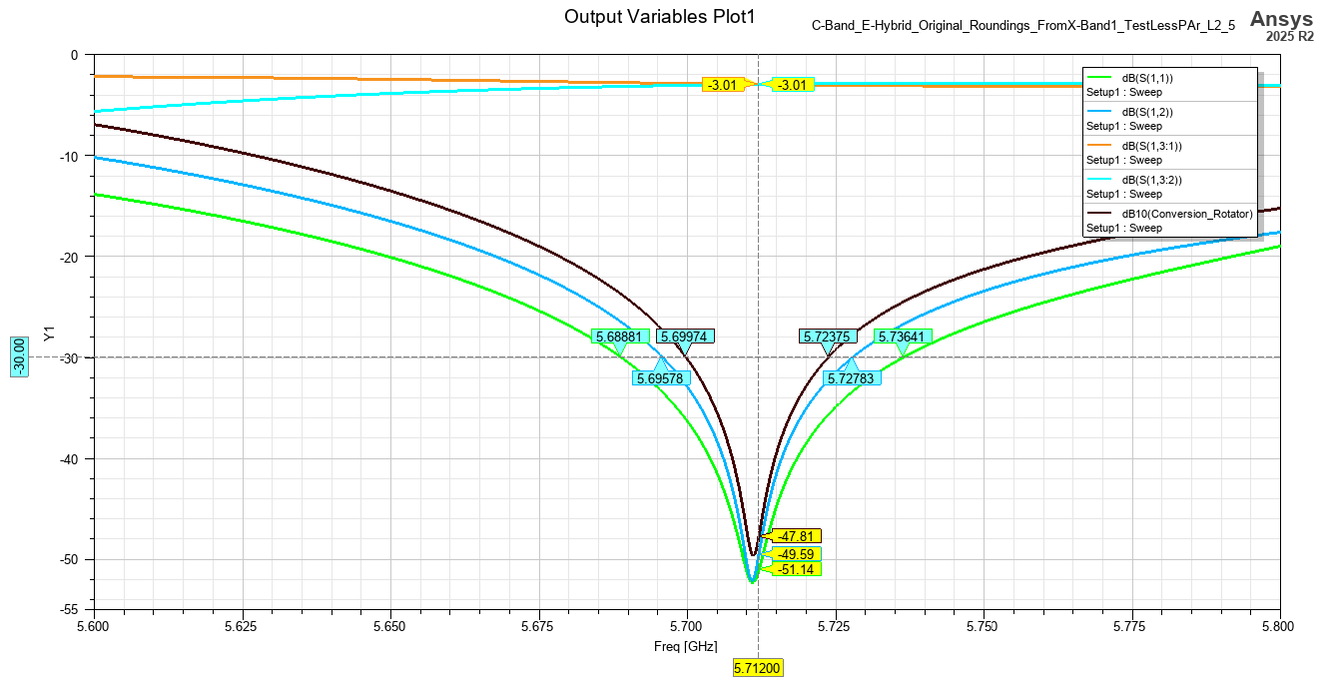
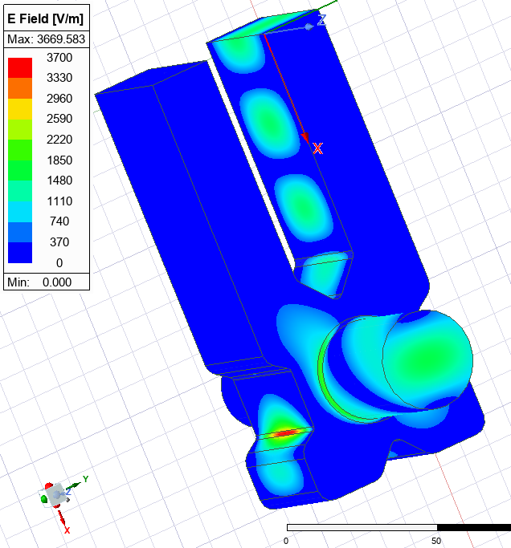
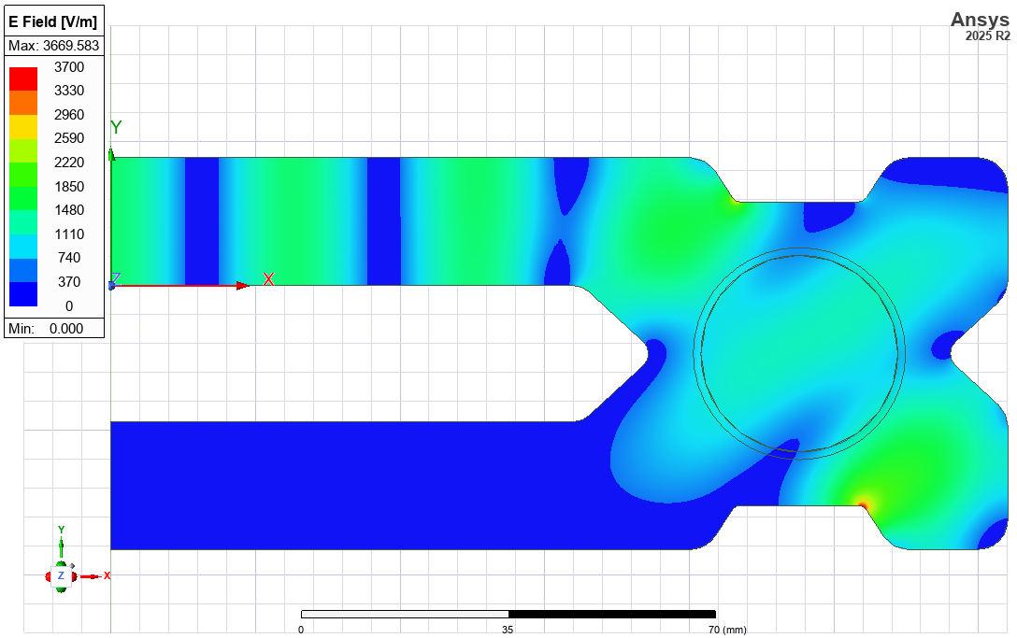
V3 final results

Slide 21
E-Field Rotator
Port 1
Port 2
The E-Rotator is a multi-task device that can be used as a brick to build many high power RF components:
If the circular waveguide port (Port 3) is short-circuited the field will “rotate” from Port 1 to Port 2 with no attenuation and the phase at the output port can be changed by changing the position of the short-circuit ➔ Phase Shifter;
If both Ports 1 and 2 are simultaneously fed, dependently on the phase difference between the two ports, a TM110 field can be launched with different polarizations at the Port 3 ➔ TDS mode launcher;
If a Hybrid Couplers is attached at the Port 1 and another at the Port 2, the power at the final hybrid coupler output can be changed (attenuated) depending on the short circuit position at the Port 3 ➔ Power Attenuators.
Port 3
Port 1
Port 2
Port 3

Slide 22
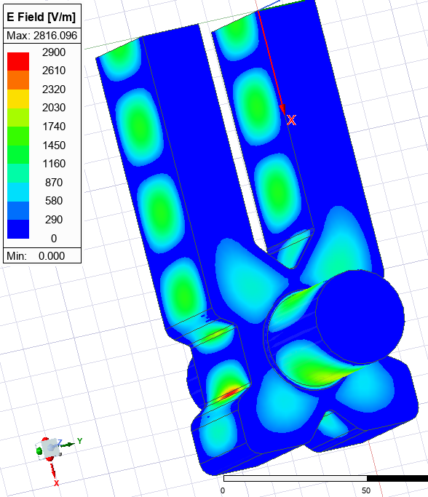




Phase shifter
Input (Phase 0deg)
The final Phase Shifter needs to develop also a dedicate movable piston for the short circuit: a design in X-Band already exists and can be easily adapted in C-Band. A rough evaluation gives 6deg/mm. Isolation <-40dB.
Short-Circuit
50mm
Input (Phase 0deg)
Isolation<-40dB
Short-Circuit
From A. Grudiev, CLIC-Note-1067
75mm
The design of the piston in X-Band already exists and can be adapted in C-Band

Slide 23
TDS Mode Launcher
Feeding both ports with different phases, will propagate a TE11 from Port 3 with a different polarization depending on the phase difference between Port 1 and 2. This can be used to launch vertical or horizontal TM110 polarizations in a Traveling Deflecting Structure (TDS).
Port 1 (0deg)
Port 1 (180deg)
Port 2 (0deg)
Port 2 (0deg)
Port 3: Launch Vx
Port 3: Launch Vy

Slide 24





Power Attenuator
Pos Short=50mm
Port 4
Port 3
Combining the E-Rotator with two E-Hybrid V3, we have a power attenuator: the power fed by Port 1 is split between Port 2 and 3, the transmission level at each Port will depend upon the position of the short-circuit at the circular waveguide of the E-Rotator. The Port 4 will remain isolated at any position of the short-circuit and can be used for example for pumping.
S13
Port 1
Port 2
Pos Short=70mm
Isolation<-40dB
Port 4
Port 3
S12
Reflection<-40dB
Port 1
Port 2

Slide 25









Hybrid Coupler S-Matrix and Merit Function
$$S=\left(\begin{matrix}0 & 0 & iS_{13} & S_{14} \\ 0 & 0 & S_{14} & iS_{13} \\ iS_{13} & S_{14} & 0 & 0 \\ S_{14} & iS_{13} & 0 & 0\end{matrix}\right)$$
Port 1
H*
Port 4
W*
Perfect Hybrid if:
${\left|S_{14}\right|}^{2}=$ ${\left|S_{13}\right|}^{2}$=0.5;
$\left|∠S_{14}−∠S_{13}\right|=π/2+nπ$
Port 2
Port 3
$$S=\frac{1}{\sqrt{2}}\left(\begin{matrix}0 & 0 & i & 1 \\ 0 & 0 & 1 & i \\ i & 1 & 0 & 0 \\ 1 & i & 0 & 0\end{matrix}\right)$$
* Main variables for the optimization: we uses also other variables to find better results but even using only these two, a good matching can be reached.
Im S13
S13
$$−ReS_{13}∙ImS_{14}=\frac{1}{2}\sin^{2}{θ}$$
+
$$ReS_{14}∙ImS_{13}=\frac{1}{2}\cos^{2}{θ}$$
Merit Function ➔ $−ReS_{13}∙ImS_{14}+$ $ReS_{14}∙ImS_{13}=\frac{1}{2}$
$$θ$$
Re S13
$ImS_{13}=\left|S_{13}\right|\cos{θ}$; $ReS_{13}=\left|S_{13}\right|\sin{θ}$
$ImS_{14}=−\left|S_{14}\right|\sin{θ}$*; $ReS_{14}=\left|S_{14}\right|\cos{θ}$*
S14
Re S14
* $\cos\left({90}^{°}−θ\right)=−\sin{θ}$; $\sin\left({90}^{°}−θ\right)=\cos{θ}$
Im S14
NB: because of the orthogonality (see condition 2.), there will be always a sign “-” in the merit function independently on the choice of $θ$

Slide 26


Active S-Parameters
Active S-Parameters identify by definition the reflection coefficient of a certain Port when another Port(s) is (are) excited. Differing from classic S-Parameters where the calculation is performed considering all other ports matched and not excited.
As for classic S-Parameters, the square of an Active S-Parameter gives the reflection coefficient in power at that port.
Feeding from Port 1
Port1
Port4
Port 2 is not excited. At the Port 4 we sweep the phase
Port2
Port3
Allowed
Not Allowed
Feeding from Port 3 and 4
Port1
Port4
Port2
Port3

Slide 27











Analysis
Pin=1 (Vin=$\sqrt{1}$)
Pout 1=0.5 (Vout 1=$\sqrt{0.5}$)
Active S-Pars=
Vout 1(2)/V Port 4 (3) (=1)
Pout 2=0.5 (Vout 2=$\sqrt{0.5}$)
$Pout={\left|Vout 1+iVout 2\right|}^{2}=A^{2}+B^{2}+2AB\sin{(Δφ)}$*
Pin 1=1 (Vin 1=$\sqrt{1}$)
* In this case the reference brings $∆φ$<0, see slide # 11
Pin 2=1 (Vin 2=$\sqrt{1}$)
In our case:
$Vout 1=\sqrt{1/2} Vin 1$ and $Vout 2=\sqrt{1/2} Vin 2$ ➔ A=B=1/2 ➔$Pout=1+\sin{(Δφ)}$
This implies that if $Δφ=π/2$ ➔ Pout=2 ➔ Active S-Par ($Δφ=π/2$ )=$\sqrt{Pout/(P Port 1 (=1))}$= $\sqrt{2}$ ➔ Active S-Par can be > 1 (differently than classic S-Parameters)

