Slide 1
Shutdowns | LINAC upgrade | COLD project
Summer 25 | Modulator hall : Civil works - Earthing of the 3 modulators
 | PINJ : New fence door connected to the PSS
Oct-25
Winter-25 | Modulator0 delivery - SAT in July-26
Mar-26 | Spare accelerating section delivered & stored in the modulator hall
May-26 | Refurbishment of the modulator hall entrance door | HLS installation in PINJ
Summer 26 | Spare accelerating section installed in PINJ & | Free space in the modulator hall
 | connected to Modulator3 | Civil work : Manholes & groove + copper plate
 | Klystron conditioning on Modulator0
Oct-26 | Test Modulator0 on section2 | Earthing of the 2 manholes
 | Wave guides connection between Mod3 & Mod1
Winter -26 | Modulator0 on section2 for Operation => RUN2027-01 | Civil work : corings in the LINAC wall for
 | Tests Modulator3 on section1 | Laser, LN2, SRE, cables, wave guides
 |  | Crane installation for S-band

Slide 2
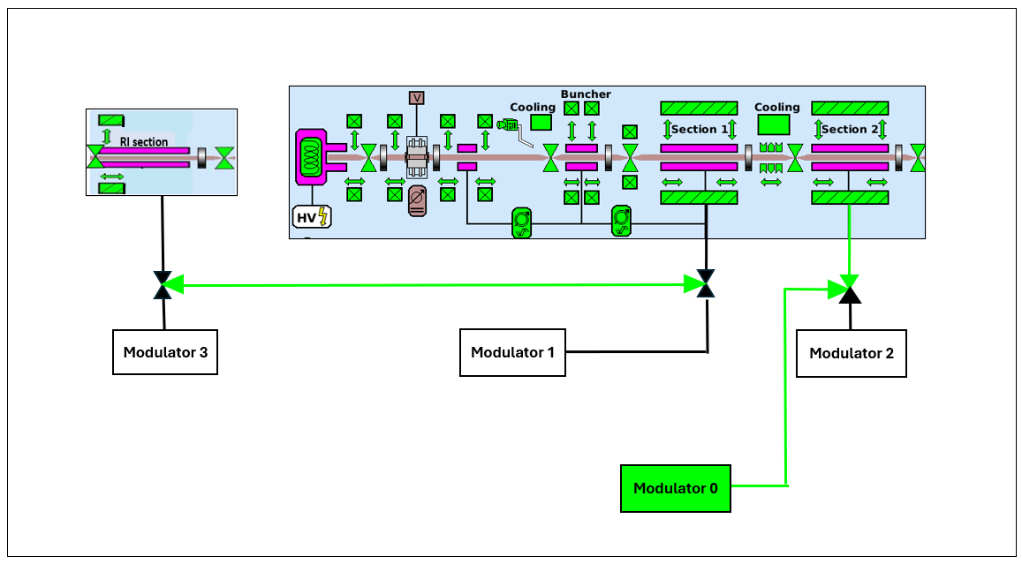
October shutdown 2026
 |  |  | COLD project |  |  | LINAC upgrade
 |  | Mode | Modulator hall |  |  | Modulator hall |  |  | PINJ (Tunnel)
Thursday | 01-Oct | USM
Friday | 02-Oct
Saturday | 03-Oct
Sunday | 04-Oct
Monday | 05-Oct | MDT
Tuesday | 06-Oct | USM
Wednesday | 07-Oct
Thursday | 08-Oct
Friday | 09-Oct
Saturday | 10-Oct
Sunday | 11-Oct
Monday | 12-Oct
Tuesday | 13-Oct | SD
Wednesday | 14-Oct
Thursday | 15-Oct |  | Grounding
Friday | 16-Oct
Saturday | 17-Oct
Sunday | 18-Oct
Monday | 19-Oct |  |  |  |  | Test Modulator0 on section2
Tuesday | 20-Oct |  |  |  |  | Wave guides connection between
Wednesday | 21-Oct |  |  |  |  | Modulator1 & Modulator3
Thursday | 22-Oct | Restart
Friday | 23-Oct
Saturday | 24-Oct
Sunday | 25-Oct
Monday | 26-Oct
Tuesday | 27-Oct | USM
Wednesday | 28-Oct
Thursday | 29-Oct
Friday | 30-Oct
Saturday | 31-Oct
Bonjour,
Pour faire suite à notre conversation téléphonique et après lecture du plan de prévention, je te confirme que l'enfoncement des pieux de terre doit être réalisé sans aucune co-activité, y compris de la part de l'ESRF.
Bonne journée.
Stéphanie
Stéphanie RICOT Classical Safety Engineer - ESRF 04 76 88 28 50
Tests

Slide 3
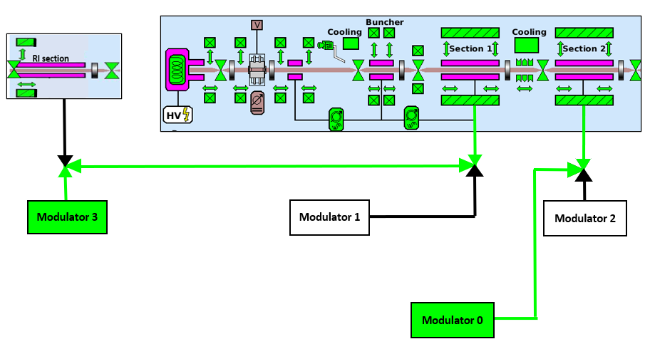
Winter shutdown 2026
Tests
 |  |  | COLD project |  |  |  |  |  | LINAC upgrade
 |  | Mode | Modulator hall |  |  | PINJ (Tunnel) |  |  | Modulator hall |  |  | PINJ (Tunnel)
Monday | 14-Dec | USM |  |  |  |  |  |  |  |  |  |  |  |  | 14-Dec | Monday
Tuesday | 15-Dec |  |  |  |  |  |  |  |  |  |  |  |  |  | 15-Dec | Tuesday
Wednesday | 16-Dec |  |  |  |  |  |  |  |  |  |  |  |  |  | 16-Dec | Wednesday
Thursday | 17-Dec | SD |  |  |  |  |  |  |  |  |  |  |  |  | 17-Dec | Thursday
Friday | 18-Dec |  |  |  |  |  |  |  |  |  |  |  |  |  | 18-Dec | Friday
Saturday | 19-Dec |  |  |  |  |  |  |  |  |  |  |  |  |  | 19-Dec | Saturday
Sunday | 20-Dec |  |  |  | Civil work : Coring |  |  |  |  |  |  |  |  |  | 20-Dec | Sunday
Monday | 21-Dec |  |  |  | 1 week |  |  |  |  |  |  |  |  |  | 21-Dec | Monday
Tuesday | 22-Dec |  |  |  | Noisy work |  |  |  |  |  |  |  |  |  | 22-Dec | Tuesday
Wednesday | 23-Dec |  |  |  |  |  |  |  |  |  |  |  |  |  | 23-Dec | Wednesday
Tuesday | 05-Jan |  |  |  |  |  |  |  |  |  |  |  |  |  | 05-Jan | Tuesday
Wednesday | 06-Jan |  | crane (S-band) installation |  |  |  |  |  |  |  |  |  |  |  | 06-Jan | Wednesday
Thursday | 07-Jan |  |  | 1 week |  |  |  |  |  |  |  |  |  |  | 07-Jan | Thursday
Friday | 08-Jan |  | Handling work/working at heights |  |  |  |  |  |  |  |  |  |  |  | 08-Jan | Friday
Saturday | 09-Jan |  |  |  |  |  |  |  |  |  |  |  |  |  | 09-Jan | Saturday
Sunday | 10-Jan |  |  |  |  |  |  |  |  |  |  |  |  |  | 10-Jan | Sunday
Monday | 11-Jan | Booster |  |  |  |  |  |  | Modulator0 connected to section2 for Operation |  |  |  |  |  | 11-Jan | Monday
Tuesday | 12-Jan | restart |  |  |  |  |  |  | Tests Modulator3 on section1 |  |  |  |  |  | 12-Jan | Tuesday
Wednesday | 13-Jan |  |  |  |  |  |  |  |  |  |  |  |  |  | 13-Jan | Wednesday
Thursday | 14-Jan | Restart |  |  |  |  |  |  |  |  |  |  |  |  | 14-Jan | Thursday
Friday | 15-Jan |  |  |  |  |  |  |  |  |  |  |  |  |  | 15-Jan | Friday
Saturday | 16-Jan |  |  |  |  |  |  |  |  |  |  |  |  |  | 16-Jan | Saturday
Sunday | 17-Jan |  |  |  |  |  |  |  |  |  |  |  |  |  | 17-Jan | Sunday
Monday | 18-Jan |  |  |  |  |  |  |  |  |  |  |  |  |  | 18-Jan | Monday
Tuesday | 19-Jan | USM |  |  |  |  |  |  |  |  |  |  |  |  | 19-Jan | Tuesday
Wednesday | 20-Jan |  |  |  |  |  |  |  |  |  |  |  |  |  | 20-Jan | Wednesday
Operation

Slide 4
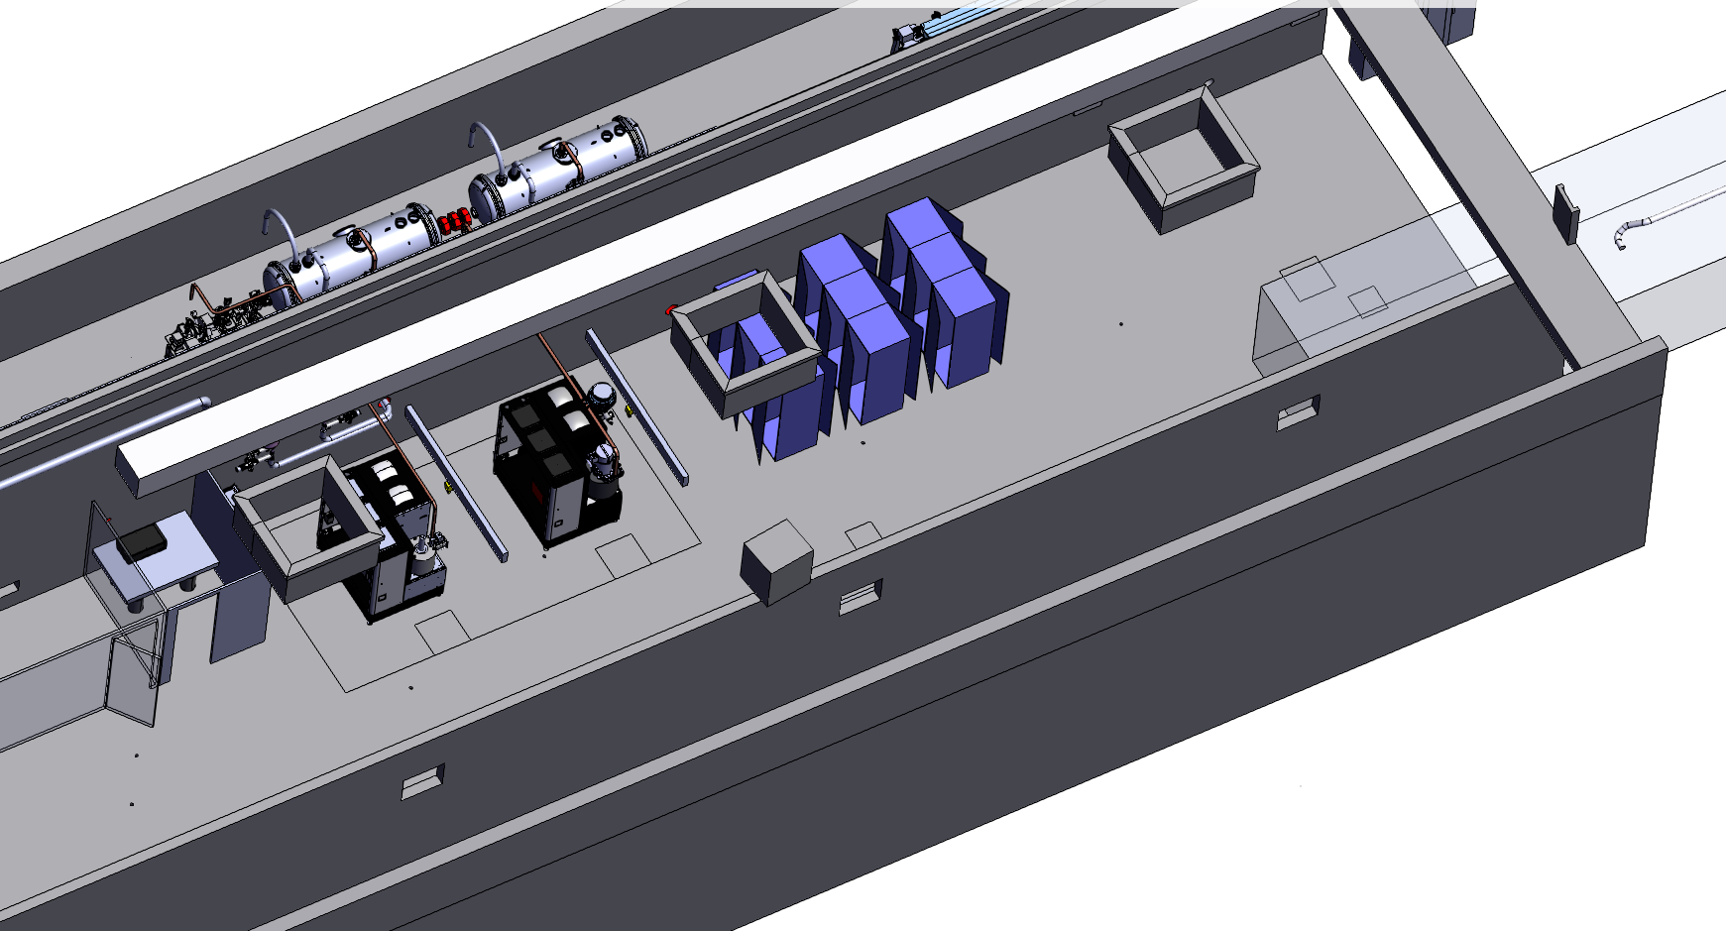
Modulator3
13 m
50cm
Faraday cage
Mise à jour plan 3D :
Insérer cage de faraday et modulateur3
Mises en plan :
Pont roulant pour modulateur S-band
Perçages trou dans mur PINJ/MH

