Slide 1
 |  |  | COLD project |  |  | LINAC upgrade
 |  | Mode | Modulator hall |  |  | Modulator hall |  |  | PINJ (Tunnel)
Mon | 27-Jul | USM
Tue | 28-Jul | SD |  |  |  |  |  |  |  | Open concrete door - Free space – new cavity
Wed | 29-Jul |  | Removal of row materials
Thurs | 30-Jul |  | after the transfer of the new cavity @ PINJ |  |  |  |  |  |  | Close concrete door
Fri | 31-Jul
Sat | 01-Aug |  |  |  |  |  |  |  | Start to | connect new | cavity to Modulator3
Sun | 02-Aug
Mon | 03-Aug
Tue | 04-Aug |  | Civil works : Manholes creation |  |  | No other intervention due to noisy work |  |  | No other intervention due to noisy work
Wed | 05-Aug
Thurs | 06-Aug |  |  | Resin
Fri | 07-Aug
Sat | 08-Aug
Sun | 09-Aug
Mon | 10-Aug |  | End of civil work - cleaning of the area
Tue | 11-Aug
Wed | 12-Aug
Thurs | 13-Aug
Fri | 14-Aug
Sat | 15-Aug
Sun | 16-Aug
Mon | 17-Aug
Tue | 18-Aug
Wed | 19-Aug
Thurs | 20-Aug | Restart
Fri | 21-Aug
Sat | 22-Aug
Sun | 23-Aug
Mon | 24-Aug
Tue | 25-Aug | USM
Wed | 26-Aug
Mon | 27-Jul
Tue | 28-Jul
Wed | 29-Jul
Thurs | 30-Jul
Fri | 31-Jul
Sat | 01-Aug
Sun | 02-Aug
Mon | 03-Aug
Tue | 04-Aug
Wed | 05-Aug
Thurs | 06-Aug
Fri | 07-Aug
Sat | 08-Aug
Sun | 09-Aug
Mon | 10-Aug
Tue | 11-Aug
Wed | 12-Aug
Thurs | 13-Aug
Fri | 14-Aug
Sat | 15-Aug
Sun | 16-Aug
Mon | 17-Aug
Tue | 18-Aug
Wed | 19-Aug
Thurs | 20-Aug
Fri | 21-Aug
Sat | 22-Aug
Sun | 23-Aug
Mon | 24-Aug
Tue | 25-Aug
Wed | 26-Aug

Slide 2
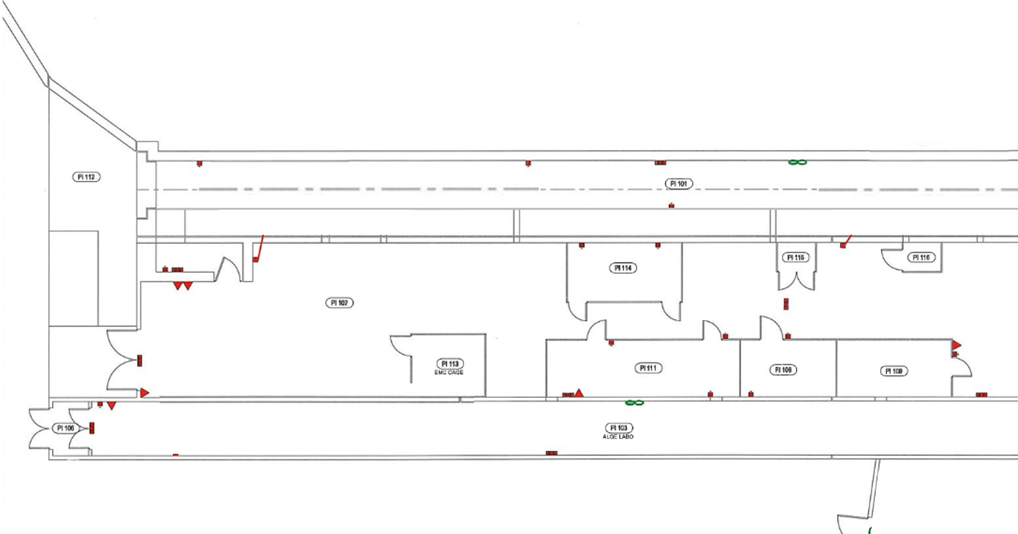
solenoid
Screen
Steerer
Fast CT
screen
BPM/BLM
RF deflector
Steerer
Quadrupole
Quadrupole
BPM/BLM
Quadrupole
BPM/BLM
Quadrupole
dipole
laser
modulator
25 (35) MW
1.5 μs
S-band (2.998GHz)
modulator
50 MW
4.0 μs
C-band 5.712GHz
Control PS
Diagnostic
Alignment
LN₂
Waveguide S-band
Waveguide C-band
Vacuum pump
pulse compressor

