Slide 2
Insertion Devices and Magnets
Gaël LE BEC
on behalf of the IDM group
ASD Workshop, 24th January 2023

Slide 3
ID status and developments
ID upgrades
Magnets
The IDM group

Slide 4
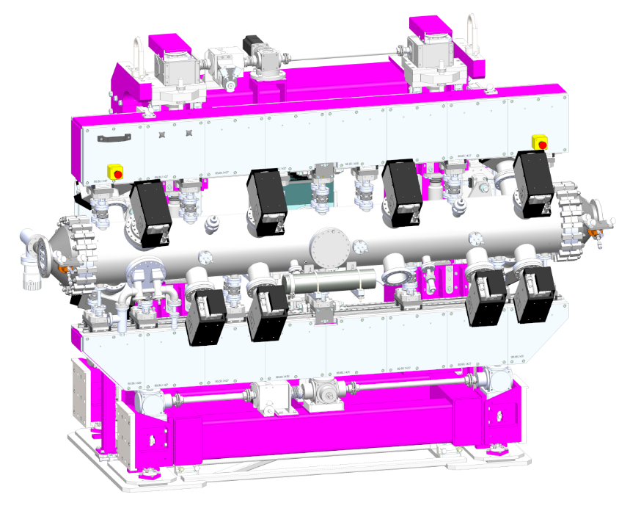
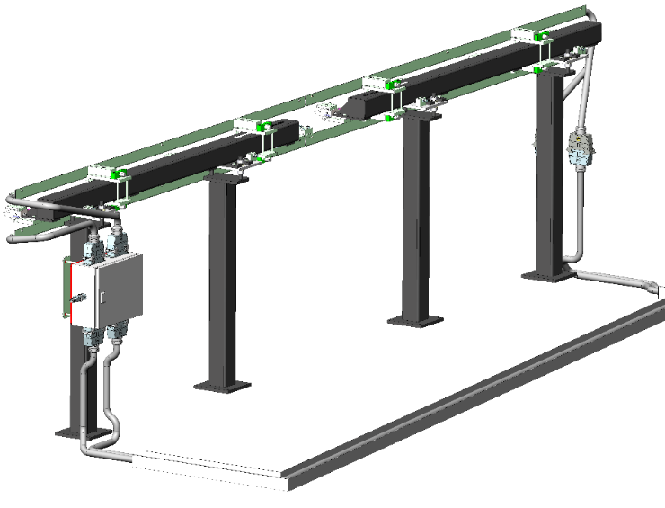
New Ids installed in 2022
ID12 HU34
March 2022
ID27 CPMU18
August 2022
Field compensation loops
ID18/20/24/28

Slide 5
ID production
Magnetic assemblies in progress
ID29 CPMU16.4
Preparation of cold measurements in progress
Installation planned during March shutdown 2023
ID03 CPMU16.4
Shimming in progress
Installation planned during summer shutdown 2023

Slide 6
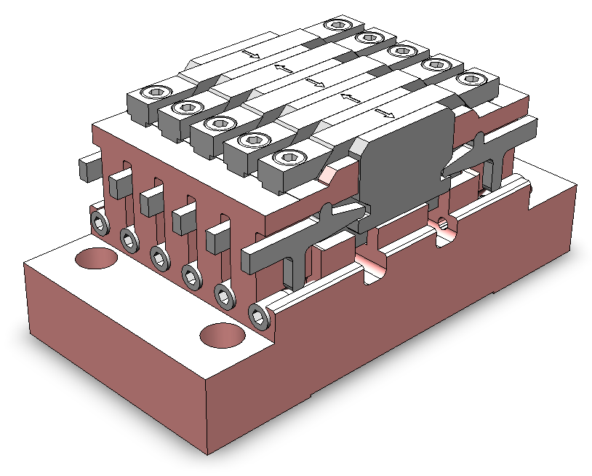
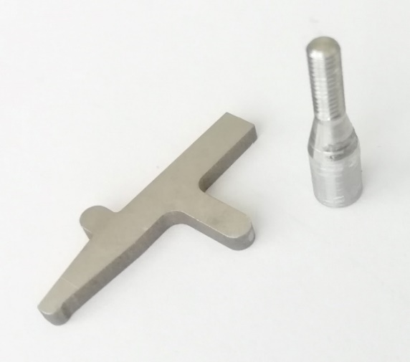
ID production: issues with CPMU
Pole positioners issue
Levers tend to block
Makes the shimming difficult
Lever and screw design modifications tested, much better but not perfect
New module design successfully tested, ordered for the next CPMUs
Mechanical tolerances more systematically tested
3D view of a CPMU magnet module

Slide 7
ID production: CPMU shimming
Field integral
New sorting procedure works well
Magnet flipping procedures developed
Magic fingers to be installed on ID03 CPMU
Spectrum shimming (radiation phase)
Systematic procedure tested
3D view of a CPMU magnet module

Slide 8
ID production
Magnetic assemblies in progress
ID32 APPLE-II HU70(1&2)
Assembly and shimming in progress
Installation planned next summer
Magnetic assemblies to start
ID24 revolver undulators: magnet procurement in progress
ID14 CPMU: magnet holder procurement in progress
ID18 CPMU: procurement in progress
ID13 CPMU
ID01 vertical polarization IVU: procurement done
ID14 U20/27: carriage procurement to start

Slide 9
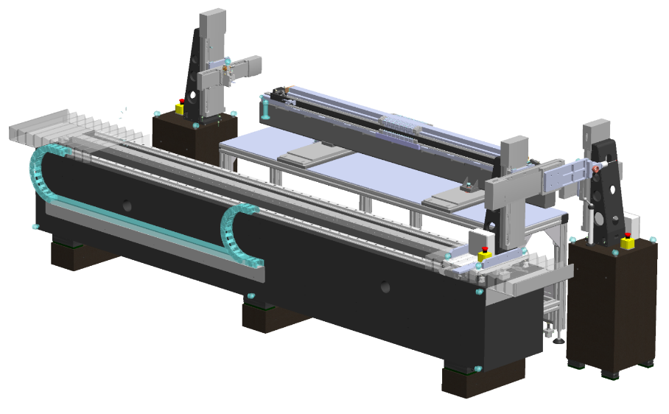
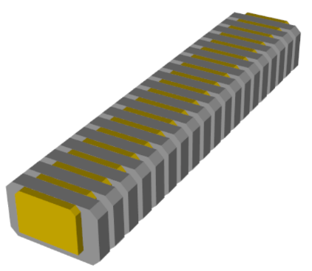
ID production: Measurement benches
New undulator bench
Most components received
Assembly optimization
New assembly and shimming methods tested
Assembly software being developed
Goal: a digital twin of undulator assembly
Next steps
Bench assembly and commissioning
Bench control software, to be based on Tango

Slide 10
RF transition issues on CPMUs
What are RF transitions?
Ensure electrical continuity for image currents
Smooth transition needed, any step should be avoided
Installed on all in-vacuum undulators and CPMUs
IVU / CPMU
PM girders
Vacuum chamber
RF transitions
Vacuum chamber
PM girders

Slide 11
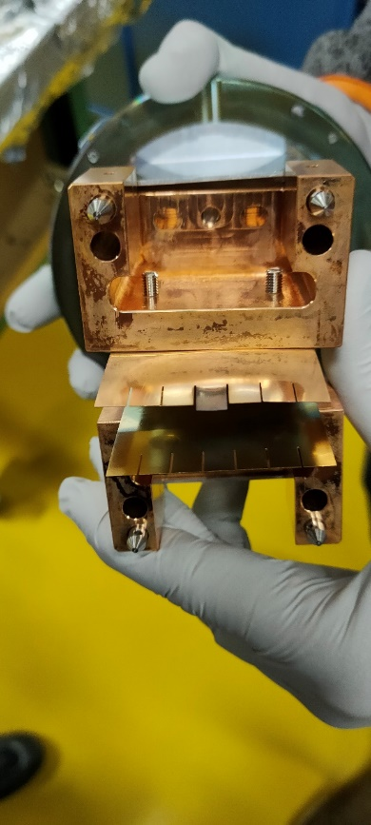
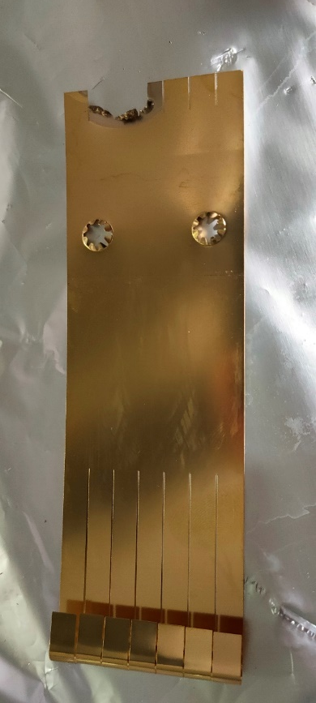
RF Transition issues on CPMUs
Recent history
RF finger redesigned to allow LN2 circulation through the girders
This new design has some weaknesses
Two problems on ID15 CPMU, in 2020 and 2022
Temporary SR current limitation in 16 bunchs mode
New design in May 2022
Replacement during summer shutdown
Dec. 2020
May 2022

Slide 12
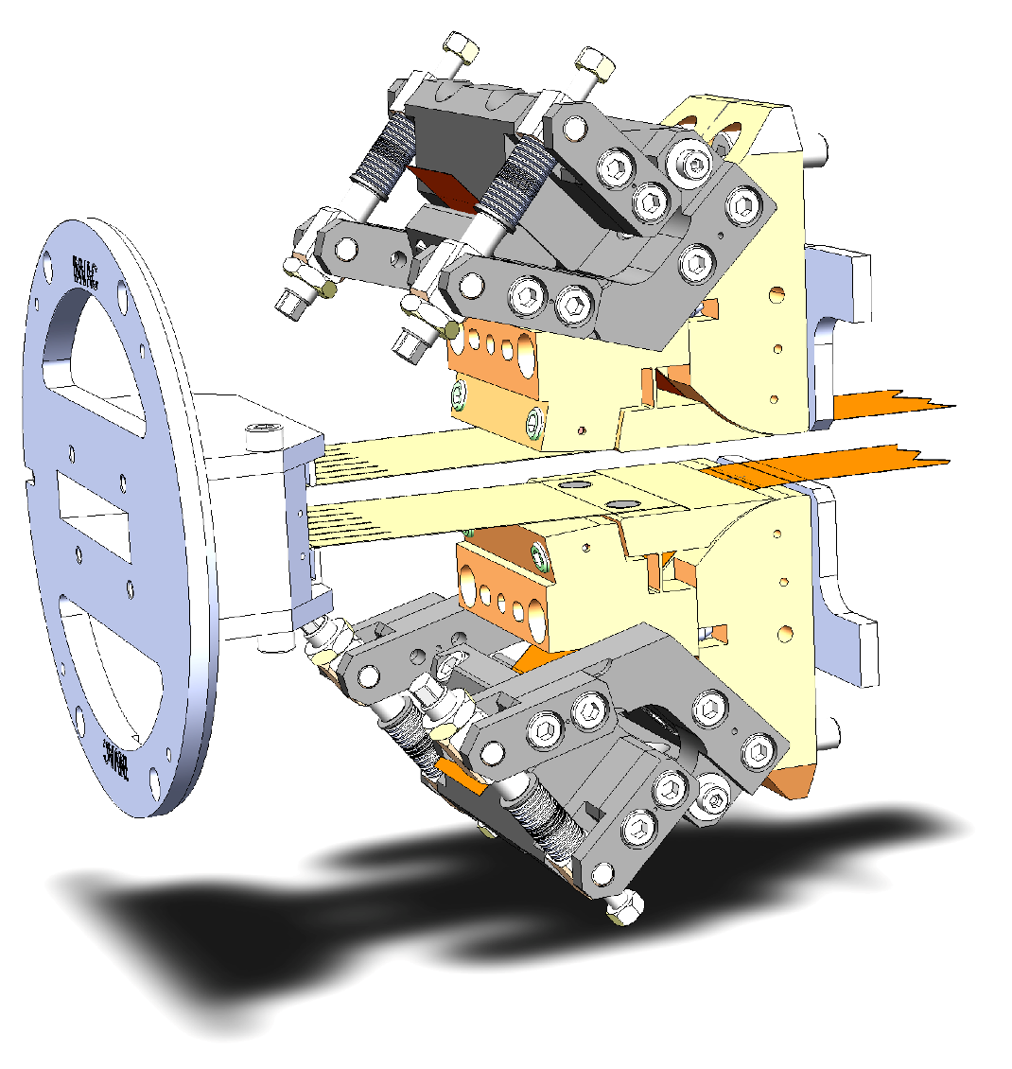
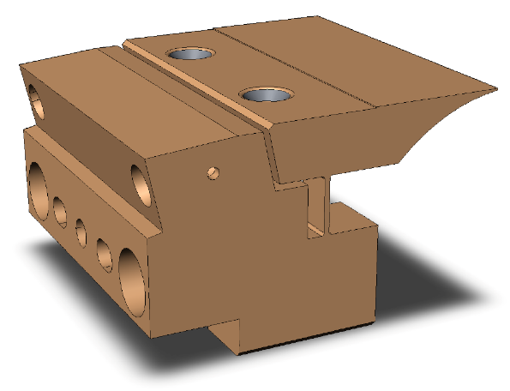
RF Transition issues on CPMUs
May 2022 design
Better contact
Thin foil replaced by a Cu block
(Courtesy T Brochard and B Ogier)

Slide 13
RF Transition issues on CPMUs
Issue on ID16 during restart
Strong beamlosses observed
Compatible with an obstacle at the entrance of the CPMU
Intervention to be done next shutdown
Gap limited to 8 mm instead of 6 mm

Slide 14
ID low level controls
ID control upgrade identified as a major project by ESRF management
Present status: specifications and CDR preparation
Project leader: Reine Versteegen – See her talk today!

Slide 15
ID status and developments
ID upgrades
Magnets
The IDM group

Slide 16
Standard Lengths of ID segments
In-air single axis, 0.8 – 1 m
In-air short taper / short revolver, 1.4 m
In-air taper / revolver, 1.6 m
In-air long taper / long revolver, 2.3 m
APPLE-II, 2.1 m
Short IVU / CPMU, 1.5 m
IVU / CPMU, 2 m
IVU / CPMU, 2.5 m

Slide 17
Straight sections with Two Insertion devices
P S
Taper / revolver – 2.3 m
Taper / revolver – 2.3 m
IVU / CPMU – 2 m – 6 mm
P S
Taper / revolver – 2.3 m
Why two segments revolvers?
Undulators are phased by adjusting their longitudinal distance
With revolvers, this can be done for one period only
Using an additional phasing segment (PS) between two segments would increase the brilliance significantly
A factor of 4 measured on ID32 at 1.5 keV, between in-phase and opposite phase
A factor of 2.3 simulated at 12.5 keV

Slide 18
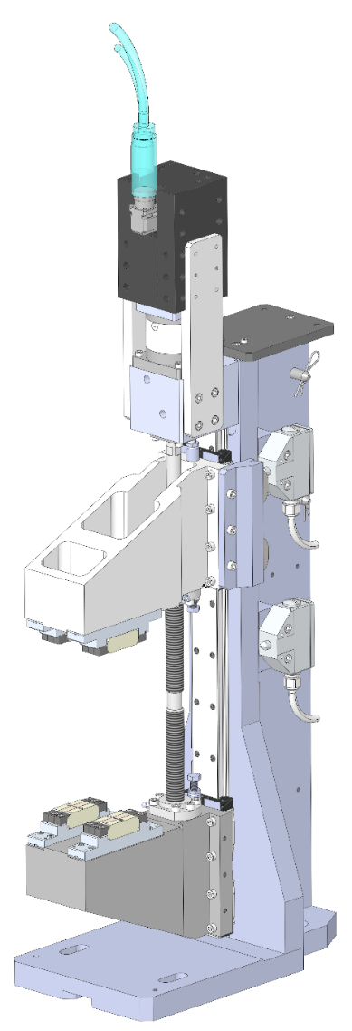
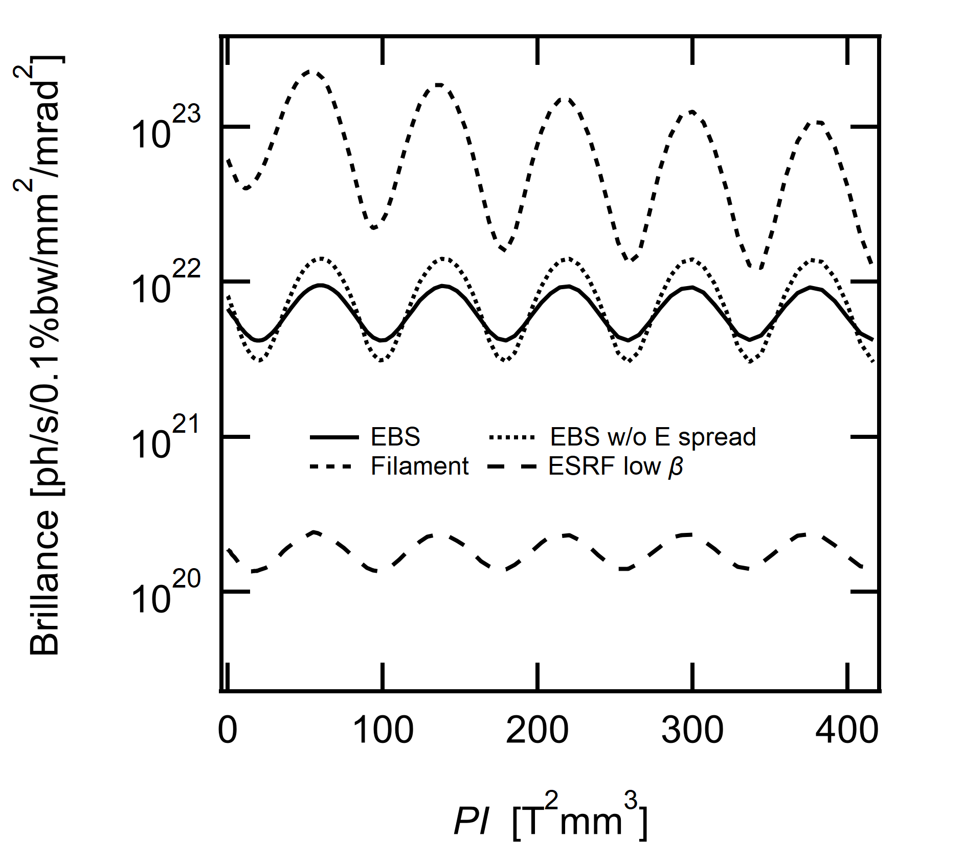
Straight sections with Two Insertion devices
Brilliance vs phase shifter strength at 12 keV

Slide 19
CPMUs in middle position
CPMU – 5 mm gap
Single CPMU: ID03, ID13, ID18, ID27, ID31
Q
Q
CPMU – 4 mm gap?
Q
Q
CPMU with mini-beta (4 mm gap?): tests planned on ID31
Short ID
CPMU – 5 mm gap
Short ID
CPMU and short IDs (5 mm gap): an option for next source upgrades, e.g. ID28

Slide 20
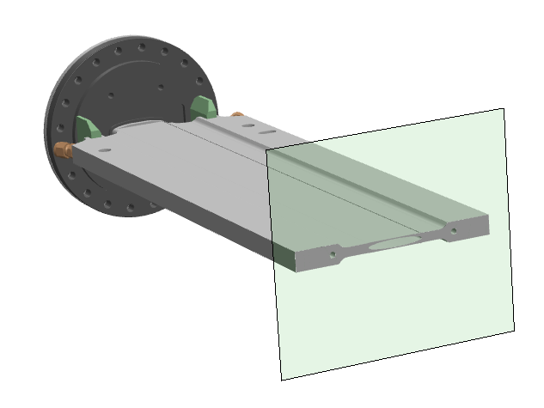
Reducing the gaps of In-air undulators
Present ID vacuum chambers
8 mm inner aperture
10 mm thickness
Up to 5 m long
Minimum ID gaps of about 11 mm
Thinner chambers
IVU/CPMU minimum gap of 6 mm
6 mm aperture / 8 mm thickness chambers seems feasible
Would allow 9 mm minimum gap IDs

Slide 21
Reducing the gaps of In-air undulators
Thinner chambers (cont’d)
2.3 m long prototype build and coated
RF transitions to check
Obvious impact on future in-air undulator specifications
Next steps: schedule the tests and find a location!

Slide 22
ID status and developments
ID upgrades
Magnets
The IDM group

Slide 23
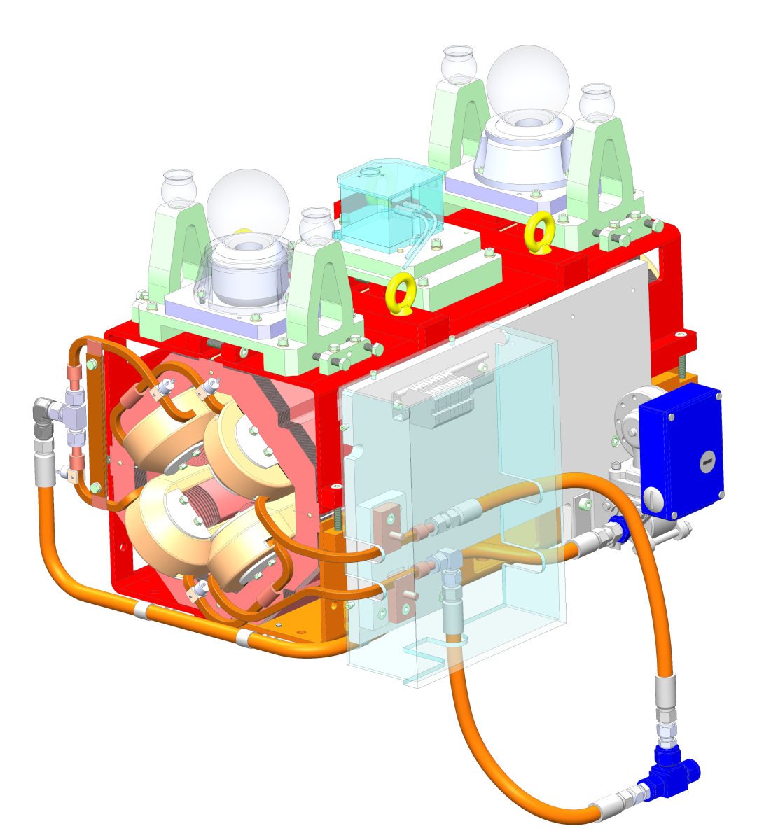
Magnet activities
Maintenance activities
Magnet maintenance in the SR and booster
Refurbishment and characterization of two spare booster quads
Magnetic design
PM injection magnets
Collaboration with PETRA
Measurements benches
Sales of magnetic measurement benchs

Slide 24
ID status and developments
ID upgrades
Magnets
The IDM group

Slide 25
IDM staff
Eleven IDM group members now
Two departures end 2022
Leang Thai, technician on magnetic assemblies, PM characterization
Ilia Asparuhov, PhD student, short period staggered undulator
Two newcomers
Jérôme Caverot
PLC
ID low level controls
Frédéric Perratone
Mechnanics
Methods

Slide 26
Thank you for your attention!

