Slide 1
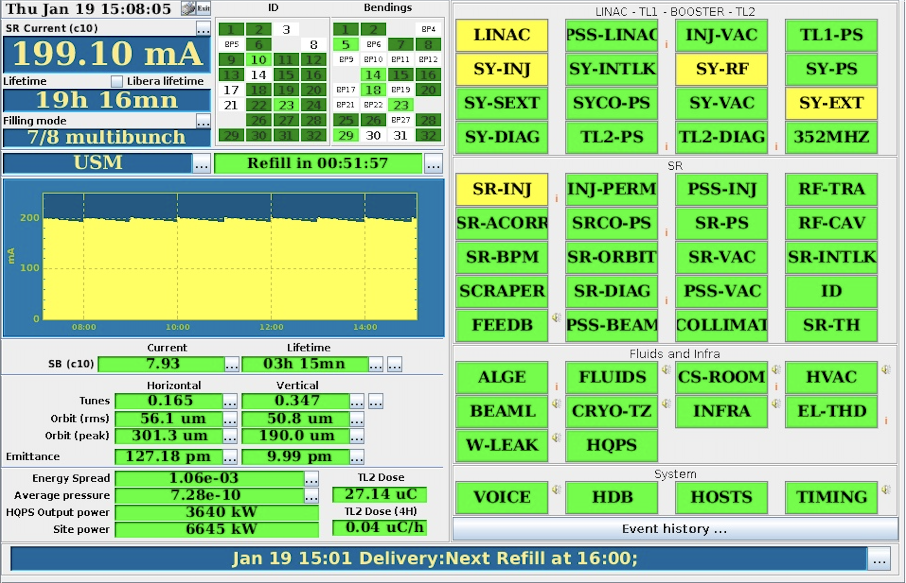
ASD Workshop - January 24th, 2023
2023 Accelerator Control Activities
Nicolas Leclercq
on behalf of the Accelerator Control Unit

Slide 2
Outlines
1
Evolution of the Staff
Highlights from 2022
Some Perspectives for 2023

Slide 3
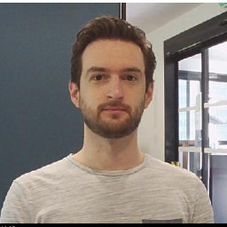
Evolution of the STAFF
2
Bye
Welcome
👋
Arthur Valiente
left mid. October 2022
🤝
Candidate Selected
Wait and see…

Slide 4
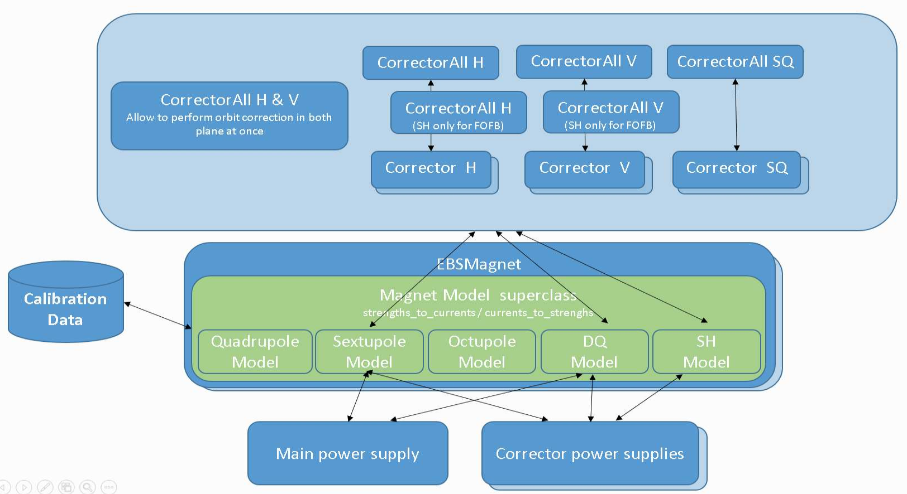
Highlights 2022
3
Refurbishment of the {Magnets, Power Supplies} Ecosystem
Motivations
ensure long term maintenance
enhance com. with hardware units and interaction between software components
enhance performances & ergonomics
Expected Added Value
maintainability, extendibility & flexibility (e.g, local/specific magnetic config.)
ergonomics: change optics params. while the slow orbit feedback (a.k.a., autocor) is running
performances: allow simultaneous autocor correction in both H & V plane + increase corr. frequency
Constraints
modify/test software components representing 22% of the control system
(4800 Tango devices among the +26500 running in the control system)
… without impacting the daily operation of the machine!
sentenced to do better than the previous design/implementation (V1)
How to Achieve these Goals
leverage knowledge acquired while developing V1 (learning while doing), manage risk
promote offline development & validation → major role played by the (enhanced) EBS simulator
optimize online tests → dedicated installation/rollback tool for MDT sessions

Slide 5
Highlights 2022
3
Refurbishment of the {Magnets, Power Supplies} Ecosystem
Status
magnets part done – in production since Oct. 2022 → the major change is validated!
significative progress on power supplies & HSM (hot swap manager) control
Actual Added Value (list validated by Beam Dyn. :-)
cleaner design = enhanced maintainability
faster autocor loop: 1 correction every 30s → every 12s (today) → every 3s (near future)
ability to change sextupole settings while autocor is on
`→ ability to optimize the lattice in USM-like conditions (or, if necessary, in USM)
ability to load new “design optics” without impact on the beam (bug fix by design)
much faster response and visualization of the magnetic strengths modifications
better integration of the calibration data provided by IDM for each magnet
simpler cycling of a single magnet (the cycling is a parallel task of the project, more to come)
enhanced EBS simulator (virtual PS + cycling)
more to come (e.g., simultaneous autocor correction in both H & V plane)
Contributions
involved groups: Beam Dyn., Diags, PSG, IDM, MachOp, ISDD-DEG-EU, ISDD-SWG-ACU
main ACU contributors: Jean-Luc Pons, Arthur Valiente, Nicolas Tappret, Faranguiss Poncet

Slide 6
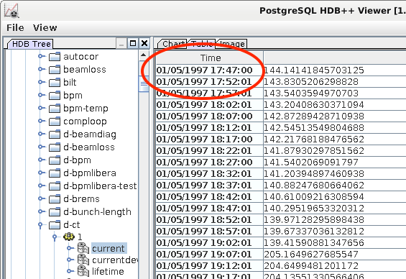
Highlights 2022
3
Transfer of the pre-EBS Data to HDB
as agreed, Damien Lacoste (HDB/TimeScale DB expert) …
… migrated 1.4 To from former Oracle & Casandra HDB to a dedicated Timescale DB
jlauncher → Moni/HDB → pre-EBS Historical Database [1997 – 2018]
oldest data from 01/05/1997

Slide 7
Highlights 2022
3
Transfer of the pre-EBS Data to HDB
concatenation of 2 decades of vacuum data from pre & post EBS SR - courtesy of Hugo Pedroso Marques

Slide 8
Highlights 2022
3
About HDB
grew by 1To in 2022
manageable so far
10To of disk space remaining on the new cluster
2.9To of EBS data + 1.4To of pre-EBS data
separated databases due to major changes in naming schema between pre & post EBS
we might need to redefine the way we store and use the HDB data
might be a subtask of a wider data logging project for EBS…

Slide 9
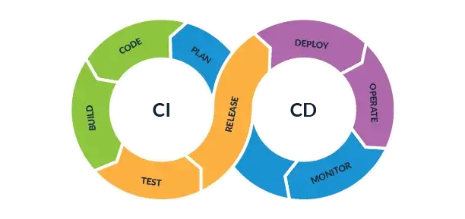
Highlights 2022
3
ACU CI/CD platform
ACU internal project
CI/CD: stands for Continuous Integration / Continuous Delivery
belongs to the DevOps toolbox
Life cycle management of our +500 Tango classes and +110 Java applications
long term maintenance of our code base
deal with evolution of operating systems, languages/compilers, dependencies (libraries), etc.
fight against orphan projects & frozen binaries
control system made of homogenous software components
Status
CI part done for C++ projects
`→ device servers are now aggregation of Tango classes compiled as shared libraries
`→ allows system wide fixes and enhancements (mutualization)
`→ allows mass compilation
we are ready to migrate our +500 Tango classes to Tango 9.4!
ACU contributors
Arnaud Le Meillour, Damien Lacoste, Reynald Bourtembourg, Nicolas Leclercq

Slide 10
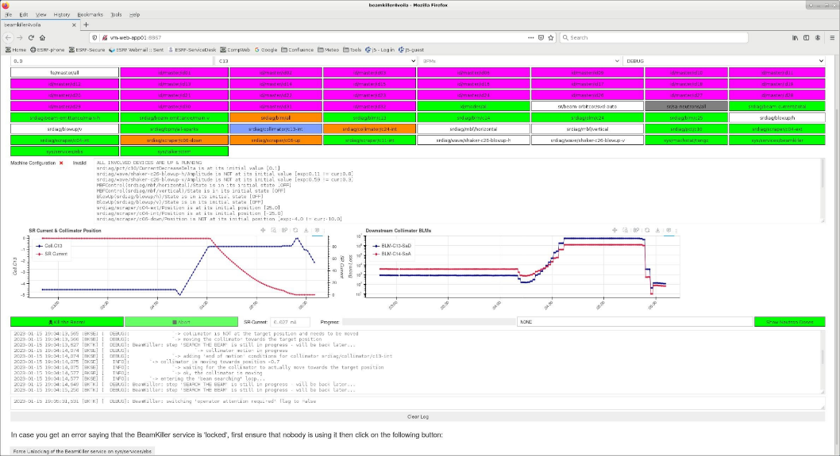
Highlights 2022
3
First web app. deployed in the CTRM
A dashboard on top of the (new) beam killer Tango device
A jupyter notebook (python) converted into a web application using Voilà
a POC related to our reflection on the future of the GUIs (see perspectives for 2023)
a Firefox tab rendering the Beam Killer dashboard - courtesy of Lee Carver

Slide 11
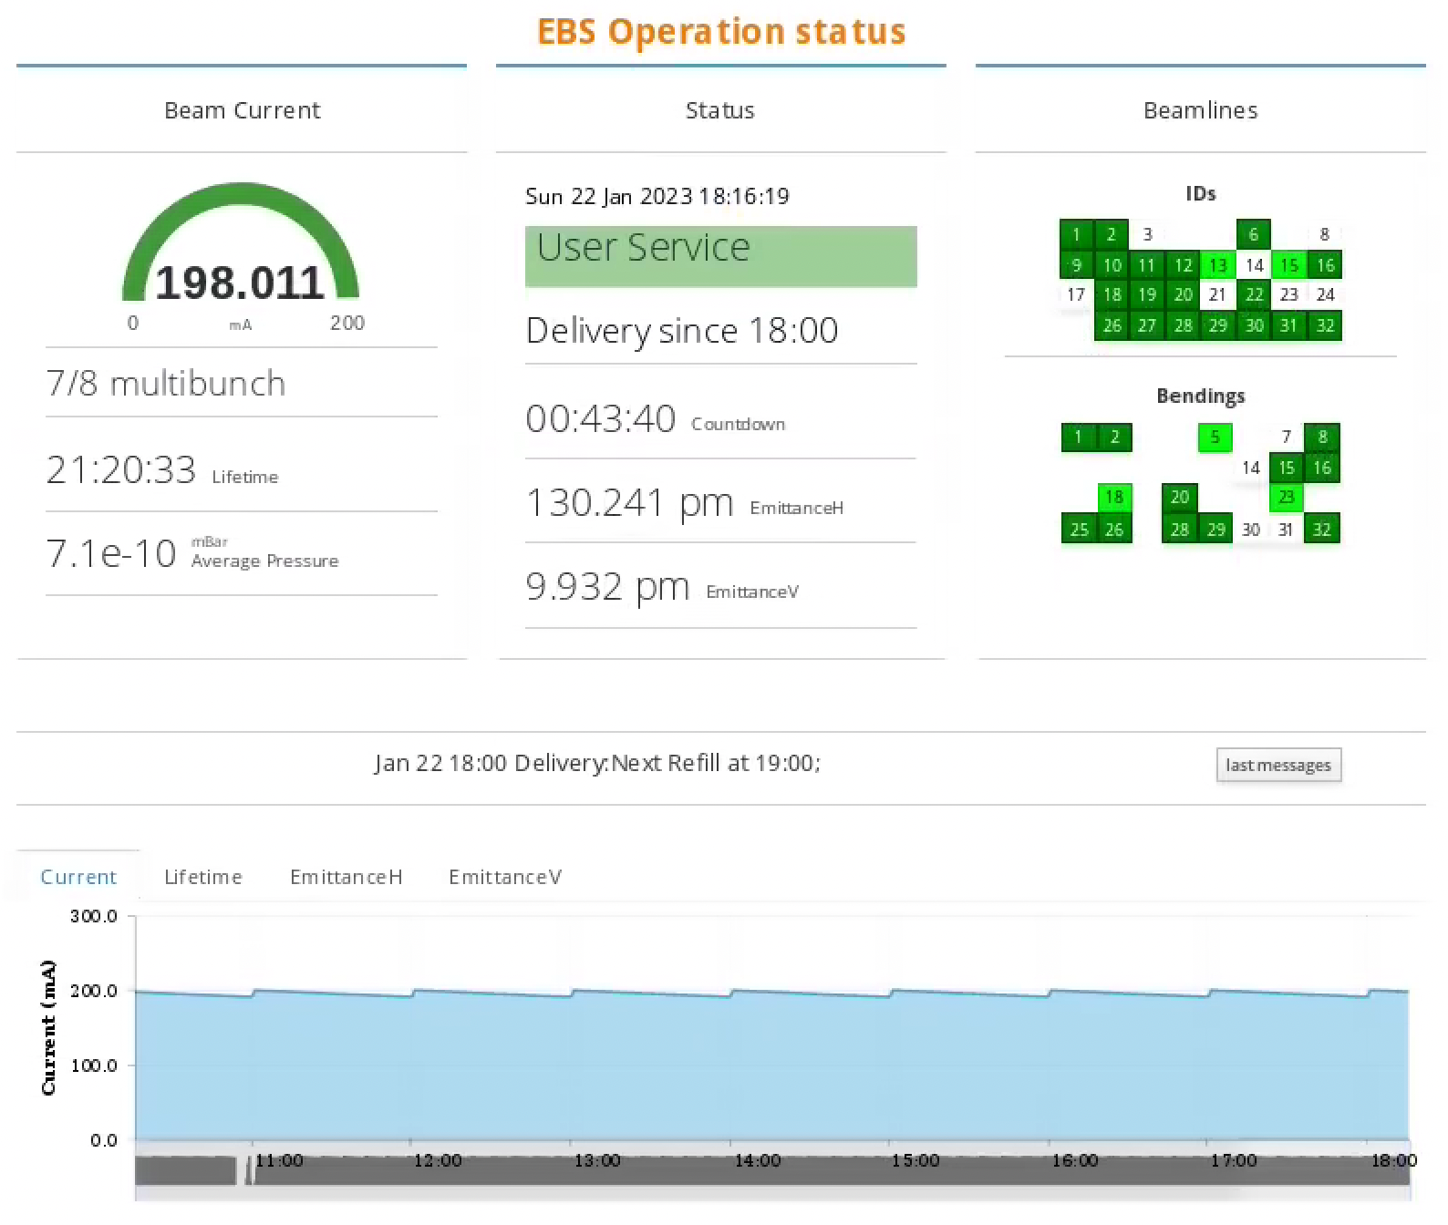
Highlights 2022
3
Upgrading the Machine Status web page
the underlying technology obsolete
Jyse (supplier no longer exists)
backend by ISDD-SWG-ACU
bridge to Tango
done, to validate
frontend by ISDD-SWG-DAU
GUI (dashboard)
in progress
part of our reflection on the future of our GUIs
pure web app
based on specific techs (e.g., React)

Slide 12
Perspectives for 2023
4
Finalize the refurbishment the Magnets/PS ecosystem (Beam Dyn., PSG)
autocor + {HSM, Comeca Statum} + cycling
Integration of the 352 MHz SSA (RF)
ready, waiting for dev. platform from JEMA (control interface)
Extension of the FOFB to 320 BPMs (DIAGs)
main idea: add the Spark units to the FOFB
already working (functionally speaking) some remaining tasks for ACU & Diags
Contribute to Inj. Perturbations Studies (Beam Dyn., DIAGs, MachOp)
e.g., finalize emittance measurement sync. with 4Hz inj. signal
in production since 01/2023, auto-gain sporadic pb. to be fixed, recently proved to be of interest
more to come…

Slide 13
Perspectives for 2023
4
Progress in our reflection on the future of our GUIs
TAURUS workshop at the ESRF on March 7th & 8th 2023
part of Tango SIG workshops series
feedback & strategy for the future – talks by both operation & computing teams
please visit https://indico.esrf.fr/event/76
Launch a series of discussions about “large scale data logging”
prerequisite for any (modern) data-driven tools & services
e.g., machine studies, advanced post-mortem analysis, AI-based models (datasets), etc.
brainstorming meetings → interest, needs, means & cost… worth it?
→ yes → 📄 proposal → official project
→ no →🗑️
several aspects: hardware, software, infrastructure → services

Slide 14
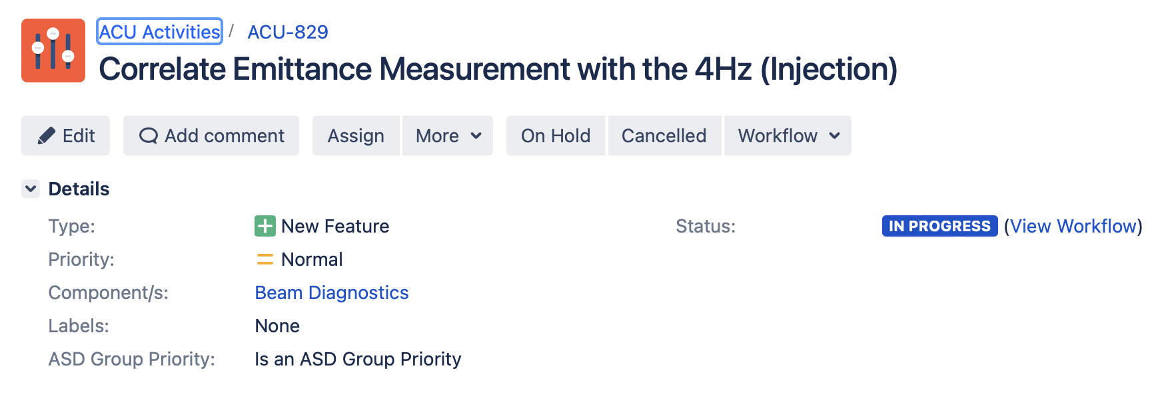
Perspectives for 2023
4
and obviously…
maintain a strong involvement in the development and the governance of
continue to support the daily operation of EBS
for non-trivial requests: meet the ACU team members, brainstorm, agree on what to do…
… then put the outcomes (specs) of your exchanges in a… Jira ticket!
` $→$ specs to validation follow-up & traceability
each ASD group can create as many tickets as necessary but please …
… provide us with visibility on the 2 “current priorities” using the dedicated flag
😱

Slide 15
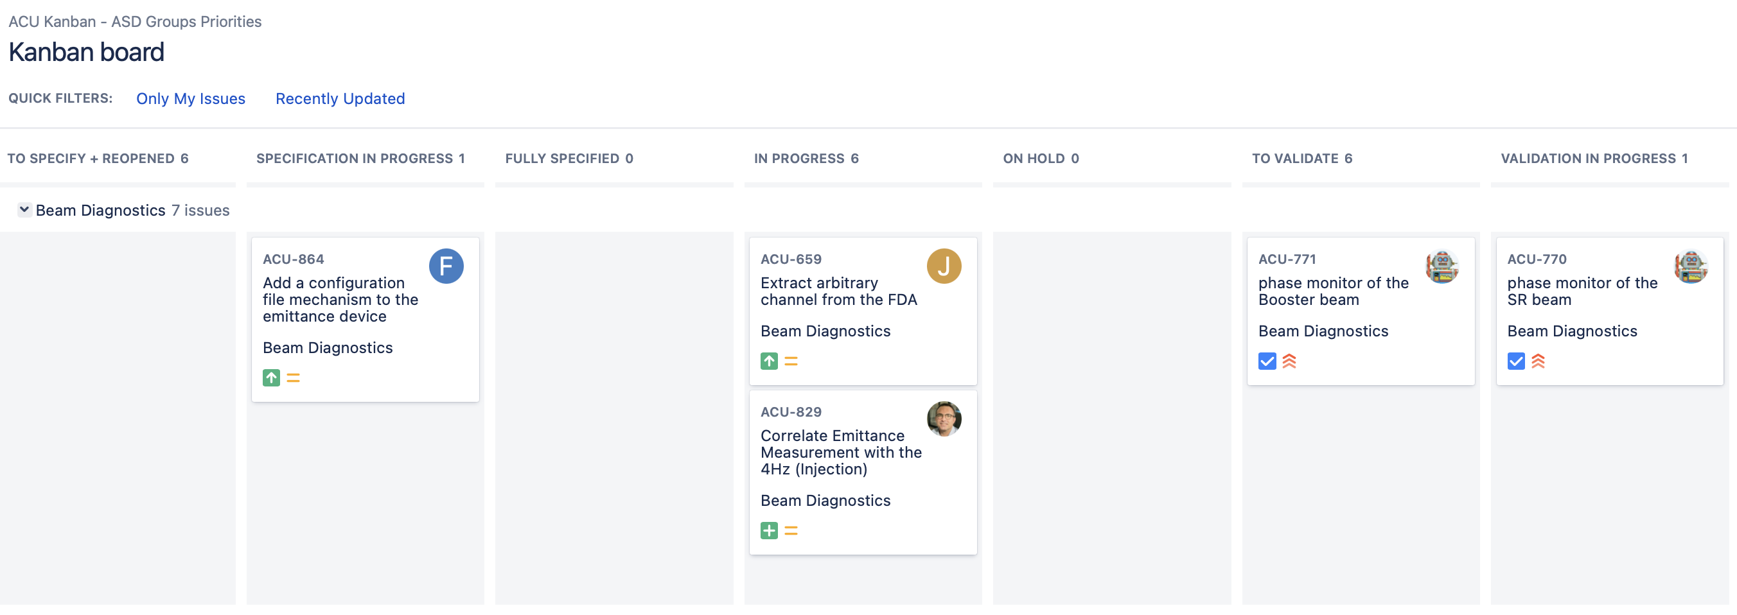
Perspectives for 2023
4
and obviously…
maintain a strong involvement in the development and the governance of
continue to support the daily operation of EBS
for non-trivial requests: meet the ACU team members, brainstorm, agree on what to do…
… then put the outcomes (specs) of your exchanges in a… Jira ticket!
` $→$ specs to validation follow-up & traceability
each ASD group can create as many tickets as necessary but please …
… provide us with visibility on the 2 “current priorities” using the dedicated flag
😱

Slide 16
Conclusion
5
ACU is aligned with the strategic objectives of the ESRF ⁽ ⁾
we are consolidating the EBS control system
enhance (fixes & new features), industrialize (reliability)
leverage knowledge, (when needed) dare to change or transform to ensure long term maintainability
…while having a look to the future
stay tuned, look around, visit & talk to peers, join/animate tech. communities
🤓

Slide 17
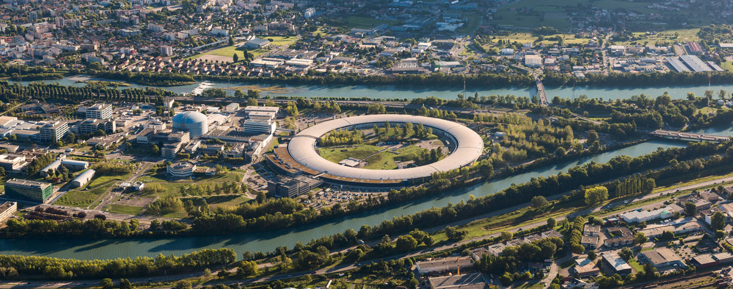
On BEHALF of ACU, THANKS for YOUR ATTENTION!
5

