Slide 1
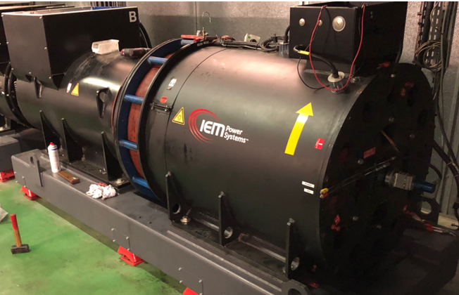

ASD Workshop
24 January 2023
Power Supplies Group
Laurent JOLLY

Slide 2
Presentation Outline:
Operation - Reliability of SR PS
Review of PSG Projects
HQPS Black Out Protection

Slide 3
Storage Ring PS Reliability
 | MTBF [h]
 | Y2020 | Y2021 | Y2022
10 x CS 360V and CS 48V | 900 | 6792 | 2224
864 x Main PS (STATUM) | 111 | 271 | 351
32 x Hotswap (MOSplates)* | N/A | 750 | >6672
864 x SF/SD Corr PS | 1350 | 2264 | 3336
294 x SH Corr PS | 216 | >6792 | >6672
Whole System | 64 | 178 | 277
2020
2021
2022
* Hotswap hardware installed but automatic swap function not operational
23 failures in Y22 (USM + MDT + Shutdown restart)
MTBF for the overall system in Y22 increased by 50% versus Y21
Failures distribution by Eqpt / Type: 78% are STATUM PS, 65% are software related
Other less visible problems: overheating power connections in HSC, waterleaks
Prediction for 2023?

Slide 4
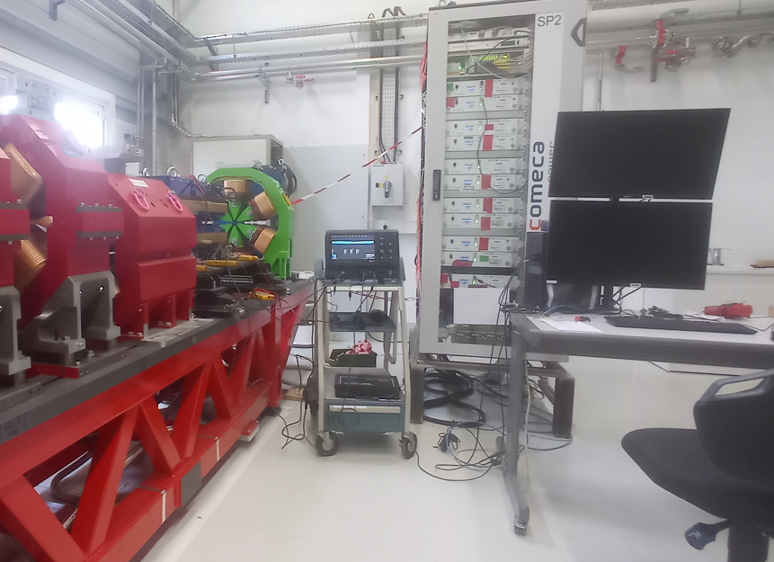
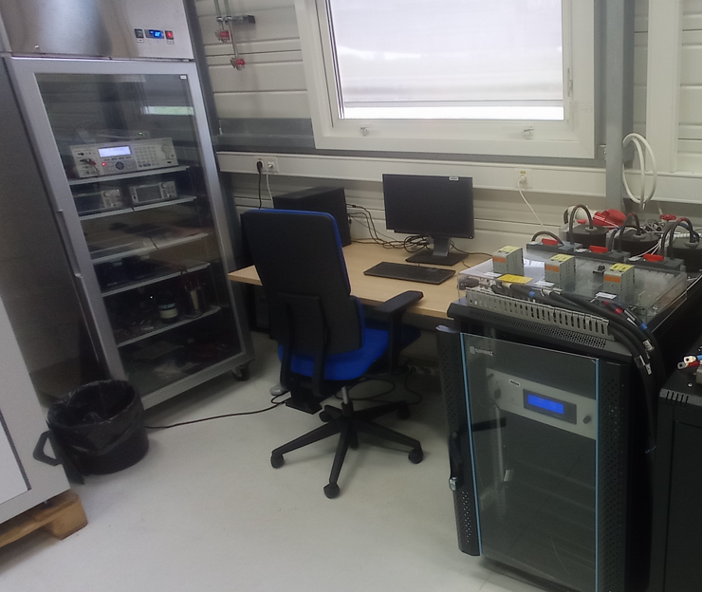
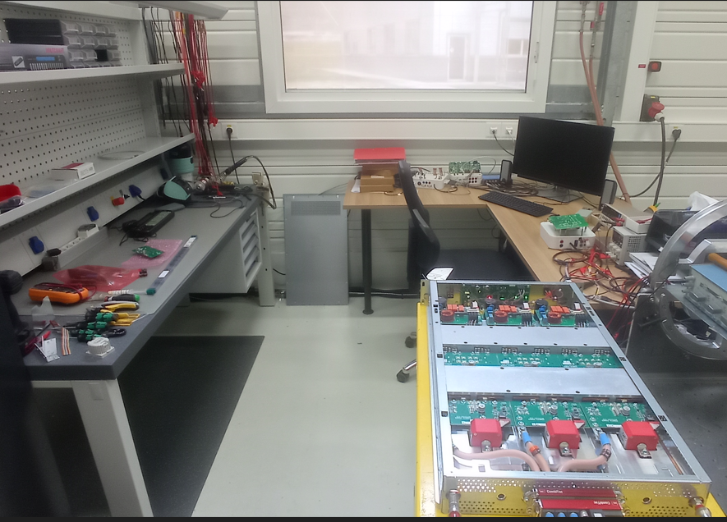
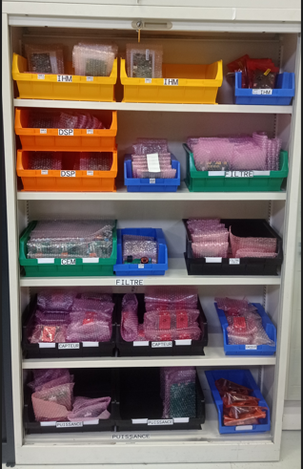
ProjectS: STATUM test and repair Lab (MD-0-16)
Full SRPS System Test stand (CS + HSC + Magnets + TANGO control)
  Used extensively for Hotswap development work
  For validation test of STATUM firmware modifications
STATUM Calibration platform
  Routine calibration of STATUM PS after repair
  Future periodic calibration campaign for 862 PS?
Repair station
  Manufactured and tested 265 electronic boards (stock of spare parts)
  Repaired 12 STATUM PS and 2 electronic boards in Y22
Main People involved:
A. Thai, S. Lagarde,
M. Michel, B. Joly
(+ PSG and TID)

Slide 5
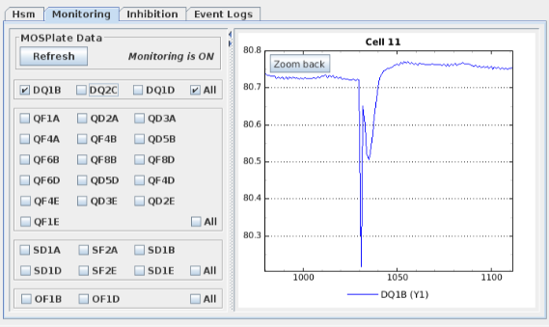
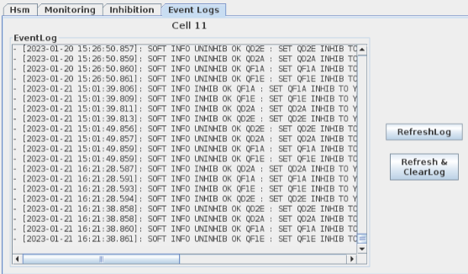
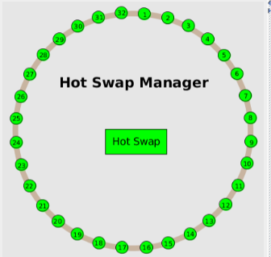
PRoJECtS: Hotswap STATUS
Activities of last 12 months
Jan – Sept 22: Developed the TANGO controls and user interface
Improved robustness of system
Sept – Oct 22: Test in the SR during MDTs only (at night)
Nov 22: partial deployment in USM (8 cells, 2-3 weeks)
17th Jan 23: full deployment in USM
What’s next:
  assess reliability of the system in USM and fix arising issues
  Improves user-interface for operators (automatic turn-off / turn-on when beam is on/off)
  Y24: Equip sextupole magnets with MOSplates

Slide 6
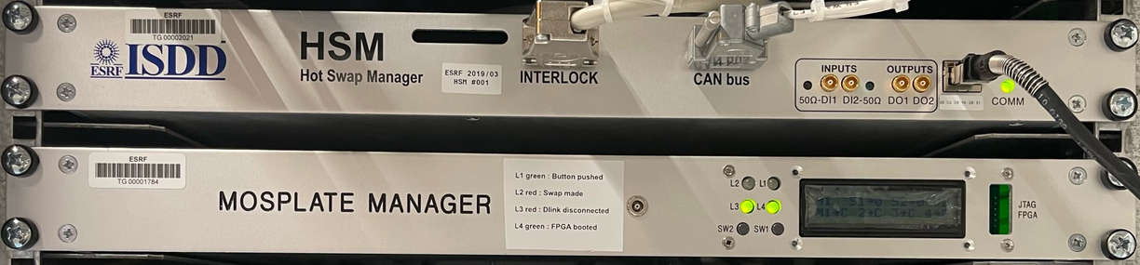
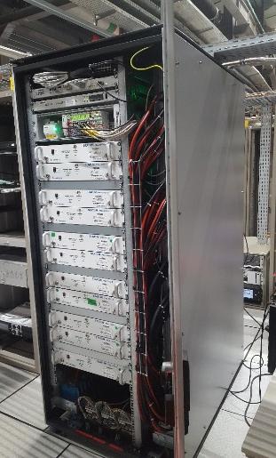
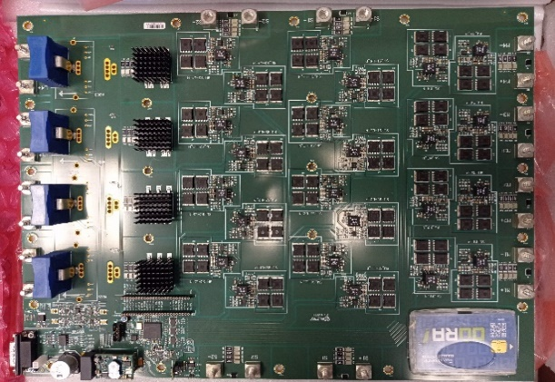
Projects: A peak at Hotswap System complexity
33 x PS Current Setpoints
Hot-Swap + MOSplate
Manager
33 x PS Current Setpoints
TANGO
Hotswap system status
84 x Power Switch
Commands
27 x Magnet Current
Measurements
27x Running PS
27x Magnets
7 x MOSplates
6x Standby PS
7 pieces of embedded software (DSP, ucontroller, FPGA) + 4 TANGO DS to control the system!
>10 people involved in the project these last 3 years with high turnover:
  JF Bouteille, M. Di Vito, P. Falaise, A. Thai (PSG)
  R Biv, A. Broquet, C. Hervé, L. Siron (ISDD-EU)
  J.L. Pons, M. Taurel, A. Valiente (ACU).

Slide 7
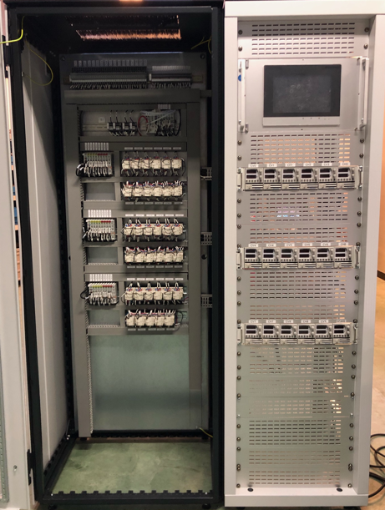
Projects: TL2 Corrector PS revamping project
Project Status
  Cubicle design and construction: Completed
    Strong focus on project doc (system specifications, elec and mech drawings)
    Cubicle assembly and wiring done in house.
  Control software (Half completed)
    PLC software completed at 50% (put on hold to focus on Hotswap deployment)
    Functional specifications for TANGO device server implementation not started
Main People involved:
P. Falaise, L. Jolly,
S. Lagarde, P. Sallamand

Slide 8
Other Ongoing PRojects
STATUM firmware improvement (O. Goudard, M. Di Vito):
  Added features for facilitating maintenance / fault diagnosis.
  Consolidated the code (software maintenability)
Upgrade of RIPS embedded control system (S. Lagarde + L. Siron)
  Regain mastery of the existing software eco-system (DSP + FPGA + TANGO DS)
  Switch to the new DANCE control platform (Y23)
  Improve RIPS current regulation performance (Y24?)

Slide 9
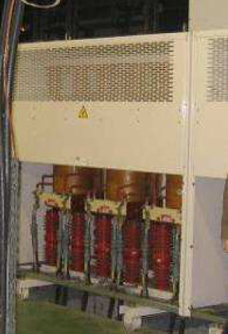
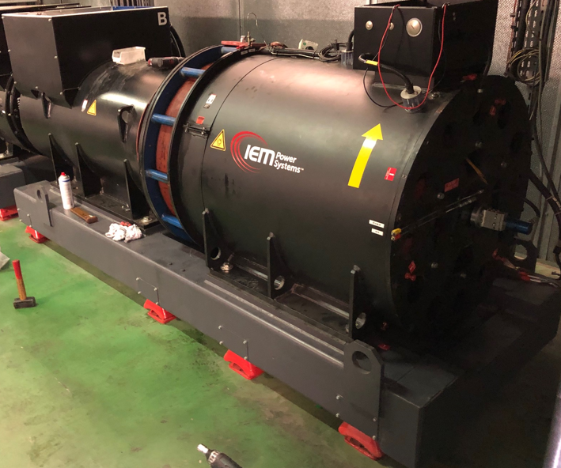
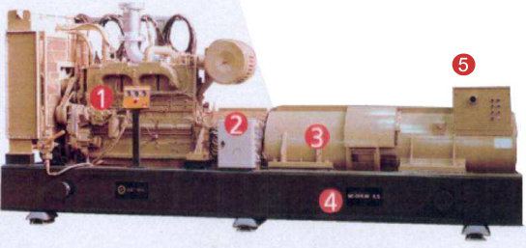
HQPS Overview
Reactors: barrier (high impedance) against “short time” disturbances coming from utility grid
Rotablocks (14 off):
Combination of a
Low impedance alternator (clean sinewave voltage source)
Kinetic energy accumulator
Diesel Engine Generator (1 off):
Able to supply 1000kW for long period of time in case of black-out on utility grid

Slide 10
Protection against Utility Black Out (1/2)
1- Normal operation (utility grid OK)
HQPS alternators do not provide any active power
2 - Suddenly a black occurs on utility grid
=>This causes a large voltage dip upstream HQPS
3 - Automatic disconnection of HQPS from the utility grid
=> HQPS’s accumulators powering ESRF
4 – After some time, accumulator’s energy reserve gets critically low
=> Load shedding of heavy consumers

Slide 11
Protection against Utility Black Out (2/2)
4 – After long time utility grid voltage is still NOT back to normal condition
=> Accumulator running out of kinetic energy
=> Load shedding of heavy consumers to avoid blackout extending to ESRF
5 – Diesel engine starts and accelerate to 1500rpm in 25s
6 – Generator connects to 20kV network and takes all the load
=> Can run continuously in such conditions till utility grid recovers from blackout.

Slide 12
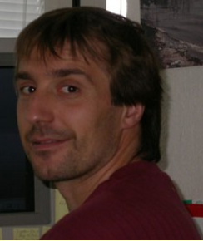
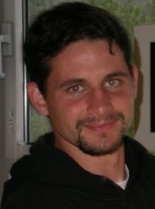

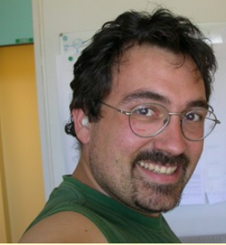
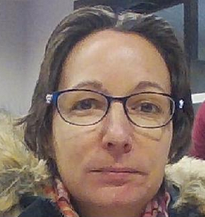
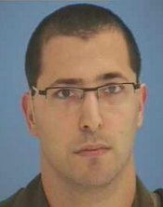
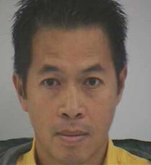
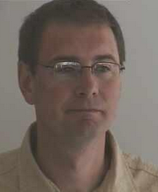

Special Thanks to the PSG TEAM
P. Falaise
O. Goudard
L. Jolly
S. Lagarde
M. Michel
P. Sallamand
A. Thai
P. Vidal
M. Di Vito

Slide 13
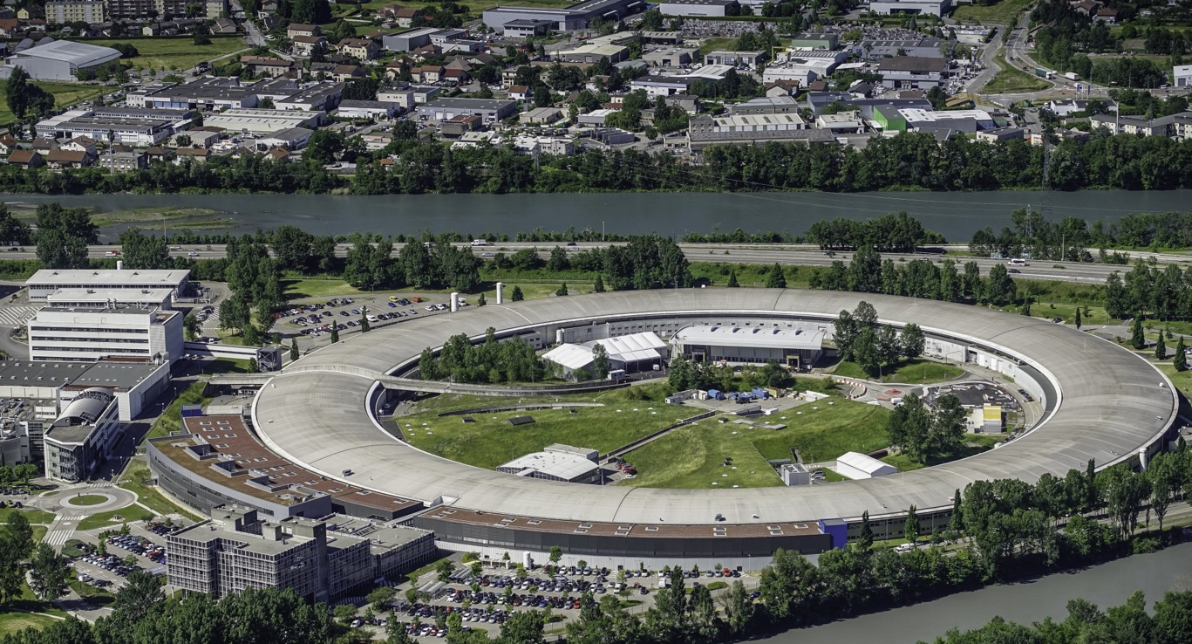
Many thanks for your attention

