Slide 2
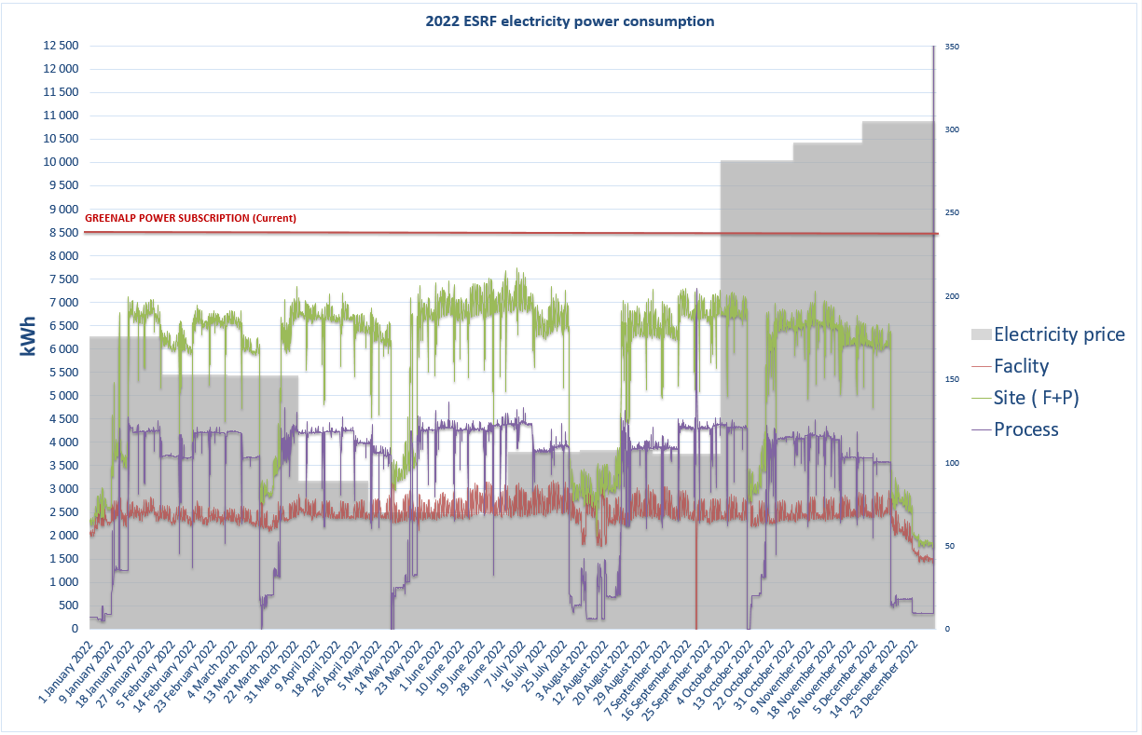
2022 ESRF electricity consumption
Site (F+P) | 50 204 647 kWh
Facility | 21 692 725 kWh
Process | 28 511 922 kWh
Average Price | 153,43 €/MWh

Slide 3
Outline
Construction and building maintenance activities
Electrical activities
HVAC and Fluids activities
Projects for ASD
Report on Infrastructure projects (Long term maintenance plan - Building sustainability - Reduction of energy consumption - Carbon footprint reduction)
Report on main EXPD projects
Conclusion - Organization of the B&I Group (BIG)
2023 ASD Workshop
Buildings and Infrastructure Group (BIG)
On behalf of F Favier – Y Gouez – T Morel – P Roux Buisson – A Ruiz Bailon

Slide 4
Construction and Maintenance of Buildings activities
Construction and Maintenance of Buildings activities
Status and Review of the works done in 2022
Perspective for the forthcoming year

Slide 5
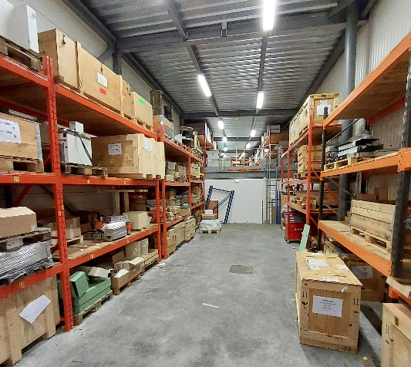
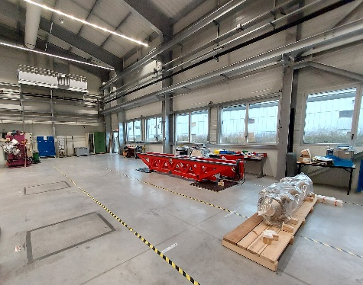
2022-2023 Mechanical workshops refurbishment
ASD-PSG workshop - MD016
ASD/RF storage area – PINJ
TID Vacuum area - ESRF01
TID/BIG storage area – MC-0-08
Central Mechanical workshops in MTBF
Works should start in May 2023
Delivery expected in November 2023
Transfer from SBGS in December 2023
MB-0-30-TID/Vac–ASD/RF

Slide 6
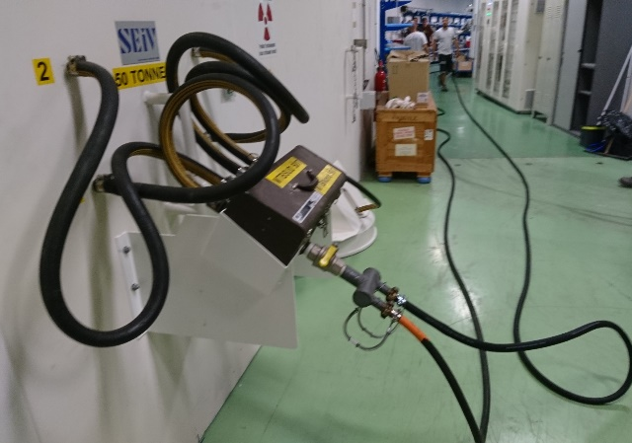
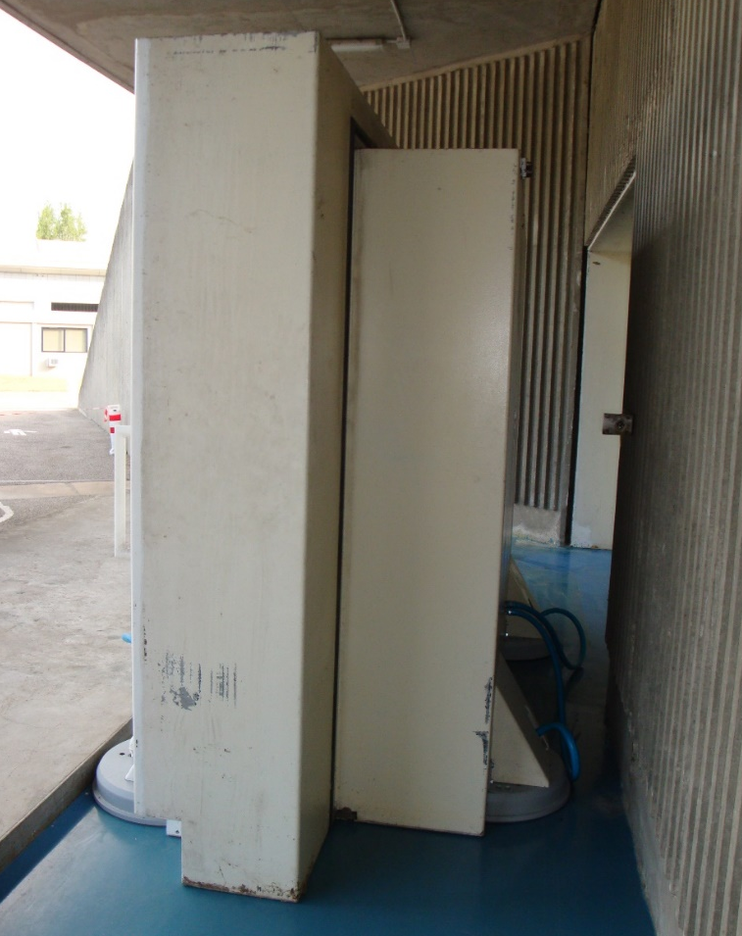
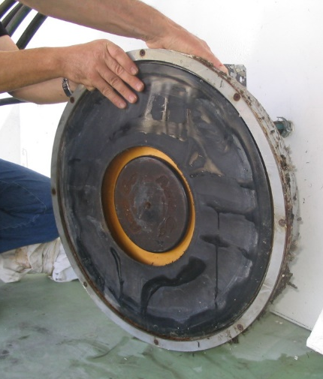
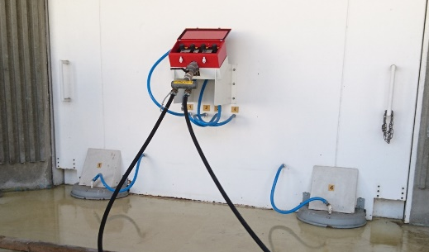
2022 august : MIDDLE TERM MAINTENANCE on 25t & 50t concrete doors
Frequency : every 3 years
Need : 10 000 l/min compressor + 120 ml pipes + 6 people
50 tons : SYTU doors (MTBN + MTBS)
8 air cushions
Unit cost = 4 500 € HT
Air cushion
25 tons : PINJ door
4 air cushions
Unit cost = 2 500 € HT

Slide 7
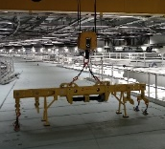
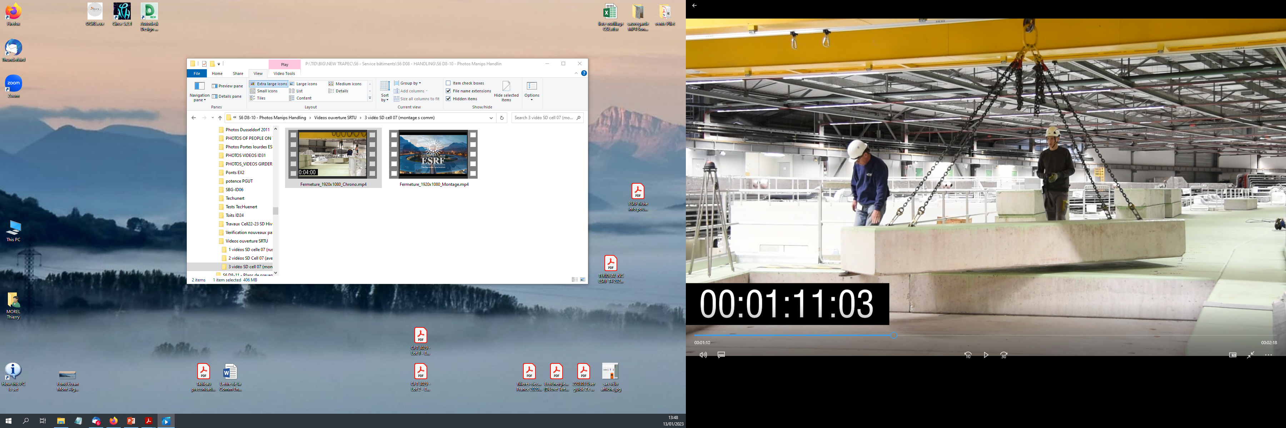
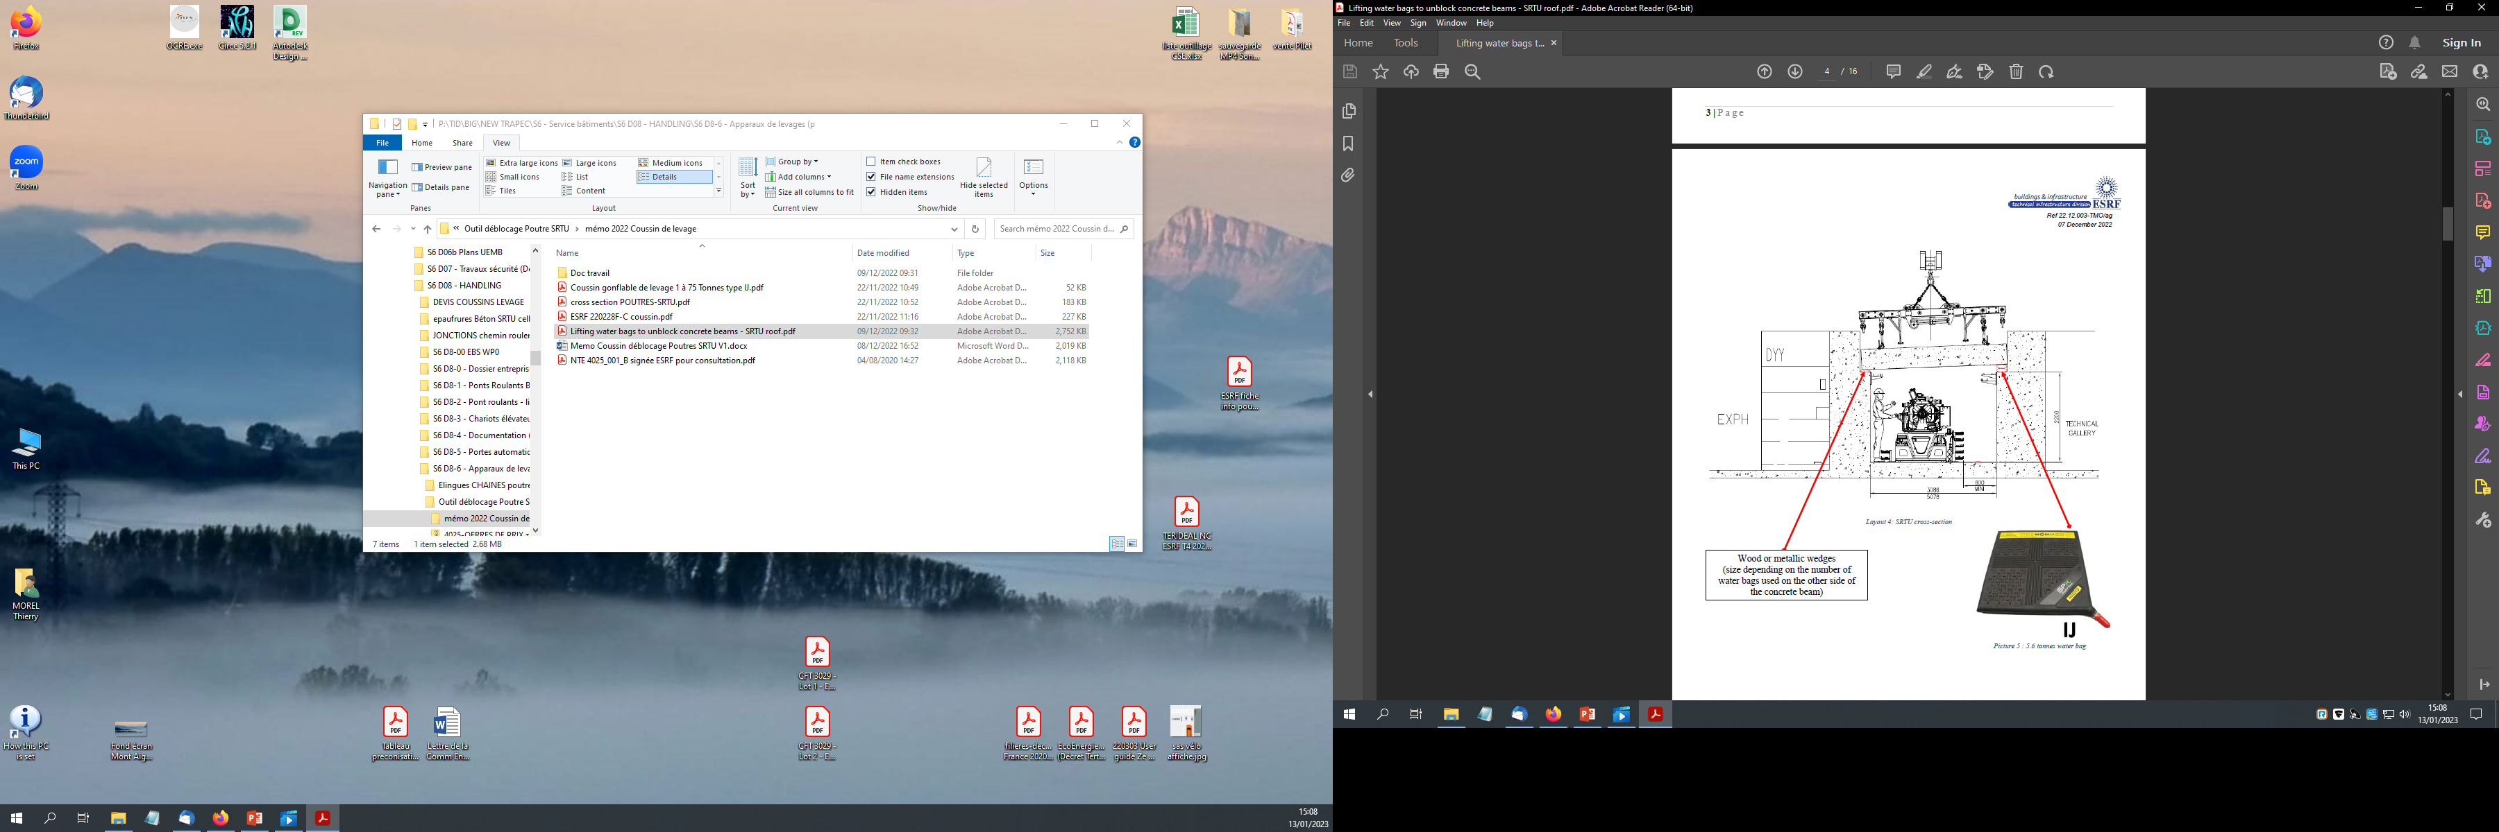
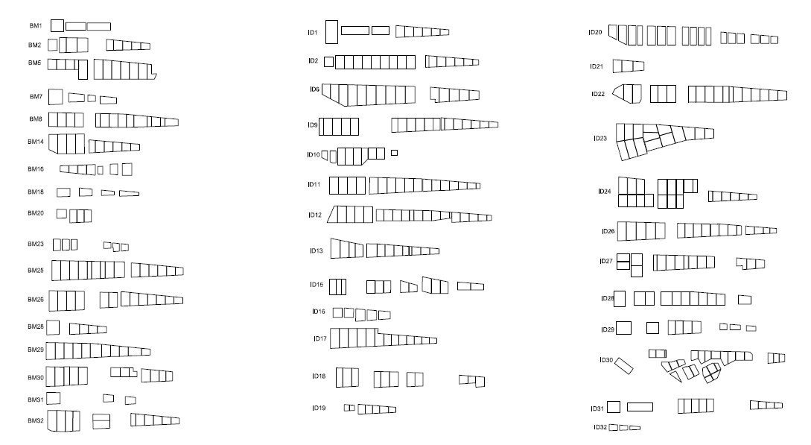
2023 projectS: Lifting tools design & manufacturing
SRTU roof lifting tool
1. Reminder 2019 (EBS) : number of handling operations
      During the EBS SD, we did 5000 opening/closing during the project (eq. of 30 years of ESRF operation)
      In 2022, we carried out  230 handling of concrete beams without blocking or particular problems
    2. SRTU roof : new release system
    concrete beams release system (by water bags)
      2022 : design by ERIA
      13/01/2023 : ASD validation
      May SD 2023 : availability of water bags system
    3. BL roofs : new handling tool
    study = new lifting tool to secure handling tasks
      20/01/2023 : Kick-off meeting with ERIA+ISDD

Slide 8
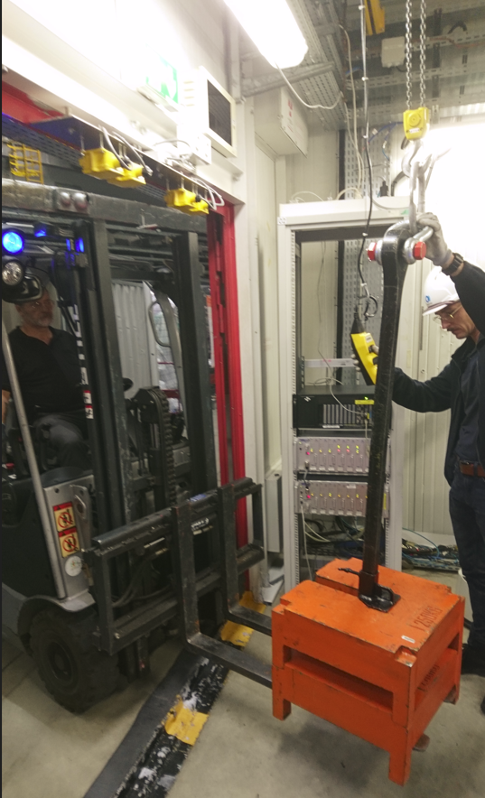
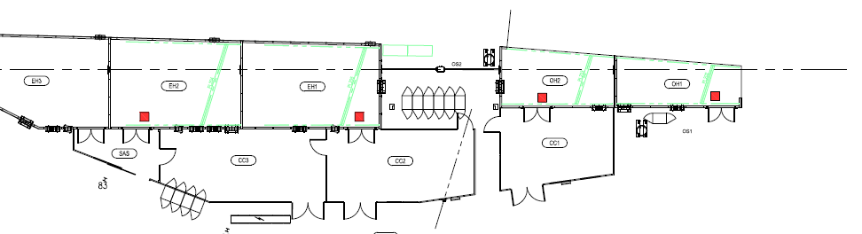
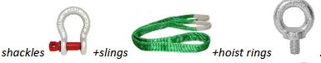
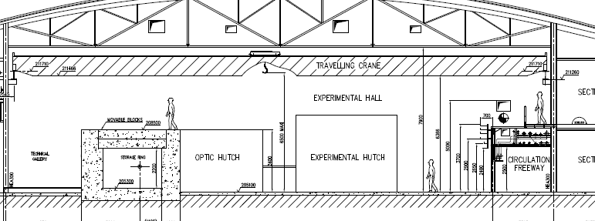
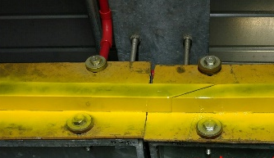
2023 projects: Mandatory CONTROLs OPTIMIZATION
+ exph overhead cranes railway MAINTENANCE
    4. Mandatory controls on 200 cranes + hundreds of lifting accessories:
      Revalidate the need for lifting capacity 250-500-1000 kg? :
        minimize total number of cranes
      Perform yearly load tests outsides BL (for manual cranes):
        avoid any damage on scientific equipment
      Ensure that everyone uses compliant lifting accessories:
    5. Exph overhead cranes railway maintenance :
      2018 :
        first campaign done before EBS
      2023 :
        Second campaign: in preparation
        Second campaign implementation: SD January 2024

Slide 9
Construction and Maintenance of Buildings activities
Construction and Maintenance of Buildings activities
Securing the technical zones
Status
Works to be done

Slide 10
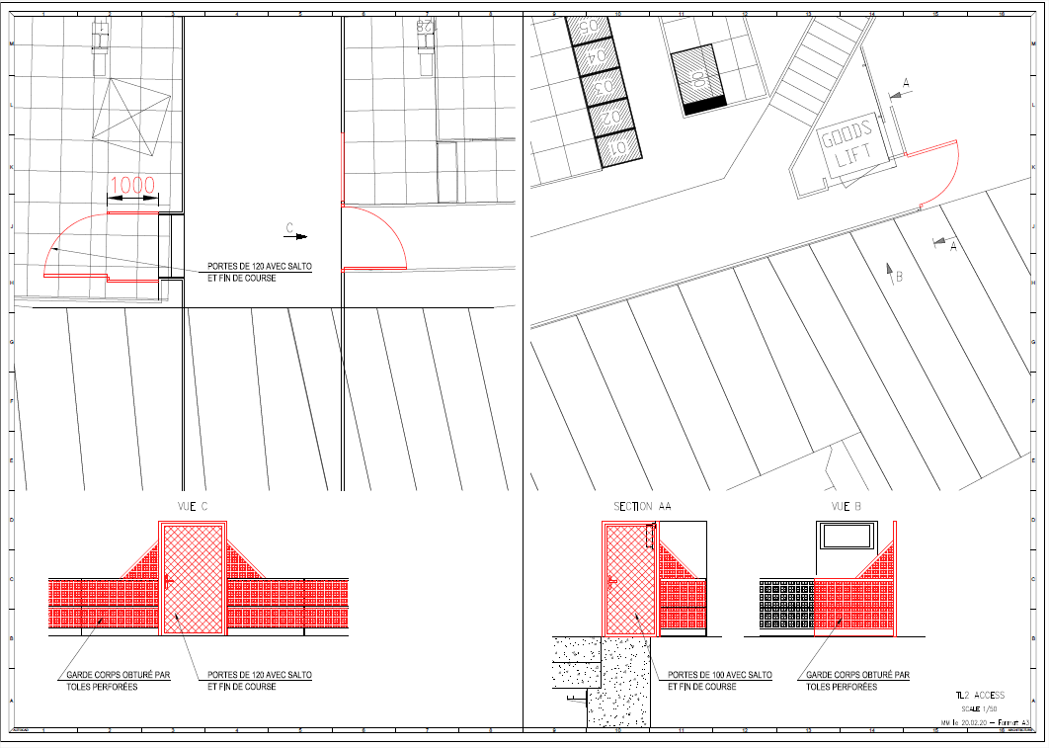
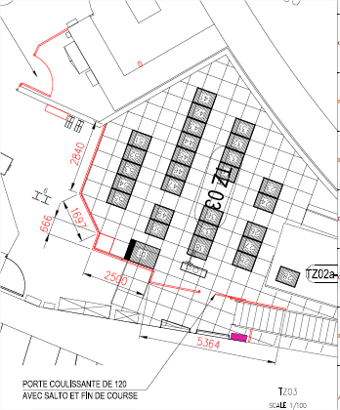
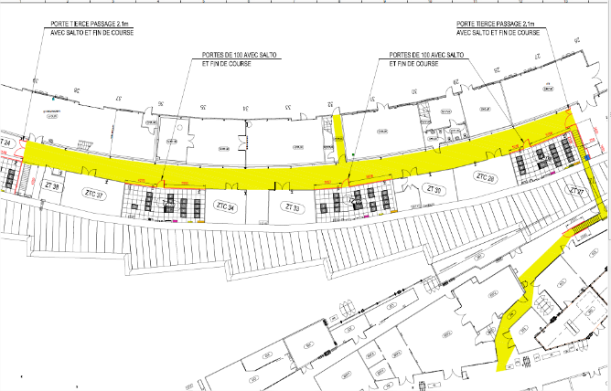
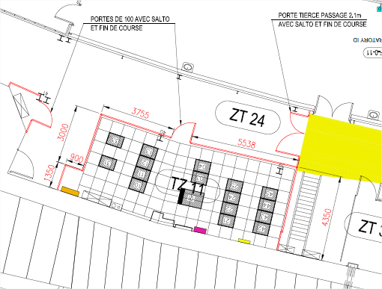
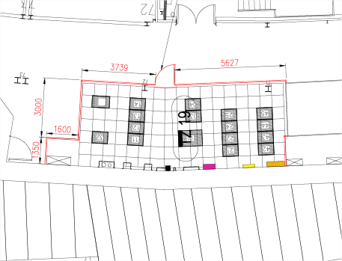
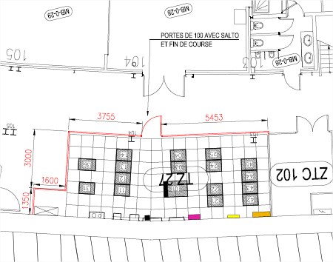
Securing the technical areas of the accelerator and source
Fences and access control of the technical zones – Phase 1 done in 2020
Phase 2 (all the zones ) to be done in 2023 / 2024

Slide 11
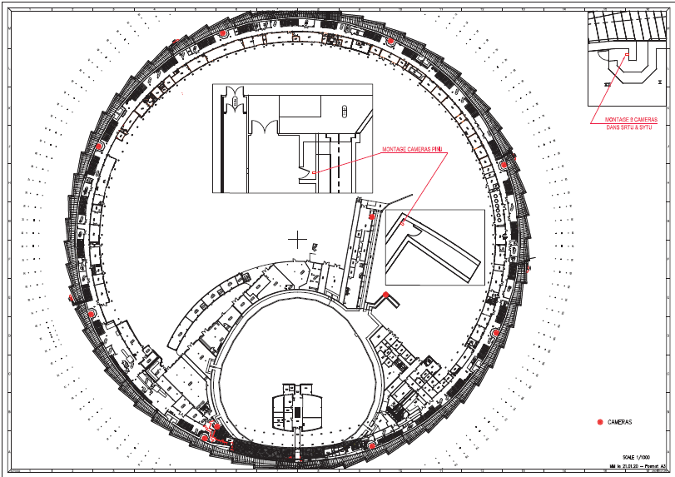
Video system
11 cameras have been installed in chicane entrances to control the access to SYTU and SRTU.
The recording is done 24/24h - 7/7 days only during shutdown periods

Slide 12
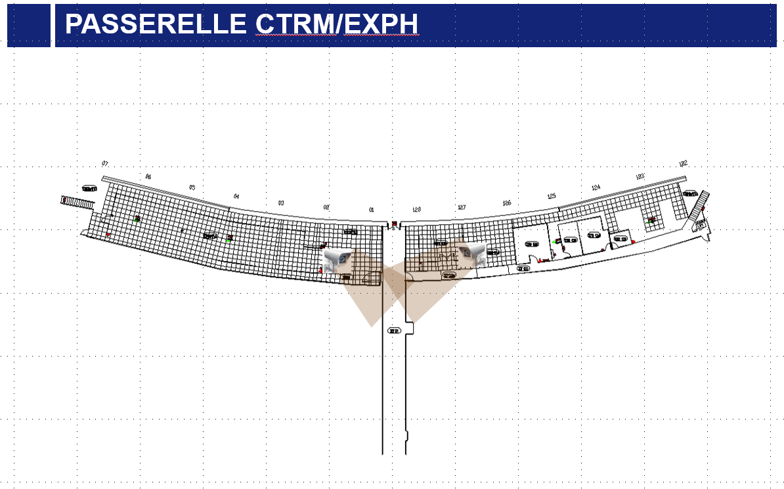
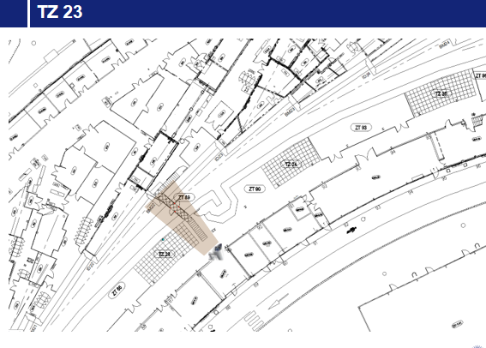
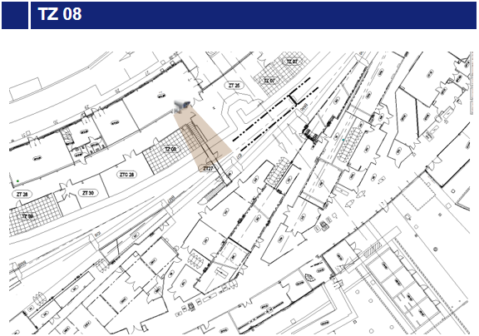
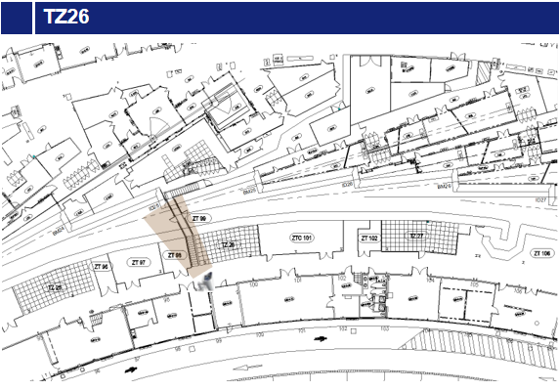
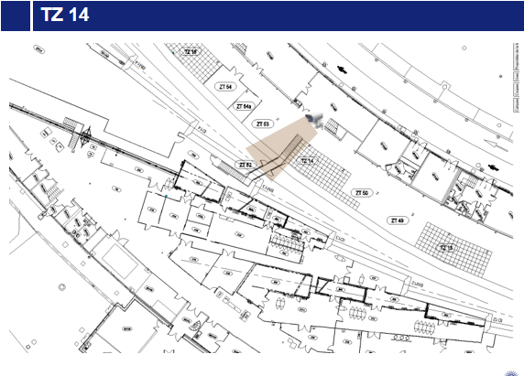
Video SyStem
6 cameras have been installed in the Technical zones to control the access from the beamlines’ side of the experimental hall.
The recording is done 24/24h - 7/7 days – 365 days/ year.

Slide 13
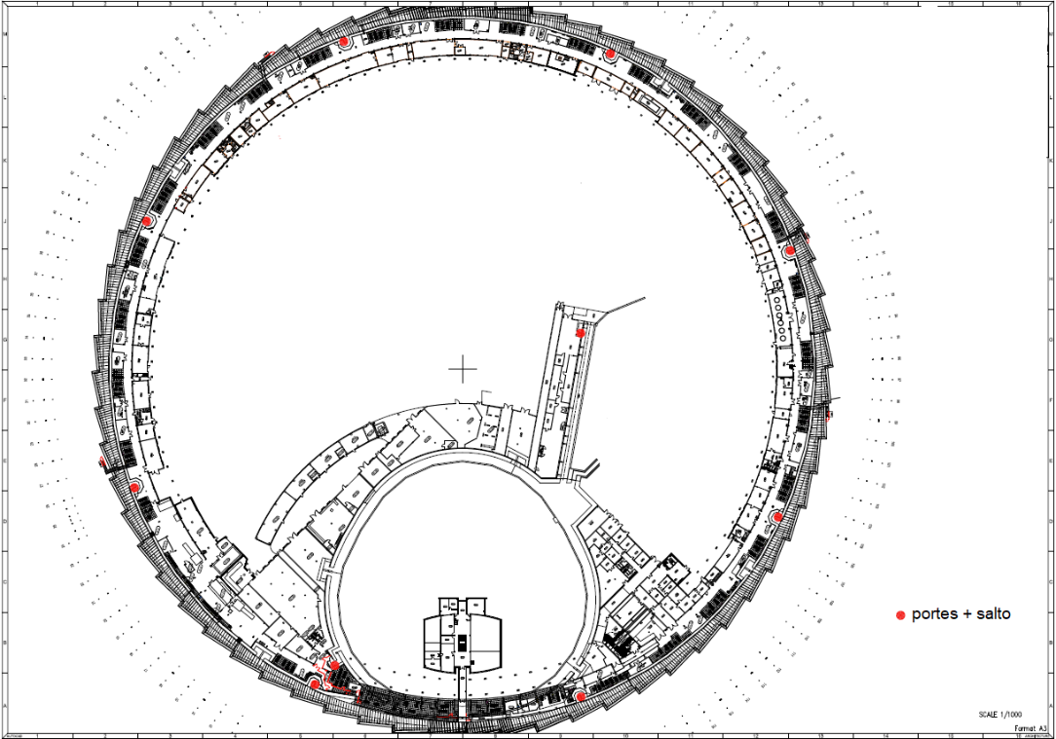
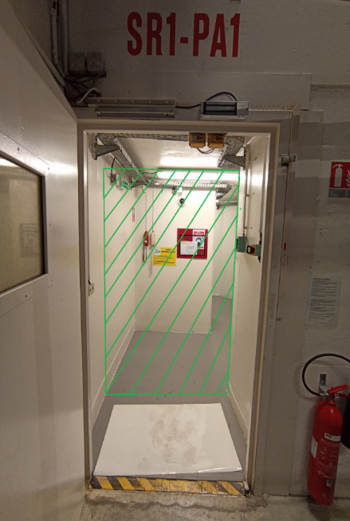
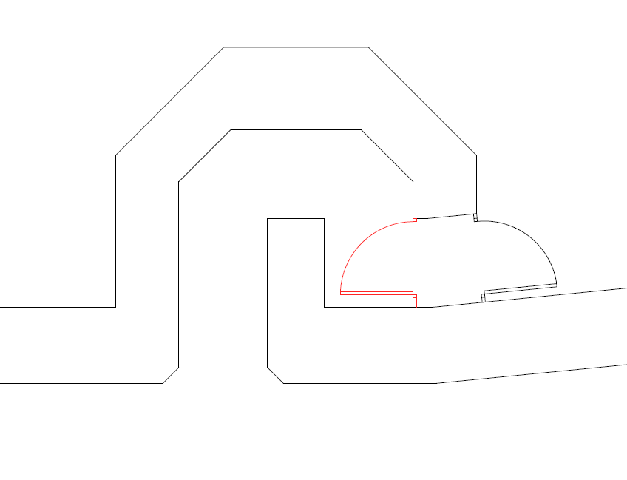
Access to the SRTU / SYTU / PINJ
In order to secure access to the SRTU, SYTU and PINJ tunnels during shutdowns, a door equipped with a SALTO system will be installed on each access chicanes (8 for the SRTU, 1 for SYTU, 1 for PINJ)

Slide 14
ELECTRICAL ACTIVITIES
Electrical activities
Interventions on damaged cables in the SRTU
See Isabelle’s Talk this afternoon
For more details

Slide 15
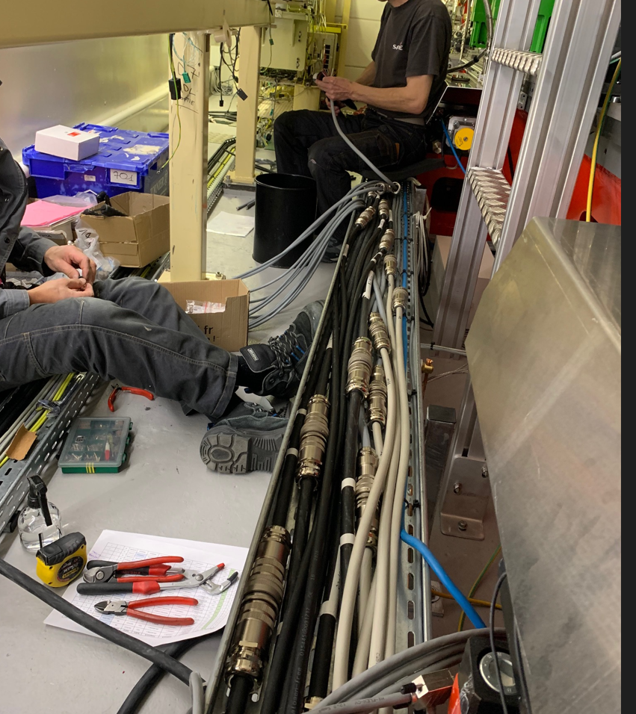
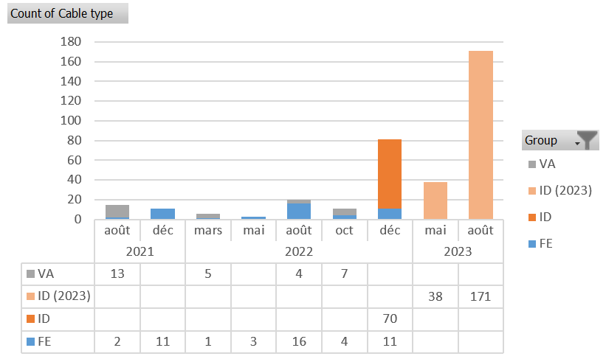
CABLING: Intervention on damaged cables
Since 2021, about 150 interventions on cables have been carried out.
Interventions on ID cables are the most difficult for the following reasons:
It requires working inside the SRTU
Multi-wires connectors must be installed
The delivery time for the connectors is about 20 weeks.
In 2023, it is planned to create 209 cable extensions for ID equipment.
At the time being, BIG does not have any information on the number of cables to be replaced for VA and FE group equipment.
Group | 2021 and 2022 Expense | Number of cables | Average amount
FE | 20 768,20 € | 48 | 432,67 €
ID | 26 903,42 € | 70 | 384,33 €
VA | 13 554,95 € | 29 | 467,41 €

Slide 16
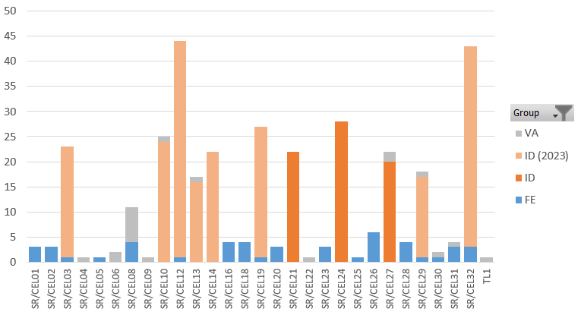
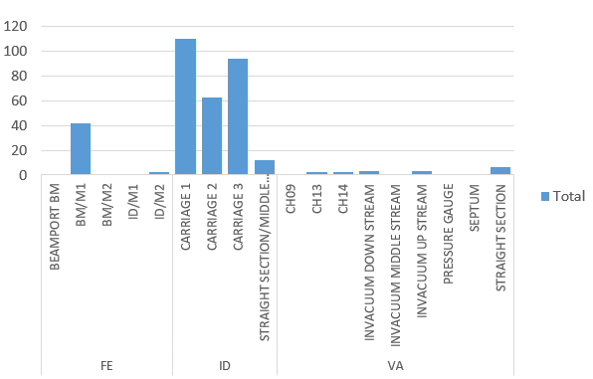
CABLING: Intervention on damaged cables
The repartition of the damaged cables over the cells did not show any clear tendency.
But on the other hand, the repartition of the cables according to the types of equipment clearly shows that the damage occurs mostly in the straight sections areas

Slide 17
HVAC AND FLUIDS ACTIVITIES
HVAC and Fluids activities
SRE - Cooling System of the machine
Status and Review of the works done in 2022
Perspective for the forthcoming year

Slide 18
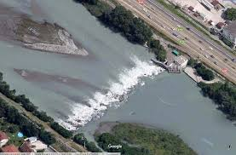
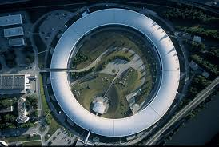
SRTU cooling system (SRE)
Drac river
ILL8
PGUT
SRTU-SYTU…
25°C
27.5°C
5°C
23°C
Pump 2500 m3/h
The Drac river supplies a basin at ILL8
This basin is common to ILL, CNRS and ESRF
The ILL8 pumping system (SEB) supplies the primary network of the SRE exchanger. It is an open network.
The cooling water (SRE) circulates through the secondary network of this SRE exchanger and supplies the machine equipment. It is a closed network.

Slide 19
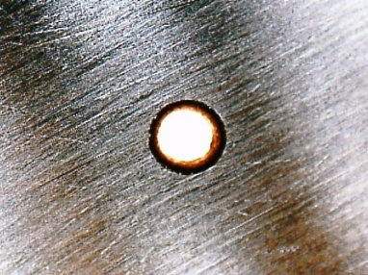
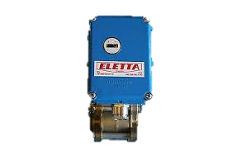
Observation on magnet flowmeters
SRE IN : 10 bars
Copper clogging
Magnet
Diameter 1-2 mm
Picture with microscope
7,3b
1l/min
The measurement is based on the differential pressure between the 2 chambers (“In” and “Out”). The reduction of the size of the orifice induces rapidly an increase of this pressure differential as if there was an increase of flow.
But the flow rate “remains” OK @ 1 l/min (according to the measurement)
→ The controller measurement is falsified and the results of the tests are not conformed.
0,2b
Flow controller
SRE OUT : 2.5 bars

Slide 20
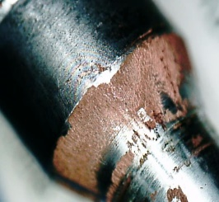
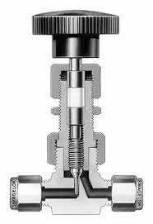
observations on absorber flowmeters
Incident explanations
SRE IN : 10 bars
3,3b
4l/min
Copper deposit on the needle valve
4b
Absorbers
Picture with microscope
TID-BIG checked the flow. The rate is NOT OK : it decreases down to 2,5l/mn.
The trigger of flowmeter is realistic
As a corrective and temporarily action, TID-BIG opened the needle valve at 100%. It is now OK, but the flow induced some vibrations and TID-BIG needs to go back to the normal set up
0,2b
SRE OUT : 2.5 bars

Slide 21
Action plan: improvement of the water quality
TID-BIG continue to focus its actions on the improvement of the water quality in order to reduce as much as possible the number of particles – the target is < 0,1µm meaning 10 times less than the situation before EBS. In parallel, the monitoring of number of particles and corrosion level will be implemented, maintenance procedures will also be improved.
Drac river
ILL8
PGUT
SRTU
25°C
27.5°C
5°C
23°C
Pump 2500 m3/h
Installation of a general filter
Installation of particles measurement
Installation of a filter on each cell
Installation of flow measurement

Slide 22
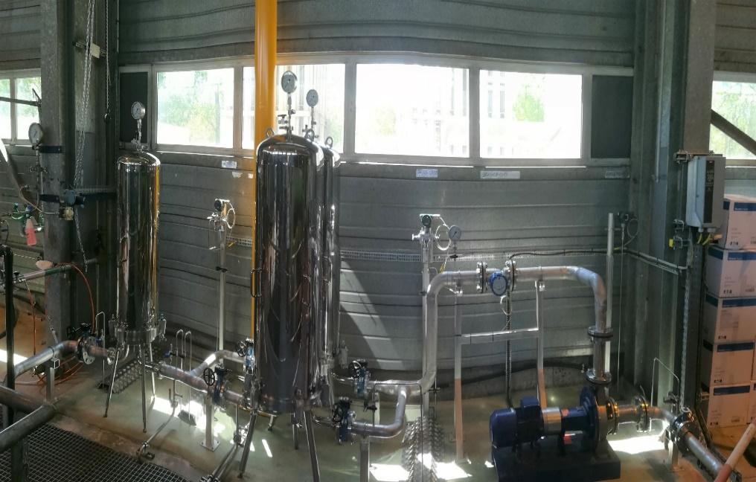
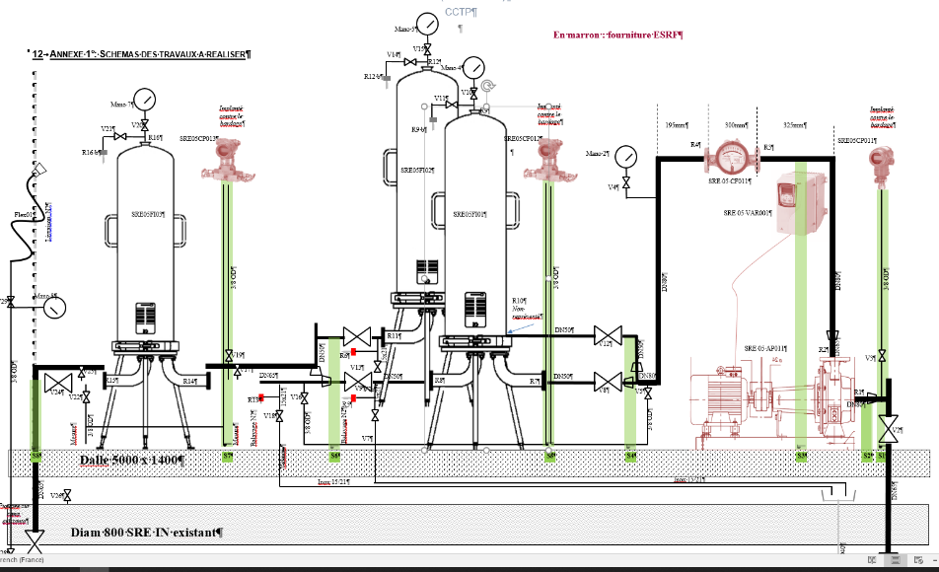
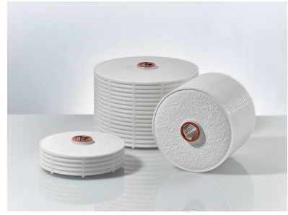
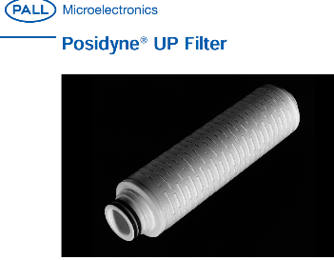
Main Action plan: additional GENERAL FILTRATION
Second filtration stage
First filtration stage
Pump for derivate flow rate
Several filtration stages (cascade)
1st : size 1 µm to 0,2 µm
2nd : size 0,1 µm - 0,04 µm possible if necessary
1St : depth filtration (lenticular filtration)
The first stage filters and protects the second stage
2nd : cartridge filtration
Diagram of derivate general filtration very high efficiency
In comparison with the cells (pocket filtration), these filters have a bigger exchange area and a bigger pressure drop. A pump is therefore necessary
To resume: water purification with
Cell high efficiency filtration: 20 V/day of 1 cell
Derivate filtration very high efficiency: 1 V/day of the total SRE

Slide 23
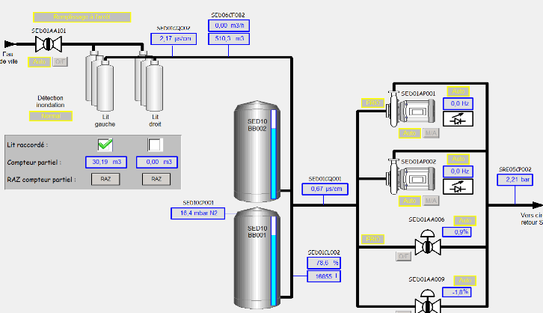
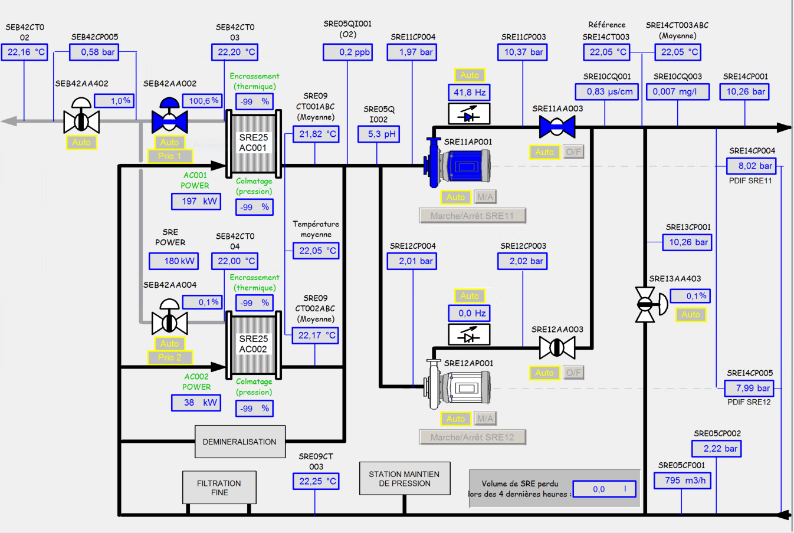
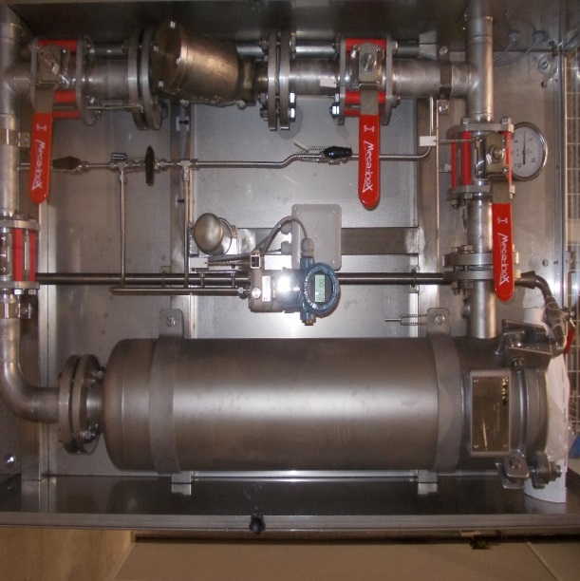
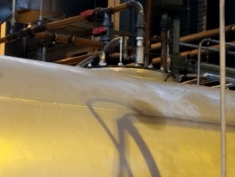
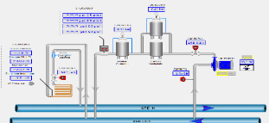


Improvement of the « SRE » machine cooling network
Process Upgrade (mechanical improvement)
Derivate filtration
0,2 µm in 1st step then 0,1µm
- Flow rate 20 m3/h
- Filtration of one volume of the SRE network per day
SRTU filtration
- 1 µm – efficiency 99,9%
- Filtration of the entire flow of a cell
- Filtration of one volume of SRE network per hour
Removal of dissolved oxygen
Filling tank with Nitrogen Sky and bubbling
Filling Tank with Nitrogen sky and bubbling
Zoom : Connections for Nitrogen Sky and bubbling
1 system per cell

Slide 24








Improvement of the « SRE » machine cooling network
Maintenance and operation
Replacement of filters at each technical shutdown
Test of flow controllers:
5 times par year
(shutdown)
An organisation has been implemented to clean the flow controllers
If necessary 400 units in 2 days
Measurement of flow rates on each piece of equipment (>1200) once a year
Nitrogen gas scan before water filling
Goal: to not oxygenate the water
Corrosion follow-up with
4 corrosion samples
Thickness measurement
Does not show any corrosion

Slide 25








Water quality management: new systems
Clogging test of the needle valve
Copper analysis
Particle counting
Manual daily measurement by Vinci
Measurement with a laboratory. Particle concentration is low.
For size 0,1 to 2 µm
- Show the absence of particles above 1µm.
- Show a concentration of copper in the form of particles (undissolved) of 0.125 mg/m3.
- Extremely low
A test valve has been installed at PGUT
Needle valve (similar to the absorber) – ½ turn opening – Significant restriction to simulate operation on an absorber
Continuous measurement: 1er semester 2023
Contradictory analysis with a laboratory
Similar results
Average 0,03 mg/l.
It is a very low concentration
Monitoring in progress
There are periods (several weeks) without fouling and others with fouling
Analysis in progress but difficult

Slide 26



Water quality management : new systems
Continuous measurement of the SRE flow on the SRTU cells: detects clogging
FT : Flowrate measurement of the cell
TT : Temperature measurement at the outlet of the cell
PDT : Differential pressure measurements cell / terminals of the cell
Normalized flow = f(F,T, PD)
T Normal = 27°C (return to SRE standard temp.)
PD Normal = 7,5 bars ( DP standard available for a cell)
TZ
Cell XX
SRTU
PDT
Magnets
TT
FT
Delivery problem (pressure sensor) -
11 systems are operational today
21 systems for the first semester 2023
32 systems for January 2024
CELL30
Normalized flow rate (corrected)
Measured flow rate
This system makes it possible to anticipate the fouling of a control valve to absorber
The system has a sensitivity of less than 1l/m (on the blue curve, we can see a variation of 0.4l in 21 days or 0.3% over the concerned period)
Differential pressure measurement
and flowrate measurement

Slide 27
Improvement of the « SRE » machine cooling network
To resume, many actions have been performed:
Filtration improvement
Removal of dissolved oxygen
Improvement of the organization of maintenance and testing
Setting of water quality indicator (clogging test, cooper and particles analysis, corrosion follow-up).
Continuous measurement of the SRE flow on each cell
We can observe that:
The copper level is low
The deposits on small restrictions disappeared during several months, but reappeared, then disappeared again. Unfortunately, we do not yest have a clear explanation about this phenomena.
The capacity for corrective actions and anticipation has been improved.
We continue the analysis and improvements of the cooling system.
A complete report will done for 2024 after 1 Year of operation.

Slide 28

HVAC and fluids activities
HVAC and Fluids activities
Liquid Nitrogen for the machine
Status
Perspective for the forthcoming years

Slide 29




LN 2 Supply – technical zone – general view - reminder
The Liquid Nitrogen supply has 4 parts :
LN2 storage (tanks): 2 x 50 000 + 1x10 000 Liters
Main network (ring in the technical zone)
Transfer line with phase separator
Closed loop
-1-
3 supply tanks
-4-
-2-
LN 2 main network in technical zone
Finished October 2018
-3-
Closed loop between Cryocooler and Undulator
Transfer line between main network and Cryocooler (in front of the cell)

Slide 30
LN 2 Supply – technical zone
Status: transfer line and closed loop
Status: Storage LN2
Cells | Date | Undulator
6 | Before EBS | In Operation
11 | Before EBS | In Operation
31 | Before EBS | In Operation
15 | EBS | In Operation
16 | EBS | In Operation
27 | 04/2021 | In Operation
29 | 05/2022 | In progress
3 | 08/2022 | In progress
14 | 01/2024 CFT In progress
18 | 08/2024 Studies In progress
13 | 01/2025 Studies to be done
date | Volume (L) | Volume by tank
2018 | 18 000 | 10 000 L + 8 000 L
End of 2019 | 60 000 | 10 000 L + 50 000 L
2021 | 110 000 | 2x50 000 L + 10 000 L
Evolution: Annual consumption
date | Volume (L)* | Volume by tank
2018 | 510 000 L | Before EBS – 3 cells
2021 | 860 000 L | 5,5 cells
2022 | 930 000 L | 6 cells
2025 | 1 500 000 L | Estimate 11 cells
*The consumption is not proportional to the number of cells because there are the thermal losses of the tanks and the network.
For 2025: the storage capacity corresponds to an autonomy of 3 weeks.
The "EPN" site is supplied with nitrogen every day.
The frequency of filling is once a week with a capacity always bigger than 65,000 liters

Slide 31


[SSA 352 MHz] project
ASD Project
[SSA 352 MHz] project for the installation of new SSA
Status of the infrastructure studies and works
CELL07
CELL05

Slide 32





RF UPGRADE SSA 352 MHz - new electrical substation
Creation of the new electrical substation scheduled for December 2023
Power supply needed: 10 x 250kVA – 400V / 3P, no NEUTRAL
The electrical power will be supplied by the PROCESS network protected by HQPS.
A new electrical power station will be created in MS117, including
2 transformers (dry transformers) 20kv/400V -2500kVA (redundancy 2N)
2 main electrical boards (with coupling devices)
4,3 km of cable (Cu 240mm²)
Electrical substation “SS1” will supply power to the new transformers (the 20kV circuit-breakers are existing and available)

Slide 33





RF UPGRADE SSA 352 MHZ – Cooling system (SRE)
New systems
Cell 7
Cell 5
4 new main cooling networks will be added to the RF branch of the SRE network in SRRF area (2 SSA + 2 dummy load), 1 antenna per SSA System.
Total flowrate = 200 m3/h
Finally, the RF flow rate decreases a little (SSA system= 75 m3/h, Klystron system = 100 m3/h).
But the RF systems remains as a “big consumers” = 400 m3/h ; 40% of SRE flow rate

Slide 34
RF UPGRADE SSA 352 MHZ – Planning of infrastructure works
[SSA 352 MHz ]: Cell 05 and Cell 07 RF SSA system installation
Preparation works | 2022 | 2023 | 2023/2024 | 2024/2025 | 2026
 | RF test AREA, LN2 modification, TZ05/TZ07 cable tray adaptations, TZ05/TZ07 pipe modifications | Modification of the WHITE CIRCUIT STORAGE AREA to store Tra0 transformers, MTBS RF extension building adaptation to enable the delivery of the new SSA cubicles |  | Finishing works
Cicil works
 |  | Creation of the new electrical station (MS 117) Cell 05/07 holes to be drilled in the wall to pass the new waveguides
Electricity (CFT 3303)
 |  | 20kV cables supply and installation Transformer supply and installation (accessories included) Main switchboard supply and installation 400V cables supply and installation Supply and installation of the electrical equipment for the new electrical station
Fluids (CFT 3302)
 |  | Fluids modification inside the EXPH for the installation of the [SSA 352Mhz ] cubicles
Final connections
 |  |  | Winter SD Cell 5 – CAV 1 Cell 7 - CAV 6 | Winter SD Cell 7 – CAV 7 Cell 7 - CAV 8 Summer SD Cell 7 – CAV 9 Cell 7 - CAV 10 | Summer SD Cell 5 – CAV 2 Cell 5 - CAV 3 Winter SD Cell 5 – CAV 4 Cell 5 - CAV 5
Financial estimation | 85 000 € | 1 200 000 € | 255 000 € | 60 000 € | 40 000 €

Slide 35
Other activities
Other activities
Long term maintenance plan & building sustainability
Reduction of energy consumption
Reduction of Carbon footprint

Slide 36
Long term maintenance plan
Long term maintenance plan

Slide 37



Long term maintenance Plan: Replacement of EXPH main electrical switchboards
The distribution of the Facility electrical network in the experimental hall is ensured by 3 mains switchboards :
1MD2/1MD3 in electrical substation SS1
2MD1/2MD2 in electrical substation SS2
2MD1/3MD2 in electrical substation SS1
These low voltage main distribution boards were installed during the construction of the ESRF and are therefore more than 30 years old. Each of them electrically supplies 1/3 of the "EXPH" premises including beamlines, laboratories and offices.
In 2021, TID-BIG started to replace the obsolete equipment.
Main switchboard 1MD2/1MD3 (SS1) has been replaced during Winter SD 2021/2022 (ESRF closure included)
Main switchboard 2MD1/2MD2 (SS2) has been replaced during Winter SD 2022/2023 (ESRF closure included)
Main switchboard 3MD1/3MD2 (SS2) will be replaced during Winter SD 2023/2024 (ESRF closure included)

Slide 38



Long term Maintenance plan – Buildings and Infrastructure
2019/2021
Complete renovation of the Guest houses
2023
Studies for façade renovation, with external thermal insulation of the Guest houses
Works in 2024/2025
2022
Façade renovation of the Common Building
A general approach will be done in 2023 and 2024 in order to merge:
The projects linked the sustainability of buildings and infrastructure (long term maintenance plan).
The respect of the « décrêt tertiaire 2019-771» for specific buildings (Central Building, LOB, Guest Houses, Common, Entrance site).
The energy savings and reduction of the carbon footprint actions
Accessibility of buildings for disabled people
Other aspects of office organization.
The goal is to prepare a coherent road map for the future years

Slide 39
Reduction of primary energy consumption
Reduction of primary energy consumption
Energy recovery
2 examples

Slide 40




1 - Solar panel project
Feasibility studies in progress - until March/April 2023 (Artelia)
Presentation and plans to the DM April/May2023 – Go/NoGo per zones
Administrative analyses of the different possibilities in term of contract / investment / insurance
Tender process
Selection of an investor Dec. 2023
Implementation in 2025/2026
Credit photo – GreenAlp
Artelia studies all the possibilities to install solar panels on site then a technical analysis will be carried out zone by zone in order to deduce the profitability.
Credit photo – STm

Slide 41
2 – Waste heat at the ESRF
Projects
Recovery of the waste heat of the cooling system of the ESRF
The total value of the waste heat produced by ESRF (mainly by the machine) is
34 000 000 kWh/ year
Drac river
ESRF
20°C
27.5°C
5°C
23°C
Pump 2500 m3/h
Notes:
To explain the waste heat at the ESRF, you should know that we have a set of processes that generate heat ( Datacentre , electron storage ring, radio frequency production, power supply, etc.) All these systems are cooled by water circuits, cold water is brought to the systems, it heats up , then it circulates in exchangers.
On the Drac river side, the cold water is pumped into the river and it is pumped then it heats up on contact with the heat exchangers, and it goes back to the Drac river. So it is at this point that the water have a thermal content of waste heat.

Slide 42





2 - Presentation of the project: “Waste” heat at the ESRF
District heating - CCIAG
Heat pump
?
District heating: 3 000 000 kWh
External use: 28 000 000 kWh
Internal use: 6 000 000 kWh
52°C
110 °C
Drac river
20°C
27.5°C
Waste heat: 34,000 000 kWh
5°C
23°C
Pump 2500 m3/h
Notes:
In Grenoble, we have district heating which heats housing and institutions like the ESRF, we use 9 million kWh of heating from the district heating network.
I think you get the idea: it's to use the heat thrown at the Drac to heat the ESRF.
To do this we need to raise the temperature level of waste heat . To go from 20 to 45°C we need a heat pump, in this case it will have a coefficient of performance of 5, and this will allow us to reduce heat consumption from 9 million kwh to 3.
The other goal would be to sell heat to the district network, we would have an unused remainder of heat, and in terms of image that would be very interesting . On the other hand, given the temperature levels of the district network, it is forced to operate their heat pump at lower performance coefficients .

Slide 43

3 - Environmental performance: co2 balance
686 t
- 410 cars !
100t
686 t/year
428 t/year
100 t/year
Notes:
Here we can visualize the cumulative emissions for 3 different scenarios:
100% District heating.
Absobtion heat pump .
Electric heat pump .
The electrical heat pump represent a very significant reduction of the emission.

Slide 44




operating costs
Current contract
100% CCIAG
500k€
Mix of ESRF electrical heat pump and CCIAG
Savings 200k€/year
Investment: 750k€
Contract with CCIAG with absorption heat pump
Savings 100 k€ –
150 k€/year
No investment
Feasibility study in progress – A decision to select the best scenario should be taken by the end of January 2023
Execution studies and works in 2023/2024 for an implementation in winter 2024
Notes:
Here I calculated the opérating cost using différent scenario for a year :
With an electric heat pump.
Using only the district .
So it is an reduction of expenses of 207 thousand euro per year.

Slide 45
Other activities
Other activities
Status of the infrastructure studies and works for EXPD

Slide 46





EXPD Projects
The new beamline ID14 – Construction in progress
1st Radiation Test: 04 April 2023
The new beamline ID18 – Tender process in progress for the satellite building
Start of works: 2023 May SD
Radiation Test (OH6/EH1) : May 2025
Refurbishment of beamline BM32 – Construction started
1st Radiation Test: Sept 2023
The new beamline ID03 – Construction in progress
1st Radiation Test: 17 May 2023
The new Microscope CM02 in Chartreuse Hall
Start of works: May 2023
Delivery: End of September 2023
Refurbishment of beamline BM30 – Construction will start
1st Radiation Test: Jan. 2024

Slide 47

BIG Organisation – As of 24 January 2023
Recruitment of the future head of the BIG in progress
Recruitment of 2 Construction Engineers in progress

Slide 48

Many thanks for your attention !
And many thanks to all the people in the group involved in the different works and activities !
Credit photo - ESRF / Vuedci.org

