Slide 1
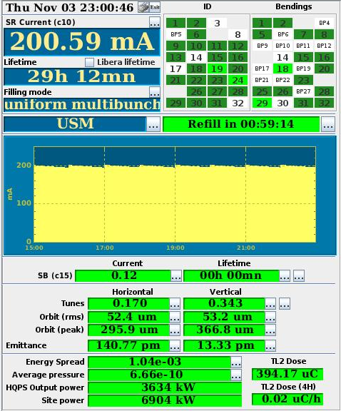
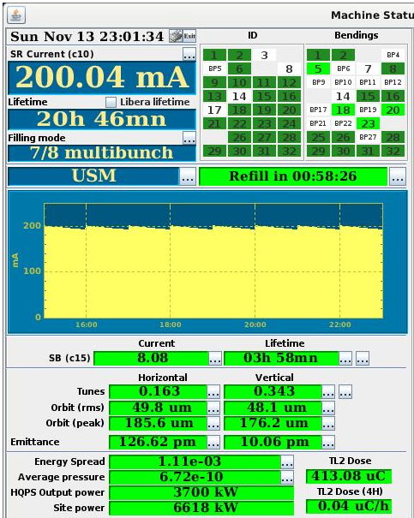
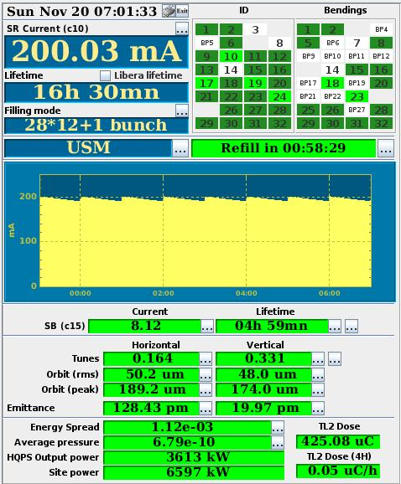
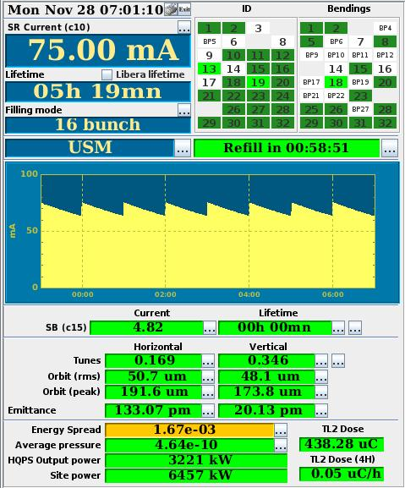
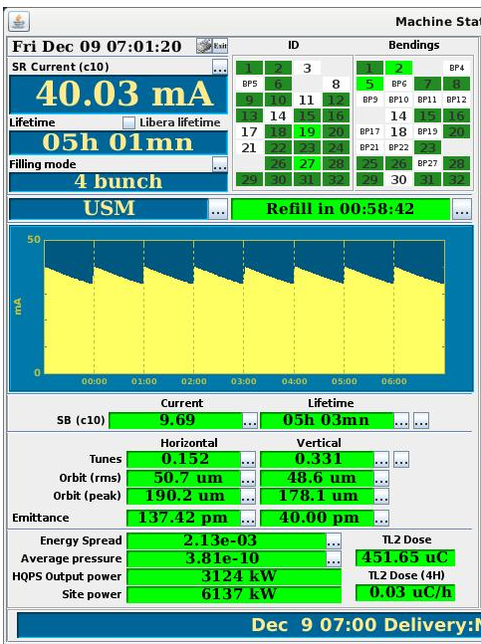

Accelerator & Source Division DAY
24st January 2023
OPERATION 2022
L Hardy, A Franchi, I Leconte, JL Revol
On behalf of the ASD Operation Group

Slide 2
OUTLINE
Operation Schedule
Filling Modes
USM delivery : Highlights and Statistics
Developments put into operation : selected topics
5. Operation Group activities
6. 2023 Priorities
7. Conclusion

Slide 3
Reminder 2021 : a very special year with “BDT” due to Covid !
2021 : 26 “buffer days (BDT)” to cope with constraints of the Covid lockdown.
Goal :
During BDTs, beamlines take beam (or not …) according to their available resources.
4 USM days per week between April 2021 and July 2021.
A standard year = 5600 USM hours
2021 = 4648 USM hours

Slide 4
2022 : EBS first year with a nominal operation schedule

Slide 5
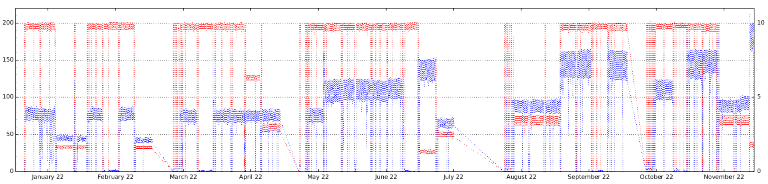
2022 : delivery modes : specific progress done in 2022
7/8 + 1 : single bunch intensity increased from 4 mA to 8 mA
single
6 mA
single
8 mA
single
8 mA
single
4 mA
single
4 mA
Total current (mA)
Single bunch current (mA)
4 bunch mode : total intensity increased from 30 mA to 40 mA
10 mA / bunch
7.5 mA / bunch
4 B
40mA
Total current (mA)
Single bunch current (mA)
Total 40mA
Total 30mA

Slide 6
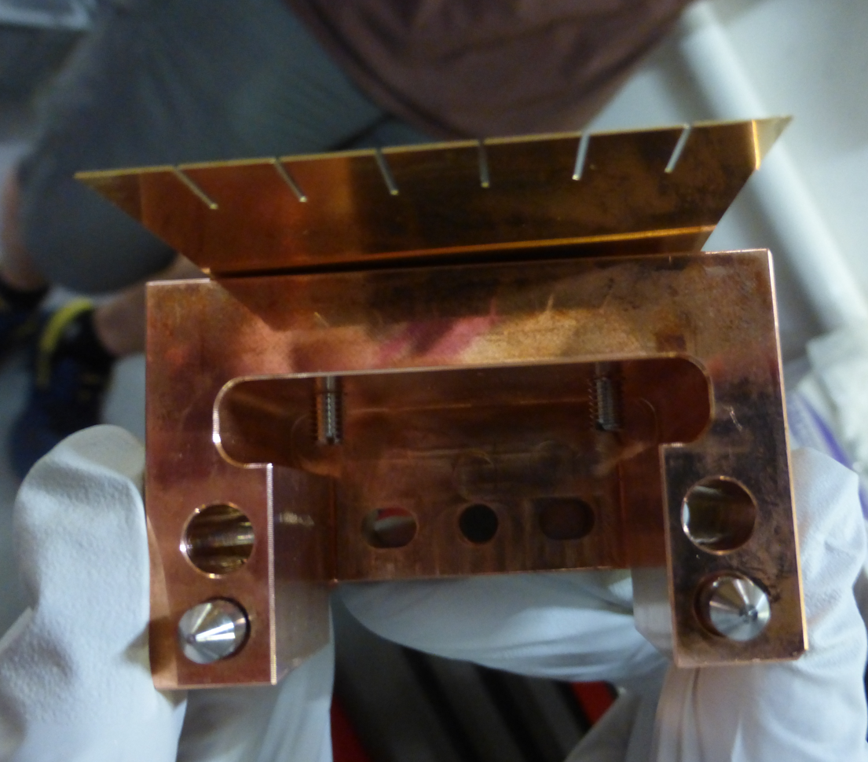
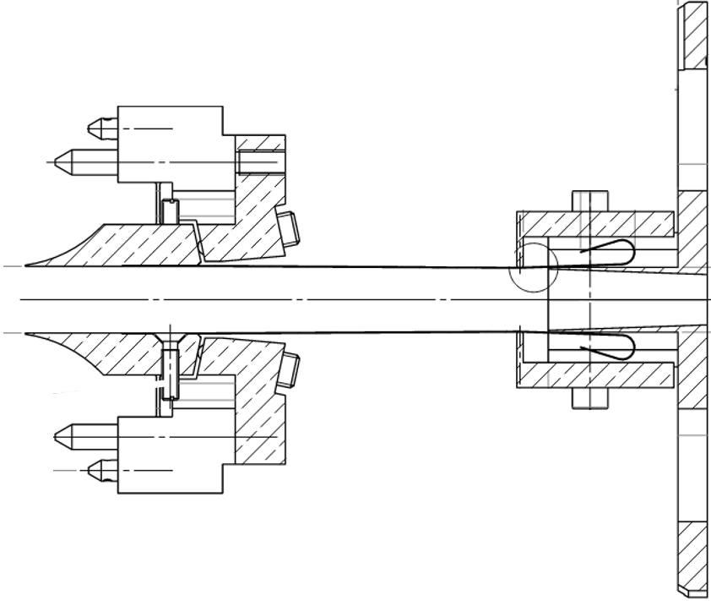
2022 : delivery modes : specific progress done in 2022
16 bunch: single bunch intensity increased from 35 mA to 75 mA
More robust RF fingers on the in-vacuum => ID ‘problem’ is OK now !
Limiting factor: waiting new model kicker ceramic chamber => safe side = 75 mA
ID15 AND ID16 need to work but RF fingers heating does not allow 65 mA => safe side = 55 mA
Exchange kicker ceramic chambers with same model but more coating to reduce heat load
kicker ceramic chambers exchanged and ID15 in vac validated for 16 bunch : safe side = 65 mA
Total current (mA)
Single bunch current (mA)
Total 75 mA
Total 75 mA
total
35 mA
total
35 mA
Total 65 mA
Total 55mA
BEFORE
AFTER
Probably 90 mA in August 2023 …after receiving new model kicker ceramic chamber
Thin RF fingers replaced by copper ends

Slide 7
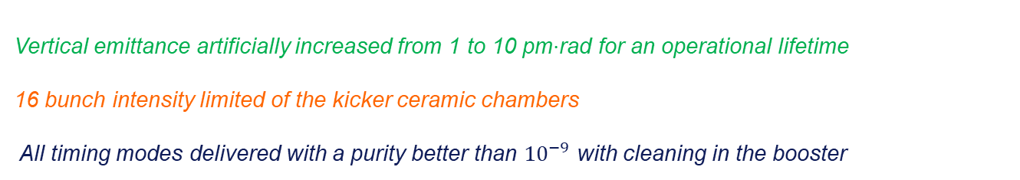
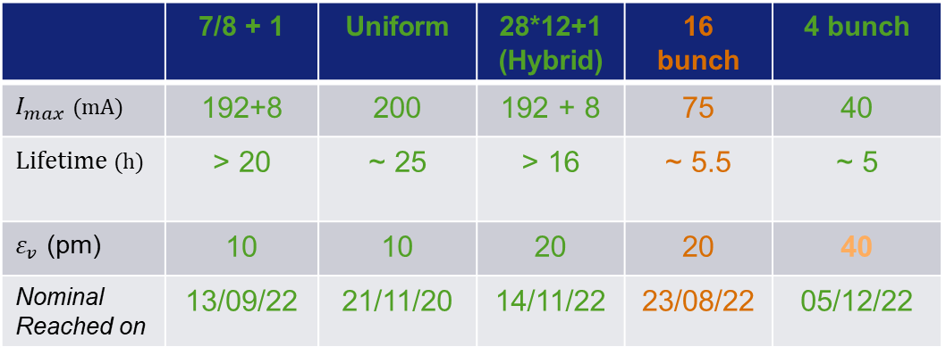
2022 : delivery modes : WHAT DO WE PROVIDE ROUTINELY TODAY ?
 | 7/8 + 1 | Uniform | 28*12+1 (Hybrid) | 16 bunch | 4 bunch
$I_{max}$ (mA) | 192+8 | 200 | 192 + 8 | 75 | 40
Lifetime (h) | > 20 | ~ 25 | > 16 | ~ 5.5 | ~ 5
$ε_{v}$ (pm) | 10 | 10 | 20 | 20 | 40
Nominal Reached on | 13/09/22 | 21/11/20 | 14/11/22 | 23/08/22 | 05/12/22
Vertical emittance artificially increased from 1 to 10 pm$⋅$rad for an operational lifetime
16 bunch intensity limited of the kicker ceramic chambers
All timing modes delivered with a purity better than ${10}^{−9}$ with cleaning in the booster

Slide 8
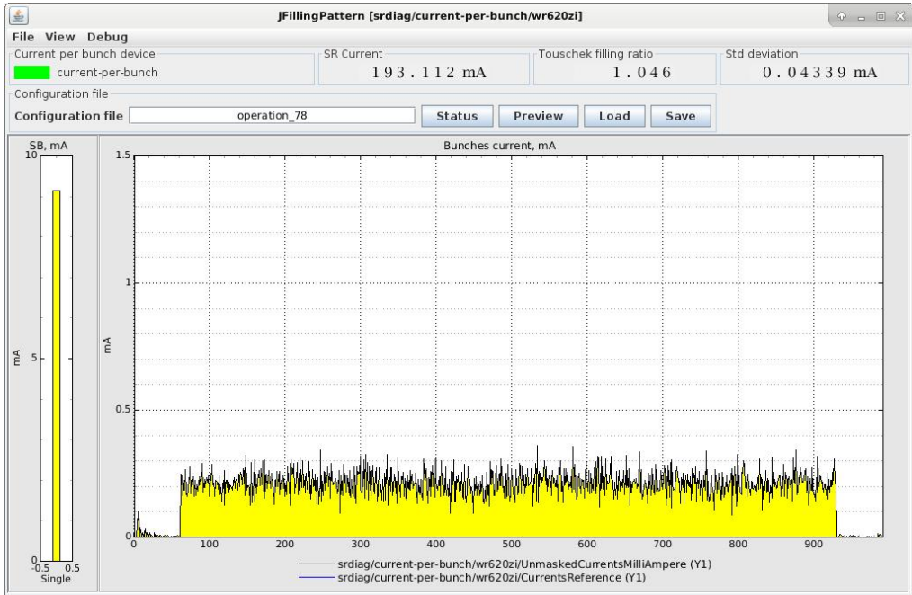
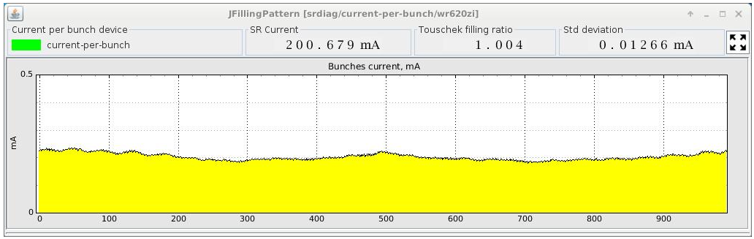
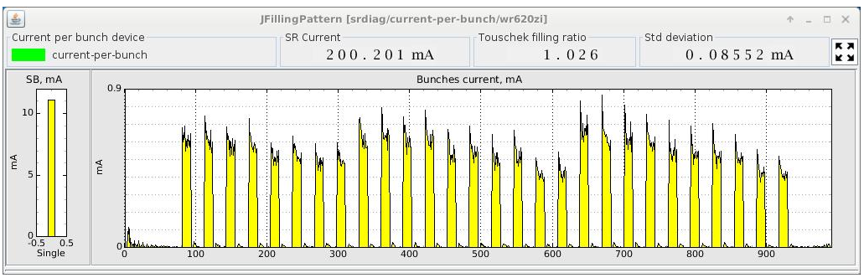
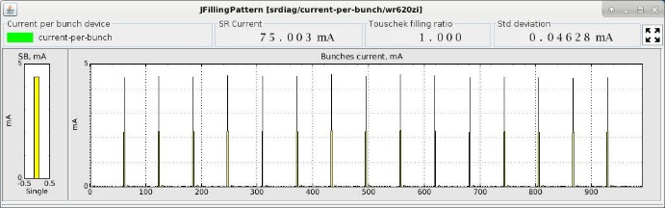
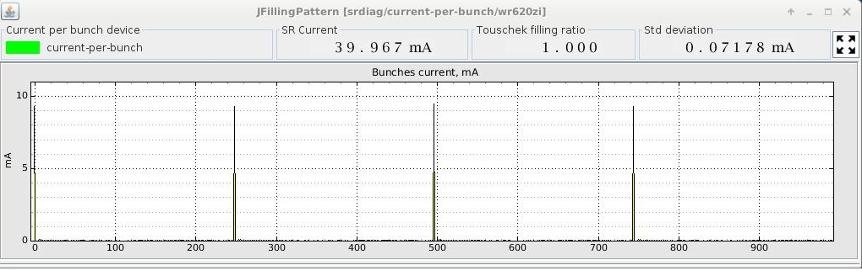
2022 : delivery modes : What they look like ?
7/8 + 1
Uniform
28 * 12 + 1
16 bunch
4 * 10 mA bunch

Slide 9
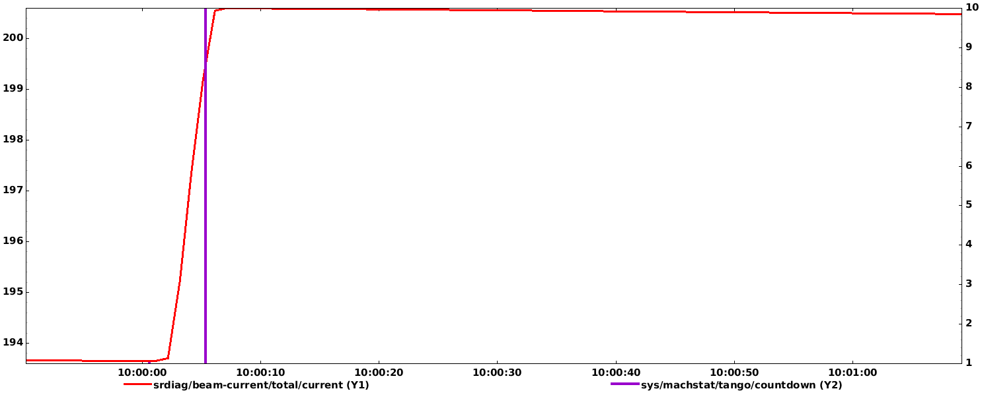
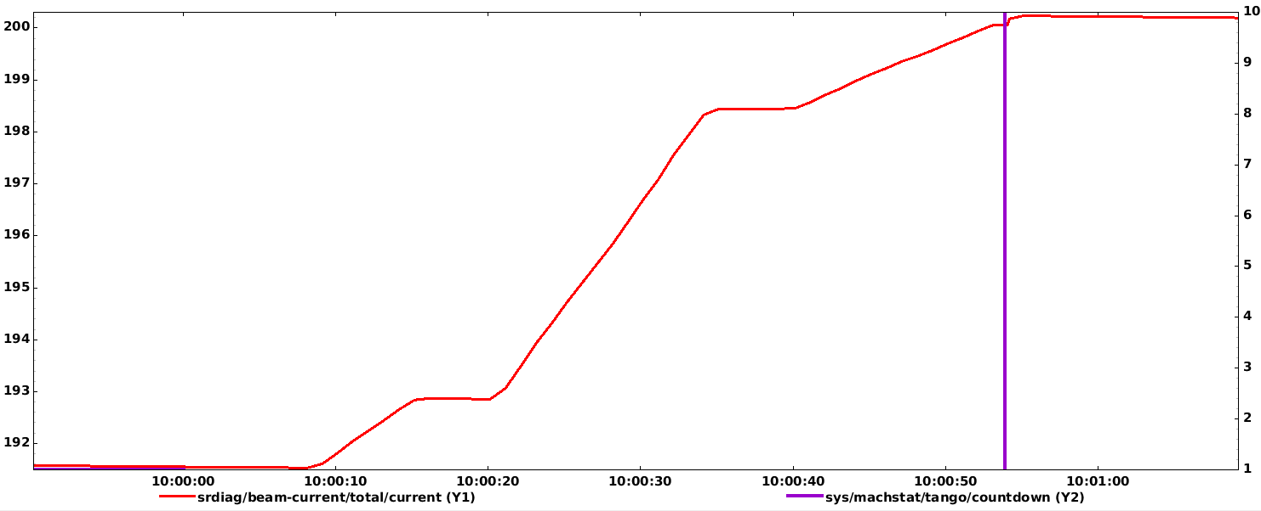
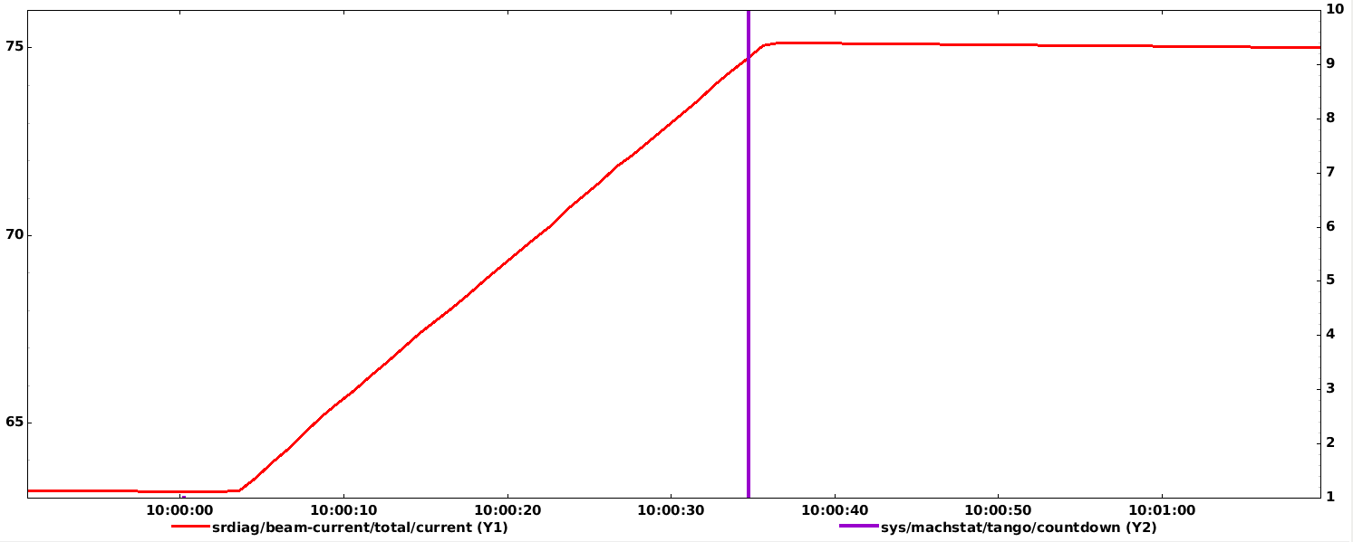
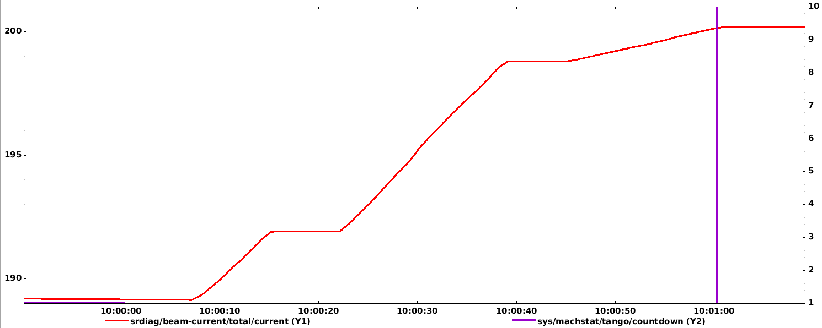
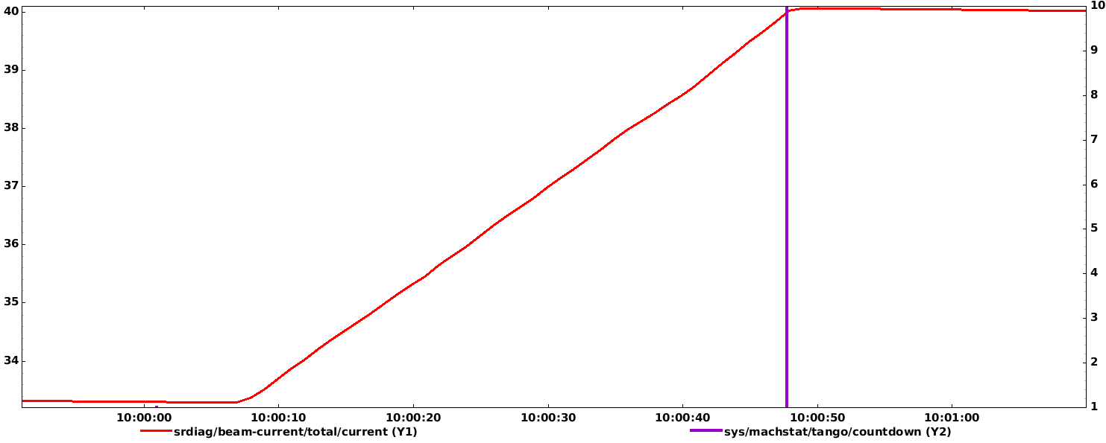
2022 : delivery modes : status of refill times
Refill in uniform
Refill in 7/8+1
~ 5 seconds
~ 50 seconds
Refill in 16 Bunch
Refill in Hybrid
~ 30 seconds
~ 60 seconds
Refill in 4 Bunch
~ 40 seconds
Courtesy JL Revol

Slide 10
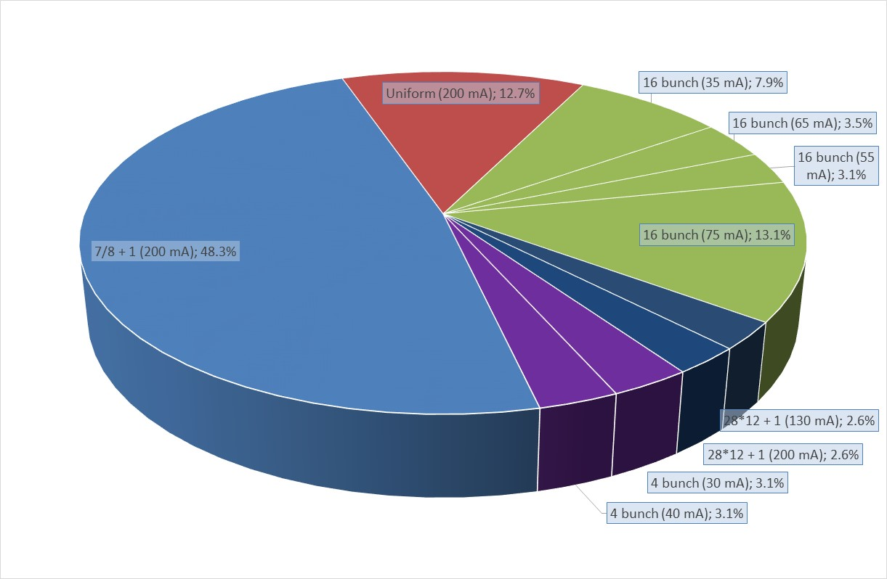
2022 : delivery modes: beam distribution
From January 2022 to December 2022
~ 27,6 %
~ 5,2 %
~ 6,2 %

Slide 11
2022 : Highlights of beam delivery : distribution of failures per week
37 weeks of delivery with 62 beam losses seen from the Users
Means: 9 weeks with 0 failure
Means: 1 week with 6 failures

Slide 12
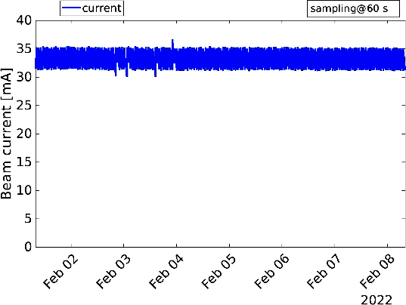
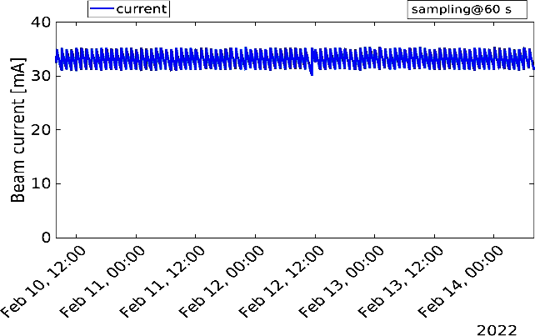
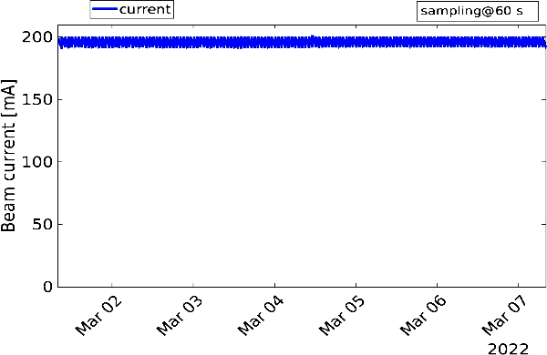
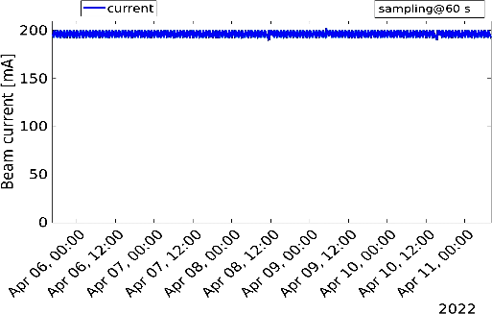
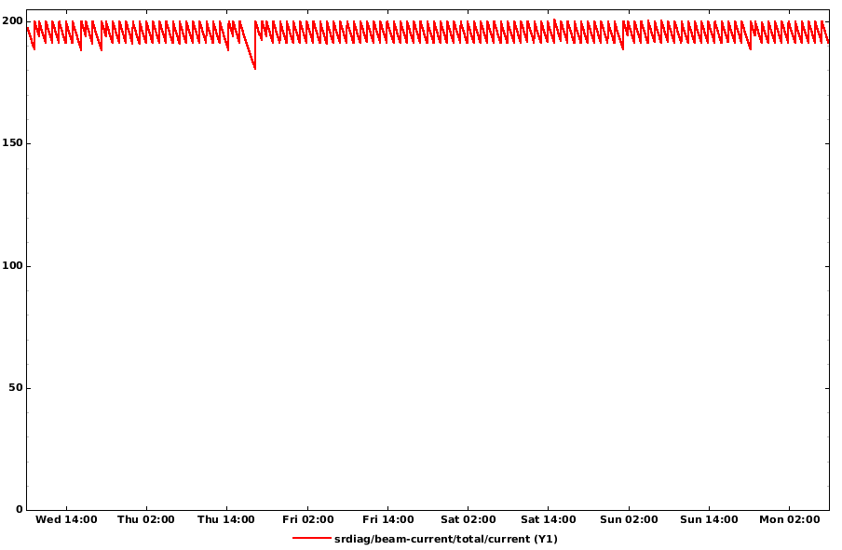
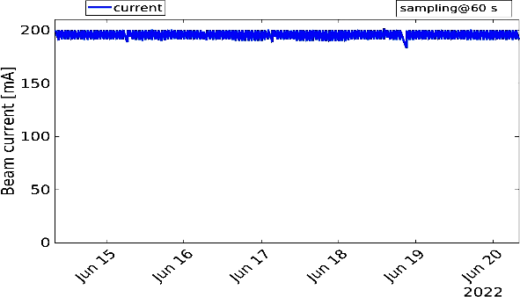
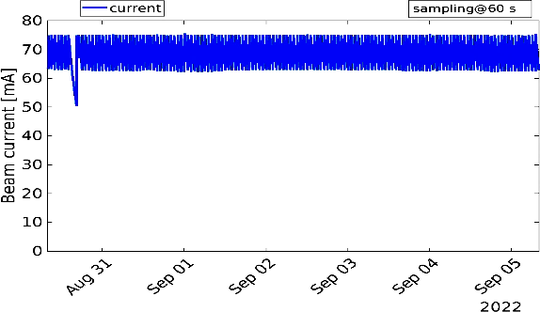
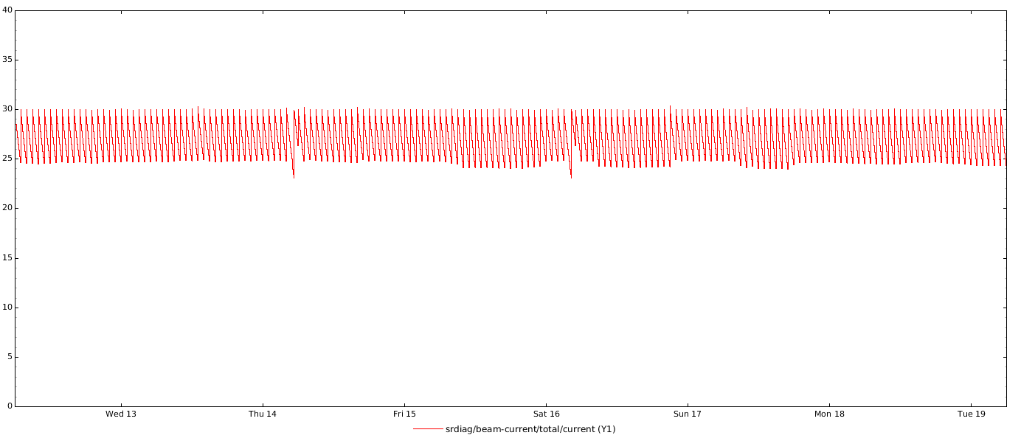
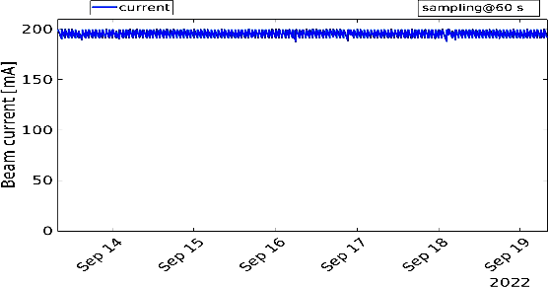
2022 : Highlights of beam delivery : the 9 weeks with 0 failure !
Run 1 16 bunch
Run 1 16 bunch
Run 1 7/8 + 1
Run 2 Uniform
Run 2 28*12 + 1
Run 3 7/8 + 1
Run 4 16 bunches
Run 4 7/8 + 1 bunches
Run 3 4 bunches

Slide 13
2022 : Highlights of beam delivery : the 9 weeks with 0 failure !
Run 1 16 bunch
Run 1 16 bunch
Run 1 7/8 + 1
Weeks without failure are spread along the year
There is not a preferred mode for which we have less failure …
Run 2 Uniform
Run 2 28*12 + 1
Run 3 7/8 + 1
Run 4 16 bunches
Run 4 7/8 + 1 bunches
Run 3 4 bunches

Slide 14
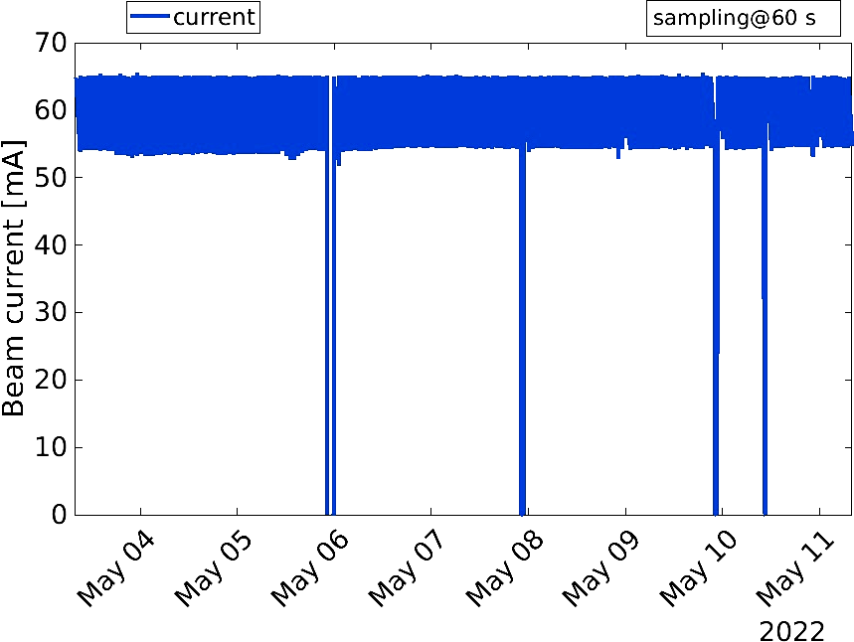
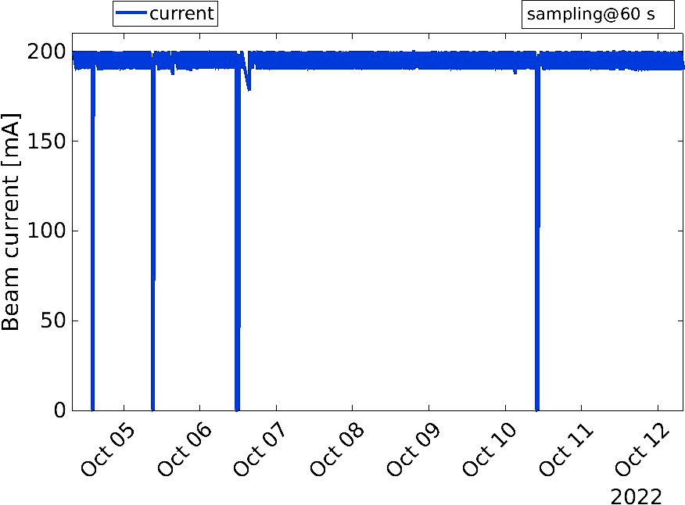
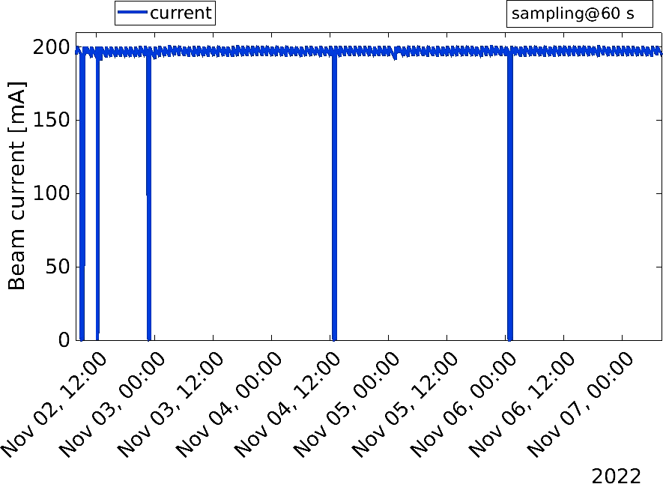
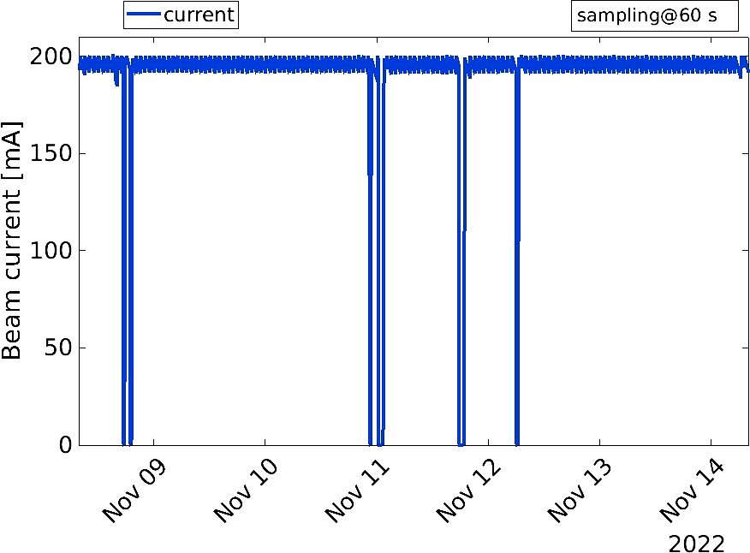
review of USM week: the 4 “worst“ weeks!
3 due to electricity provider !!
Run 2 16 bunch
4 failures
Run 4 7/8 bunch
4 failures
RF
Human mistake
INJEXT
Infra
Run 5 uniform
5 failures
Run 5 7/8 bunch
6 failures
PSS
RF
RF
RF
Power Supply
Power Supply
RF
RF
RF
RF
Power Supply

Slide 15
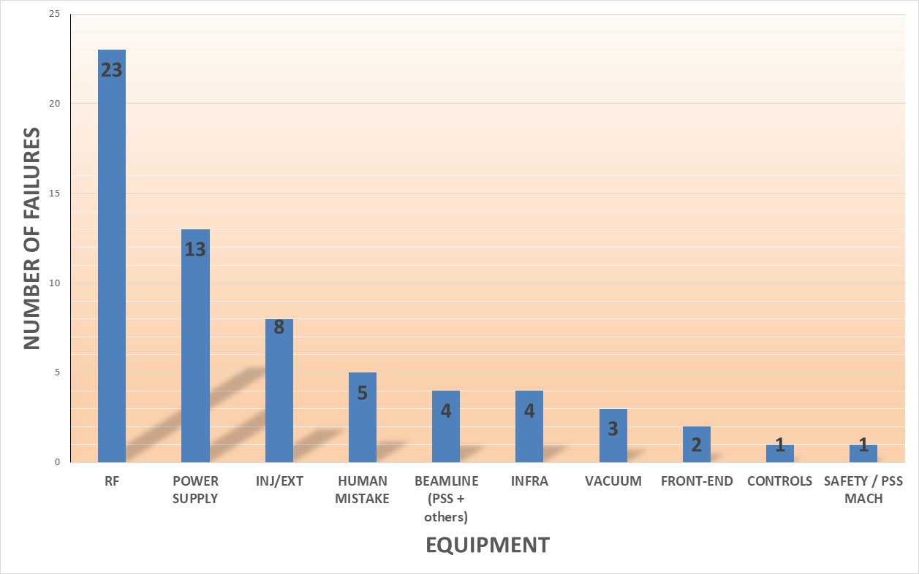
2022 : Summary of failures affecting MTBF
Many voltage breakdown (8)
TRA 1 input power issues (6)
Total : 64 failures (seen from machine side)
Fault on racks (C1/C3/C4/C5/C8/C9/21) (7)
Common source HS or earth leak) (2)
8 failures only can be directly attributed to EBS developments still in progress.
Wrong or missing kicker shot during refill (6 out of … 5414 refills !)
Includes 20 KV power cable cut on Place Mandela
36 triggered outside working hours

Slide 16
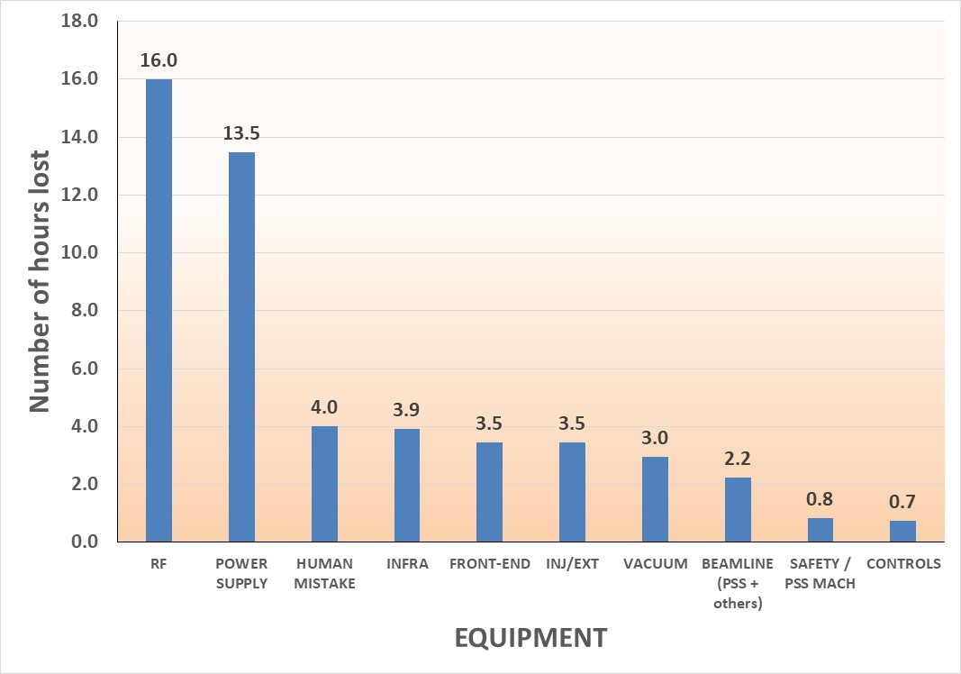
2022 : Summary of failures affecting AVAILABILITY
Mistuned reflected power interlock : RF did not start (2.7 h)
Breakdown cavity 7 + vacuum interlock (1.8 h)
Breakdown cavity 9 (1,7 h)
All of them outside working hours
Power fault on rack outside working hours (2.2 h)
Common source out of order outside working hours (2.2 h)
Fault on rack outside working hours (2.2 h)
Total : 51 hours
Quad PS switched off by mistake
TRA 1 circuit breaker activated when working on TRA 2
More than 34 hours of intervention outside working hours

Slide 17
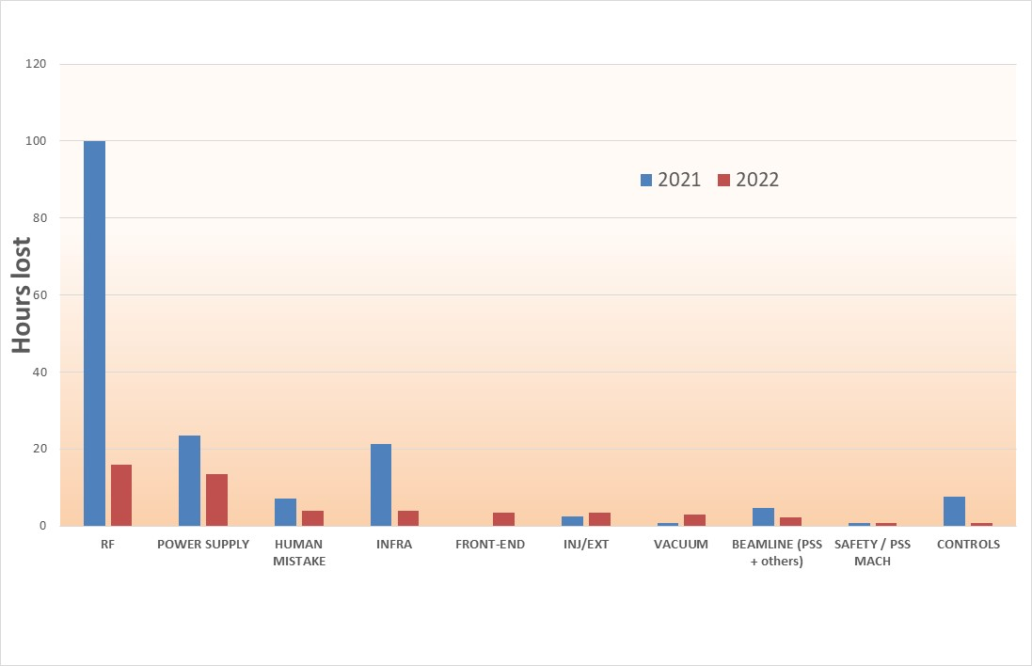

2022 : failures affecting AVAILABILITY – compared with 2021
Mainly Coupler cavity 7
2021 : 169 hours lost
2022 : 51 hours lost

Slide 18
2022 : DETAILED STATISTICS

Slide 19
2022 : Highlights of beam delivery
Machine Statistics for 2018 at the ESRF and for 2020 – 2022 (EBS)
• 4978 hours of beam delivered in 2021 out of 4648 scheduled
• Overall availability in 2021: 96.35 %
• 5438 hours of beam delivered in 2022 out of 5490 scheduled
• Overall availability in 2022: 99.06 %
MACHINE – USM
 | 2018 | 2020 | 2021 | 2022
Availability (%) | 98.47 | 96.08 | 96.35 | 99.06
Mean Time Between Failures (hrs) | 104.30 | 46.00 | 66.4 | 88.5
Mean duration of a failure (hrs) | 1.60 | 1.80 | 2.42 | 0.83

Slide 20
2022 : OTHERS developments (selected topics …) put into operation
POWER SUPPLIES Hot Swap Manager : Today Fully Operational !
Talk L. Jolly
DIAG : installation of non destructive Halo Monitors
Talk K. Scheidt
Reduction of Injection Perturbation : improved + still in progress
Talk S. White
New RF working point : allows to save electricity
Talk J. Jacob

Slide 21
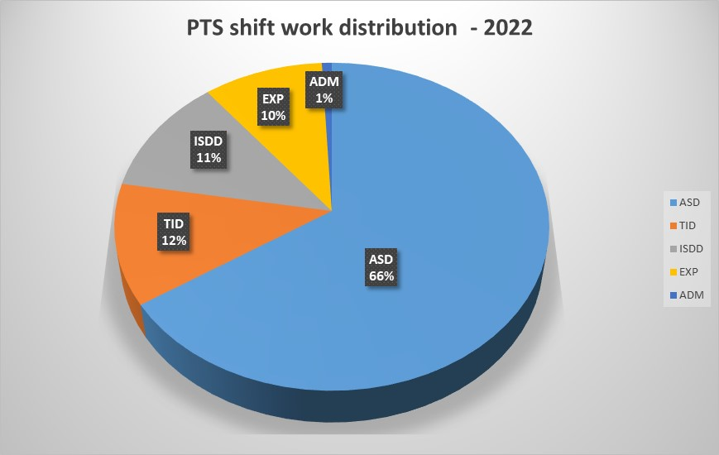
Control room : continuous shift work organization in 2022
1095 shifts covered by Full Time CTRM Operator
including 745 USM shifts covered in duo by 76 Part Time Shiftworker
2022 : Many last minute cancellations from PTS for medical reasons.
Average: 10 shifts / year / person

Slide 22
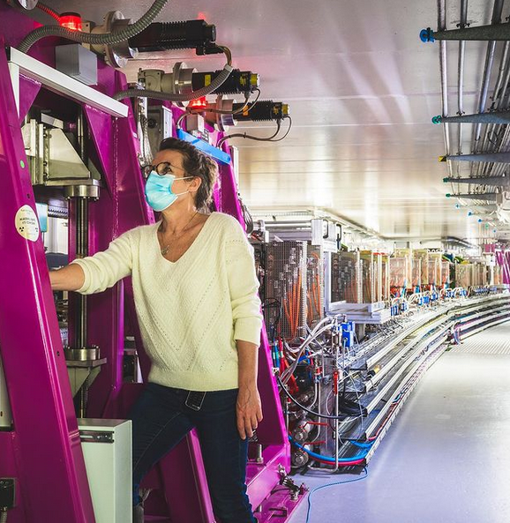
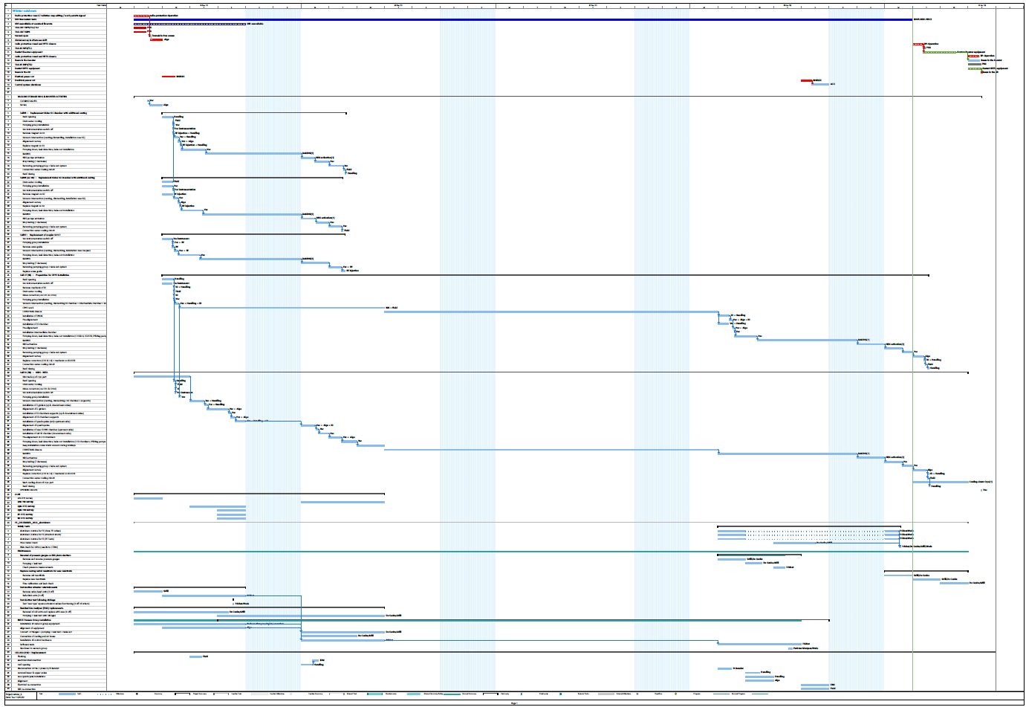
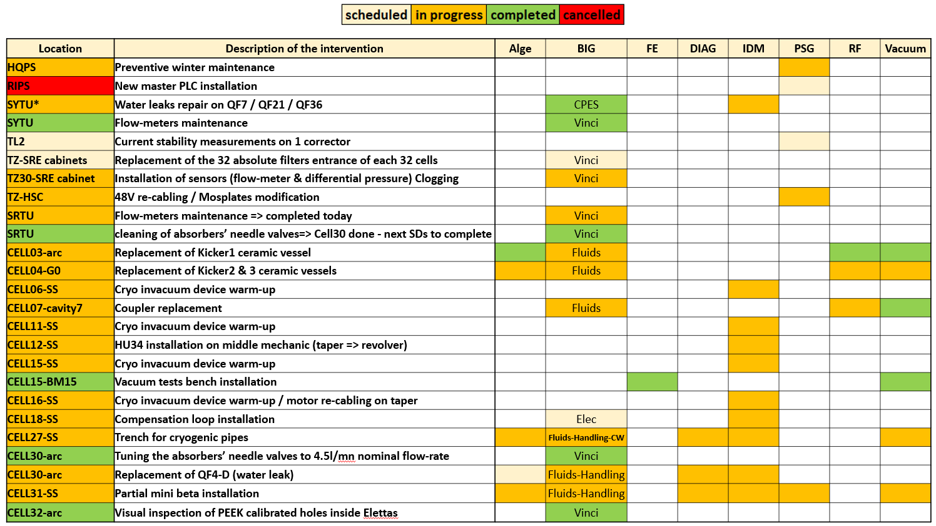
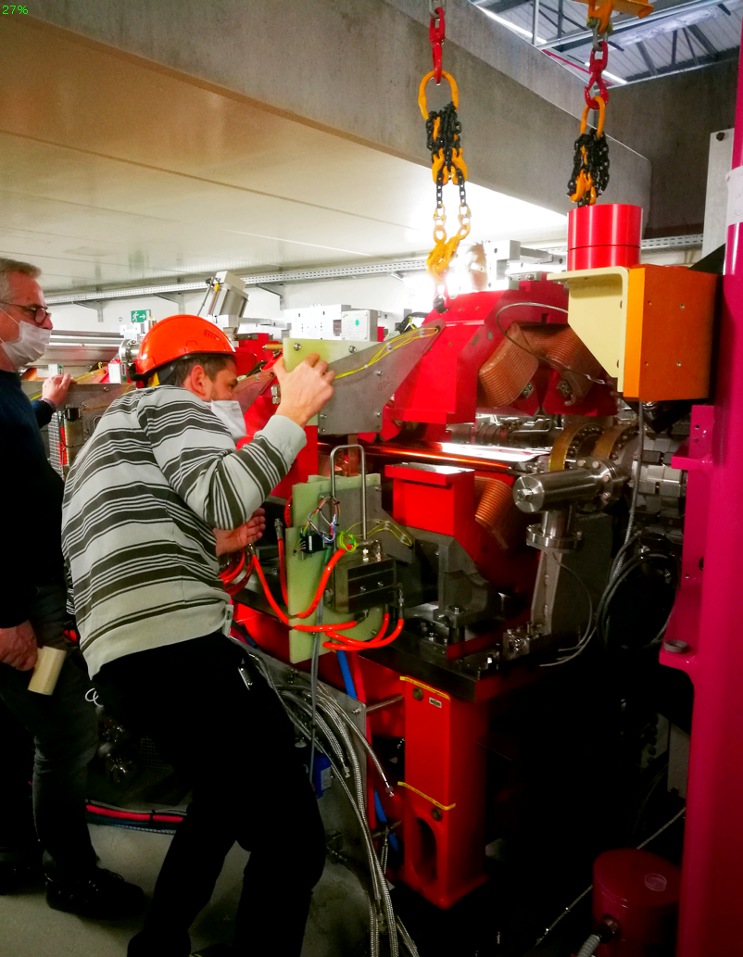
2022 : shutdown activities
Shutdown coordination requires lots of coordination between all ESRF Divisions / Groups
Requests
Requests
Requests
Requests
Activities
Groups
All 2022 details in talks all day.

Slide 23
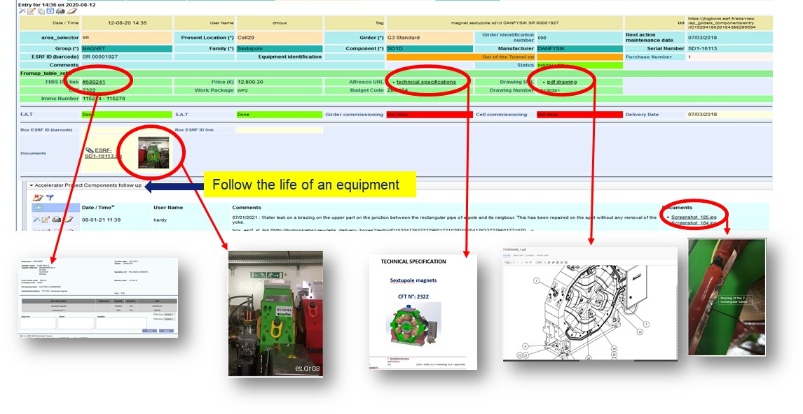
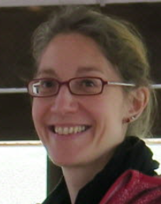
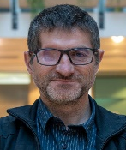
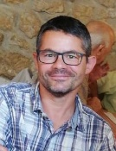
OPERATION GROUP: side Activities
1. Continuous update of EBS components database
      Reminder: since 2016, ALL EBS + Booster + TZ components are recorded in a huge database. Used by Technical Experts, Finance , Inventory, Radiation Protection, MEG, maintenance, etc.
      December 2020 : 17 000 components recorded.
      January 2023 : > 20 000 components recorded !
30 fields of information for all equipment (specs / drawings / spare parts / maintenance date / picture /etc).

Slide 24
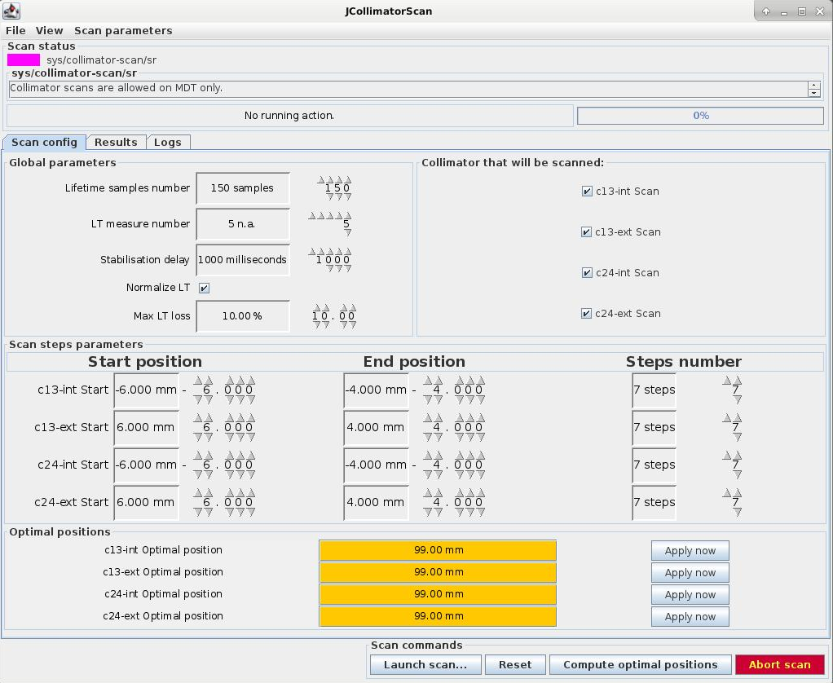
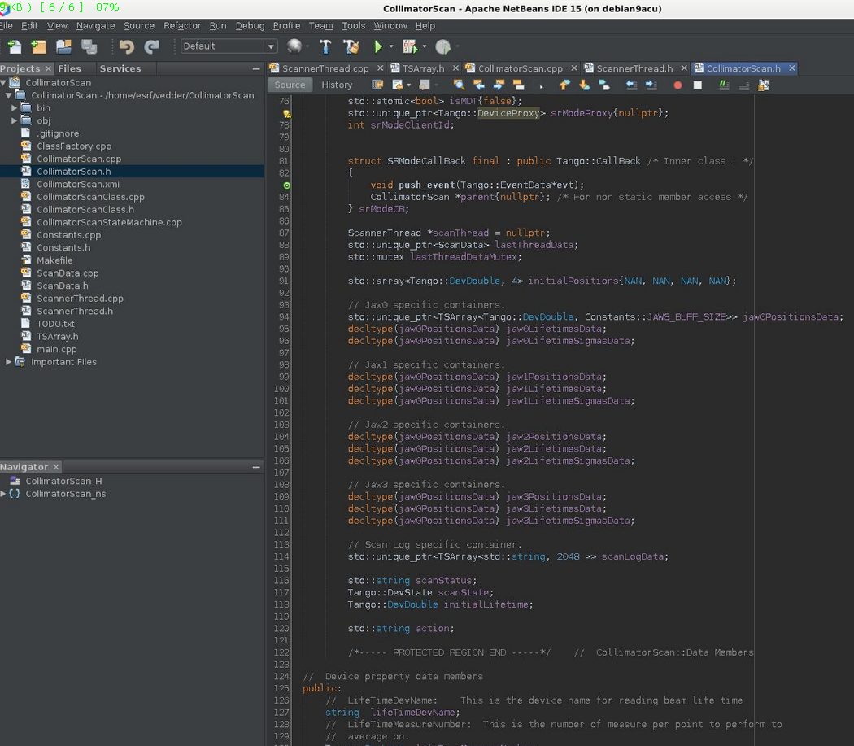
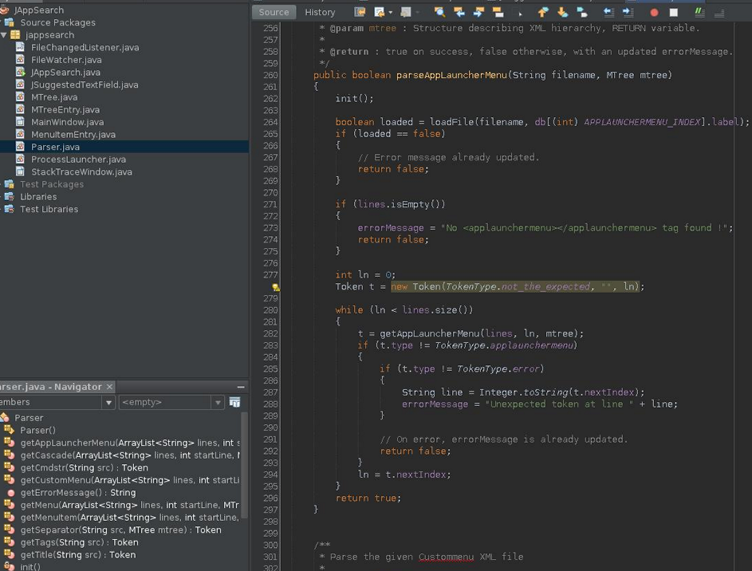
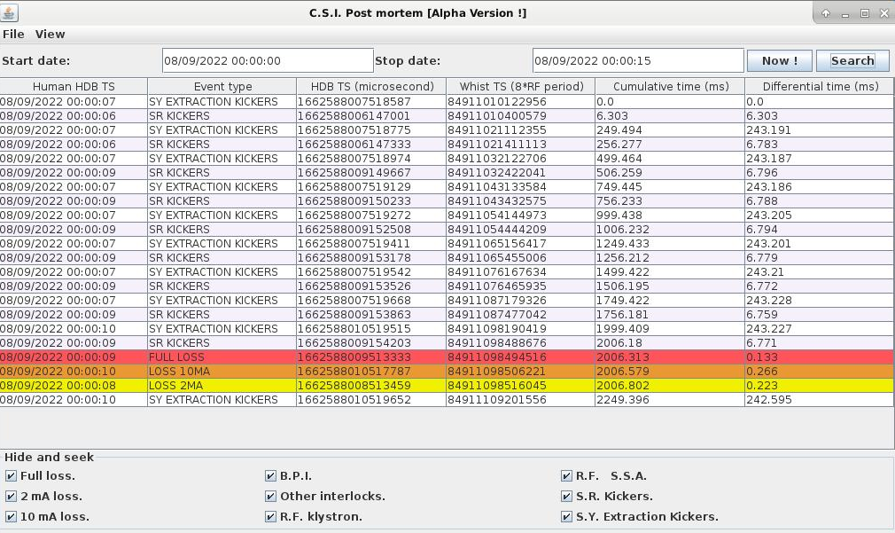
OPERATION GROUP: side Activities done by the operators
2. Application developments for the Control Room
Ex 1: Collimator scan & optimization
Ex 2: Beam loss post mortem investigation or … crime scene investigation !

Slide 25



OPERATION GROUP Activities
3. Application developments for the Control Room Electronic Logbook
Jlogbook automatic reports
PhP coding to extract and process data from JLOG for automatic statistics

Slide 26
2022: 2021 priorities reminder
Main priorities for 2022 were :
  Reach nominal intensities / parameters for all modes
    March 2022 : 2 others re-coated kickers (K3 & K4) will be installed.
    ➔July 2022 : progressive intensity ramping, many MDTs to quantify lifetime / losses / temperatures.
    Warning : we can not exclude the discovery of side effects / other effects never seen before on other equipment due to high intensity per bunch!
Almost (all OK except 16 bunch)
Indeed … effects saw on RF fingers CPMU ID 15 & ID 16 but solved !
  stabilize the availability > 98 %
  & MTBF > 72 hours
(99 % - 88 hours)

Slide 27
2023: MAIN priorities
Main priorities for 2023 are :
  Install new model of ceramic kicker chamber and reach 90 mA in 16 bunch (> August 2023)
  Fully assess the Hot Swap Power Supplies System
    (The goal is to increase the reliability of the power supplies)
  Continue to minimize the perturbations at injection
  ? Winter 2023-2024: Start replace RF klystrons with SSAs ?
  Maintain the high level of availability & MTBF

Slide 28
2022: conclusions
The second year of EBS and the first full year of normal operation :
  All 5 different modes delivered at nominal specifications (except one)
  Availability > 99 % - MTBF = 88 hours
  RF fingers weaknesses discovered and solved : OK for 16 bunch .
  On-Going improvements with respect to reduction of perturbations at injection
  Power Supplies Hot Swap : Fully Operational !

Slide 29










Special thanks for special efforts !
A special thank to ALL the CTRM operators for their solidarity and team spirit in these hard times
These 8 people made the accelerators running 24/24 7/7 365/365
despite undergoing the Covid crisis.
Many last minute change of organization (back from holidays / from rest period / more hours worked) : 100 % transparent for Users !
Reliability can not be improved by chance: this is the result of all groups involved in the accelerators maintenance AND also the fast reaction of all people in standby 24/24.
THANKS to ALL of them !

Slide 30

Many thanks for your attention ! Time for questions
behind the scene…
Control Room continuously recruits Part Time Shift Workers ;)

