Slide 1


ASD Matters
Q. Qin
24/01/2023

Slide 2
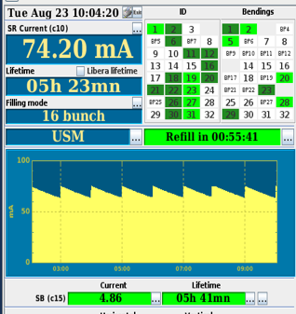
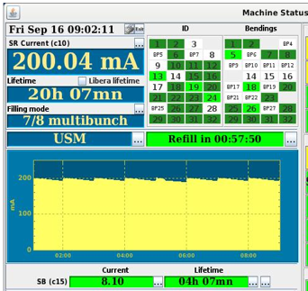
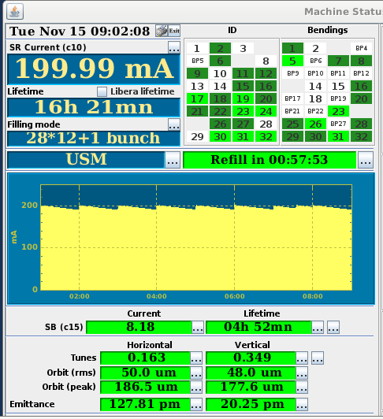
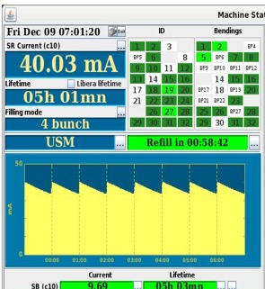
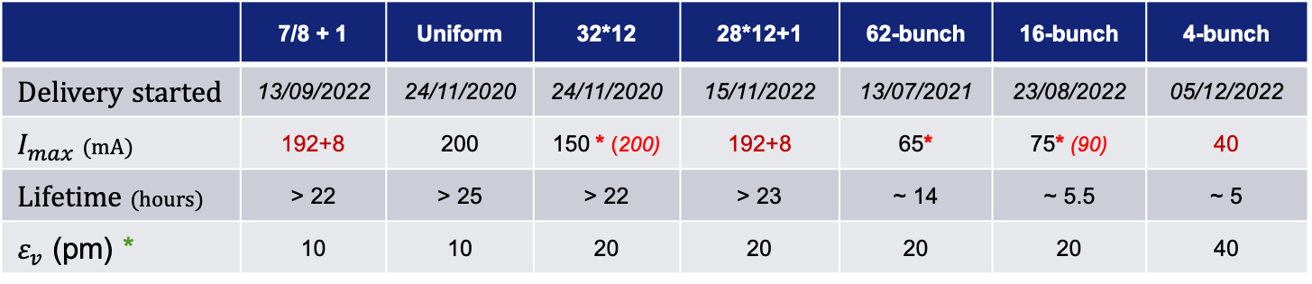
Beam current records in USM operation (since 25.08.2020)
 | 7/8 + 1 | Uniform | 32*12 | 28*12+1 | 62-bunch | 16-bunch | 4-bunch
Delivery started | 13/09/2022 | 24/11/2020 | 24/11/2020 | 15/11/2022 | 13/07/2021 | 23/08/2022 | 05/12/2022
$I_{max}$ (mA) | 192+8 | 200 | 150 * (200) | 192+8 | 65* | 75* (90) | 40
Lifetime (hours) | > 22 | > 25 | > 22 | > 23 | ~ 14 | ~ 5.5 | ~ 5
$ε_{v}$ (pm) * | 10 | 10 | 20 | 20 | 20 | 20 | 40
* Intensity limitation for timing modes due to mechanical weakness of the kicker ceramic chambers
* Vertical emittance could be intentionally increased from 1 to 10 pm, and 20 pm or bigger for an operational lifetime
New records of beam current during user operation achieved in 2022:

Slide 3

A remarkable achievement in EBS operation
Machine Statistics of USM operation in 2022, the 1st year with full operation schedule since 25/08/2020
• 5438.5 hrs of beam delivered in 2022 out of 5490 scheduled
• Overall availability in 2022: 99.06 %
 | 2018 | 2020 | 2021 | 2022
Availability (%) | 98.47 | 96.08 | 96.35 | 99.06
Mean Time Between Failures (hrs) | 104.30 | 46.00 | 66.4 | 88.5
Mean duration of a failure (hrs) | 1.60 | 1.80 | 2.42 | 0.83

Slide 4
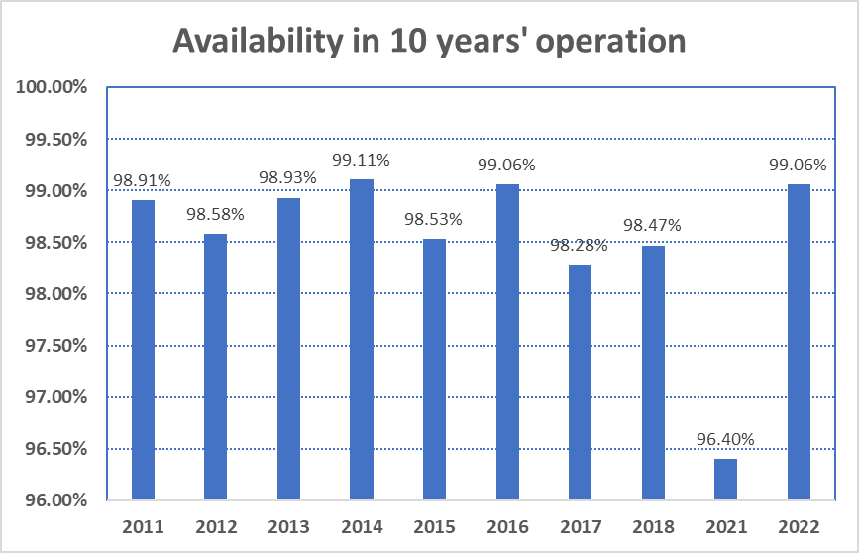
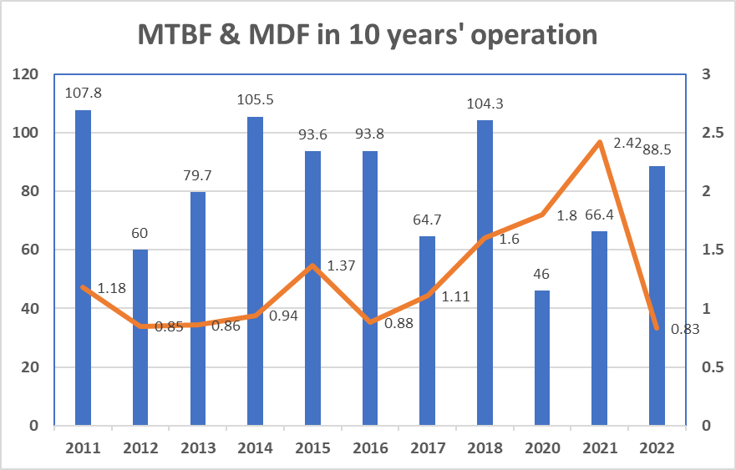

Slide 5
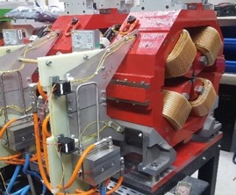
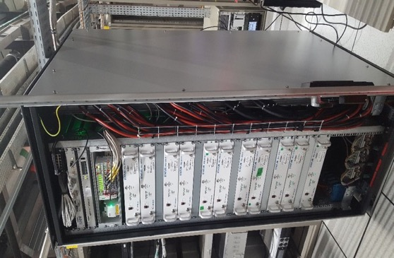
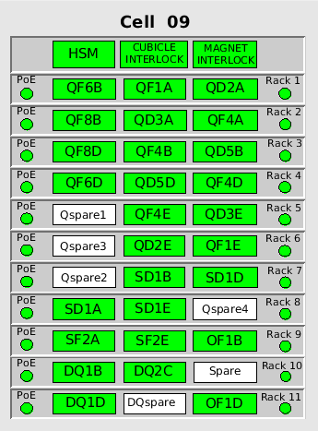
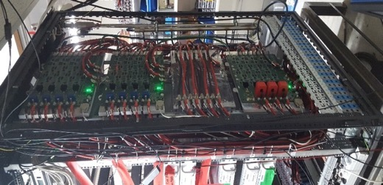
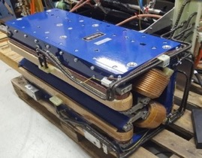
Preventive maintenance In progress
Implement hot- swap system for power supplies
HSM
Mosplate manager
Presentation in ASD Day 2022 !
Mosplates
STATUM racks (PS)
2022 : Make the system robust enough to be deployed without negative impact on the operation of the accelerator
Hot Swap architecture
MOSplates for all the sextupoles’ power supplies – to be covered by HotSwap Sys.
-- it will be hopefully done in mid-2023.
-- less beam loss due to sextupole PS failures is foreseen.

Slide 6
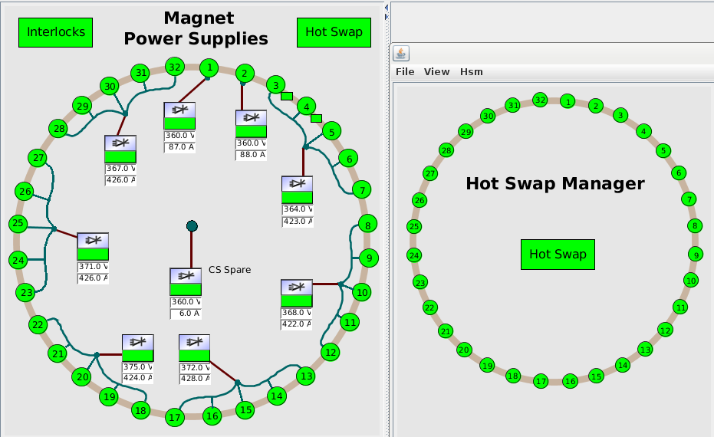
Hotswap system starts operation in USM from 17/01/2023

Slide 7
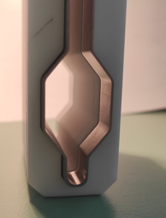
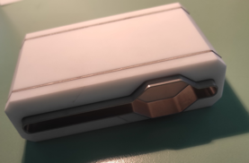
medium- and long-term scientific programs
Kicker ceramic chamber

Slide 8
Injection improvement
Non-linear Kicker scheme
TL2 shift
Transparent & high efficient injection
Strip-line kicker scheme

Slide 9
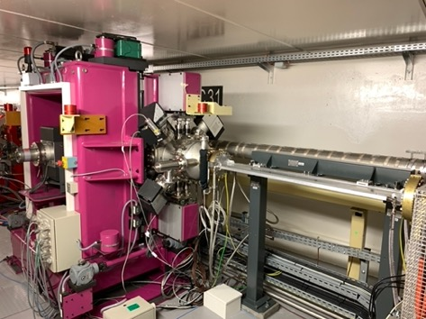
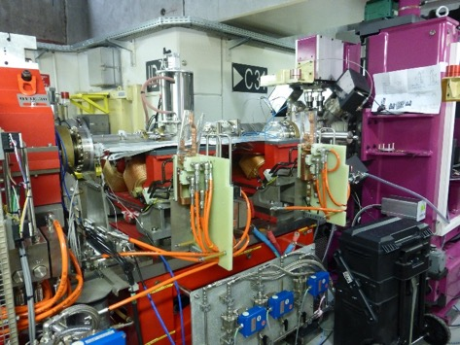
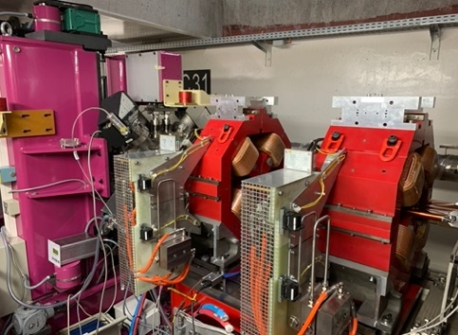
mini-𝜷
Preparative work of hardware at Cell31 done during the shutdowns in 2021
4 quads were successfully installed in the winter shutdown 2022
Commissioning for the test of mini-𝜷 will be carried on mid of this year.
More “mini-𝜷” beamlines will be constructed on requests by the ExpDiv.
Lower gap of IDs at the mini-𝜷 section will benefit to the brightness of X-ray.

Slide 10
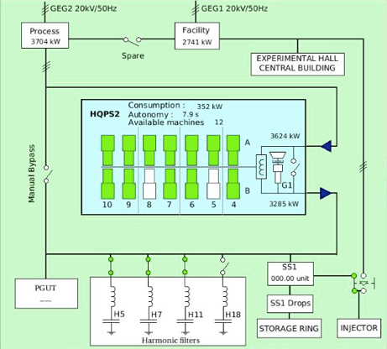
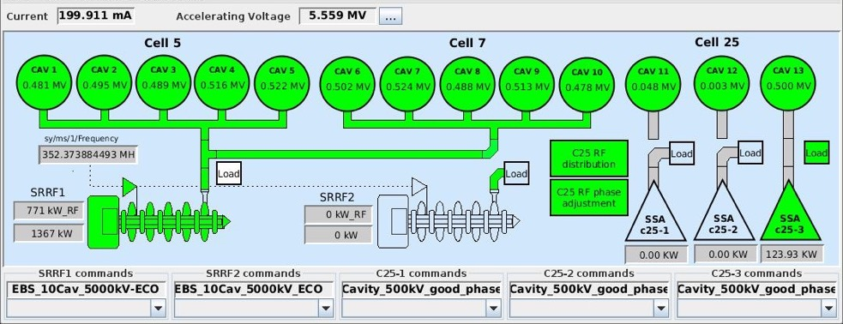
energy savings from HQPS & RF
HQPS:
Switch off HQPS at all the shutdowns
Reduce 2 machines out of 14 in routine operation
Economical HQPS operation could get an electricity
saving of ~584 MWh/y
ECO RF mode
Reduction of total V_{acc} from 6.0 to 5.5 MV
Increase AC to RF conversion efficiency
~200 kW AC power saving@200 mA
Same beam lifetime for typical ID losses around 0.4 … 0.5 MeV/turn
      With the IDs closed, save ~1100 MWh/y @ ECO configurations of RF working points.

Slide 11
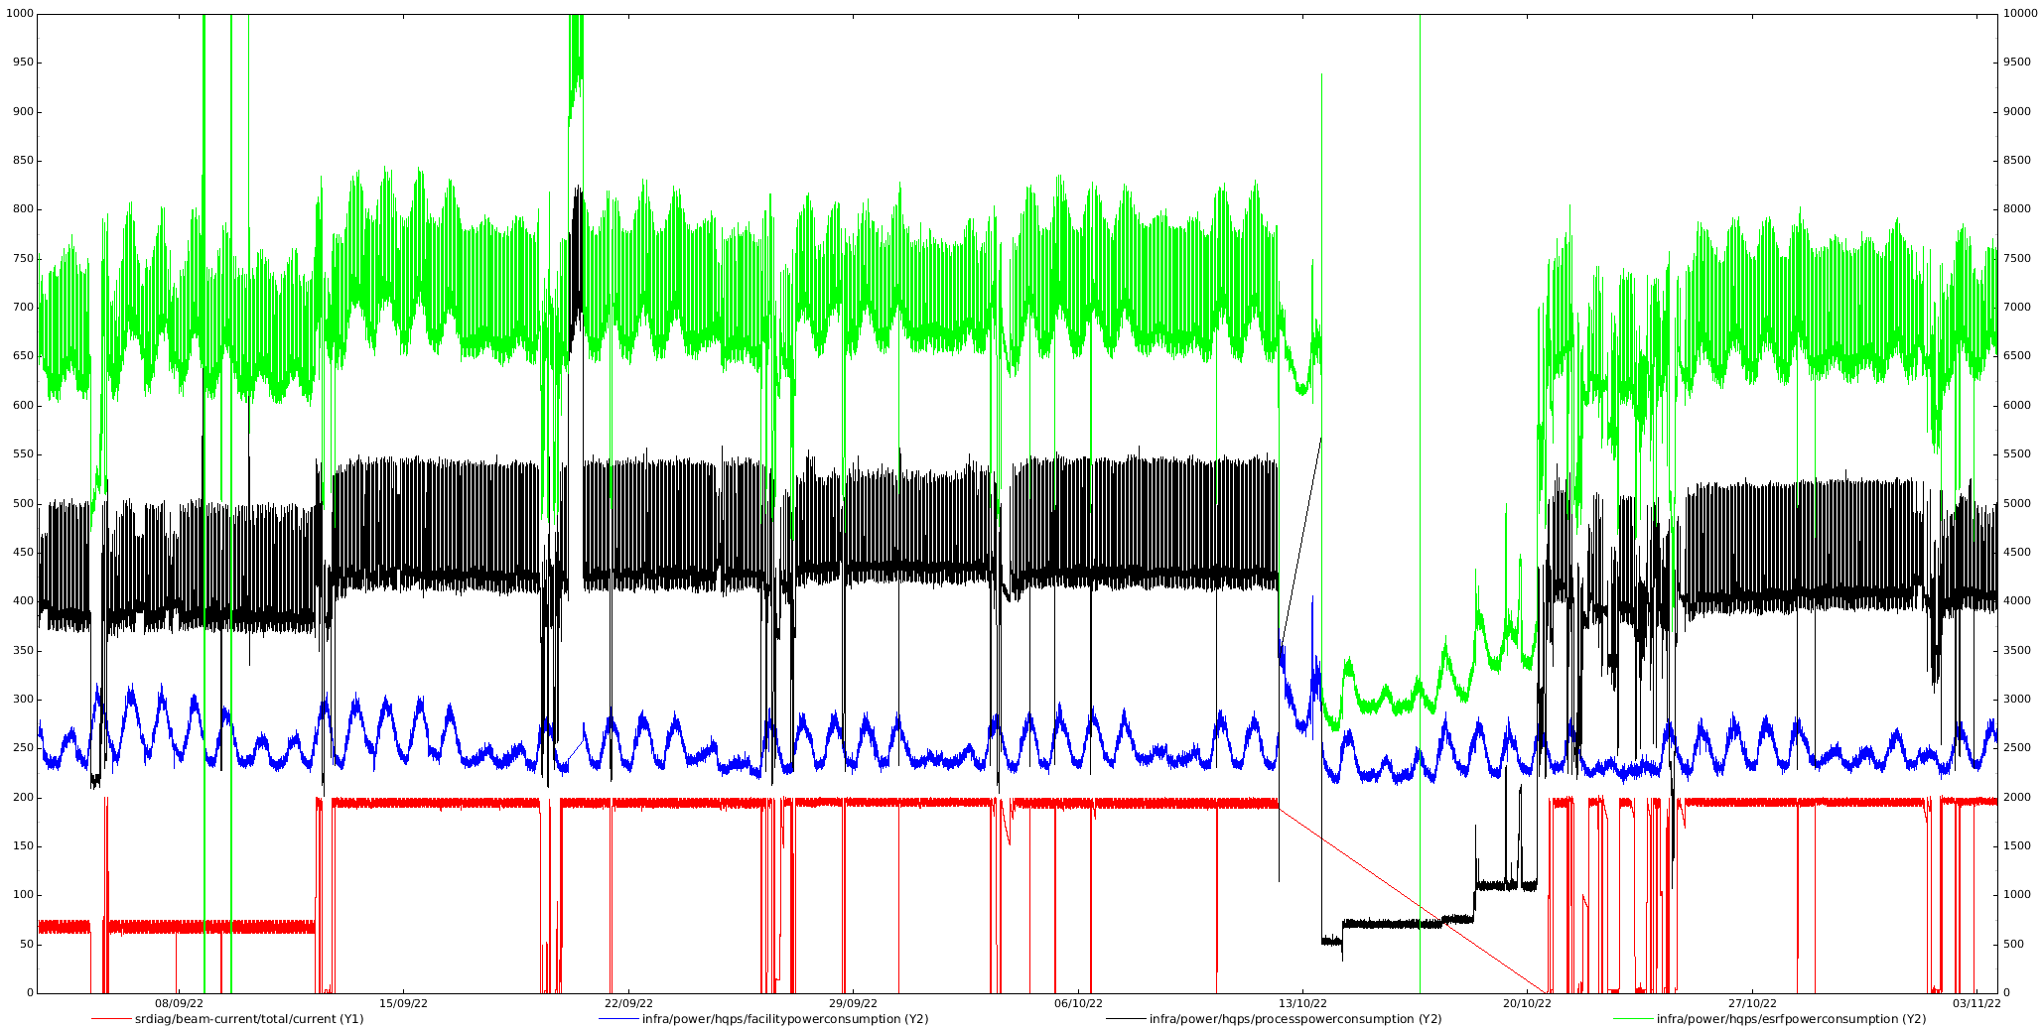
energy saving of accelerator complex
ESRF site power
Facility & beamlines power
Nominal RF configuration
EBS accelerator power
Beam current
~8000kW
Eco RF mode
Beam current (mA)
Power consumption (kW)
~6300kW
~4000kW
7/8+1, I=191-200mA
7/8+1, I=191-200mA
16-bunch, I=66-75mA
08/09/22 15/09/22 22/09/22 29/09/22 06/10/22 13/10/22 20/10/22 27/10/22 03/11/22

Slide 12
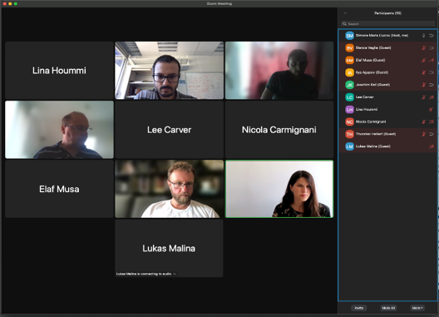
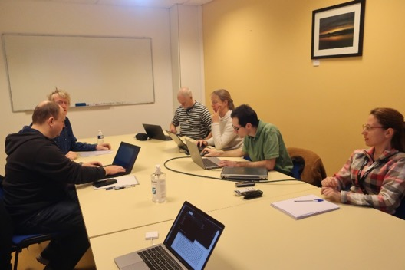
International collaborations
Eurizon – beam dynamics, diagnostics, etc.
ESRF-DESY – TLB magnet, lattice deign,
beam commissioning, etc.
ESRF-PSI – fast kicker and injection issue
ESRF-CERN – FCC design study
ESRF-LBNL – magnet bench
ESRF-SOLEIL – RF, assembly, etc.
LEAPS – photon-diagnostics
MAC members of some labs/machines

Slide 13
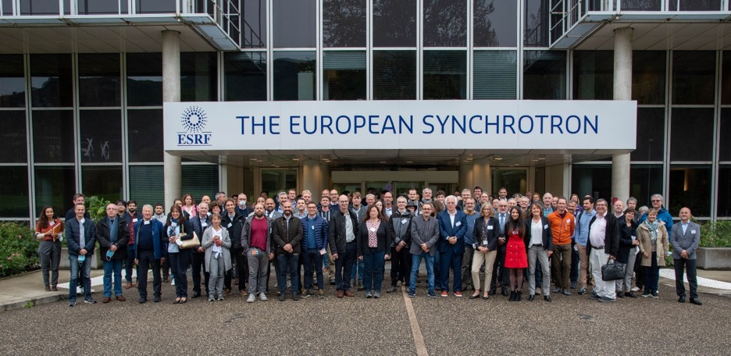

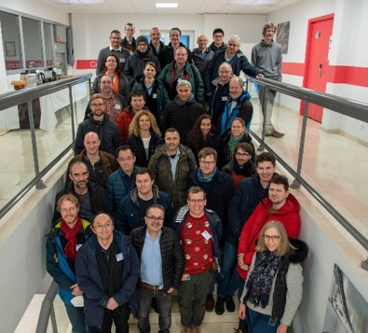
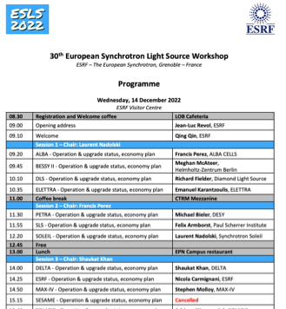
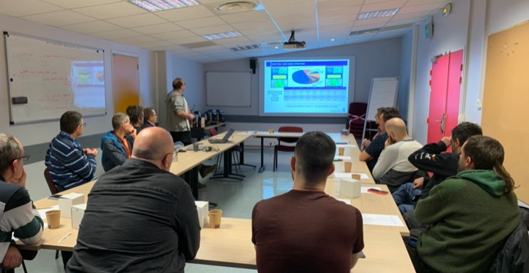
meetings, workshops, visits
ASD Day 2023 – Q. QIN
ALBA op. group
visit ESRF

Slide 14
prospects of new year 2023
EBS accelerator had been running very smoothly in its second year of USM operation. Continue to keep the operation performance as well as possible.
Challenges ahead to keep ESRF at the frontier of science and innovation require the R&D program of accelerator to improve reliability and stability, increasing brilliance and coherence.
      Preventive maintenance, radiation damage treatment
      Reaching all BES design parameters (90 mA@16-bunch, lower emittance @ timing modes)
      RF power source & injector upgrade
      IDs construction and ID control upgrade
      4th harmonic cavities, mini-beta scheme & mini-gap IDs
      Studies on higher bunch current, lower emittance (off-momentum lattice, round beam), beam stability, which are requested from beamlines.
More communications between machine and beamline people.

Slide 15
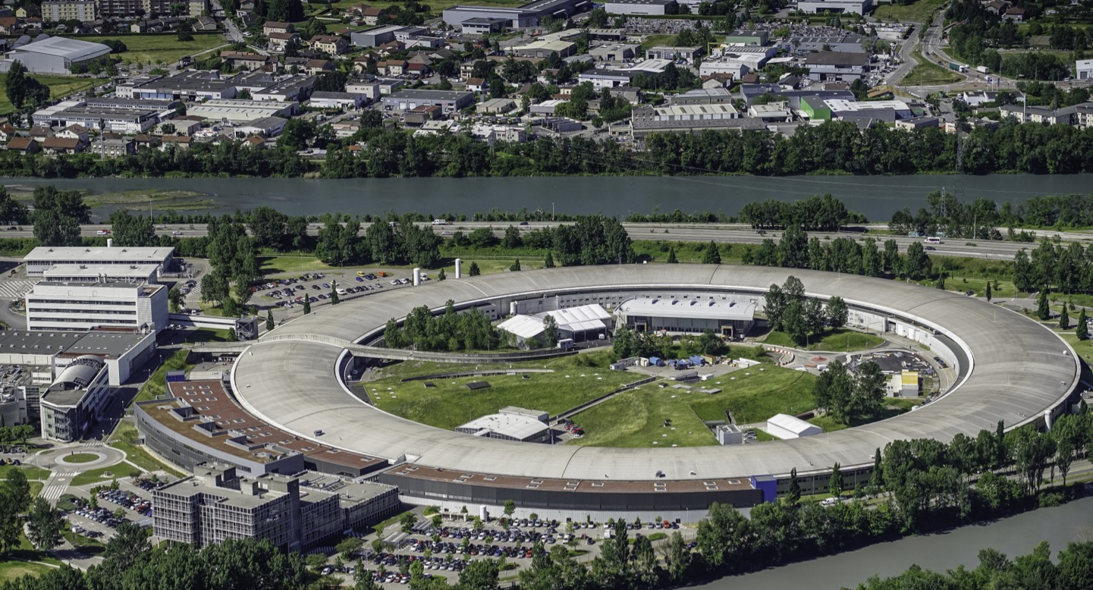
Many thanks for your attention !
Thanks to all of your contributions to the ASD Day !

