Slide 1
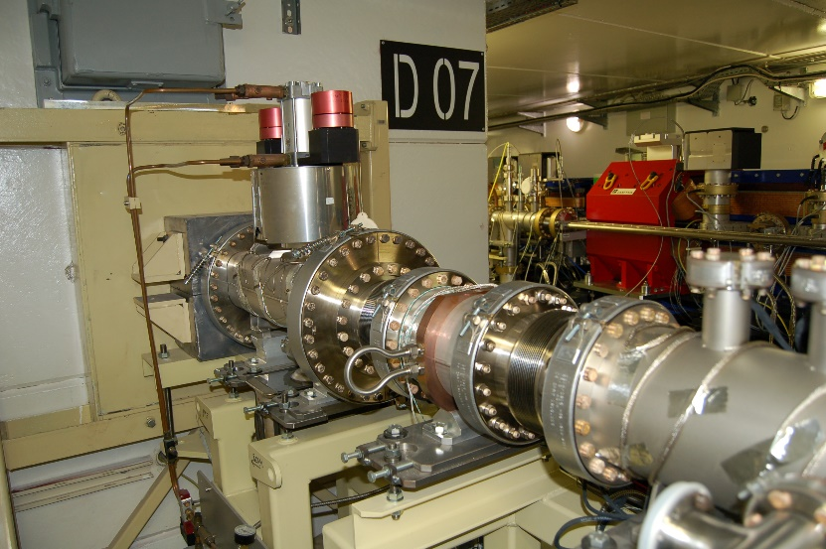
ASD Day 2023
Front Ends Group update since EBS installation
Jeff Wade

Slide 2
Summary
Front End developments since EBS
Modifications and limitations for high power beamlines
ID08 – The ‘remaining’ ASD Beamline
Front End module 2 vibration study
FE ‘Expert Alarms’
Front End component failures
Front End support to other groups

Slide 3
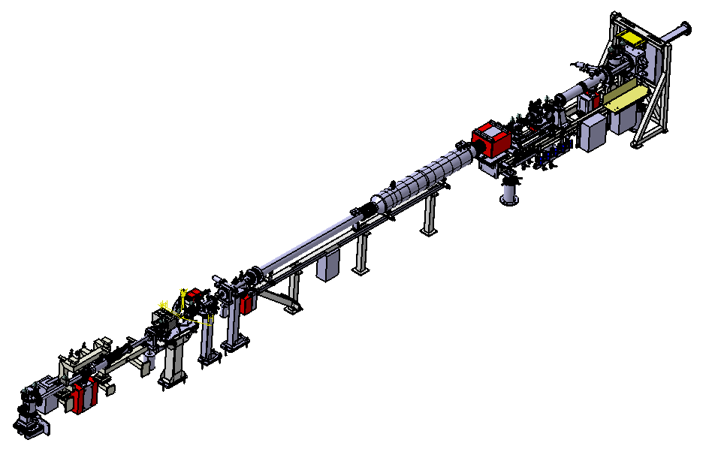
FRONT ENDs EBS Overview
Front End ID
Front End BM
Module1: removed from the tunnel
Photon Shutter stored for reinstallation
Transition Module : removed from the tunnel
Acoustic delay line stored for reinstallation
Module2 : remained in the tunnel
MODULE2
Beamline
TRANSITION MODULE
MODULE1
Module1: removed from the tunnel
Transition Module : removed from the tunnel
Acoustic delay line stored for reinstallation
Module2 : remained in the tunnel
Storage Ring

Slide 4
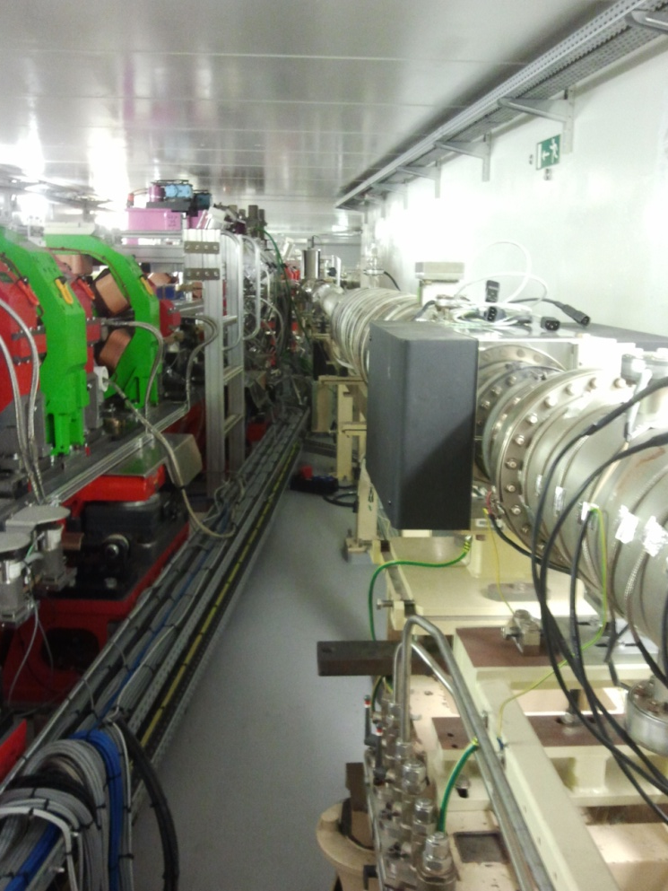
FRONT ENDs – what’s new since EBS
45 Front Ends :
-28 Insertion Devices
-17 Bending Magnets
12 (+2) Diagnostic FE :
-3 Bunch Purity,
-3 Emittance DQD1 source,
-2 Emittance DL1A_5 source,
-1 Visible Light Monitor Beam Port,
-2 Halo Monitors (new),
-1 Energy Monitor (new),
-2 XBPMs incorporated into working BMs (new),
1 Vacuum Group :
-1 photon desorption test bench (new),

Slide 5
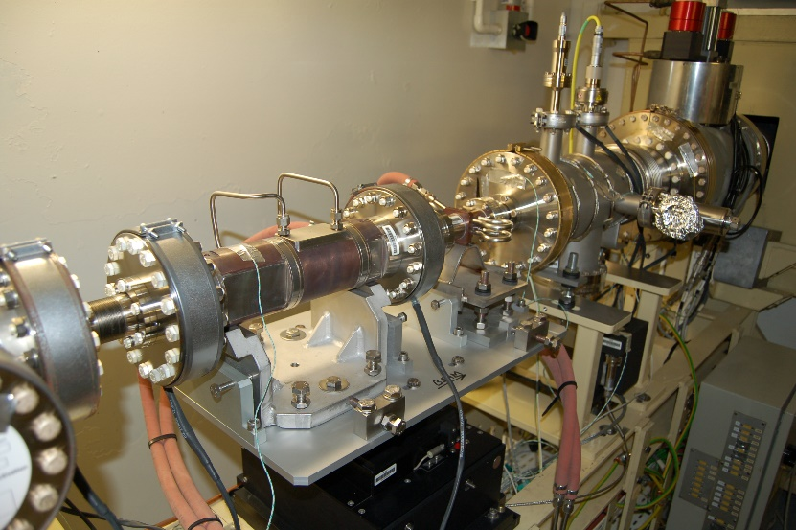
Modifications and limitations for HIGH power beamlines
Due to the installation of new Cryogenic Permanent Magnet Undulators (CPMUs) many ID beamlines optics hutches cannot cope with the new higher heat loads.
Current solution
Modification to smaller fixed apertures in the Front Ends, typically 2mm horizontal x 1mm vertical in size. Not a problem for Front Ends aside integration of longer slits, but on-going issue for beamline optics in the future. Implemented on ID31 pre-EBS, ready on ID03 and ID14, and to be placed on ID18 in 2023.
Thanks goes to Sylvie Jarjayes MEG, Juan Reyes Herrera MEG, and, Philipp Brumund MEG for their support in heat load simulations.

Slide 6
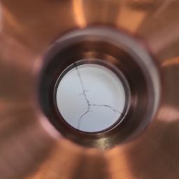
Modifications and limitations for HIGH power beamlines cont’
ID beamlines using multiple in-air undulations in series and wanting larger beam sizes are creating heat load limitations on Front End diamond windows, i.e. the vacuum barrier between FE and experimental hutches.
Current solution
Limitations on insertion device power densities (135kW/mrad^2 for ID19), based upon power absorption simulations of diamond windows and physical constraints (400-600MPa stress) combined with empirical data gained from ID11.
This should prevent diamond window damage as seen on ID19 in August 2021.
Concerns
This current design and use of these diamond windows will need to be reviewed further, as beamlines are likely to request higher power densities in the future.
Thanks goes to Philipp Brumund MEG, Juan Reyes Herrera MEG, Reine Versteegen IDM, Jonathan Wright ID11, and, Alexander Rack ID19 for their support.

Slide 7
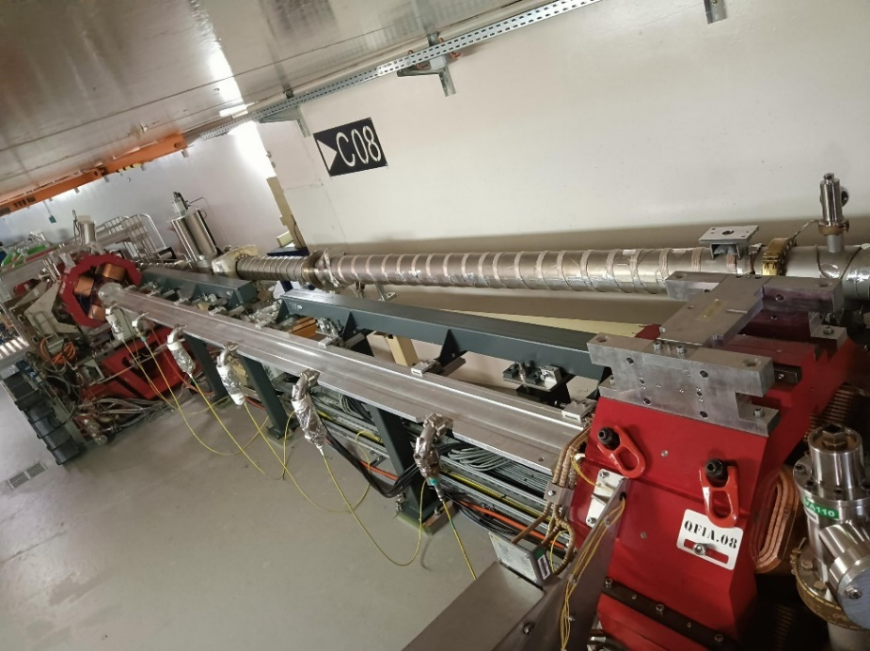
Id 08 – The ‘remaining’ ASD Beamline
Previously the ASD had two beamlines, ID08 and ID14.
Due to the upgrade of ID14 to a fully working beamline, all aspects of the two beamlines needed to be incorporated into the remaining ID08.
Key stakeholders concerned to use remaining ID08
Front End group (to facilitate discussions and implement the transfer)
Vacuum Group (need 5m straight section to condition vacuum chambers)
Radio Frequency Group (need a straight section to test new cavities)
Beam Dynamics Group (need space to test new ‘kickers’)

Slide 8
Id 08 – The ‘remaining’ ASD Beamline cont’
Solution now in place
Front End group has implemented the transfer of ID14 to ID08 keeping the 5m straight section for Vacuum Group vacuum chamber conditioning.
Radio Frequency and Beam Dynamics groups have found alternative straight sections on working beamlines that can accommodate their needs.

Slide 9
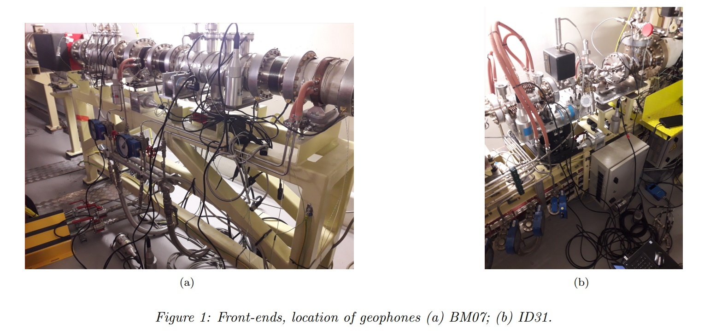
Front end module 2 vibration study
As noted in several places in the EBS ‘orange book’ it was foreseen that Compound Refractive Lenses (CRL) would be used in the Front End IDs. However, this was not implemented at EBS. To review this point, in the Front Ends group we have undertaken some vibrational studies to review the current chassis suitability for such CRLs.
Two different types of chassis, new (2 off) and old (everything else), are used in the ‘Module 2’ area where such CRLs and other sensitive items could be placed. Vibration measurements have been taken on both chassis to review background vibration, but also with the cycling of the adjacent radiation shutter. This work was undertaken by Marc Lesourd, ISDD, with support from David Frichet, Front Ends.

Slide 10
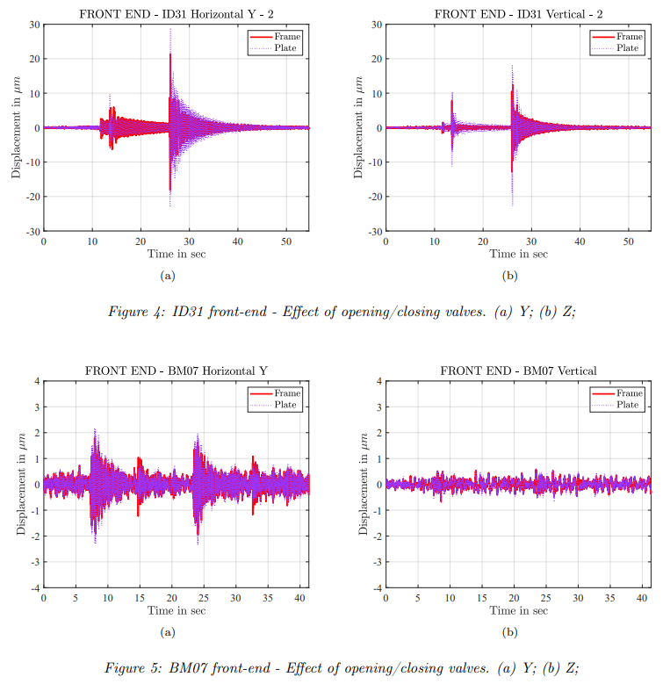
Front end module 2 vibration study cont’
The results are in a preliminary form, but the ‘old’ chassis are susceptible to displacements of up to 50 microns and do not recover for ~30 seconds.
The ‘new’ chassis are stiffer and mechanically isolated from the radiation shutter and only see displacements of 4.5 microns.
Conclusion
Current ‘old’ module 2 chassis are not well designed for the use of CLRs or other sensitive items. A full chassis upgrade would be required should such stability be needed in the future.
Reference - BM07 and ID31 Front-Ends vibration. Marc Lesourd - March 2022 - October 2022

Slide 11
FE Expert Alarms
Provides opening and closing time diagnostics on photon shutters, radiation shutters and valves.
Thanks goes to David Frichet, FE, and the ACU for it’s implementation.

Slide 12
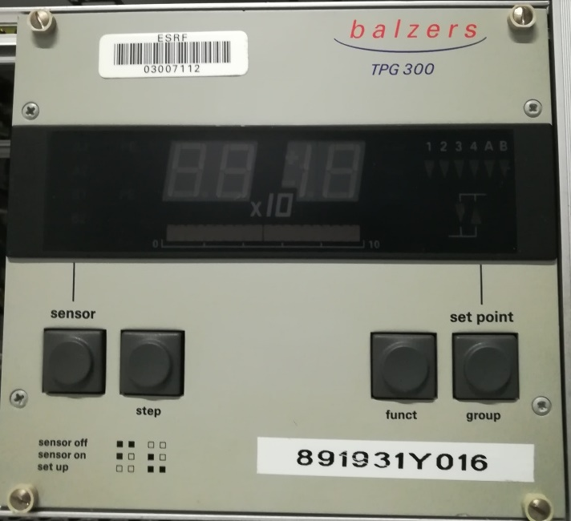
Front END Component Failures
- Beam loss – Failure of pressure gauge controllers, Balser TPG300.
Random failure of controllers due to internal components at end of life. The current solution is to change out controller for new or refurbished unit. Broken controllers are sent for analysis and repair.
- Beam loss – Spurious interlock alarm on ID25 FE where there is no beamport.
Suspected cause due to no change in logic state since restart at EBS, as no beamport present. ID25 has since been removed from the machine interlock as it is not needed, along with ID07 which also has no beamport.

Slide 13
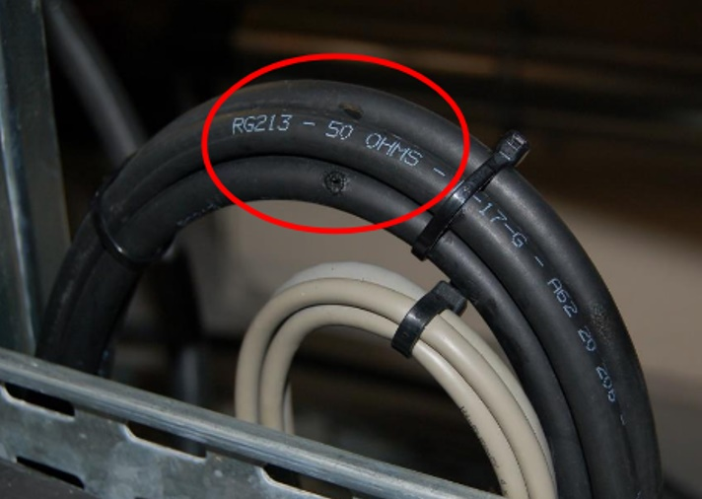
Front END component Failures cont’
No beam loss – Recurring cable insultation failure for vacuum pumps due to cable specifications not being adhered to during EBS installation, i.e. minimum bending radius.
Failures are detected by pump controllers and stop pumps prior to further damage. Failures have been corrected when discovered and a re-cabling campaign is underway to correct others.

Slide 14
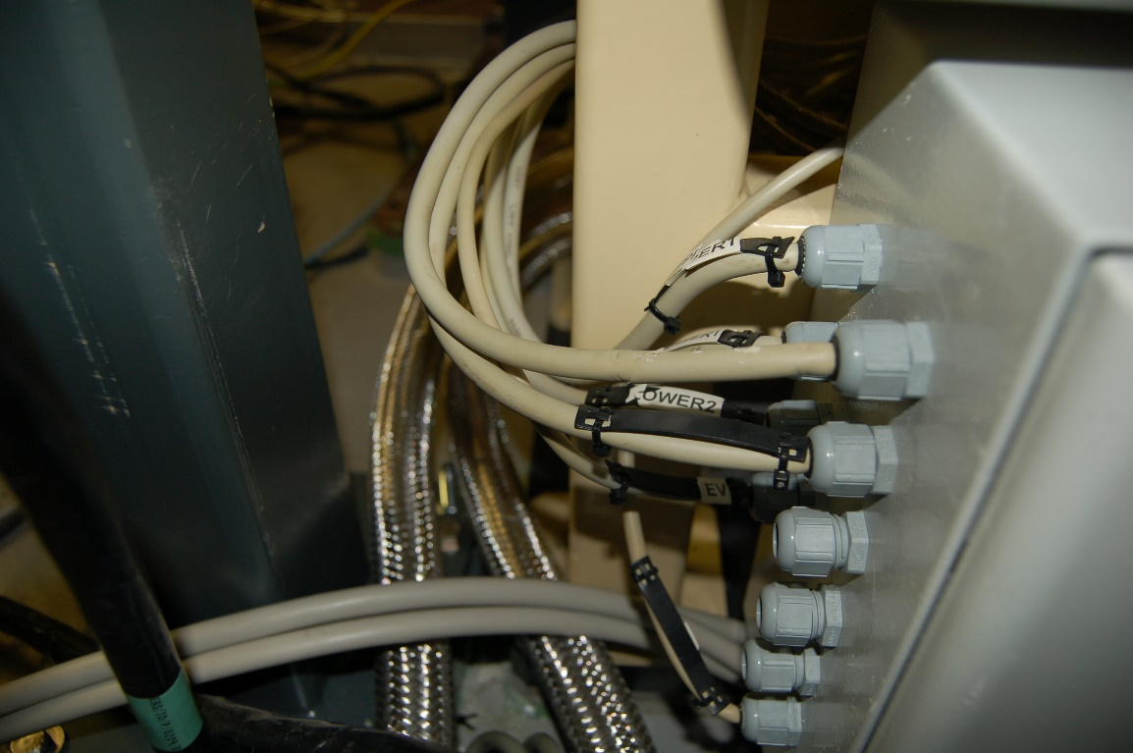
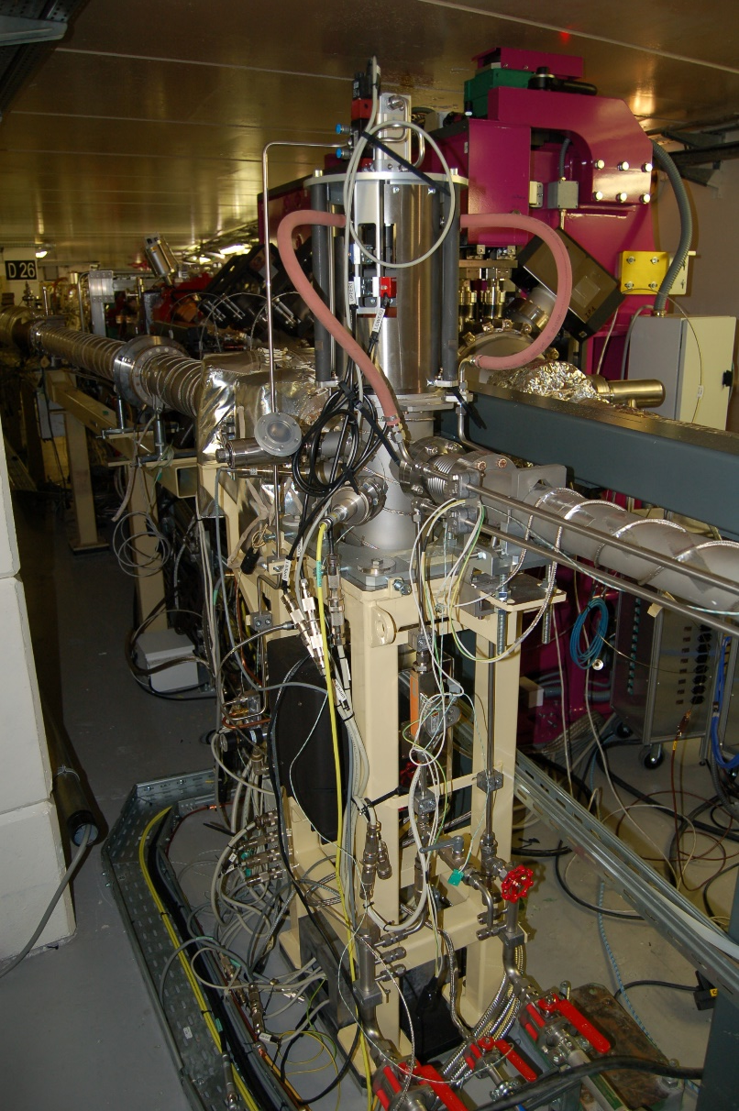
Front END component Failures cont’
No beam loss – Radiation damage to FE Bending Magnet Module 1 cabling.
Visible and physical damage to cabling in and around the module 1. Current shielding campaign is underway to be finished by mid 2023. This will also include re-cabling once shielding is in place.

Slide 15
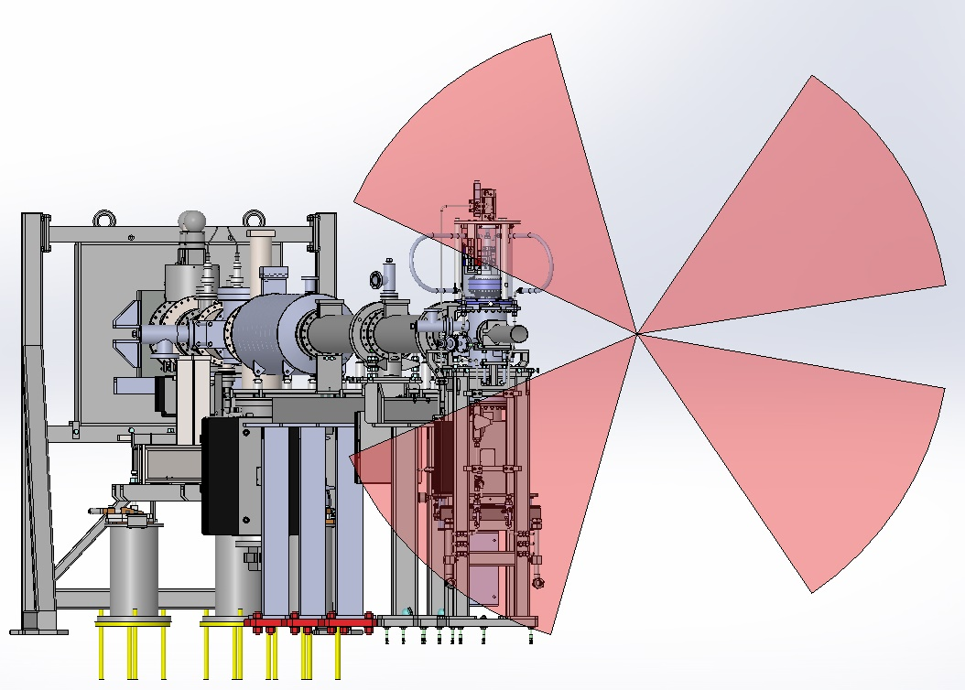
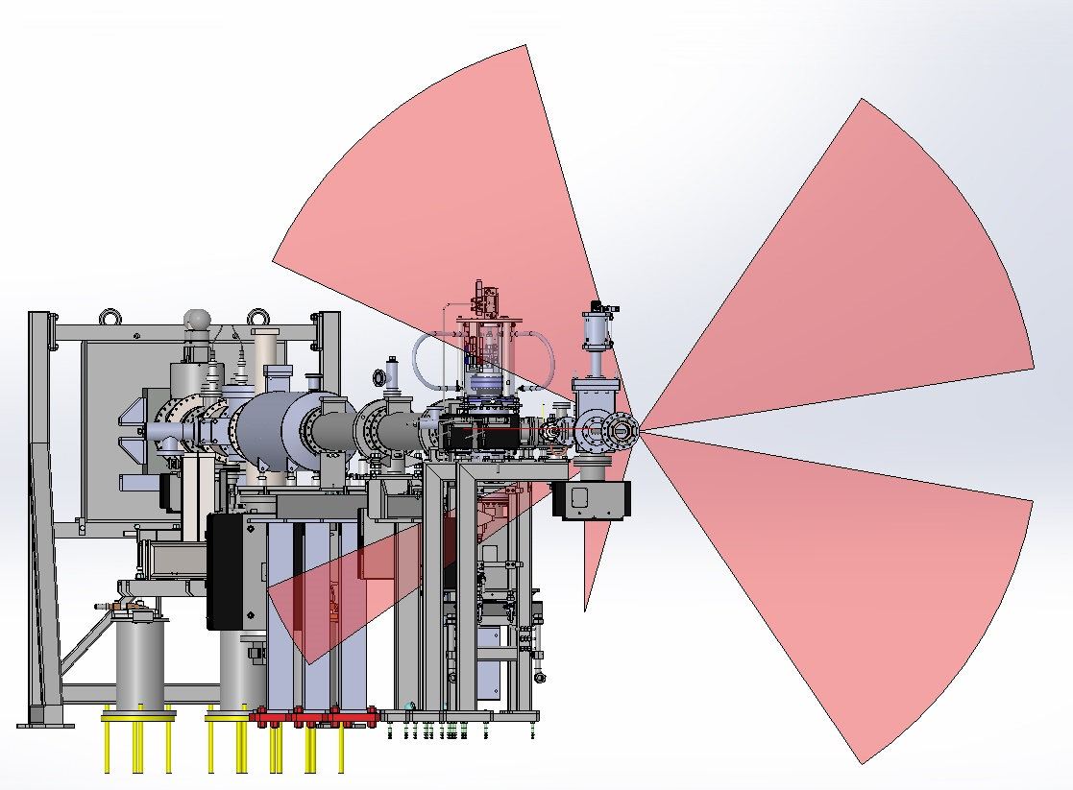
Front END component Failures cont’
No Shielding – undulator gap at 200mm
Cable tray shielding only – undulator gap at 200mm

Slide 16
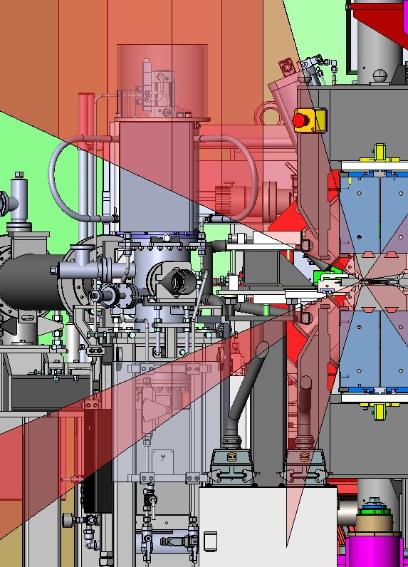
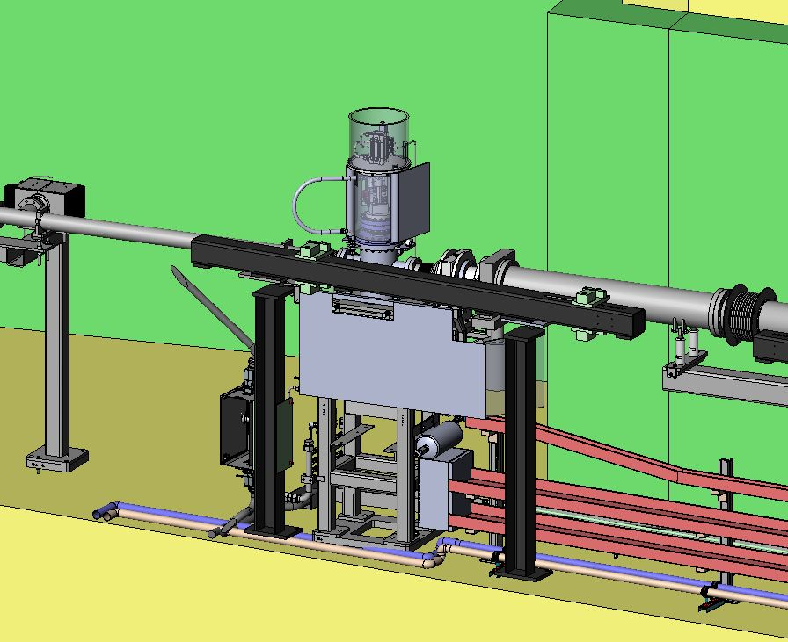
Front END component Failures cont’
Localised shielding to be implemented to cover overlap with cable tray shielding.

Slide 17
Front end SUPPORT to others
Beam diagnostics
– Support with installation of Halo and Energy monitors on BM10, BM11 and BM12.
– Support with installation of XBPMs on BM08 and BM16 and implementation of monitoring status for the operators provided by FE and Accelerator Control Unit (ACU).
Beam dynamics
– Advice for off-energy tests.
Vacuum group
– Photon desorption test bench installed on BM15.
– Technical support for machine interlocks.
Insertion Devices and Magnets
– Current cabling re-works around straight sections.
Experimental Division
– Support for FE slits realignment with experimental operators.
– Technical support for ISDD photon shutter tests and maintenance of cryocoolers.
– Direct discussions for future beamline developments.
Thanks goes to Vincent Grilli, Samuel da Cunha, David Frichet and Frédéric Llop of the Front Ends group.

Slide 18
KEY Conclusions
FE group needs to review further diamond windows accepting larger beams for the highest power densities generated by current and future IDs.
ID08 ASD FE is commissioned and running.
Continual review and maintenance of historic pre-EBS FE components including their risk of failure.
Implement radiation protection for cabling and other susceptible components.

Slide 19
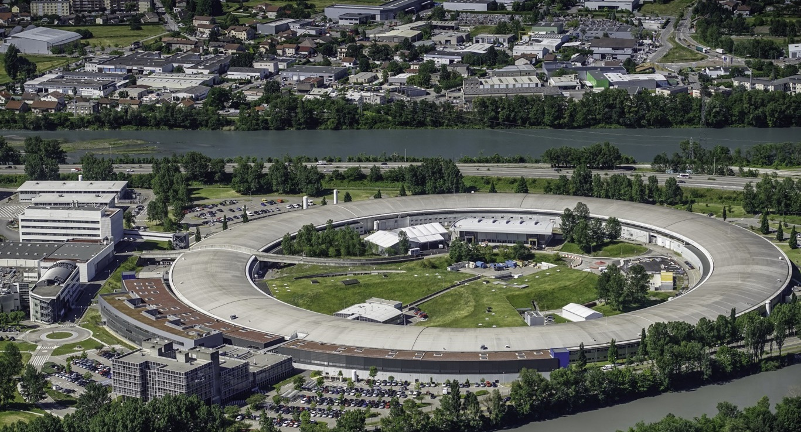
Many thanks for your attention

