Slide 1


beam stability issues and
diagnostics developments :
Kees Scheidt
ASD-day, Grenoble, January 24, 2023

Slide 2
the Diagnostics Group
beam stability issues and
diagnostics developments :
on behalf of the
Diagnostics Group :
Nicolas Benoist
Elena Buratin
Guillaume Denat
Friederike Ewald
Benoit Roche
Kees Scheidt
Fouhed Taoutaou
ASD-day, Grenoble
January 24, 2023
Kees Scheidt

Slide 3
outline of this presentation
the beam’s positional stability
too much reliance on the 320 e-BPMs only → can NOT warrant a perfect stability ...
version-1 X-BPMs on two BM-sources : full results >1year, but (almost) only during MDT
version-2 X-BPMs on two BM-sources : now (Jan. 2023) installed → first results & perspectives
temperature stabilization in the cubicles of the BPM-electronics → in good progress
the upgrades of the (slow/fast) orbit control system
Diagnostics Developments
two units of non-destructive vertical beam Halo monitors → excellent results
the measurement of ultra-low beam-current, down to the single electron
general upgrades, activities, corrections or improvements on numerous Diag. systems
1
2
3
4
5
6
7
8

Slide 4
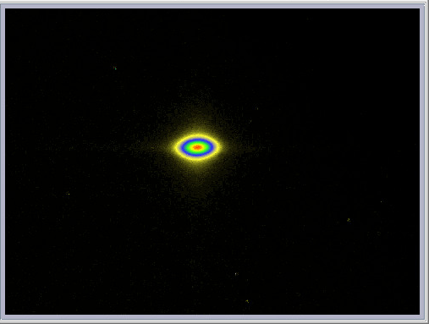
Beam’s positional stability : How good is it really ??
“the EBS has very good stability ”
“the beam stability is excellent ”
“the stability is really perfect !! ”
image from the
X-ray pinhole camera
it is an image, NOT a movie …
if I had put a movie
you would NOT see the difference :
the beam appears extremely stable !
this since the first days
of commissioning of EBS
i.e. 3 years ago
January 2020

Slide 5
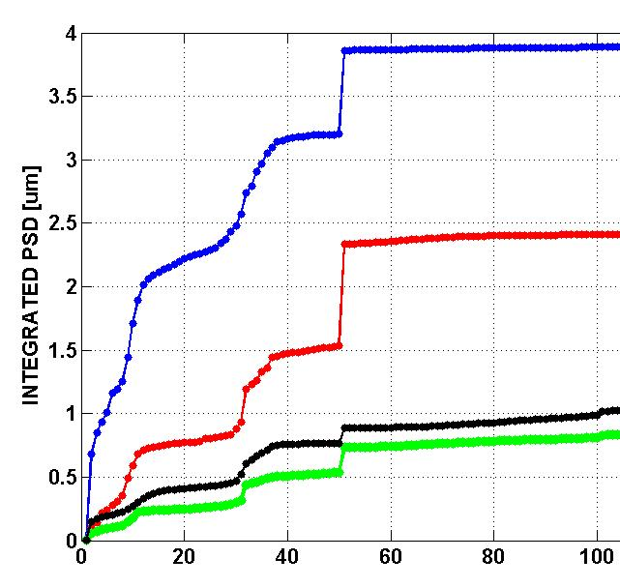
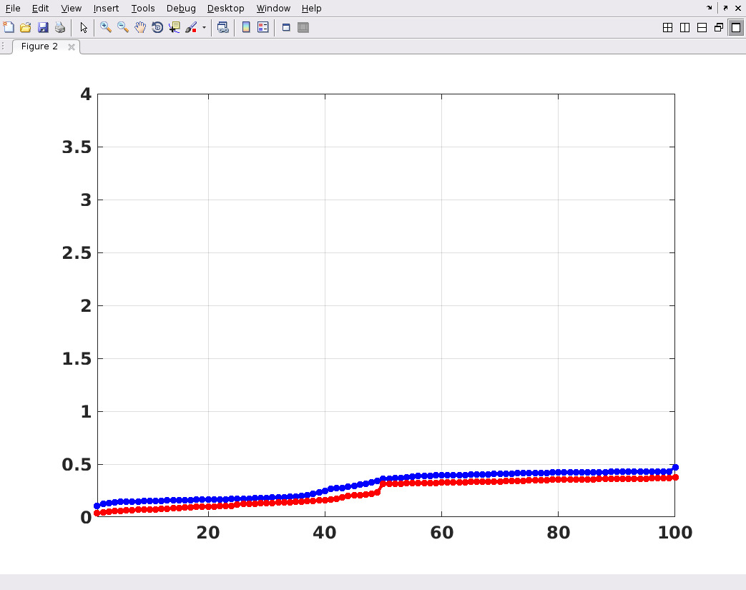
AC domain stability is very good → thanks to girders etc. etc.
from ASD-day 3 years ago, 2020
comparison between the old (data from 2010) and the new EBS ring :
Stability in the low-AC domain (1 – 100Hz)
old ring 2010, FOC On & Off new ring, no FOC (yet)
Hoff
Voff
Hon
Von
H
V
freq. [Hz]
freq. [Hz]

Slide 6
stability needs assessment over a large time domain
month
week
day
hour
1
0.1
0.01
0.001
time span
5
4
[sec]
10
10
1000
100
10
previous slide
frequency [Hz]
0.1
1
10
100
1000
“slow” (movements, drifts)
AC domain (vibrations)
with our present e-BPM system we are :
un-certain
more difficult
excellent !!

Slide 7
we are really good in the fast domains (faster then 1hr)
we see our beam
jumping every minute …
we have a 7Hz
in our beam …
month
week
day
hour
1
0.1
0.01
0.001
time span
5
4
[sec]
10
10
1000
100
10
previous slide
frequency [Hz]
0.1
1
10
100
1000
“slow” (movements, drifts)
AC domain (vibrations)
with our present e-BPM system we are :
un-certain
more difficult
excellent !!

Slide 8
we need to better address (only) the slow domains
our beam is not
where it was
5 days ago …
there is 1hr periodic
motion in our beam …
month
week
day
hour
1
0.1
0.01
0.001
time span
5
4
[sec]
10
10
1000
100
10
previous slide
frequency [Hz]
0.1
1
10
100
1000
“slow” (movements, drifts)
AC domain (vibrations)
with our present e-BPM system we are :
un-certain
more difficult
excellent !!

Slide 9
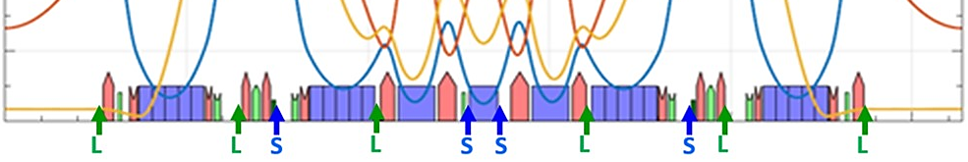
layout of the e-BPMs and the Steerers
the EBS orbit stabilization has distinctive FAST & SLOW parts
for the FAST part it uses 192 e-BPMs (later all 320) and 96 fast steerers , both H & V planes
for the SLOW part it uses 320 e-BPMs and 288 slow steerers, also both H & V planes
→ in EBS we had NOT foreseen X-BPMs → so our e-BPMs are both Judge & Party
BM-
source
fast/slow
corrector
slow
correctors
fast/slow
corrector
slow
correctors
fast/slow
corrector
ID-source
ID-source
L=fast-BPM (6) S=slow-BPM (4)
some 7th BPMs in the Ring
suffer from instabilities

Slide 10
X-BPMs on BM-8 and BM-16 added in Oct. 2021
the new
X-BPM
SBM of 0.875T
BM-source
X-ray beam
L=fast-BPM (6)
S=slow-BPM (4)
6
7
some 7th BPMs in the Ring
suffer from instabilities

Slide 11
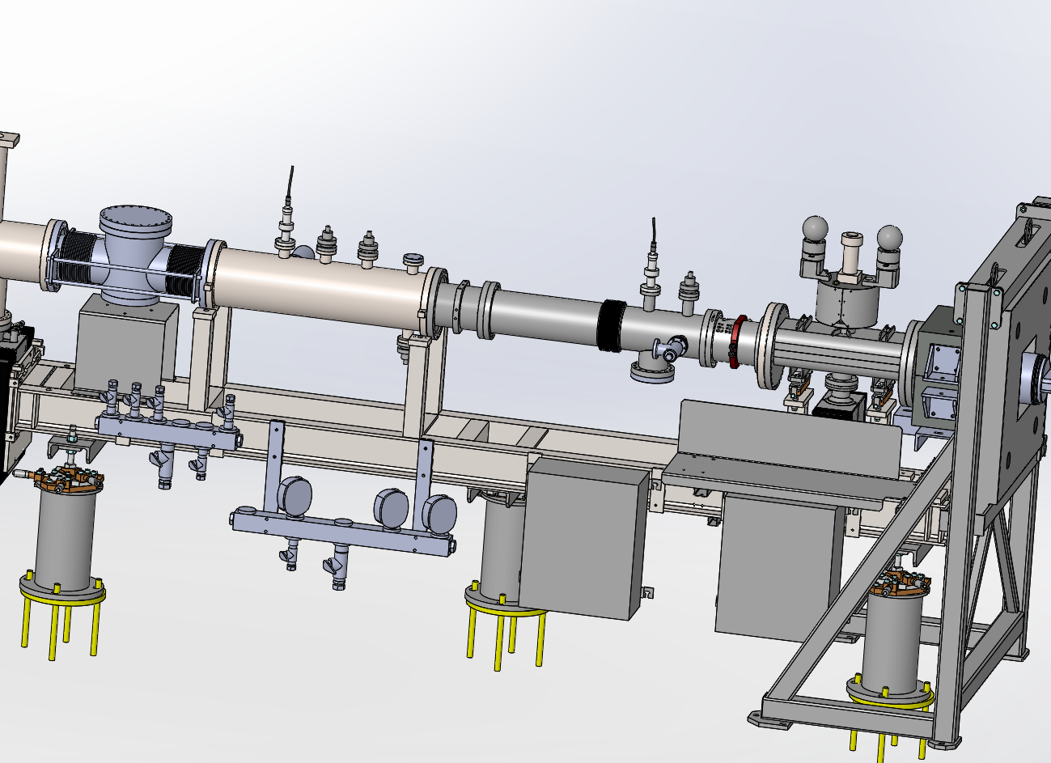
available Front-End chambers at 23m from source
X-BPM @23m
from source
radio-protection shutter
BM-beam
end of
Tunnel
out of 17 BM sources
11 Front-Ends have such chamber

Slide 12
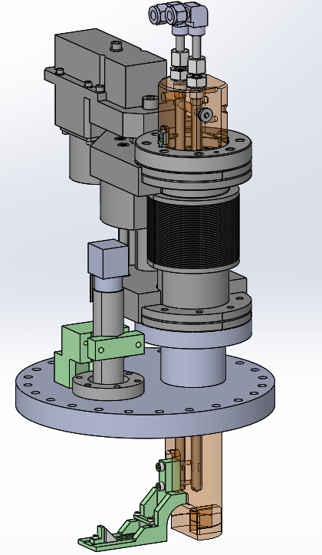
the V1-X-BPM for BM Oct-2021 to Dec-2022
VERSION_1
simple and
low-cost device
bellows &
motorized translation
optics & camera
water-cooled absorber
Scintilator
15 x 15 x 1.5
mirror
X-ray beam

Slide 13
the V1-X-BPM for BM Oct-2021 to Dec-2022
camera
optics
UHV-window
in yellow :
the existing
FE-chamber
>15
IN
OUT
an image of the X-ray beam is
projected on the scintillator (green)
the light emitted from that is captured/focused
on to a camera via mirror (blue), window, lenses
a water-cooled absorber is in front of the scintillator
so when the BM uses the beam then
this X-BPM is OUT (>15mm)

Slide 14
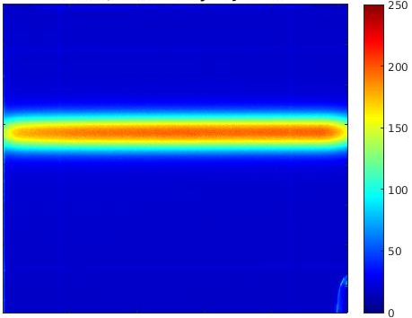
this X-BPM yields images we use only vert. position
image
only vertical position
is of use & interest
Vert. Position
of beam center
Vert. profile
this V1 X-BPM :
is interceptive → we can only use 1 day/week (MDT)
only yields vertical position → is not such on issue
is slow (few Hz data rate) → is not an issue

Slide 15
comparing between two independent position results
comparing the vertical position of the new X-BPM
with that from the e-BPMs in the Ring
SBM of 0.875T
@23m
the new
X-BPM
BM-
source
X-ray beam
L=fast-BPM (6)
S=slow-BPM (4)
6
7
Pos V = 0.8060 *V_BPM_6 + 0.0990 *V_BPM_7
Ang V = -0.9696 *V_BPM_6 + 0.49478 *V_BPM_7

Slide 16
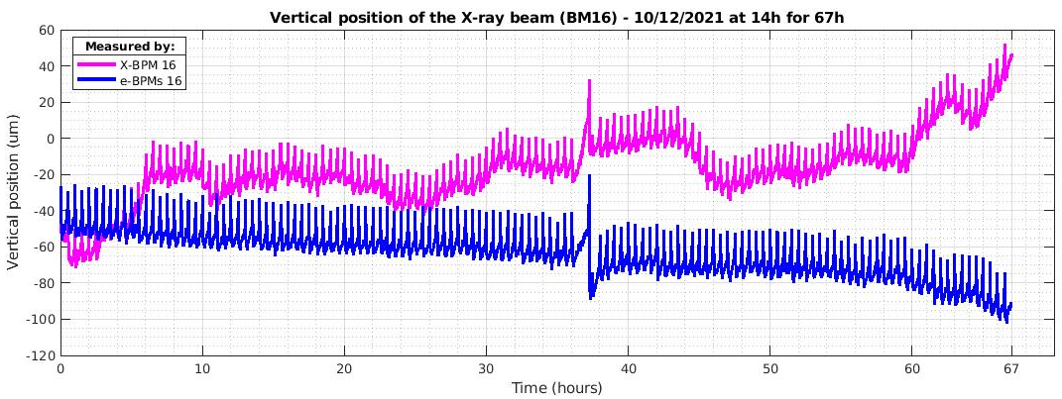
discrepancy between two independent position results
67 continuous hours in 20mA, 10-12 December 2020
BM-16
observation :
the X-BPM and e-BPM results drift in opposite direction, attaining 150um difference …
in contradiction to what is so often said
about EBS positional stability ( “very good”, “excellent”, “perfect” )
we now have clear indication/proof that it is NOT …
1) what is the cause ? 2) what can we do about it ?

Slide 17
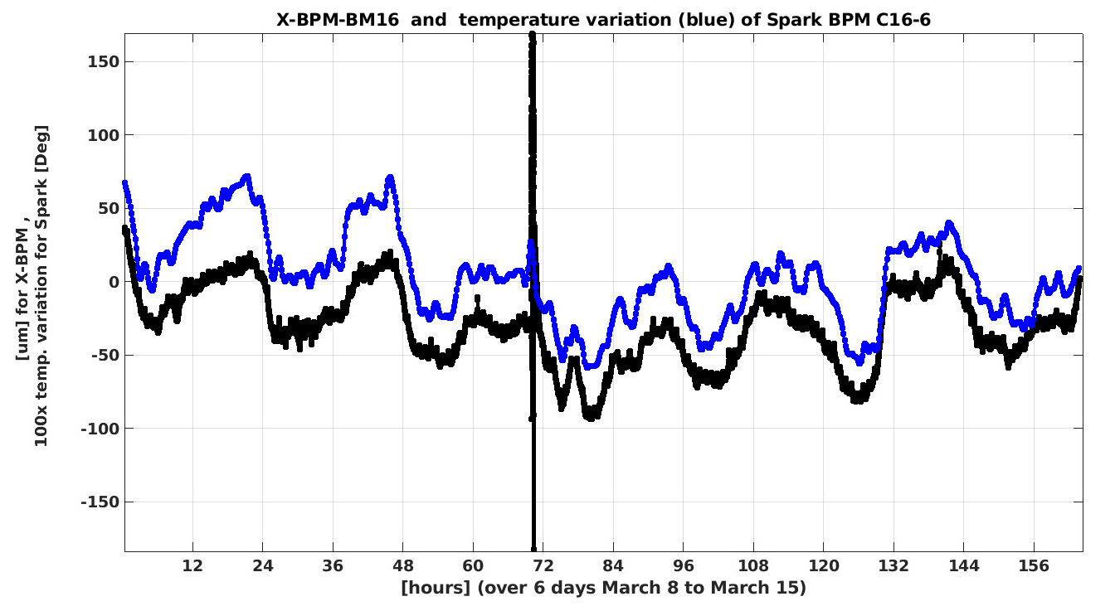
the cause of the discrepancy : temperature of e-BPMs
strong correlation between BM-16 X-BPM and temperature of that C16-6 Spark
this measurement was only possible since BM-16 allowed us
to keep the X-BPM inserted for a full 6 days
Spark
temperature
X-BPM
Vert. position

Slide 18


from Version-1 to Version-2 → permanent monitoring
the un-used X-rays of close-by EBS dipoles
can be used with the same purpose
courtesy of J.Chavanne
retractive
V1 :
the interceptive
X-BPM
served in 2022
DQ1D
SBM
DQ2C
SBM hor. width inside X-BPM-chamber,
i.e. 51mm at 23m
DQ1D
SBM
DQ2C
V2 :
the fixed & NON-interceptive X-BPM
results since January
fixed !
or
fixed !

Slide 19
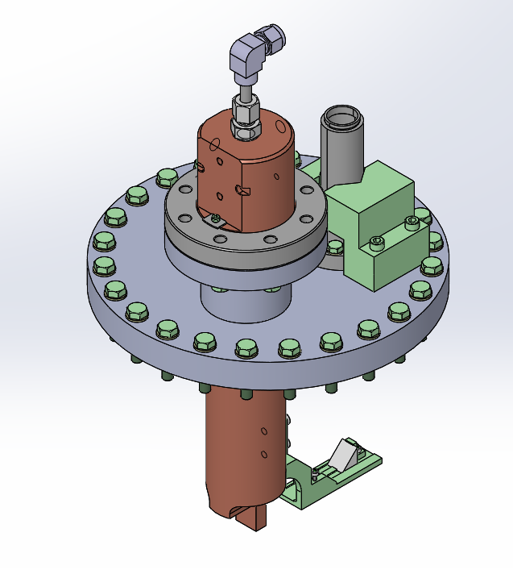
replacing the V1 with the V2 X-BPM for BMs
simpler, cheaper
more efficient !
installed this
January on
both BM-8
and BM-16
VERSION_2
VERSION_1
see results next slides !

Slide 20
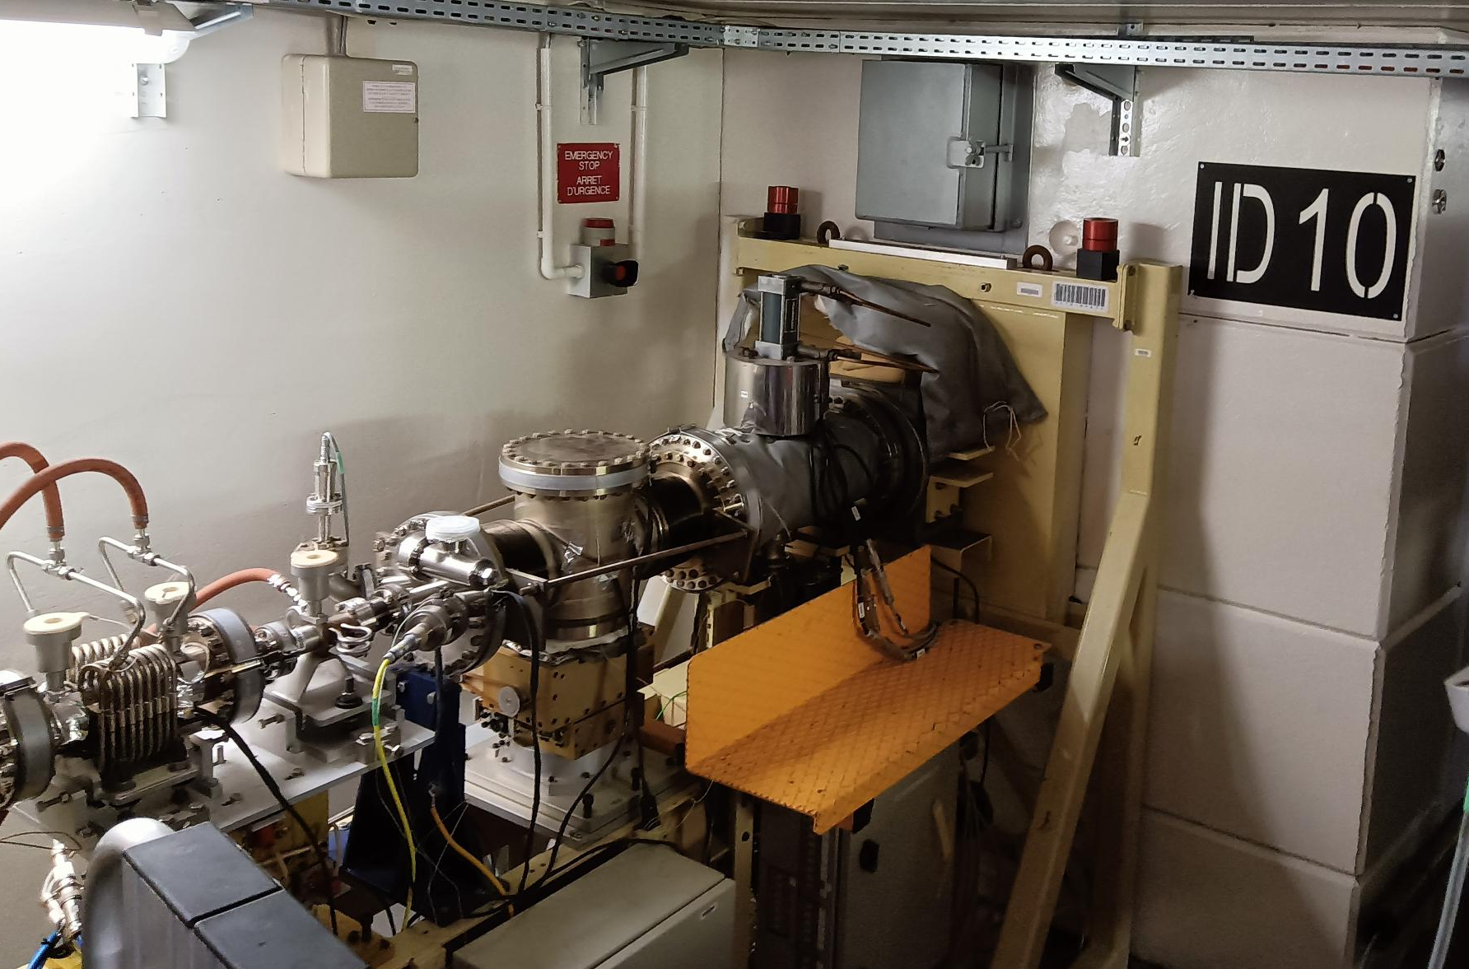
What about Insertion Device X-BPMs ?
I wanna be
an X-BPM !!
the Front-Ends of many (11) IDs
also have an identical chamber
available at the very end of the FE

Slide 21
the X-BPM for IDs would be interceptive & retractable
camera
optics
UHV-window
in yellow :
the existing
FE-chamber
>15
IN
OUT
so when the ID uses the beam then
this X-BPM is OUT (>15mm)

Slide 22
What use for an Insertion Device X-BPMs ?
1) very regularly different beamlines ask for (and get)
an angular bump (on the e-beam) so to bring their
X-ray beam back to where they want it
we have no way to know if such X-ray beam-shift was
caused by the EBS e-beam or by the beamline itself
with such an X-BPM we would know
2) the electronics of e-BPMs have excellent reliability
but can have a rare failure. Replacing them during USM
is sometimes unavoidable.
this can be a problem for those e-BPMs that are
around the IDs : this replacement can introduce a small
but very disturbing angular shift of the e-beam,
and thus ID X-ray beam.
the X-BPM would be used to compare new position
values with those taken every week (during MDT) and
can thus serve to correct such shift.
camera
optics
UHV-window
IN

Slide 23
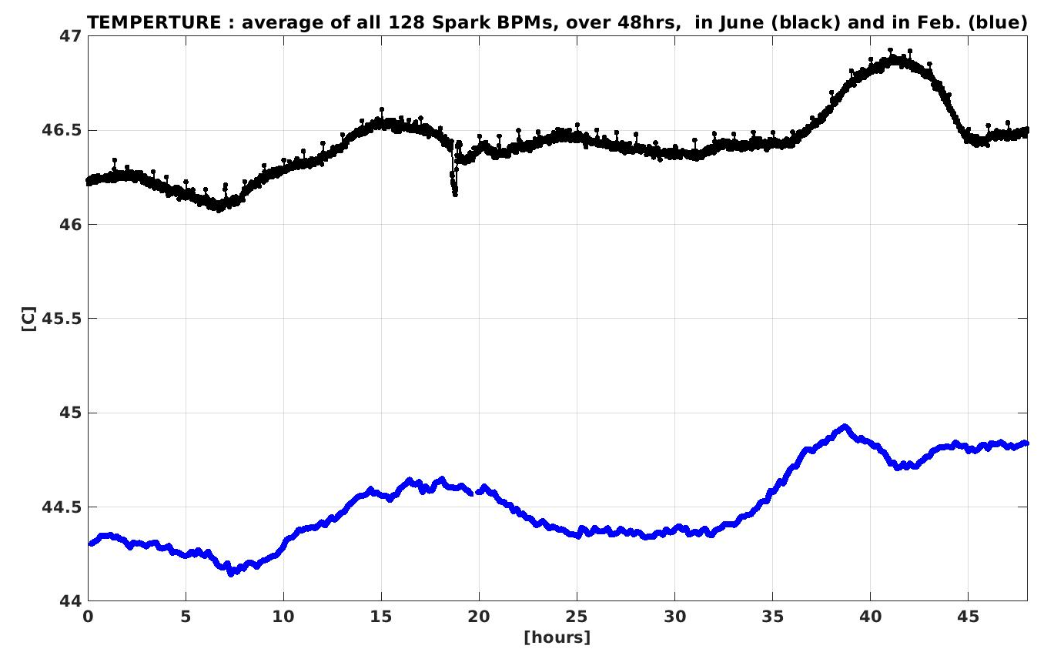
situation of temperature fluctuations on e-BPMs (Sparks)
JUNE
1 deg.
fluctuation
day / night
2 deg. between
winter/summer
FEBRUARY
1 deg.
fluctuation
day / night
2 days
these are averages of all 128 Spark units, the worst ones are a few times worse !

Slide 24
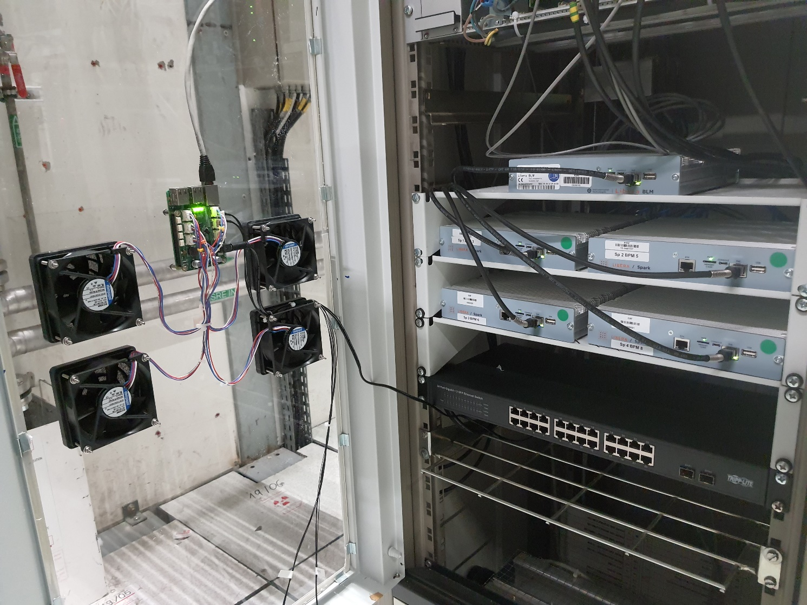
solution to dampen the temperature fluctuations of BPM
home-made
solution
Costs : 500 Euros
per unit (cubicle)
in total 17 units to be done,
5 units partly done in 2022
all 17 will be completely done by summer 2023

Slide 25
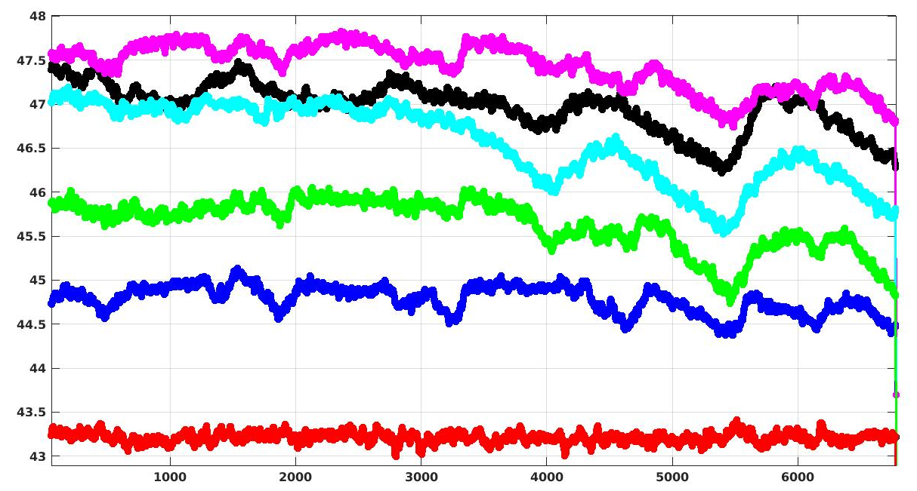
installation in good progress, will be finished summer 2023 (17 units)
Spark
Temperature
[deg. C]
5 other Cells
no control yet
C16 → temperature control installed & active
C16
5 days
ACU has delivered an efficient device-server for the temp. control

Slide 26
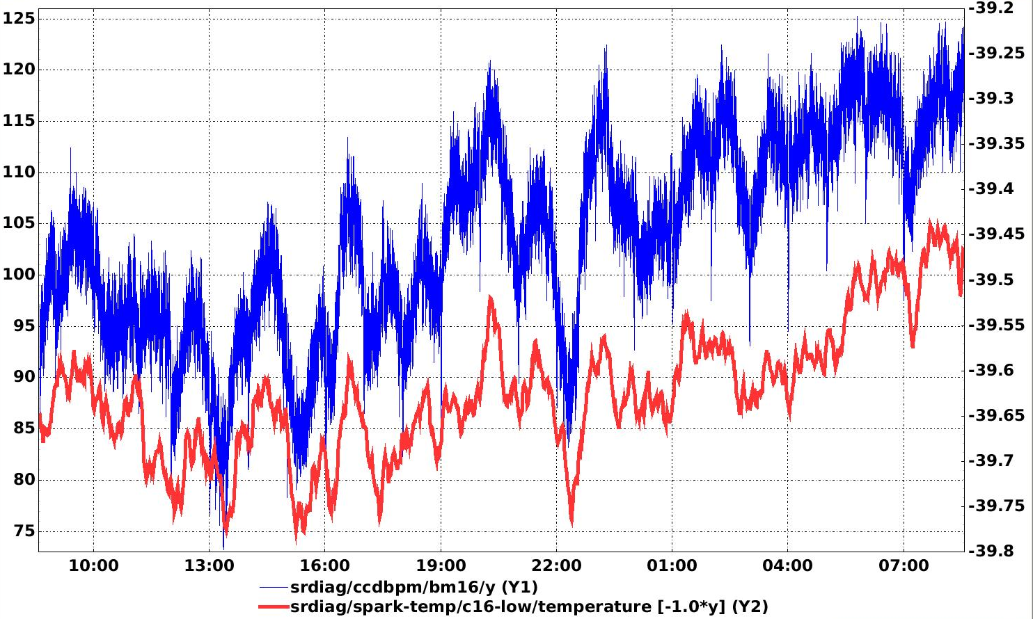
first results with permanent V2 X-BPM on BM-16
blue=X-BPM-vert. position
red=temperature
46um
0.2deg
2 days
46um at 23m = 2urad !
Jean-Louis Hazemann of
BM-16 asks for 1urad stability …
the temperature control in SR-BPM cell 16
was ON but not well configured
due to suddenly cold weather of last week

Slide 27
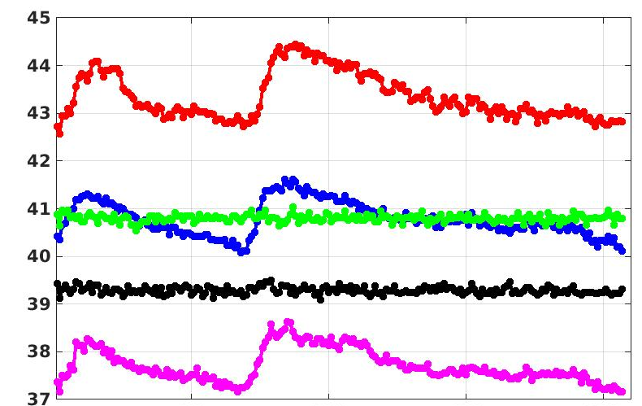
limitations of temperature control on e-BPMs (Sparks)
3 cells NO temp. control versus 2 cells WITH control
[C]
Cell-28
Cell-16
2 days

Slide 28
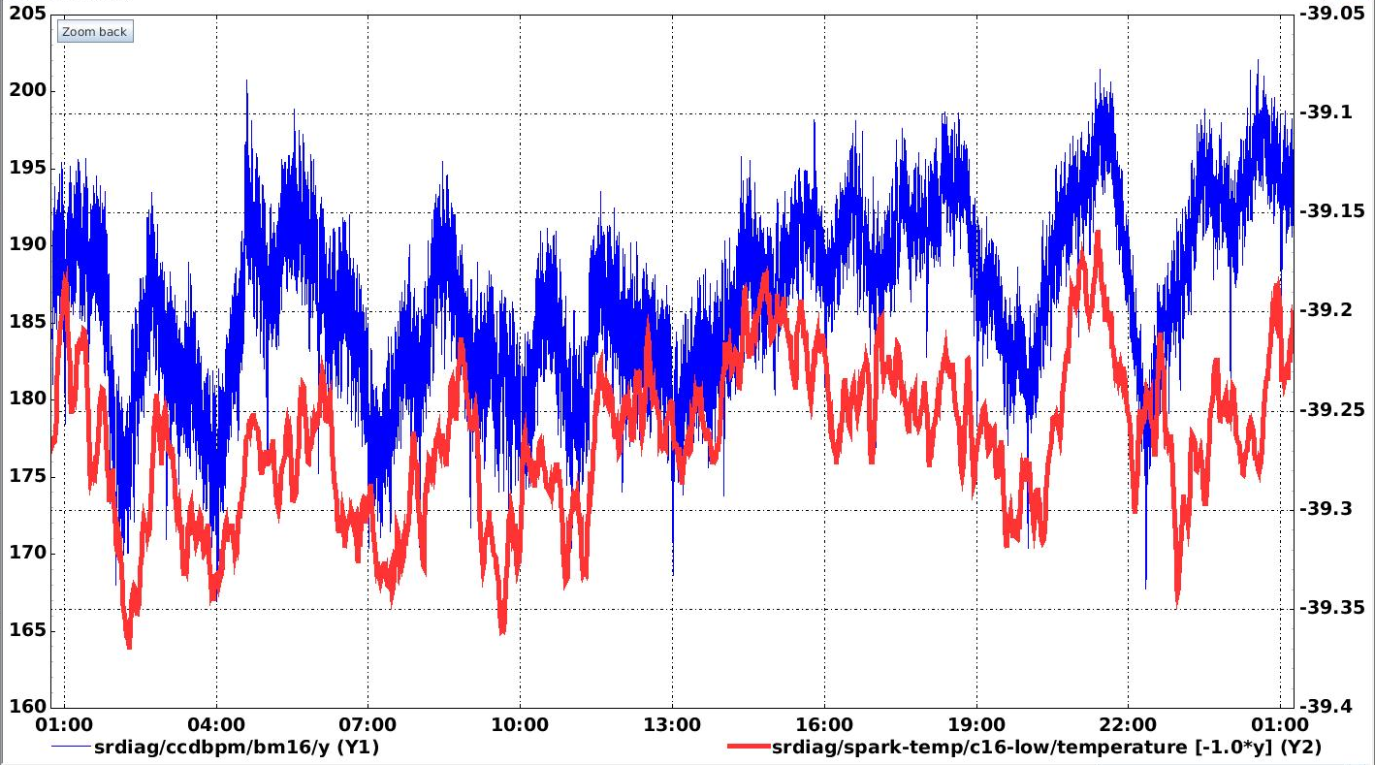
situation of temperature fluctuations on e-BPMs (Sparks)
blue=X-BPM-vert. position
red=temperature
23um
=1urad
0.2deg
1 day
+/- 0.1 deg temperature control is the best we can do ! if not good enough
then we could use the X-BPM to further stabilize the BMs beam position

Slide 29
conclusion and prospects for X-BPMs
BM
out of 17 BM sources 11 Front-Ends have such available chamber :
7 x SBMs (Single-Bending-Magnet)
4 x 2PWs (2-Pole-Wiggler)
the costs per unit is about 8 KEuros
this year (2023) we expect to install about 4 SBMs
and the next year(s) the 7 others
ID
out of all 17 ID sources 11 Front-Ends have such available chamber :
the costs per unit is about 12 KEuros
this year (2023) we intend to install one prototype (May, or August)
perhaps one more in 2nd part of 2023
and if prototype experience is successful then
the others in the next year(s)

Slide 30
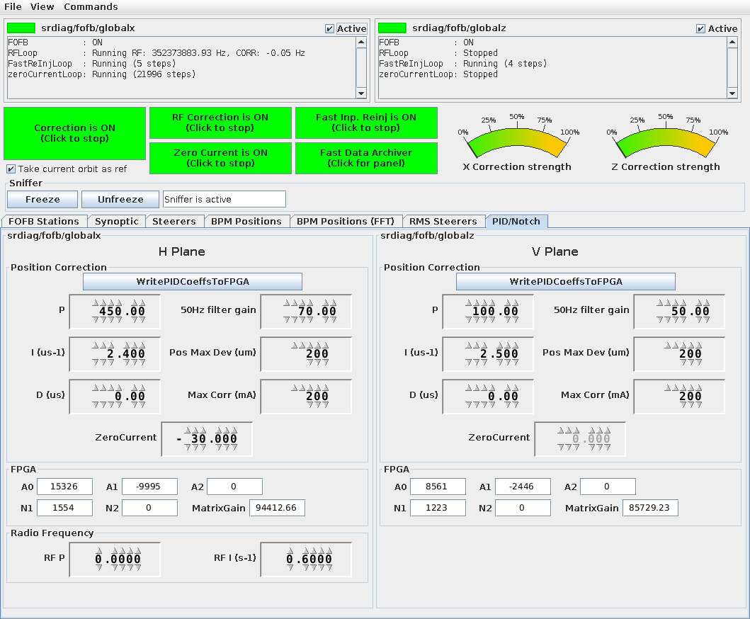
the upgrades on the fast orbit correction system
1) Adding the 10KHz data-stream on all 128 Spark-BPM-electronics for optimized
Fast Orbit Feedback (FOFB) and specific & dedicated applications
2) Optimization of the PID parameters
for more flexibility & performance
the old system for setting/controlling
these parameters has been fully and
drastically modernized
this allows a strongly increased efficiency
during MDT studies in assessing and
optimizing the performance and behavior
of the FOFB
application window

Slide 31
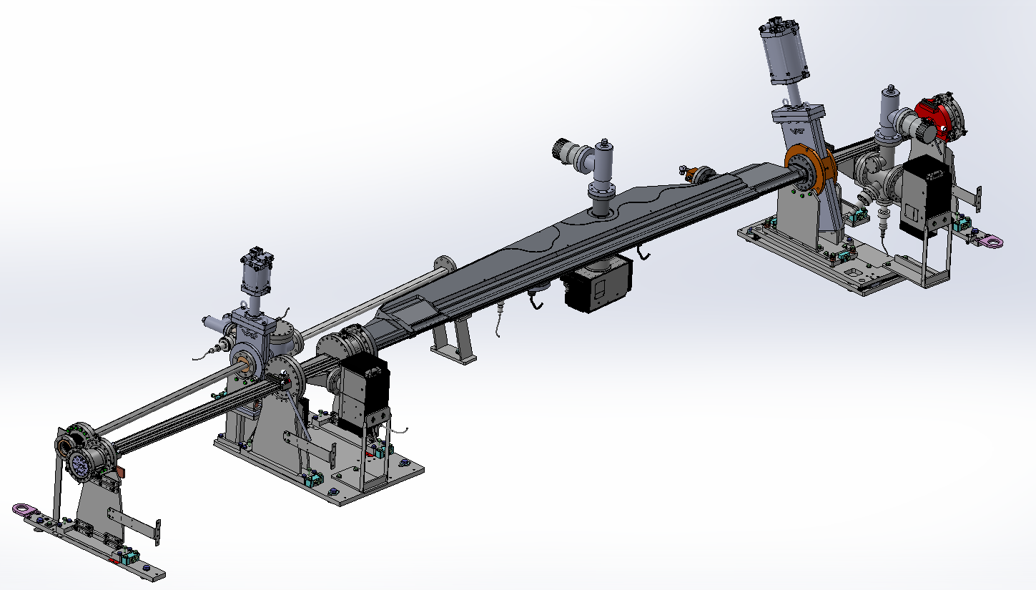
two units of vertical non-destructive HALO-monitors
Components:
dipole source (DQ1D, 0.57T)
free beamport
vertically adjustable X-ray Absorber to shadow the intense beam-core
Aluminium window to let the X-rays from UHV to air
sensitive Detector to image the X-rays
in the (free) Front-Ends of cells 10 & 11
In-air Halo
detector
CH14
vertical
movable
absorber
Alu window
SR/FE
valve
CH13
X-rays
CH12
CH11

Slide 32
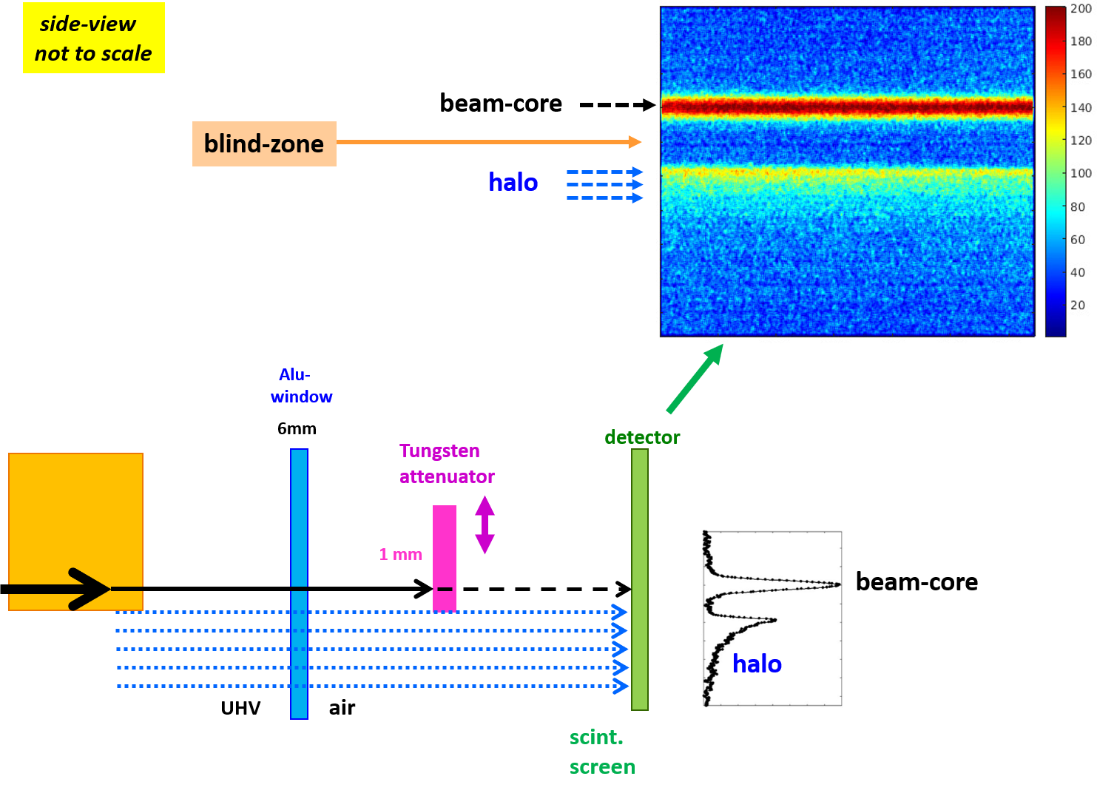
two units of vertical non-destructive HALO-monitors
Vert.
Hor.
beam-core
typ. 2mm

Slide 33

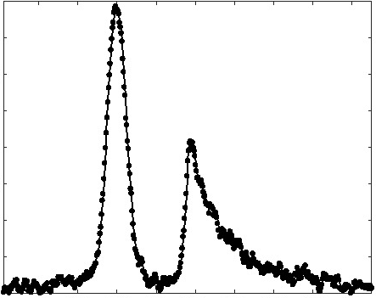
our Diagnostics now measure all kind of electrons
the “work-horse”
electrons
all our diagnostics
measure these
no diagnostic before,
now two HALO-monitors
Halo
electrons
50nA
measured by
Lifetime and
beam-loss
detectors
the dying
electrons
2mm

Slide 34
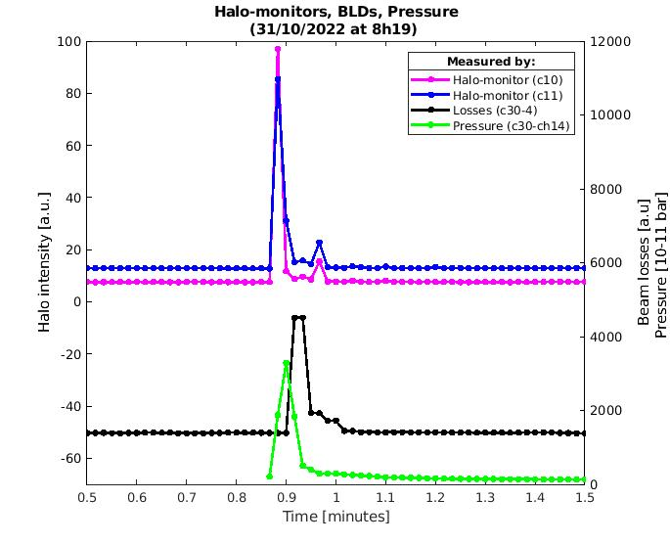
the HALO-monitors are an excellent watch-dog on Vacuum
the 2 Halo
monitors
BeamLoss
detectors
vacuum
gauge

Slide 35
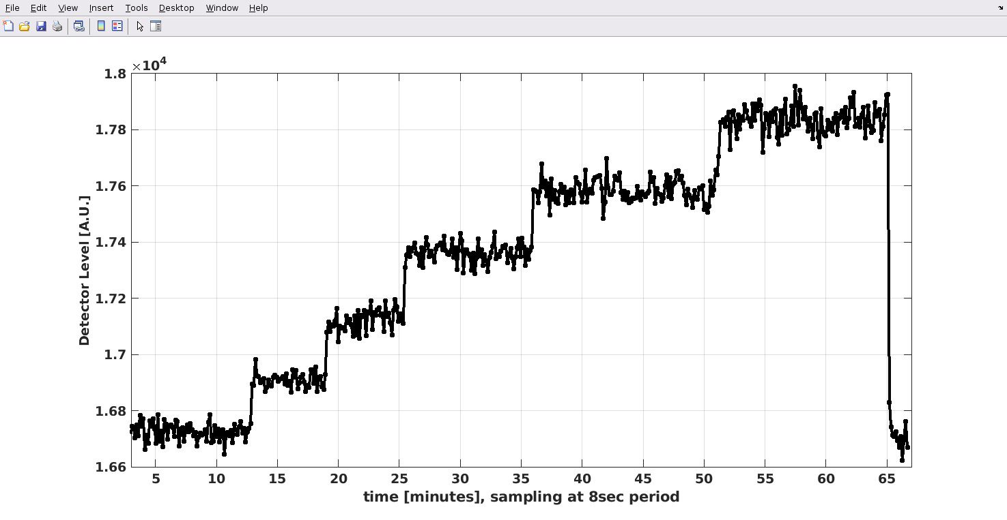
single electron(s) in the EBS
at 200mA there are : 3 500 000 000 000 electrons
can we put & measure only 1 electron ?
typical time of 10min
is 2400 injections
5th
Detector Level [A.U.]
integration at
8sec sampling
to reduce noise
4th electron
3rd electron
2nd electron
beam kill
1st electron
offset
offset
time [minutes] , sampling at 8sec period

Slide 36
other developments & activities
improvements on the damping of injection perturbation
this is a FeedForward system that often needs fine-tuning & optimization
the precise calculation of the FF parameters is now semi-automized
→ see presentation Simon White
2) all emittance-monitors now have Injection-synchronized gating added
this allows to much better assess the effect of injection perturbations
and also the effect of its damping system

Slide 37
KEEP OUR DIAG. STAFF !!
we have lots of essential systems to look after
and projects that will yield benefits to the ASD
we just need to keep our staff !!
ASD-day, Grenoble
January 24, 2023
The Diagnostics Group :
Nicolas Benoist
Elena Buratin
Guillaume Denat
Friederike Ewald
Benoit Roche
Kees Scheidt
Fouhed Taoutaou
Kees Scheidt

Slide 38
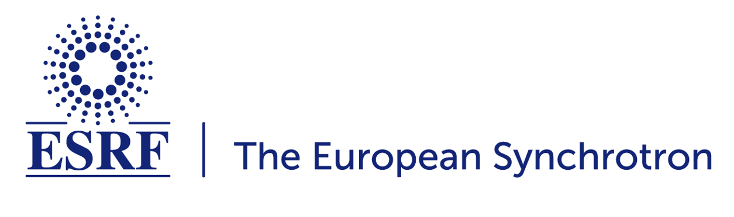
ASD-day, Grenoble
January 24, 2023
Kees Scheidt
on behalf of the
Diagnostics Group :
a big thank-you for help & support
from colleagues in :
Vacuum , RF , Beam-Dynamics , ACU ,
FE , Operation , ALGE , TID
Radio-Protect. , Mech. Engineering

