Slide 1
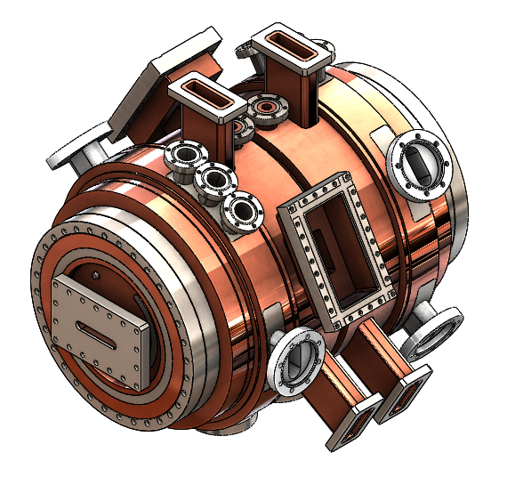
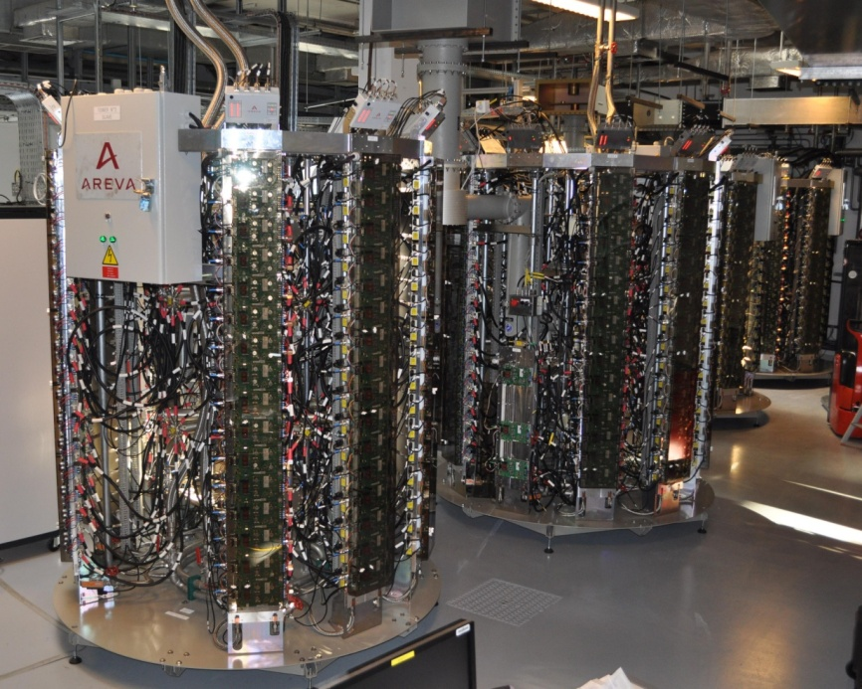

2023 ASD Workshop
Grenoble, 1st February 2022
RF System
Including Linac, Injection/Extraction, Booster and Storage Ring 352 MHz systems
Jörn Jacob
On behalf of the RF Group

Slide 2
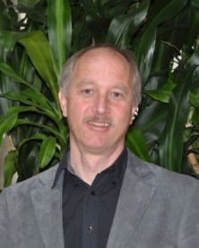
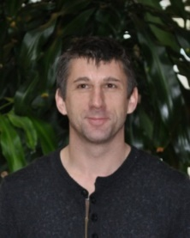
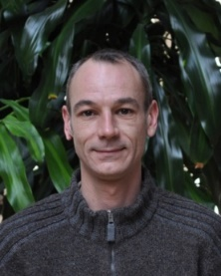
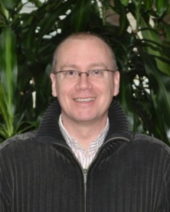
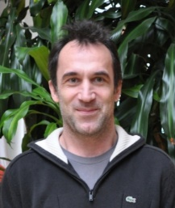
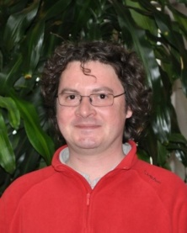
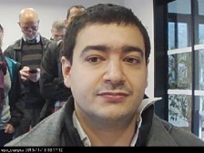
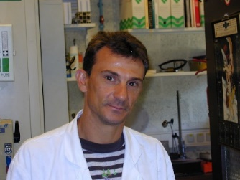
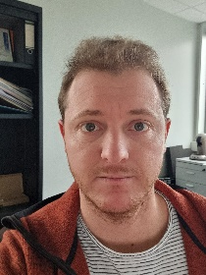
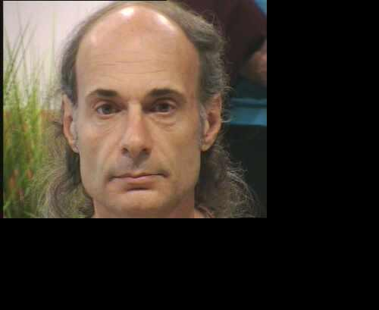
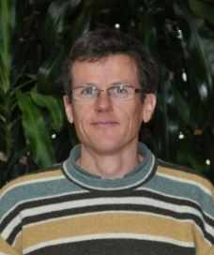
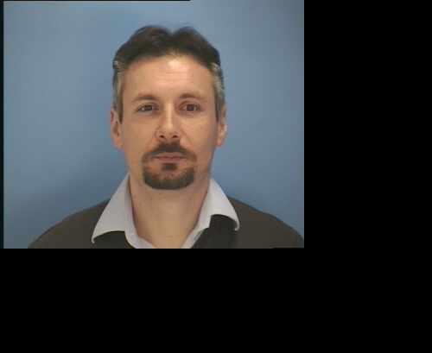
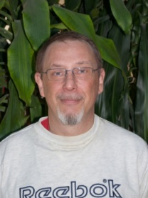
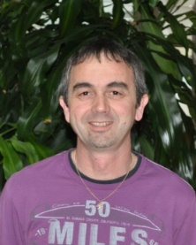
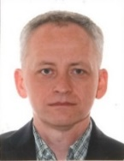
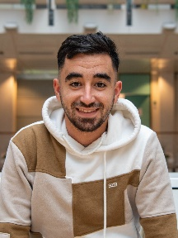
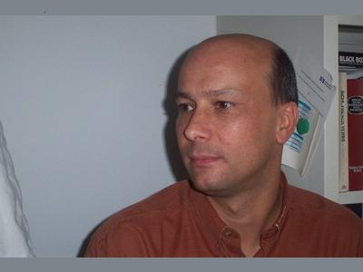
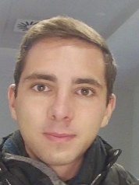
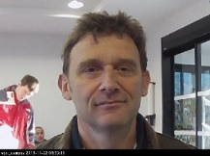
Radio Frequency - RF Group
On behalf of the RF Group
LLRF, Control, Timing…
Linac & Injection/Extraction
Jörn Jacob
Georges Gautier
RF Design & Mechanical support
Nicolas Michel
Massimiliano De Donno
Marc Dubrulle
retired Feb 2023
Mathieu Morati
Vincent Serrière
RF Cavities
Marc Dumas
Claude Richard
Bernard Cocat
Hervé Delamare
RF Power Amp’s - Klystrons, SSAs
Alessandro D’Elia
Philppe Henrissat
Didier Boilot
Pawel Borowiec
Claude Rival
Philippe Chappelet
Louay Khlaifi
Student Trainee, 2y
Clément Sestito
Student Trainee, 2y

Slide 3
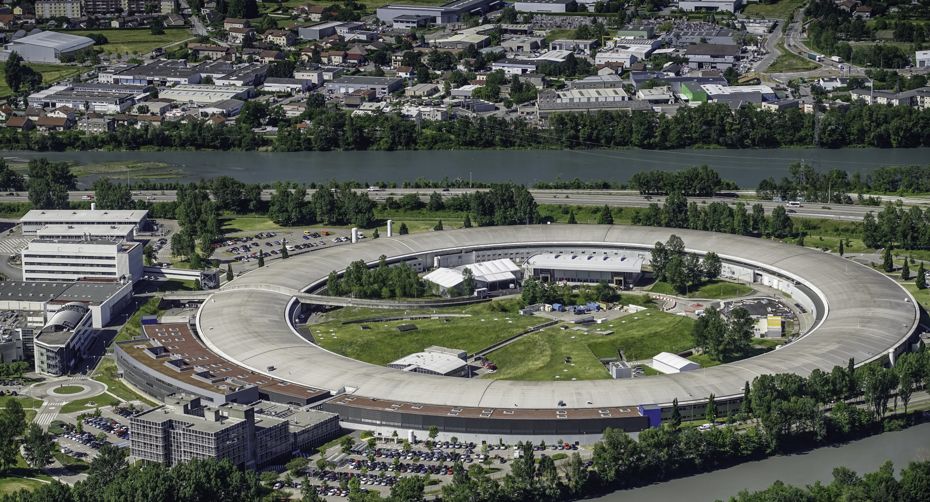
outline
Linac
Injection /Extraction
352 MHz RF System
  Operation
  New SSA
4th harmonic RF system

Slide 4
Linac
Ongoing LINAC maintenance and update
    Improved pre-buncher amplitude and phase control
      NB: Signal directlty coupled from high power RF pulse of 1st acceleration section
      Motorized amplitude and phase modulators
      2022: first tests with new phase modulator
      2023: completion, including amplitude modulator
    Replacement of obsolete Klystron focus power supplies
      New power supplies in house
      New PLC controller
      2023: 1st cubicle for modulator MOD 3
      Prototype for MOD 1 and MOD 2
      On wheels ⇒ can be connected in short time to MOD 1 or 2 if needed

Slide 5
Injection Extraction - INJEXT
Operation
      6 beam losses attributed to injection kicker failures:
        ongoing analysis and improvement of tricky interplay between fast kicker timing and non-synchronized high level control
      1 beam loss due to S3 water cooling interlock
Ongoing INJEXT preventive maintenance and upgrade
    2022
      New in house built SY-Bumper power supplies taken into operation for increased bump amplitude [→ Simon White’s talk]
      Spare S3 in-vacuum septum magnet: almost fully assembled
    2023
      Completion of spare S3
      Improve control of S3 water cooling (implement flow measurement via PLC)
      Procure spare booster in-vacuum septum Se1
        Spare tank → Vacuum Group
        Planned CFT for spare magnet
        Part of update campaign of 30 y old spare stock
      Slow down kicker PS’s to reduce stored beam perturbation [→ Simon White’s talk]
      Study of full sine excitation of S3 to minimize wake and stored beam perturbation, in view of moving S3 closer to the stored beam [→ Simon White’s talk]

Slide 6
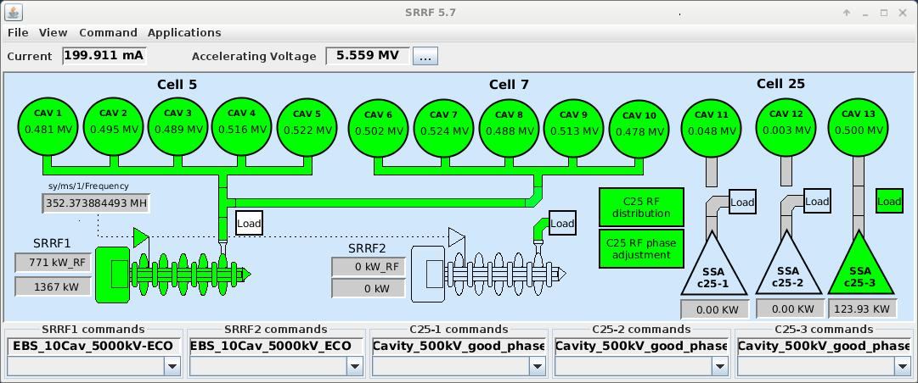
352 MHz Storage Ring RF - ECO Mode since END October 2022
P_{AC} = [ V_{acc}² / (N_{cav} x 2R_{s}) + P_{beam} ] / η_{RF/AC}
ECO mode:
Reduction of total V_{acc} from 6.0 to 5.5 MV
Increase AC to RF conversion efficiency:
  10 years old 150 kW SSA in cell 25 haven’t yet drain voltage modulation and are operated way below nominal power on EBS, at 90 …100 kW, where the efficiency is low. NB: new SSA from JEMA will have drain voltage modulation and better efficiency at low power like klystrons with anode modulation !
  Increase the share of Klystron power by increasing Cav 1 to 10 voltage from 4.5 to 5.0 MV
  Operate with only 1 SSA e.g. Cav 13 at 0.5 MV
  Gain in efficiency over-compensates adverse effect of lower N_{cav}
RESULT:
200 kW AC power savings at 200 mA
Same beam lifetime for typical ID losses around 0.4 … 0.5 MeV/turn
500 kW total savings possible if operation at 100 mA

Slide 7
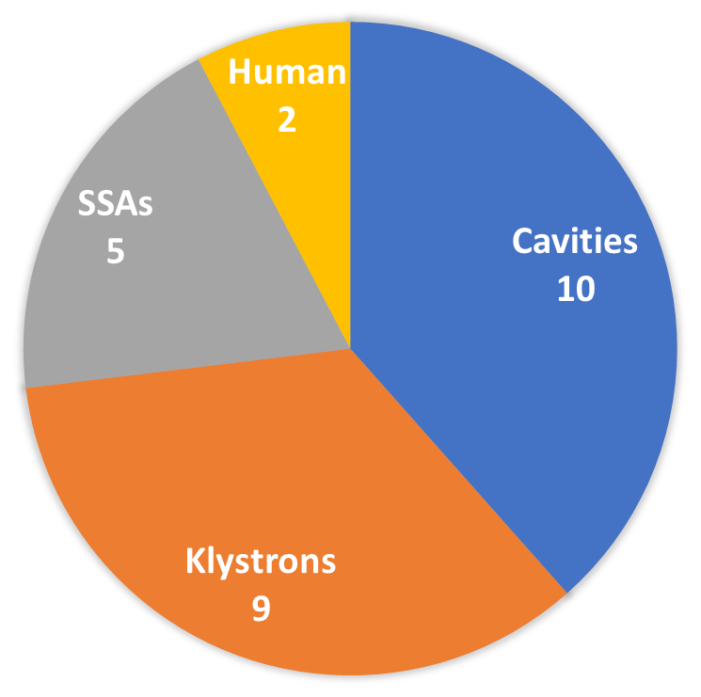
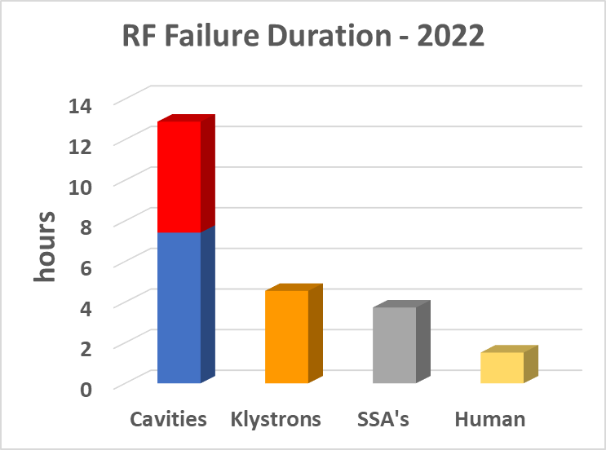
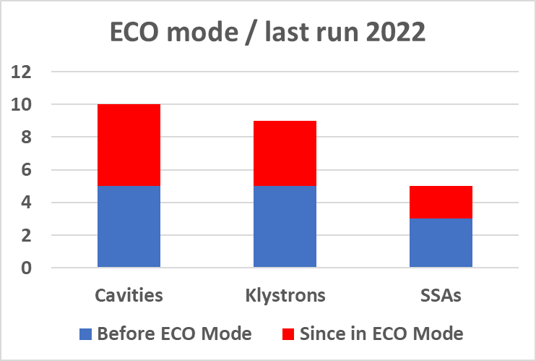
352 MHz Storage ring RF – RF Beam losses in USM 2022
Cav7 coupler failure
Remarkable events
      8 cavity break downs on several cavities - followed by ceramic window leak on Cav7
        Insufficient protection => set lower interlock thresholds for cavity reflected power
        Thresholds slightly too low => further trip on 29 June => intervention for threshold re-adjustment
        RF couplers should now be well protected !
      SSA: twice wrong interlock from AC/DC converter PLC => CPU exchange
      TRA1: tricky hunt finally revealing false interlock from ion pump controller of IP2
        4 trips => finally strapped interlock, relying fully on IP1 for protection
        Last week: new problem with IP controller of TRA1, now on both IP1 and IP2
        Klystron itself not incriminated => refurbishment of IP controllers under way
      Human 1: @ Extremely hot June, mistake when reconnecting a fan (necessary urgent action)
      Human 2: EmOff button on idle TRA2 triggered a stop on TRA1 in operation
26 Beam losses in USM due to RF
Including agreed 4.5 hours intervention to put cavity 7 in passive on 24 June
Each trip counted, even close-by trips that later concatenated to 1 longer interruption for EBS statistics

Slide 8
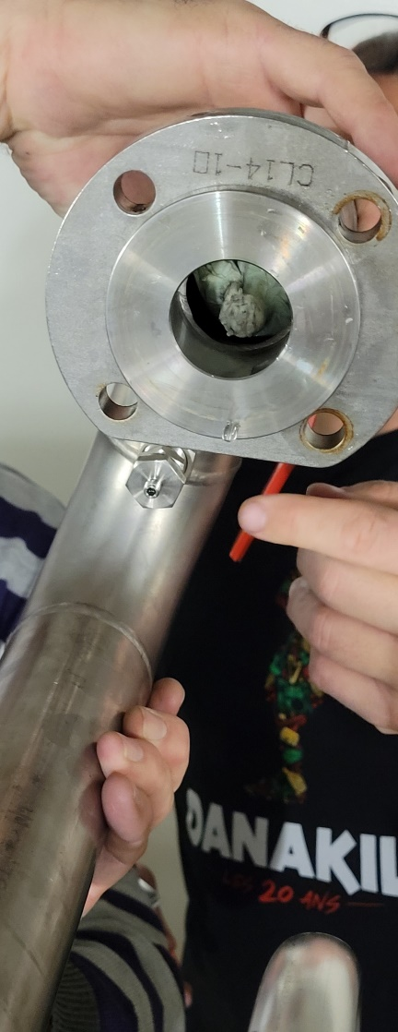
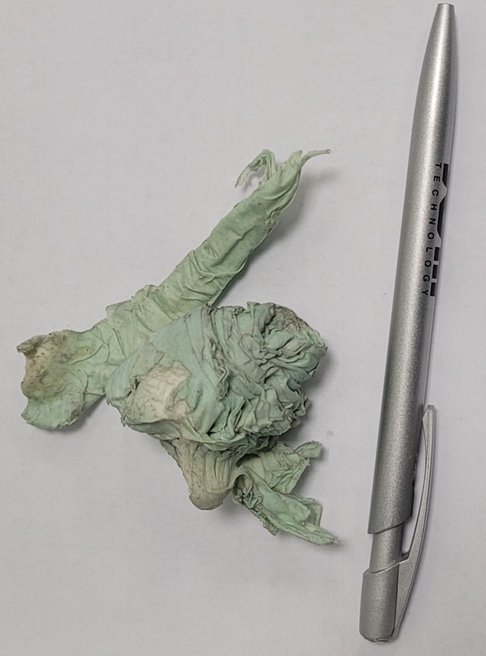
… SR CAvities
Cavity 4 coupler exchange
      September 22: glow discharge observed on cav#4 coupler subsequent to wrong file configuration
        Degradation with time of this brand of couplers is known
        No impact on USM, however, Implementation of ECO mode postponed to last run
        Coupler exchanged in October shut down & successfully reconditioned at restart
        ECO mode applied at October restart for last run
Cavity 2 – obstruction of 1 water cooling circuit
      Problem: bad tuning of cavity 2 in RF low state after a beam trips in run 5
        Longer thermal time constant
        Suspected partial obstruction
        New highly sensitive phase detector installed on tuning loop: mitigated problem for operation
      Winter SD: Obstruction of one cooling channel confirmed (Disc + Nose cone cooling)
        Obstruction left inside manifold by piping supplier
        Present since the beginning of EBS operation
        Revealed during ECO mode due to increased Voltage and dissipation per cavity
Piece of cleaning paper probably forgotten by manifold manufacturer at factory
Obstruction of one sub circuit at 1st pressurization on cavity 4 on the teststand

Slide 9
Gradual implementation of 10 SSA (each 110 kW RF, max 250 kW AC)
Cell 5
Cell 7
SAT for each SSA connected to RF power teststand, switching between:
cavity in teststand and
load with variable mismatch (EH tuner)
03
04
05
06
07
02
08
09
01
10
10 new 110 kW SSAs / JEMA F
2023
2026
2026
2026
Dec.
2026
Dec.
2023
2024
2024
2025
2025
Klystron 1 dismounted in Autumn 2026 to free space for last 2 SSAs for cavities 04 and 05
Keep Klystron 2 if still spare klystrons left as a unique high power RF source for the teststand
KLYS 1
KLYS 2
TID/BIG - Infrastructure
10 x 240 VAC / 250 kVA transformers, MCB’s and switch board
  Civil engineering for electrical station in place of obsolete SYRF HV transformers
High & low power cabling
Cooling water distribution
Several smaller adaptation works on existing services, well in progress
← RF Teststand
Space for 4th harmonic RF system
3 existing 150 kW SSAs / ELTA
13
12
11
Cell 25

Slide 10
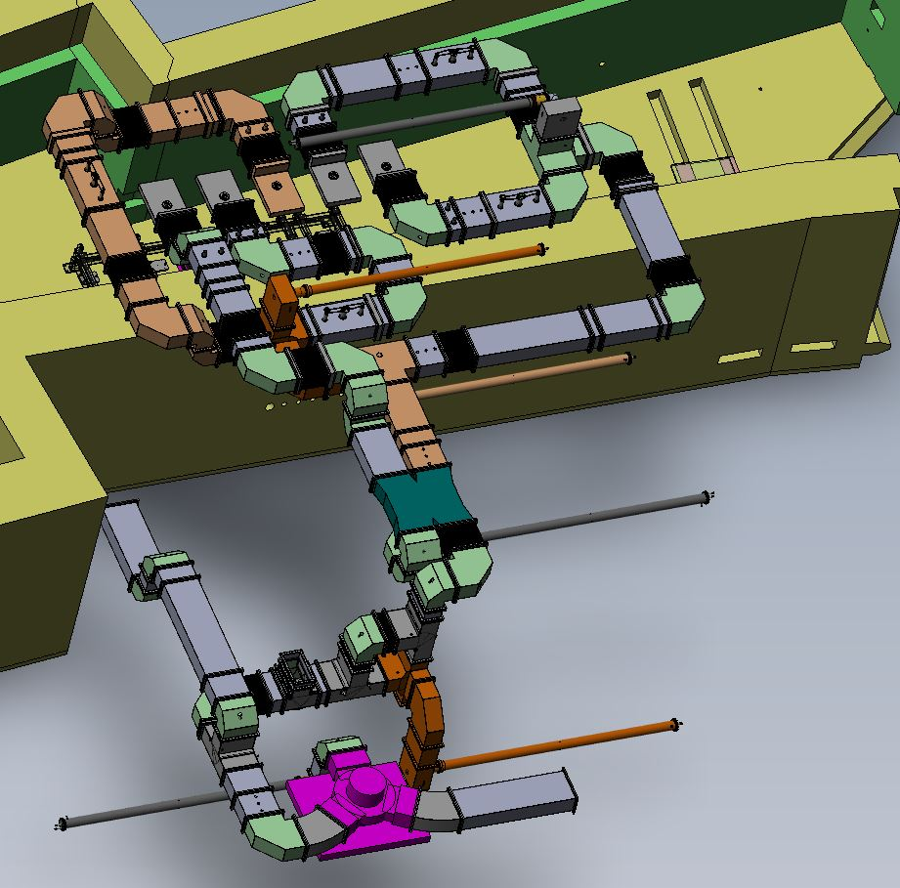
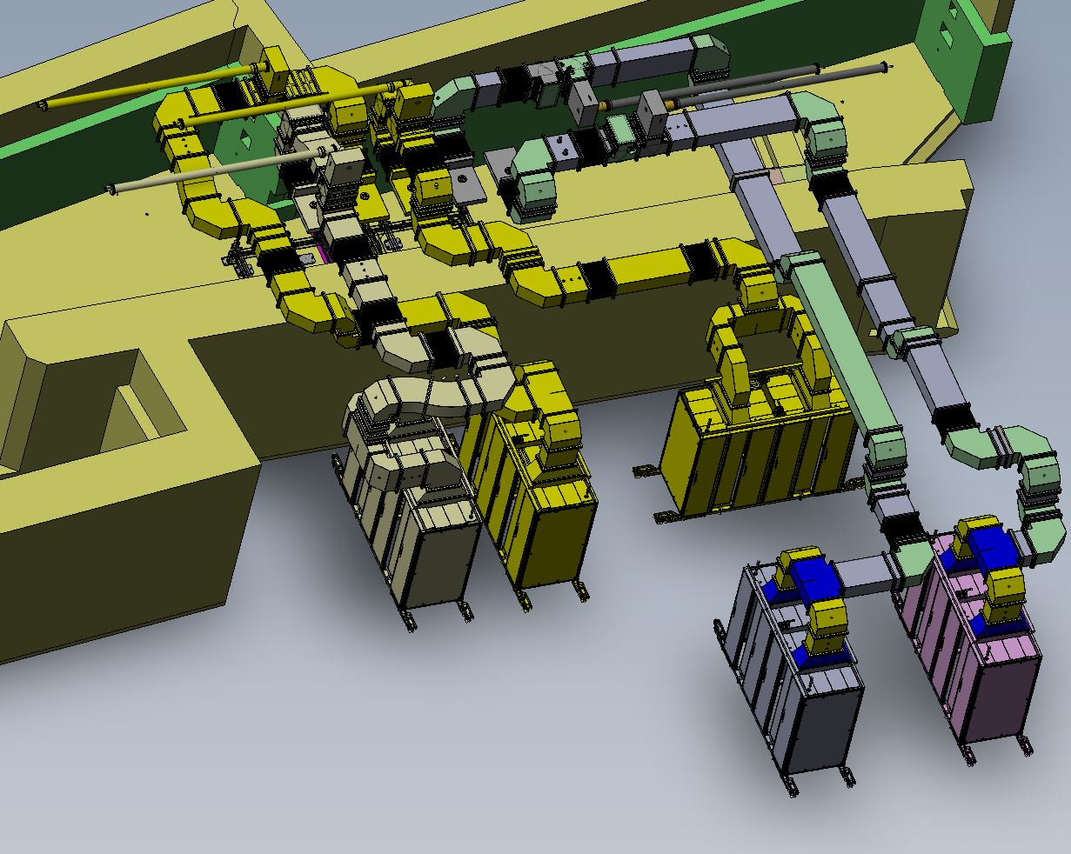
Challenge: gradual installation in existing klystron room
Cell 5 (Cav 1, 2, 3, 4, 5) today
Cell 5 (Cav 1, 2, 3, 4, 5) from January 2027

Slide 11
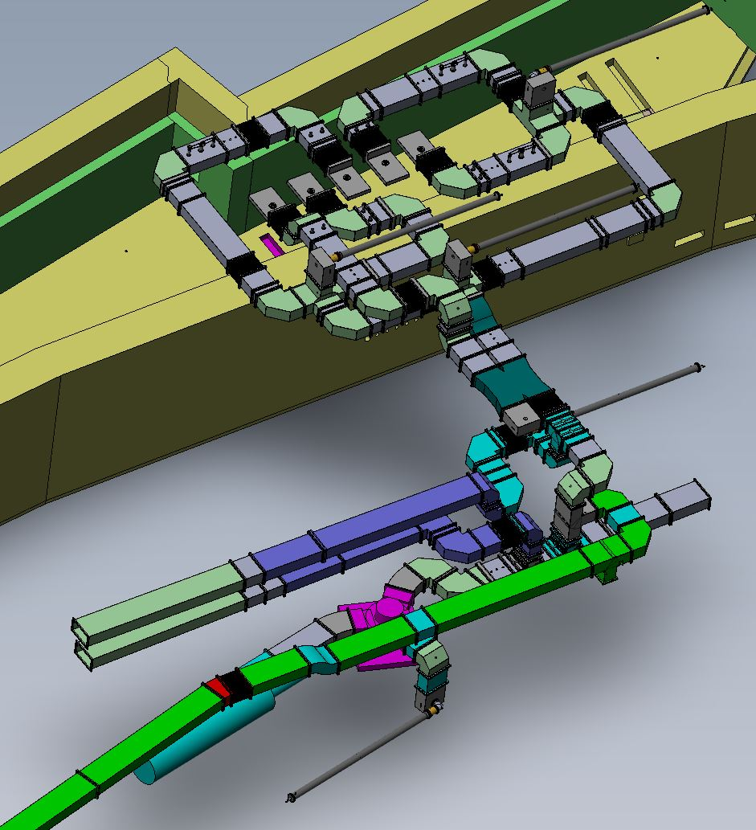
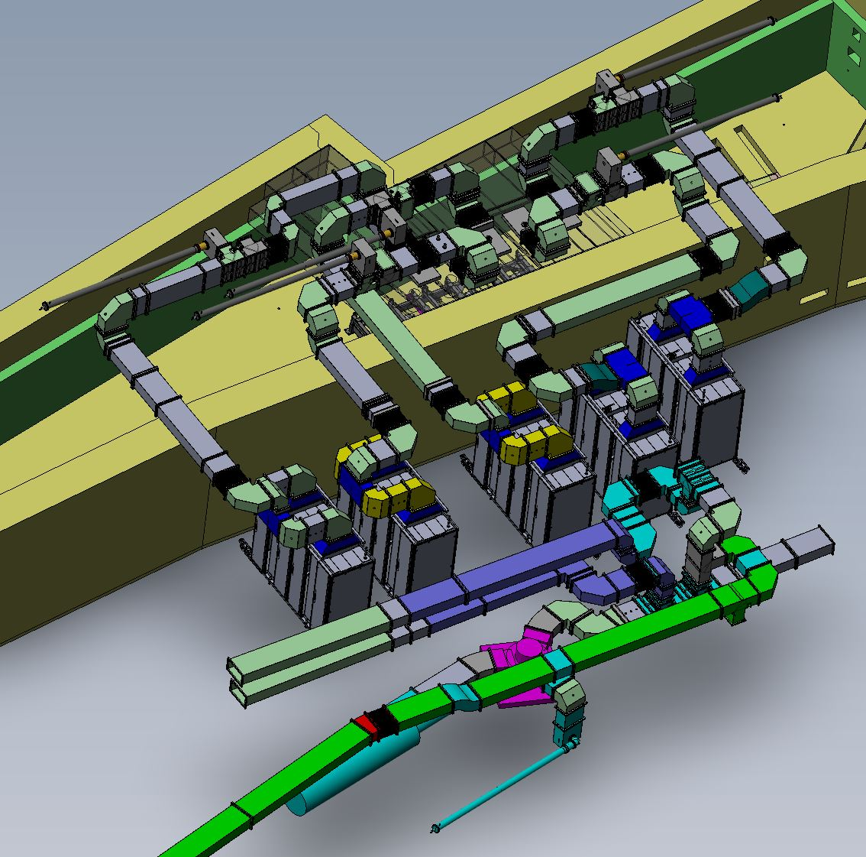
Challenge: gradual installation in existing klystron room
Cell 7 (Cav 6, 7, 8, 9, 10) today
Cell 7 (Cav 6, 7, 8, 9, 10) from August 2025

Slide 12

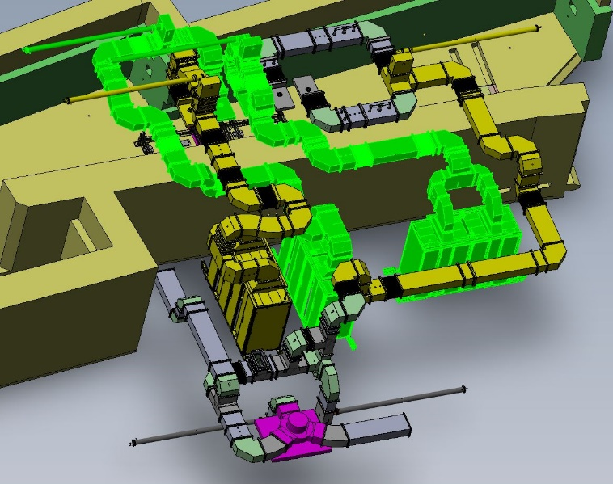
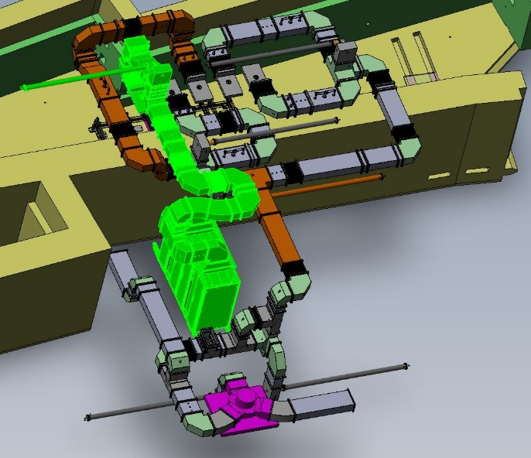
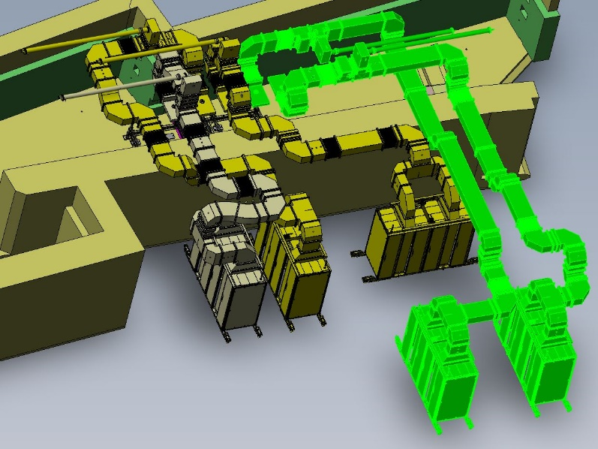
Cell 5: Gradual implementation Sequence
0
2
1
3

Slide 13
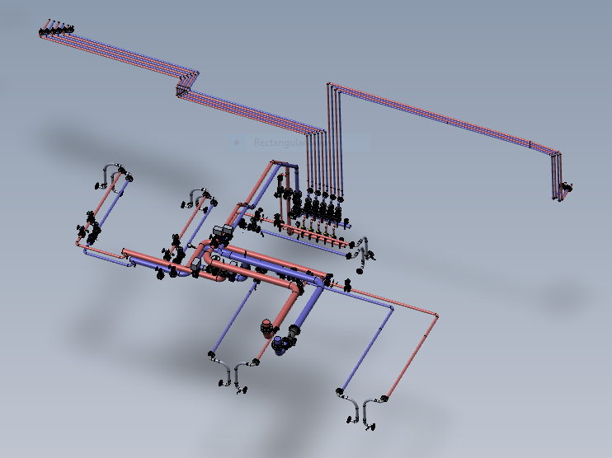
Cell 5: Cooling water distribution – Ssa and loads

Slide 14
352 MHz Ssa Project status
ESRF preparation
  Model, drafting (RF, BIG, MEG, subcontractor ERIA)
      3D model of waveguides, incl. installation stages
        2D drawings for each stage in progress (for execution of works)
      Water cooling drawings ready for CFT / BIG
      Cable tray layout: by end of January 23
  BIG Preparatory works on site
      Agreed master plan to coordinate BIG and RF tasks (Microsoft Project planning)
      Modification of water & compressed air manifolds, of LN2 line and existing cable trays
      Installation of SRE outlets for SSA cooling
      Installation of cable trays outside SRRF has started
  ACU
      End January 23: controller from JEMA to start tests for the connection to ESRF control system
  RF
      E/H tuner on teststand, for variable mismatch setting needed at SAT
      Reorganization of spares storage to release space for SSA installation
      LLRF system designed and under implementation

Slide 15
352 MHz Ssa Project status
SSA contract with JEMA France
    1150 W RF pallet still requires some optimization to meet the specification. FAT for milestone 1 of the contract is further delayed.
    AC/DC converters under test also not ready for series production. JEMA proposes to use a commercial AC/DC converter to build the 9 kW RF module (8 RF pallets) and provisionally for the first 110 kW SSA.
    Nevertheless JEMA is purchasing necessary components for the future milestones at its own risk, allowing them to parallelize the work and minimize the delay for the first complete SSA.

Slide 16
352 MHz Ssa Project status
RF Pallet under test since Sept. Optimization Pw: 1150 W / efficiency
JEMA has anticipated RF module fab. at its own risk, x8 combiner ready
AC/DC converter still under debugging ⇒ final tests Jan/Feb 2023
AC/DC from external company only for anticipated RF qualification
SSA1 substantially delayed
SSA6 probably slightly delayed as well
Still connection to Cav#1 at 23/24 winter SD
Connection to Cav#6 likely delayed to March 24 SD
Cavities 1 and 6 disconnected from klystron in October 2023
  Time needed to prepare installation of SSAs and connection to cavities
  Last run of 2023 with 11 cavities
    in operation right now as RF ECO mode: full beam performance achieved
  1st run 2024 with 12 cavities, i.e. still 1 spare
ESRF preparation on schedule

Slide 17
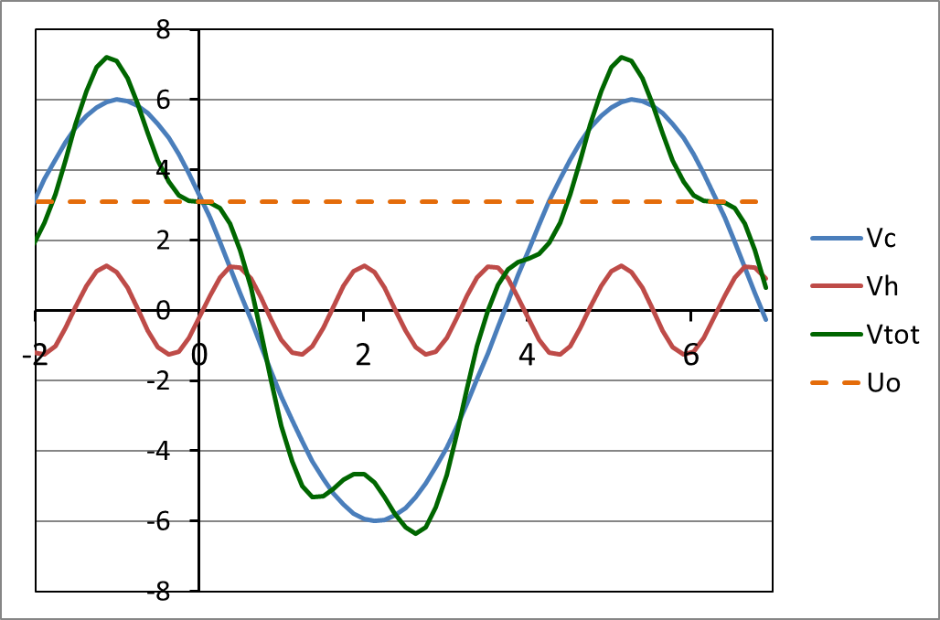
STATUS - 4th harmonic RF system for bunch lengthening
For all modes: Hor. Emit. ε_{z} = 135 pm | Multibunch 7/8 filling | 16-bunches | 4-bunches
Total current | 200 mA | 92 mA | 40 mA
Current per bunch | 0.23 mA | 5.75 mA | 10 mA
Bunch length (calc.) | 13 ps | 31 ps | 37 ps
Vert. Emit. ε_{z} set at | 10 pm | 20 pm | 20 pm
Touschek Lifetime | 33 h | ≈ 4,5 h | ≈ 4 h
Bunch lengthening by a factor 2.5 to 3
H4 @ 1.41 GHz
    1st Priority for high I / bunch (16 bunch and 4 x 10 mA)
    Reduced Touschek scattering, IBS and microwave instability:
      Increased lifetime → less frequent injections, reduced loss rate and radiation load
      Improved overall stability
      Room for smaller In-Vacuum ID gaps
      alleviate possible impact from future lattice developments like mini-beta straights
      Reduced emittance and energy blow up
    Reduced heat-load and stress of critical chambers, like ceramic chambers or In-Vacuum IDs

Slide 18
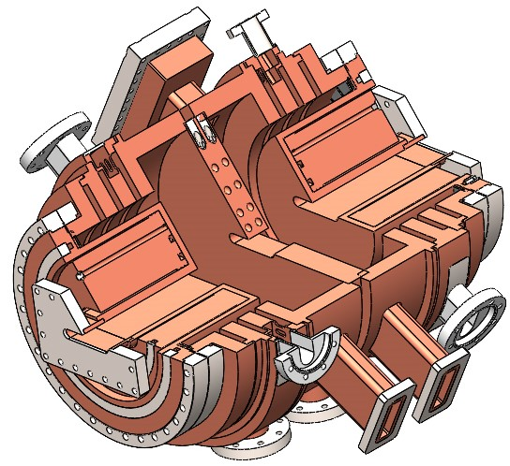
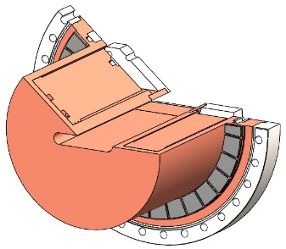
4th harmonic 2-cell - 1.41 GHz - E020 mode cavity - in house R&D
Vacuum ports on HOM dampers preserving Q0
Ferrite LOM (E010 mode)
& HOM absorber
650 mm
Coaxial HOM damper, at zero of E020 H-field, overmoded at 1.4 GHz
3 Stub filters to stop 4 propagating modes at 1.4 GHz otherwise damping accelerating E020 mode
(TEM, TE11, TE21, TE31)
Features:
    E020 mode: low R/Q and high Q₀ (first proposed by N. Yamamoto/KEK)
    Elaborate coaxial LOM/HOM damper (ESRF design)
    Magnetic inter-cell coupling: Q₀ degradation ⇒ abandoned:
    Study of pair of adjacent but decoupled cells requiring additional azimuthal HOM dampers (as on drawings)
    Retained recent solution: 2 electrically coupled cells (ESRF design):
      High Q₀ ≈ 35000
      R/Q reduced from 44 to 33 Ohm/cell
      No additional azimuthal HOM dampers needed
Mechanical design well in progress
    Elaborate water cooling
    Detailed design including assembly processes and sequences
    3D model in progress
    Then 2D drawings by MEG
    CFT planned this spring:
      1 prototype
      Conditional order of 2 or 3 series cavities
    Launch also CFT for SSAs for power tests

Slide 19
Thank you for your attention !
Thanks to the numerous colleagues from all ESRF divisions for their fruitful collaboration !
LLRF, Control, Timing…
Linac & Injection/Extraction
Jörn Jacob
Georges Gautier
RF Design & Mechanical support
Nicolas Michel
Massimiliano De Donno
Marc Dubrulle
retired Feb 2023
Mathieu Morati
Vincent Serrière
RF Cavities
Marc Dumas
Claude Richard
Bernard Cocat
Hervé Delamare
RF Power Amp’s - Klystrons, SSAs
Alessandro D’Elia
Philppe Henrissat
Didier Boilot
Pawel Borowiec
Claude Rival
Philippe Chappelet
Louay Khlaifi
Student Trainee, 2y
Clément Sestito
Student Trainee, 2y

