Slide 1
Injectors and injection
S. White
On behalf of the injection team

Slide 2
outline
Booster studies
Injection studies
Future plans

Slide 3
Ideal injection
Poor injection has multiple consequences that we would like to avoid:
Inefficient electron production: electrons lost during injection are wasted
Losses in uncontrolled locations: hardware activation or even damage (demagnetization of IDs for example)
Longer injection period: injectors more solicited, more energy consumption, longer “dark” time for beam lines that are perturbed
Perturbations to beam lines: data acquisition interrupted, non optimal use of beam time
In an ideal world:
100% efficiency: all the electrons produced at the gun used to produce x-rays in the SR
Transparent injection: injections invisible to the beam lines
What we have in reality:
Imperfect transmission: ~50-60% Linac to Booster, ~70-80% Booster to SR
Visible perturbations: horizontal effective beam size increased by ~30% during injection
Injectors and injection studies aim at improving these aspects

Slide 4
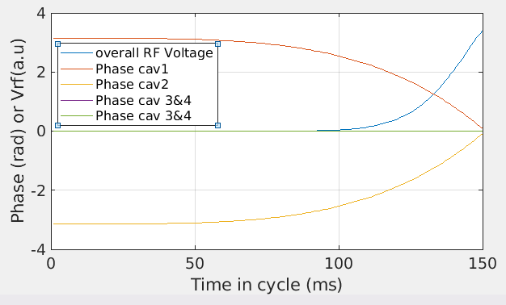
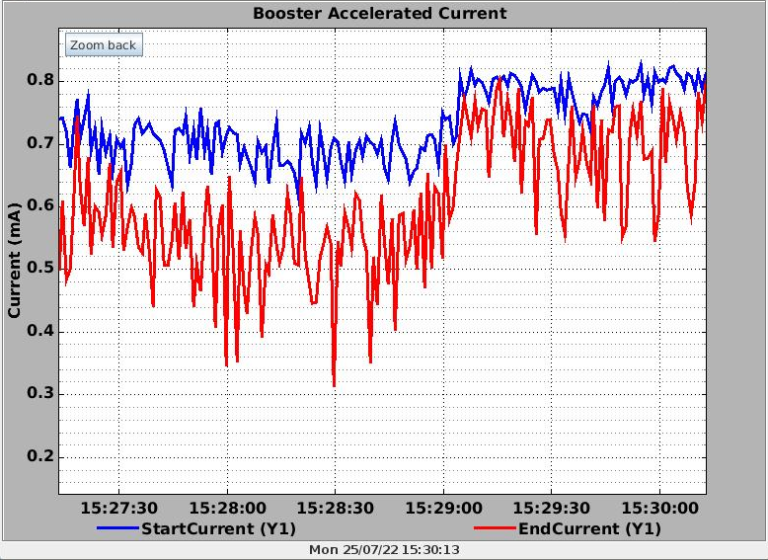
Improving LINAC to BOOSTER transmission
Identified limitations: The optimal RF voltage for capture at injection energy is very low but the RF phase regulation loops are unstable at this low voltage
Consequences: the voltage is increased to provide stable operation at the cost of transmission efficiency
Solution proposed: operate the RF cavity out of phase at injection to increase their voltage and slowly bring them back in phase during the ramp in energy
Reduction of the effective voltage improves the capture: 30% gain in end current
Validation of increased individual cavity voltage
Phase ramping of each individual cavity has been implemented and tested
70% transfer efficiency achieved
T. Perron, G. Gautier, N. Carmignani

Slide 5
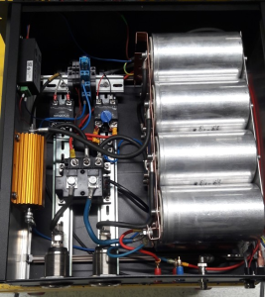
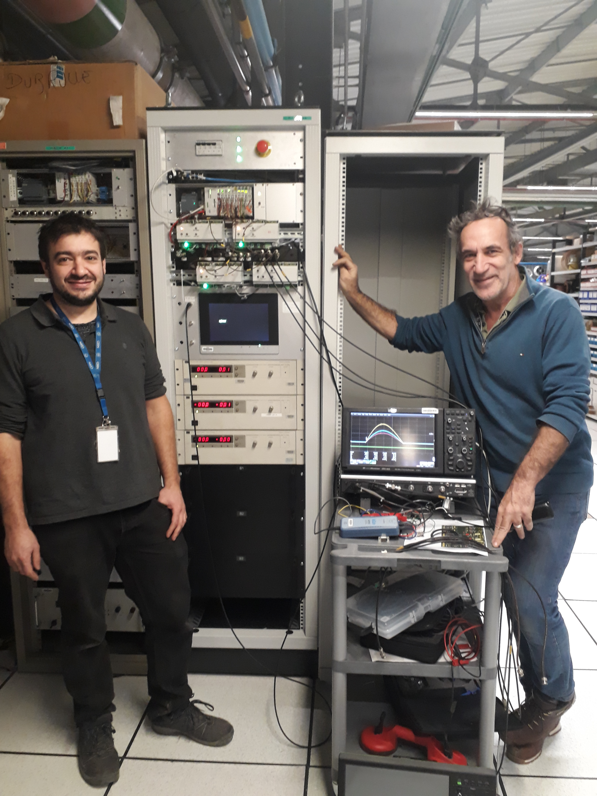
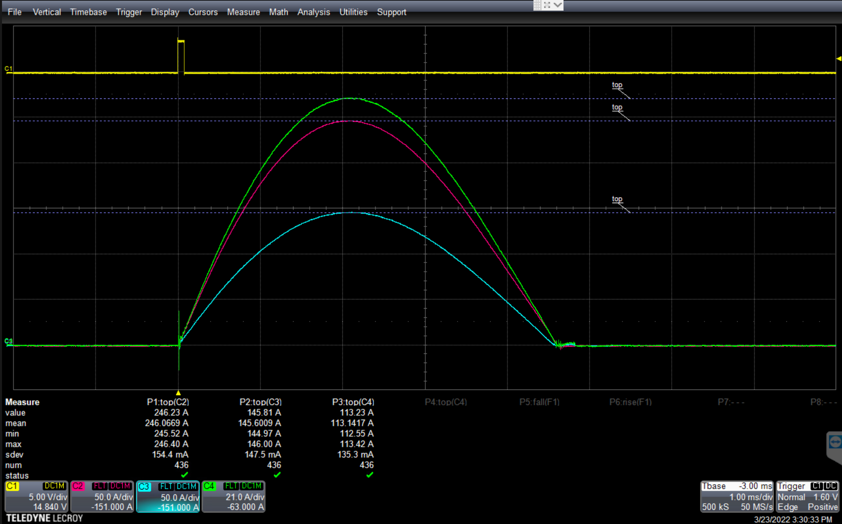
New bumpers PS operational
As part of the refurbishment / upgrade of the booster, the bumpers power supplies were replaced.
This development was also motivated by the implementation of new optics with lower emittance in the booster requiring stronger bumpers.
M. Morati, M. Dubrulle
New bumpers: major step towards implementation of new booster optics, could extract with 60% efficiency
Remaining limitation: out of strength in septum SE1
Following a realignment of the 1st TL2 stripline and full retuning of the transfer line additional margin gained on SE1: test will proceed with this new configuration
Full In-house development by
injext team: in operation since last run
4.5ms@4Hz

Slide 6
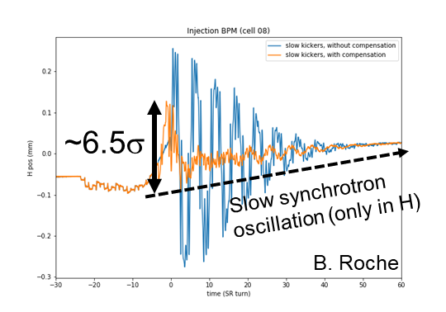
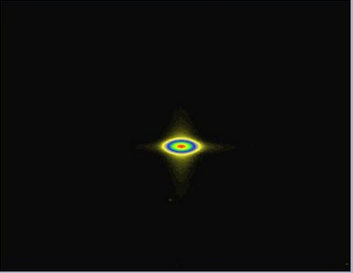
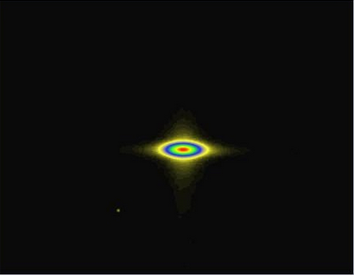
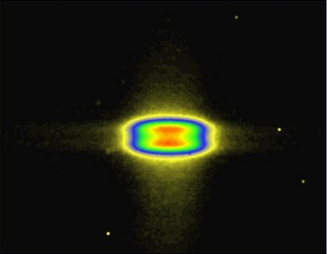
Injection perturbations
Beam lines can be disturbed by beam displacement or beam size increase during injection:
Prevents data acquisition during injection
Usable beam time reduced
These perturbations cannot be avoided with the present injection systems
Mitigation measures:
New kickers power supplies: significant improvement ~ factor 5
Implementation of active compensation systems
Work-around:
fast trigger proof of principle in ID15
keep injection period at 1h
Still not sufficient: joint ASD-ExpD MDTs with ID16, ID15, ID13
and BM5 indicate that at least another factor 2 reduction of
the perturbations is required
Perturbations are not the full story:
not compatible with low gaps operation (losses on IVU)
100% efficiency will not be achieved
Injection
Quiet beam
Injection + compensation

Slide 7
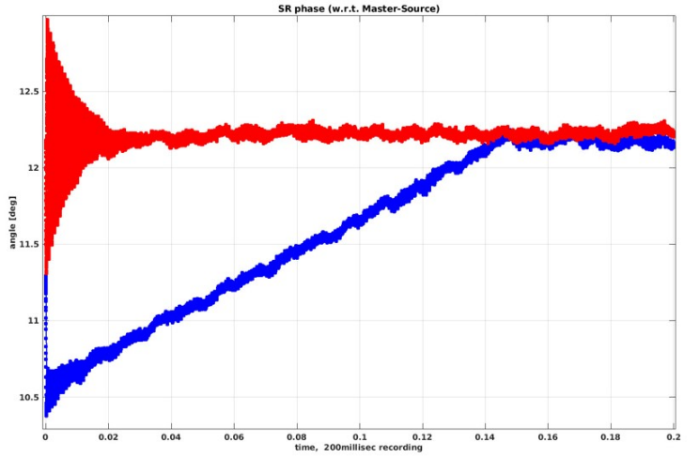
Longitudinal compensation
The slow kickers reduce the betatron oscillation due to imperfect closure, but introduce synchrotron oscillations due to path lengthening for about 20 turns
Consequences:
Energy oscillations without compensation ΔE/E~0.001
Mostly a problem for BM beam lines with non-zero dispersion
The phase of the RF cavities shifts with injection bump ramp-up of 60 μs and is then restored in 150 ms.
0
60 μs
150 ms
Correction OFF
Correction ON
Beam to master source phase (deg)
Amplitude [mm]
time (s)
Sample #
J. Jacob, G. Gautier, B. Roche

Slide 8
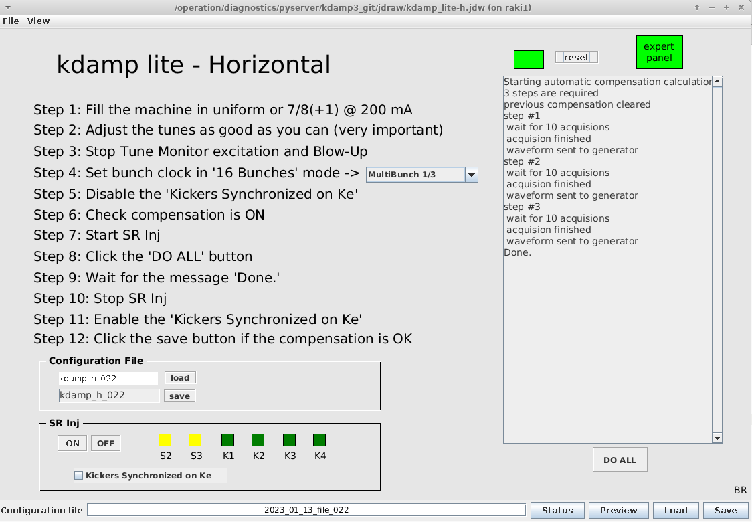
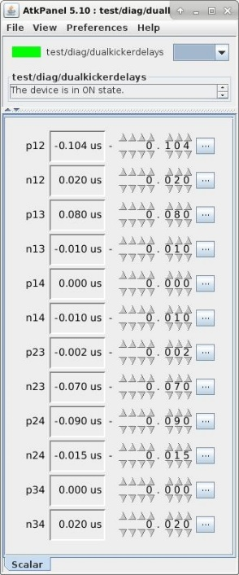
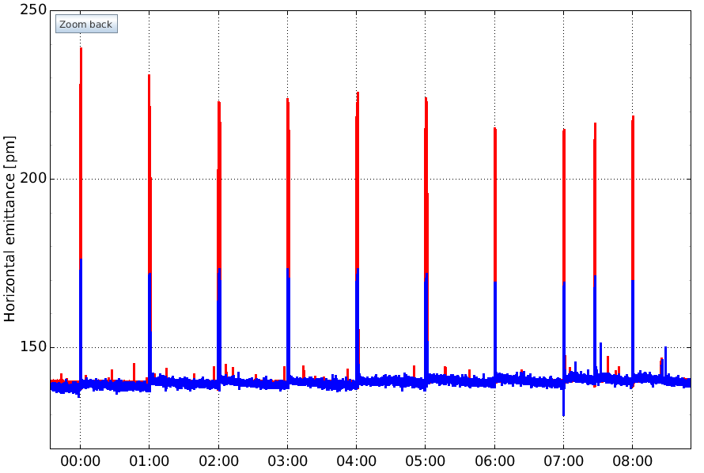
Improved diagnostics
Several improvement for the active compensation systems:
Semi-automated generation of the feedforward waveform
Multi-knobs (pairs) to tune kickers delays
Triggered emittance measurement: measures max. emittance blow-up
To be improved: kickers delay adjustments are still manual
Standard data: integration ~17ms, 15Hz acquisition
averaged over 1s, not synchronized
Triggered
Not triggered
Increase during Injections
Triggered data:
integration ~2ms
synchronized
F. Ewald,
B. Roche,
N. Leclercq
Emittance
250ms
Time

Slide 9
Present status
Emittance growth without compensation
$$σ(D=0)=\sqrt{βε}$$
$$σ_{p}=\sqrt{\frac{ε_{p}}{ε_{0}}}σ_{0} \sim 1.3σ_{0}$$
$$ε_{p}=225 pm.rad$$
$$ε_{0}=140 pm.rad$$
Conditions provided
during joint MDTs
Latest measurements
Some improvements since joint ASD-ExpD MDTs (Dec. 2021) but the requested factor 2 is still not achieved
Short term incremental improvements:
we have finally received the electronic components necessary to lengthen the fall time of the kickers, bench test to start in the coming months
Reduced perturbation amplitude and frequency: more efficiency compensation
This will (most probably) not provide a factor 2
How do we achieve the requested factor 2?

Slide 10
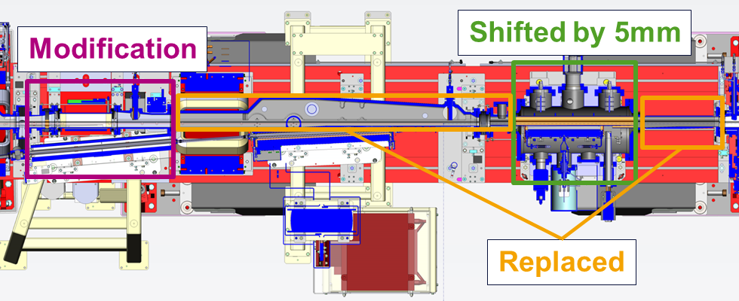
Mid-Term factor 2 reduction
Measurements have shown that the effective emittance growth scales with the bump amplitude
Proposal:
move the S3 blade closer to the stored beam and reduce the injection bump amplitude
Relatively modest modification and cost effective solution (~150keuros) to provide the factor 2 required by beam lines
No impact on lifetime or injection efficiency (verified experimentally)
Timeline: installation could take place at the earliest during winter SD 2023
26/09/22
26/09/22
The septum S3 is displaced by 5mm as a whole, no modification of the existing design : the blade moves from 15mm to 10mm from the beam axis
SR chambers upstream and downstream S3 have to be replaced, most difficult is the long Al chamber (CH16inj)
S1 septum zone may need some modifications due to interferences with SR flanges and supports
All TL2 elements are kept, a small PM dipole is needed to recover the trajectory
$$σ_{p}=1.15σ_{0}$$
$$ε_{p}=188 pm.rad$$
$$ε_{0}=140 pm.rad$$
D. Coulon,
B. Ogier

Slide 11
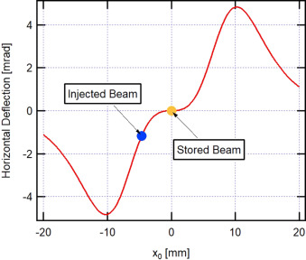
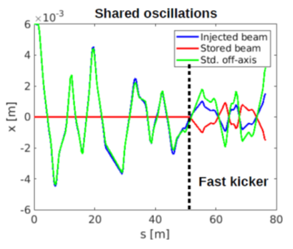
Long term Technical Solutions
High efficiency fully transparent injection compatible with low gap operation cannot be obtained with present systems:
Entirely new injection scheme and systems required
Complex technologies involved, advanced R&D needed: multi-year/ multi-millions development
Additional constraints: no modification of SR, intervention compatible with USM planning
2 technologies identified as potential candidates for ESRF:
Non-linear kickers: provides full transparency
Fast injection kickers: provides high efficiency and allows low gap operation
Methods can be combined to achieve design goals
Major developments required in both cases: design studies and R&D started
Non-linear kicker (NLK) injection:
Injection kickers replaced by NLK
Entirely new injection cell design required
Stored beam does not see any field: fully transparent
Potential degradation of injection efficiency: new booster needed?
Fast injection kicker:
Fast kicker added downstream existing injection
Requires existing injection to be transparent
Acts on single bunch: transparent only for multi-bunch modes
Reduces injection oscillations by factor 2: 100% efficiency, low gap operation
NLK@MAXIV

Slide 12
PRoposed Long term strategy for injection upgrade
Proposal for long term strategy: guidance from ExpD is necessary to clearly define design goals and constraints
Present situation: at least factor 2 improvement needed
Winter 2023 S3 displacement: ~factor 2 improvement
Perturbations not ok
Perturbations ok
Non-linear kicker injection:
Multi-year development (3y?)
R&D started: integration issues
May require new booster (5y?)
Shared oscillation with fast kicker:
Multi-year development (3y?)
R&D started
Low gap high efficiency
Full transparency
High efficiency transparent injection for low gap operation

Slide 13
Summary
Several improvement on the injectors:
Improvement of Linac to Booster transfer efficiency using RF phases demonstrated
New bumpers power supplies commissioned and operational
Injection perturbations further reduced:
Compensation of longitudinal oscillations
Semi-automated tuning of active compensation systems
Improved monitoring and characterization diagnostics
Fast trigger signal provided to ID15, no other requests received so far
Next steps:
Continue to improve existing systems
Improve operation procedures and monitoring to maintain optimal conditions
Injection perturbations:
Finalize and implement the S3 displacement: reduction of perturbation by a factor ~2
Continue R&D on new injection systems
Guidance from ExpD to define specifications, design goals and constraints is essential

Slide 14
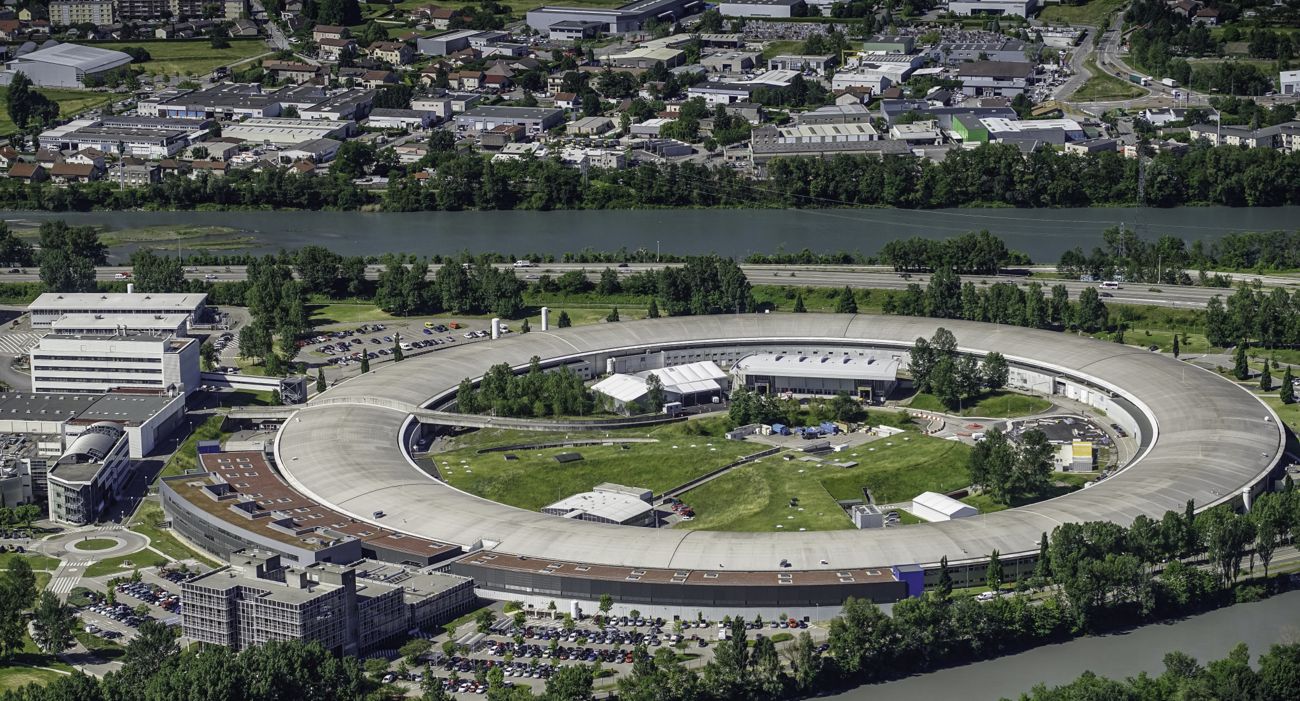
Many thanks for your attention

