Slide 1
Water cooling “scheduling” and preliminary RF needs for the different COLD Phases
A. D’Elia

Slide 2
SAT & Phase 0
Discussing with Marc, we may (ONLY FOR SATs!) steal the water from Mod0. This possibility must not impact the run test of Mod0 on the Linac Section! Additional: what about electrical power? Earthing to be provided this year: Summer SD?
 | Jan 2027 |  | July 2027 |  | After July 2027 – End 2027
 | SAT S-Band RF Unit |  | SAT C-Band RF Unit |  | COLD - Phase 0: RF Cond. and test of SLAC struc.
SAT S-Band | Load SAT: 5l/min (3.15kW¹) | RF Unit: 91l/min (ΔP<5bar@91l/min)
SAT C-Band | - | - | Load SAT: 6l/min (4kW²) | RF Unit: 123l/min³ (ΔP=5bar@123l/min)
Phase 0 | - | - | - | - | C-Load: 0.5l/min (300W⁴) | C-RF Unit: 123l/min³ (ΔP=5bar@123l/min) | C-RF Wind.: 1x3l/min⁵
Tot | 96 l/min & 3.15kW |  | 129 l/min & 4kW |  | RF=126.5 l/min NB: All quads will be air cooled
¹ Assuming ΔT=10deg and 35MW*4.5us*20Hz.
² Assuming ΔT=10deg and 50MW*4us*20Hz.
³ Preliminary communication from Scandinova, not yet the real value that most probably will be lower (for S-Band the preliminary value was 113l/min).
⁴ Here we are NOT considering the pulse compression scheme that could be not yet available (see next slides).
⁵ The idea of putting RF windows close to the input of the cavities has been aborted: as commented by PSI colleagues putting a ceramic window in a region subject to very high fields and huge thermic stresses between cold and warm parts, is more a risk than a solution. However it could be useful to have a RF window allowing to intervene (for calibration for ex.) on the Directional Coupler at the output of the klystron without touching the vacuum of the whole installation. If that has to be cooled down or hasn’t, it is not clear (in case of SF6-vacuum separation the cooling is not needed). Here I put the worst case using the value given in the S-Band RF Unit for cooling the RF Window.

Slide 3
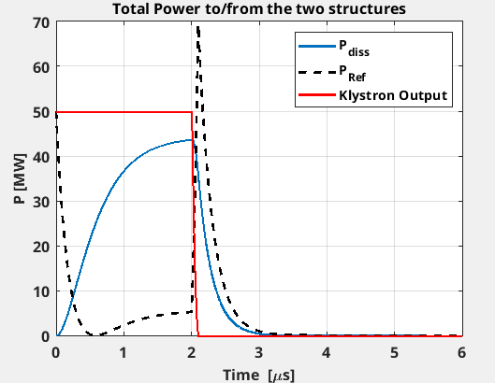
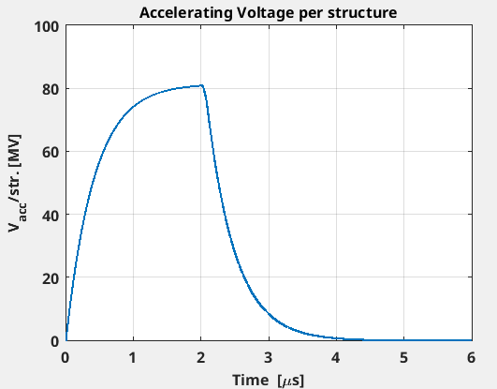
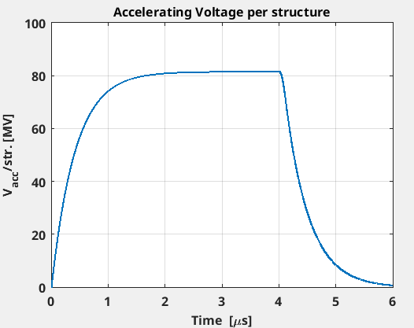
C-Band: Phase 0 without pulse compression
2nd Half 2027
Considering that β_{str}=2, and a margin of 30% additional power for waveguide losses, all 50MW are needed without BOC. But with only 2us we can reach the nominal 80MV (Vmax=81.6MV reached after 3us).
Being an overcoupled SW structure: full reflection at the beginning of the pulse, some permanent reflection during the pulse, largest peak reflected power at the end of the pulse ➔ Planar hybrid with load is needed.
50 MW
2μs, 10Hz
C-band
Pref_{Av}=300W
PKlys_{Av}=1020W
Pdiss_{Av}=727W
load
Planar hybrid
DC
DC
Ph.
Shift
Atten
Atten
Pref_{Av}=403W
PKlys_{Av}=2020W
Pdiss_{Av}=1035W
C3 1m struct
C3 1m struct
C3 1m struct

Slide 4
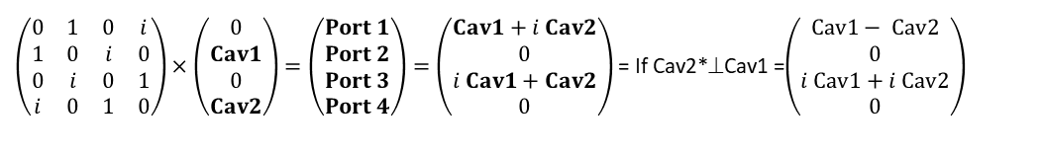
Considerations on the hybrid scheme
C3 structures are SW this means that:
A reflected power will be present at the beginning and at the end of each filling pulse;
A constant reflected power will be present during the pulse when the structure is overcoupled (as it is in our case).
The planar hybrid will provide to zero reflection back to the klystron only if:
The “cavity waves” are in quadrature;
The “cavity wave” modules are equal.
This implies that we need a fine control of the phase and amplitude from the cavities. I am a bit worried about that…
Typical return loss values for klystrons are 20dB ➔ for 50MW, ~500kW Pref allowed
Planar hybrid
Port 3
Load
Port 1
Klys
Planar Hybrid S-Matrix
Input
Output
$\left(\begin{matrix}0 & 1 & 0 & i \\ 1 & 0 & i & 0 \\ 0 & i & 0 & 1 \\ i & 0 & 1 & 0\end{matrix}\right)×\left(\begin{matrix}0 \\ Cav1 \\ 0 \\ Cav2\end{matrix}\right)=\left(\begin{aligned}Port 1 \\ Port 2 \\ Port 3 \\ Port 4\end{aligned}\right)=\left(\begin{matrix}Cav1+i Cav2 \\ 0 \\ i Cav1+Cav2 \\ 0\end{matrix}\right)$ = If Cav2*⊥Cav1 =$\left(\begin{matrix}Cav1− Cav2 \\ 0 \\ i Cav1+i Cav2 \\ 0\end{matrix}\right)$
If Cav1=Cav2 ➔ Port1=0
Port 4
Cav2
Port 2
Cav1
Im
i Cav2*
Note that the quadrature sign matters: Cav1 and Cav2 must be at +π/2 as in the phasor diagram here on the left. In this case Port1=Cav1-Cav2. If they are at -π/2: Port1=Cav1+Cav2!!
See next slide
Cav1+Cav2
Feeding from cavities
Cav2
Feeding from cavities
Cav1
Cav1
Re

Slide 5
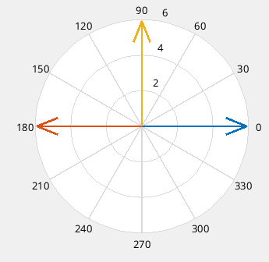
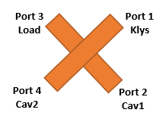
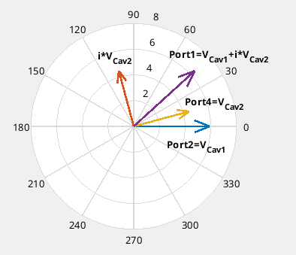
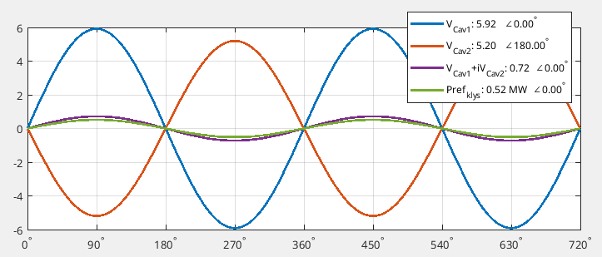
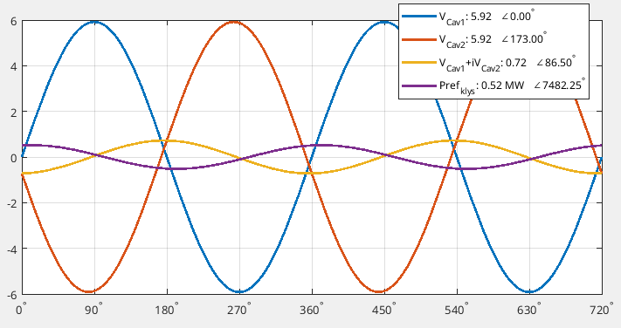
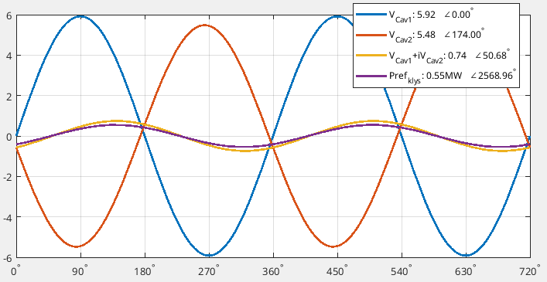



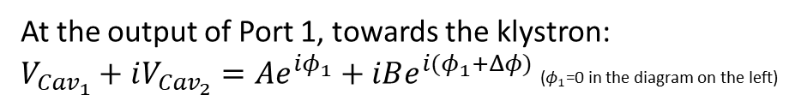
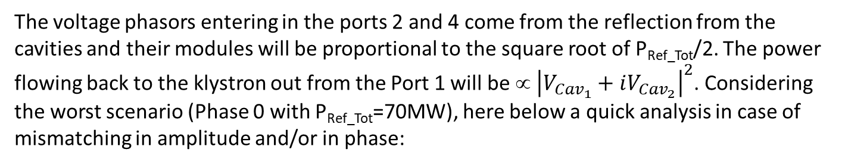
Some calculation on the hybrid scheme
Phasor Diagram
At the output of Port 1, towards the klystron:
$V_{{Cav}_{1}}+iV_{{Cav}_{2}}=Ae^{iφ_{1}}+iBe^{i{(φ}_{1}+Δφ)}$ ($φ_{1}$=0 in the diagram on the left)
$${\left|V_{{Cav}_{1}}+iV_{{Cav}_{2}}\right|}^{2}=A^{2}+B^{2}−2AB\sin{(Δφ)}$$
P_{ref klys}=0 only if A=B and $Δφ$=π /2
(The module of the sum is independent on $φ_{1}$)
Δφ
The voltage phasors entering in the ports 2 and 4 come from the reflection from the cavities and their modules will be proportional to the square root of P_{Ref_Tot}/2. The power flowing back to the klystron out from the Port 1 will be ∝ ${\left|V_{{Cav}_{1}}+iV_{{Cav}_{2}}\right|}^{2}$. Considering the worst scenario (Phase 0 with P_{Ref_Tot}=70MW), here below a quick analysis in case of mismatching in amplitude and/or in phase:
Δφ=84°; Pref₁=35MW; Pref₂=30MW
Δβ/β≈5% or ΔV/V≈7%; Δφ/φ<7%
Δφ=90°; Pref₁=35MW; Pref₂=27MW ➔ Δβ/β≈10% or ΔV/V≈11%
Δφ=83°; Pref₁=Pref₂=35MW ➔ Δφ/φ≈8%

Slide 6
Components needed for Phase 0 (2nd half 2027)
 | Components | Comments
Waveguides x C-Band | Planar Hybrid
 | C-Band Load | 70MW peak power, 300W average Power
 | 2 x Dir. Coupler C-Band
 | Phase shifter
 | Attenuators
 | Cables+electr.
Vacuum x C-Band | IP+electr.
 | Gauges+electr.
 | Vacuum valves (?) | In this way we won’t vent the cavity for the next phases.
Of course we need also the waveguides but w/o drawings we can’t fix the layout. Delay for delivery tbd with PSI or with a Company if we want to profit for a qualification. With a Company I think that the leadtime should be at least 6 months if we don’t need special components (twists, particular bends…). PSI told us that they paid for waveguides ≈100kEuros/5m (several years ago): do we need a CFT?

Slide 7
Phase 1
From PSI on the BOC: apparently they have a dedicated cooling water group. In their case with a rep. rate of 100Hz they need input flow rate of 102l/min that in our case becomes, divided by 10, ~10l/min! Can we guarantee the regulation with a dedicated chiller air condensed?
 | 2028 |  |  | 2029
 | RF Gun Conditioning and Test |  |  | COLD – Phase 1: 150MeV beam acceleration
Gun RF Conditioning and Test | Isolator: 3.5l/min (ΔP=2bar@nom. flowrate) | S-RF Unit: 91l/min | Load Isolator: 5l/min (0.45kW¹) (ΔP=2bar@nom. flowrate)
Phase 1 | - | - |  | Isolator: 3.5l/min (ΔP=2bar@nom. flowrate) | S-RF Unit: 91l/min | Load Isolator: 5l/min (0.38kW²) (ΔP=2bar@nom. flowrate) | C-RF Unit: 123l/min | C-Load: <0.5l/min (210W³) | C-RF Wind.: 1x3l/min | Dipoles: 1.5l/min (1.04kW) | Solenoid: 5l/min (10kW) | +Defl. Cavity Load(s): 5l/min (<150W)
Tot | ~100 l/min & 0.45kW |  |  | RF=226 (+10 for BOC) l/min + Magn.=6.5 l/min & 11.04kW (Def. Cav➔ +5l/min & +0.15kW) NB: All quads will be air cooled
¹ The isolator is dimensioned to work at 30MW*1.5us*10Hz=450W;
² In operation the RF gun should need 25MW*1.5us*10Hz=380W;
³ Here we are considering the pulse compression scheme but only one cryomodule ➔ needed only 25MW power but 4us.
Water distribution for magnets is in Linac tunnel ➔ That is not in the budget of Pinj distribution: how much is it available from there?

Slide 8
S-Band: Phase 1
2028-2029
NB: Def. Cavity not needed for Phase 2. S-Band installation layout for Phase 2 ≡ Phase 1a.
20-25 MW
1.5μs, 4Hz
S-band
~30 MW
1.5μs, 4Hz
S-band
load
load
Power Splitter (~10dB)
DC
…
Atten
Ph.
Shift
Switch
load
DC
load
DC
RF Window Vacuum-SF6
RF Window or whole under SF6?
DC?
Isolator under SF6
Isolator under SF6
RF Window SF6-Vacuum
RF Window: Vacuum/SF6
DC
DC
Phase 1a: no def. cav.
Phase 1b: with def. cav.
C-Band Installation
pen
pen
IP
IP
valve
valve
Defl. Cavity
GUN
GUN

Slide 9
Power splitting scheme to feed the deflecting cavity: no need of an additional isolator
So far we are considering for the def. cavity same working parameters (voltage, power) as at SPARC. In case, from detailed calculations, this isn’t the case and Pref>>300kW we can derive the line for the def. cavity after the isolator. Same splitting scheme.
Pin
30 MW
1.5μs, 4Hz
S-band
RF Gun
27MW
In case of full ref.
In case of full ref.
Defl. Cavity
Load
Splitter Splitt. Fact. S
3MW
In case of reflection from the Defl. Cavity, because of the presence of the splitter itself, the power reflected back to the klystron is 1/S^2 = 1/100 ==> if i consider Pklys=Pgun+Pcav~30MW, Pref_from_gun~ 300kW (~2.7MW will go to the load in "line" with the RF gun).
Which is line on what the klystron may tolerate in reflection (VSWR~1.2 (max 1.4) in normal operation ==>~20dB return loss==> Pref~350kW).

Slide 10
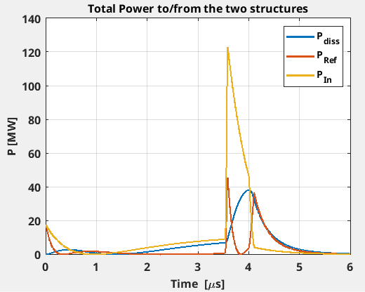
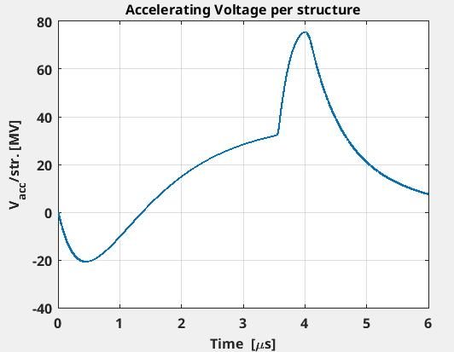
C-Band: Phase 1
2028-2029
25 MW
4μs, 10Hz
C-band
Pref_{Av}=210W
PKlys_{Av}=1008W
PBOC_{Av}=575W
Pdiss_{Av}=365W
Considering a margin of 30% additional power for waveguide losses.
BOC
load
Planar hybrid
DC
DC
Ph.
Shift
Atten
Atten
C3 1m struct
C3 1m struct
C3 1m struct

Slide 11
Components needed for Phase 1 (End of 2028)
 | Components | Comments
Waveguides x C-Band | BOC
 | C-Band Load (?) | 50MW peak power, 210W average Power (we may use the same as in Phase 0)
Waveguides x S-Band (Phase 1a) | Isolator+Load | Leadtime 9-10 months. Price 76kEuros ➔ CFT time to be considered
 | RF Windows SF6-Vacuum
 | 2 x Dir. Coupler
Waveguides x S-Band (Phase 1b) | Isolator+Load | Leadtime 9-10 months. Price 76kEuros ➔ CFT time to be considered
 | RF Windows SF6-Vacuum
 | 4 x Dir. Coupler
 | Attenuator
 | Phase shifter
 | RF Switch
 | Power splitter - 10 dB 4-ports
 | 2 x RF Load S-Band | 3MW peak, 200W average power (not a detailed calculation)
Vacuum x S-Band | IP+Gauges+cables+electronics+…
Of course we need also the waveguides but w/o drawings we can’t fix the layout.

Slide 12
Phase 2
From PSI on the BOC: apparently they have a dedicated exchanger. In their case with a rep. rate of 100Hz they need input flow rate of 102l/min that in our case becomes, divided by 10, ~10l/min! Can we guarantee the regulation with a dedicated chiller air condensed?
 | 2030
 | COLD – Phase 2: 300MeV beam acceleration
 | Isolator: 3.5l/min | S-RF Unit: 91l/min | Load Isolator: 5l/min (<0.38kW) | C-RF Unit: 123l/min | C-Load: 2x<0.5l/min (2x210W) | C-RF Wind.: 1x3l/min | Dipoles: 1.5l/min (1.04kW) | Solenoid: 5l/min (10kW) | +Def. Cavity¹ Load(s): 5l/min (<0.15kW)
Tot | RF~226.5 (+10 for BOC) l/min + Magn.=6.5 l/min & 11.04kW (Def Cav ➔ +5l/min & +0.15kW) NB: All quads will be air cooled |  | (3.5+113+5+123+24+12+25.6+6+5)l/min & 26.3kW (+5l/min & 0.15kW)
¹ In this phase we shouldn’t need a deflecting cavity
Water distribution for magnets is in Linac tunnel ➔ That is not in the budget of Pinj distribution: how much is it available from there?

Slide 13
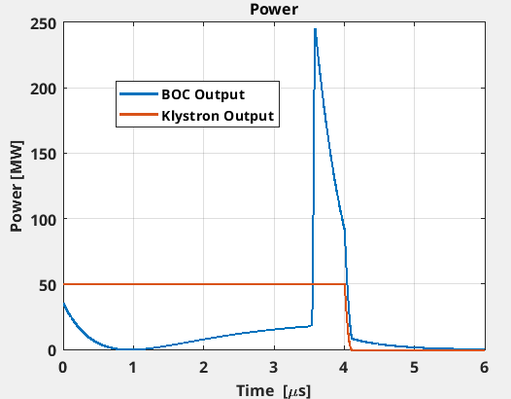
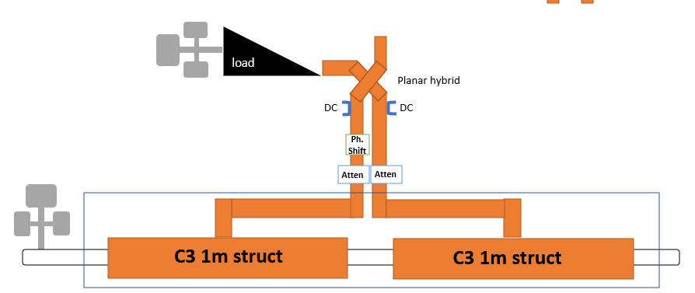
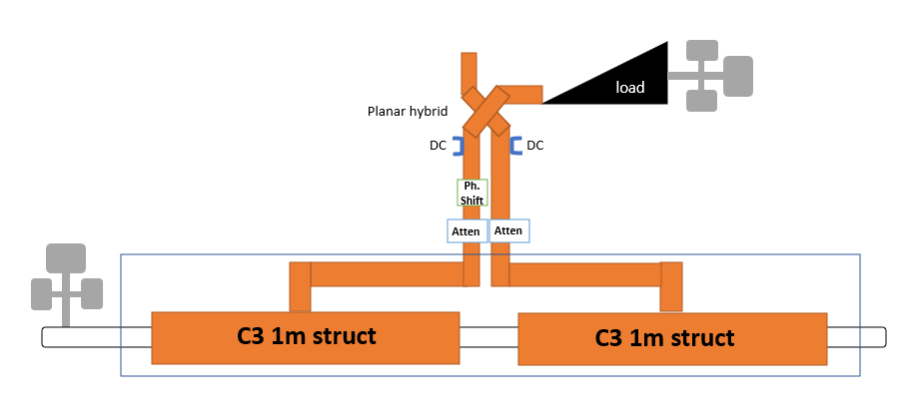
C-Band: Phase 2
2030
Considering a margin of 30% additional power for waveguide losses.
Pref, Pload, Pdiss remain the same as Phase 1 (25MW per branch)
50 MW
4μs, 10Hz
C-band
PBOC_{Av}=1.15kW
BOC
3dB Splitter

Slide 14
Components needed for Phase 2 (End of 2029)
 | Components | Comments
Waveguides x C-Band | 3 dB Splitter C-Band
 | C-Band Load | 50MW peak power, 210W average Power (probably we can buy it directly it during phase 0 or 1)
 | 2 x Dir. Coupler C-Band
 | Phase shifter
 | Attenuators
 | Planar Hybrid
Of course we need also the waveguides but w/o drawings we can’t fix the layout. Delay for delivery at least 6 months if we don’t need complicated pieces (twists, particular bends…)

Slide 15
In addition
C-Band RF Unit CFT3690 launched:
  Writing Tech Specs, dispatch date 19th March 2026;
  Bid submission deadline 20th April 2026;
  Estimated Contract date 29th June 2026;
  Estimated Delivery date 30th June 2027.
LLRF COD Position:
  49 applications received, shortlist defined, first round of video interview soon for a preliminary selection;
  In person (possibly) interviews will follow.

