Slide 1


A Preliminary Overview of Open Science Practices in China
Dr. ZHANG Lili
Computer Network Information Center, CAS
@IUCr Workshop 012 - From Open Data to Global Open Science
11 Aug. 2026

Slide 2
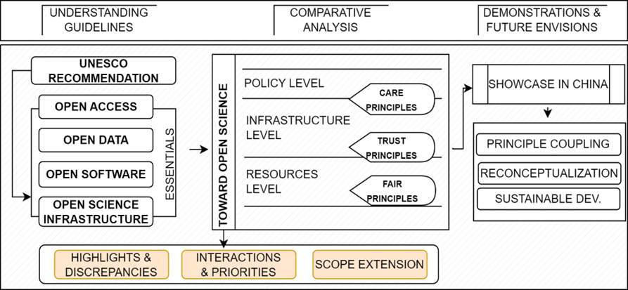

Slide 3
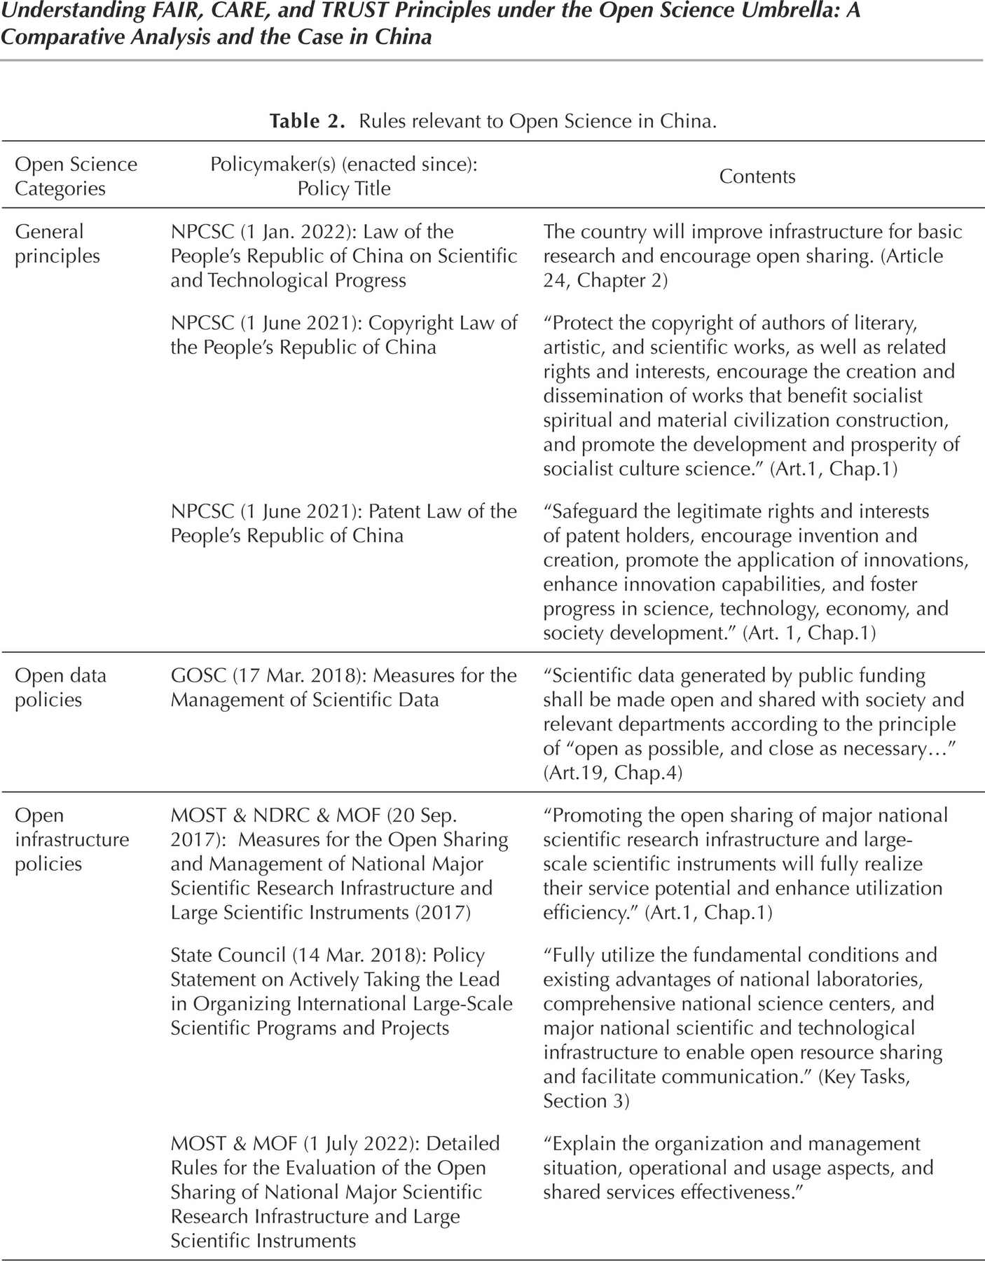
Notes:
[]

Slide 7
I. Guiding framework
UNESCO
China's International Cooperation Posture
Aims to make research accessible to everyone
UNESCO Open Science Framework promotes universal access to scientific knowledge, breaking down barriers for researchers worldwide.
MOST（Ministry of Science and Technology of the People’s Republic of China） Action Plan
Action Plan for International Cooperation in Open Science(2025-12-19)
Highlights governance, interconnection & interoperability of open science data platforms, infrastructures, training, etc.
Explicit endorsement of UNESCO Recommendation on Open Science
Cooperation priorities:
Open science infrastructure
Trusted data spaces
AI-enabled scientific applications
Emphasizes inclusiveness, equity, sustainability
Three core pillars ensuring open science benefits all communities fairly and remains viable long-term.
"As open as possible, as closed as necessary"
The guiding principle balancing transparency with legitimate restrictions for privacy, security, or commercial interests.

Slide 8
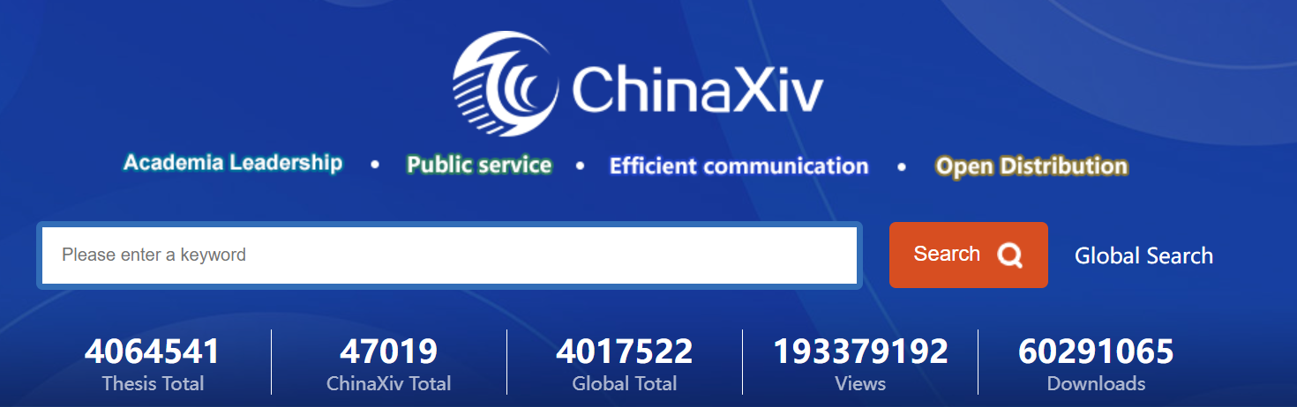
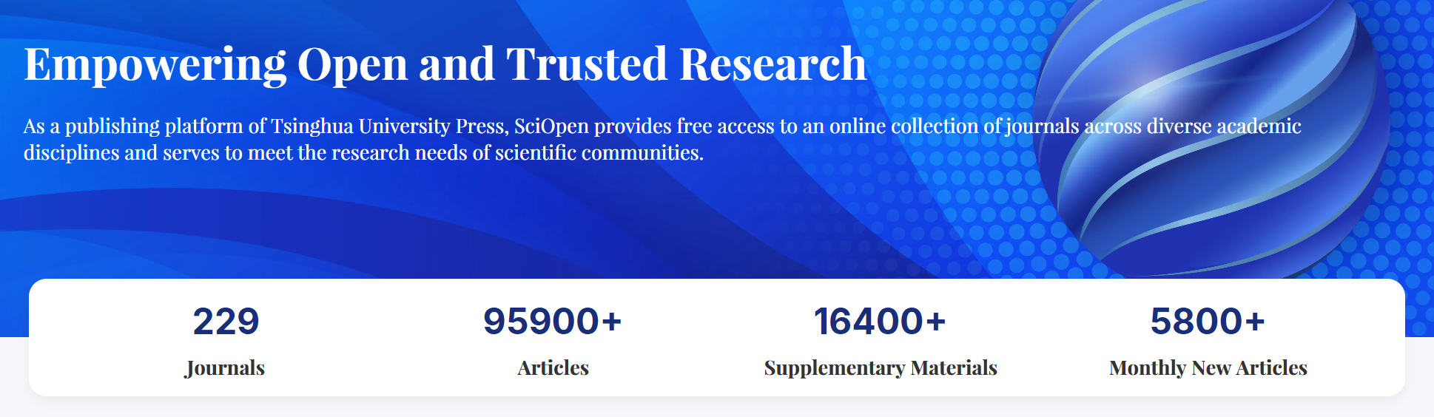

II. Open Access examples
Preprint platform
OA Journal Platform
ChinaXiv
SciOpen
Operated by National Science Library, Chinese Academy of Science（CAS）
Free browsing
A publishing platform of Tsinghua University Press
Free search
Free full-text browsing, downloading & sharing
Free download
Most journals on SciOpen are Gold OA
Publisher Service
Publisher Service
OA journals indexed: 27,000+
Full-text papers: ~17 million
High-quality OA journals selected: 1,000+ from global OA journals
Indexed OA papers: 20 million+ real-time updated
KeAi Publishing
GoOA
Repurposed as OA journal publishing service provider in 2013
One-stop discovery platform for OA journals & papers
Operated by National Science Library, Chinese Academy of Sciences (CAS)
280+
journals in portfolio

Slide 9
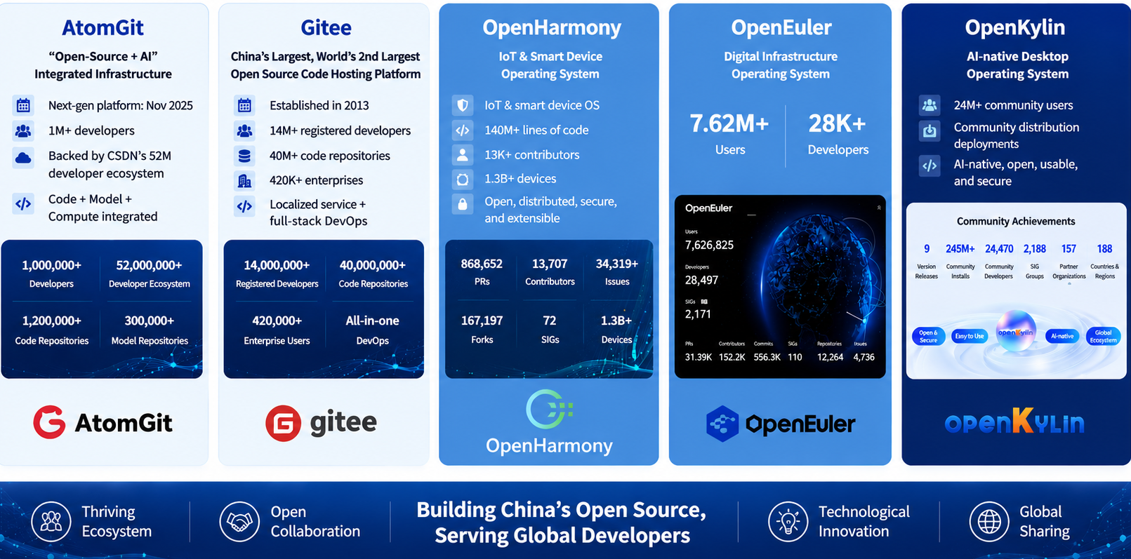
III. Open Source

Slide 10
IV. Open Data
52.26ZB
(2025)
MOST & MOF notice (2019)
Total Data Production in China
In order to better support the national scientific and technical innovation, economic and social development, and national security, in June 2019, the Ministry of Science and Technology (MOST) and the Ministry of Finance (MOF) issued a decree, announcing the establishment of 20 National Science Data Centers as important carriers for the open sharing of scientific data in China.

Slide 11

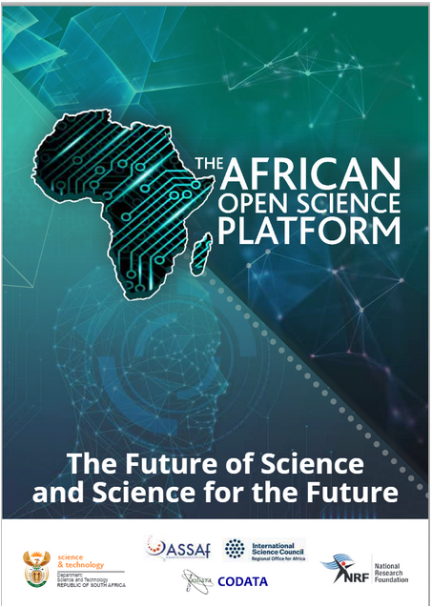


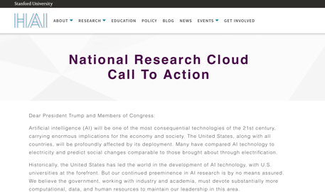
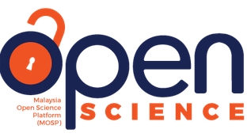
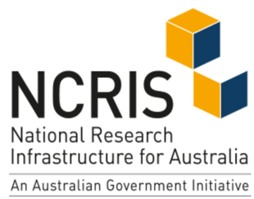

V. Open Science Infrastructure
Among different efforts, the consensus to co-develop a Global Open Science Cloud was researched in 2019 during a CODATA Beijing conference.
The GOSC vision is of a global Open Science environment connecting trusted research e-infrastructures to enable innovative scientific discoveries.
The GOSC mission is to facilitate accessibility, interconnectivity, interoperability, and inclusiveness of worldwide research e-infrastructures for Open Science and international research collaborations.
European Open Science Cloud 2015
African Open Science Platform 2018
China Science & Technology Cloud 2017
……
It is urgent to break down science silos and promote OSI connectivity and interoperability to address grand human challenges.

Slide 12
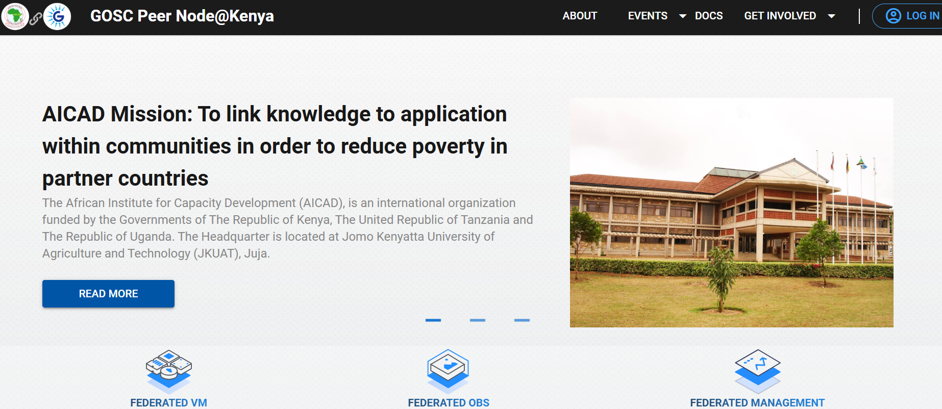

GOSC Testbed Prototype Regional adoption in East Africa
Trustworthy Collaborative Virtual Research Environment for Open Science and SDGs research

Slide 13
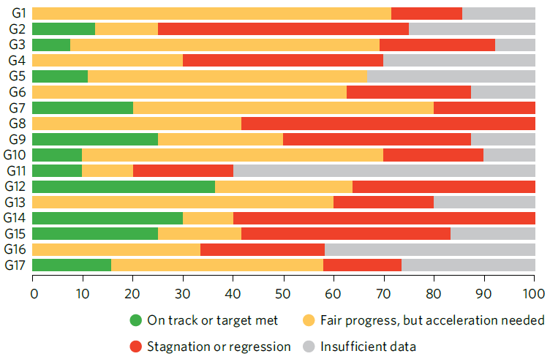
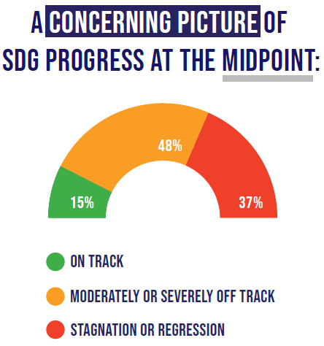



Slide 14
Engagement in the IDSSD
UNESCO’s International Decade of Sciences for Sustainable Development (IDSSD) has endorsed 287 initiatives (accessed 2026-07-22), with 120 contributed by Chinese efforts.

Slide 15
Summary
Open Science is not only a scientific paradigm, but also a cornerstone of resilient, inclusive, and sustainable global development. Together, we can transform scientific knowledge into a global public good that benefits all.
UNESCO has established Open Science as a global framework that makes scientific resources a shared global public good.
As one of the largest developing countries, China is positively advancing Open Science through open-source software, scientific data platforms, AI models, cloud computing, and national research infrastructures to support scientific innovation and international collaboration.
The future requires coordinated progress in technology, practice, and governance for trusted, interoperable, and sustainable OS ecosystems.
GOSC calls for long-term collaboration
  CODATA TG Metadata for Open Science Cloud Services that addresses interoperability, interconnectivity, and inclusiveness solutions of modal resources calls for more partnerships.
Notes:
What to do
Fully harness the advantages of science and digital technology for Open Science and SDGs
What we can do
Promote open dialogues for communities
Co-develop resilient OSI for research
Support collaborative research by OSI addressing pressing challenges
Community outreach and capacity building for Global South.
Nourish trustworthy and sustained research ecosystem

Slide 16
Thanks for your attention!

