Slide 1
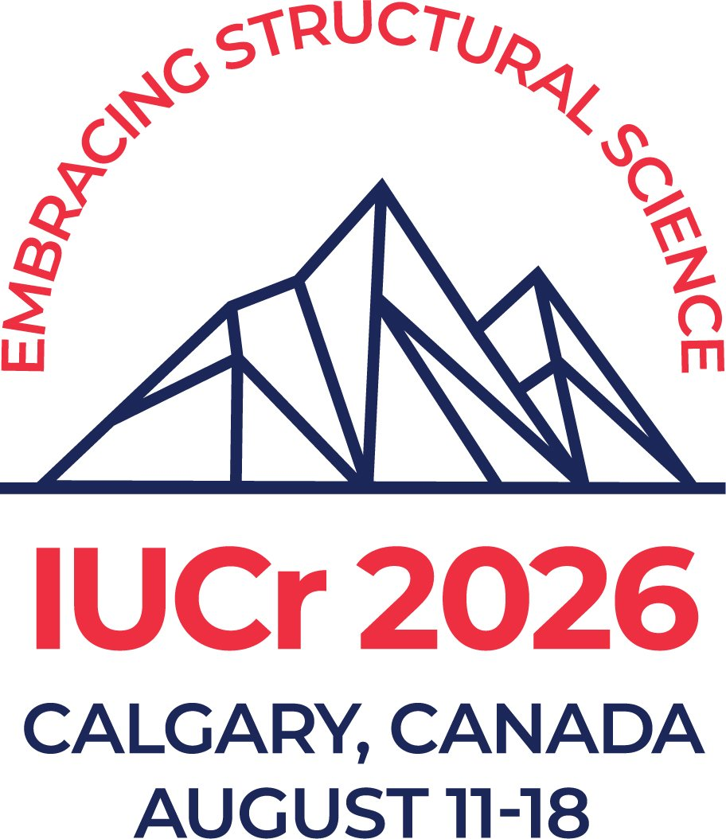


IUCr 2026
CommDat Workshop on Open Science
Open publications and their underpinning data, open software code and the Global Instrumentation Commons
John R Helliwell
John.Helliwell@manchester.ac.uk
Synchrotron Radiation Source
1976-2008
Chemistry Department
1989-

Slide 2
Open access
YES
Open peer review
YES, if journal allows
Open data (+raw)
YES
Are you an
Open Science
scientist?
Open about false positives?
No
Open software
YES
Publish negative results?
No
Coordinates and structure factors deposited
YES

Slide 3
Contents
Make all my scientific outputs as available as possible
Make beamlines at SRS Daresbury as accessible as possible
Assume roles at international synchrotron and neutron facilities
Assume roles for IUCr in its Commissions, Journals and as its Representative to ICSTI, CODATA, UNESCO and the ISC
Findings

Slide 4
JRH science background, a few points
As a pure scientist I have always followed the open science model (beamlines, software, PDB deposits,), when it was called the global commons, continuing now (Green then Gold OA papers and the raw data underpinning my publications at Zenodo).
But I also worked supporting industry with the best analytical methods we had at the SRS. I see the importance of industry research for society because they make the products for us in society. UNESCO and the ISC do not make our products.
The UN I see as different, and better than UNESCO and the ISC, because as well as a peace maker they also recognise industry in its SDG9.

Slide 5
Make all my scientific outputs as available as possible
Subscriber model; 1977 to about 2012
Green open access until about 2014
Gold open access from about 2014
Diamond open access for publications?
Nb The Royal Society’s Phil Trans journal was founded in 1665 and was in effect diamond open access for many years until costs to The Royal Society became too great to bear

Slide 6
Make beamlines at SRS Daresbury as accessible as possible
Academia
Low- and Middle-Income Countries (the “Global Instrumentation Commons”)
Industry in its competitive ie private work and its pre-competitive research

Slide 7
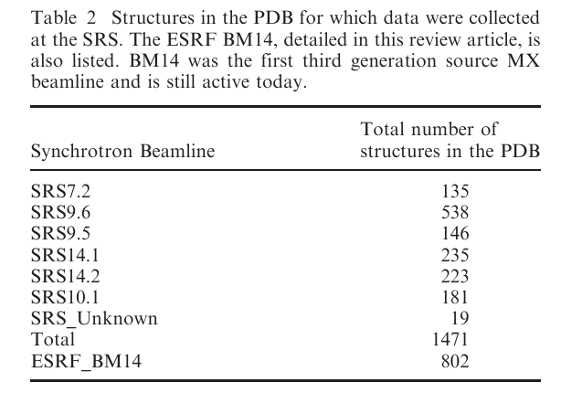
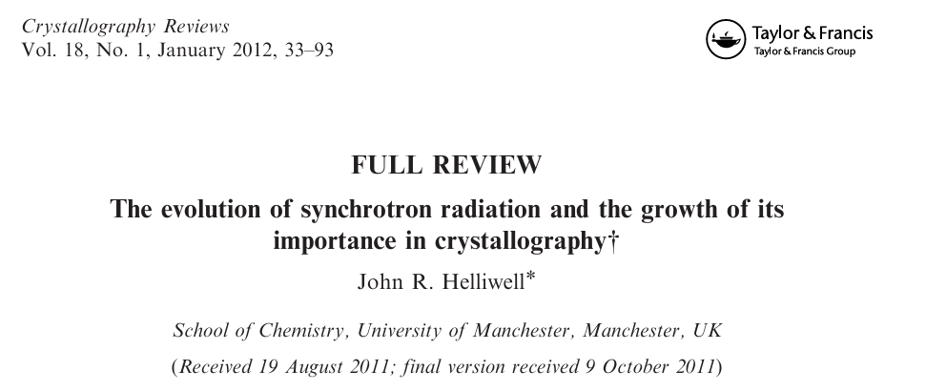
Academia: UK but also EU access schemes

Slide 8
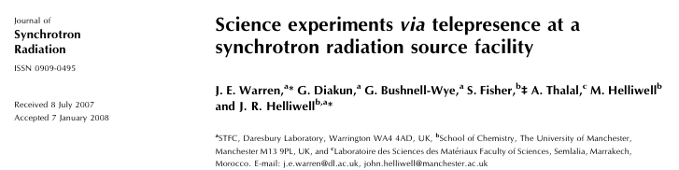
The Global Instrumentation Commons: Low- and Middle-income countries
Try to help resolve the power asymmetry between Global North and Global South

Slide 9
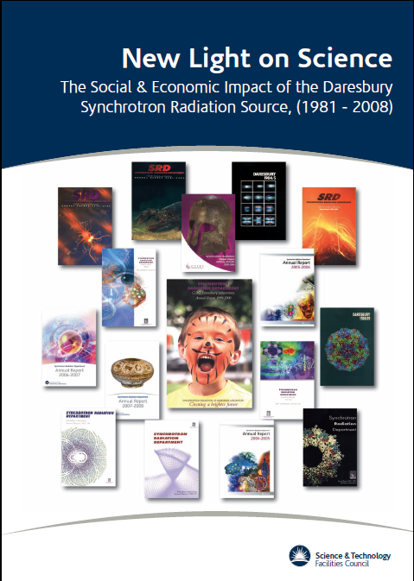
Daresbury Analytical and Research Technical Services (DARTS) for industry; an important aspect of the Economic Impact of the SRS

Slide 10
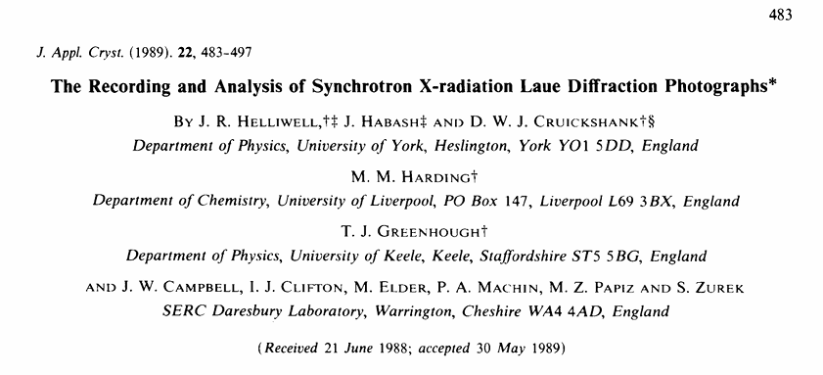
Open software
Open-source code from the outset,
harnessed not only at other synchrotrons
notably ESRF but also neutron sources
Worldwide. In about 2020 the source code was
not easy to find so>>>>>

Slide 11
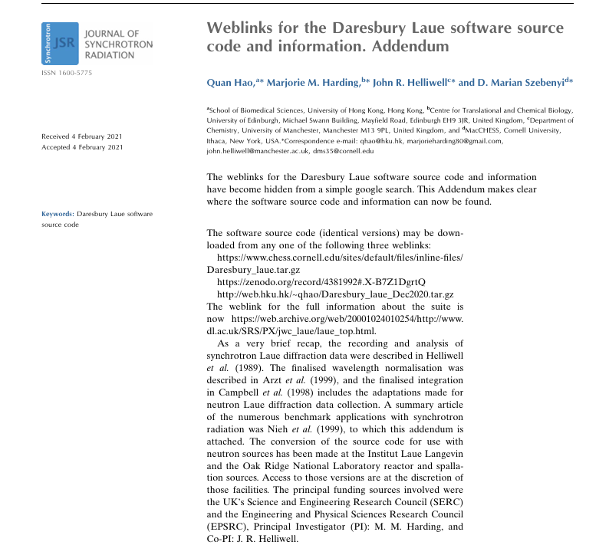

Slide 12
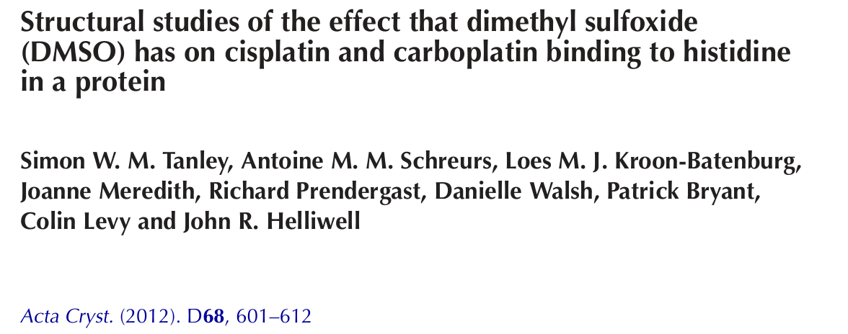
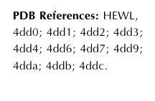
Research: Open processed data and derived molecular models into the PDB

Slide 13
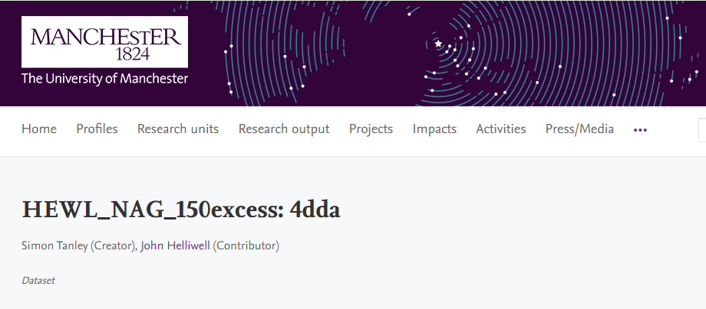
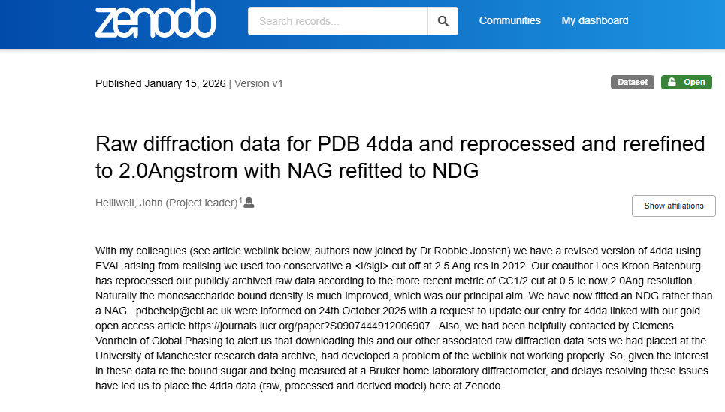
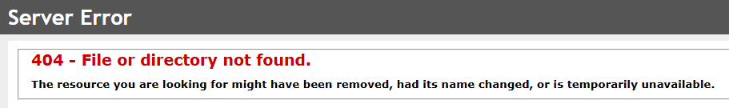
Research: Open raw diffraction data
2026
2012
Alerted “unavailable” 2025, so>>>>>

Slide 14
My unpublished research
Two out of 100 or so synchrotron experiments at SRS and also ESRF, and several the ILL neutron source ie ~98 published
I see no point releasing those two unpublished studies’ folders of raw data, as they would just waste other researchers time, although not actually mislead as they were ‘basic science’ of interest just to academic colleagues.

Slide 15
I assume roles at international synchrotron and neutron facilities on Advisory Committees
ESRP and ESRF (from 1985 to about 2002)
APS (from 2003 to 2007)
Gigayen neutrons project Japan
Institut Laue Langevin Neutron beams in Biology
Spanish Synchrotron ALBA
UK Physical Sciences Data Infrastructure (PSDI)
DAPNE4NFDI Germany (Data project)

Slide 16
I assume roles for IUCr as its Representative to
ICSTI
CODATA
UNESCO
ISC
Ie Global science organisation>>>>>

Slide 17
Global science organisation
Rising above the personal and national concerns are the international organisations. For crystallography this is IUCr of course.
Across all the sciences and wider we have the UN and its subsidiaries UNESCO and the International Science Council and its committee for data, CODATA. IUCr sends representatives to these bodies.

Slide 18
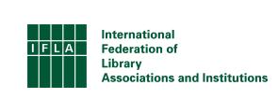
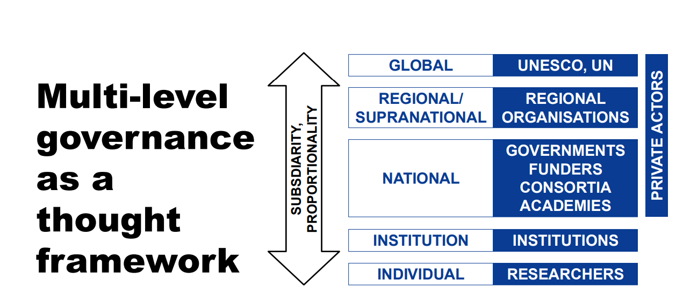
At UN Open Science and Knowledge conference Oct 2025 Tokyo
“private actors” is a UNESCO term, it means:
Any non-state entity — including universities when acting commercially — whose incentives may conflict with
the public-good provision of education.

Slide 19
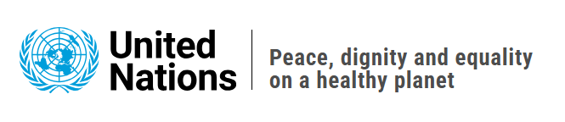
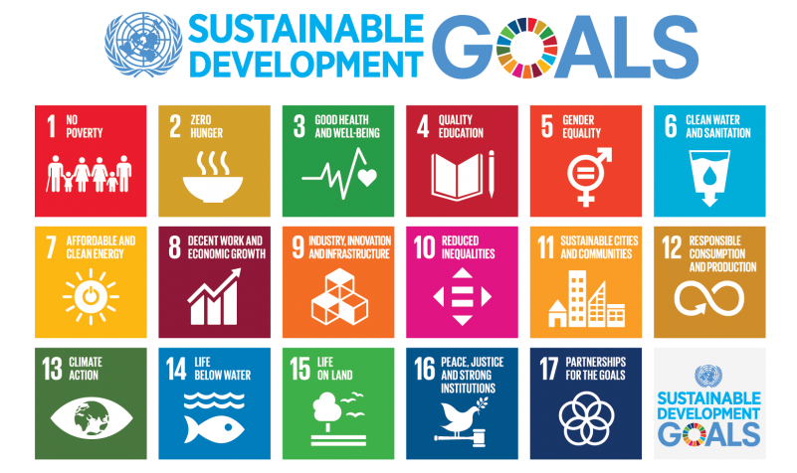

Slide 20
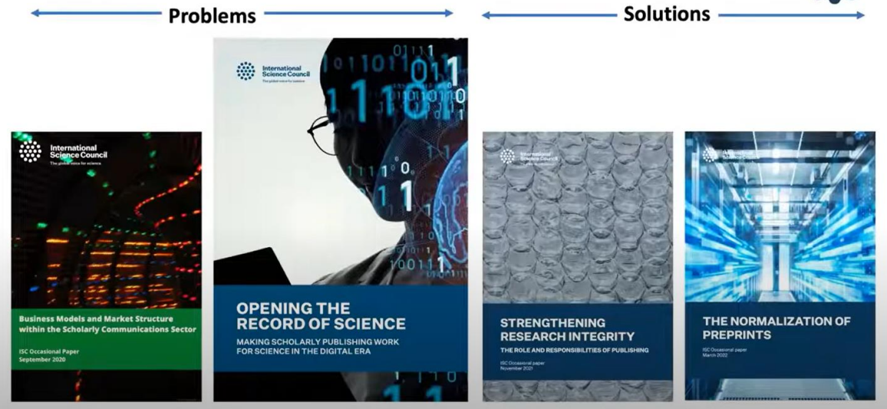
International Science Council’s
Work on Open Science

Slide 21
Conclusions, by category>>>>

Slide 22
What have I found at these organisations?
The UN is keen to engage with “private actors” eg see its recent Pact for the Future as well as its SDG9
UNESCO and the ISC are shy of industry and highly suspicious of commerce and especially commercial publishers. They have little to no experience and do not effectively guide its adherents to the Open Science principles it espouses
Indigenous peoples have insisted that in the UNESCO and ISC mission statement of “as open as possible as closed as necessary” they are in the closed category otherwise ‘Open Science’ is just another form of colonialism. The UN and UNESCO accept this, ie recognising the indigenous peoples’ worries over the “power asymmetry of the global north over the global south”

Slide 23
Who will solve societal challenges?
Climate change; industry finding solutions such as electric vehicles or hydrogen cars
Diseases; industry finding solutions with new drugs
Productive employment; industry
But the Global South is poor; this leads to neglected tropical diseases, Poor infrastructure
Synchrotron analytical services are harnessed by industry; confidentiality is a must, hence paid-for-beamtime>>>>>>>>

Slide 24
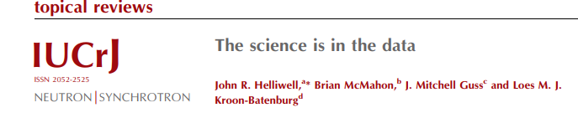
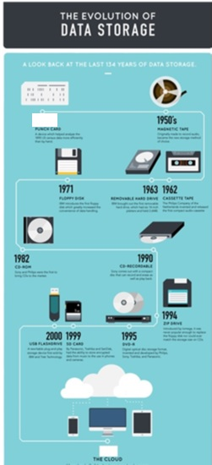
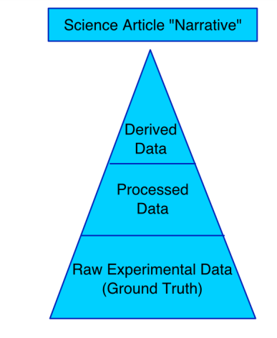
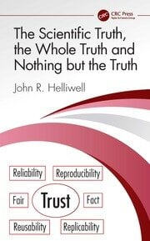
Today we can start to include our raw data as part of our preserved workflow
A big impact for Trust in Science: Case studies here:-
Subjective
1940s
Digital data
storage capability
Objective£
2020
£ Nb an instrument must be calibrated by a person and this leaves some degree of subjectivity

Slide 25
My own shortcomings
I do not publish my negative experiments’ raw data; this is being caught now anyway by mainland Europe’s PaNOSC raw data release policy with automatic release after 3 years
I have not obviously specified the false positives I report but am trying to rectify that:-
  biological structures at a living system temperature (37C) where possible
  complete structures ie an nMX structure to accompany an X-ray MX structure where possible
  But, so far, I offer no cross check with another method ie studying my structures in solution rather than in crystallo such as with solution NMR or ‘near native state’ cryo sample EM (‘cryoEM’)

Slide 26
Thankyou

