Slide 1
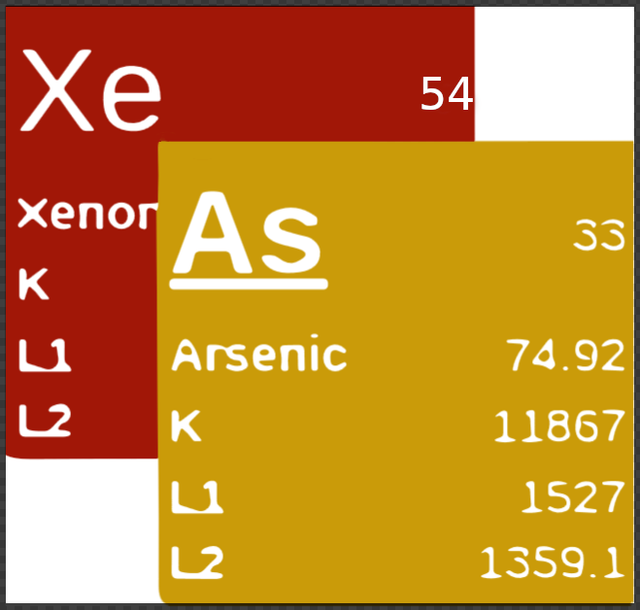

XASDB and Beyond: Modernizing Data Accessibility at the Canadian Light Source
Denis Spasyuk
IUCr Workshop 012 - From Open Data to Global Open Science
Aug 11th, 2026

Slide 2

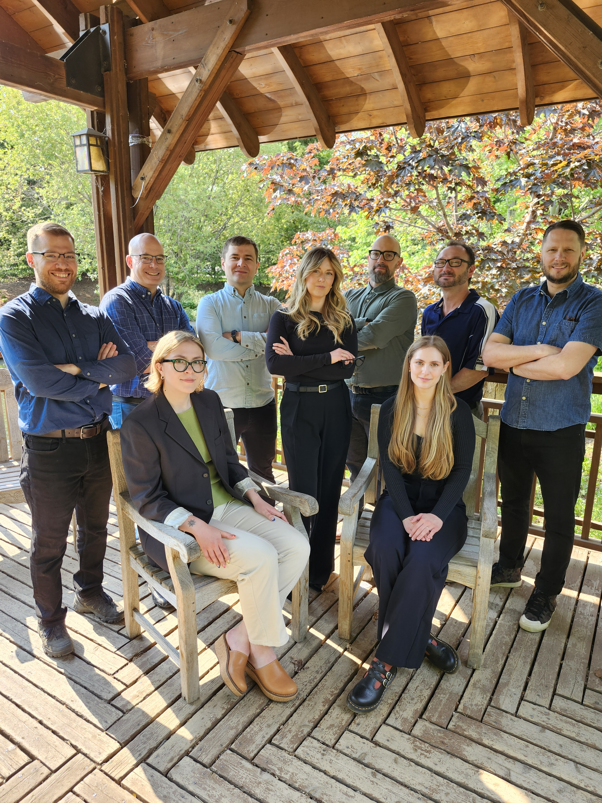
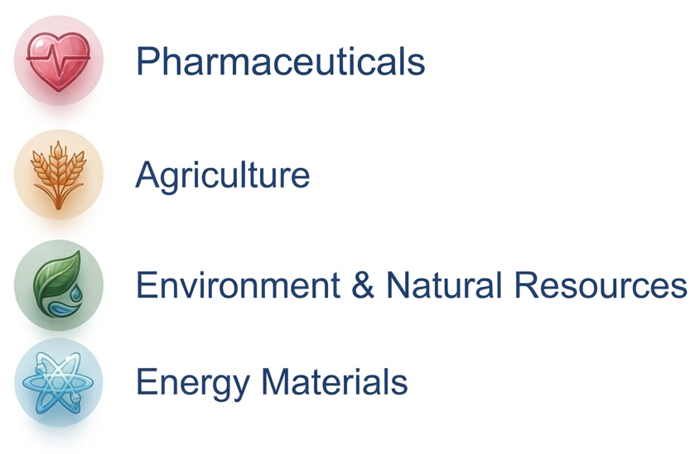
XASDB -Introduction
Industry Services Group (ISG)
XASDB started in the ISG group at the CLS to organize XAS reference data
Key Areas of Interest:
https://www.lightsource.ca
XASDB — xasdb.lightsource.ca | CC BY 4.0

Slide 3
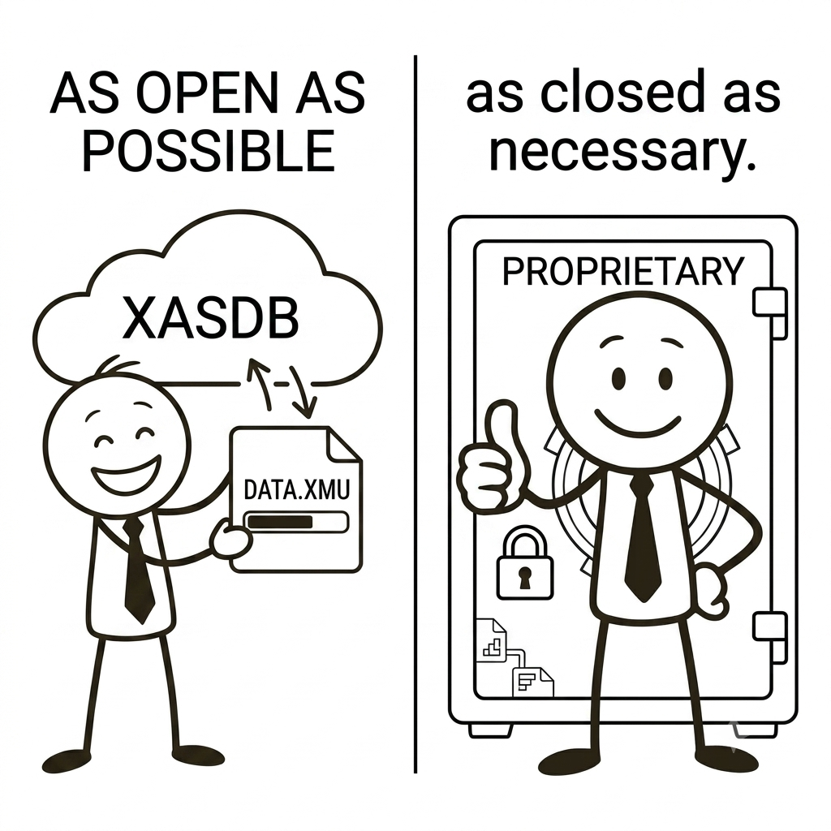



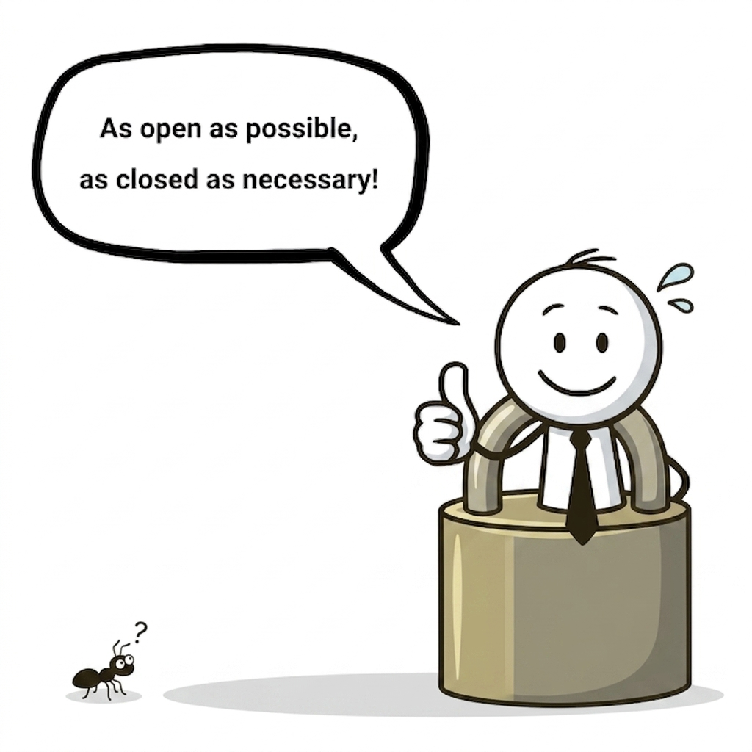
XASDB adopts
Tri-Agency Research Data Management Policy
This framework is not designed to force absolute open data, but rather to ensure that publicly funded research data is securely preserved, discoverable, and responsibly shared under the philosophy of:
"As open as possible, as closed as necessary."
XASDB — xasdb.lightsource.ca | CC BY 4.0

Slide 4


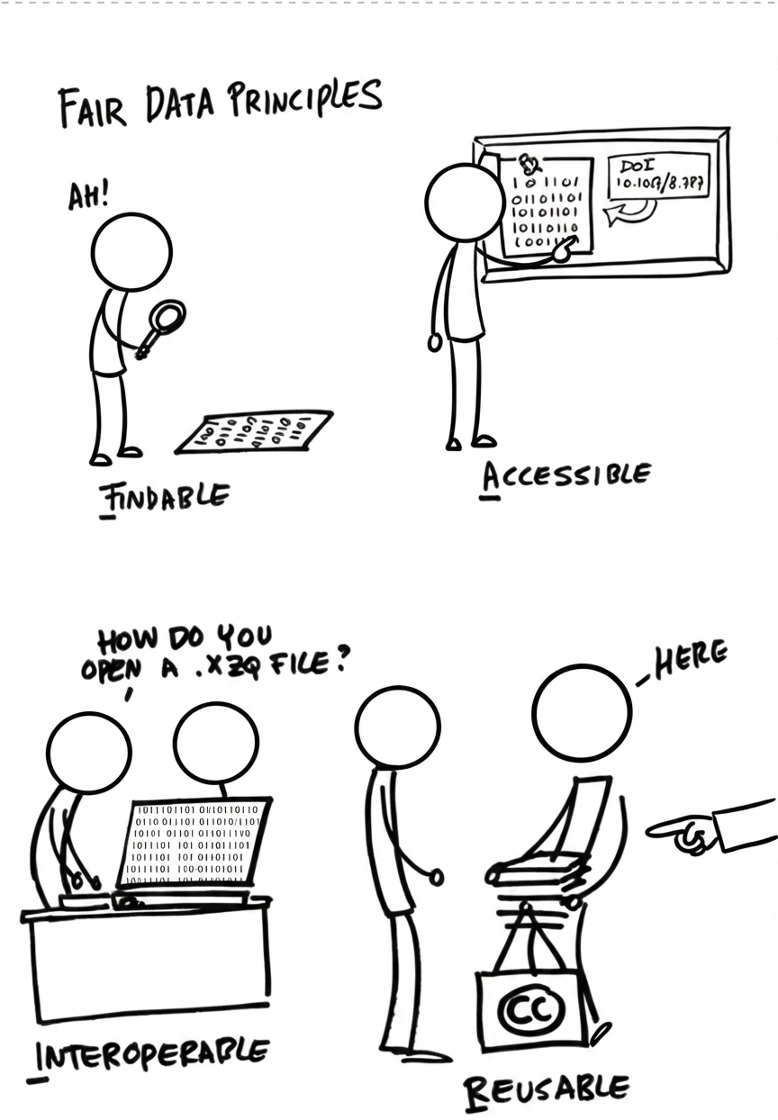

Principle 1: FAIR
F
Findable
A
Accessible
Datasets and metadata must be described with rich, persistent identifiers so they are easily discoverable by both humans and computer algorithms.
Data must be retrievable using standardized, open, and secure communication protocols, allowing clear access permissions.
I
Interoperable
R
Reusable
The data must be structured to naturally integrate and cooperate with other datasets, software applications, and workflows.
Proper licensing and rich documentation are essential to ensure future researchers can repurpose and replicate the findings safely.
XASDB — xasdb.lightsource.ca | CC BY 4.0

Slide 5



Principles 2 & 3: Deposit & Retention
PRINCIPLE 2: DATA DEPOSIT
Deposited to a Recognized Digital Repository
Grant recipients must deposit all digital research data into a recognized digital repository.
Supported Canadian platforms include FRDR (Federated Research Data Repository) and Borealis.
PRINCIPLE 3: MINIMUM RETENTION
5
YEARS POST-GRANT
All deposited datasets must be securely maintained and kept available for at least five years after the formal conclusion of the grant.
XASDB — xasdb.lightsource.ca | CC BY 4.0

Slide 6
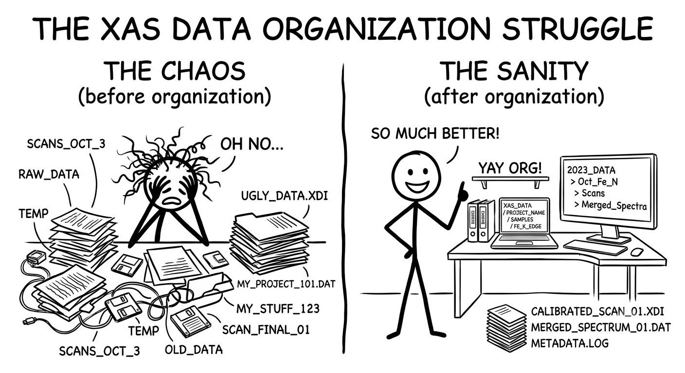
Motivations Behind XASDB
1
Data organization
XASDB — xasdb.lightsource.ca | CC BY 4.0

Slide 7
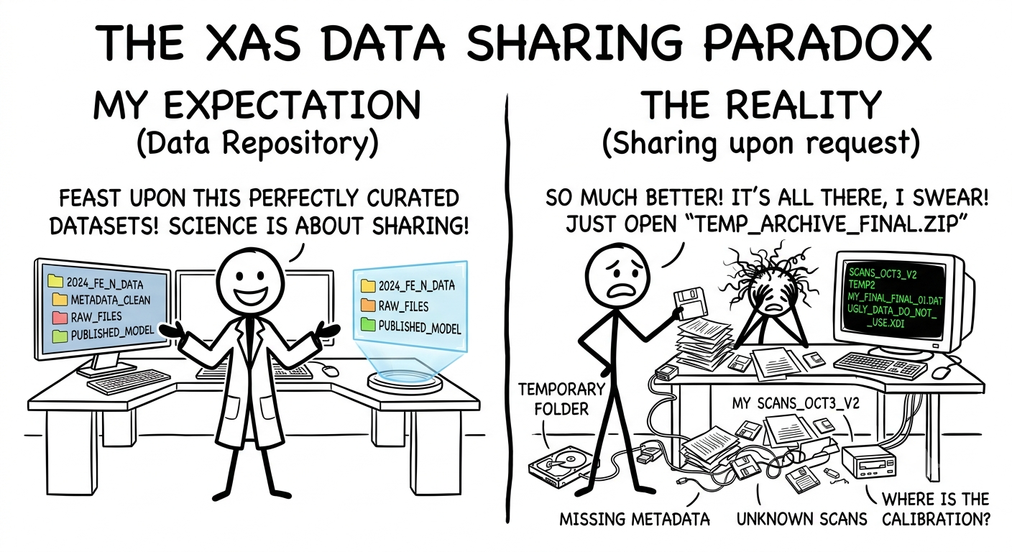
Motivations Behind XASDB
2
Data sharing and distribution
XASDB — xasdb.lightsource.ca | CC BY 4.0

Slide 8
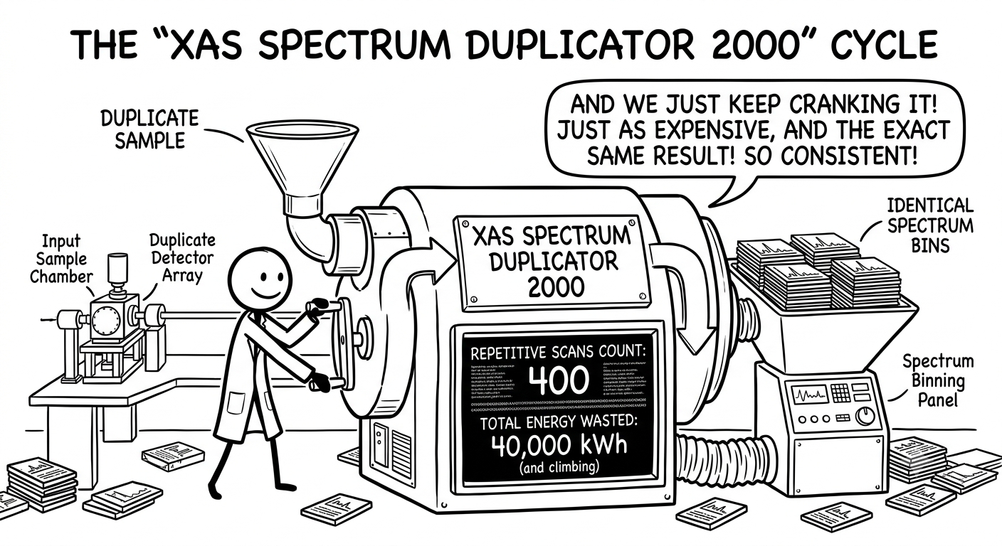
Motivations Behind XASDB
3
Avoid duplication of effort
XASDB — xasdb.lightsource.ca | CC BY 4.0

Slide 9
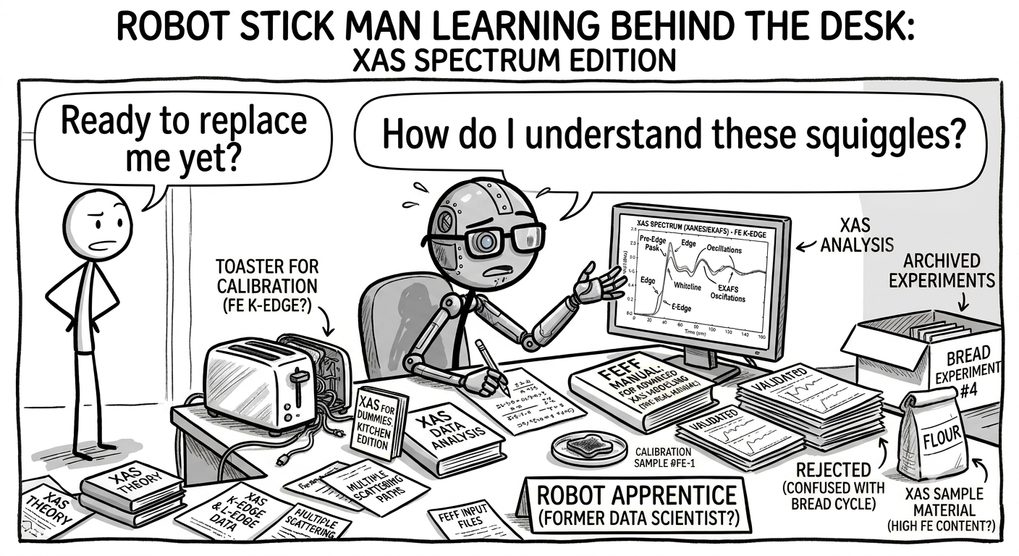
Motivations Behind XASDB
4
Machine learning (ML)
XASDB — xasdb.lightsource.ca | CC BY 4.0

Slide 10
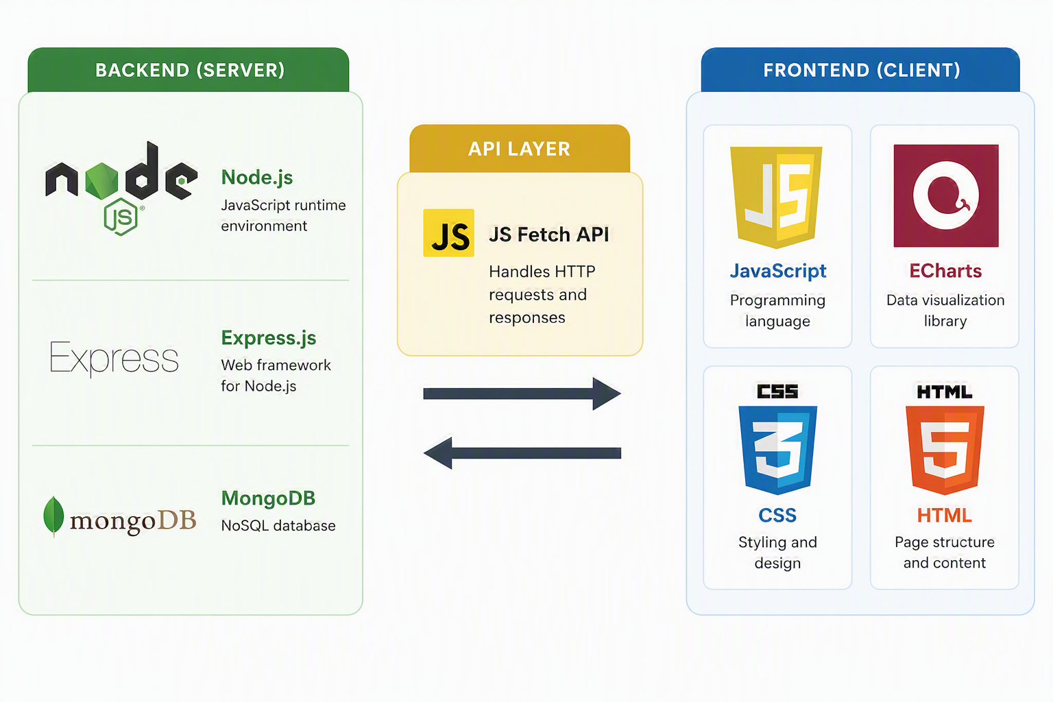
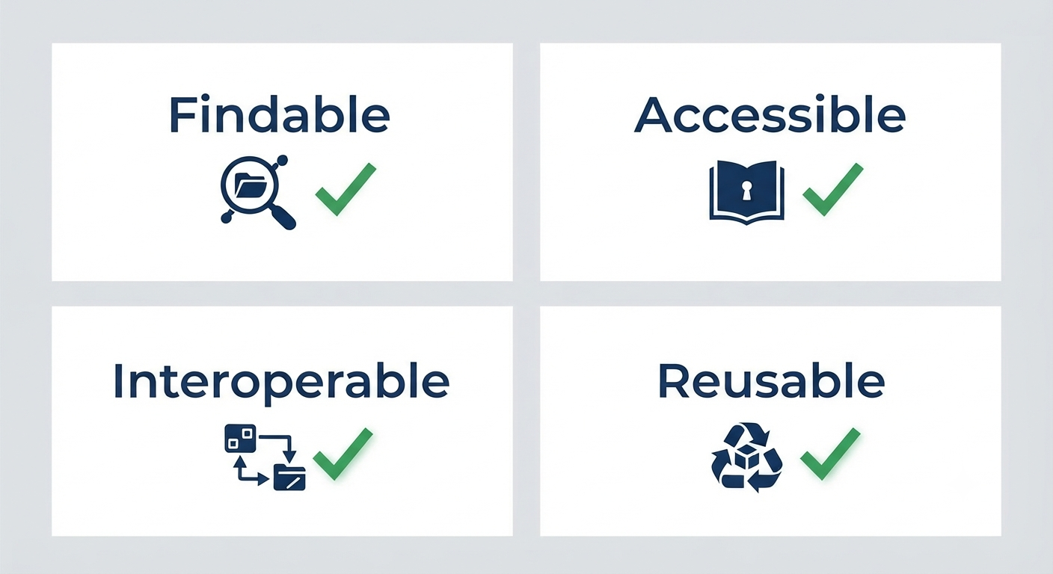
Main Programming
Components
Web Application
XASDB — xasdb.lightsource.ca | CC BY 4.0

Slide 11
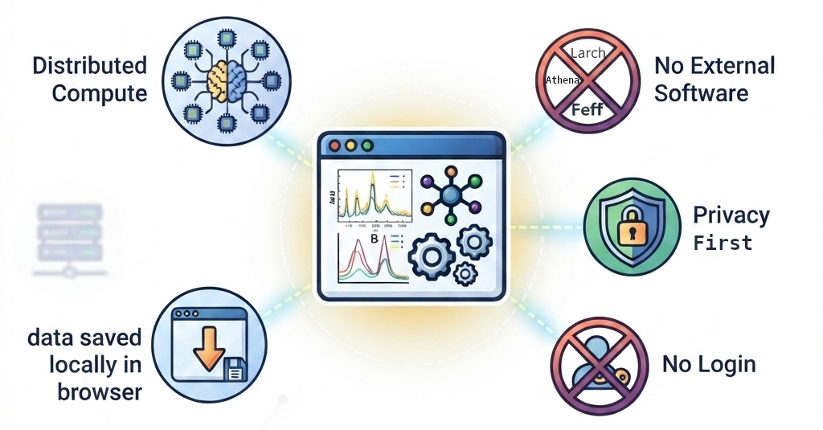
XASDB
Frontend
All computations are done on the a Client Side (Frontend)
XASDB — xasdb.lightsource.ca | CC BY 4.0

Slide 12
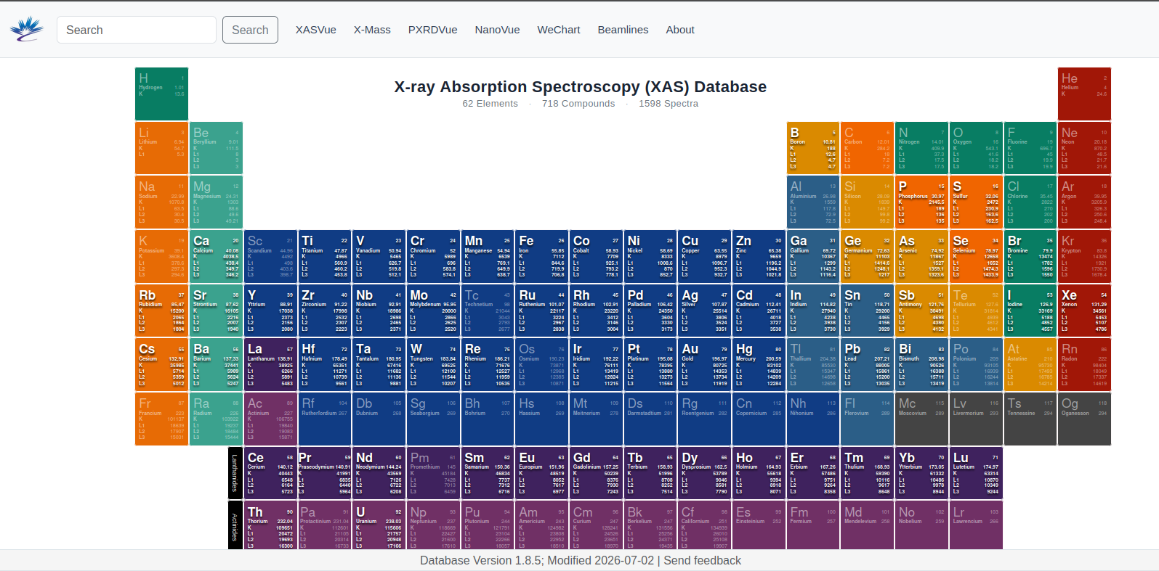
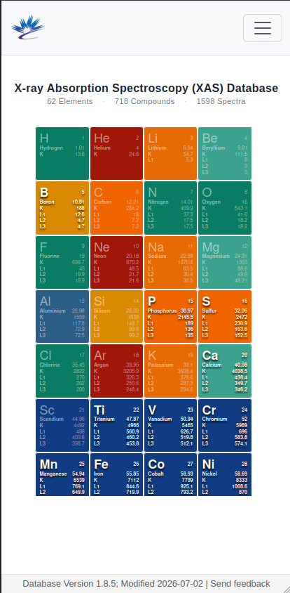
XAS Database
xasdb.lightsource.ca
Main Interface
Desktop View
Mobile View
XASDB — xasdb.lightsource.ca | CC BY 4.0

Slide 13
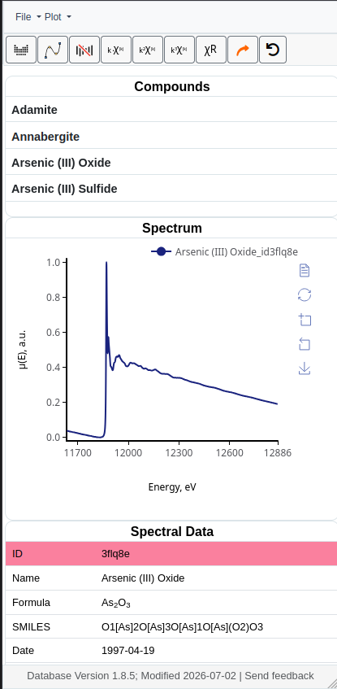
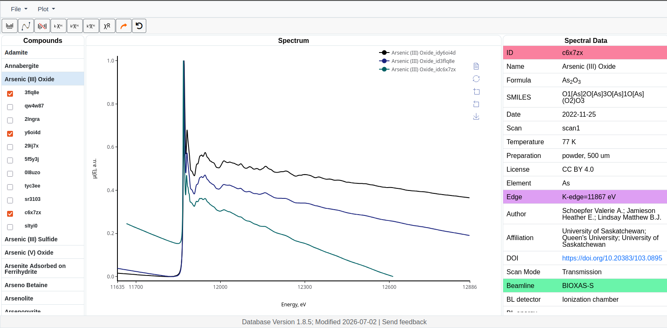
Database explorer
Spectra List
Spectrum Viewer
Metadata Panel
Mobile View
XASDB — xasdb.lightsource.ca | CC BY 4.0

Slide 14
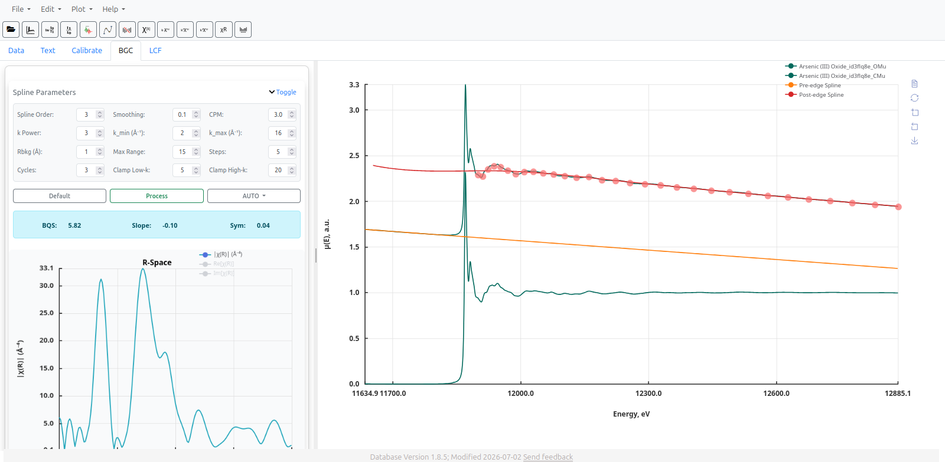
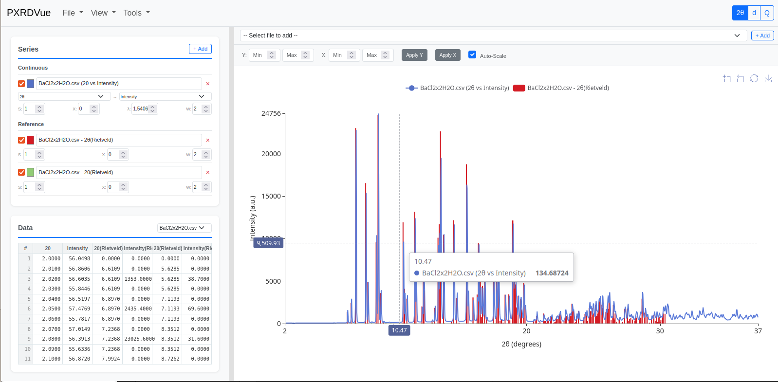
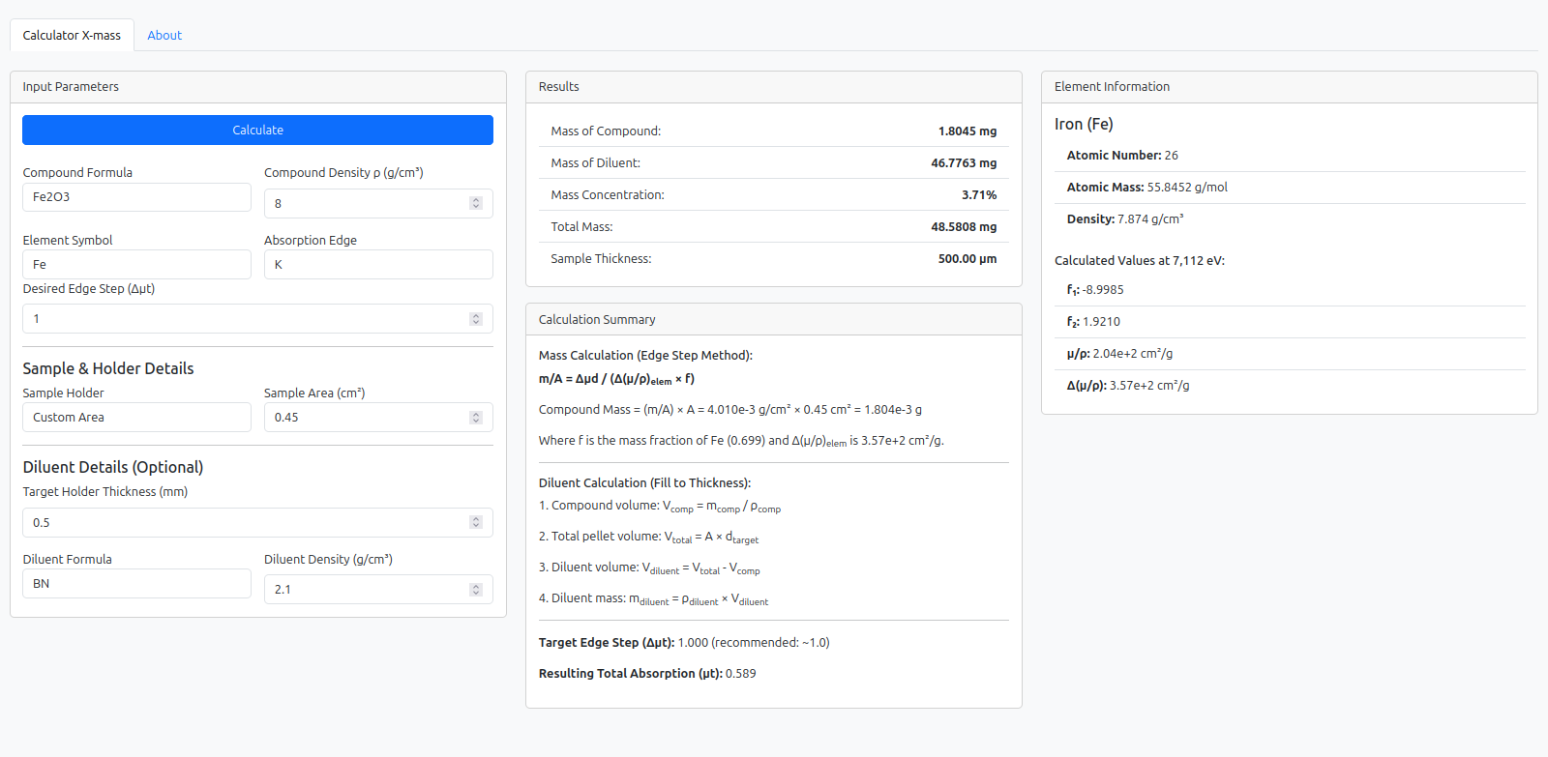
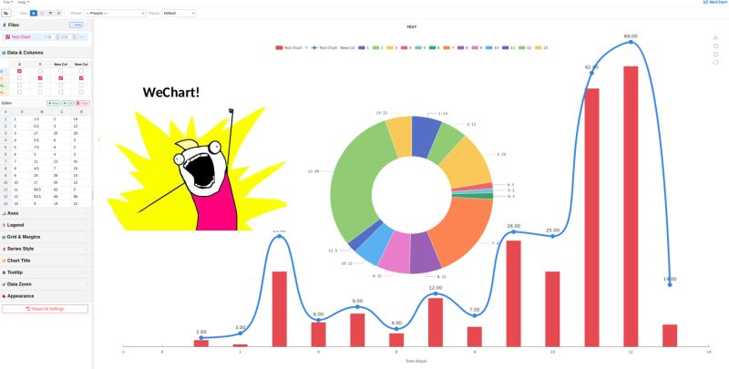
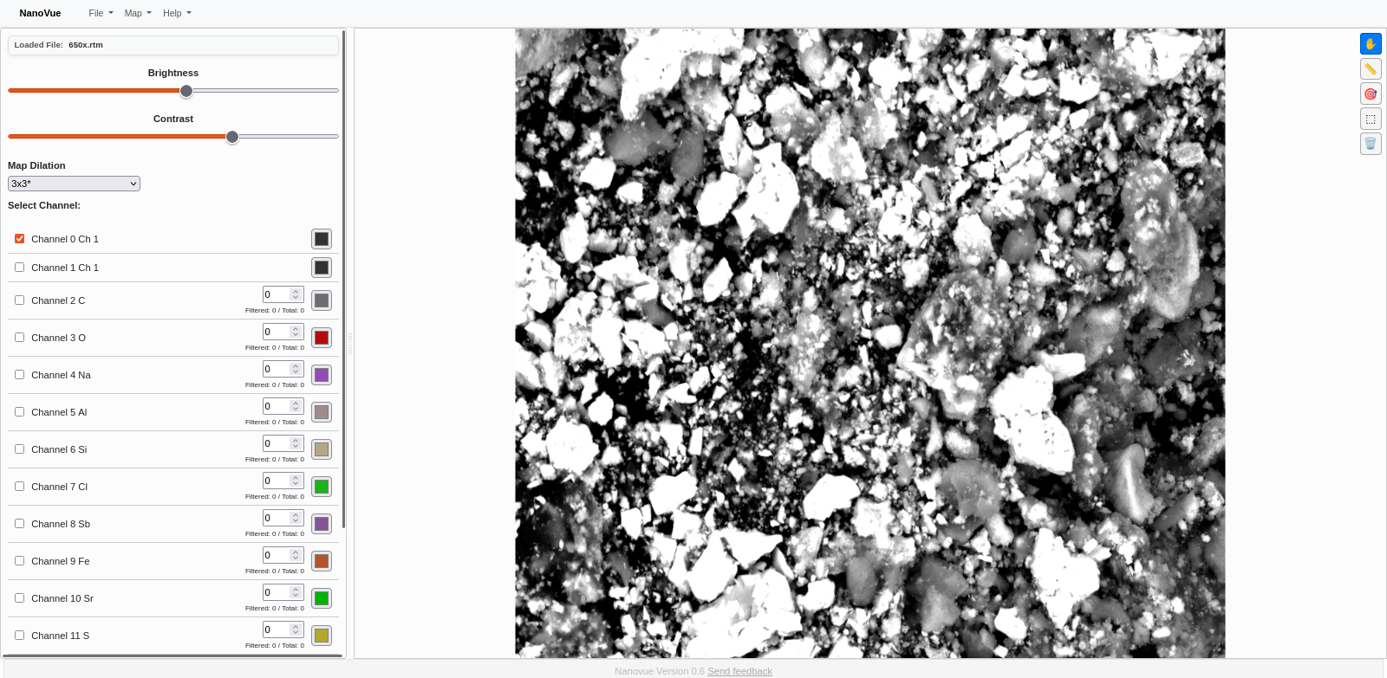
Main Programs in XASDB application
XasVue
Database Explorer
PXRDVue
X-Mass
WeChart
NanoVue (Maps and XRF)

Slide 15
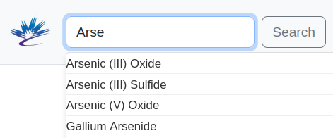
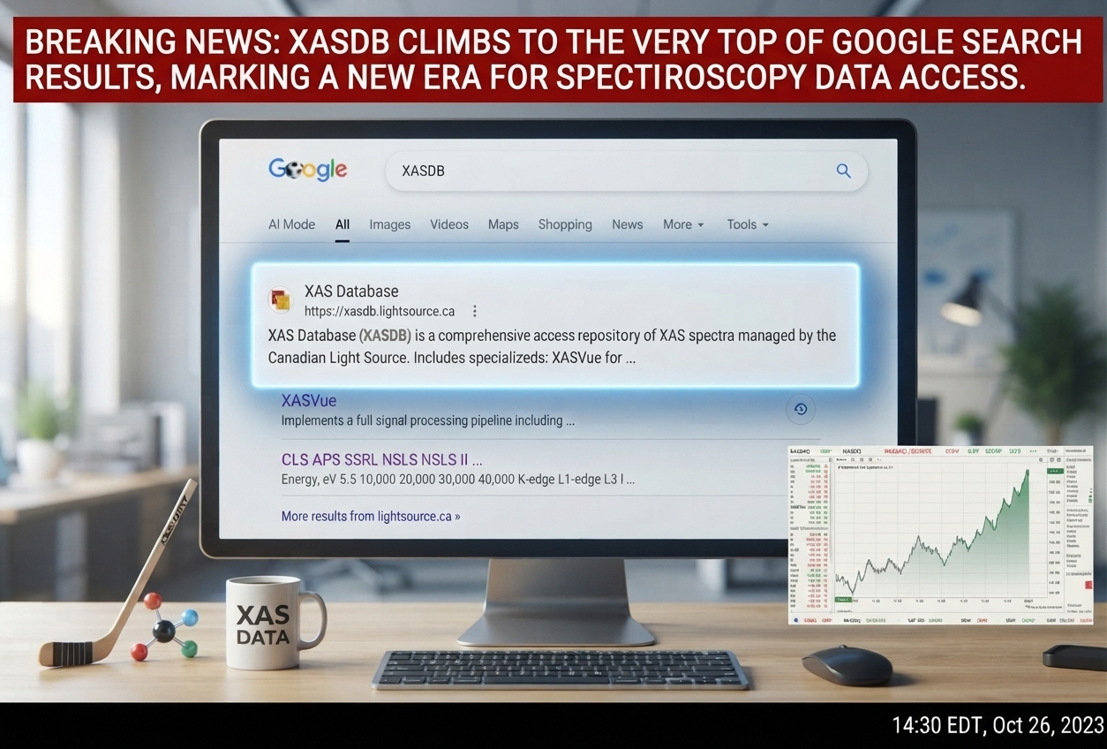
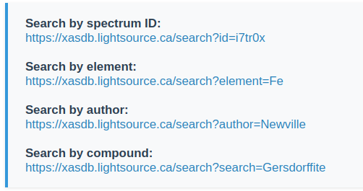
Database Search
Search via UI:
Search by:
Element
Compound
Spectrum ID
Author Names
Beamline
Search via API:
Application programmable interface
XASDB — xasdb.lightsource.ca | CC BY 4.0

Slide 16
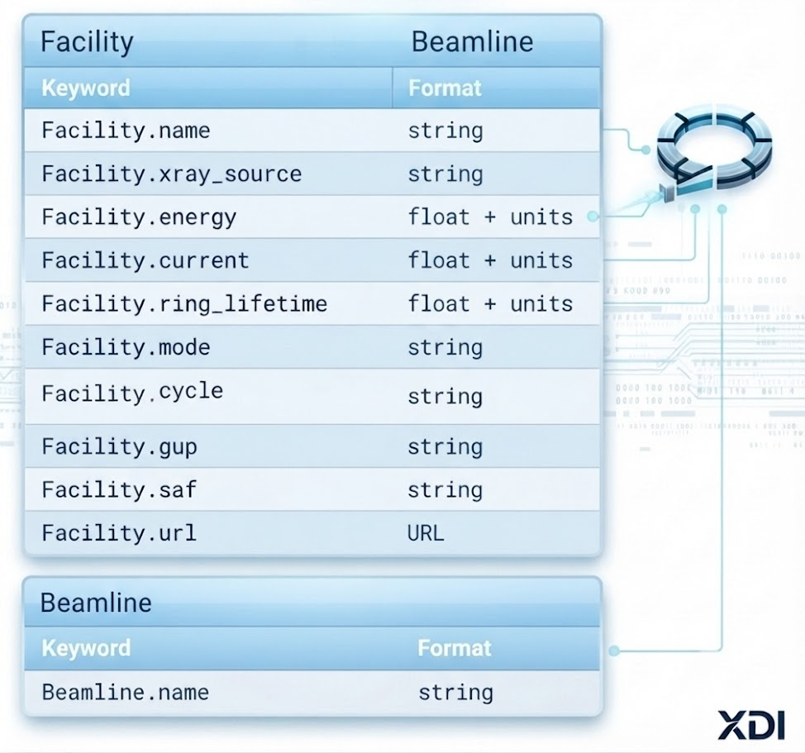
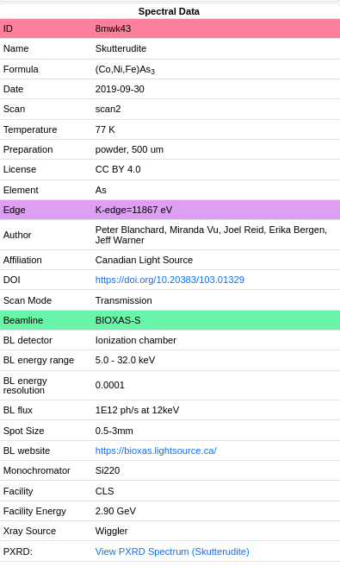
Metadata and XDI
XDI File Format
Metadata
• Newville, M. (2024) XAS Data Interchange (XDI) Format Specification v1.0. GitHub: XraySpectroscopy/XAS-Data-Interchange
• Newville, M. Larch: An Analysis Package for XAFS and Related Spectroscopies. https://xraypy.github.io/xraylarch/
• Newville, M. (2013) Larch: An Analysis Package for XAFS and Related Spectroscopies. PMC4971576
XASDB — xasdb.lightsource.ca | CC BY 4.0

Slide 17
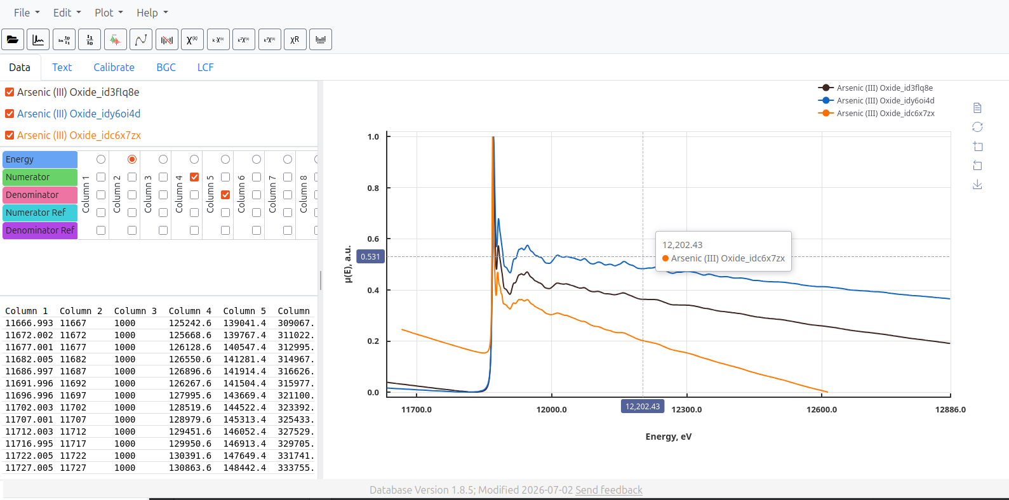
Dynamic Data
Dynamic Immutable Data not Static Images or PDFs
XASDB — xasdb.lightsource.ca | CC BY 4.0

Slide 18
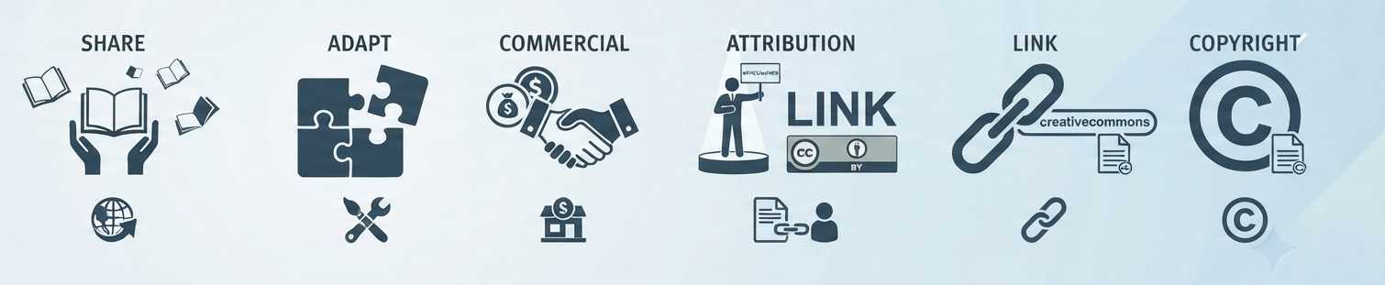
Reusable Data
Clear Open Licence Policy (CC BY 4.0)
Clear Data Format (XDI)
XDI ensures reusability by providing a standardized, machine-readable format that enables seamless data integration across different software and research platforms.
Accurate Metadata
Accurate metadata makes data reusable by providing the necessary context and parameters for others to correctly interpret, reproduce, or build upon experiments without needing further explanation.
XASDB — xasdb.lightsource.ca | CC BY 4.0

Slide 19


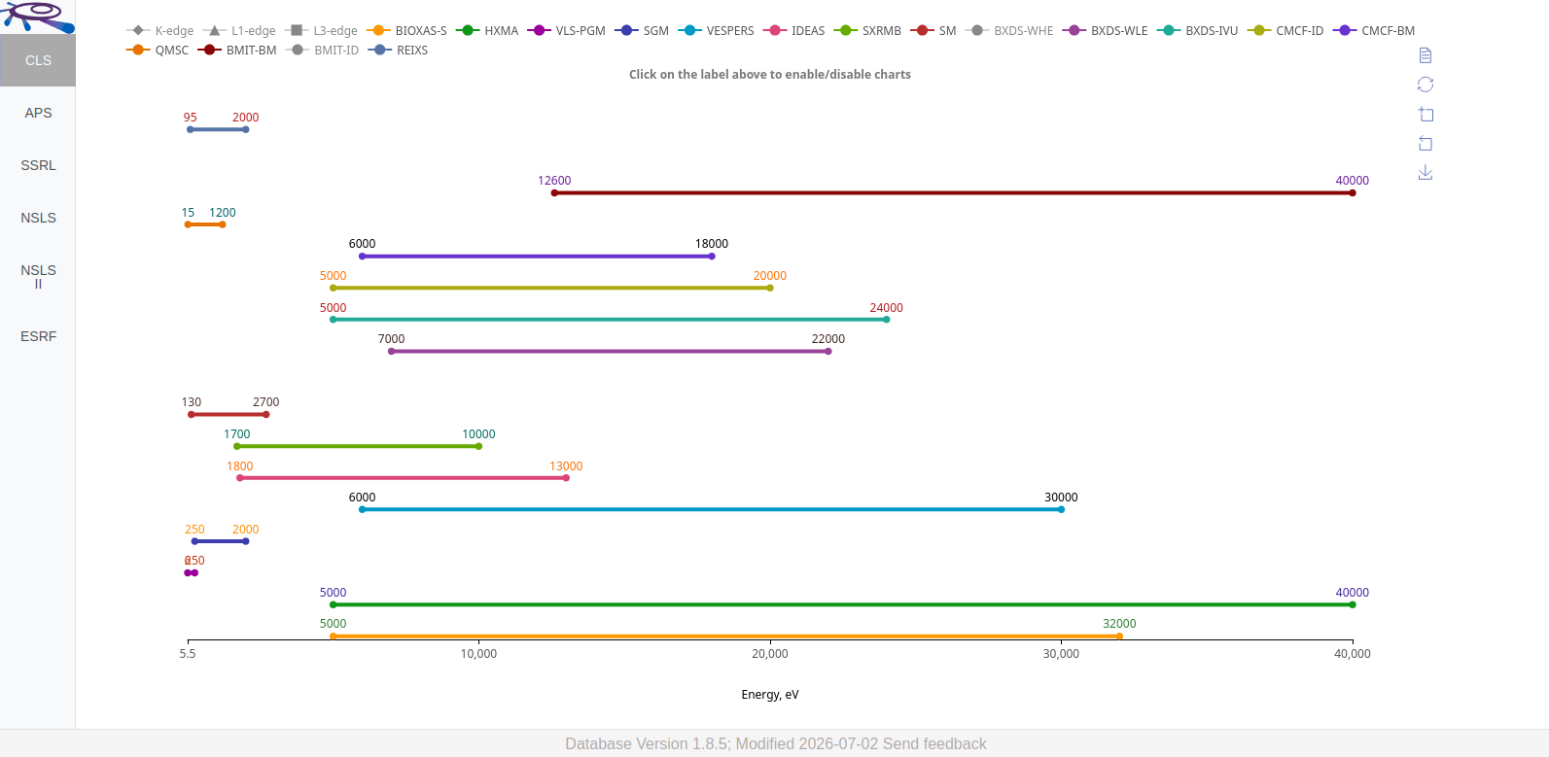




Beamlines and Facilities
Contributing beamlines viewer and their energy ranges

Slide 20

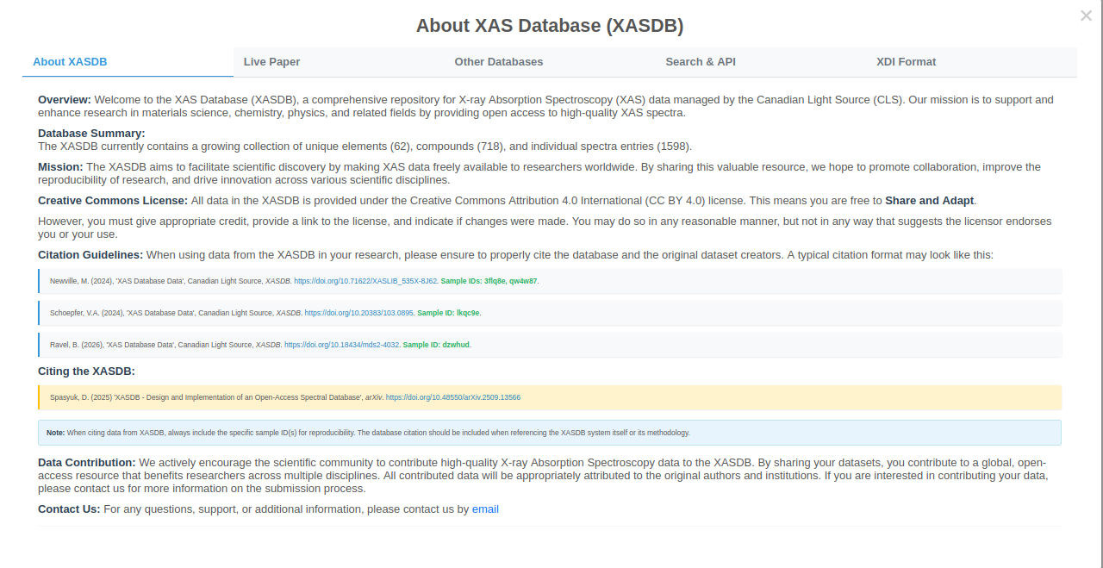
More information?
Look in about

Slide 21
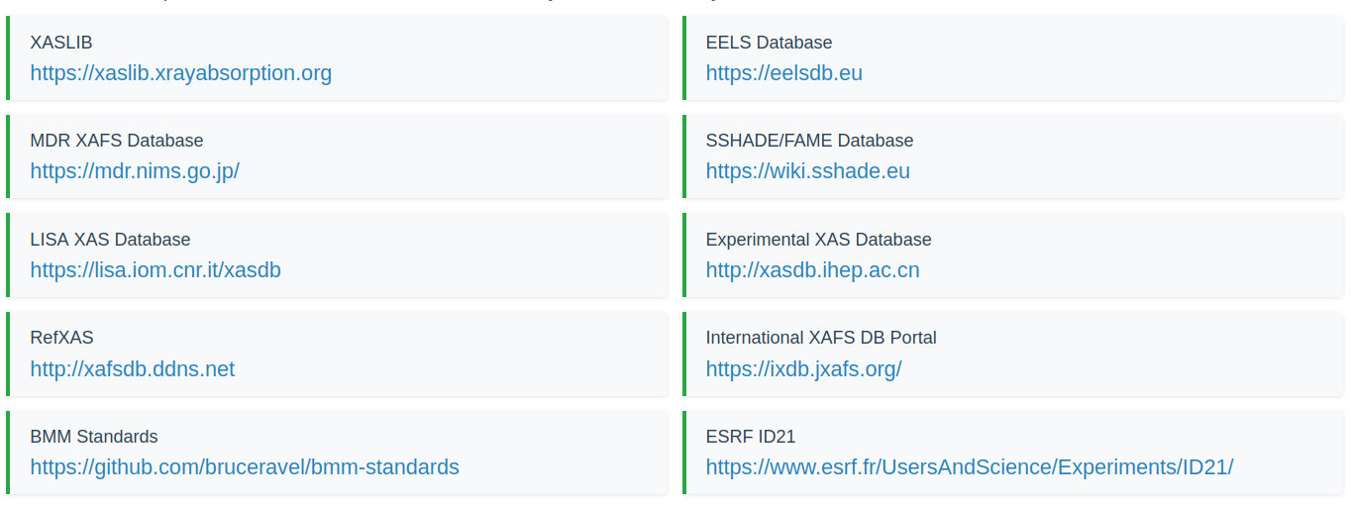
Other Databases

Slide 22


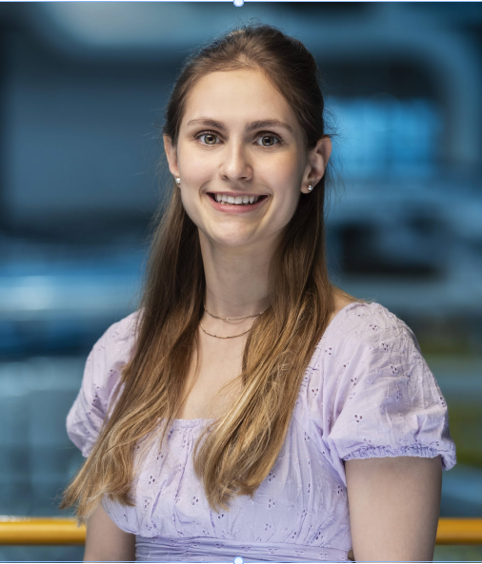
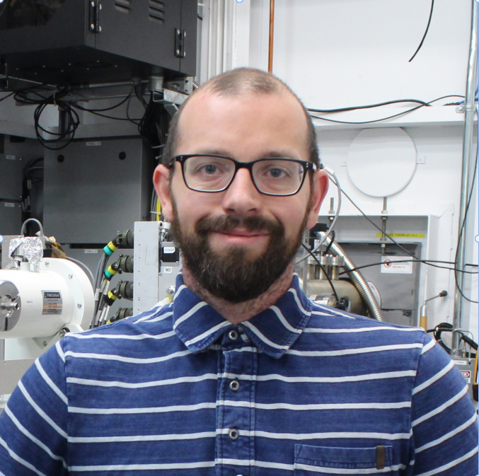
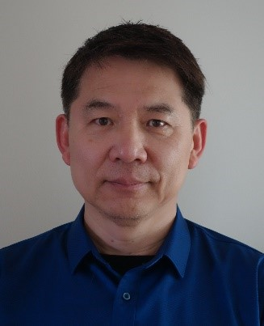


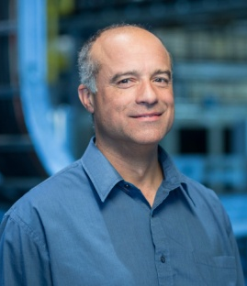
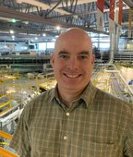
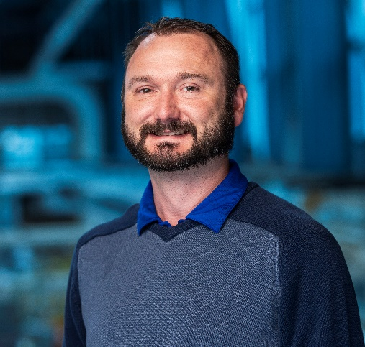
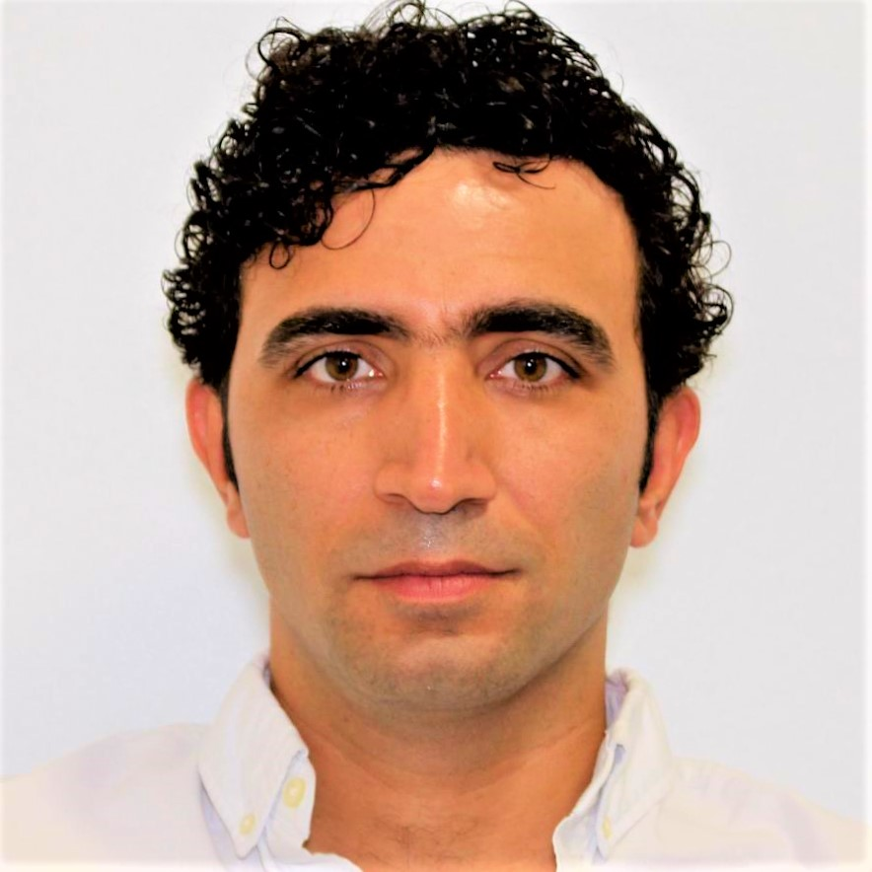
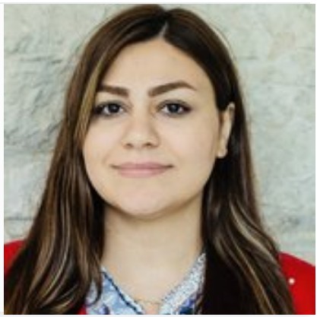
Acknowledgments
Danielle Veikle
Erika Bergen
Miranda Vu
Peter Blanchard
Ning Chen
Morgane Desmau
Amani Ebrahim
Jeff Warner
Joel Reid
Kurt Nienaber
Mohsen Shakouri
Mehrnaz Mikhchian
Schoepfer Valerie, Jamieson Heather, Lindsay Matthew, Yuanming Pan, Jinru Lin, Matt Newill, Bruce Ravel, Alessandro Puri, Marine Cotte

Slide 23
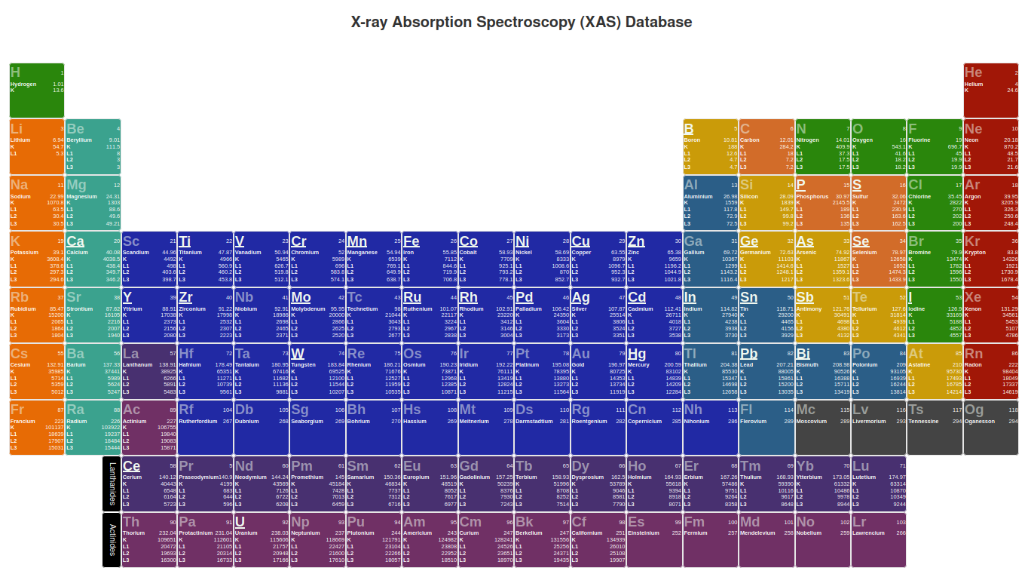
DEMO
https://xasdb.lightsource.ca

