Slide 1

The state of Open Science in the UK
From Open Data to Global Open Science
11th August 2026
Simon Coles
University of Southampton, UK
https://www.psdi.ac.uk/

Slide 2
RCUK 2013 Data Policy
The Common Principles on Data Policy mandate
  Publicly funded research data must be openly accessible to the maximum extent possible.
  Data underpinning published findings must be preserved and shared to support research integrity, transparency, and validation.
Key requirements and principles:
  Statement of Access: Publications must include a data access statement describing how and where the underlying data, samples, or models can be accessed.
  Data Preservation: Data that validates research findings should be safely preserved and, where appropriate, made publicly available for a minimum of 10 years.
  Justifiable Restrictions: Making data "open" is the default expectation, but not if there are legitimate ethical, legal, or commercial reasons (e.g., patient confidentiality, intellectual property).
  Exclusive Use: Researchers are entitled to a period of exclusive use of their generated data, but this right typically extends only up to the point of publication.
  Data Management Plans: Researchers must create robust data management plans as part of their grant proposals to detail how data will be captured, stored, and curated.

Slide 3
Domain Perspectives
Each of the 7 Research Councils have their own take on the RCUK Common Principles on Data policy
EPSRC Policy Framework on Research Data – actually dates back to 2011
7 Core Principles
  Publicly funded research data should generally be made as widely and freely available as possible in a timely and responsible manner.
  The research process should not be damaged by the inappropriate release of such data.
Data should be preserved for 10 years FROM LAST ACCESS
Responsibility for data management lies with the institution, not the investigator

Slide 4
How was this perceived?
‘Put it in a repository’
Or maybe don’t put it in a repository
Is Open Science achievable this way?
Is this approach actually useful for driving Open Science?
Is this policy really implementable / practicable now?

Slide 5







Problems then – and now?
  EXPONENTIAL DATA GROWTH
  LOST DATA & OPPORTUNITIES
  COMMUNITY NEEDS
Research Data is growing exponentially, which could provide great opportunities but also poses significant challenges
Data is often poorly stored or described, making access and collaboration very difficult
Going forward there is a clear need for tools and training to support researchers
  FRAGMENTED RECORDING
  REPRODUCIBILITY CRISIS
Scientists have a fragmented approach to recording their data, leaving experiments scattered and inconsistent
A vast quantity of scientific research cannot be reproduced, re-used or built upon

Slide 6

2016 FAIR Principles
Incredibly well communicated
A ‘household name’ understandable by all
But have we become FAIR over the last decade?
What do the principles mean in practice?
Findable: PIDs, metadata, indexing (ID registered in a searchable resource).
Accessible: Standardised protocols (open, free & universally implementable), authorisation, metadata persistence.
Interoperable: Shared languages, controlled vocabularies, references.
Reusable: Clear licensing, provenance, community standards.

Slide 7
10 years on - Is FAIR data Open Data?
Data can be FAIR without being open, and Open Data is often not FAIR!
The Goal: FAIR aims to make data machine-readable and reusable; Open Data aims to make data publicly available.
Access: FAIR allows data to be closed or restricted due to privacy or security; Open Data should be accessible to anyone without restrictions.
The Target: FAIR designs data primarily for computer systems; Open Data is more for human access and transparency.
FAIR and Open: Gold standard - highly organised, machine-readable, and free to use. Barely any examples of this!
FAIR but Closed: Secure records with standardised vocabularies and strict metadata, but require authorised credentials to access. Journal articles – the way research is communicated!
Open but Not FAIR: A PDF on a public website - anyone can download, but machines cannot easily search, extract, or integrate the data. Supporting Information?!
Closed and Not FAIR: Private, unindexed files stored locally on a personal laptop. 95% of publicly funded research data!

Slide 8
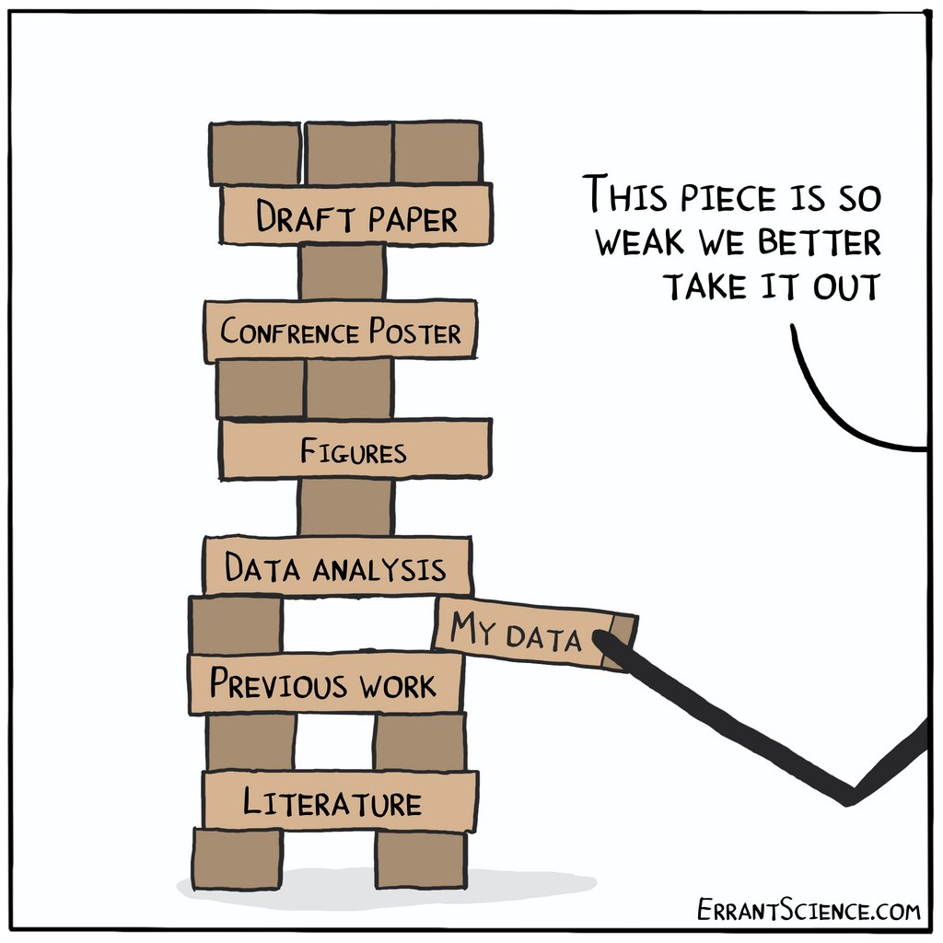
Current Barriers & Challenges to Open and Transparent Digital Research
Data
Standards
Software
Hardware
Cost
Time
Trust
People / Adoption
CC BY-ND 4.0 Errant Science - https://errantscience.com

Slide 9
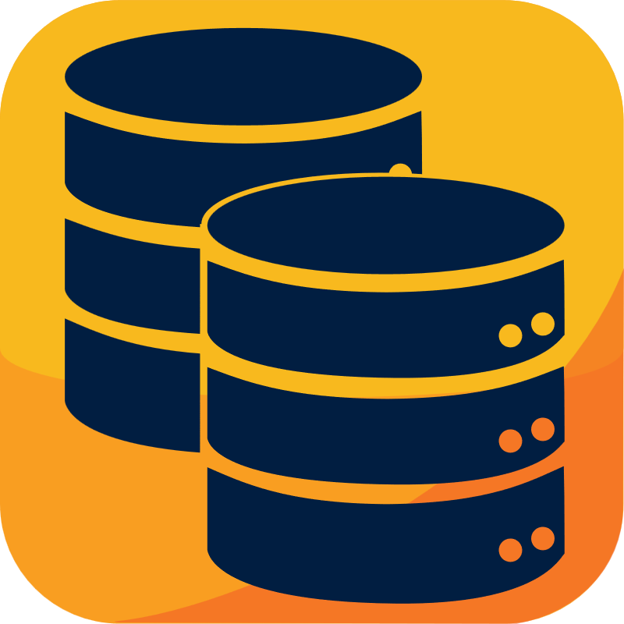


Open Science is not just a Technology problem
Data
Lack of access to reusable structured datasets
Un-FAIR Data
Data locked away in proprietary formats
Lack of metadata / provenance
Cost of storing data
Technology
Too many (and yet not enough) formats and standards
Complexity in selecting and adhering to standards
Lack of interoperability between software
People
Attitude and adoption of standards and principles
Lack of knowledge and skills around data management (need data stewards!)
Lack of time and human resource
Notes:
Nikki
The Driver
Data needs in research are growing at previously unimaginable rates and the need for collaboration around data has never been clearer. Data is not simply a research output, but a driver of further discovery across all research. However, in the Physical Sciences, many research bodies, from large facility to laboratory, have their own data infrastructure with limited ability to share, integrate and reuse data across systems.

Slide 10






Vision: We all generate and publish FAIR Open data
Re-use
Digitalisation
Experiment Design
FAIR Data
Electronic Lab Notebooks
Repositories
Common Standards
Standards
Disclosure/ Publication
Experiment/ Data Collection
Community
Data
Processing
Analysis

Slide 11

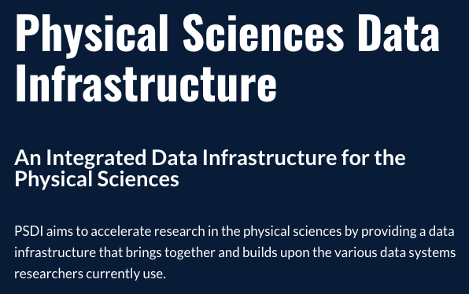
PSDI – the UK Solution?
UK funded project through the UKRI Digital Research Infrastructure theme (DRI) via EPSRC
Developed out of a community statement of need
Lead institutions: University of Southampton and Science and Technology Facilities Council (STFC)
First launch of resources are now live!
Notes:
Nikki:

Slide 12
Aim of PSDI
A data infrastructure that
connects existing
experimental and computational facilities
within Physical Sciences and beyond
A platform for data collection, sharing, aggregation, integration and curation
Supporting analysis across experimental, simulation and reference data
Combining and enhancing existing data infrastructures
Sustaining data resources beyond lifespan of individual research projects
What it isn’t:
A data dump for any
kind of data
Replacing existing facilities
An HPC facility
Notes:
Nikki
The Driver
Data needs in research are growing at previously unimaginable rates and the need for collaboration around data has never been clearer. Data is not simply a research output, but a driver of further discovery across all research. However, in the Physical Sciences, many research bodies, from large facility to laboratory, have their own data infrastructure with limited ability to share, integrate and reuse data across systems.

Slide 13

PSDI: filling a Gap in Provision
Other domains have established
provision in the UK, e.g.
EBI in Life Sciences
NERC Data centres in Environmental Science
UK Data Archive in Social Science
USA: Materials Genome Initiative
Japan: NIMS
European data infrastructures, e.g. E-CAM, MaX and NOMAD
German National Research Data Infrastructure (NFDI)
Other countries have initiatives
underway in this domain, e.g.
We are building a UK, Physical Science, Data Infrastructure
  Supporting UK Chemistry, Materials and related disciplines
  Interfacing to other domains:
    eg. Life, Medical, Engineering and Environmental Sciences
  Interfacing with international initiatives
Notes:
Nikki

Slide 14

PSDI Principles
Connecting existing infrastructures
Workflows to connect between systems
National and international collaboration
Best use of data
Find Data across multiple data sources (reference, experimental, simulation)
Better structured data & metadata
Reproducible data processing workflows
Best use of people
Community co-ordination
Build skills and providing training
Support and sharing guidance
Best use of technology
Deploying extensible tools and services
Use of standards and ontologies

Slide 15
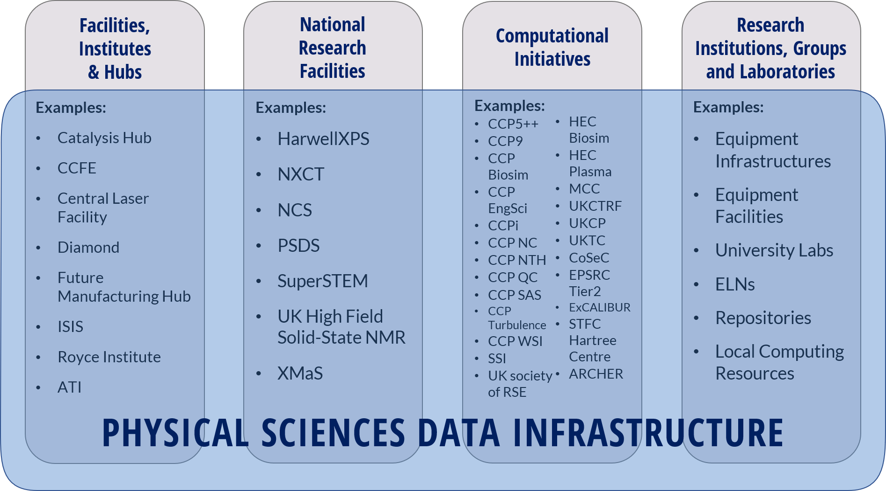
The bigger picture (just in the UK)

Slide 16






















Community and Partnerships
Notes:
Now, who have we worked with? It’s quite a big list. But what I want to mention is that all of these universities of the right, are our new partners who are onboarding this September from our first funding call. I’ll talk to you about their projects later.

Slide 17
Generating and Accessing Data Collections
Over 45 different data sources
Community Data Collections
Reference quality open and licensed data
Including:
Licensed data sources
Propersea (Property Prediction)
Chemical Availability Search (ChASe)
Chemotion
STFC Open Data
Optimade data sources
Revived and legacy data sets
Cross Data Search Service

Slide 18



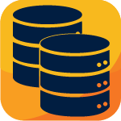


What does PSDI have available?
Data Services
Data Tools
Community
Underpinning services
Authentication &
Authorisation
Data Indexing
Containerisation
& deployment
Resource
Catalogue
Guidance,
Training &
Case Studies
Access to
Data Sources
Collaboration
Find our resources on www.psdi.ac.uk!

Slide 19
FAIR for the future?
Search and discovery
Tools to perform research
Supporting workflows
Data driven research
Autonomous labs
Underpinning AI/ML
Skills for researchers

Slide 20
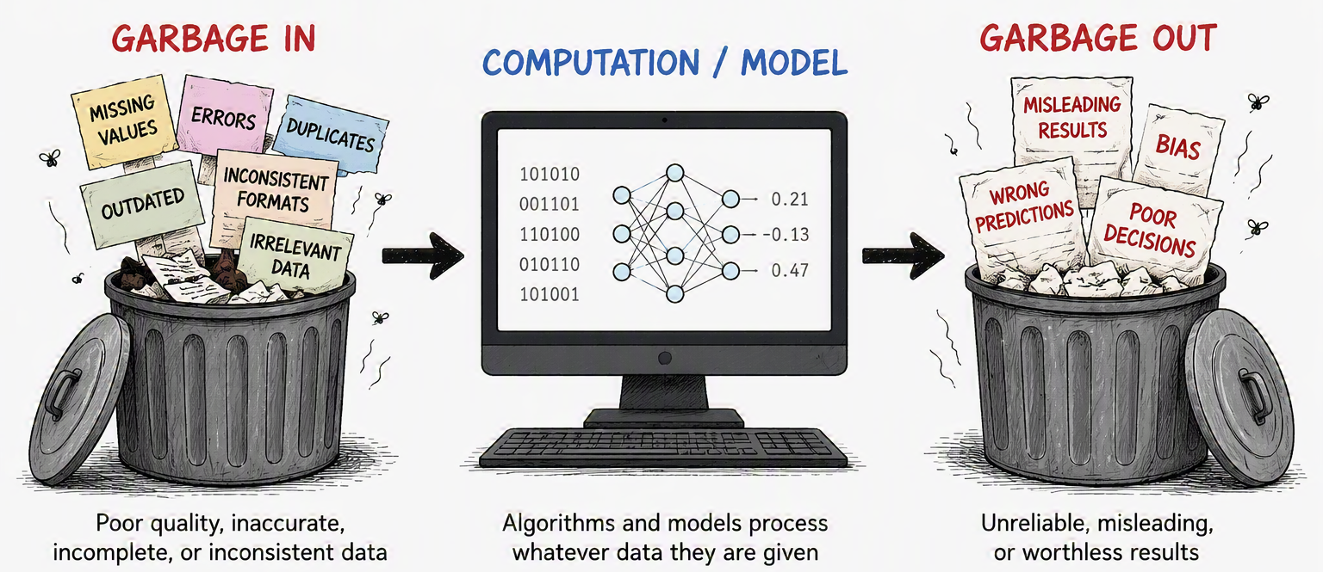
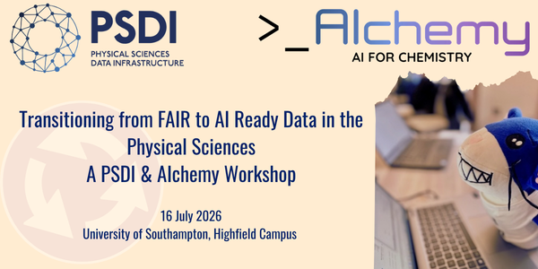
Open Data in an AI-driven World?

Slide 21
Does FAIR = Fully AI-Ready data?!
Simply making data available is not enough. Data must be structured, documented, and connected to its scientific context to be useful for AI.
PSDI AI for Science project
  AI Ready Datasets Collection spanning microscopy, diffraction, crystallography, physical chemistry, and computational chemistry
  Standards eg Croissant metadata and RO-Crate to capture provenance, variables, relationships, annotations, intended use.
  Usable data needs context: AI systems require clear descriptions of what data represents, where it came from, and how it should be interpreted.
  AI-ready data supports both human understanding and machine processing.
  No single data format fits all applications; successful AI readiness depends on metadata, standards, expertise, and curation.
AI-ready data = FAIR data + rich metadata + provenance + expert curation + clear scientific context.

Slide 22
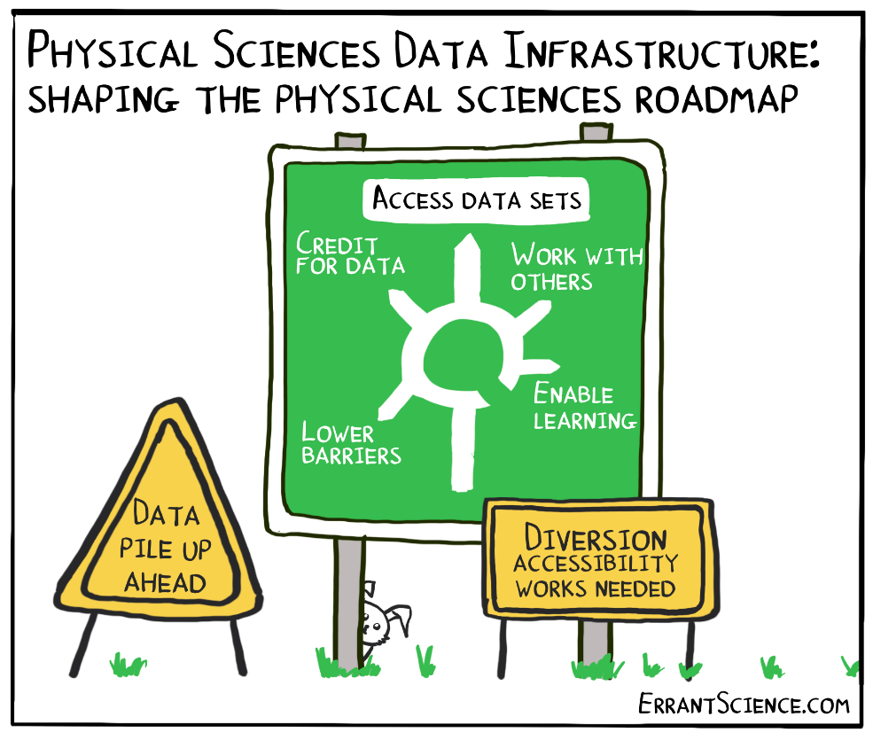
Community
Not just about technology
Channel with Publishers
Internships & Placements
Validation of ideas
Advocacy
Sharing Best
Practice
Community of
Practice
Identify Skills Gaps
Data skills
Training
Research Culture
Provision of guidance
Champions
Channel with Funders
Policy Design & Implementation
Requirements gathering
Notes:
Importance of research culture, barriers, best practices, not about technology, requirements gathering, validation, awareness, training / guidance

Slide 23
Outlook
Emphasis on AI is going to drive activity in the UK
New UKRI ‘Common Principles’ data policy 2027
Domains revisiting their respective approaches
Need for ACTIONABLE Data Management Plans
  Need infrastructure to support this!
Long term is not just about storage – preservation AND curation
  Development of standards and processes
Much more specificity regarding suitable ‘repositories’
  Drive development of more domain specific repositories

