Slide 1
National Research Data Infrastructure (NFDI)
Bridget Murphy
Speaker DAPHNE4NFDI / NFDI Senate member
University Kiel / DESDY

Slide 2
More and more research results are achieved by using already existing research data.
see FAIR principles: https://doi.org/10.1038/sdata.2016.18

Slide 3
However, significant efforts are still required to find the right data set, understand it and use it for the purpose at hand.
see FAIR principles: https://doi.org/10.1038/sdata.2016.18

Slide 4

NFDI Association
in numbers
> 300 association members
> 1500 people involved
26
consortia & Base4NFDI
5
sections

Slide 5
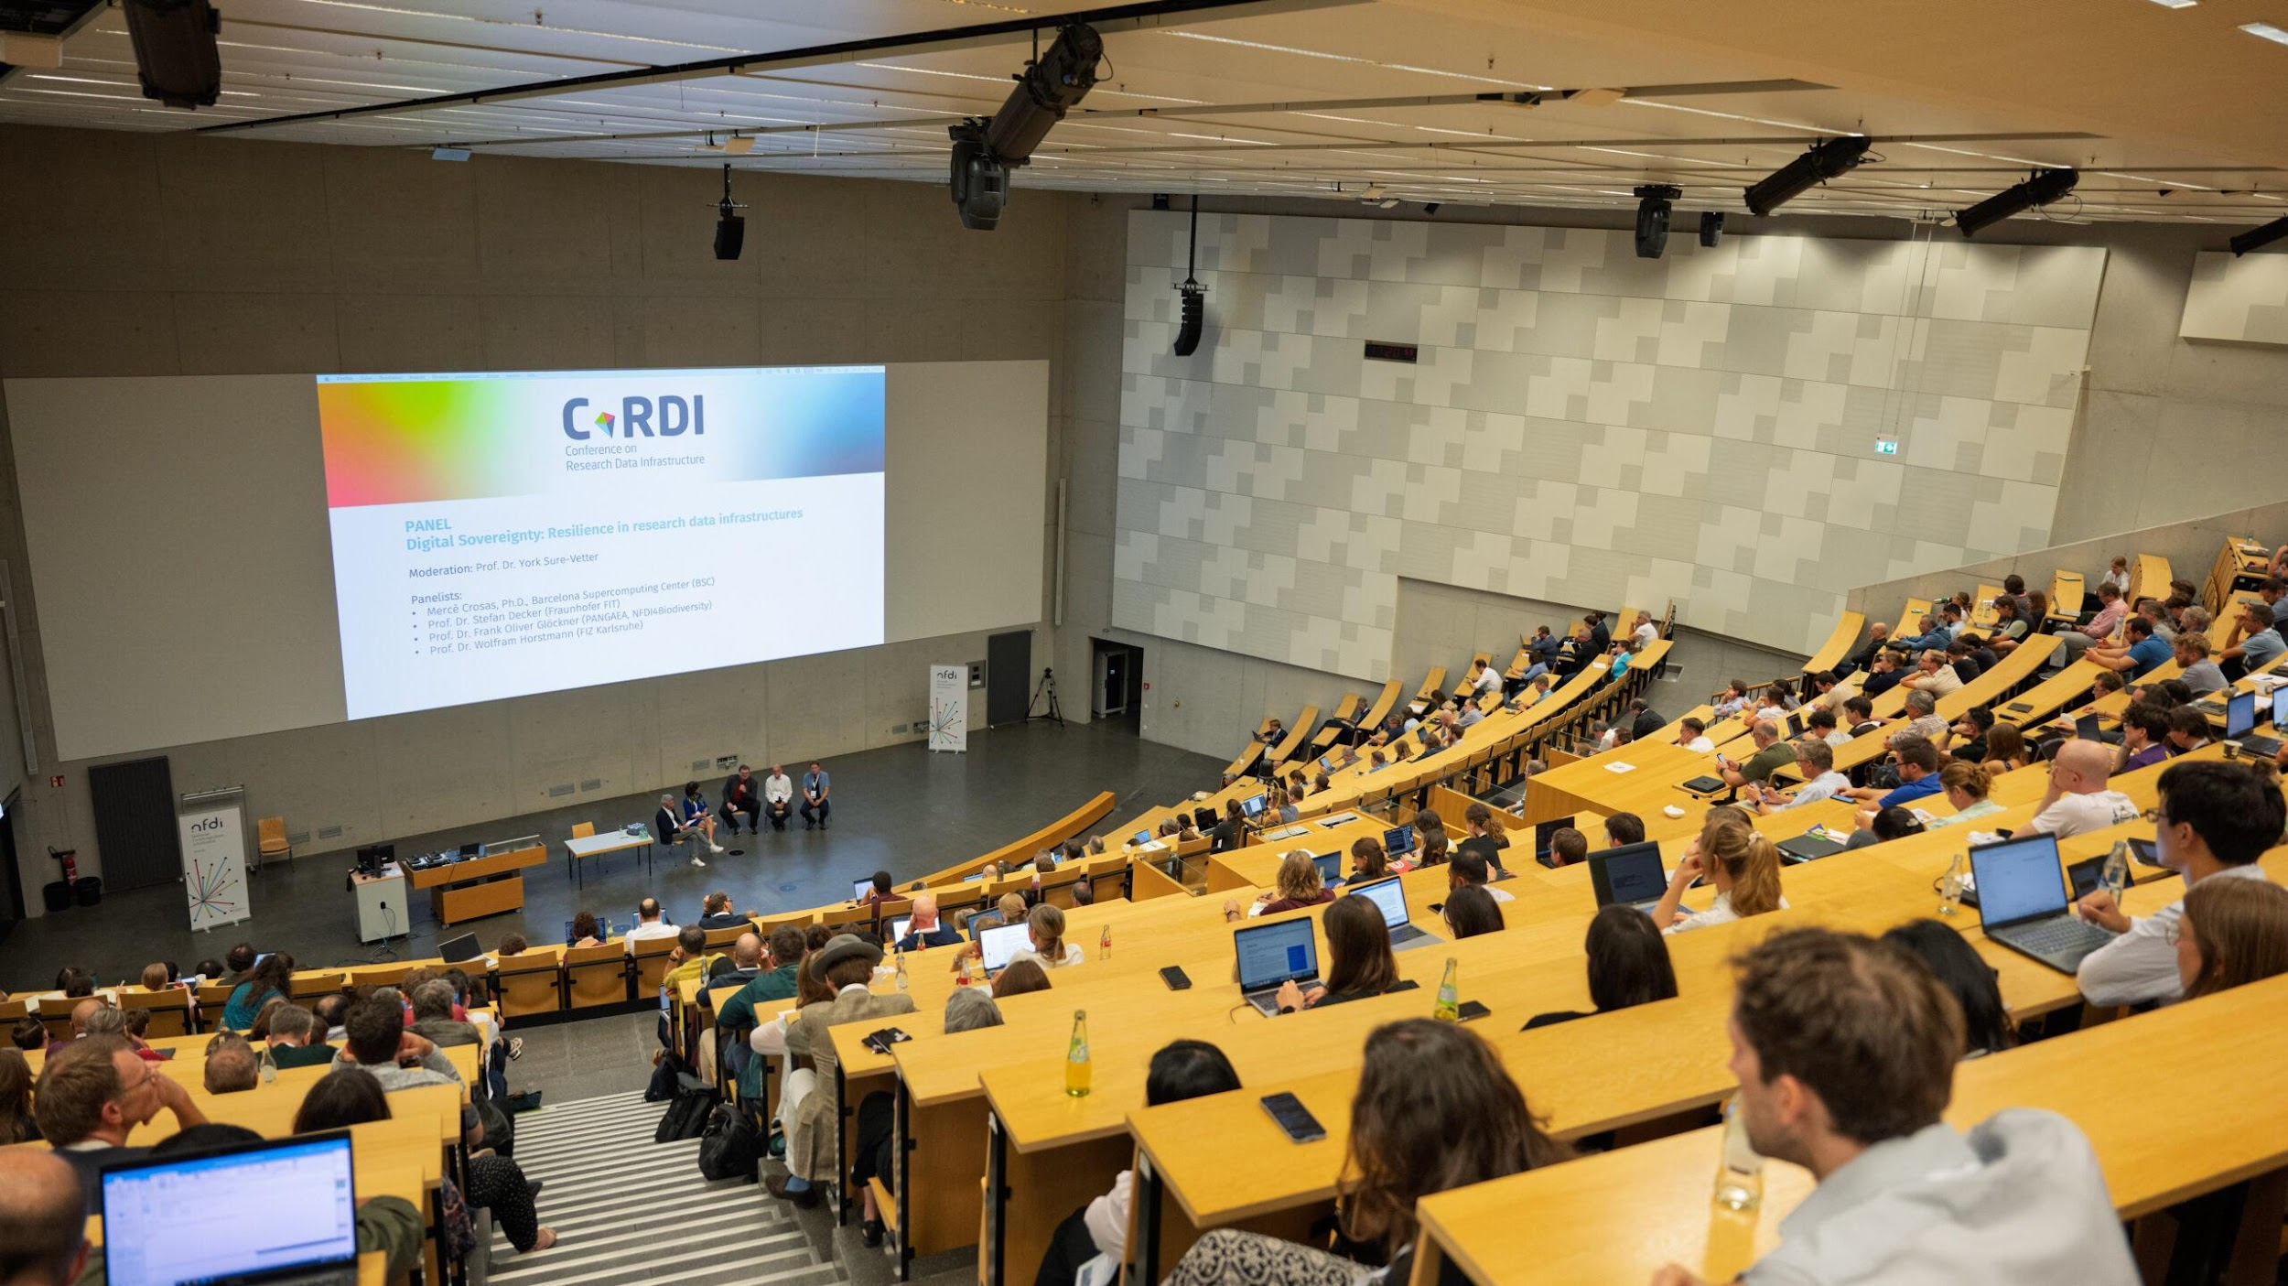
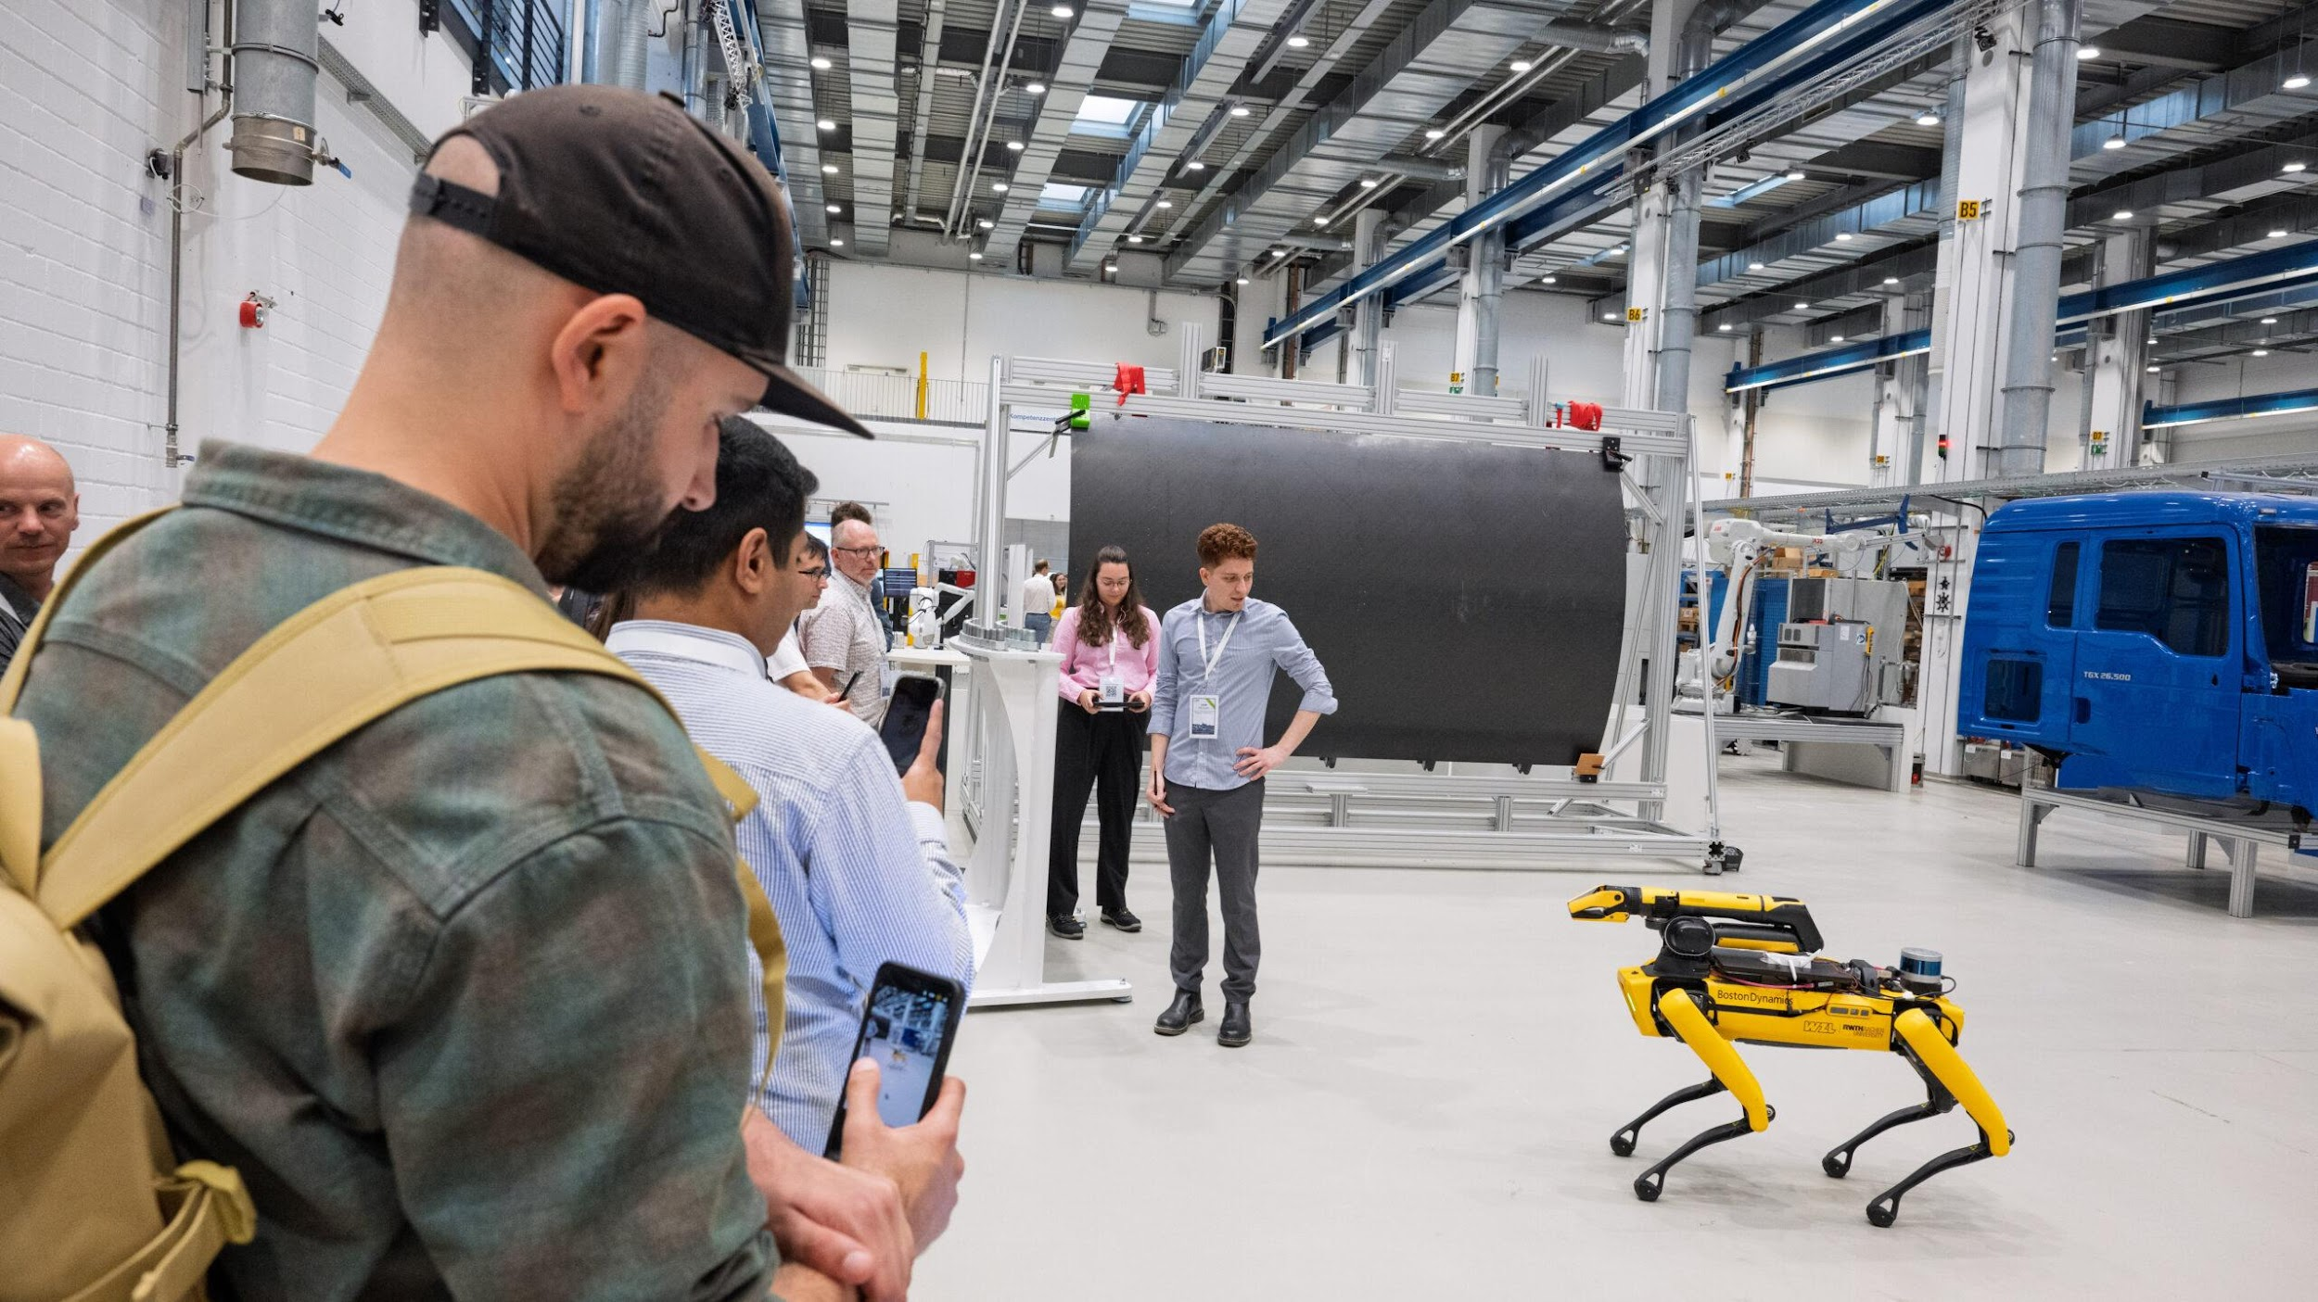
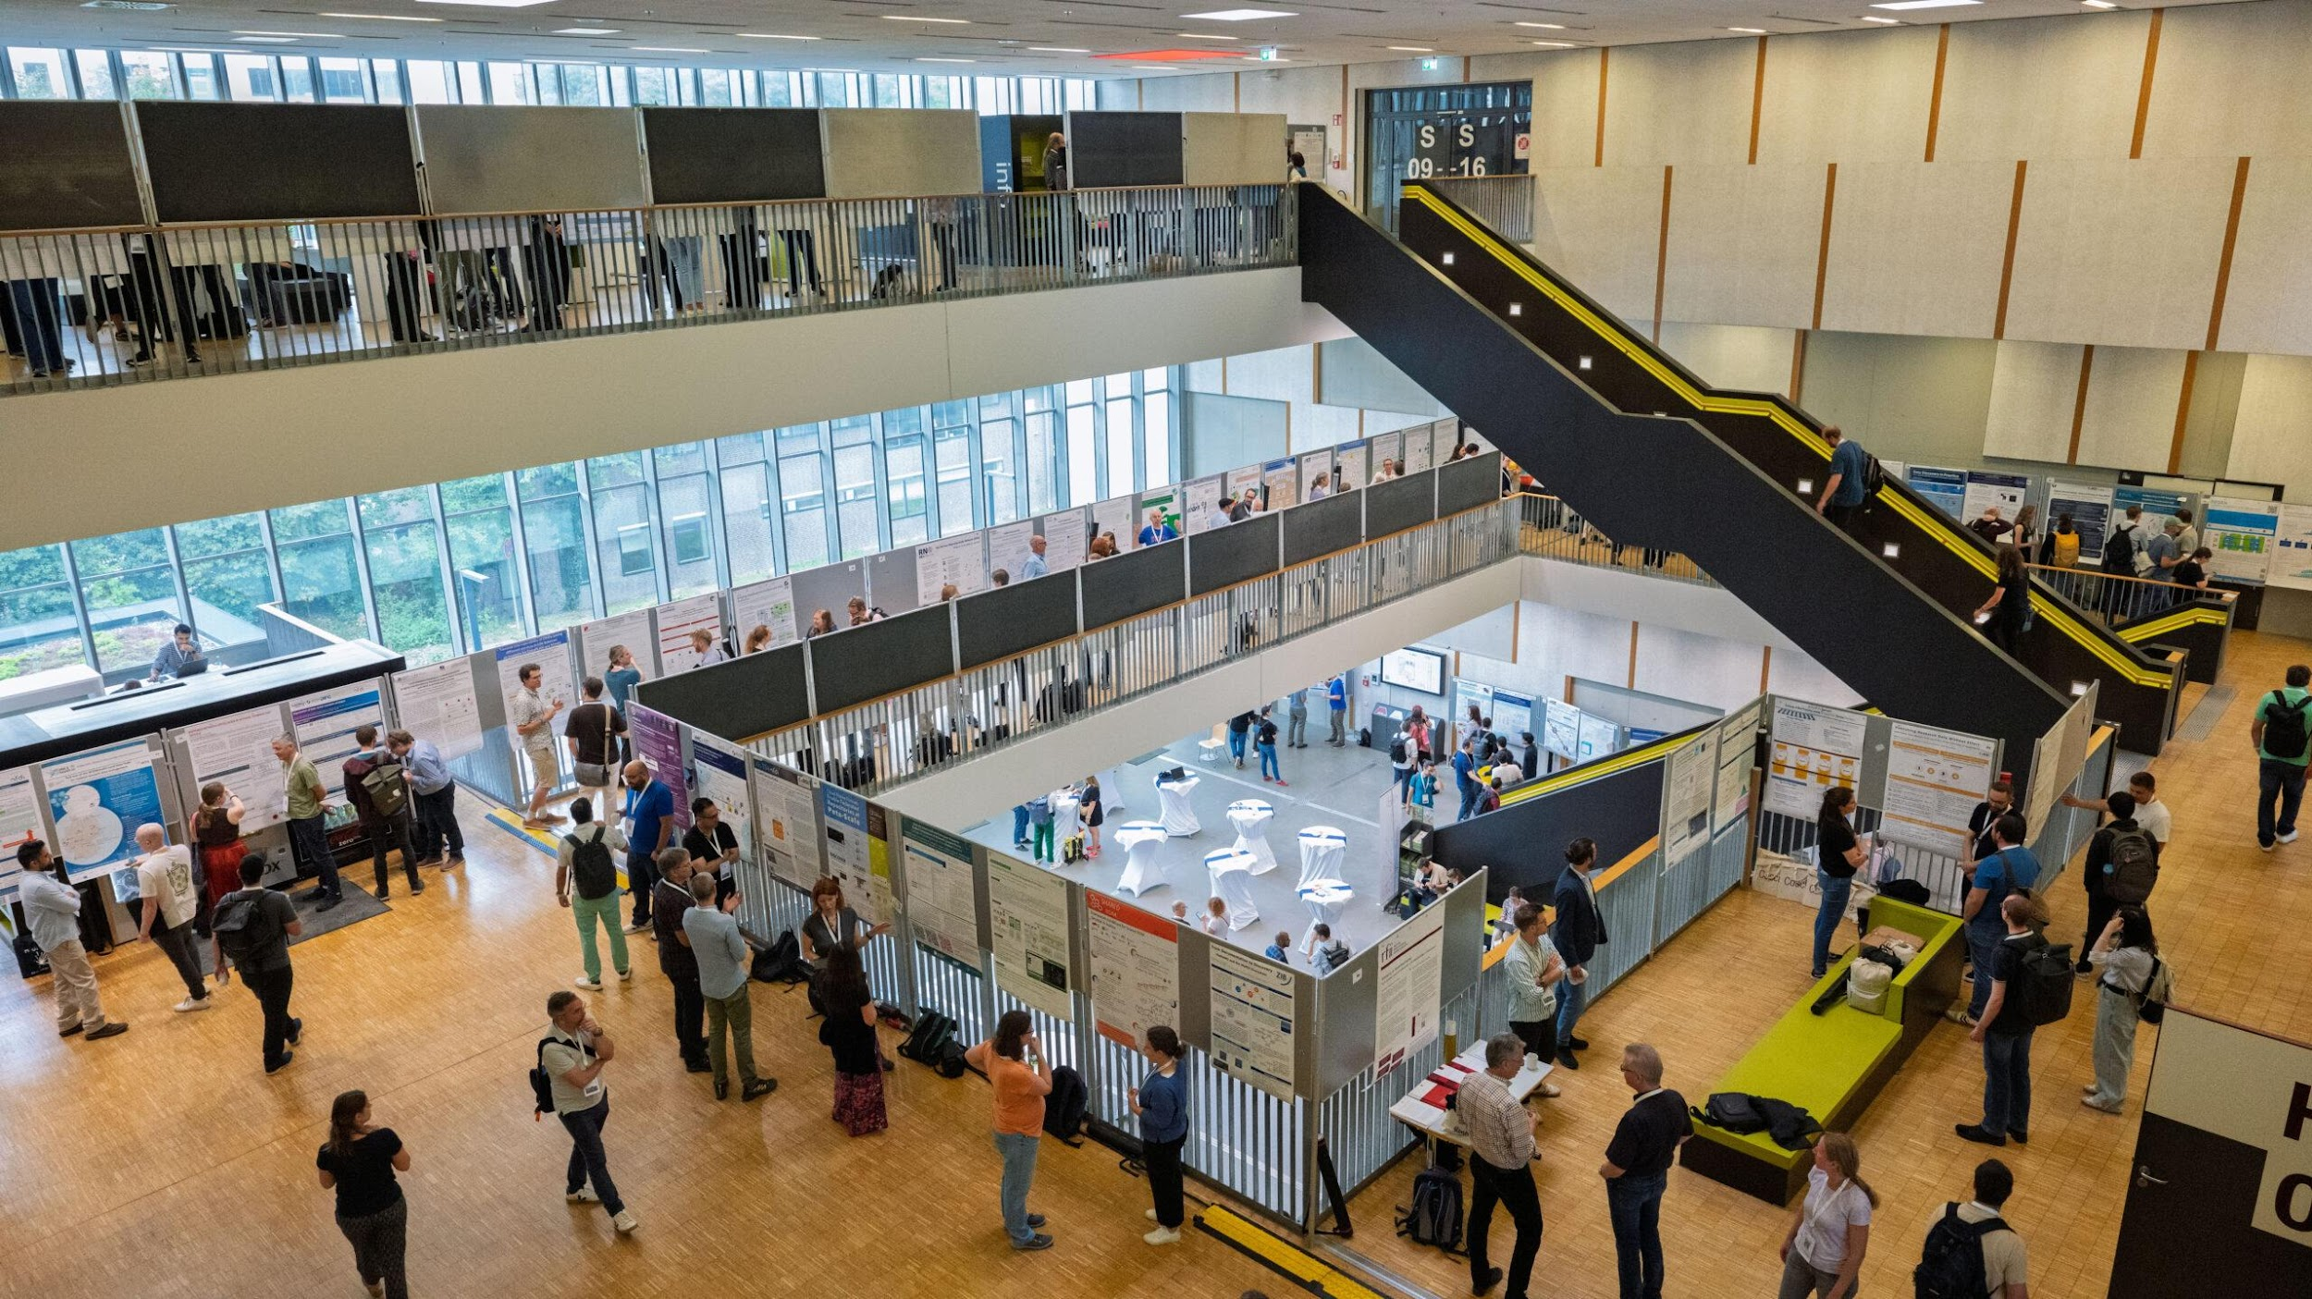
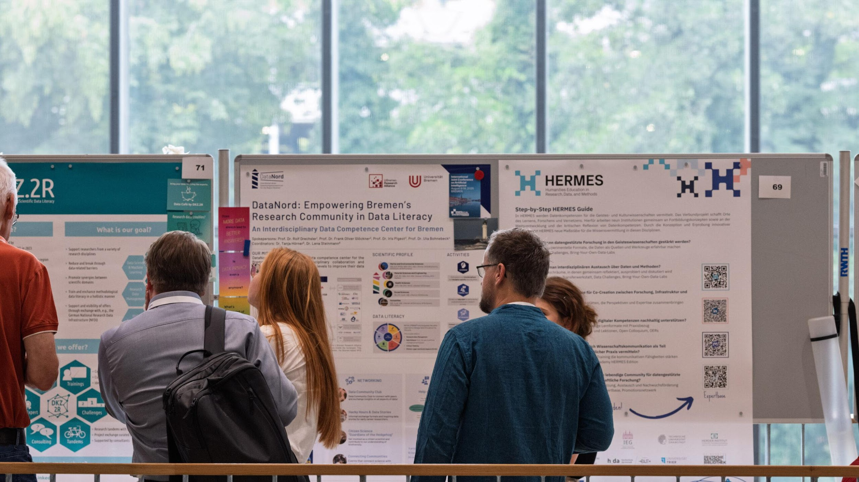
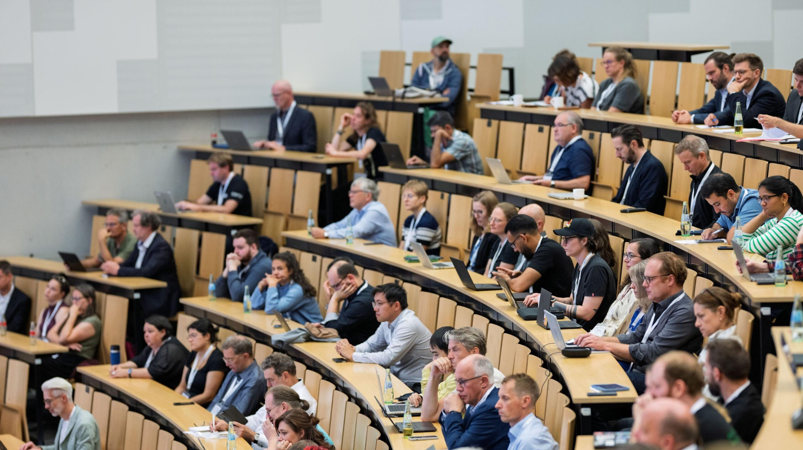
NFDI Association
RDM in Action @CoRDI 2025

Slide 6

NFDI Association
Vision and Mission
NFDI: Data as a common good for excellent research, organised by science in Germany.
Step by step, we are improving the possibilities for using data for science and society. Through our cooperation in the NFDI Association, an umbrella organisation for research data management in all branches of science is being created. In cooperation with national and international partners, we are creating the framework conditions for legally compliant, interoperable and sustainable data infrastructures that are easily accessible for researchers in their everyday work. We educate people, strengthen their competence in dealing with data and open up new career paths.

Slide 7
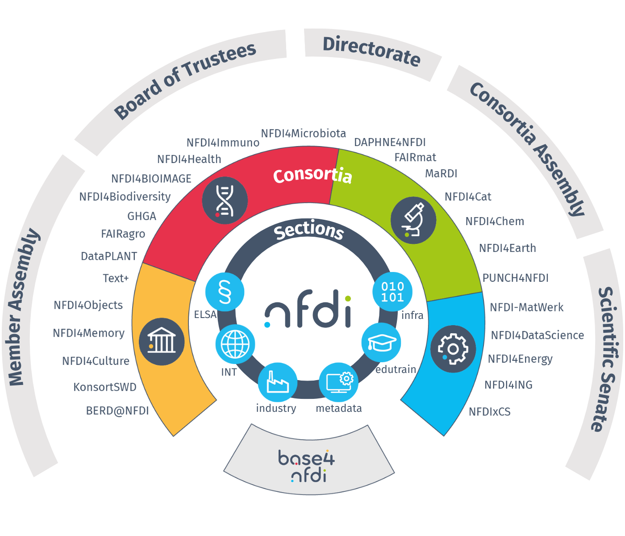
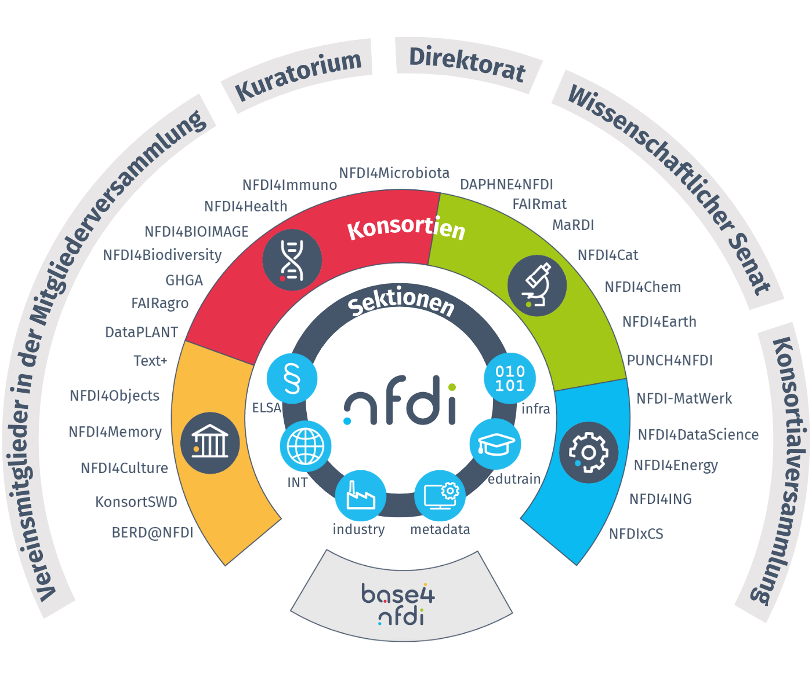
Association Overview

Slide 8
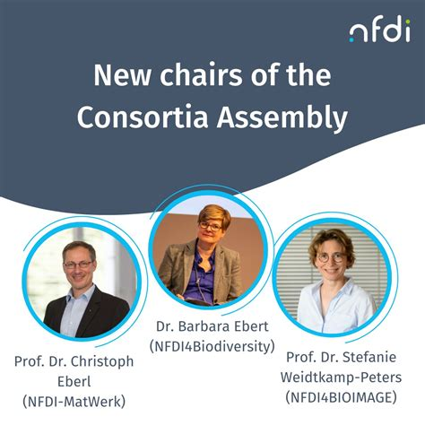

Governance (bodies of association)
Member Assembly
Konrad Förstner (NFDI4Microbiota)
Michael Goedicke( NFDIxCS)
ChristianBusse (NFDI4Immuno)
Bridget Murphy (DAPHNE4NFDI)
306
Board of Trustees
Members
Scientific Senate
9 Members
13
Members
Departments
Consortia „gemäß Satzung“ (according to the statute)
Sections
26 Consortia
Board of Directors
Consortia Assembly
Directorate
Christoph Eberl (NFDI-MatWerk)
Barbara Ebert (NFDI4Biodiversity)
Christof Wolf (KonsortSWD – NFDI4Society)
Supported by
NFDI office in Karlsruhe

Slide 9
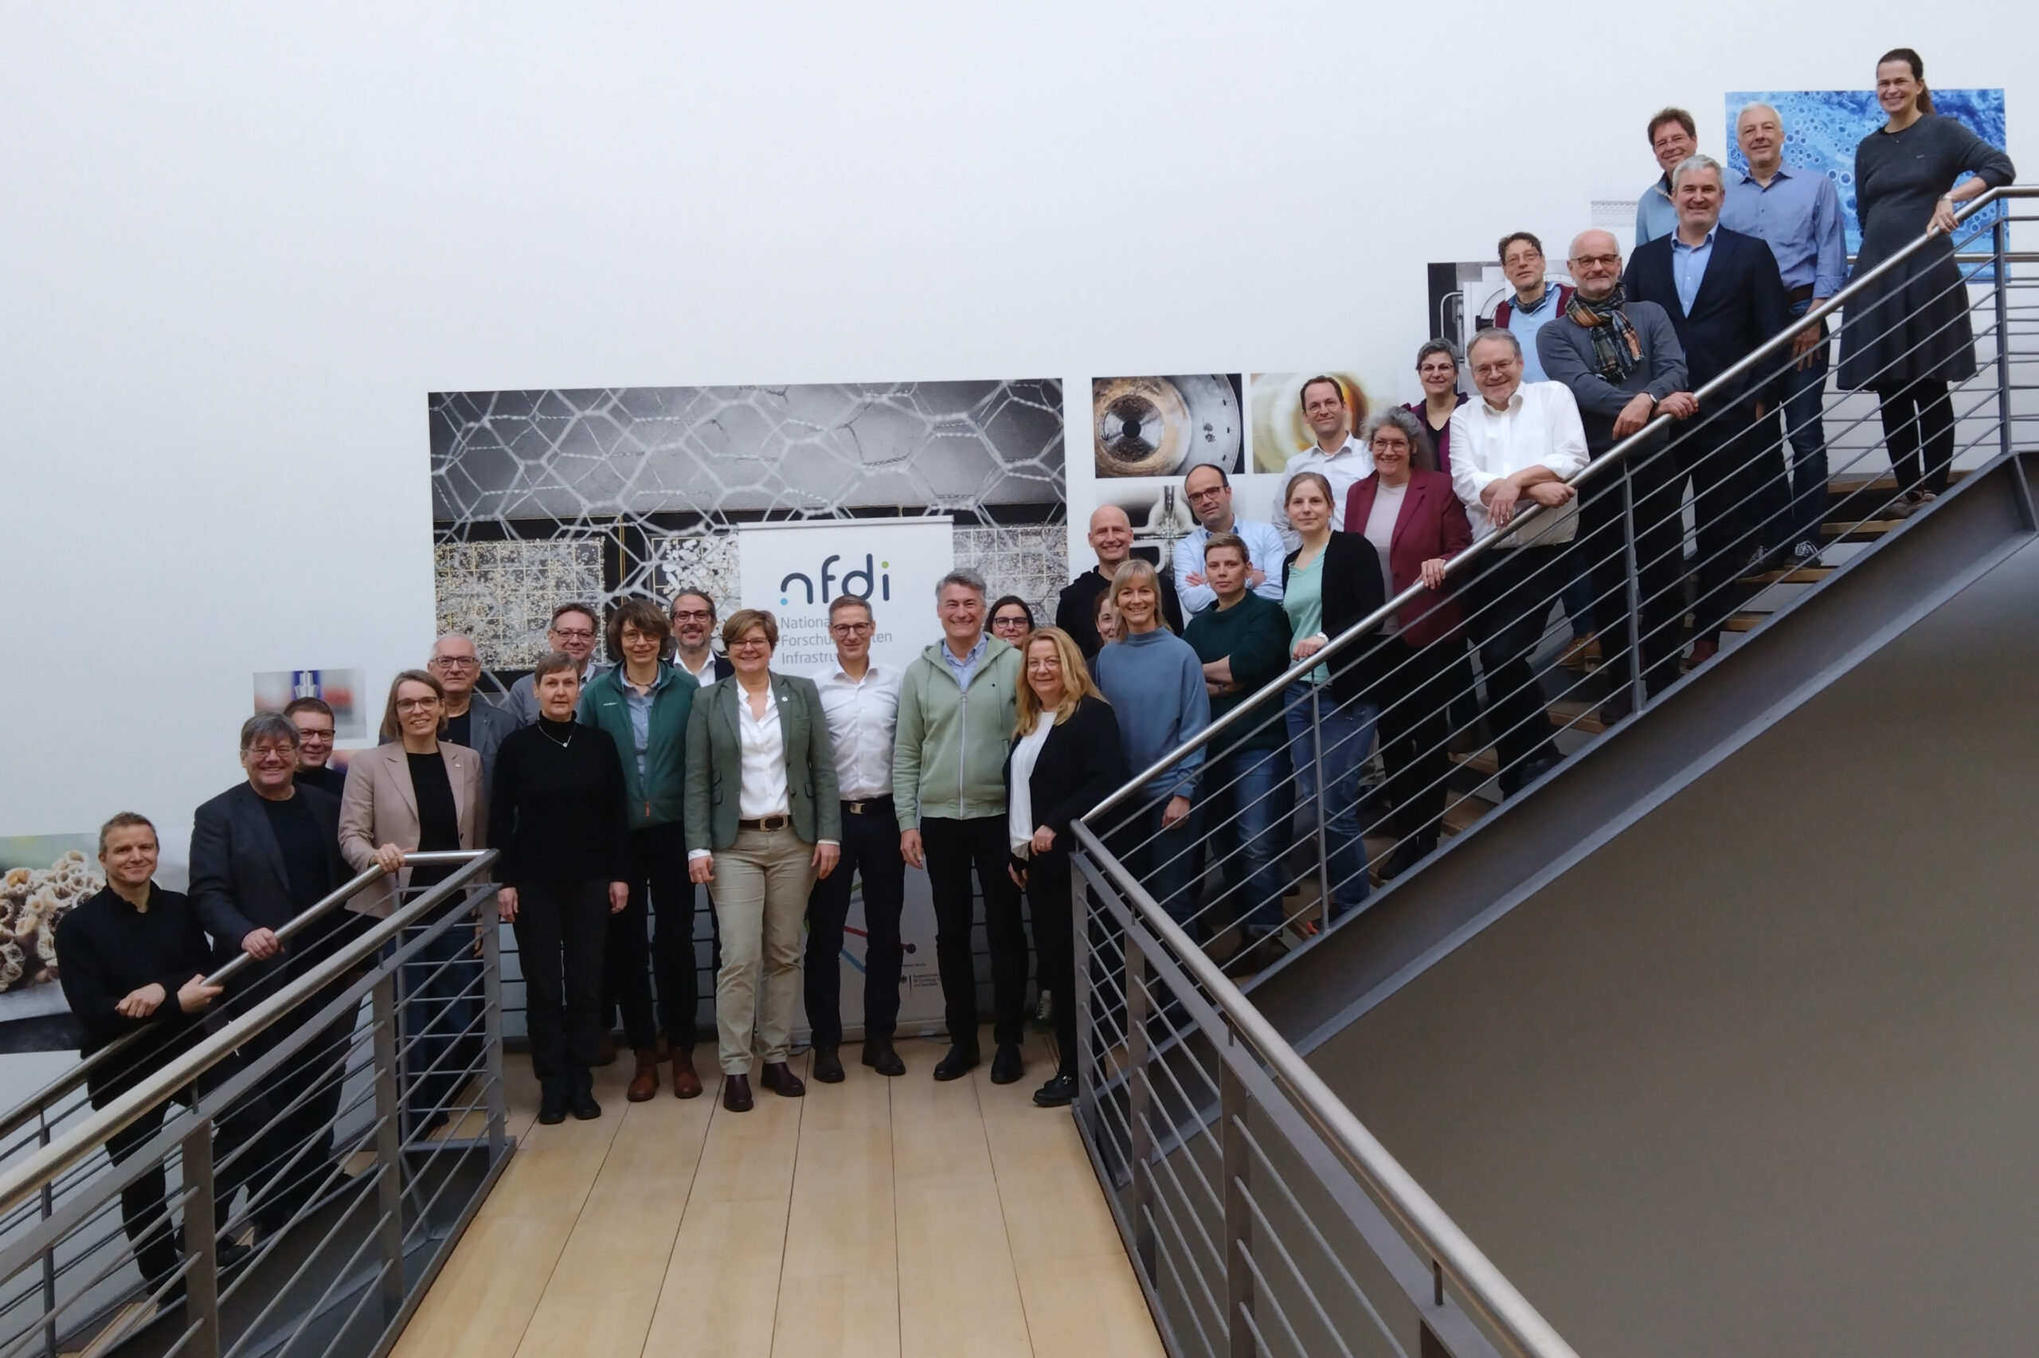
Consortia Assembly

Slide 10
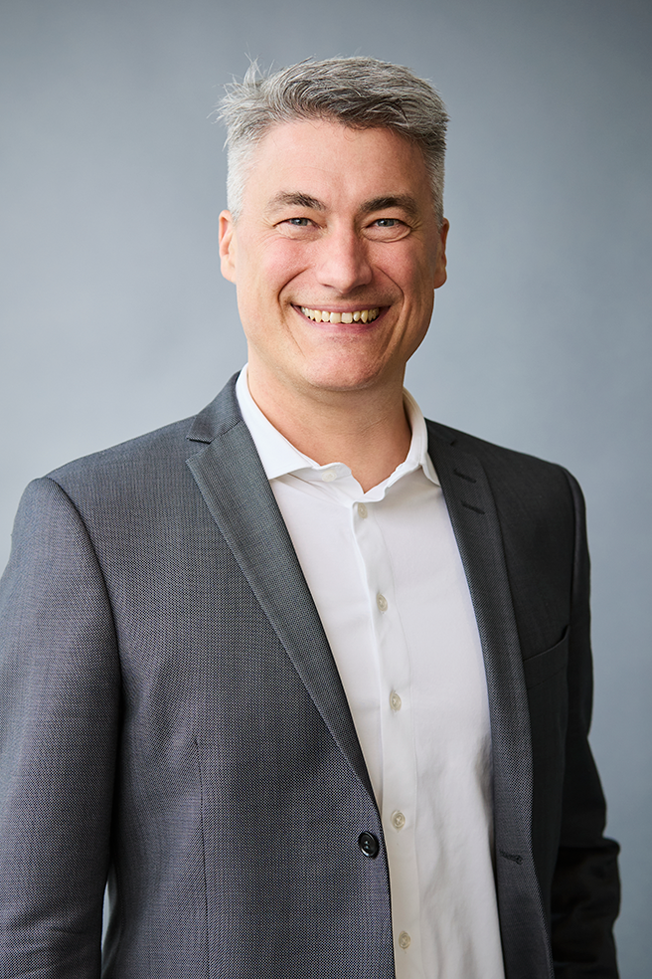
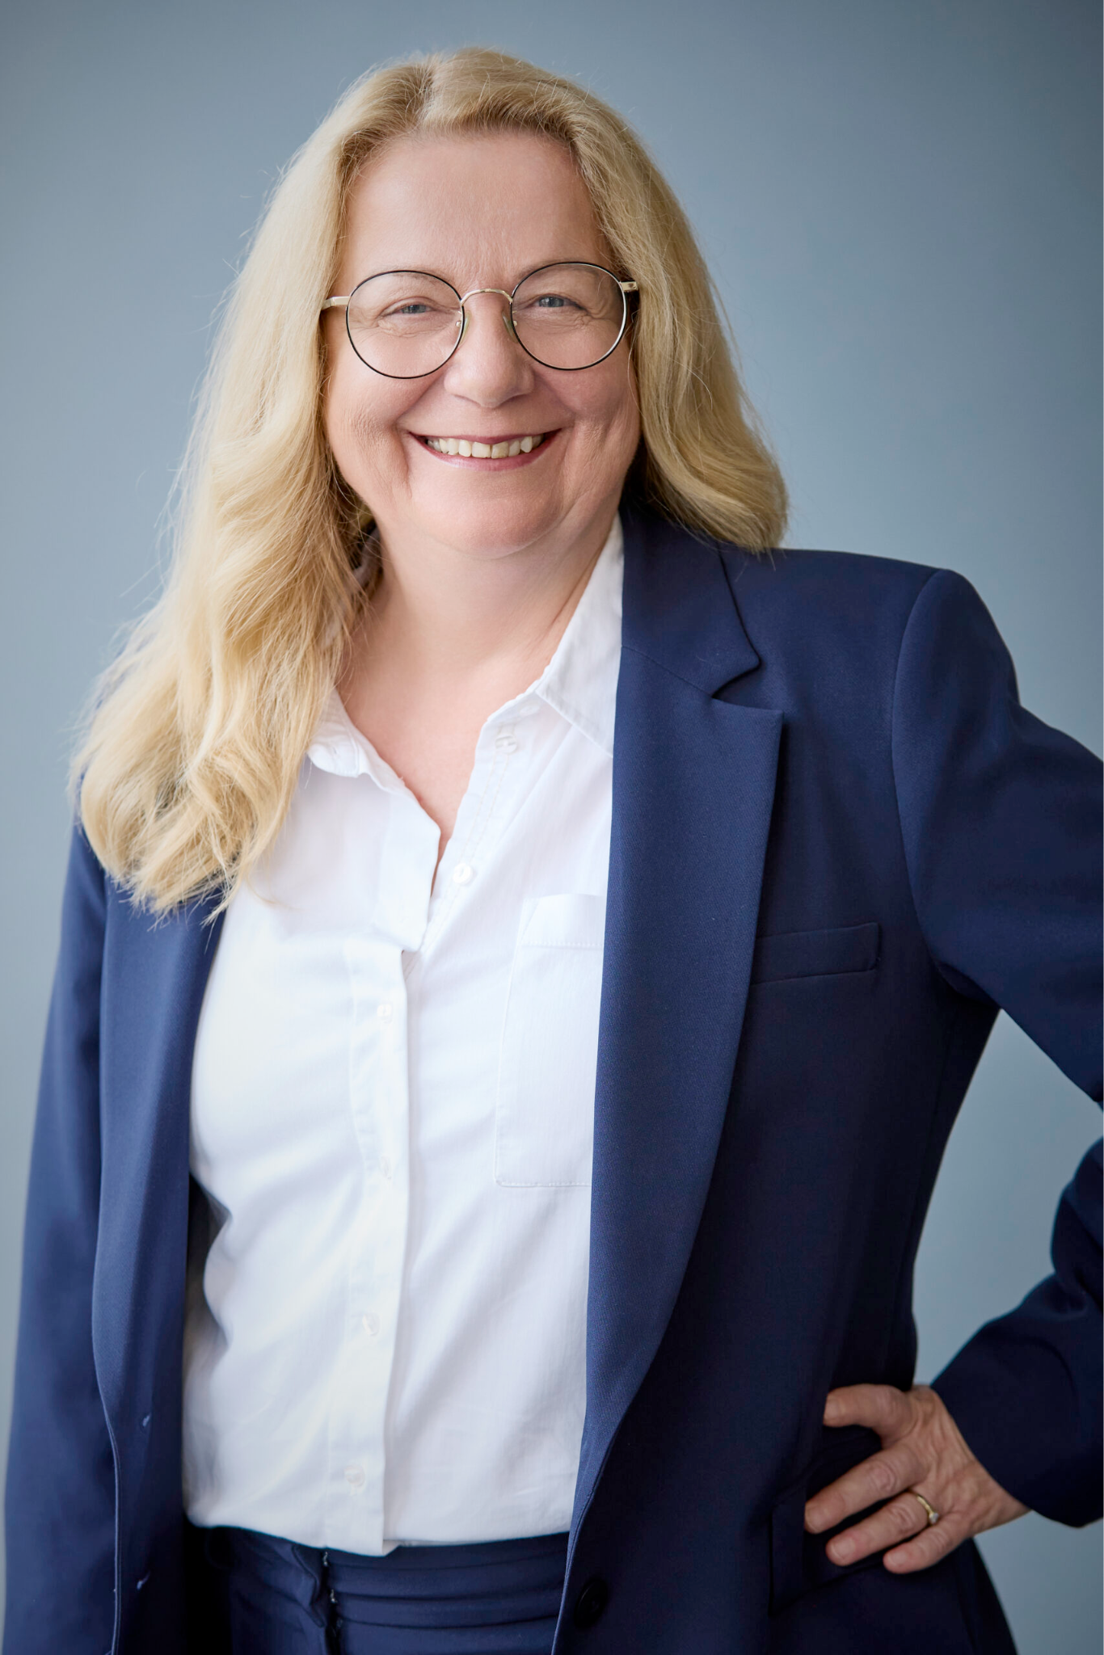
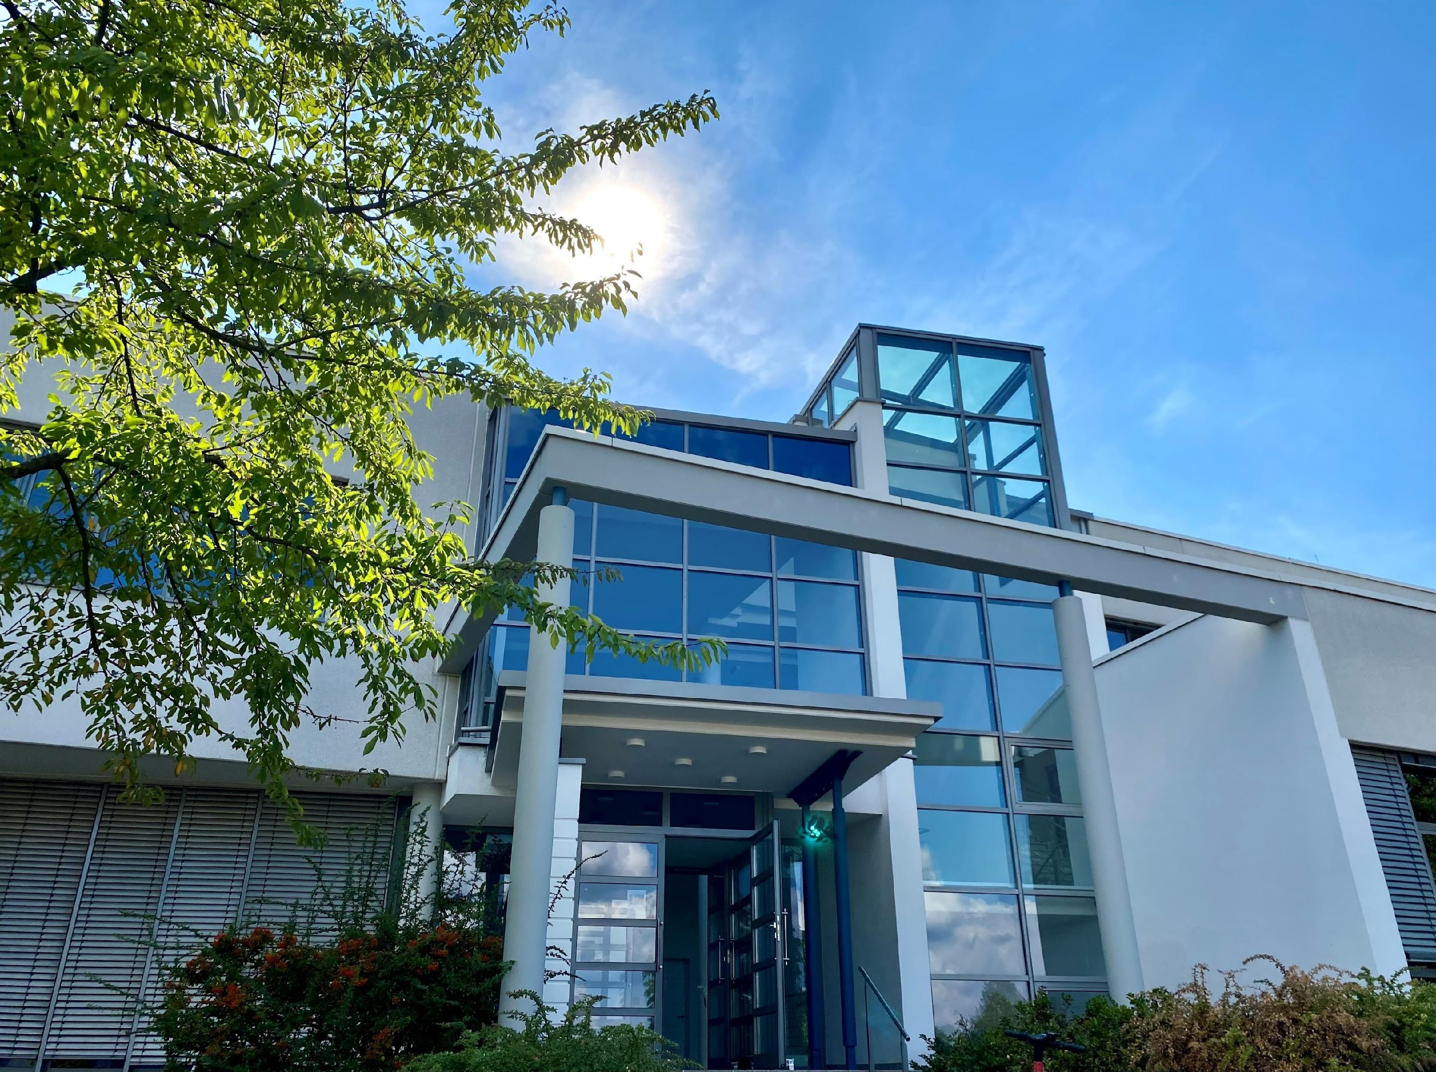
Director and NFDI Office
Prof Dr York Sure-Vetter
Director
Susanne Walter-Augustin
Administrative Director
Supported by the NFDI office in Karlsruhe, Germany

Slide 11
Purpose of the association
The association aims …
  to guide and coordinate the development of a coordinated, networked information infrastructure;
  to establish processes and procedures for a standardized research data management;
  to develop interdisciplinary meta data standards;
  to interlink with European and international platforms;
  to create a shared base for protection, sovereinty, integrity, security and quality of data.
cf. NFDI statutes §2(3)

Slide 12
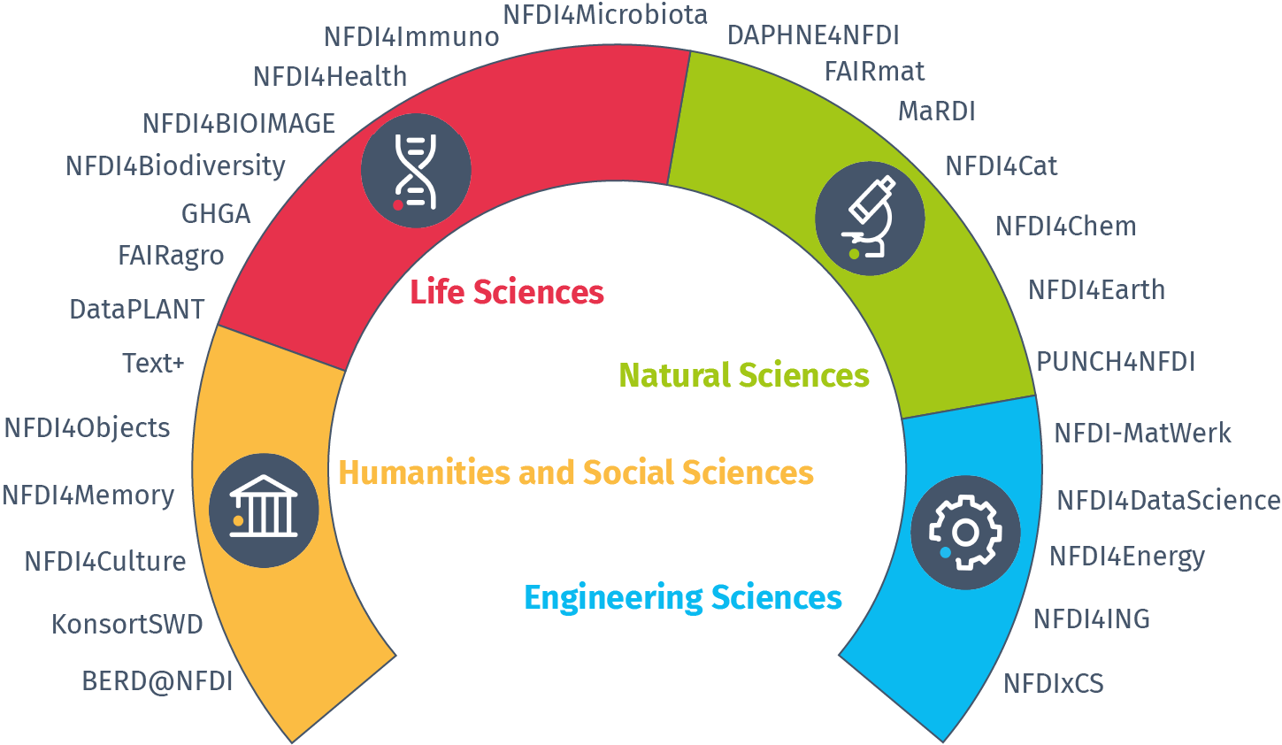
Consortia
Network of consortia:
Base4NFDI

Slide 13

Consortia
Humanities and Social Sciences
BERD@NFDI: NFDI for Business, Economic and Related Data
KonsortSWD: Consortium for the Social, Educational, Behavioural and Economic Sciences
NFDI4Culture: Consortium for Research Data on Material and Immaterial Cultural Heritage
NFDI4Memory: The Consortium for the Historically Oriented Humanities
NFDI4Objects: Research Data Infrastructure for the Material Remains of Human History
Text+: Language and text-based research data infrastructure

Slide 14

Consortia
Engeneering Sciences
NFDI4DataScience: NFDI for Data Science and Artificial Intelligence
NFDI4Energy: National Research Data Infrastructure for Interdisciplinary Energy System Research
NFDI4Ing: NFDI for Engineering Sciences
NFDI-MatWerk: National Research Data Infrastructure for Materials Science and Materials Engineering
NFDIxCS: National Research Data Infrastructure for and with Computer Science

Slide 15

Consortia
Life Sciences
DataPLANT: Plant research data
FAIRagro: FAIR Data Infrastructure for Agrosystems
NFDI4Immuno: National Research Data Infrastructure for Immunology
GHGA: German Human Genome-Phenome Archive
NFDI4Biodiversity: Biodiversity, Ecology and Environmental Data
NFDI4BIOIMAGE: National research data infrastructure for microscopy and bioimage analysis
NFDI4Health: NFDI personal health data
NFDI4Microbiota: NFDI for Microbiota Research

Slide 16

Consortia
Natural Sciences
DAPHNE4NFDI: Data from PHoton and Neutron Experiments for NFDI
FAIRmat: FAIR Data Infrastructure for Condensed-Matter Physics and the Chemical Physics of Solids
NFDI4Cat: NFDI for sciences related to catalysis
MaRDI: Mathematical Research Data Initiative
NFDI4Chem: Chemistry consortium for the NFDI
NFDI4Earth: NFDI Consortium Earth System Sciences
PUNCH4NFDI: Particles, Universe, NuClei and Hadrons for the NFDI

Slide 17
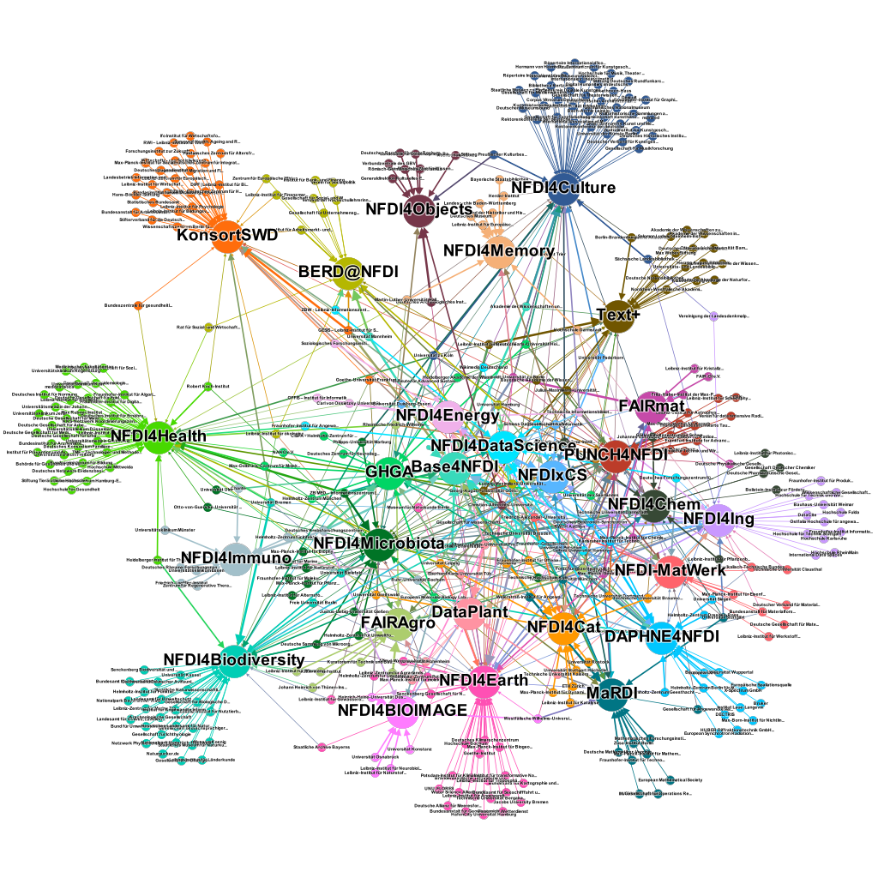

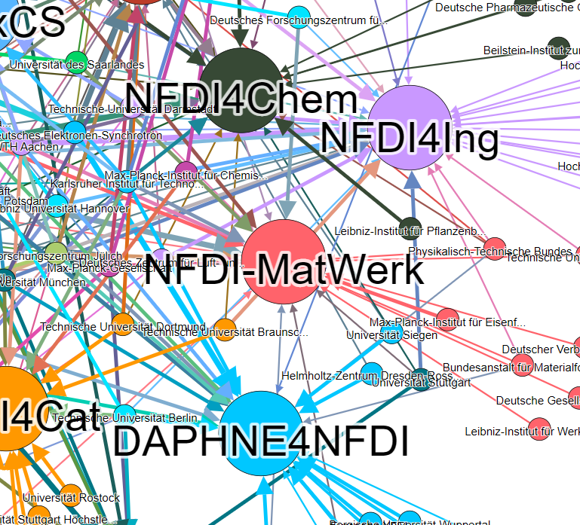
A strong network
Source: Wikidata
(07.11.2022)

Slide 18
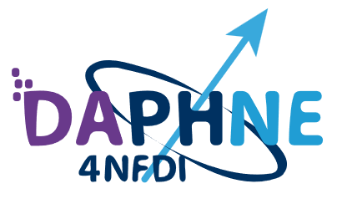
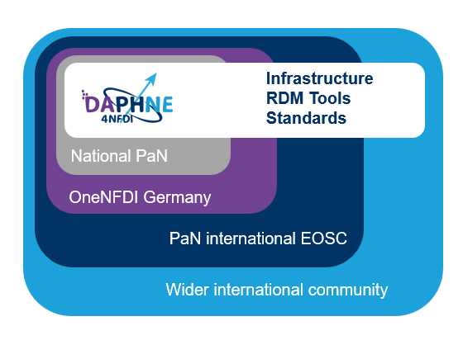
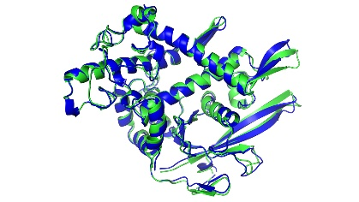

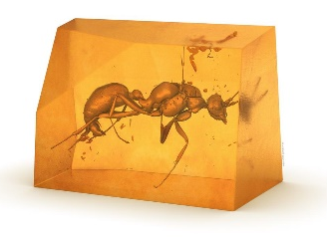
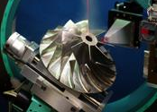
DAPHNE4NFDI
embeded in the photon and neutron community
> 5500 users
> 3000 experiments
> 250 patents in Europe
> 3000 publications
3000 publications
> 50 000* extended community
> 50 PB data
Society
challenges
Health
Environment
Energy
Materials
Transport
Knowledge
*DAPHNE4NFDI DFG data sheet, July 2024
Research
domains
Medicine
Life Science
Physics
Chemistry
Engineering
Notes:
Composition does not change
Pan Community is consistent
logos or participating instutions
Composition of the consortium and its embedding in the community of interest
The DAPHNE4NFDI consortium directly represents approximately 7,000 registered facility users in Germany. These users conduct around 3,000 experiments per year, publish approximately 3,000 scientific papers (with an average of nine authors per publication), and generate more than 50 petabytes (PB) of data annually. Importantly, the data collected by facility users is also reused by broader scientific communities from which these users originate.
DAPHNE4NFDI thus extends deeply into these broader research communities, including solid-state physics (represented by the DPG-SKM with 19,000 members), molecular and atomic physics (DPG-SAMOP, 8,500 members), DECHEMA (5,800 members), the German Chemical Society GDCh (31,000 members), among others.
At the European level, DAPHNE4NFDI is embedded in a wider network of over 30,000 registered users of photon and neutron facilities. These users carry out more than 6,000 experiments annually, leading to over 5,000 scientific papers, and producing in excess of 100 PB of research data each year.
The consortium DAPHNE4NFDI is a joint undertaking between facility users conducting experiments at photon and neutron sources and the operators of beamlines and instruments at these large-scale facilities (for its strategic positioning see Fig. 1). German users are represented through the Komitee Forschung mit Synchrotronstrahlung (KFS) and the Komitee für Forschung mit Neutronen (KFN), which serve as elected representative bodies for the community. DAPHNE4NFDI co-speaker Christian Gutt currently serves as chair of the KFS.
The photon and neutron user communities play a central role in DAPHNE4NFDI, acting as a key link between data resulting from measurements made at the facilities, and the much wider community of researchers seeking to utilize these results as illustrated in Figure 1. In Germany, these user communities are composed of research groups - primarily based at universities – providing perfect opportunities for training in best research data management practices and significant multiplier effects. They also include groups from non-university research organizations such as the Helmholtz Association, the Max Planck Society, the Fraunhofer Society, and the Leibniz Association. These groups span a range of scientific disciplines (as seen in the list of participating institutions). Naturally, only a subset of these user groups can be formal co-applicants in this proposal.

Slide 19
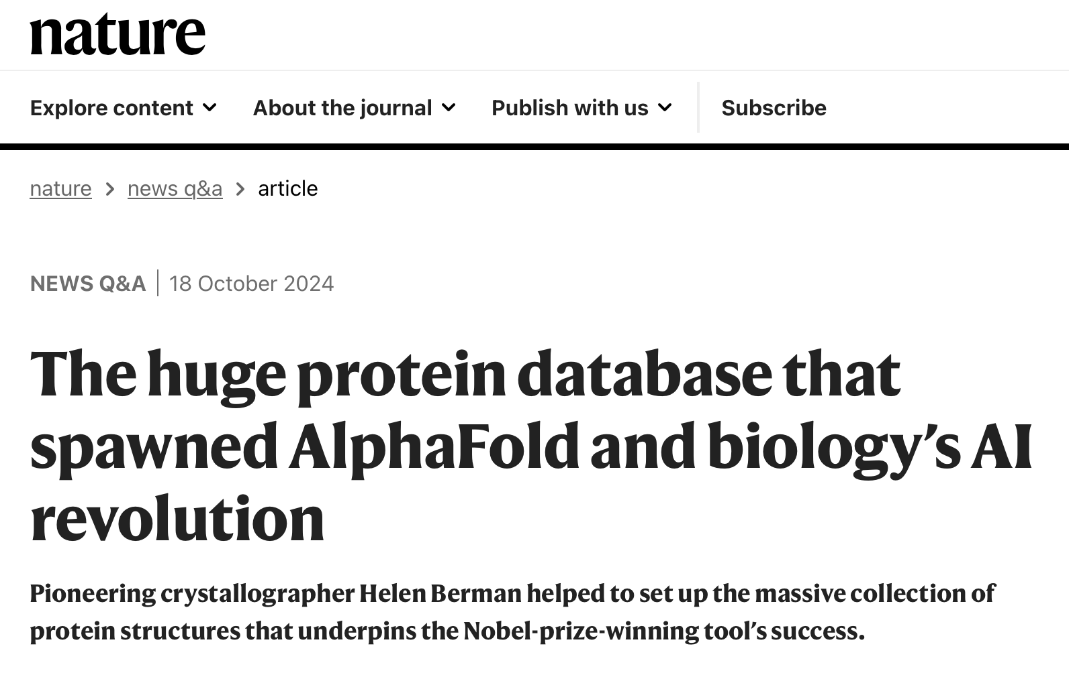

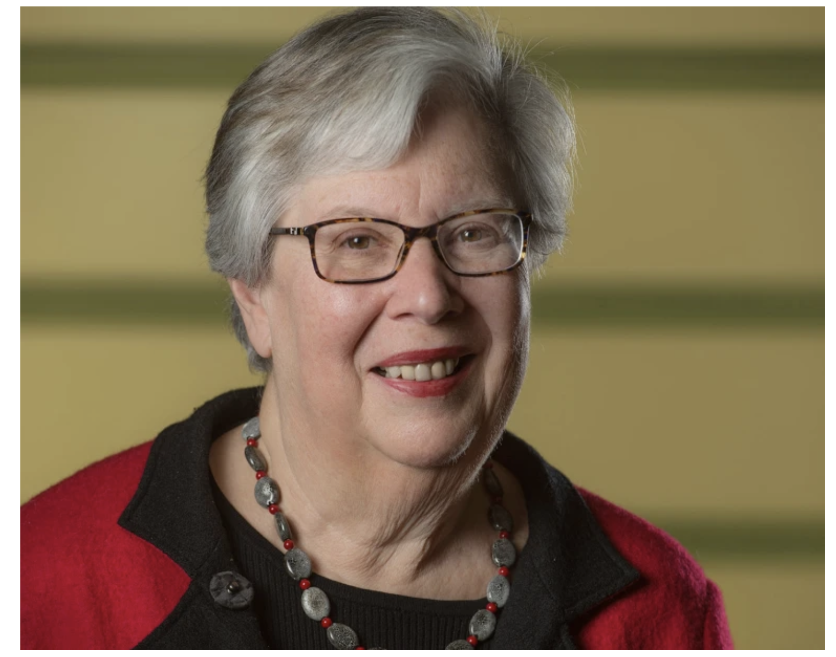
The PDB as bases for AI revolution in biology
Inspiration for DAPHNE4NFDI
Does it speak to the importance of experimental data for powering AI breakthroughs in science?
Yes, 100%. People will say, ‘Oh, well, the PDB data are really special.’ But we actually know why they’re special. It took a long, long time to figure out how to handle the data, how to represent the data, how to collect the data. We as a community, the PDB community, know how to do this.
I think that other communities can, should and must do this. Because otherwise we’re not going to get the big breakthroughs. The methodologies that allow you to do protein prediction and protein design — the same thing could happen in chemistry. It could happen in geology. It could happen in physics. [1]
Crystallographer
Helen Berman co-founded the Protein Data Bank in the 1960s.
[1] Nature 634, 1028-1029 (2024)
historical perspectives: Acta Cryst. A 64, 88 (2007) & Nature 634, 1028 (2024)

Slide 20
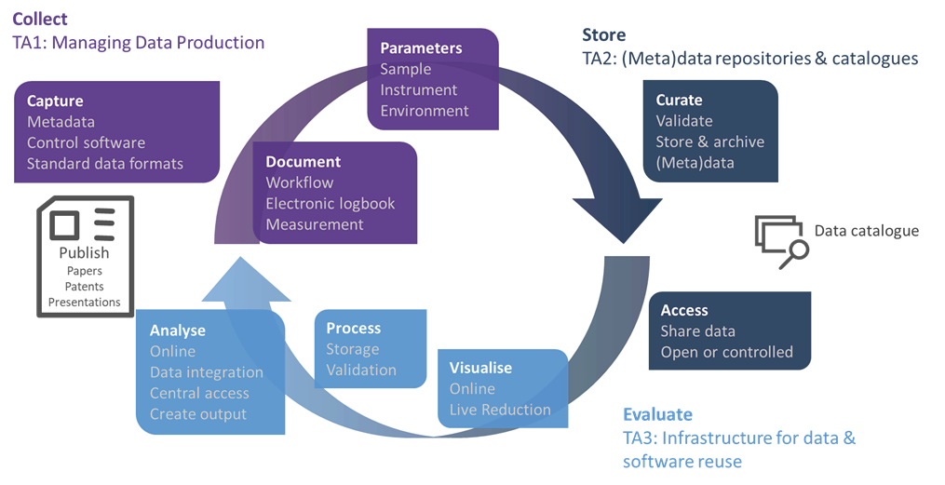
Research data management data lifecycle
Workflows at a largescale research facility and in DAPHNE4NFDI
Proposal
Peer
reviewed
Notes:
Research Data Management Strategy
Scientific relevance and quality of the measures
Metadata standards
Implementation of the FAIR principles and data quality assurance
4.4 Services provided by the consortium ( at the end or here?)
4.5 Impact of changes of external conditions / constraints

Slide 21
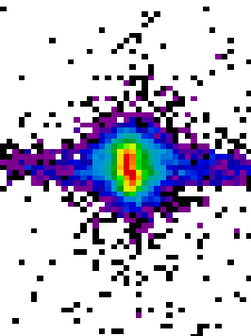
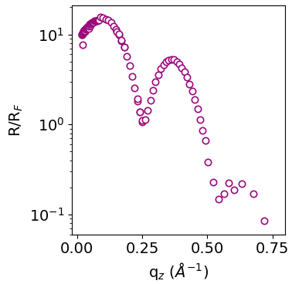
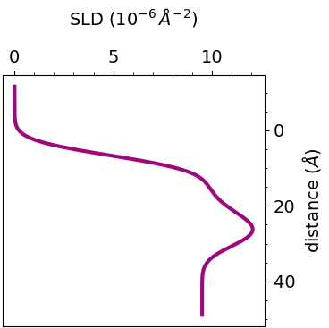







Research data management can improve science
From sample preparation to publication
Collect
Store
Evaluate
Software
Documentation
electronic logbook
Metadata catalogue
Open Data
IGSN
Publication
Proposal
Peer
reviewed
Sample
Raw data
Fitting & Modelling
Saved as .nxs
Extraction
X-ray studies of bidirectional structural changes induced by photoswitching in phospholipid membranes s
FAIR
data publication
Persistent sample identifier service
Open data
Machine learning based online analysis
Open data DB
S. Hövelmann, IUCr J 11, 4 (2024)
L. Pithan, J. Synchr. Rad. 30, 1064 (2023)
https://pan-finder.panosc.ess.eu/
© SangyaPundir / CC BY-SA 4.0
Notes:
Automating FAIR Data Workflows in the DAPHNE4NFDI X-Ray Reflectivity Use Case
¹
Nicolas Hayen

Slide 22

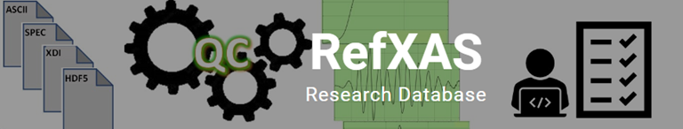
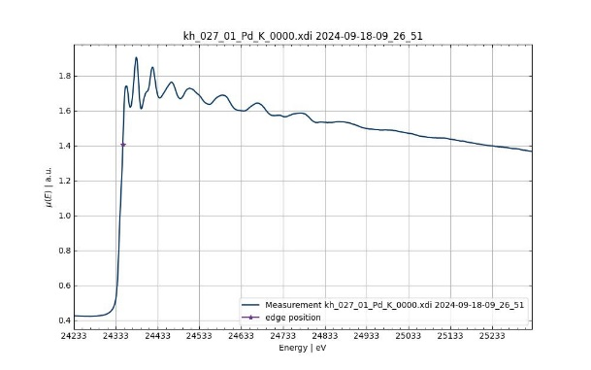




Use case - X-ray absorption spectroscopy
Instrument
Proposal
management
Metadata aggregation
Sample
Data analysis [1,2]
Open Data Repository [3,4]
  Curated high quality reference data
  Provenance and quality assurance
  Foundation for ML based analysis tools
[1] Gaur et al. ACS Catal. https://doi.org/10.1021/acscatal.1c04767
[2] data publication to 1, https://doi.org/10.35097/0k5f6x56uxjsw7cw
[2] http://xafsdb.ddns.net/ , https://doi.org/10.5281/zenodo.8412918
[3] Paripsa, S. et al .2024, Journal of Synchr. Radiation, https://doi.org/10.1107/S1600577524006751

Slide 23






Contribution to the EOSC Federation
DAPHNE4NFDI contributes to two planned nodes
Node
Node
Public–data.DESY.de
https://www.panosc.eu/members/
| DAPHNE4NFDI | Bridget Murphy

Slide 24
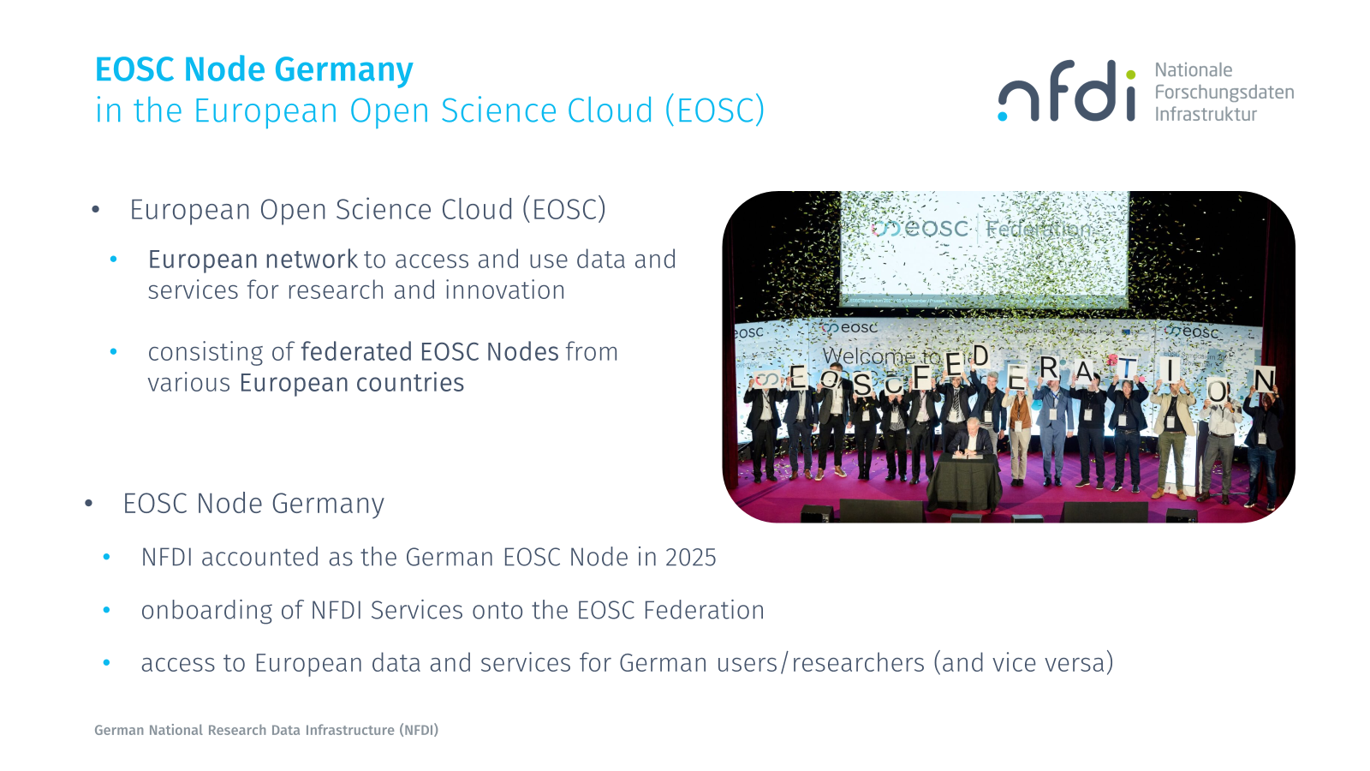

Slide 25








NFDI Sections
Section-metadata
(Meta)daten, Terminologien, Provenienz
Section-infra
Common Infrastructures
Common challenges, common solutions
Section-edutrain
Training & Education
Section-INT
International Engagement
Section-ELSA
Ethical, Legal and Social Aspects
Section-industry
Industry Engagement
Nationale Forschungsdateninfrastruktur (NFDI) e.V.

Slide 26
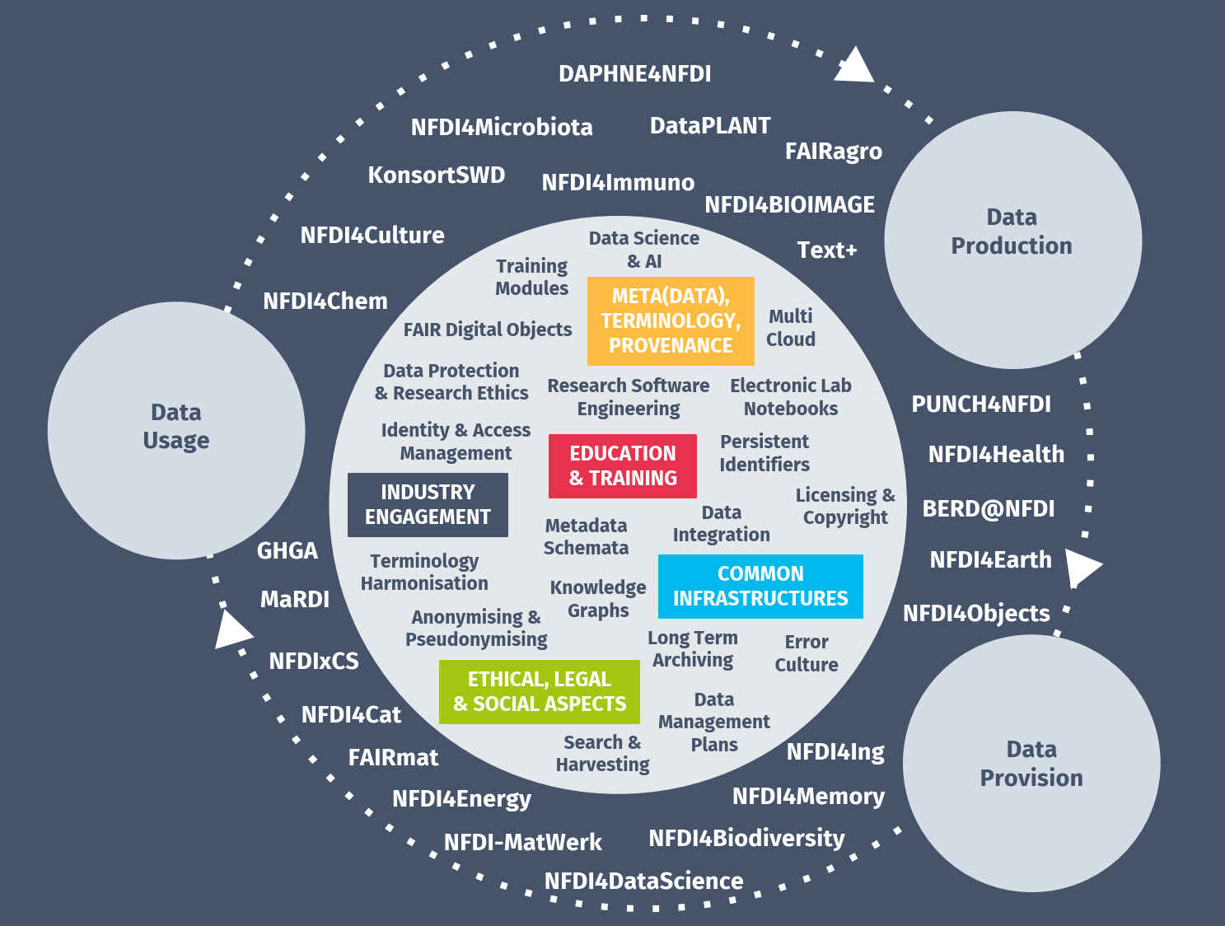
Base4NFDI
Joint basic service initiative of all NFDI consortia.
A basic service is a technical-organizational solution that includes storage and computing services, software, processes, workflows, and the necessary personnel support.
Example: Authentication and Authorization Infrastructure (AAI)
Base4NFDI coordinates and establishes basic services for all consortia and sections according to defined, participative processes within the association.
Source: CC-BY Base4NFDI; https://base4nfdi.de/

Slide 27
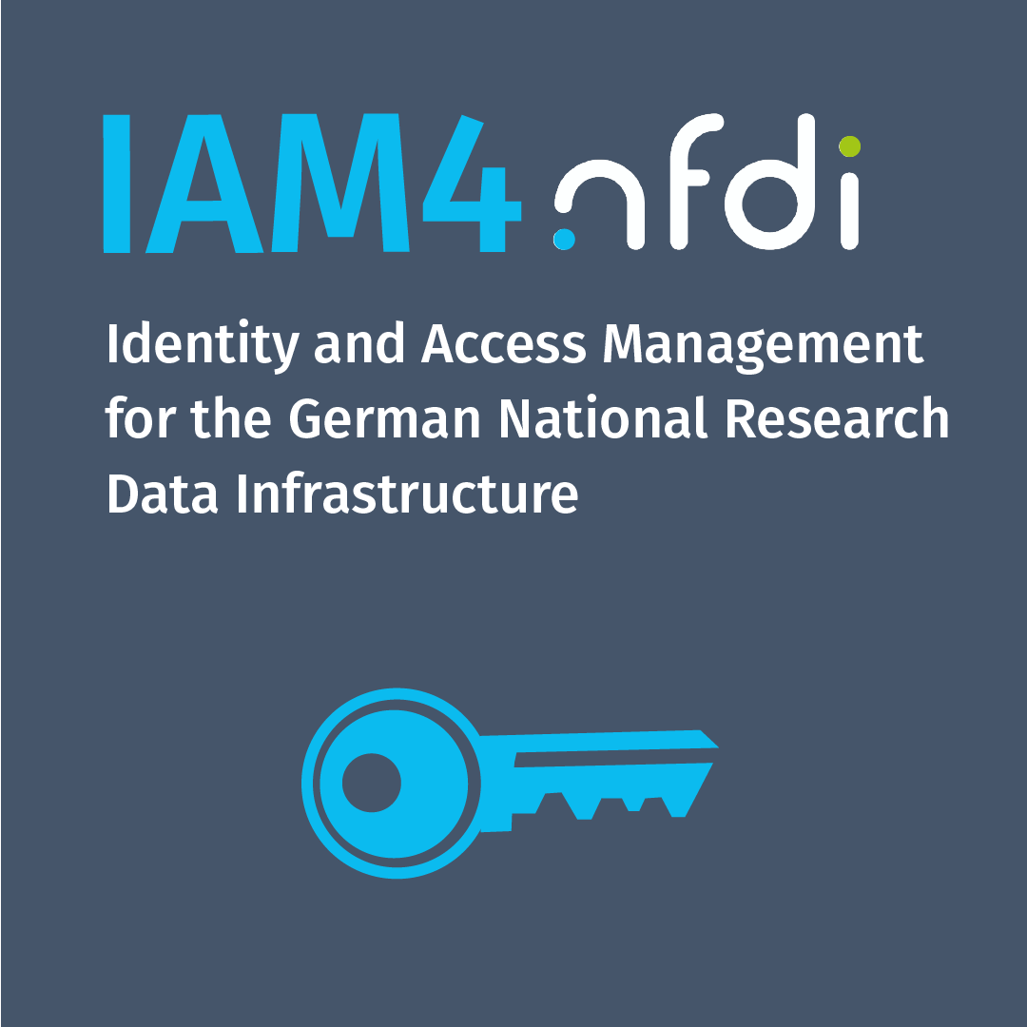
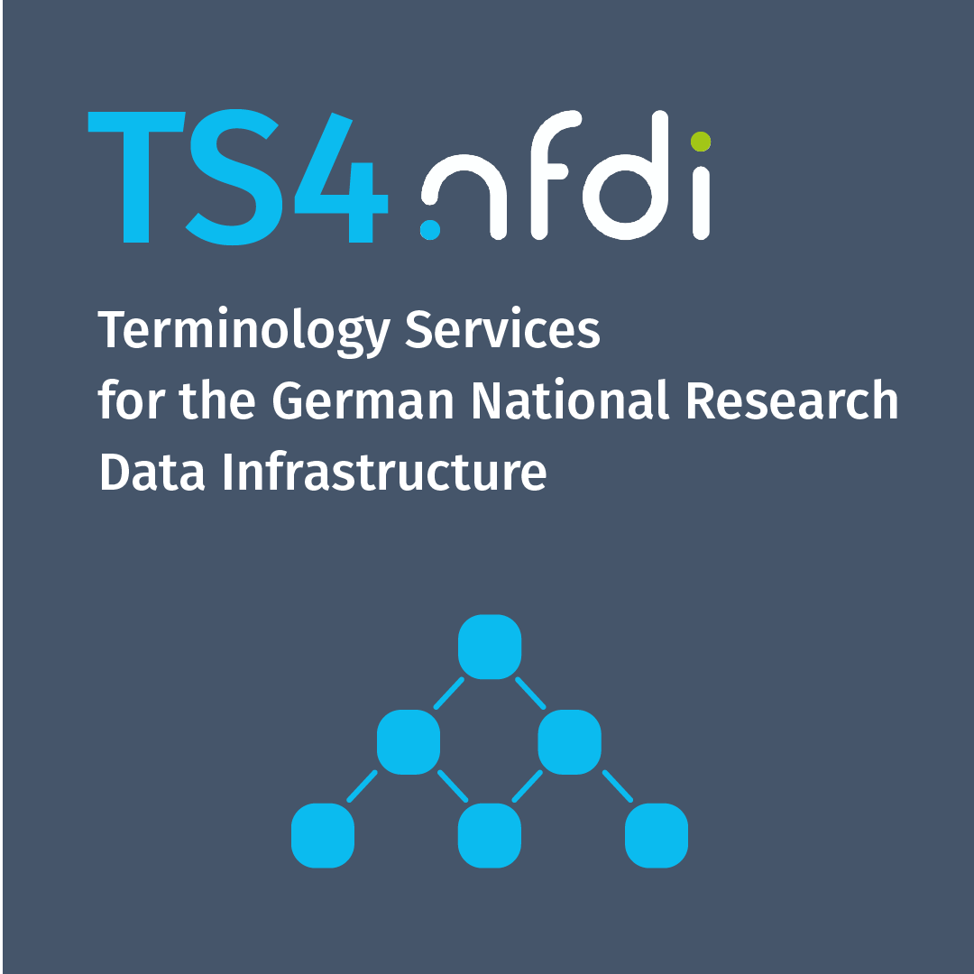
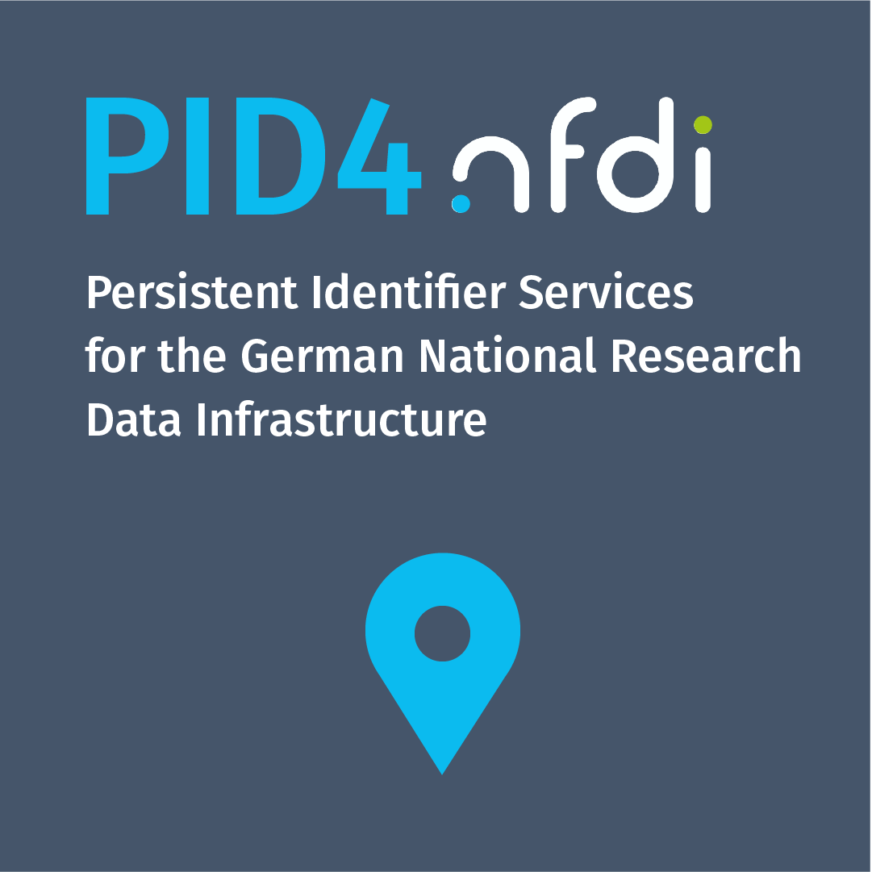

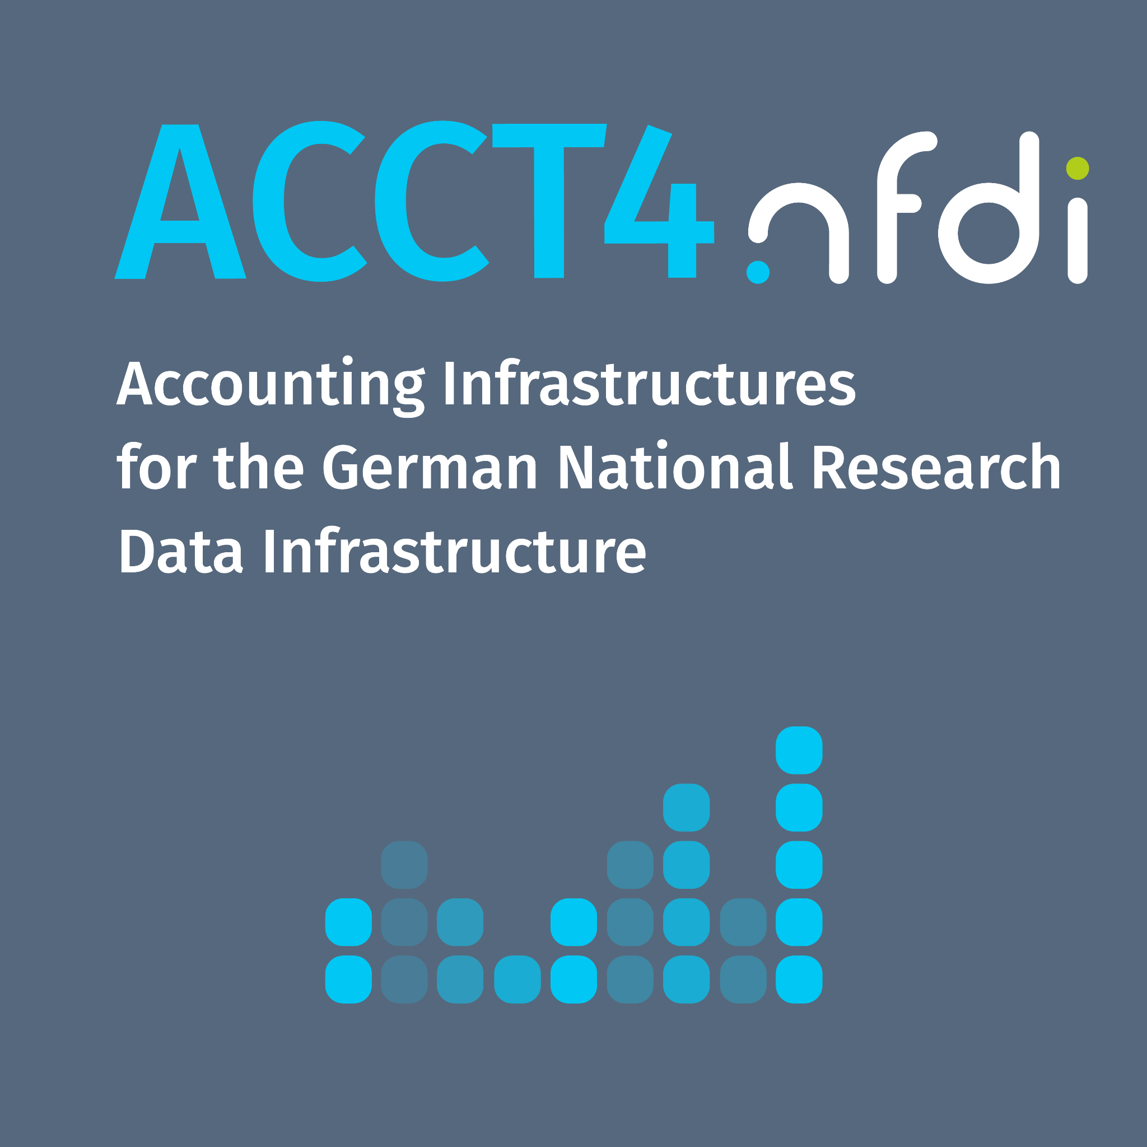

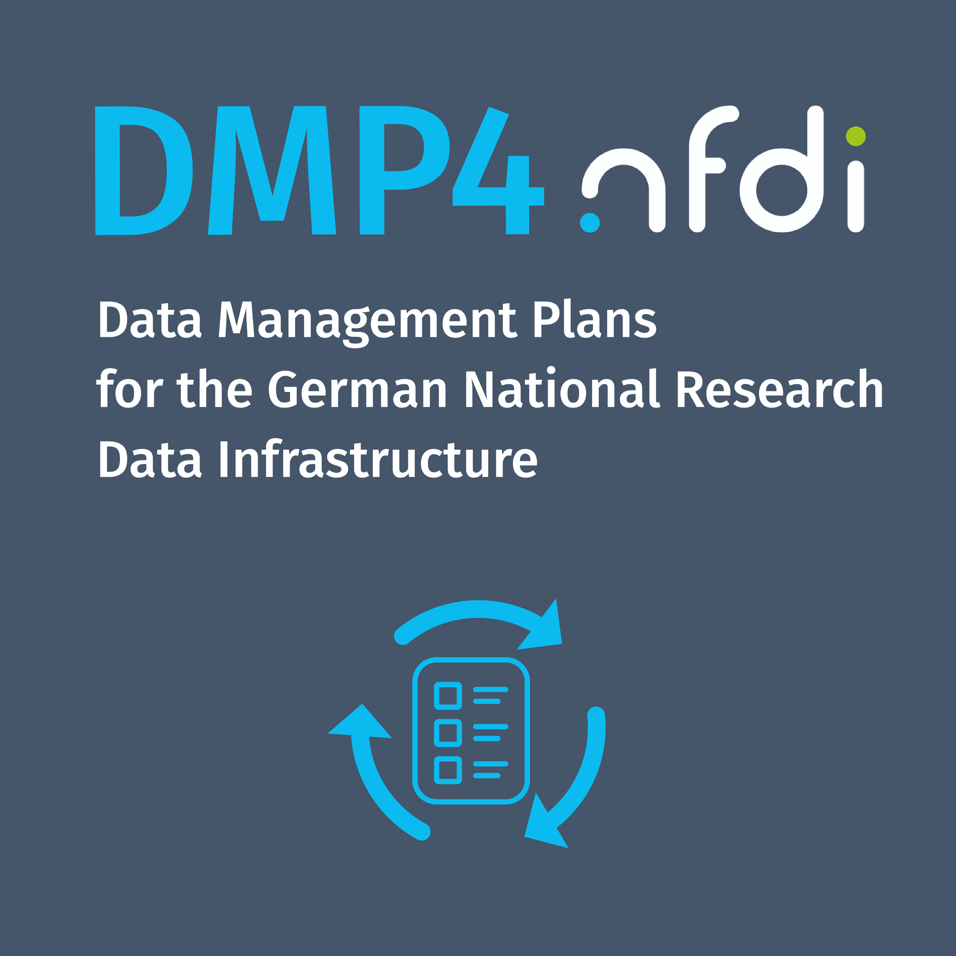


Base4NFDI
Projects

Slide 28
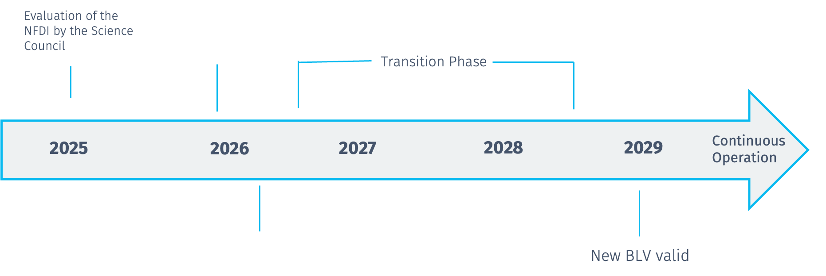
Future of NFDI
Now
BLV decision

Slide 29
Current Strategy 2026/2027
Improving the environment for collaboration
Increasing the use of consortium and basic services
Enable the comprehensive implementation of the FAIR principles
Expanding international cooperation
Strengthen competence in handling data
Ensuring sustainability through operating models
Courtesy Translation of the, on November 7, 2024, by the Scientific Senate approved German Version
Notes:
Improving the framework conditions for collaboration In order to develop the NFDI into a cross-consortium infrastructure, we need the effective participation of all members and consortia. To this end, we are making the work within the sections more effective and the section structure more sustainable, so as to achieve binding, joint outcomes. To this end, we are establishing a structure for the sections’ objectives and work that is as simple and transparent as possible, and we are improving the integration of the sections with the Academic Senate.
Increasing the use of consortium and core services We are creating a cross-cutting service portfolio with the aims of strategically steering the further development of consortium and core services and increasing the use of these services within the academic community. Consortia can propose services. We define criteria by which the Academic Senate decides on the inclusion and removal of services within the overarching service portfolio. Enable comprehensive implementation of the FAIR principles We are creating a portfolio of metadata standards, thereby laying the foundation for the comprehensive implementation of the FAIR principles across the consortia. To this end, we are developing criteria for decision-making regarding which metadata standards should be implemented as mandatory or optional within the NFDI. We are thereby negotiating related processes to optimise interoperability during the establishment, further development and international coordination of the standards. We ensure a cross-consortium metadata standard to improve the accessibility of research data in researchers’ day-to-day work. Expanding international cooperation International collaboration between association members and consortia is the indispensable basis for shaping international developments, particularly European data spaces. It is a key component for optimising connectivity and the development of structures. We are coordinating the development of a national node within the European Open Science Cloud (EOSC), which ensures collaboration and concrete data exchange within the European Research Area. For NFDI’s participation in EOSC, we are developing an “NFDI-EOSC Vision 2028”.
Strengthening data literacy Improving researchers’ data literacy is a key prerequisite for the effective use of services and metadata standards. Consortia and sections develop subject-specific, high-quality and attractive training programmes that are visible, open and FAIR. NFDI supplements this with third-party training programmes that meet the criteria outlined here.
Ensuring sustainability through operational models Operational models and appropriate governance structures are essential for the sustainable and reliable operation of services. We are drafting an “NFDI Vision 2029” on this topic, which will serve as a basis for negotiations with stakeholders. The vision provides guidance on the critical issues of funding, liability and coordination.

Slide 30

Future of NFDI after BLV 2028
Funding secured until 2038
Needs-based approach
Cross-cutting services
Common, interoperable architectures
Long-term, interlinked operational and funding models
Interoperability
Reliable legal and organisational framework
Digital sovereignty
Source: Zenodo DOI: 10.5281/zenodo.13961033
Photo©DFG
Notes:
Needs-based approach: For the NFDI to continue, a focus on the needs of the
scientific communities remains central. These needs are subject to constant
change and must therefore be met with appropriately flexible structures.
⯈ Cross-cutting services: Services spanning multiple consortia to meet the
fundamental needs of a broad spectrum of communities are a key component
for the further development of an NFDI. They enhance the usability of an NFDI
for different target groups, thereby increasing acceptance and providing a
common foundation both for networking within an NFDI and for its national and
international interoperability. The implementation of cross-cutting services for an
NFDI must therefore continue to play an important
role in the future. As with the development of an NFDI in general, the allocation
of tasks in the implementation of cross-domain services should also take place
through a science-led and participatory process.
⯈ Common, interoperable architectures: Furthermore, the scientific community
must be enabled to work with data across domains and disciplines. To this end,
the collaborative development of common architectures within the framework of
an NFDI is an essential building block. In this context, the coexistence of
different technical architectures is conceivable, provided that their
interoperability is guaranteed, for example through cross-domain standards.
This requires architecture management that is adequately resourced in terms of
both personnel and funding.
⯈ Long-term, interlinked operational and funding models: An NFDI must be
geared towards the long term. Operational models must be designed to be
transparent in this regard and must offer infrastructure users the assurance of
reliable structures and services with a long-term perspective. Given the wide
variety of consortia, different models must be permitted within an NFDI,
although the compatibility of all models – including from an organisational and
legal perspective – is absolutely essential. This requires a crisis-proof funding
concept that is incorporated from the outset. This concept must take into
account the fact that an NFDI cannot be self-sustaining and that public funding
is justified by the public interest orientation of an NFDI.
⯈ Interoperability: An NFDI must not only ensure the networking of stakeholders,
disciplines and structures within Germany, but also guarantee international
interoperability. As a science-led and community-driven information
infrastructure, an NFDI develops significant reference solutions at various levels
that serve as models. An NFDI must therefore aspire to help shape standards
as a clear anchor point for national and international activities – across all
disciplines. Not least, this means that an NFDI, by definition, functions as a
national node for the European Open Science Cloud (EOSC) and also acts as a
pioneer in the field of research data beyond Europe.
⯈ Reliable legal and organisational framework: A reliable legal and
organisational framework across the country is essential for the dependable
provision of services at both national and international levels. Its collaborative
development with the relevant stakeholders, both within an overall NFDI system
and beyond, will remain crucial in the future.
The future of the NFDI following the expiry of the federal-state agreement
in 2028
6
⯈ Digital sovereignty: An NFDI designed in this way makes a significant
contribution to national digital sovereignty, which is indispensable in view of
current and anticipated future scientific, technical and political developments.

Slide 31
Implementation of Internal Strategy 2025/2026
Consortium Assembly has established four projects
Increasing the use of consortium and core services:
  criteria and governance process for the NFDI service portfolio.
Increasing the use of consortium and core services:
  Website for the NFDI service portfolio
Expanding international cooperation:
  Position paper on linking NFDI standardisation activities with European initiatives.
Strengthening data literacy:
  Compilation of training opportunities on nfdi.de.
Notes:
Increasing the use of consortium and core services: criteria and governance process for the NFDI service portfolio.
Project leads: Stephan Ferenz ,York Sure-Vetter
Increasing the use of consortium and core services: Website for the NFDI service portfolio
Project leads: Julia Armin, York Sure-Vetter
Expanding international cooperation: Position paper on linking NFDI standardisation activities with European initiatives.
Project Lead: Stefanie Weidtkamp-Peters
Strengthening data literacy: Compilation of training opportunities on nfdi.de.
Project Lead: Nathalie Rathgeb,

Slide 32
Future of NFDI
Now
BLV decision

Slide 33





Social networks
For a FAIR data future.
www.nfdi.de
Podcast
Newsletter
Mastodon
YouTube
LinkedIn
Bluesky
Nationale Forschungsdateninfrastruktur (NFDI) e.V.

