Slide 1
IUCr as a global community facilitator for the common good
Kruna Vukmirovic, Head of Publishing Strategy, IUCr

Slide 2

Academic publishing is a facilitator of innovation
Funding
Activity
Outputs
Innovation
Publishing helps funders assess quality of research and point to emerging research areas
Publishers support and improve research activity through peer review , editorial oversight, production.
Publishers make research accessible, searchable, discoverable, archived. Journals organise research
Publishers create and develop platforms and tools; collaboration management
IP and attribution by establishing research primacy by data-stamping author precedence ownership of an idea, approach and finding
creates a permanent record, so ideas can be validated, challenged, and extended.
connects researchers through citations and literature networks, which helps identify gaps and opportunities.
supports reproducibility by encouraging detailed methods, data sharing, and transparent reporting

Slide 3
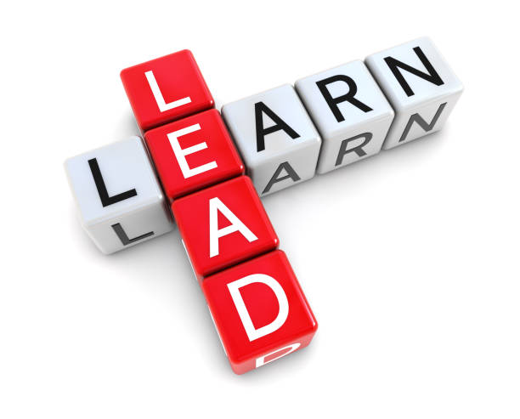
The role of Learned Societies
Gatekeepers of Quality
Learned societies help uphold standards in research and professional practice. They do this by supporting peer review, setting disciplinary benchmarks, maintaining ethical norms, and recognising high-quality scholarship.
Economic Engines for the Society
Many learned societies contribute to the financial sustainability of their wider organisation through membership, conferences, publishing, sponsorship, and professional services. This income can then be reinvested into activities that support the discipline and its community.
Publishing Programme
A society’s publishing programme often includes journals, books, newsletters, conference proceedings, and digital content. This allows the society to disseminate research, shape scholarly communication, and provide authoritative platforms for its field.
Fund Community Initiatives
Learned societies frequently use their resources to support grants, awards, outreach, public engagement, regional activities, and special projects. These initiatives help build a stronger, more connected professional community.

Slide 4
The role of Learned Societies
Advocate for the Discipline
Societies act as a collective voice for their subject area, promoting its value to funders, policymakers, universities, industry, and the public. They help raise awareness of the discipline’s importance and influence decisions that affect its future.
Increase Equity, Diversity, and Inclusion (EDI)
Learned societies can help make their fields more inclusive by removing barriers to participation and progression. This may include inclusive governance, diverse speakers and committees, accessible events, transparent processes, and targeted support for underrepresented groups.
Support Early Career Researchers
Societies often play a major role in mentoring, networking, training, awards, travel grants, and career development for students and early career professionals. This support helps build confidence, visibility, and pathways into long-term careers.
Societal Impact (SDG Goal Alignment)
Learned societies can align their work with the UN Sustainable Development Goals by encouraging research and activities that address global challenges such as climate action, health, education, equality, and responsible innovation. This strengthens the relevance of the discipline beyond academia.

Slide 5
Open Science in IUCr journals: four pillars
Open access to research outputs
FAIR data and metadata
Four fully open-access journals, six hybrid titles, transformative agreements and author-friendly licensing — with diamond routes under active consideration.
CIF as the community metadata standard, routine deposition to the CSD, PDB and IUCr archives, and IUCrData publishing validated datasets as citable objects.
Open methods and software
Editorial transparency and integrity
Methods and software as first-class outputs: four of the ten most-cited crystallography papers of the past decade are IUCr-published tools.
checkCIF validation before submission, integrity screening, published editorial policy
Each pillar is examined at the intersection of publications, data and methods.

Slide 6
IUCr and its journals: a timeline
1944
1948
1968
1983
1993
1994
Ewald’s lecture
IUCr founded
Acta splits; JAC launched
Acta C
Acta D
J. Synchrotron Rad.
Stresses the need for an international union of crystallography.
IUCr founded; Acta Crystallographica launched the same year.
Acta divides into Sections A & B; Journal of Applied Crystallography established.
Acta Crystallographica Section C created.
Acta Crystallographica Section D created.
Journal of Synchrotron Radiation launched.
OA from Jan 2022
2001
2005
2014
2016
Acta E
Acta F
IUCrJ launched
IUCrData launched
Acta Crystallographica Section E launched.
Acta Crystallographica Section launched
Launched in the UN International Year of Crystallography.
Short descriptions of crystallographic and related datasets.
OA from 2008
Native OA journals
The IUCr operates as a not-for-profit, Learned Society Publisher.

Slide 7
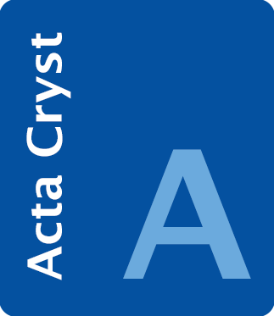
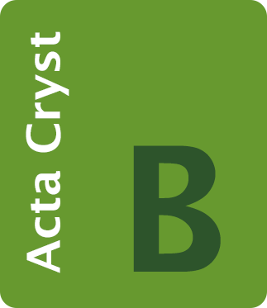
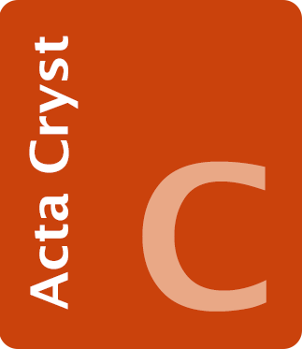
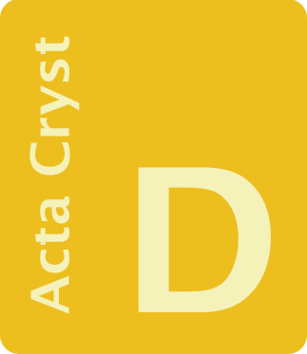
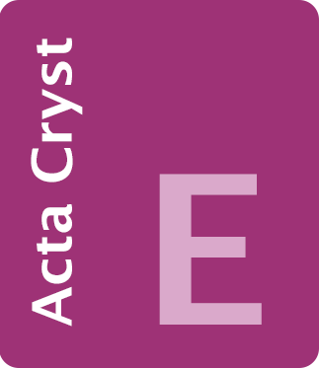
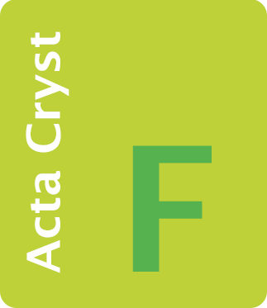
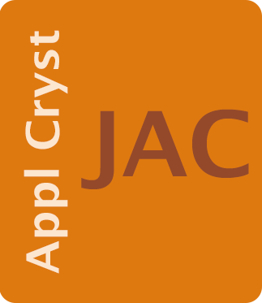



IUCr journal portfolio
IUCr Hybrid Open Access journals
The International Union of Crystallography (IUCr) publishes six hybrid open-access journals that publish cutting-edge research in materials science, structural biology and chemistry.
Acta Crystallographica Section A: Foundations and Advances
Acta Crystallographica Section B: Structural Science, Crystal Engineering, Materials
Acta Crystallographica Section C: Structural Chemistry
Acta Crystallographica Section D: Structural Biology
Acta Crystallographica Section F: Structural Biology Communications
Journal of Applied Crystallography
IUCr Open Access journals
The International Union of Crystallography (IUCr) publishes four world-renowned fully Open Access journals in cutting-edge research in crystallography and structural science, materials and synchrotron radiation. The IUCr's Open Access portfolio includes IUCrData that facilitates access to data through publication of crystallographic datasets in the biological, chemical or materials science fields.
Acta Crystallographica Section E: Crystallographic Communications
IUCrJ
IUCrData
Journal of Synchrotron Radiation

Slide 8

What is Open Science?
Open Science is a global movement to make scientific research transparent, collaborative, and accessible to everyone. It relies on key pillars like open access publishing, sharing raw data, and open peer review. (Centre for Open Science)
Open science is a set of principles and practices that aim to make scientific research from all fields accessible to everyone for the benefits of scientists and society as a whole. Open science is about making sure not only that scientific knowledge is accessible but also that the production of that knowledge itself is inclusive, equitable and sustainable. (UNESCO)
Science Europe Position Statement presents a shared vision where aligned assessment systems and open science principles enable research cultures that reward quality, integrity, and collaboration. In doing so, they strengthen research and innovation systems, and support a diverse and inclusive ecosystem of talented individuals, effective teams, and career pathways. Ultimately, they ensure that excellence in research is defined by – and grounded in – our shared values, for the benefit of all.
Source:
Saenen, B. and Morris, J. (2026) Connecting Open Science and Research Assessment Reform. Science Europe, 30 April. doi: 10.5281/zenodo.19886162

Slide 9
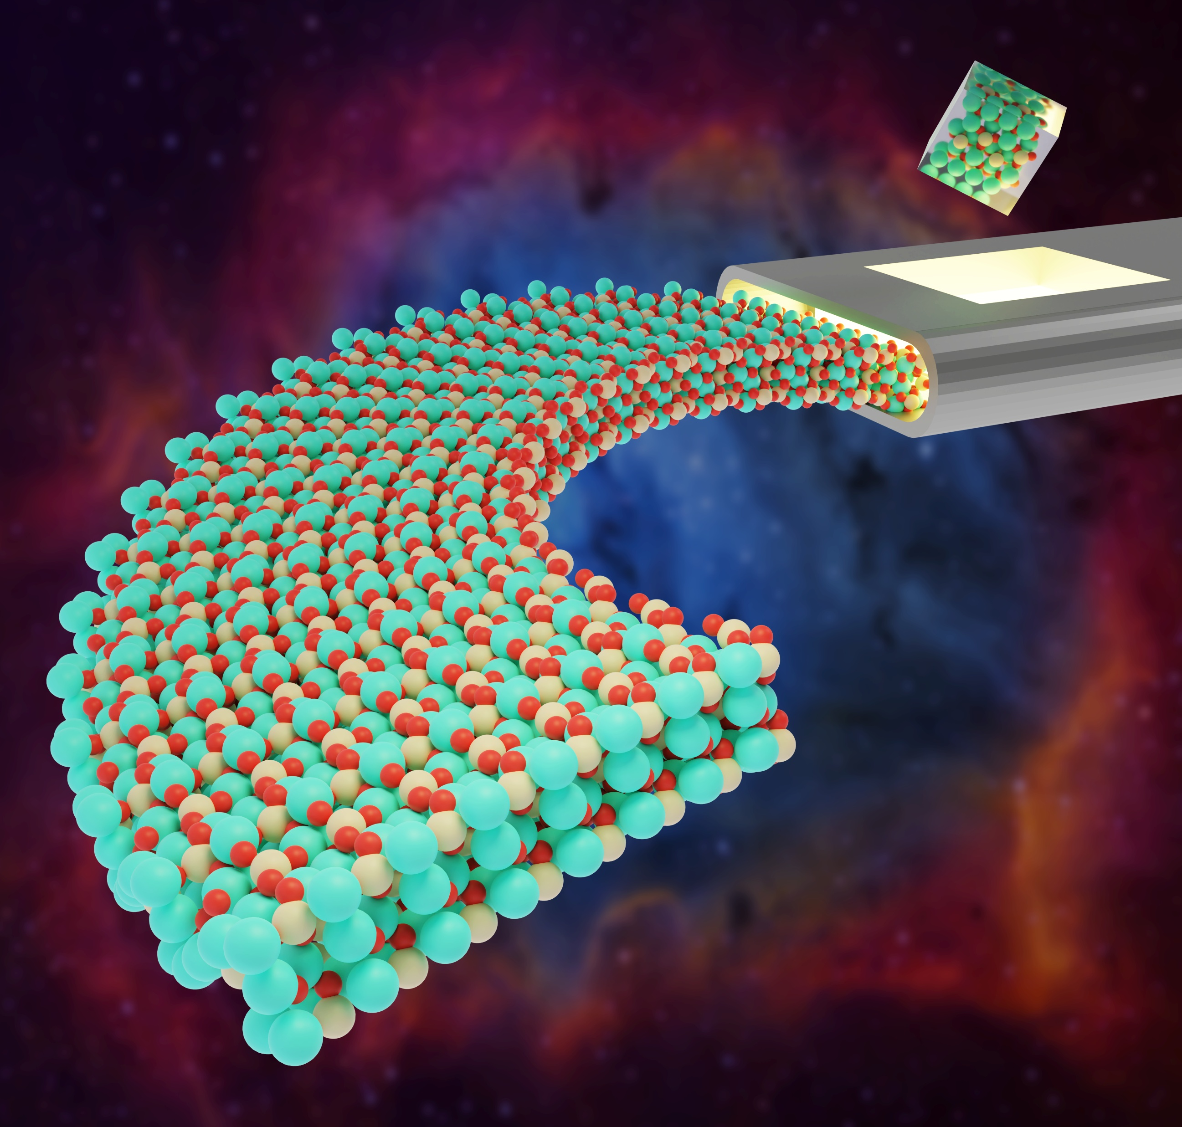
Purpose and vision for IUCr Journals
Purpose Statement for IUCr Journals:
To advance structural science globally by disseminating high-quality, peer-reviewed research that fosters innovation, collaboration, and knowledge sharing, while supporting and promoting the principles of Open Science to ensure equitable access and reproducibility.
Vision Statement for IUCr Journals:
To empower a thriving structural science community by being the premier platform for impactful, openly accessible research, fostering scientific discovery, and promoting Open Science practices that drive future breakthroughs in science.

Slide 10
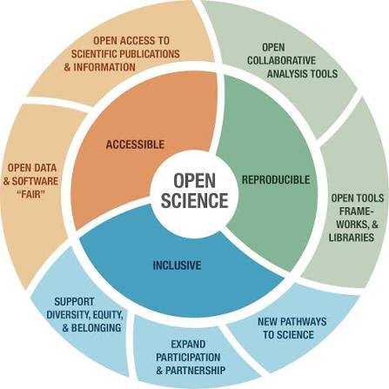
IUCr Journals: championing Open Science
IUCr Journals are at the forefront of open access and open science in structural science, ensuring that high‑quality research and data are freely available to the global community.
The discipline pioneered systematic data sharing through resources such as the Cambridge Structural Database and the Protein Data Bank, and more recently through the archiving of raw experimental data.
By choosing IUCr Journals, authors benefit from wide visibility, rapid dissemination and long‑term preservation of their work in trusted, community-led titles.
We offer a portfolio of fully open access and hybrid journals, flexible open‑access options (including support via institutional and transformative agreements) and clear, author-friendly licensing that enables broad reuse of published articles and data. Our policies actively encourage sharing of underlying data and resources, helping to drive transparency, reproducibility and innovation across structural science and related disciplines.

Slide 11
As open as possible, and as closed as necessary
It comes from the FAIR data / open science context, especially the EU Horizon 2020 guidance on FAIR data. The wording is commonly given as “as open as possible, and as closed as necessary” to mean data should be open by default, but restricted when needed for privacy, legal, ethical, or IP reasons
European Commission, Directorate‑General for Research & Innovation. H2020 Programme Guidelines on FAIR Data Management in Horizon 2020, Version 3.0, 2016: “data should be as open as possible and as closed as necessary.”
UNESCO (2021) Recommendation on Open Science, which states that scientific knowledge should be `as open as possible and as closed as necessary’.
The recommendation further recognizes a range of justified restrictions – including privacy, intellectual property, human subjects, Indigenous knowledge and security considerations – and explicitly notes that such conditions may evolve over time.
Sources:
https://ec.europa.eu/research/participants/data/ref/h2020/grants_manual/hi/oa_pilot/h2020-hi-oa-data-mgt_en.pdf
Crystallography in Open Science and its open educational resources, John R Helliwell, https://doi.org/10.1107/S2053273326004146 (https://doi.org/10.1107/S2053273326004146)

Slide 12
Setting the data standards
1991
1992
1999
2002
CIF
Electronic submission
Journals online
The full archive online
The Crystallographic Information File (CIF) is adopted as the standard structure for archiving and exchanging crystallographic data.
Electronic submission of articles to the IUCr journals is introduced.
Online access to the electronic editions of the journals is launched.
All back issues of the journals, to 1948, become available online.
checkCIF
Three levels
ALPSP
Run before submission
Completeness, consistency, geometry
Award for Publishing Innovation
Authors must validate a structure with checkCIF before submitting it to an IUCr journal.
A completeness prefilter, followed by CIF consistency checks, then geometry and symmetry checks. Anomalies are returned ranked by severity.
CIF and checkCIF were recognised by the Association of Learned and Professional Society Publishers in 2006.
CIF is maintained on behalf of the IUCr by COMCIFS, the Committee for the Maintenance of the CIF Standard.

Slide 13



What IUCrData publishes
Data Reports
Raw Data Letters
Validated crystal structure reports — concise, citable, peer-reviewed descriptions of a determined structure.
Short notes on raw diffraction data sets that have features of particular methodological interest.
Positioned as a specialist complement to IUCr’s nine traditional research journals — built for routine, data-centric publication rather than long interpretative articles.

Slide 14


Strengthening the data ecosystem
Reinforces routine deposition
Publishing concise, citable descriptions of structures and raw data sets strengthens the culture of depositing data in community databases such as the Cambridge Structural Database and IUCr-managed archives.
Surfaces data that would stay buried
Editorials on Raw Data Letters note these publications enhance data retrieval, draw attention to interesting data features, and enable re-analysis by methods and software developers.
Reinforces the wider IUCr journal ecosystem
Though not captured in standard journal metrics, IUCrData works alongside high-impact, cross-cutting journals like IUCrJ, connected through citation links and reuse of structural data.

Slide 15
OA vs closed access
IUCr Journals
Gold | 7374 | 39977 | 5.42
Closed | 5541 | 37731 | 6.81
Global Crystallography research
Closed | 199347 | 3706167 | 18.59
Gold | 81504 | 1861601 | 22.84
Source: Dimensions AI, August 2026

Slide 16
Why aren’t we there yet?
While research has become increasingly collaborative, computational, international, and infrastructure-dependent, the journal article remains the dominant unit of recognition and reward.
Many contributions essential to modern research, including data, code, methods, protocols, and technical infrastructure, remain difficult to recognize, assess, and reuse within existing systems.
At the same time, APC-based publishing models continue to create barriers to participation and reinforce article-centred incentives.
Gold APC: one complete payment that covers peer review, editorial infrastructure, long‑term archiving and discoverability — the full cost of publishing that article forever.
Hybrid APC: a “top‑up” that makes a single article open in a subscription journal that still collects subscription revenue.
Source: Fenter, F. (2026, June 10). To maintain trust in open access, we must finally complete the transition. Times Higher Education. https://www.timeshighereducation.com/opinion/maintain-trust-open-access-we-must-finally-complete-transition
Balance Open Access ambitions with long-term financial sustainability and responsible stewardship of our journals.

Slide 17
AI and transformation of scholarly publishing
Research is more open today than at any point in history: free to read, widely distributed, and increasingly global in scope. But open was never the ultimate goal. The goal was discovery, understanding, application, and progress.
Transformation is already underway
How research is accessed, synthesized and applied.
Access is not understanding and without it there can be no trust
Researchers, publishers, librarians, funders – defining opportunity for scholarly communication
Open science not just giving the access to knowledge, but the ability to understand it and be able to apply it and act wisely
Who controls the systems through which knowledge is organised, validated and reused?
Continuously strengthen fraud safeguards: AI screening, expert integrity checks, and system upgrades.
Reproducibility standards themselves will need to evolve as AI becomes more embedded in research.
.
CARE Principles – Collective Benefit, Authority to Control, Responsibility and Ethics.
Data justice to protect indigenous people’s data rights
TRUST Principles - TRUST highlights Transparency, Responsibility, User Community, Sustainability, and Technology
Sources: Carroll, S. R., Garba, I., Figueroa-Rodríguez, O. L., et al. (2020). “The CARE Principles for Indigenous Data Governance.” Data Science Journal, 19, Article 43. https://doi.org/10.5334/dsj-2020-043
Lin, D., Crabtree, J., Dillo, I., et al. (2020). “The TRUST Principles for digital repositories.” Scientific Data, 7, Article 144. https://doi.org/10.1038/s41597-020-0486-

Slide 18

Trust and value in the age of AI
In the age of AI, what value publishers bring to the research ecosystem?
Machine as readers, content creators, workflow agents – how do we measure our impact and the impact of research we publish with historical indicators and metrics – platform traffic, COUNTER reports, downloads (human only reading).
How do we ensure that we continue being the gatekeepers of quality and preserve the markers of provenance, ethical conduct in both published content as well as correct attribution.

Slide 19
Sustainable Development Goals (SDGs)
The papers published in the IUCr Journals from 2016 to 21026 YTD are categorised within the following SDGs
Table 1 Alignment with SDG goals – published papers in the IUCr journals 2016 to 2026YTD
03 Good Health and Well Being:
protein crystallography; cryoEM; antiviral drug discovery, vaccines, cancer therapeutics
07 Affordable and Clean Energy:
battery materials, photovoltaics, hydrogen catalysts, fuel cells, superconductors
13 Climate Action:
carbon capture materials, catalysts, improved batteries, sustainable materials
12 Responsible Consumption and Production:
Pharmaceutical quality control, crystallisation processes, waste minimisation, recyclable materials
06 Clean Water and Sanitation:
Membrane materials, catalysts, adsorption materials, environmental mineralogy
Sustainable Development Goals | Count
03 GOOD HEALTH AND WELL BEING | 5912
07 AFFORDABLE AND CLEAN ENERGY | 620
13 CLIMATE ACTION | 259
12 RESPONSIBLE CONSUMPTION AND PRODUCTION | 248
06 CLEAN WATER AND SANITATION | 70
11 SUSTAINABLE CITIES AND COMMUNITIES | 58
02 ZERO HUNGER | 51
04 QUALITY EDUCATION | 26
09 INDUSTRY INNOVATION AND INFRASTRUCTURE | 10
15 LIFE ON LAND | 9
05 GENDER EQUALITY | 8
14 LIFE BELOW WATER | 8
10 REDUCED INEQUALITY | 2
16 PEACE AND JUSTICE STRONG INSTITUTIONS | 2
01 NO POVERTY | 1
08 DECENT WORK AND ECONOMIC GROWTH | 1
Source: Web of Science, August 2026

Slide 20
Measuring impact: Top cited papers
Table 2: Top cited papers in crystallography 2016 to 2026 YTD
Mentioned by
1 blog
30 X users
4 patents
1 Facebook page
1 Wikipedia page
5021 citations
1746 Mendeley
Article Title | Source Title | Times Cited
Mercury 4.0: from visualization to analysis, design and prediction | JOURNAL OF APPLIED CRYSTALLOGRAPHY | 5866
Macromolecular structure determination using X-rays, neutrons and electrons: recent developments in Phenix | ACTA CRYSTALLOGRAPHICA SECTION D-STRUCTURAL BIOLOGY | 5449
Accurate prediction of protein structures and interactions using a three-track neural network | SCIENCE | 4057
MolProbity: More and better reference data for improved all-atom structure validation | PROTEIN SCIENCE | 3578
Real-space refinement in PHENIX for cryo-EM and crystallography | ACTA CRYSTALLOGRAPHICA SECTION D-STRUCTURAL BIOLOGY | 2461
First-principles Phonon Calculations with Phonopy and Phono3py | JOURNAL OF THE PHYSICAL SOCIETY OF JAPAN | 1557
ISOLDE: a physically realistic environment for model building into low-resolution electron-density maps | ACTA CRYSTALLOGRAPHICA SECTION D-STRUCTURAL BIOLOGY | 1451
BaTiO3-based piezoelectrics: Fundamentals, current status, and perspectives | APPLIED PHYSICS REVIEWS | 1253
Robust deep learning-based protein sequence design using ProteinMPNN | SCIENCE | 1243
RCSB Protein Data Bank: powerful new tools for exploring 3D structures of biological macromolecules for basic and applied research and education in fundamental biology, biomedicine, biotechnology, bioengineering and energy sciences | NUCLEIC ACIDS RESEARCH | 1229
From 2016 to 2026 YTD, IUCr journals published 4 of the top 10 most cited crystallography papers (40%).
Mentioned by
5 news outlets
4 blogs
18 X users
52 patents
1 Wikipedia page
1 research highlight platform
8117 Dimensions citations
2054 Mendeley readers
Sources: Web of Science, July 2026
Dimensions AI, August 2026

Slide 21
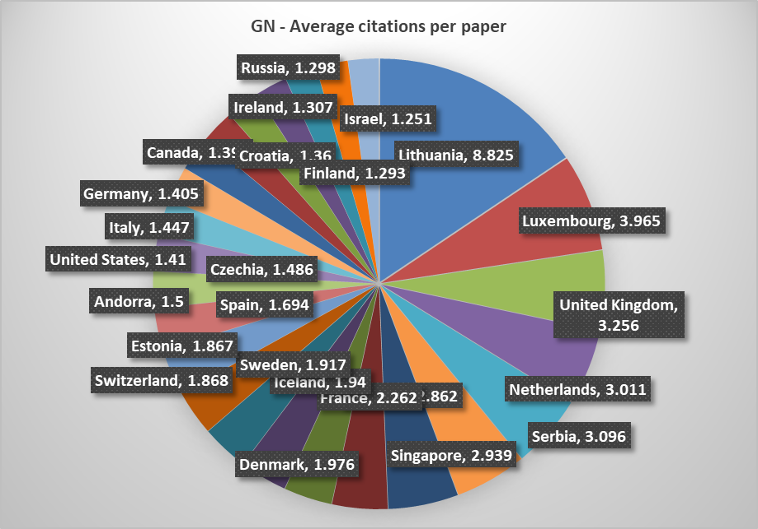
Equity in academic publishing
Table 3 Geographical spread of published papers and associated citations in the IUCr Journals 2016 to 2025
Geopolitical classification | #countries/regions | annual average #publ.papers | annual average citations | annual per paper citations | Highest cited country region (average per paper citation)
Global North | 51 | 1696.5 | 28363.2 | 16.71 | Lithuania (8.825)
Global South | 74 | 642.2 | 4006.2 | 6.23 | UAE (6.592)
Figures 1a and 1b – Geographical spread of published papers and associated citations in the IUCr Journals 2016 to 2025
Source: Dimensions, February 2025

Slide 22


Community and Educational Impact
Democratising access
Supporting early-career researchers
Fully open access, with no paywall for readers
Extends high-quality crystallographic data to researchers, students and educators worldwide — including institutions without strong subscription budgets
Immediate access to supporting information and structured metadata makes articles usable as training material for teaching crystallography, data stewardship and structural validation
Offers a recognised, peer-reviewed outlet for careful structure determinations or data curation work that doesn’t warrant a long interpretative article
Helps researchers and practitioners receive credit for data stewardship work
Builds track records aligned with evolving open-science incentives around data-centric contributions

Slide 23

Early Career Boards
Early Career Boards (ECB) initiative
Attracts international ECRs to serve across 8 IUCr journals.
Provides mentorship and currently includes 23 members.
A new cohort of 32 members is expected to join next.
Members consistently value mentorship, peer-review training, and closer engagement with IUCr journals, including attendance at Editorial Board meetings.
Peer-review opportunities are seen as one of the most valuable parts of the programme, including mentored reviews, progression to independent reviewing, insight into editorial decision-making, confidence in evaluating manuscripts, and discussion of reviewer reports with mentors.
Professional benefits
Members said the peer-review workshop and follow-up mentoring provided a strong foundation for developing reviewing skills.
Broader benefits included understanding the publication process, exposure to editorial activities, awareness of publishing standards, and networking within the crystallographic community.
Several members expressed interest in progressing towards editorial roles within IUCr journals.

Slide 24
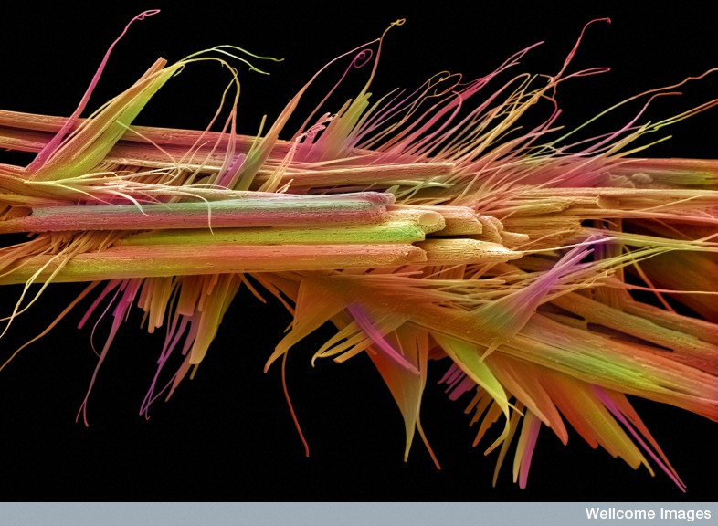
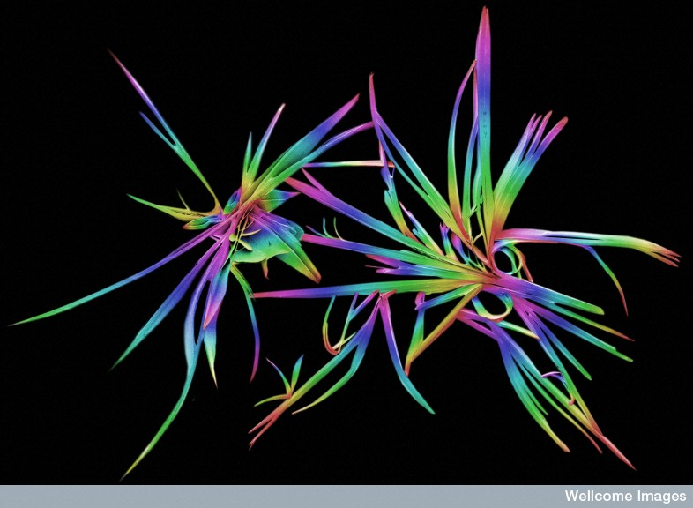
Outreach
Capacity building and training
Over 25 major workshops and schools in 2025, including advanced crystallography, spinning electron, and synchrotron training
Diversity, inclusion and equity
Gender-balanced participation at major events
Support for Early Career Researchers
Funding and support for scientific exchange and education
IUCr Outreach Fund: $30,000 USD in 2025 – supported dozens of events
25 events funded through our $96,000 USD fund that is allocated for meetings and capacity building
Visting Professorship: $119,000 USD invested to boost expertise and training in underserved areas

Slide 25
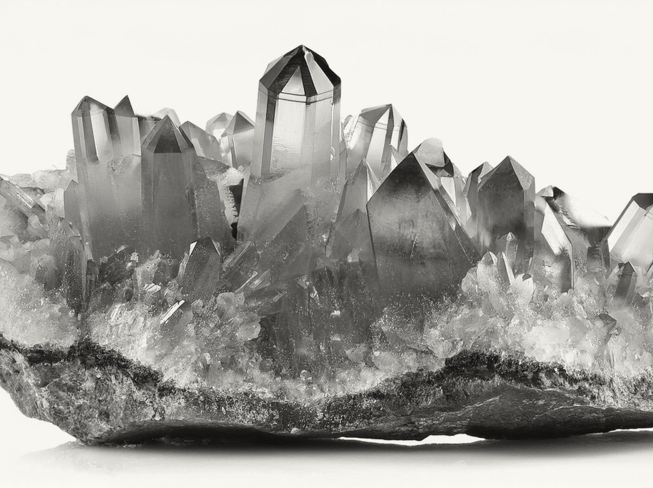
Outreach
Global reach and participation
IUCr outreach engaged students, teachers, and researchers in over 30 countries across all continents
Crystal Growing Competitions: over 80 schools in Argentina, 90+ in Chile and 60+ in Jamaica
Africa initiative success
AFRAMED Project : Researchers from over 10 African countries trained via remote labs and schools
First national crystallization contest in Kenya: 16 teams; 66 students, 6 schools
Latin America and Caribbean Leadership
LACA-ABCr meeting: 240 participants from 20 countries, 60 students trained in advanced techniques
Caribbean Crystallography School 60 students trained, inaugural event in Jamaica

Slide 26
How might we amplify our positive impact?
Removing APCs – Diamond Open Access?
What is Diamond Open Access?
  Diamond Open Access is an equitable approach to scholarly publishing. It provides online access to research outputs with no fees for readers or authors. Diamond Open Access relies on shared infrastructures and open licensing. These conditions enable scholarly knowledge to circulate as a digital public good. (UNESCO)
Diamond Open Access risks becoming an ethical aspiration constrained by structural (and financial) realities.
Commission on Teaching in the early 1980 introduced its Teaching Pamphlets on Crystallography Series. The IUCr Online Dictionary of Crystallography is also free to access online.

Slide 27
An agenda for society publishers
Keep standards and infrastructure community-governed
Own the standard, not only the journal — COMCIFS shows how a discipline can steward its own data format.
Make validation a service to the field, not a gate
checkCIF runs before submission and is open to anyone: quality control as shared public infrastructure.
Align the business model with equitable access
Cost each route transparently and treat diamond open access as a question to answer, not a slogan.
Publish the outputs that assessment overlooks
Data reports, raw-data letters and software papers give credit for work the article-centred system misses.
Build openness into early-career practice
Mentored peer review can introduce early-career researchers to the practical principles of open science, helping them apply greater transparency and reproducibility in their publishing work.
IUCr as case study — the pattern is transferable to any disciplinary union.

Slide 28
Questions for discussion/contemplation
If machines become the primary readers of our journals, what does a society publisher’s quality signal need to look like? And who validates it?
Which parts of our infrastructure must stay community-governed for open science to remain equitable, and which can safely be shared or outsourced?
What would it take for data, software and methods to carry the same career weight as the article — and what can publishers, research communities do here that funders cannot?
Society publishers as trusted stewards of open science, keeping it equitable, reusable and socially valuable, not just free to read.

Slide 29
Sources
Title | Authors | Journal | Year
Crystallography Open Database – an open-access collection of crystal structures | S. Gražulis, D. Chateigner, R. T. Downs, A. F. T. Yokochi, M. Quirós, L. Lutterotti, E. Manakova, J. Butkus, P. Moeck, A. Le Bail | Journal of Applied Crystallography | 2009
Validation of the Crystallography Open Database using the Crystallographic Information Framework | A. Vaitkus, A. Merkys, S. Gražulis | Journal of Applied Crystallography | 2021
Archiving raw crystallographic data | T. C. Terwilliger | Acta Crystallographica Section D | 2014
Experiences with making diffraction image data available: what metadata do we need to archive? | L. M. J. Kroon-Batenburg, J. R. Helliwell | Acta Crystallographica Section D | 2014
Companion DDDWG article on rationale and practicalities of raw data archiving | J. M. Guss, B. McMahon | Acta Crystallographica Section D | 2014
Companion DDDWG article on raw data archiving practicalities | T. C. Terwilliger, G. Bricogne | Acta Crystallographica Section D | 2014
Raw diffraction data preservation and reuse: overview, update on practicalities and metadata requirements | L. M. J. Kroon-Batenburg, J. R. Helliwell, B. McMahon, T. C. Terwilliger | IUCrJ | 2017
Raw diffraction data are our ground truth from which all subsequent workflows develop | J. R. Helliwell | Acta Crystallographica Section D | 2022
The evolution of raw data archiving and the growth of its importance in crystallography | J. R. Helliwell et al. | IUCr journals / arXiv preprint | 2024
Introduction of the 'Raw Data Letters' section of IUCrData | L. M. J. Kroon-Batenburg et al. | IUCrData | 2022
Raw data availability: the small-molecule crystallography perspective | IUCr Newsletter contribution | IUCr Newsletter, Vol. 28, No. 1 | 2020
The science is in the data | IUCr commentary (Acta Cryst. Section M / Newsletter) | Acta Crystallographica Section M / IUCr Newsletter | 2017
75 years of IUCr Journals: 1948 to 2023, an Editor-in-Chief's perspective | A. Allen | IUCrJ | 2023
Crystallography in Open Science and its open educational resources | J. R. Helliwell | Acta Crystallographica Section A | 2026

Slide 30
Thank you for your attention!
Email: kv@iucr.org
WeChat: KVuk15

