Slide 1
The Landscape of Open Science in Canda Through a Neuroscience Lens
Amanda Rande MSc.
Open Science Coordinator | Hotchkiss Brain Institute
Amanda.rande1@ucalgary.ca

Slide 2
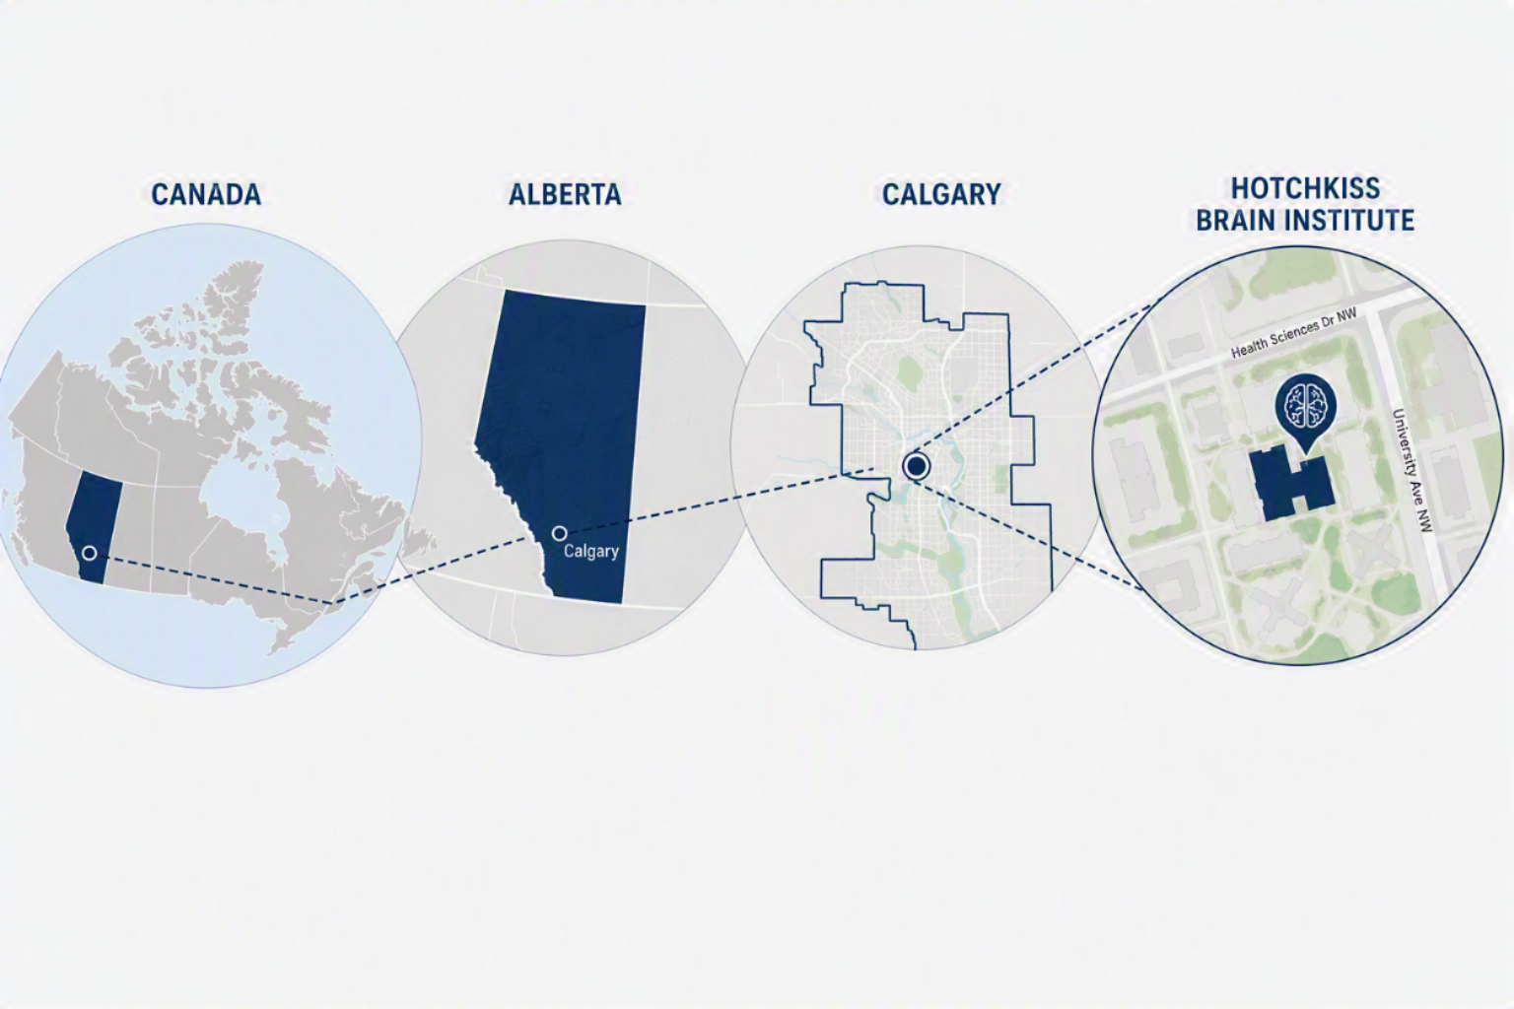

Slide 3
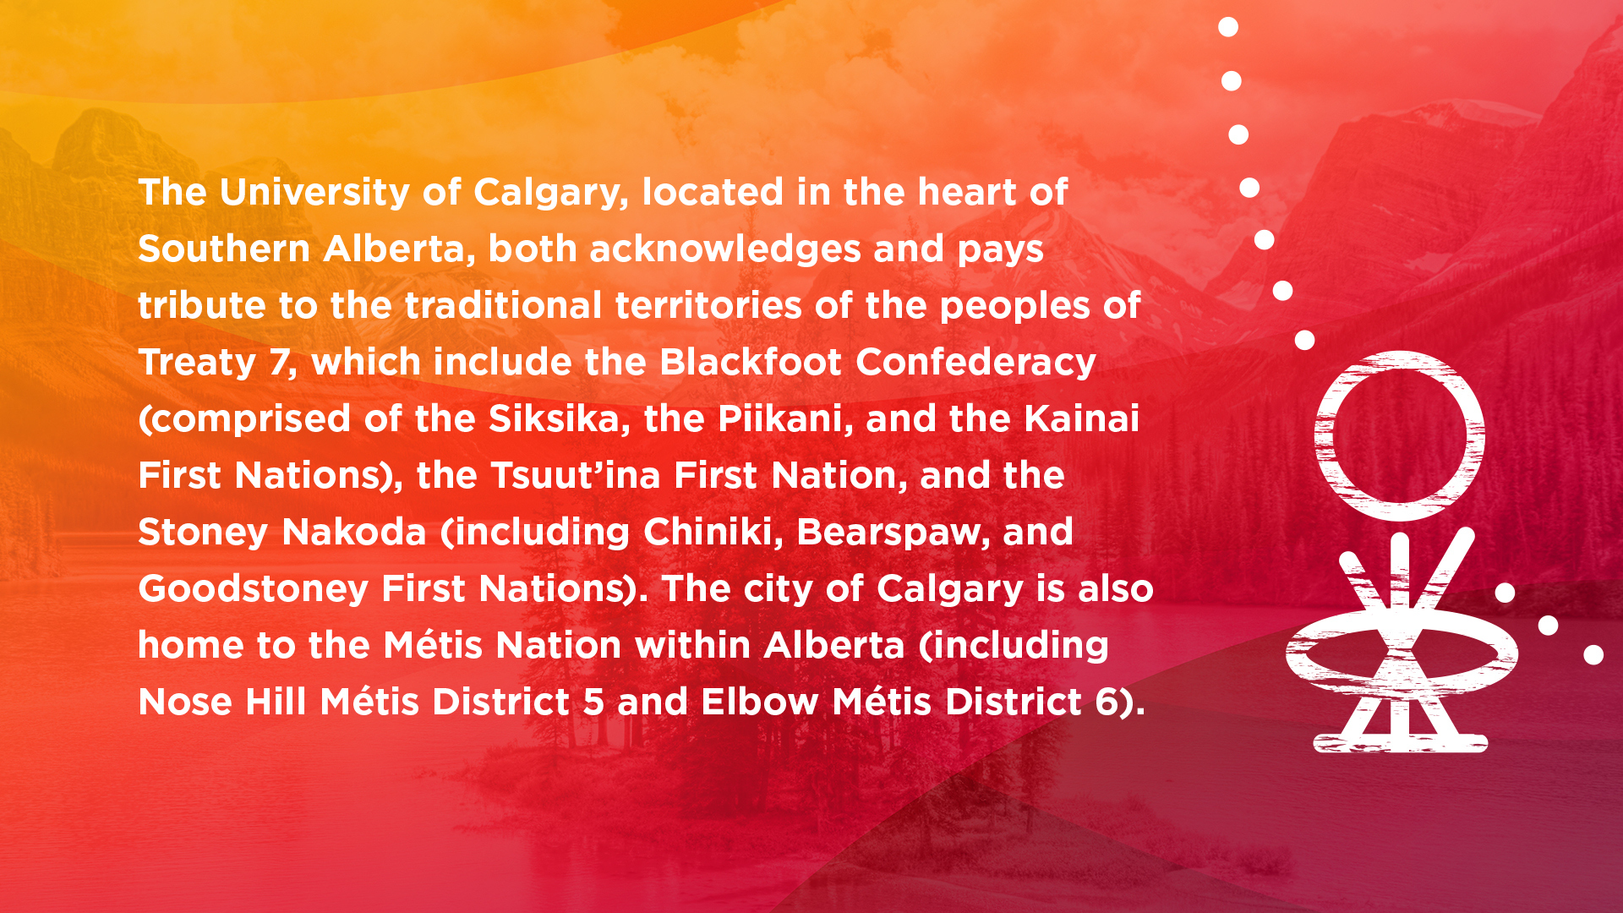

Slide 4
Open Science has Entered a New Era
2021
Tri-agency policies for data management and sharing
Now
Roadmap for Open Science
UNESCO Recommendations on Open Science
DORA
Institutional sharing requirements
Joining of Open Science Alliances
2021
Ongoing

Slide 5
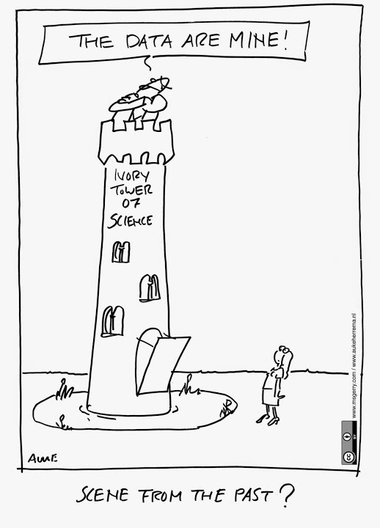
Zooming In: What Does Open Science Look Like at an Institute?
The HBI is committed to promoting Open Science.
  Will support the public release of research data and findings, irrespective of outcomes.
  Synergistic with existing Open Science collaborations.
  Strategically aligned with key stakeholders, and research, education, and administrative structures.
Has established five guiding principles
  Help guide the HBI’s policies and allocation of resources, without infringing on the academic autonomy of HBI members
  https://hbi.ucalgary.ca/research/institute-initiatives/openscience

Slide 6
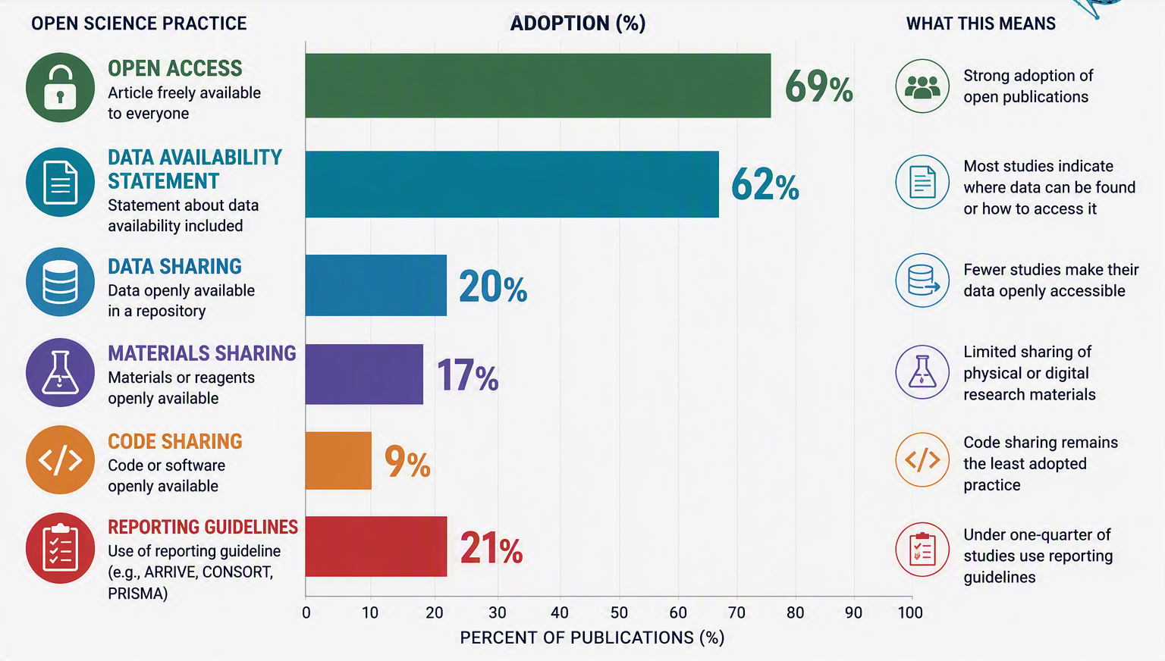
Snapshot #1: Open Science is Happening, But Unevenly
Ganshorn, et al., (2026) https://doi.org/10.1016/j.gni.2026.100004

Slide 7
What Creates this Gap?
If researchers support open science, why do some practices become difficult to implement?

Slide 8
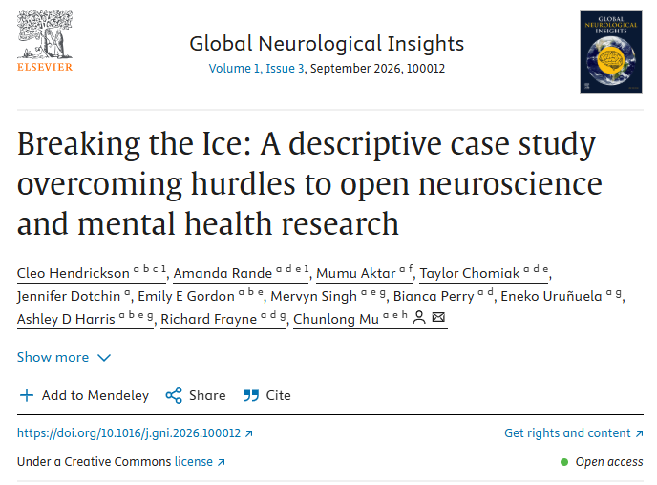
Snapshot #2: What We Learned from the Community
The barriers are not primarily technical
Participants discussed:
Resources
Knowledge
Skills
Incentives
Institutional Support
Sustainability
Hendrickson, et al., (2026) https://doi.org/10.1016/j.gni.2026.100012

Slide 9
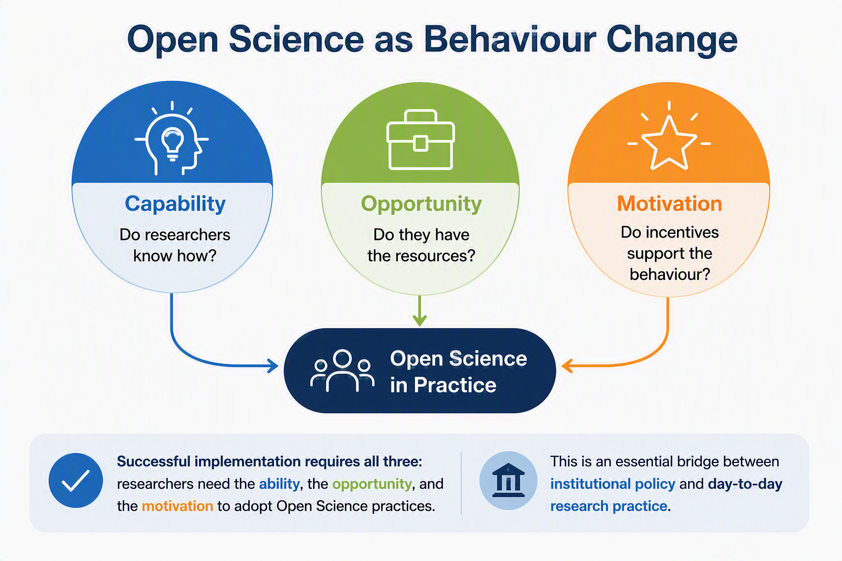
Snapshot #3:

Slide 10
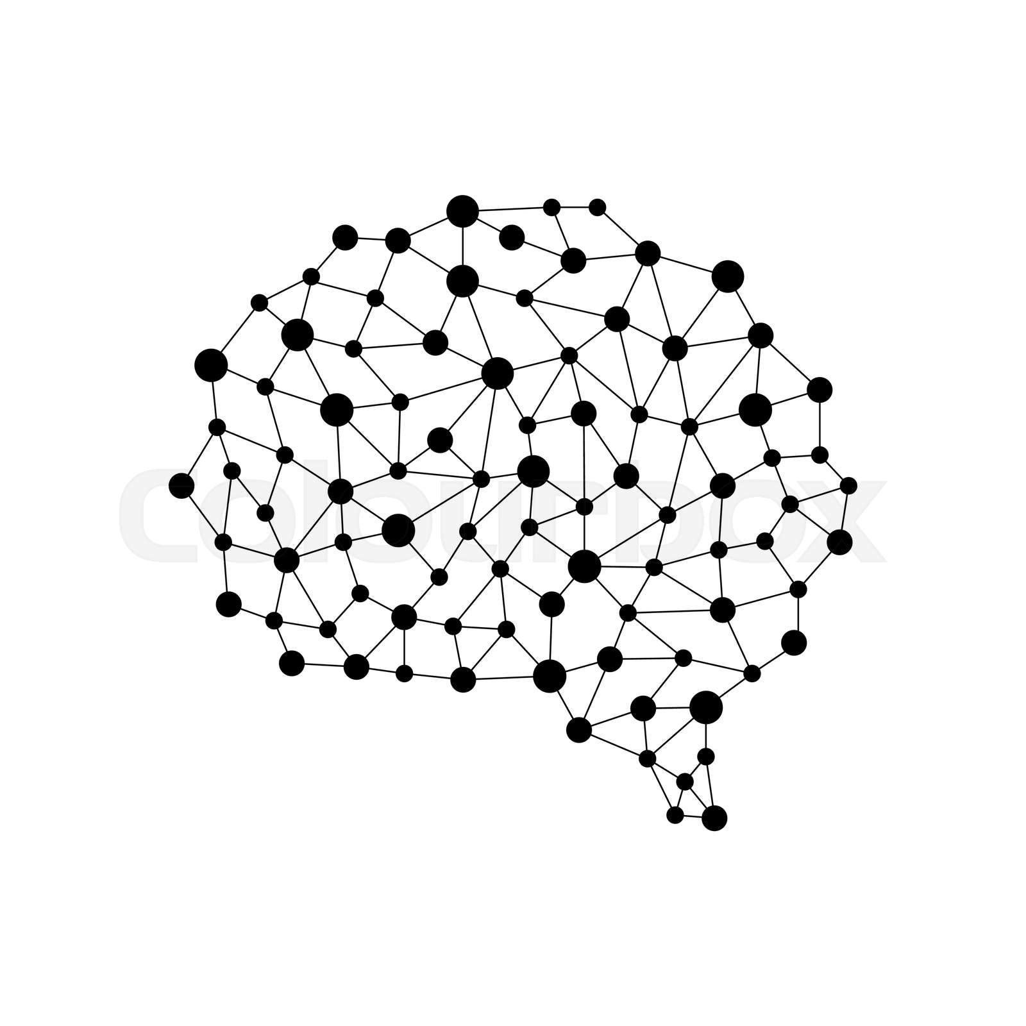
Snapshot #4: Nobody Should Have to Do This Alone
The TOSI Alliance for Open Neuroscience
Together we:
Build relationships across disciplines and institutes
Share resources and expertise
Develop training and educational materials
Solve common challenges
Amplify impact of open science and neuroscience research across Canada
https://www.mcgill.ca/neuro/open-science/tanenbaum-open-science-institute-tosi/promoting-open-science-across-canada

Slide 11
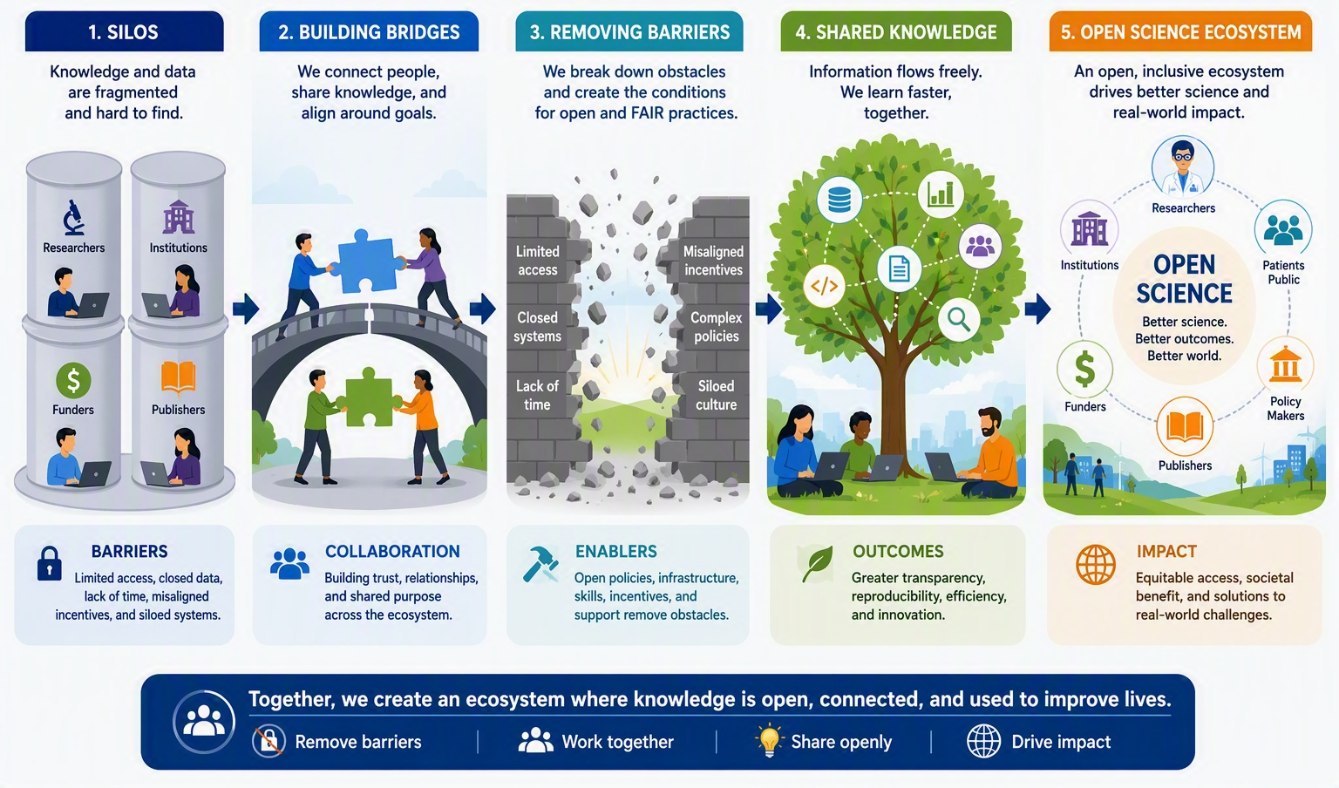
Evolution of Open Science

Slide 12
The Next Chapter of Open Science in Canada
Move towards supporting the researchers for sustainable open practices

Slide 13
Questions?

