Slide 1
COLD Project Review Meeting
WP2 – Diagnostics & Laser for Photo Gun
Friederike Ewald
On behalf of the EBS accelerator team
and the collaboration:
SLAC, INFN, CERN, PSI, Cornell

Slide 2
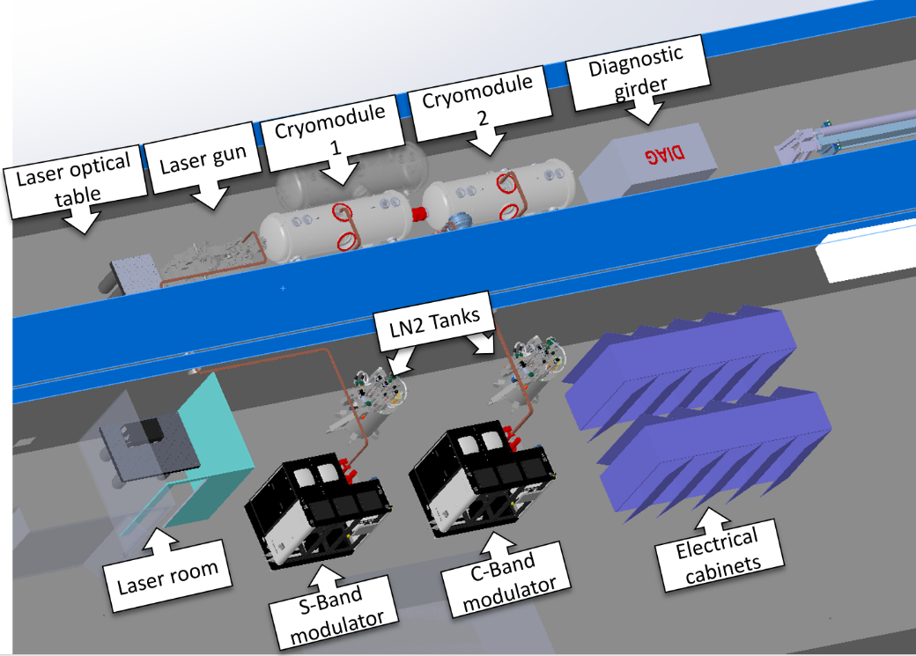

Outline
Preliminary 3D-sketch of the COLD setup
Part I – Laser and optics for the photo gun
  Requirements
  Technical choice
  Implementation
Part II – Diagnostics
  Diagnostics layout for phase 0
  Diagnostics layout for phases 1 & 2
  Specifications
T. Brochard/MEG

Slide 3
Part I – Drive laser for the RF Photo Gun
Requirements / Specifications
Possible candidate for the laser
Synchronisation to RF
Layout of laser installation
Conclusion

Slide 4
Requirements For RF-Photon-Gun Drive Laser
Photo cathode material | Copper
Quantum efficiency QE for electron emission from Cu: | ~10⁻⁵ – 10⁻⁴
→ Work energy for Cu-cathode | 4.53 – 5.1 eV
→ Laser wavelength in the UV | < 243 nm – 274 nm, e.g. 266 nm from 3rd harmonic of Ti:Sa e.g. 257 nm from 4th harmonics of Yb-based lasers
Electron bunch charge (wished) | ~ 1 nC
→ needed Laser pulse energy (4.3 eV * 1 nC/QE) | ~ 50 – 100 μJ on the cathode Losses during beam transport: → 200 μJ minimum at laser output
Parameters defined by RF-cavity and LINAC design
Laser pulse duration | ~200 fs
Laser spot shape and size on the cathode | 600 μm radius, round flat top (maybe Gaussian OK)
Longitudinal pulse profile | Gaussian
Other requirements
Repetition rate: | 4 Hz… 10 Hz
Synchronisation capability | Phase locking to RF (2.9989 GHz & 5.712 GHz)
Stability | High reliability and as much as possible maintenance free
Limited Space | Compact dimensions

Slide 5
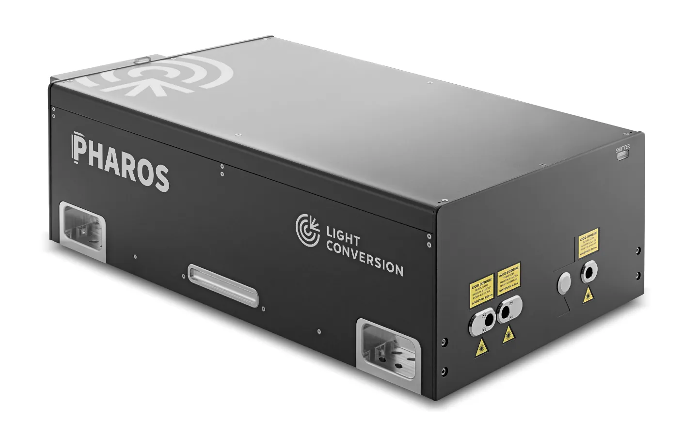

→ Yb solid state laser technology
Good candidate: Pharos 2H-4H from Light Conversion
Diode pumped Yb-crystal laser (λ = 1030 nm)
with integrated 4th harmonics generation:
  λ = 257 nm
  E = 200 μJ / pulse ^{(*)}
  190 fs pulse duration minimum
  Transverse beam diameter at exit ~7mm
  Single shot – 100kHz
  Oscillator frequency 60 – 84 MHz
  Compact
492 cm
827 cm
25 cm
190 fs
(*) 2 mJ at fundamental wavelength (1030 nm)
10% conversion efficiency into 4th harmonics (257 nm)
This laser is already used for RF photo guns at
DESY (S-band photoinjector at SINBAD-ARES)
CERN CLEAR/CTF2 photoinjector
Photoinjector of CXFEL (Arizona State University)
Positive feedbacks on performance and maintenance
(beam quality, stability, long term reliability,…)

Slide 6
Synchronisation of Laser to RF
The laser is driven by a mode locked oscillator.
The oscillator frequency may be chosen within certain limits (for the Pharos: 60 – 84 MHz)
The common RF-frequency between European S-Band and C-Band:
142.8MHz
x 21
x 40
÷ 2
Gun
2998.8 MHz
Accelerating structures
5712.0 MHz
Laser oscillator frequency
71.4 MHz

Slide 7




Approximate Schematic Principle of the Laser Installation Layout
UV-viewer for beam spot observation
LINAC tunnel
Photo gun
Optical table
with enclosure
Optical
breadboard
To be defined
Electrons
LINAC tunnel wall
Chiller
Laser
Modulator hall (Pinj)
To be defined
Laser cabin
(temperature stabilized ± 1 deg C)
Shutter
Contact switch

Slide 8
Laser Beam Transport
Wish list:
Distance from laser output to cathode as short as possible
Adjustment of beam dimensions (horizontal / vertical) on the cathode surface (~300 um radius)
Adjustment of transverse position on the cathode
Adjustment of photon flux on the cathode
Maybe adjustment of pulse duration
UV wavelength and short pulses :
Damage thresholds of optical coatings and bulk material to be taken into account
Fused silica for transmission optics and viewports
Carbon deposit on optical surfaces will affect photon flux and beam profile quality
Total beam losses due to beam shaping and transport can be very high
Choose laser pulse energy enough margin
If pulse stretching is needed, this will come at the cost of pulse energy
Where possible use (dielectric) mirrors instead of lenses
As few optical elements as strictly necessary
Is the flat top transverse profile really needed? (ARES & CTF2 experience: No)

Slide 9
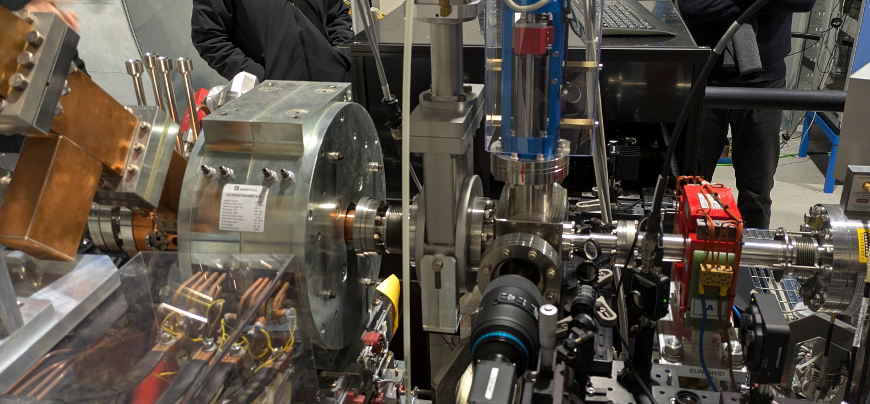
Detail of the Laser Injection Window and Diagnostics of the Gun Section (INFN Frascati)
Viewport for laser beam
INFN

Slide 10
Part I – Conclusion on Drive Laser for Photo Gun
Specifications of the Pharos 2H-4H laser meet perfectly our requirements
Positive feedback concerning operation and reliability from other institutes
Why not Ti:Sa technology?
  As compared to FEL LINAC installations we do not need complicated time-structures, which would impose Ti:Sa technology
  Much higher space requirements, lower reliability/stability during operation,
  more maintenance, more expensive
Next steps are the design of the optical pathway / beam transport up to the cathode surface
Thanks to F. Burkhart & W. Kuropka (DESY / ARES)
and E. Granados (CERN / CTF2)
for discussion and advice

Slide 11
Part II – Electron Beam Diagnostics
Approximate layout of diagnostics installation for phase 0 of the project
Approximate layout of diagnostics installation for phases 1 & 2 of the project
Diagnostics specifications
Conclusion

Slide 12
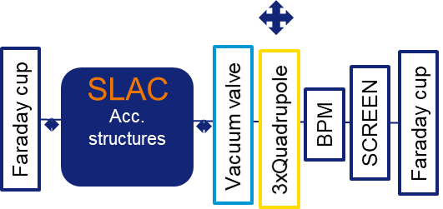
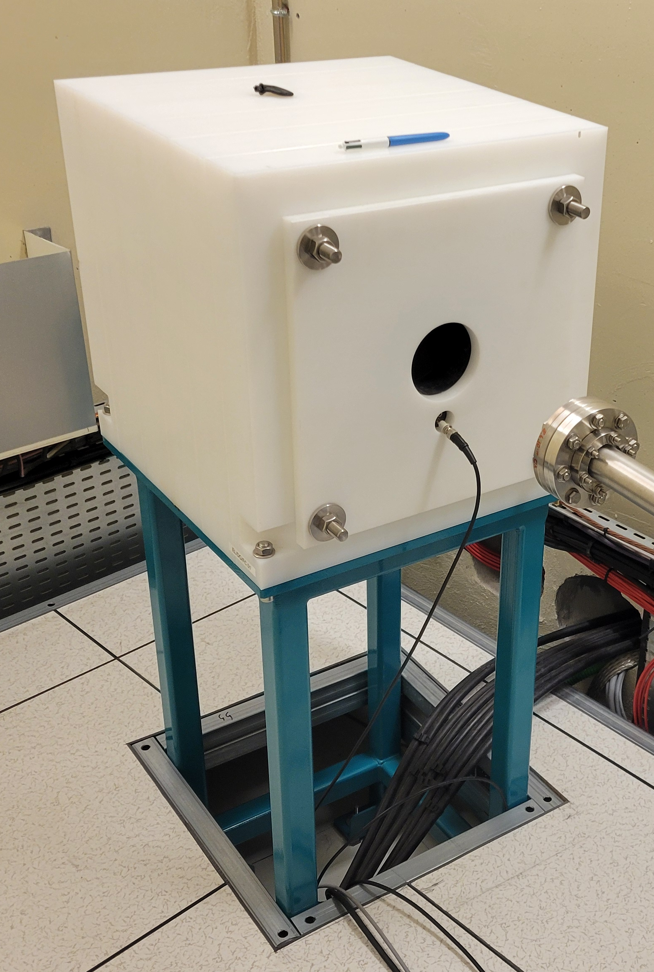

PHASE 0 – Accelerating Structures Without Photo Gun → Dark Current Measurements
Neutron absorber
Electron beam
Lead
Beam Dump Thom-X (50 MeV),
Soleil 150 MeV design
Graphite
A screen may complement the diagnostics in Phase 0.
Expected dark charges in the order of nC
Faraday cups is the beam dump.
Two Beam Dumps for 350 MeV (maximum)
→ to be designed by Radio Protection Group

Slide 13
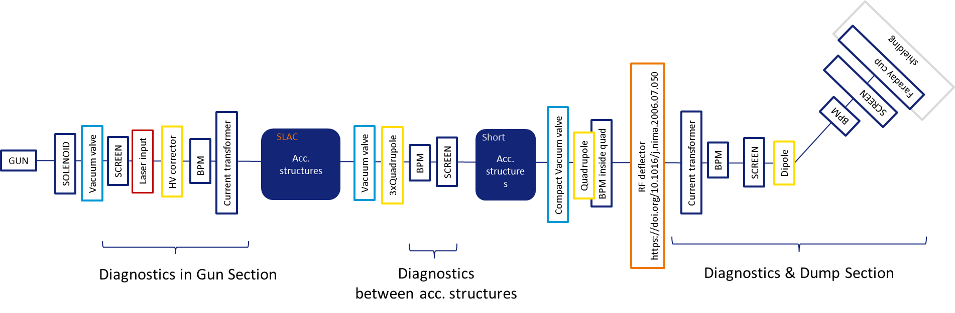
PHASES 1 & 2
Phase 1:
Photo gun and the diagnostics & dump section will be installed, leaving space for the installation of a shorter accelerating structure in Phase 2.
The standard diagnostics for phase 1 and 2 are essentially the same.
Phase 2:
RF-deflector for longitudinal profile; depending on budget

Slide 14
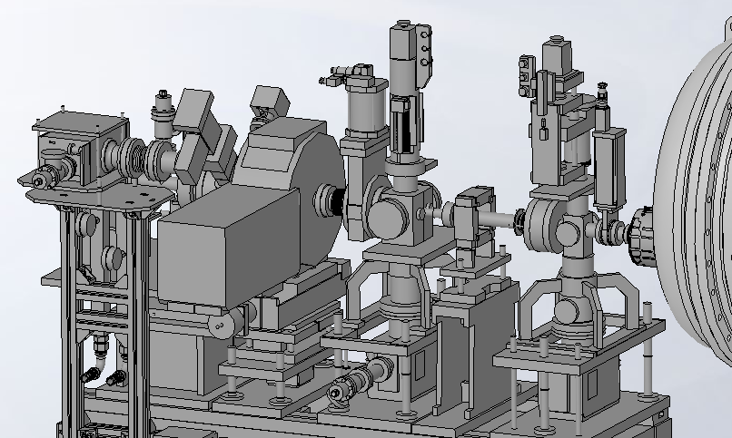
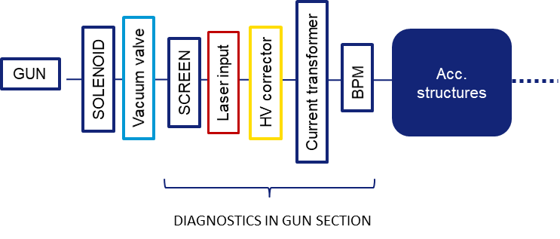
PHASE 1 – Installation and Commissioning of Photo Gun → RF-Gun Diagnostics
3D-view of Gun Section (from INFN):
Screen monitor
Solenoid
BPM
Current transformer
Photo Gun
Steerer
Laser

Slide 15
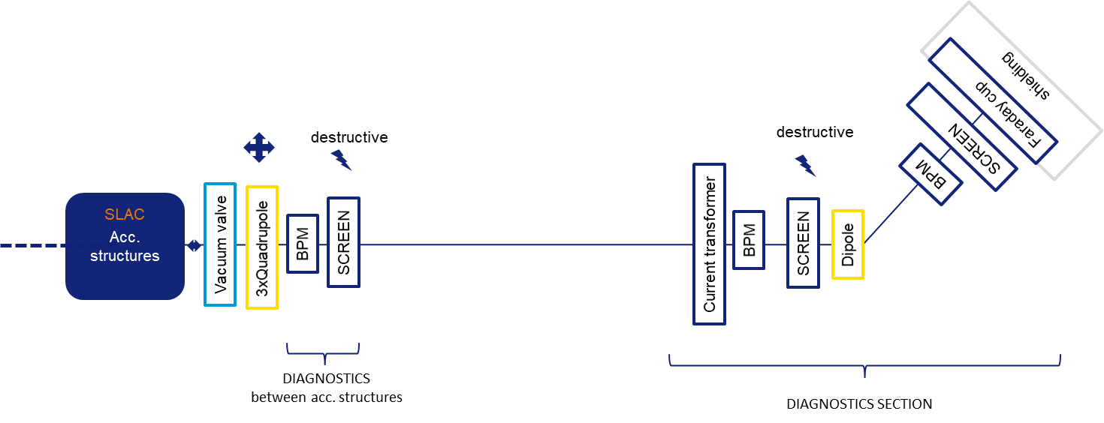
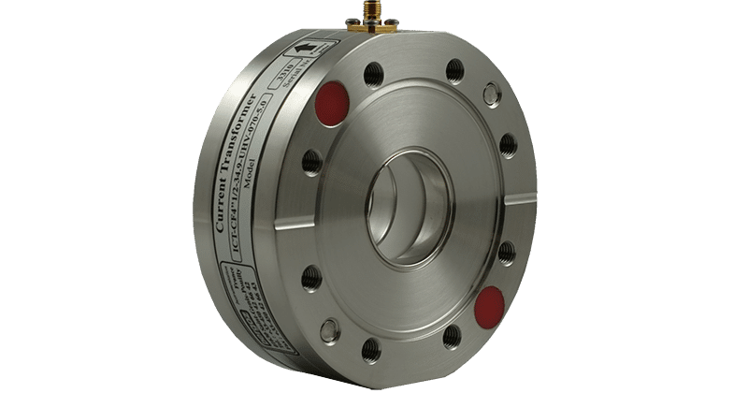
PHASE 1 – Installation and commissioning of photo gun → Diagnostics Section
Insertable Screen monitor for
Beam position and
Transverse size (1 – 3 mm)
YAG:Ce or GAGG:Ce with adequate imaging for high resolution
Dipole magnet + Screen + Imaging optics
Specified for maximum of 350 MeV
(for Safety, beam max. energy = 300 MeV)
→ Stripline? Button BPM? Cavity BPM?
→ Which resolution is needed / achievable?
2 ps, single-pass 4 Hz, beam charge ≤ 700 pC
In-flange ICT (commercial solution)
Beam charges ≤ 700 pC

Slide 16
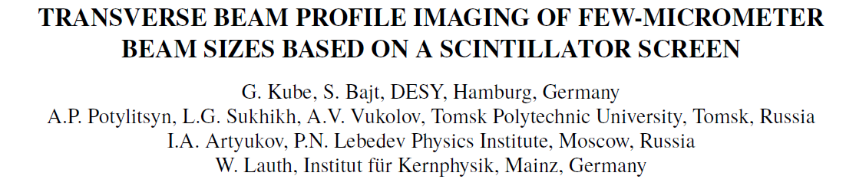
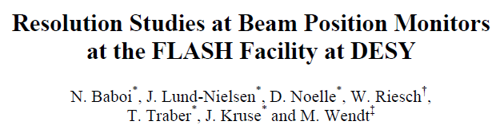

Diagnostics Specifications Summary
Beam parameter | Order of magnitude | Instrumentation | Remarks
Electron energy Energy spread | 0 – 350 MeV 0.18 % | Dipole spectrometer with scintillating screen + imaging | Dipole design → IDM Group with specifications from Beam Dyn.
Dark current during commissioning | ≈ nC | Faraday cup (FC); Integrated into beam dump | Beam Dump design → Safety / RP group
Bunch charge | ≤ 700 pC | FC; Current transformer (ICT) | Commercial solutions available
Transverse beam profile | ≈ 1 – 3 mm | Screen monitors (destructive) Optical Transition Radiation (OTR) ? | Screen monitor resolutions < 5 um possible
Emittance | 5.5 mm.mrad | Focus scan + screen monitor
Beam position | ≈ μm … ? To be specified | Stripline/ Button-BPM / Cavity BPM / Screen → Choice of BPM-type still open | Achievable single pass resolution(RMS) in the order of 10 μm
Bunch length | ≈ 2 ps | Deflecting cavity
https://doi.org/10.1063/1.2401409
https://doi.org/10.1016/j.nima.2006.07.050

Slide 17
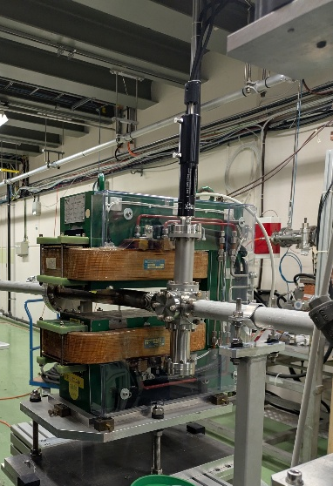
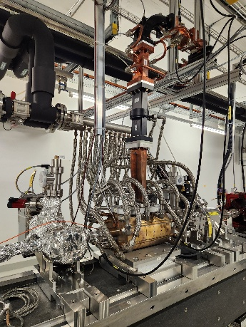
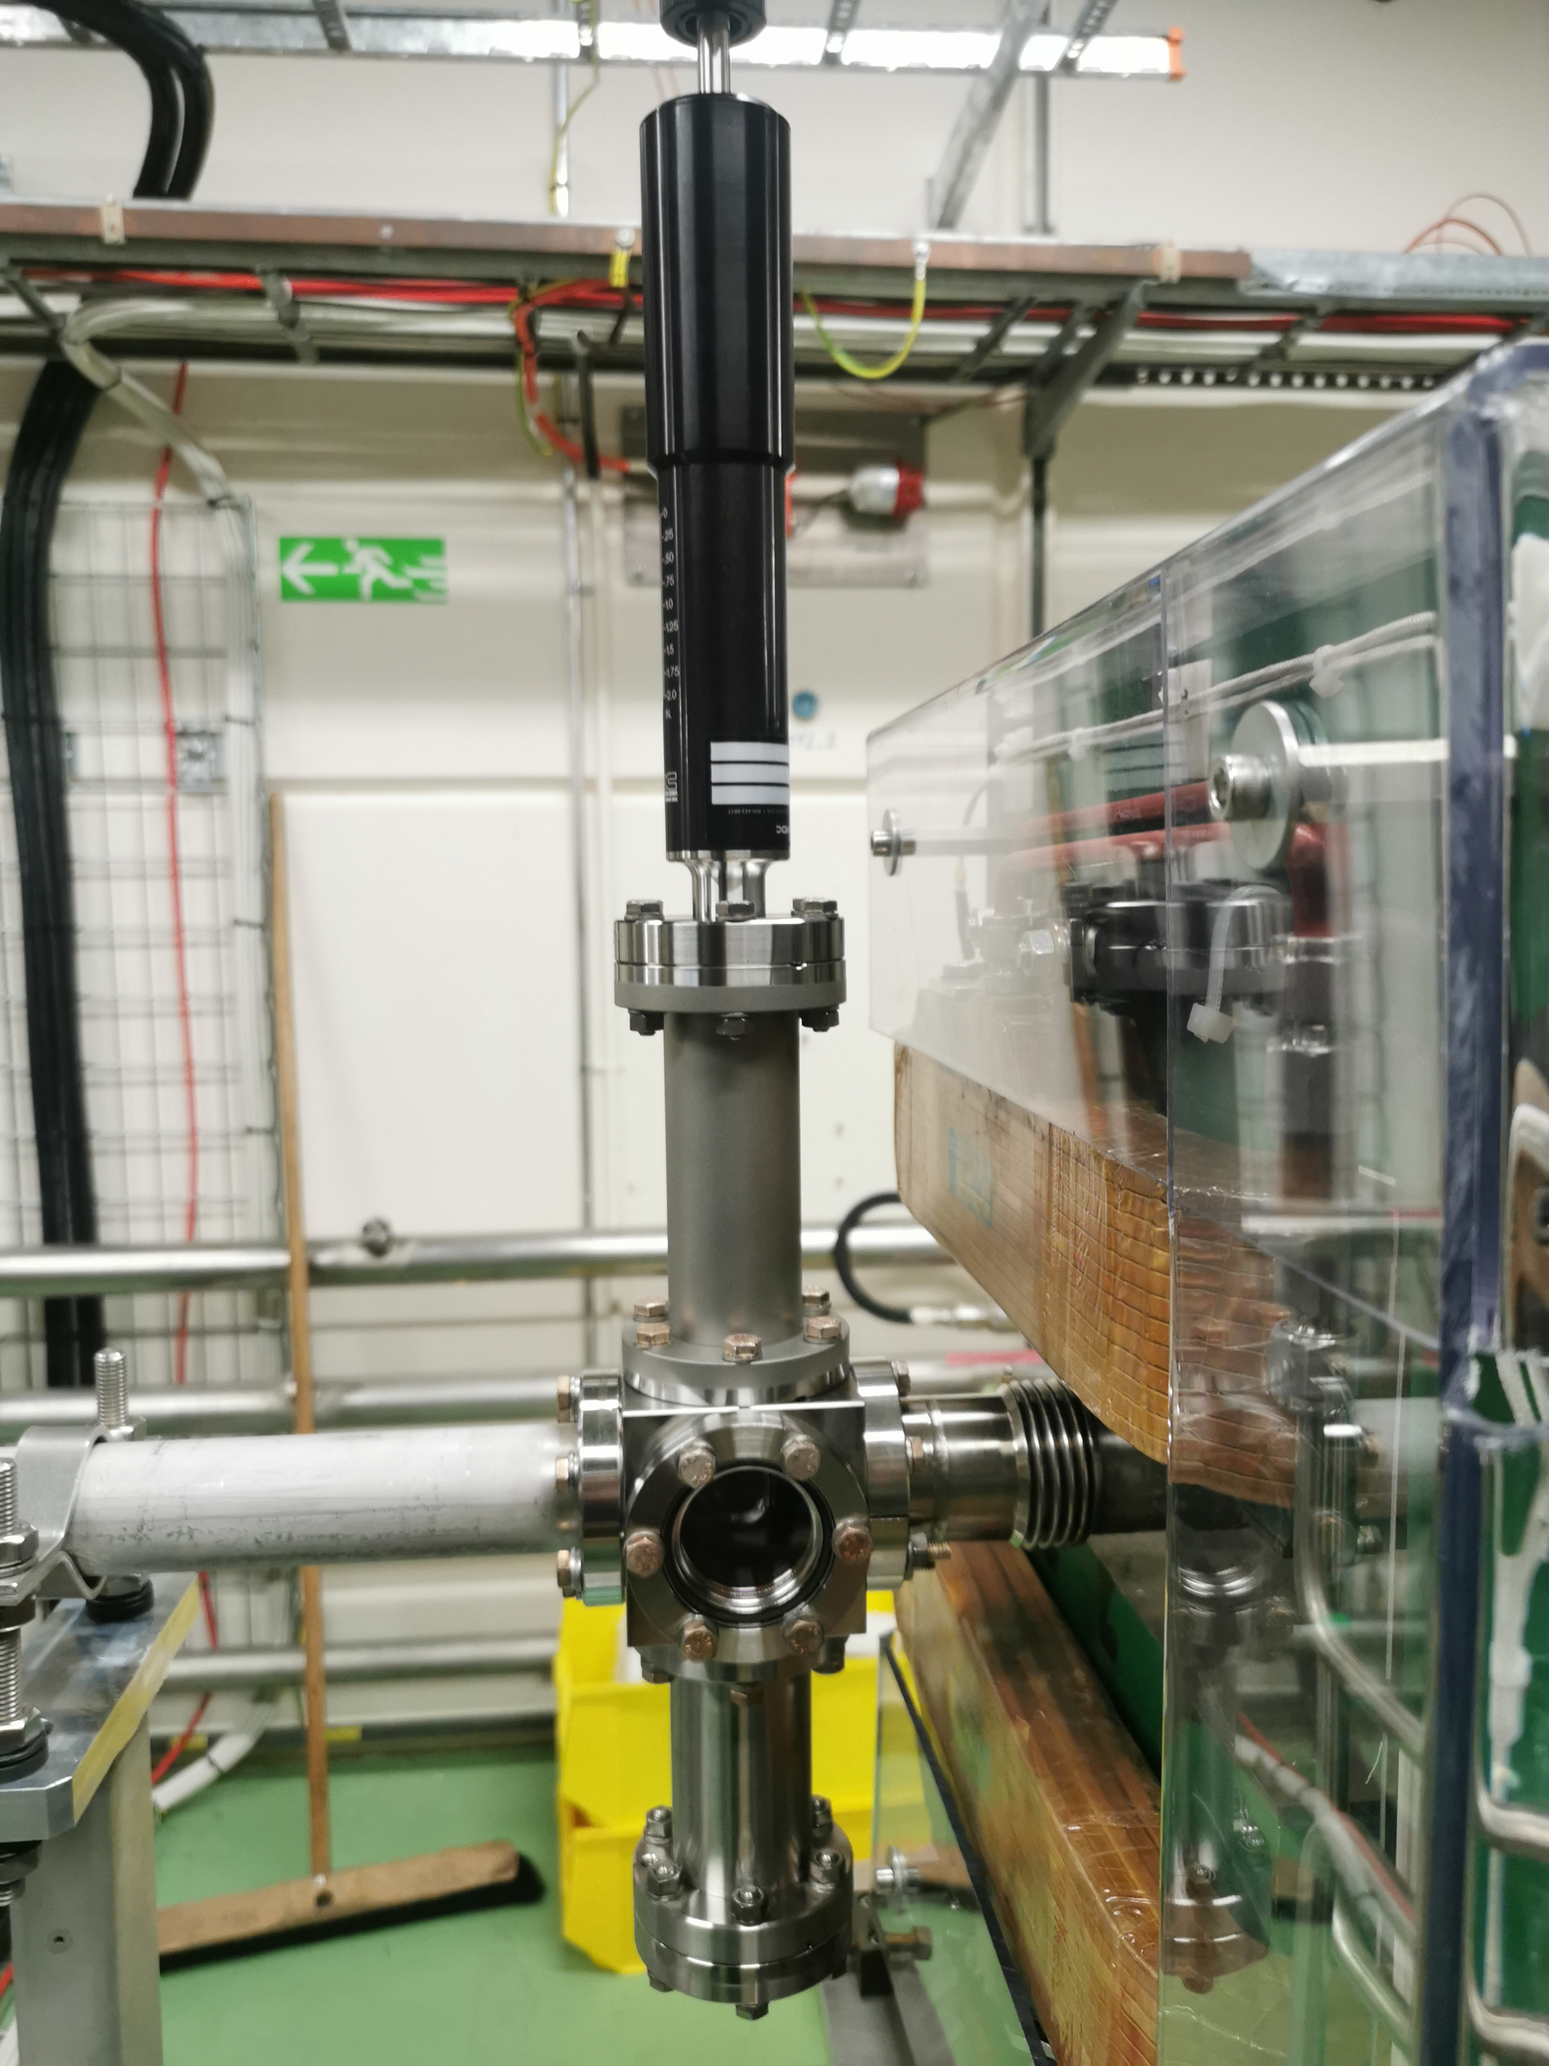
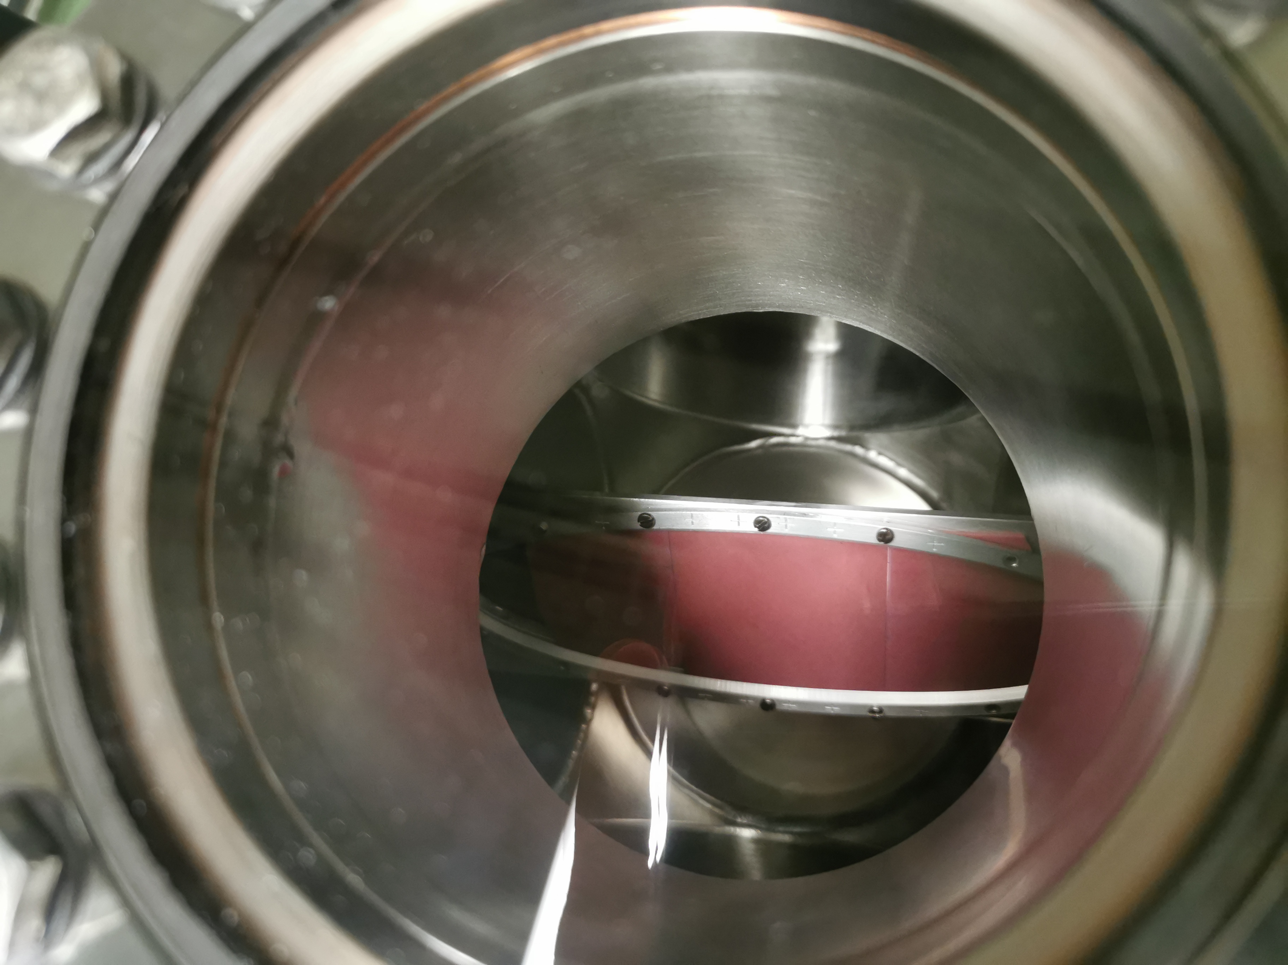
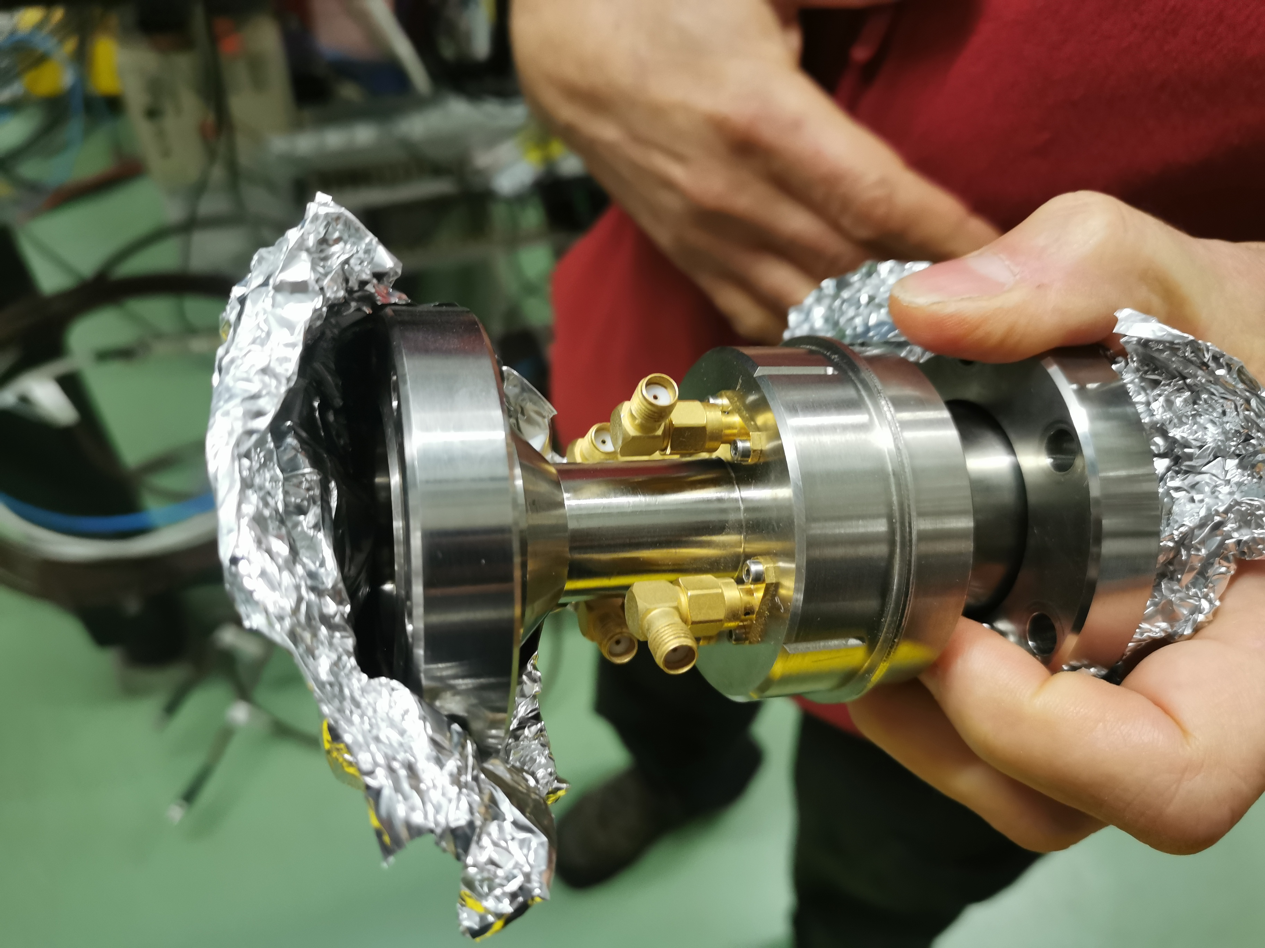
Part II – Electron Beam Diagnostics - Conclusion
Required beam parameters and general layout still evolving
Very early stage of diagnostics planning, few details yet
We will mainly rely on
  Well established techniques / instruments already used at the ESRF
  On the experience / instrumentation of other LINAC installations
Visit at CTF2 & CLEAR at CERN in November 2025
Visit at PSI January 2026
Contact with ARES/DESY in 2025
Collaboration INFN Frascati
Visit at MAXIV
…
Dipole CTF2/CERN
PSI RF-deflector
Screen monitors
CTF2/CERN
CTF2 Spectrometer screen
CLEAR cavity BPM

Slide 18
Human resources for WP2
 | Beam Dynamics Group | Diagnostics Group | Mechanical Engineering/ Drafting (ESRF) | Building & Infrastructure (ESRF) | IDM Group (Magnet design) | Other
Optical layout for drive laser installation |  | X | X + optics engineer
Laser room Hole drilling |  | X | X | X
Laser installation/ maintenance |  | X +? | ? |  |  | ?
BPMs | X | X | X | X |  | Depending on type of BPM → fixed term contract?
Dipole spectrometer | X | X | X |  | X
Screen monitors | X | X | X
Current transformer | X | X | X |  |  | Commercial product
Faraday cups |  | X | X |  |  | Radioprotection group For beam dump design
Work load on the long term?

Slide 19
Closing Remarks
Laser requirements well defined.
Rough needs and layout for beam diagnostics instruments are defined
Precise specifications, technological choices, simulations and design of diagnostics to be done
Principle of choice of equipment (diagnostics as well as laser installation):
  As simple as possible, without compromising the needed performances
  Reliability and low maintenance needs
  Based on:
      commercial instruments,
      in-house knowledge and
      experience from other institutes (BPMs, screens monitors,…)
Most of the work can be done with in-house resources from ASD, ISDD and TID.
We may need to consider additional resources for
  The long-term laser maintenance (in-house?)
  Maybe for the design of BPMs (if not standard solution)
  & during installation & commissioning phase

Slide 20
Thank you for your attention.

