Slide 1


RF POWER AND DISTRIBUTION
Alessandro D’Elia – WP01 RF

Slide 2
Contents
The Team
Preliminary Installation Drawings
Initial Considerations and Studies
RF Distribution along the different Phases of the COLD Project
Infrastructure Needs
LLRF System and Timing
Page 2

Slide 3

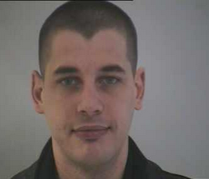
The team
Myself
younger
N. Benoist
Technician in the Diag. Group (part-time for COLD)
LLRF Eng.
COD - Recruitment in progress
The RF Group has many other very high priority Projects to follow (for ex. 4th Harmonic RF System, Linac Refurbishment, …) that makes very difficult to provide for a dedicated support of the COLD Project. That is why additional, external support is vital for the success of this activity. Of course this does not prevent, when the other activities will reduce, to have a support during the Project.
Nonetheless, thanks to the RF Group and in particular to M. Dubrulle and M. Morati for the advises and help to define S-Band RF Unit Tech specs, interlock list and many other advises.
RF Eng.
COD - Position Approved within ASD, need DM approval
Technician
COD - ?
Page 3

Slide 4
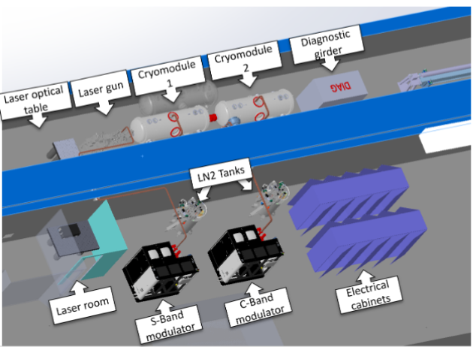
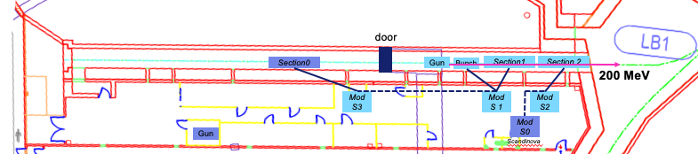
Preliminary installation drawings
Today
More in J. L. Revol: 6GeV Linac and COLD project: Installation, implementation and safety aspects – Next Talk
COLD
The installation of the COLD project is guided by the two following principles:
Avoid any interaction with the existing operational linac.
Minimize civil works (e.g. the use of existing openings between the modulator hall and the linac tunnel).
Additional information:
The 300-liter liquid nitrogen tanks are placed close to the wall to enable automatic filling of the cryomodules without entering the linac tunnel.
Installing an overhead crane in the linac tunnel is not possible due to tunnel dimensions. Handling of heavy equipment will therefore be performed using manual pallet jacks or dedicated electrical movers, such as the e-Motion 40 units used during the EBS installation.
Preliminary drawings/studies of the final COLD Installation Phase 2 (WP04-MEG: T. Brochard & L. Eybert)
Deflecting Cavity not yet included
Page 4

Slide 5
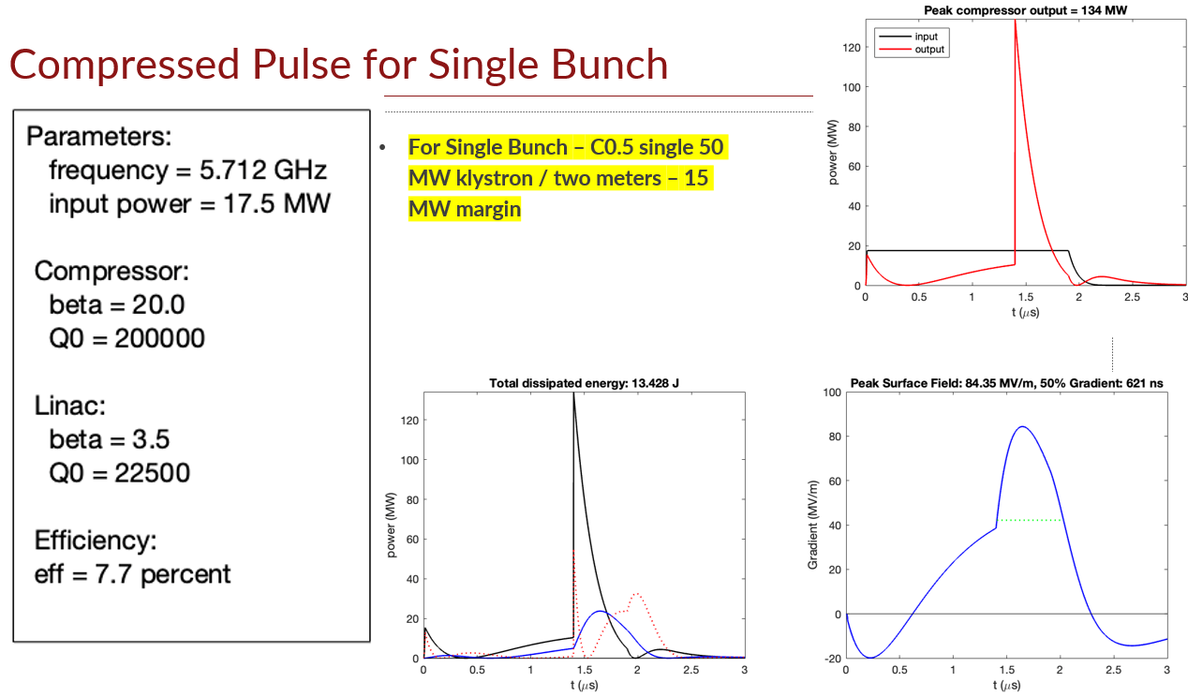
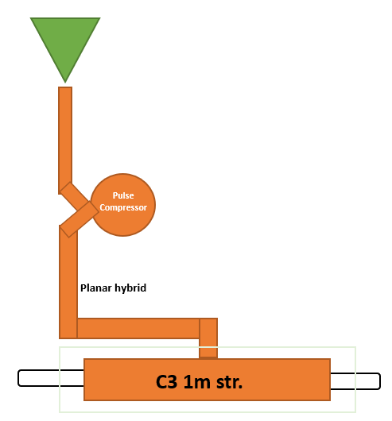
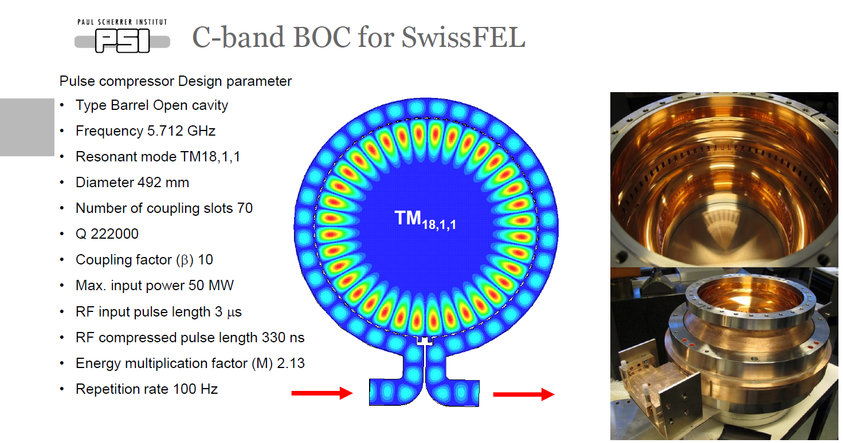
Pulse compression scheme
We asked Emilio some preliminary study on the possibility of using a pulse compression scheme and the results showed that this was possible (single bunch) and the parameters of the compressor were compatible with those of the PSI’s BOC!
This is a very important point as we do not have enough resources to support R&D’s and we need to rely as much as possible on existing and well assessed technologies whenever is possible.
E. Nanni
Page 5

Slide 6
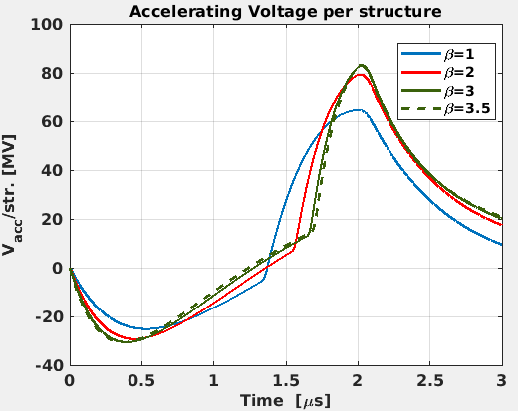
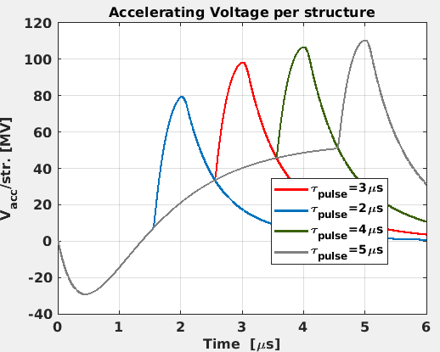
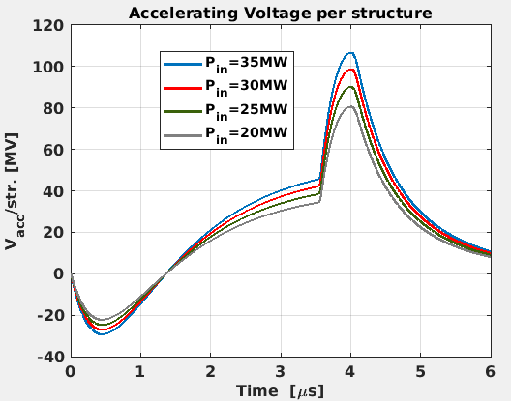
Pulse compression studies
Freq. (GHz) | 5.712
Pin (MW) | 20-35
Pulse length (μs) | 2-5
BOC
β | 9.4
Q0 | 220000
Acc. Structure
# of Str. | 2 (One SLAC Cryomodule)
β | 1-3.5
Q0 | 22500
Rsh (Mohm/m) | 300
P_{in}=35MW
Pulse length=2μs
P_{in} =35MW
β=2
β structure variation
Pulse length variation
Losses in the waveguides not yet considered.
Pulse length=4μs
β=2
P_{klys} variation
Page 6

Slide 7
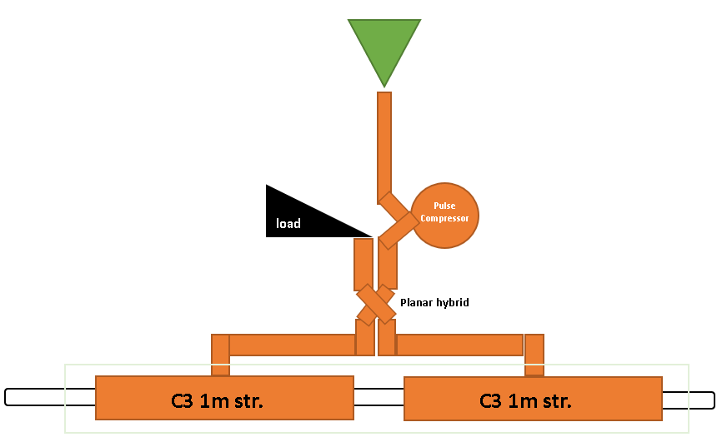
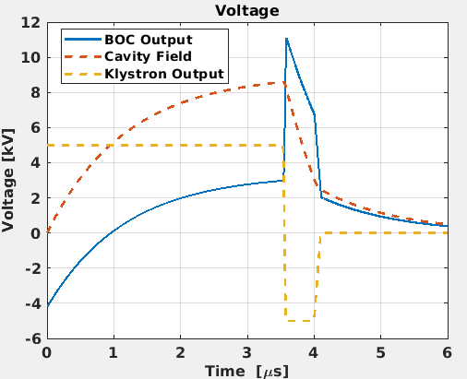
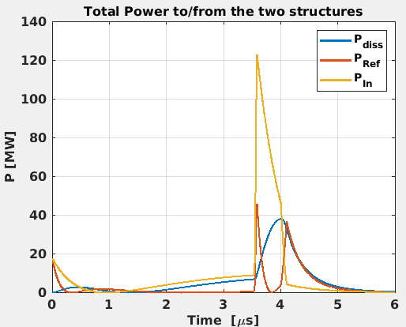
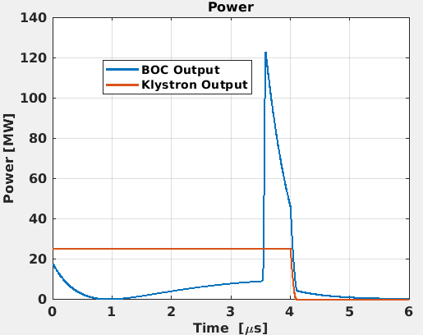
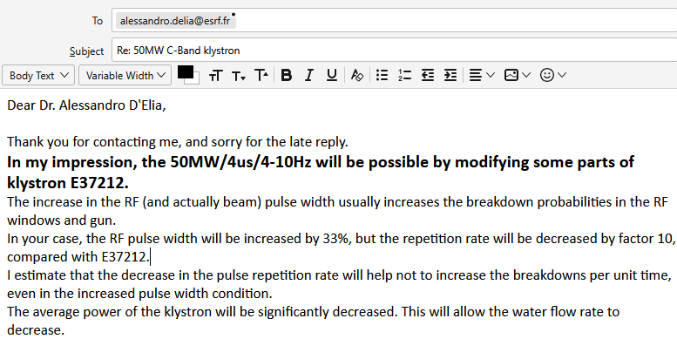
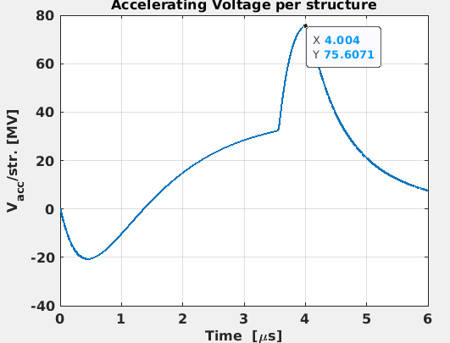
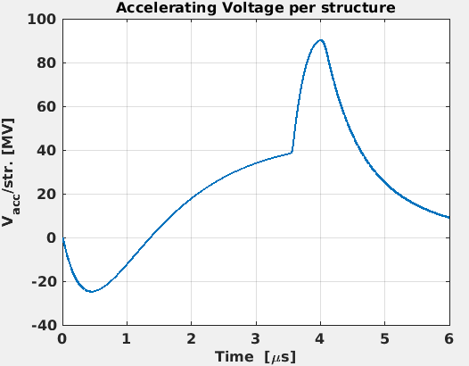
Can we reduce the number of the klystrons?
Freq. (GHz) | 5.712
Pin (MW) | 25
Pulse length (μs) | 4
BOC
β | 9.4
Q0 | 220000
Acc. Structure
β | 2
Q0 | 22500
Rsh (Mohm/m) | 300
Losses in the waveguides (-20%) and some klystron power margin (-10%) have been considered.
(PSI-BOC)
Canon Private Communication
This implies that we can feed 2 cryomodules (4xC3 structures) with one klystron: the distribution becomes very similar to that of the SwissFEL
No power reduction
Page 7

Slide 8
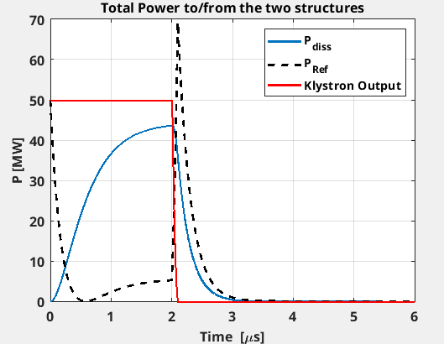
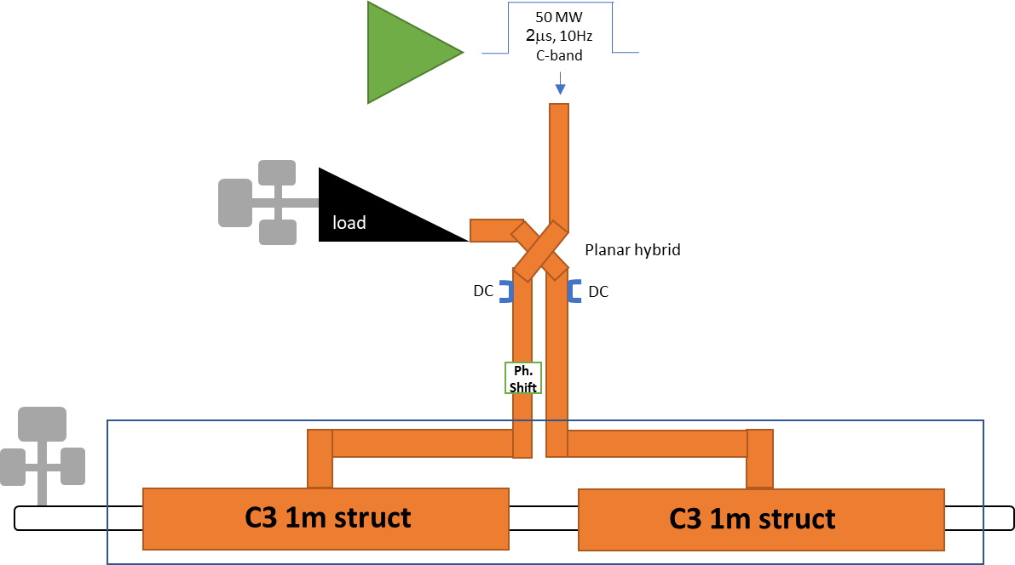
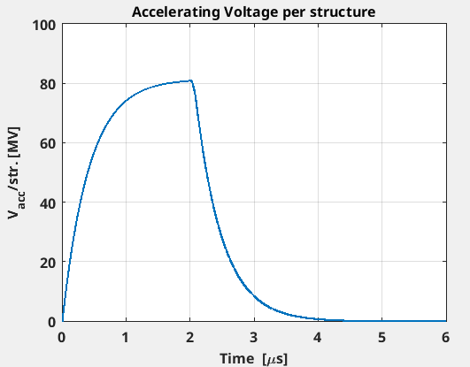
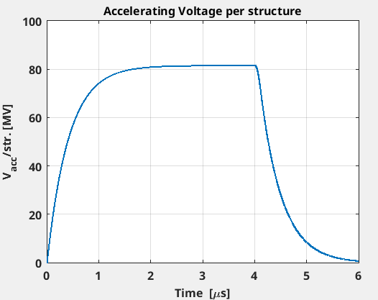
Phase 0
Phase 0 is preceded by SATs of S- and C-Band RF Units: differently than other steps these ones are mandatory ➔ grounding to be provided before January 2027
Considering that β_{str}=2, and a margin of 30% additional power for waveguide losses, all 50MW are needed without BOC.
Being an overcoupled SW structure: full reflection at the beginning of the pulse, some permanent reflection during the pulse, largest peak reflected power at the end of the pulse ➔ Planar hybrid with load is needed.
Pref_{Av}=300W
PKlys_{Av}=1020W
Pdiss_{Av}=727W
Page 8
8

Slide 9
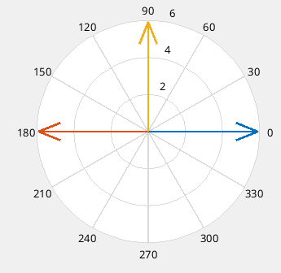
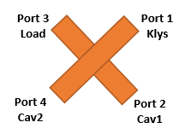
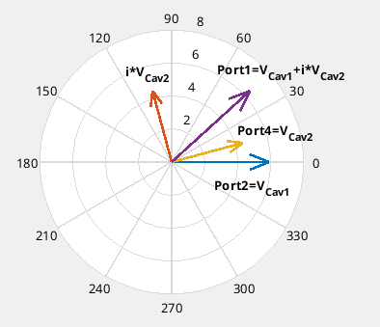
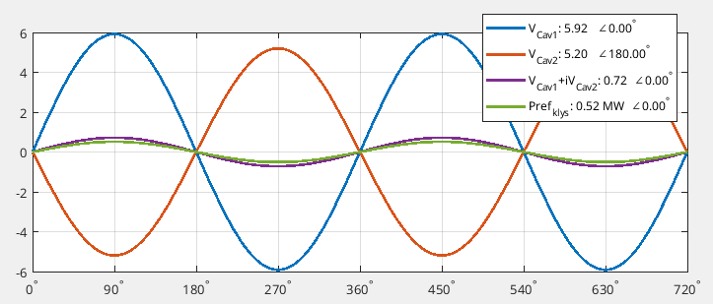
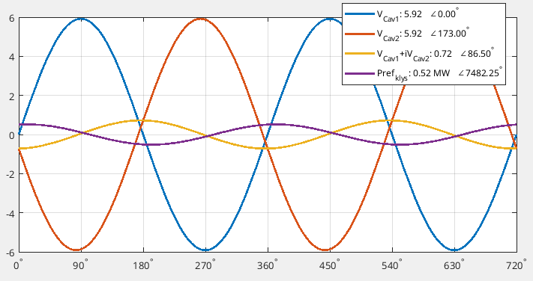
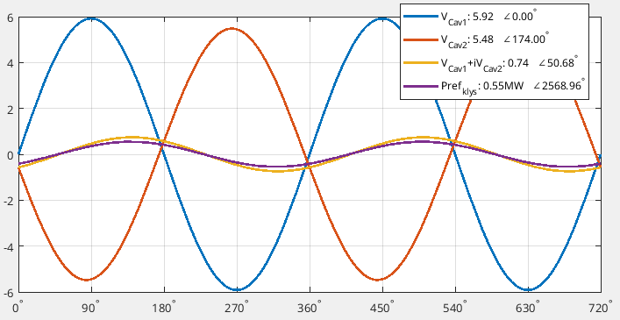


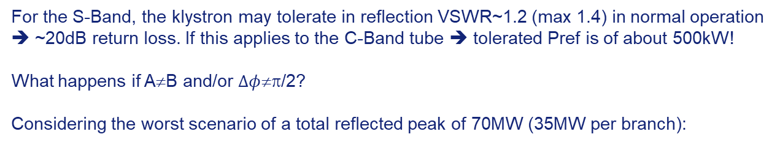

planar hybrid scheme
Phasor Diagram
At the output of Port 1, towards the klystron:
$V_{{Cav}_{1}}+iV_{{Cav}_{2}}=Ae^{iφ_{1}}+iBe^{i{(φ}_{1}+Δφ)}$ ($φ_{1}$=0 in the diagram on the left)
$${\left|V_{{Cav}_{1}}+iV_{{Cav}_{2}}\right|}^{2}=A^{2}+B^{2}−2AB\sin{(Δφ)}$$
P_{ref klys}=0 only if A=B and $Δφ$=π /2
Δφ
For the S-Band, the klystron may tolerate in reflection VSWR~1.2 (max 1.4) in normal operation ➔ ~20dB return loss. If this applies to the C-Band tube ➔ tolerated Pref is of about 500kW!
What happens if A≠B and/or $Δφ$≠π/2?
Considering the worst scenario of a total reflected peak of 70MW (35MW per branch):
Δφ=84°; Pref₁=35MW; Pref₂=30MW
ΔV/V≈7% & Δφ/φ<7%
Δφ=90°; Pref₁=35MW; Pref₂=27MW ➔ ΔV/V≈11%
Δφ=83°; Pref₁=Pref₂=35MW ➔ Δφ/φ≈8%
Page 9

Slide 10
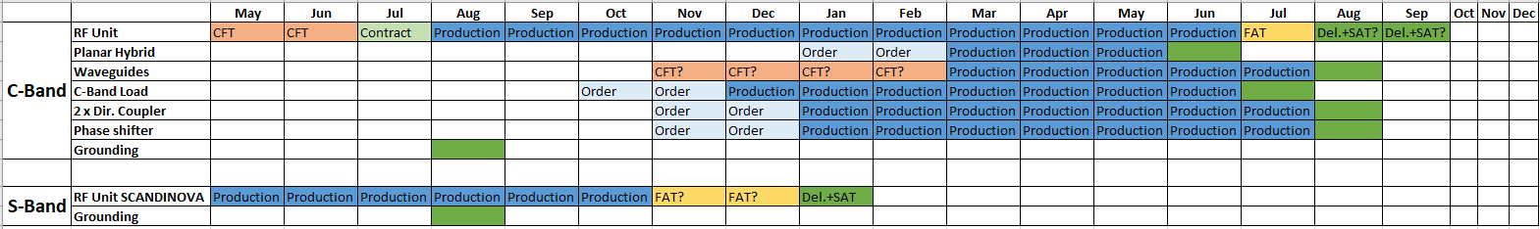
What is needed for phase 0
2026
2027
Realistic start of the RF Test
Phase 0 is preceded by the SAT of the S- and C-Band RF Units ➔ grounding in the modulator hall must be provided well in advance;
For waveguides a rough estimation of the cost is 20kEuros/m (we need at least 5m only for Phase 0) ➔ CFT. For the other components we would rely on PSI’s help. View the tight scheduling we need to clarify these points quite soon;
The resources recently added for the new S-Band modulator in PINJ are sufficient for both SATs and Phase 0. However for Phase 0 (SLAC structure RF Tests) we need to not interfere with the long run test of the new modulator on the operational ESRF Linac;
Of course we would need to provide also for vacuum components and control. But also crane in PINJ for the installation of the RF Units, handling tools inside the tunnel, …
Page 10

Slide 11
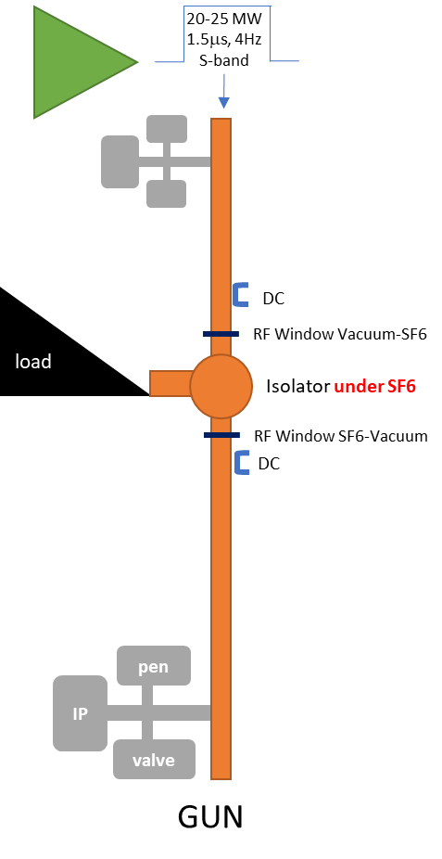
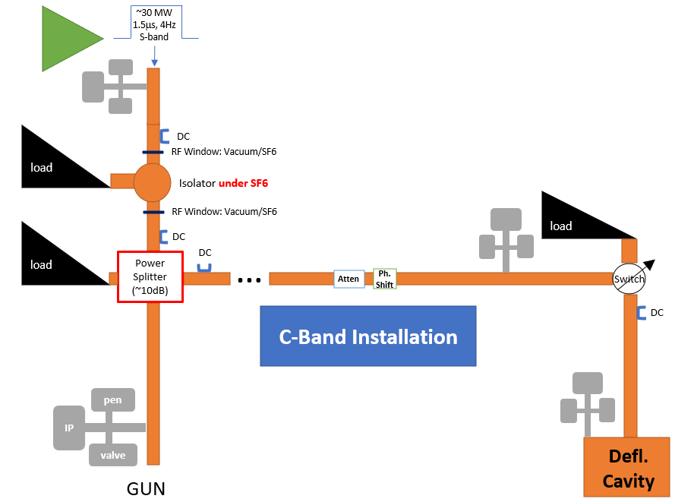
Phase 1: S-band line
Budget for Def. Cav. only in Phase 2 ➔ To be foreseen for Phase 2 the RF distribution
Phase 1 (w/o def. cav.)
Page 11

Slide 12

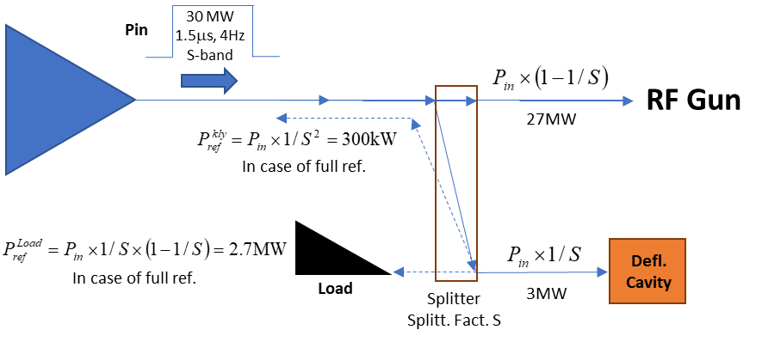
Active defl. Cavity and Splitting scheme
For the deflector to fully characterize the 6D phase space we can use the same system as in SPARC. According to the power needs, the splitting scheme could be also placed upstream the isolator. Of course this system will make the S-Band RF distribution a bit more intricated but, more important, the cost of the system would be significantly impacted. For this reason we will design the RF distribution considering this active system but we will install it only in the Phase 2 of COLD.
Another option we are considering is to use a passive system like at PSI and this could be installed immediately for Phase 1.
Page 12

Slide 13
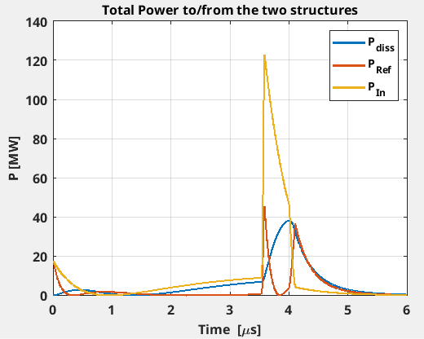
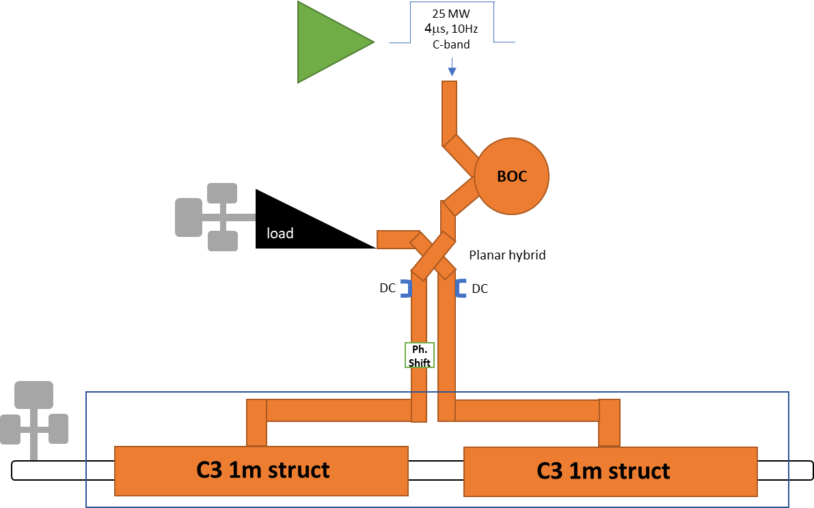
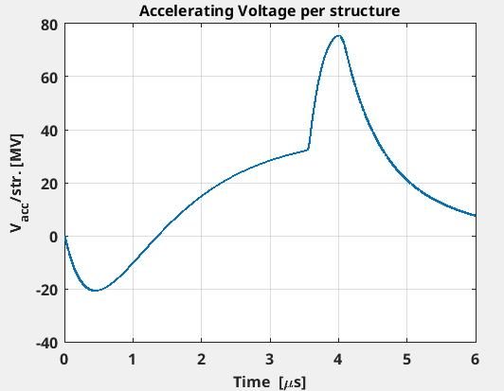
Phase 1: C-band line
Pref_{Av}=210W
PKlys_{Av}=1008W
PBOC_{Av}=575W
Pdiss_{Av}=365W
Page 13

Slide 14
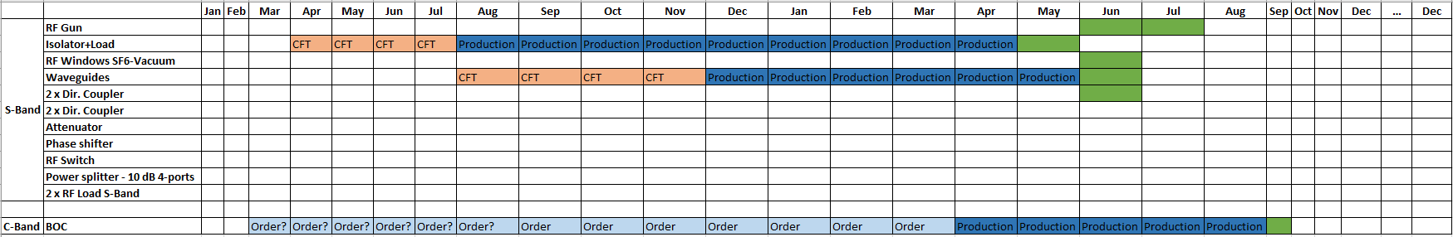
What is needed for phase 1
2027
2028
2029
X Def. Cavity ➔ Phase 2
AFT has been contacted for the Isolator: the price requires a CFT and 9-10 months lead-time;
All components for the deflecting cavity can be postponed to Phase 2 (but drawings, space for the installation and civil engineer works to be considered earlier). Of course the situation can completely change if we go for a passive deflector: can we go for a passive system? In this case we need it for Phase 1: is it feasible?
No BOCs have been produced in the last 8 years: between 12-18 months needed for procurement. BOC will need also a dedicated cooling system and related control*;
As for Phase 0, vacuum components and control are needed.
For the commissioning of the RF Gun same needs as for Phase 0 but from 2029 we will need the full water cooling system availability.
* Operation range is 35+/-7degC and needs to be stabilized better than 0.1degC. At PSI each pulse compressor has its own cooling circuit with a dedicate heater and a dedicate variable valve, both are controlled by a feedback loop.
Page 14

Slide 15
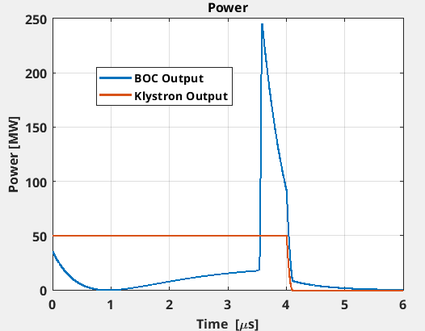
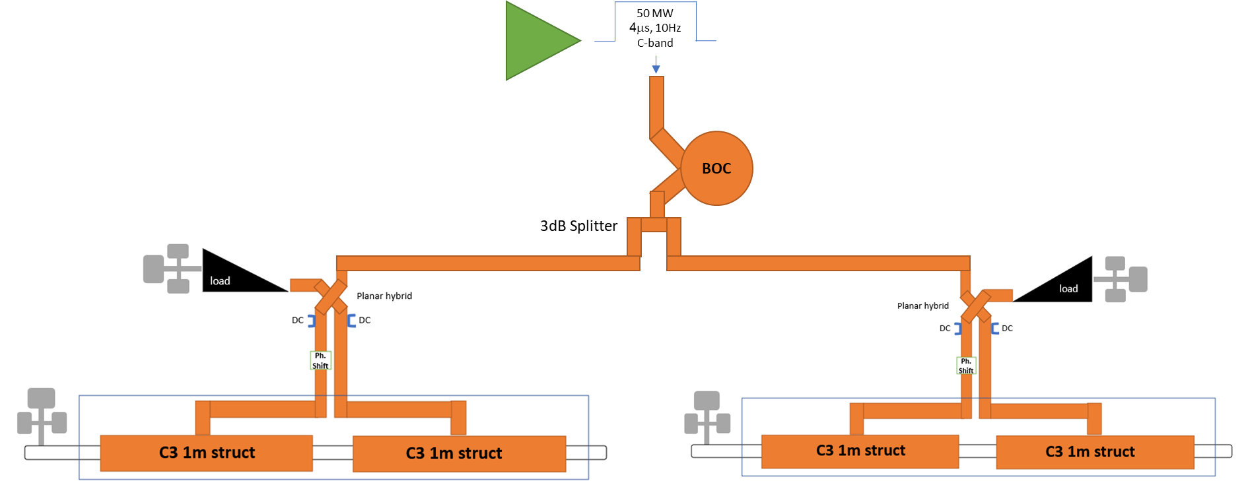
Phase 2
Considering a margin of 30% additional power for waveguide losses.
Pref, Pload, Pdiss remain the same as Phase 1 (25MW per branch)
PBOC_{Av}=1.15kW
Page 15

Slide 16
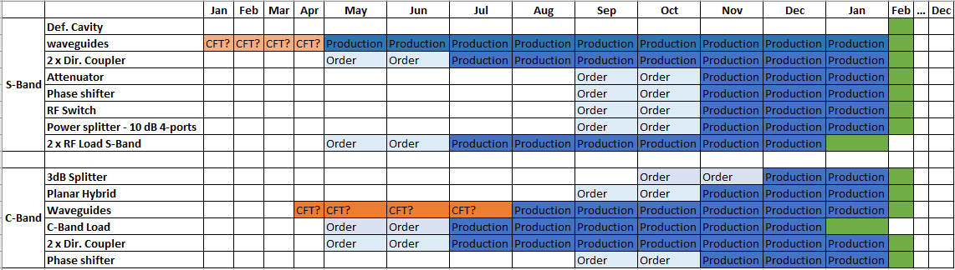
What is needed for phase 2
2029
2030
Very preliminary, to have an idea of the needed component and related delivery.
Depending on the budget profile, we will decide if going for a single CFT/Band:
Procuring all C-Band equipment during Phase 0;
Procuring all S-Band equipment during Phase 1.
Page 16

Slide 17
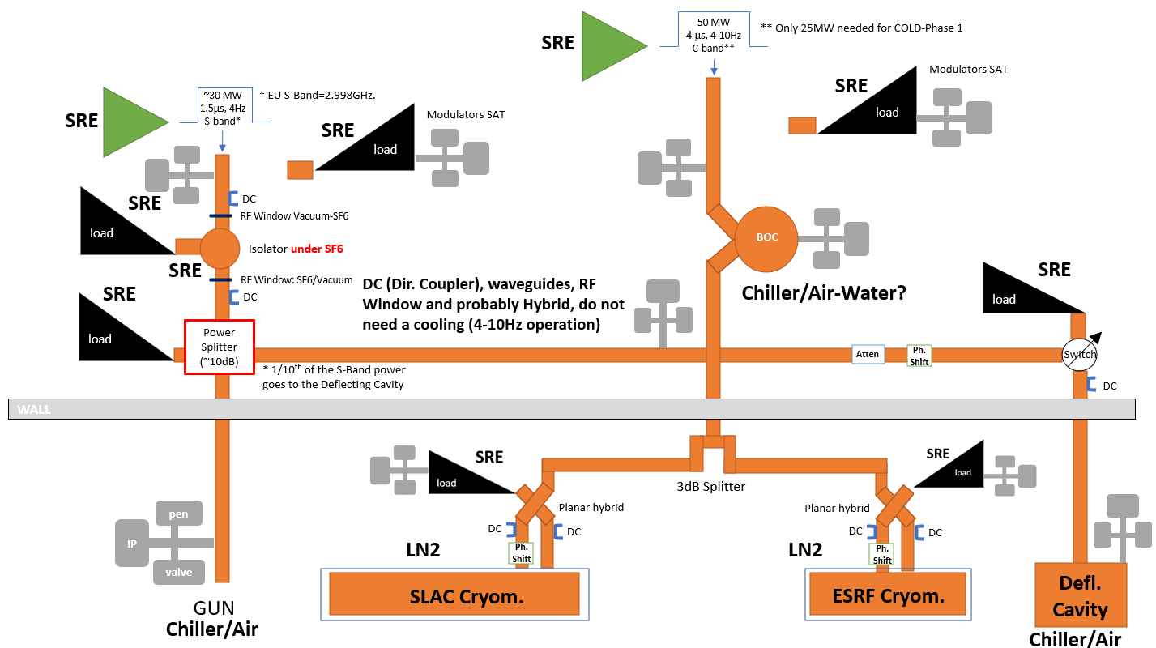
COLD RF waveguide distribution and infrastructure needs (preliminary)
SRE=Water Cooling System
All “chiller” devices (dedicated water groups) are not in charge of the Infrastructure Group (BIG) but of the user (in this case, the RF Group). However in case of water condensed devices (for ex. for the BOC), is to BIG to provide for the needed inlet flow-rate.
PINJ Entrance
Existing
Existing
LINAC
Hole for laser beam to be drilled here
Hole for waveguide passage to be drilled here
Page 17

Slide 18
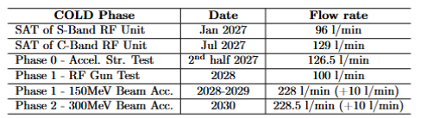
More in J. L. Revol: 6GeV Linac and COLD project: Installation, implementation and safety aspects – Next Talk
Infrastructure
COLD Needs
Advantages:
This solution offers a high level of reliability of the cooling system (same as the main accelerators);
Least expensive solution.
Dis-Advantages:
In case of failure on the new COLD SRE cooling distribution, the effect can have an impact on the accelerators SRE cooling systems. This will be monitored and eventually the part of the circuit bringing water to COLD would be isolated from the one needed to operate the facility.
Some phases of the pipes installation can only be done during shutdown periods. That will lead to additional delay in the completion of the works.
* If the BOC needs a water condensed device
2028
<130l/min
2029
*
≈250l/min
*
Solution A – Delivery: May 2028
Solution B – Delivery: October 2028
Advantages:
In case of failure on the new Cold SRE cooling distribution, the effect will have no impact on the accelerators SRE cooling systems.
The installation work has no impact on accelerator operations and does not need to be carried out during shutdown periods.
Dis-Advantages:
This solution offers a low level of reliability of the cooling system and could not be used for operational equipment.
Additional maintenance costs.
COLD
Approved
New SRE Distribution
COLD
WP05-BIG: F. Favier, JM Gay, Y. Gouez & A. Ruiz Bailon
Page 18

Slide 19
llrf and timing
On this task we need to build all competences. A young Engineer with a profile well oriented on Digital Electronics is going to be hired (time limited contract).
The schematic on the left shows the SwissFEL RF System which drive an RF Photogun in S-Band and C-Band accelerating structure and therefore very similar to what we need for COLD.
For this young Engineer it has to be most probably foreseen a kind of training at PSI and/or at INFN-LNF.
But the first task of this Engineer will be to provide for the system to test and RF conditioning SLAC structures in Phase 0. For this, collaboration/contacts with CERN will be probably necessary to build a system similar to the X-BOX.
Another subject, but on a longer term, is to think about the timing and synchronization for the injection in the Booster (Phase 3) or Storage Ring where the RF frequency is 352MHz.
Z. Geng, R. Kalt, M. Jurcevic, W. Koprek, M. Huppert
LLRF Topical Workshop –Timing, Synchronization, Measurements and Calibration, INFN-LNF, Italy, 28–30 Oct2024
Page 19

Slide 20
conclusions
We need to rapidly create a dedicated team for the WP01: a LLRF Engineer is going to be hired, an RF Engineer position should appear, hopefully, soon. But we need also technicians;
Detailed drawings of the installation are going to be provided: they are mandatory to define the real layout of the waveguides to assess the budget, to start the procurement and to schedule the installation to avoid conflicts with other activities;
An important point is to define the strategy for the deflecting cavity that has a consistent impact on the budget and on the installation;
The most delicate point is the LLRF System and Timing which will be heavily inspired to that of the SwissFEL but needs to be “translated” at the ESRF which means we need to identify the requirements for COLD and to identify the hardware and all the needed components. First urgent task: providing for the system and routine for the RF test of the first SLAC cryomodule in the second half of 2027 (Tomorrow)!
Page 20

Slide 21


THANKS FOR YOUR ATTENTION

