Slide 1


S-band brazing free high charge Photo electron gun and RF deflector
David Alesini
INFN-LNF, Frascati, Italy
21-04-2026

Slide 2
RF GUN AND RF DEFLECTOR OF THE COLD PROJECT
modulator
25 (35) MW
1.5 μs
S-band (2.998GHz)
modulator
50 MW
4.0 μs
C-band 5.712GHz
Control PS
Alignment
Diagnostic
Interlocks
PSS Safety
LLRF
klystron
laser
klystron
Waveguide S-band
Waveguide C-band
Vacuum pump
pulse compressor
LN₂
isolator
planar hybrid
Beam dump
dipole
Photo-gun
solenoid
Quadrupole
Quadrupole
Quadrupole
BPM/BLM
BPM/BLM
Quadrupole
Steerer
Fast CT
RF deflector
screen
Steerer
BPM/BLM
Screen
Vibration
SLAC’s C-band distributed coupling accelerating structures
D. Alesini, S-band brazing free high charge Photo electron gun and RF deflector, COLD project Review Meeting, 21-04-26.

Slide 3
RF GUN AND RF DEFLECTOR OF THE COLD PROJECT
The presentation focuses on these two devices which, as we will show, can be similar to those implemented at SPARC_LAB.
modulator
25 (35) MW
1.5 μs
S-band (2.998GHz)
klystron
Waveguide S-band
isolator
dipole
Photo-gun
solenoid
RF deflector
Fast CT
screen
Steerer
BPM/BLM
Screen
D. Alesini, S-band brazing free high charge Photo electron gun and RF deflector, COLD project Review Meeting, 21-04-26.

Slide 4
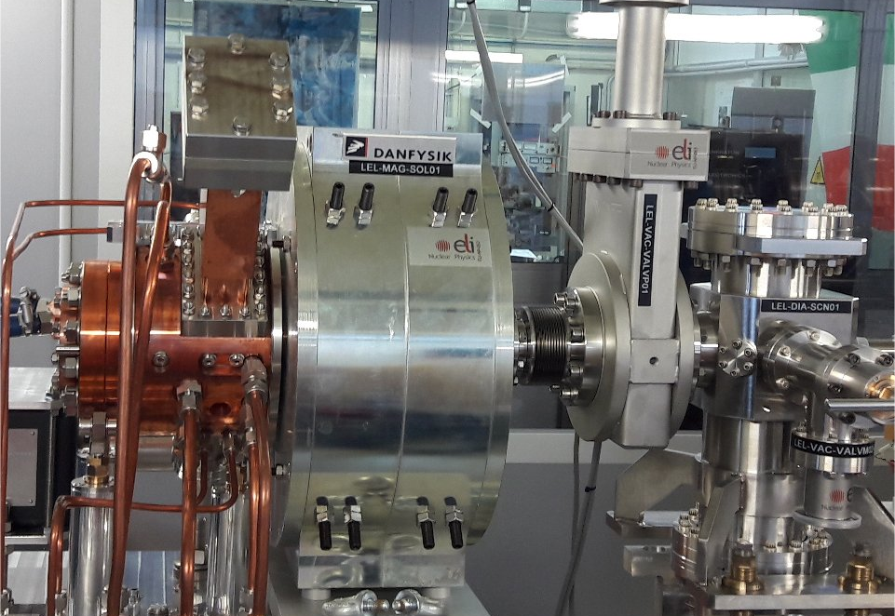
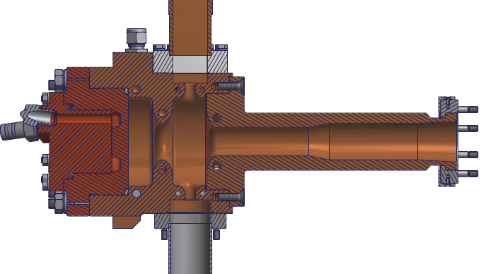
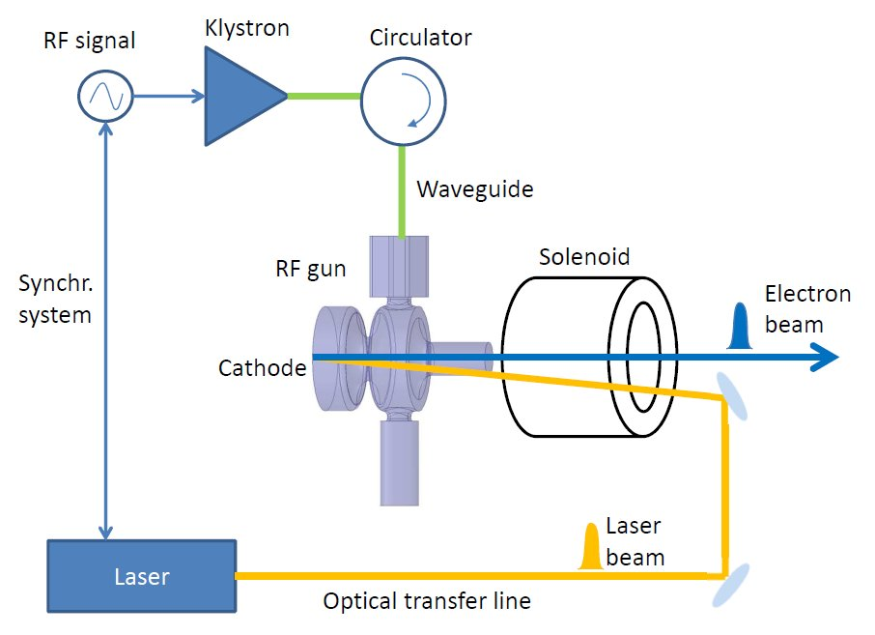
RF PHOTO-GUNS: INTRODUCTION
RF Photo-injectors based on RF guns are widely used in FEL, as very low-emittance and high-brightness electron sources.
The electron beam is generated by photo-emission using a drive-laser pulse to illuminate the cathode. The electrons are immediately accelerated by an intense RF Electric field (60-120 MV/m) at the cathode surface.
The combination of small laser spot sizes, high electric field and solenoid immediately after the gun allow t reach very low emittances (ε_{n}< 1 mm mrad)
RF power
cathode
solenoid
The RF guns are based of SW 1.5-2.5 cells cavities working on the π-mode. RF technology mostly used is the L or S-band (f_{RF}=1.3 or 3 GHz).
The higher the peak electric field on the cathode, the better the quality of the beam emerging from the Gun.
Cathode can be of different material: Cu (QE 1-5x10⁻⁵, UV laser), semiconductor (for example Cs₂Te, QE 1-10%, UV laser).
laser
e⁻ beam
E_{z}
D. Alesini, S-band brazing free high charge Photo electron gun and RF deflector, COLD project Review Meeting, 21-04-26.

Slide 5
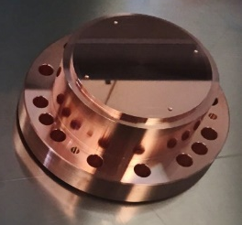
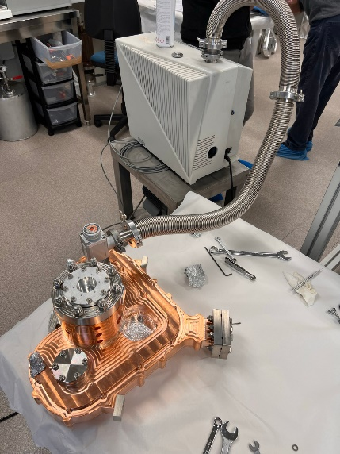
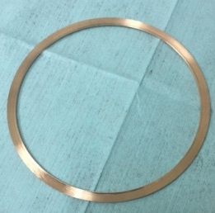
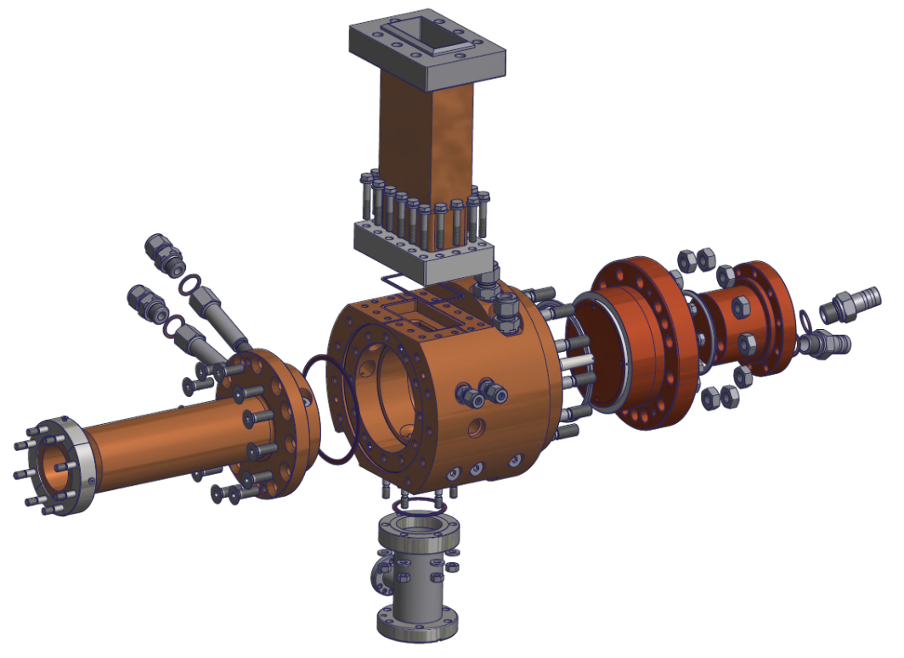



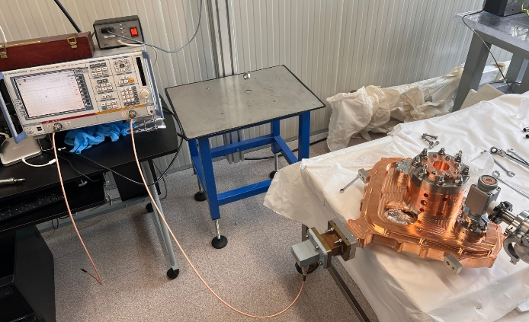
BRAZING FREE RF STRUCTURES Fabrication
ADVANTAGES
The brazing free technology for the realization of RF structures uses a novel process developed at INFN (Frascati) involving the use of special RF-vacuum gaskets (same Cu material of gun) that guarantee (simultaneously) the vacuum seal and a perfect RF contact when the structure is clamped.
simplify the fabrication (brazing furnace)
reduce the cost and the risk of failure (no brazing)
reach in principle (because of the hard copper not annealed) higher accelerating field with lower BDR and lower conditioning time.
waveguide
Cu Special gaskets
Body of the gun (single piece of OFHC copper)
Closing cup and pipe
S-BAND
C-BAND
[D. Alesini et al., Phys. Rev. ST Accel. Beams 18, 092001 (2015)]
[Int'l patent application PCT/IB2016/051464]
D. Alesini, S-band brazing free high charge Photo electron gun and RF deflector, COLD project Review Meeting, 21-04-26.

Slide 6
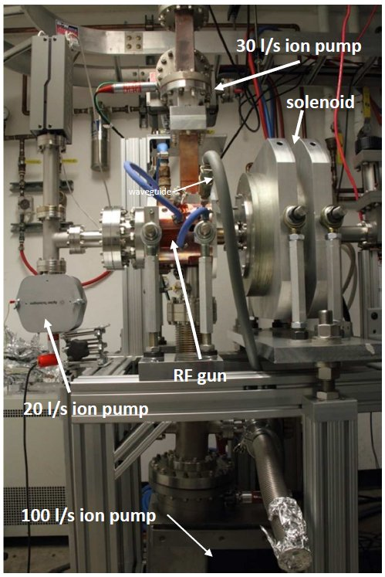
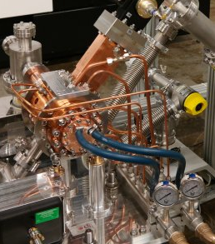
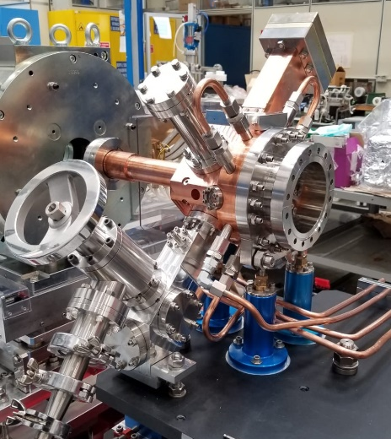
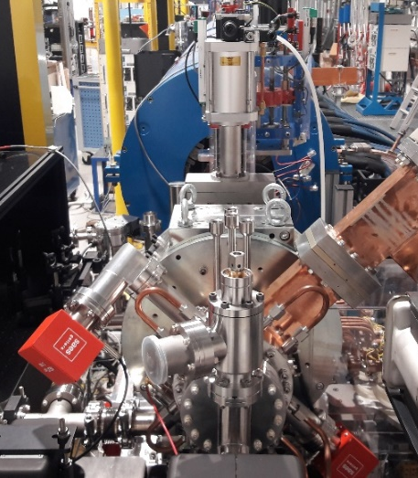
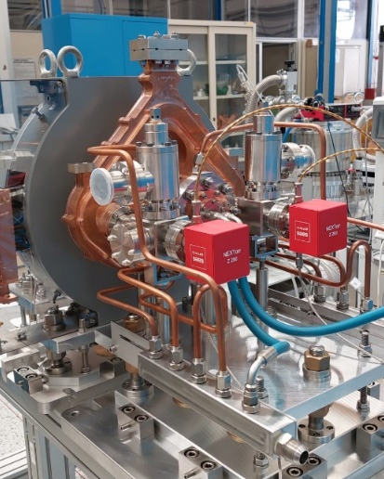
BRAZED FREE REALIZED RF PHOTO-GUNS
In the last ∼10 years different RF photo-injectors have been fabricated, tested and put in operation @INFN-CERN-UCLA-PSI (Frascati). All injector realizations are based on the new INFN technology w/o brazing but with the use of special RF-vacuum gaskets.
NEW SPARC_LAB
C BAND (I.FAST/TUAREG)
SPARC
ELI-NP
CLEAR (CERN)
D. Alesini et al., Phys. Rev. ST Accel. Beams 18, 092001 (2015)
D. Alesini et al., PHYS. REV. ACCEL. BEAMS 21, 112001 (2018)
In operation @ CERN (2020)
V. Shpakov et al., et al 2022 JINST 17 P12022 (2022)
High power Tested @ PSI
In operation
@SPARC_LAB
A. Giribono et al., PRAB 26, 083402, 2023
In operation @UCLA
Tested at high power
D. Alesini et al., PRAB 29, 012001 (2026)
S Band (3 GHz)
1.5 cells
C Band (5.712 GHz)
2.5 cells
D. Alesini, S-band brazing free high charge Photo electron gun and RF deflector, COLD project Review Meeting, 21-04-26.

Slide 7

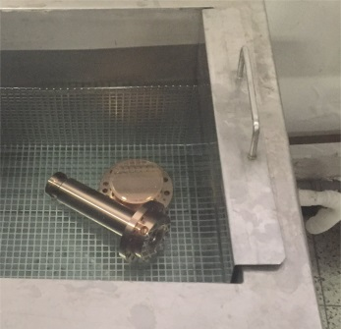
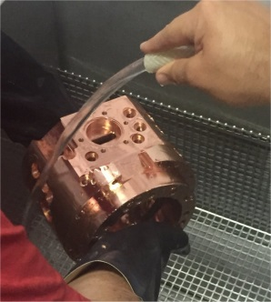
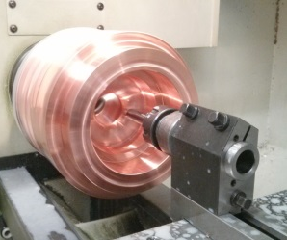
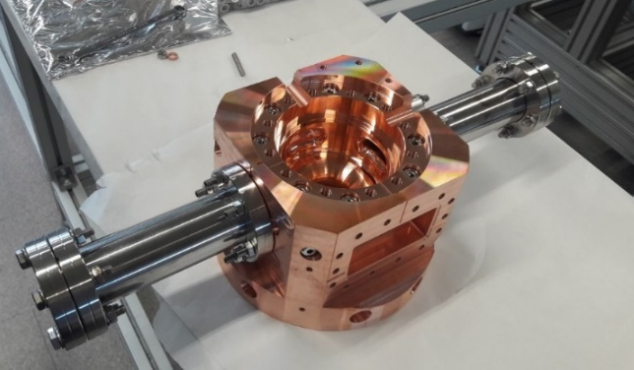
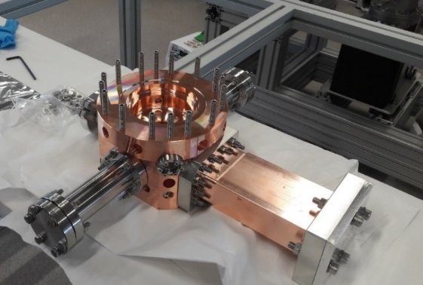
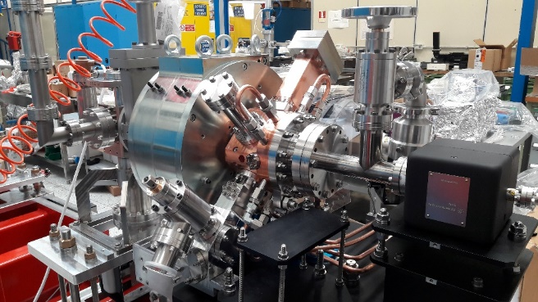
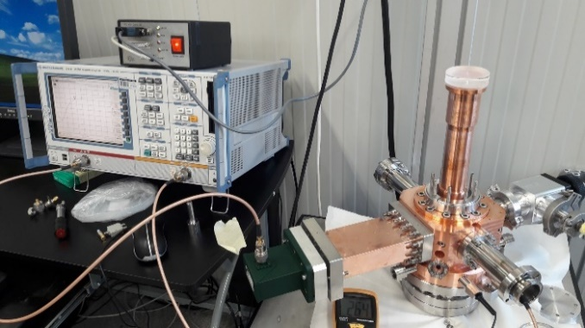
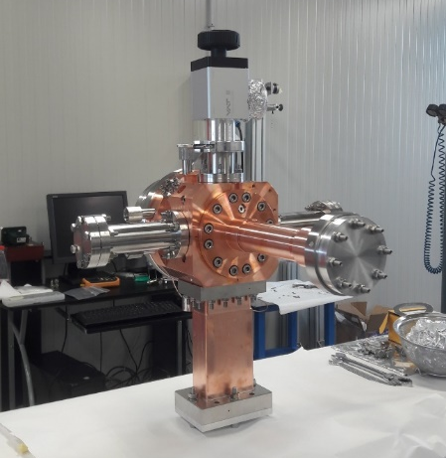
TYPICAL ASSEMBLY PROCEDURE OF THE RAZED FREE RF GUNS
All parts are fabricated with a precision of ±10 μm and surface roughness <150 nm.
All parts cleaned with a detergent (NGL) in ultra-sound, followed by a bath in organic acid (citric) and in distilled water then dried with N₂ flux
The rf gun is then assembled, leak tested and low power RF tested
The rf gun is then assembled in the injector (pumps, valves, cooling, support,…)
D. Alesini, S-band brazing free high charge Photo electron gun and RF deflector, COLD project Review Meeting, 21-04-26.

Slide 8
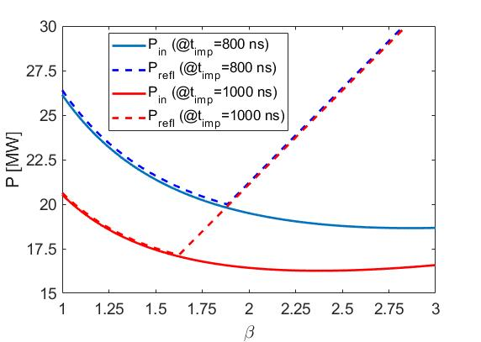
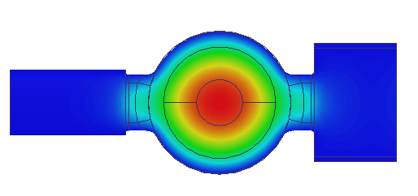
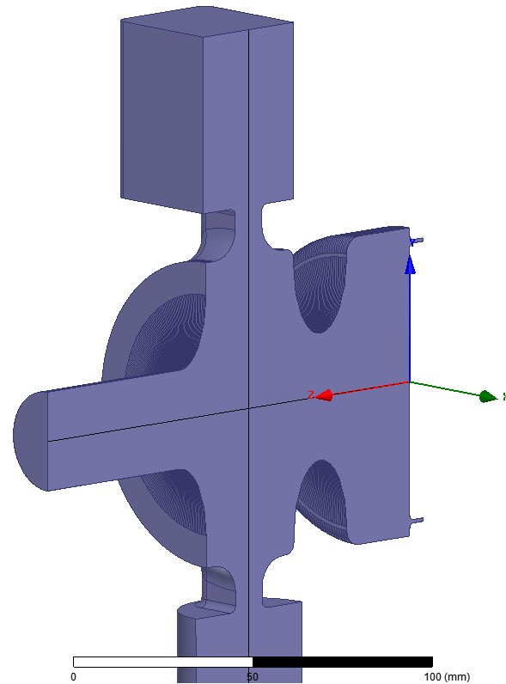
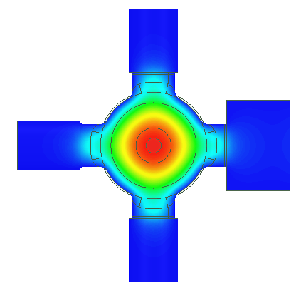
ELECTROMAGNETIC PROPERTIES OF THE NEW GENERATION RF GUNS @ LNF (S-BAND)
The RF GUNs implement several new features both for the realization point of view than from the electromagnetic point of view.
SPARC (Ver. 1)
ELI-NP
Large coupling holes for large coupling to allow operation with shorter RF pulses (<1μs) reducing the BDR, power dissipation and to allow RF gymnastics in case of multi-bunch operation (ELI-NP case)
Single feed (simple, no splitter)
120 MV/m
Strongly rounded couplers (reduced pulsed heating)
Large iris aperture
(to increase the mode separation 0-π and have better cathode pumping and to avoid the excitation of the 0-mode when fed with short pulses)
NEW SPARC_LAB
CLEAR
Iris Elliptical shape
(reduced E peak field)
Pumping ports
Holes for dipole and quadrupole rf field components (1 or 3 added pumping ports)
Large aperture for external laser injection
[D. Alesini et al., PRAB 18, 092001 (2015)]
[D. Alesini et al., PRAB 21, 112001 (2018)]
[V. Shpakov et al., JINST 17 P12022 (2022)]
D. Alesini, S-band brazing free high charge Photo electron gun and RF deflector, COLD project Review Meeting, 21-04-26.

Slide 9
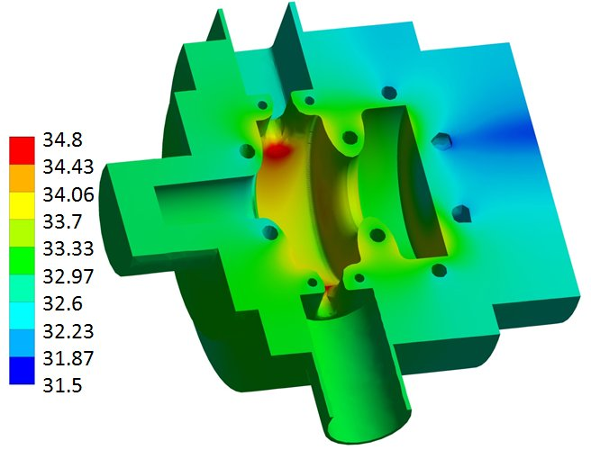
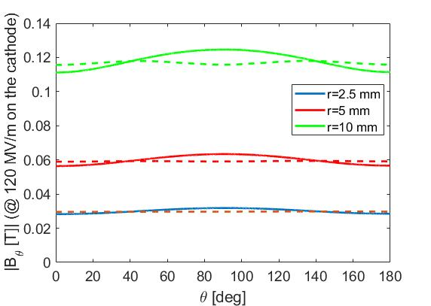
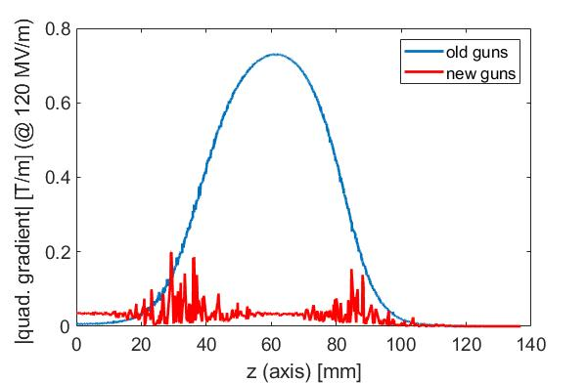
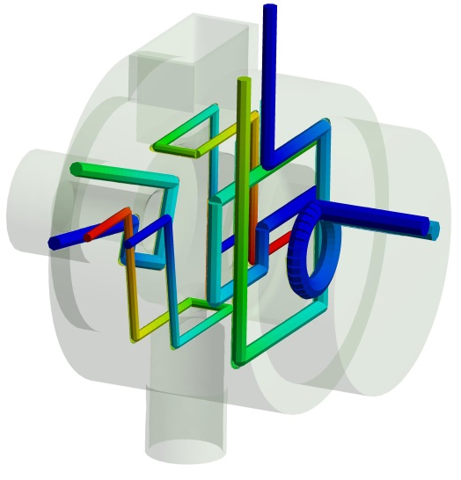
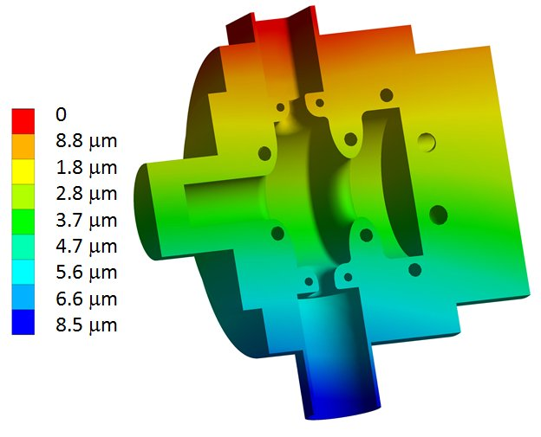
PERFECT COMPENSATION OF THE QUADRUPOLE COMPONENTS, PUMPING SPEED AND COOLING
SPARC (Ver. 1)
NEW SPARC_LAB
Thermo-mechanical design
The new geometry with 4 pumping ports allows to completely cancel the dipole and quadrupole components induced by the input coupler and allow to have a increased pumping speed on the gun itself (pressure in operation ∼10⁻¹⁰ mbar)
ELI-NP
CLEAR
In the ELI-NP case, 100 Hz and long RF pulses for muti-bunch the av. diss. power is larger than 1kW
To avoid detuning under powering and hot spots a 6 cool. channels (incl. cathode) with total water flow of 30 liter/min has been designed
full coupled thermal-structural analysis (Ansys Workbench) has been performed
detuning of the gun under power <100 KHz (<2 deg temp.) w/o affecting the field flatness
Magnetic field on an arc in the center of the coupler (cont. old guns, dash new guns)
Quadrupole component along the longitudinal axis
[D. Alesini et al., PRAB 18, 092001 (2015)]
[D. Alesini et al., PRAB 21, 112001 (2018)]
[V. Shpakov et al., JINST 17 P12022 (2022)]
D. Alesini, S-band brazing free high charge Photo electron gun and RF deflector, COLD project Review Meeting, 21-04-26.

Slide 10
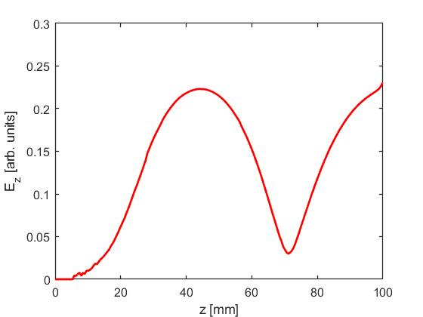
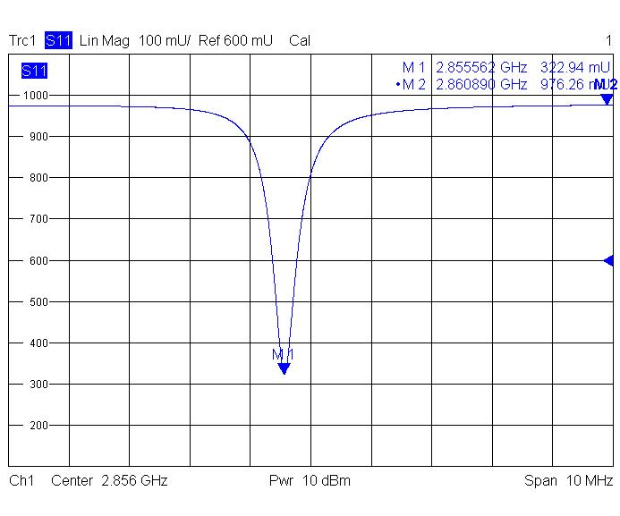
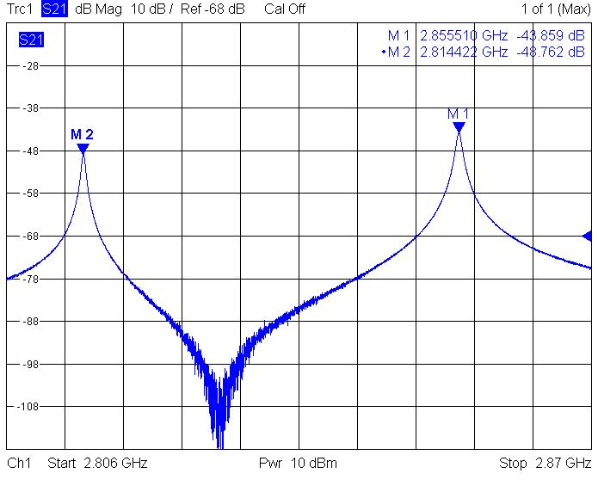
TYPICAL LOW POWER RF CHARACTERIZATION OF THE NEW GUNS (EX. NEW SPARC_LAB)
Cathode position
Parameters | TEOR. | MEAS
f_{res}[GHz] | 2.856 | 2.856
Q₀ | 14300 | 13900
Coupling β | 2 | 1.99
Cathode field [MV/m] | 120
Filling time [ns] | 515
E_{surf_peak}/E_{cathode} | 0.88
E_{cathode}/√(P_{diss}) [MV/m/MW^{0.5}] | 37.5
Freq. sep. 0-π modes [MHz] | 41
Pulsed heating (T_{RF}=1 μs) [°C] | <30
Rep. rate [Hz] | 10
Average dissipated power [W] | 80
RF pulse length T_{RF} [μs] | 1
RF input power [MW] | 16
Working temperature [°C] | 25
Scattering parameters measurements have been done and bead drop measurements to characterize the field flatness
D. Alesini, S-band brazing free high charge Photo electron gun and RF deflector, COLD project Review Meeting, 21-04-26.

Slide 11
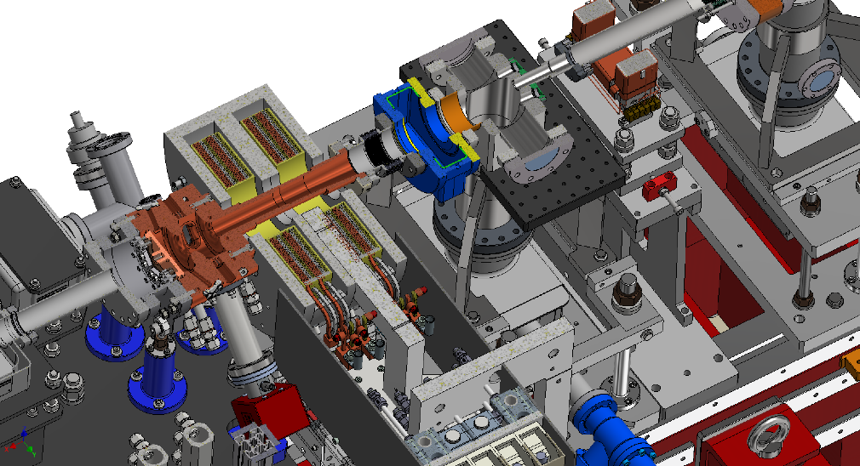
NEW SPARC_LAB (CLEAR) PHOTO-INJECTOR LAYOUT
The RF gun is inserted in a complex system (RF photo-injector) that:
Integrates a solenoid (in SPARC it has a remote control of the transverse position at the <+/-10 μm level);
allows on axis laser injection with the last mirror in air and not in vacuum;
has been designed with the possibility of a future integration of an X/C band cavity linearizer (velocity bunching compression);
has a variable skew quadrupole after the gun, in the solenoid, for the compensation of residual quadrupole components and fine tuning of the x-y emittances;
Laser injection
Vacuum chamber
Solenoid
gun
cathode
D. Alesini, S-band brazing free high charge Photo electron gun and RF deflector, COLD project Review Meeting, 21-04-26.

Slide 12
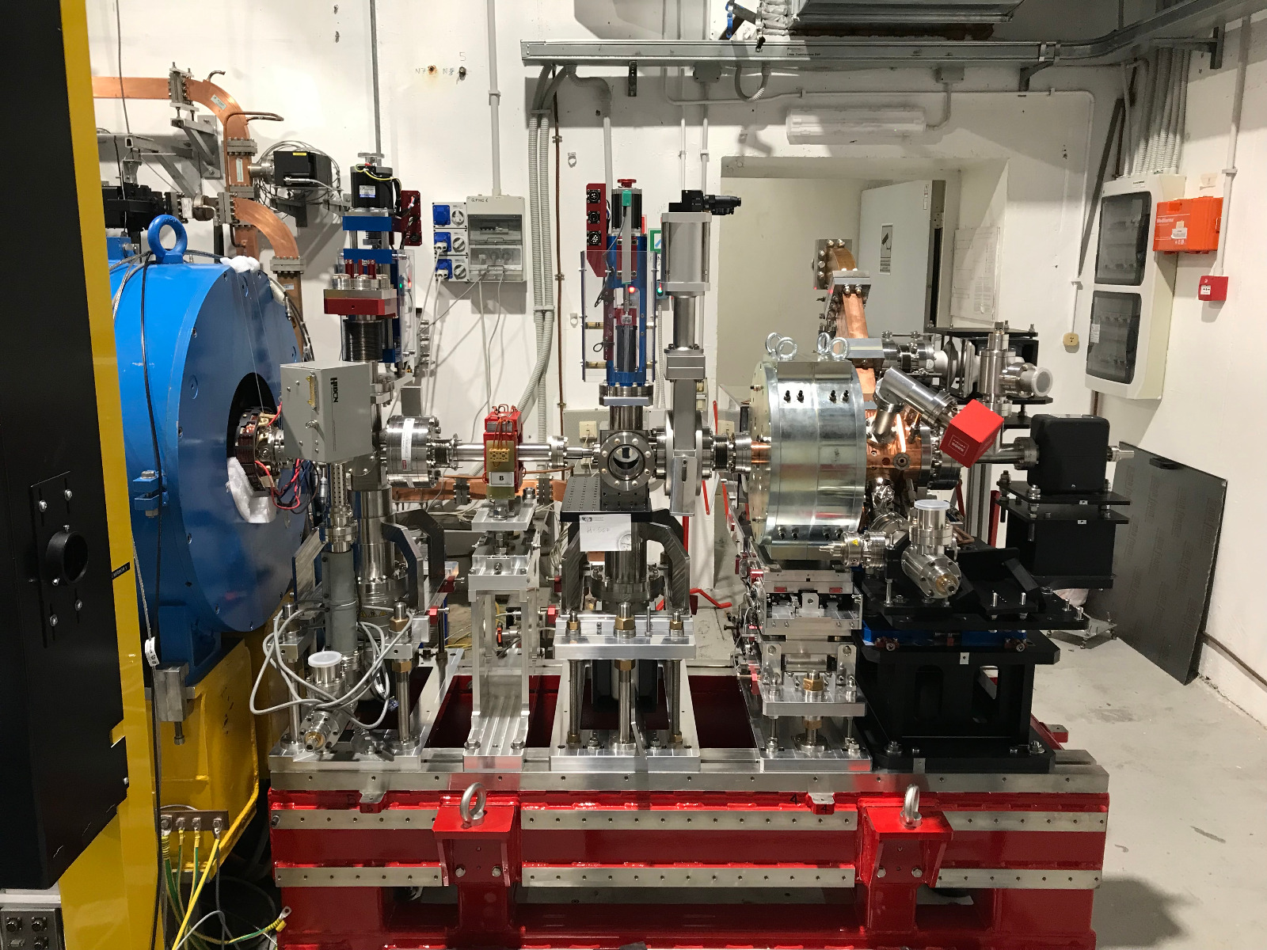
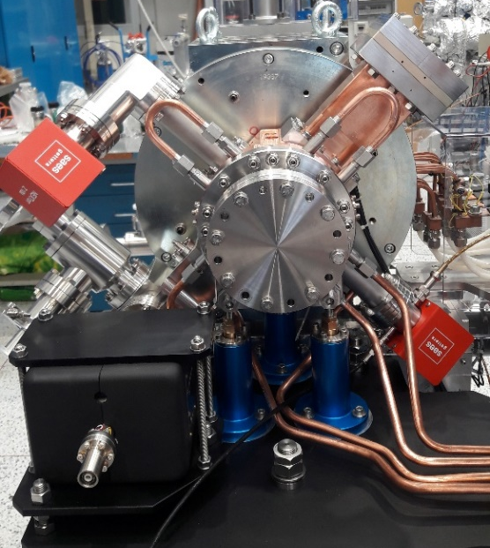
NEW SPARC_LAB PHOTO-INJECTOR: FINAL LAYOUT
Diagnostic chamber
Laser injection
V. Shpakov, D. Alesini et al., et al 2022 JINST 17 P12022 (2022)
gun
LINAC
toroid
corrector
Vacuum valve
Solenoid
D. Alesini, S-band brazing free high charge Photo electron gun and RF deflector, COLD project Review Meeting, 21-04-26.

Slide 13
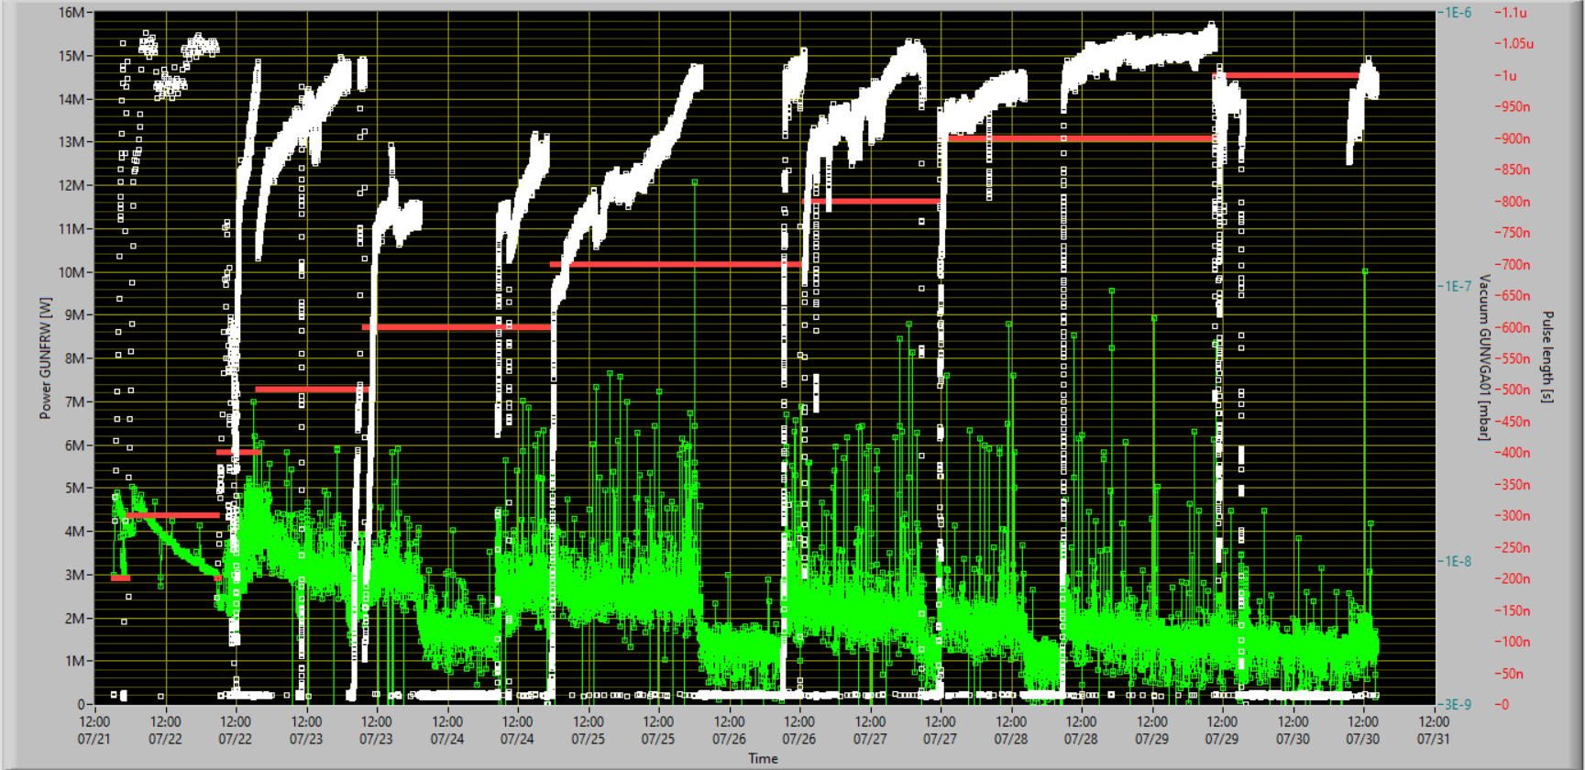
RF GUN CONDITIONING PROCEDURE: DETAIL
V. Shpakov, D. Alesini et al., et al 2022 JINST 17 P12022 (2022)
∼5x10⁶ pulses, total cumulated discharges (vacuum) <10³
HARD COPPER showed extremely good properties in term of conditioning time! No discharges now in operation >110 MV/m
D. Alesini, S-band brazing free high charge Photo electron gun and RF deflector, COLD project Review Meeting, 21-04-26.

Slide 14
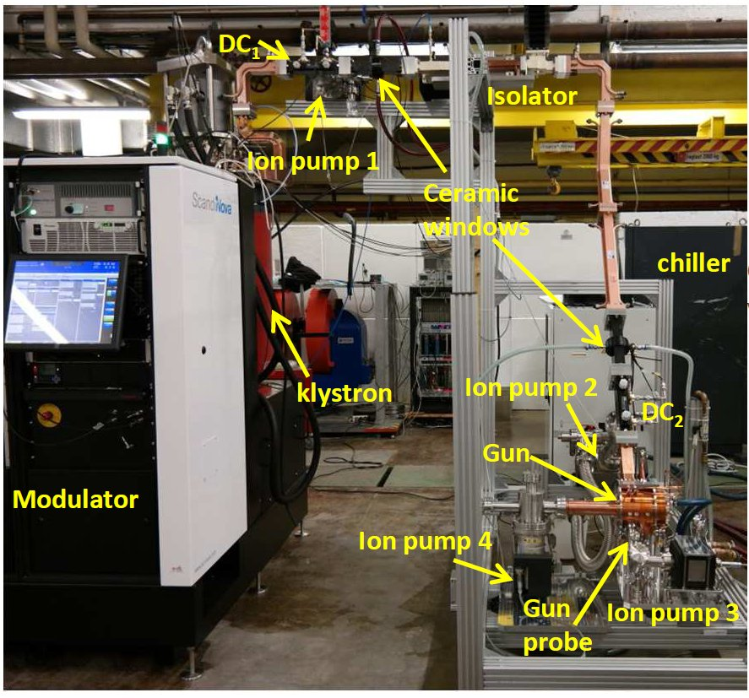
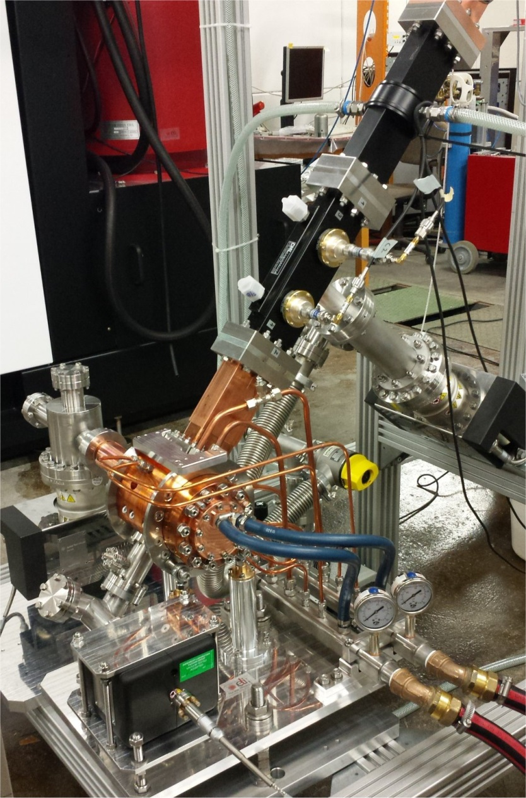
EXAMPLE ELI-NP RF GUN HIGH POWER RF TEST SETUP
High power RF tests have been performed at the Bonn University under the Research Instruments responsibility. The power source was the ELI-NP Scandinova RF Unit based on Solid State modulator K2-3 and 60MW S-band Toshiba klystron.
Ceramic window
DC₂
Gun
Ion pump 2
DC₁
Ceramic window
KLY
Isolator (SF6)
Directional coupler
Ion pump 1
Ion pump 2
DC₂
Ion pump 4
Ion pump 3
GUN
Ion pump 3
Gun probe
D. Alesini, S-band brazing free high charge Photo electron gun and RF deflector, COLD project Review Meeting, 21-04-26.

Slide 15
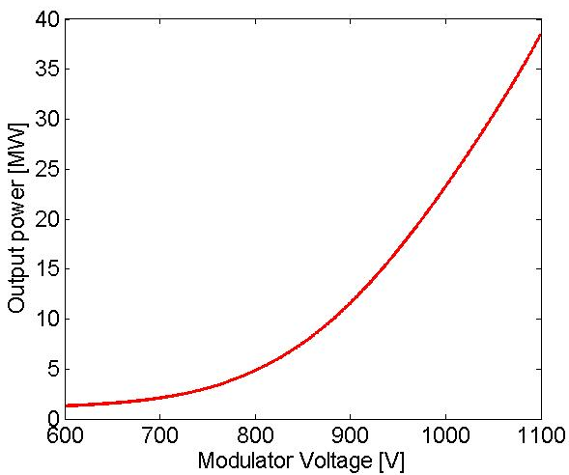
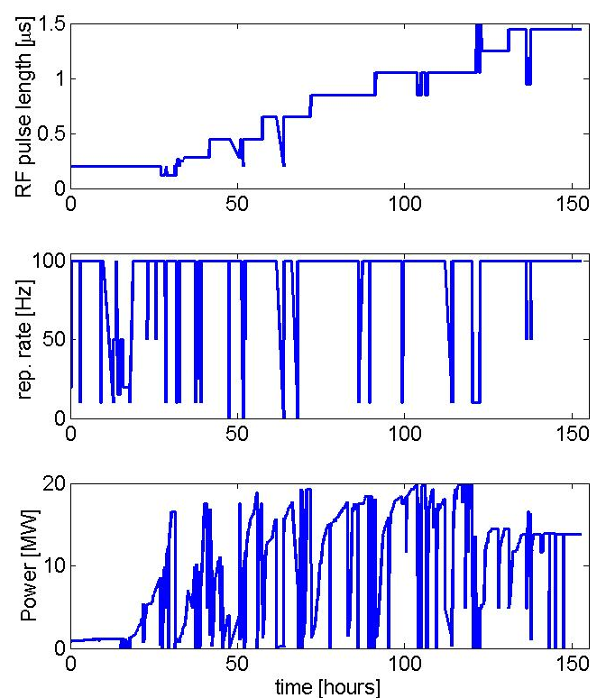
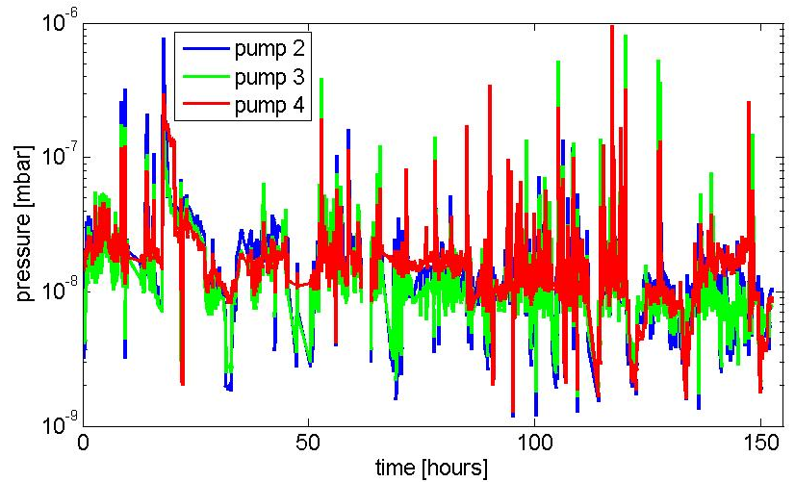
HIGH POWER RF TEST: CONDITIONING RESULTS
The RF conditioning lasted about 160 hours and the gun finally reached the nominal parameters with a break down rate of few 10⁻⁵ bpp. The vacuum pressure was measured by the ion pumps current during the whole process. It was of the order of 1x10⁻⁸ mbar at full power and always maintained a decreasing trend. At the end of conditioning and without power the vacuum pressure in the gun was lower than 5x10⁻¹⁰ mbar.
Conditioning history
Output power from the klystron
Vacuum pressure from ion pumps current
D. Alesini, S-band brazing free high charge Photo electron gun and RF deflector, COLD project Review Meeting, 21-04-26.

Slide 16
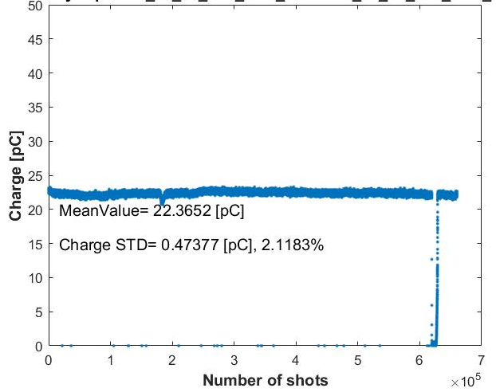
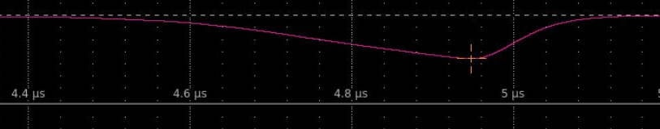
RF GUN PERFORMANCES WITH BEAM (SPARC_LAB CASE)
Beam energy at the exit of the gun as a function of the input power. The red dashed line is the simulations made by GPT.
Dark current measurements as a function of the input power in the gun.
Measured quantum efficiency for different diameters of the laser spot at the cathode. The drop of the QE at low charge/laser energy is, probably, related to our inability to measure properly the energy of the laser pulse at such levels...
Dark current in 24 hours operation showing the very stable operation (BDR<10⁻⁶ bpp)
V. Shpakov, D. Alesini et al., et al 2022 JINST 17 P12022 (2022)
D. Alesini, S-band brazing free high charge Photo electron gun and RF deflector, COLD project Review Meeting, 21-04-26.

Slide 17

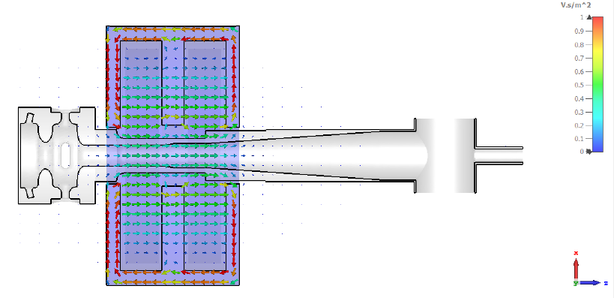
SPARC GUN: DARK CURRENT STUDIES
Dark current simulations have been performed using CST with and w/o solenoid
Current transported up to the laser injection chamber has been calculated
Parameter | Unit | 112 MV/m | 184 A
Solenoid Current | A | 0 | 115
Q_{period} emitted | fC | 17 | 17
Q_{period} transported | fC | 0.33 | 0.85
I_{avg} emitted | uA | 48.4 | 48.4
I_{avg} transported | uA | 0.94 | 2.4
Transport ratio | % | 1.94 | 5
Maximum energy | MeV | 5.3 | 5.7
Input parameters:
β = 70-75
Φ = 4.65 eV
A_{e} = 0.01 um²
A_{cathode} = 1520 mm²
E_{cathode}=111.9 MV/m
Courtesy of F. Cardelli

Slide 18

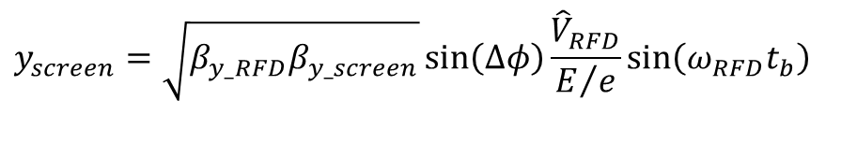

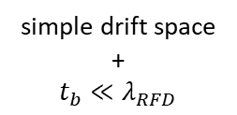

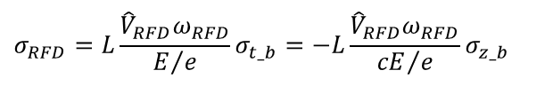
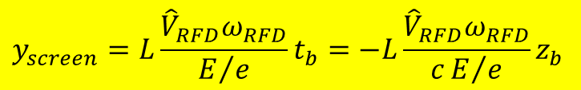

RF DEFLECTOR: WOKING PRINCIPLE
With an RFD it is possible to measure the bunch longitudinal profile and, adding a dispersive system, the longitudinal beam phase space. Similarly, since the longitudinal beam distribution can be projected along a transverse coordinate, the transverse emittance of each longitudinal bunch slice can be measured using the quadrupole scan technique.
The phase of the deflecting voltage is chosen to have a zero crossing of the transverse voltage in the center of the bunch, giving a linear transverse deflection from the head and the tail of the bunch itself. After the deflector the transverse kick results into a transverse displacement of each longitudinal bunch slice, proportional to its position with respect to the bunch center.
RFD (TDS)
$$y_{screen}=\sqrt{β_{y_RFD}β_{y_screen}}\sin\left(Δφ\right)\frac{{\hat{V}}_{RFD}}{E/e}\sin\left(ω_{RFD}t_{b}\right)$$
SCREEN
$$V_{RFD}$$
Optical functions
simple drift space
+
$$t_{b}≪λ_{RFD}$$
L
y
$$y_{screen}=L\frac{{\hat{V}}_{RFD}ω_{RFD}}{E/e}t_{b}=−L\frac{{\hat{V}}_{RFD}ω_{RFD}}{cE/e}z_{b}$$
Beam axis
$$σ_{RFD}$$
$$σ_{RFD}=L\frac{{\hat{V}}_{RFD}ω_{RFD}}{E/e}σ_{t_b}=−L\frac{{\hat{V}}_{RFD}ω_{RFD}}{{cE}/e}σ_{z_b}$$
$$σ_{t_b}$$
$${\hat{V}}_{RFD}$$
D. Alesini, S-band brazing free high charge Photo electron gun and RF deflector, COLD project Review Meeting, 21-04-26.

Slide 19
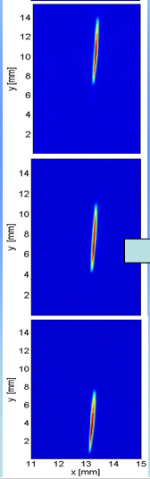







RF DEFLECTOR: CALIBRATION
The other important characteristics of such system is that it is possible to “self calibrate” the measurements. The coefficient that relates the vertical coordinate at the screen with the time coordinate of the bunch can be directly find measuring the bunch centroid position on the screen for different values of the RFD phase.
y
$$y_{screen}=L\frac{{\hat{V}}_{RFD}ω_{RFD}}{E/e}t_{b}=−L\frac{{\hat{V}}_{RFD}ω_{RFD}}{cE/e}z_{b}$$
RFD ON
$${Δφ}_{RFD}$$
Beam axis
$$Δ\left\langle y_{screen}\right\rangle$$
$$\left\langle t_{b}\right\rangle =\frac{E/e}{{L\hat{V}}_{RFD}ω_{RFD}} \left\langle y_{screen}\right\rangle$$
$$\frac{Δ\left\langle t_{b}\right\rangle }{Δ\left\langle y_{screen}\right\rangle }=\frac{{{Δφ}_{RFD}}/{ω_{RFD}}}{Δ\left\langle y_{screen}\right\rangle }=\frac{E/e}{{L\hat{V}}_{RFD}ω_{RFD}}\left[ps/mm\right]$$
D. Alesini, S-band brazing free high charge Photo electron gun and RF deflector, COLD project Review Meeting, 21-04-26.

Slide 20













RF DEFLECTOR: RESOLUTION
Since the beam has a finite transverse emittance, the distribution of the deflected bunch at the screen position is the superposition between the deflected beam profile and the transverse size of each bunch slice.
The rms resolution length ($σ_{t_res}$) can be defined as the bunch length that gives, on the screen, a vertical spot exactly equal to ${\sqrt{2}σ}_{0}$.
SPARC typ. values;:
$σ_{0}=100 μm$ ($β_{s}≈1m$)
$$E=100 MeV$$
$$L=4 m$$
$$f_{RF}=2.856 GHz$$
$${\hat{V}}_{RFD}=2.5 MV$$
RFD OFF
$$σ_{t_res}=\frac{E/e}{ω_{RFD}{L\hat{V}}_{RFD}L}σ_{0}$$
$$σ_{res}≈50fs$$
Beam axis
$$σ_{0}$$
$$σ_{t_res}=\frac{E/e}{ω_{RFD}{\hat{V}}_{RFD}L}\sqrt{εβ_{s}}$$
It is convenent to have a waist on the screen
Its is NOT convenient to increase L after the waist
$$σ_{t_b}$$
L
$$β_{s}$$
[D. Alesini et al., Proc. of DIPAC09, Basel, Switzerland, 2009]
RFD ON
L
$$σ_{y_meas}=\sqrt{σ_{0}^{2}+σ_{RFD}^{2}}$$
$$V_{RFD}$$
D. Alesini, S-band brazing free high charge Photo electron gun and RF deflector, COLD project Review Meeting, 21-04-26.

Slide 21











RF DEFLECTOR: GENERAL PROPERTIES OF DEFLECTING STRUCTURES
[D. Alesini et al., NIM A 568 (2006) 488–502]
RFDs are multi-cell devices working on the TM11-like mode.
Both E and B field contribute to the total deflection (the ratio depends on the iris diameter. For small irises the deflection is mainly magnetic).
The long. E field is zero on axis but increases linearly off-axis. It is 90 deg out-of-phase with respect to the deflecting voltage (Panosky-Wenzel theorem), it introduces an energy spread inside the bunch when the deflectors are used for beam diagnostics. The contribution of the RFD to the energy spread is not negligible and, to the first order depends linearly on the vertical beam size inside the RFD ($σ_{y_b}$).
There are two possible polarities of the deflecting field. Polarizing rod or holes are can be introduced to force an azimuthal asymmetry in the structure fixing the working polarity itself.
Because of the dominant magnetic coupling between cells the structures are backward (TW: phase velocity has opposite direction with respect to the group velocity; SW: π-mode has the lower frequency)
$${\tilde{V}}_{RFD}=j\frac{c}{ω_{RFD}}\frac{d{\tilde{V}}_{z_RFD}}{dy}$$
[D. Alesini et al., Proc. of DIPAC09, Basel, Switzerland, 2009]
$$y$$
$$E_{z}$$
$$σ_{E_RFD}=\frac{ω_{RFD}}{c}{\hat{V}}_{RFD}σ_{y_b}$$
SPARC typ. Values:
$$σ_{y_b}=150 μm$$
$σ_{E_RFD}≈$20 keV
D. Alesini, S-band brazing free high charge Photo electron gun and RF deflector, COLD project Review Meeting, 21-04-26.

Slide 22








RF DEFLECTOR: MEASUREMENTS
[D. Alesini et al., Proc. of DIPAC09, Basel, Switzerland, 2009]
Longitudinal phase space
The longitudinal phase space can be characterized using the combination of RFD and a dipole. From the phase space picture the slice energy spread can be measured. In these measurements both vertical and horizontal β-function at the screen have to be minimized to increase resolution and the emittance contribution to the energy spread measurement. The dominant systematic error is the energy spread is that induced by the RFD long. E field.
Longitudinal beam profile
[D. Filippetto et al., PRST-AB 14, 092804 (2011)]
Slice emittance measurements
The technique is similar to the usual quadrupole scan. The RFD deflects the beam vertically, a set of values for the quadrupoles must be find in advance to change only the horizontal dimension of the beam, keeping constant the vertical size in order to have the same longitudinal resolution.
D. Alesini, S-band brazing free high charge Photo electron gun and RF deflector, COLD project Review Meeting, 21-04-26.

Slide 23








COLD RF DEFLECTOR: BASELINE PARAMETERS
Deflecting mode | SW, π
Number of cells | 5
Frequency | 2.998 GHz
Quality factor (Q₀) | 16000
Coupling coefficient (β) | 2
Filling time | 570 ns
Max. input power (P_{RF}) | 5 MW
Transv. shunt imp. (R_{T}) | 2.4 MΩ
Defl. voltage at regime (${\hat{V}}_{RFD}$) | 4.6 MV
Defl. voltage after 1 μs (${\hat{V}}_{RFD}$) | 3.8 MV
Similar SPARC parameters
Enough power from the klystron gun: the power required for the RFD can be spilled out form the gun line
Relatively simple design and realization:
5 cells, SW, f_{RF}=2.998 GHz, β=2 (for 1 μs RF pulses)
20 MW
Switch
Att.
PS
6dB
5 MW
RF gun
LINAC
$$σ_{0}=200 μm$$
$$E=150 MeV$$
$$L=3m$$
$$σ_{y_B}=200 μm$$
$$σ_{res}≈140fs$$
$σ_{E_RFD}≈$50 keV
D. Alesini, S-band brazing free high charge Photo electron gun and RF deflector, COLD project Review Meeting, 21-04-26.

Slide 24


CONCLUSIONS
For the COLD project we can adopt a photo-injector based on brazing free RF photo-gun with parameters equal to the SPARC_LAB ones. Supports, vacuum chambers, diagnostics etc… can be similar (or identical) to the SPARC ones
The proposed RF deflector is a 5-cell device fed by the same RF gun klystron. Resolution at the level of 100 fs can be easily achived.
ACKOWLEDGEMENTS
All my LNF collegues that contributed to the developments of the two systems and related calculations (see authors of the mentioned publications). In particular the LNF vacuum, RF, Beam Dynamics, SPARC_LAB and LINAC group.
D. Alesini, S-band brazing free high charge Photo electron gun and RF deflector, COLD project Review Meeting, 21-04-26.

