Slide 1

QCM Accelerator Structure ESRF CDR Contribution
21 April 2026
Galen Aymar, Emilio Nanni, Andy Haase, Zenghai Li

Slide 2
Agenda
QCM Overview
Schedule
Accelerator RF Design
QCM Design and Build Status
Alignment Requirements
External Mounts
Cryogenic Requirements
Vacuum Requirements

Slide 3
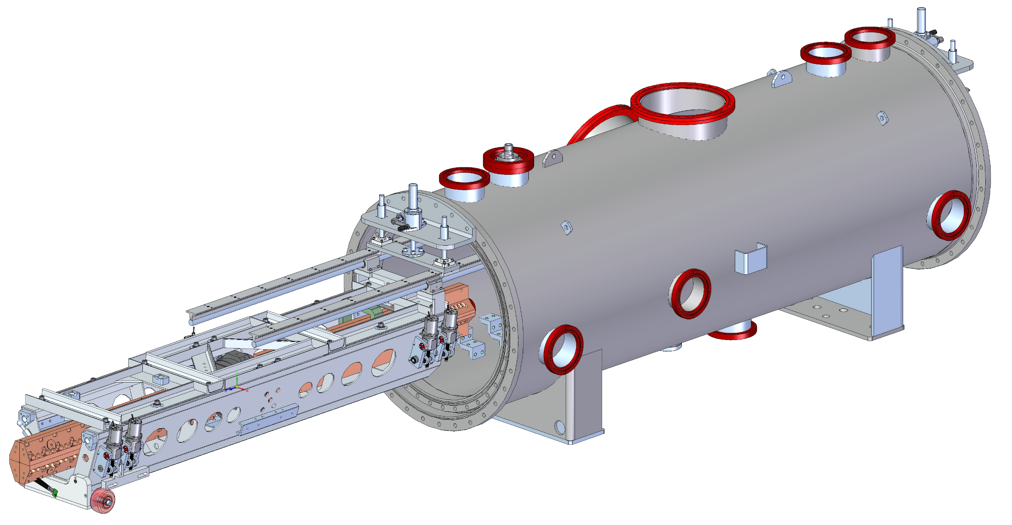
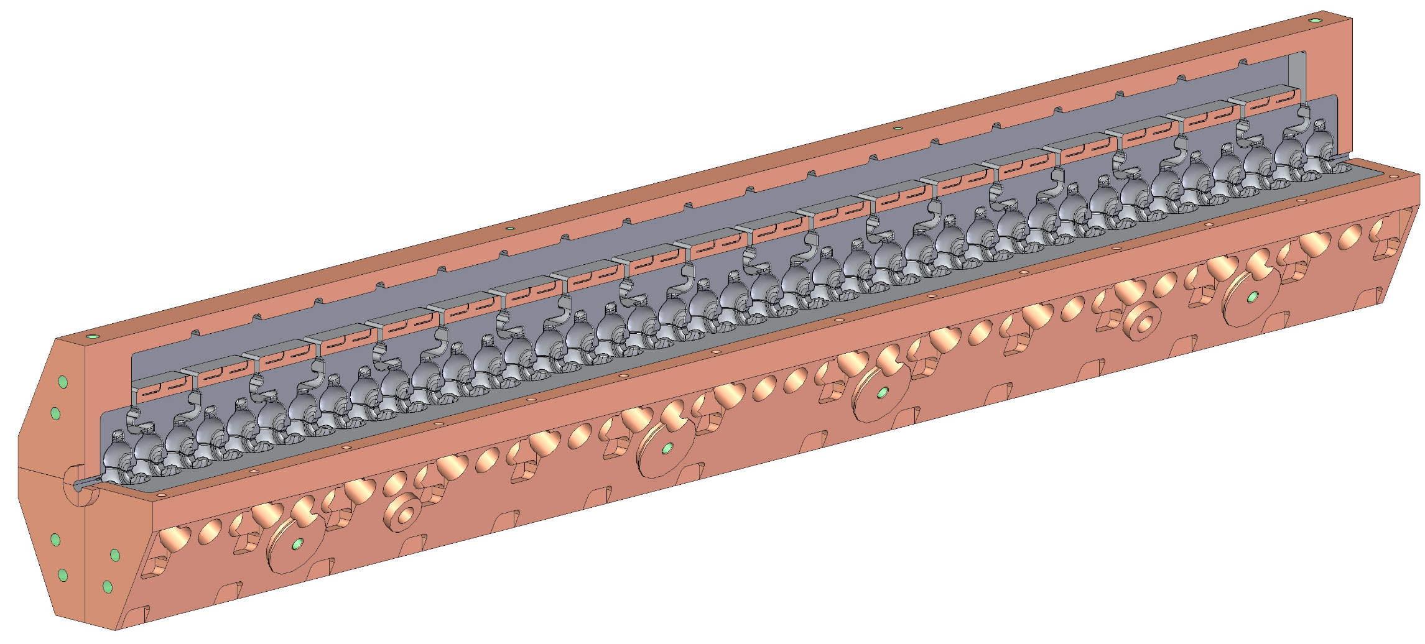
QCM Overview
Original goal: demonstrator for C³
Additional goal: provide QCM to ESRF
The full C³ design works for ESRF, but ESRF has less stringent requirements
VESSEL
QUADRUPOLE (not used)
ACCELERATOR STRUCTURE
INSTALLATION HARDWARE
RAFT
MOUNTS

Slide 4
Proposed Schedule
Mechanical assembly of the QCM to start by Nov 2026, allowing testing before shipment to ESRF by July 2027

Slide 5
Procurement Status
Long Lead Items
Accelerator Structure
Request for Proposal process completed via Sam.gov website – received 8 bids
A vendor has been identified, but paperwork and contracts are still in process
Lead time for the first set of parts is 28 weeks and for the complete two sets of parts is 34 weeks.
Receive at SLAC in November 2026
Cryomodule
Received at SLAC in 2025

Slide 6
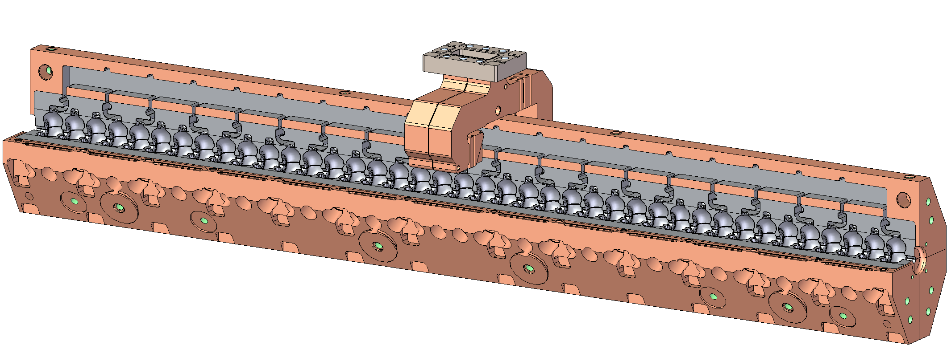
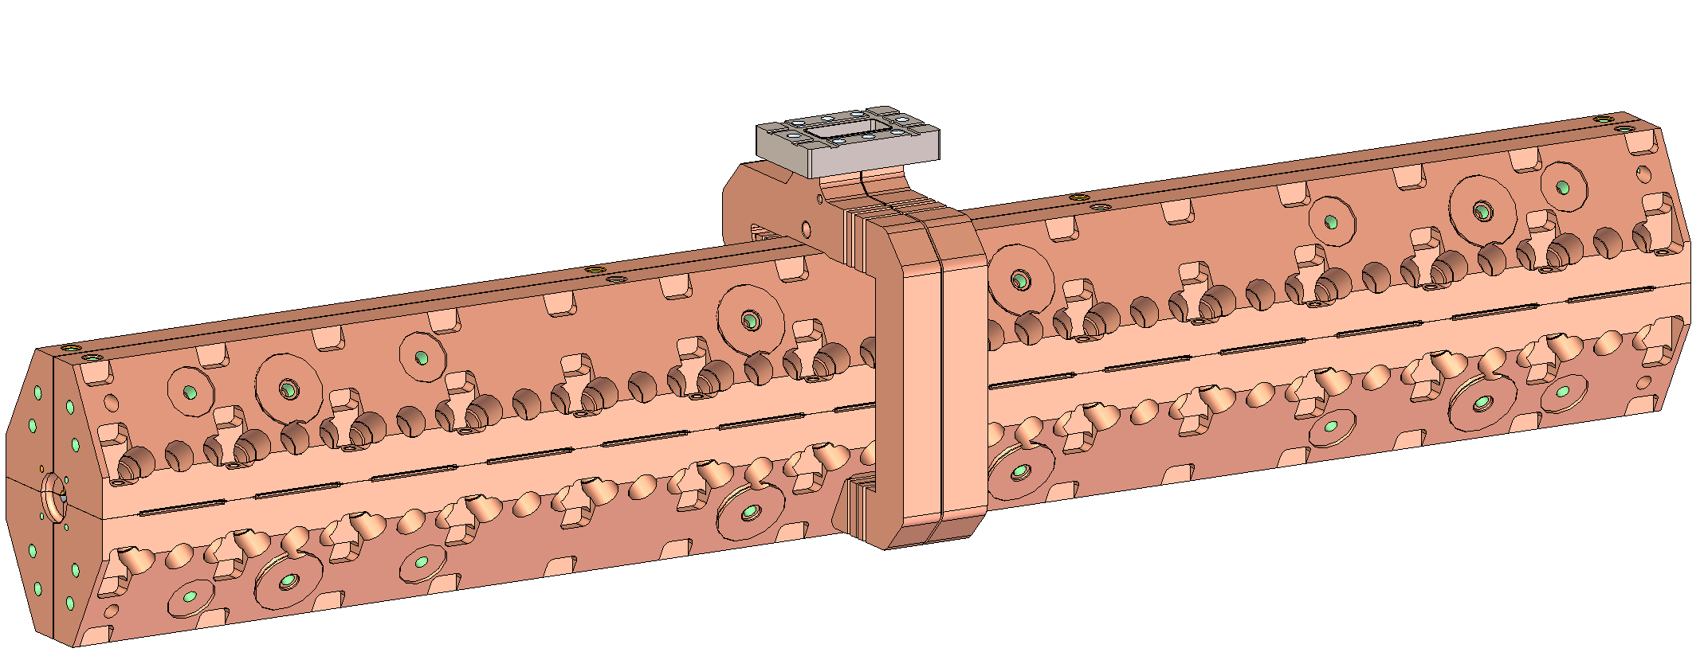
Design and Build Status – Accelerator Structure

Slide 7
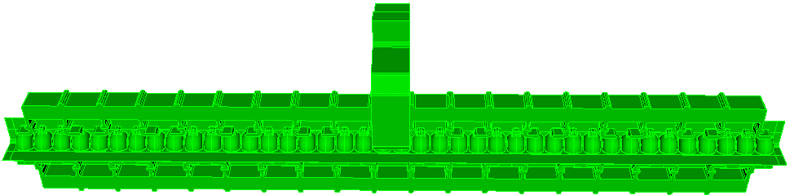
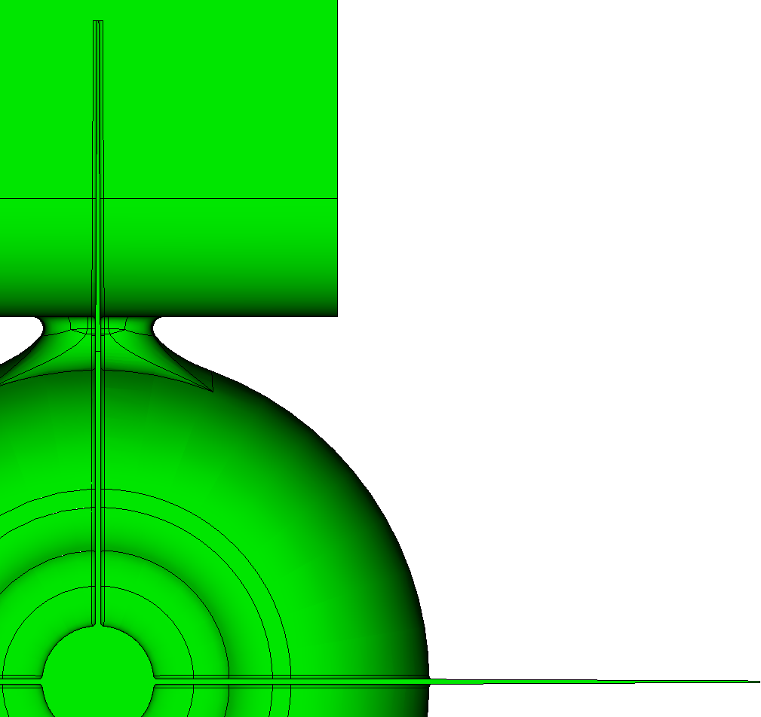
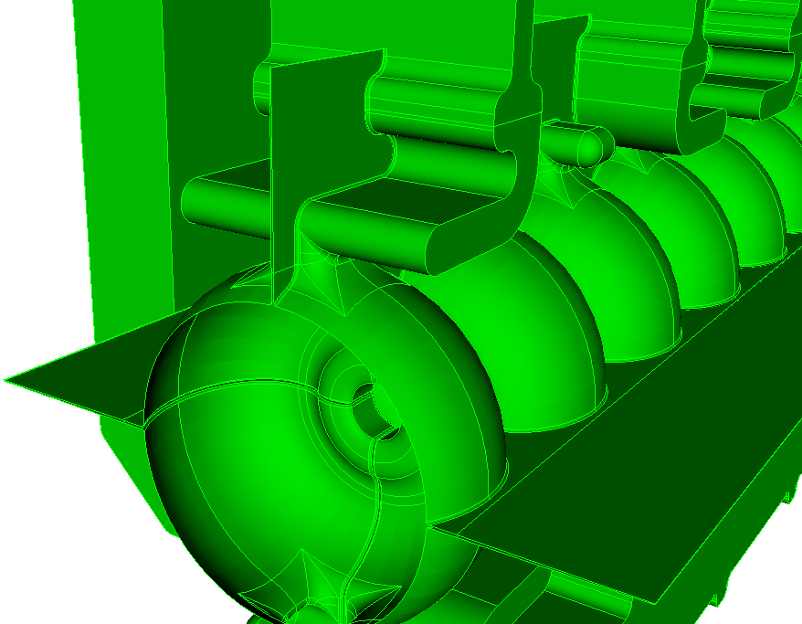
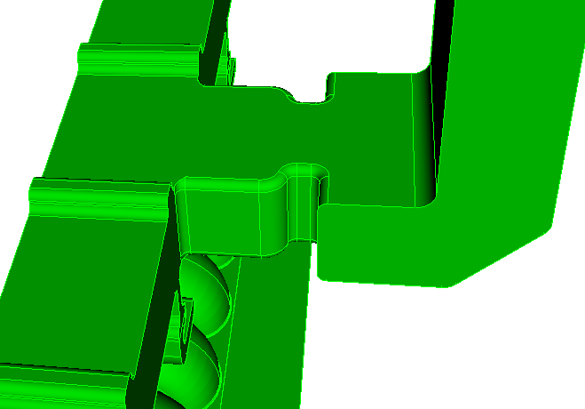
Final RF Geometry
Features
40 cells with pair wise side to side distributed coupling
Cell Balancing features
4 damping slots extending to the beam center line (4 part open cells and iris)
Structures to be spaced so that cell center to center distance is (N+.5)*26.242 at operating temperature
1-m structure: 40-cell with damping slots
0.3mm
0.1mm
R2mm
21.010 mm
0.25 mm rounding
42.020 mm
Damping slot
Waveguide corner rounding

Slide 8
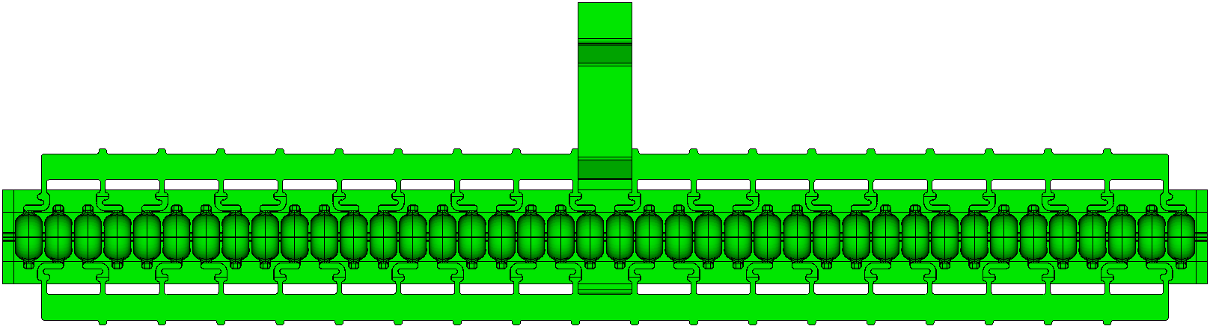
Final RF Geometry
Position and RF Phasing Two or More C-Band Structures to Cancel Backward Acceleration
C-Band PI-mode cell length L_{cell} = 26.242 mm
Separation required to cancel acceleration: dL
Measured from center to center of two end cells
dL = (n + 1 + 0.5)*L_{cell}
n = 0, 1, …
Structure RF phase
phase_down – phase_up = -(n+0.5)*180 degree
Note: all dimension measured at operating temperature
applies to more than two structures
upstream structure
(phase_up)
downstream structure
(phase_down)
Beam direction
dL

Slide 9
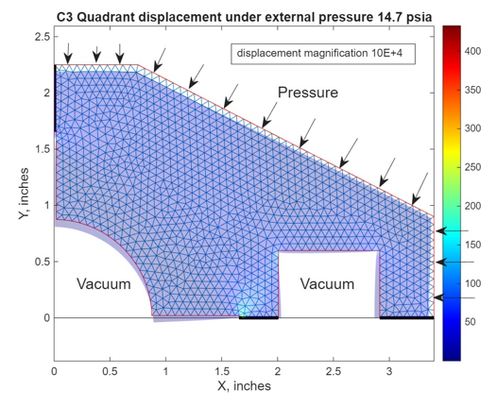
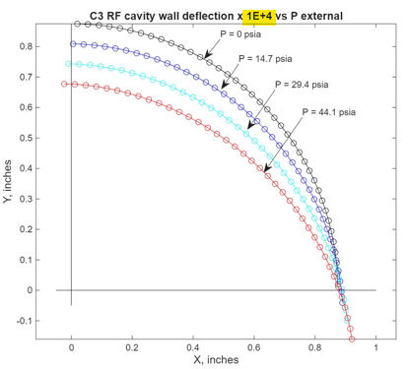

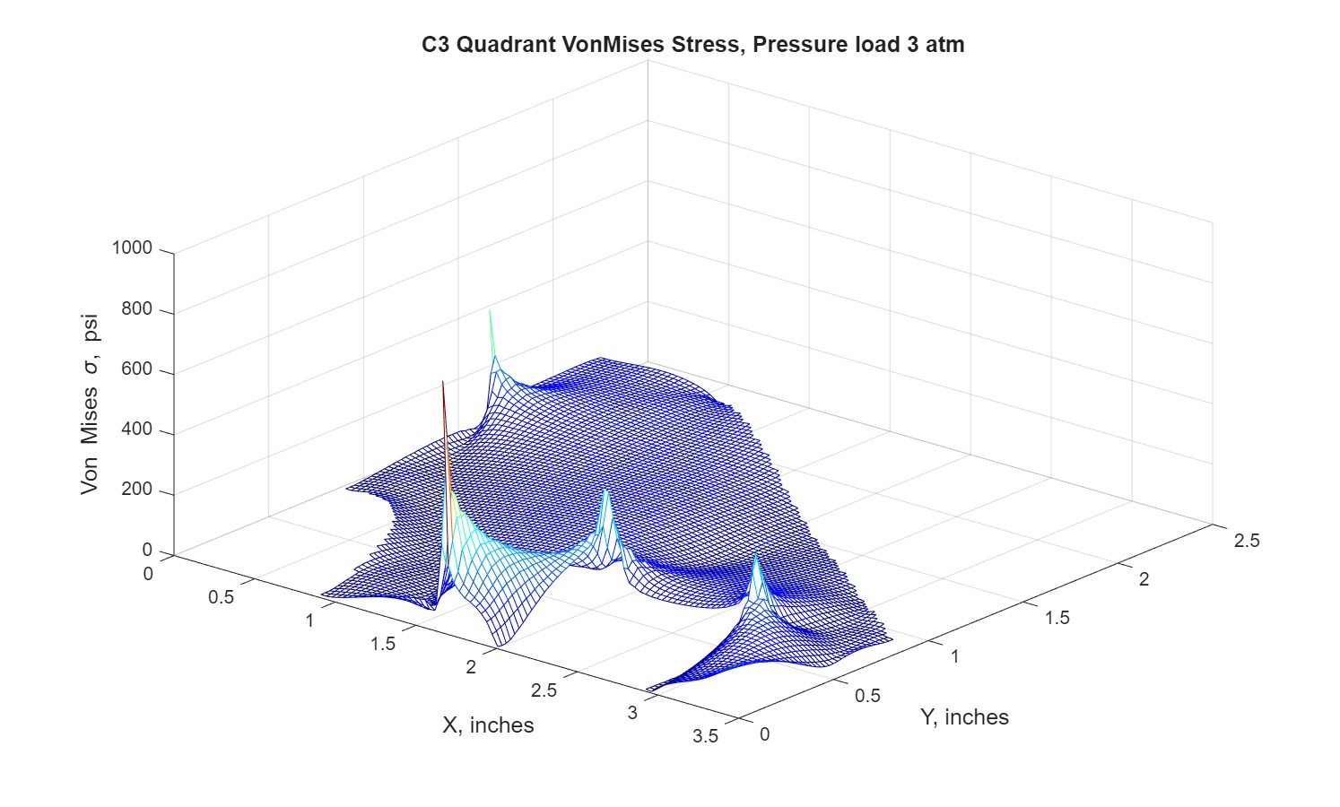
FEA: Deflection Under Pressure, 2D
The “2r” wide damping slots create continuous vacuum space that must be supported to prevent excessive displacement of the cell surfaces. Small predictable elastic deformation can be compensated for during structure tuning.
This was initially reviewed with simplified geometry in 2D to determine if the span would need support within the damping slots or if the full span could be supported by the structure.
With distortion in the range of .3µm conclusion is that the damping slots can remain continuous without interruption for support as long as the inner WG joint is well connected.
The motion of the upper end of the cavity wall under external pressure in microns is:

Slide 10
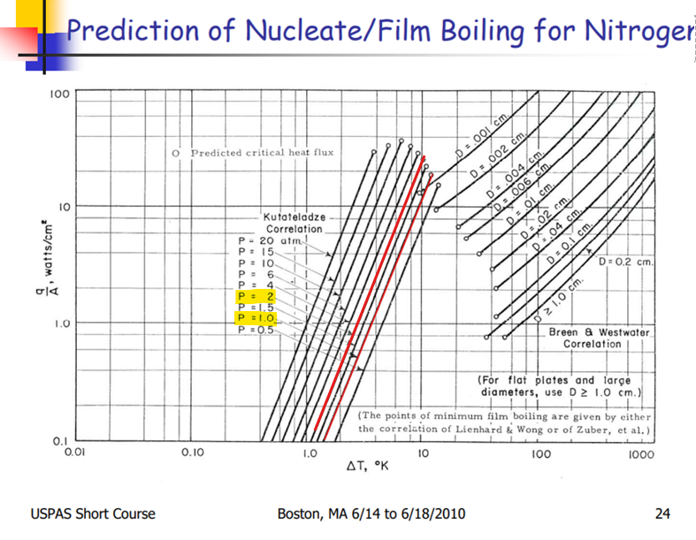
FEA: LN Pool Boiling
Chart shows heat transfer coefficient in nucleate and film boiling regimes as well as transition temperatures. The design goal is to avoid film boiling, staying in nucleate boiling.
To remain in nucleate boiling (at nitrogen pressures between 1 and 2 atm) the surface/bulk temperature difference must remain below ~10 K.
In nucleate boiling the heat transfer coefficient will vary from ~.1 to 10 W/cm^2 as the surface/bulk temperature difference ranges from ~1 to 10K. (.1 to 1 W/cm^2/K)
Other sources were checked with similar coefficients. Simulations indicate that this is not critical as the surface heat flux is well below onset of film boiling.

Slide 11
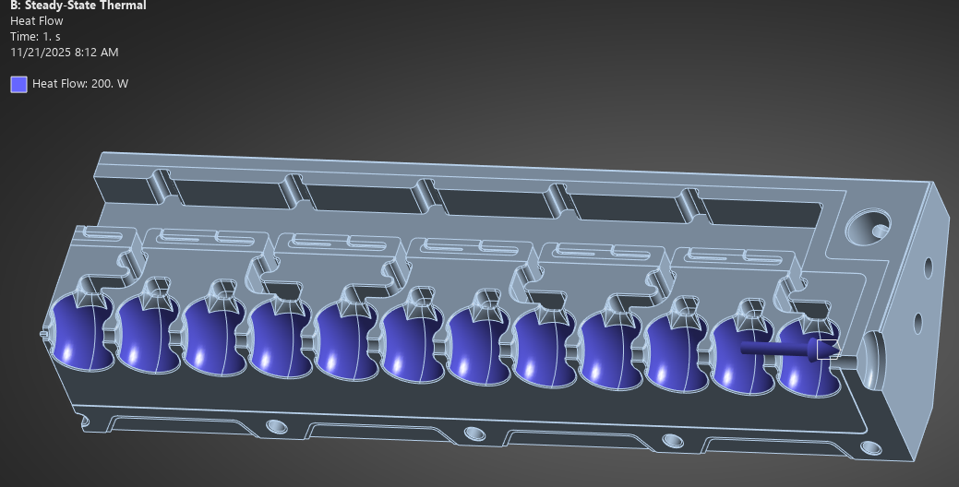
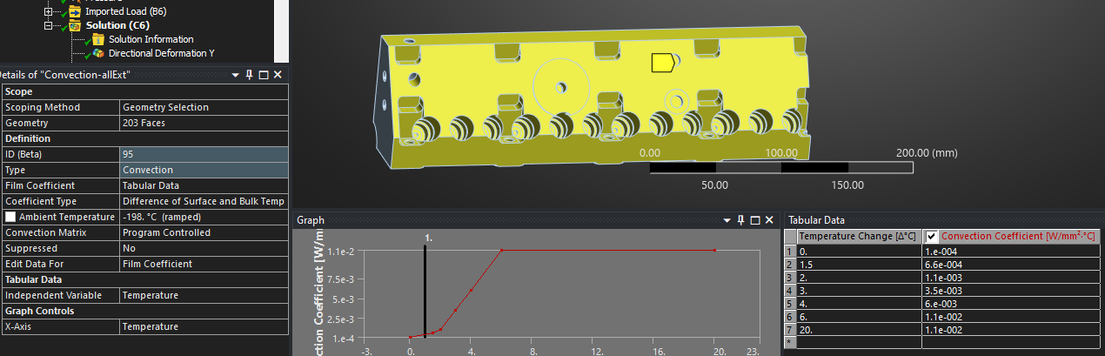
FEA: Structure Cooling
Our typical (and proposed) tuning features create 2 potentially problematic conditions.
Gas trapped areas that will not be well cooled
Areas close to the cell walls that may flash to film boiling
Used 12 cells and included “end effect”
Loss then 2500/40*12/4=187 > round up to 200 W
Cooling ranged from all exterior to just the main faces
Used convection coeff from ~relevant sources

Slide 12
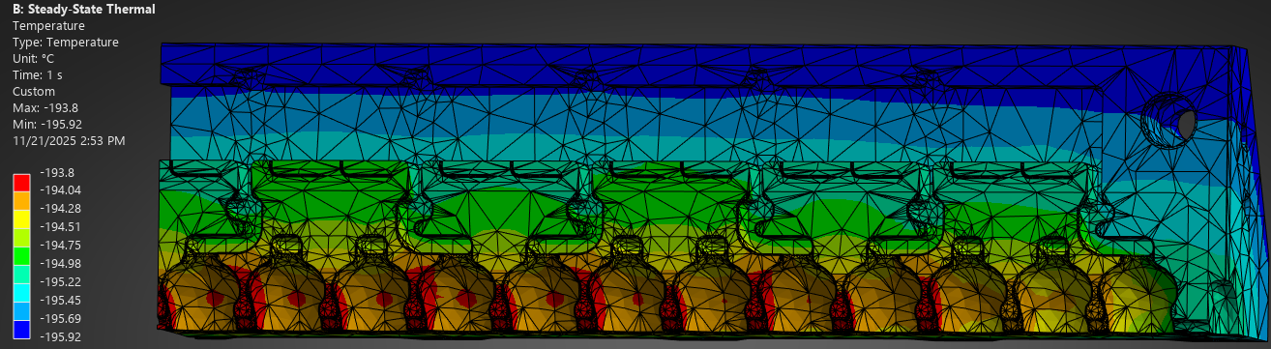
FEA: Pool Boiling Temperatures
Case with no cooling at the tuner surfaces indicates inside temperatures at approximately 4° above the LN bulk temperature.
As this is “well below” the film transition temperature of ~10°, no modification of the tuning features is thought essential.
This also shows the extent of the additional end cooling which is discussed on subsequent slides.

Slide 13
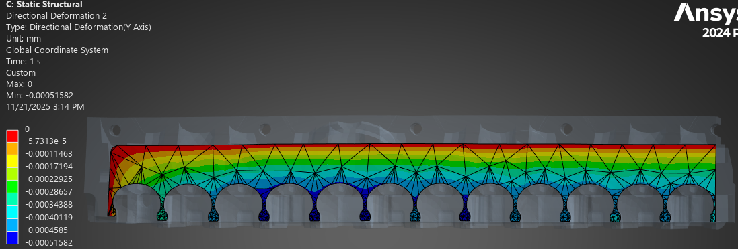
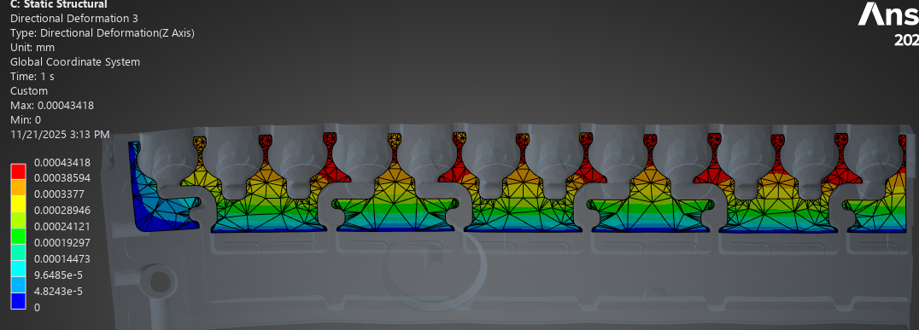
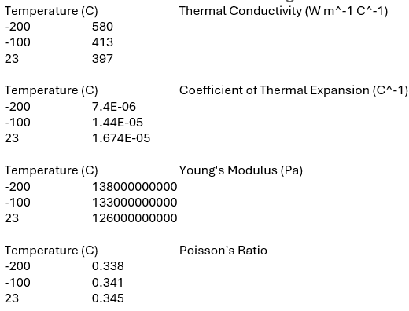
FEA: Heat Transfer, Pressure, & End Effects
Deformation normal to the damping slot
Distortion from RF heating and 3 atm pressure (1.5x design)
Case without any tuner surface heat transfer
Displacement of less than 0.5 µm is acceptable
Some tuning offsets to compensate for end effects may be incorporated.

Slide 14
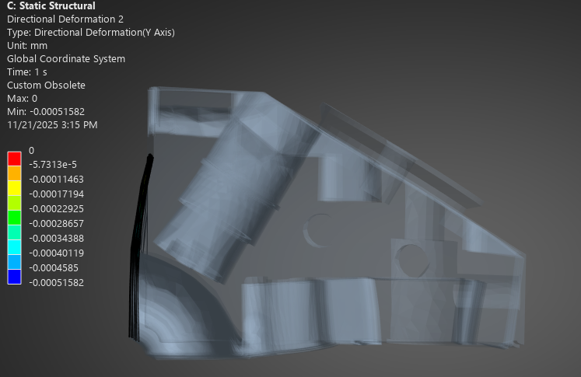
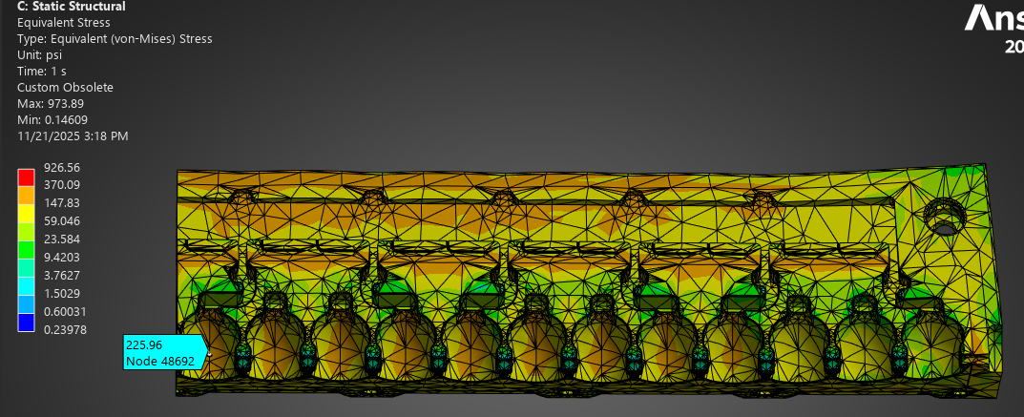
FEA: Heat Transfer, Pressure, & End Effects
Conditions from previous slide
Distortion 3D visualization
Von-Mises stress below 1 kpsi. Annealed copper yields at >3 kpsi.
Yielding is not expected

Slide 15
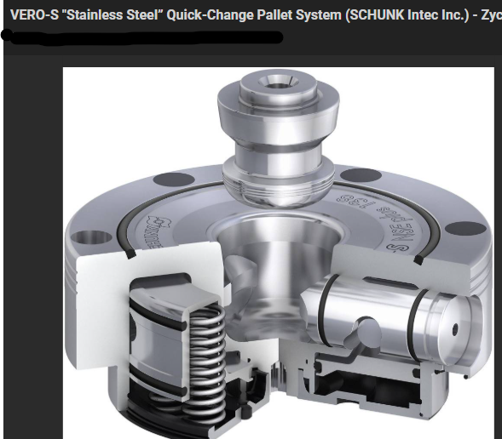
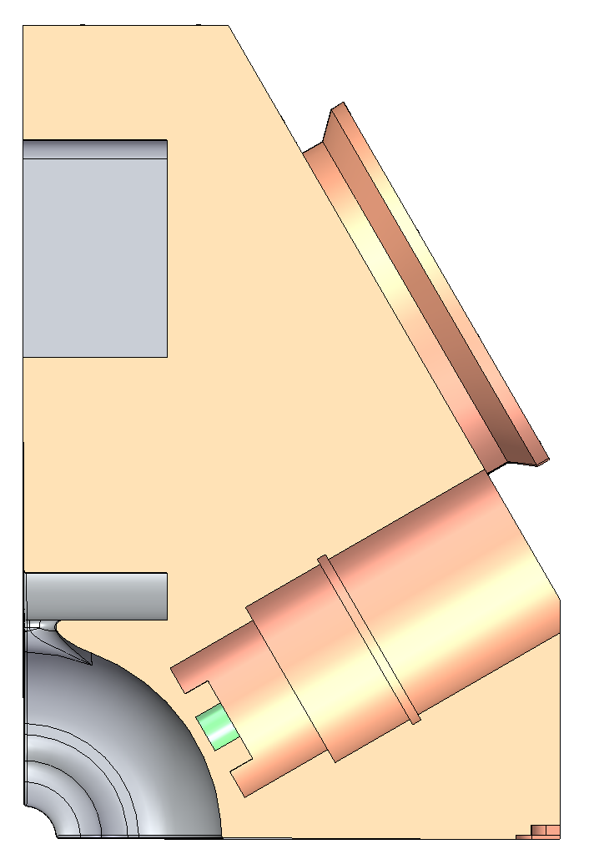
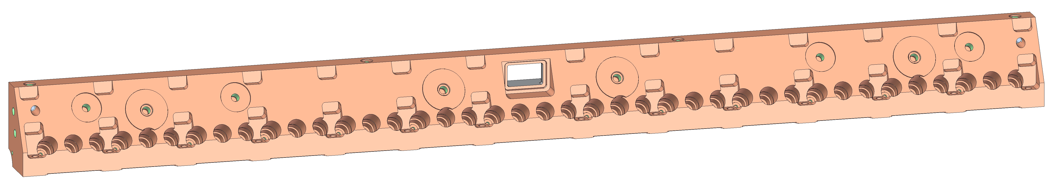
Mechanical Features - External
Mounts for Rasnik or laser nests
Alignment surfaces to be machined in one pass at the final step, checked/recorded
Part handling feature for machining – TBD by vendor
Mounts for struts to support raft
Cell tuners
Thru-holes for bolt clamping at braze
Braze clamping pads

Slide 16
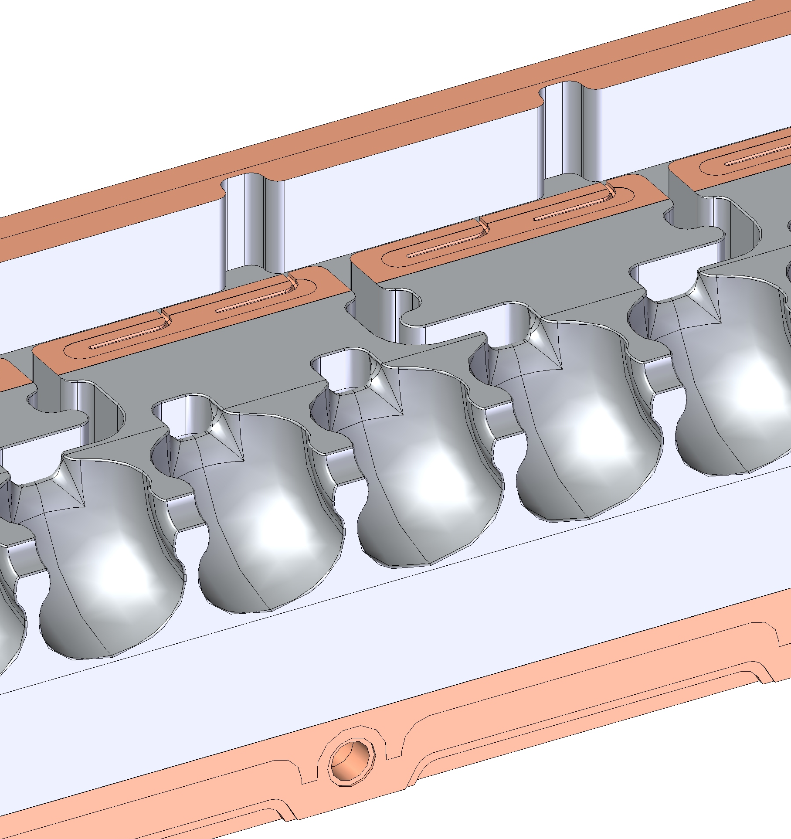
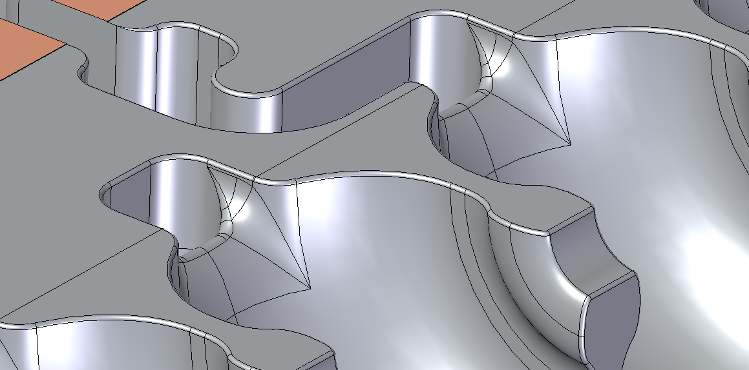
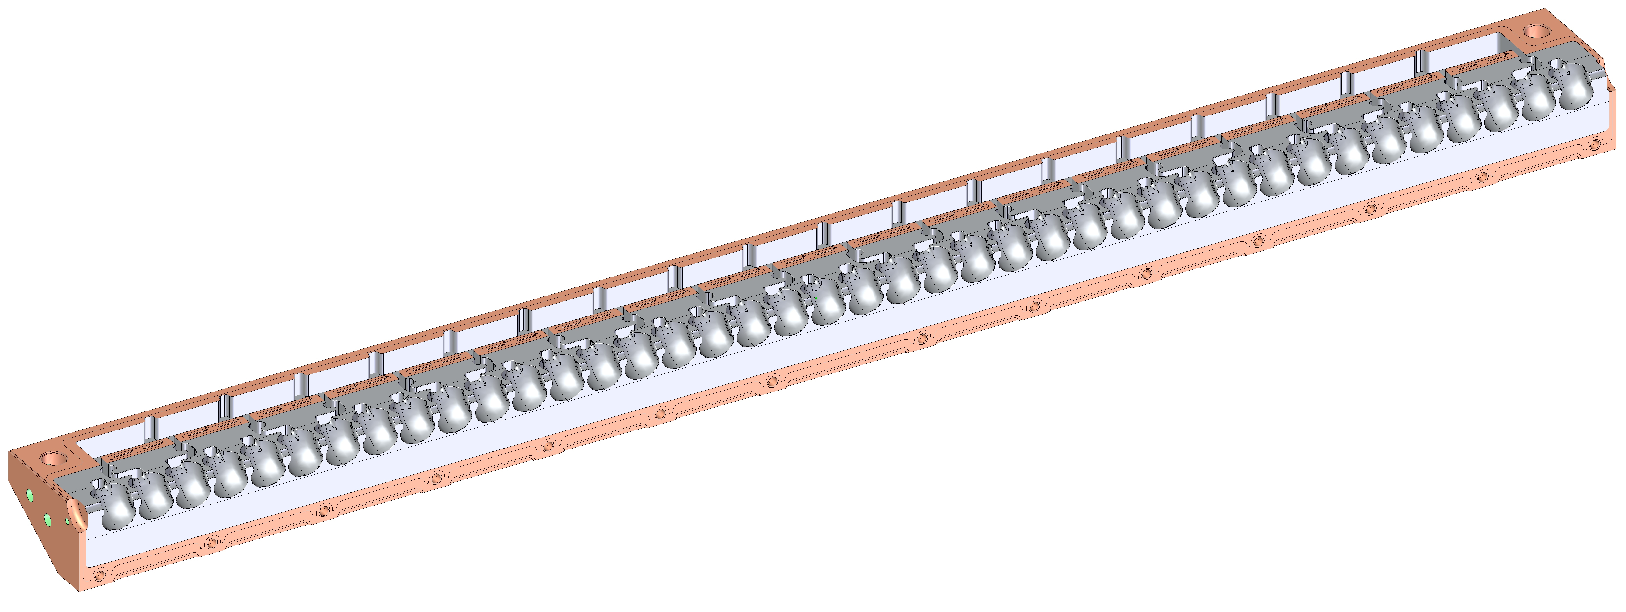
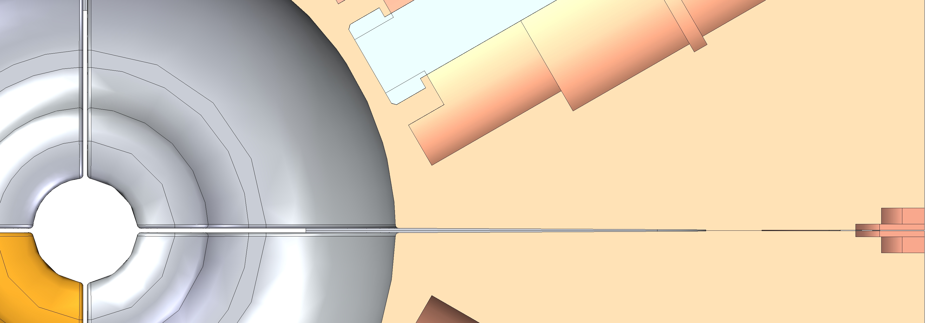
Mechanical Features - Internal
Damping slots
Internal radii around cells at split face
Waveguide feed
Braze surfaces
Cells and irises
R_{damping slot}
R_{cell}
R_{iris}

Slide 17
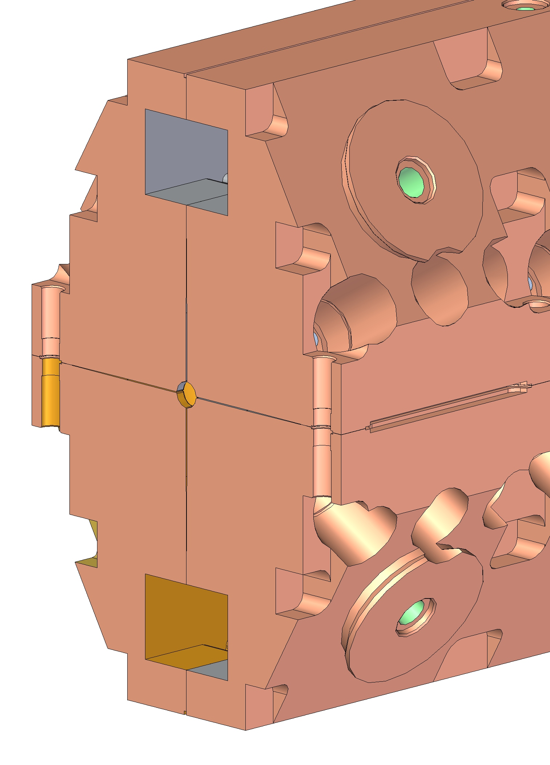
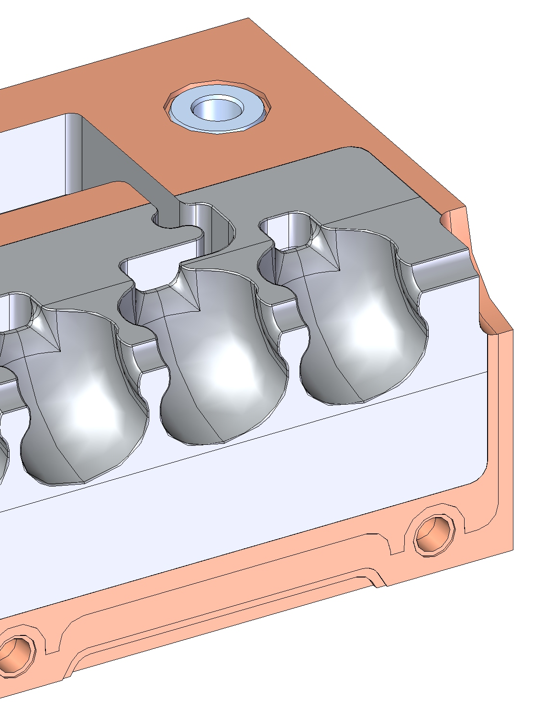
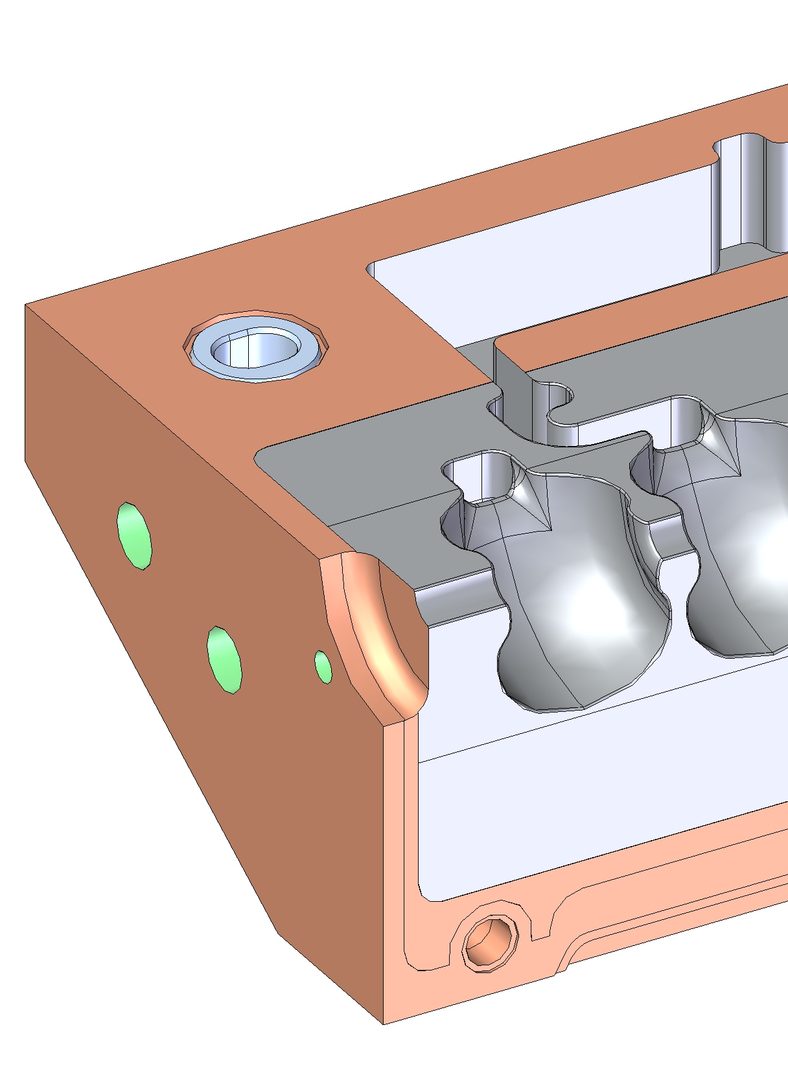
Braze Steps and Features
3 critical “perimeter” joints (2 vacuum, 1 mechanical)
During braze, the braze joints are held by external clamps and compression bolts.
At assembly, alignment is achieved with a pin and slot arrangement, using stainless steel inserts to prevent deformation of the hole and slot (exterior flat surfaces may also be used)

Slide 18
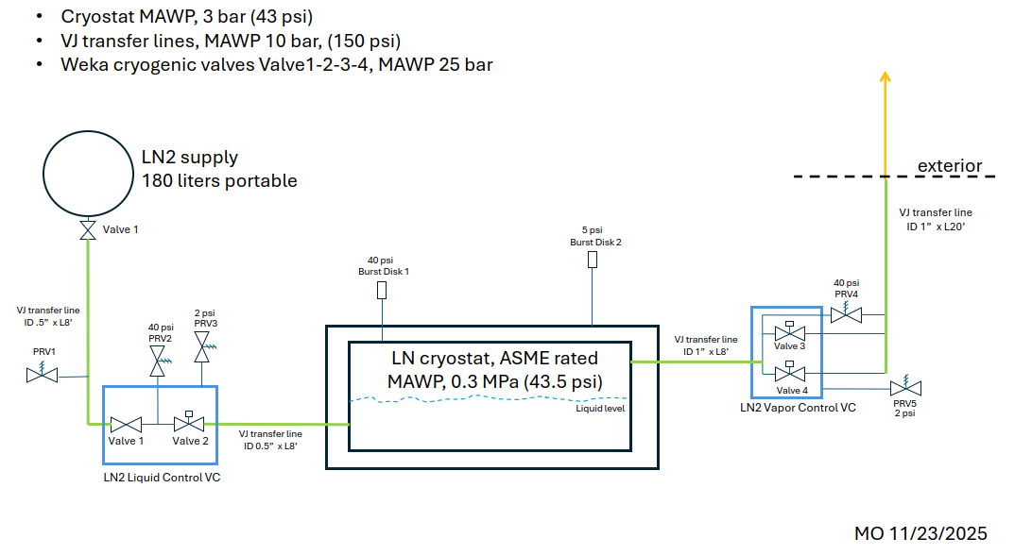
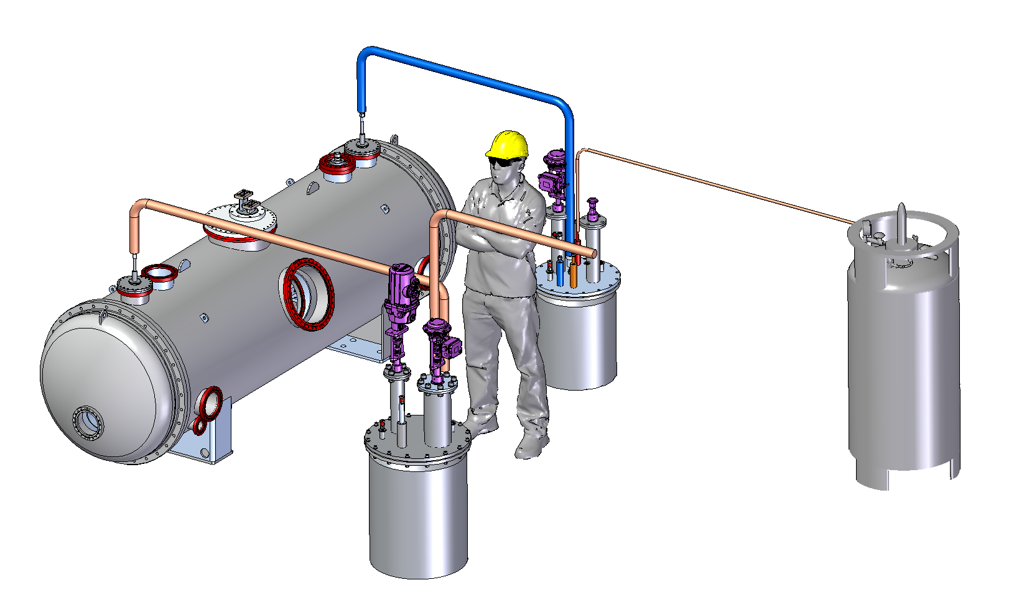
Design and Build Status – Cold Box/Fill Lines
Cold boxes designed to enable controlled filling/venting of cryomodule.
P&ID agreed upon with SLAC pressure vessel safety team.
Valves are already received at SLAC.
Half of the transfer lines and bayonets are received at SLAC, but will require additional components or modification.
Boxes and lids are in final design.

Slide 19
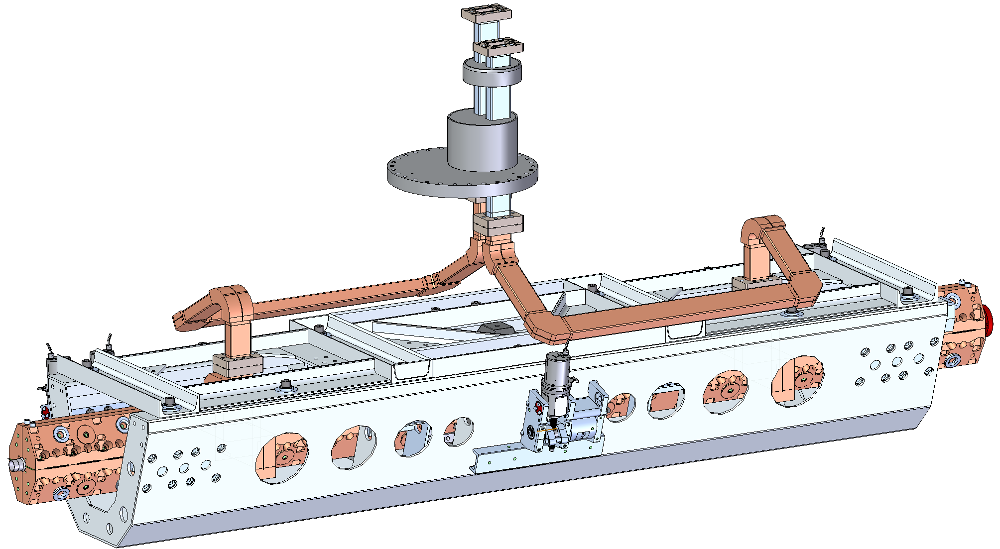
Design and Build Status – HPRF Waveguide
Feedthrough into the QCM is via stainless steel waveguides bolted externally and internally.
Internal waveguides are of copper and have an elongated path to make them flexible, allowing for mm-scale adjustments of the raft and accelerator while the feedthrough is fixed.

Slide 20
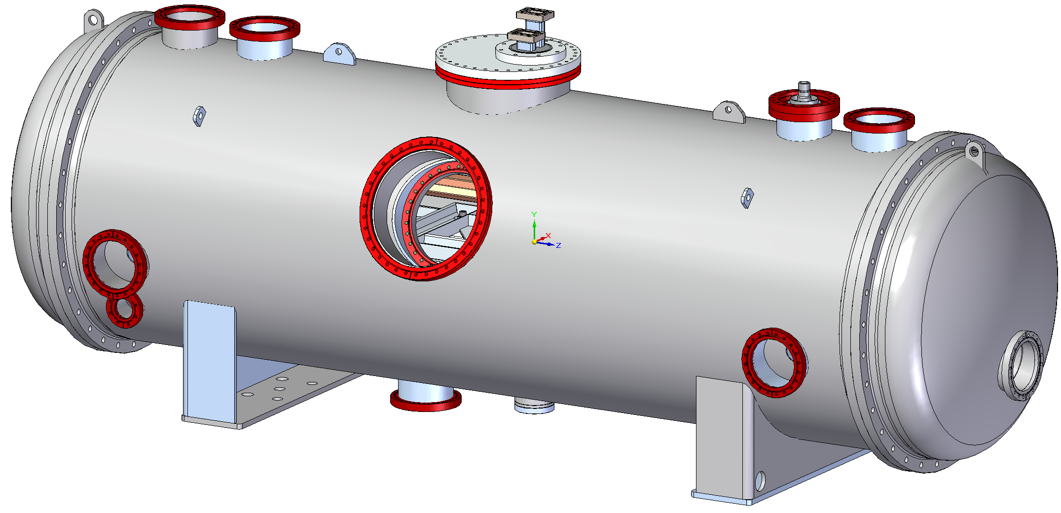
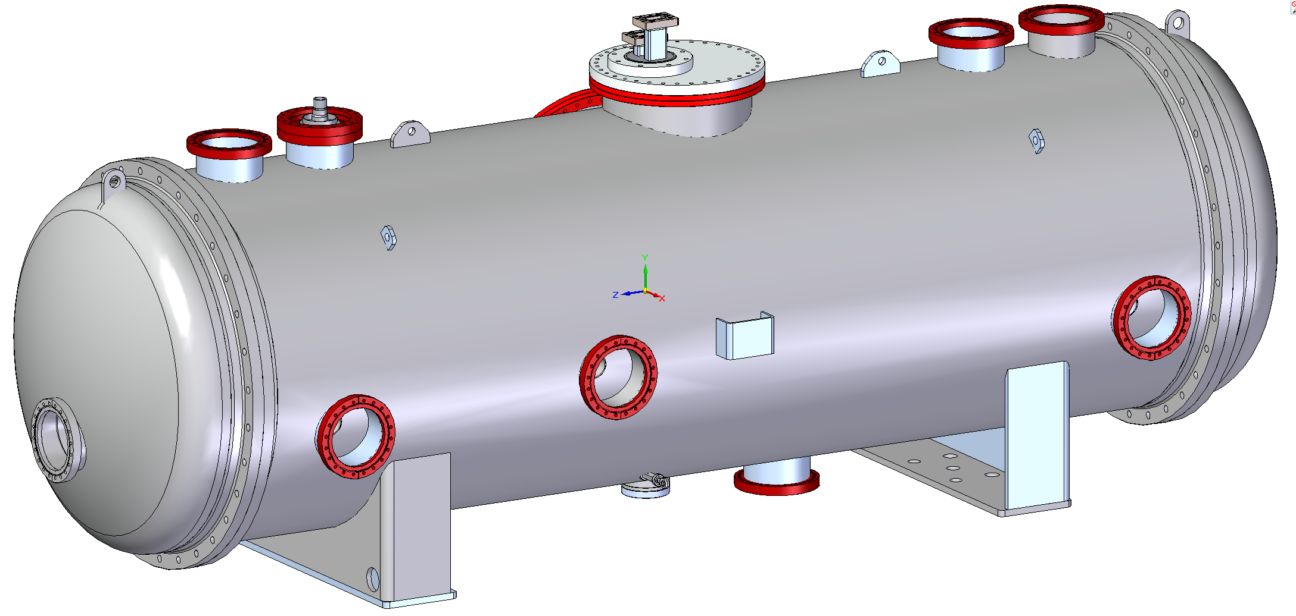
Design and Build Status - Feedthroughs
Proposed feedthrough locations
HPRF & N2 Vapor Out
LN2 In
Instrumentation
Service Hatch
Vacuum
Alignment/ unused
Alignment/ unused
Beamline
LN2 Drain
Mechanical Centering Pin

Slide 21
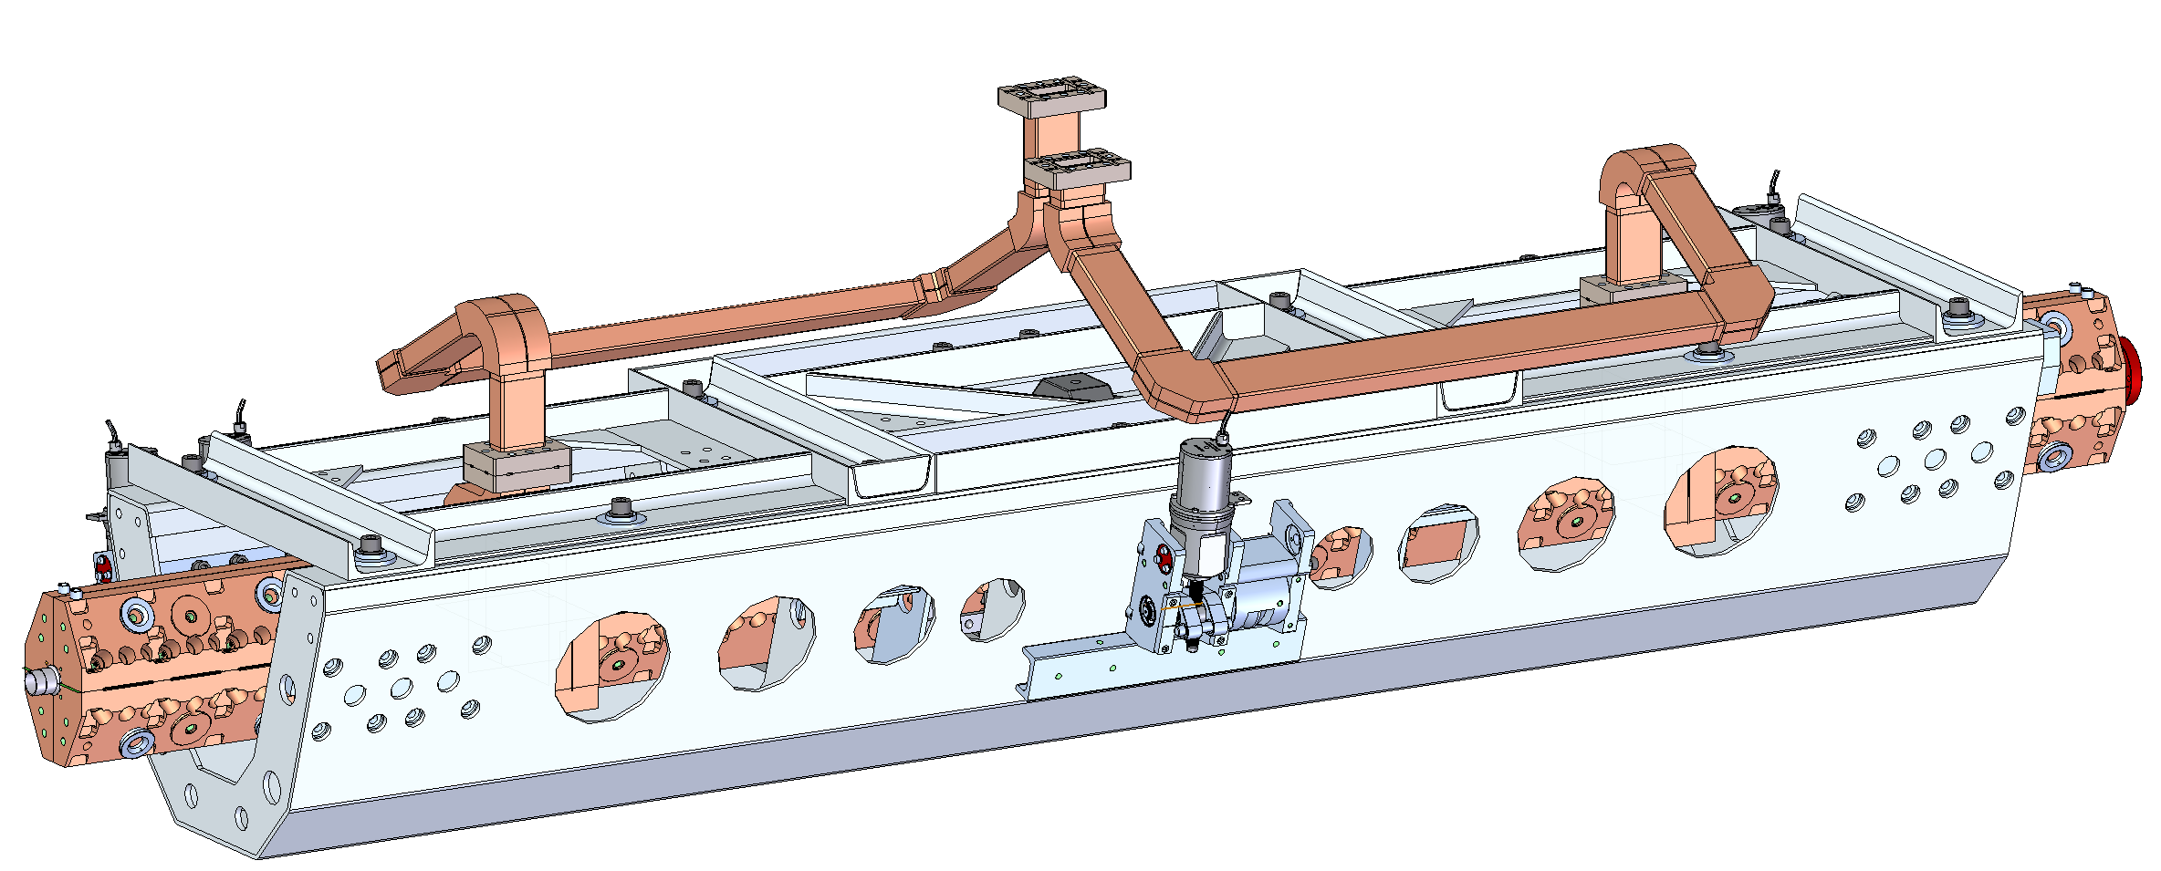
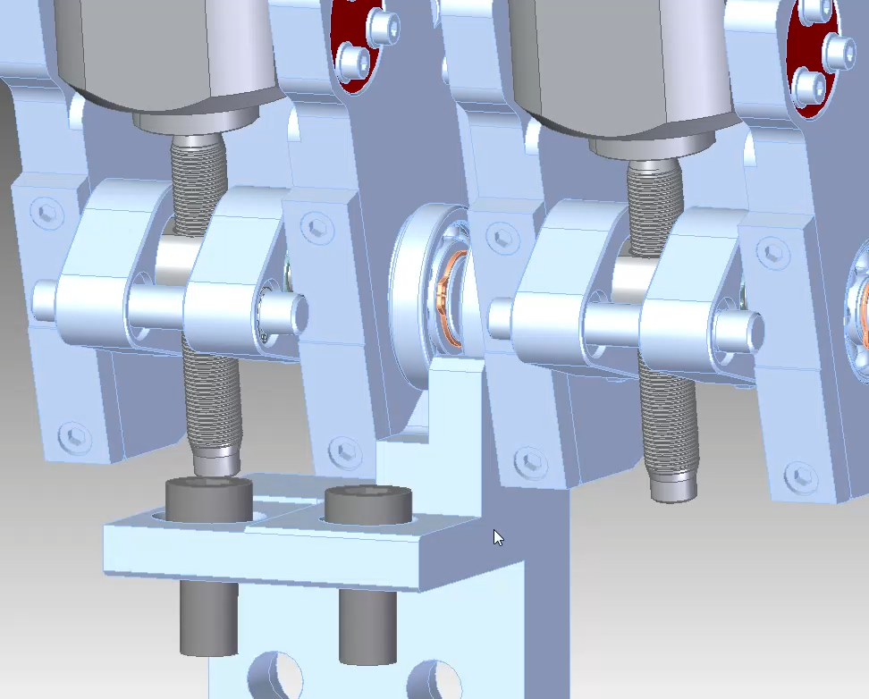
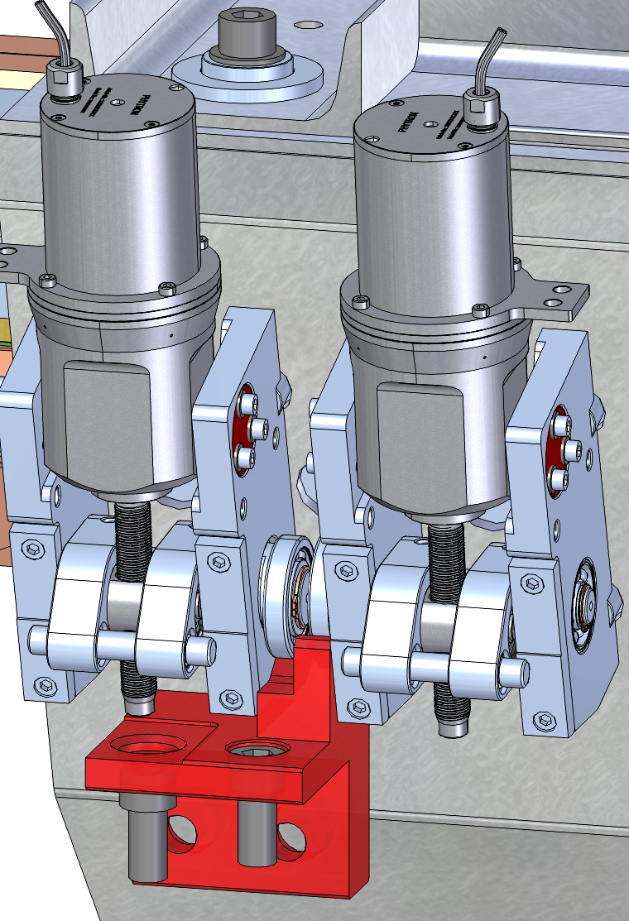
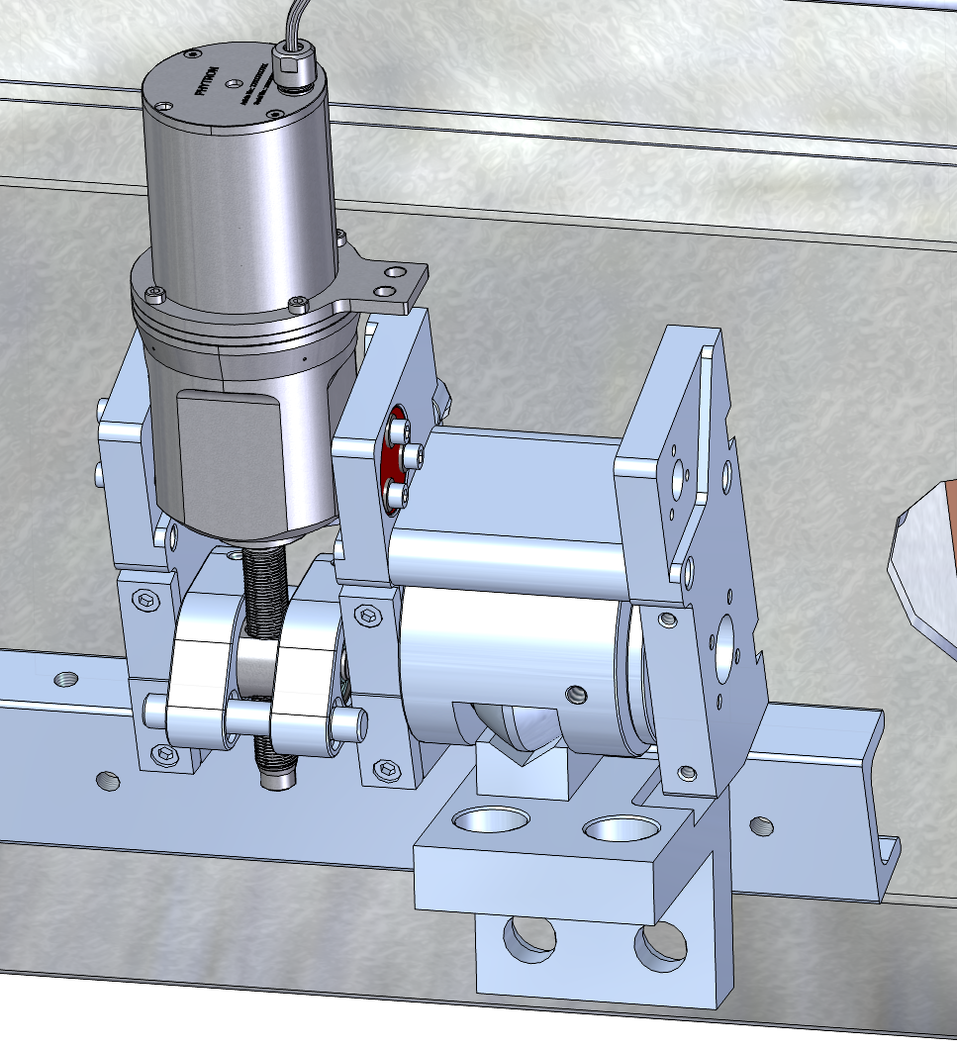
Design and Build Status – Mounts/Movers/Loaders
5 adjustable mounts for 5 degrees of freedom
Adjustable range is mm-scale, with the exact limits to be agreed upon with ESRF and then set by SLAC.
3
4
1
2
5
Animation showing various movements for one pair of movers

Slide 22
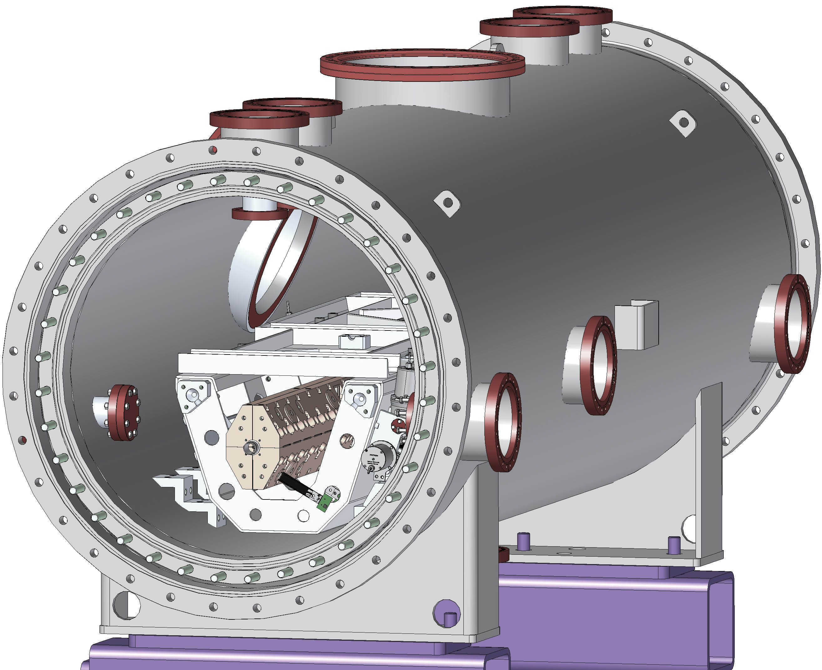
Mechanical Features – Alignment and Fiducials
ESRF needs: Precision alignment of the structures in the QCM to the machine coordinates (beam tunnel/mating components) and a means of verification/adjustment.
Will want to check alignment while warm with cryovessel open – confirm if any movement during shipping.
Needs confidence of the location while cold, however that is established.
Option 1: While warm, transfer datums to external fiducials and use a calculated or empirical “cold-warm” adjustment.
Need to qualify and ensure consistency in this adjustment factor.
Option 2: Use the Rasnik alignment system to be installed and tested by SLAC.
Option 3: Use optical viewports through vacuum and liquid nitrogen to directly measure fiducials on the accelerator.
Unclear if this is even possible and requires additional experimentation.

Slide 23
Mechanical Features – Alignment and Fiducials
Actions
ESRF: Finalize mechanical alignment accuracy required before switching to beam-based alignment.
SLAC: Perform small-scale tests of measurement through windows and LN2.
SLAC: Investigate alternative alignment methods.
SLAC: Propose a plan for qualifying the alignment method chosen to ESRF’s needs.

Slide 24
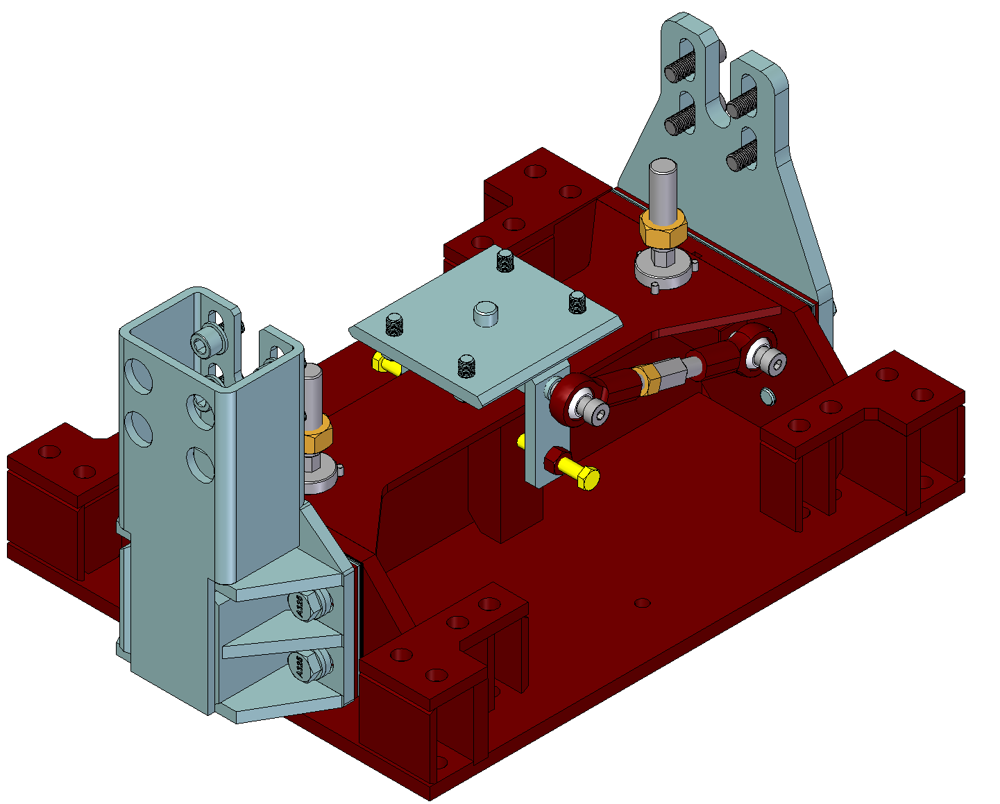
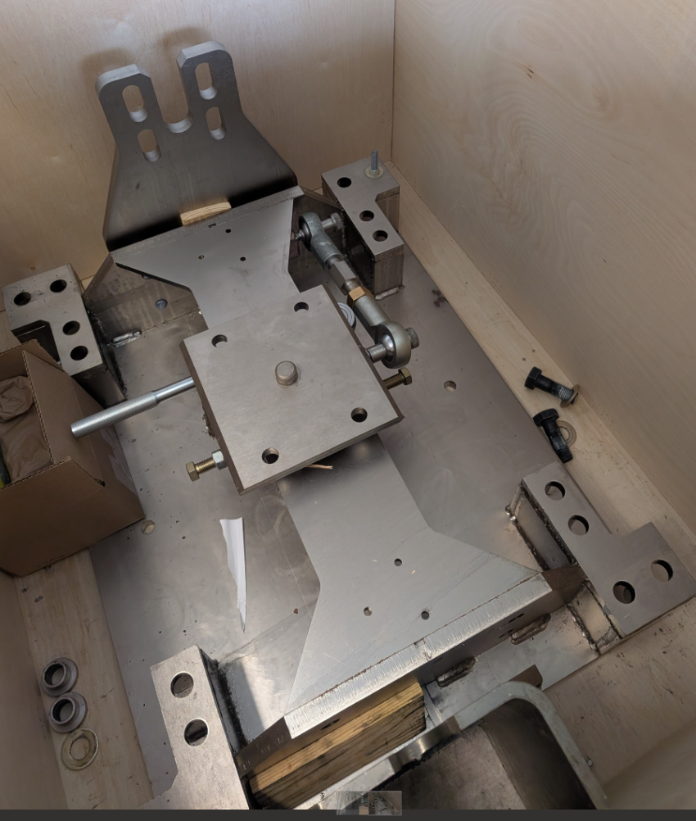
External Mounts
Adjustable mounts were originally designed by Fermilab for the LCLS-II LINAC cryomodules.
Allow for vertical, transverse, and longitudinal adjustment.
Include additional seismic restraints on the sides.
Vertical
Transverse
Longitudinal

Slide 25
Cryogenic and Vacuum Requirements
LN used on cooling fill: 1400 L
Vessel volume: 550 L
Cooling the structure: ~720 L
Loss during fill: ~100 L (over 12 hours)
Standby losses: 133 L/24 hr for 286 W standby power loss
Radiation: ~247 W
Conduction: ~38 W
Convection: 0 W (assuming <1x10⁻⁵ torr vacuum)
Operating losses will vary and be in addition to the above.
Vacuum
Primary concern is to maintain vacuum <5x10⁻⁵ torr to ensure no convection heat loss.
This vacuum level requires turbo pumps (and appropriate backing pumps), but the exact size of pumps depends on system outgassing and leak rates, which will be determined during testing at SLAC.

Slide 26
Conclusion

