Slide 1


ESRF Overview and its long-term plan with the injector upgrade
21 April 2026
Qing Qin, ASD Director
On behalf of the accelerator team, ESRF

Slide 2
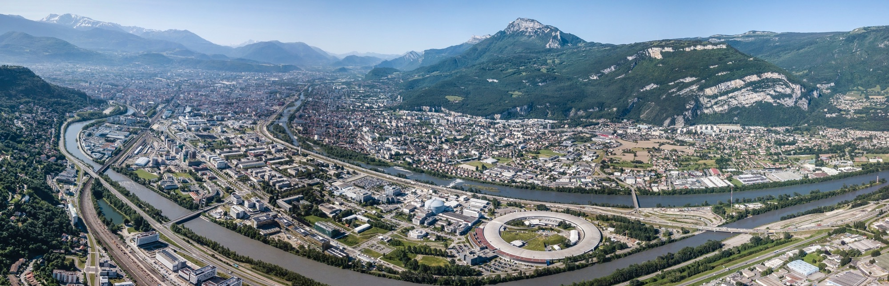



















MORE THAN 30 YEARS OF SCIENCE AT THE HEART OF a science and innovation european campus
3 European research institutes, members of EIROforum and the Institute for Structural Biology, at the heart of GIANT, the campus of Innovation (Grenoble Innovation for Advanced New Technologies)
Common research and training platforms

Slide 3








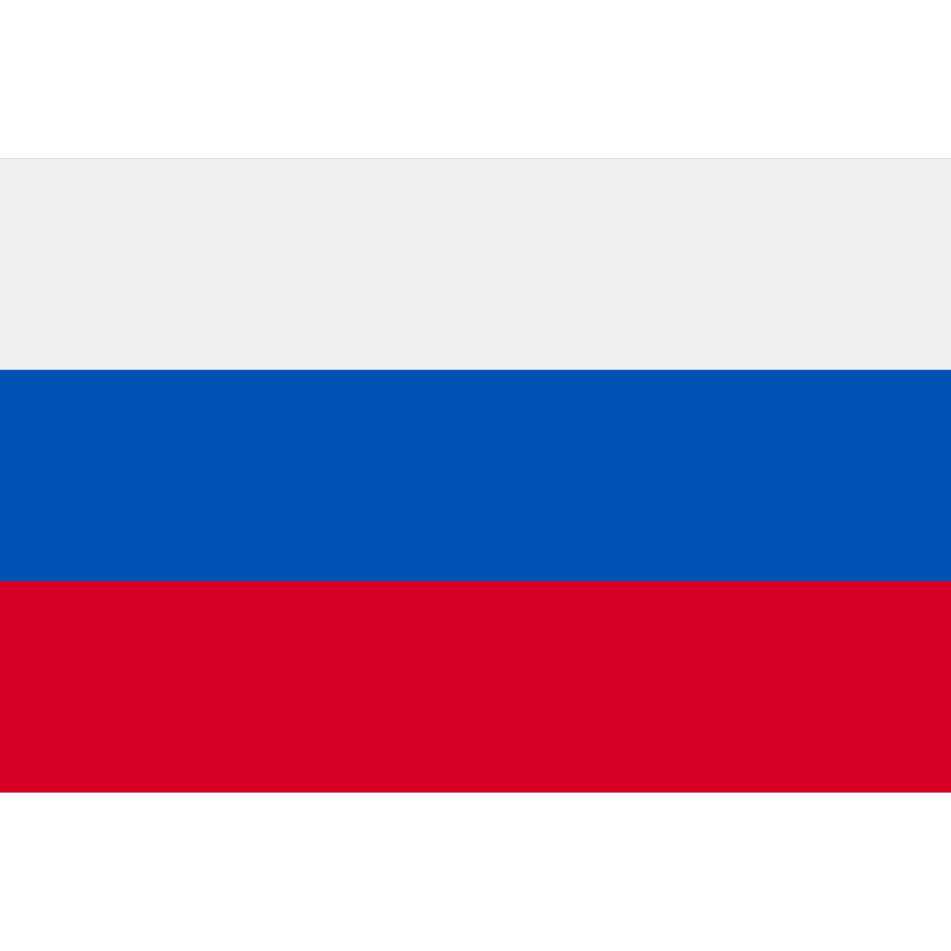




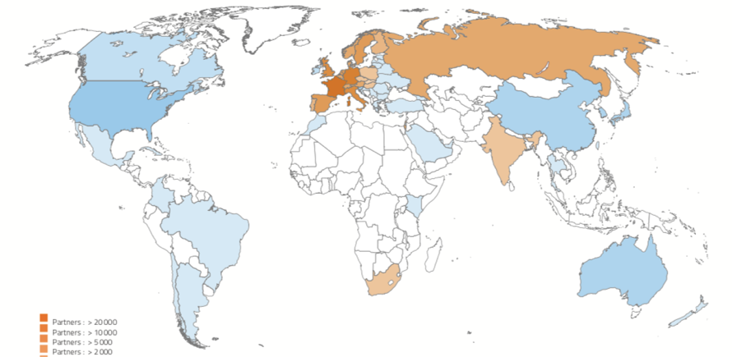






ESRF: an international HUB To pioneer science
FROM 2015 TO 2025
70 000 USER VISITS FROM 67 COUNTRIES
7 000 INDIVIDUAL LABS OR UNIVERSITIES
19 PARTNER COUNTRIES
13 MEMBER STATES
France | 27.5%
Germany | 24.0%
Italy | 13.2%
United Kingdom | 10.5%
Russia | 6.0%
Benesync (Belgium, The Netherlands) | 5.8%
Nordsync (Denmark, Finland, Norway, Sweden) | 5.0%
Spain | 4.0%
Switzerland | 4.0%
6 GeV
34 + 12
2
6 ASSOCIATE COUNTRIES
Austria | 1.75%
Israel | 1.75%
Poland | 1.00%
Portugal | 1.00%
Czech Republic | 0.60%
South Africa | 0.30%
Synchrotron
Beamlines
(public + CRG)
CryoEM
10 000
7
1500
10
>300
Scientific visitors each year
Nobel prizes to ESRF users
Scientific publications/year
ERC grants based on ESRF-EBS
Industrial clients

Slide 4
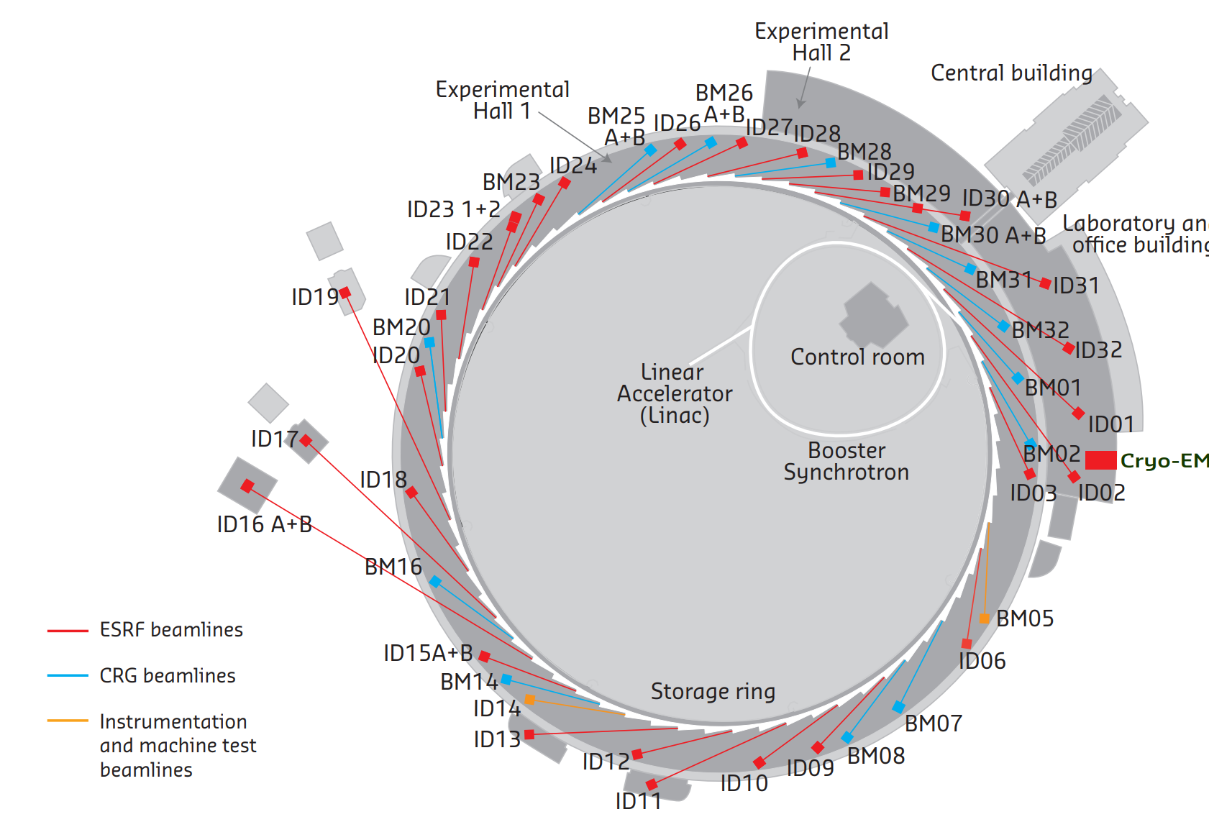
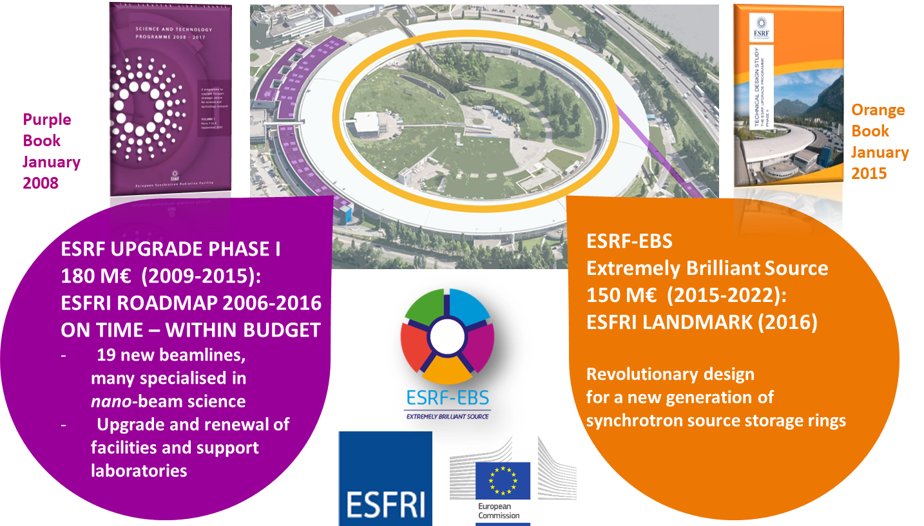
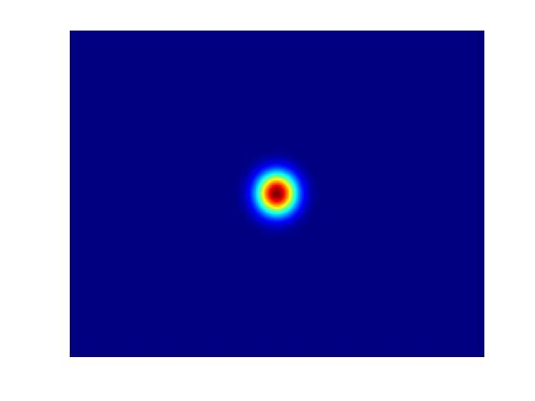
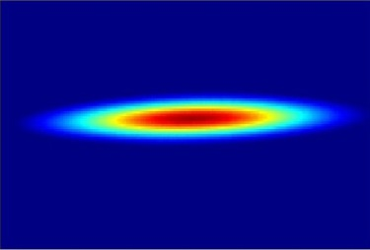
ESRF facts and figures
Light source in operation since 1994
Located in Grenoble, France
Annual budget: ~140 million euros
Staff: 650
E- Linac
200 MeV
Booster synchrotron
300m, 4Hz
Storage Ring
6 GeV
32 cells
The ESRF Extremely Brilliant Source upgrade :
Decrease the horizontal emittance
Increase the source brilliance
Increase the source coherence

Slide 5
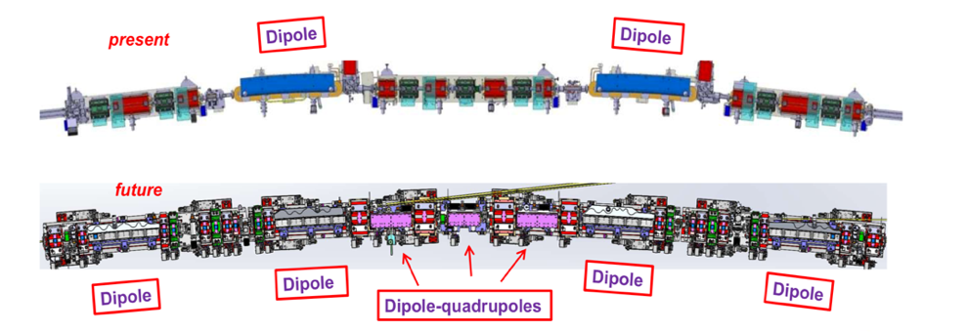
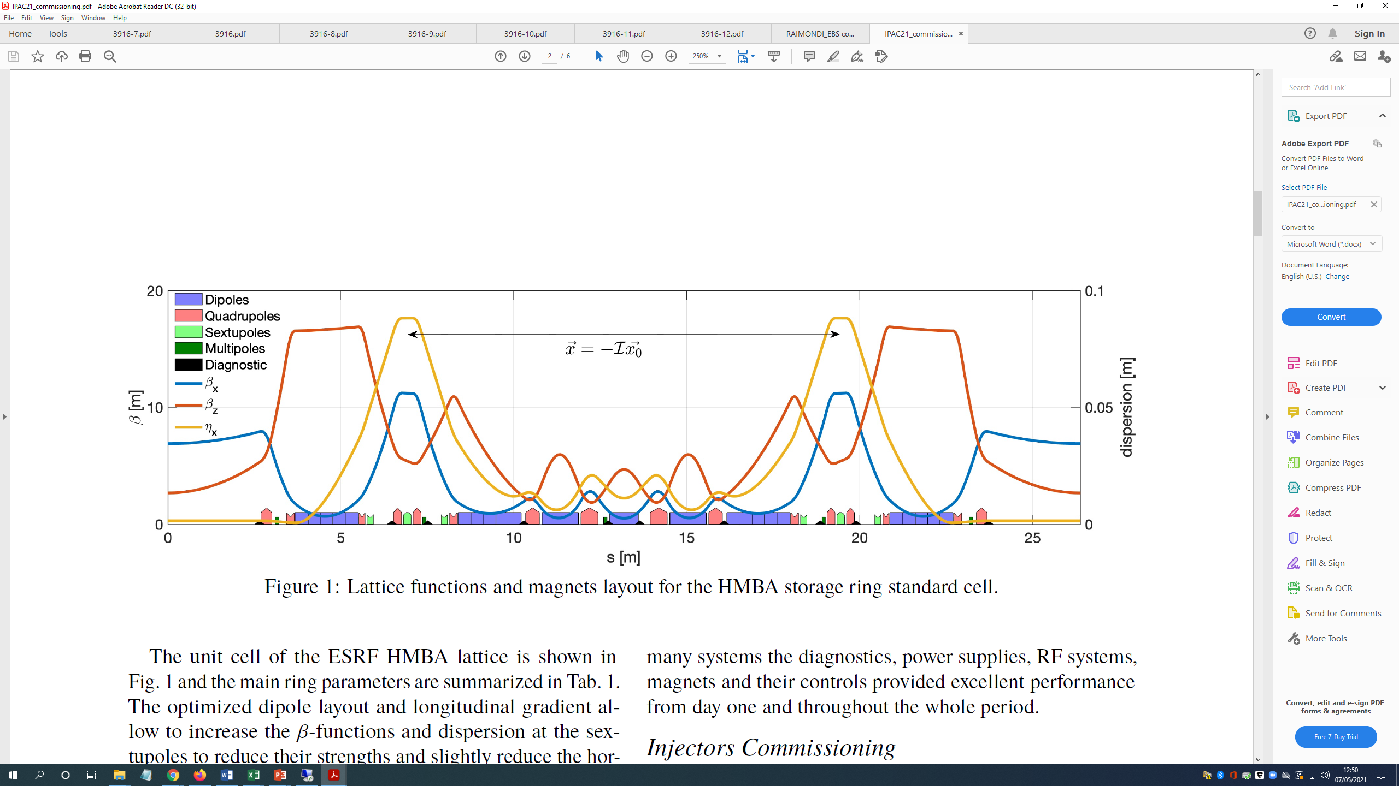
Overview of EBS project
Old ESRF
EBS storage ring
program
ESRF-EBS
EBS main design parameters
Beam energy, E | 6 | GeV
Circumference, C | 843.98 | m
No. straight section/cell | 32
Natural hori. emittance, ε_{h} | 133 | pm⋅rad
Beam current, I | 200 | mA
Lifetime, L | 20 | hour
Internal SD
SF
Octupole
Octupole
External SD

Slide 6
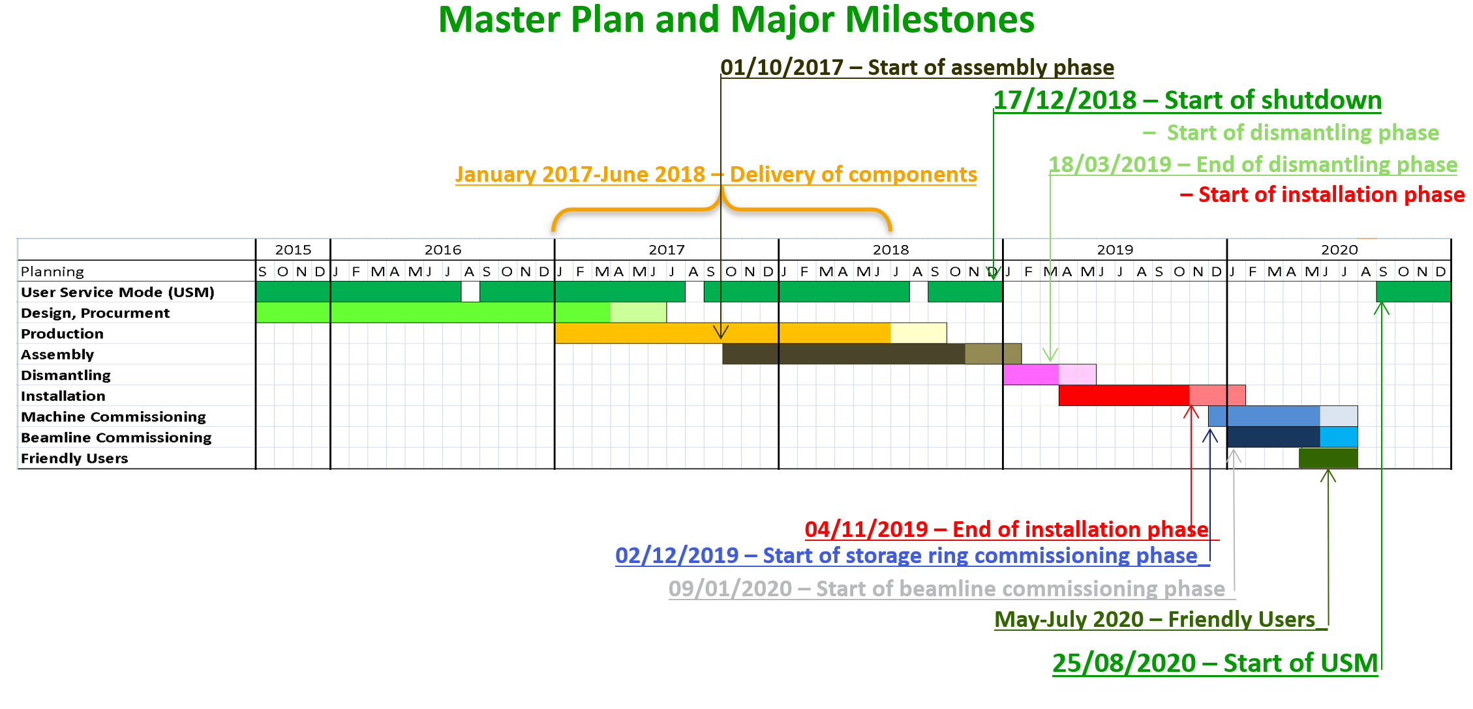
Overview of the EBS project
Fixed at the 3rd MAC meeting, April 2016

Slide 7
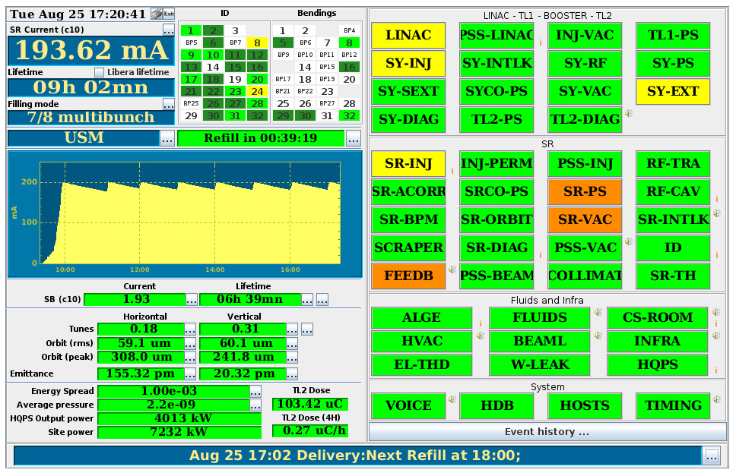
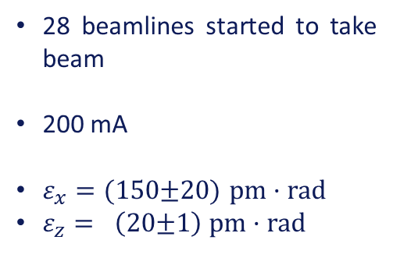
25th August 2020 : a time to remember !
The 25th August 2020, first official USM shift starts !
On-schedule beam delivery shows the very advanced state of the new machine !
28 beamlines started to take beam
200 mA
$ε_{x}=(150$±20) $pm·rad$
$ε_{z}= \left(20\text{±}1\right) pm·rad$
Due to the COVID-19 pandemic, all user experiments were performed using the remote access or mail-in systems.
Start of USM on 25 August as planned, with as many (28) beamlines as possible.
Essentially beamline commissioning.

Slide 8
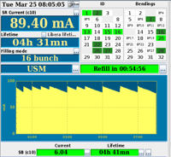
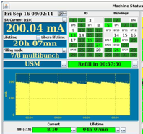
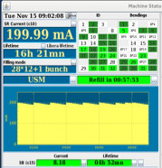
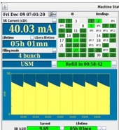
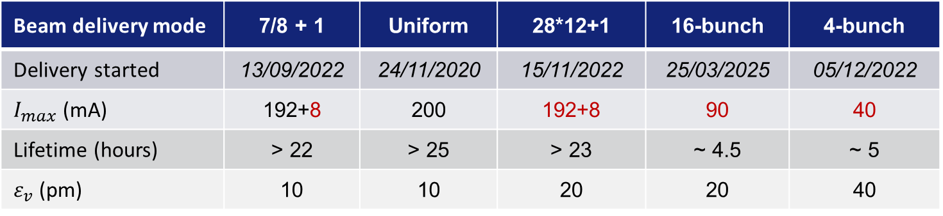
EBS Operation – nominal beam current reached in operation
All design beam currents achieved during USM operation
Beam delivery mode | 7/8 + 1 | Uniform | 28*12+1 | 16-bunch | 4-bunch
Delivery started | 13/09/2022 | 24/11/2020 | 15/11/2022 | 25/03/2025 | 05/12/2022
$I_{max}$ (mA) | 192+8 | 200 | 192+8 | 90 | 40
Lifetime (hours) | > 22 | > 25 | > 23 | ~ 4.5 | ~ 5
$ε_{v}$ (pm) | 10 | 10 | 20 | 20 | 40
Last kicker with new ceramic chamber installed in 12/2024

Slide 9
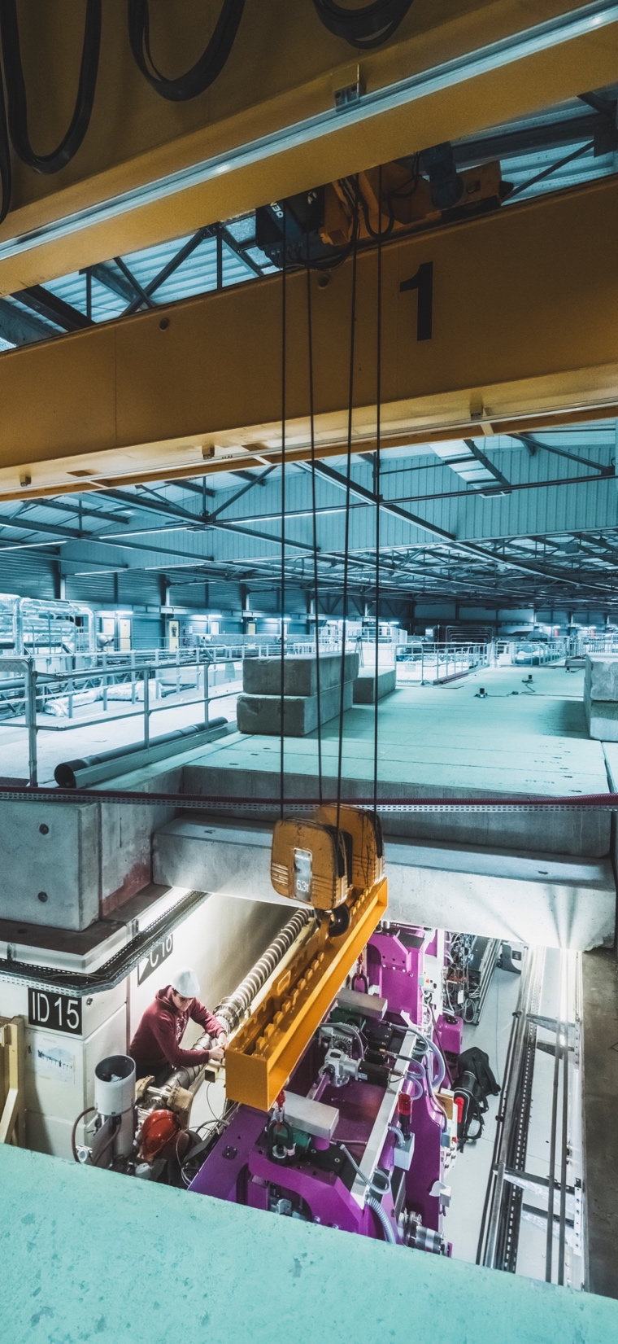

ESRf-EBS machine statistics 2020 – 2025
Machine Statistics for 2020 – 2025
• 5372 hours of beam delivered in 2024 out of 5486 scheduled
• 5431.4 hours of beam delivered in 2025 out of 5489 scheduled
MACHINE – USM | 2020 | 2021 | 2022 | 2023 | 2024 | 2025
Availability (%) | 96.08 | 96.35 | 99.06 | 99.28 | 97.92 | 98.95
Mean Time Between Failures (hrs) | 46.0 | 66.4 | 88.5 | 107.1 | 72.0 | 133.9
Mean duration of a failure (hrs) | 1.80 | 2.42 | 0.83 | 0.77 | 1.59 | 1.40

Slide 10
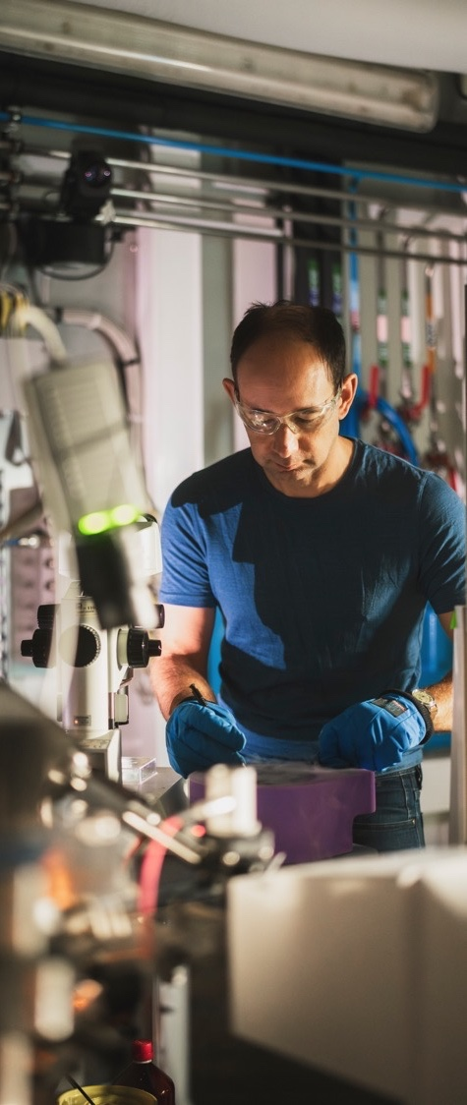








A FACILITY IN HIGH DEMAND
PUBLIC BEAMTIME USER OPERATION AND STATISTICS
2 392
1 018
16 770
1 257
Submitted
proposals
in 2025
ESRF-EBS RECORD
Accepted
proposals
in 2025
ALL-TIME ESRF RECORD
Shifts delivered in 2024
(incl. Commercial beamtime)
ALL-TIME ESRF RECORD
Submitted
proposals
for 2026-I
(= 17 199 shifts)
NEW ESRF-EBS RECORD
USER VISITS & EXPERIMENTAL SESSIONS (2024)
2787
~800
10432
7439
Experiment
Sessions
ALL-TIME ESRF RECORD
Commercial
sessions
User visits
(34% remote)
ALL-TIME ESRF RECORD
Public user visits
ALL-TIME ESRF RECORD
PUBLICATIONS
1600
+300
Peer-reviewed
publications in 2025
as of 09/01/2026
(40 % in journals with IF>7)
Compared to
2021, 2022, 2023

Slide 11


5 years of achievements to OPTIMISE the exploitation of ESRF-EBS
Beamline & Accelerator upgrades
Beamline & Accelerator enabling technologies
Different filling modes including timing, ~99 % availability, hotswap system, ECO mode
24 Insertion Devices built, 1st equipement delivered for the LINAC refurbishment ; restart of the 4th harmonic cavity project
10 beamlines built/refurbished in the period
Beamline upgrades: ID10-COH, ID11, ID12, ID13
ID18 (nanoimaging for life sciences) TDR in March 2026, commissioning in the second half of 2027
44 new 2D x-ray detectors, 3 with Lima2
3 new ESRF DCMs installed, 2 procured
> 50 mirrors characterised, 150 multilayer optics, 400 analyser crystals, 1100 refractive lenses
Data Strategy
40 beamlines using BLISS
EWOKS deployed on 35 beamlines
E-logbook used at 25 beamlines
2.4 M datasets in DRAC
VISA
2 open data portals
Attracting & training the next generations
79 PhD students and 148 post-docs recruited since 2020, InnovaXN, NEXSTEP, GATES programs
> 10.000 pupils welcomed at Synchrotron@school
« Girls, dare to do science »
HUB
Engagement towards sustainable operation of the ESRF
New access modes for academia New services for industry
Overall energy consumption reduced from 75 Gwh to 54 Gwh (EBS storage ring, ECO mode, reuse of waste heat.
Environmental strategy 2025-2030 : solar panels, purchases, travel policy
Human Organ Atlas and European Battery HUBs
9 BAGS (4 new at last cal)l
34 EU projects (25 M€) ; 14 ERC projects (11 active), 1 EIC project

Slide 12


ESRF DATA STRATEGY: Towards a fully data-centric approach
50 Petabytes
SOFTWARE DEVELOPMENTS
of data archived since 2015 at ESRF
BLISS
LIMA2
1.5 PB
Beamline control – data collection.
Deployed at 40 beamlines.
Advanced features (compression, data triage).
Deployed at 3 beamlines.
produced in a single experiment
Ongoing update of
the data strategy
More efficient tools for data processing and data analysis
DRAC
DATA WORKFLOW
@ THE ESRF
e-LOGBOOK
Advanced data catalog for Open Science for all techniques (including MX) based on ICAT metadata catalogue
Development of metadata together with improved automation workflows and AI exploitation of data
Allows data integration in data catalog. Used at 25 beamlines.
Increased data FAIRness
VISA
EWOKS
Metaworkflow system deployed at 35 beamlines.
Web platform for remote data analysis online and offline

Slide 13
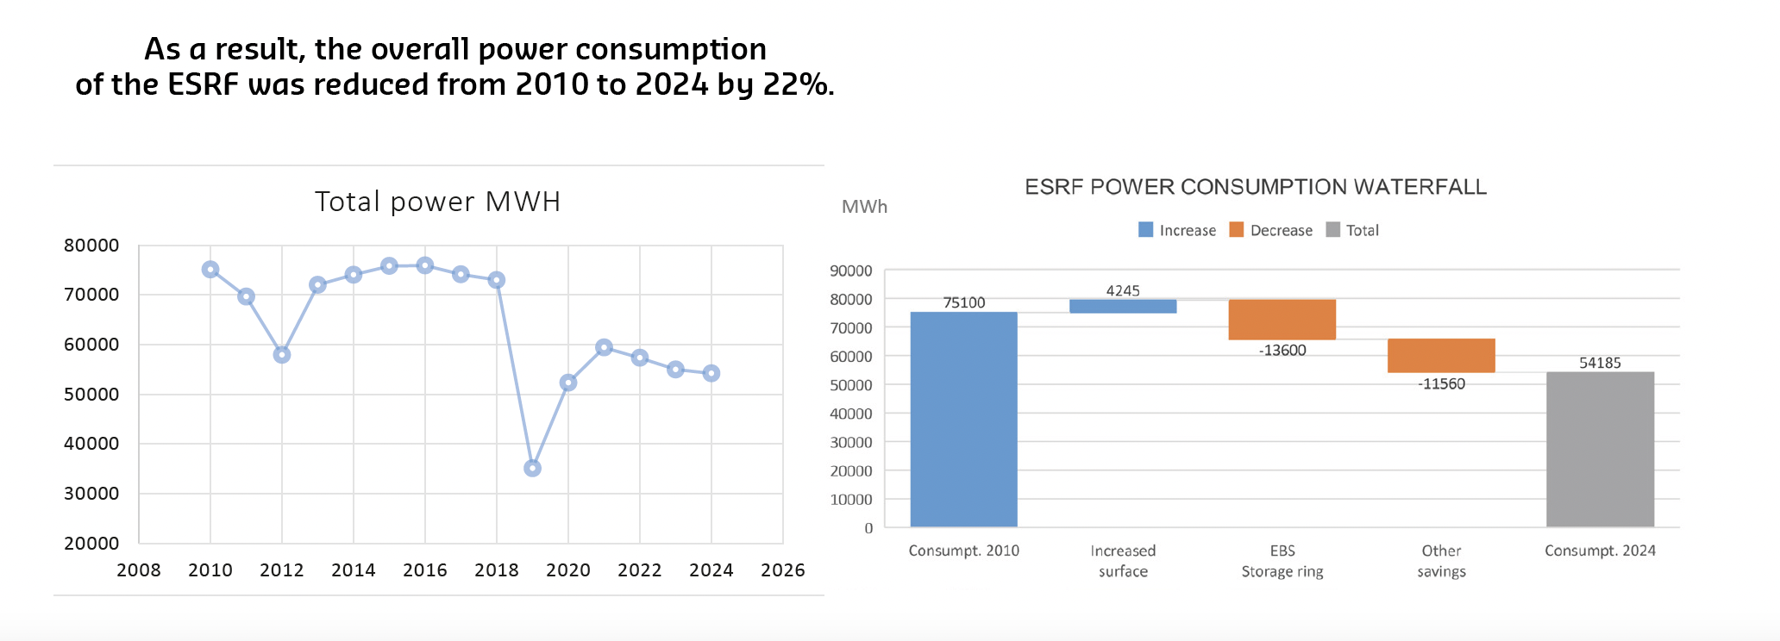
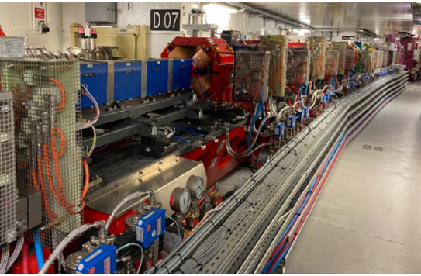
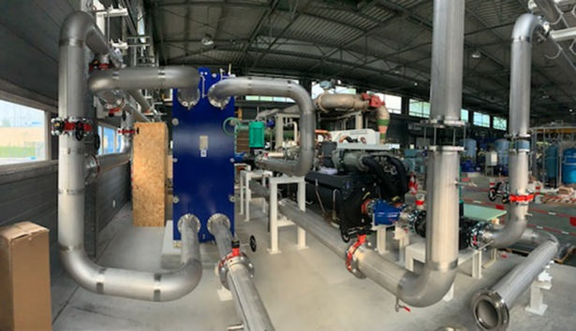
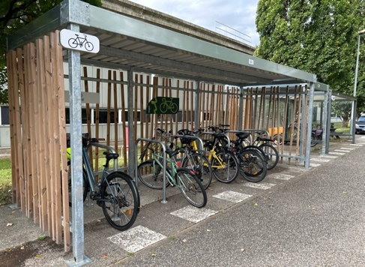
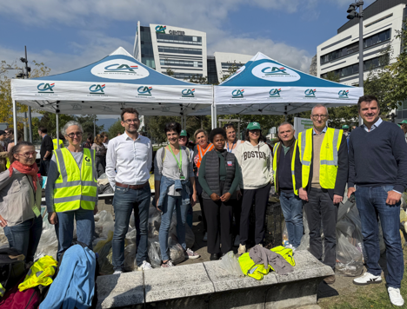
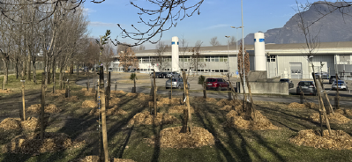
Towards an environmentally responsible facility – ACTIONS IMPLEMENTED over 2020-2025
YEAR | DESIGNATION | ENERGY SAVING/YEAR | Eq CO₂ SAVING/YEAR
2020-2022 | Injector, storage ring & X-ray source | 13 600 MWh | 680 tons
 | EBS storage ring Machine ECO mode | 12 000 1 600 | 600 80
2023-2024 | Actions implemented since EBS | 2 660 MWh | 241,5 tons
 | Guest house insulation Heat pumps Chilled water system optimisation | 60 1 400 1 200 | 11,5 170 60
2025 | Actions towards sustainable development
 | New bike sheds (sector 10 and 26) Sustainability mobility allowance Helium recovery improvement Trees plantation (between Vercors parking and the highway) Participation to the Clean Walk
Overall power consumption of the ESRF reduced from 2010 to 2024 by 22%
ESRF Environmental Report

Slide 14
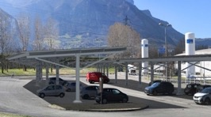
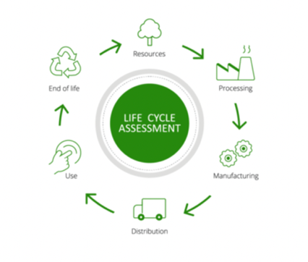
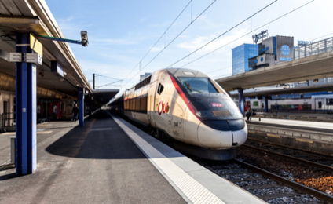
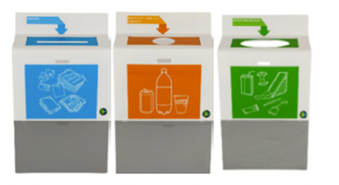
Towards an environmentally responsible facility – ESRf environmental strategy 2025-2030
ESRF environmental strategy 2025-2030
01
REDUCE ESRF CARBON FOOTPRINT
Installation of solar panels
Optimisation of processes, including real-time monitoring for energy consumption
Installation of solar blinds
ENERGY
PURCHASES
EBS higher flux & coherence
10 to 100 increase in data flow
02
PURCHASES
Towards carbon footprint and Life Cycle Assessment in all RFQs & CFTs
Implement coding within the purchasing tool to facilitate the integration of standard emission factors.
TRAVELS
RESOURCES MANAGEMENT
 | ENERGY | CARBON EMISSIONS
Target SNBC / Regulations | -30% in 2030 (vs 2012) | -47,5% in 2030
Reference figure | 72 024 MWh (2013) | 6 020 tons CO₂e (2013)
Status In 2023 | -24% (vs 2013) 54 987 MWh | -42% (vs 2013) 3 494 tons CO₂e
2030 ESRF objectives | -27% (vs 2013) 52 400 MWh | -60% (vs 2013) 2 400 tons CO₂e
03
REVISE THE TRAVEL POLICY
To promote low carbon travel solutions
04
RESOURCES MANAGEMENT
- Achieve a recycling target of 80%
Include circular economy actions in the policy/relations with suppliers
xxx

Slide 15
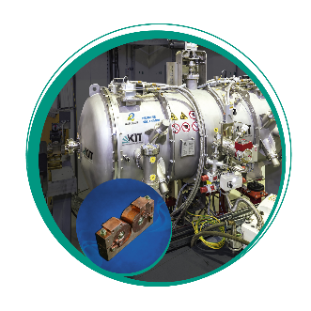
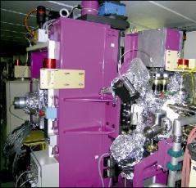
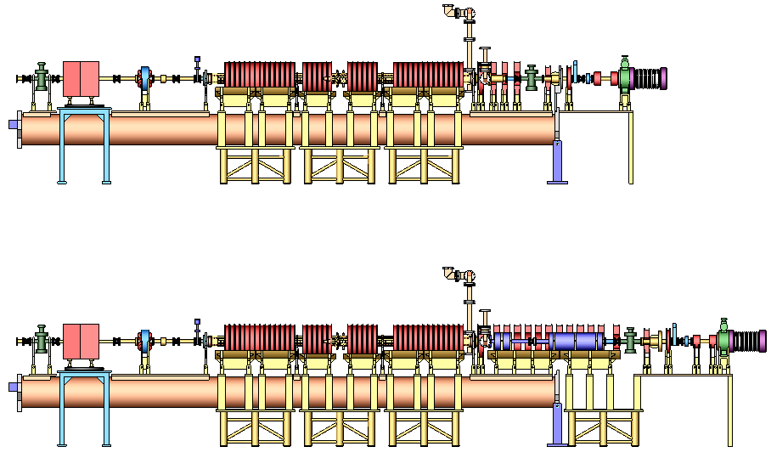
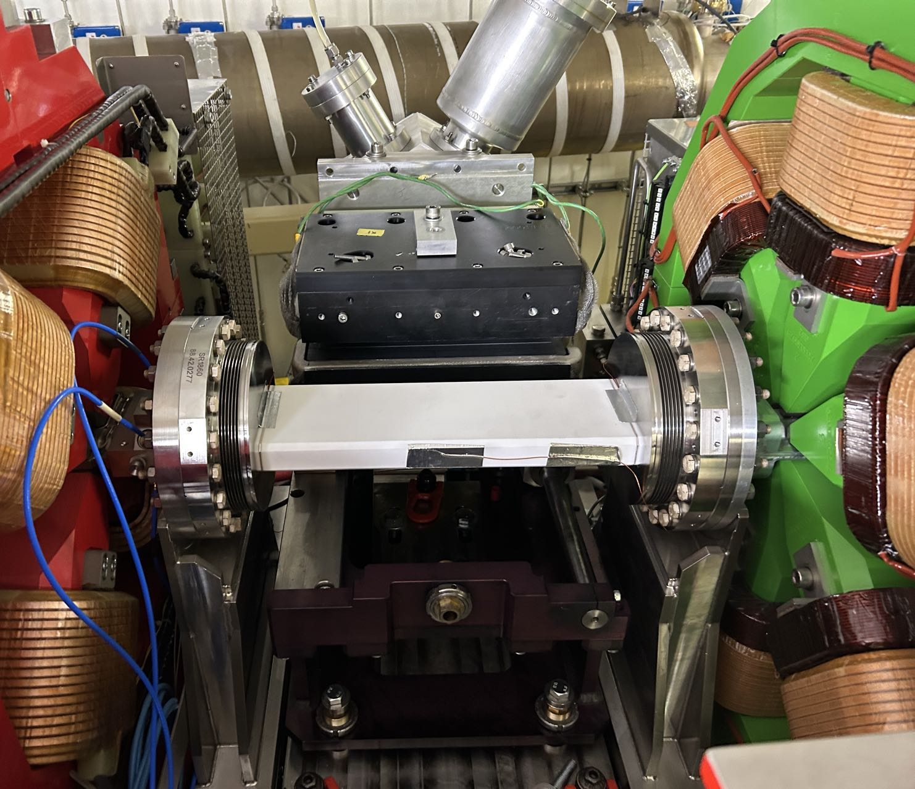
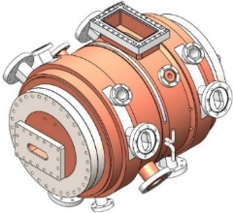
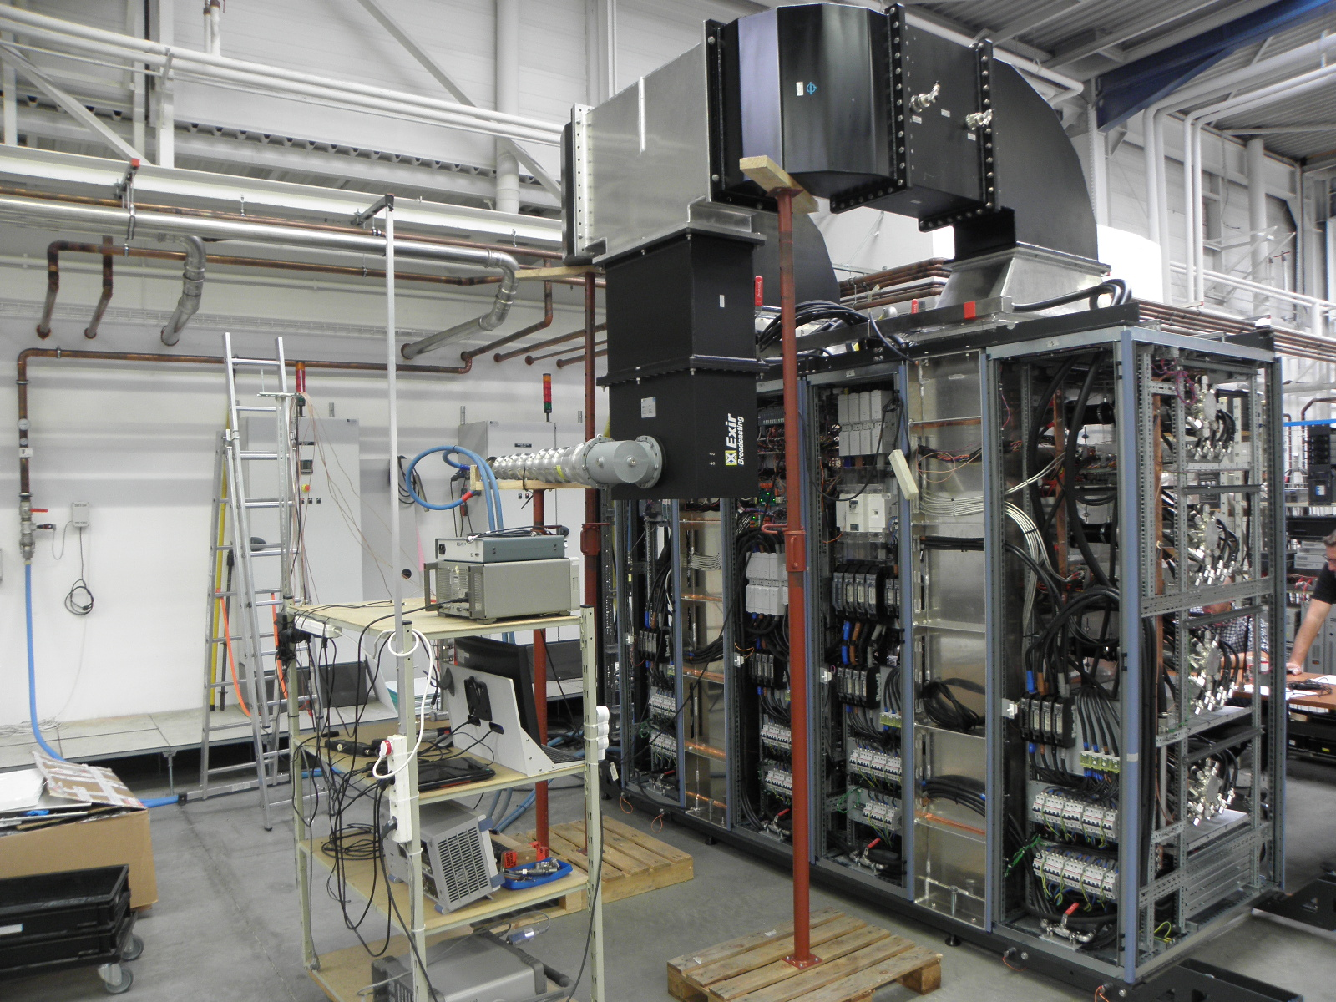
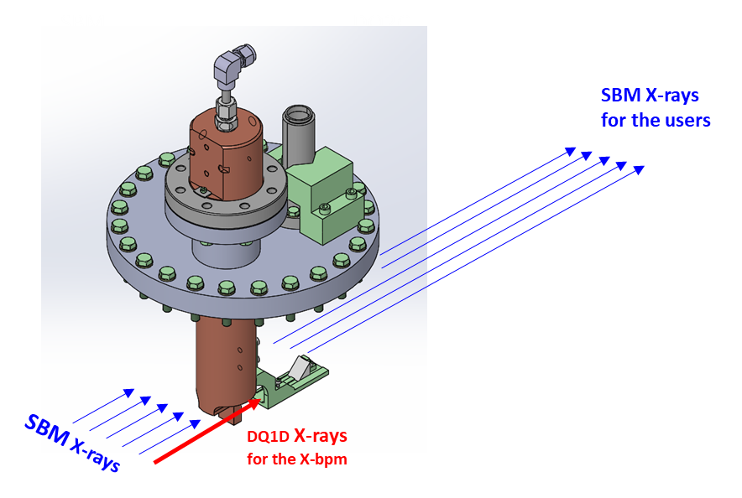
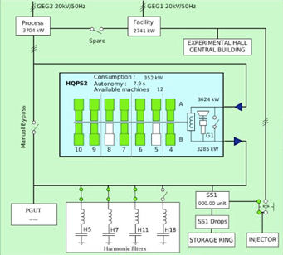
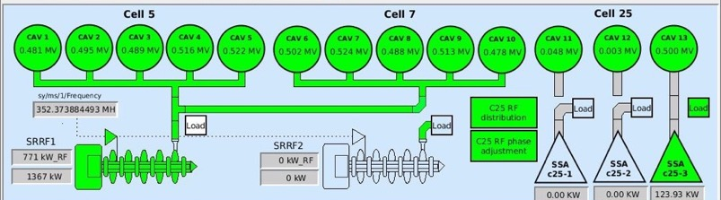
Medium-Term Scientific Plan of ASD
Issues related to the injector :
Ageing, few spares;
Lack of diagnostics;
Water cooling sys.;
Control & tuning of Linac;
Unmatched emittance from booster to SR;
Low injection efficiency;
Large injection perturbation;
etc.
Brightness
Coherence
Reliability Availability
Stability
E B S
Accelerator
Sustainability

Slide 16
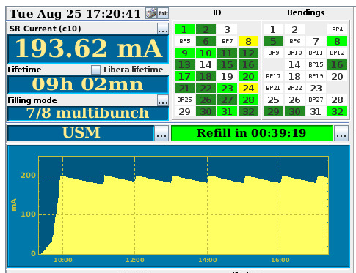
2020-2025: Accelerator & source developments
Key objectives: High reliability, availability, stability and sustainability of USM operation +
Improvement of beam delivery and EBS performance
 |  | 2021 |  |  |  | 2022 |  |  |  | 2023 |  |  |  | 2024 |  |  |  | 2025
 |  | Q1 | Q2 | Q3 | Q4 | Q1 | Q2 | Q3 | Q4 | Q1 | Q2 | Q3 | Q4 | Q1 | Q2 | Q3 | Q4 | Q1 | Q2 | Q3 | Q4
Operation Consolidation | Ceramic chamber | Design |  |  |  | Test |  |  | Prototyping & Procument |  |  |  |  | Delivery & Installation |  |  |  | 90 mA operational
 | Hot-Swap system | Test & off-line commissioning |  |  |  | Control development |  |  | Deployment |  | Quad & DQ in operation |  |  |  |  | Sext. & Oct. |  | Full SR operation
 | ECO mode |  |  |  |  |  | Test |  | ECO mode operation
 | RF Power SSA |  |  |  | CFT & Contract |  | Infrastructure, SSA construction
 | ID construction | ID32, ID15, ID16b, ID32 |  |  |  | ID18, ID12, ID27, ID28, ID20, ID24 |  |  |  | ID29, ID03, ID32 x 2, C12(3PW) |  |  |  | ID14, ID09, ID28 x 2, ID14 (PS) |  |  |  | ID28, ID24 x 2, ID01
 | ID control |  |  |  |  |  |  |  | Design |  |  |  |  | Prototyping & Test
 | Linac refurbishment |  |  |  |  |  |  |  |  |  |  |  |  | Design |  | CFT, Procurement, Construction |  |  |  | Delivery
Performance Improvement | S3-TL2 Displacement |  |  |  |  |  | Study & design |  |  |  | Procurement, delivery, validation |  |  |  |  | Installation, operation
 | Nonlinear kicker |  |  |  |  |  |  |  | Beam dynamics study |  |  |  | Simulation study |  |  |  |  | TL2 lattice design, ceramic delivery
 | Stripline kicker |  |  |  |  |  |  |  |  |  |  |  |  |  |  |  |  |  | Design study
 | Booster light upgrade |  |  |  |  |  |  |  |  | Design study |  |  |  |  | Magnet design, simulation |  |  |  |  | CFT
 | 4th harmonic RF | Physics design & cavity design |  |  |  |  |  |  | Cavity design, beam dynamics simulation |  |  |  |  | Postponed due to financial crisis |  |  |  |  |  | Relaunched
 | Mini-beta | Preparation & beam dynamics study |  |  |  |  |  |  | Installation & test
R & D for LTP | COLD |  |  |  |  |  |  |  |  |  |  | Beam dynamics study |  |  |  |  |  | Kick-off, collaboration, CFT
 | mini-gap & new type IDs |  |  |  | Investigation |  |  |  |  |  | R & D

Slide 17
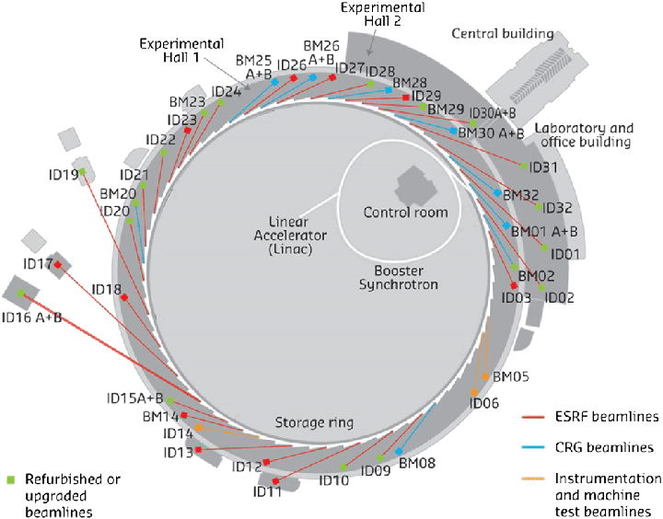
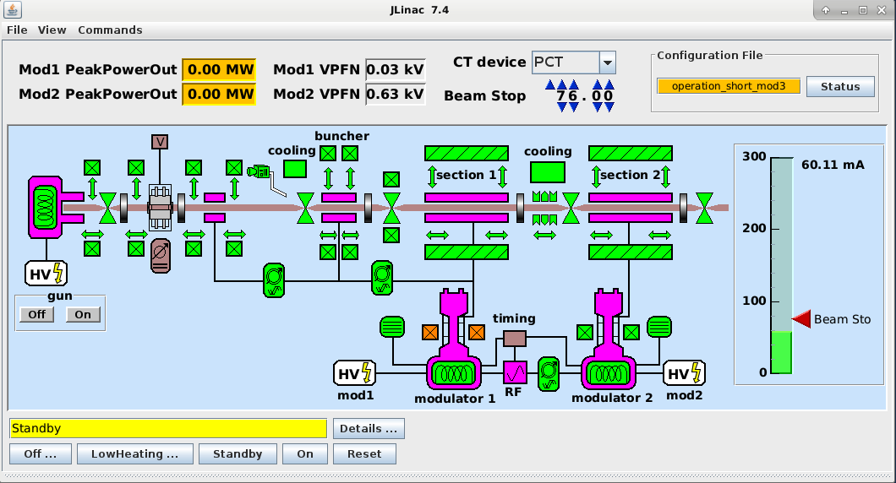
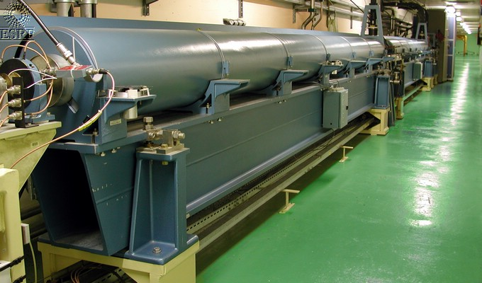
injector of EBS
0.09MeV
15MeV
Energy | 200MeV
Charge single bunch | 1-5, 1 nC (short pulse)
Charge long pulse | 300 pulse, 10 nC (long pulse, 1 ms)
Bunch length | ~ 1000 ps (pulse length, 3 bunches)
Bunches per pulse | 1,2,3,4,5 (short pulse) 300 (long pulse)
Repetition rate | 4 Hz
Frequency | 3 GHz
Normalized emittance | 15 π mm.mrad (long pulse) 35 π mm.mrad (short pulse)

Slide 18
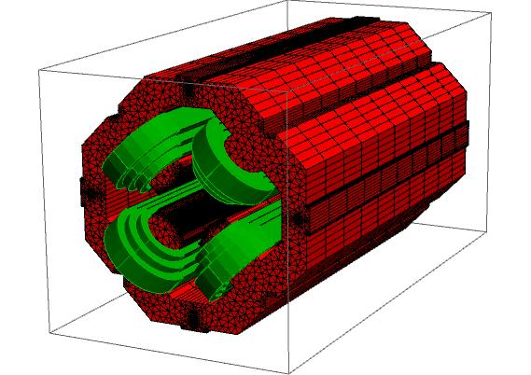
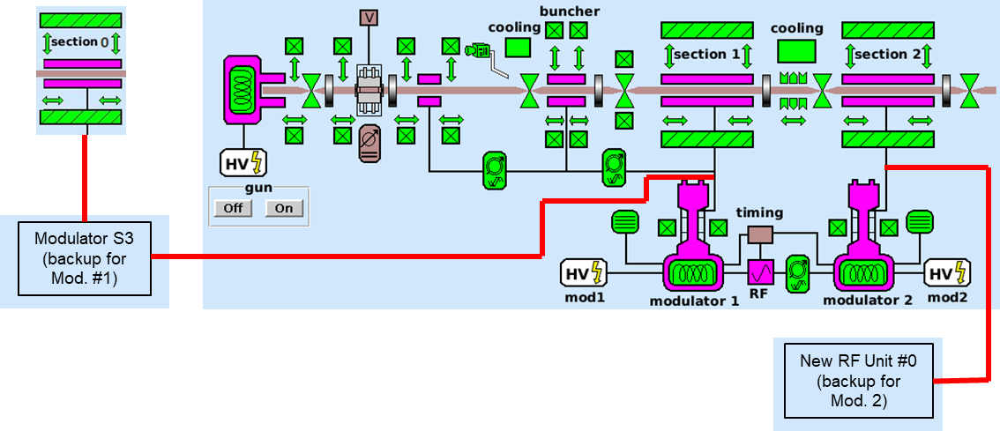
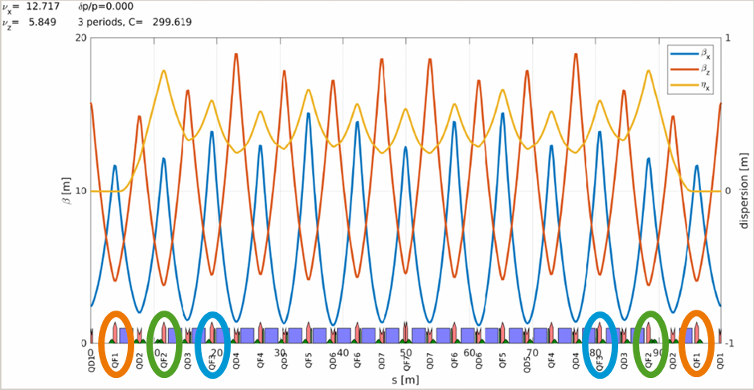
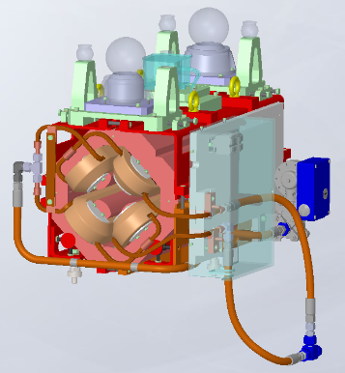
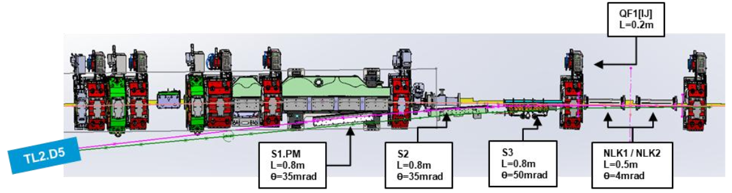
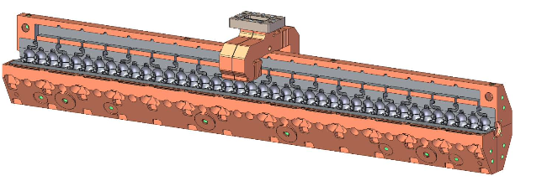
medium- & long-term scientific plan (since 2025) – injector upgrade
Injector Upgrade
Linac refurbishment (maintenance & new spares for the existing )
Booster light upgrade
New lattice
5 quad families
39 QD, 21 QF,
6 QF1, 6 QF2, 6 QF3
ε_{x} = 59.6 nm
BL = 19.9 mm
New Linac: COLD
Storage ring injection improvement
Courtesy G. Aymar

Slide 19
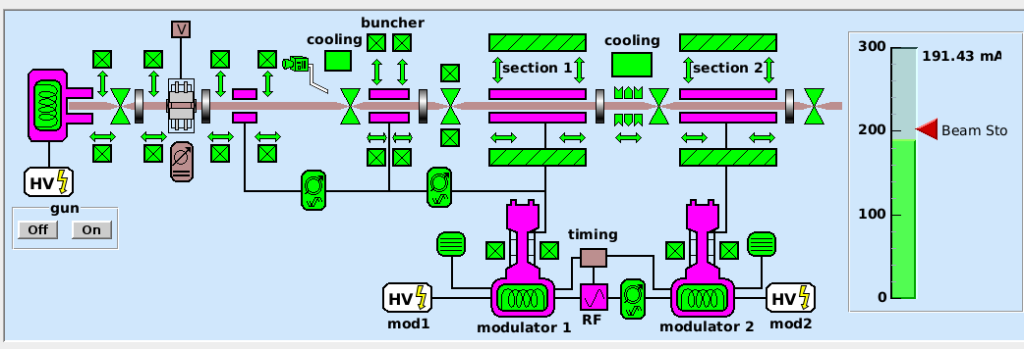
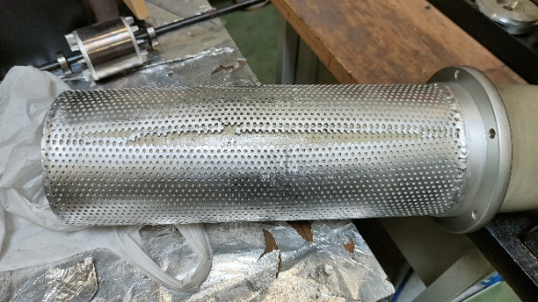




series issues of linac in 2024
Linac Refurbishment:
Improve the present Linac (short- & medium-term)
spare klystrons (2024)
replacement of all HV capacitors (2024-25)
repair of HV power supply of Modulators (2024)
spare accelerating section(s) (CFT in 2024)
linac control update to improve the switching to a spare modulator
new modulator(s) (CFT in 2024)
injection in the booster at 100 MeV with only one modulator (done)

Slide 20







Injector upgrade – linac refurbishment
Linac configuration
New power supplies
Old power supplies

Slide 21






kicker ceramic chamber & Injection efficiency improvement (2024)
Time (2024) | March SD | May SD | Summer SD | October SD | Winter SD
Activity | K4 installation | K4 dismount & coating check | K2 & K3 installation + movement of S3 & related TL2 | K4 installation | K1 installation
Beam current to be increased @ 16-bunch
Injection perturbation reduction at different beam delivery modes
$$ε_{H}≈122 pm⋅rad, 7/8+1$$
$$ε_{V}≈10 pm⋅rad, 7/8+1$$

Slide 22


COLD – Space available
~0.5GeV C³ demonstrator could fit in the empty tunnel and allows independent EBS operation
60m long tunnel
Empty tunnel space 40m
Present linac 19.5m
The empty tunnel space will be used for conditioning of RF structures (S-Band, C-band, …), test of diagnostics, training of personnel with high-power, pulsed RF, UHV, laser technology…
Safety (PSS, shielding) check,
ASNR validation in progress

Slide 23

ESRF strategic objectives for 2025
ESRF LONG TERM STRATEGY

Slide 24





From ESRF-EBS science to the Long-term Scientific Plan (2026 – 2035)
1987
1997
2007
2014

Slide 25





LTSP 2026 – 2035
Exploit EBS now, prepare next leap
Focusing resources to maximise impact
Integrative Science & Collab. Access
Source - Experiment Tailored Instrumentation
Pioneering
new research opportunities
with In-House Research
Beamlines operate increasingly as coordinated platforms for holistic scientific approaches
IDs, timing & filling modes, real-time control, Autonomous experiments; mechatronics;
at-wavelength metrology; customized detectors, integrating data treatment at detectors
Facility equally
accessible
to novice & expert users
Making the most of a beamtime
(training)
Data & User-centric operations
A View Beyond 2035
Real time
access to relevant information
FAIR data management automated pipelines, metadata enrichment, open, community-driven databases & data portals, AI/ML analytics, user-friendly digital services
New LINAC, diffraction-limited high-energy
X-ray source with next-generation beamlines to address future scientific challenges
Reliable synchrotron tools for advancing science
Enhance productivity
& reproducibility

Slide 26
COLD
modulator
25 (35) MW
1.5 μs
S-band (2.998GHz)
modulator
50 MW
4.0 μs
C-band 5.712GHz
Control PS
Alignment
Diagnostic
Interlocks
PSS Safety
LLRF
laser
klystron
4Hz
klystron
4Hz
C² (cold copper)
Operation
Linac
Demonstrator
Waveguide S-band
Waveguide C-band
Vacuum pump
pulse compressor
LN₂
isolator
planar hybrid
A demonstrator:
To prove high gradient cryogenic accelerating structures for users facility grade operation at low repetition rate.
The pre-injector of a new 6GeV linac.
Beam dump
dipole
Photo-gun
solenoid
Quadrupole
Quadrupole
Quadrupole
BPM/BLM
BPM/BLM
Quadrupole
Steerer
Fast CT
RF deflector
screen
Steerer
BPM/BLM
Screen
Vibration
SLAC’s C-band distributed coupling accelerating structures
If 6-Gev linac is approved, this facility will become a conditioning/test facility and most components will be part of the 6-GeV linac. If not approved remains C-band cryogenic RF test stand.

Slide 27







INFN-LNF SPARC (or CLEAR) photo-GUN:
Enabling technologies available from the international collaborators
SLAC distributed coupling standing wave cryogenic accelerating structures and cryomodule
high gradient (135MV/m)
Low breakdown rates at 77K
high charge,
small emittance, short pulse length
D. Alesini et al. https://doi.org/10.1103/PhysRevAccelBeams.21.112001
PSI: Pulse compression
https://arxiv.org/abs/2203.09076
CERN: simulation tools (RF-Track)
High quality factor C-band RF pulse compressors
https://abpcomputing.web.cern.ch/codes/codes_pages/RF-Track/
CORNELL: FEL options
R.Zennaro et al. C-band RF Pulse Compressor for SwissFEL, IPAC2013

Slide 28

Long term PLANS (after 2032) – 6-Gev full energy linac
Design requirements for future:
Low emittance and short bunch
On-axis accumulation
Optimized energy consumption
High efficiency transparent injection
Enable ultra low ID gaps in both planes
Enable ultra-low emittance lattice upgrade
Possible choices:
Low emittance booster/accumulator – long shutdown
Full energy linac
Recent developments on high gradient accelerating structure:
Extremely compact design
Competitive cost
Better overall beam characteristics
State-of-the-art technology: improve attractiveness of ESRF

Slide 29
Injector
upgrade
SR Injection section
improvement
Booster
refurbishment
Linac
refurbishment
NEW
Linac
Long-term
COLD
Started
Replace existing injectors with a full energy injector linac
Higher injection efficiency, lower injection perturbation, enable/facilitate future SR upgrades
6GeV + margin
> 600 pC (single bunch)
< 1 nm.rad at SR injection
< 0.1 % energy spread
< 1 mm bunch length
> 4 Hz repetition rate
Bunch spacing 2.8 ns (in the SR)
Fits on site (maximum 180 m)
As low energy consumption as possible
User facility:
Reliability
Stability
Sustainability
Reproducibility
Maintainability
Advanced
✓
Non-linear injector kicker
Transparent injections
Maintain injection efficiency
Advanced
design
✓
Procurement
✓
Lower natural emittance
Higher injection efficiency in SR
Higher extraction efficiency
More reliability
Modernization
Higher energy
Medium-term

Slide 30
COLD: C^2 (cold copper) operation linac demonstrator
Schematic view, to be installed in the present linac tunnel
OBJECTIVES:
Test C-band 77K high gradient technology (invented at SLAC)
High Acc. Gradient
Breakdowns
Dark currents
Reliability
Maintainability
Gain experience with new technology, training
C-band structures / modulators
Laser
Cryogenics
Evaluate potential to extend to 6 GeV
Validation for long-term robust operation with users facility standards
Strong interest in the accelerator community for light source, colliders or medical applications
Strong collaboration with major actors in the field
e⁻ beam

Slide 31





Key milestones in 30 + 1 years of esrf’s history
First electron beam in the storage ring
ESRF convention signed
First ESRF
Highlights
1988
1989
1992
1994
1995
First Users
Meeting
User operations begin with 15 beamlines
Nobel Prize in Chemistry
for ESRF User: Brian Kobilka
(G-protein–coupled receptors)
Number of beamlines: 44
(CM01)
Phase I Upgrade
Programme (UP)
Number of
Beamlines: 40
First ESRF News magazine
2018
2017
2015
2012
2009
1998
1996
20-month
EBS shutdown
Phase II UP: EBS project launched
The ESRF designs a
revolutionary storage
ring (H7BA Lattice)
Nobel Prizes in Chemistry
for ESRF Users: Ada Yonath
Venkatraman Ramakrishnan
(Ribosome)
SR current: 200mA; 4000 pmrad
B: 10²⁰ ph/mm²/mrad²/0.1%bw
Restart User
operations with EBS
Remote experiments
Number of Beamlines: 45
Shaping the future of the
ESRF Science & Innovation Programme
2026 - 2035
2020
2021
2024
2025
Horizontal emittance: 134 pmrad
B: 10²² ph/mm²/mrad²/0.1%bw
Coherent flux: x 30- x 40
Nobel Prizes in Chemistry for ESRF collaborators:
David Baker & John Jumper (protein design)
Nobel Prize in Chemistry for ESRF collaborator Omar Yaghi
(for metal-organic–frameworks)
Page 31

Slide 32


THANK YOU FOR YOUR ATTENTION

