Slide 1
ID Controls for Diamond-II
Ronaldo Mercado
ID26 Workshop, Deauville, France
16 May 2026

Slide 2
Contents
Self introduction and organisation of groups involved
Diamond and Diamond-II upgrade
Insertion Devices Controls Development Project
Torque tests and apple knot ID
Optics synchronisation for Diamond-II
Conclusions

Slide 3
Acknowledgements and thanks
Austen Rose
Xuan Tran
Brian Nutter
Gary Dade
Joe Williams
Dave Reading
Mark Popkiss
Steve Milward
Angela George
Fajin Yuan
Deep Biswas
Victor Rogalev
Marco Marziani
Steve Hale
Martin Reeves
Lee Hudson
Zena Patel
Geetanjali Sharma
Sumit Tripathi
Austin Brine
Tom Cobb
Gregory Gay
Konstantin Ignatyev
Ali Ramezani Moghaddam
Ken Jones
Simon Lay
Nico Rubies
Tien Lin-Lee
Kevin Bolt
Paul Amos
Colin Stunnel
Many others
  Former colleagues
  Current colleagues
  External collaborators

Slide 5
Contents
Self introduction and organisation of groups involved
Diamond and Diamond-II upgrade
Insertion Devices Controls Development Project
Torque tests and apple knot ID
Optics synchronisation for Diamond-II
Conclusions

Slide 6
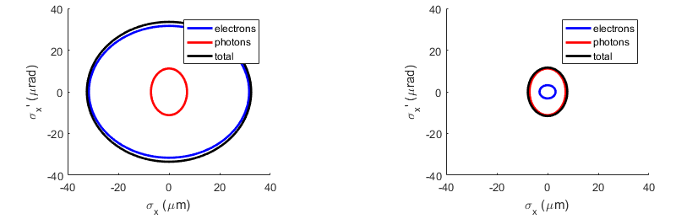
Diamond
Diamond is a 3rd generation synchrotron light source
Located at Rutherford Appleton Laboratory, Oxfordshire, UK
Joint Venture between UK Government and Wellcome Trust
Commissioned in 2006, first users in 2007
Diamond-II upgrade

Slide 7
Dec 2025
Completion of the
Diamond Extension Building ​
Sep 2029 ​
First Phase of beamlines become operational
July 2023
Approval for Diamond-II
and start of funding
Dec 2028 ​
Mar 2030 ​​
End of the
D-II project ​
Start of storage ring beam commissioning ​​​
Mar 2023
Mar 2024
Mar 2025
Mar 2026
Mar 2027
Mar 2028
Mar 2029
2023/24 FY
2024/25 FY
2025/26 FY
2026/27 FY
2027/28 FY
2028/29 FY
2029/30 FY
Q1 | Q2 | Q3 | Q4
Q1 | Q2 | Q3 | Q4
Q1 | Q2 | Q3 | Q4
Q1 | Q2 | Q3 | Q4
Q1 | Q2 | Q3 | Q4
Q1 | Q2 | Q3 | Q4
Q1 | Q2 | Q3 | Q4
Aug 2026
Start of main girder assembly​
Dec 2027 ​
Start of the
dark period ​​
Jan 2030
First User on a Flagship Beamline
Dec 2026
Third Readiness Review ​
June 2029
End of the dark period; start of regular beamline X-ray commissioning
7

Slide 8
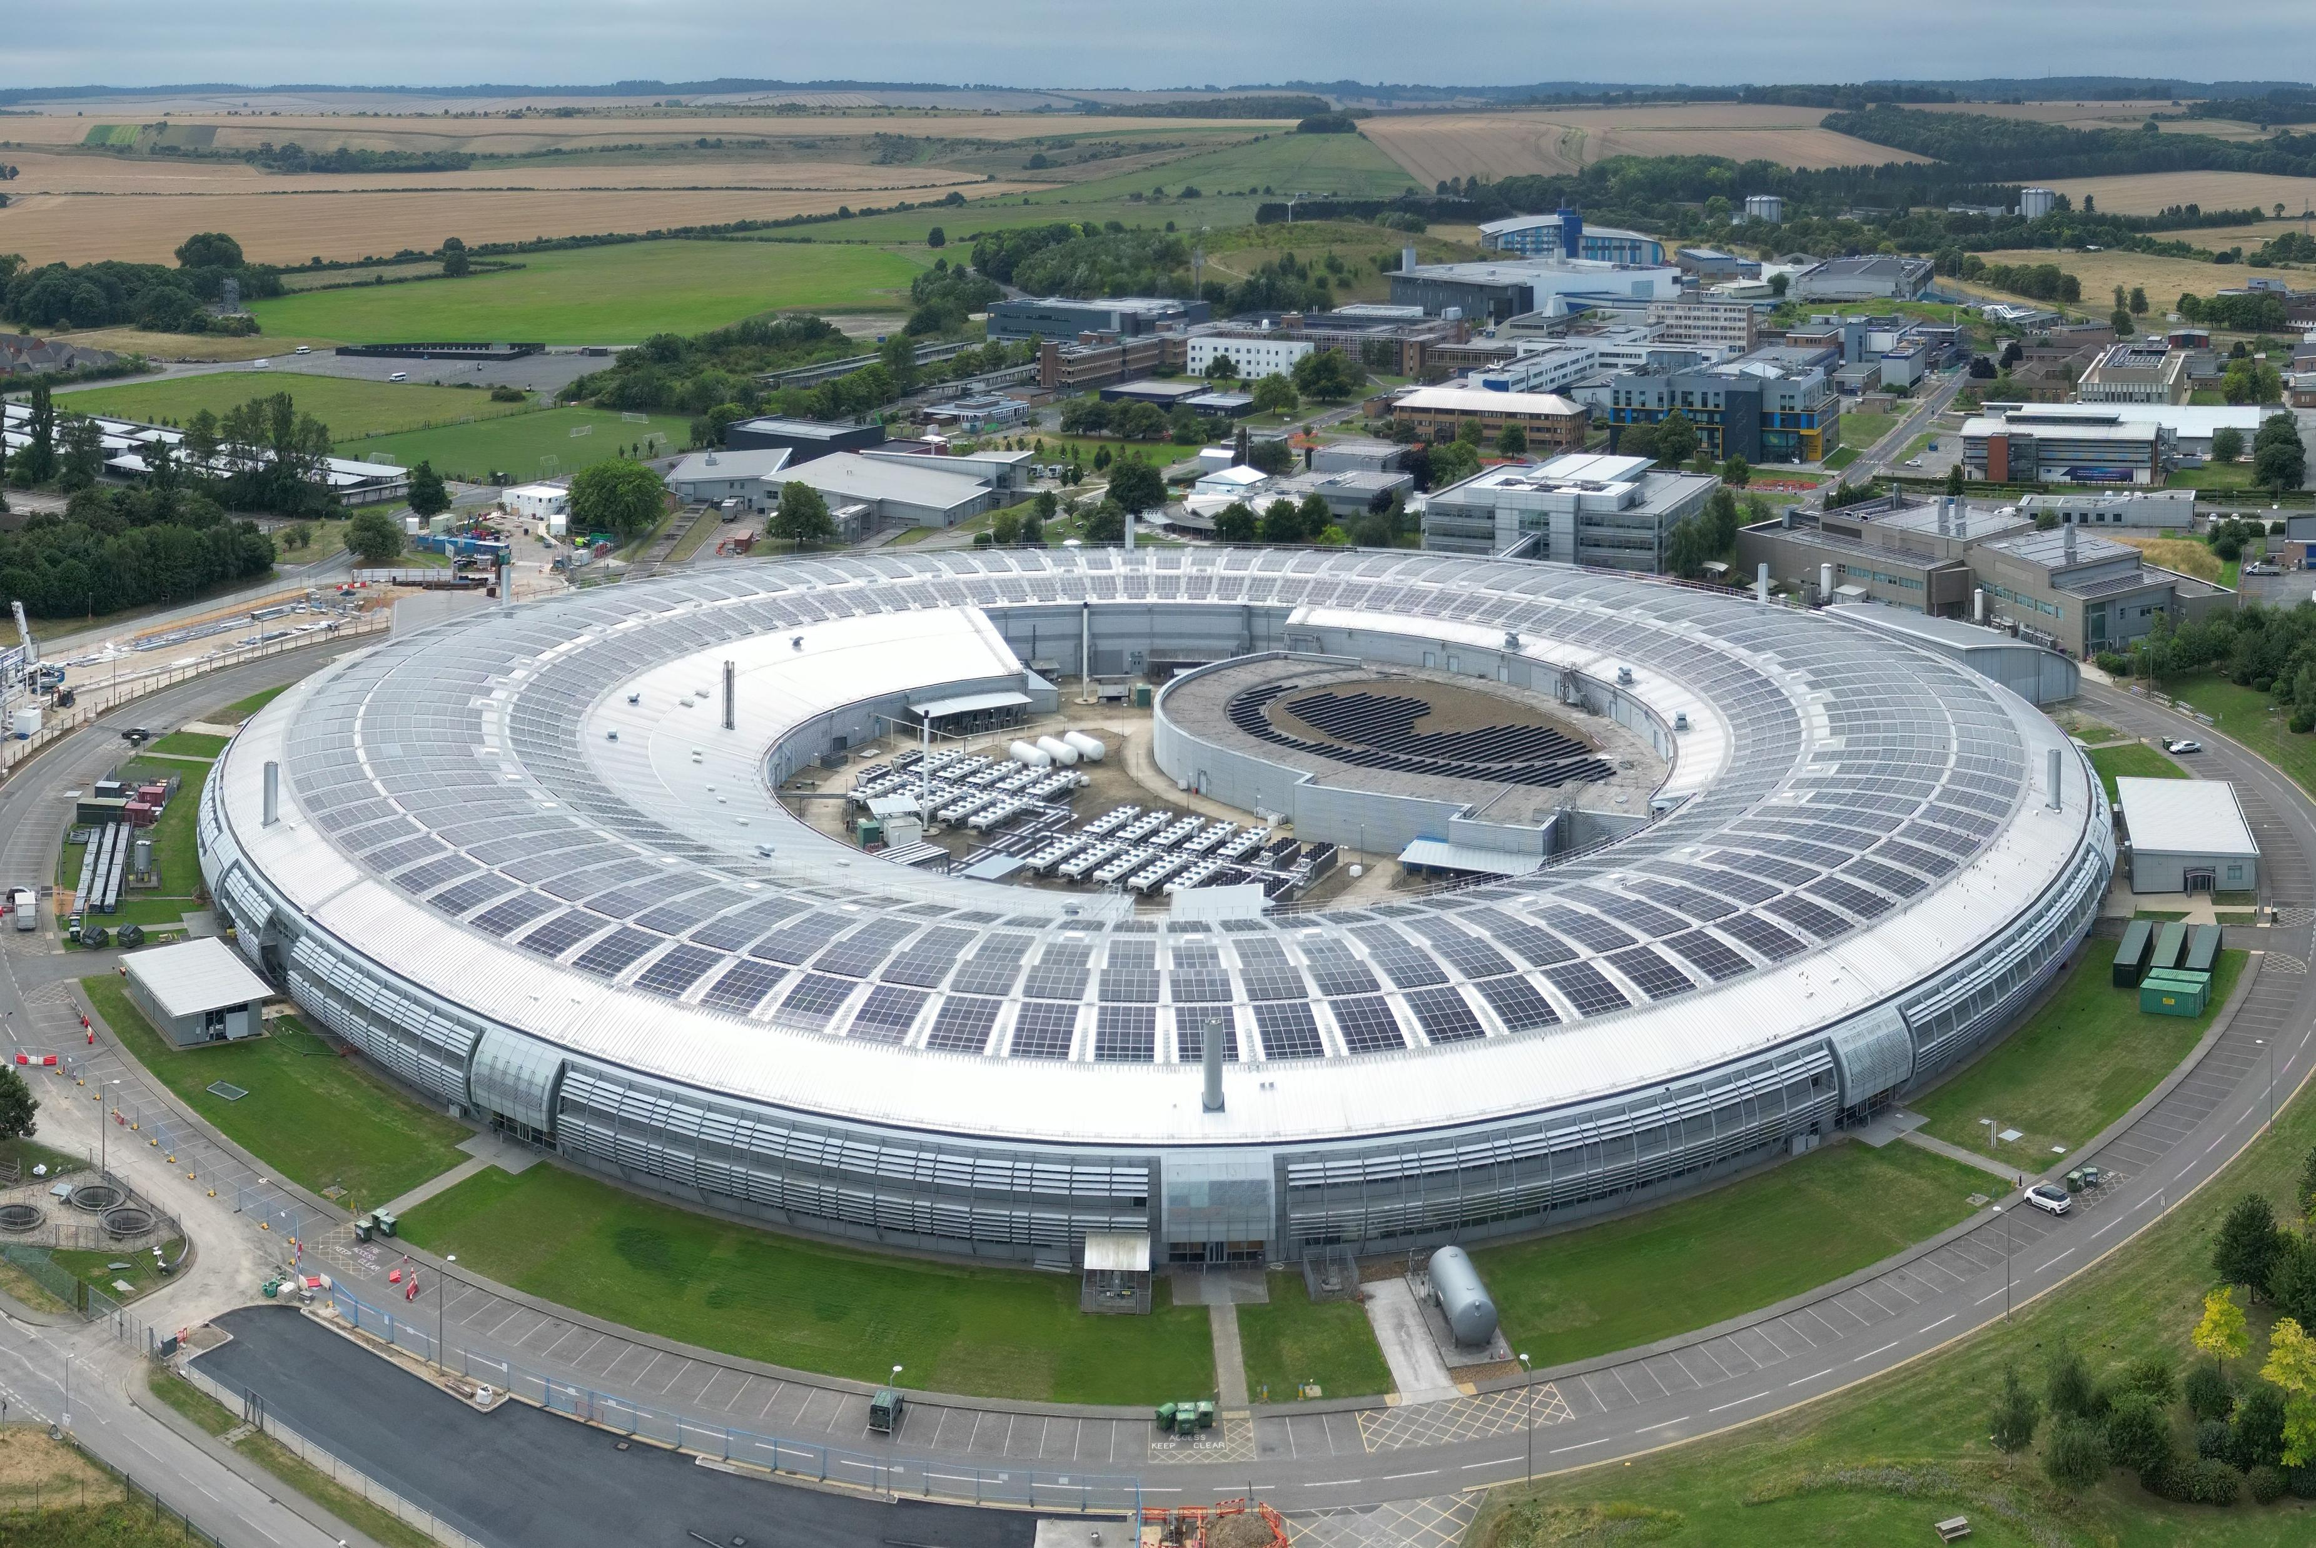
Motivation
Refresh architecture of control system for an insertion device
Context: Facility upgrade that includes build of 12 insertion devices.

Slide 9
Scope of work (ID group view)
Diamond
CPMU-1 rework
CPMU-2 rework
Spare SCW
Diamond-II
In-house builds: 4
K02 CPMU-6
I05 APPLE-Knot
I06 EMPHU
I17 APPLE-II
Industry builds: 8
K16 HPMU
K21 HPMU
I06 APPLE-II
I08 APPLE-II
I10 APPLE-II
K18 3PW
K14 MPW
K07 APPLE-II
9

Slide 10
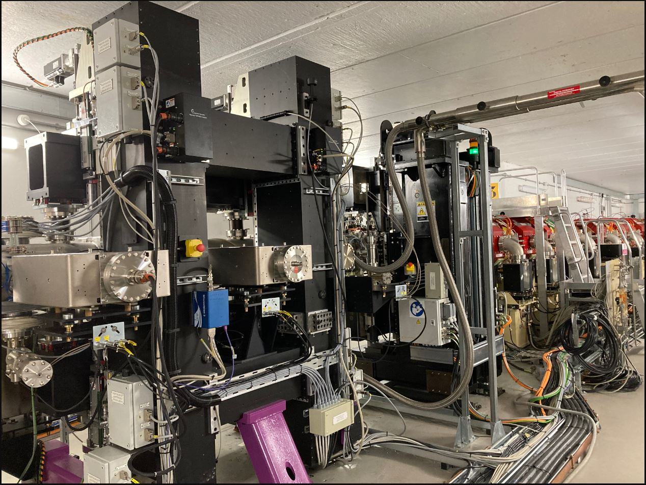
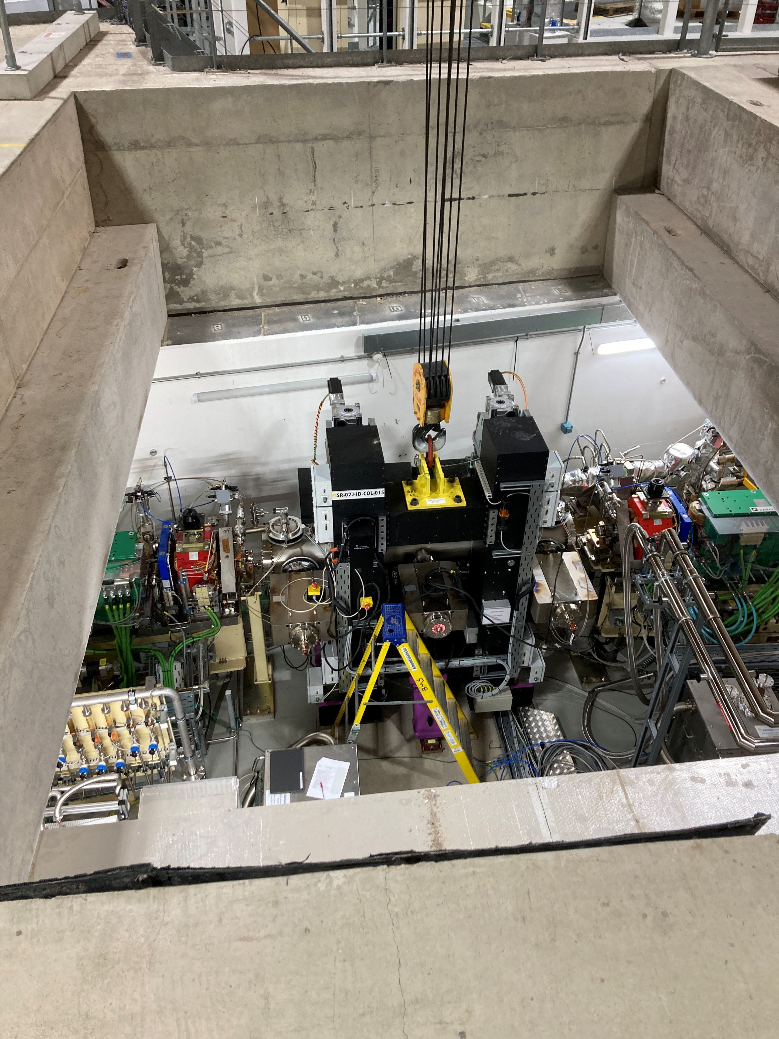
CPMU4 and HPMU1 installed ca 2022
CPMU-5 (ID J02) installation Oct 2024

Slide 11
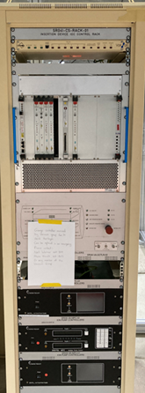
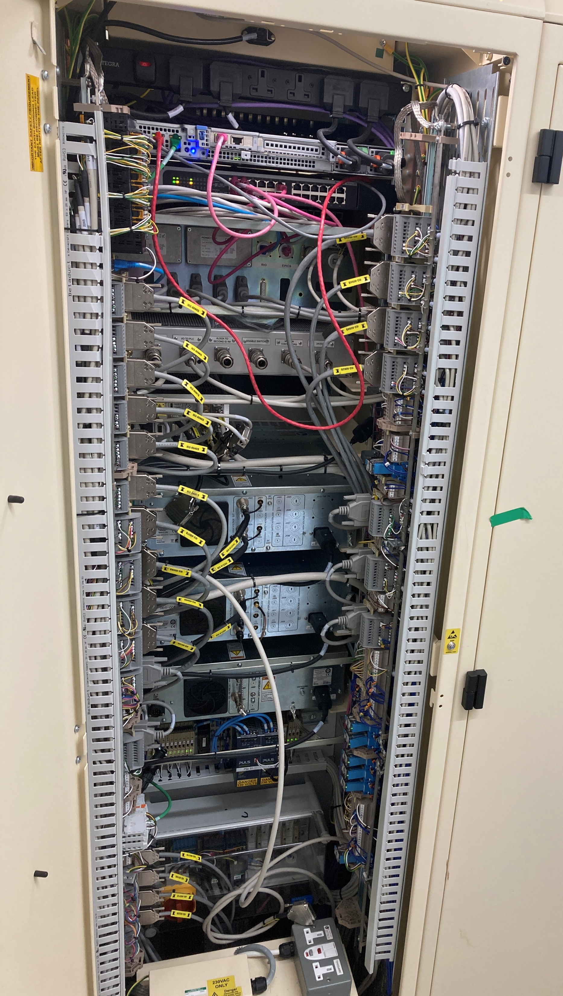
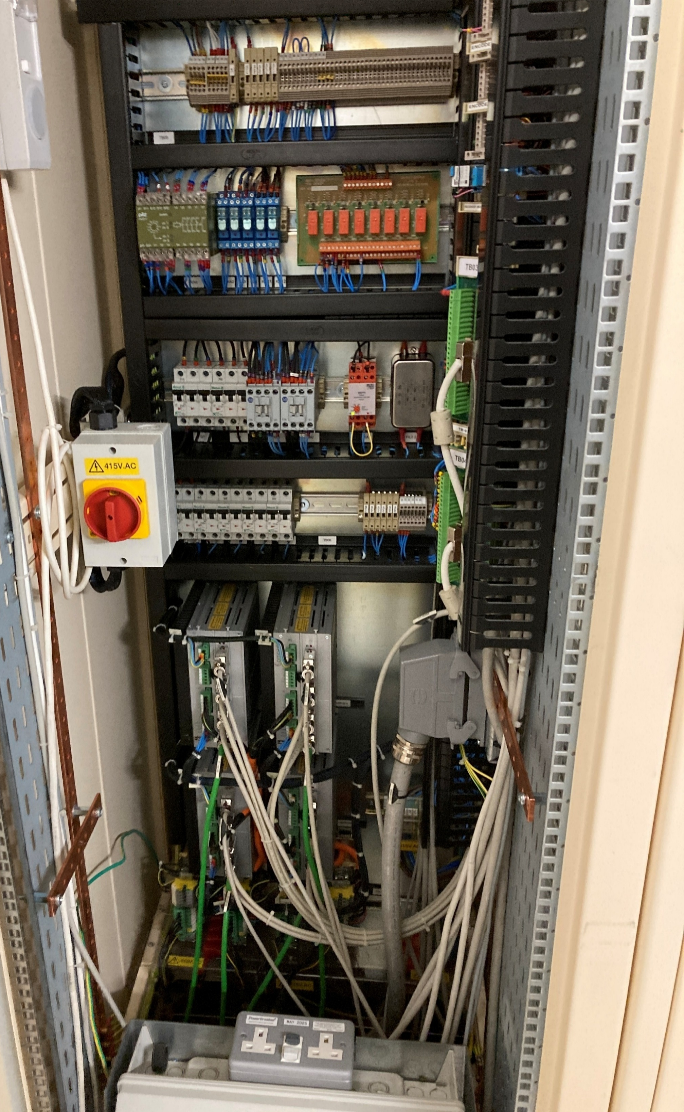
Rack space considerations
VME crate
First generation of
Control system takes up two racks
Shrunk to one rack for the latest two IDs installed
(right)

Slide 12
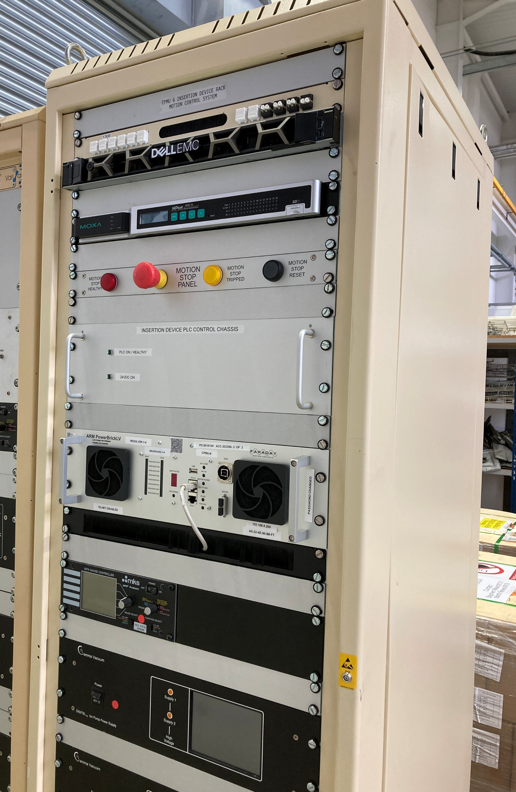
CPMU-6 rack
First system using a powerbrick
October 2025

Slide 13
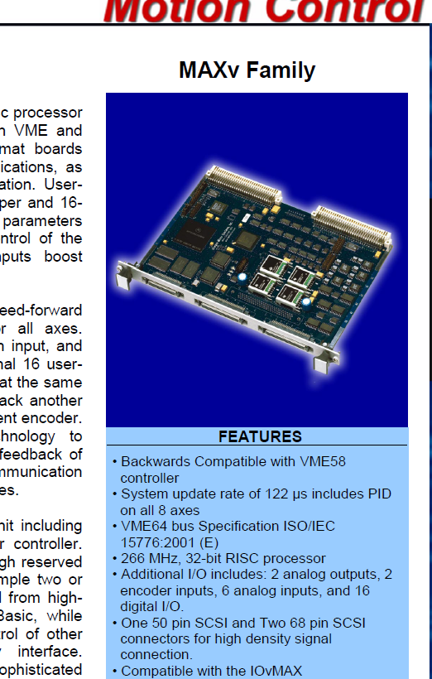
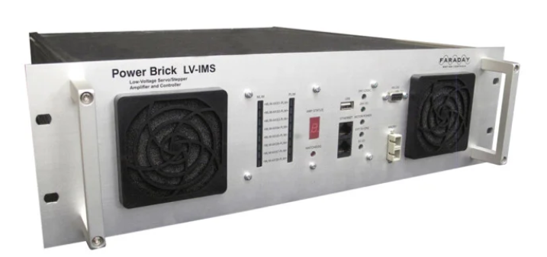

Slide 14
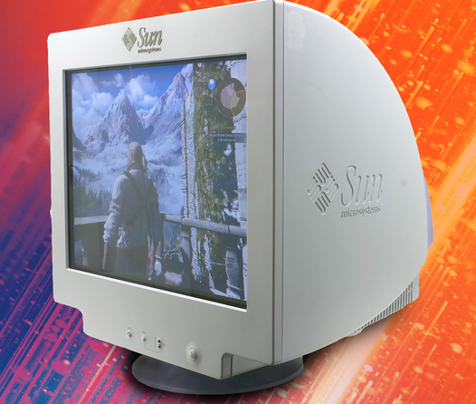


Slide 15
Contents
Self introduction and organisation of groups involved
Diamond and Diamond-II upgrade
Insertion Devices Controls Development Project
Torque tests and apple knot ID
Optics synchronisation for Diamond-II
Conclusions

Slide 16
Insertion devices development project
Digital communication instead of analogue
  EtherCAT
  Step and direction
Alternatives for encoders
Trial a standard beamline controller
  Use internal amplifiers
Check structure deformation
  Fit encoders across the beam and verify reading against encoders in structure

Slide 17
Motor controllers
ACCELERATOR SYSTEMS
OMS 58
OMS MaxV
Delta Tau Brick Controller
DeltaTau/Omron CK3M (PowerPMAC)
DeltaTau/Omron PowerBrick
BEAMLINE SYSTEMS
TWO systems
-
Not used in beamlines
Delta Tau Geobrick (internal amplifiers, hundreds of systems)
All upgrades and new systems
Obsolete
Obsolete
Obsolete

Slide 18
Analogue velocity demand

Slide 19
Analogue velocity demand
Use a powerPMAC

Slide 20
Analogue velocity demand
Go digital

Slide 21
Analogue velocity demand
Use internal amplifiers

Slide 22
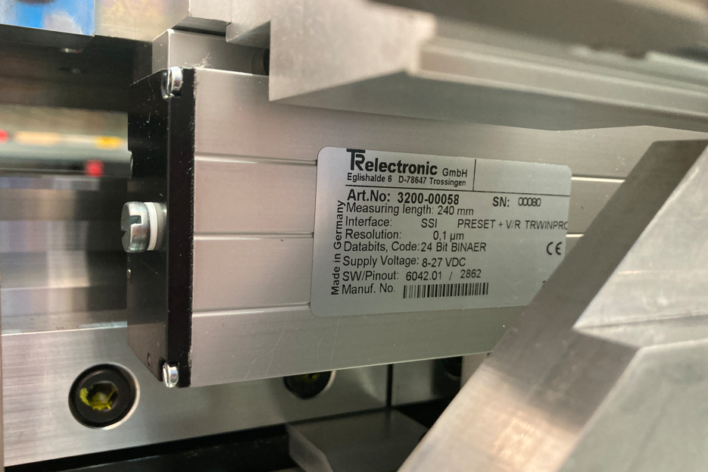

Slide 23
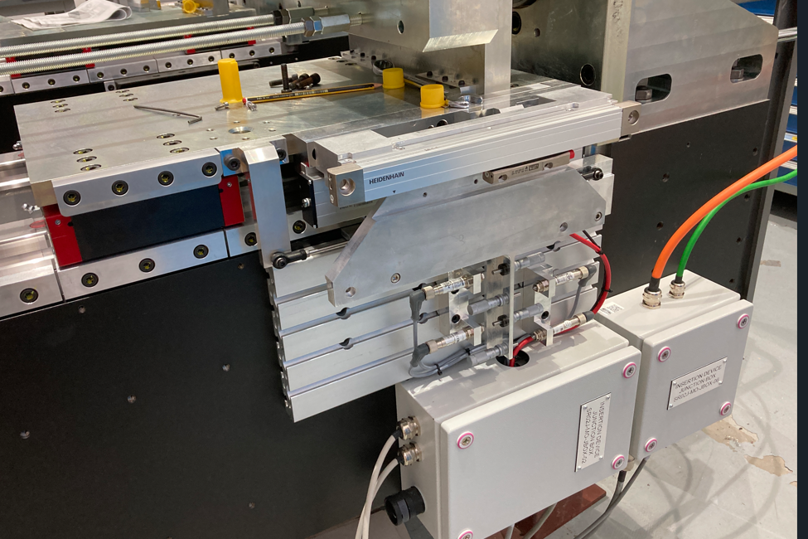
LC 415 encoder
(10 nm)
TR LT240S encoder 100 nm
Tests reading a
10 nm alternative
part no 3200-0196
Potentiometer
Extra mounting
bracket
Photograph taken in Oct 2022

Slide 24
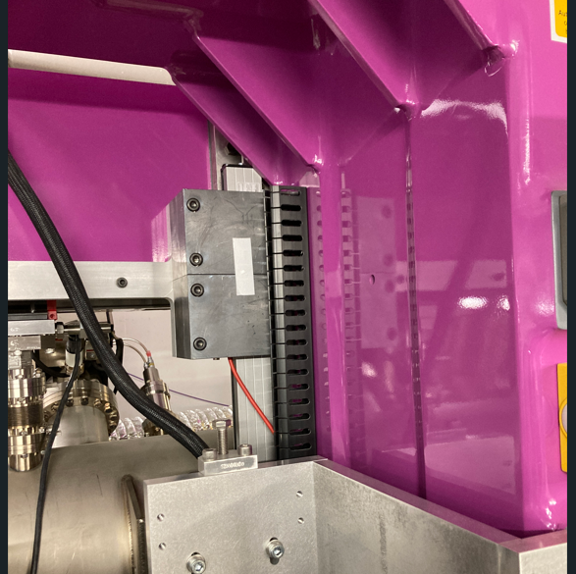
Radiation damage
Has been a problem since the early days.
Attempts to mitigate using lead shielding
Mechanism in place to power-cycle encoders to recover.
Affects most IDs directly after the collimator
Regular encoder swapping

Slide 25
Contents
Self introduction and organisation of groups involved
Diamond and Diamond-II upgrade
Insertion Devices Controls Development Project
Torque tests and apple knot ID
Optics synchronisation for Diamond-II
Conclusions

Slide 26
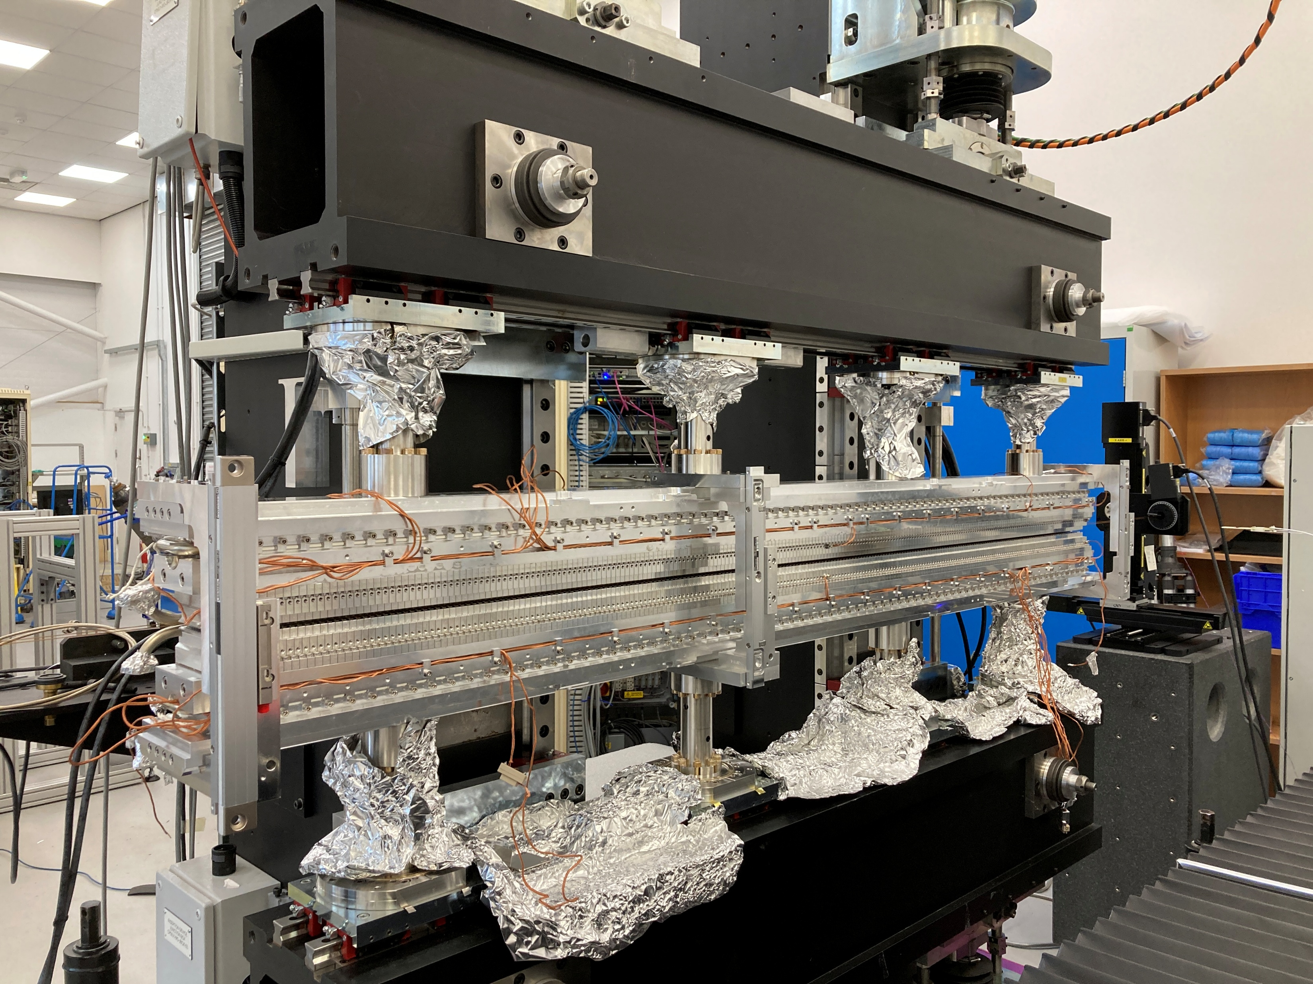
CPMU-1 structure
Structure will be used at 4 mm gap
Forces increase when cold, therefore tested at gap 3.4
Photograph taken July 2023

Slide 27
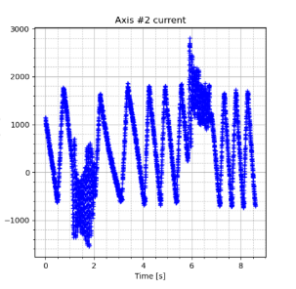
Test results
Maximum current 3.3 Amp
Motor rating 4.9 Amp
32 % headroom
Internal Report TDI-ID-CTRL-020

Slide 28
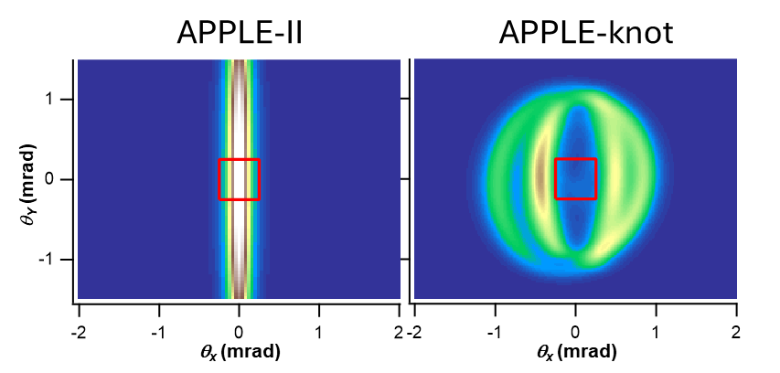
Torque tests for Apple-Knot
Motivation
Provide low photon energies
Variable polarisation: vertical, horizontal and circular
Reduce on-axis heat load – damage to optical components
Designed and built in SSRF (Shanghai)
Visit by Prof Shan Qiao April 2019
Ref.: e.g. S. Qiao, D. Ma, D. Feng, S. Marks, R. Schlueter, S. Prestemon, and Z. Hussain, “Knot undulator to generate linearly polarized photons with low on axis power density,” Review of Scientific Instruments 80, 085108 (2009).

Slide 29
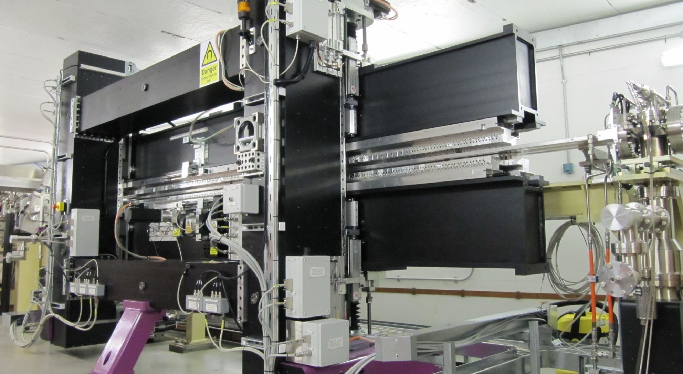
5 metre device
Challenges in forces
and heat load

Slide 30
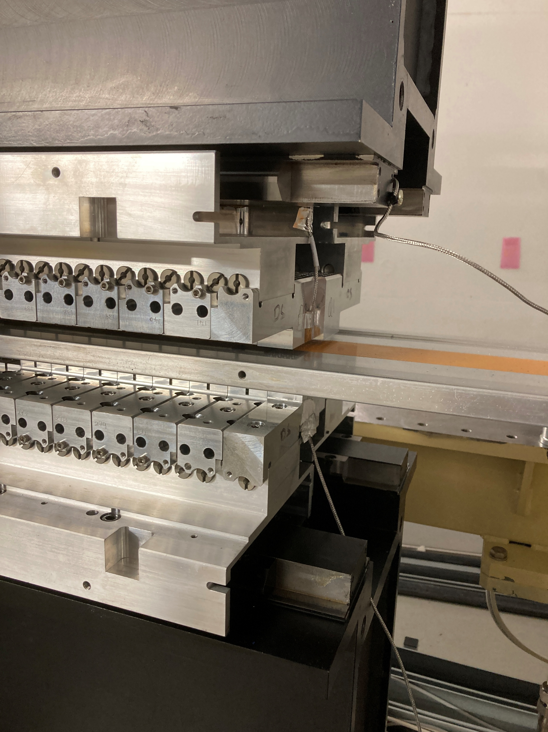
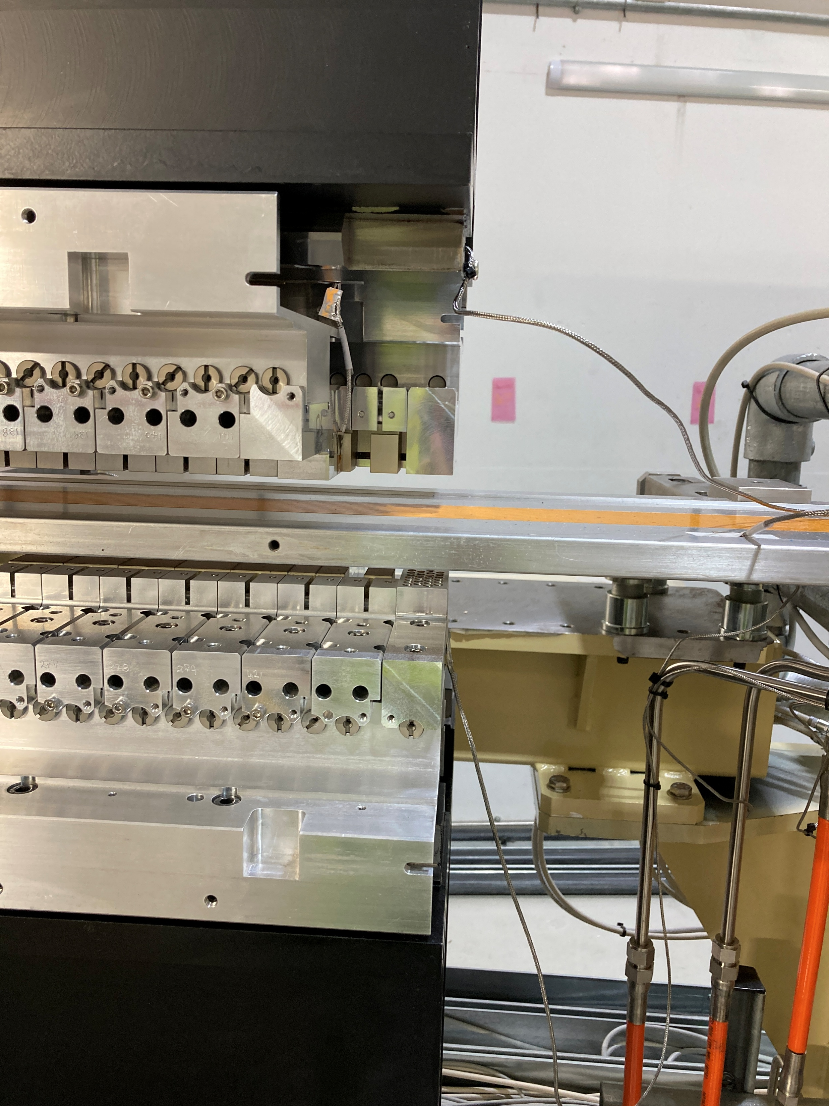
Offset zero
Offset ½ period

Slide 31
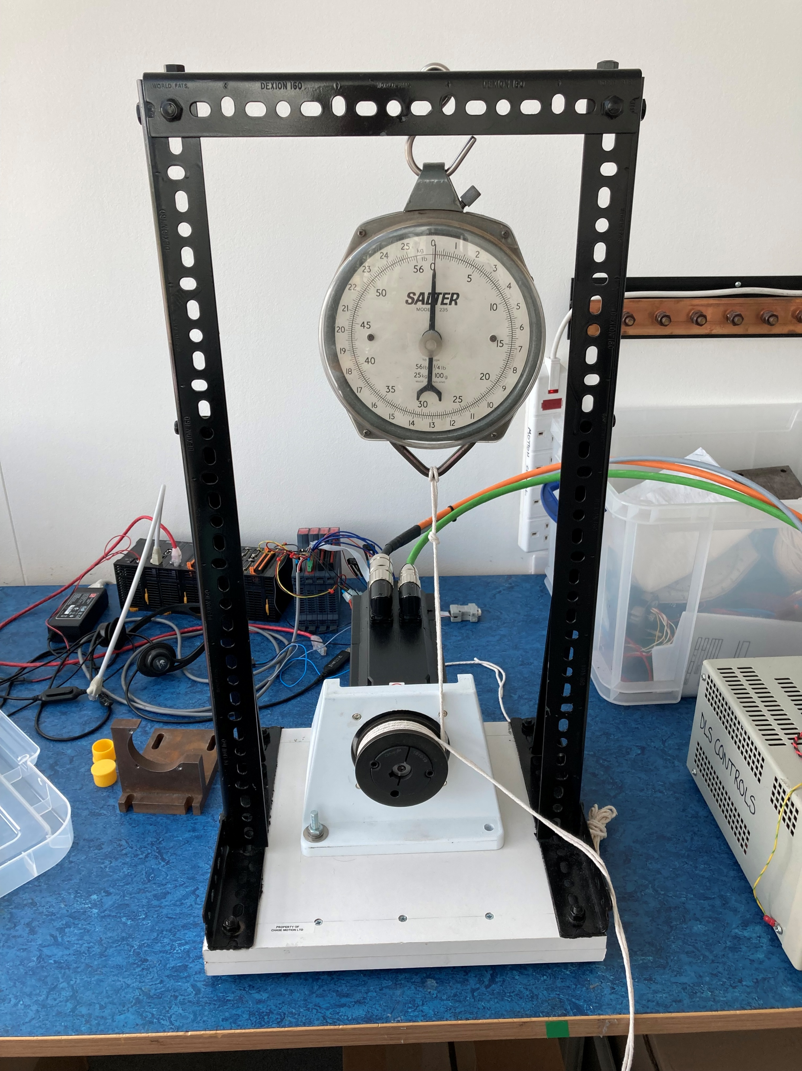
Test setup in motion control lab
Support from ID group to build rig
and evaluate results
Requirement from the beamline:
Drive the phase motor at 1 mm/sec
Conclusion from test:
Maximum rotation speed is ~7.9

Slide 32
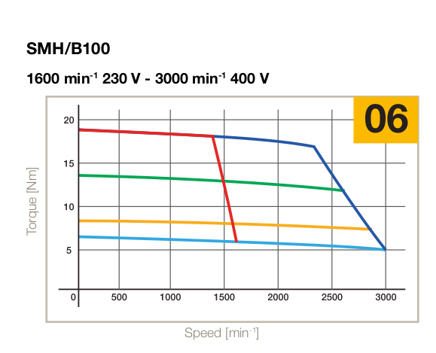
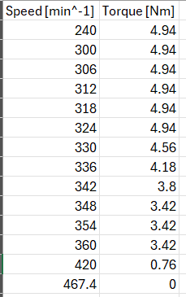
Torque curves
Torque curves from Parker catalogue
Reported by X Tran ca. July 2025
Maximum rpms much smaller at 48 V voltages

Slide 33
Contents
Self introduction and organisation of groups involved
Diamond and Diamond-II upgrade
Insertion Devices Controls Development Project
Torque tests and apple knot ID
Optics synchronisation for Diamond-II
Conclusions

Slide 34
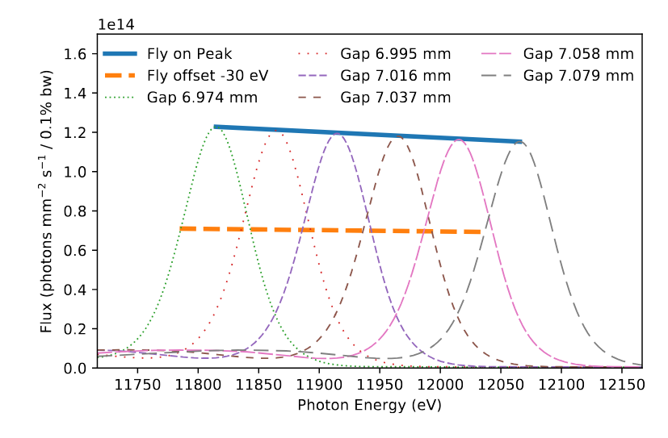
Optics synchronisation
20 times speed-up compared to step-scan at the SRX beamline
Ref.: D Hidas, AM Kiss, M Rakitin, J Sinsheimer, T Tanabe, M Musardo High precision real-time insertion device and monochromator synchronization at NSLS-II Nuclear Instruments and Methods in Physics A 1031 166505 (2022).

Slide 35
Synchronization scheme
Master/slave technique using compensation tables as hardware synchronisation method.
Encoder signal from Mono Bragg axis is taken into ID motion controller
Tests performed ID system (CK3M controller)

Slide 36
Synchronization scheme orchestrated externally

Slide 37
Agreed schematic control for Apple-Knot ID

Slide 38
Conclusions
There are advantages to using a powerbrick
There are alternatives if we can’t use a powerbrick
We have validated the synchronization scheme when driving four axes
We have done work to validate the motor controller
  Torque verification
  Selected method to synchronise when driving eight axes (gap and phase IDs)

