Slide 1
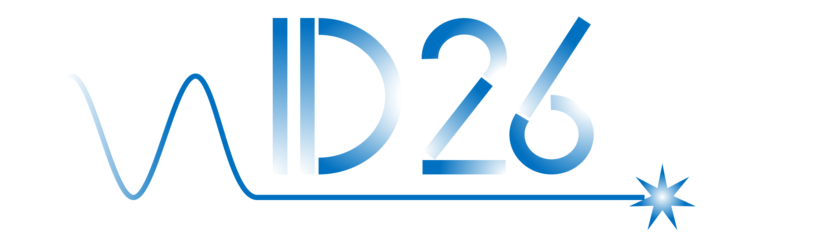
HTS IDs developments at the ESRF
May 15 – 16, 2026, Deauville, France
L. Bortot, F. Cianciosi, G. Le Bec,
F. Perratone, Z. Qiu

Slide 2
Introduction
HTS IDs Developments
Infrastructure and Tests
Summary & Outlook

Slide 3
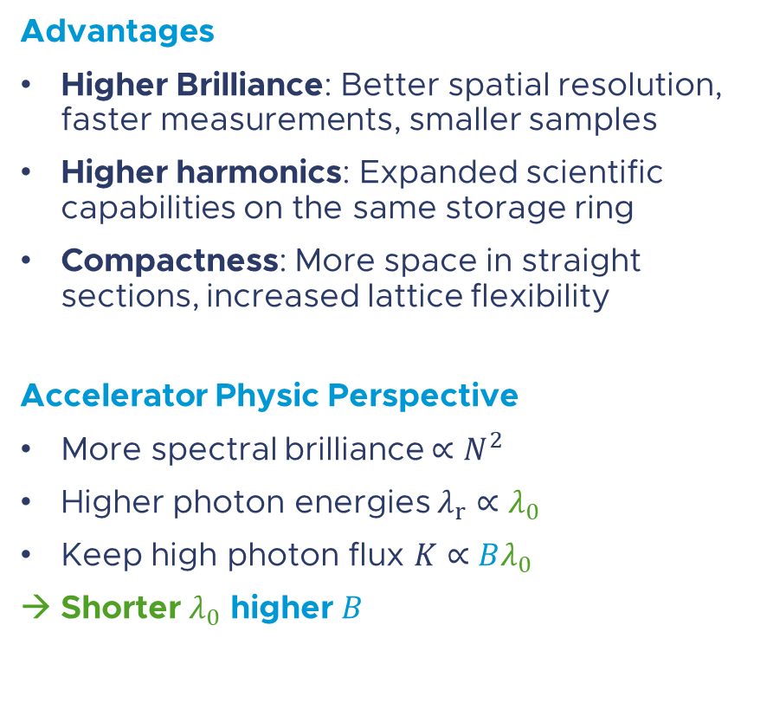
Motivation: High-Field, Short-Period Undulators
Data from [1,2]
Advantages
Higher Brilliance: Better spatial resolution,
faster measurements, smaller samples
Higher harmonics: Expanded scientific capabilities on the same storage ring
Compactness: More space in straight
sections, increased lattice flexibility
Accelerator Physic Perspective
More spectral brilliance $∝N^{2}$
Higher photon energies $λ_{r}∝λ_{0}$
Keep high photon flux $K∝Bλ_{0}$
Shorter $λ_{0}$ higher $B$
R&D Space
Device
Model
Figure: Planar undulators (various technologies)
(1) Zhang, K., Calvi, M.. 2022 SUST 35 093001
(2) Benabderrahmane, C et al. doi:10.18429/JACoW-IPAC2022-THPOPT050
Notes:
ONLY DEVICES
More power, not necessarily useful one
Power density B*dz
More periods -> brilliance
Short periods, higher energy
- Check units font

Slide 4
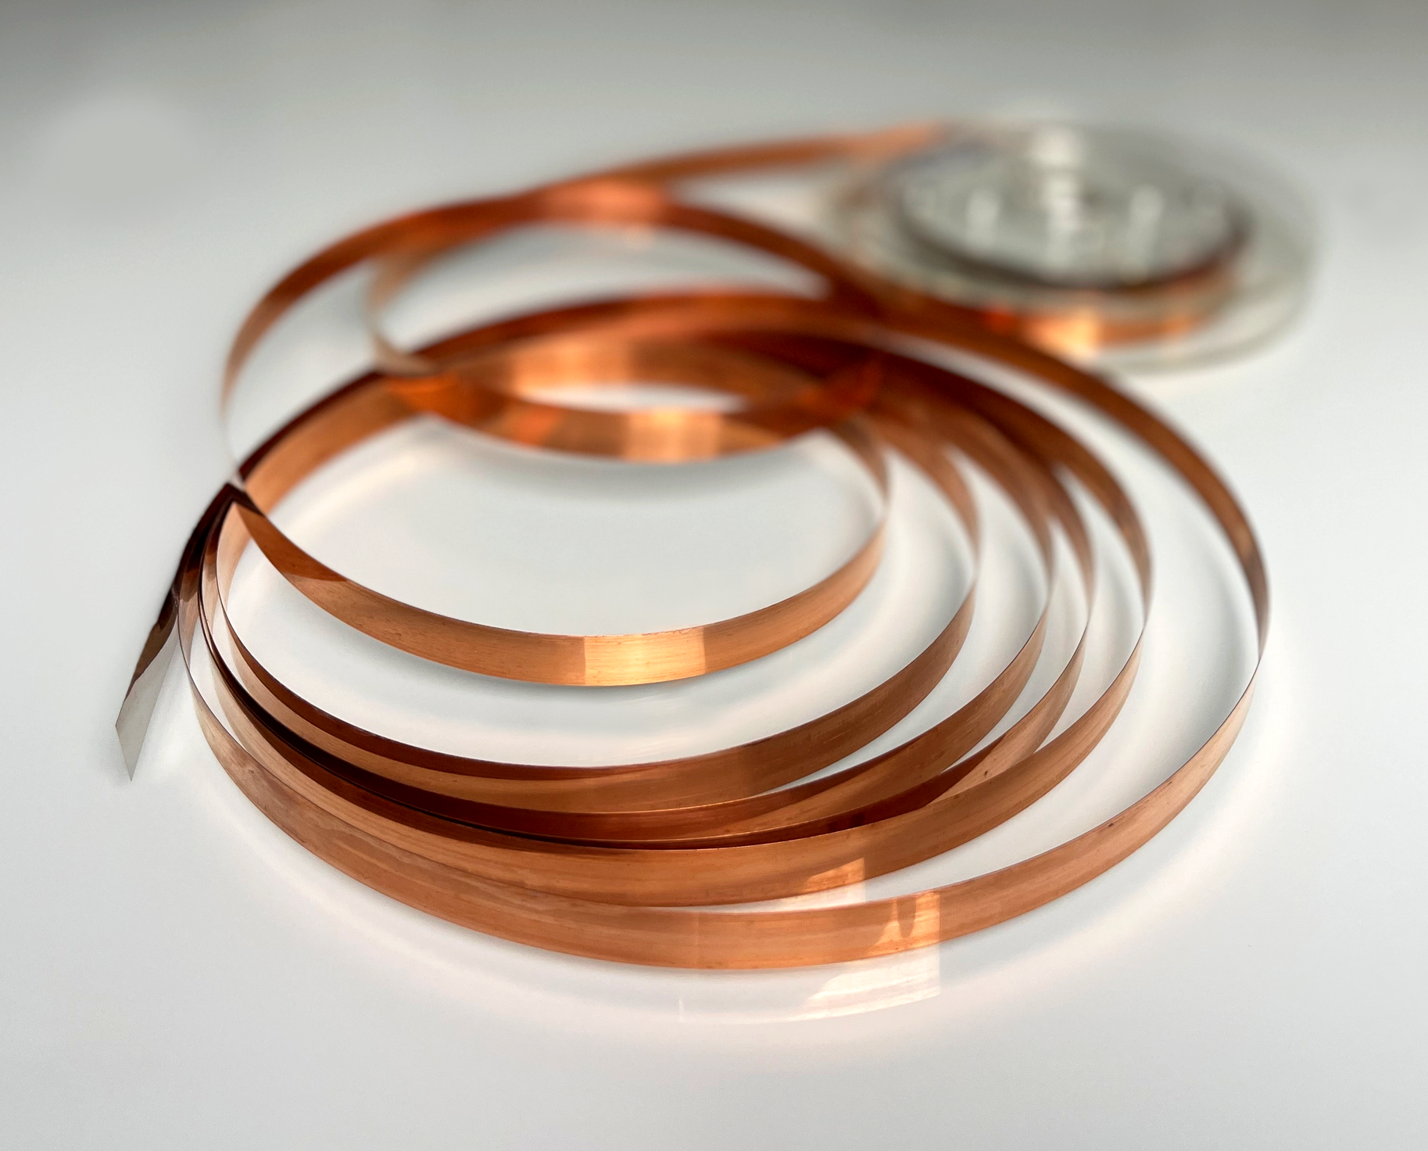
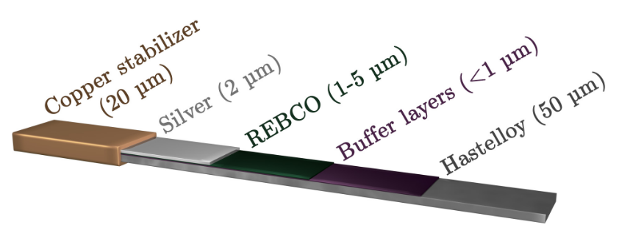
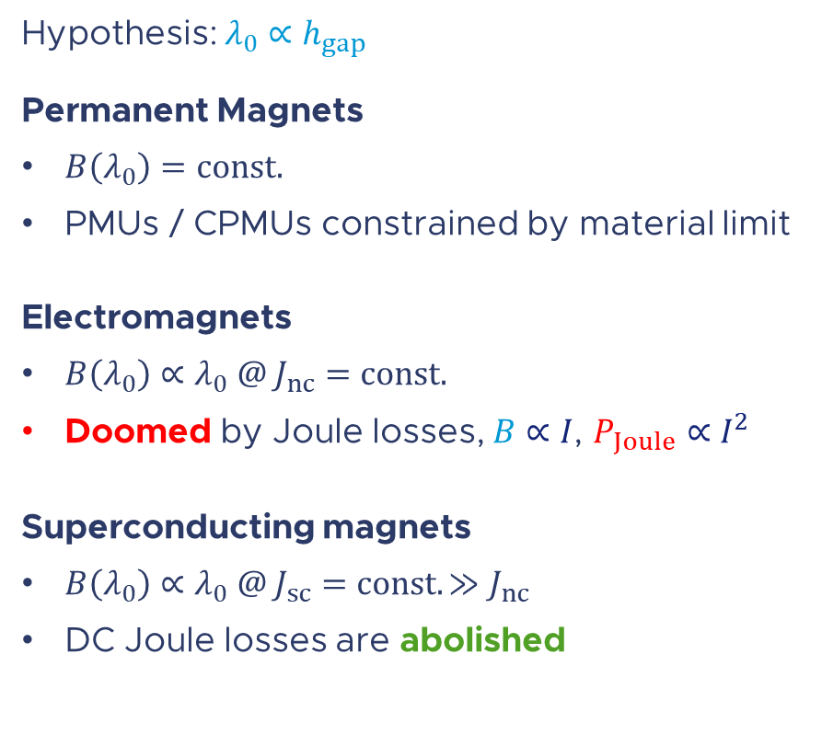
Currently Available Technologies (Industrial Scale)
Hypothesis: $λ_{0}∝h_{gap}$
Permanent Magnets
$B\left(λ_{0}\right)=const.$
PMUs / CPMUs constrained by material limit
Electromagnets
$B\left(λ_{0}\right)∝λ_{0} @ J_{nc}=const.$
Doomed by Joule losses, $B∝I$, $P_{Joule}∝I^{2}$
Superconducting magnets
$B\left(λ_{0}\right)∝λ_{0} @ J_{sc}=const. ≫J_{nc}$
DC Joule losses are abolished
HTS-ReBCO Tapes
Mature technology (~km of tapes)
Cryogen-free (no LHe)
Record-high engineering current density
  500 A/mm² in a 2T field, at 60 K
  2000 A/mm² in a 5T field, at 20 K
→ Compact design (high power density)
Dilasser, G. PhD Dissertation, 2017
Notes:
- Scaling factor: dimensions vs B field and gradient

Slide 5
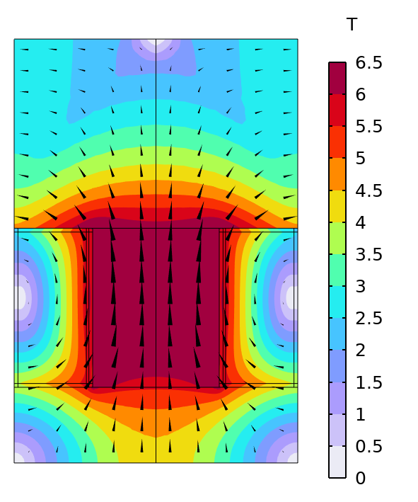



Potential Leap for Insertion Devices
(1) see also https://indico.cern.ch/event/1326603/contributions/5773995/
(2) https://www.faradaygroup.com/en/product/
Magnetostatics Simulations⁽¹⁾
Planar undulator, simplified 2D geometry
Fusion grade⁽²⁾, 65 um REBCO tape
Operations at 4.5 K, 80 % critical current
Tech
advance
Potentially
at reach!
Devices Models
In figure:
Is = 1000 A
$λ_{0}$= 15 mm
$h_{gap}$= 4mm
Vacoflux 50 yoke
Simulations
Coil
$$h_{gap}$$
$$\vec{e}$$
Unmatched HTS performance → Exploration of R&D space

Slide 6
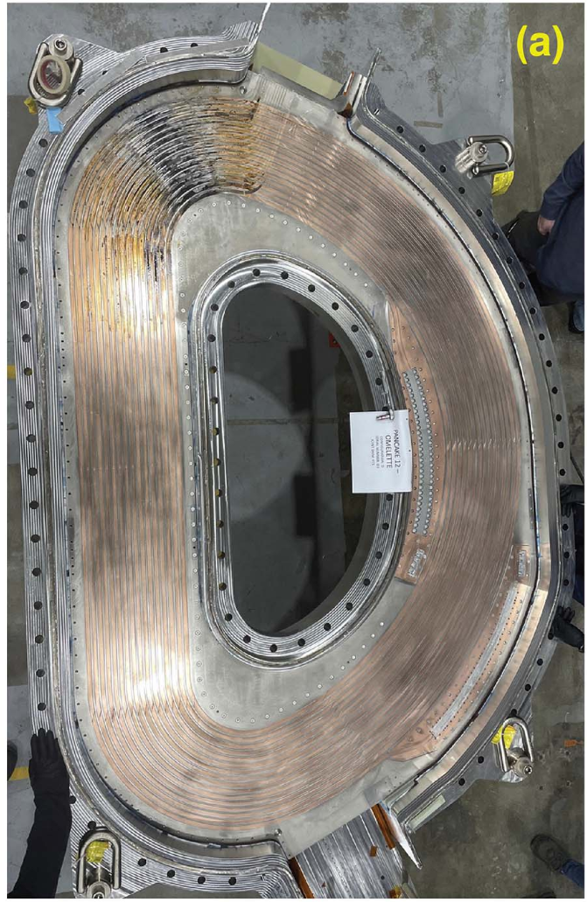
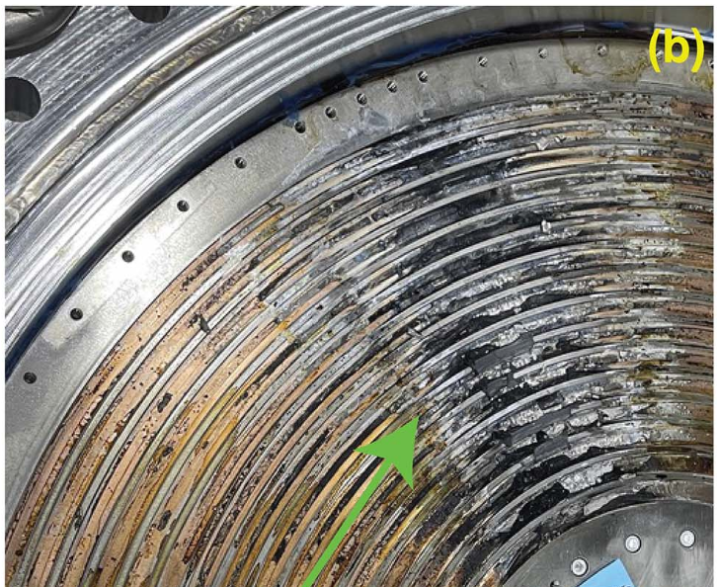
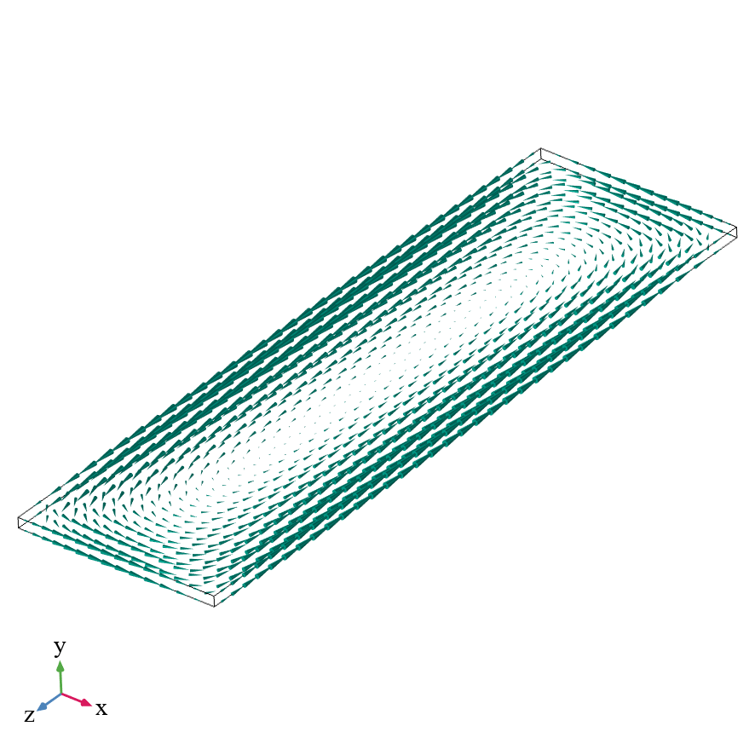

Technology challenges
Persistent Magnetization
Persistent eddy currents in superconductors, undesired contribution to principal magnetic field
Mechanical Degradation
Brittle HTS layer, local defects, bending limits, delamination, Lorentz forces (static and transient phenomena)
Quench Phenomena
Local transition to the resistive state, Joule dissipation of stored energy
Tension (ab)
Tension (c)
Compression
$$M_{pers}$$
~700 MPa
~50 MPa
>100 MPa
Shear
Cleavage
Peel
Quench in the
CFS-SPARC
TF Coil⁽¹⁾
Eddy currents
in an HTS tape
>20 MPa
~ 1 MPa
~ 1 MPa
(1) https://snf.ieeecsc.org/files/ieeecsc/
slides/LaBombard%20presentation.pdf
Hideaki M., Yoshinori Y. IEEE 2014 4602412.
Field quality degradation
Performance degradation
Possibly Irreversible degradation

Slide 7
Introduction
HTS IDs Developments
Infrastructure and Tests
Summary & Outlook

Slide 8
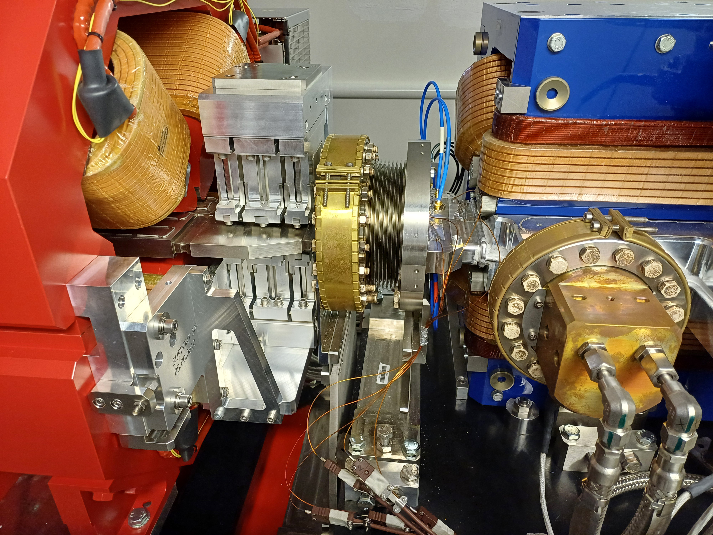

A Superconducting Wiggler for BM18
BM18 Upgrade
field-tunable wiggler
low-photon-energy applications
tight space constraints (~250 mm length)
Principal Design Choices
Approach: simple, robust, modular
Iron-dominated electromagnet
80A, 1.58T @ 65K
Magnet vacuum separated from beam
Planar, double-pancake windings
No-insulation technique
High quench margin (~ 35%)
Demountable joints
Normal-conducting current leads
$$\vec{e}$$
QF8
3PW
Flange
BPM
DQ2
Maximize learning
Validate critical interfaces
De-risk details before they become failures
Technological development platform
towards short-period, HTS undulators

Slide 9
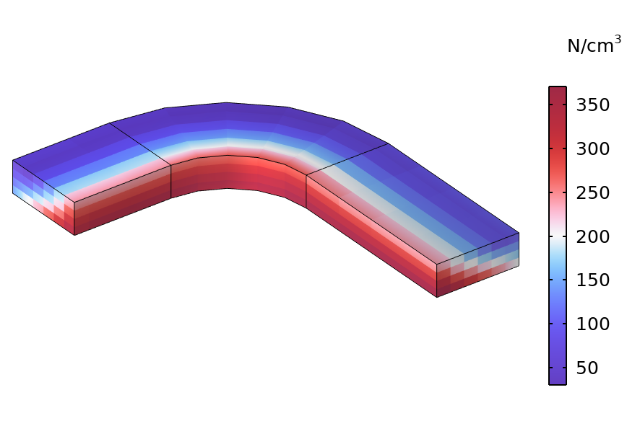
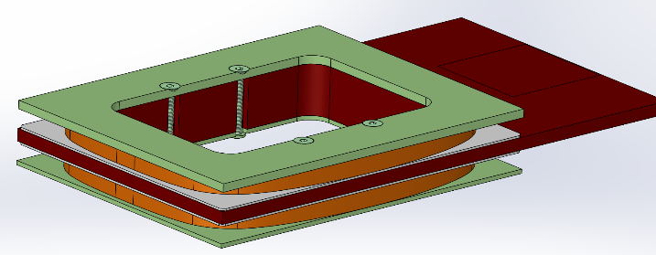
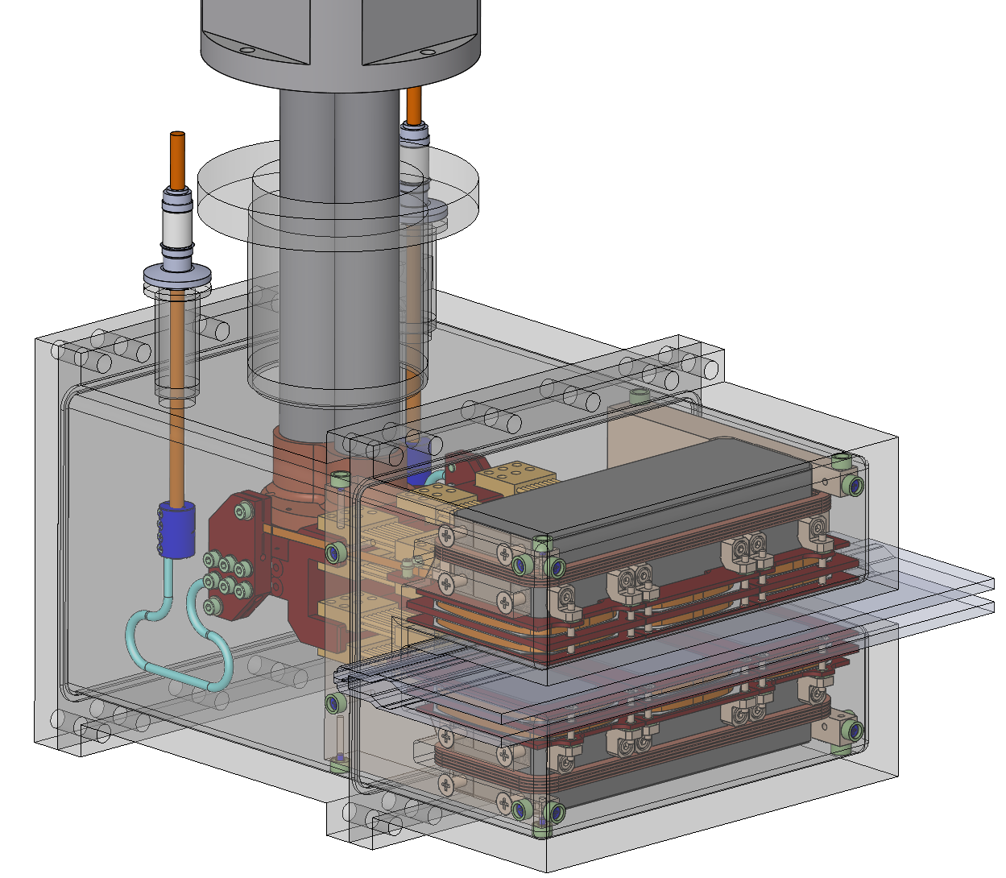

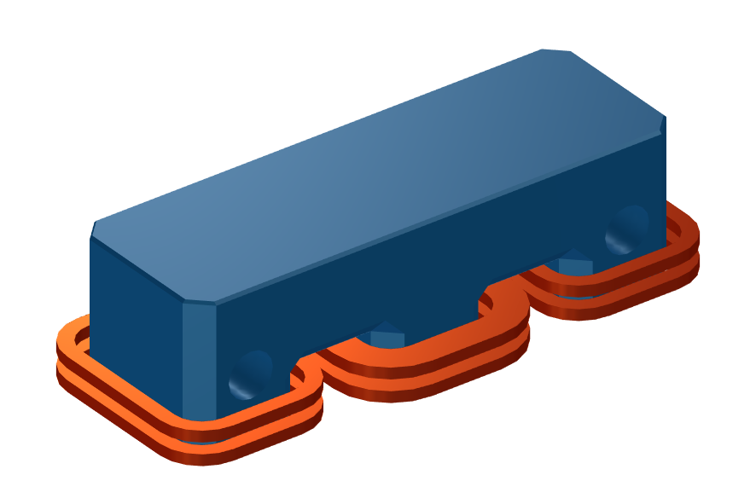
Mechanical Assembly
Wiggler Assembly
Mechanical Forces
Central pole,
beam-side winding
Relevant radial forces
127
53
76
61
62
2
2
168
102
Pulse-tube cryocooler
Electrical feed-through
Vectors in N Colormap in N/cm3
Vacuum chamber
Detail: winding mandrel
Iron
yoke
HTS
coil
Beam vacuum
chamber
beam
Upper | N | 40 | 260 | 40 | 5000
Lower | N | 450 | 1275 | 450
Current lead
Correction coil
Forces management is crucial!

Slide 10
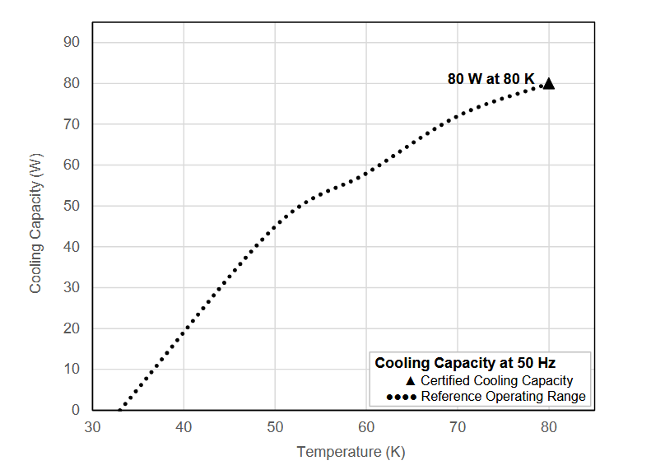
Cryo-Electrical System
Layout
Conduction-cooled system
Electrically conducting mandrel
Aluminum nitride insulating interfaces
Bridge joints (Indium pressed, demountable)
Cryogenics unit
Pulse Tube, single-stage Cryocooler:
Less vibrations and maintenance than a GM
Only vertically oriented
Operation
range
Electrical
insulation
Cryo
System
Winding
X2 safety
factor @ 60K
Copper mandrel
(winding support)
Losses
bridge
connection
Open questions
Tunnel integration (utility lines)
Radiation hardness
Interfaces
reliability!

Slide 11





Quench and Beam Dynamics
No-Insulation Coils
Low turn-to-turn resistivity
Current redistribution during a quench
“Hot-spot” zone bypassed, reducing $T_{MAX}$
Quench-Beam Interaction
Tape: quench initiation and propagation
Winding: electro-thermal dynamics
Coil: magnetic coupling
Simulations
Nonlinear numerical problem:
multi-physics, -scale $\left(μm− m \right)$, -rate ($μs−s\text{)}$
$$Φ_{mag}(t)$$
+
beam
-
$$i_{s}(t)$$
+
-
+
-
Bypass
current
Winding
current
$$T_{MAX}$$
Superconducting (left) and
quenched (right)winding
Reliable and efficient simulations, how?

Slide 12
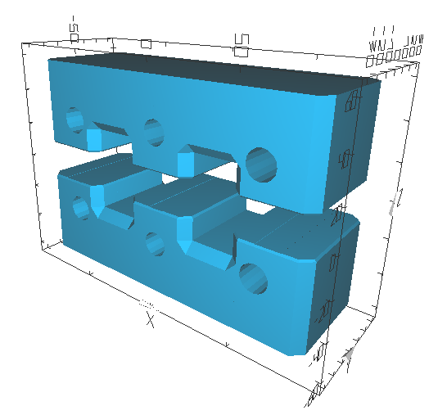
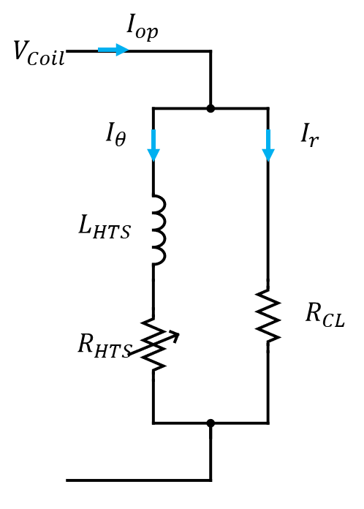
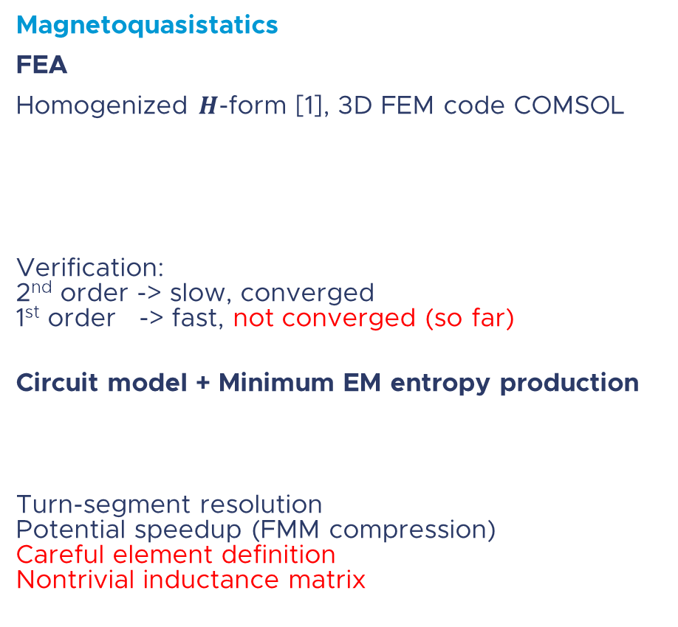


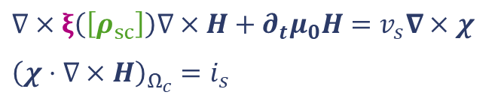
Numerical Simulations
$ξ\left(.\right)$ winding orientation
$$\left[ρ_{sc}\right]=\left[\begin{matrix}ρ_{a} & 0 & 0 \\ 0 & ρ_{b} & 0 \\ 0 & 0 & ρ_{c}\end{matrix}\right]$$
Magnetostatics
RADIA: the workhorse of the community
Exceptional for conventional ID geometries
Less flexible for non-symmetric designs
Magnetoquasistatics
FEA
Homogenized $H$-form [1], 3D FEM code COMSOL
Verification:
2nd order -> slow, converged
1st order -> fast, not converged (so far)
Circuit model + Minimum EM entropy production
Turn-segment resolution
Potential speedup (FMM compression)
Careful element definition
Nontrivial inductance matrix
$$∇×ξ\left(\left[ρ_{sc}\right]\right)∇×H+∂_{t}μ_{0}H=v_{s}∇×χ$$
$${\left(χ⋅∇×H\right)}_{Ω_{c}}=i_{s}$$
$$∂Φ\left(I, ∂_{t}I,t\right)=0 s.t. KCL$$
Z. Qiu
Example:
non-convex iron shape with round holes
[1] Mataira, R. C., et al. SuST 33.8 (2020): 08LT01.
Notes:
Energy variation in a circuit subjected to KCL, voltages are lagrange multipliers associated to CKL constraint

Slide 13
Introduction
HTS IDs Developments
Infrastructure and Tests
Summary & Outlook

Slide 14










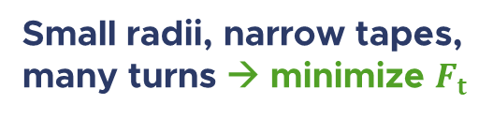


Coil Mechanical Considerations
$$F_{t}$$
Coil as stack of thin-walled cylinders
$r_{0}>10t_{t}$ ($r_{0}\sim 10 mm$, $t_{t}<0.1 mm$)
Individual turn
hoop stress
normal pressure
Coil as stack of $N_{t}$turns
Example:
Small coil for short-period undulator (in mm):
$$w_{t}=2, t_{t}=0.05, r_{0}=5, η^{(∗)}=5\%$$
$$σ_{⊥}$$
$$r_{0}$$
$$σ_{h}=\frac{F_{t}}{w_{t}t_{t}}$$
Winding
tension (N)
$$σ_{⊥}^{n}=σ_{h}\frac{t_{t}}{r_{n}}$$
$$w_{t}$$
$$t_{t}$$
Tape
cross-section
$$σ_{⊥}=σ_{h} \frac{1}{η} \left(\sum_{n=1}^{N_{t}}{\frac{1}{n} \frac{1}{\frac{r_{0}}{nt_{t}}+1}}\right)$$
$η<1$ tape surface
in mechanical contact
$σ_{h}∝$winding tension
$f\left(n\right):$ geometry
Small radii, narrow tapes,
many turns → minimize $F_{t}$
$$f\left(n\right)$$
(*) estimated via SEM analysis and study of “fingerprints”
Usoskin, A., et al. IEEE Transactions on Applied Superconductivity 27.4 (2016): 1-5.

Slide 15
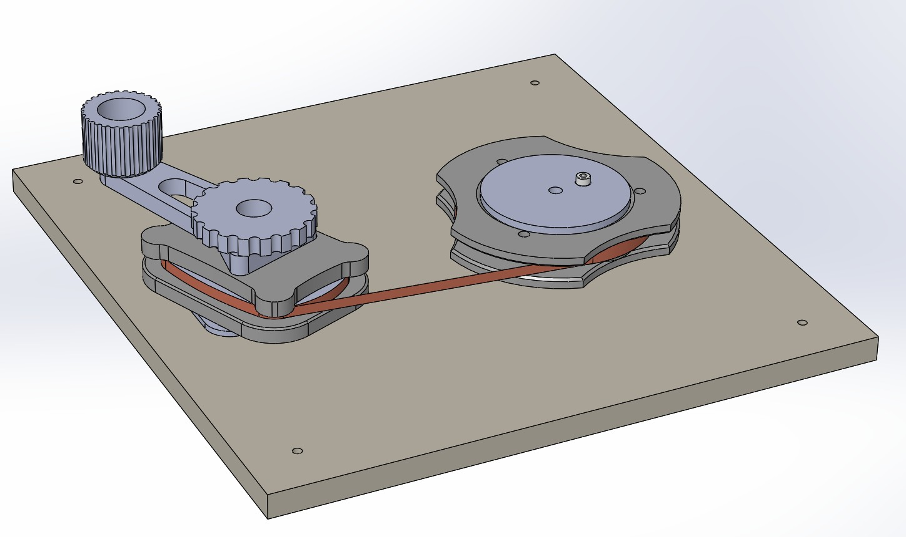
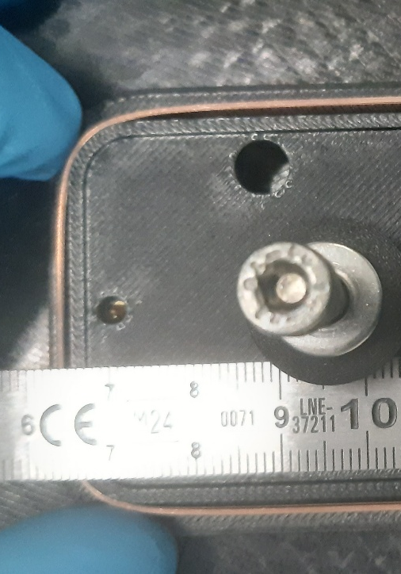
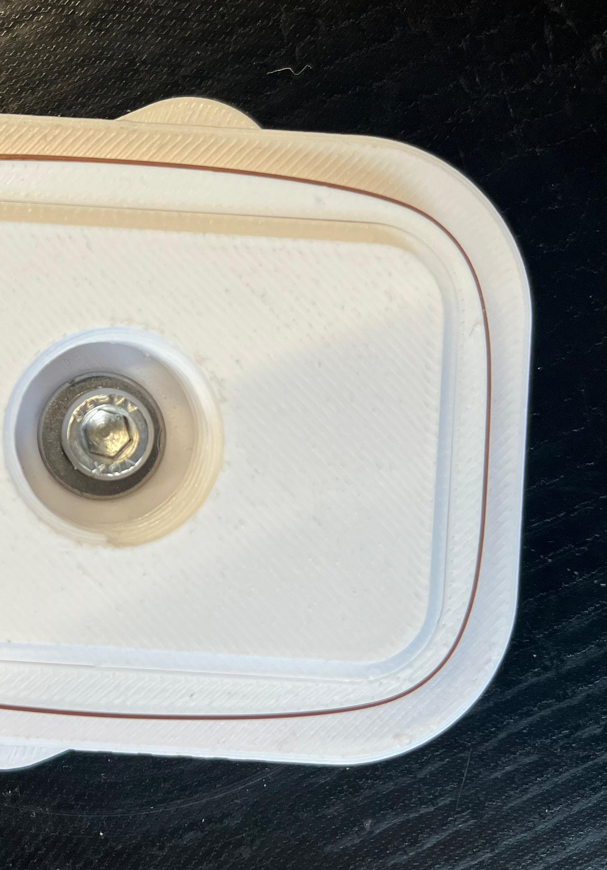
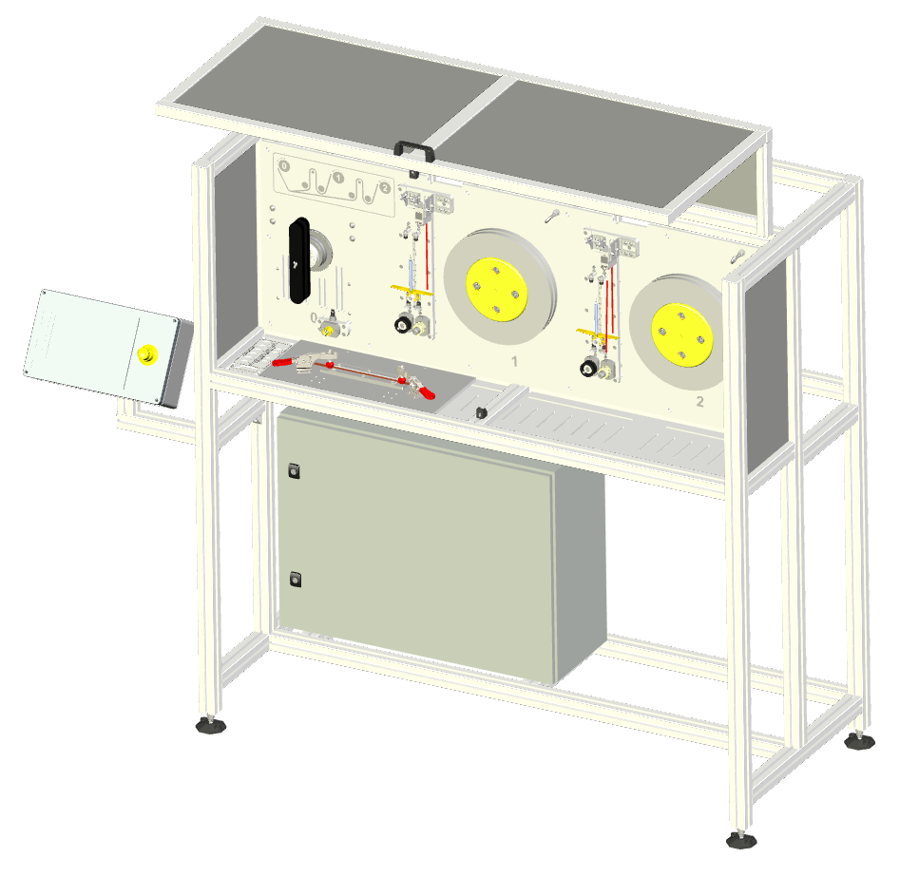
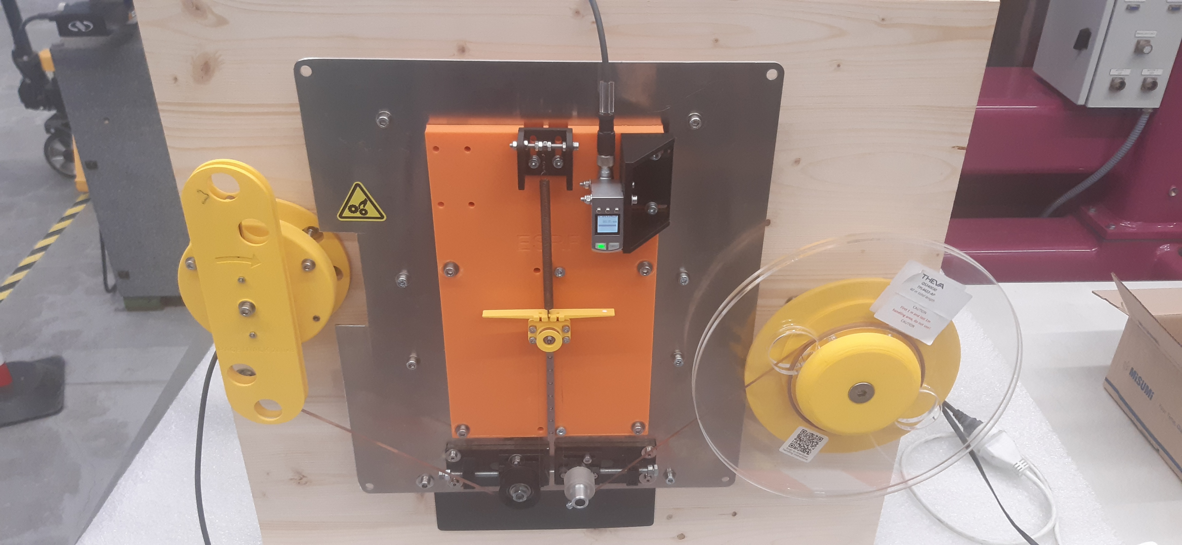
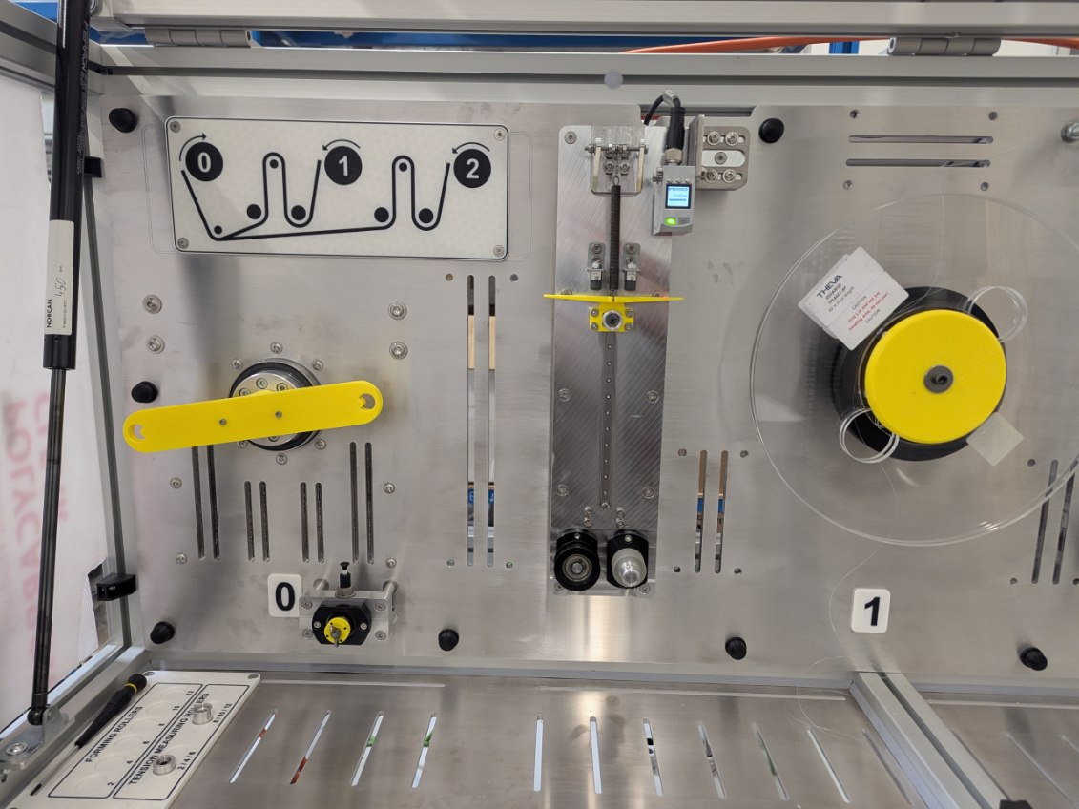


Winding Machine Procurement
Winding tests
HTS tape behavior at small radii ( 5-10 mm)
In-house built winding machine
Experimental shape optimization
Excellent contact at tape-to-mandrel interface
Reduced stress concentration in transitions
Design and Fabrication
2-12 mm tapes
6$×$10 to 250$×$250 mm coil dimensions
1-10 N tension range with $±5\%$ control
tape position accuracy $±0.1$mm
dual, independent payload for co-winding
Low tape tension, tight control
winding machine
Prototype
Winding machine
Notes:
CE compliant
Logo Automachine

Slide 16
Prototype testing – 77K Liquid Nitrogen
Testing Philosophy
Learn robust current-controlled operation
Validate design principles for undulators
De-risk technology
Phase 1: 77 K Tests
Magnetic field mapping
Current-controlled scans → dynamic losses
Inter-turn resistance → current redistribution
Quench behavior → NI self-protection
Mechanical response
  Over-current regime
  Thermal cycles
  Quench transient
Quench
protection
Power supply
Quench
detection
Voltage
monitoring
Temperature
monitoring
Heater
Hall Probe
bench
HTS coil
LN2
@ 77K
CTRL
& DAQ
Conduction-cooled
test bench for HTS coils
PC

Slide 17
Prototype testing – 60 K Cryocooler
Phase 2: 60 K Tests (Full Operation)
Full thermal characterization
  Mechanical assembly
  Cryocooler
  Current leads
  Joints
Magnetic field integral measurements
35% quench margin verification
Thermal cycling (10+ cycles)
  Windings assembly
  Demountable joints reliability
Mechanical response
  Lorentz forces
Quench
protection
Power supply
Quench
detection
HTS
wiggler
Voltage
monitoring
Temperature
monitoring
Undulator
bench
Pulse-tube
Cryocooler
CTRL
& DAQ
Conduction-cooled
test bench for HTS coils
Vacuum pump
PC
Notes:
Undulator bench ( HALL probe + stretch wire)

Slide 18
Introduction
HTS IDs Developments
Infrastructure and Tests
Summary & Outlook

Slide 19
Summary and Outlook
Summary
HTS materials as key-enabling technology for high-field, short period undulators
Reliability and maintainability crucial aspects for adoption of HTS technology in light sources
HTS wiggler for BM18 upgrade as technological development platform
R&D program focused on bridging the gap between design and real operational reliability
Outlook
2025
2026
 | Q3 | Q4 | Q1 | Q2 | Q3 | Q4
Coil design
REBCO tapes
Winding of prototype coil
Initial cold tests (LN2, 77 K)
Winding machine
Winding of magnet coil
Integration, tests (65 K)

Slide 20



MANY THANKS TO
ESRF-IDM :
C. Benabderrahmane, O. Benezech,
F. Bidault, J. Caverot, B. Cottin, G. Giroud, M. Michel, L. Samaille,
R. Versteegen
ESRF-ISDD:
L. Eybert, F. Villard, B. Pelissier
ESRF-EXP-BM18:
P. Tafforeau
THANKS FOR YOUR ATTENTION

Slide 21
Backup slides

Slide 22
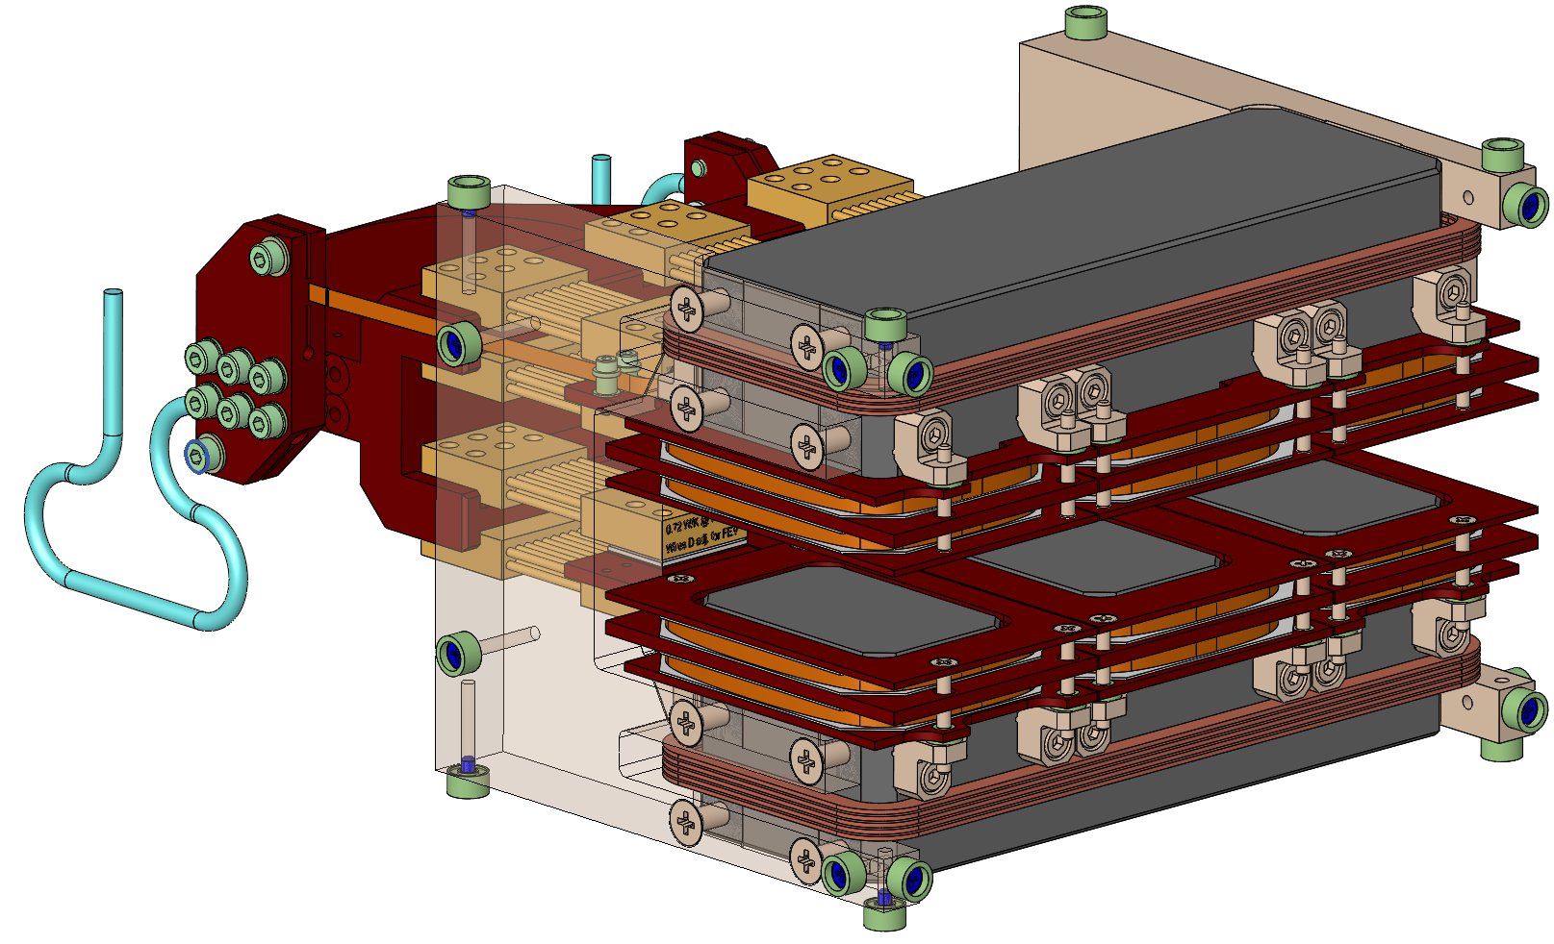
Magnet Assembly

Slide 23
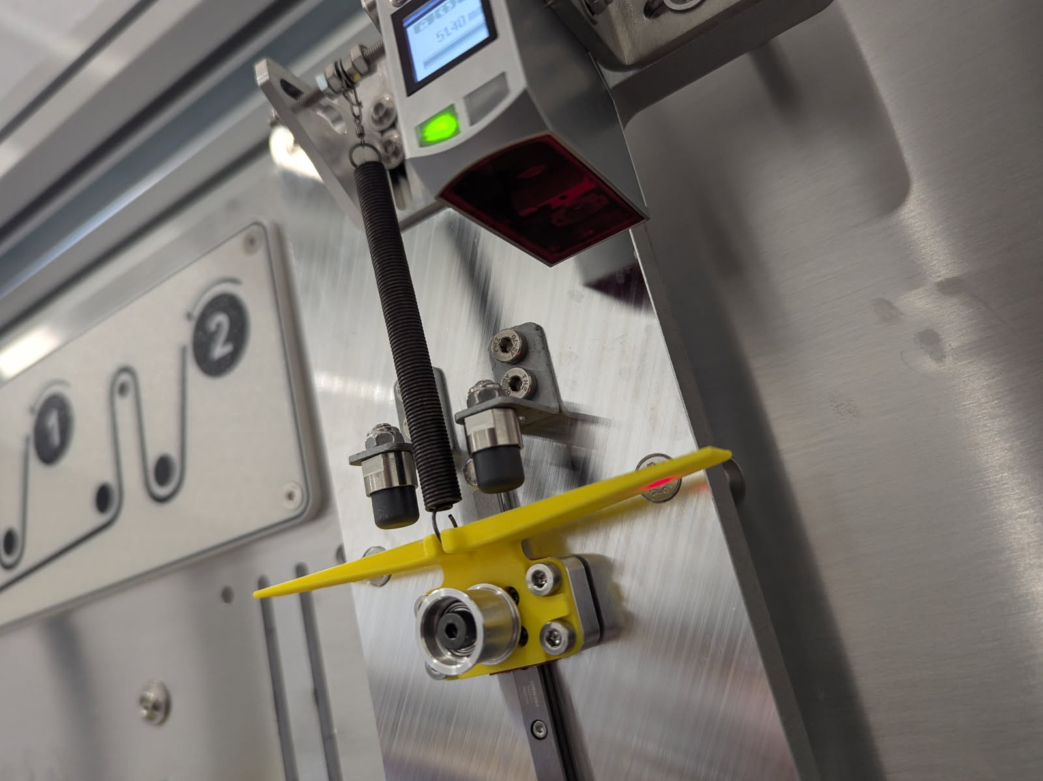

Winding Machine Layout
Specifications
2-12 mm tapes
6$×$10 to 250$×$250 mm coil dimensions
1-15 N tension range with $±5\%$ control
tape position accuracy $±0.1$mm
dual, independent payload for co-winding
Low tension and tight control
Design and Fabrication (CE compliant)
Vertical alignment
Soldering station
Brushless motors
HMI
  Recipe system
  Data logging
  USB interface
ReBCO tape
spool
Metal tape spool
Winding former
Prototype test, 26-02
Winding unit, 26-05

Slide 24
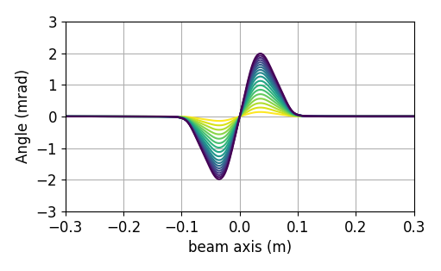
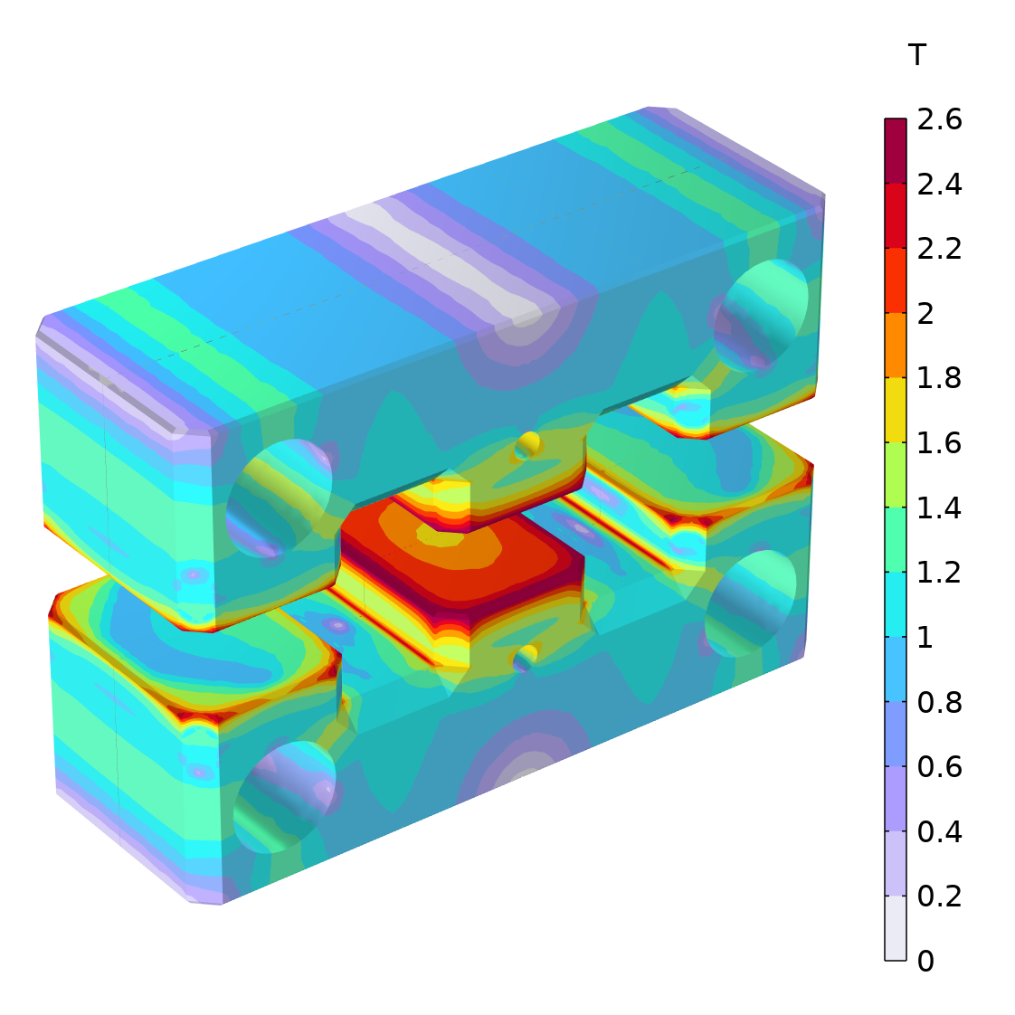
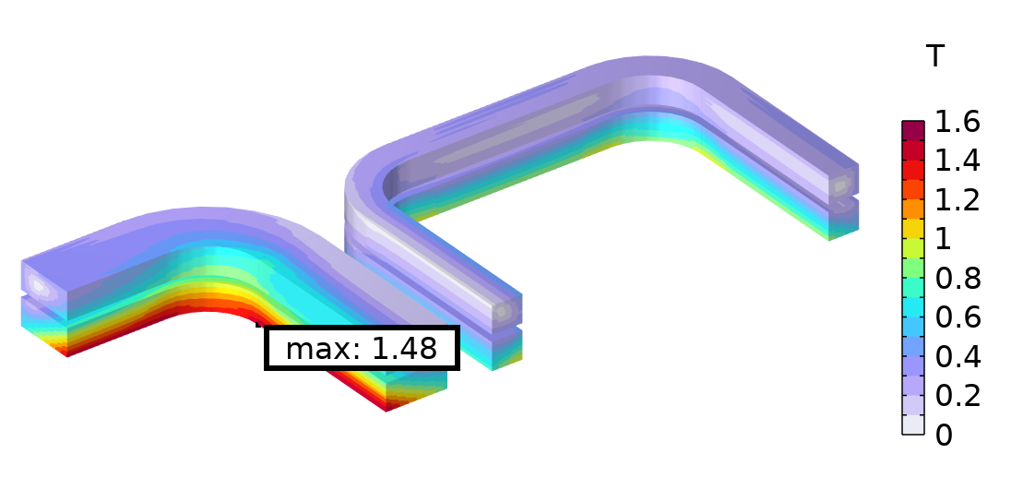
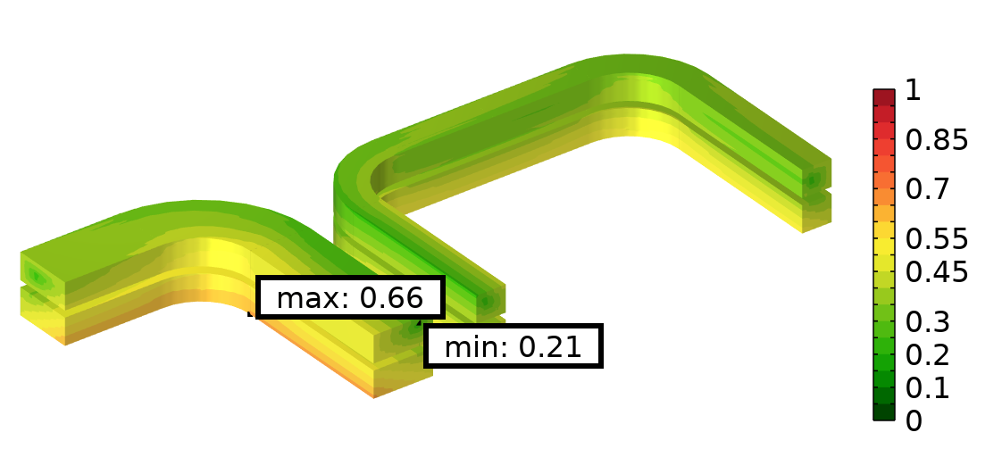
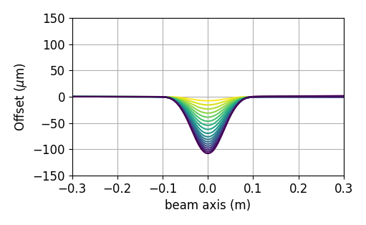
Magnetic design
Beam angle, in mrad
Magnetic flux density
in the iron yoke. Holes for
field quality optimization.
Magnetic flux density (top)
and coil load line (bottom)
Beam offset, in $μ$m
~ 65% of load line for operations at 65K
First and second field integrals corrected

Slide 25



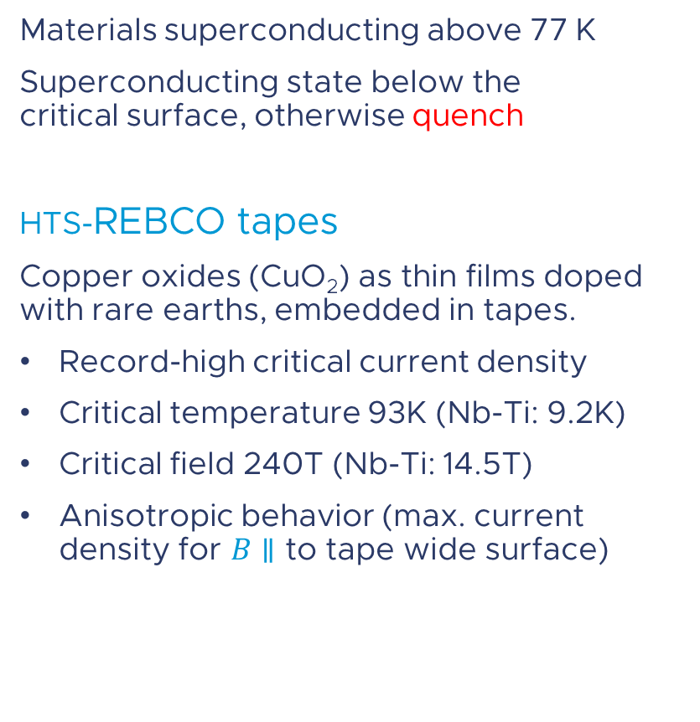






HIGH-temperature superconducting TAPES
Materials superconducting above 77 K
Superconducting state below the
critical surface, otherwise quench
HTS-REBCO tapes
Copper oxides (CuO₂) as thin films doped
with rare earths, embedded in tapes.
Record-high critical current density
Critical temperature 93K (Nb-Ti: 9.2K)
Critical field 240T (Nb-Ti: 14.5T)
Anisotropic behavior (max. current
density for $B∥$ to tape wide surface)
(Amm²)
$$1x{10}^{5}$$
$Nb$-$Ti$
$${Nb}_{3}Sn$$
$$ReBCO$$
$$1x{10}^{3}$$
$$50$$
$$100$$
$$200$$
$$100$$
(K)
(T)
Critical surface (temperature, magnetic field, current density) for various superconductors.
HTS performance > x10 than LTS !

Slide 26
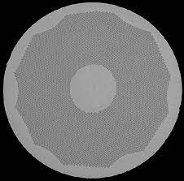
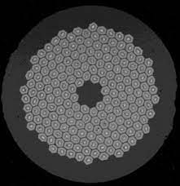
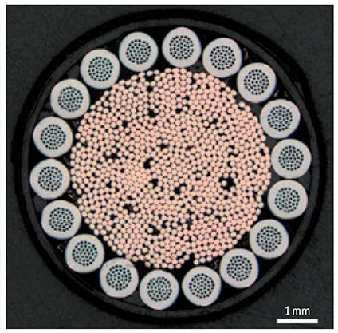
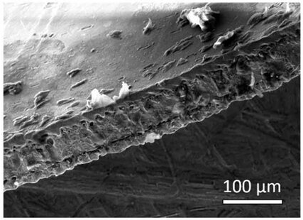




Commercially available superconductors
Considerations (some)
Physics:
Temperature, magnetic field, current density, mechanical forces, radiation hardness…
Coil design:
Shape, number of turns, layers and windings,
joints, terminals …
Complexity:
Power supply, vacuum system, cryogenic system, diagnostics …
Technology:
Quality, characterization, data availability, reproducibility, quantity at industrial scale, supply chain resilience, price …
LTS
HTS
Liquid Helium
Nb-Ti
wire
Nb3Sn
wire
MgB2
wire
REBCO
tape
Liquid Nitrogen
YBCO
bulk
BSCCO 2212 wire
BSCCO
2223 tape
0
10
20
30
T
Low field
High field
Ultra High field

Slide 27



technological Limits of REBCO TAPES (1/3)
Quench
Local transition from superconducting to normal conducting state
Stored magnetic energy → heat in the superconductor
Possible degradation due to local stress and thermal runaway
REBCO tapes:
High energy density
Slow quench propagation (high $T_{c}$)
→ difficult quench detection → Potential damage
LHC accident (2008)
tape
Quench in the
CFS-SPARC
TF Coil
LaBombard IEEE-ASC 2024. https://snf.ieeecsc.org/files/ieeecsc/slides/LaBombard%20presentation.pdf
Hot spot
Time
Mitigate consequences of quench !

Slide 28







magnetic field quality
Iron yoke shape optimized for minimizing field integrals
Optimization loop :
Model parameters
Model assembly
Stochastic optimization
Coil load-line
verification
INIT
END
RADIA code ⁽¹⁾
CPython C API ⁽²⁾
…
Multiprocessing on ESRF HPC cluster
Critical current measurement ⁽³⁾
https://github.com/ochubar/Radia
https://gitlab.esrf.fr/radia-esrf/radia-python
https://htsdb.wimbush.eu/dataset/25893079

