Slide 1
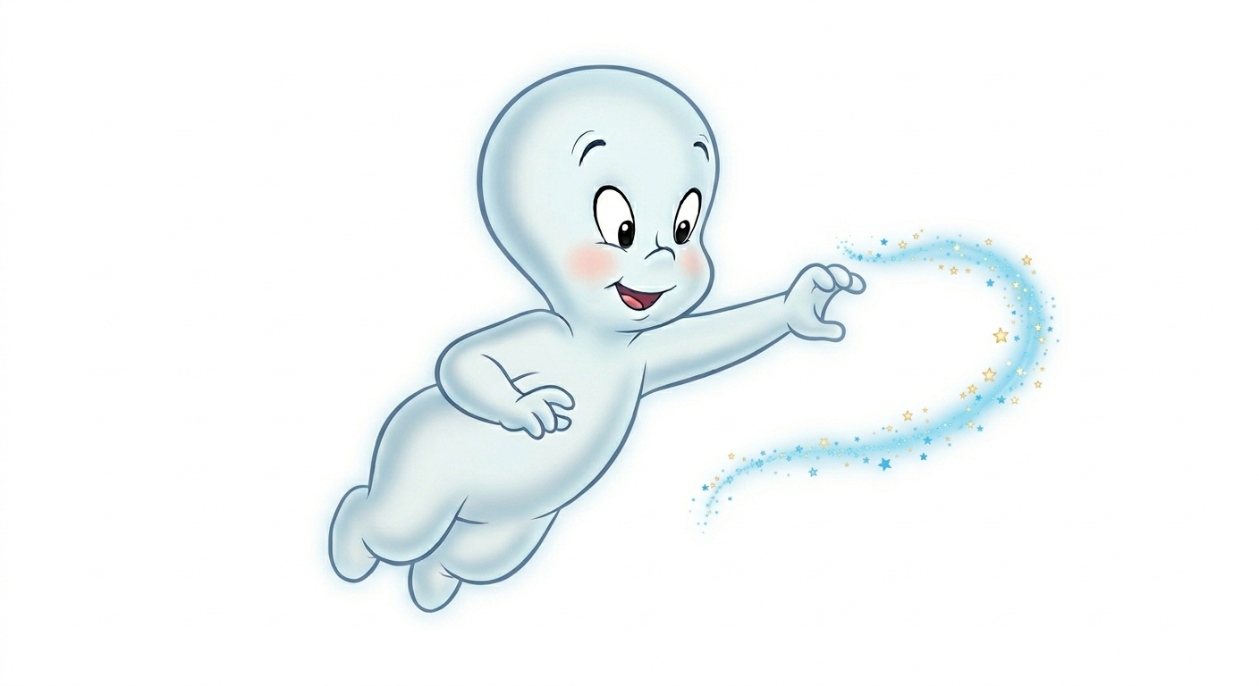
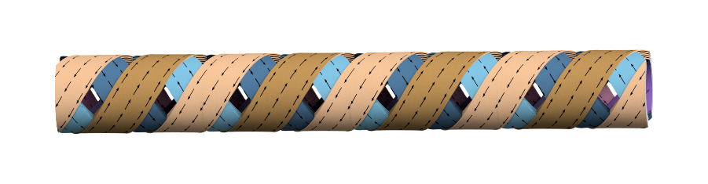
CASPER
Compact Arbitrary Superconducting Polarization Emitting Radiator
Alexandre Arsenault and Marco Calvi
ID workshop, May 15, 2026
Notes:
Mention that CASPER is also a measurement facility

Slide 2
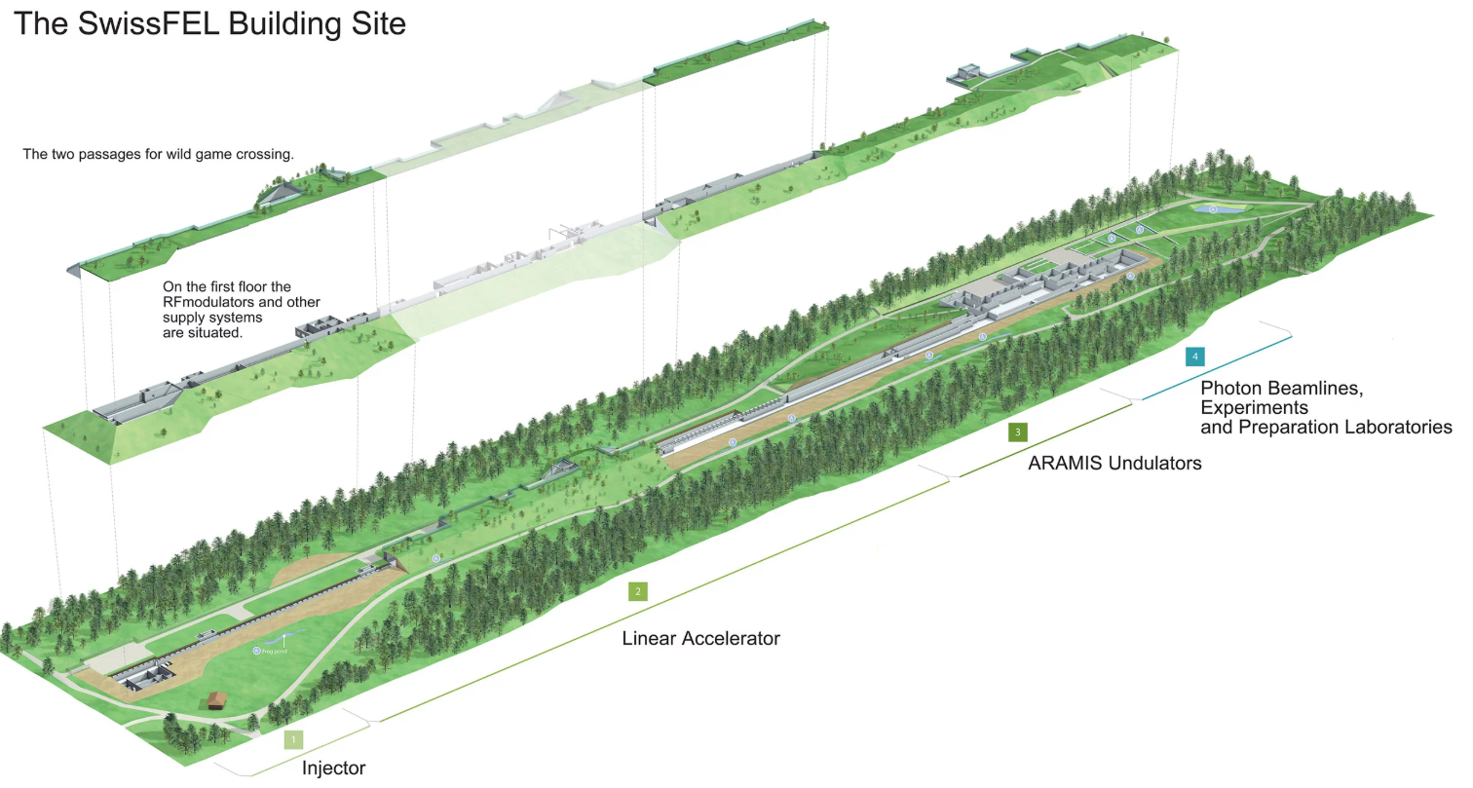
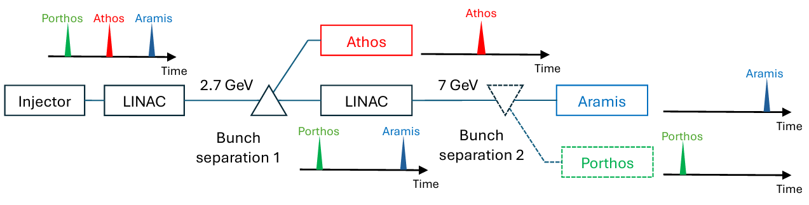
Compact Arbitrary Superconducting Polarization Emitting Radiator
SwissFELplus upgrade requiring high field and variable polarization:
  Aramis afterburn
  New Porthos beamline

Slide 3
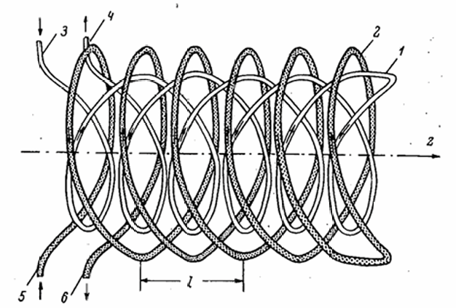
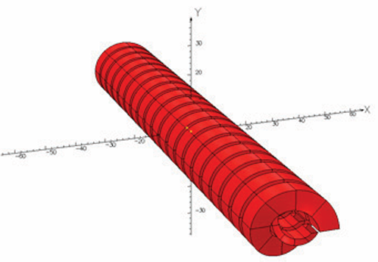
Compact Arbitrary Superconducting Polarization Emitting Radiator
Universal superconducting undulator
Concentric helical undulators
Inner helix -> Right-handed
Outer helix -> Left-handed
Y. Ivanyushenkov, Proceedings of the 5th Int. Particle Accelerator Conf., vol. IPAC2014, p. 3 pages, 2014

Slide 4
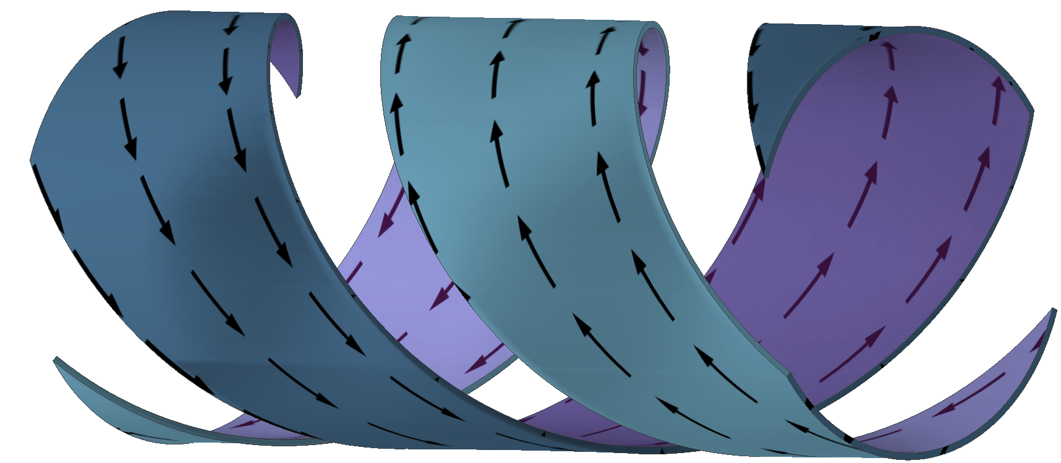
Compact Arbitrary Superconducting Polarization Emitting Radiator
CASPER undulator: Intertwined helices
Layer 1

Slide 5
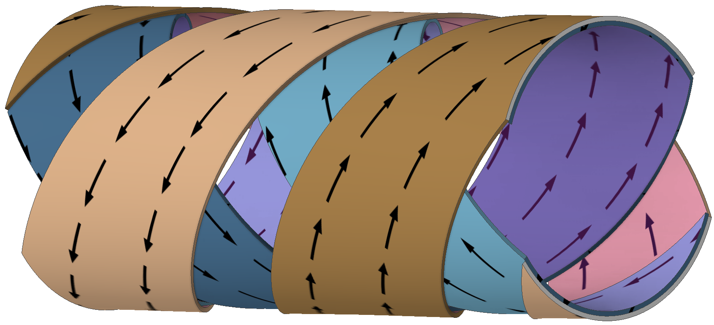
Compact Arbitrary Superconducting Polarization Emitting Radiator
CASPER undulator: Intertwined helices
Layer 2

Slide 6
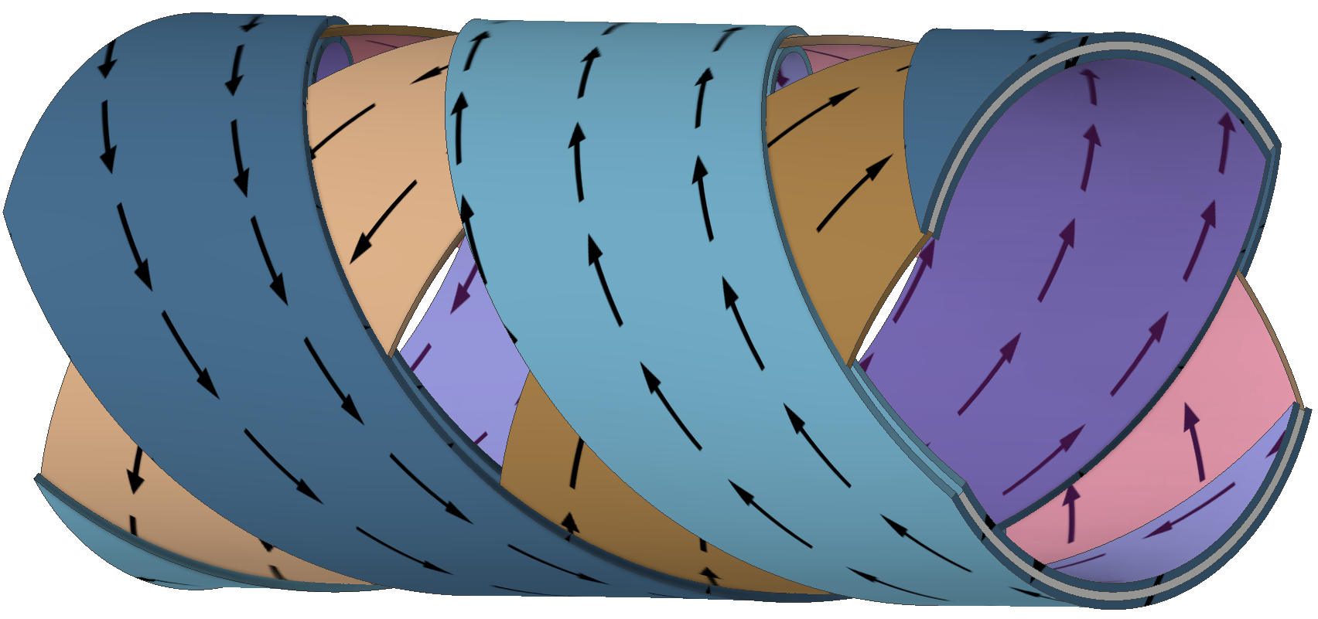
Compact Arbitrary Superconducting Polarization Emitting Radiator
CASPER undulator: Intertwined helices
Layer 3

Slide 7
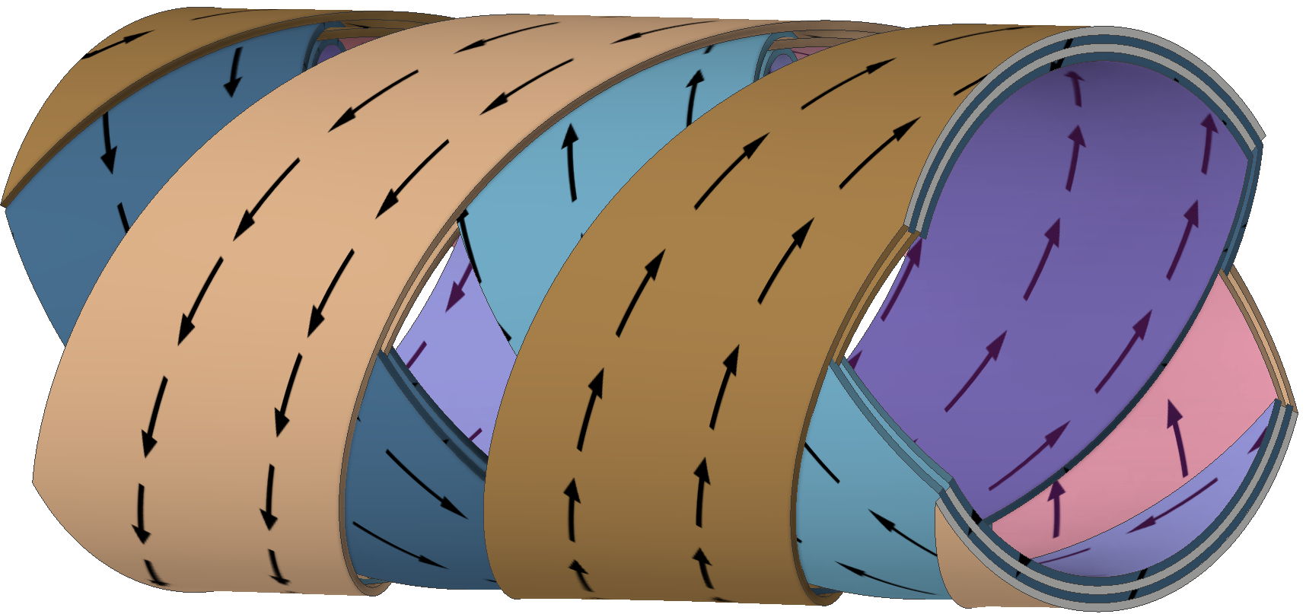
Compact Arbitrary Superconducting Polarization Emitting Radiator
CASPER undulator: Intertwined helices
Layer 4

Slide 8
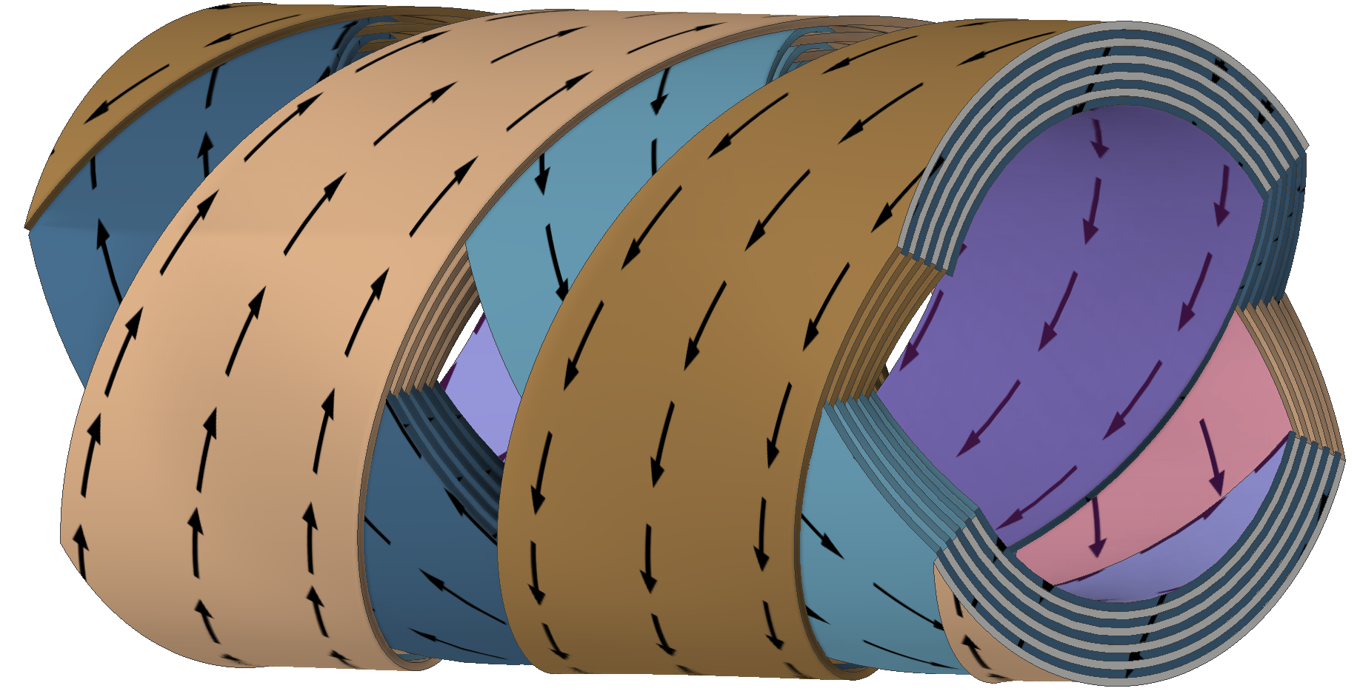
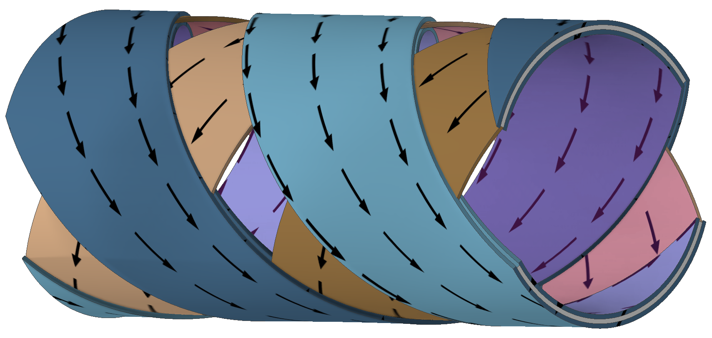
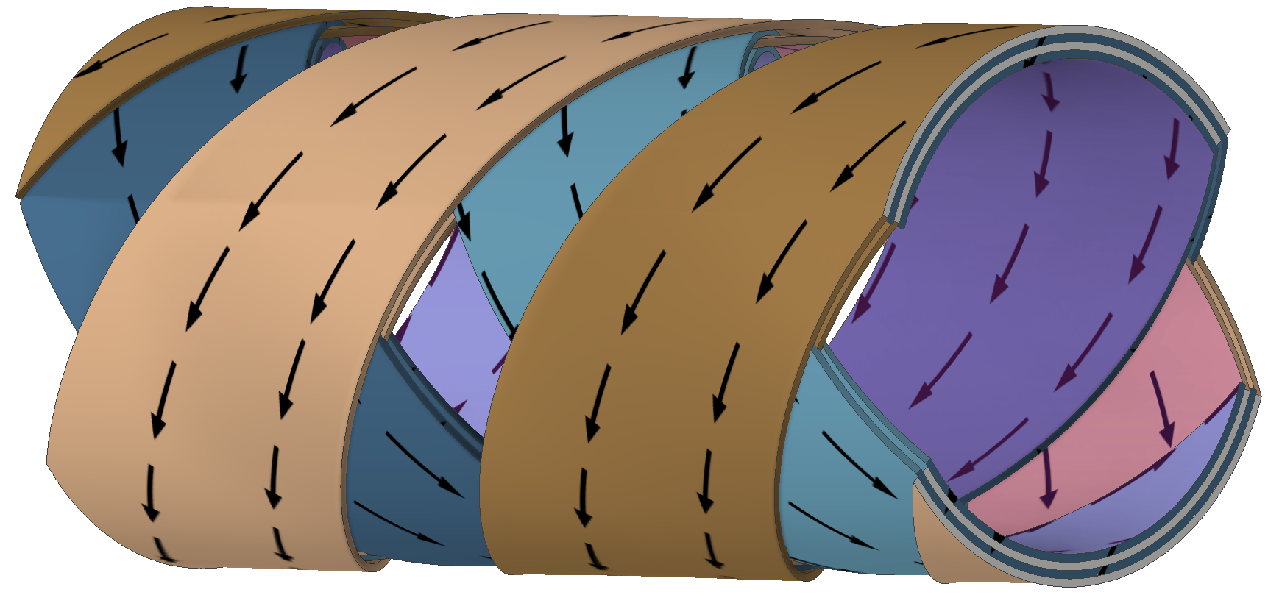
Compact Arbitrary Superconducting Polarization Emitting Radiator
CASPER undulator: Intertwined helices
Layer 10

Slide 9
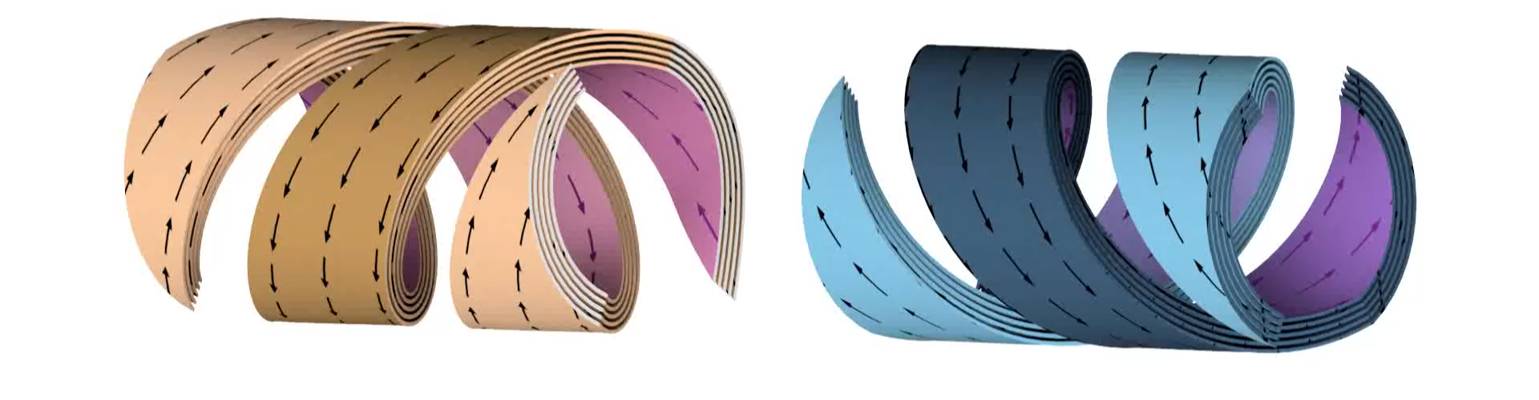
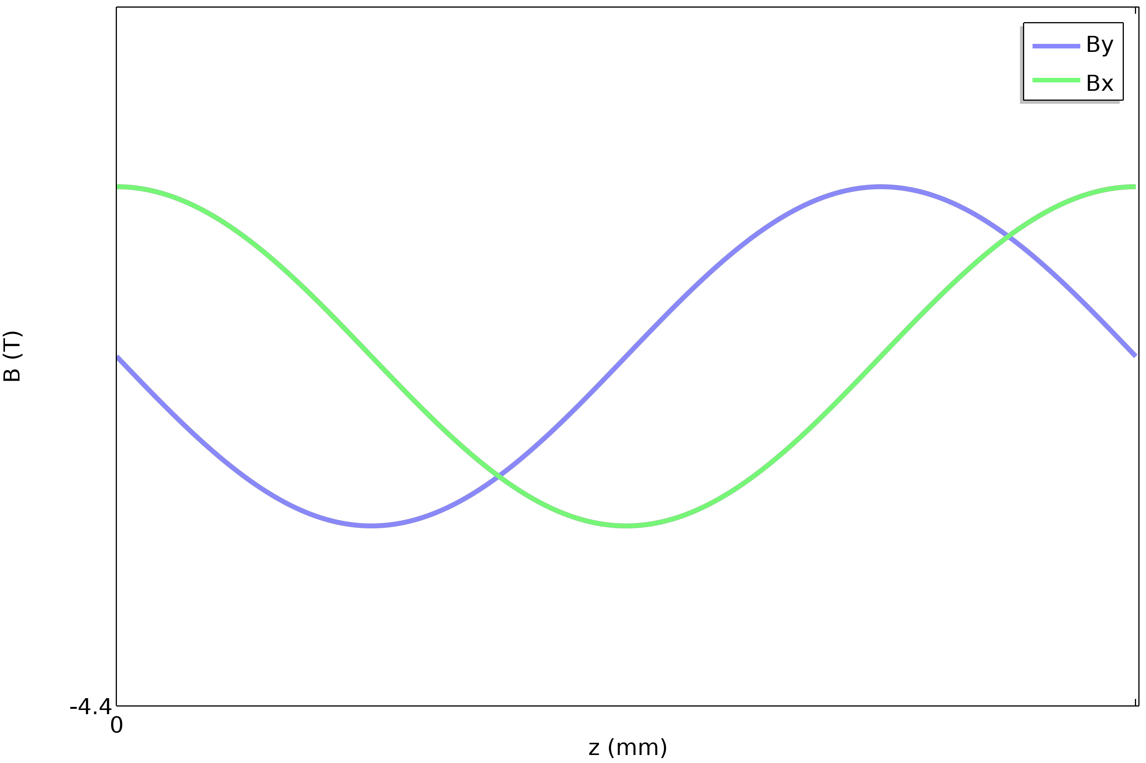
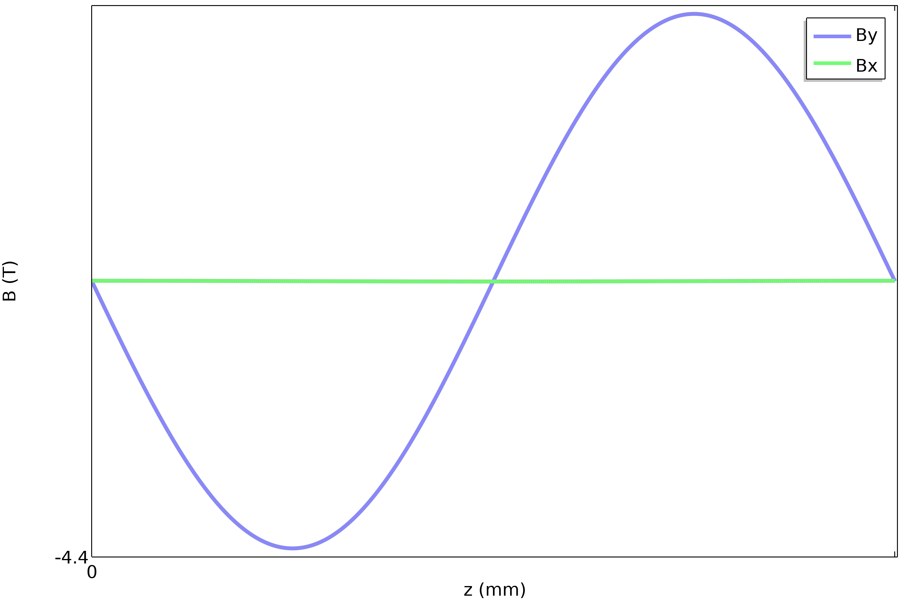
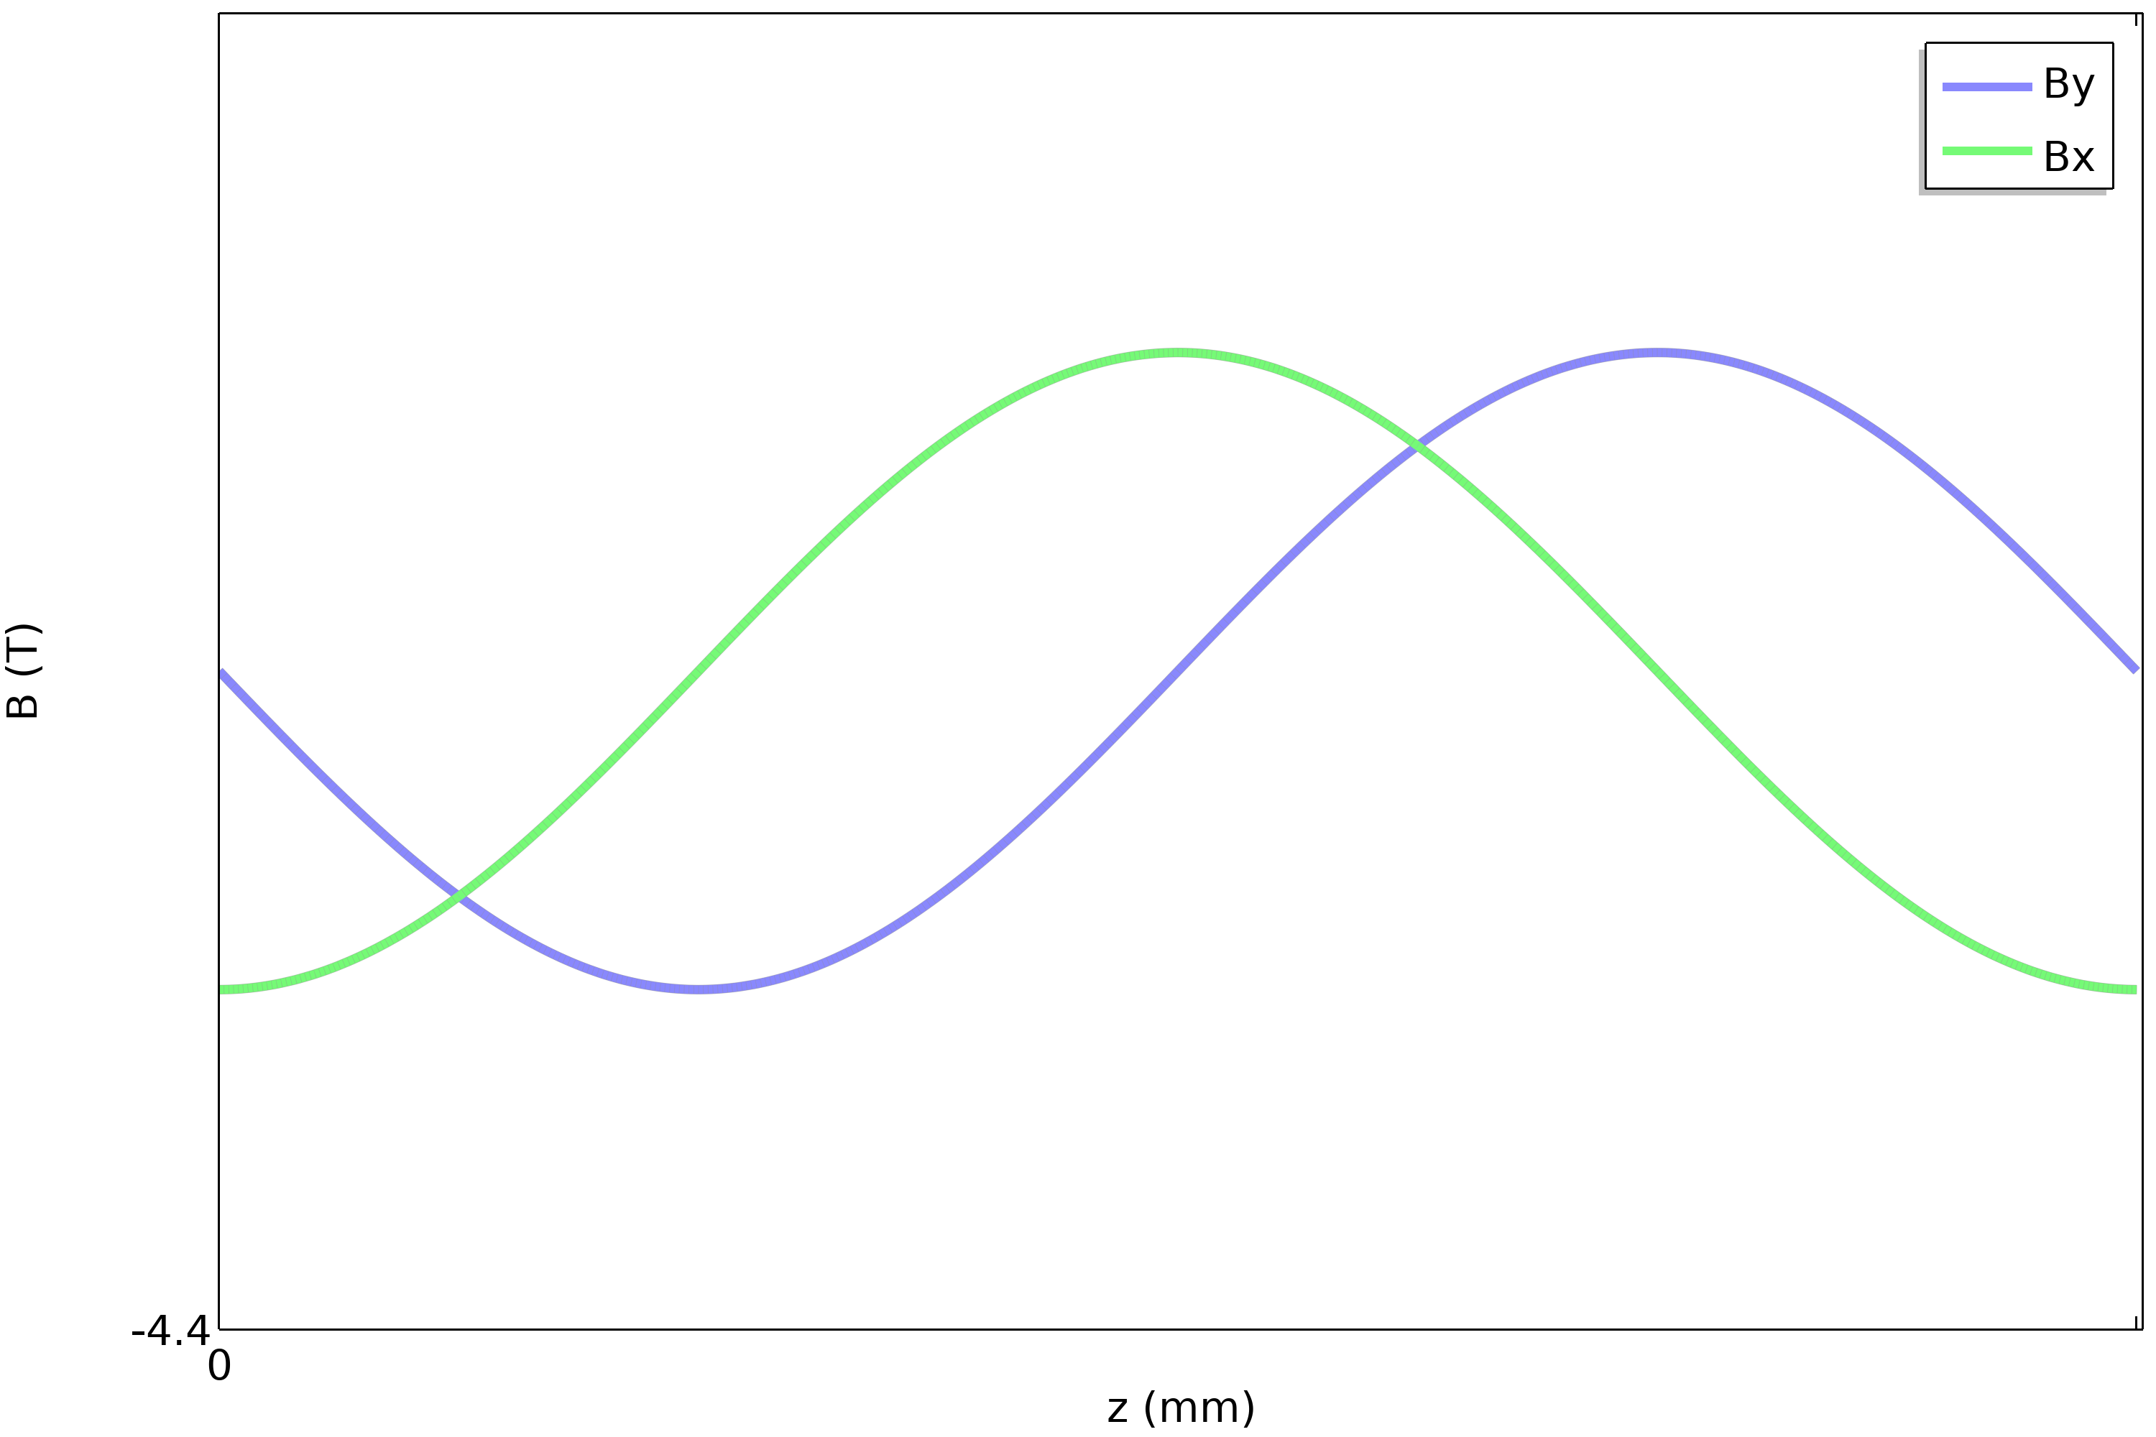
Compact Arbitrary Superconducting Polarization Emitting Radiator

Slide 10
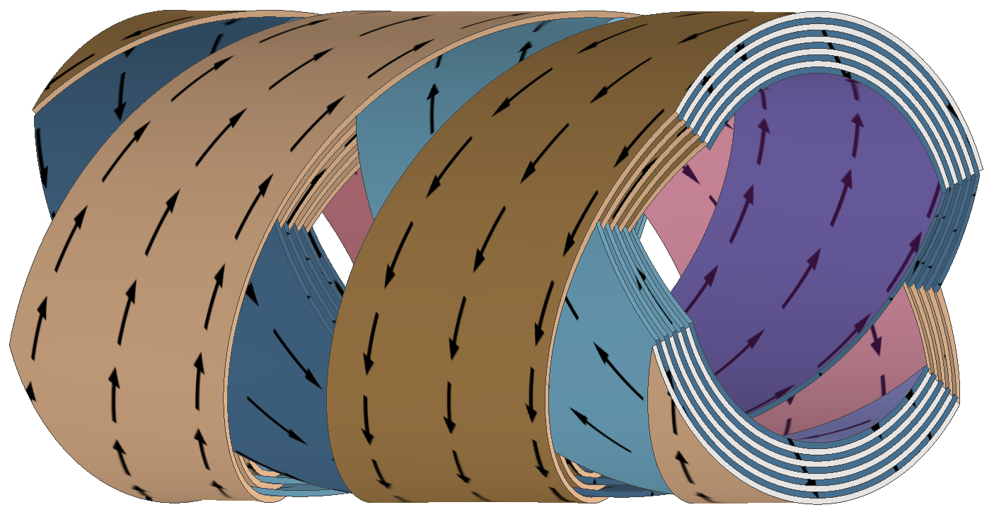
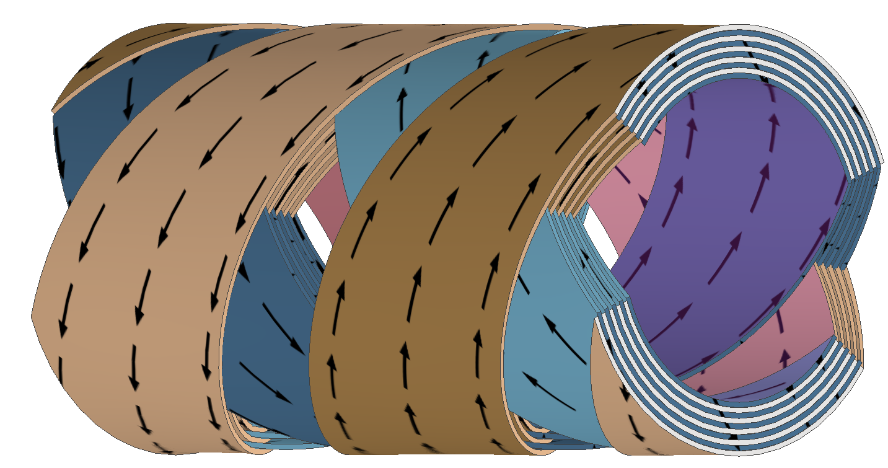
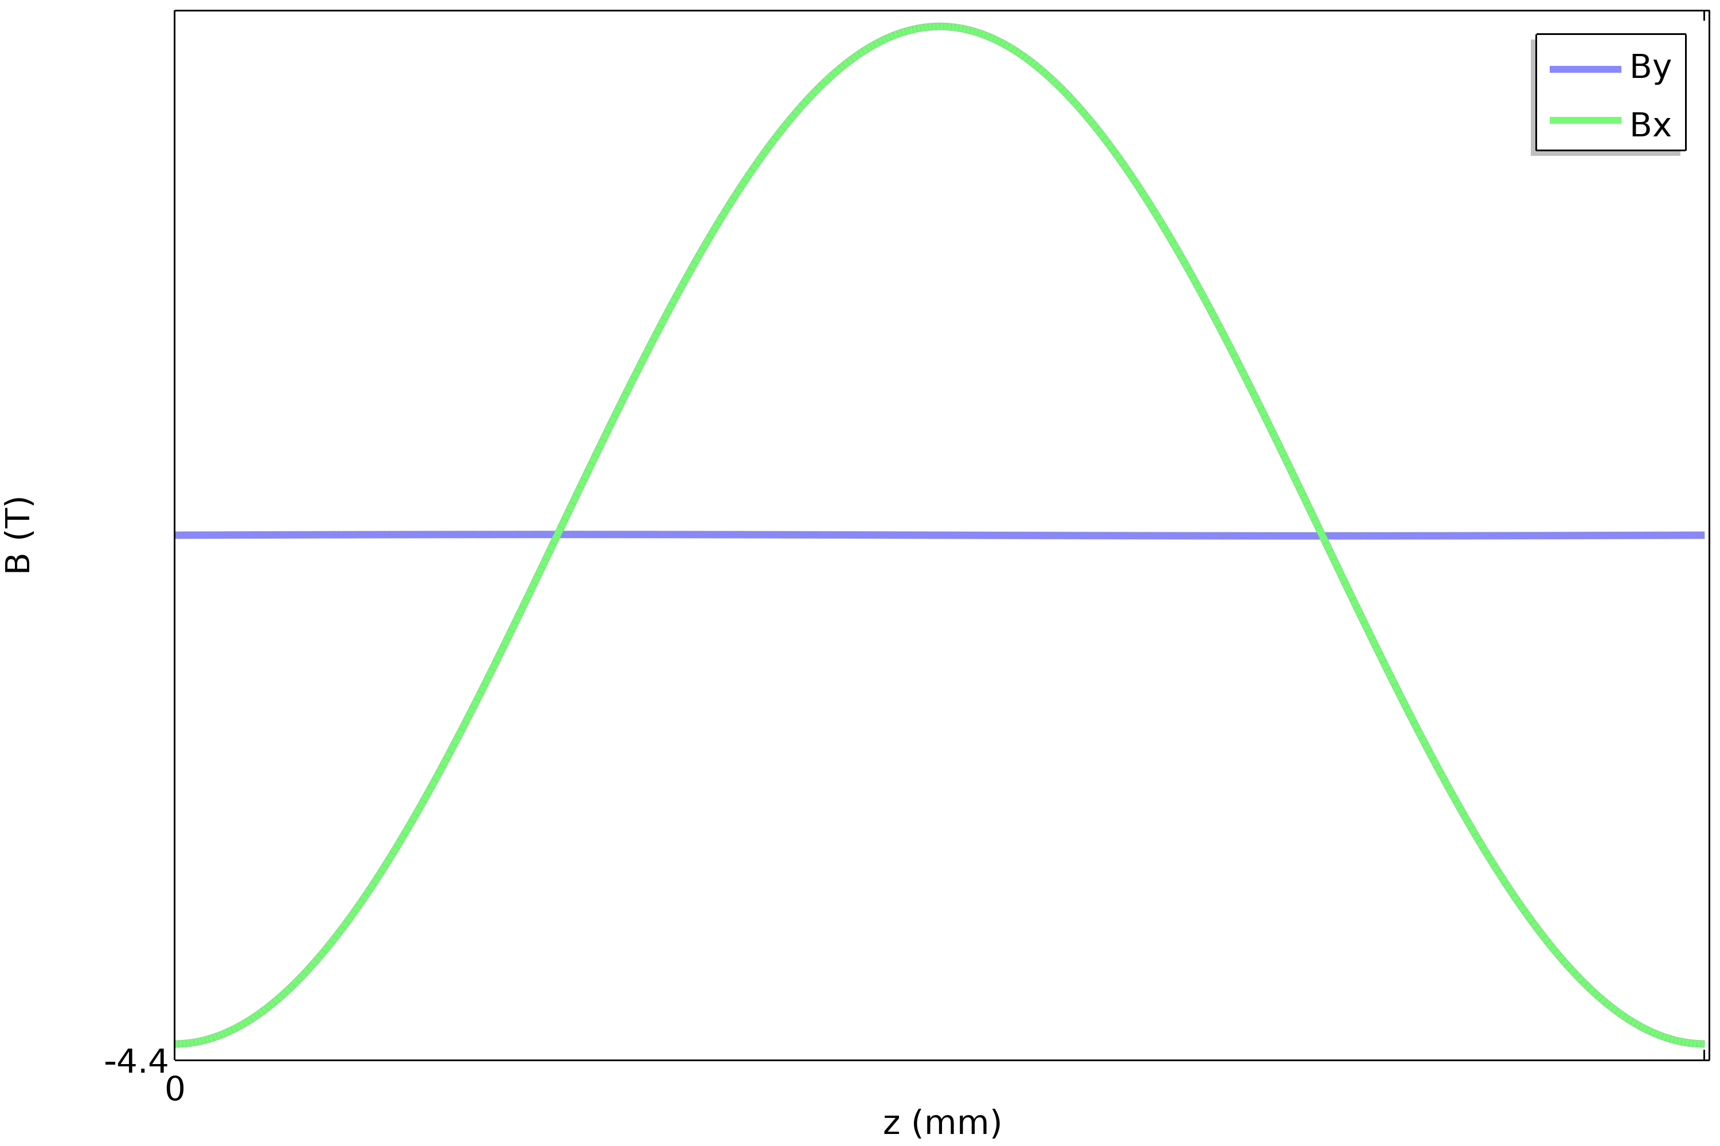
Compact Arbitrary Superconducting Polarization Emitting Radiator
Changing current direction

Slide 11
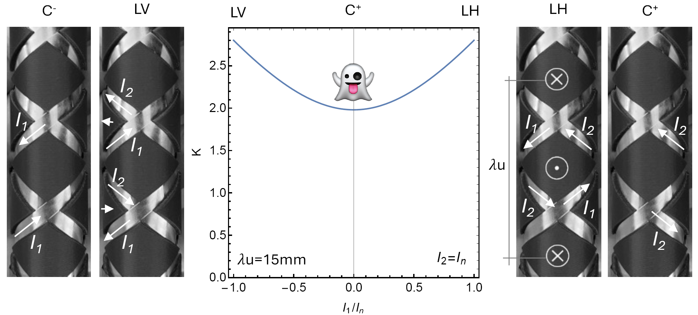

Compact Arbitrary Superconducting Polarization Emitting Radiator
With a circular field amplitude of 1T, the K value remains above 2.0 for a period length of 15mm
$$K^{2}=K_{x}^{2}+K_{y}^{2}$$

Slide 12
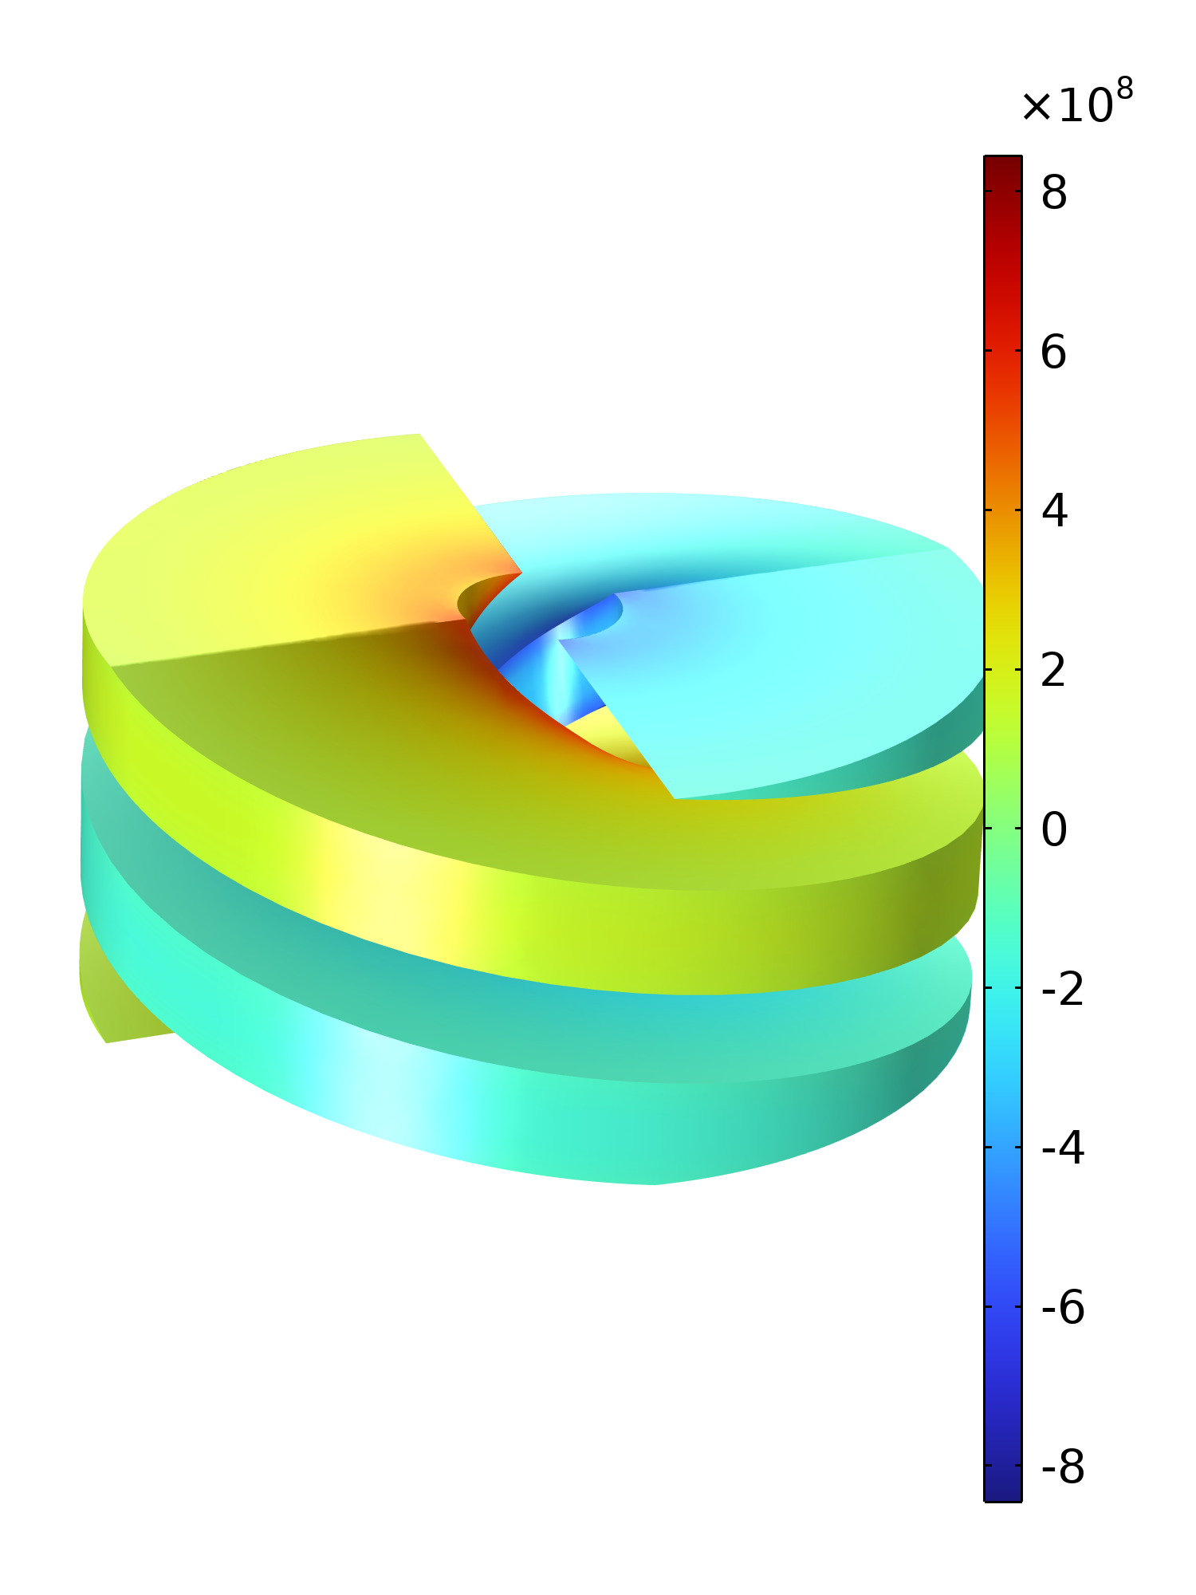
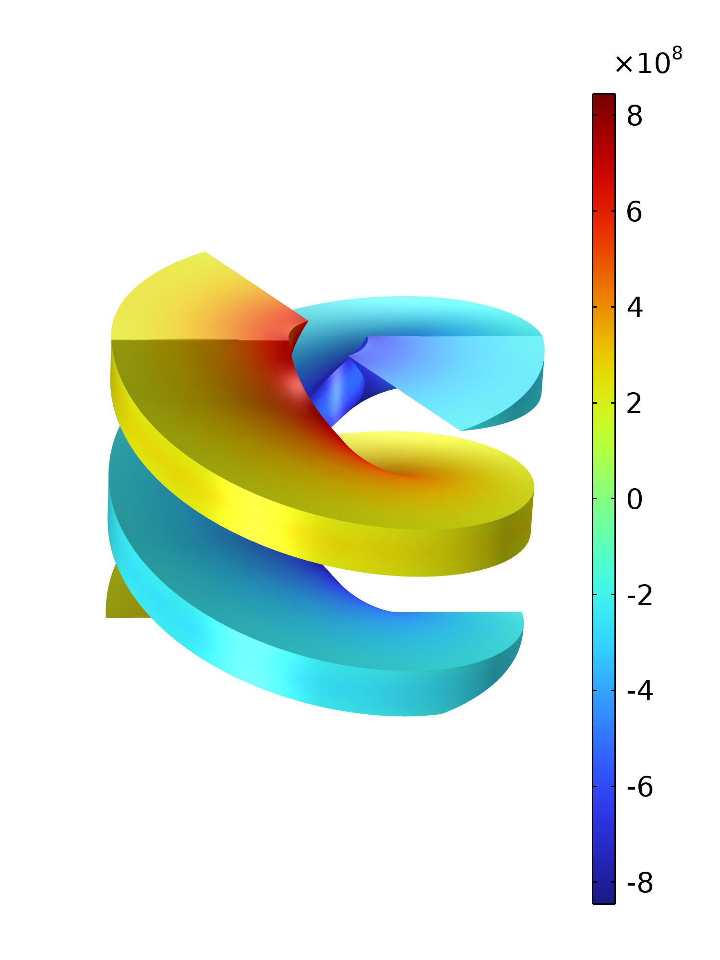
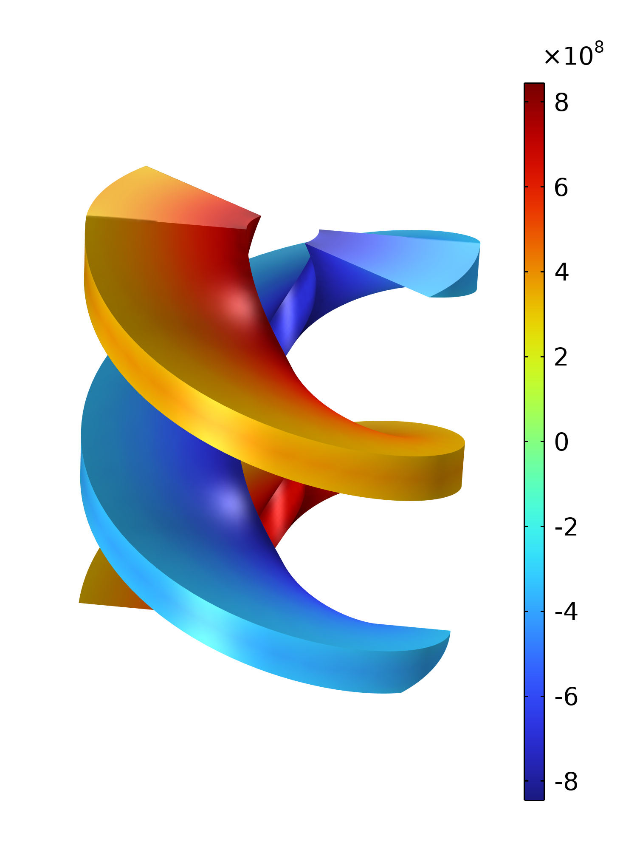
Compact Arbitrary Superconducting Polarization Emitting Radiator
Gap of 6mm
Assuming constant current of 320 A (80% of Ic at 2T)
Notes:
Mention that Athos 38mm, Porthos aims at 25-30 mm, Aramis afterburner 15mm

Slide 13
Compact Arbitrary Superconducting Polarization Emitting Radiator
SwissFELplus pre-project
Winding, liquid nitrogen testing, splicing
Test facility and measurements
10 periods prototypes, 1 meter-long prototype
2026
Specifications
Parameter | Values relaxed | Values optimal
Gap | 6 mm | 6 mm
Period length | 38 mm | 15 mm
Field amplitude | 2-4 T | 1-2 T
K_{eff} values | 9.9(circular) - 14 (linear) | 2(circular) – 2.8 (linear)
Temperature | 4.2 K | 4.2 K
2028
Notes:
Mention relaxed parameters for first prototypes, then more realistic ones for Porthos and finally towards hard X-ray variable polarization

Slide 14
Compact Arbitrary Superconducting Polarization Emitting Radiator
Main challenges :
Magnetization currents
Design of the end terminations
Small bending radius (<3mm)
Alternating local thicknesses between crossing points and straight segments
Insulation

Slide 15
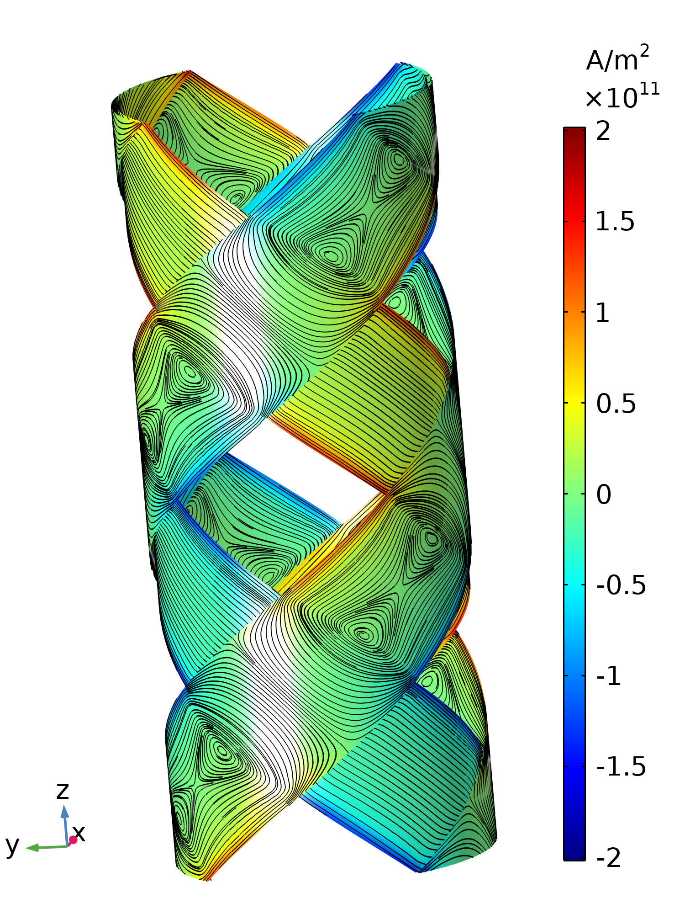
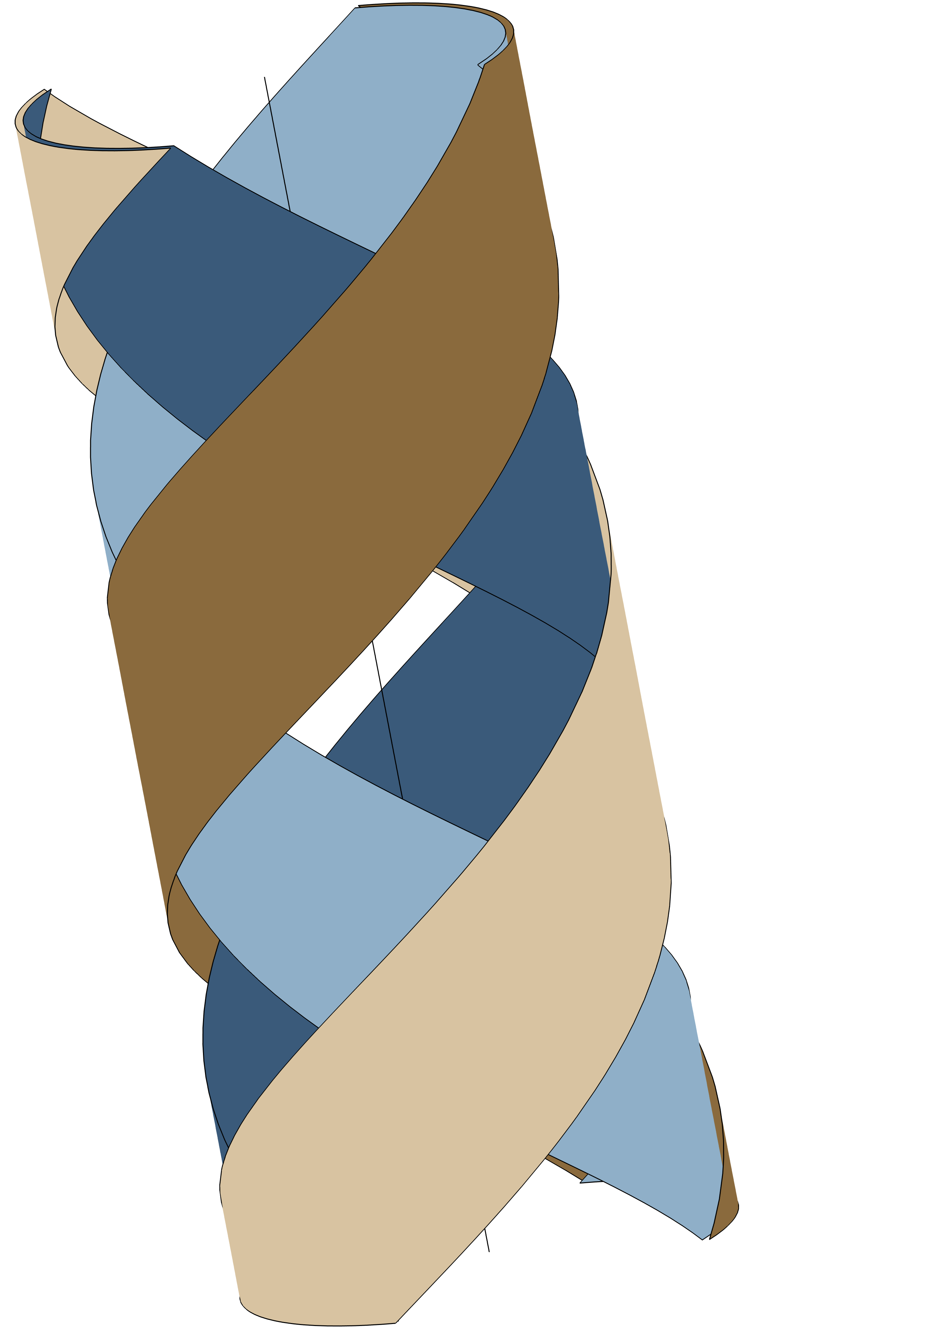
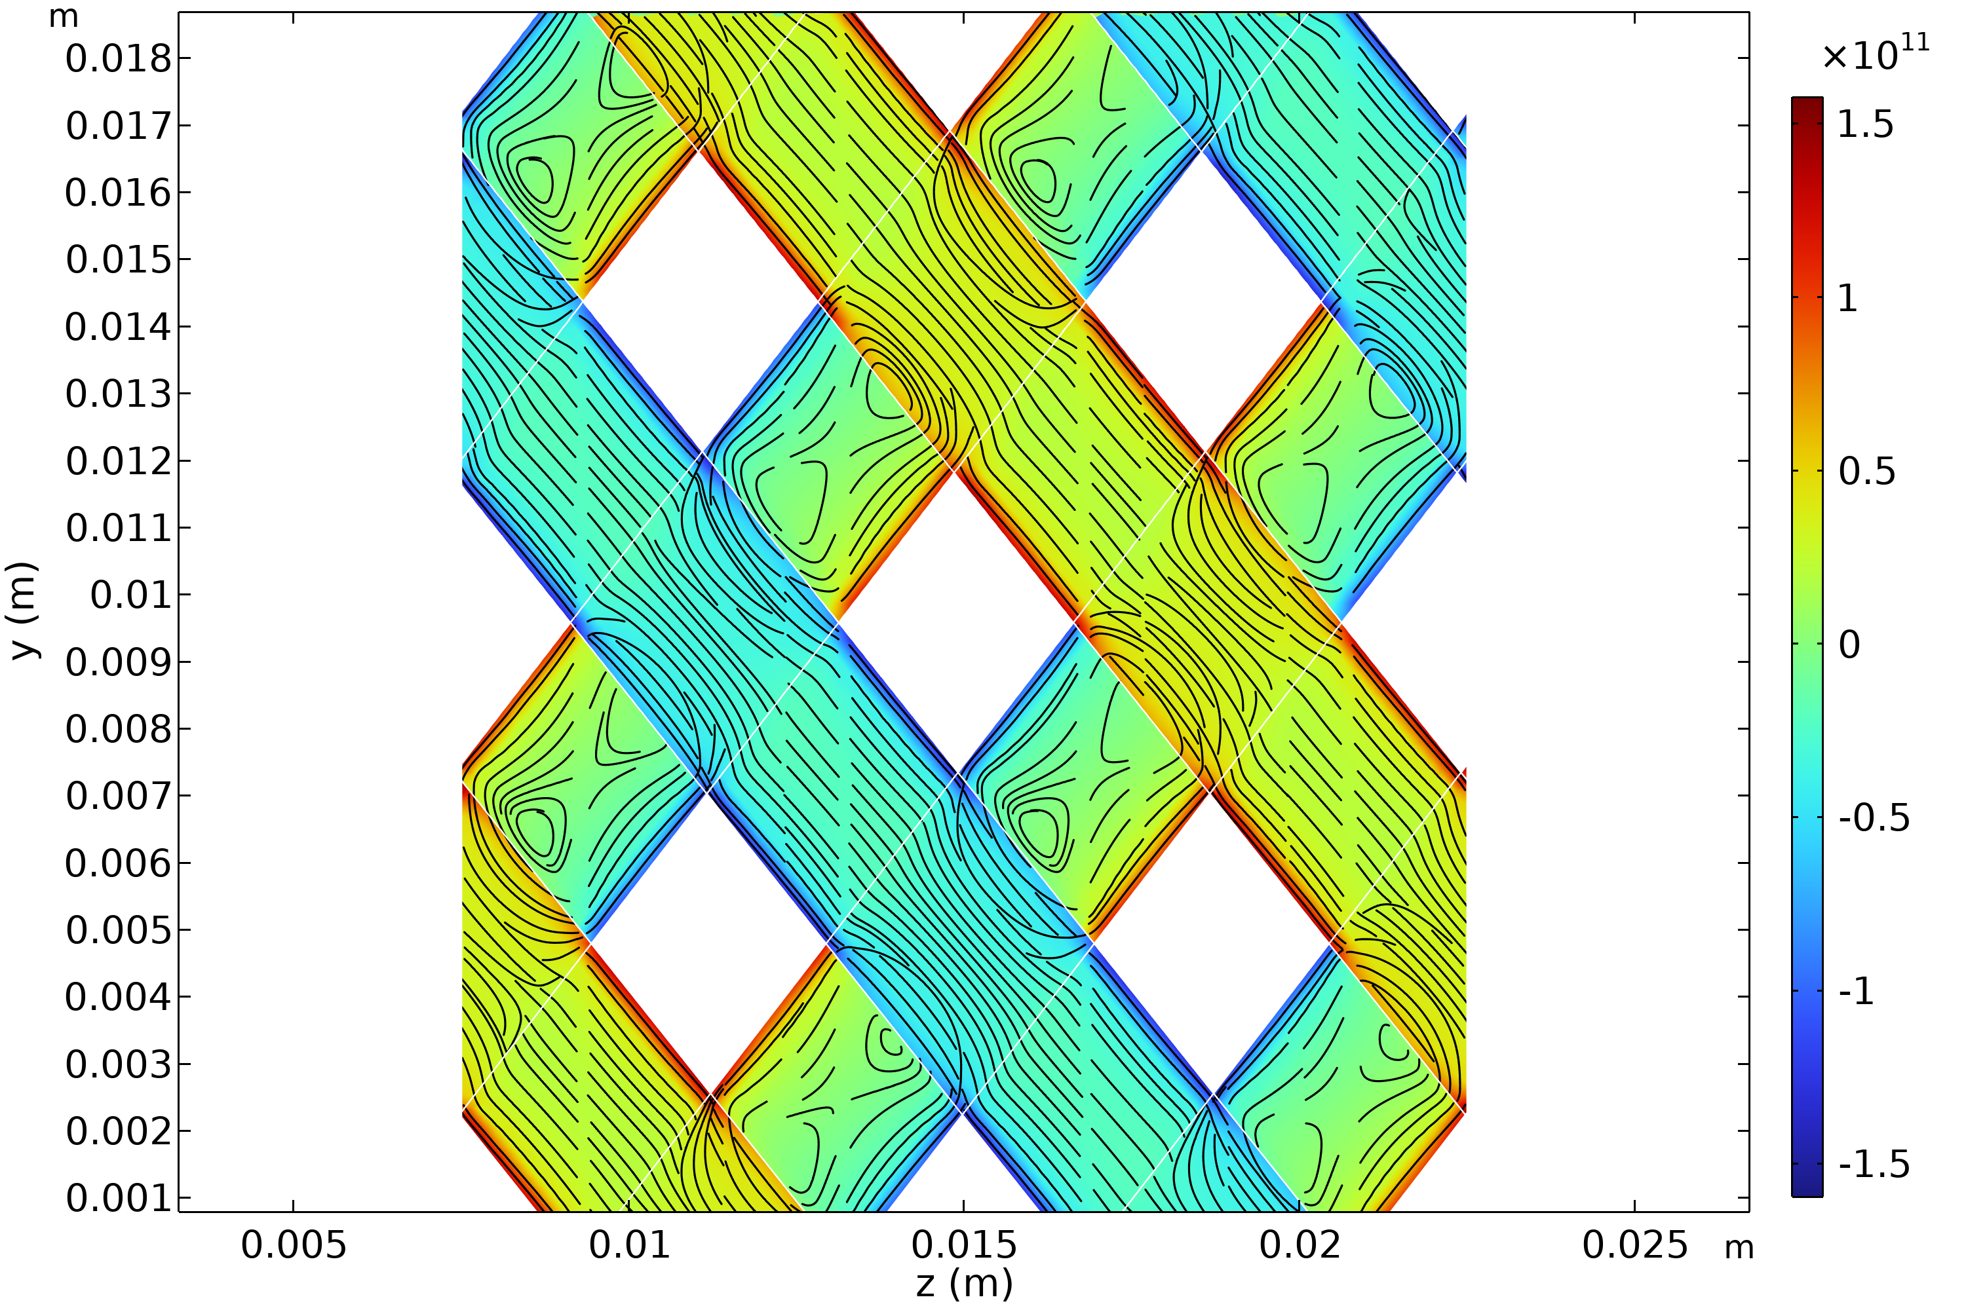
CASPER : Magnetization currents
Single helix powered

Slide 16
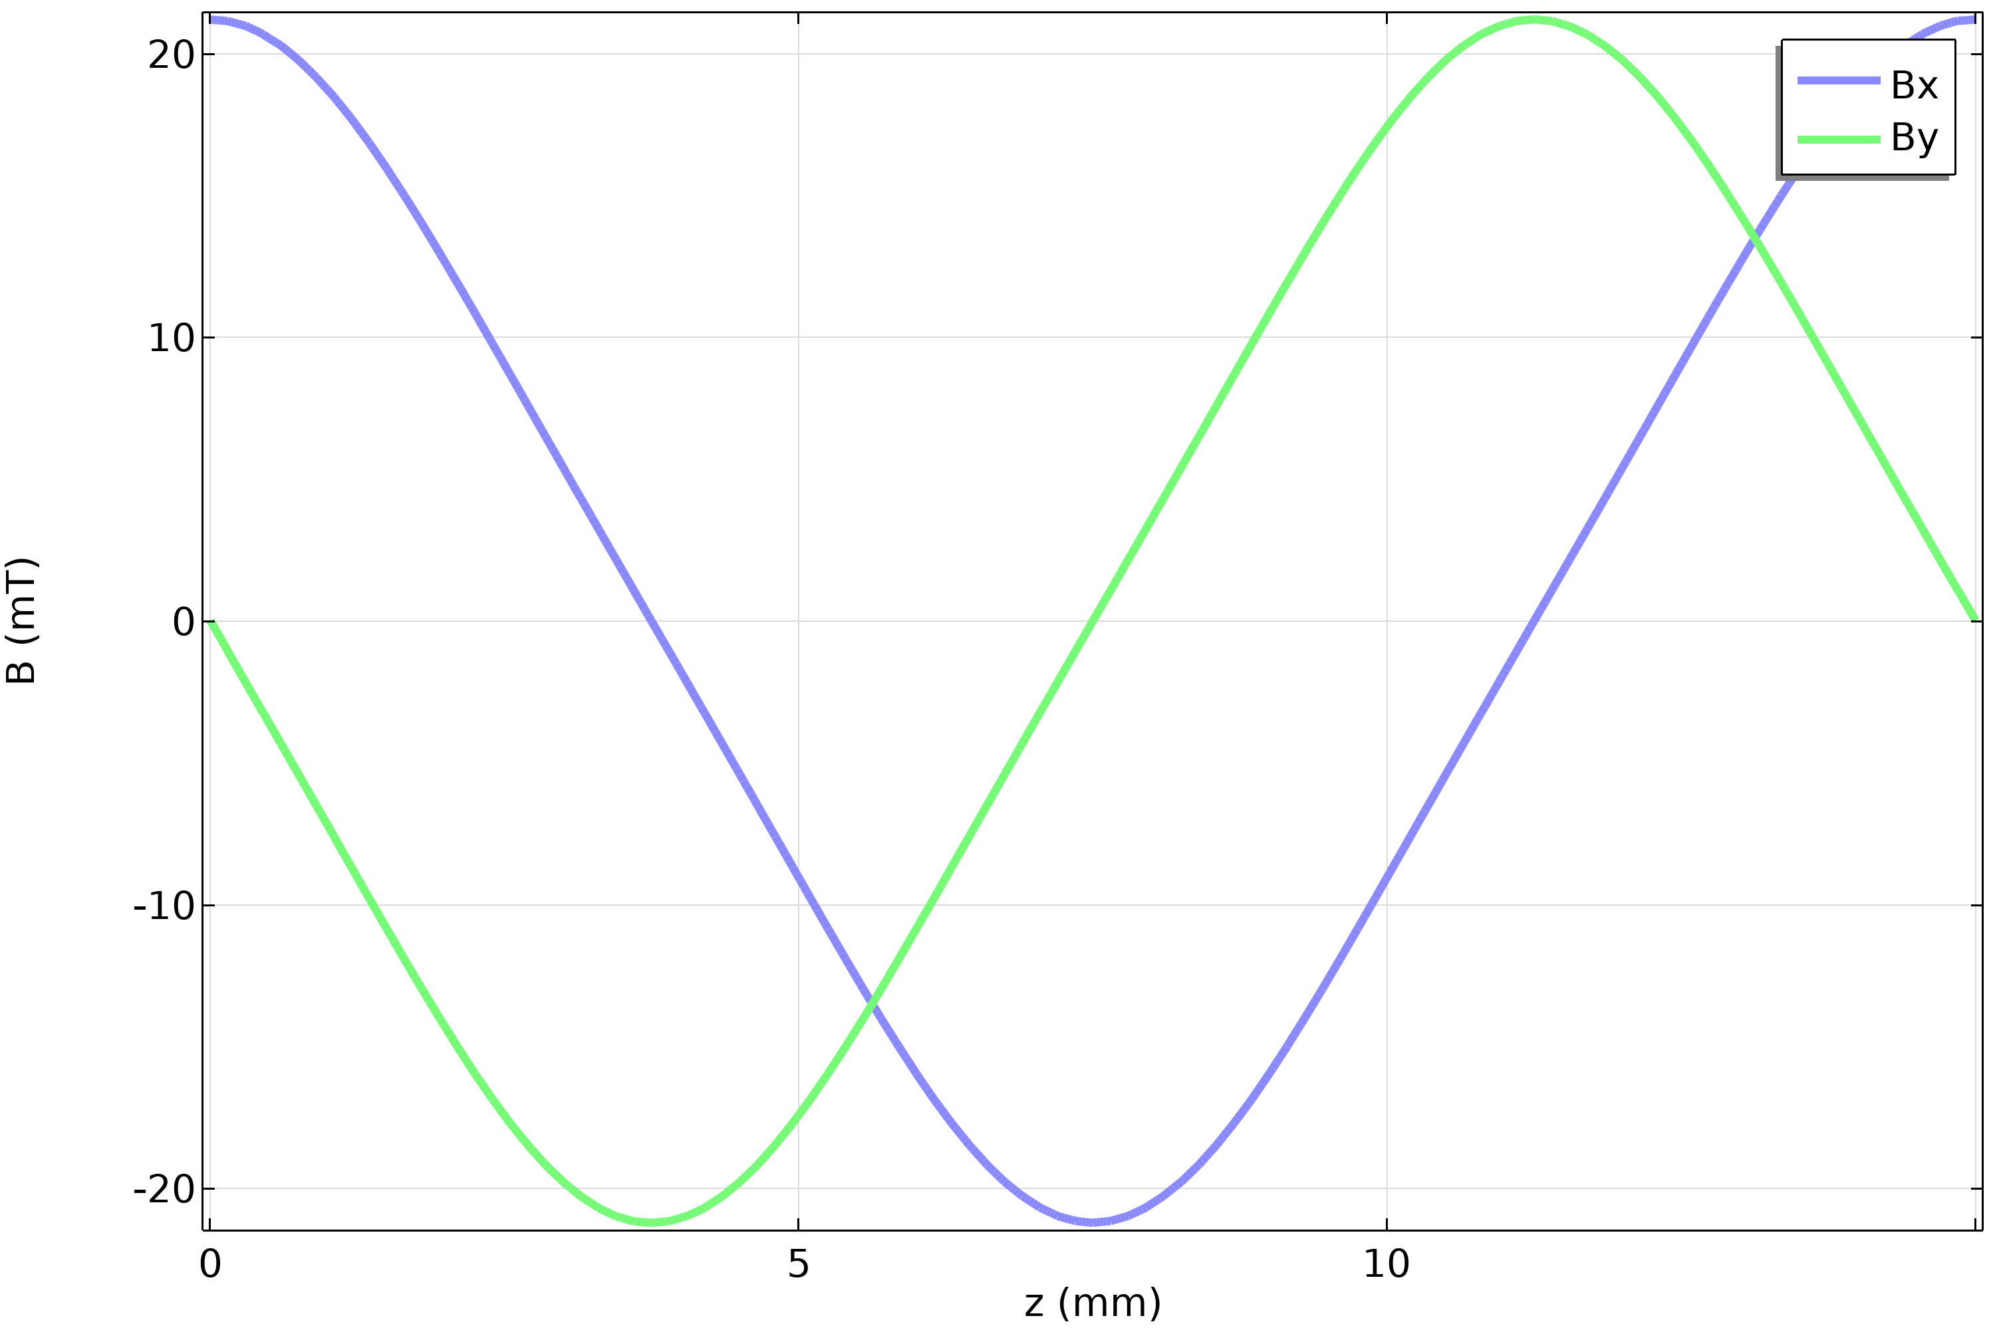
CASPER : Magnetization currents
Single helix powered
Single tape layer produces circular field of 20 mT

Slide 17
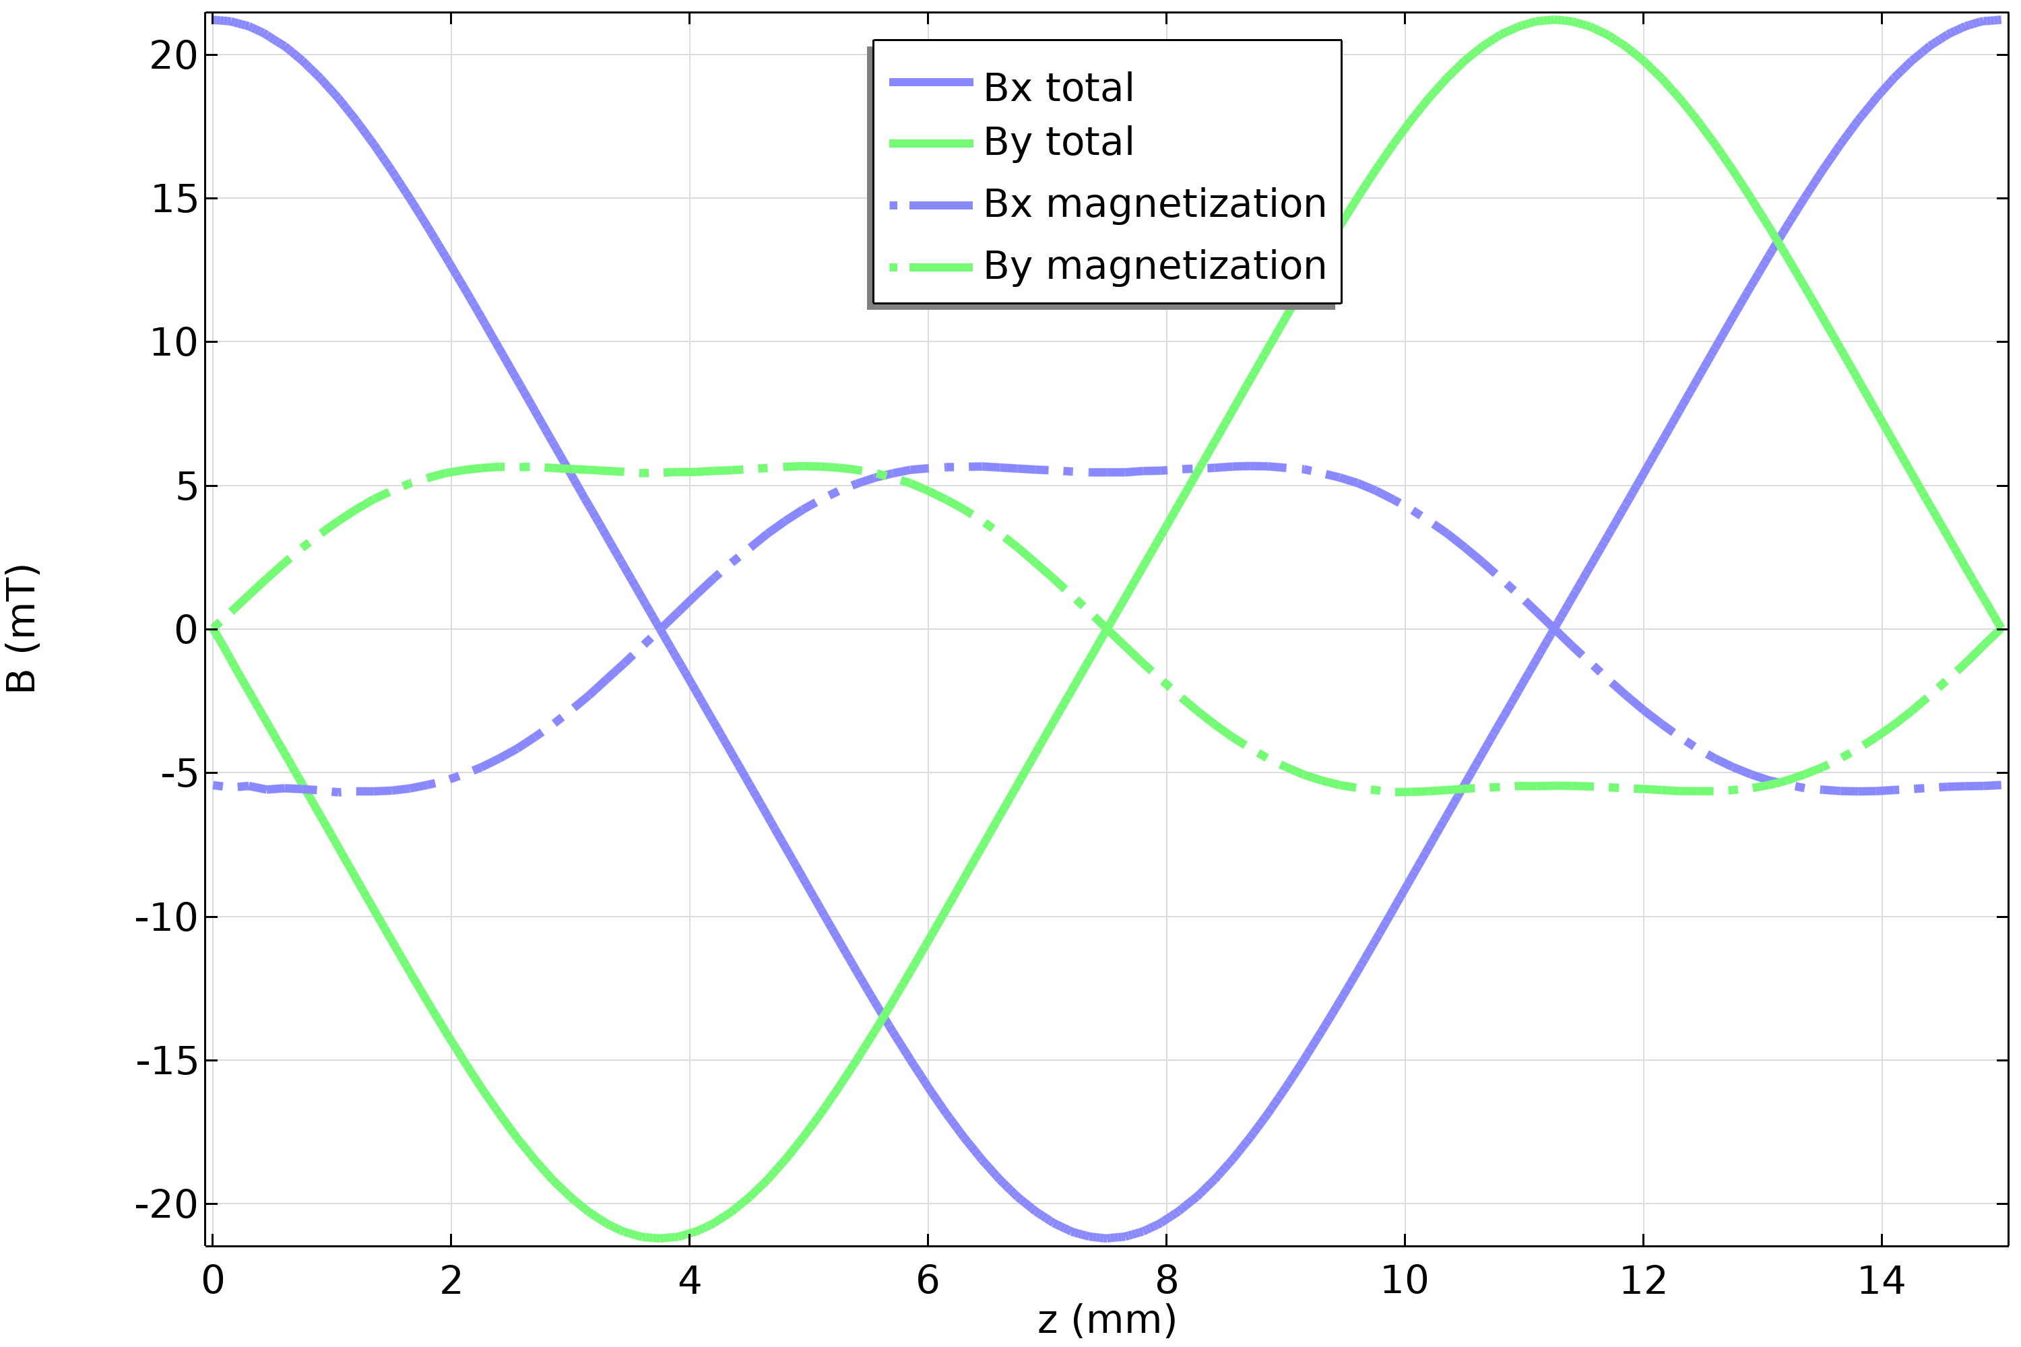
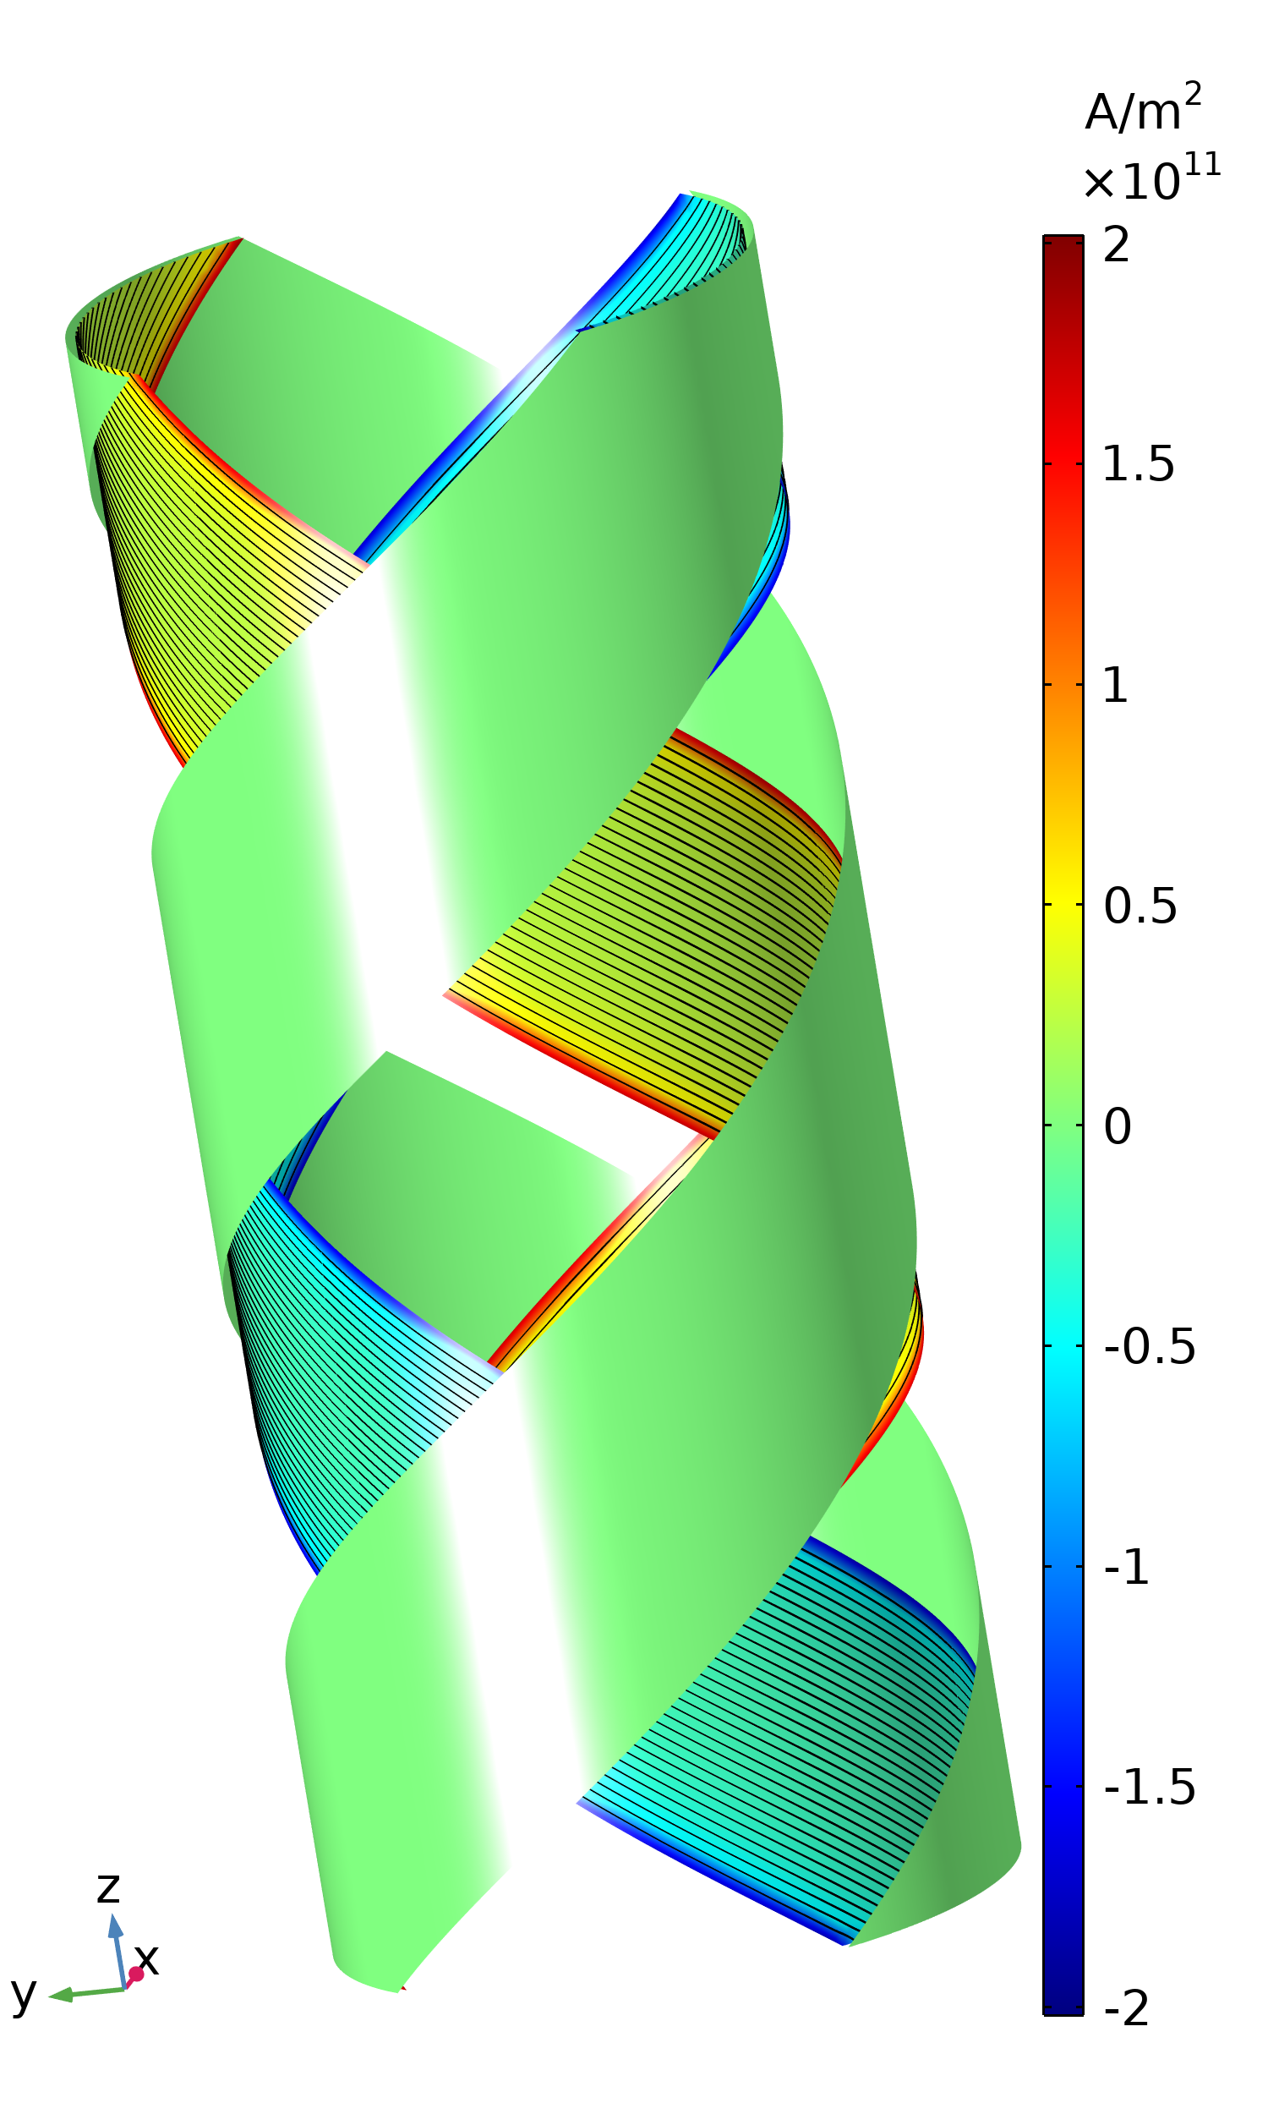
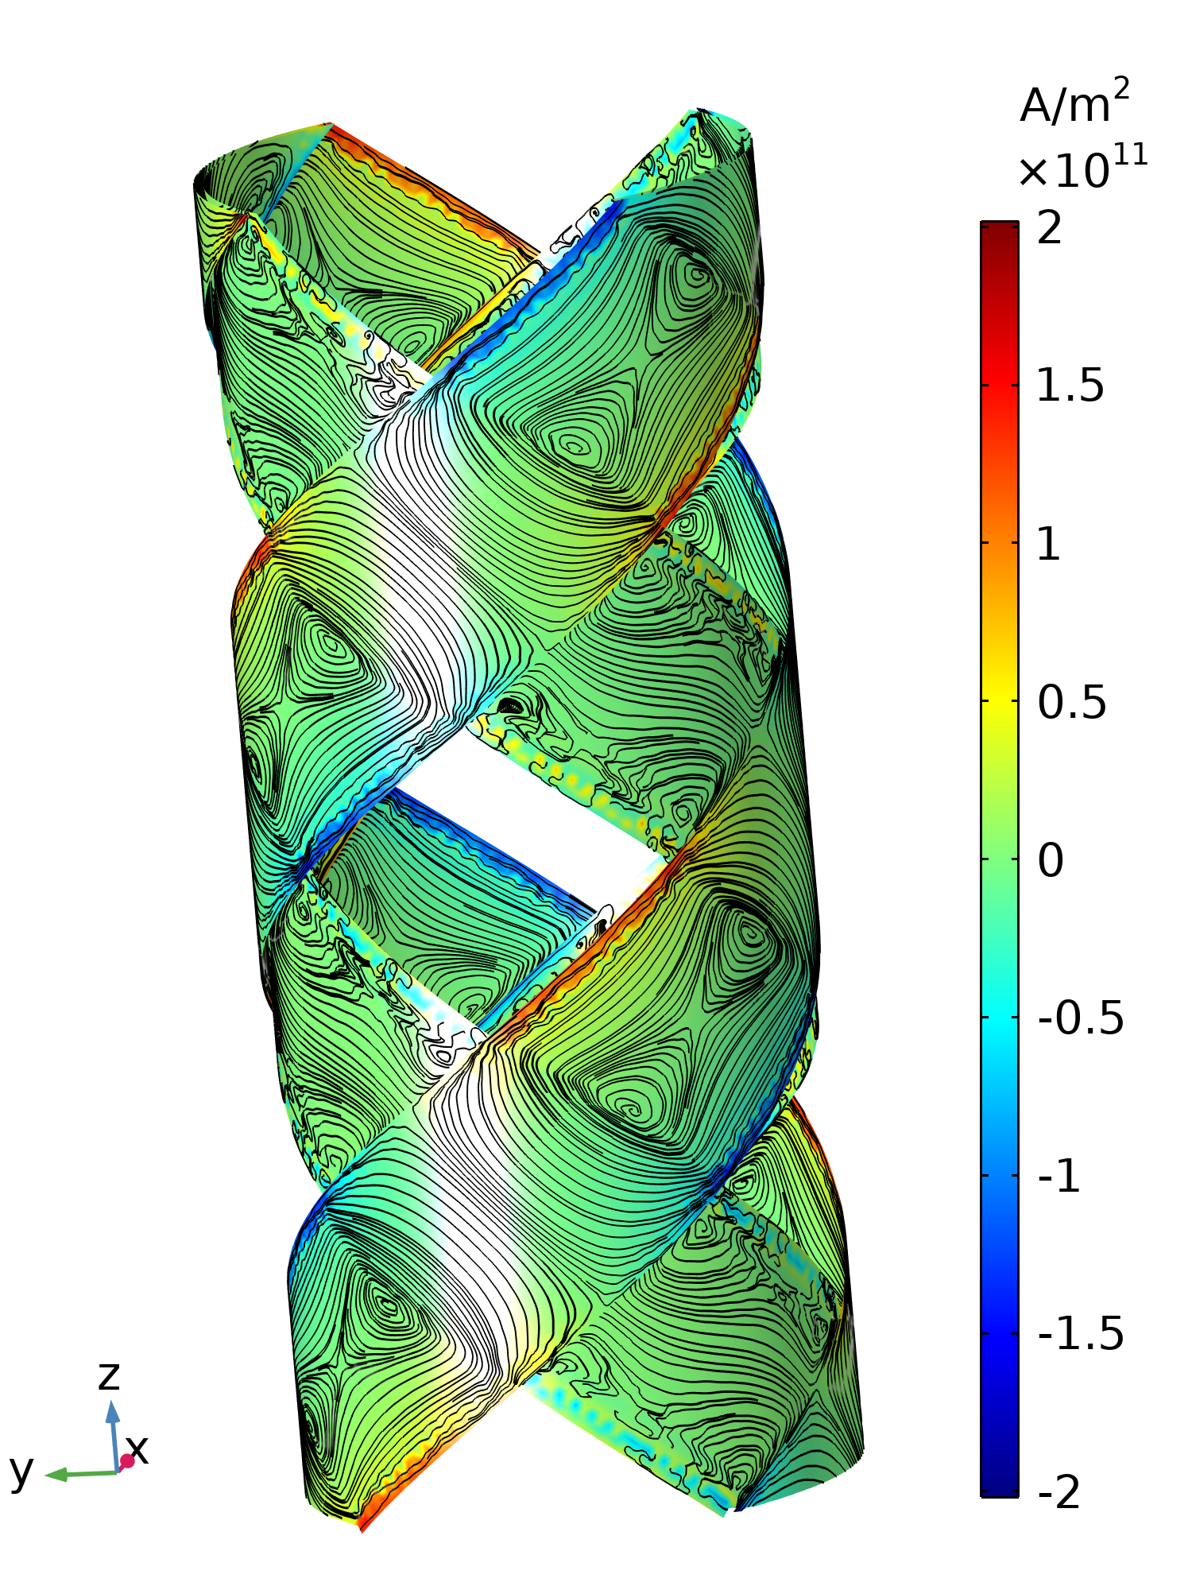
CASPER : Magnetization currents
Single helix powered
-
=
Magnetization currents reduce the field by ~20%

Slide 18
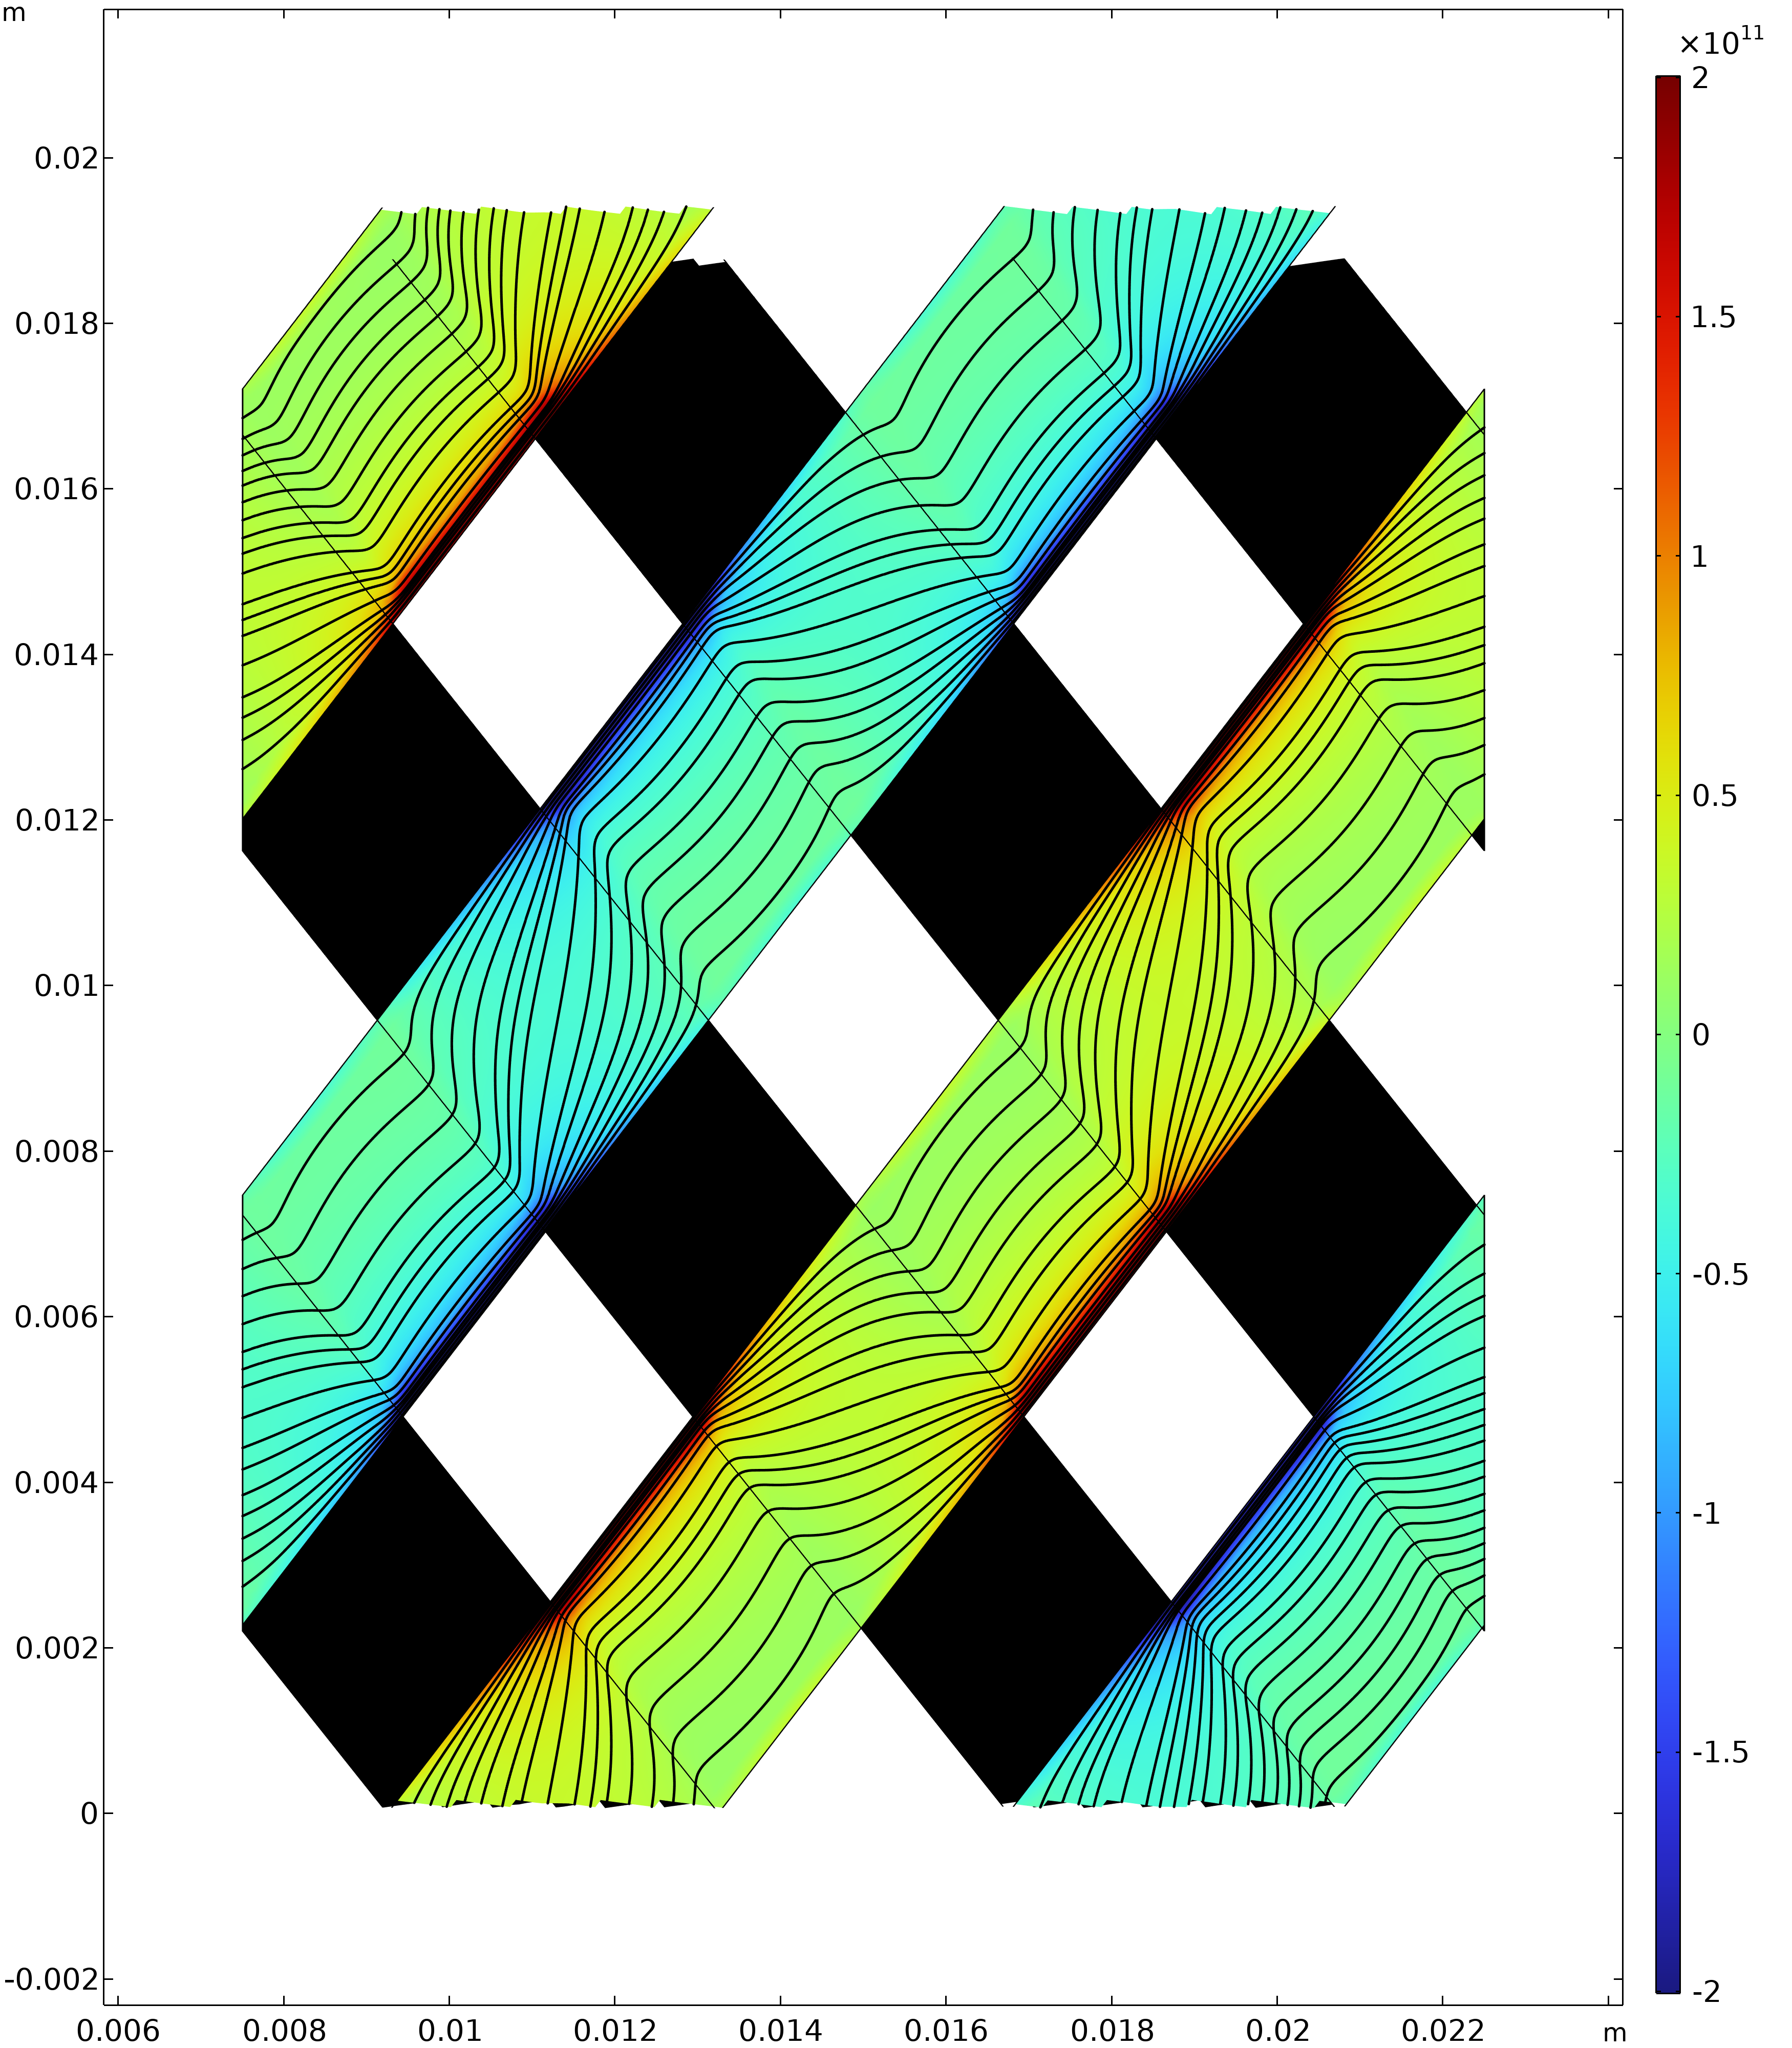
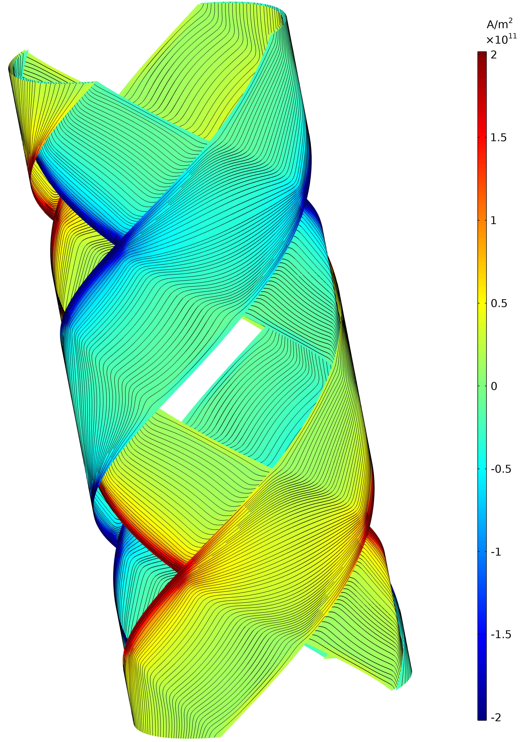
CASPER : Magnetization currents
Two helices powered

Slide 19
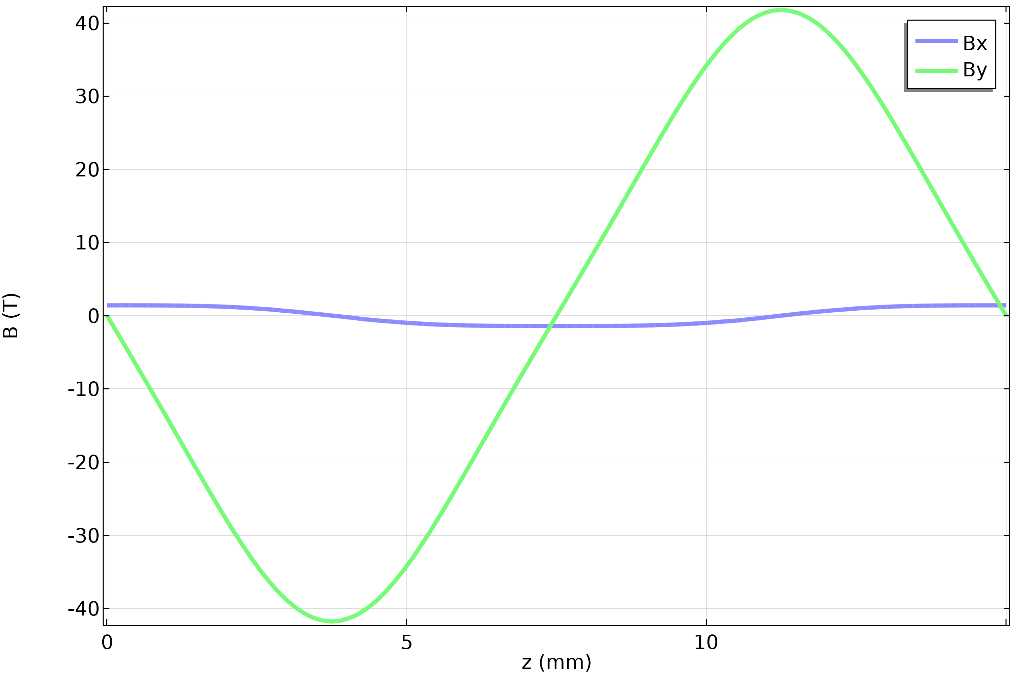
CASPER : Magnetization currents
Two helices powered
Nonzero (~3%) perpendicular field

Slide 20
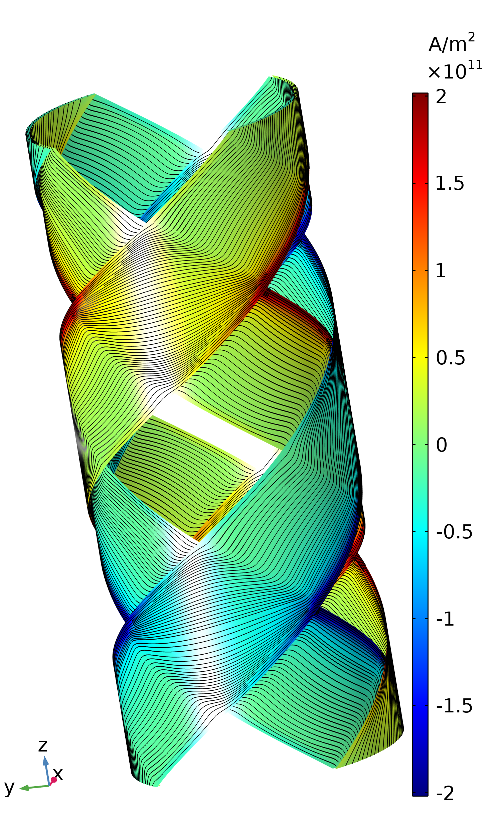
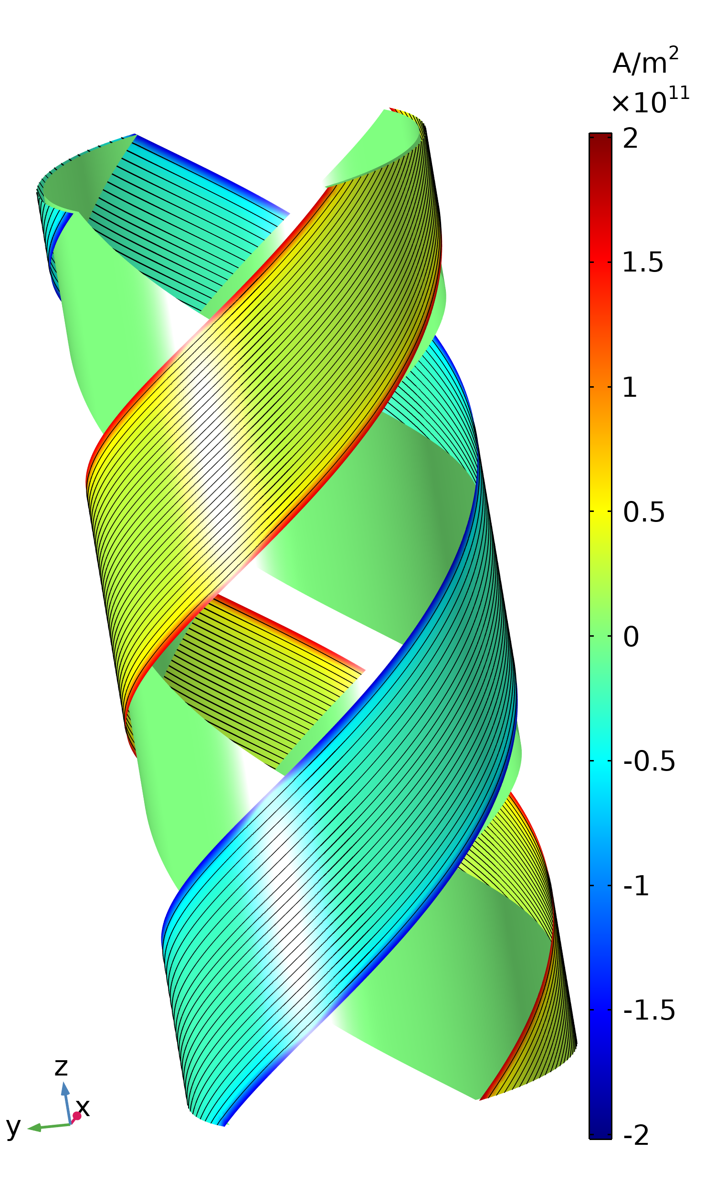
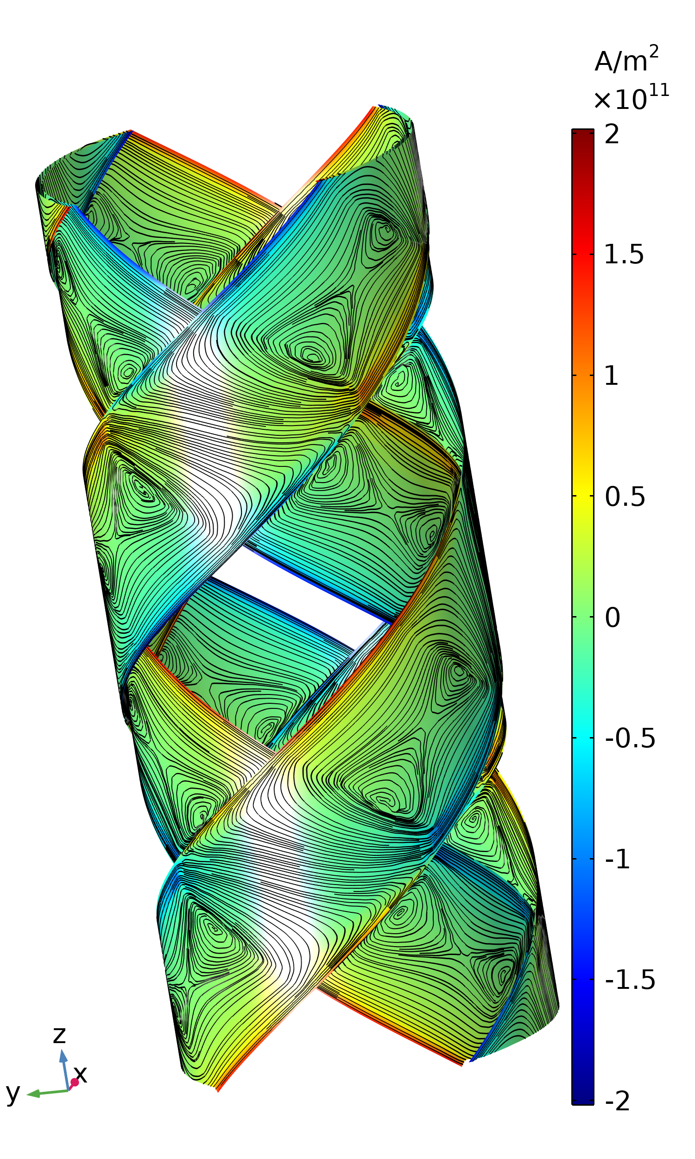
CASPER : Magnetization currents
Two helices powered
-
-
=
All tapes powered
Left-handed powered
Right-handed powered
Magnetization currents

Slide 21
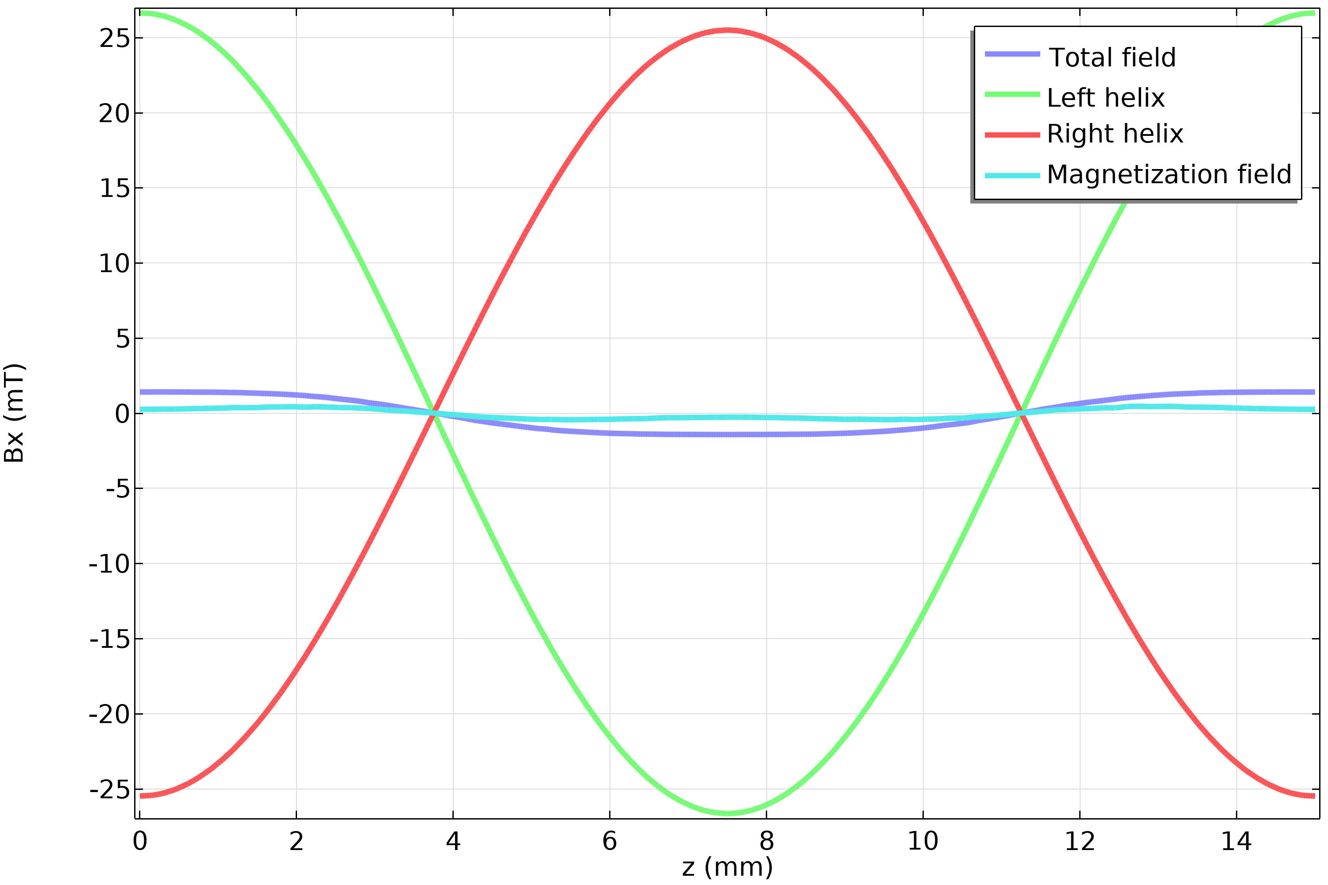
CASPER : Magnetization currents
Two helices powered
Magnetization currents
Total
Left helix
Right helix
Magnetization effects account for <1% of Bx

Slide 22
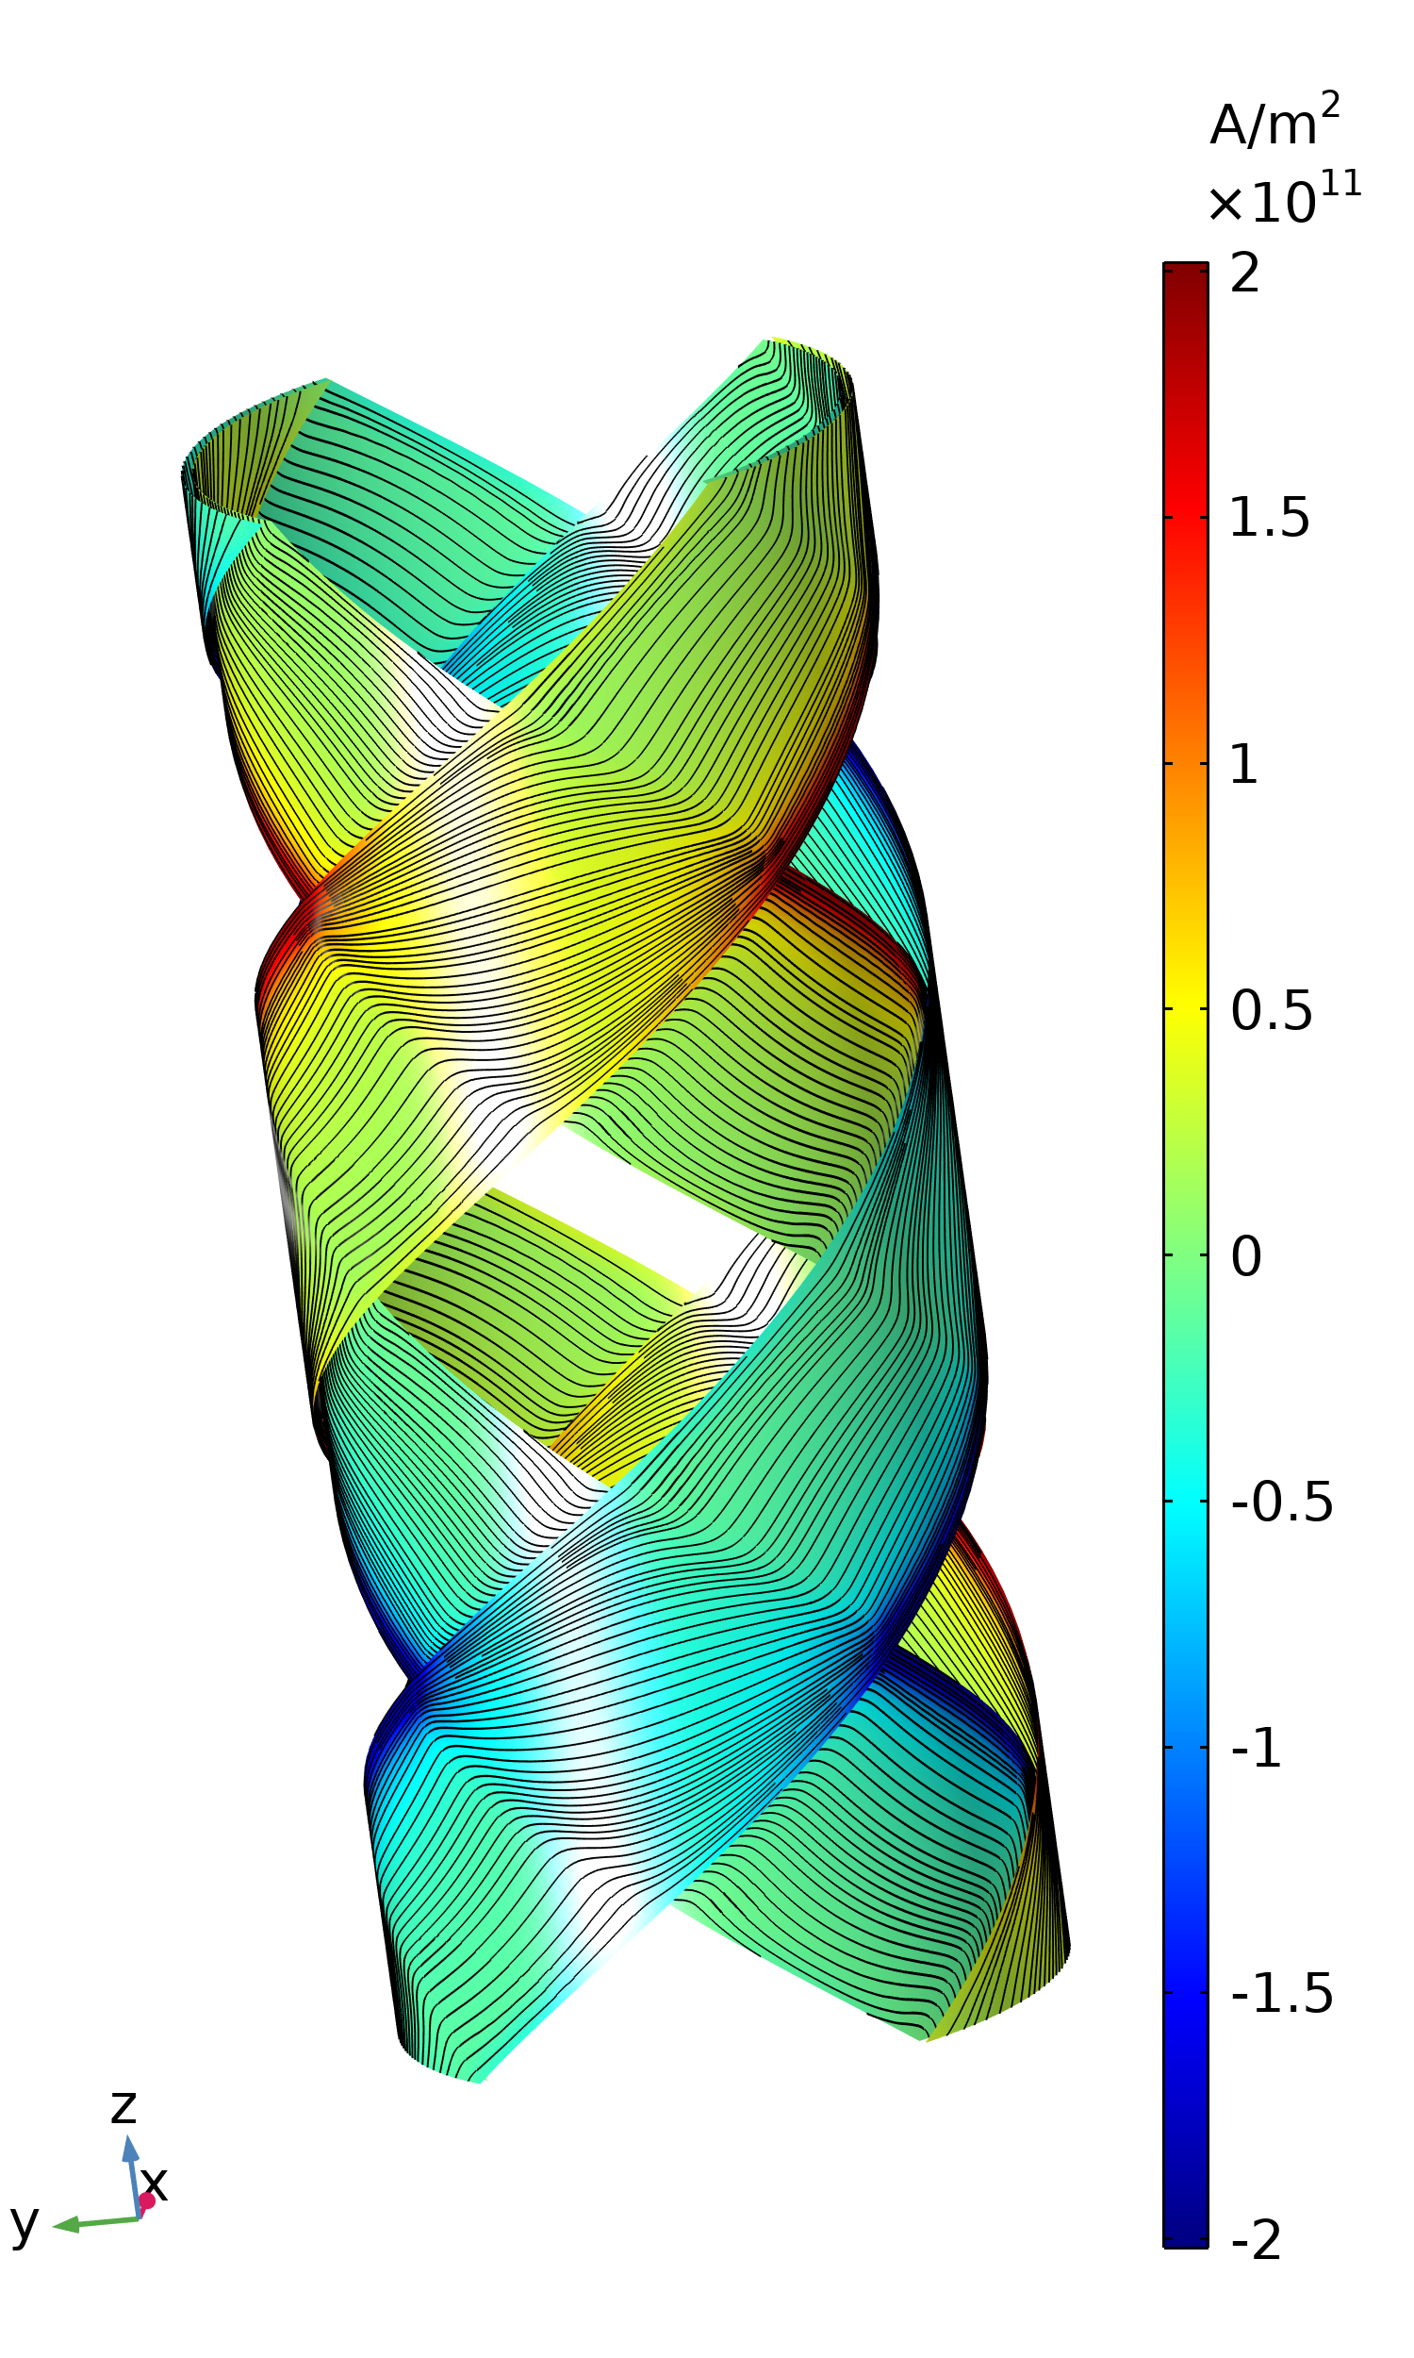
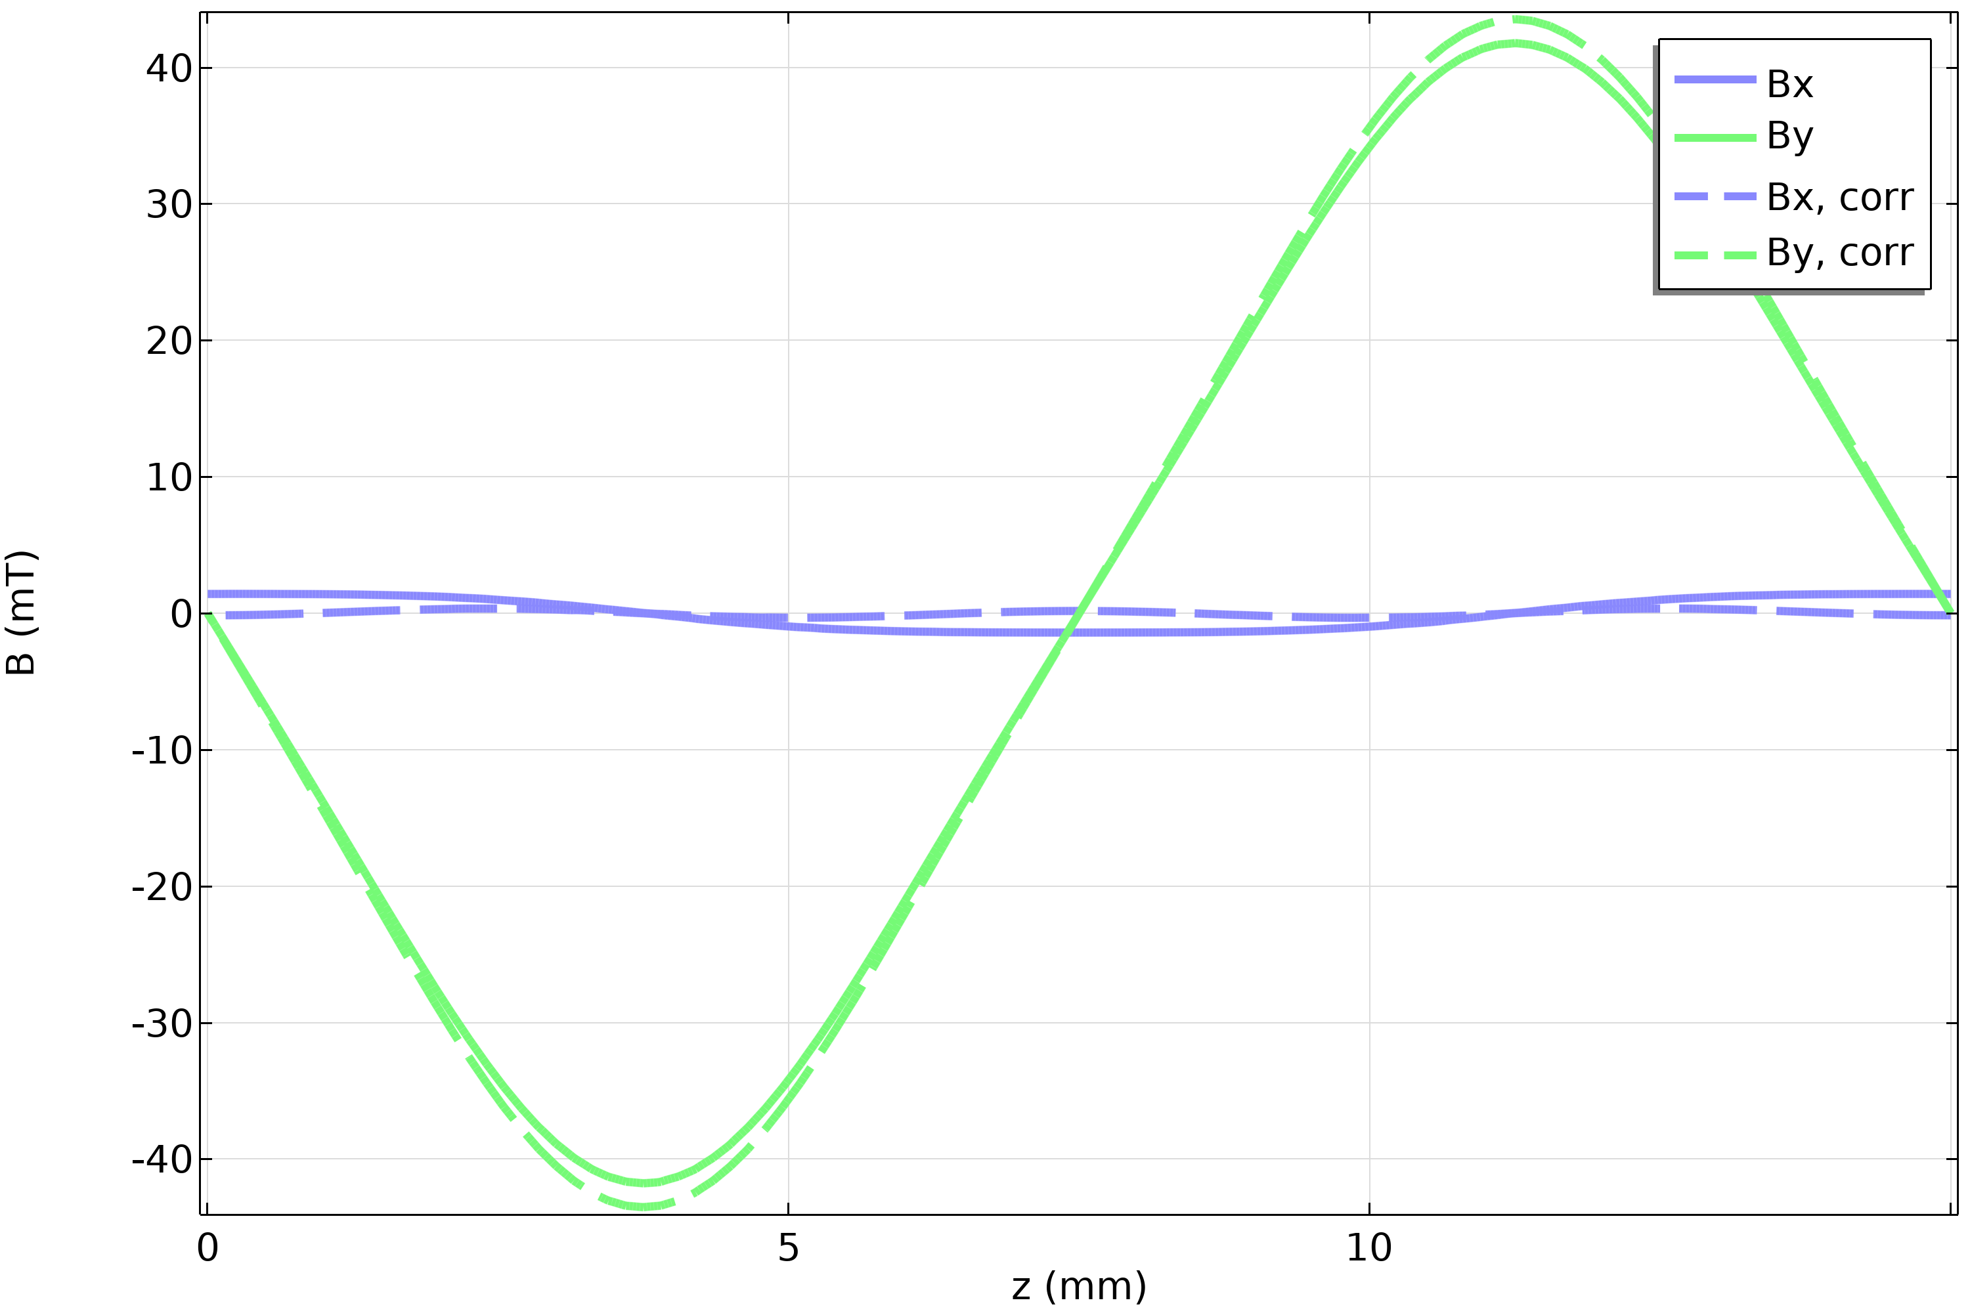
CASPER : Magnetization currents
Two helices powered
Using 250 A in inner helix and 270 A in outer helix, Bx is suppressed (<1% of By)

Slide 23
Compact Arbitrary Superconducting Polarization Emitting Radiator
Main challenges :
Magnetization currents
Design of the end terminations
Small bending radius (<3mm)
Alternating local thicknesses between crossing points and straight segments
Insulation

Slide 24
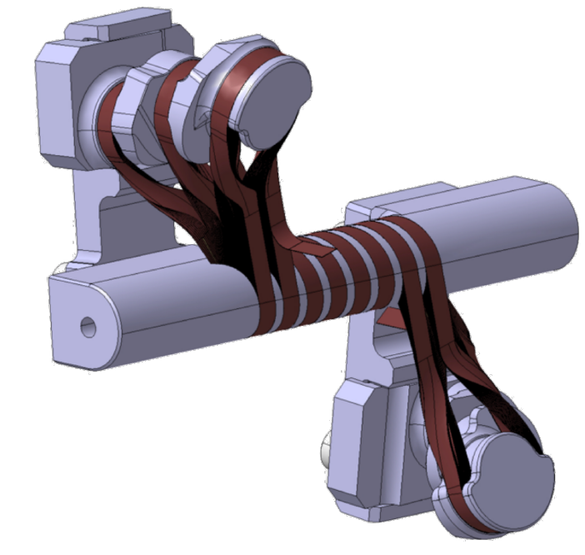
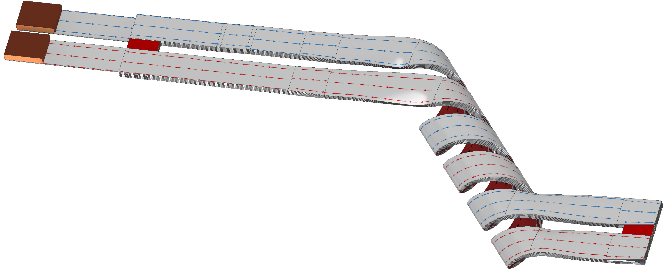
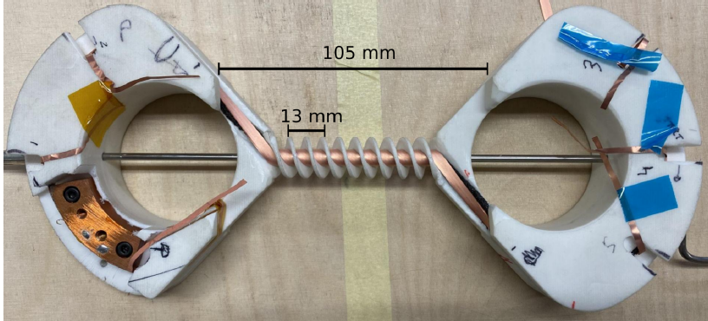
CASPER : End terminations
Current leads
Credit: S. Richter, PhD thesis 2023
HTS splices
Option 1: Looping each tape back
Option 2: Splicing each tape layer in series
Notes:
Stress the fact that tapes need to be bended such that HTS is under compression

Slide 25
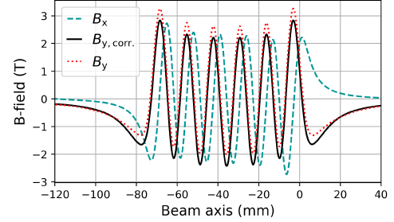
CASPER : End terminations
Credit: S. Richter, PhD thesis 2023
Advantages:
  Continuous winding
Disadvantages:
  Complex geometry
  May create dipole
  Limited length
Option 1: Looping each tape back

Slide 26
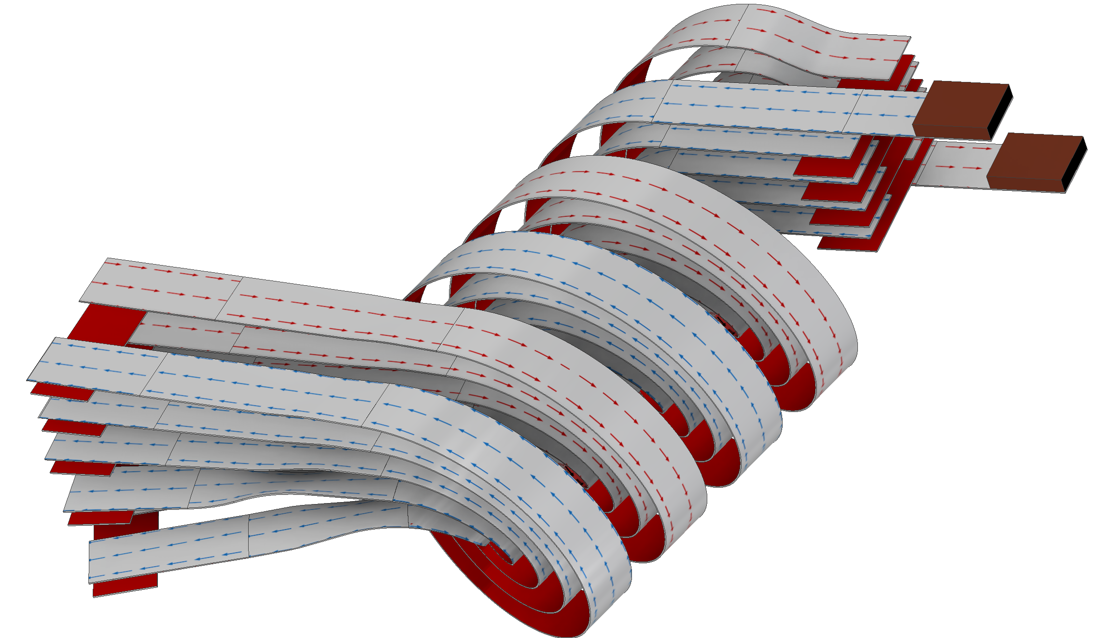
CASPER : End terminations
Option 2: Splicing each tape layer in series
Current leads

Slide 27
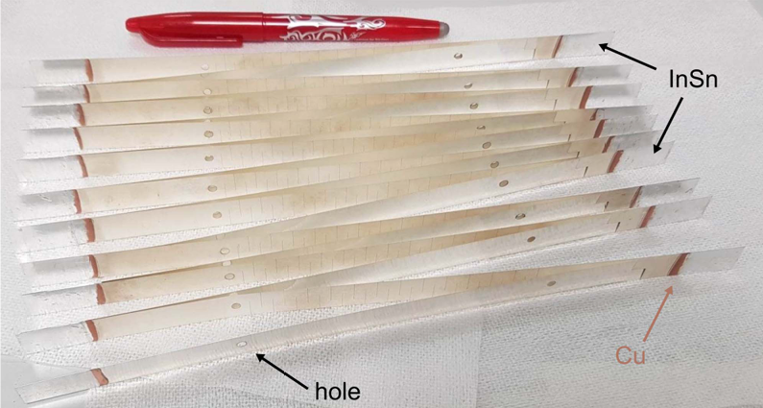
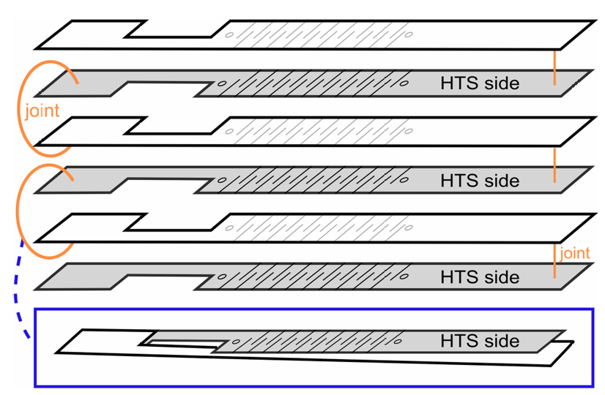
CASPER : End terminations
Option 2: Splicing each tape layer in series
B. Krasch, F. Abusaif, T. Arndt, N. Glamann, A. Grau, and D. S. de Jauregui, IEEE Transactions on Applied Superconductivity, vol. 34, no. 5, pp. 1–4, Aug. 2024

Slide 28
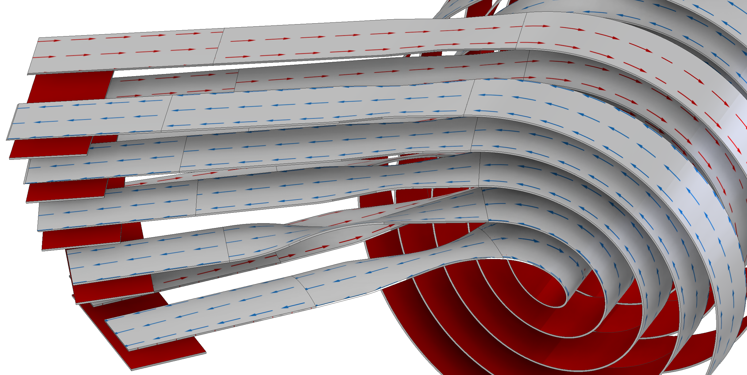
CASPER : End terminations
Option 2: Splicing each tape layer in series
Current leads
Helices connected in same layer

Slide 29
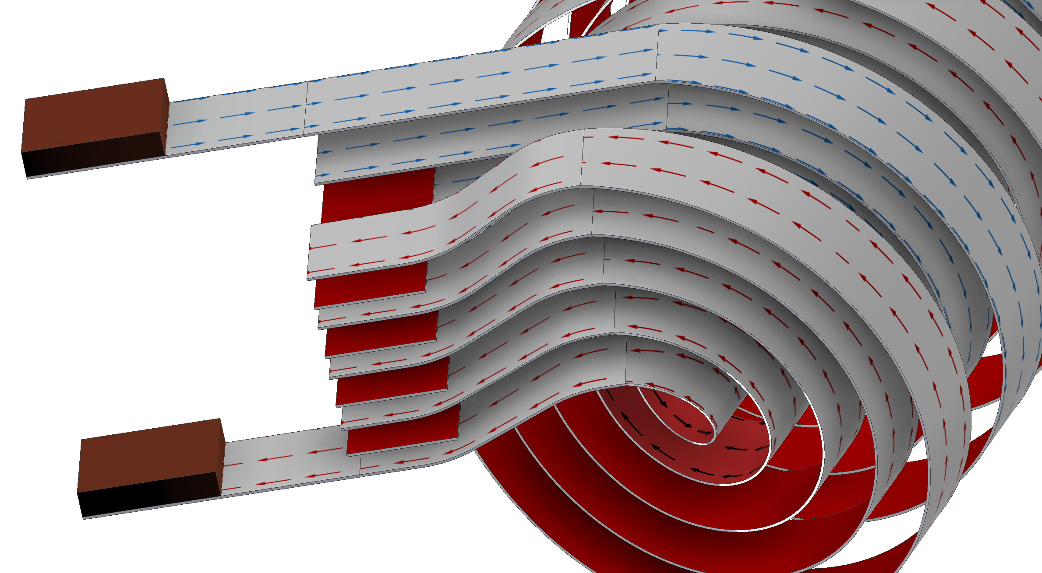
CASPER : End terminations
Option 2: Splicing each tape layer in series
Current leads
Tapes connected to layer above/below

Slide 30
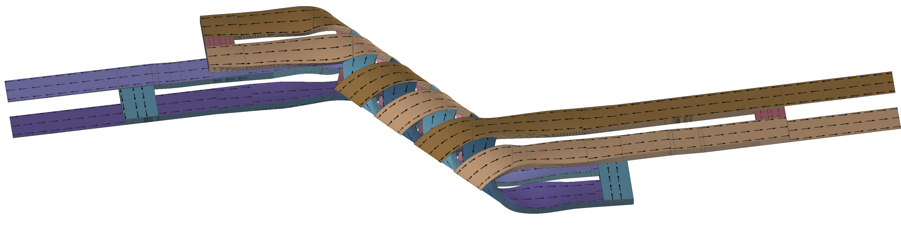
CASPER : End terminations
Option 2: Splicing each tape layer in series
Advantages:
  Easier to bring tapes out of coil
  More scalable
Disadvantages:
  Requires ~800 low resistance joints
  Heat buildup

Slide 31
Compact Arbitrary Superconducting Polarization Emitting Radiator
Main challenges :
Magnetization currents
Design of the end terminations:
Small bending radius (<3mm)
Alternating local thicknesses between crossing points and straight segments
Insulation

Slide 32




CASPER : Minimum bending radius
S. Richter et al., Proceedings of the 12th International Particle Accelerator Conference, vol. IPAC2021, p. 4 pages, 2021
T. Mulder et al., IEEE Transactions on Applied Superconductivity, vol. 28, no. 3, pp. 1-4, April 2018, Art no. 4800504
Single tape minimum bending radius of ~2mm
~82% critical current reduction for CORC winding

Slide 33
Compact Arbitrary Superconducting Polarization Emitting Radiator
Main challenges :
Magnetization currents
Design of the end terminations:
Small bending radius (<3mm)
Alternating local thicknesses between crossing points and straight segments
Insulation

Slide 34


CASPER : Crossing points spacing
Tapes stacked on each other
Spacing between tapes

Slide 35
Compact Arbitrary Superconducting Polarization Emitting Radiator
Main challenges :
Magnetization currents
Design of the end terminations:
Small bending radius (<3mm)
Alternating local thicknesses between crossing points and straight segments
Insulation

Slide 36

CASPER : Insulation
Full insulated
Non-insulated
Hwang YJ et al., Applied Sciences. 2020; 10(5):1564
Faster current ramping
Lower current density
Complicated quench protection
Slow ramping time
Possible current sharing
Easier quench protection

Slide 37
Conclusion
CASPER undulator promises high field at small period lengths with variable polarization
Several challenges need to be overcome:
    Magnetization currents
    Winding and end terminations
    Minimum bending radius studies
    Spacings between tapes
    Insulation

Slide 38





Compact Arbitrary Superconducting Polarization Emitting Radiator
Tape thickness variation
perpendicular
K. Tsuchiya et al., Cryogenics, vol. 85, pp. 1–7, Jul. 2017
Assuming constant current of 320 A (80% of Ic at 2T)

