Slide 1

APPLE III developments at DESY
Variable polarisation for FLASH
Kathrin Götze (DESY Undulator group)
ID26 workshop Deauville, 15th May 2026
On behalf of: Markus Tischer, Pavel Vagin, Andreas Schöps, Paul Neumann, Thorsten Vielitz, Philip Eckoldt and the other members of the DESY undulator group, and with thanks to colleagues at the central mechanics and mechanical design groups and at FLASH machine and controls

Slide 2
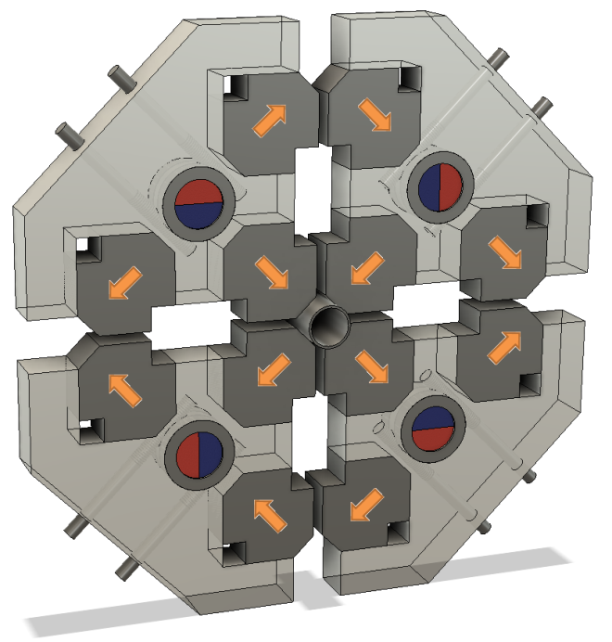
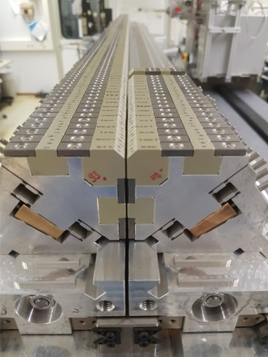
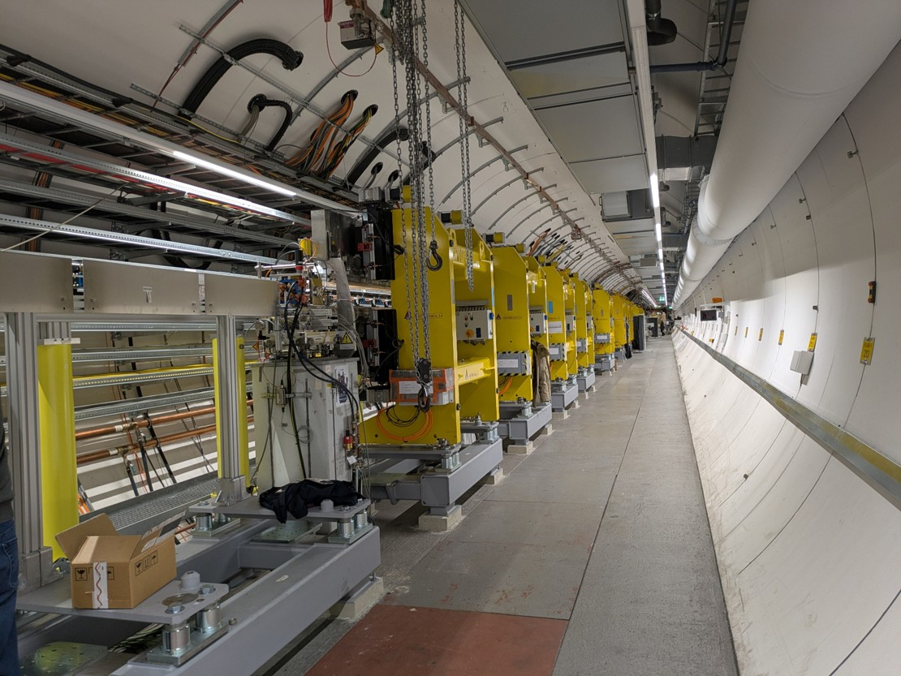
Outline
APPLE III developments at DESY
APPLE III concept
The “prototype”: APPLE III Afterburner for FLASH2, UE17.5
The seeding upgrade: Six UE35 APPLE III for FLASH1
Lessons learnt
Summary and outlook
e⁻

Slide 3
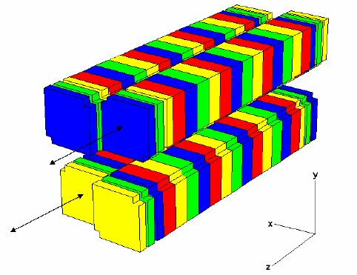
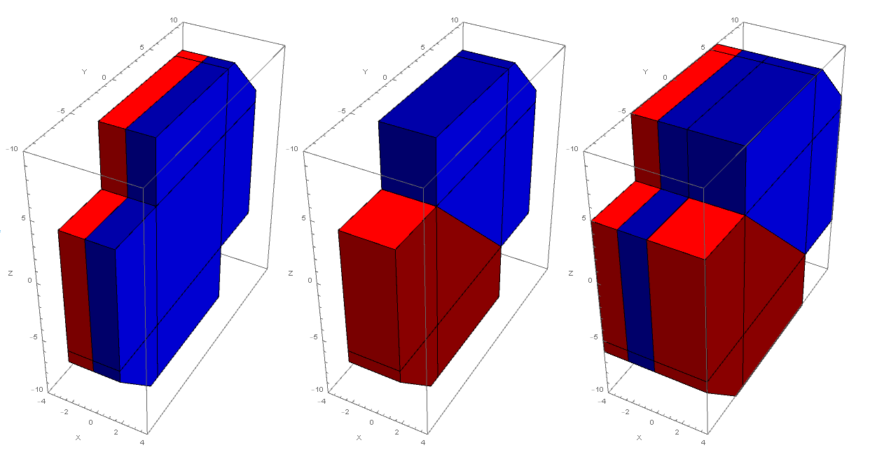
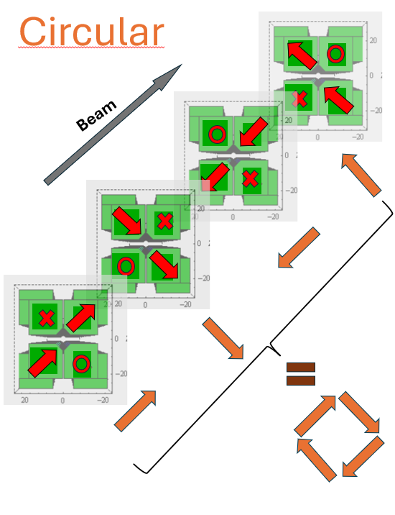
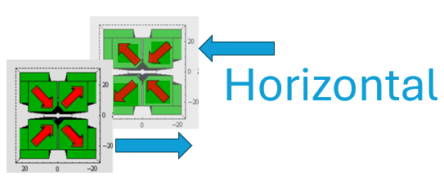
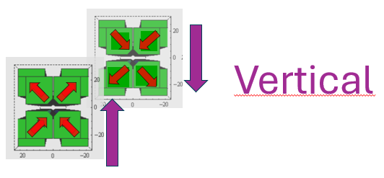
APPLE III concept
Variable polarisation for investigating magnetism and chirality
Gap
change
e⁻
A
B
AB
Shift drive for different polarization modes
  APPLE III: highest field, less bulky, cost efficient
  Force reduction up to factor of 8 - reuse of planar undulator support structures
shift λ/4
Variable field direction:
shift λ/2
shift 0
APPLE III design: Bahrdt J, Frentrup W, Gaupp A, Kuske B, Meseck A, and Scheer M 2004 Proc. SRI Conference 2003 AIP CP 705 215‒18
Source shift drive picture: Hannon, F.E., et al., Proceedings of EPAC. 2004.
Notes:
Force compensation allows to reuse our usual planar undulator support structures (e.g. in comparison to bulky PU04 without compensation, or APPLE-X)

Slide 4
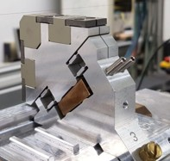
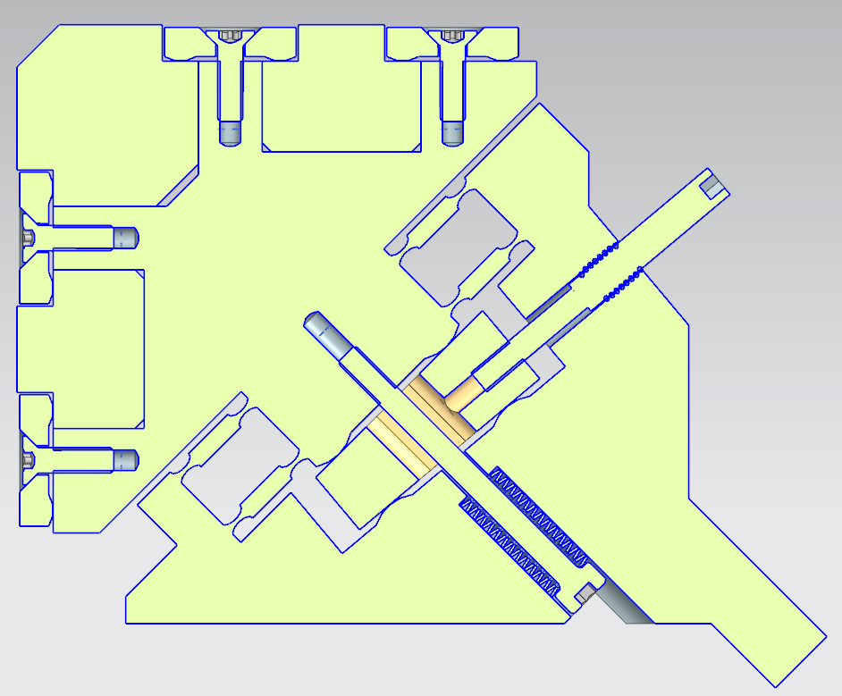
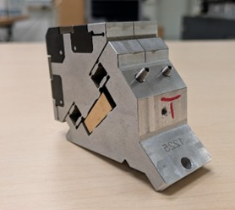
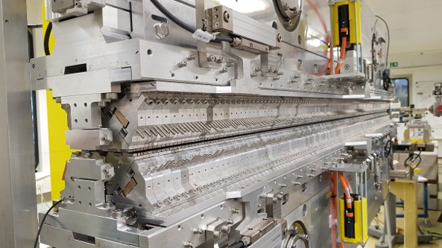
APPLE III concept
◄FLASH2 Afterburner keeper 17.5mm period length
Magnet and keeper design
Full period (17.5 or 35mm) keepers
Function magnets
Force compensation magnets
Differential screw
Force compensation magnets
FL1 radiator keeper ► 35mm period length
Wedge
Pretension Screw and Spring
Vacuum chamber:
Field tuning by virtual shimming
Keeper body: aluminium, wedge: copper tin bronze CuSn₂.
Differential screw (M3/M4 thread)
One full period per keeper, separated by cut in keeper body for individual tuning of half periods.
8
mm
blade
0.5mm
1mm
magnetic gap

Slide 5
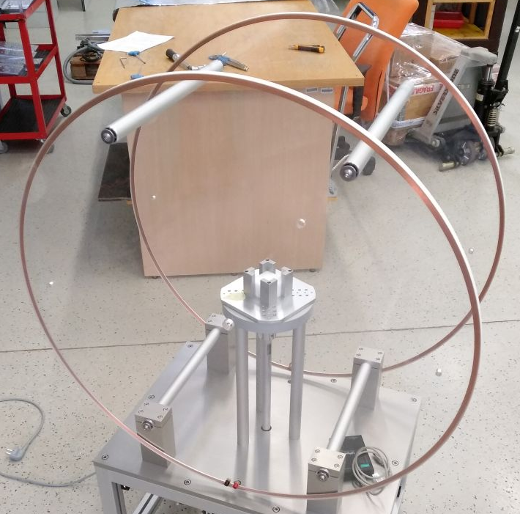

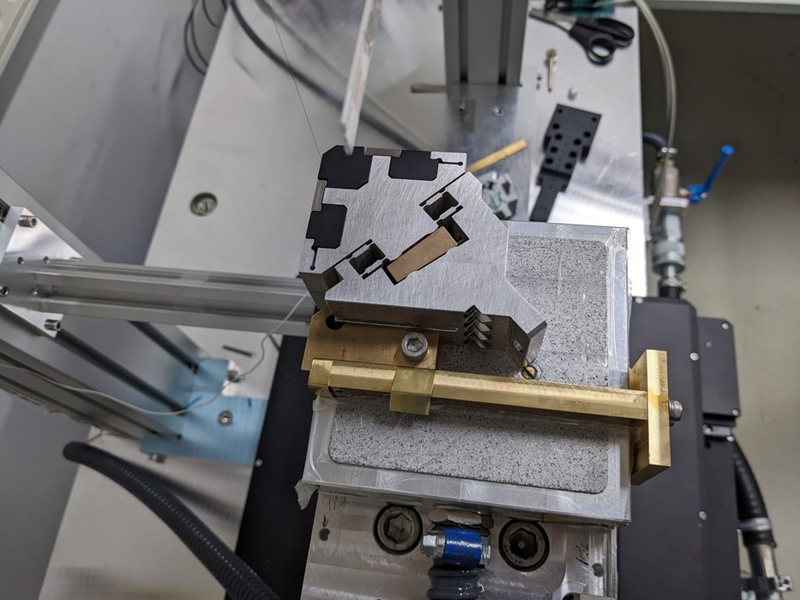
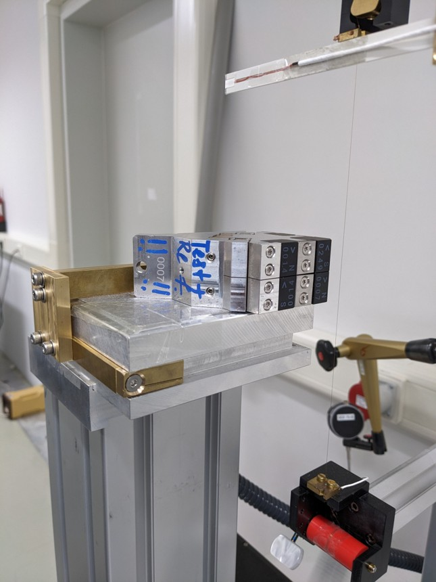

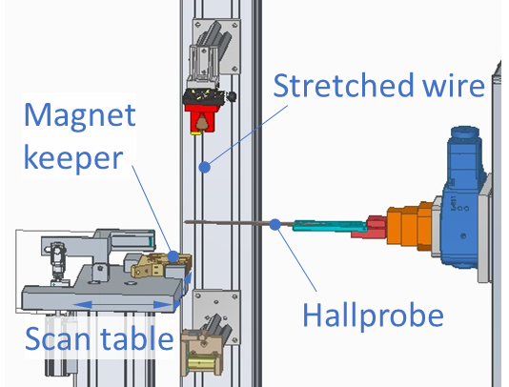
APPLE III concept
Magnet and keeper characterisation
Glued AB magnets measured individually by Helmholtz coil
Magnets sorted into pairs and mounted into keepers
(one keeper=one period=two function magnet pairs)
Stretched-wire and Hall measurements of all individual keepers
Sorting list for each device based on these data
Assembly onto girders/support structures
◄▲Keeper on measurement stand
Measurement and tuning of complete device with Hall probe and stretched-wire set-up
Measurement stand scheme

Slide 6
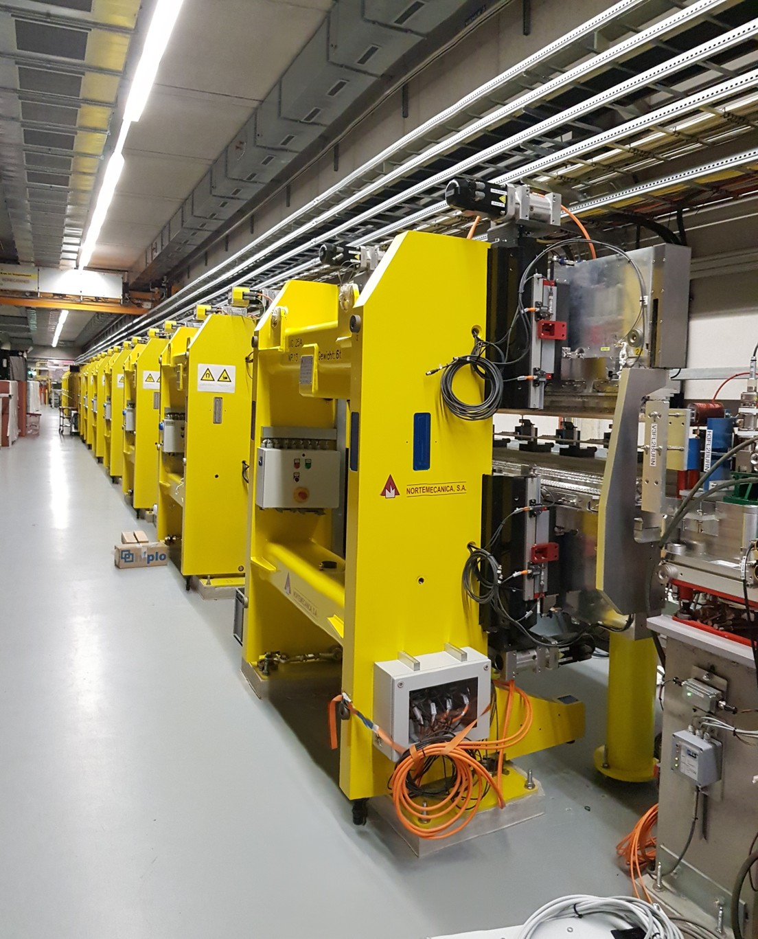
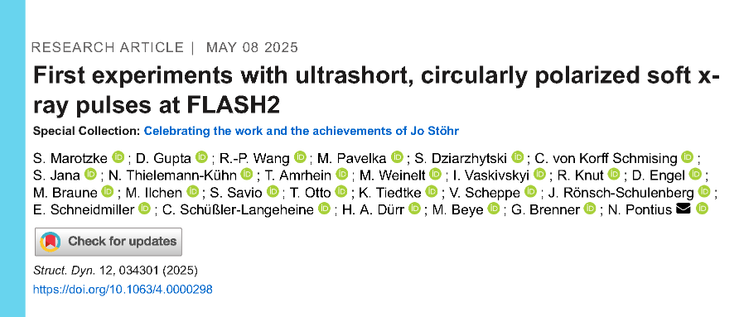
APPLE III Afterburner
Circularly polarised SASE radiation at FLASH2.
Period length 17.5mm
Wavelength range FLASH1: 3.3 – 90 nm (3rd Harmonic Wavelength down to 1.7 nm)
Radiates on the third harmonic of the SASE section to provide photon energies around the L-edges of iron, cobalt and nickel (890-700 eV or wavelength range 1.33--1.77 nm) for studies of ultrafast magnetisation dynamics.
Installed August 2023
First publication May 2025
https://doi.org/10.1063/4.0000298
Notes:
Support structures look the same – thanks to force compensation concept, no reinforcement needed

Slide 7
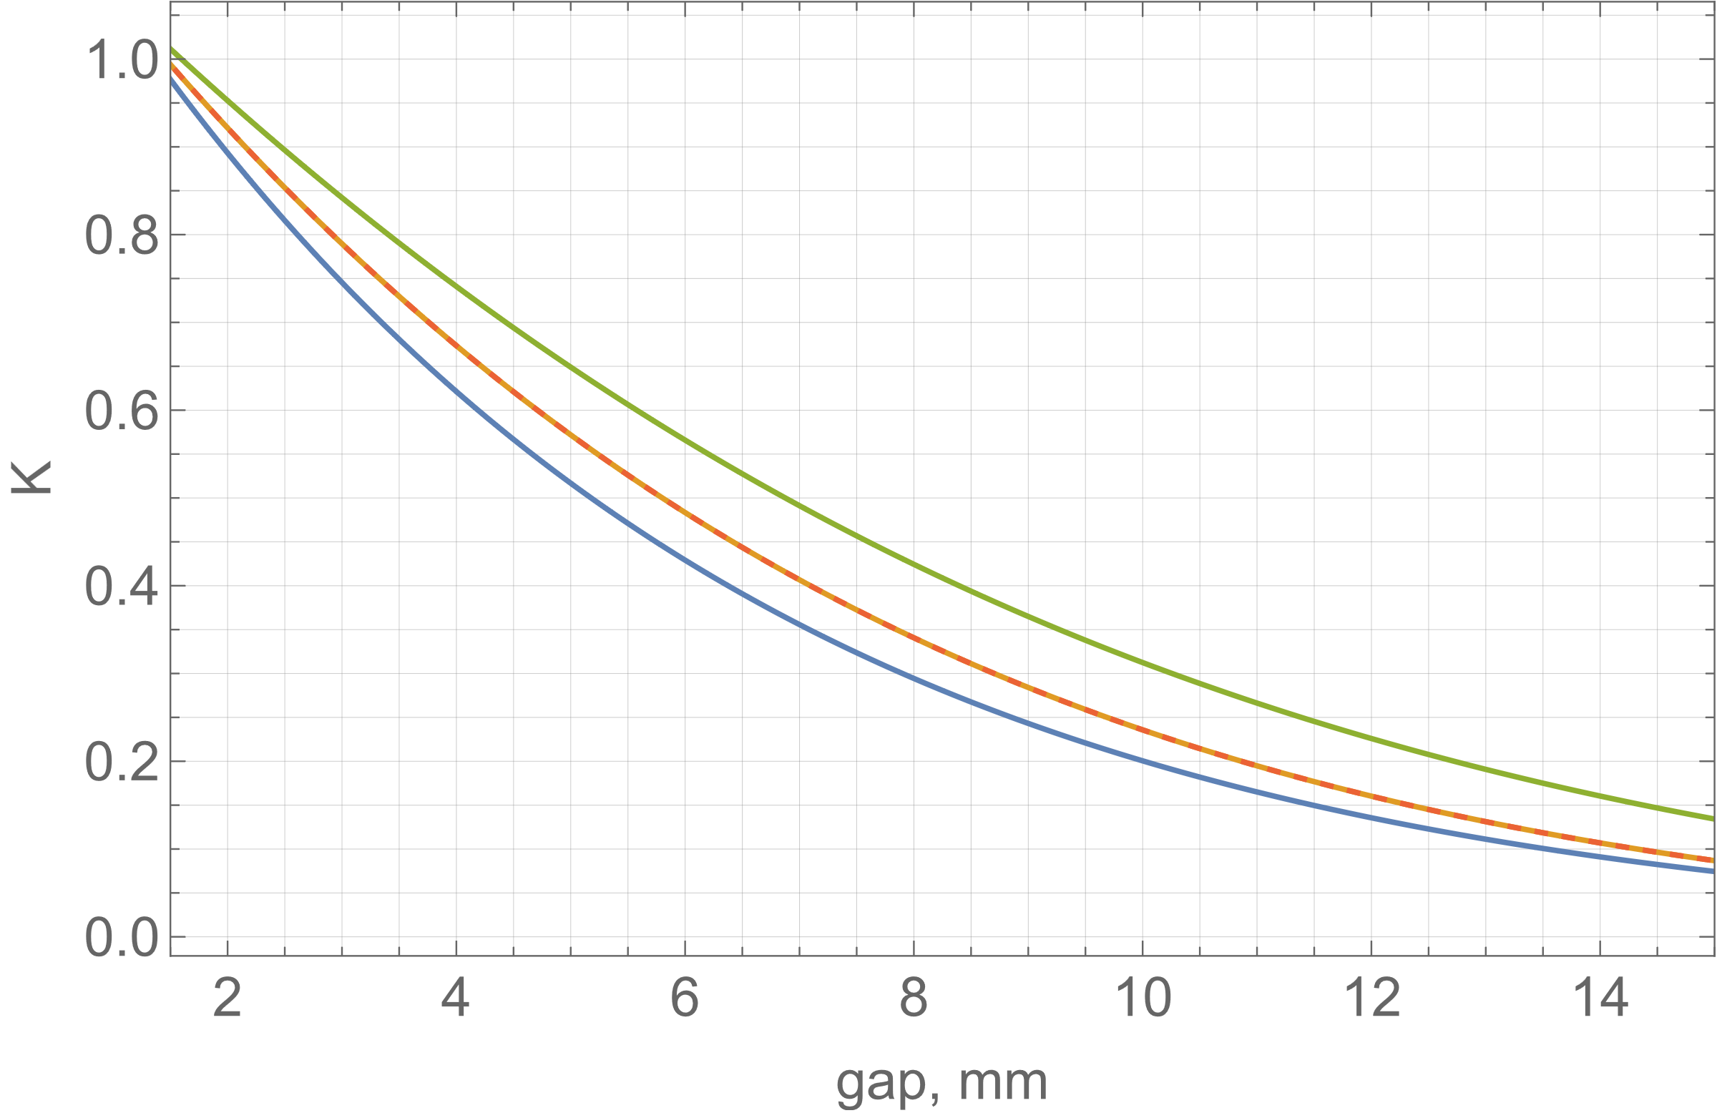
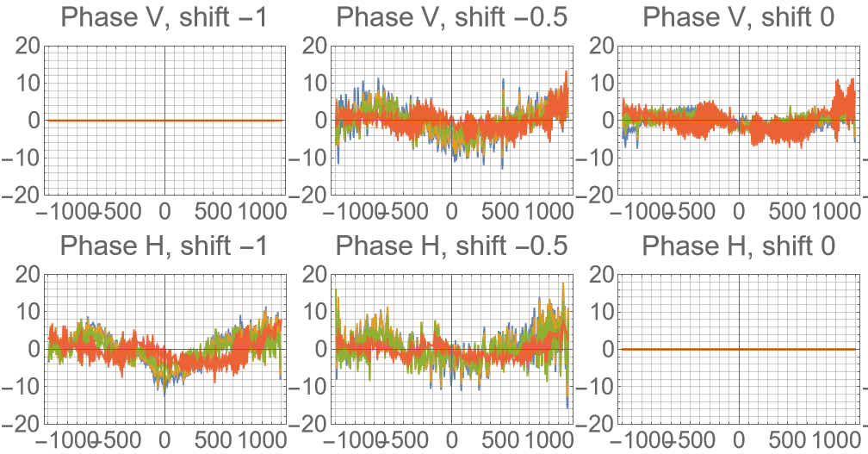
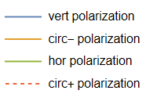
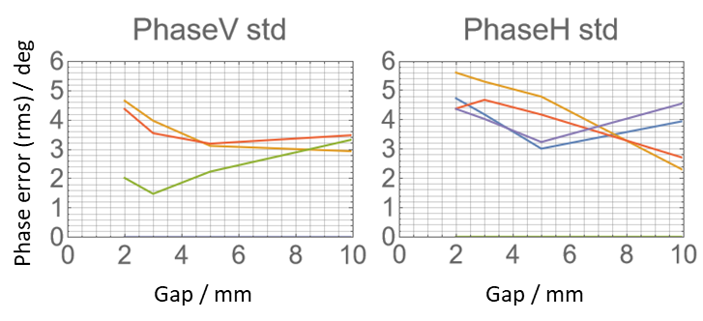
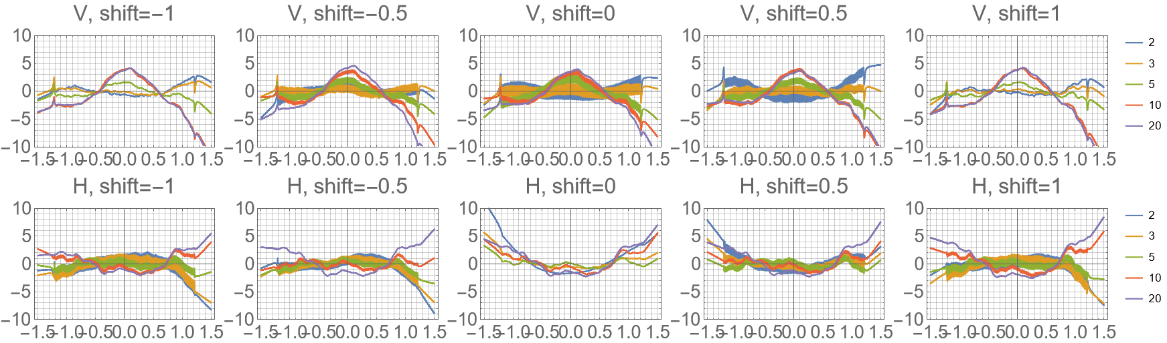
APPLE III Afterburner for FLASH2
see also Markus Tischer et al. 2025 J. Phys.: Conf. Ser. 3010 012045
DOI 10.1088/1742-6596/3010/1/012045
Characteristics and results
K value
Phase error
minimum gap: 1.5mm
vert
circ
hor
Trajectories (@1.35GeV)
RMS phase error gap dependence
vert
circ
hor
circ
circ
µm
hor pol
ver pol
<6deg after tuning.
Taper-corrected: <5deg.
µm
m
m
m

Slide 8
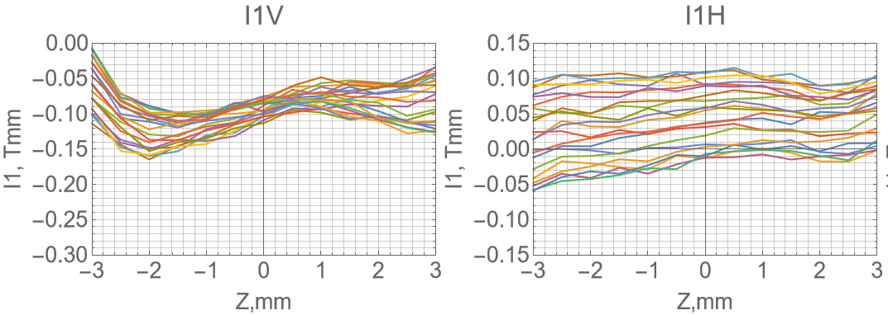
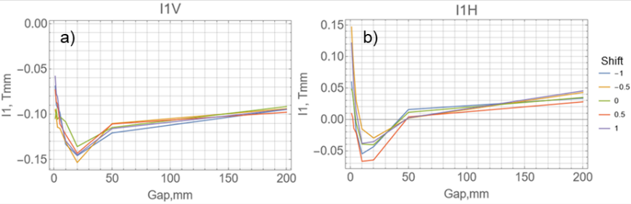
APPLE III Afterburner for FLASH2
see also Markus Tischer et al. 2025 J. Phys.: Conf. Ser. 3010 012045
DOI 10.1088/1742-6596/3010/1/012045
Characteristics and results
Kick errors and multipoles
Shift dependence
Transverse dependence of vert. and horiz. field integrals at gap = 2mm
Gap dependence
Dipoles: ±50 Gcm gap dependence plus shift-dependent kick error of similar size.
Corrected in a feed-forward by small air coils.
Only small quadrupole contribution.

Slide 9
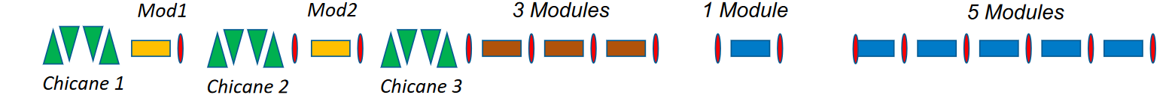
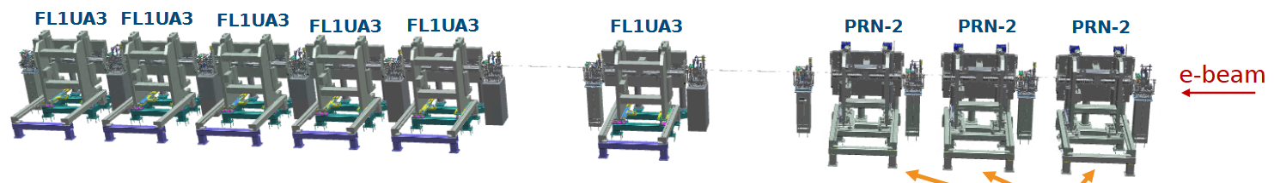
FLASH1 Seeding upgrade
General layout of the radiation section
2 Modulator undulators with 84mm period length and hybrid (magnets&poles) structure.
3 refurbished planar U32 undulators from sFLASH to increase the pulse energy at short wavelengths.
6 radiator undulators of APPLE III type UE35.
Wavelength range: 4 – 60 nm
e-beam
U32 undulators from sFLASH
Radiator undulators (APPLE III)

Slide 10
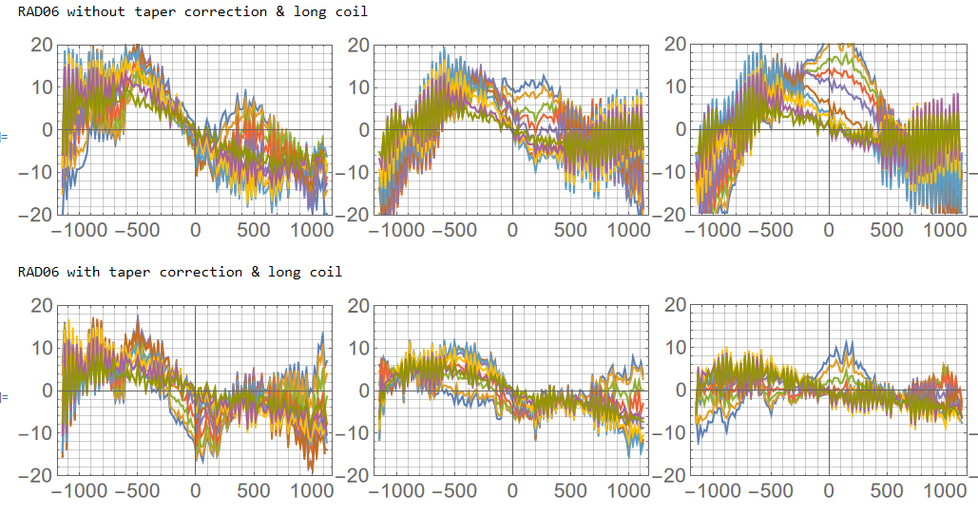
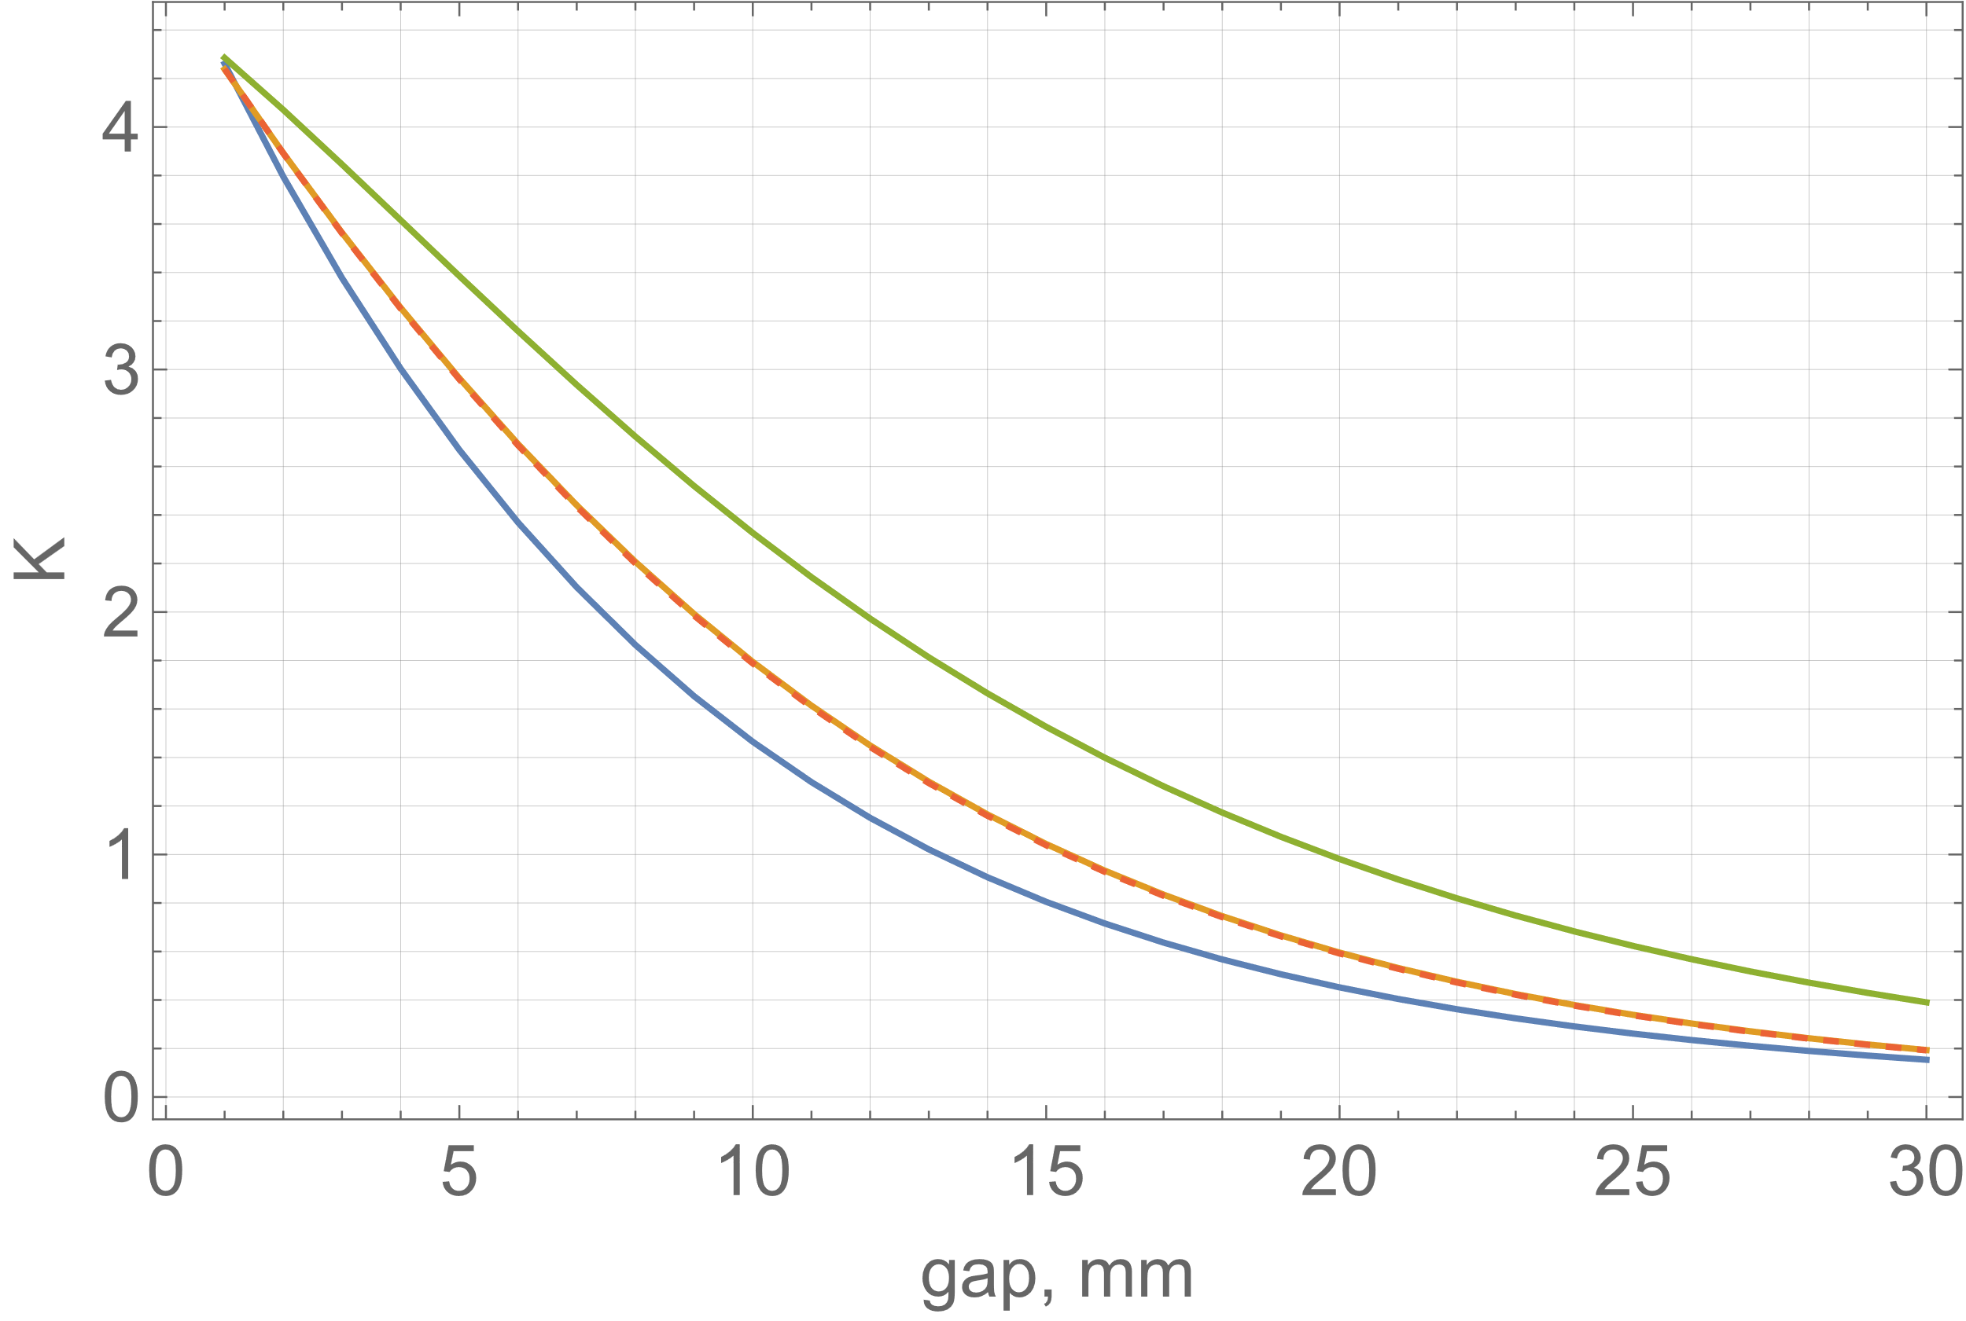
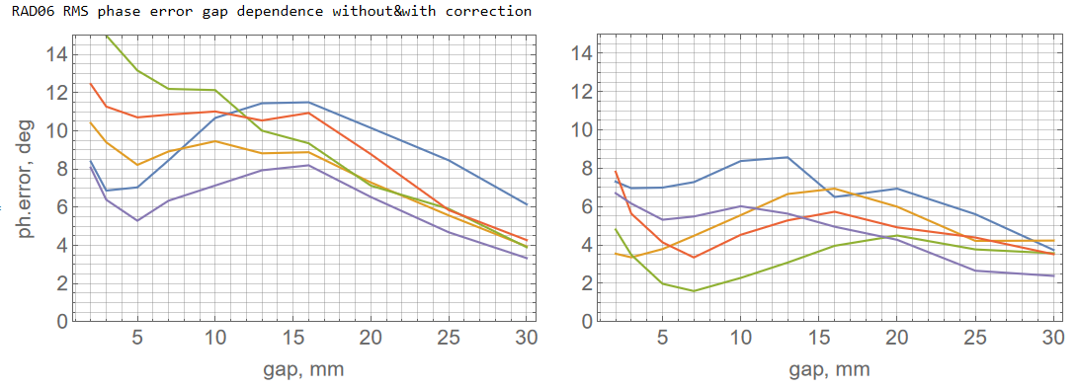
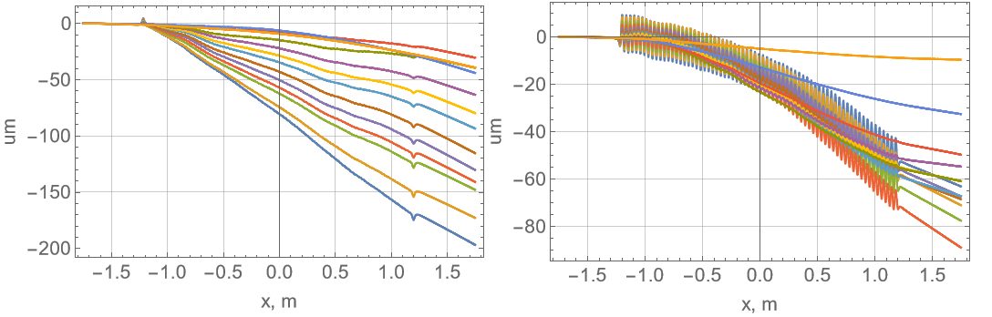
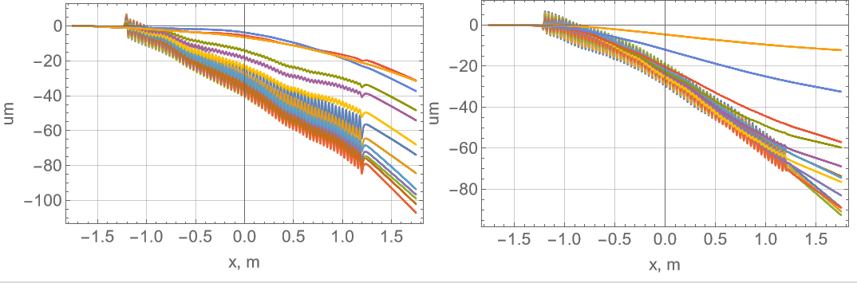
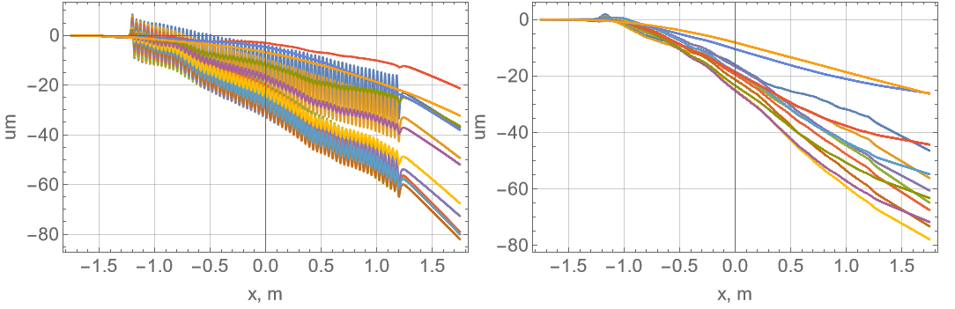
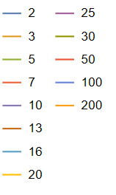
Six UE35 APPLE III for FLASH1
Characteristics and results
Phase error
K value
without taper correction & long coil
minimum gap: 1.3-1.4mm
vert
hor
K_{max}=4.3
ph.err, deg
circ
with taper correction & long coil
vert
hor
ph.err, deg
circ
x, mm
x, mm
x, mm
Trajectories (@1.35GeV)
RMS phase error gap dependence
with taper& long coil
vert
circ
hor
without taper& long coil
Significant variation of phase error for different polarisation modes. Correction by taper and resistive long coil.
vert
circ
hor
Gap dependence
Notes:
coil is 3 turns (at bottom and top, respectively) of ~5mm^2 copper wire
makes 38uT per Ampere at minimum gap 1mm, and 6.3uT at fully opened gap 200mm
x2.5m long makes 95mTmm/A @ 1mm and 16mTmm/A @ 200mm
maximum current 10Amp -> 380uT / 0.95Tmm
coil width 100mm, distance between top&bottom coils 50mm at minimum gap

Slide 11
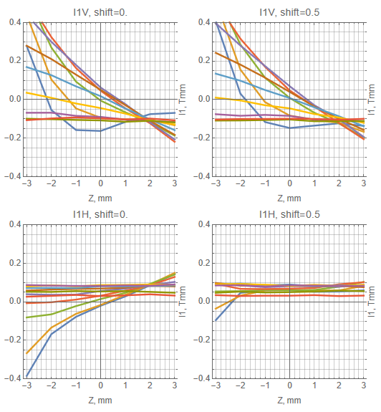
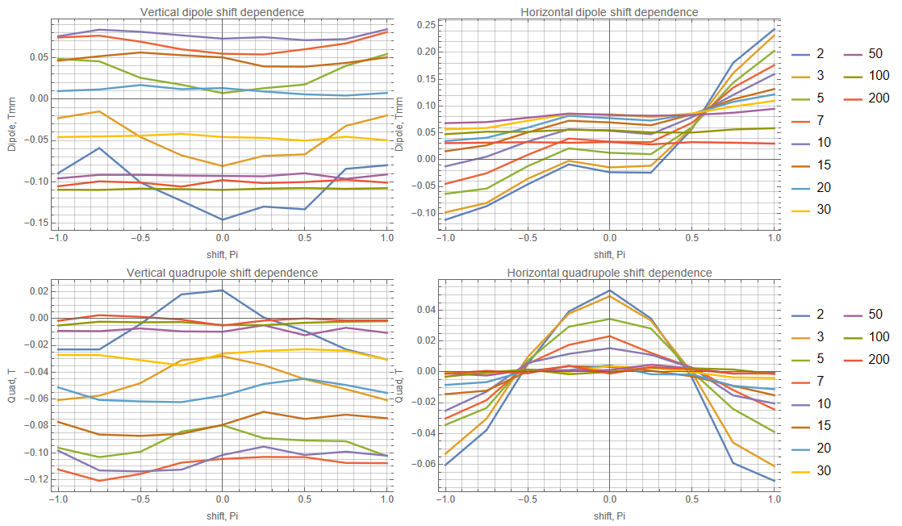
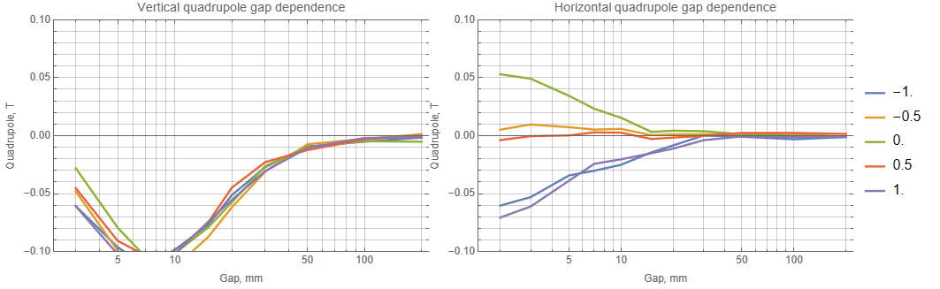
Six UE35 APPLE III for FLASH1
Multipoles errors
Characteristics and results
I1V
I1V
ver dipole, shift dep
hor dipole, shift dep
hor
circ
I1, Tmm
ver quad, shift dep
hor quad, shift dep
I1H
hor
I1H
circ
I1, Tmm
Optimized for circular mode
vert
circ
hor
circ
vert
vert
circ
hor
circ
vert
Transverse dependence of vert. and horiz. field integrals for shift 0 (hor pol) and shift 0.5 (circ) at different gaps
shifts
Optimized for circular mode
Shift and gap dependence of vert. and horiz. quads
Notes:
coil is 3 turns (at bottom and top, respectively) of ~5mm^2 copper wire
makes 38uT per Ampere at minimum gap 1mm, and 6.3uT at fully opened gap 200mm
x2.5m long makes 95mTmm/A @ 1mm and 16mTmm/A @ 200mm
maximum current 10Amp -> 380uT / 0.95Tmm
coil width 100mm, distance between top&bottom coils 50mm at minimum gap

Slide 12

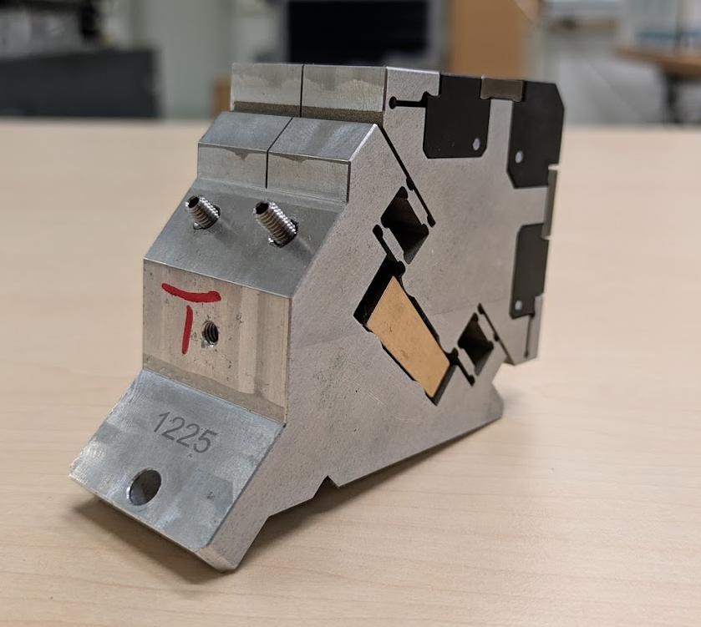

Lessons learnt
AB
Gluing of magnets to AB-pairs
One-period keepers for UE35 (and for UE17); longer super-structures (e.g. like SwissFel Apple-X) could be good option for future. Single keeper flipping/swapping was not necessary.
Pre-characterisation at several stages in the assembly process (magnets separately, single keepers, sub girders mechanically) costs time but is worth it.
Additional linear encoder for shift drive regarded as mandatory; helped to detect deficiencies with the shift drive.
Shift drive design needs substantial safety margins in terms of load. Exceeding manufacturing tolerances will quickly use up any buffer on the parameters of the drive train assembly (motor, coupling, bearings, spindle nut).
Focusing properties of Apple-3/X structures: need sufficient awareness on the beam physics side.

Slide 13
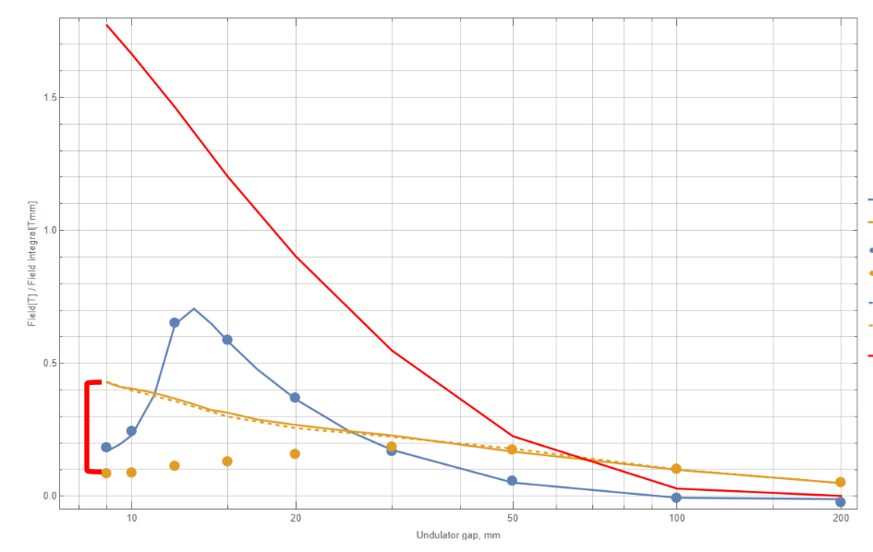
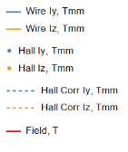
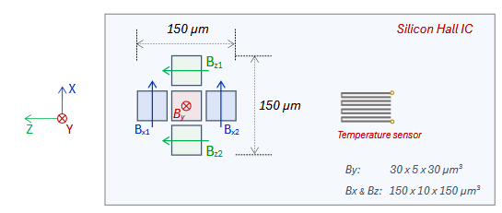
Lessons learnt
https://www.senis.swiss/wp-content/uploads/2024/10/Datasheet-F3A-Magnetic-Field-Transducer_rev.1.2.pdf
“Planar” Hall effect: Hall measurements show an unusual behaviour of the transverse field for the U84 modulators
  Large discrepancy between Hall probe and stretched-wire measurements for transverse direction that cannot be explained by misalignment, mispositioning or wire sag. Adjusted the Hall calibration polynomial by B_{z}+=0.00011B_{y}² (dashed). But: correction should be checked/recalibrated by stretched wire for different devices.
  If sensor is rotated by 90 deg around horizontal axis, difference to the wire is significantly reduced. → Horizontal sensors are vertically displaced and there is no vertical gradient of the vertical field.
1.5
1.0
Field(T)/Field integral(Tmm)
0.5
0.35
Tmm
beam direction
0.0
10
20
50
100
200
Undulator gap (mm)
Notes:
"with adjusted calibration polynomial by Bz+=0.00011By^2" correction should be checked/recalibrated by stretched wire for different devices (most probably depends on undulator period/field gradients)
If sensor is rotated by 90 deg around horizontal axis, difference to the wire is significantly reduced.
Because in this case the horizontal sensors are vertically displaced and there is no vertical gradient of the vertical field.

Slide 14
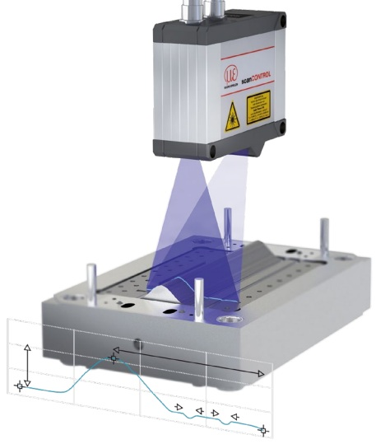
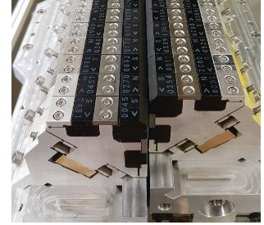

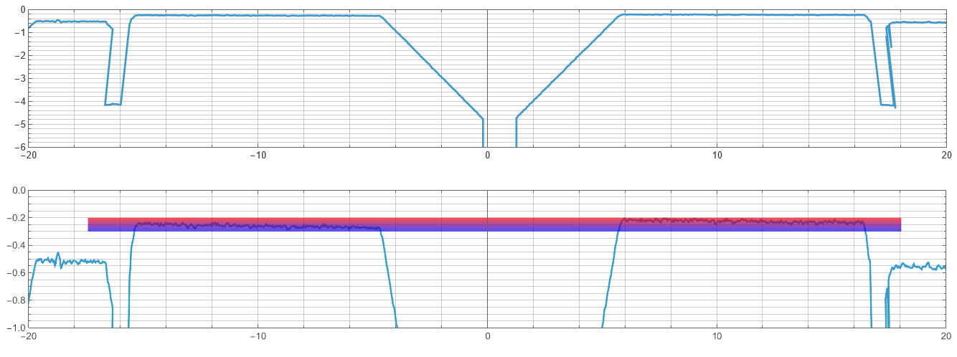
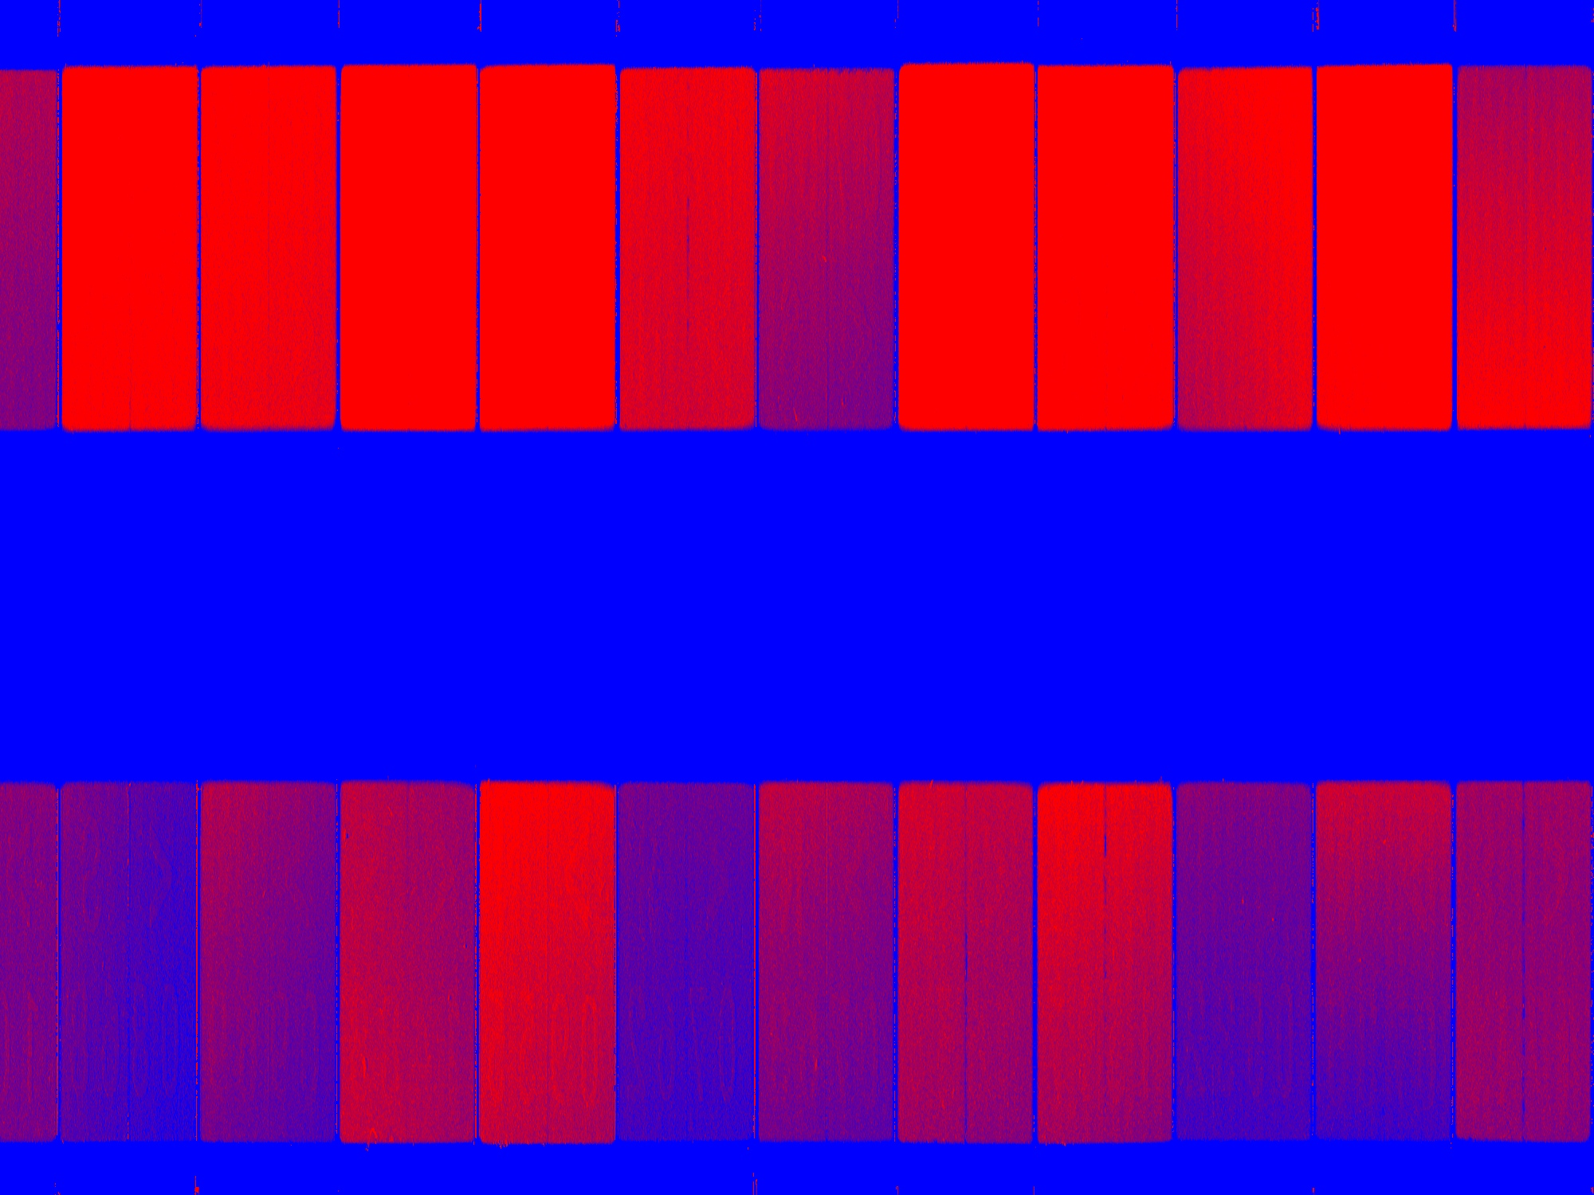
Lessons learnt
Skew quad investigation:
Conducted optical measurements of local mechanical movement of the magnets during shift movement (resolution <1um)
Magnets on one keeper move by about 25um and 0.1mrad in pitch angle during one shift cycle.
Difference between magnet pairs on one keeper: 5-7um and 1E-5rad.
Small but systematic difference for "positive" / "negative" halfperiods most probably causes multipoles shift dependence.
shift moving from
-1…….-0.5..…..0..…..+0.5.……+1

Slide 15
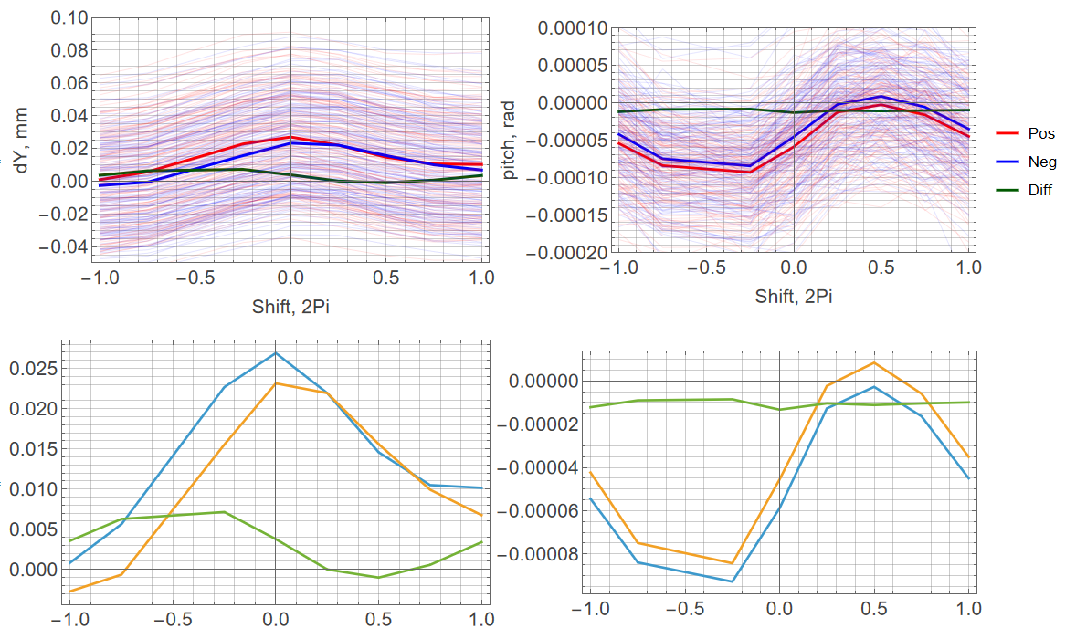
Lessons learnt
Skew quad investigation:
Conducted optical measurements of local mechanical movement of the magnets during shift movement (resolution <1um)
Magnets on one keeper move by about 25um and 0.1mrad in pitch angle during one shift cycle.
Difference between magnet pairs on one keeper: 5-7um and 1E-5rad.
Small but systematic difference for "positive" / "negative" halfperiods most probably causes multipoles shift dependence.
Shift, Pi
Shift, Pi

Slide 16
Summary and Outlook
We successfully designed, manufactured and tuned six APPLE III UE35 and one afterburner APPLE III UE17 for the free-electron laser FLASH.
Devices were tuned by virtual shimming (wedge movement on the keepers), magic fingers, (shift dependent) taper and resistive long coils.
Phase error between 2 and 10 deg for UE35 and <5deg for UE17 afterburner.
Hall measurements show an unusual behaviour of the transverse field for very high vertical fields (gradients), calibration function needs to be adapted.
UE35: Skew quads minimized for circular mode. Might be caused by keeper deformation/movement of halfperiods. Further investigation by optical measurement of magnet displacement during shift movement planned.
Notes:
UE17 no skew quad

Slide 17
Back up
Additional slides

Slide 18
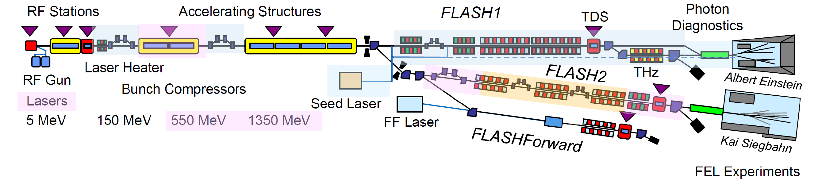
The FLASH2020+ upgrade
The future high repetition rate XUV and soft X-ray FEL facility
Small increase in electron beam energy to 1.35 GeV
Tunable undulators at FLASH1 allow fully parallel operation of two FEL lines.
FLASH1 fully externally seeded with full repetition rate that FLASH can provide in burst mode.
Afterburner for FLASH2 to provide circularly polarised light
Extended the wavelength reach of the fundamental harmonics to the oxygen K-edge and L-edges of Fe, Co, and Ni.
FL1: 4 – 60 nm, FL2: 3.3 – 90 nm (3rd Harmonic Wavelength down to 1.7 nm)

Slide 19
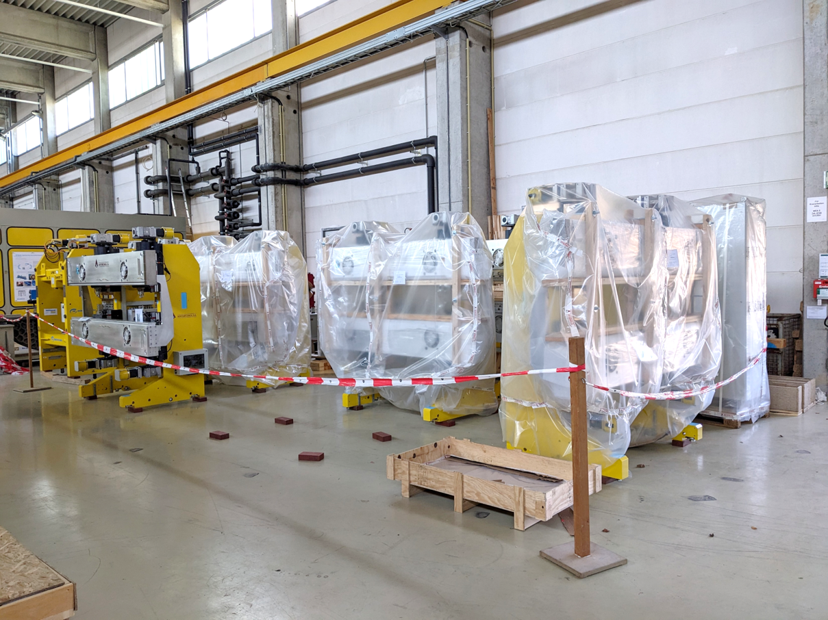
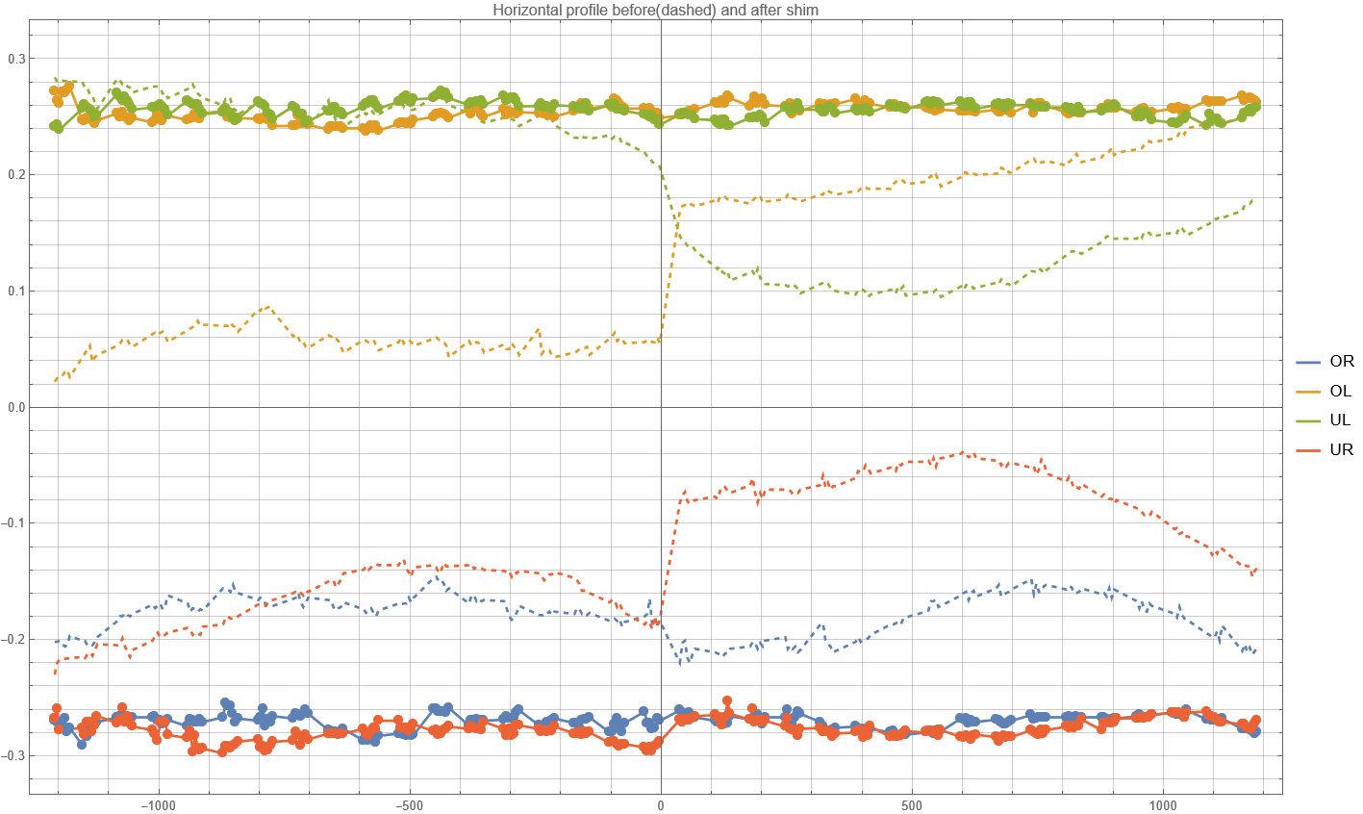
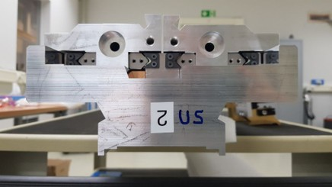
Six UE35 APPLE III for FLASH1
Support structures
Mechanical shimming
Horizontal profile before (dashed) and after shimming (Touch probe)
0.3
0.2
Left
0.1
h, mm
0.0
-0.1
-0.2
Right
-0.3
-1000
-500
0
500
1000
x, mm
  Manual shimming of subgirders to even out differences in height of up to 200um (“chain of tolerances”)
Position of shims for vertical and horizontal shimming
Notes:
Touch probe measurements of the girder profiles after assembly to the support structure but before mounting keepers, with dummy mechanical keeper to measure both actual horizontal and vertical positions. Hall probe bench temporarily converted into CMM.

Slide 20



Six UE35 APPLE III for FLASH1
Characteristics and results
K value
Phase error
K_{max}=4.3
minimum gap: 1.3-1.4mm
with taper& long coil
without taper& long coil
Significant variation of phase error for different polarisation modes. Correction by taper and resistive long coil.
Kick errors and multipoles
gap dependence
before
After multipole tuning and magic fingers: ±0.15Tmm (ver), ±0.25Tmm (hor)
Skew quad optimised for circular mode
Notes:
coil is 3 turns (at bottom and top, respectively) of ~5mm^2 copper wire
makes 38uT per Ampere at minimum gap 1mm, and 6.3uT at fully opened gap 200mm
x2.5m long makes 95mTmm/A @ 1mm and 16mTmm/A @ 200mm
maximum current 10Amp -> 380uT / 0.95Tmm
coil width 100mm, distance between top&bottom coils 50mm at minimum gap

Slide 21

Lessons learnt
Skew quad investigation:
Conducted optical measurements of local mechanical movement of the magnets during shift movement (resolution <1um)
Magnets on one keeper move by about 20um and up to 1mrad in angle during one shift cycle.
Difference between magnet pairs on the keeper: 2-3um.
Small but systematic difference for "positive" / "negative" halfperiods most probably causes multipoles shift dependence.
difference
magnet pair 1
change in angle (rad)
magnet pair 2
magnet pair 2
change in position (mm)
magnet pair 1
shift moving from
-1…….-0.5..…..0..…..+0.5.……+1

Slide 22







APPLEIII Afterburner for FLASH2
E_{ACC} = 880 MeV
hv = 104.6 eV / 313.8 eV
In operation
P1= 0.08
P1= 0.98
Ball chamber instrument
Measuring angular distribution of photoelectron emission
of a certain photoelectron feature from 3rd harmonic
P1= 0.06
P1= 0.98
ABU shift = +/- 0.25
ABU shift = +/- 0.5
Circularly polarized light down to 1.46 nm generated
First successful user experiments
P1= 0.99
ABU shift = 0.0
Courtesy M. Braune, K. Tiedke, J. Rönsch-Schulenburg and colleagues

Slide 23


Modulators
Two U84 planar undulators with hybrid structure (magnet and poles)
Length = 2.5m
Period = 84mm
Min. gap = 9mm
B_{max} = 1.8T
Specs: K=11, achieved: K = 12.9
84mm
5E-5
0
-5E-5
5E-5
0
-5E-5
Sorting of magnets based on novel Hall mapper reduces amount of pole tuning
Parameters were within specs without any pole tuning (straight trajectory, phase error <4°).
Additional girder curvature spoiled phase error
Strong fields
Strong forces
Reaching limits of sensor calibration
-1.5 -1.0 -0.5 0 0.5 1.0 1.5
-1.5 -1.0 -0.5 0 0.5 1.0 1.5
x/m
1.005
1.000
0.995
0.990
10
5
0
-5
12
8
4
0
-1000 -500
0 500 1000
x/mm
K
phase
Gap/mm

Slide 24


Modulators
Two U84 planar undulators with hybrid structure (magnet and poles)
5E-5
0
-5E-5
5
0
-5
After tuning
Trajectories further straightened
0.5deg RMS phase error at minimum gap
Girder shape strikes back at intermediate gaps due to different gap dep.
K = 12.9
„Target" value was K_{target}=11 at 9.5mm gap, to reach 343nm at 1.4GeV
Now at 1.35GeV: 343nm reached at K=10.6, or operating gap ~12.5mm
Both Modulators tuned and close to ready.
-1.5 -1.0 -0.5 0 0.5 1.0 1.5
x/m
-1000 -500 0 500 1000
x/mm
K
phase
Gap/mm

Slide 25




Refurbished U32s from sFLASH
Three devices for the interim to increase pulse energy at short wavelengths
Three planar devices with 32mm period length from the former sFLASH experiment were retuned.
sfund01: Severe radiation damage (>10%) – flipped 18 magnet pairs and replaced end magnets upstream.
K between 2.65 and 2.70 at min gap of 9mm
Phase errors <3°
sfund01
phase
Remaining kick errors: ±50 Gcm. Corrected in a feed-forward by small air coils.
K
-- Field before
-- Field after flipping 18 magnets US

Slide 26





Resistive coils with variable field direction
Ferrite enforced steerer/corrector coils (air-cooled)
35mm
vertical
horizontal
quadrupole
Correct (gap dependent) kick up and down stream of undulators
In-house design for stronger coils with slow feedback option
Resistive, air-cooled coils
Compact and cost-efficient design
Ferrite-based – 0.55Tmm at 1A
Four sub-coils per unit – variable field direction
AC capability
Series of 40 coils manufactured
Stored coils
On-axis first field-integral as a function of current (hor/vert field).

Slide 27






Phase shifters
Compact, permanent magnet-based phase shifters on intersections
Compact, permanent magnet-based design
Pre-sorting allows for using lower quality, low price magnets
Series of 10 phase shifters built and tuned
<0.02Tmm (6µrad) on-axis kick remaining
high uniformity within series
beam
Magnetic set-up
As measured
Phase shifter
Background subtracted
Intersection
Phase advance as a function of gap.
All 10 phase shifters achieve at least 2.8*2π for 20nm@1.35GeV.
Magnet blocks. Size: 35x35x15mm³

Slide 28



Phase shifters and corrector coils
Managing cross-talk
Originally only 22mm distance between permanent magnets of phase shifter and ferrite enforced coils
Strong, unwanted dampening of PS fringe fields due to cross-talk
Increased the distance to 30 mm (max)
Passive compensation by installing two sets of ferromagnetic screws above and below the beam pipe.
Phase shifter
PM
Coil w/ ferrite core
PM
ferromagnetic screws

